Slide 1
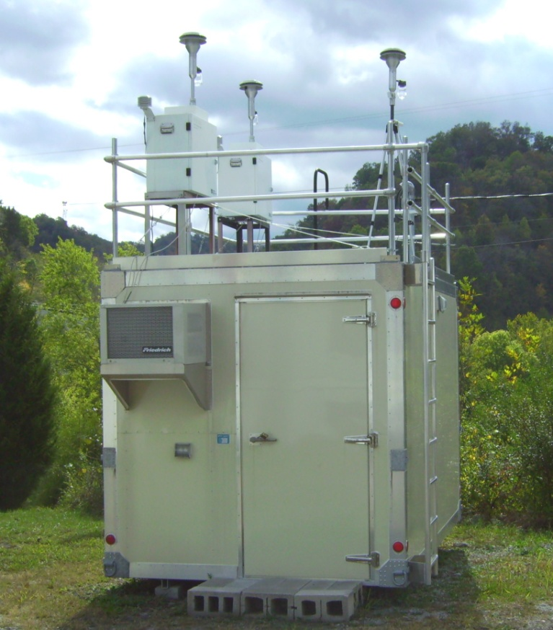
Atmospheric Chemistry and Air Quality Instrumentation
Erik Crosman
John Horel
Kevin Perry

Slide 2
Outline
Basics of air pollution monitoring
Sensors commonly used
Integrating air quality observations from diverse sources

Slide 3
Driving factors for monitoring air quality
Longstanding drivers
  Meet federal regulatory requirements
  Commercial needs for clean production environments
Increasing pressure
  Public concerns over personal exposure

Slide 4
Technologies are Evolving
Federal Equivalent Method sensors: $10000-20000+
Research-grade sensors: $3000-10000
Internet of Things Sensors: $20-200
IOT All-in-one sensor packages: $200-3000
Listing of IOT sensors: http://www.aqmd.gov/aq-spec/sensors

Slide 5
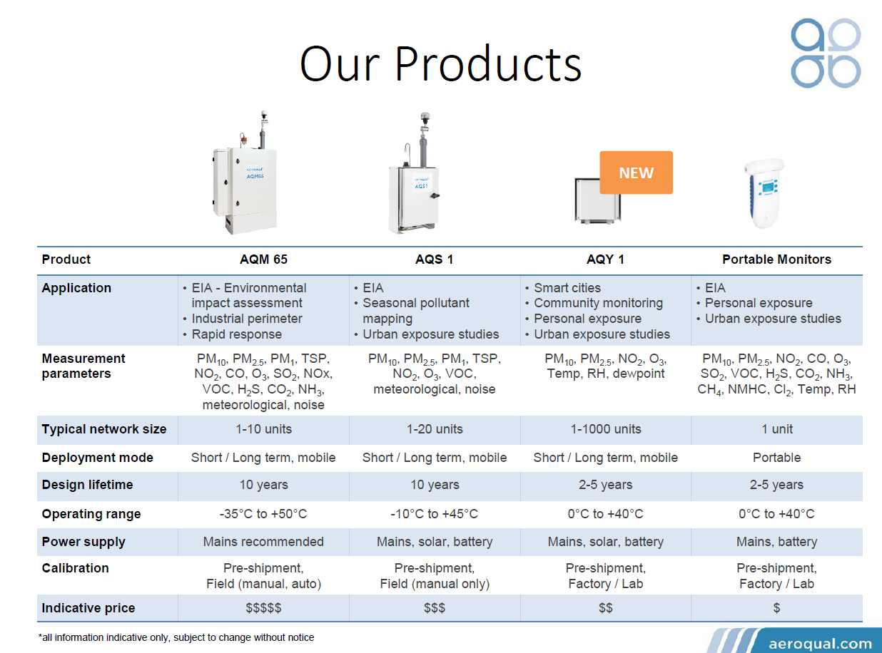
Spectrum of All-In_One Sensor Systems

Slide 6


Slide 7


Slide 8
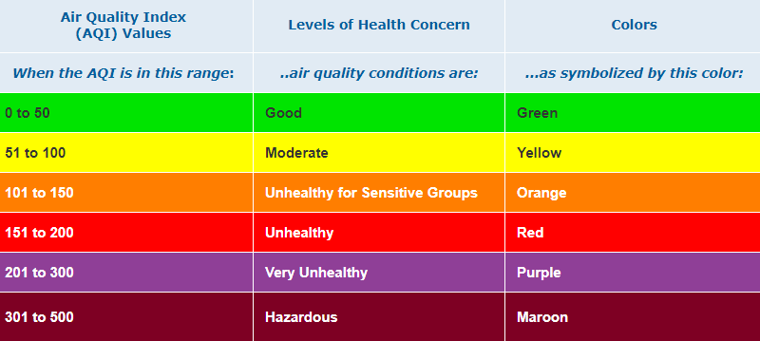
Air Quality Index of 100 =
PM 2.5 concentration of 35 micrograms/m³

Slide 9
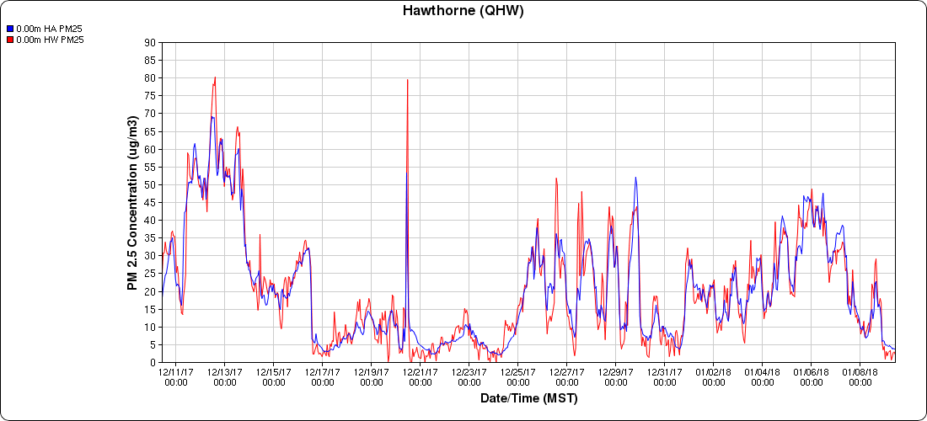
PM 2.5 Salt Lake City: 12 Dec 17– 9 Jan 18
http://mesowest.utah.edu/cgi-bin/droman/time_chart_dyn.cgi?stn=QHW&unit=1&hours=720&past=1&day1=09&month1=01&year1=2018&hour1=11&time=LOCAL&var=PM25&gsize=1&level=All

Slide 10
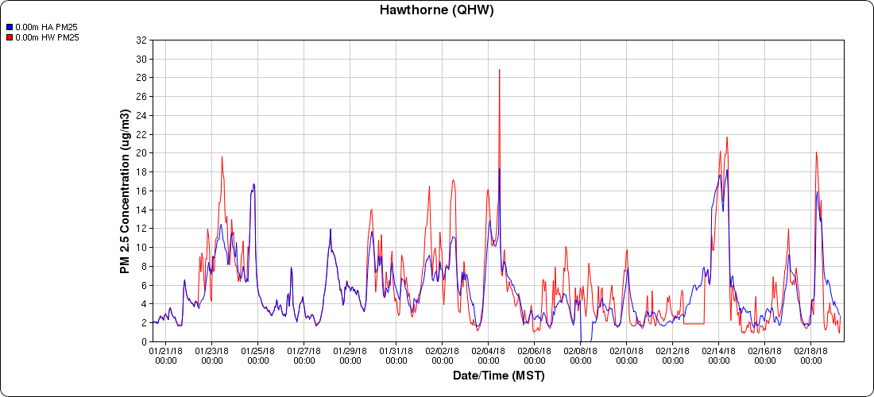
PM 2.5 Salt Lake City: 20 Jan – 19 Feb 18

Slide 11
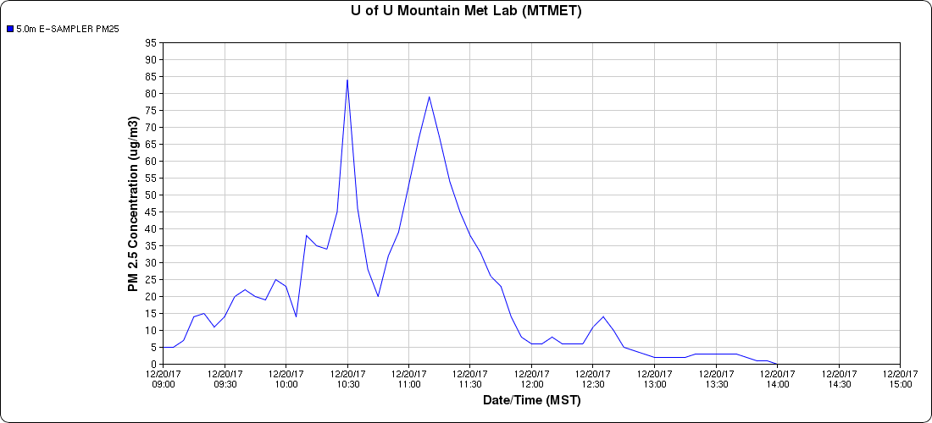
Dec. 20 PM2.5 UU campus
Dust event

Slide 12
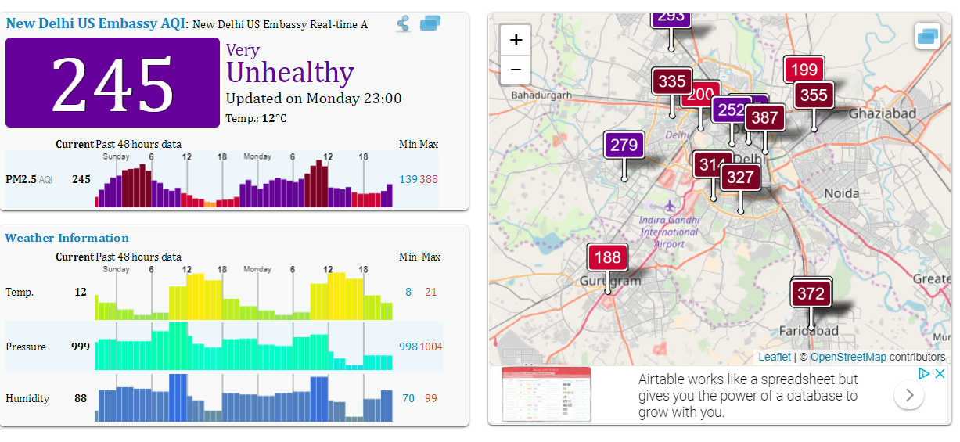
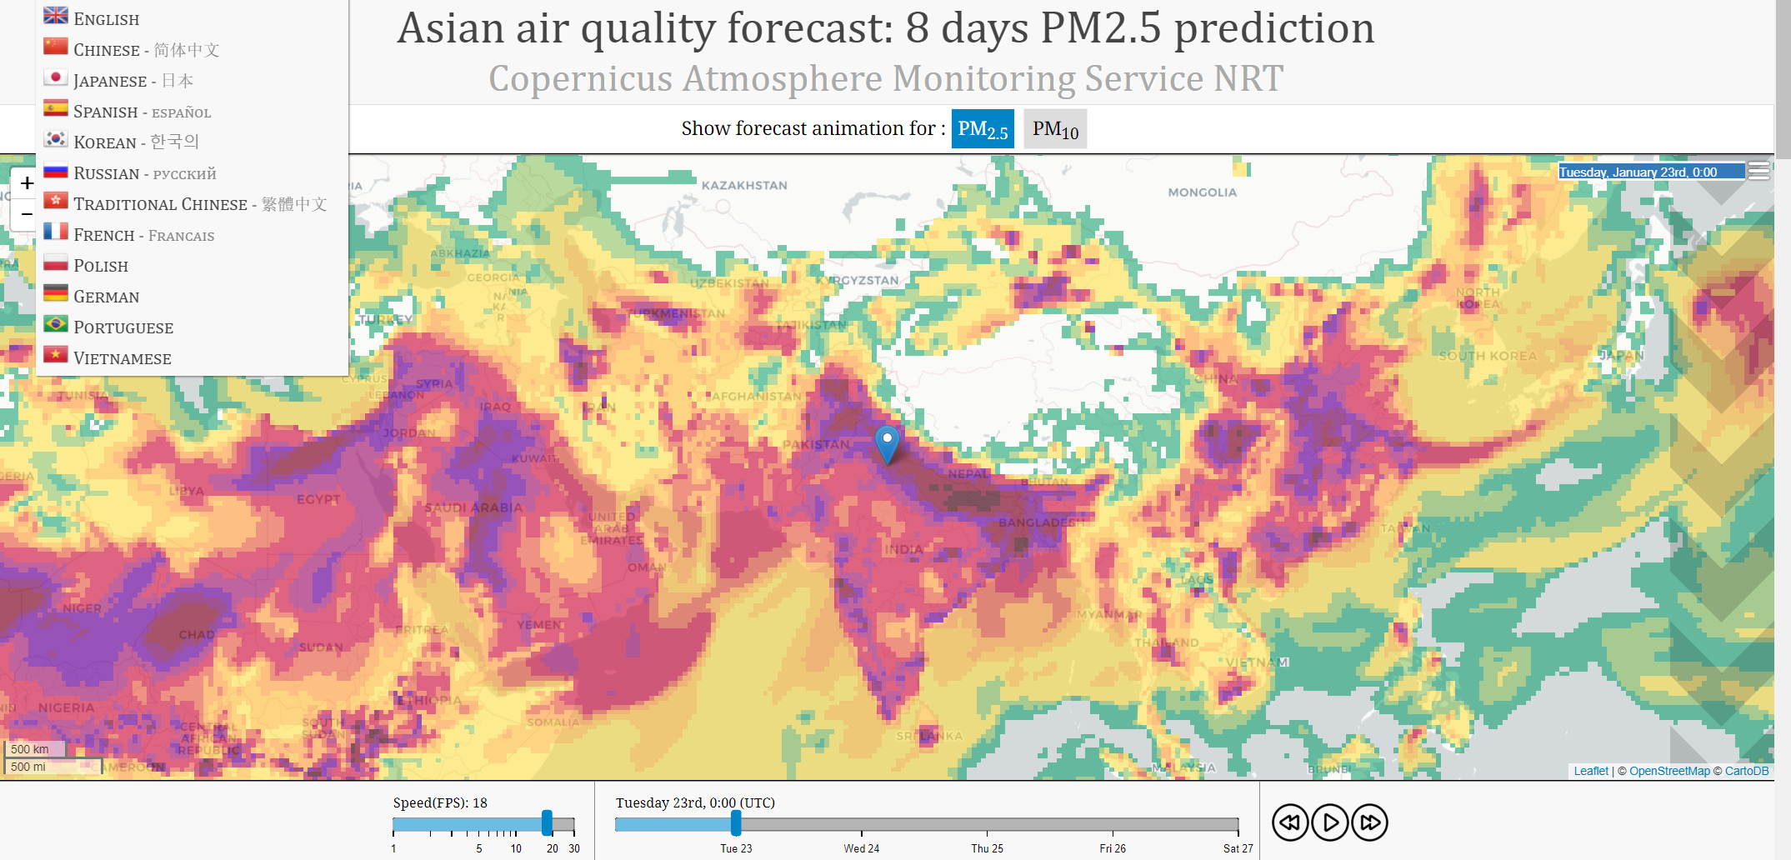
Air Pollution in Asia
http://aqicn.org/city/india/new-delhi/us-embassy/
http://aqicn.org/forecast/asia/#s:7024

Slide 13
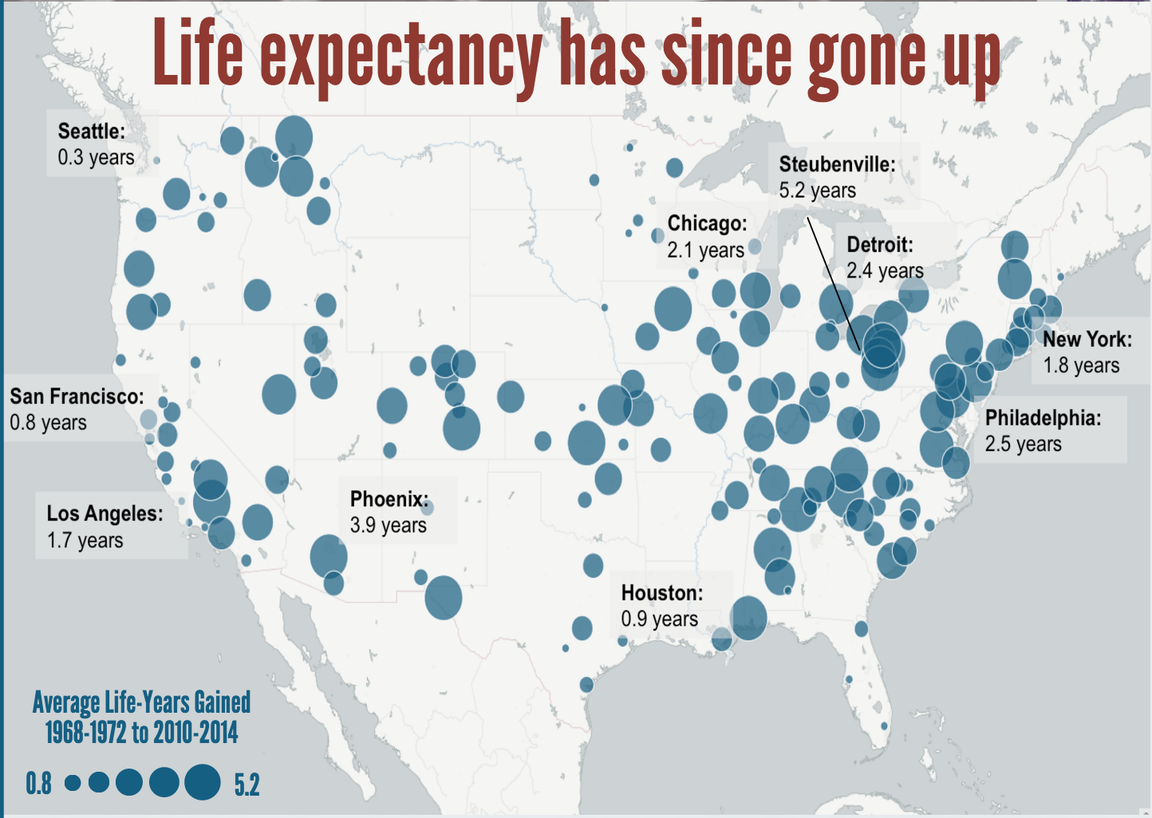
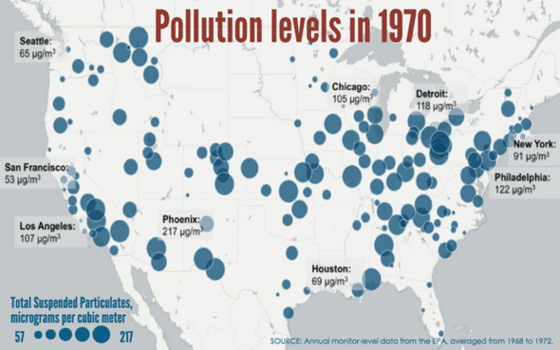
Clean Air Act
The Clean Air Act (CAA) is the law that defines the Environmental Protection Agency’s responsibilities for protecting and improving the nation’s air quality.
The CAA was originally passed by President Richard Nixon in 1970 and was significantly amended in 1990 by President George H.W. Bush.

Slide 14
Clean Air Act
Authorizes EPA to set limits on ambient concentrations of criteria air pollutants
Authorizes EPA to set limits on emissions of hazardous air pollutants
Requires EPA to base regulations on scientific evidence of human-health-based (primary standard) or environmentally-based (secondary standard) impacts

Slide 15
EPA Air Quality Enforcement
Requires monitoring of ambient air quality
Areas that do not meet National Ambient Air Quality Standards (NAAQS) are designated as “nonattainment” areas
Nonattainment areas must develop a state implementation plan (SIP) within 18-36 months of designation depending on the pollutant
  SIP outlines strategies and emissions control measures and shows how these changes will improve air quality and meet the NAAQS
Failure to comply with these requirements can result in the loss of all federal highway funds for a state

Slide 16
Categories
Criteria Air Pollutants
  Gaseous
  Particulate Matter
Hazardous Air Pollutants (HAPs)
Greenhouse Gases
Catalysts and Other Reactive Species

Slide 17
Criteria Air Pollutants
CO, SO₂, NO_{x}, O₃, Pb, PM₁₀, PM_{2.5}
Carbon Monoxide (CO) – a primary pollutant originating from incomplete combustion. Most CO emissions are from mobile sources (i.e., cars and trucks). CO reduces oxygen delivery to the body’s organs and tissues.
Sulfur Dioxide (SO₂) – a primary pollutant emitted by fossil fuel combustion, refineries, smelters, and other industrial facilities. Most SO₂ emissions are from point sources (i.e., smokestacks). Acute exposure to SO₂ can cause respiratory illness especially in children, the elderly, and asthmatics.

Slide 18
Criteria Air Pollutants
Lead (Pb) – a primary pollutant emitted by industrial facilities and by some types of motor vehicles. Pb exposure can adversely affect the nervous system, kidney function, immune system, reproductive and developmental systems and the cardiovascular system. is linked to airway inflammation in healthy people and increased respiratory symptoms in asthmatics.
Infants and young children are especially sensitive to Pb exposure which can contribute to behavioral problems, learning deficits, and permanently lowered IQ.

Slide 19
Criteria Air Pollutants
Nitrogen Oxides (NO_{x}) – a primary pollutant emitted by high temperature combustion. NO_{x} emissions come from both mobile and point sources. Acute exposure to NO_{x} is linked to airway inflammation in healthy people and increased respiratory symptoms in asthmatics.
Ozone (O₃) – a secondary pollutant formed by photochemical reactions of NOx and volatile organic compounds (VOCs). Acute exposure to O₃ can trigger a variety of health problems including chest pain coughing, throat irritation, and congestion. It also worsens bronchitis, emphysema, and asthma.

Slide 20
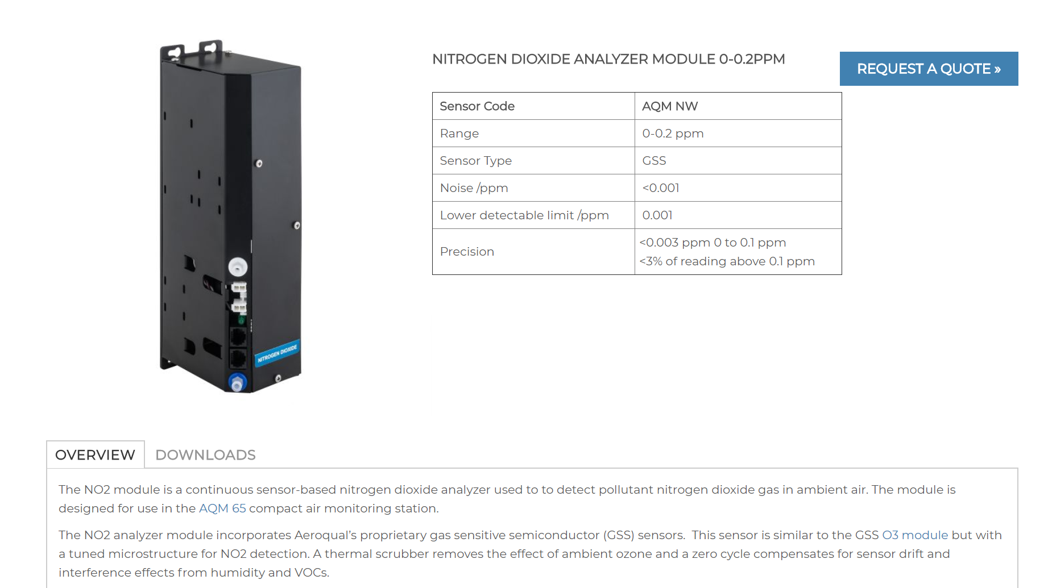
IOT NO2 sensor

Slide 21
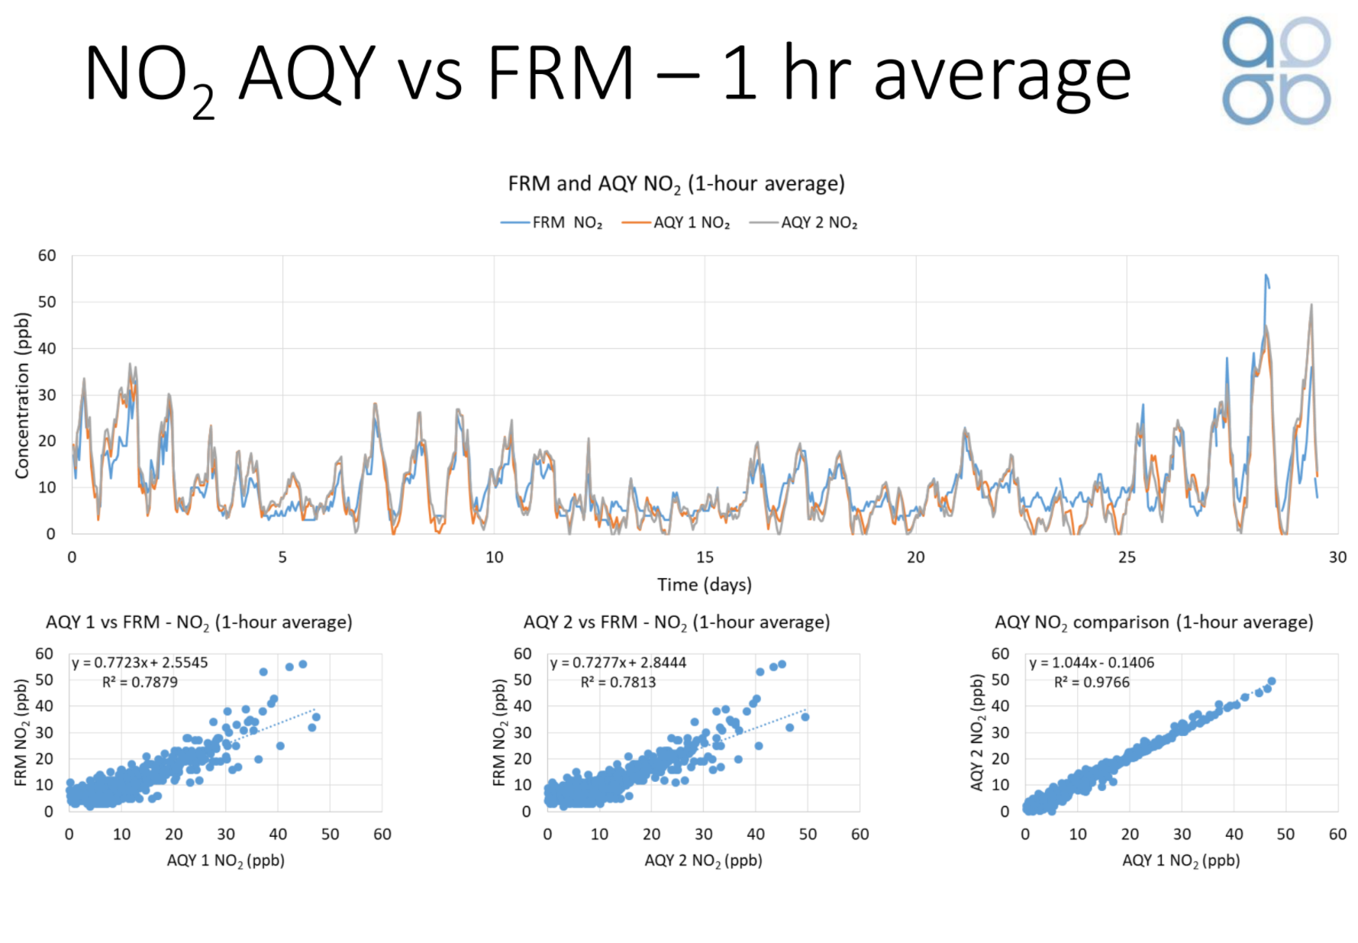
Comparing NO2 Sensors

Slide 22
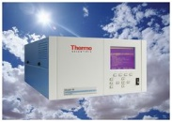
Ozone Gas Phase Sensors
Electrochemical cells
--All gases are detected by air passing over electrochemical
Gas-sensitive semiconductors (GSS)
UV-based detection
Thermo Fisher 49i ozone monitor

Slide 23
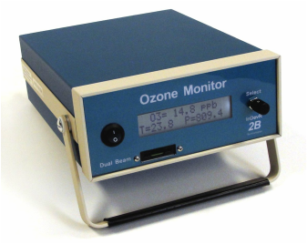
2 B 205 Ozone Monitor
EPA Federal Equivalent Method (FEM)
Used extensively by UTAH DAQ and in Summer Ozone Study
On TRAX train and KSL helicopter

Slide 24
2B 205 Ozone Monitor
The Model 205 Dual Beam Ozone Monitor makes use of two detection cells
UV absorption at 254 nanometers (dual beam)
In the Dual Beam instrument, UV light intensity measurements Io (ozone-scrubbed air) and I (unscrubbed air) are made simultaneously.
Combined with other improvements, this made it possible to reduce the time between ozone measurements to 2 seconds, making instrument the fastest UV-based ozone monitor on the market

Slide 25
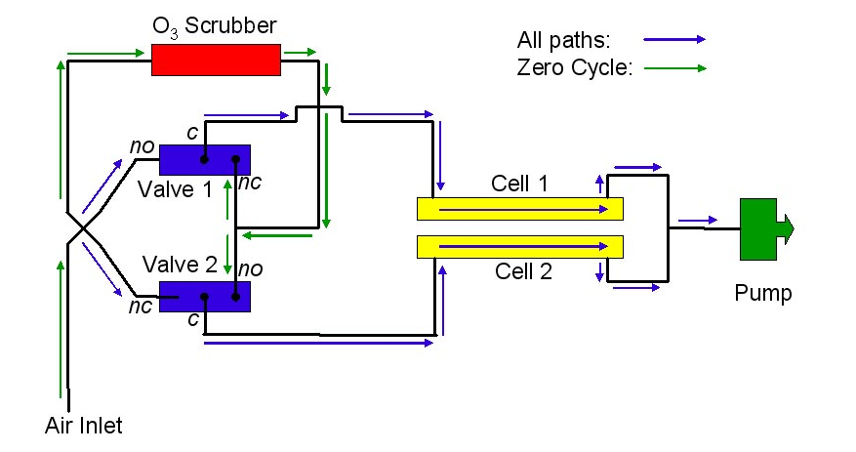
2B 205 Ozone Monitor

Slide 26
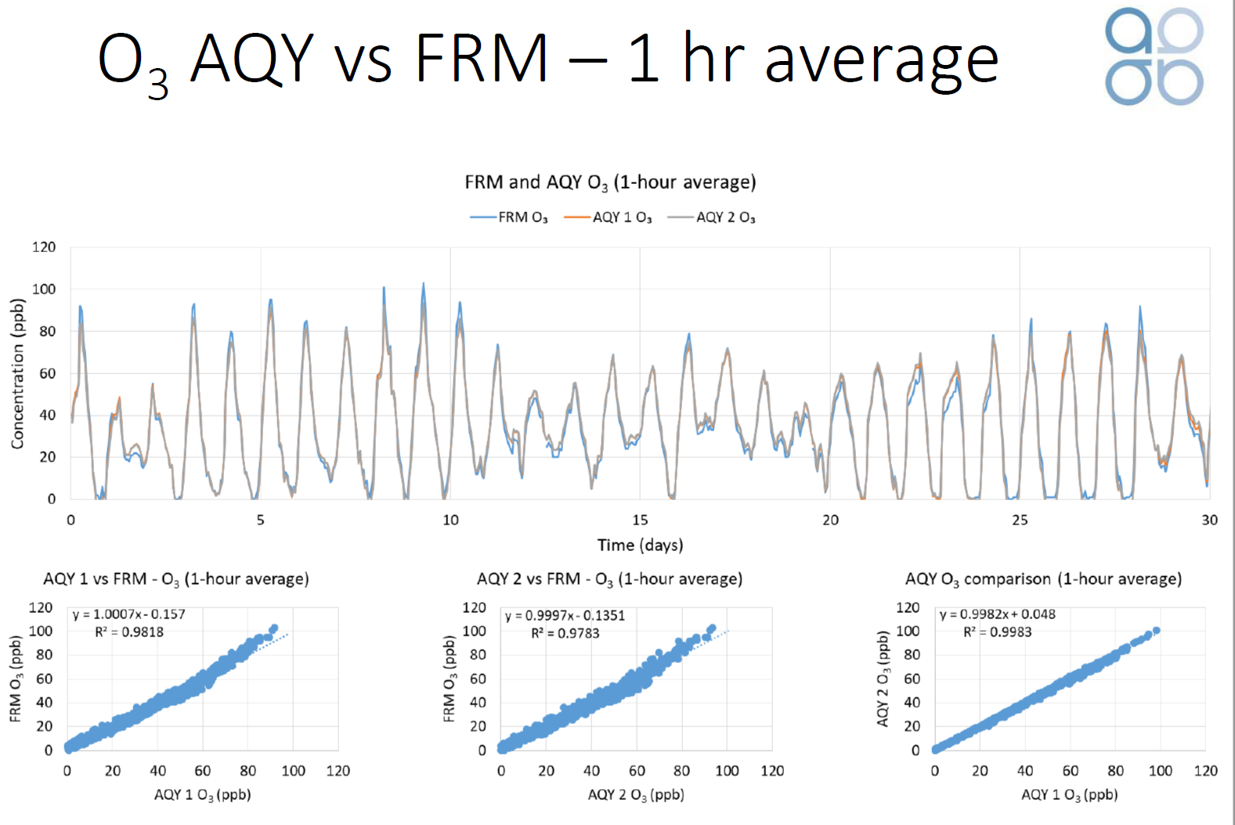
Ozone sensor comparison

Slide 27
Particulate Matter
PM₁₀ refers to particulate matter in the atmosphere with aerodynamic diameters < 10 μm. PM_{2.5} is a subset of PM₁₀ and refers to particulate matter in the atmosphere with aerodynamic diameters < 2.5 μm. Both are linked to the following health effects.
Increased respiratory symptoms
Decreased lung function
Aggravated asthma
Development of chronic bronchitis
Irregular heartbeat
Heart attacks
Premature death in people with heart or lung disease

Slide 28
Particulate Matter Sources
PM is both a primary and secondary pollutant that is derived from both mobile and point sources.
Primary Sources of PM
Incomplete combustion (i.e., soot)
Windblown soil
Seasalt
Volcanoes
Plant spores and pollen
Secondary Sources of PM
SO₂ emitters
NO_{x} emitters
VOC emitters

Slide 29
Hazardous Air Pollutants (Air Toxics)
Pollutants known or suspected to cause cancer or other serious health effects such as reproductive effects or birth defects. Emission of more than 600 HAPS is tracked by the EPA and compiled in an annual Toxic Release Inventory (TRI).
Example HAPS include:
Asbestos
Benzene, toluene, ethylene glycol
Vinyl chloride
Mercury, cadmium, arsenic, etc.

Slide 30
Measurements of Particulate Matter
Total Number Concentration (CN)
Particle Size Distribution
Particle Mass Distribution
Total Mass
Bulk Composition
Size-Segregated Composition
Sing Particle Composition

Slide 31
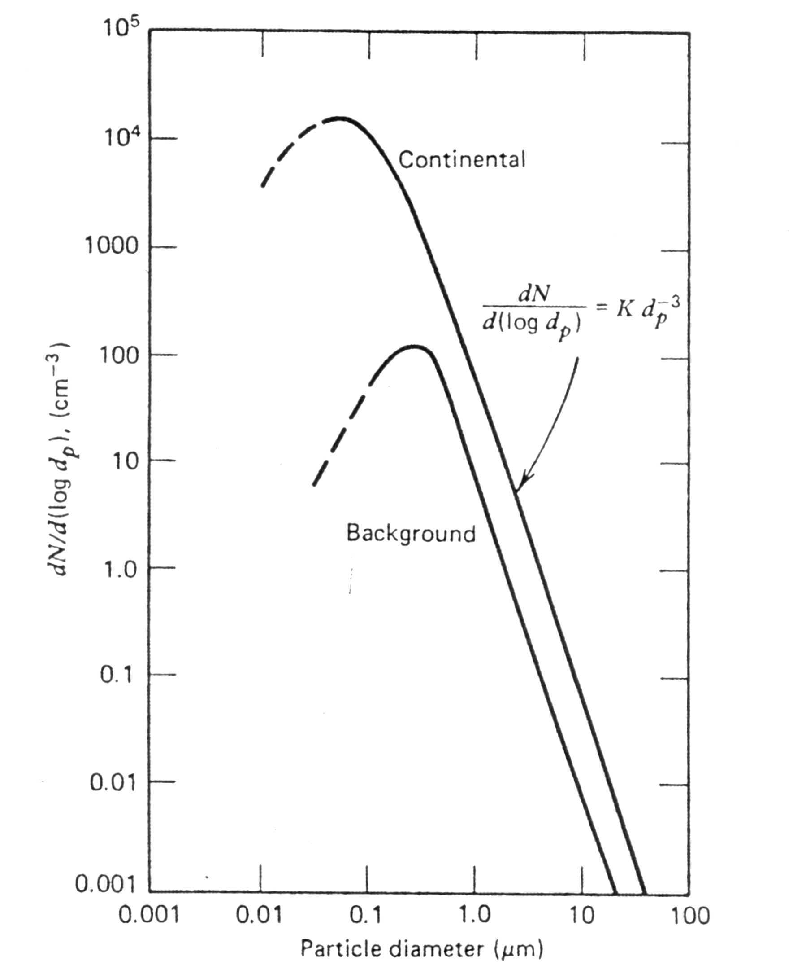
Typical Aerosol Number Distribution
(log-log plot)
Why would we be interested in the number distribution?
Every particle scatters light (visibility reduction)
Constrains CCN concentrations
Indicates presence of ultrafine particles
Hinds, Aerosol Technology, 1982

Slide 32
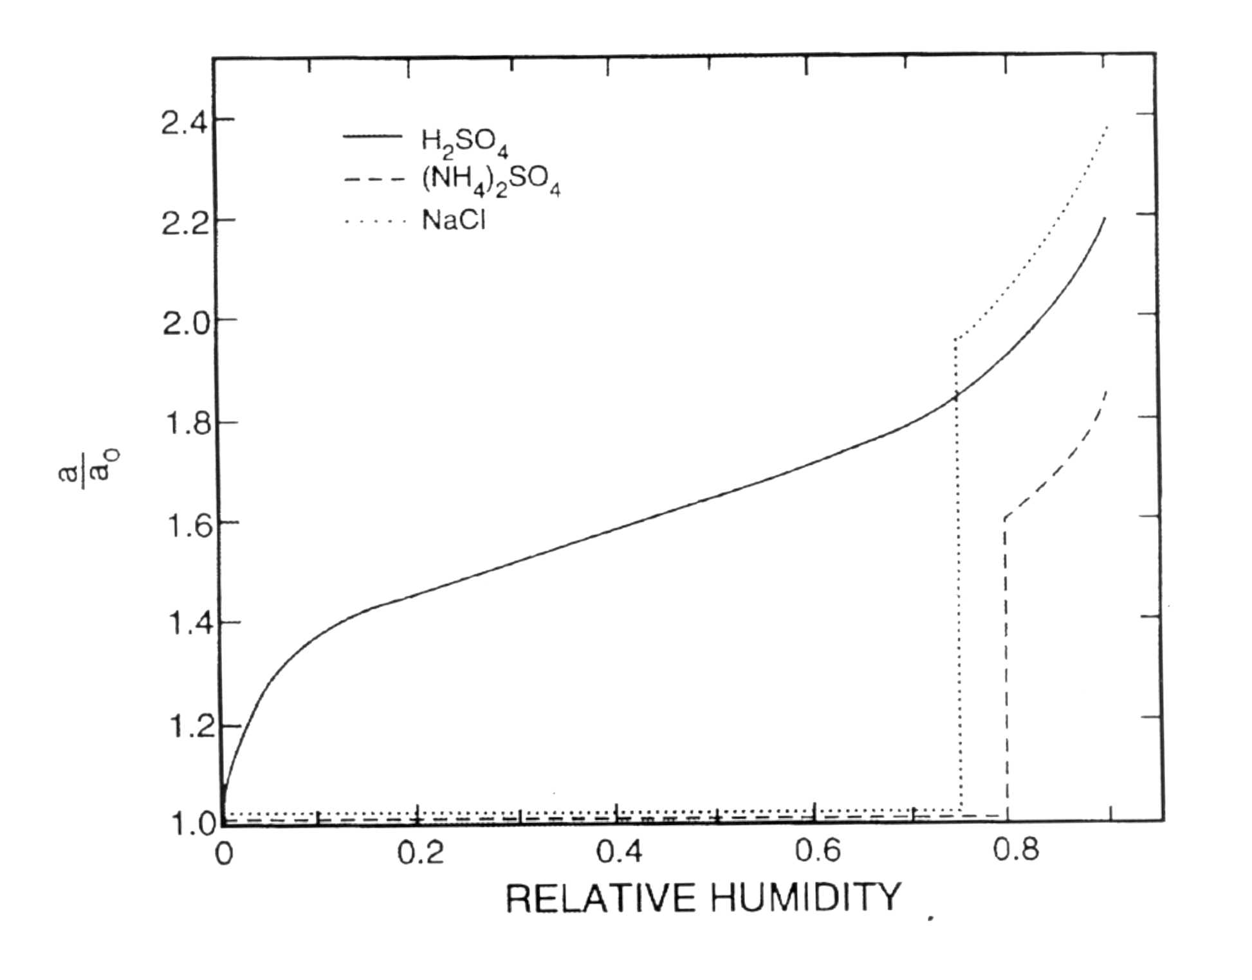
Effect of Relative Humidity on Particle Diameter
Salby, Fundamentals of Atmospheric Physics, 1996.

Slide 33
Particle Mass Measurements
Need a size-selective inlet
  Cyclones
  Impactors
Need a method to collect particles
  Impaction
  Filtration
  Electrostatic Precipitation

Slide 34
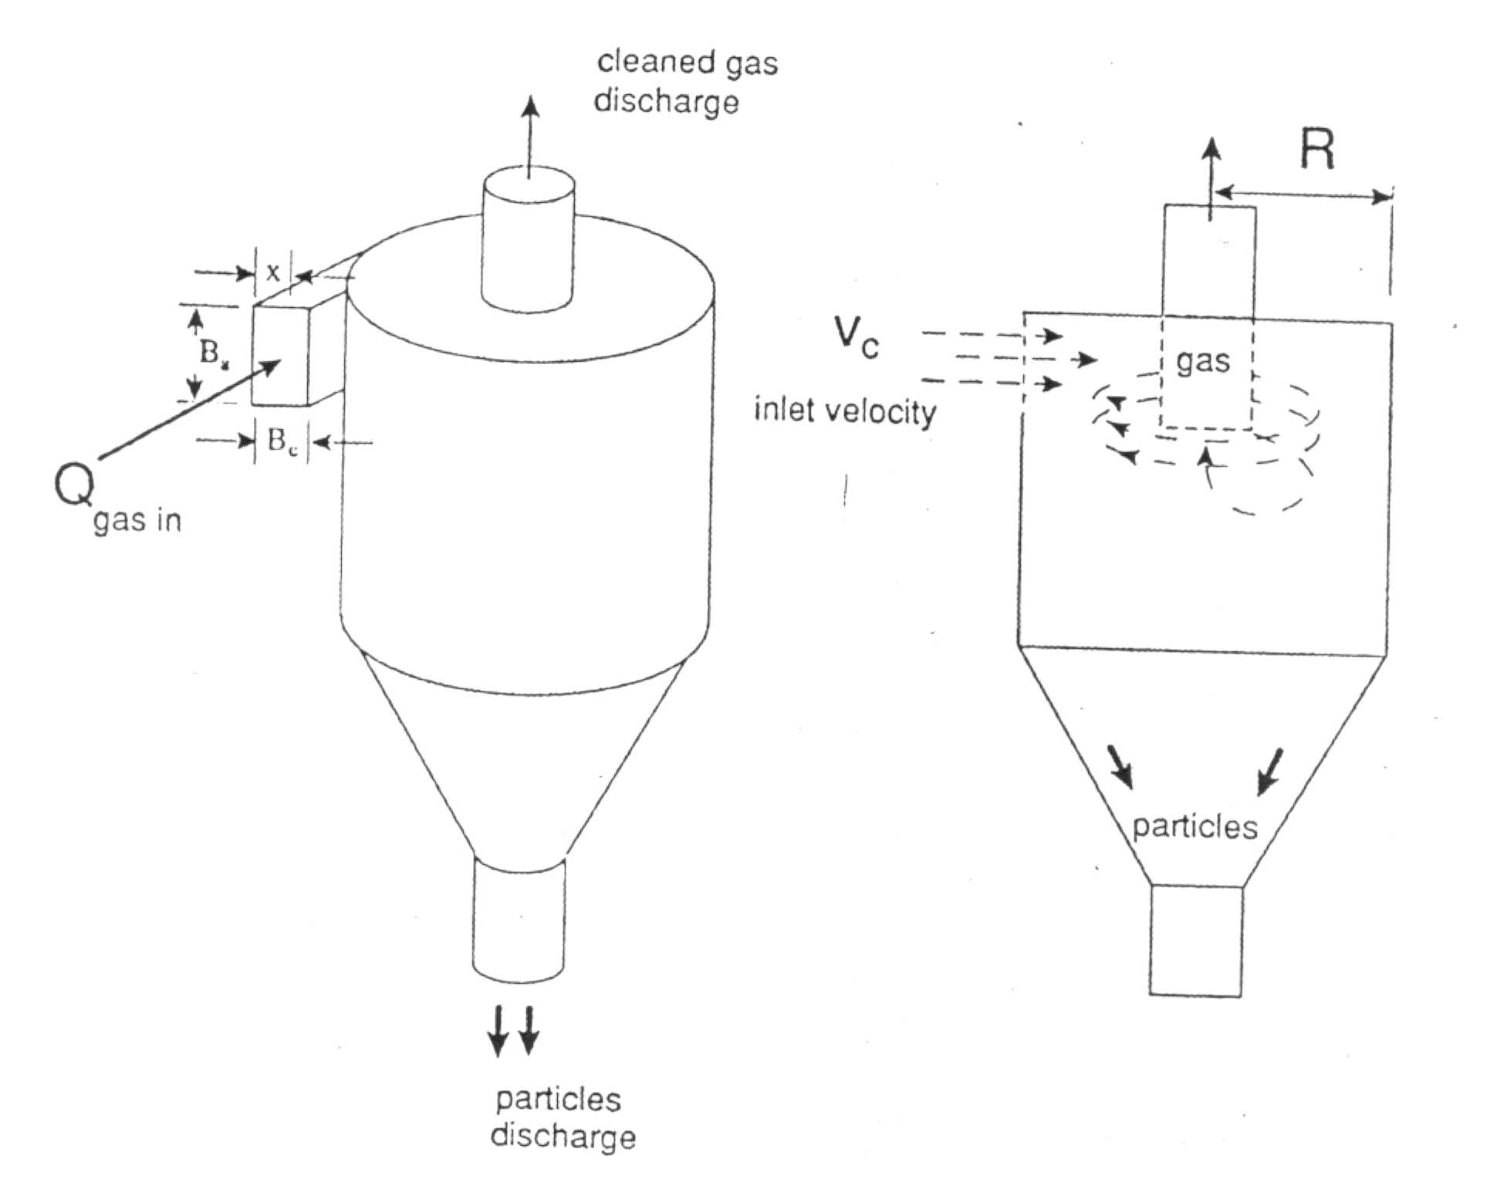
Schematic Diagram of a
Cyclone Separator

Slide 35
Impactors for Size-Resolved Aerosol Chemistry Measurements
Most Commonly Used
- Cascade Impactor
- Multi-Orifice Uniform Deposit Impactor (MOUDI)
Davis Rotating Unit for Monitoring Impactor (DRUM)
Less Commonly Used
Lundgren Impactor, Anderson impactor, Mercer impactor, University of Washington Mark III impactor, Electrical Low Pressure Impactor (ELPI)

Slide 36
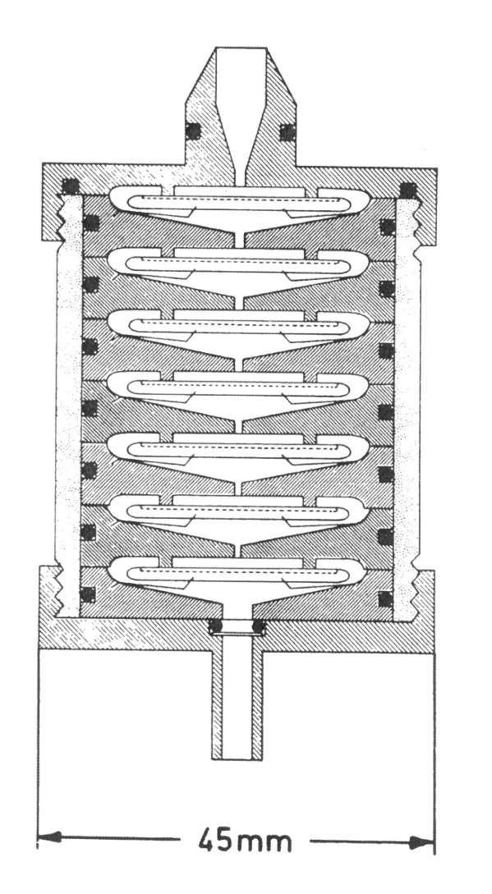
Schematic Diagram of a
Cascade Impactor

Slide 37
Basic Aerosol Sampling Methods #1
Filtration
Typically used for bulk chemical analysis
Most analytical methods require sample durations of 6 hours or more under normal atmospheric conditions
Substrate is optimized for the analytical technique used
Impaction
Physically separates different size fractions based on aerodynamic diameter
Can be used for size-resolved chemical analysis, but requires very sensitive analytical techniques

Slide 38
Measurement Challenges
Not altering the physical or chemical properties of the target analyte prior to measurement
Calibration
Contamination
Detection limits
Leaks… Leaks… Leaks…
Stable, known flow rate

Slide 39
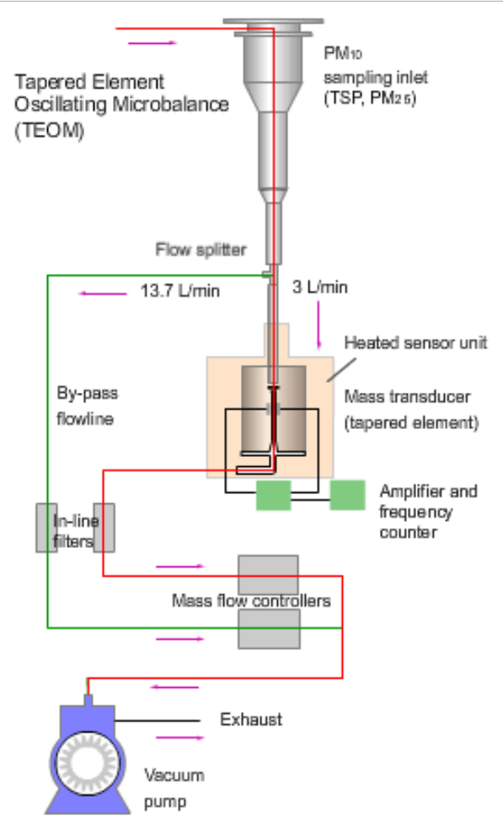
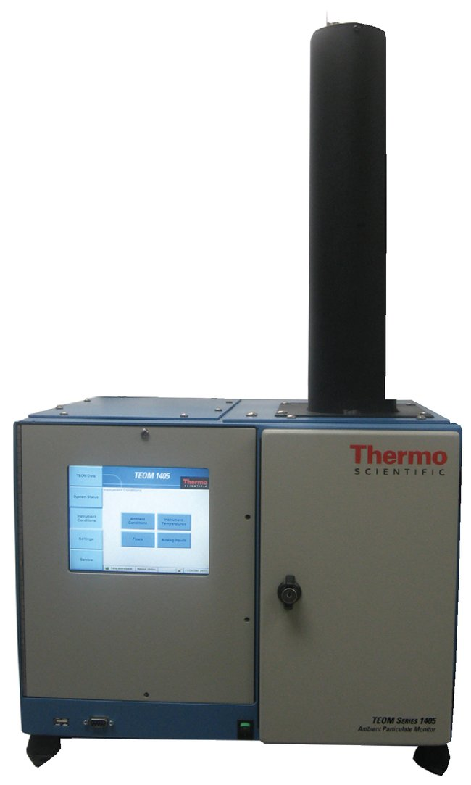
FEM-Particulate Sensor
TEOM: tapered element oscillating microbalance (TEOM): detection of aerosol particles by measuring their mass concentration.
small vibrating glass tube whose oscillation frequency changes when aerosol particles are deposited on it.

Slide 40
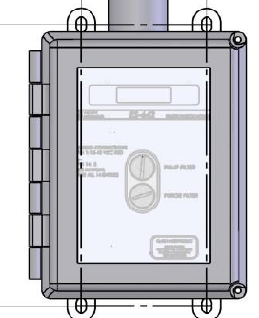
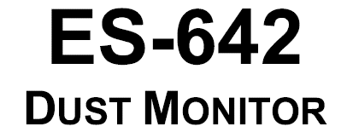


Slide 41
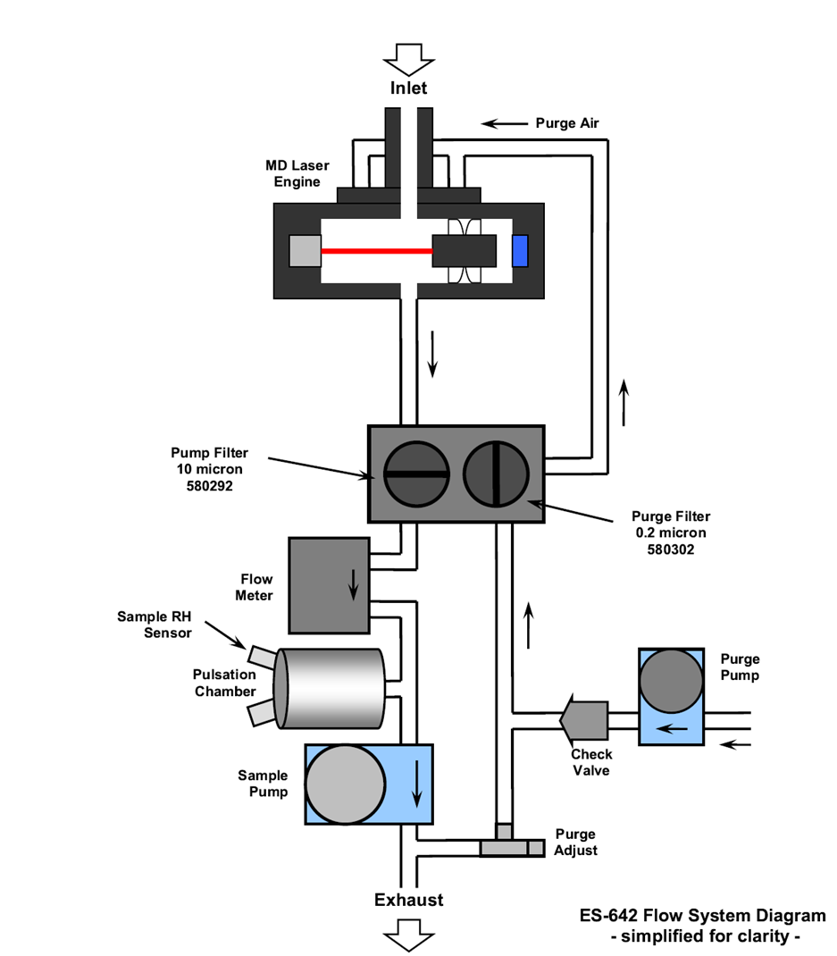
PRINCIPLE OF OPERATION
The Met One Instruments model ES-642 is an active flow nephelometer which measures,
by means of interchangeable sharp cut cyclones, PM10 & PM2,5 or TSP aerosol concentration levels using the principle of forward laser light scatter. Furthermore, with a heated inlet, the ES-642 is able to compensate for elevated levels of humidity. This function is user-selectable however the norm is to activate the compensation at the 40% level.
Notes:
Principle of Operation

Slide 42
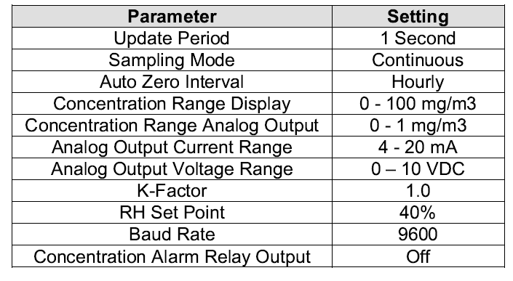
FACTORY SETTINGS

Slide 43
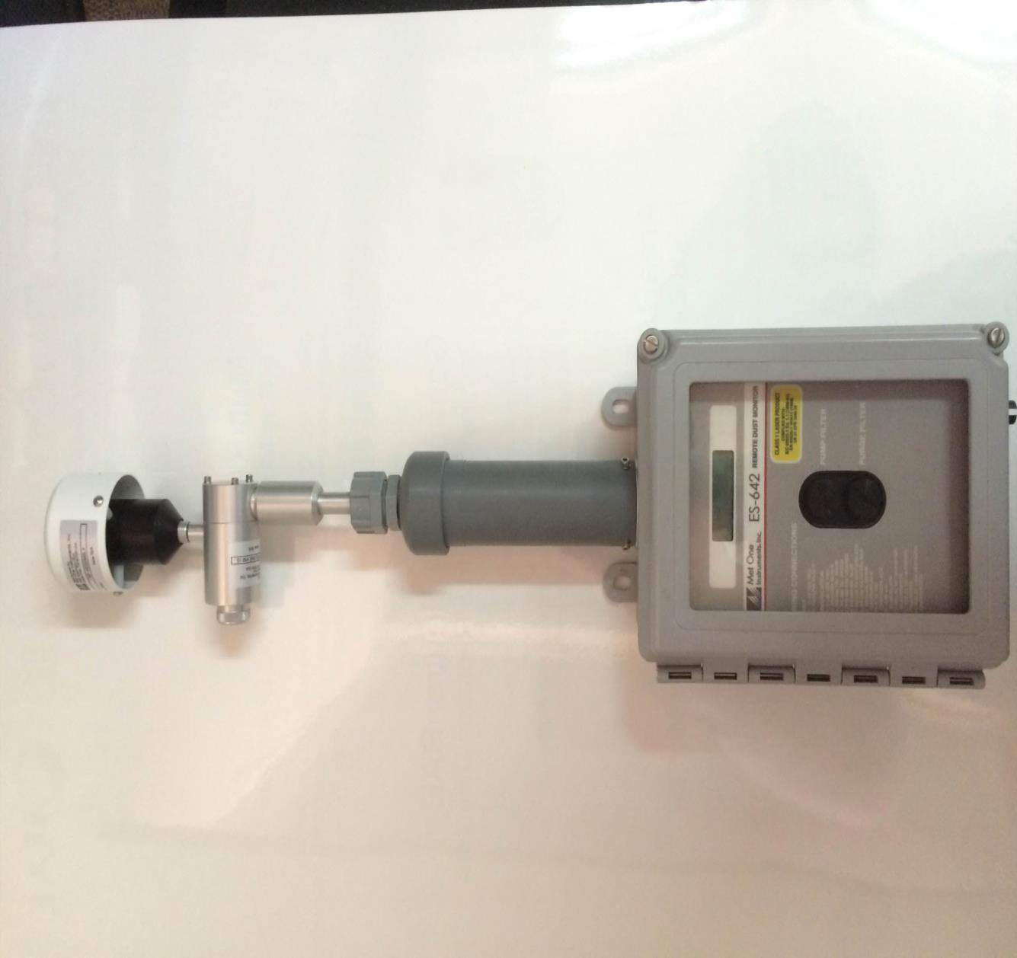
KEY FEATURES
TSP INLET
PM 10 SHARP CUT CYCLONE
(PM2.5)
ACTIVE HEATED INLET
ACTIVE SAMPLING PUMP
PUMP FILTER
PURGE FILTER

Slide 44

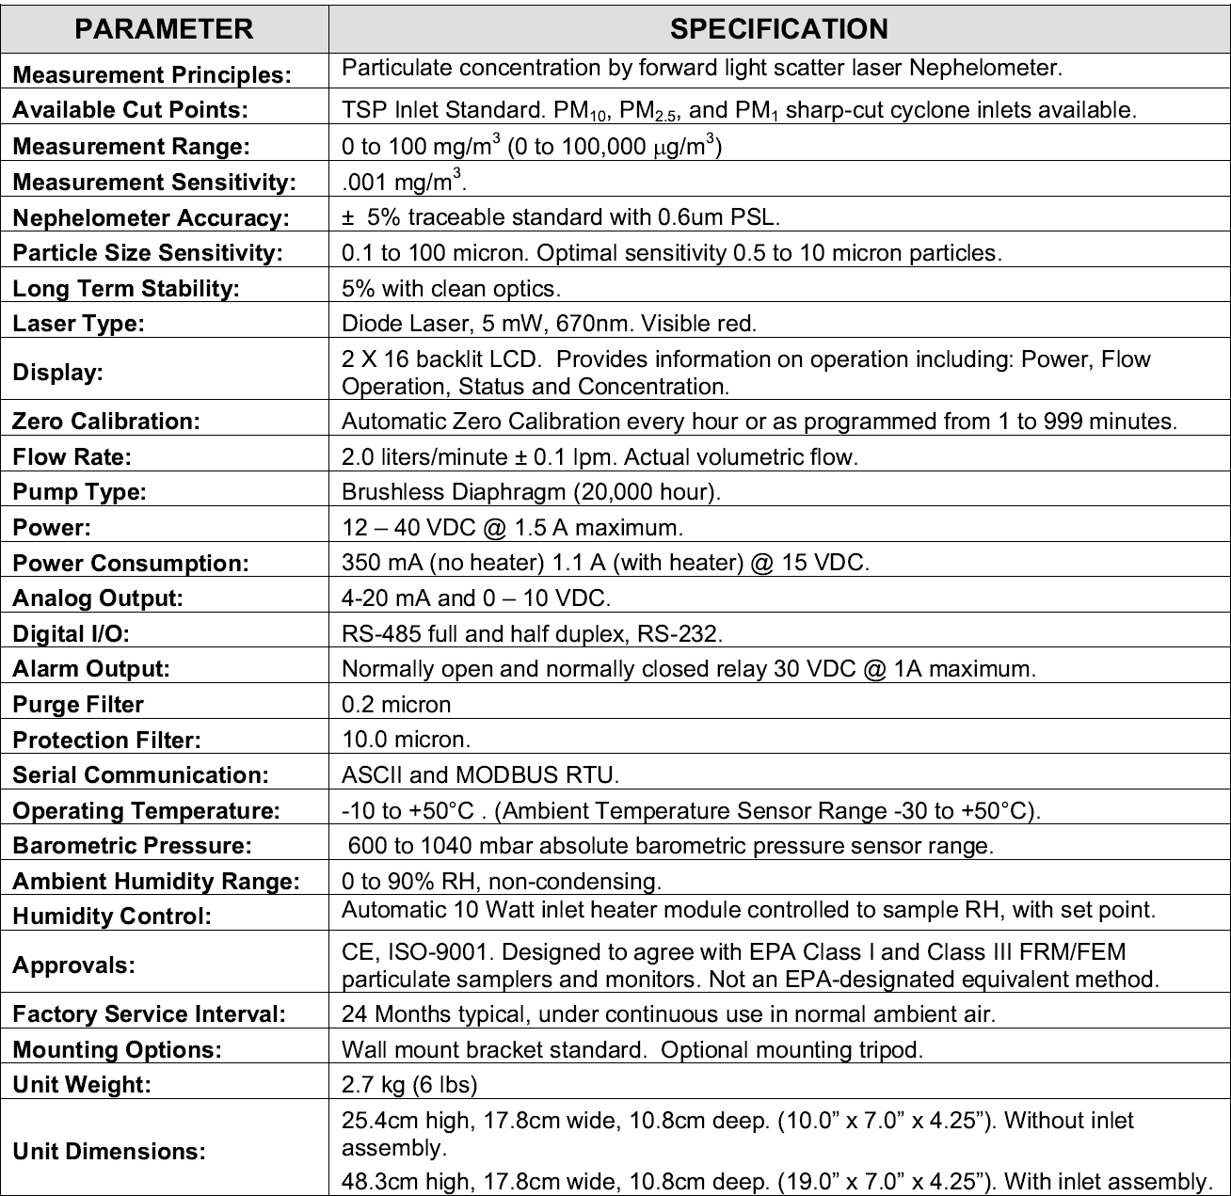

Slide 45
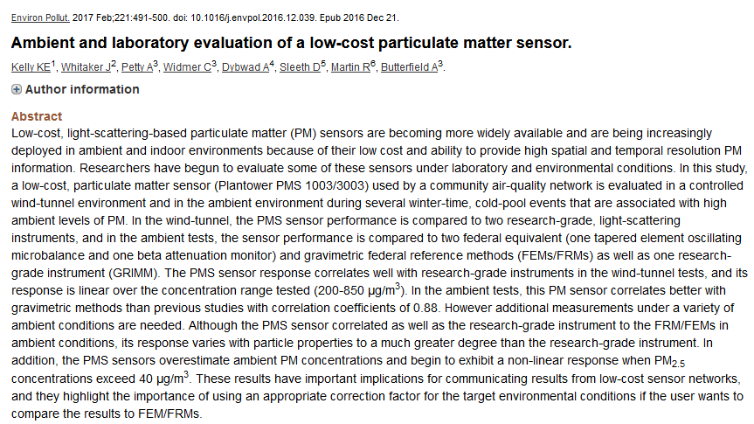
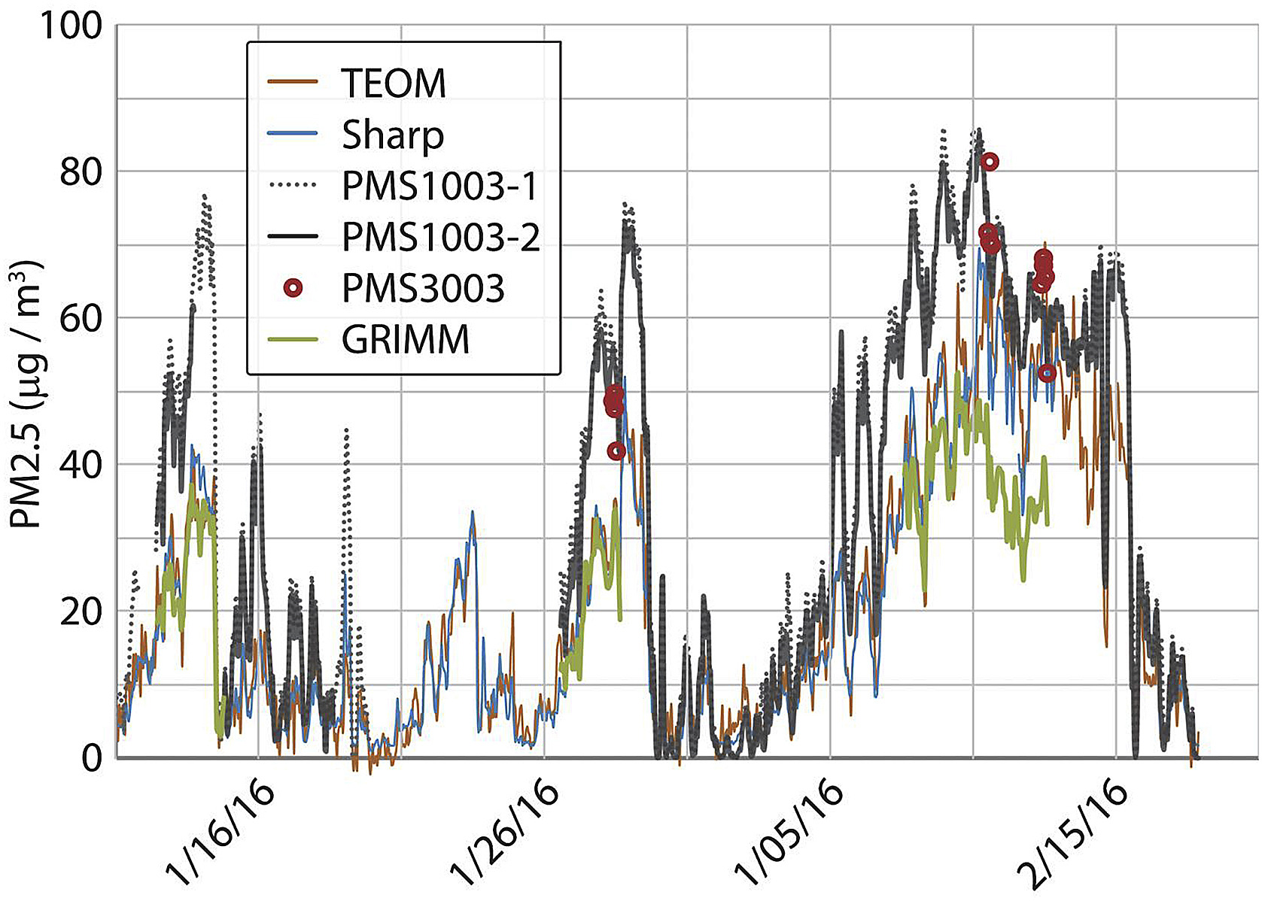

Slide 46
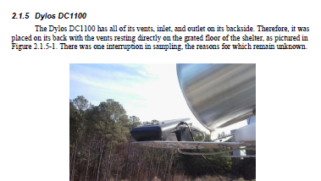
Dylos

Slide 47
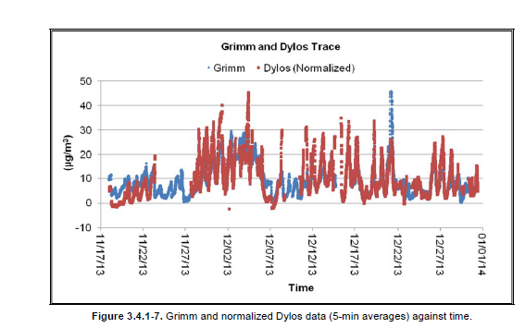
Problems with dylos unknown
Potentially vehicle exhaust with unusual particle size distribution or increased humidity

Slide 48
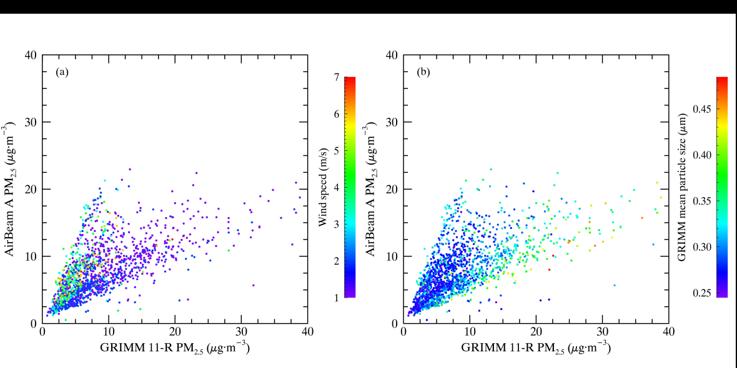
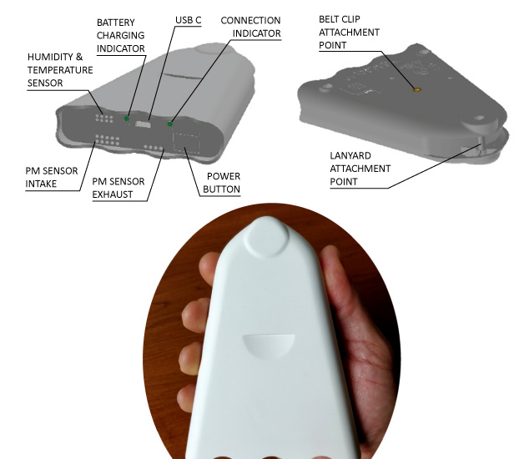
Effect of Wind Speed and RH on low-cost AirBeam Sensor
http://www.takingspace.org/aircasting/airbeam/
Sensors 2017, 17, 1805; doi:10.3390/s17081805

Slide 49
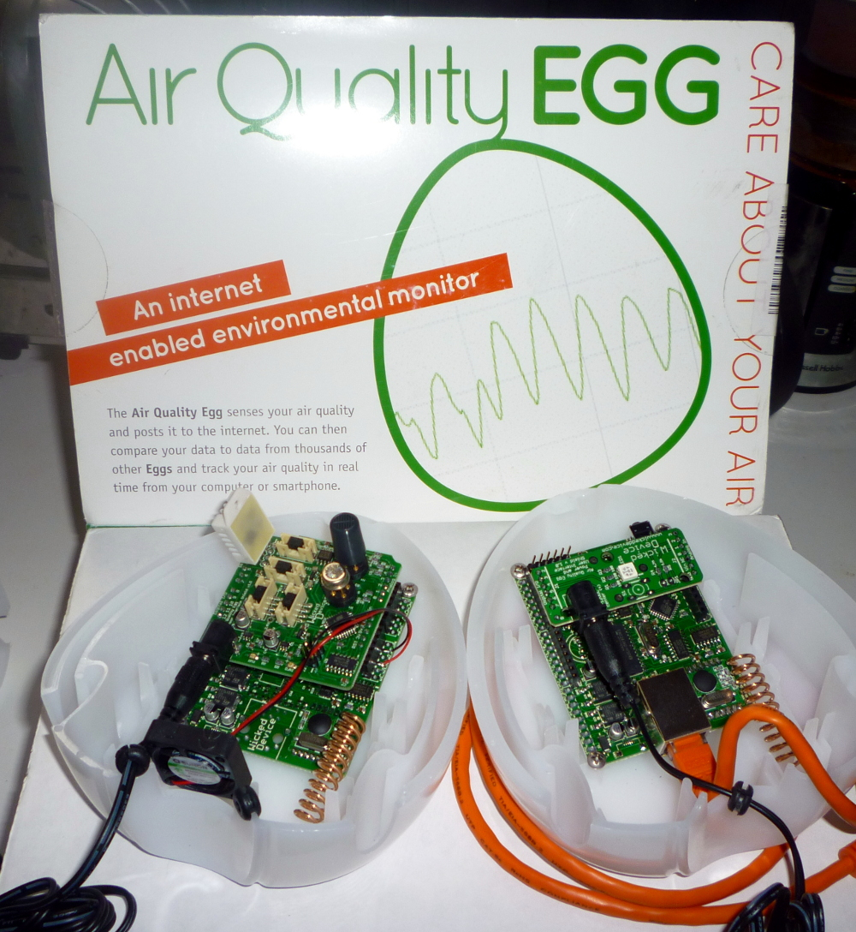
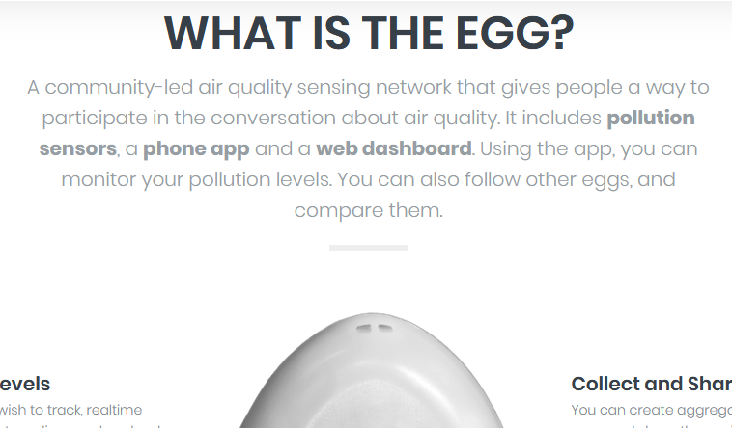
Air Quality Egg

Slide 50

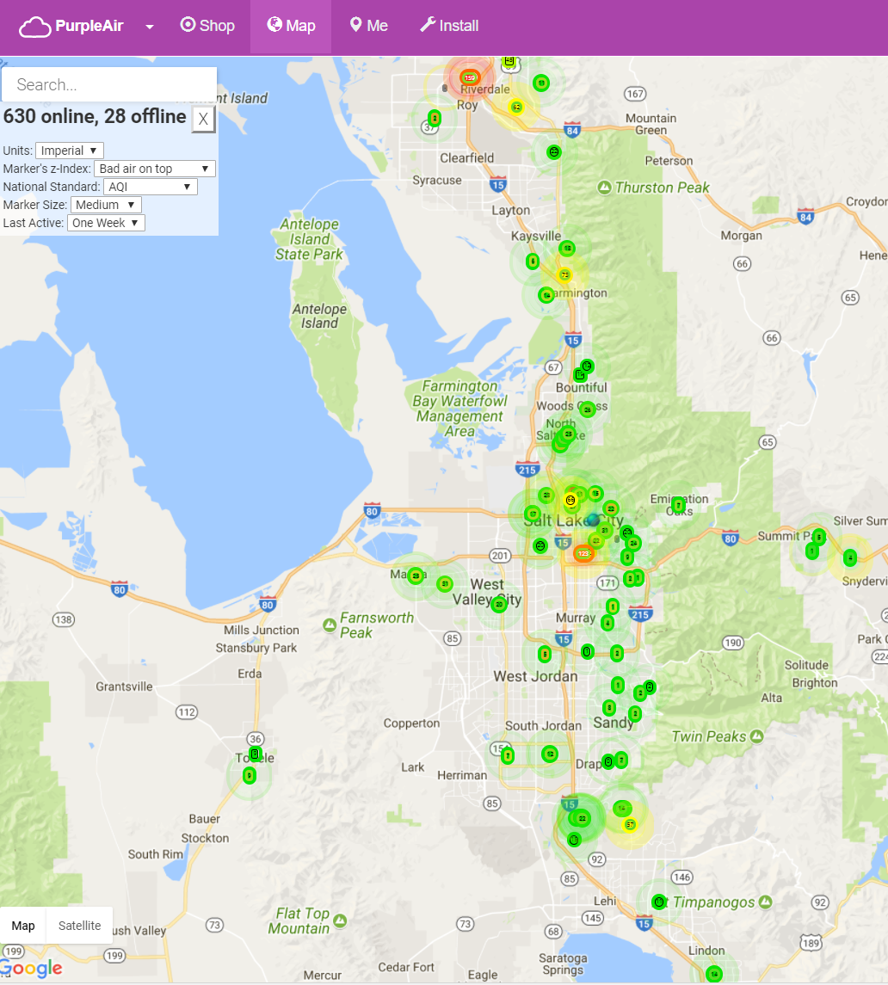
Purple Air: https://www.purpleair.com/
U.S. EPA Smart City Air Challenge Webinar 16

Slide 51


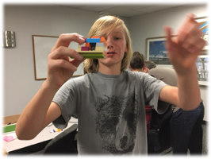
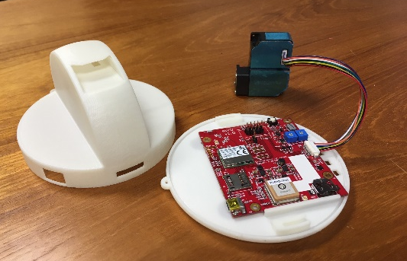


AirU
https://airu.coe.utah.edu/
Kelly and Butterfield, Chemical Engineering
Bringing low-cost, air quality sensors and teaching modules to classrooms along the Wasatch Front
It’s not just a black box! Hands on: how can you use light scattering to detect pollution?
Host an air quality sensor: help us understand air quality and low-cost sensor performance
https://youtu.be/xq7YiR8wdCM

Slide 52
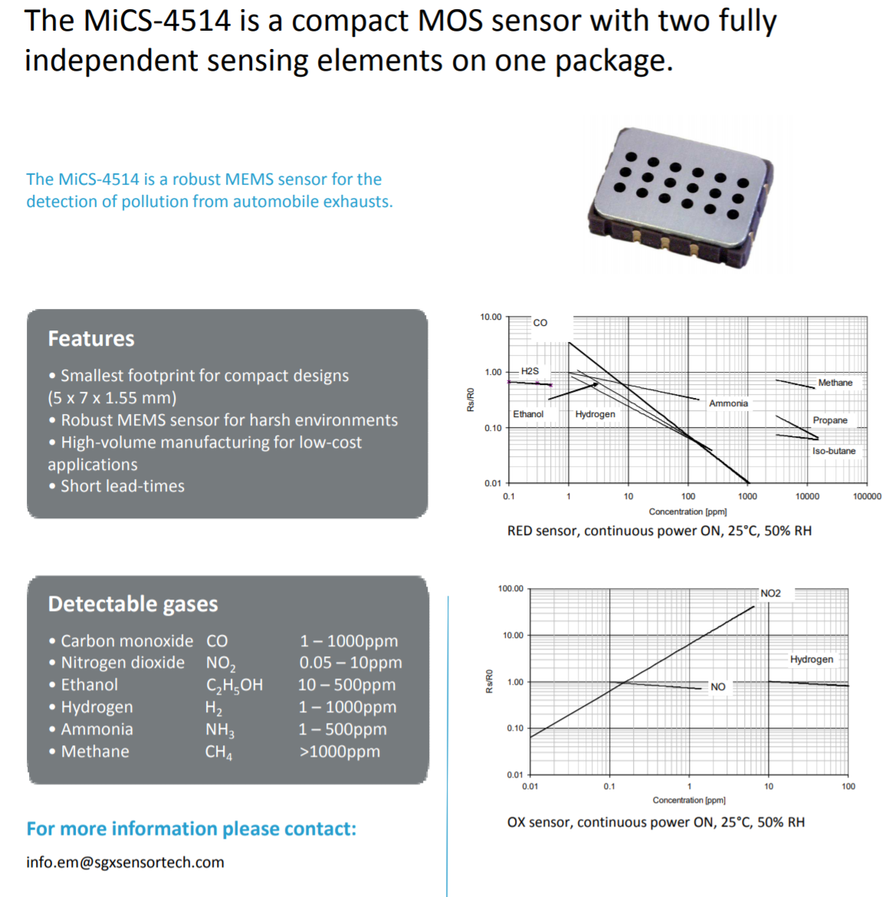
CO/NO2 sensor intended for car exhaust applications

Slide 53
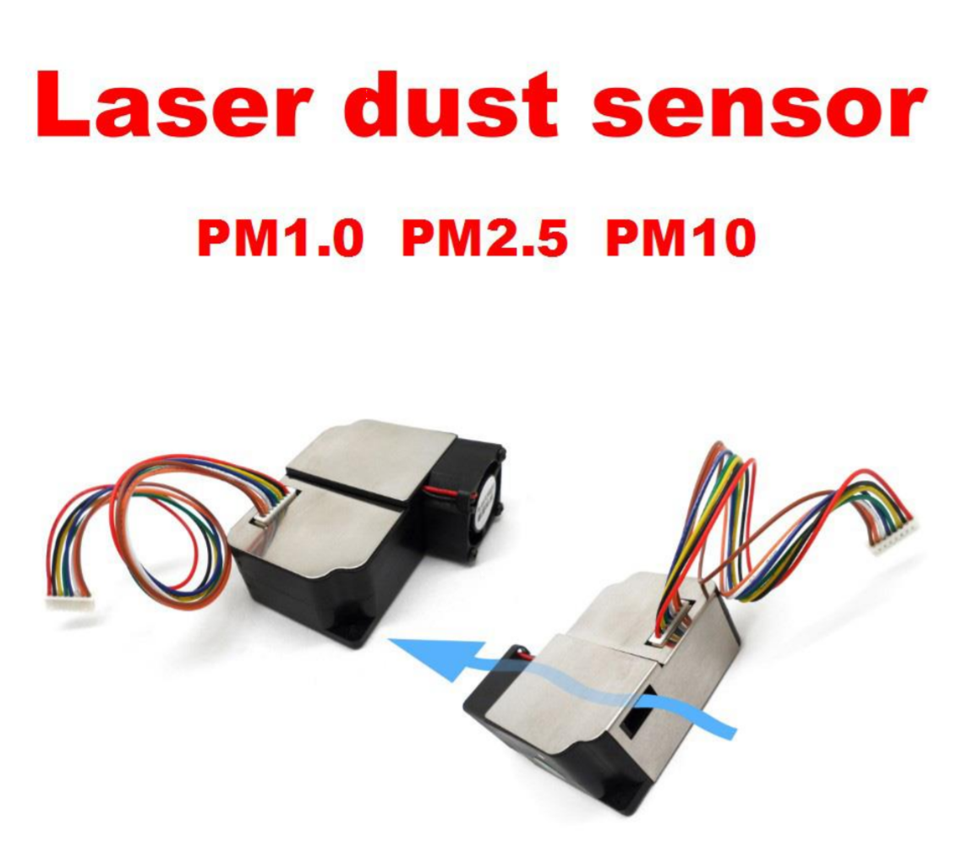
Plantower

Slide 54
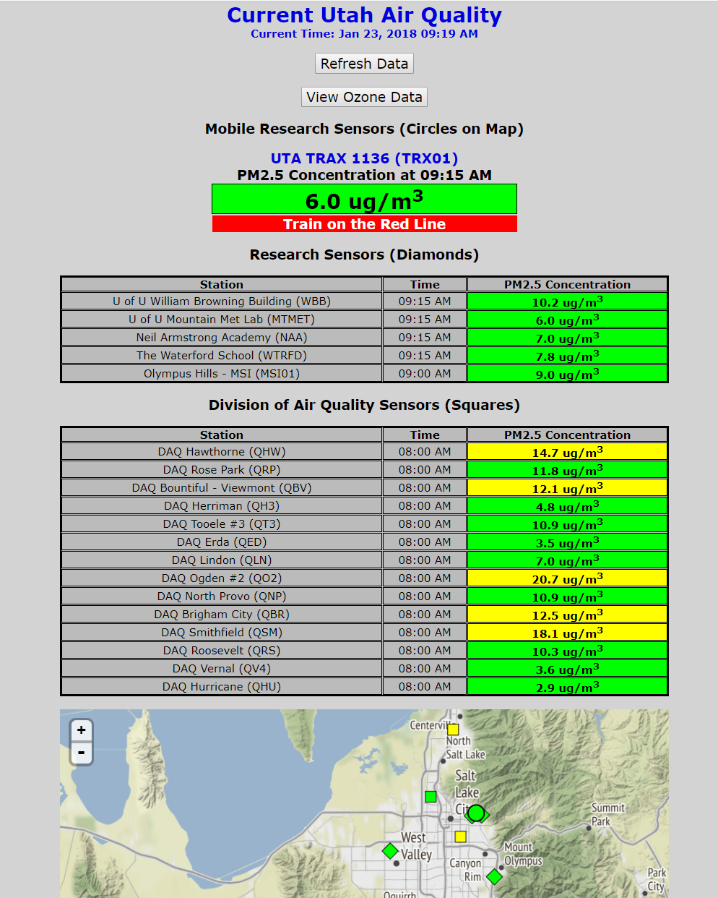
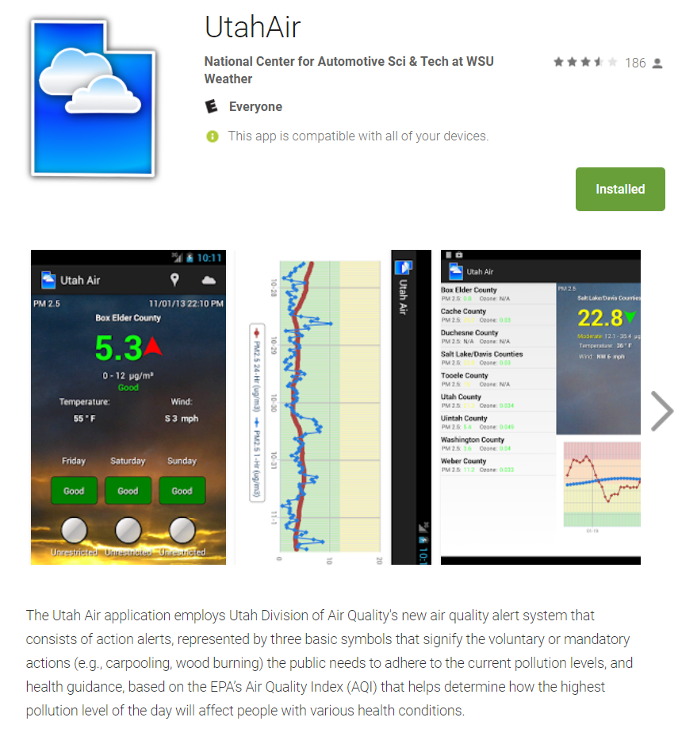
Sources for quick look at local air quality data
http://utahaq.chpc.utah.edu/aqmobile

Slide 55
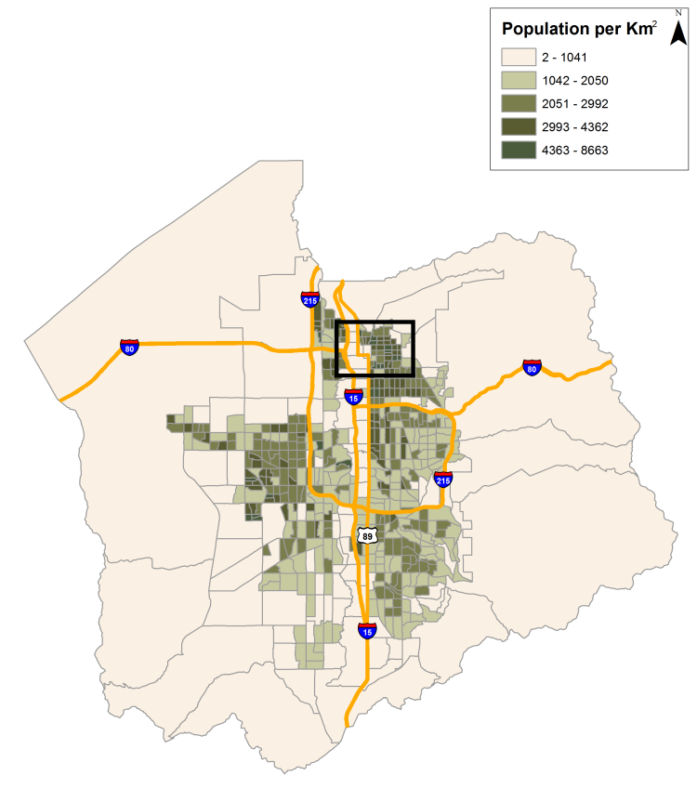
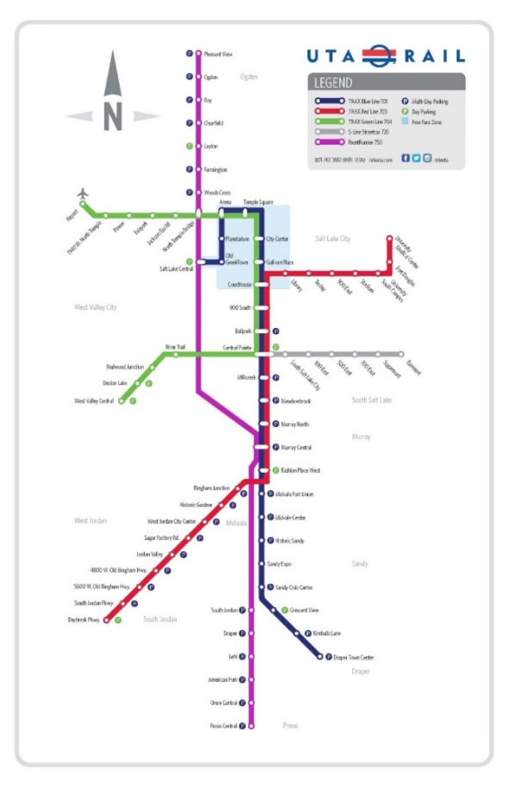
Air Quality & UTA TRAX
TRAX lines are ideally situated to monitor air quality:
  Red Line: diagonal transect across valley
  Green Line: “C” shape transect through urban corridor
  Blue Line: north-south transect along valley floor
55

Slide 56
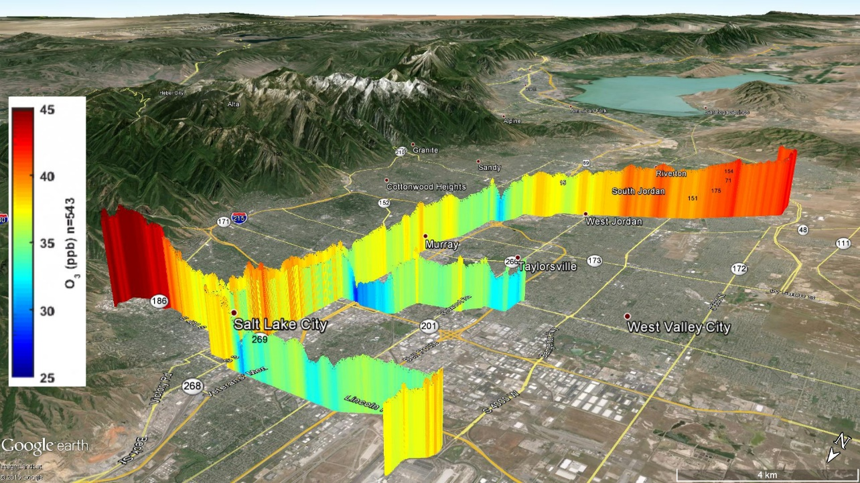


Slide 57
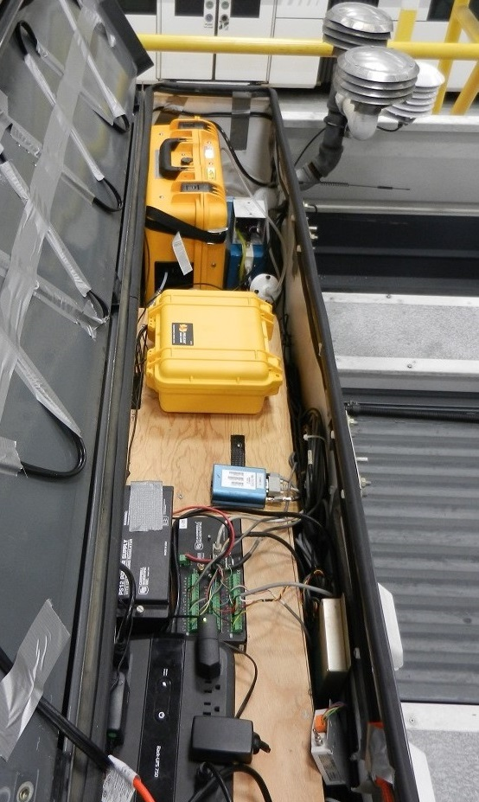
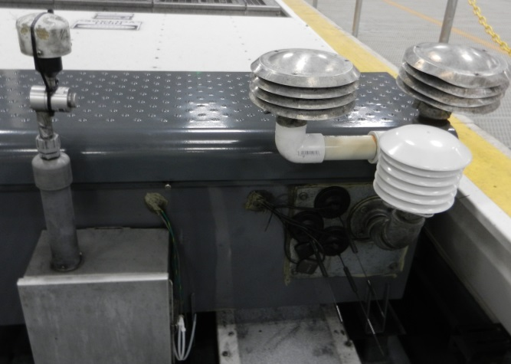

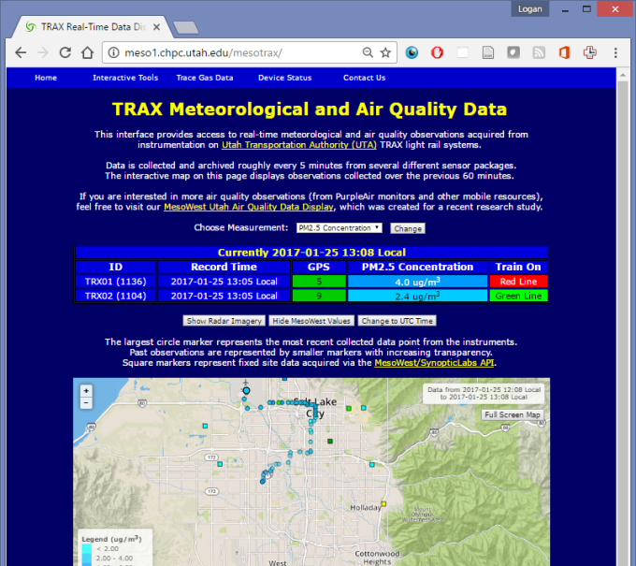
Air Quality (O₃, PM_{2.5}) and Greenhouse Gas (CO₂, CH₄) Sensors
CO₂
CH₄
O₃
PM_{2.5}
Data are publicly available via the web
57

Slide 58
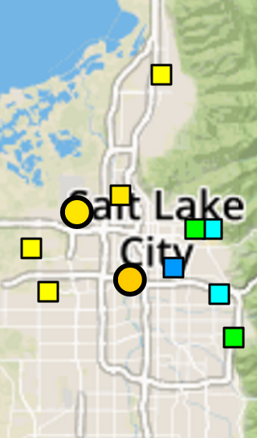

Real-Time Monitoring
Update with Tuesday morning data
http://meso2.chpc.utah.edu/aq/
Update with Tuesday morning data
https://air.utah.edu/
58

Slide 59

Variations in pollutant concentrations across the Valley
have been examined since Dec 2014
Dec 2014 – Nov 2015
Hours: 0400-2400
Train in middle of traffic
Elevated along the urban corridor
Lower CO₂ on urban periphery
Highest CO₂ downtown
59

Slide 60
Confirming Impacts of Conventional Traffic Flows
Dec 2014 – Nov 2015
Hours: 0400-2400
Higher CO₂ along major roads
60

Slide 61

Summer Poor Air Quality Not Limited to Valley Floor
May 2015 – Sept 2015
Hours: 0400-2400
Higher O₃ on urban periphery
Lower O₃ in urban corridor
61

Slide 62

Monitoring Industrial Sources of Methane
Dec 2014 – Nov 2015
Hours: 0400-2400
Brick factory
Landfill
Natural gas power plant
62

Slide 63


KSL Chopper

Slide 64
Additional Slides

Slide 65


Ozone

Slide 66

Typical Number, Surface Area, and Volume Distributions
(lin-log plot)
Why would we be interested in the surface-area distribution?
Indicates where condensable species will deposit
Indicates where heterogenous reactions are most likely to occur
Why would we be interested in the mass distribution?
Whitby, Int. Conf. on Nucleation, Leningrad, 1973
Quantifies the transport of nutrients and toxics
Required for regulatory purposes

Slide 67
CN Measurements
Technique developed during WWII for hunting submarines
Increase RH to ~300% through rapid expansion
Measure total light scattering from all particles

Slide 68
Size Distribution Measurements
Charge particles
Use a differential mobility analyzer to select a particle size range
Use CN counter or measure number of particles in that size range
Assume spherical particles to translate into a surface area distribution
Assume particle density to translate into a mass distribution

Slide 69
Common Particle Shapes
MORPHOLOGY COMMON SPECIES
Spherical sulfuric acid, sulfate, nitrate, water, fly ash, some organics
Crystalline salts, some soils
Fibrous plant material, asbestos
Aggregates soot
Disks/Plates clay, silt

Slide 70

Examples of Different Particle Morphologies
Fuchs, The Mechanics of Aerosols, 1964

Slide 71
Basic Aerosol Sampling Methods #2
Electrostatic Precipitation
Imparts a known charge distribution to aerosols
Segregates aerosols based upon their mobility in an electric field
Can be used to collect all aerosols or to create a monodisperse aerosol distribution from a polydisperse source
Real-Time Analysis
- Limited to size distribution, optical properties, and single particle chemical analysis at present
- Requires EXTREMELY sensitive or highly targeted analytical techniques

Slide 72
Electrostatic Precipitation
Not Widely Used Except:
To lightly coat polycarbonate filters for SEM/TEM analysis
To generate a monodisperse aerosol from a polydisperse source using an differential mobility analyzer (DMA)

Slide 73
Real-Time Analysis of Aerosol Chemical Composition
Early work involved impacting particles on a hot filament that ionized the species in the particles and detected the resultant ions using mass spectrometry
Most recently this technique has evolved so that single particles can be sized, ionized by a laser, and detected using mass spectrometry (ATOFMS)
Continued development is a high priority for many different applications

Slide 74

Instruments to Measure Concentration and Size Distribution of PM
Amaral et al. 2015. Atmosphere 2015, 6, 1327-1345; doi:10.3390/atmos6091327

Slide 75
Instruments to Concentration and Size Distribution of PM
Gravimetric method, the particle mass concentration is determined by weighing the filters before and after the sampling period.
In the optical detection methods, aerosol particles are lit by a light beam and irradiate this light in all
directions.
Microbalance detection methods use the alteration of the resonance frequency when particles are collected on surface of microbalance element to
determine the PM concentrations
Atmosphere 2015, 6, 1327-1345; doi:10.3390/atmos6091327

Slide 76


Slide 77


Slide 78

CONNECTIONS
Power Requirements
The ES 642 operates on 15 – 40 Volt D/C
Output
Notes:
Outputs

Slide 79




INSTALLATION OPTIONS

Slide 80
METONE INSTRUMENTS – THE E-SAMPLER

