Slide 1
Data Sets Related to Utah Air Quality
Matt Lammers, University of Utah/MesoWest

Slide 2
Outline
Particulates in the Salt Lake Valley (Whiteman et al. 2014)
University of Utah 2-Dimensional Variational Surface Analysis (UU2DVAR)
Surface Observations of Atmospheric Variables in Utah from MesoWest
Recap and Questions

Slide 3
Salt Lake Valley
A 10.5 MB, tab-separated text file aggregated by members of Dr. David Whiteman’s group in the University of Utah Department of Atmospheric Sciences
Contains the following information for the period 1 January 1973 to 31 March 2013:
Meteorological data at 12-hour intervals from National Weather Service (NWS) radiosonde soundings
Cloud and snow cover data at 12-hour intervals from observations by the NWS Forecast Office
24-hour averaged concentrations of different pollutants measured at varying locations in the Salt Lake Valley

Slide 4
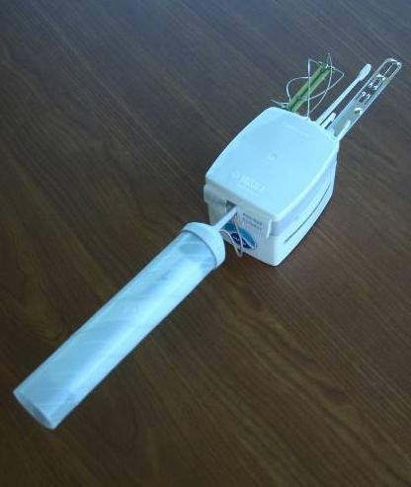
Salt Lake Valley
Radiosondes (more commonly known as “weather balloons”) are launched every 12 hours at 00 and 12 UTC (17 MST and 5 MST, respectively) from the National Weather Service office near the Salt Lake City International Airport
These instruments typically measure air temperature, relative humidity, pressure, and wind speed and direction.
Image of a Vaisala RS92 radiosonde package currently used by the National Weather Service (www.nws.noaa.gov)

Slide 5
Salt Lake Valley
The radiosonde values featured in the Whiteman, et al. data are primarily averaged or integrated over a depth representative of the valley basin. Both surface to 1800 m Mean Sea Level and surface to 2200 m Mean Sea Level were included. Explicit descriptions of each variable can be found in the associated ReadMe.txt and in the Whiteman, et al. paper.
The variable derived from the soundings that was determined to have the best Pearson product-moment correlation is heat deficit to 2200 meters, which is the heat needed to warm a 1 square-meter column with its base at the surface to the potential temperature (temperature of a parcel of air if brought down to sea level without any outside heating) at 2200 meters. Its units are MJ m⁻².
Raw sounding data can be found at the University of Wyoming archive: http://weather.uwyo.edu/upperair

Slide 6
Salt Lake Valley
Snow cover and cloud cover both promote the development of persistent multi-day inversions within the valley
If snow cover is observed at the airport at 1700 MST, it is assumed that there is snow cover throughout the valley for that entire day
Cloud cover is represented as an index value: ‘1’ if there is there is broken, overcast, or obscured clouds with a base below 3000 ft above ground level, ‘0’ otherwise.

Slide 7
Salt Lake Valley
Pollution data comes from varying sites around the valley – a “station of record” was established for each of the pollutants
Particulates have been measured at different sizes over the 40-year period, starting with Total Suspended Particulates (TSP) in 1973, followed by Particulate Matter with aerodynamic diameter less than 10 micrometers (PM₁₀) in 1986, and finally PM_{2.5} beginning in 1999.
Number of 24-hour averaged samples of TSP (cyan), PM₁₀ (blue), and PM_{2.5} (red), concentrations in the winter half-year in the Whiteman, et al. data. Yellow columns are the number of samples that were in exceedance of their respective National Ambient Air Quality Standards (NAAQS). (Whiteman, et al. 2014)

Slide 8
Salt Lake Valley
Locations of stations used as the “stations of record” for the following pollutants in the Whiteman, et al. data:
- Salt Lake Health Department (HD): TSP
- North Salt Lake (NS): PM₁₀
- Hawthorne Elementary (HW): PM_{2.5}
- Cottonwood (CW): Carbon Monoxide (CO)
- Sugarhouse and University of Utah (Not Shown): Carbon Dioxide (CO₂)
- All meteorological data is from Salt Lake City Weather Forecast Office (KSLC)
(Whiteman, et al. 2014)

Slide 9
Salt Lake Valley
Central conclusions include:
Overall particulate concentrations in the Salt lake Valley have decreased over the past 40 years.
Valley heat deficit correlates well with high PM_{2.5} concentrations. During strong heat deficit periods, vertical mixing of air is suppressed, and winds aloft decouple from valley flows, keeping pollutants and moisture trapped.
No statistically significant trend in stability can be discerned in the 40-year dataset (e.g., occurrences of multi-day inversions are not increasing or decreasing).

Slide 10
UU2DVAR
Originally developed in 2010 by Dr. Dan Tyndall in collaboration with Dr. John Horel and later Xia Dong.
The goal has been to assess the impact of surface observations - when, where, and why does an observation provide information that is not evident in the background field?
The background grids are taken from the Rapid Refresh (RAP) model run by the National Center for Environmental Prediction (NCEP), downscaled to 2.5 km.
These grids are then adjusted based on assimilating data from surface observations.

Slide 11
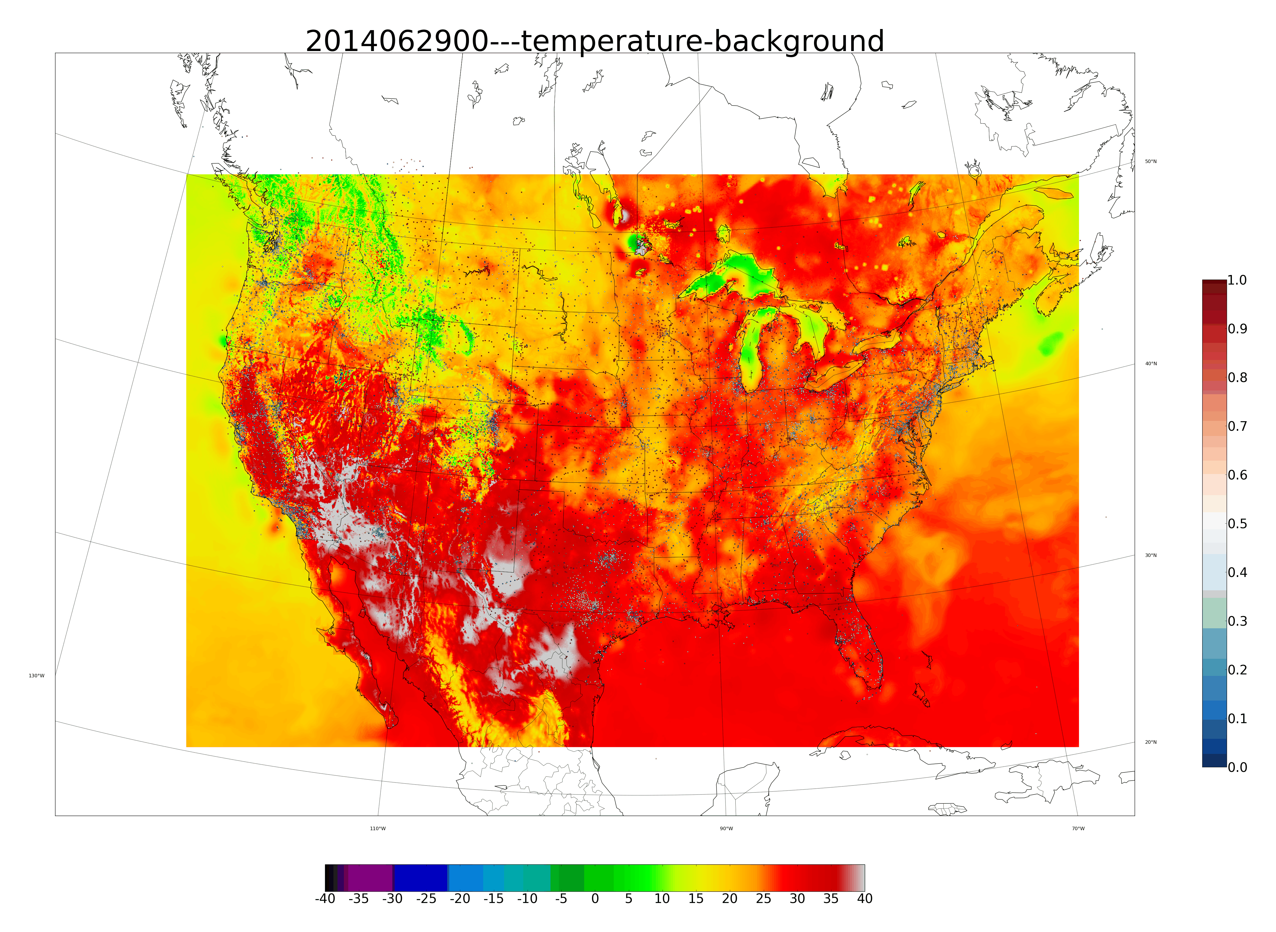
UU2DVAR

Slide 12
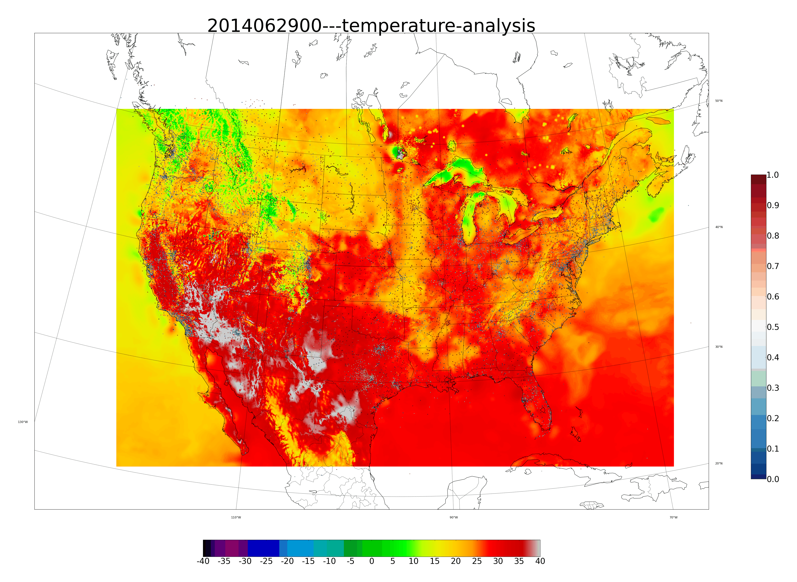
UU2DVAR

Slide 13
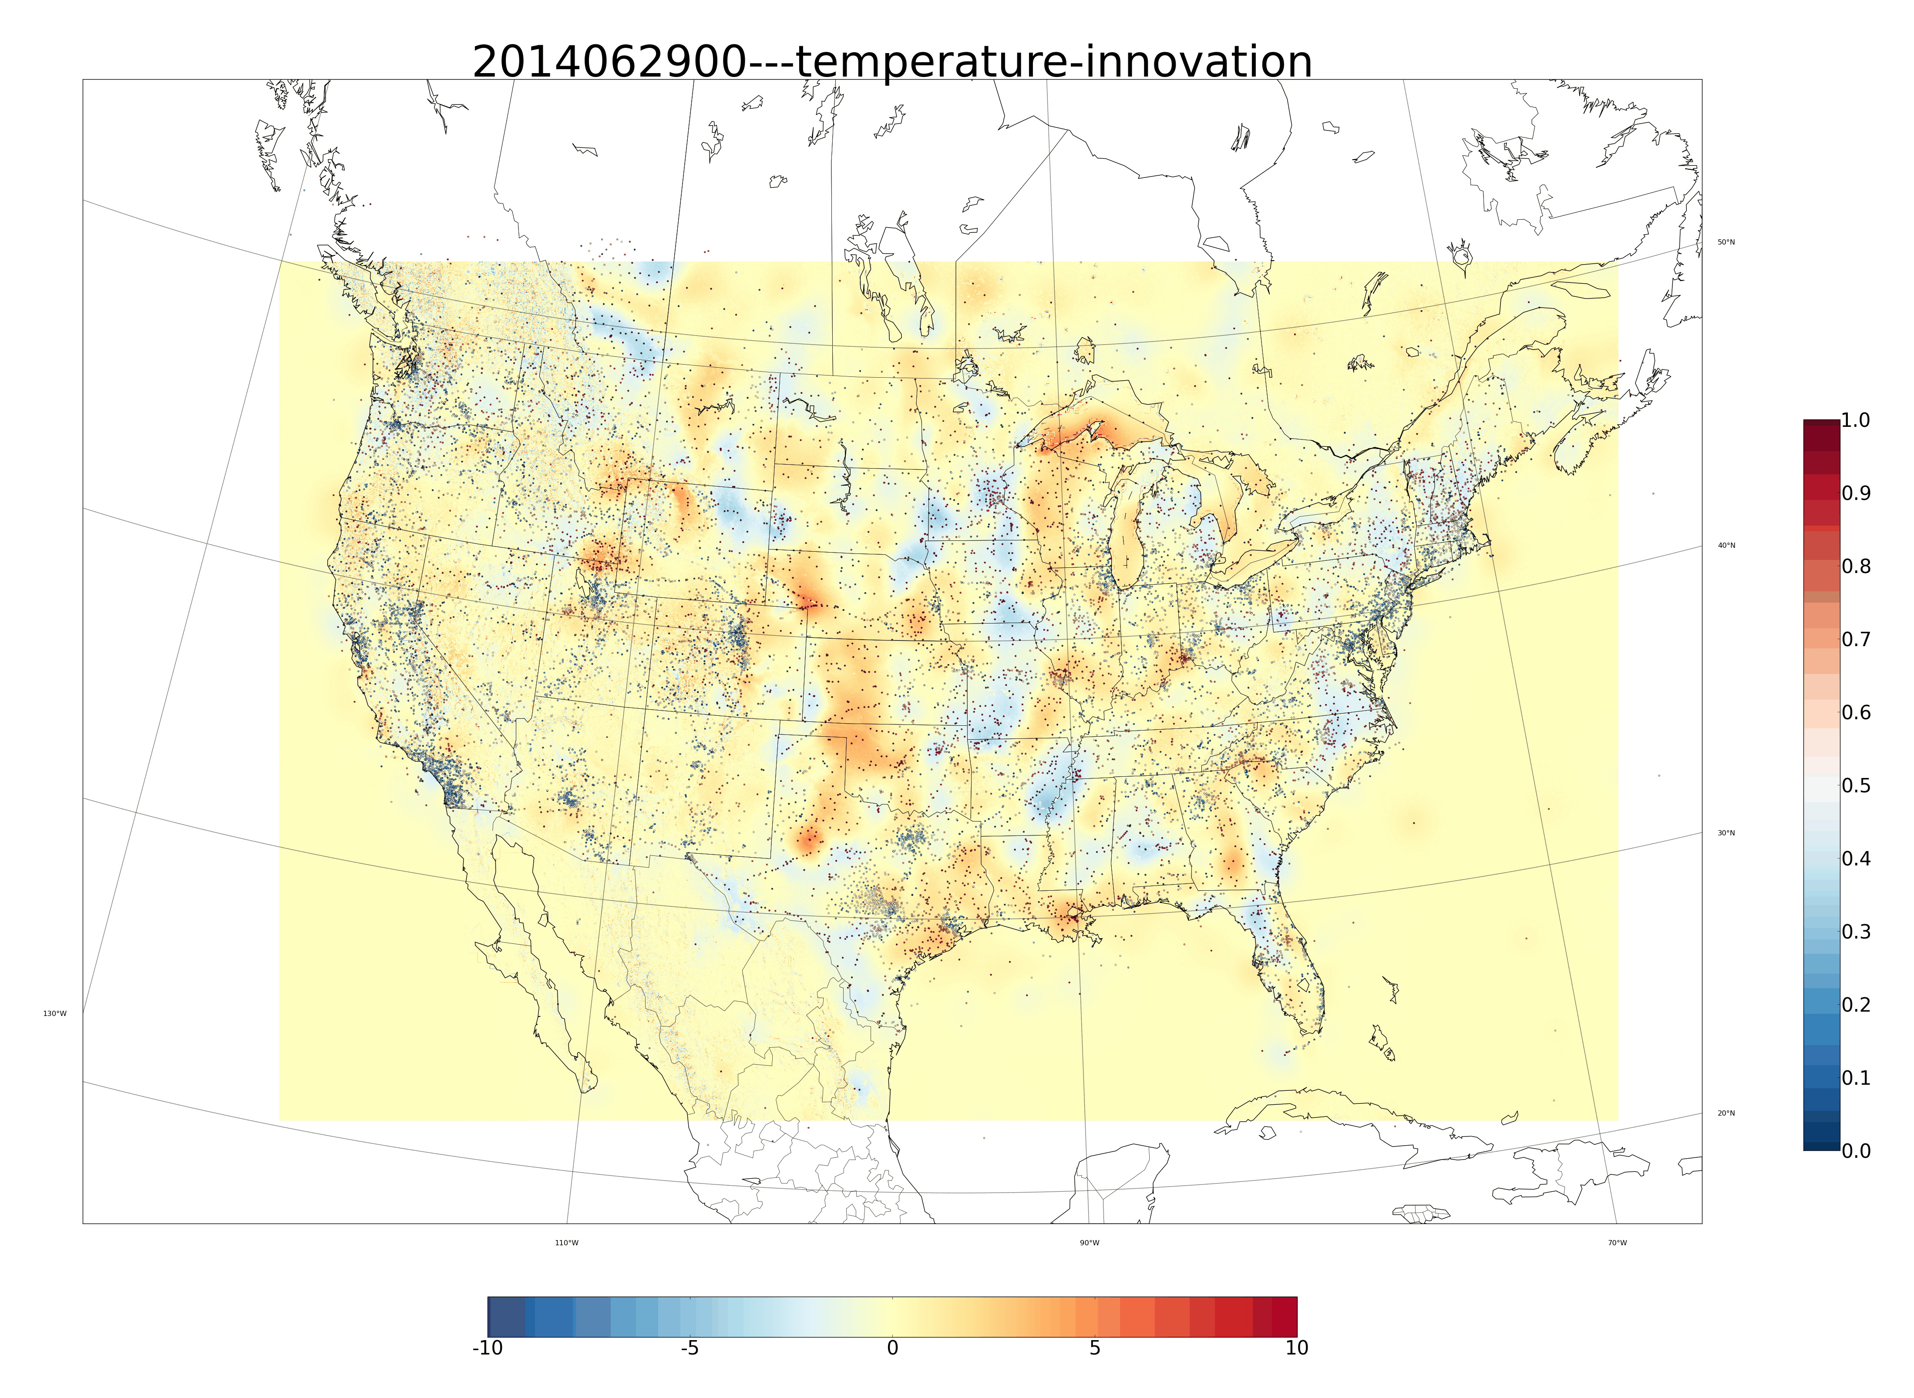
UU2DVAR

Slide 14
UU2DVAR
Available for the purposes of this competition are these grids on a Utah regional domain.
The hourly grids are available at meso1.chpc.utah.edu/utahUU2DVAR in daily HDF5 files.
The latitude/longitude reference grid is at that page in a file called utah_grids.h5
We have also provided an article on the national UU2DVAR (Tyndall and Horel, 2013), a PowerPoint presentation on the current applications of the UU2DVAR, and a readme file on how to read the HDF5 grids in Python.
There are grids for temperature, dewpoint, u-wind speed (east-west), and v-wind speed (north-south).

Slide 15
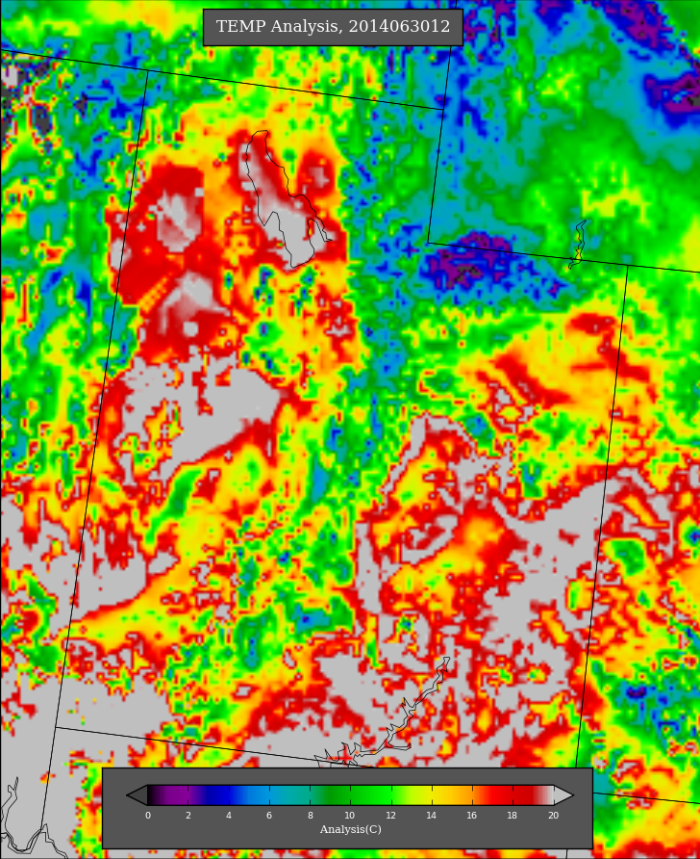
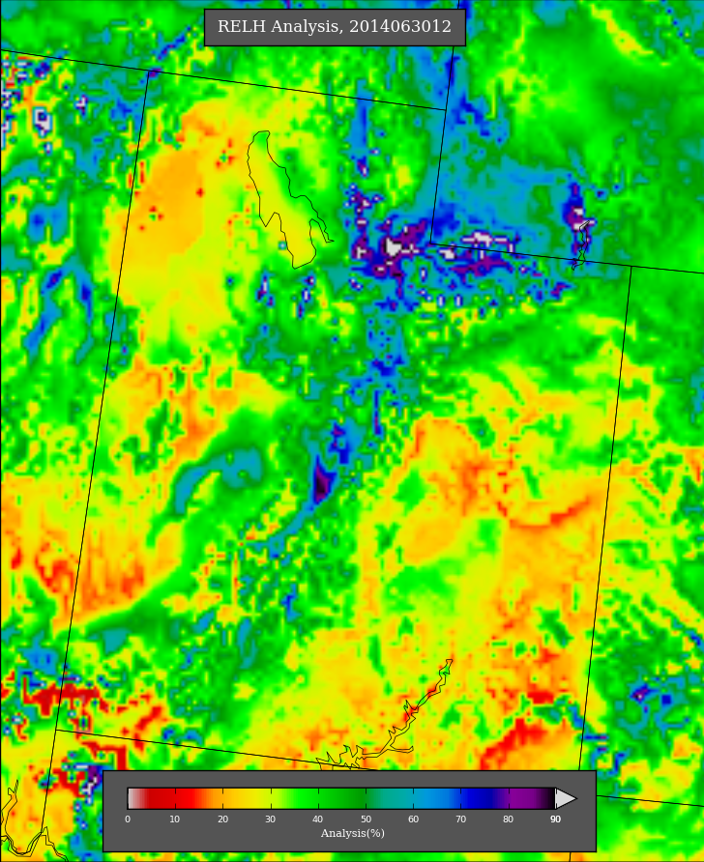
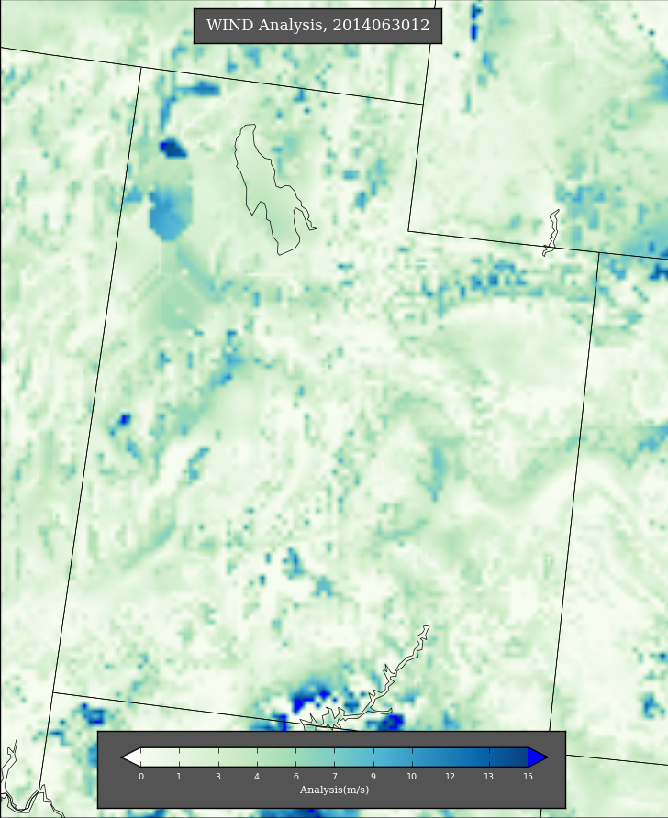
UU2DVAR

Slide 16
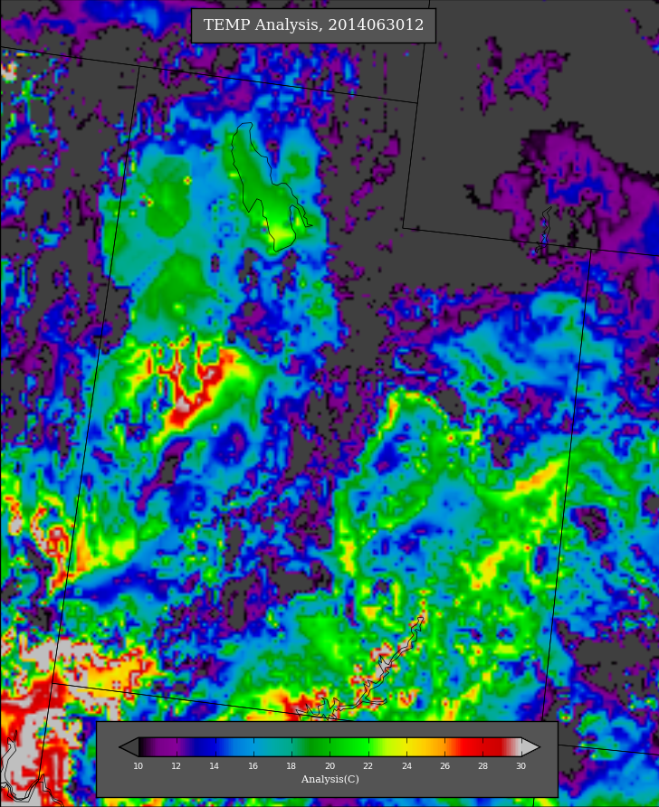
UU2DVAR
Use http://gl1.chpc.utah.edu/uu2dvar/idi/cgi-bin/uu2dvarUtah.cgi to verify that you are reading the grids correctly

Slide 17
Surface Observations (MesoWest)
MesoWest has been aggregating surface meteorological observations since January 1997, beginning with a single tower on top of the William Browning Building at the University of Utah. It now archives data for over 28,500 active stations.
These stations report anywhere from 1 to 32 variables at frequencies up to once every 5 minutes
The majority of stations report values for temperature, relative humidity, and wind speed and direction.

Slide 18
Surface Observations (MesoWest)
There are currently 834 active stations aggregated in MesoWest in the state of Utah
Some stations are seasonal (primarily associated with ski areas), others were deployed for field campaigns and thus have short periods of data, but most are persistent

Slide 19
Surface Observations (MesoWest)
Observations from all Utah stations dating back to 1 January 1997 have been output from the database into csv files divided by station using the mysqldump command, they are stored in a tar.gz file at meso1.chpc.utah.edu/utahCSV/
Each file is named DATA_#####.txt, where the number corresponds to the station’s internal, unique ID.
Using the file “STNINFO.csv,” metadata about the station (location, elevation, station name) can be discovered.
Using the file “VARIABLE.csv,” the (generally) four-letter variable IDs can be connected to information about what the variable is, what multipliers should be applied to the value to get it into its native units, and values are reasonable for that variable (useful for quality control).
More information can be found in the associated readme.txt file.

Slide 20
Surface Observations (MesoWest)
Example of data contained in the csv file for a single station (FLSU1 – Fish Lake SNOTEL).
Note the Date/Time (“DATTIM”) format and the NULL handling.
The files for the stations with the longest periods of record contain over 1.5 million rows.

Slide 21
Recap
Particulates in the Salt Lake Valley (Whiteman et al. 2014)
Long-term record of particulates and pollutants as observed in the Salt Lake valley
Vertically averaged/integrated meteorological indices observed at Salt Lake International Airport
University of Utah 2-Dimensional Variational Surface Analysis (UU2DVAR)
Hourly gridded analysis of surface meteorological variables on a 2.5km grid over the state of Utah for the period January 2012 – current
Surface Observations of Atmospheric Variables in Utah from MesoWest
Observed values of surface meteorological variables dating as far back as January 1997, at time intervals as brief as every 5 minutes.

Slide 22
Questions/Things to Ponder
If you are looking at trends in pollutants as related to specific point sources or collective sources, is it important to control for specific atmospheric variables/conditions?
Are the atmospheric conditions that are favorable for high pollutant concentrations in one part of Utah the same as those in other parts of the state? (Wasatch Front vs. Cache Valley vs. Uinta Basin)

