Slide 1
John Horel (31 yrs) & Erik Crosman (14 yrs) Research Group
Adam, Alex, Brian, Chris F., Chris G., Erik, Joe, John,
Judy, Kevin, Luke*, Nola, Mike, Randall, Taylor

Slide 2
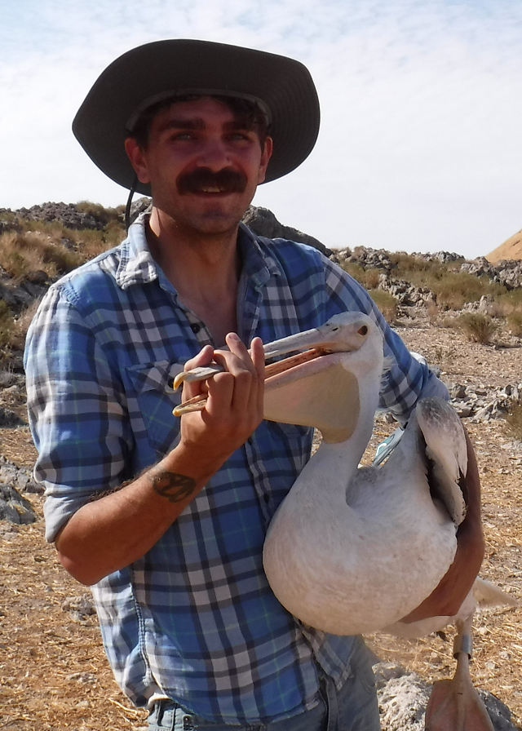
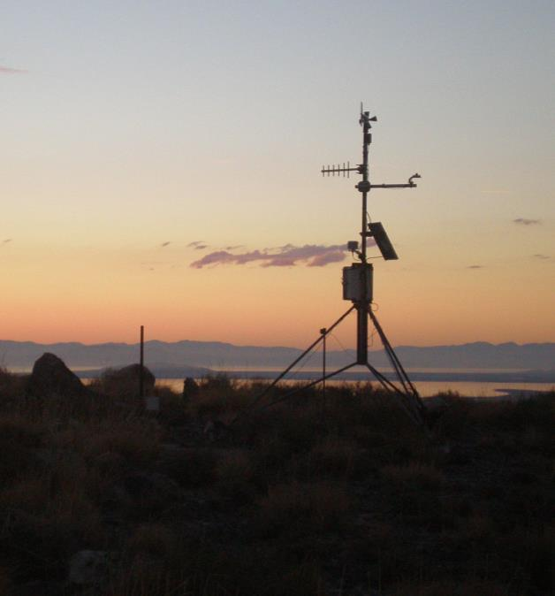
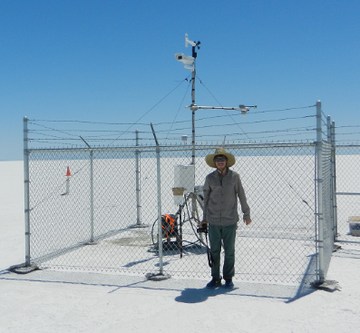
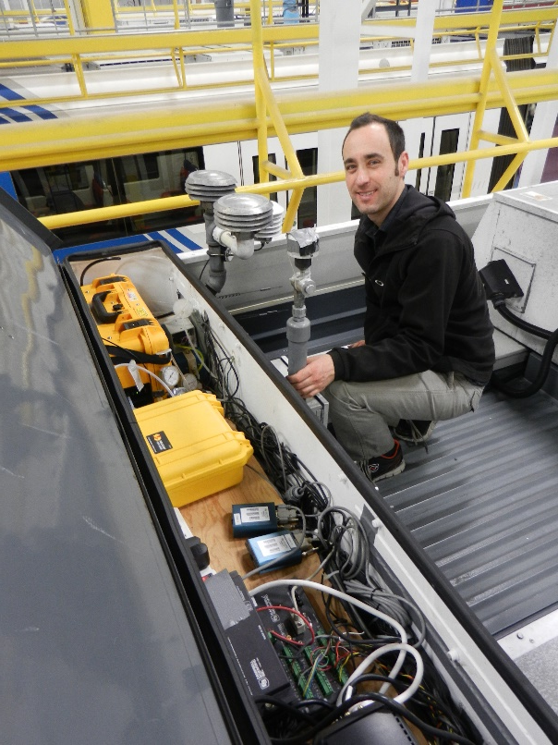
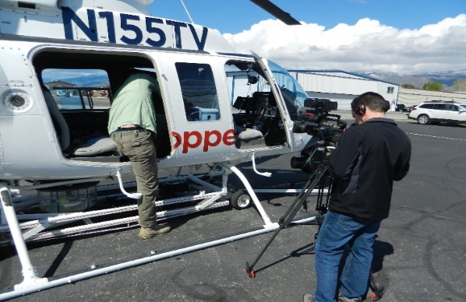
What we do: foster access & analyze environmental information locally
Support from NWS National Mesonet Program and other sources
Integrate observations from hundreds of locations in Utah
Remote deployments: islands in the Great Salt and Utah* Lakes, Bonneville Salt Flat
Novel deployments: traffic copter, UTA light rail, UAV copter, reusable sondes

Slide 3
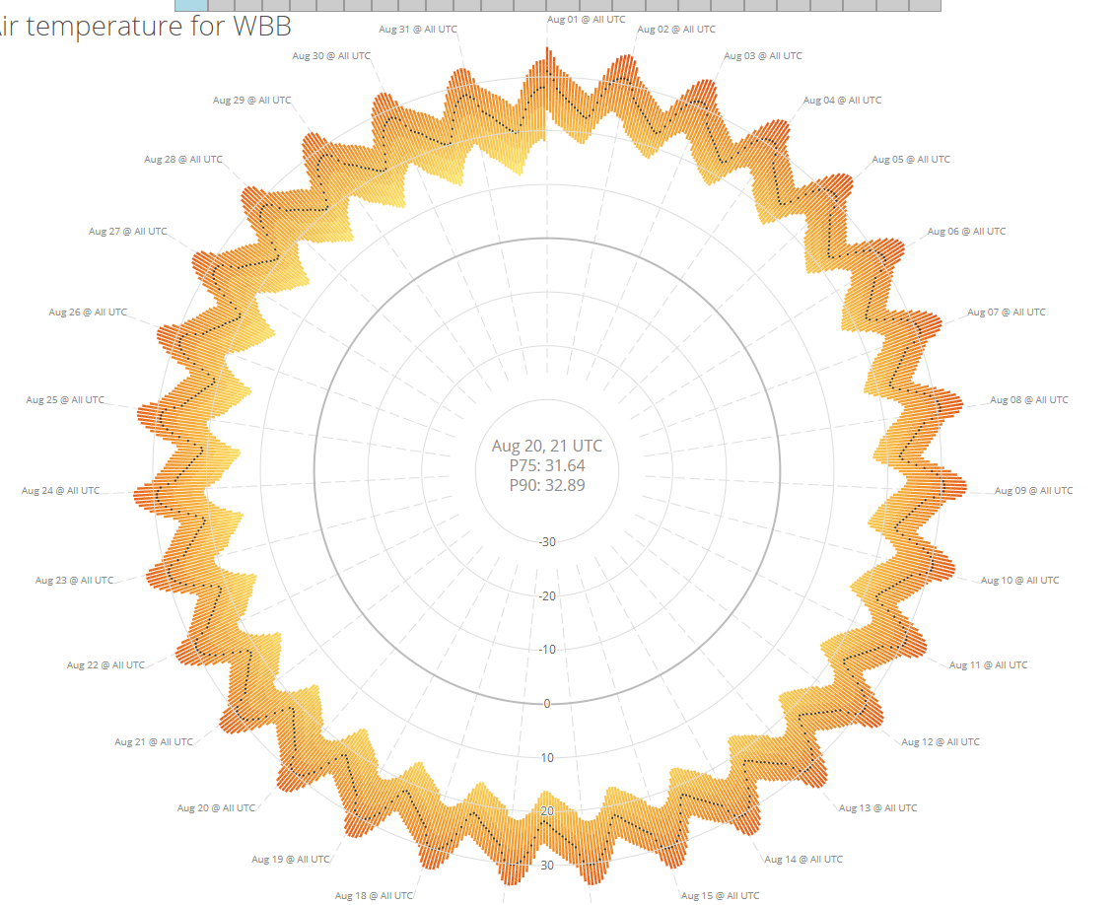
R&D to access, archive, and distribute environmental observations nationwide
Alex Jacques
Judy Pechmann
Joe Young
Adam Abernathy
Chris Galli
Providing services for others to use
NOAA monthly usage: 23 million requests; 108 billion data values

Slide 4
2017 publications
McCorkle (M.S.) An Evaluation of the Experimental High-Resolution Rapid Refresh – Alaska
LeClair-Marzolf+ Retrospective and Ongoing Analyses of Aerosol Layers Using Laser Ceilometers. Submitted to Journal Atmospheric Oceanic Technology*
Foster + Constraining methane emissions in Utah’s Uintah Basin. Submitted to J. Geophys. Res. Atmos.
Blaylock + Cloud archiving & data mining of High Resolution Rapid Refresh Model Output. Computers & Geosciences
Jacques + Tracking Mesoscale Pressure Perturbations Using the USArray Transportable Array. Mon. Wea. Rev.
Crosman + A Novel Approach for Monitoring Vertical Profiles of Boundary-Layer Pollutants. Atmos. Pollution Res.
Crosman + Evaluation of the Multi-Scale Ultra-High Resolution analysis of lake surface temperature. Remote Sensing
Foster + Simulations of a Cold-Air Pool in Utah’s Salt Lake Valley. Boundary Layer Meteorology
Crosman + Large-eddy simulations of a Salt Lake Valley cold-air pool. Atmospheric Research

Slide 5
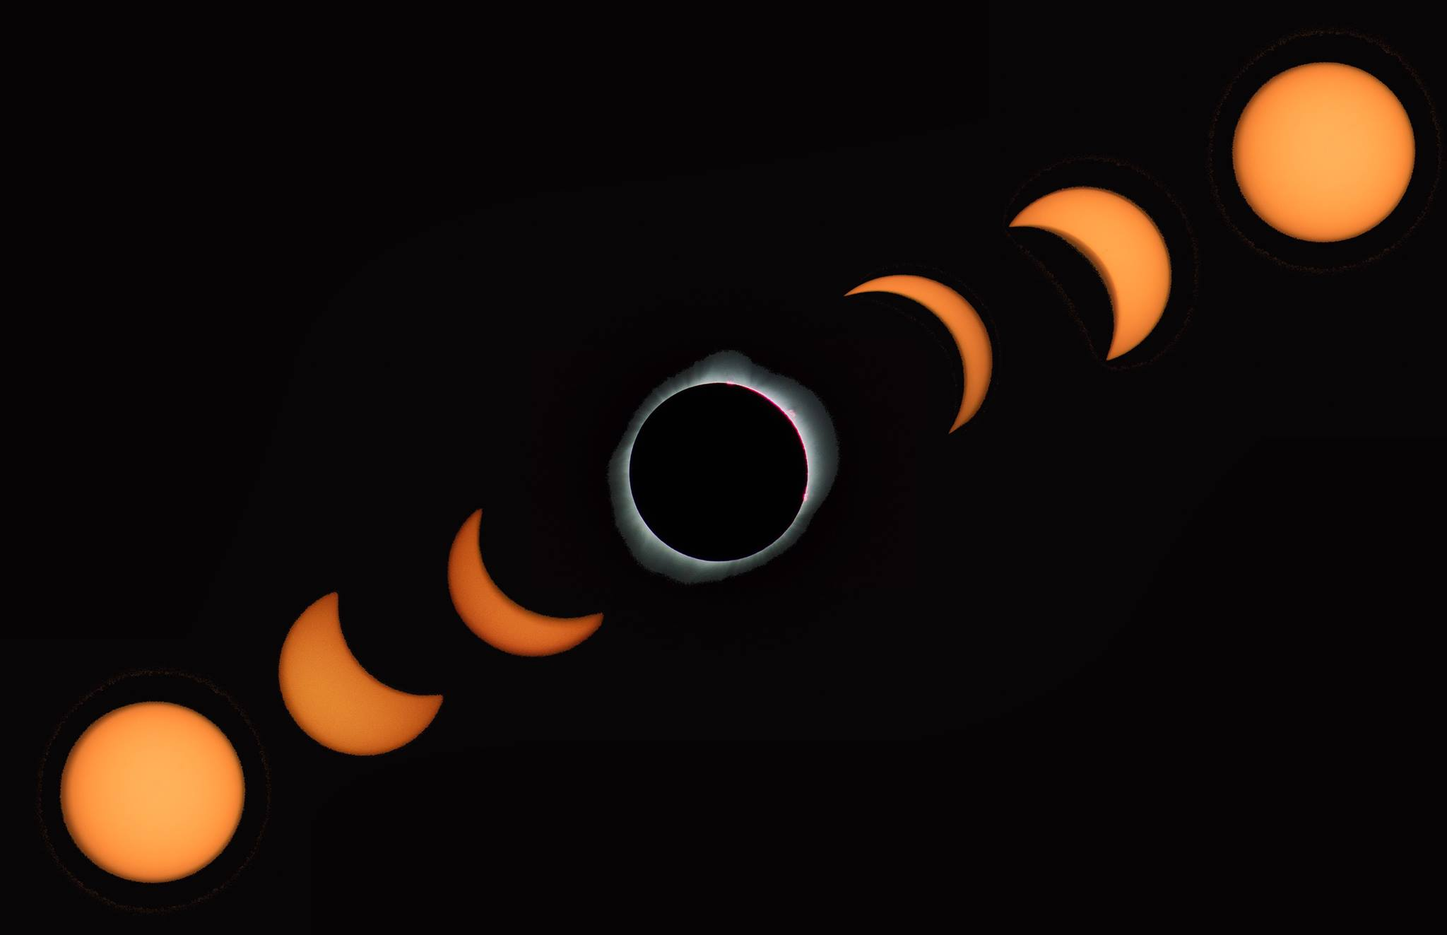
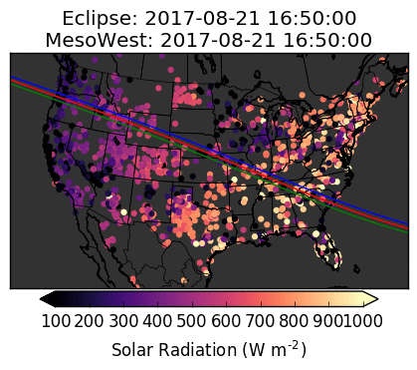
Looking Ahead
Josh Newcomb
Funding for National Mesonet Program projected for next 2+ years
Chris Foster: Uintah Basin Greenhouse Gas Study (PI J. Lin, NOAA)
Brian Blaylock & Taylor McCorkle: Assessment of HRRR Model Forecasts of Convective Outflows in the Fire Environment (JFSP)
Kevin Craft: Impact of Variations in Playa Surface Albedo (PI Bowen, NSF)
Mike Wessler: Examining Frontal Passages in Complex Terrain (NMP)
Big data (NSF, PI Li)
Childhood asthma study (NIH, PI Sward)
Future air quality field study(s)? Summer ozone/wildfire and/or winter particulate cold-air pools?
Brian Blaylock

Slide 6
Mike Wessler

