Slide 1
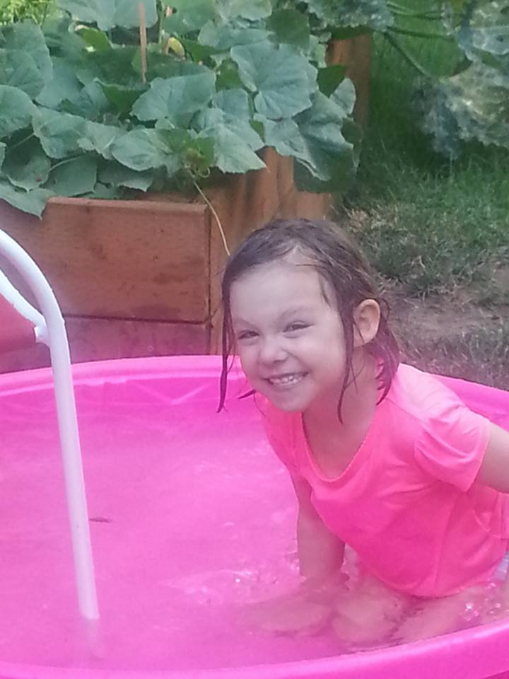
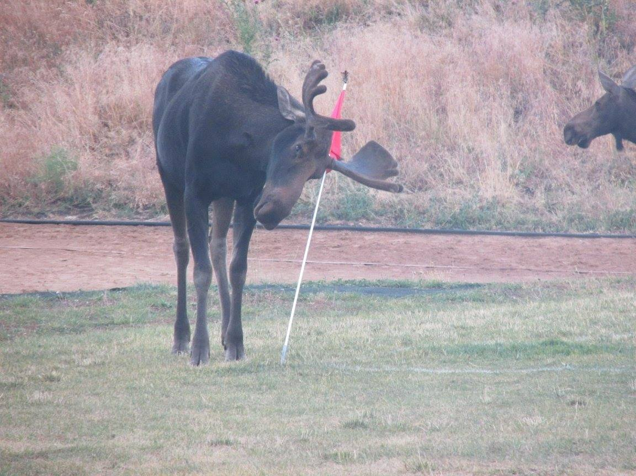
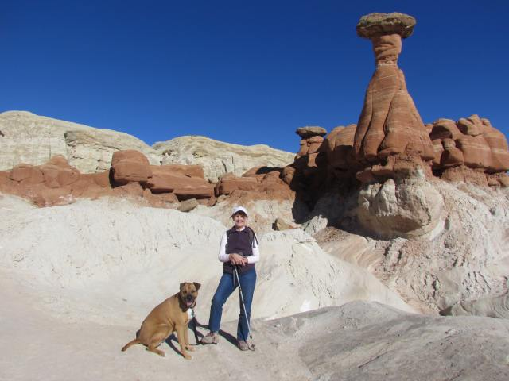
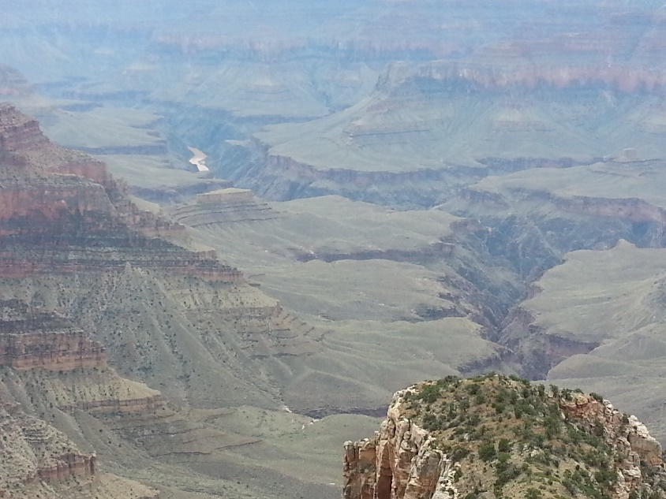
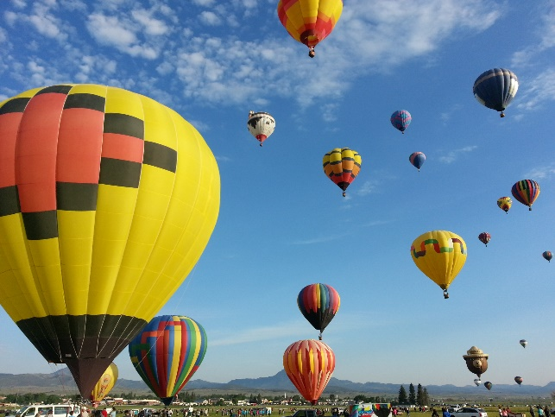
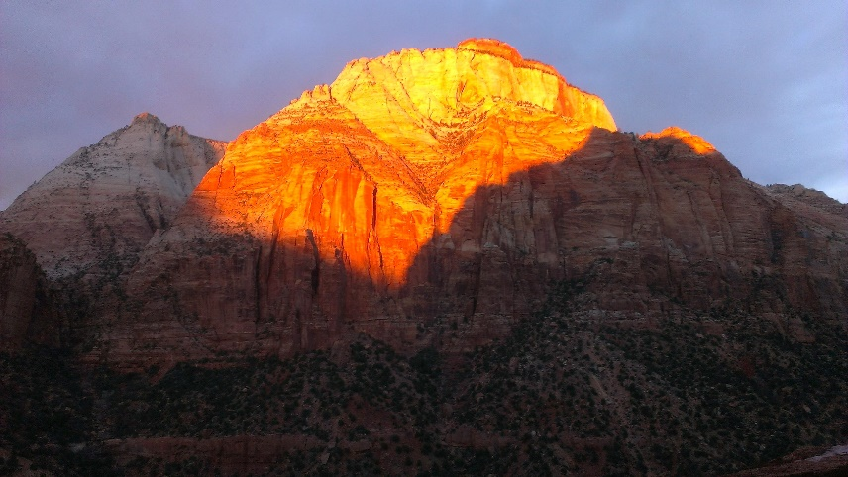
John Horel
Originally from Eureka, CA
San Jose State, University of Washington, Scripps Institution of Oceanography
31st year at the U/U
8 children, 2 grandchildren
Live in SugarHouse
2nd home in Orderville, southwestern Utah

Slide 2
Research Group
Erik Crosman, Assistant Research Professor
Nola Lucke, Program Manager
Six researchers, 6 graduate students, 3 undergraduates
$6+ million in research funding during past 10 years from federal and state agencies and commercial firms
Ten research papers published or submitted in past two years
http://meso1.chpc.utah.edu/mesowest_overview/
Focus:
basic research on weather processes in complex terrain
applied R&D relevant to diverse societal needs
improve access and visualization of environmental information
enhance understanding of weather on air quality and public health

Slide 3
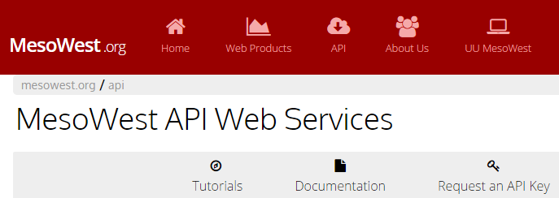
Software R&D to access, archive, and distribute environmental observations
Kevin Nelson
Judy Pechmann
Joe Young
Xia Dong
Chris Galli
Alex Jacques
MesoWest: R&D
Synoptic: Commercial applications

Slide 4
Graduate Students: Current Research Projects
Brian Blaylock & Ansley Long: The Uintah Basin Greenhouse Gas Study (lead PI J. Lin, NOAA); 2015 Great Salt Lake Summer Ozone Study (Utah DAQ)
2015-2016 new students: Taylor McCorkle and Dillon Ulrich (NSF big data)
Alex Jacques: Perturbation Pressure Variations (NSF)
Chris Foster: Improve Air Quality Modeling (Utah DAQ)

Slide 5
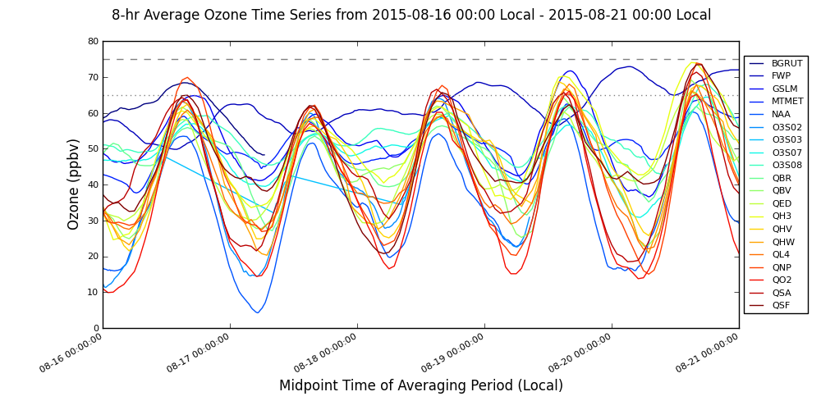
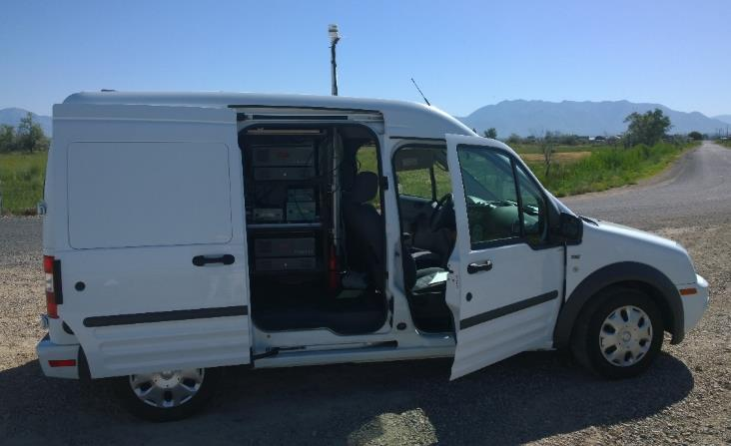
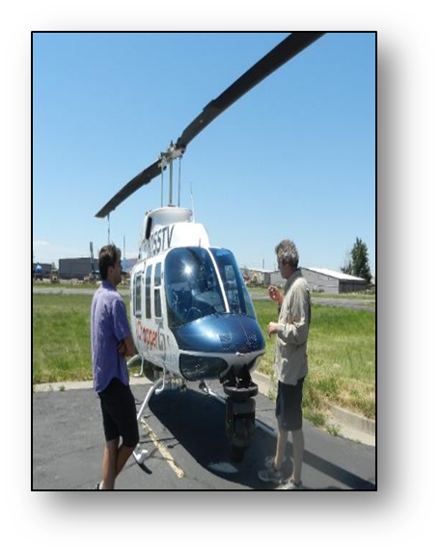
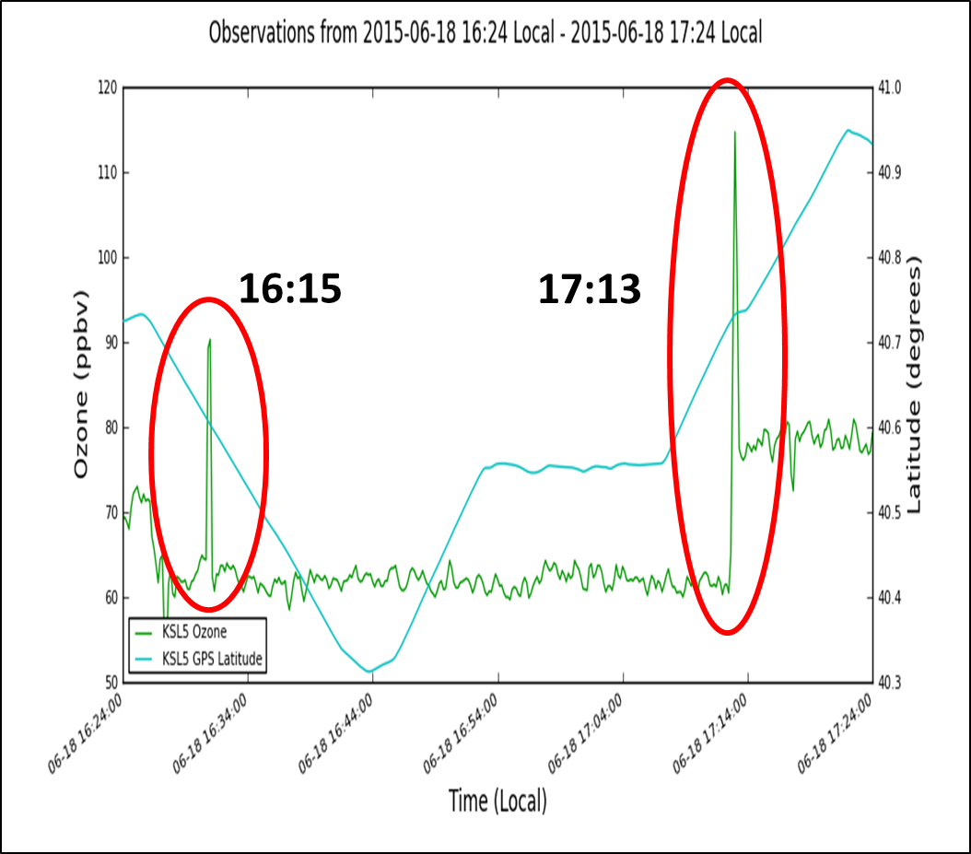
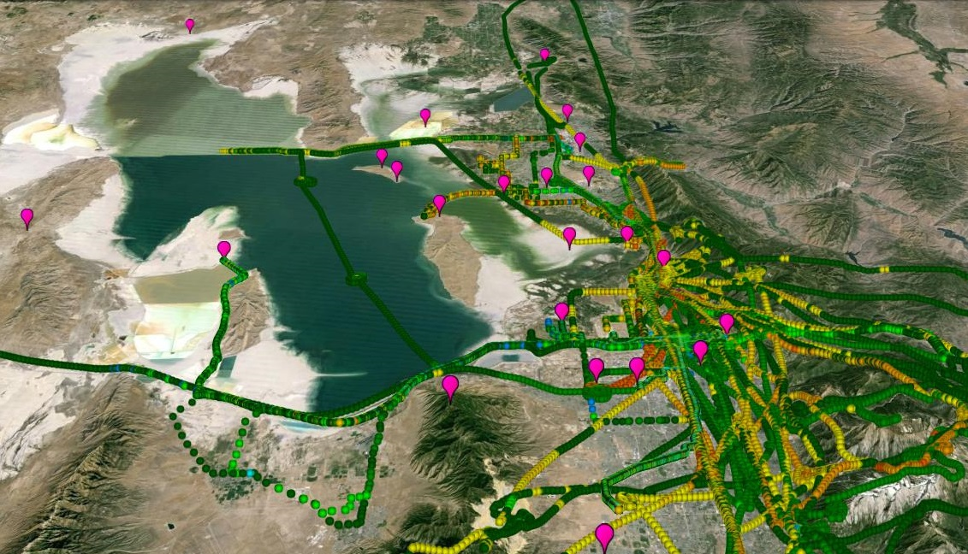
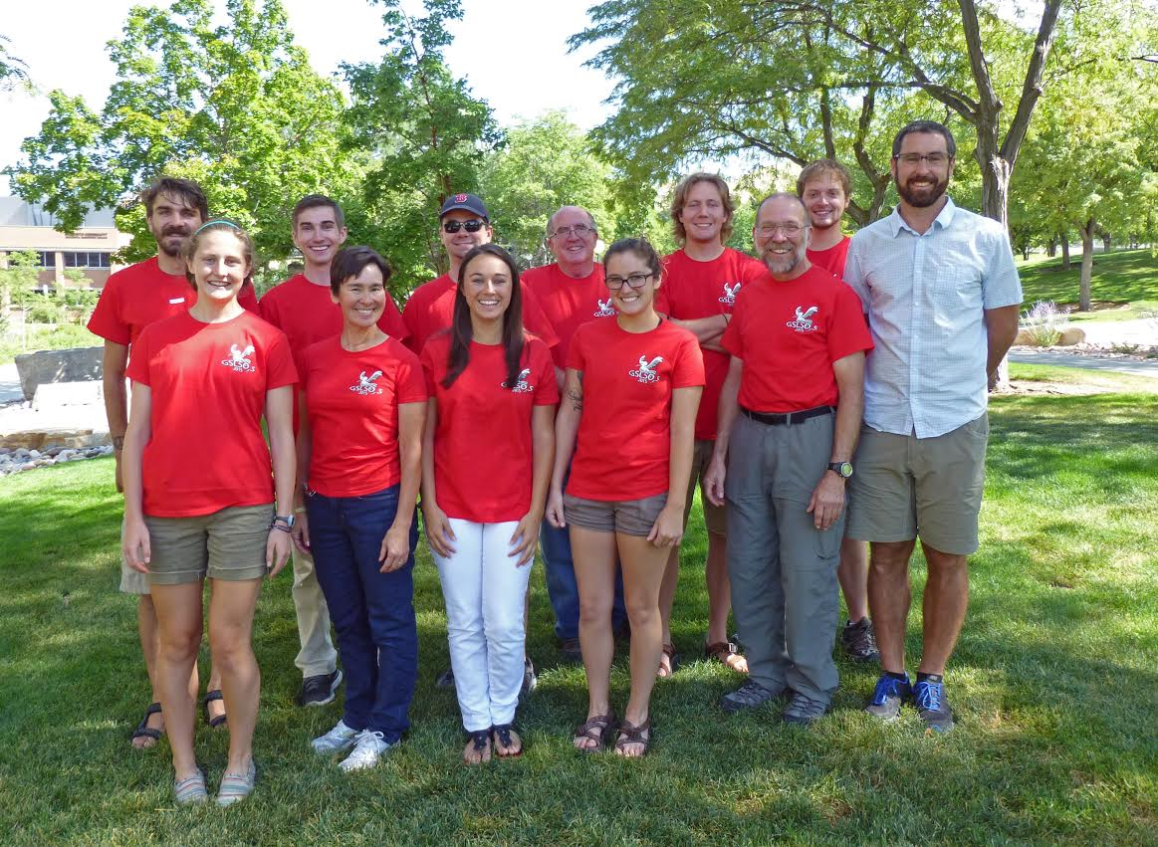
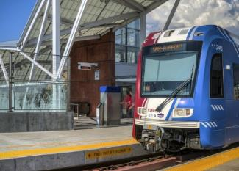
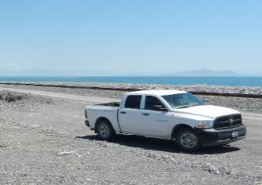
Great Salt Lake Summer Ozone Study
Ozone spikes aloft when crossing lake breeze front

