Slide 1
Large-amplitude gravity waves as an unclassified type of storm Observations and inferences from three decades of synoptic data monitoring applying pattern recognition Anton Seimon Appalachian State University, Boone NC Anton.Seimon@gmail.com Lance F. Bosart University at Albany, Albany, NY lbosart@albany.edu 2016 SPARC Gravity Wave Symposium Penn State University, 16 May 2016

Slide 2
Presentation
Data
Some major events and associated hazards
The case for a storm classification scheme
Numerical prediction
Real-time detection
Recommendations

Slide 3
Data
Case studies from 1983-2016 of large amplitude IGW (>5hPa) identified in real-time using conventional synoptic data
Other material from published case studies
Wake-lows trailing mesoscale convective systems are not included, though share many similarities

Slide 4
Some notable US cases
11 April 1944 (Brunk 1949) – first scientific study and still largest documented event (-15 hPa, 35 m s⁻¹ sustained wind)
11 Feb 1983 (Bosart & Sanders, 1986) – Within intense East Coast snowstorm.
27 Feb 1984 (Bosart & Seimon 1988) – Carolina piedmont event
15 Dec 1987 (R. Schneider, Powers &Reed studies), multiple IGWs in bombing Midwest cyclone, post-event mesoscale modeling success
4 Jan 1994 (Bosart et al., 1998) –WSR88D radar paired with mesoscale observation “network”
20 Mar 2006 – successful GFS prediction 150 hrs in advance
7 Mar 2008 (Ruppert & Bosart 2014) – detailed mesoanalysis
13 Dec 2015, explicit predictions by operational mesoscale and global models, evidence for interfering wave trains

Slide 5
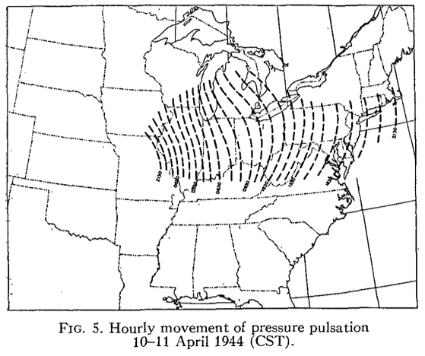
Brunk (1949)

Slide 6
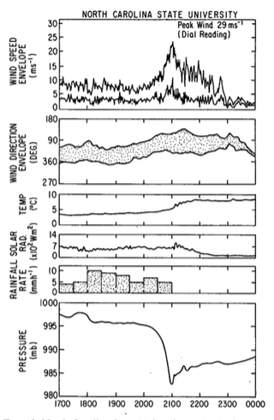
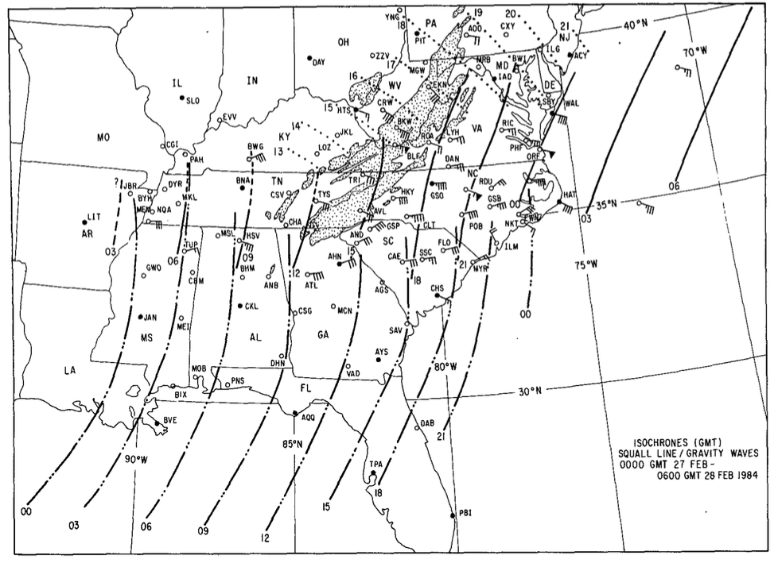
27 Feb 1984 Carolinas case (Bosart and Seimon 1988)

Slide 7
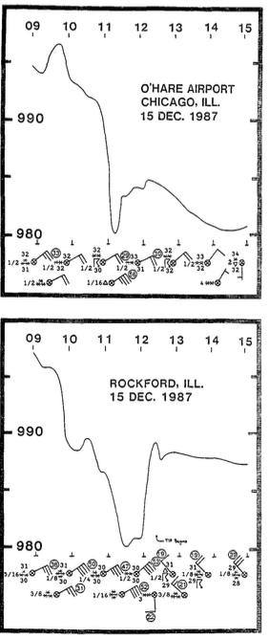
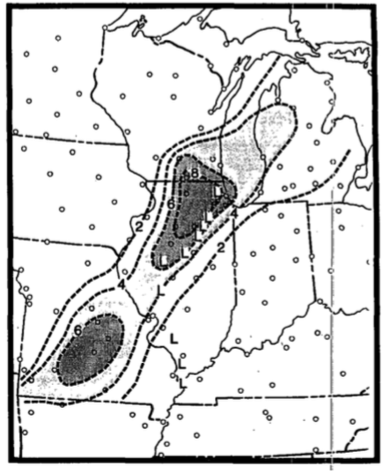
15 Dec 1987 -- Midwest bombing cyclone
Schneider 1990

Slide 8
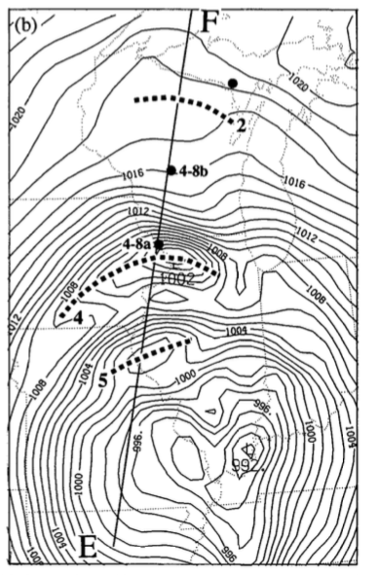
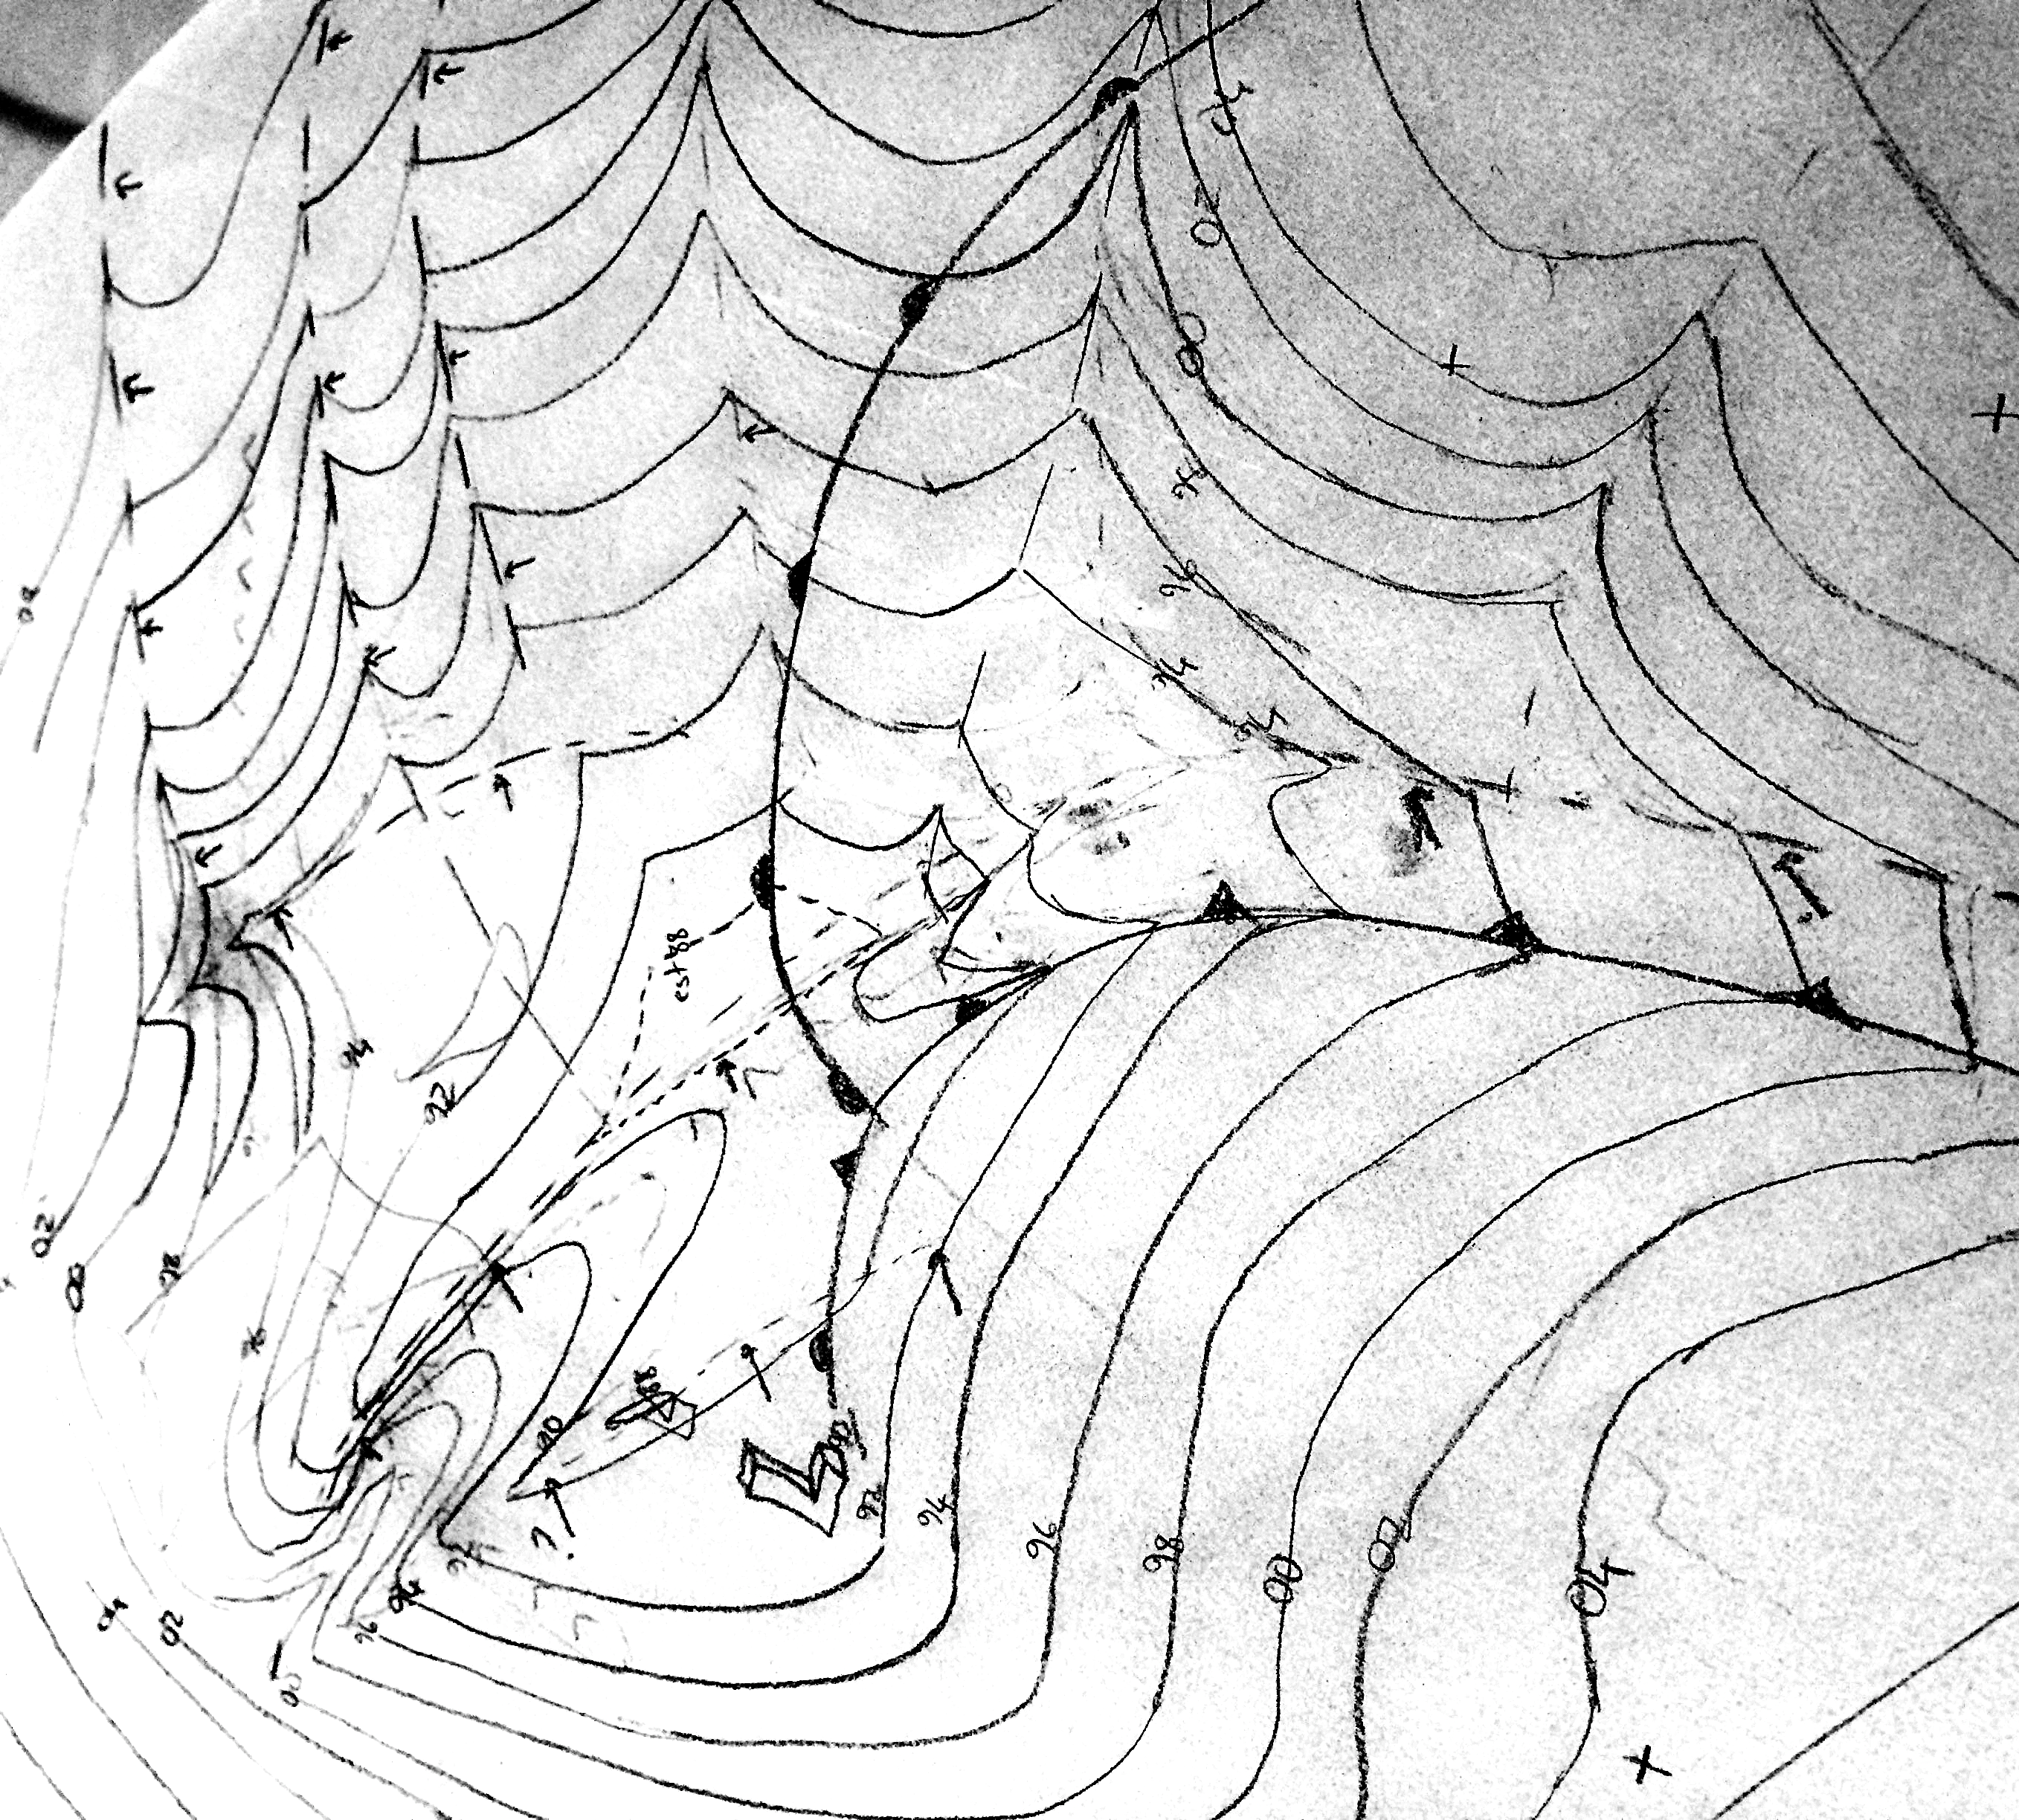
PSU-NCAR MM4model
8 hr SLP simulation
Powers & Reed (1993)
0750 UTC Mesoscale manual analysis
Seimon (unpublished)

Slide 9
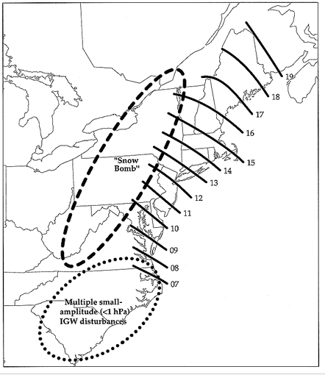
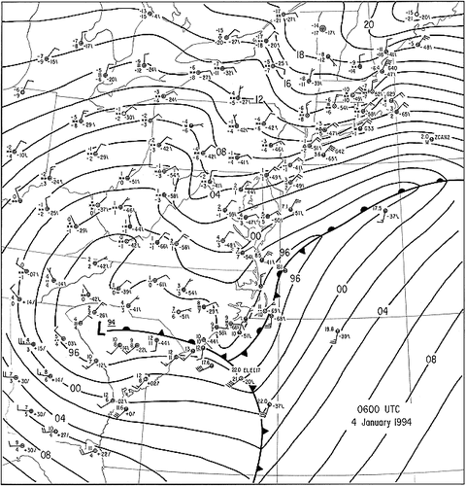
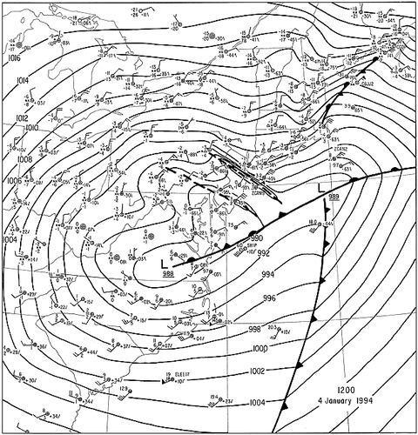
4 Jan 1994 New England snowstorm case
Bosart et al. (1998)

Slide 10
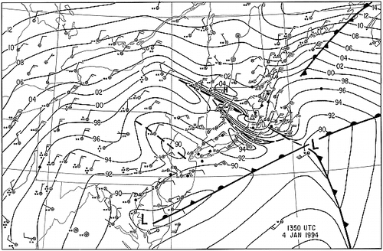
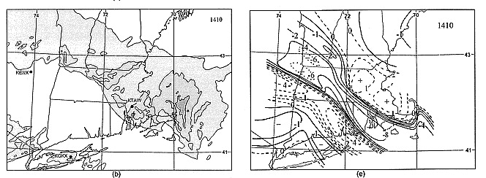
Bosart et al. (1998)

Slide 11
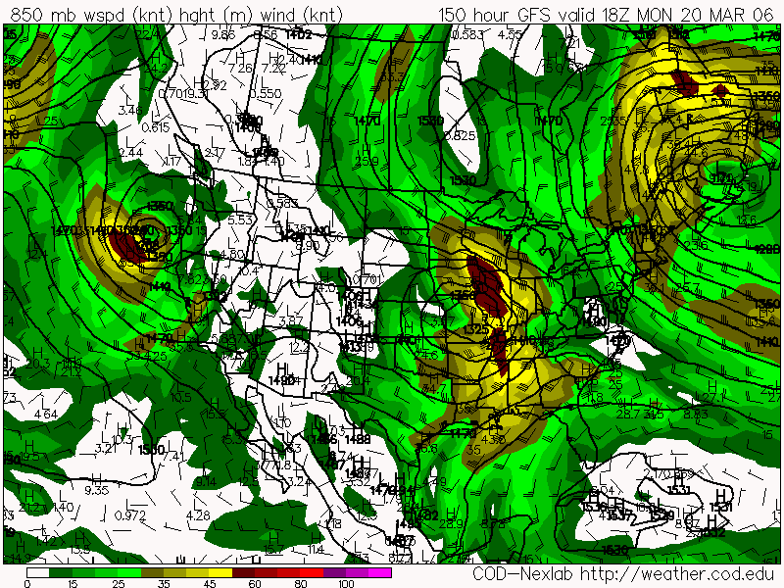
20 March 2006 IGW prediction by operational GFS
Email to coauthor 6 days before event:
“…the GFS 00z/14th control run…has a classic synoptic IGW configuration.
…model output actually shows a large-amplitude gravity wave propagating eastward across the IL-IN-OH area between 18z/20th and 00z/21st.”

Slide 12
6 days later….
“Not a bad forecast! …The recent obs at North Little Rock (KLRF) show a good wind squall accompanying an ~8 hPa fall in 21 minutes, followed by an almost equal rise over the next 39 minutes.”
“Gravity wave is about to propagate across Memphis. Local NWS doesn't seem aware of this, based on the short term forecast issued an hour ago. Jonesboro, Arkansas just recorded similar wind conditions experienced 90 minutes earlier in
North Little Rock. “

Slide 13
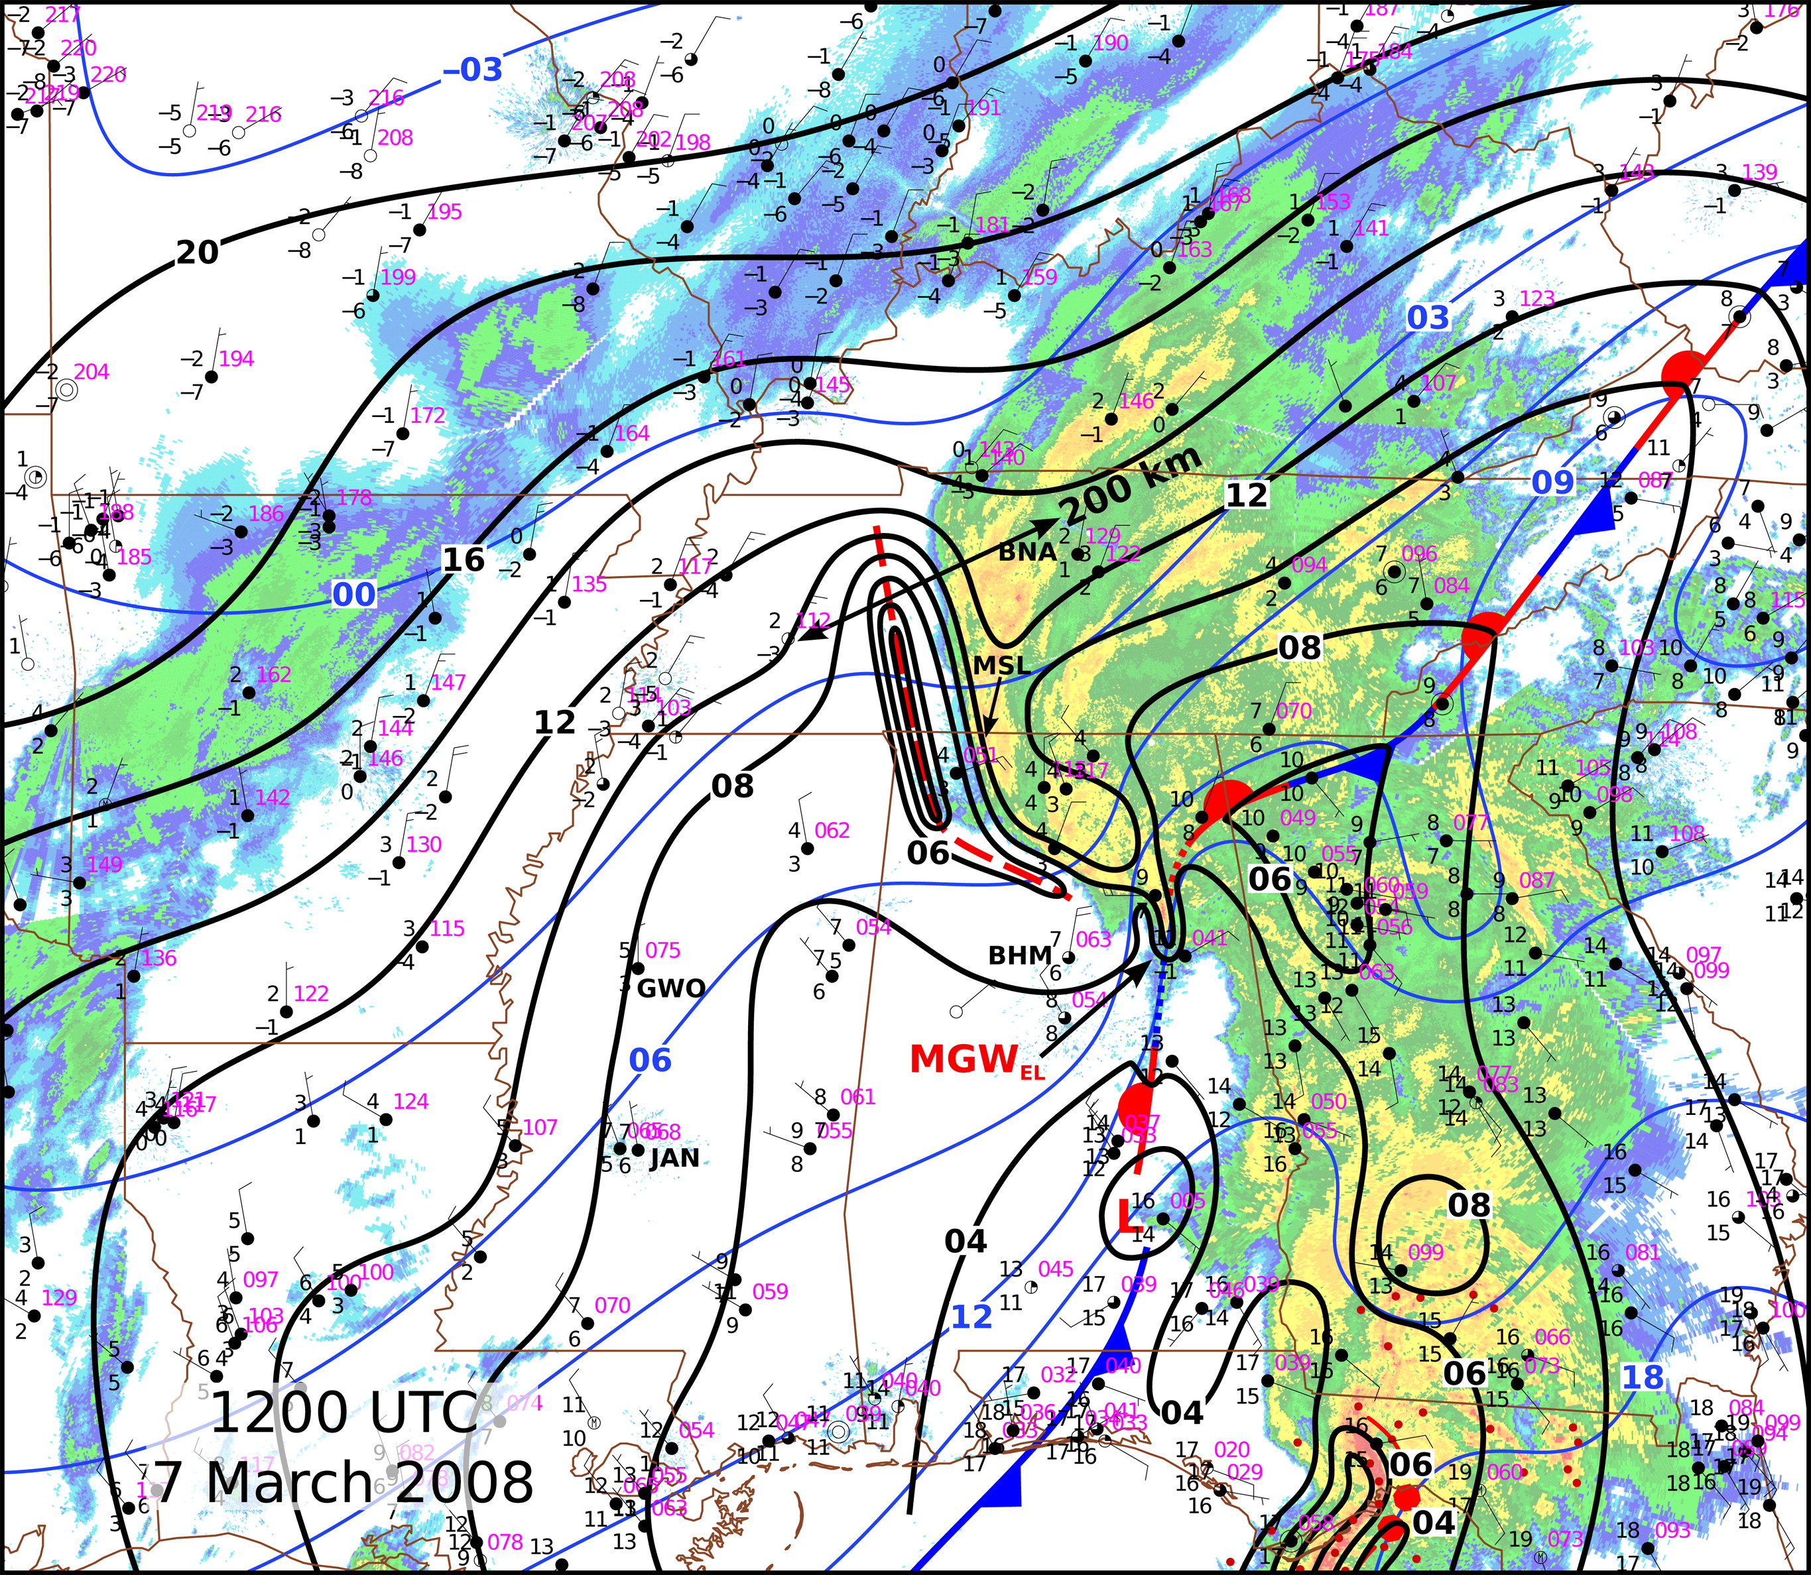
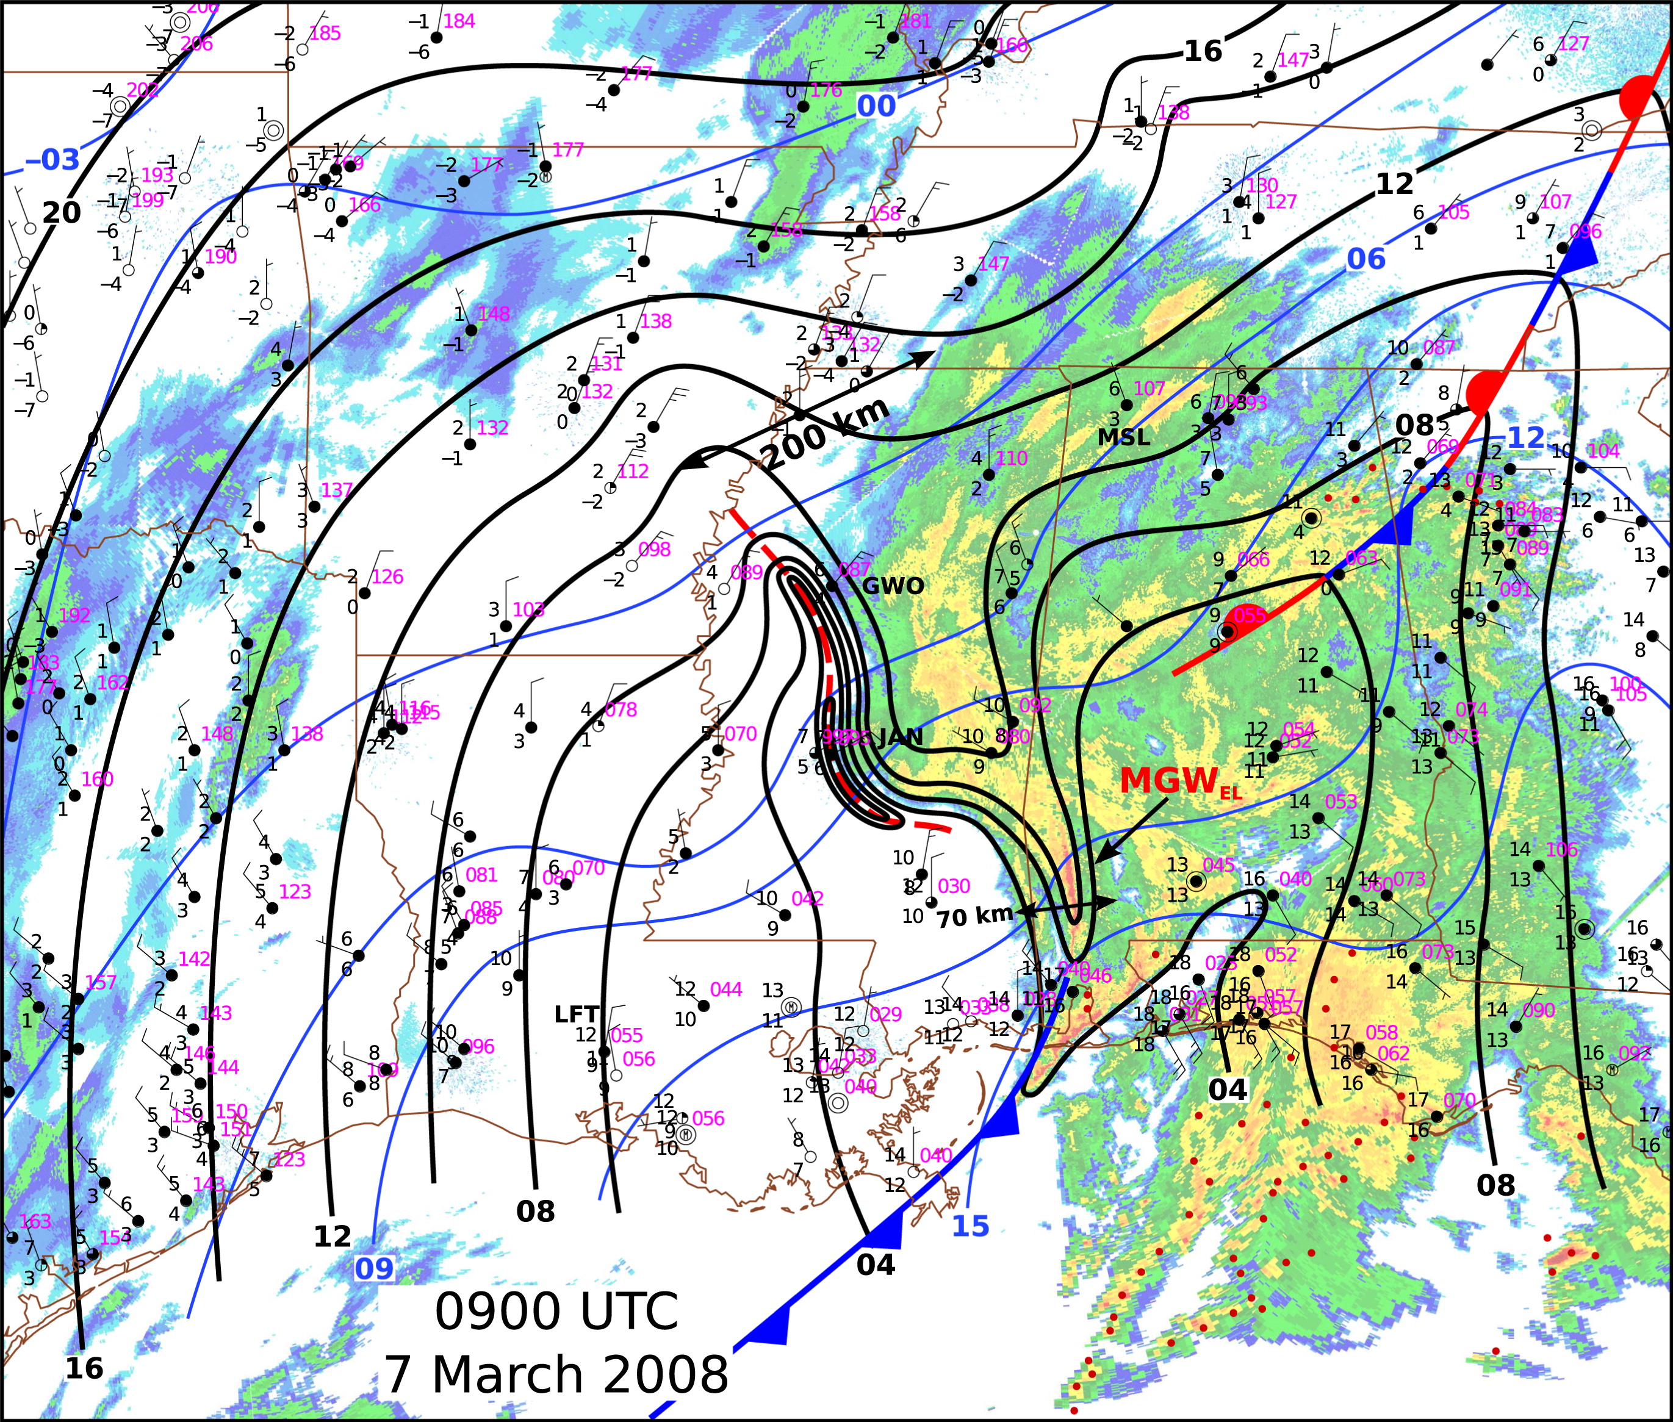
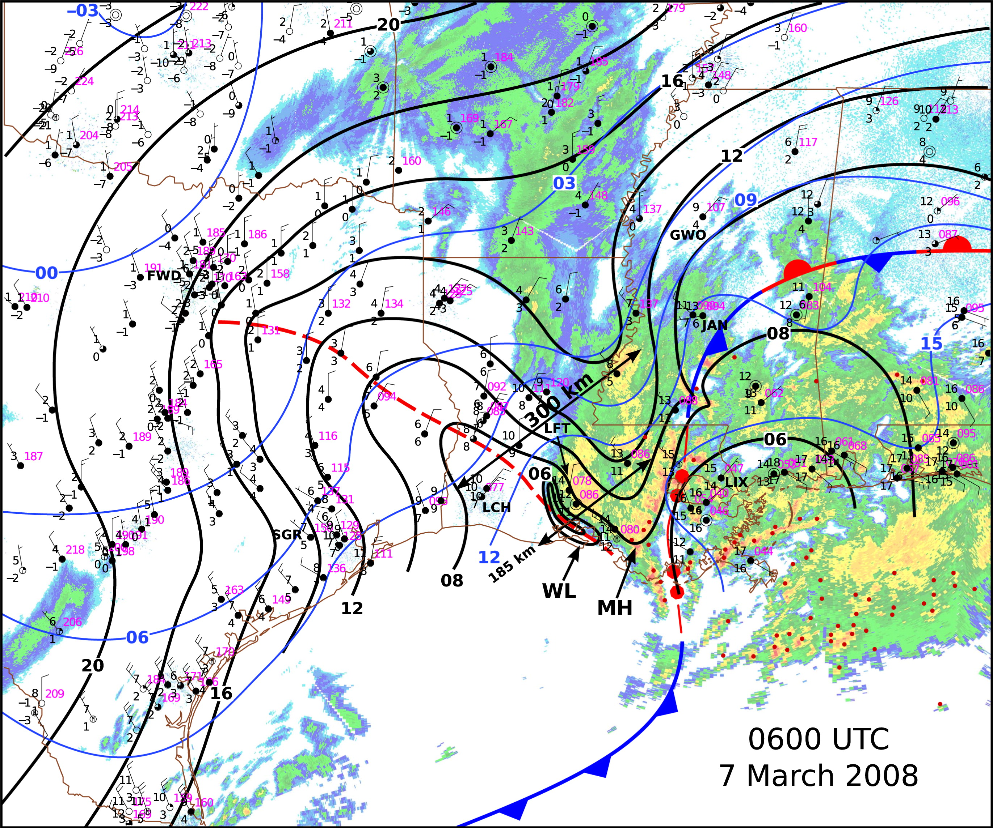
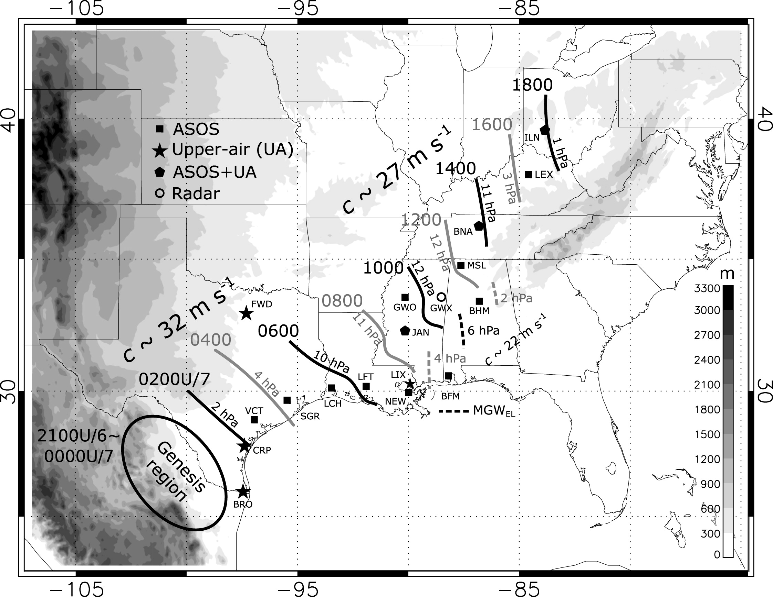
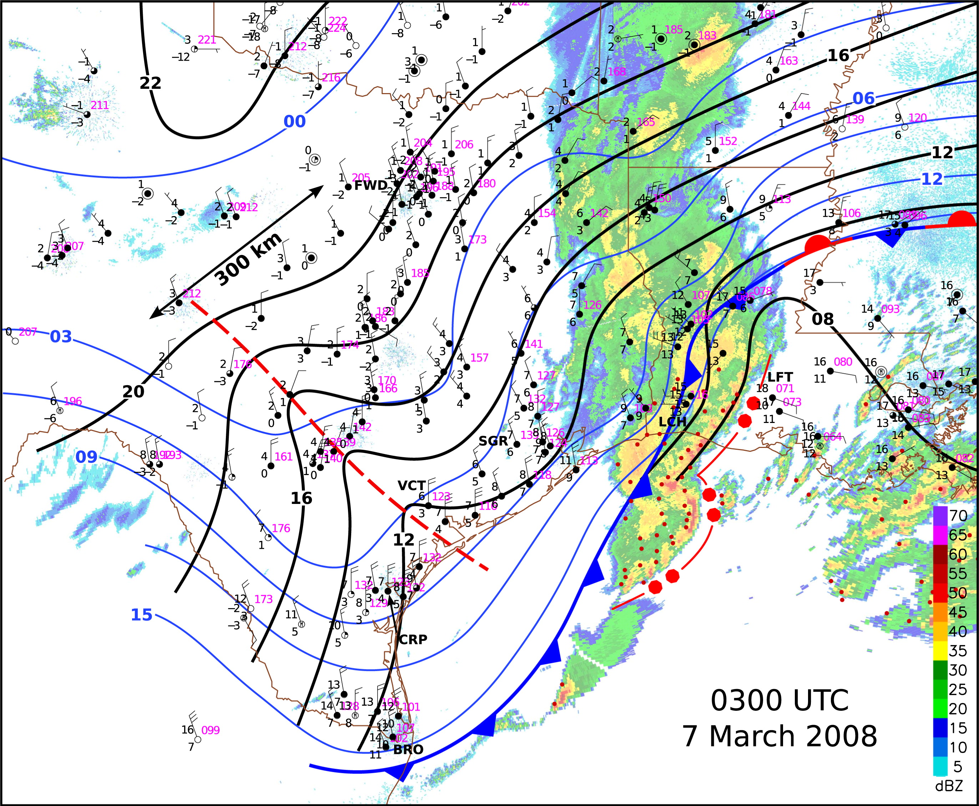
7 March 2008 (Ruppert and Bosart 2014)
waves of small amplitude (~ 1 hPa) until interaction with back edge of convection

Slide 14
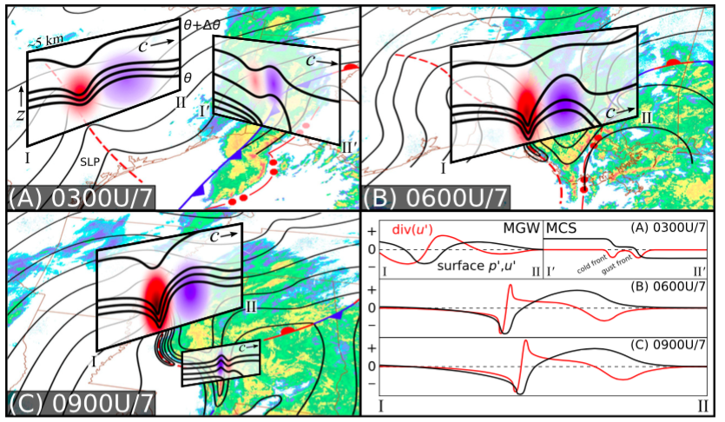
Schematic cross sections
(Ruppert and Bosart 2014)

Slide 15
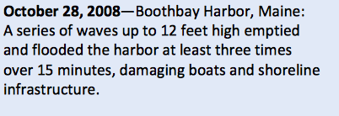
28 Oct 2008 Hudson Valley-coastal New England
AT 13 UTC, 6-7 hPa IGW over southern NY State moving NE within a cyclonic system
At 19 UTC, multiple sea level oscillations up to 3.5 m affect coastal Maine
News report:

Slide 16
2 March 2009 Explicit model prediction for coastal winter storm - Operational WRF model predicts IGW within a high impact winter storm. - Forecast verifies, but this is not communicated in public advisories. - Reports of wind damage.

Slide 17
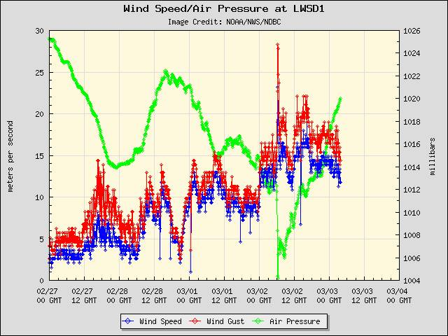
Coastal marine 6-min wind, pressure, sea level
Lewes, Delaware.
Winds reach 23 gusting 28 m s⁻¹. Pressure -8.1mb/30min;
-4mb/6 min
Atlantic City, NJ
Sea level change of 1.3 m coincides with IGW passage (at low tide, fortunately)

Slide 18
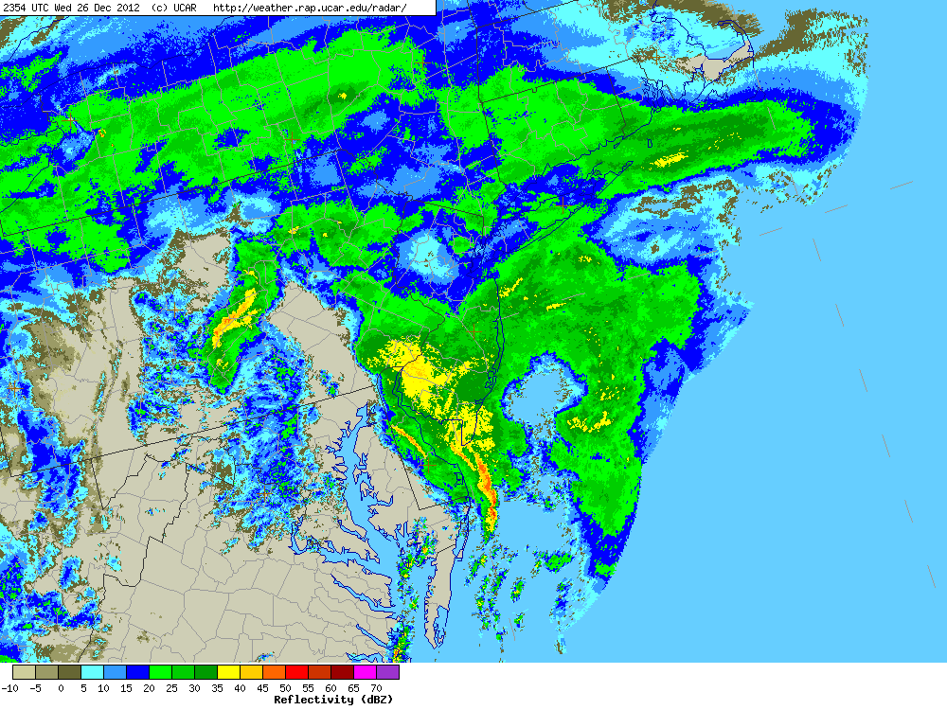
26 Dec 2012 Coastal Mid-Atlantic
From: "Bosart, Lance F”
Subject: Re: Inertia gravity wave tracking towards NYC metropolitan area
”recent obs from DOV (Dover, DE)……a westerly wind shift at 0000 UTC 27 Dec, westerly winds from 0000-0009 UTC, SSE winds at 0012 UTC, and back to ENE winds at 0015 UTC. At 0026 UTC ENE winds are sustained at 43 kt with gusts to 56 kt.”

Slide 19
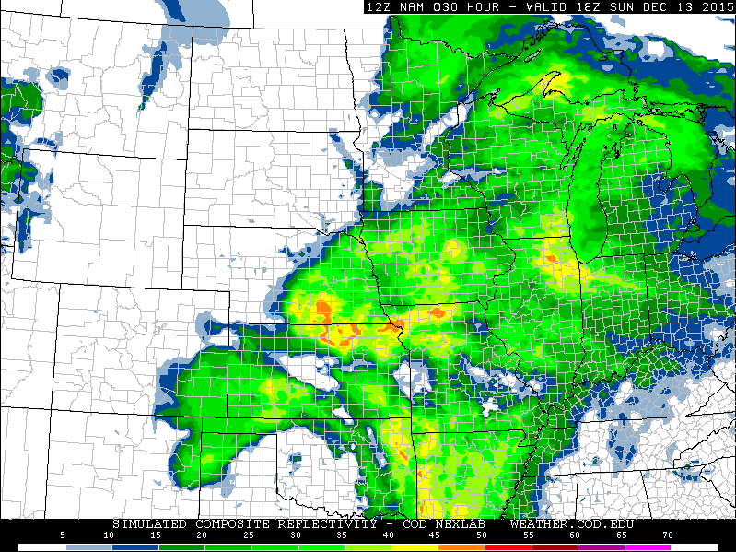
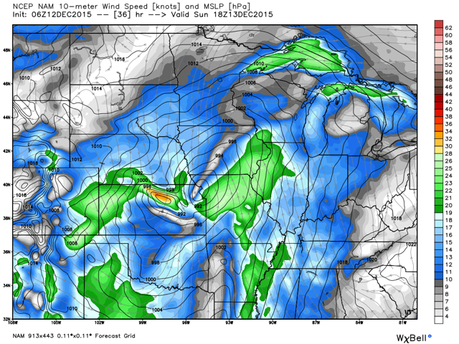
13 December 2015 Kansas – Central plains
Simulated reflectivity
NCEP NAM, T-36 hrs
SLP, 10-m winsdpeed (kt)

Slide 20
Operational forecasting challenges
Lack of formal designation contributes to IGW phenomenon remaining obscure and poorly understood by most meteorologists and other warning personnel.
Rarity (est. 1-3 events per year)
Detection and recognition can be difficult
Misattribution of IGW parameters to other phenomena
Lack of conventions for classifying intensity of IGW
Real-time detection requires high temporal resolution observations, and a means of diagnosing them
Explicit IGW depictions in numerical predictions go unrecognized without conceptual framework and/or machine algorithms for automated detection

Slide 21
A call for classification
Hazardous weather associated with the passage of large-amplitude IGW , particularly surface winds that may reach 20-40 m s⁻¹, constitute a storm by standard definition, yet remain unclassified as such.
AMS Glossary of Meteorology:
In synoptic meteorology, a storm is a complete individual disturbance identified on synoptic charts as a complex of pressure, wind, clouds, precipitation, etc., or identified by such mesometeorological means as radar or sferics.
Sensible weather associated with the passage of IGW >5 hPa amplitude:
1) Pre-storm. A small positive pressure anomaly of duration ~1 h, accompanied by moderate precipitation and windspeeds 5-10 ms-1
2) Storm. Abrupt pressure fall (or sometimes, rise) with delta P rates that can exceed 1 hPa/min, and 14 hPa/40 min. Winds increase steadily in proportion to rate of pressure fall, and reach maxima >20 m s⁻¹ at Pmin. Precipitation decreases during pressure drop, ending around Pmin
3) Recovery. Pressure and winds returns to ambient condition, precipitation may resume.

Slide 22
Large-amplitude IGW or Wake Low: does it make a difference?
Distinctly different phenomena according to generation, evolution and structure
In terms of sensible weather and hazards to public, both phenomena are largely the same, except in winter storms.
Neither currently has a classification scheme: opportunity to create a unified intensity scale for use in public advisories

Slide 23
Recommendations
Seek formal recognition as a storm type
Denominate with sassier name than “large-amplitude inertia gravity wave”!
Use objective criteria to classify events, both in predictions and during/after event
Improve forecaster situational awareness for decision-making and warning issuance
- Training
- Online wiki for quick reference
Develop algorithms to automate IGW detection in numerical output
Provide plain-language website for public awareness and information access when advisories issued
Notes:
Okay bawss, it is a joke.

Slide 24
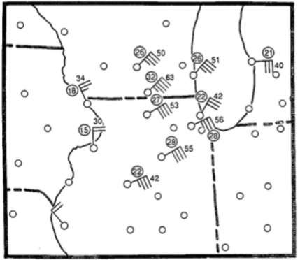
Pressure-wind relationship provides basis for classification criteria
Brunk (1944)
Adapted from Schneider (1990)

Slide 25
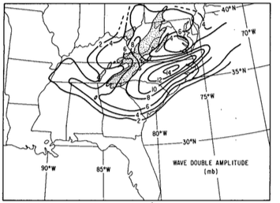
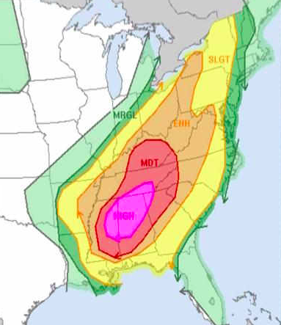
Suggested scale and graphical depiction of hazard
Scale | Delta-P/30 min
0 | <4.0 hPa
1 | 5.0-6.9 hPa
2 | 7.0-8.9 hPa
3 | 9.0-10.9 hPa
4 | 11.0-12.9 hPa
5 | >13.0 hPa
Bosart & Seimon(1988)
SPC Convective Outlook

