Slide 1
Observing, Analyzing, and Simulating the Boundary Layer in Northern Utah and Beyond
John Horel, Erik Crosman, Xia Dong, Matt Lammers, Neil Lareau, Dan Tyndall

Slide 2
Predictability in Complex Terrain
~1990
Terrain more important than data
But ”…the predictability enhancement by topography has been difficult to quantify”
Berri, Guillermo J., Jan Paegle, 1990: Sensitivity of Local Predictions to Initial Conditions. J. Appl. Meteor., 29, 256–267.
Paegle et al., 1990: Chapter 10. Atmospheric Processes over Complex Terrain.
Now(?)
Topography may enhance predictability of certain flow types, but this has never been proven or refuted
Orography can exacerbate large-scale errors, reducing forecast utility
Meyers and Steenburgh (2011). Mountain Weather Prediction: Phenomenological Challenges and Forecast Methodology. AMS Mountain Weather and Forecasting Monograph

Slide 3
Underlying research premise of Horel group during past 15 Years
Since operational forecast models can’t resolve the underlying terrain in sufficient detail to adequately resolve the details of boundary layer flows over complex terrain
Then knowing the initial state of the boundary layer over complex terrain is less critical for data assimilation than for:
Understanding the physical processes underway
Nowcasting
Forecast verification

Slide 4
Flipping the question- from what’s the role of terrain to what’s the role of synoptic-scale systems: contribution to rising motion after reducing influence of local terrain
Lareau and Horel (2011; in press MWR)

Slide 5
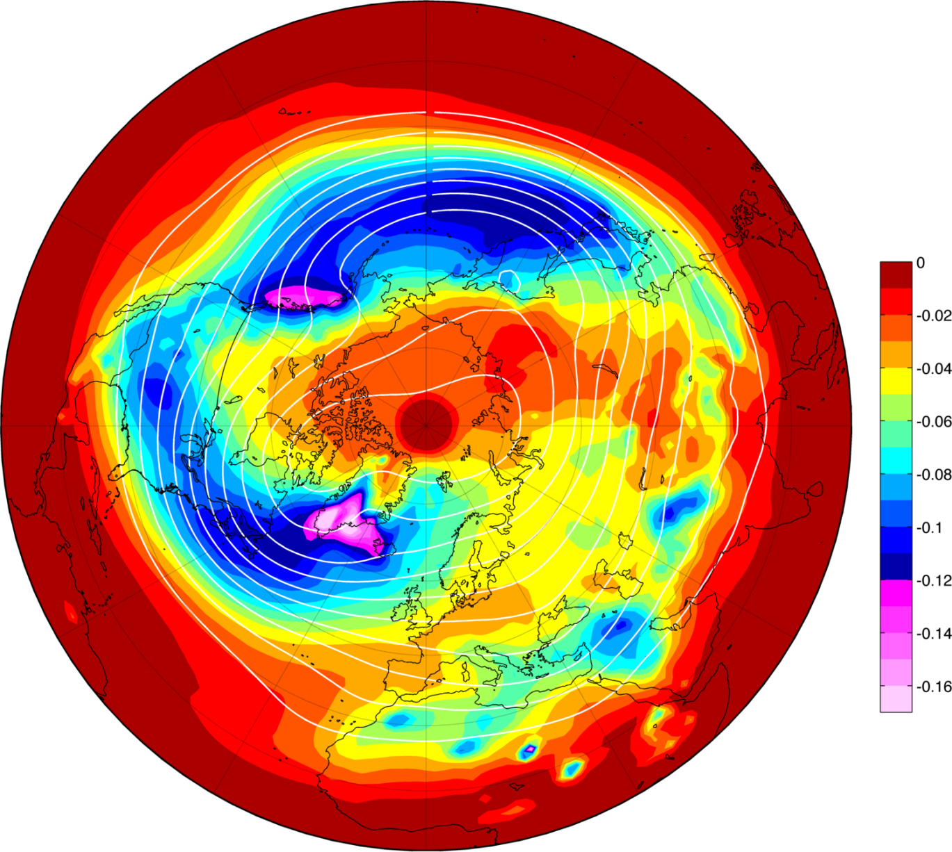
Coming soon…
32 year ERA interim climatology of synoptic-scale ascent

Slide 6
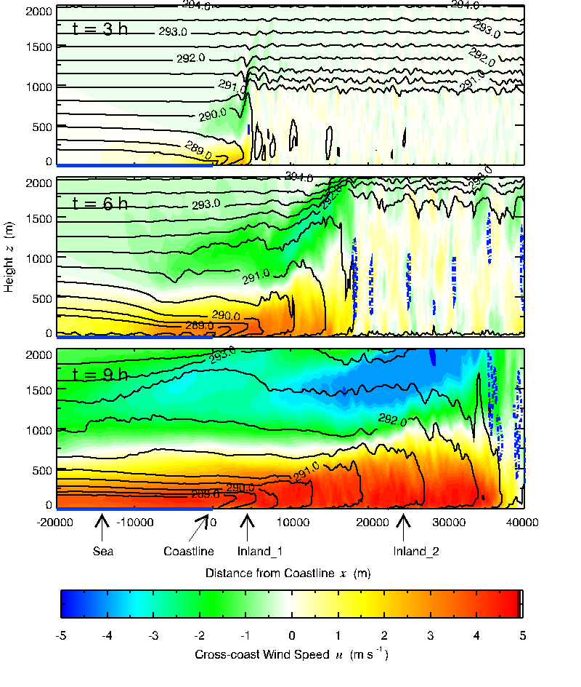
Answering a simpler(?) question with idealized WRF LES: lake breeze
Crosman, E. and J. Horel, 2012: Idealized Large-Eddy Simulations of Sea and Lake Breezes: Sensitivity to Lake Diameter, Heat Flux and Stability. Boundary Layer Meteorology. In press.
Crosman, E., and J. Horel, 2010: Numerical sensitivity studies of sea and lake breezes: a review. Boundary Layer Meteorology. 137, 1-29.

Slide 7
Evolution in Resources/Capabilities
Utah Mesonet -> MesoWest
ADAS/ARPS -> RTMA -> UU2DVAR Matlab -> UU2DVAR Python
Core goals:
provide access to and integrate disparate observations
Use analyses to synthesize the observations for variety of applications
Forecast verification
Nowcasting
Network design (station additions AND REMOVAL)
Observation quality control

Slide 8
MesoWest/Local & National Surface Analysis Refs
Tyndall, D. and J. Horel, 2012: Impacts of Heterogeneous Mesonet Observations on Meteorological Surface Analyses. To be submitted to WAF.
de Pondeca, M., G. Manikin, G. DiMego, S. Benjamin, D. Parrish, R. Purser, W. Wu, J. Horel, D. Myrick, Y. Lin, R. Aune, D. Keyser, B. Colman, G. Mann, J. Vavra, 2011: The Real-Time Mesoscale Analysis at NOAA's National Centers for Environmental Prediction: Current status and development. Wea. Forecasting, 26, 593-612.
Horel, John D., and X. Dong 2010: An evaluation of the distribution of Remote Automated Weather Stations (RAWS). Journal of Appl. Meteor. and Clim., 49, 1563-1578.
Tyndall, D., J. Horel, and M. dePondeca, 2010: Sensitivity of surface air temperature analyses to background and observation errors. Wea. Forecasting, 25, 852-865
Myrick, D., and J. Horel, 2008: Sensitivity of surface analyses over the western United States to RAWS observations. Wea. Forecasting, 23, 145-158.
Myrick, D., J. Horel, 2006: Verification over the Western United States of surface temperature forecasts from the National Digital Forecast Database. Wea. Forecasting, 21, 869-892.
Horel, J., B. Colman, 2005: Meeting Summary: A community meeting on real-time and retrospective mesoscale objective analysis: An Analysis of Record summit. Bull. Amer. Meteor. Soc., 86, 1477–1480.
Myrick, D., J. Horel, S. Lazarus, 2005: Local adjustment of the background error correlation for surface analyses over complex terrain. Wea. Forecasting, 20, 149-160.
Lazarus, S., C. Ciliberti, J. Horel, K. Brewster, 2002: Near-real-time applications of a mesoscale analysis system to complex terrain. Wea. Forecasting, 17, 971-1000.
Horel, J., T. Potter, L. Dunn, W. J. Steenburgh, M. Eubank, M. Splitt, and D. J. Onton, 2002: Weather support for the 2002 Winter Olympic and Paralympic Games. Bull. Amer. Meteor. Soc., 83, 227-240
Horel, J., M. Splitt, L. Dunn, J. Pechmann, B. White, C. Ciliberti, S. Lazarus, J. Slemmer, D. Zaff, J. Burks, 2002: MesoWest: Cooperative Mesonets in the Western United States. Bull. Amer. Meteor. Soc., 83, 211-226.

Slide 9
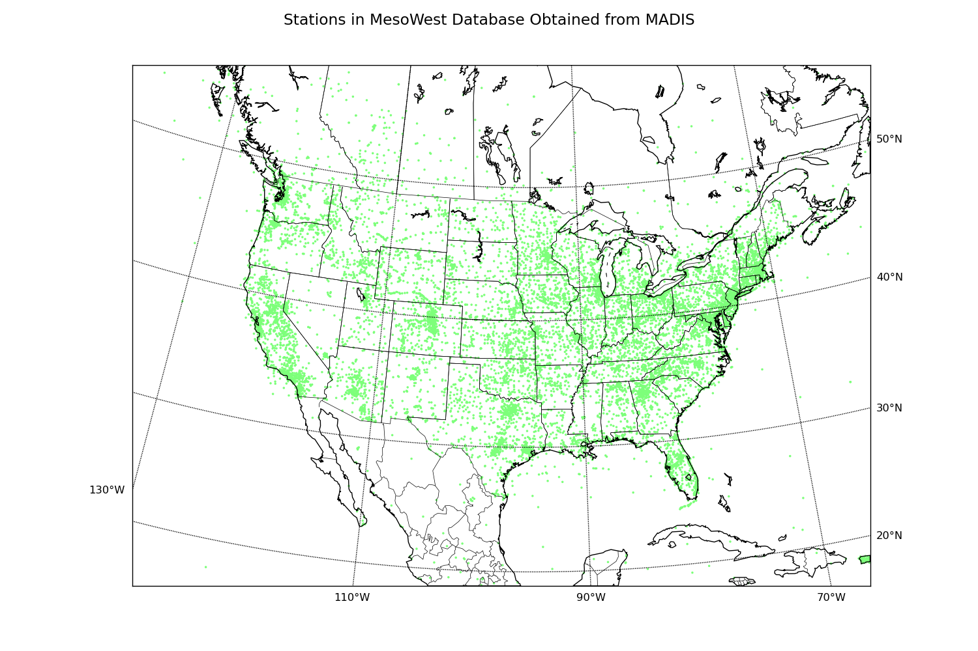
MesoWest currently provides 5,338 observational stations to MADIS from 80 different networks.

Slide 10
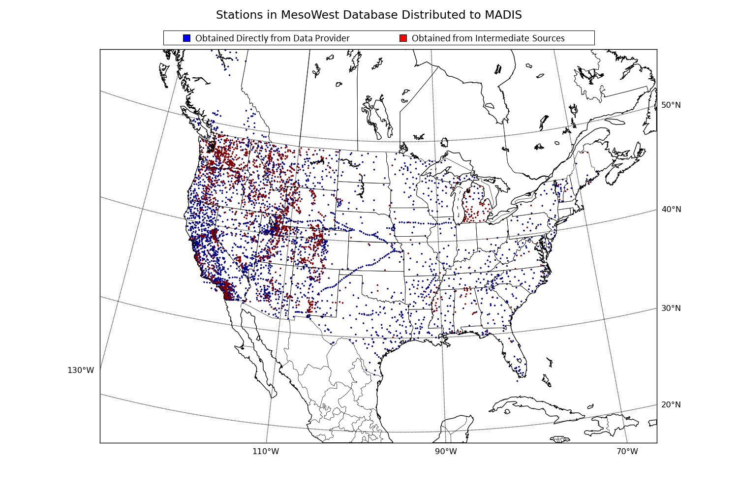

Slide 11
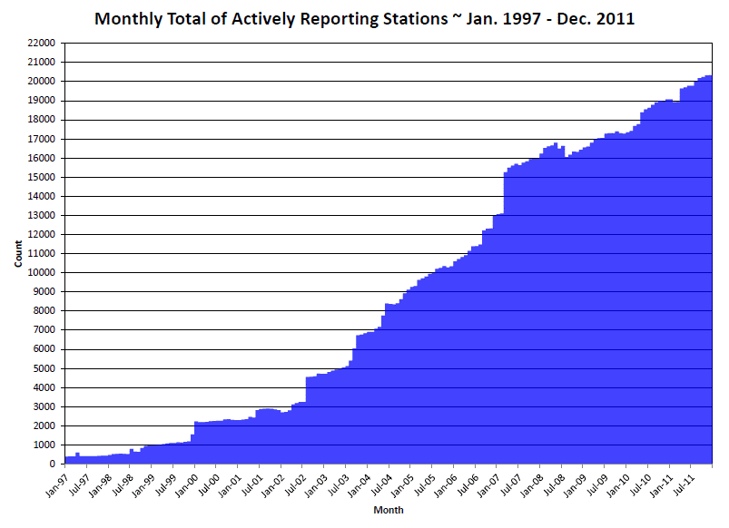

Slide 12
Integrating Mesonet Observations: Hourly T, TD, Wind CONUS Analyses
8 processors in ~20 minutes for CONUS

Slide 13
Issues we’ve spent a lot of time dealing with but are still a struggle
Specifying background and observation error covariances
Estimating representativeness errors
Impact of heterogeneous observations through data denial and adjoint sensitivity/impact studies
QC’ing observations manually and automated procedures

Slide 14
Tyndall and Horel (tbs WAF)
Given the heterogeneous equipment, maintenance and reporting practices, and siting of stations in mesonets, subjective decisions tend to be made to use some observations and avoid others
We determine objectively high impact surface T, Td, and Wind observations using the adjoint of a two-dimensional variational surface analysis over the contiguous United States
High impact observations are defined as arising from:
low observation quality,
observation representativeness errors,
or accurate observed weather conditions not evident in the background field
Impact of nearly 20,000 surface observations computed over a sample of 100 analysis hours during 25 major weather events.
Impacts are determined for each station as well as within broad network categories.
For individual analysis hours, high impact observations are located in regions of significant weather—typically, where the background field fails to define the local weather conditions.
Low impact observations tend to be ones where there are many observations reporting similar departures from the background

Slide 15
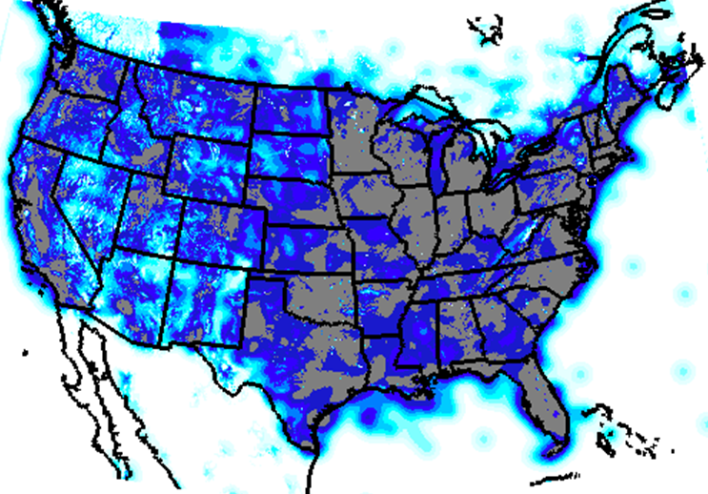
Assessing Existing National Network Density: Integrated Data Influence
Stations reporting at least 50 times within 100 h sample
Dense
Sparse

Slide 16
ASSUMED Observation/BACKGROUND Error RATIO
Group ID | Group Purpose/Type | No. of Networks | Total No. of Stations | Median IDI | Temp. σ_{o}²/σ_{b}² | Dewp. σ_{o}²/σ_{b}² | Wind Spd. σ_{o}²/σ_{b}²
AG | Agricultural | 9 | 472 | 0.94 | 1.5 | 1.5 | 2.0
AQ | Air quality | 8 | 796 | 0.96 | 1.5 | 1.5 | 1.5
EXT | Offshore, Canadian, Mexican | 6 | 940 | 0.71 | 1.5 | 1.5 | 1.5
FED+ | Federal networks, OK and W. TX Mesonets | 21 | 849 | 0.95 | 1.0 | 1.0 | 1.0
HYDRO | Hydrological | 11 | 3580 | 0.85 | 2.0 | 2.0 | 1.5
LOCAL | Commercial, state, and WFO aggregates | 41 | 799 | 0.94 | 1.5 | 1.5 | 1.5
NWS | NWS/FAA | 1 | 1814 | 0.94 | 1.0 | 1.0 | 1.0
PUBLIC | CWOP | 3 | 6808 | 0.96 | 1.5 | 1.5 | 2.0
RAWS | Fire weather | 1 | 1986 | 0.86 | 2.0 | 2.0 | 2.0
TRANS | RWIS, rail | 24 | 1653 | 0.93 | 1.5 | 1.5 | 1.5
TOTAL |  | 125 | 19697

Slide 17
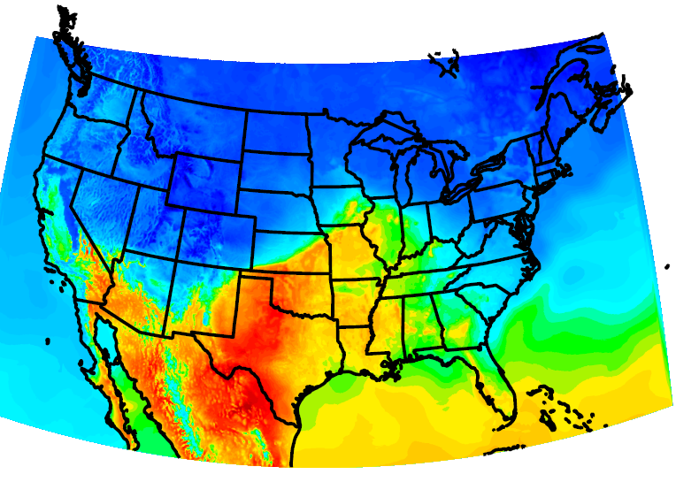
0000 UTC 04 April 2011 Temperature Background Field

Slide 18
0000 UTC 04 April 2011 Temperature Analysis

Slide 19
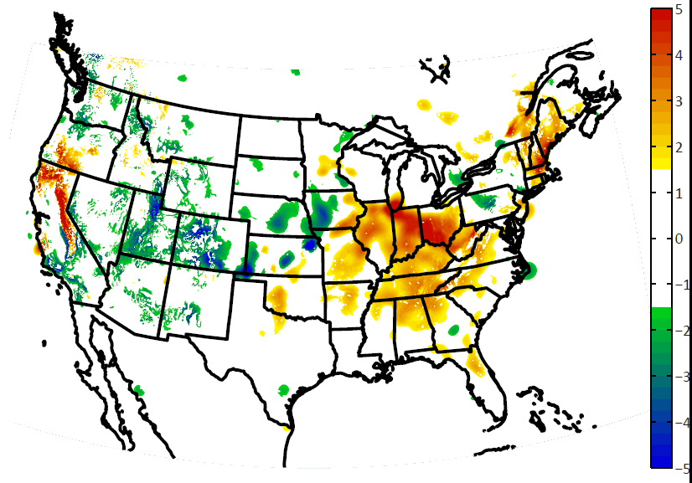
0000 UTC 04 April 2011 Temperature Analysis Increments
5
4
3
2
1
0
-1
-2
-3
-4
-5

Slide 20
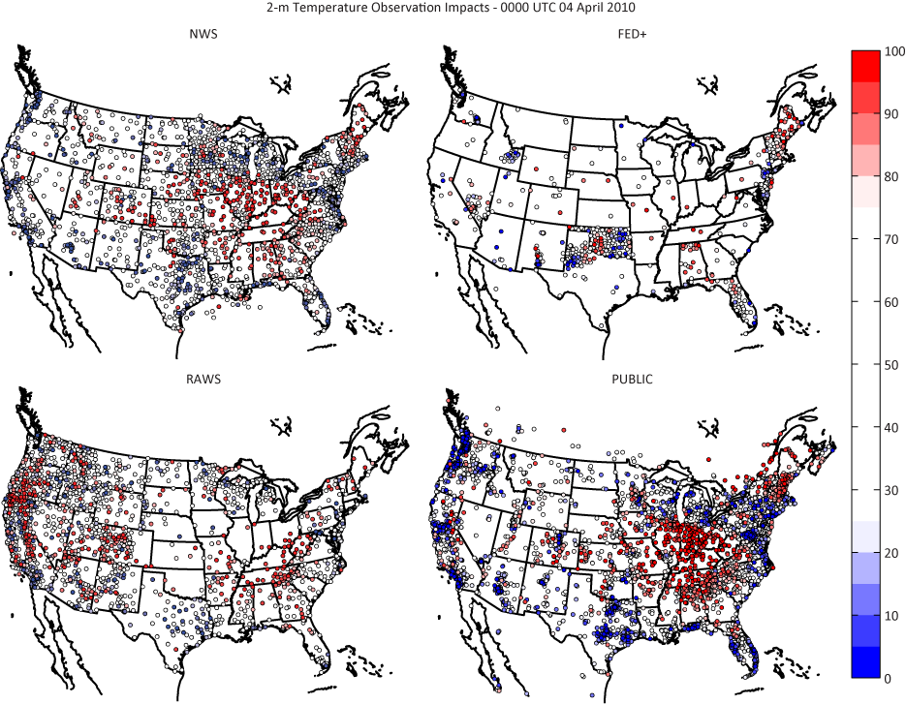
Relative impact of temperature observations from selected categories 0000 UTC 04 April 2011
NWS
FED+
High Impact
RAWS
PUBLIC
Low Impact

Slide 21
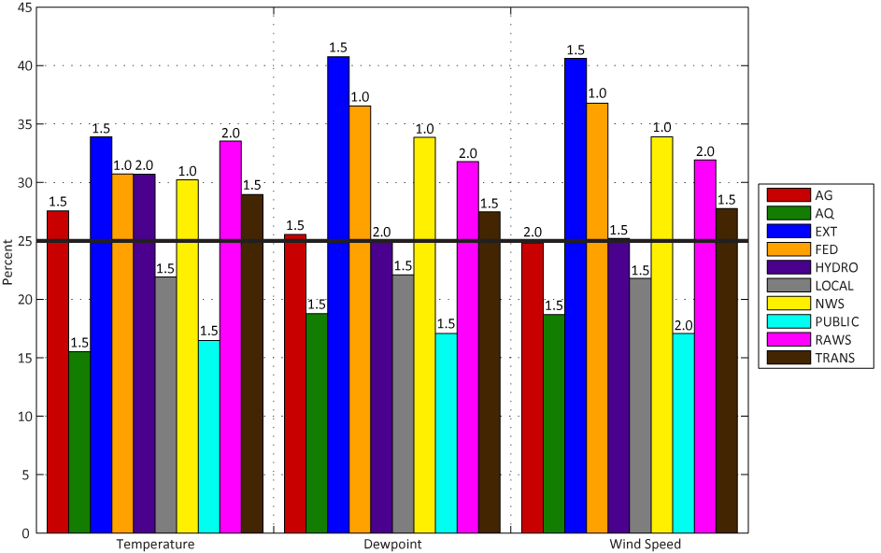
100 cases: Fraction of Reports in Network Category with impact in upper Quartile

Slide 22
Transitioning to Real-Time QC
Running T, Td, Wind analyses every hour
Computing adjoint impact for each analysis
Accumulating statistics on impact and observation bias for each day and over 3-week period
Tons of graphics & text files being generated
http://gl1.chpc.utah.edu/images/

Slide 23
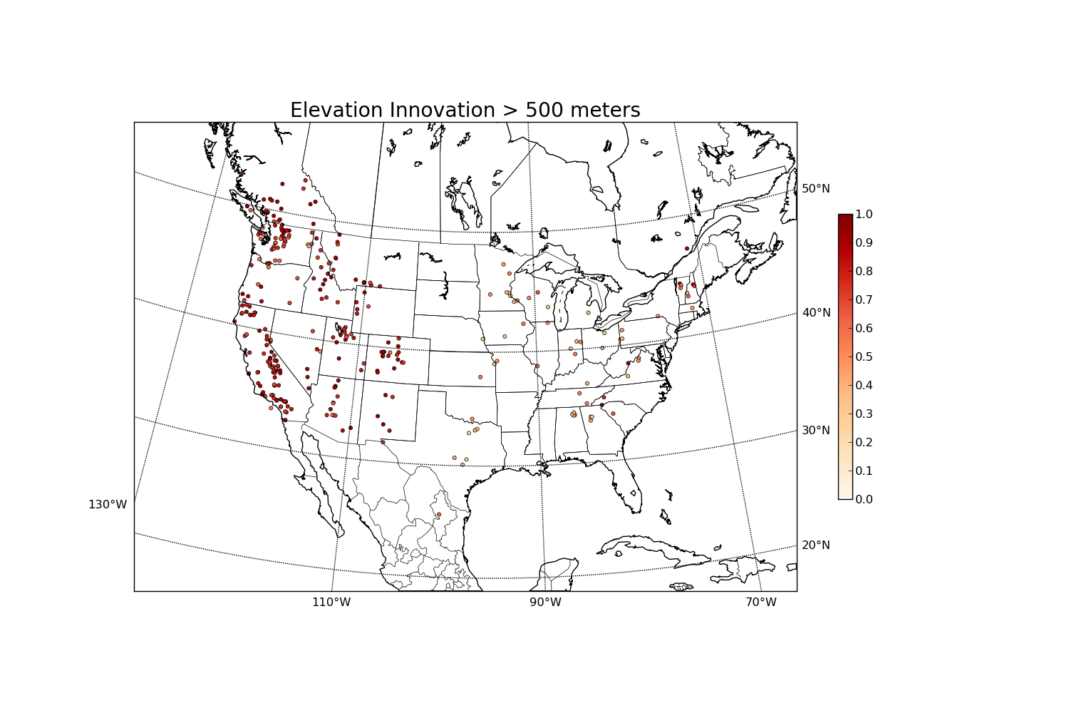
The mix of metadata and representativeness errors
Difference between station and background elevation (e.g., fuzzy NRCS locations)

Slide 24
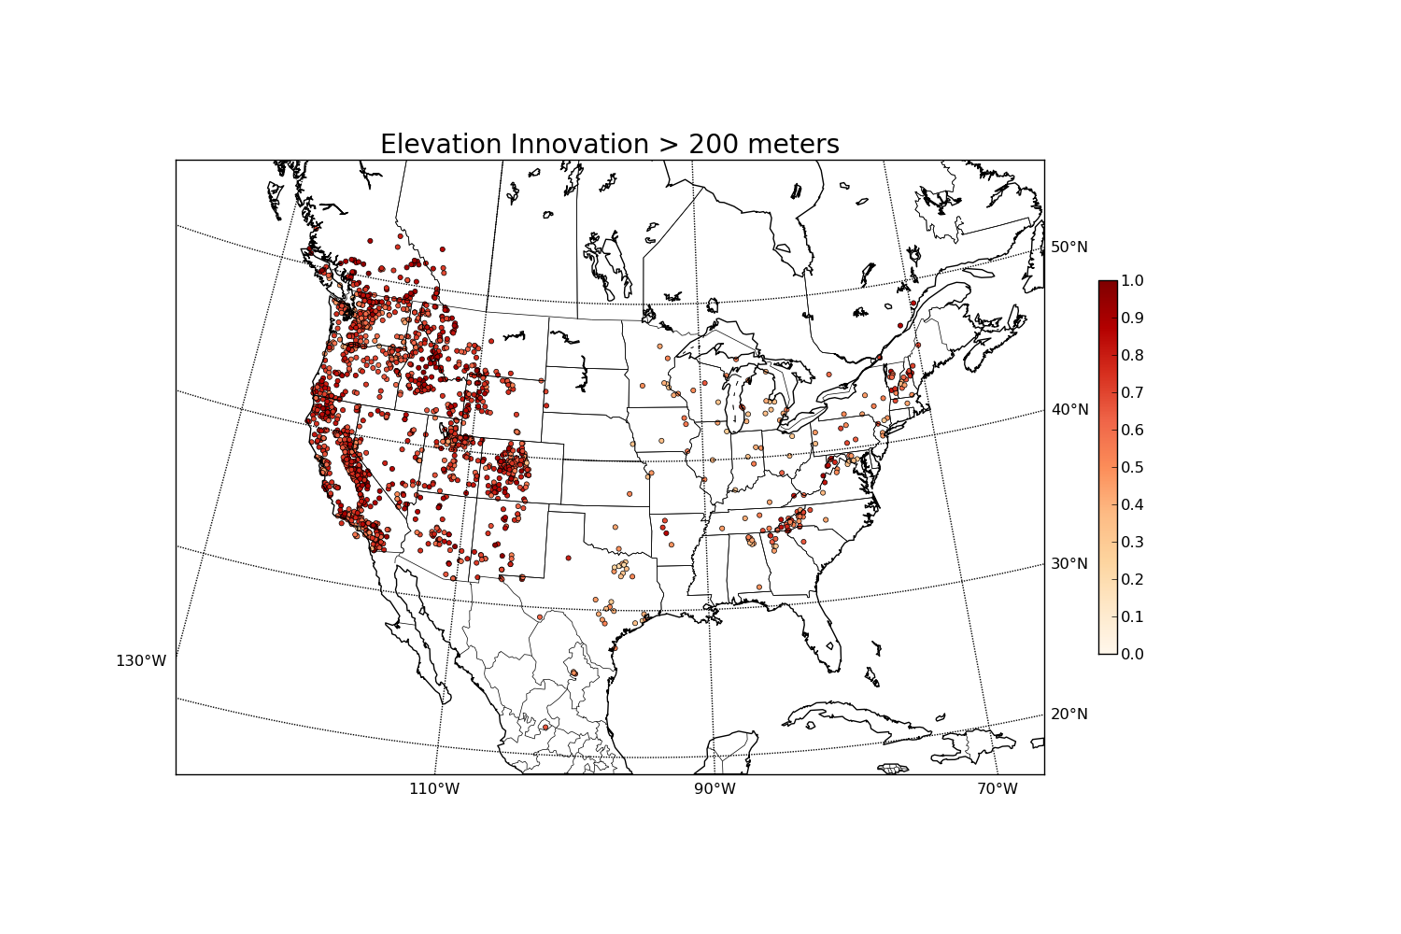
The mix of metadata and representativeness errors
Difference between station and background elevation

Slide 25
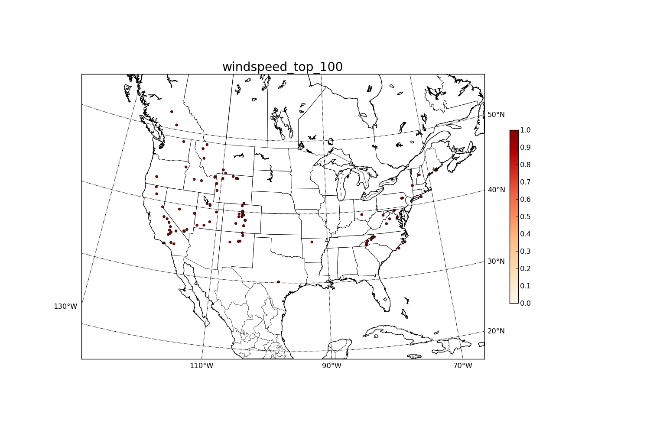
Mix of Weather and Background/Observation Issues Wind Speed Bias: Jan 27, 2012

Slide 26
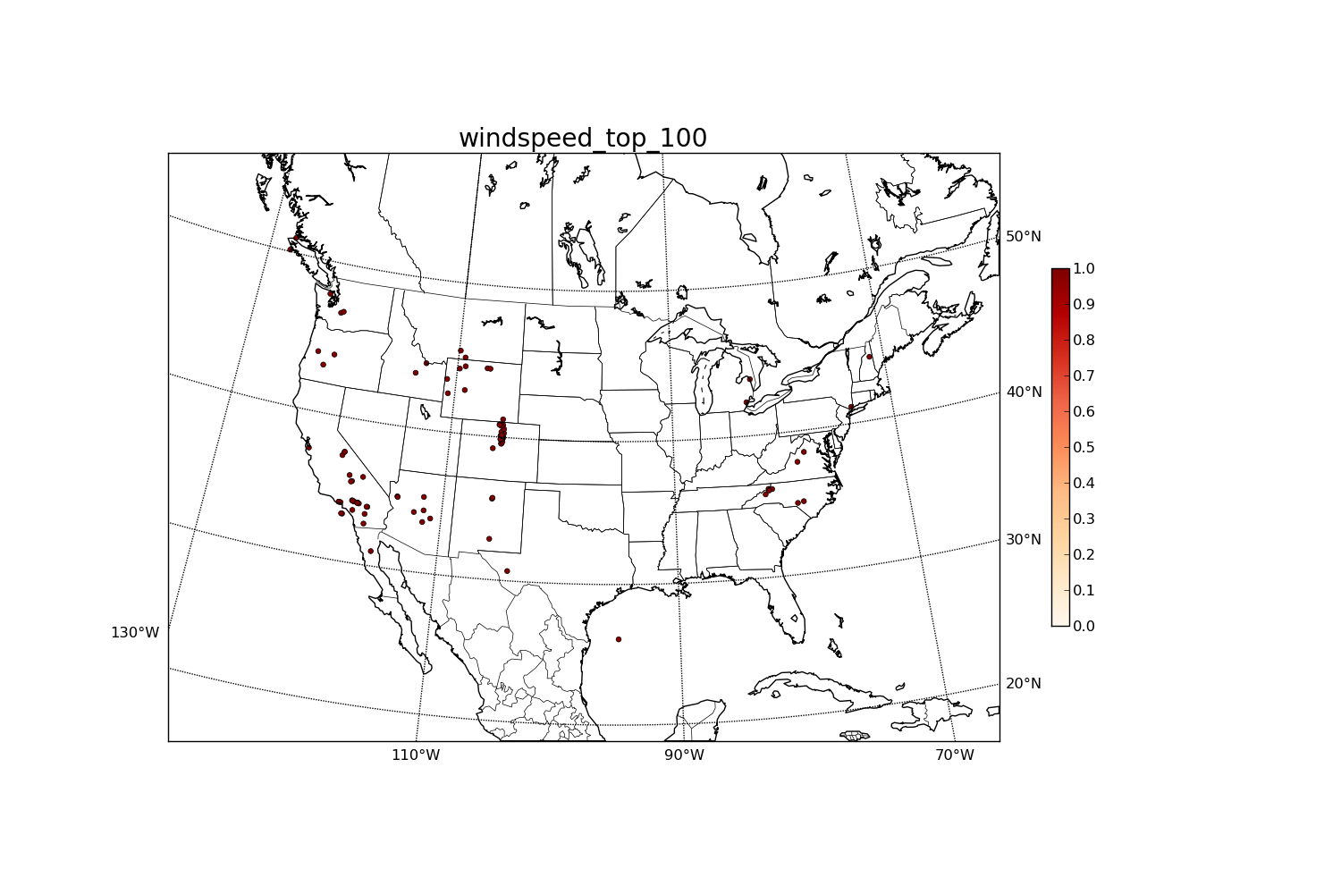
Mix of Weather and Background/Observation Issues Wind Speed Bias: Feb. 17, 2012

Slide 27
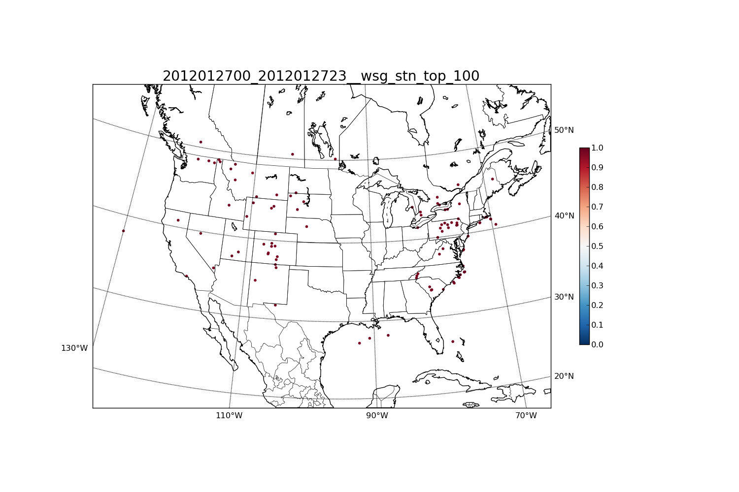
Mix of Weather and Background/Observation Issues Wind Speed Impact: Jan 27, 2012

Slide 28
Mix of Weather and Background/Observation Issues Wind Speed Impact: Feb 17, 2012

Slide 29
Coming up with a scheme to automatically blacklist
Blacklist stn if: some weighted combo of bias, impact, and elevation difference is high relative to other stations over multiweek period
One weighting scheme: equally weight stn bias and impact percentiles. Reject if > 0.85
% Rej | AG | AQ | EXT | FED+ | HYD | LCL | NWS | PUB | RAWS | RWIS
T | 4 | 3 | 4 | 3 | 9 | 8 | 1 | 1 | 5 | 4
Td | 1 | 3 | 4 | 3 | 4 | 4 | 1 | 1 | 2 | 2
WS | 3 | 1 | 1 | 1 | 9 | 2 | 1 | 4 | 5 | 2

Slide 30
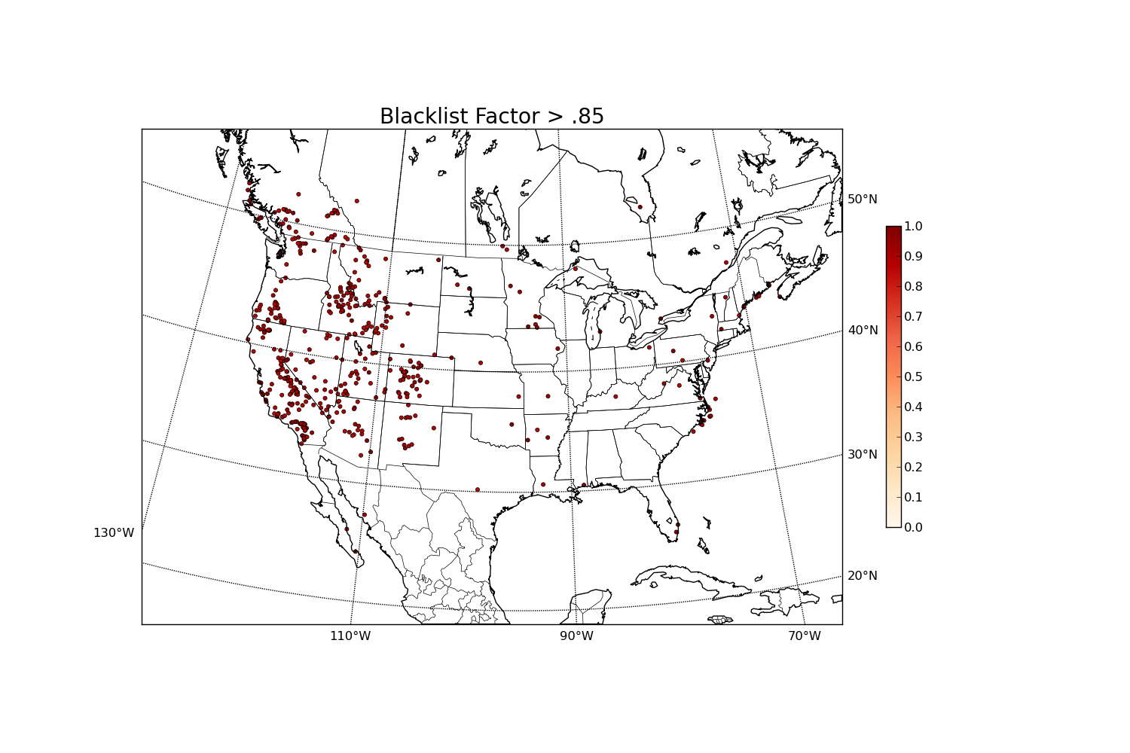
Temperature blacklist

Slide 31
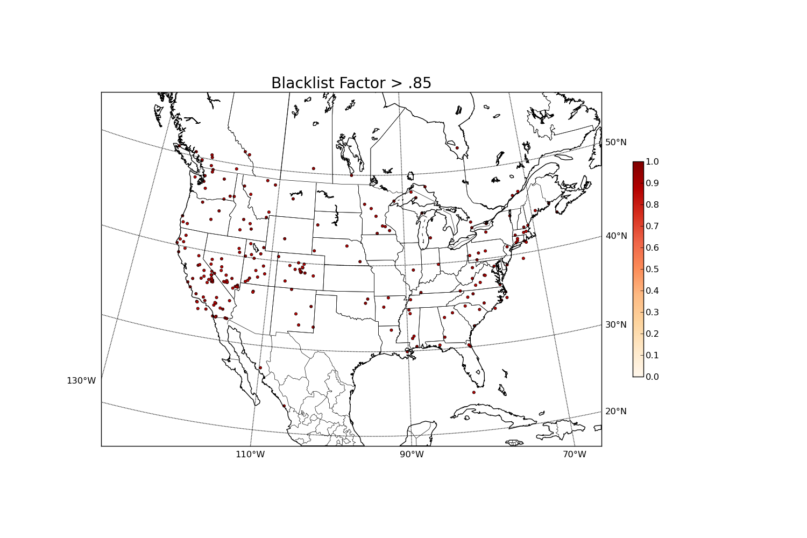
Dew point Temperature Blacklist

Slide 32
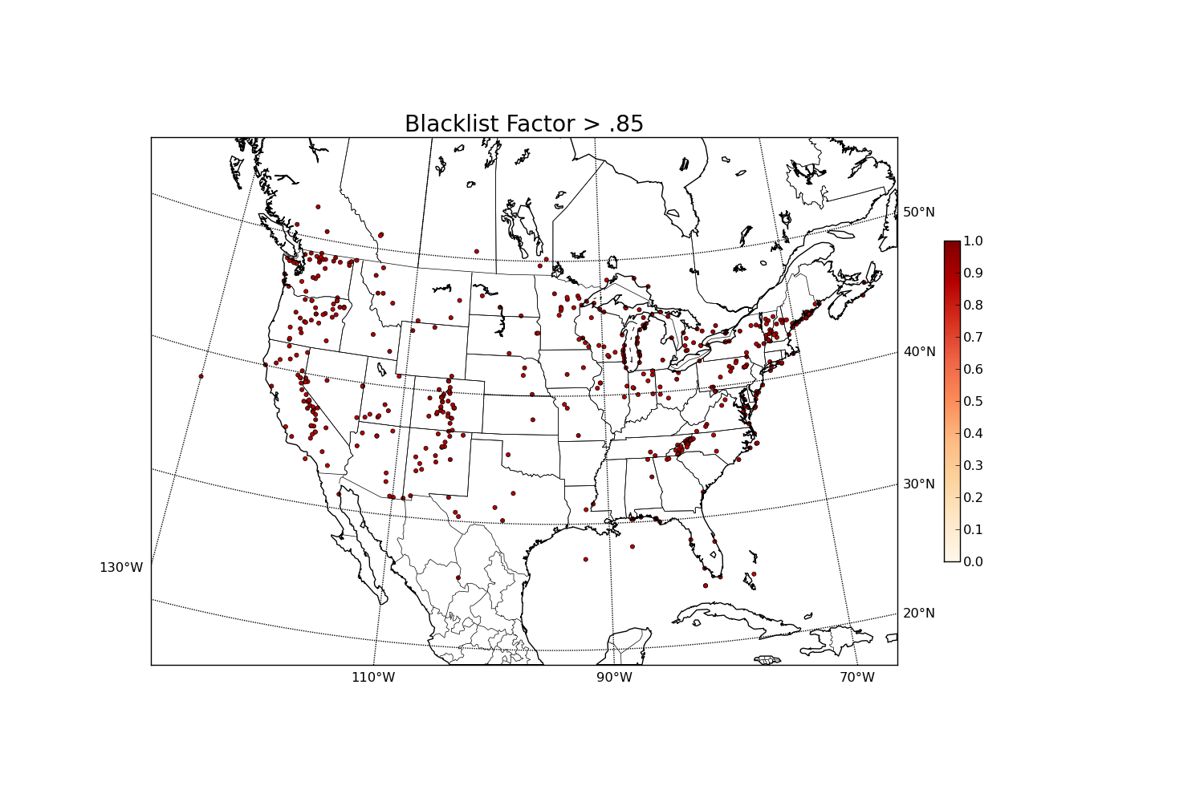
Wind Speed blacklist (no elv)

Slide 33
Summary
Evolution in research over the years has been a tap dance around some basic questions:
What physical processes are important? Role of mountains vs. synoptic-scale motions; lake breeze; cold pools, etc.
How can we integrate observations in complex terrain from multiple sources?
What is the relative impact of observations from different networks?
How can the combination of the observations and analyses serve as quality control for the observations and uncertainty information about the analyses?

