Slide 1
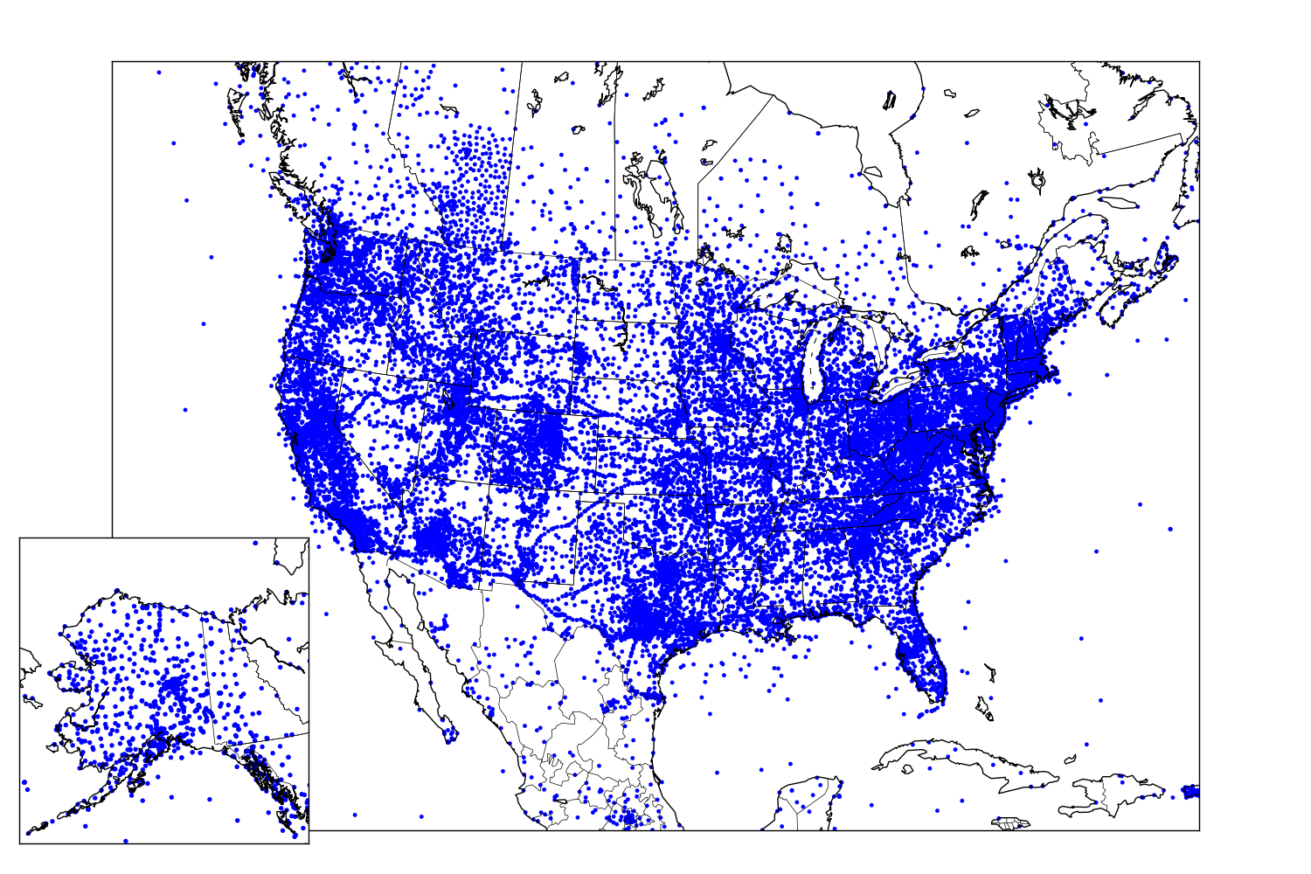
Recent Improvements to Mesonet Observation Access via MesoWest/SynopticLabs
Alexander A. Jacques, John D. Horel, Chris Galli, Judy Pechmann, Adam Abernathy, and Joseph Young
Department of Atmospheric Sciences, University of Utah
289
Motivation and Objectives
API Services
Data Checking and Metadata Improvements
Synoptic Data is funded by the NWS National Mesonet Program to provide real-time access to observations from surface weather stations nationwide
Synoptic Data supports software R&D and maintenance provided by University of Utah staff to disseminate the observations to the MADIS system and other National Weather Service entities
New capabilities developed for data access include:
Flexibility for customized data requests
Improved automated checking algorithms for erroneous observations
Simplified access to precipitation observations
Support usage restrictions defined by data providers
Allows software developers to integrate and utilize observations available from Synoptic Data for their own products and resources
Primary API Services:
metadata: request station and sensor metadata
timeseries: request observations for a desired time period
nearesttime: request observations at or around a desired time
latest: request the most recent observations reported by stations/sensors
API allows expanded customization so users can target specific datasets for their needs:
Restrict by mesonet, location, individual station, measurement type, time period, etc.
API services utilized heavily by NWS Western Region and many NWS WFOs:
130 billion data units delivered via 25 million api data requests during December 2017
Need for improved automated real-time data checking procedures to identify erroneous or physically implausible observations
Operational SynopticLabs Data Checking Algorithms
Physical Range: observation outside an expected physical/plausible range
Rate-of-Change: observations changing at an unrealistic rate over time
Persistence: observations appear “stuck” on a value over long periods of time
Spatial: observations flagged due to spatial differences with surrounding observations
Data Checking Procedures Currently Under Development
Improvements upon criteria for existing spatial and temporal consistency checks
Climatological Range: incorporation of station-derived historical percentiles as a means to identify observations that fall far outside historical climatological bounds
Data Provider Checks: development of automated algorithms to incorporate data checking/quality control supplied by data providers (real-time objective and historical subjective quality control procedures)
Metadata Improvements
Historical Platform Locations: discover previous deployment history for sites
To be implemented into data services when accessing data from past events
To be implemented into metadata services for viewing entire station history
Very important for portable RAWS stations deployed at wildfires
Sensor Metadata: leverage additional information on sensor types, models, etc. for platforms where sensor metadata exists
Data
Hurricane Harvey - 5 Day (ending 00 UTC 30 Oct 2017) Estimated Precipitation Totals
Houston Area Automated Weather Stations
Real-time data accessed from networks intended for diverse purposes
Fire wx, road wx, agriculture, research, citizen science, etc.
1 Jan 2018: # stations from # mesonets actively transmitting data
# stations and # mesonets added during 2017
Publicly-Accessible Stations: 1997 to the Present
RAWS Station TT020 History
Most recently deployed for catastrophic California wildfires in December 2017 (green marker)
First deployed in central Idaho in September 2012
Deployed at over 10 different locations across western US over last 5 years (blue markers)
Publicly-Accessible Active Platforms– 1 Jan 2018
Improved Precipitation Services
Data providers record precipitation amounts in a variety of forms
precipitation at intervals from 1-60 min
accumulating totals that reset daily, after calibration, water or calendar yr, etc.
Existing API precipitation service allows the user to retrieve estimated total precipitation accumulations over a desired time period
Improved API service under development expands upon existing precipitation services by creating derived interval precipitation time series for every station
Simplifies comparing precipitation from multiple networks
Allows for more flexible requests (e.g. daily totals, totals in last 3/6/24 hours, etc.)
Automated location updates for all incident RAWS weather stations once they are deployed and transmitting. Current location updated iand available in all MesoWest and Synoptic Data api services.
Future Work
Derived Precipitation Time Series
Total Precipitation Values
Continued development and improvements to existing API Services
Derived precipitation services
New/improved data checking algorithms
Self-describing sensor metadata
Additional historical station metadata
Streamed Observations and Alerting Capabilities
Streaming services that transmit observations to end-users that satisfy specific desired criteria (e.g., wind speed > 20 mph and relative humidity < 10%)
Reduced data latency by pushing observations to the user as opposed to user requests
Station ID | Time (UTC) | Raw Precip Accum (in) | Derived Precip Interval (in) | Derived Period Accum (in)
MTMET | 09:40 | 5.79 | 0.00 | 0.00
MTMET | 09:45 | 5.79 | 0.00 | 0.00
MTMET | 09:50 | 5.82 | 0.03 | 0.03
MTMET | 09:55 | 5.89 | 0.07 | 0.11
MTMET | 10:00 | 5.98 | 0.08 | 0.19
MTMET | 10:05 | 6.10 | 0.12 | 0.31
MTMET | 10:10 | 6.20 | 0.10 | 0.42
MTMET | 10:15 | 6.33 | 0.13 | 0.55
MTMET | 10:20 | 6.45 | 0.12 | 0.66
MTMET | 10:25 | 6.52 | 0.07 | 0.73
MTMET | 10:30 | 6.67 | 0.15 | 0.88
MTMET | 10:35 | 6.84 | 0.17 | 1.05
MTMET | 10:40 | 6.97 | 0.13 | 1.18
Total precipitation for weather station MTMET ending at
12:00 UTC 26 Jul 2017
over:
Data Ingest/Dissemination Process
Synoptic Data ingest servers in Amazon Cloud (AWS) routinely access data via pull/push methods preferred by data providers (including MADIS)
New/updated observations identified and processed into like formats
Observations simultaneously ingested into data check algorithms
Observation latency (time ob reported to time ingested) also logged
Data stored in AWS MariaDB MySQL Databases (TokuDB engine)
Fast querying speeds and data compression on disk
Multiple Dissemination Access Points
Synoptic Data API Services (https://synopticlabs.org/api/)
MesoWest Web Pages (http://mesowest.utah.edu/)
Numerous NWS-based products and NOAA MADIS system
Previous 1 h: | 0.02 in
Previous 3 h: | 1.34 in
Previous 6 h: | 1.35 in
Previous 12 h: | 1.35 in
Previous 24 h: | 1.47 in
Acknowledgements
Funding for SynopticLabs at the University of Utah provided by Synoptic Data as part of the National Mesonet Program.
Interested in contributing observations or interested in our data API services? If so, please contact us at support@synopticlabs.org.

