Slide 1
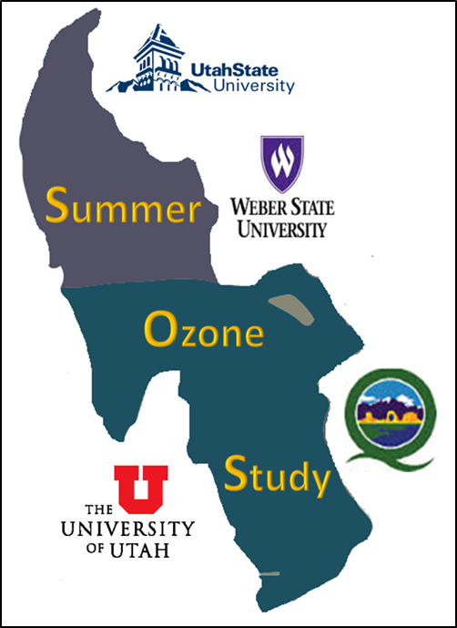
The Great Salt Lake Summer Ozone Study
John Horel, Erik Crosman, Alex Jacques, Brian Blaylock, Ansley Long, University of Utah
Seth Arens, Utah Division of Air Quality; Randy Martin, Utah State University and John Sohl, Weber State University

Slide 2
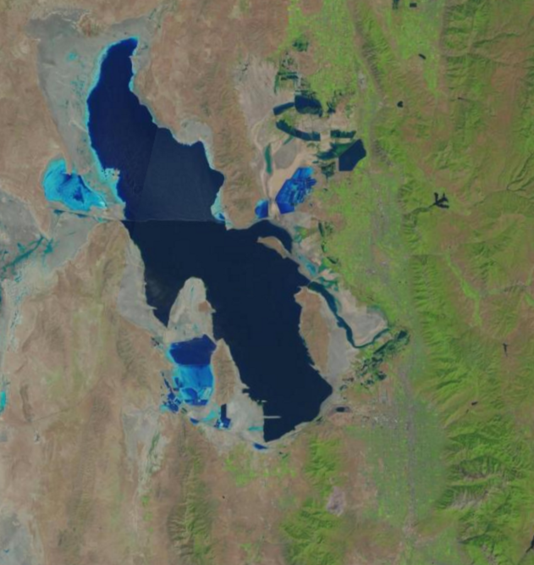
Why is ozone a concern along Wasatch Front?
Background ozone levels in the west are high and likely to increase
Distant, regional, local emissions and transport
Increased wildfires
Prior field & modeling studies by Utah Division of Air Quality (DAQ) indicated high ozone concen-trations over & near the Great Salt Lake
Great Salt Lake
Wasatch Front
Wasatch Mountains
Salt Lake
Valley

Slide 3
Objectives of this pilot study…
Determine the distribution of ozone near the Great Salt Lake during summer
Improve understanding of the meteorological processes that control ozone concentrations over and surrounding the Lake during summer
Contribute to improved ozone forecasts by Utah DAQ

Slide 4
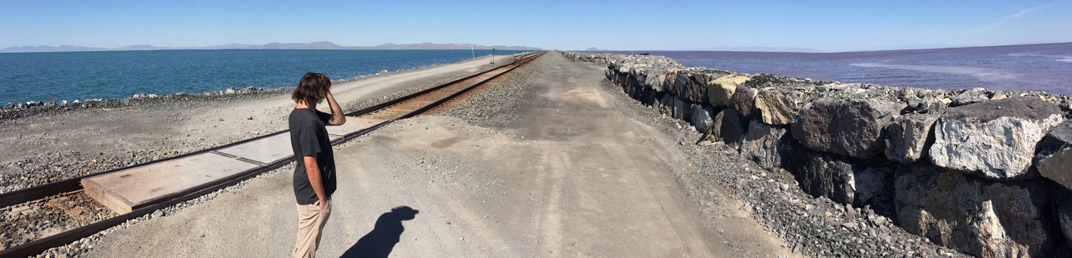
Cost-effective pilot field study
Small budget from Utah DAQ leveraged by other funds
Used existing infrastructure in our own backyard to reduce costs
Real-time data collection and analysis: 1 June - 31 August 2015
Summer study allowed for more graduate & undergraduate student participation
Great Salt Lake Causeway

Slide 5
Leveraging Existing Resources
Real-time Ozone Measurements During the 2015 Great Salt Lake Summer Ozone Study
Jacques et al., Paper 7.2 18th Symposium on Meteorological Observation and Instrumentation
Instruments | Resource
DAQ Fixed Site Ozone Monitors | DAQ Ozone Monitors - part of regular monitoring network
Temporary Fixed Site Ozone Monitors | DAQ and UofU temporary deployments, some adjacent to existing UofU weather stations and available in real-time
Weather Observations | MesoWest (http://mesowest.utah.edu) MesoWest API (http://mesowest.org/api)
Mobile Ozone Observations | UTA TRAX Light Rail Car (continuous) KSL-TV “Chopper” 5 (often late afternoon) UofU Nerdmobile (IOPs) UofU Additional Vehicles (IOPs)
Boundary Layer Air Quality Observations | USU UAV WSU Tethersonde
Boundary Layer Remote Sensing | UofU Sodars, Lidar, and Ceilometers

Slide 6
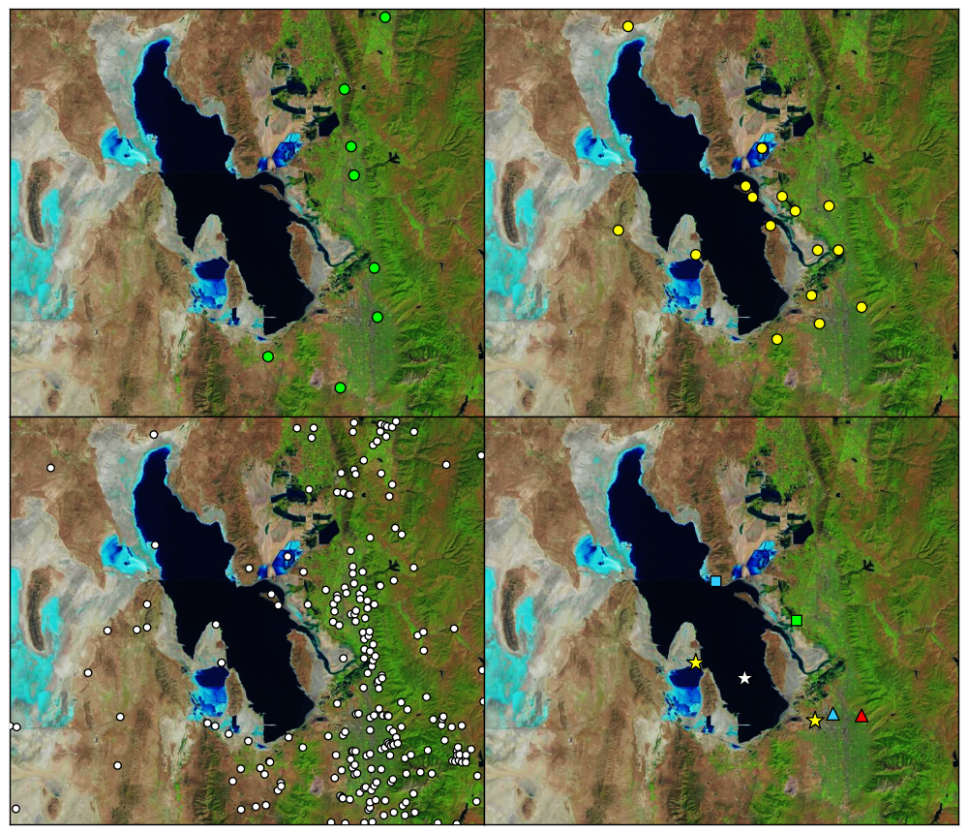
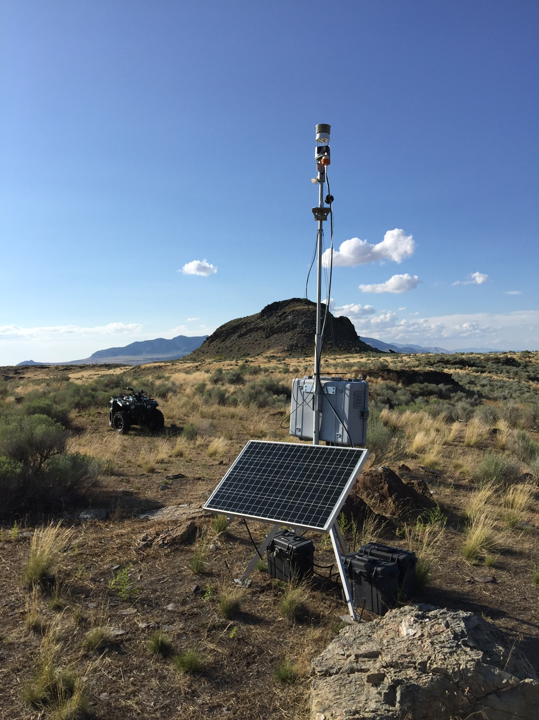
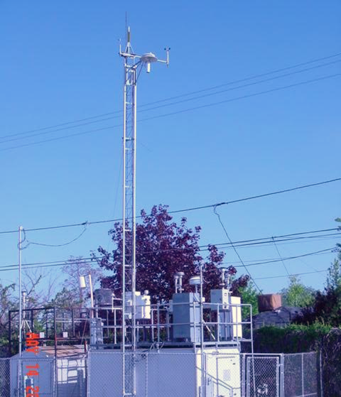
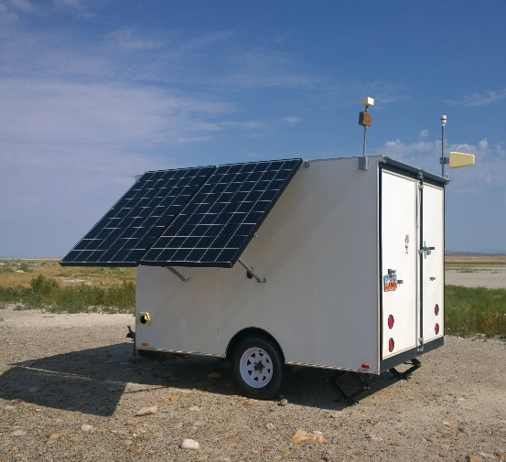
DAQ Ozone Monitors
Temporary Ozone Monitors
Hawthorne
Fremont Island
MesoWest Sites
Sodars, Buoy, Lidar, Ceilometers,
UAV, Balloon
Badger Island

Slide 7
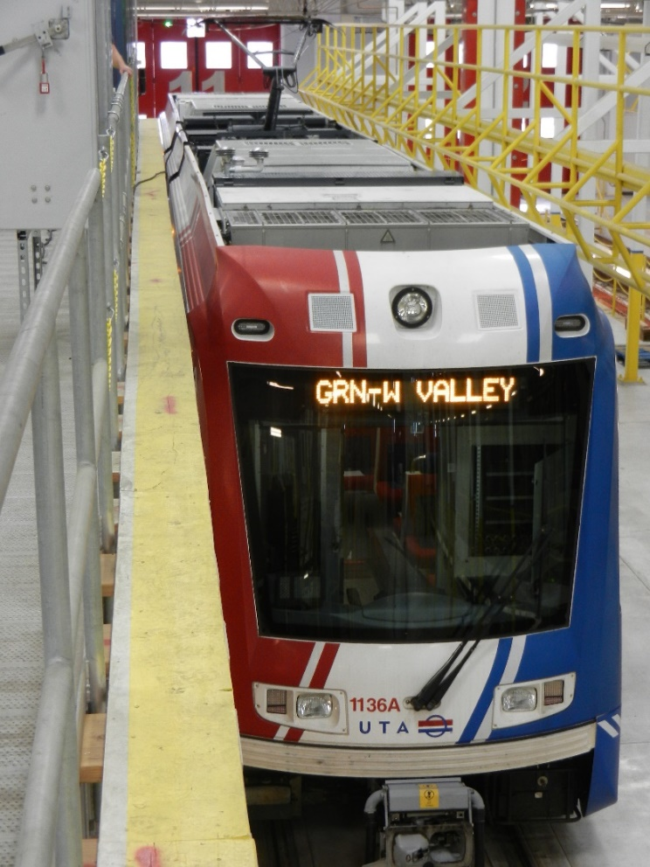
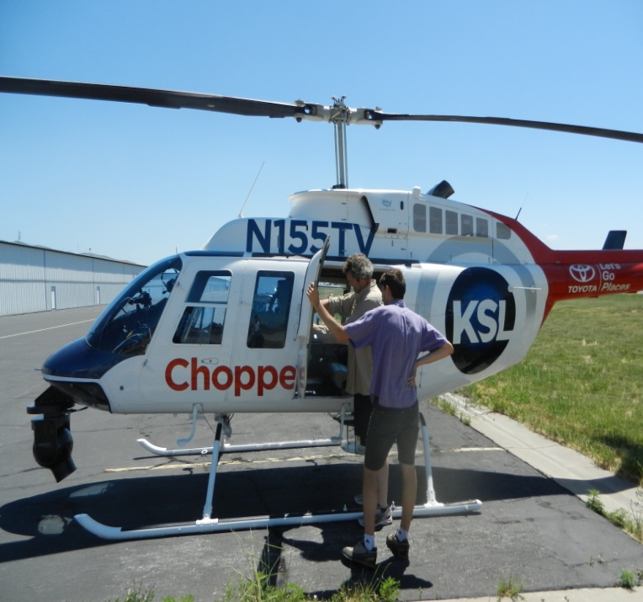
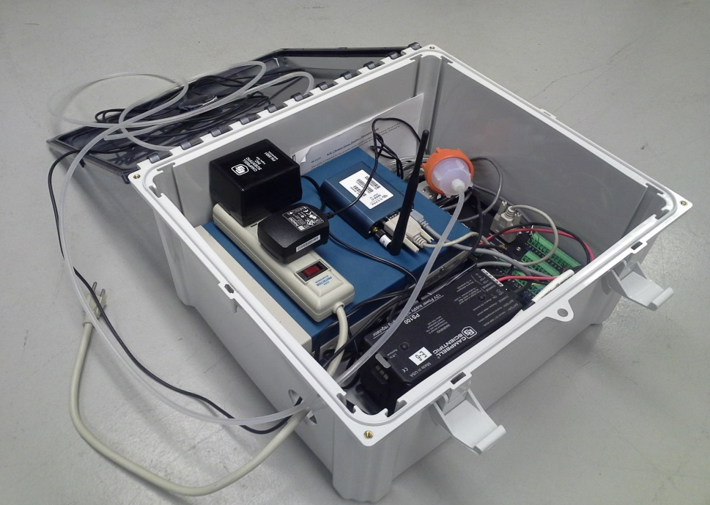
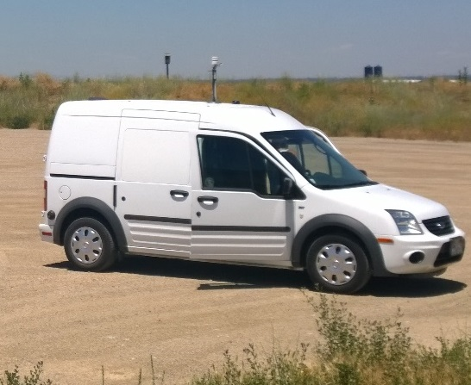
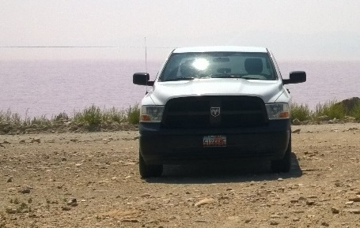
Mobile Ozone Observations
Continuous real-time monitoring via instrument deployed on Utah Transit Authority (UTA) TRAX Light Rail Car
Intermittent deployment of mobile units with real-time cellular communications deployed in vehicles and on KSL-TV “Chopper 5” helicopter

Slide 8
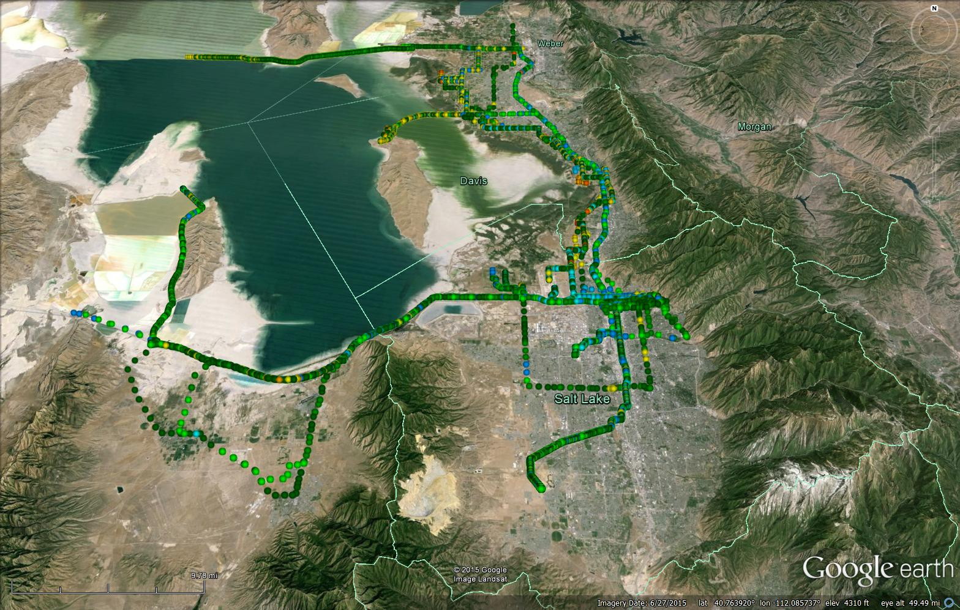
Mobile Observations
June-August 2015
Repeated Routes
TRAX
Red Line

Slide 9
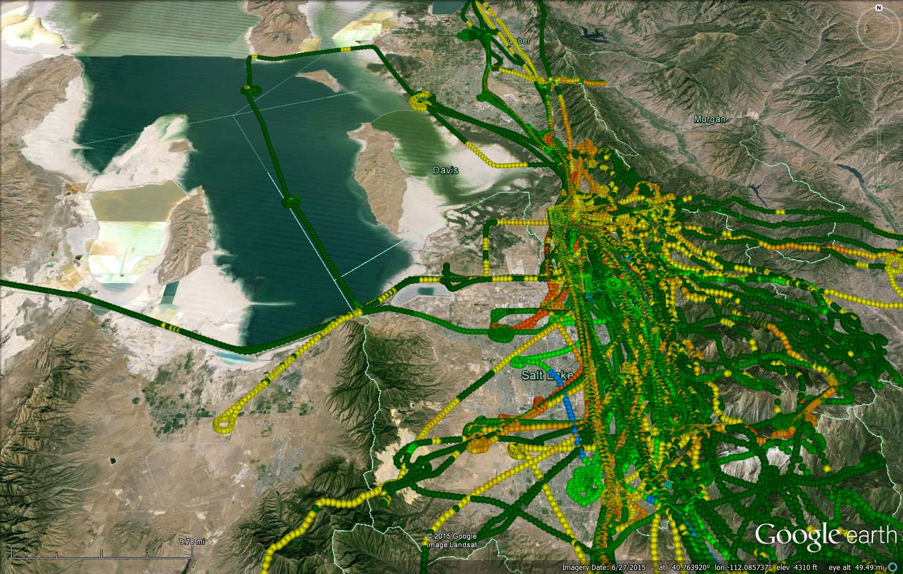
Chopper: Opportunistic flights
June-August 2015

Slide 10
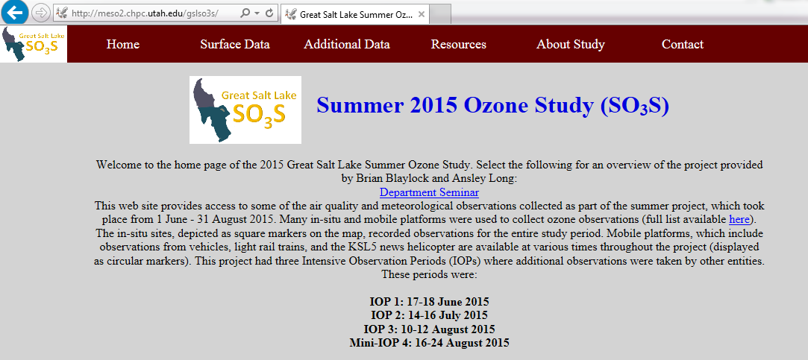
Real-Time Ozone Processing and Display
Data collected from logging devices in real-time
Processed into MesoWest database (fixed sites) or HDF5 (mobile)
Data synthesized on website: http://meso2.chpc.utah.edu/gslso3s

Slide 11
Daily 8-h Maximum Ozone in Salt Lake Valley (Hawthorne) during summer
Synoptic Ridge
Wildfire Smoke
Station | # 2015 Summer Days > 70 ppb
Farmington Bay | 19
Salt Lake Valley (Hawthorne) | 18
Badger Island | 17
Saltaire | 16

Slide 12
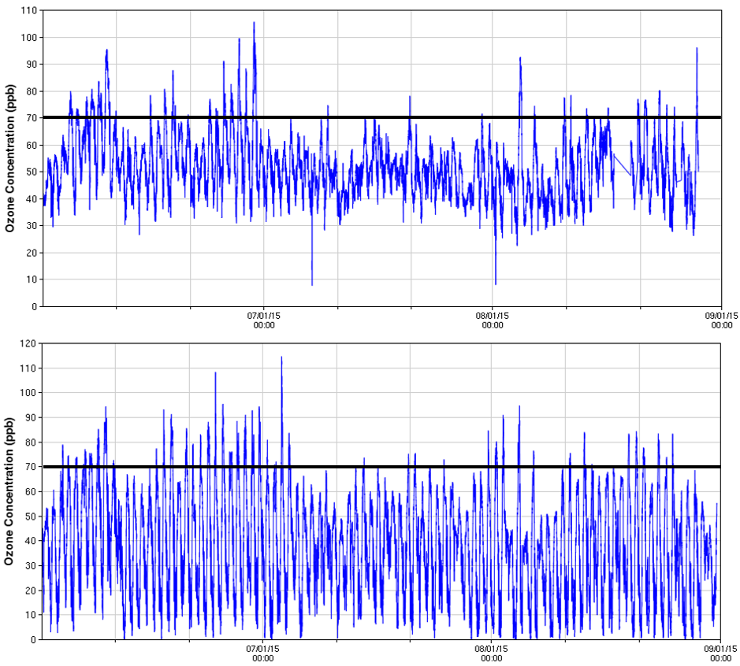
In-Situ Observations at 5-min intervals
Badger
Island
Farmington
Bay
Badger Island
Farmington Bay
1 Jun 15 Jun 1 Jul 15 Jul 1 Aug 15 Aug 1 Sep
Nocturnal titration reduced at remote Badger Island relative to Farmington Bay located between Lake and urban areas
1 Jun 15 Jun 1 Jul 15 Jul 1 Aug 15 Aug 1 Sep

Slide 13
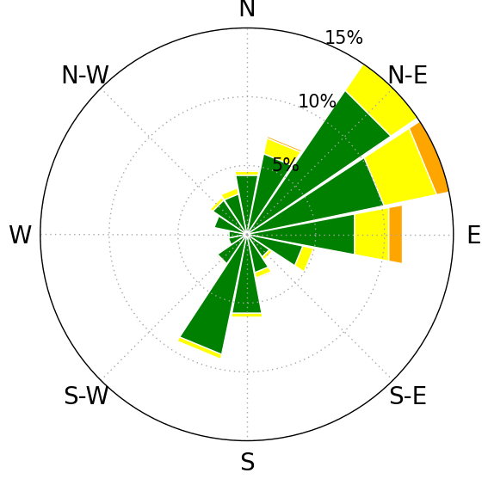
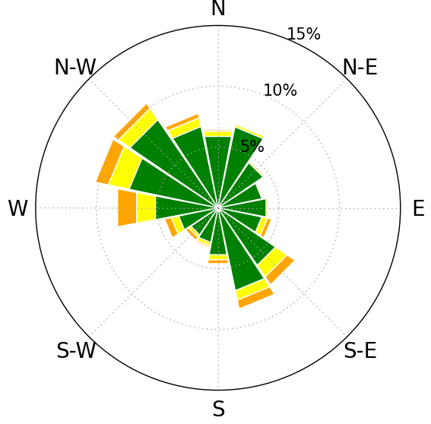
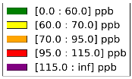
Ozone Roses: 1 June - 31 August
Badger
Island
Farmington
Bay
Badger Island Farmington Bay
Dominated by nocturnal land breezes and
Daytime lake breezes
(replace with daytime only one?)
Persistent cross-lake
easterly flow

Slide 14
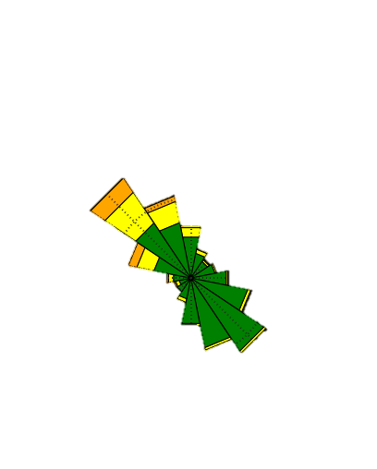
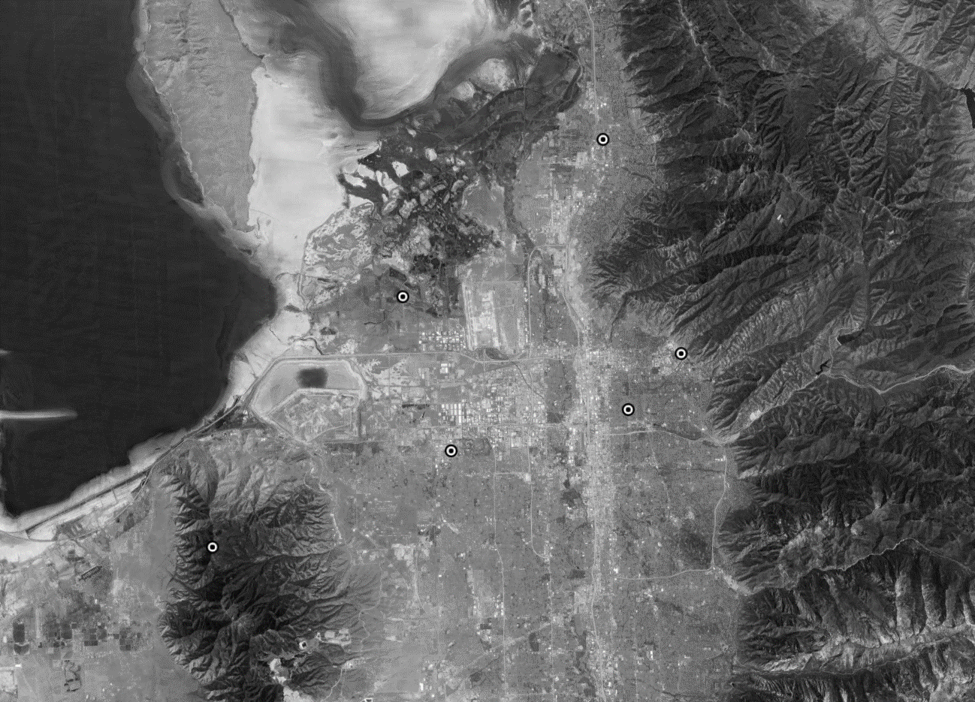
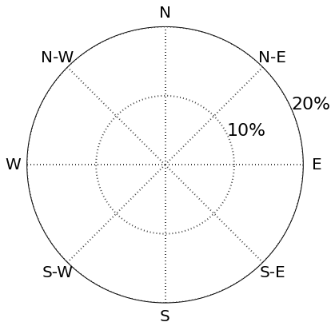
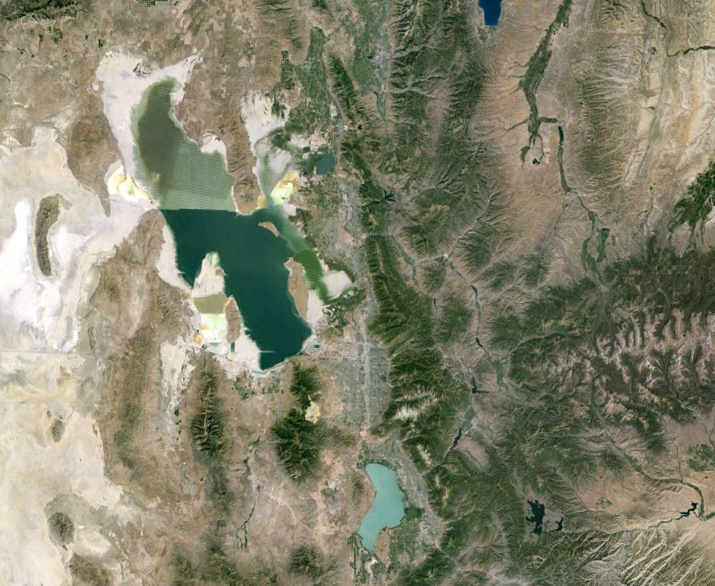
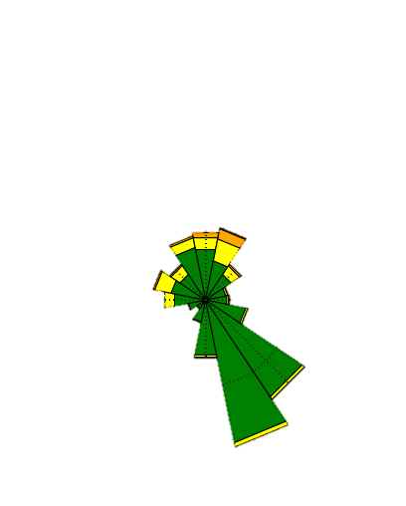
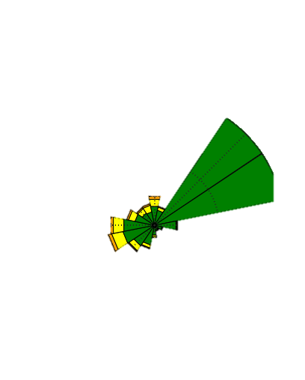
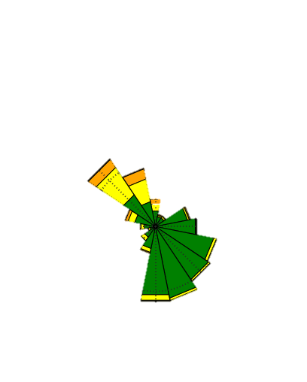
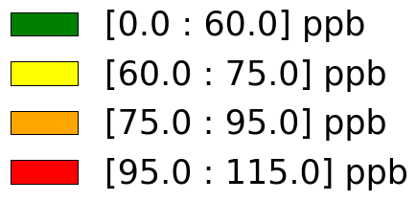
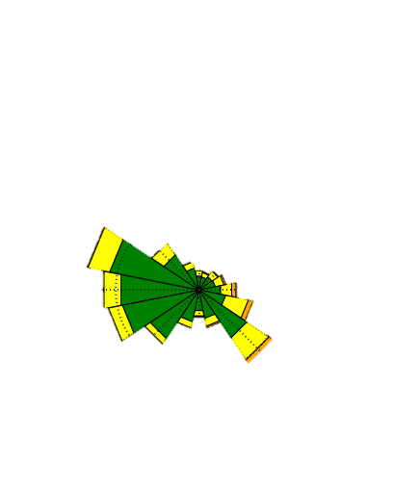
Ozone Rose
Notes:
Now we’re going to look at some of the data we collected…
Ozone roses
Show the frequency of wind direction for each ozone interval of ozone concentration

Slide 15
Intensive Observing Periods (IOPs) and Other Periods of Interest
Period | Conditions | Ozone (ppb) | Field Notes
3 June | Evening Thunderstorm | Over 70 ppb at Salt Lake Valley stations | June 3
17 June - 3 July | Ridging & hotter than normal | Peak ozone over 70 ppb somewhere every day | Chopper 5
IOP 1: 17 - 18 June | Strong lake breeze front on 18th | Ozone concentrated along frontal boundary aloft | IOP 1
IOP 2: 15 - 16 July | Well mixed, deep boundary layer up to 550 mb with afternoon convection | Peak concentrations barely exceeding 70 ppb | IOP 2
IOP 3: 10 -12 August | Monsoonal conditions | 8 h avg over 70 ppb in Salt Lake Valley | 14 August Daily Summary
16 - 24 August | Regional smoke transport | Elevated ozone and PM2.5 concentrations | Smoke Week
Next talk:
Brian Blaylock

Slide 16
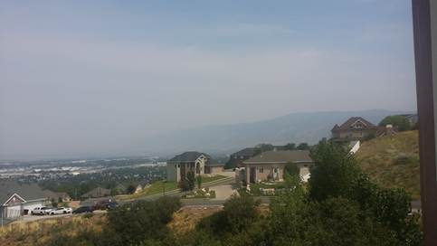
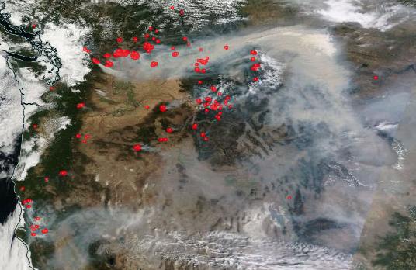
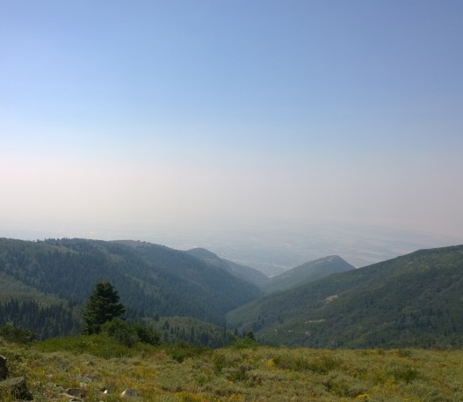
Wasatch Front: Crossroads of the Smoky West
15-24 August 2015
Cessation of summer monsoon; dry NW flow advected smoke from Pacific Northwest and California wildfires
Elevated ozone and particulate levels obscured visibility

Slide 17
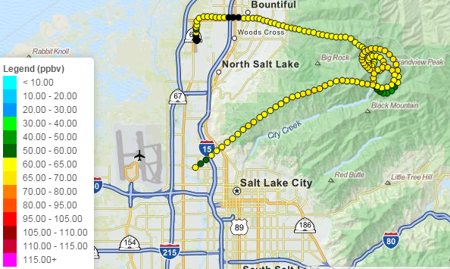
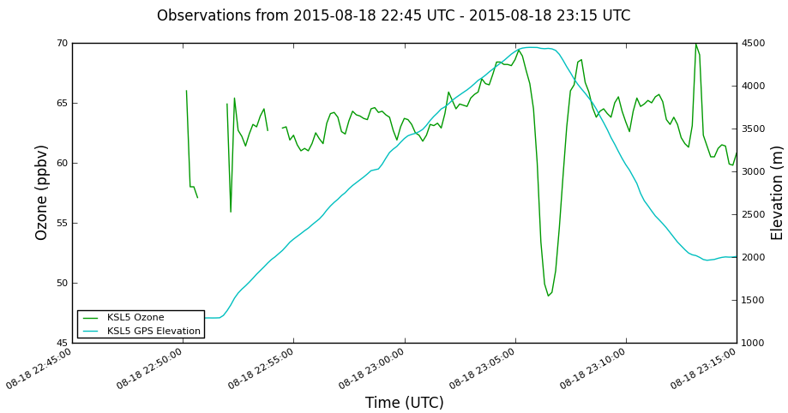
18 August: Chopper 5 asked to fly above smoke in boundary layer

Slide 18
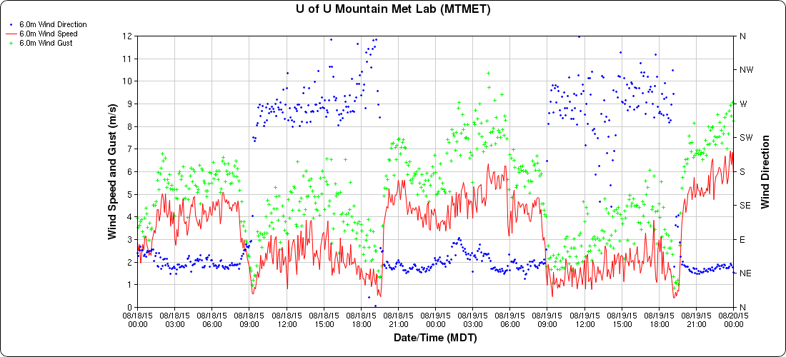
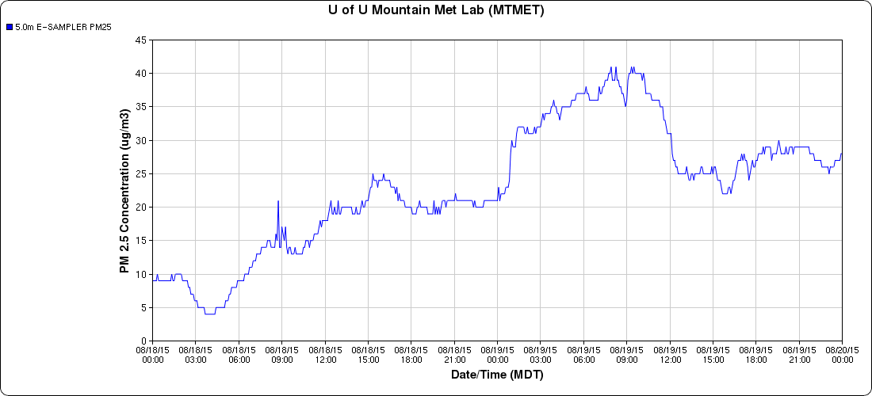
18- 19 August: Conditions on UU Campus on eastern side of Valley
Night
Day
Night
Day
W
Blue: wind direction
Red: wind speed
Green: peak wind
NE
Chopper
flight
Blue: PM 2.5

Slide 19
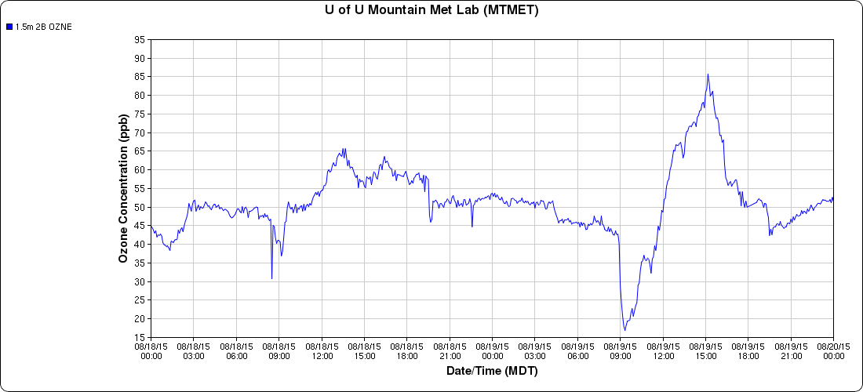
18- 19 August: Conditions on UU Campus on eastern side of Valley
Night
Day
Night
Day
W
Blue: wind direction
Red: wind speed
Green: peak wind
NE
Chopper
flight
Ozone: PM 2.5

Slide 20
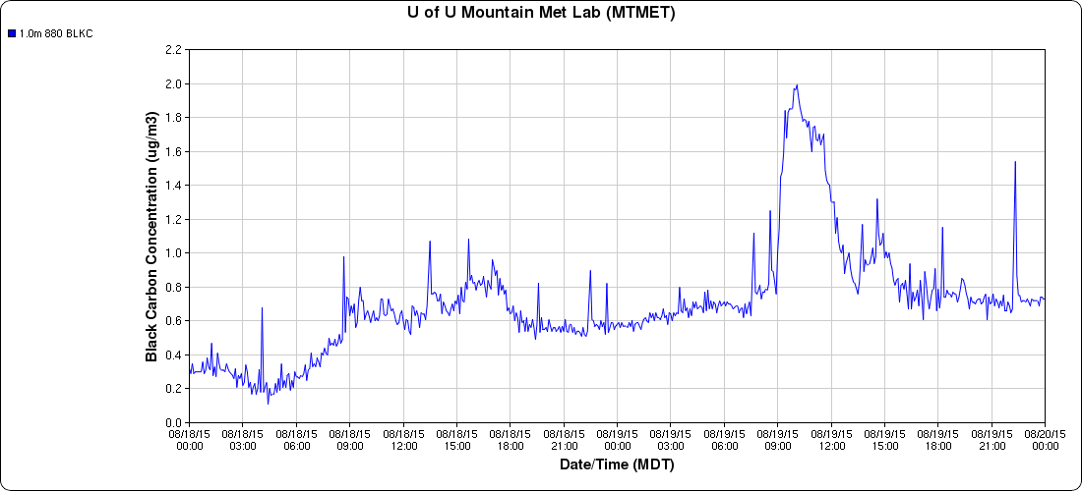
18- 19 August: Conditions on UU Campus on eastern side of Valley
Night
Day
Night
Day
W
Blue: wind direction
Red: wind speed
Green: peak wind
NE
Chopper
flight
Black Carbon. Aethalometer provided by Sonoma Tech

Slide 21
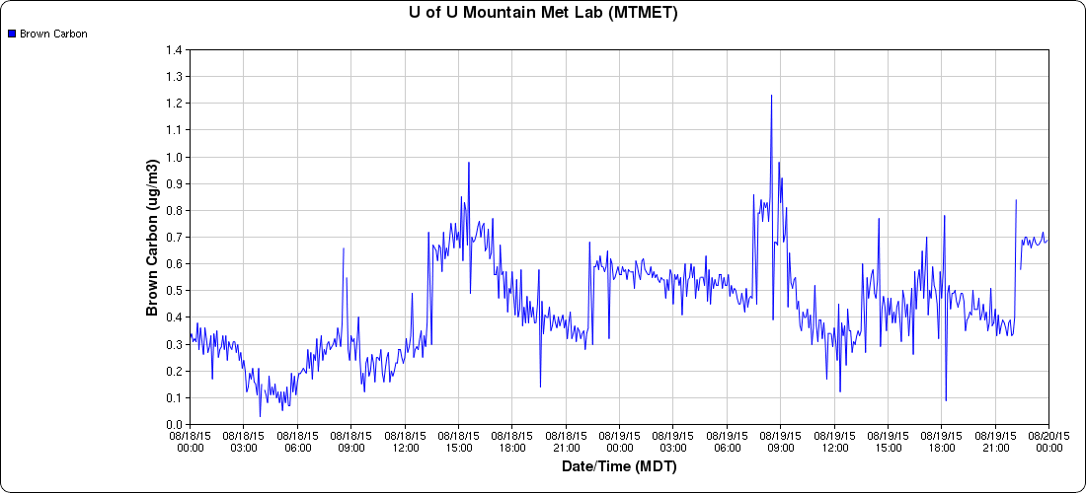
18- 19 August: Conditions on UU Campus on eastern side of Valley
Night
Day
Night
Day
W
Blue: wind direction
Red: wind speed
Green: peak wind
NE
Chopper
flight
Brown Carbon. Aethalometer provided by Sonoma Tech

Slide 22
Summary
Even though a pilot study, the Great Salt Lake Summer Ozone Study was the most extensive field study ever undertaken related to summer air quality along the Wasatch Front
We utilized existing infrastructure, temporary deployments, and sensors on diverse mobile platforms
Real-time data collection and web displays helped us target how to collect the data as well as allow quick-look analyses
Access the data and preliminary analyses from meso2.chpc.utah.edu/gslso3s/
Notes:
To conclude, we hope you take these points home with you…
Ozone is bad, and hopefully you realize that residents on the WF are exposed to unhealthy levels through the summer.
.
.
.
.

Slide 23
Incompletely answered issues and questions
Wet spring on low-lying and hillside vegetation possibly leading to generation of biogenic ozone precursors
Early season shallow lake thermocline leading to shallow Lake boundary layer and higher ozone
Why were the highest ozone concentrations near the margins of the Lake rather than further offshore?
What was the influence of enhanced albedo from the exposed salt flats on ozone formation?
What are the direct and secondary roles of the Great Salt Lake on ozone production including chlorine chemistry?
How does the intensity and duration of nocturnal titration along the shores of the Great Salt Lake depend on other pollutants (NOX, etc.)?
How are the ozone concentrations affected by the relative strength, intensity, and timing of land and lake breezes compared to those of concurrent mesoscale and synoptic-scale circulations?
What are the impact of canyon flows and other terrain-circulations on ozone and precursor transport along the Wasatch Front?
To what extent did the regional transport of wildfire smoke and its impacts on particulate concentrations affect ozone production?
Notes:
We have a lot of data. Still trying to sift through everything.

Slide 24
Acknowledgements
Funding provided by the Utah Division of Air Quality
Field study participants:
UofU: Luke Leclair-Marzolf, Will Howard, Jeff Jenkins, Allyson Dugan, Sebastian Hoch, Susan Bush, Xia Dong, Nola Lucke, Taylor McCorkle, Dillon Ulrich, Tom Gowan, Chris Galli, Fahad Alotaibi
DAQ: Seth Arnes, Munkh Baassandorj
USU: Randy Martin and group
WSU: John Sohl and group

Slide 25
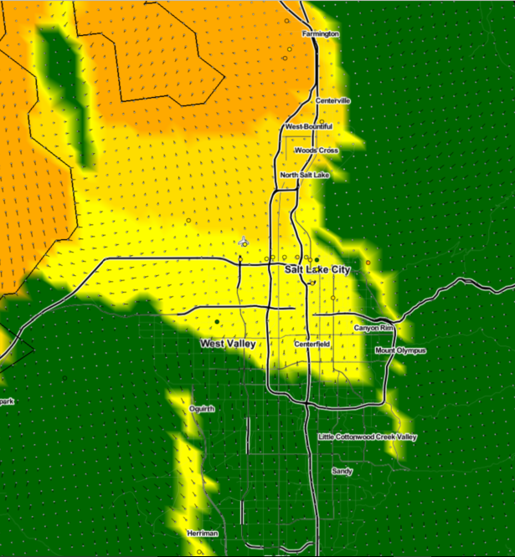
Objective analyses of ozone and wind near the surface: 18 June. Impact of lake breeze
Noon MDT
18 June
Case discussed further in the next talk by Brian Blaylock
Here: 1 km horizontal resolution surface analyses of ozone and vector wind

Slide 26
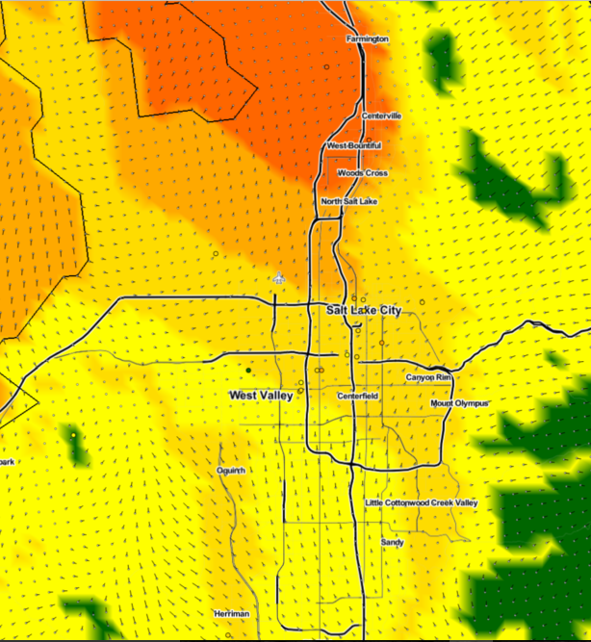
Objective analyses of ozone and wind near the surface: 18 June. Impact of lake breeze
1:00 PM MDT
18 June
Ca

Slide 27
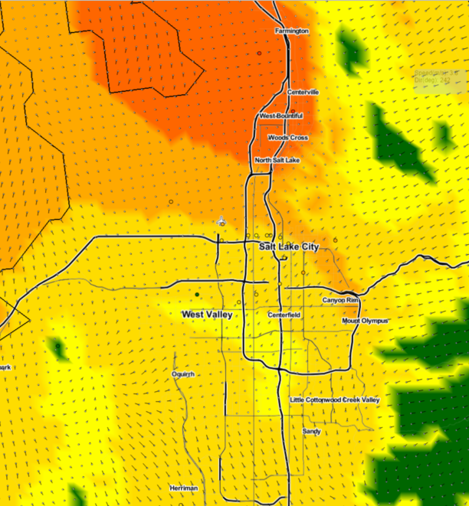
Objective analyses of ozone and wind near the surface: 18 June. Impact of lake breeze
2:00 PM MDT
18 June
Case

Slide 28
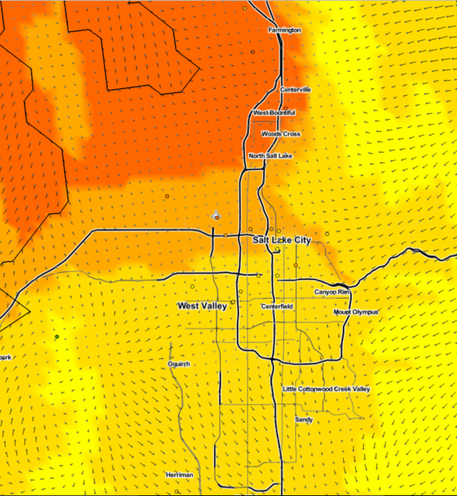
Objective analyses of ozone and wind near the surface: 18 June. Impact of lake breeze
3:00 PM MDT
18 June
Case

Slide 29
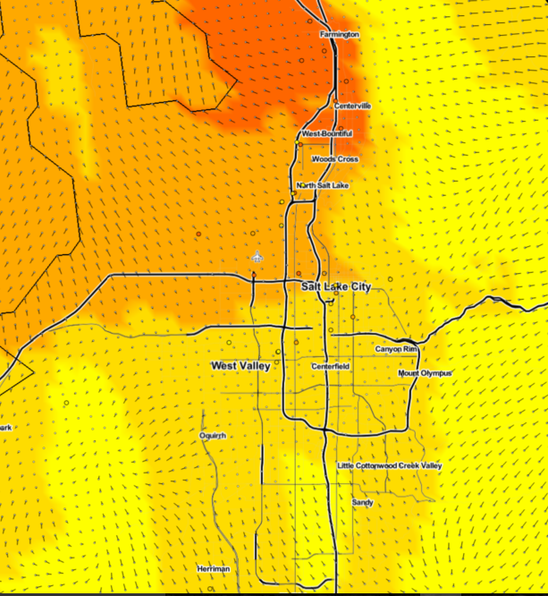
Objective analyses of ozone and wind near the surface: 18 June. Impact of lake breeze
4:00 PM MDT
18 June
Case

Slide 30
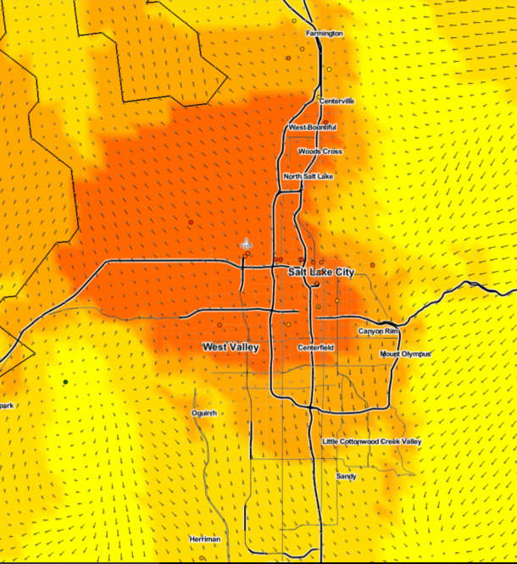
Objective analyses of ozone and wind near the surface: 18 June. Impact of lake breeze
5:00 PM MDT
18 June
Case

Slide 31
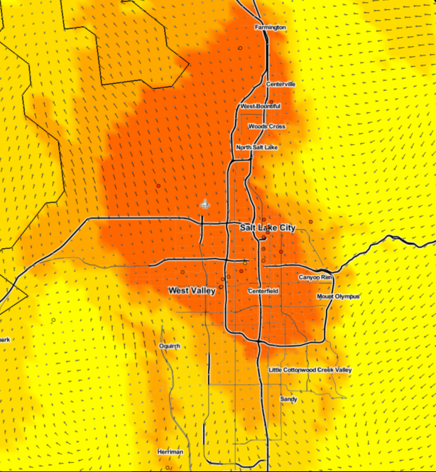
Objective analyses of ozone and wind near the surface: 18 June. Impact of lake breeze
6:00 PM MDT
18 June
Case

Slide 32
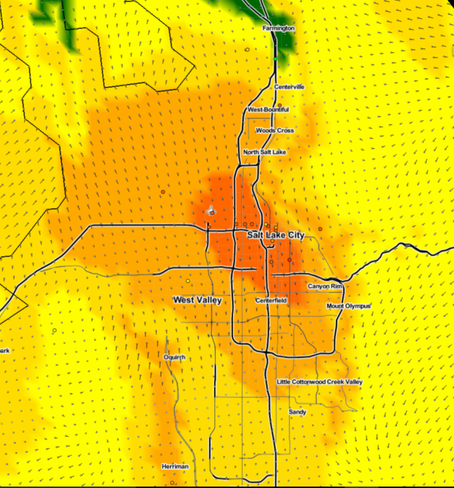
Objective analyses of ozone and wind near the surface: 18 June. Impact of lake breeze
7:00 PM MDT
18 June
Case

