Slide 1
Influence of Thermally-Driven Flows on
Summer Ozone Concentrations
John Horel, Erik Crosman, Alex Jacques, Brian Blaylock, Ansley Long
University of Utah
UofU: Luke Leclair-Marzolf, Sebastian Hoch, Will Howard, Jeff Jenkins, Allyson Dugan, Susan Bush, Xia Dong, Nola Lucke, Taylor McCorkle, Dillon Ulrich, Tom Gowan, Chris Galli, Fahad Alotaibi
Division of Air Quality: Seth Arens, Munkh Baassandorj
Utah State University: Randy Martin and group
Weber State University: John Sohl and group
Notes:
ABSTRACT
The Impact of the Great Salt Lake on Air Quality along the Wasatch Front
The Great Salt Lake plays an important role in modulating pollutant concentrations along Utah's heavily urbanized Wasatch Front. Great Salt Lake breezes can transport either clean or polluted air into the Wasatch Front depending on the meteorological conditions. In the summer of 2015, Researchers from the University of Utah, Utah State University, and Weber State University and the Utah Division of Air Quality examined the distribution of boundary-layer ozone in the vicinity of Utah's Great Salt Lake. The summertime study was the first to provide a detailed examination of the complex temporal and spatial variations in boundary-layer ozone in the region and the impacts of thermally-driven Great Salt Lake breezes on summertime pollution transport into the Salt Lake Valley. The data collected as part of this study is relevant to understanding the potential impact of the more stringent ozone standards proposed by the EPA throughout the western United States. An overview of pollutant transport into the Salt Lake Valley by Great Salt Lake breezes will be presented, with a focus on the findings from the 2015 summertime ozone study.

Slide 2
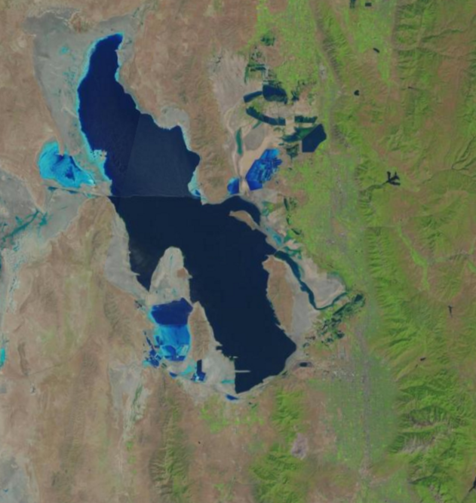
Why is summer ozone a concern in Utah?
Great Salt Lake
Health effects
Background ozone levels in West are high and will likely increase
State will be in non-attainment
Wasatch Front
Wasatch Mountains
Salt Lake
Valley

Slide 3
2015 Great Salt Lake Summer Ozone Study funded by Utah Division of Air Quality (DAQ)
Objectives:
Determine distribution of ozone near Great Salt Lake during summer
Examine meteorological processes that control ozone concentrations near the Lake to improve ozone forecasts by DAQ

Slide 4
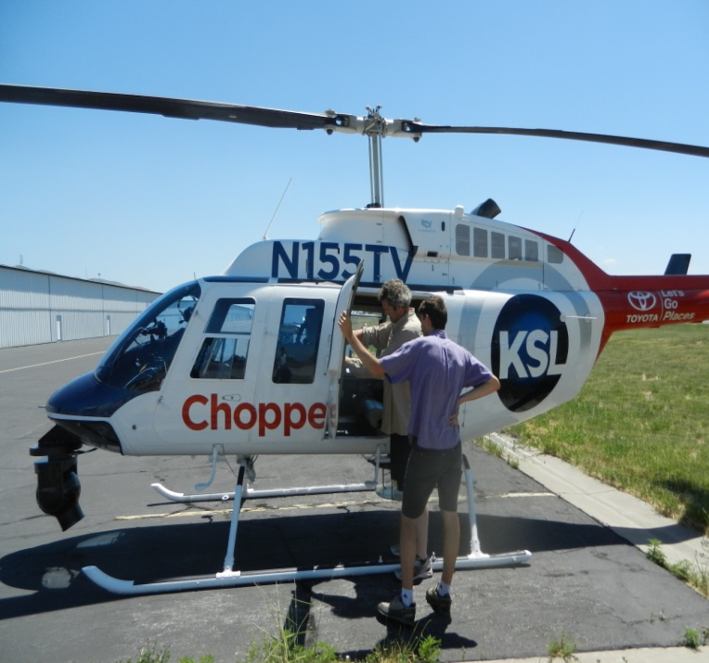
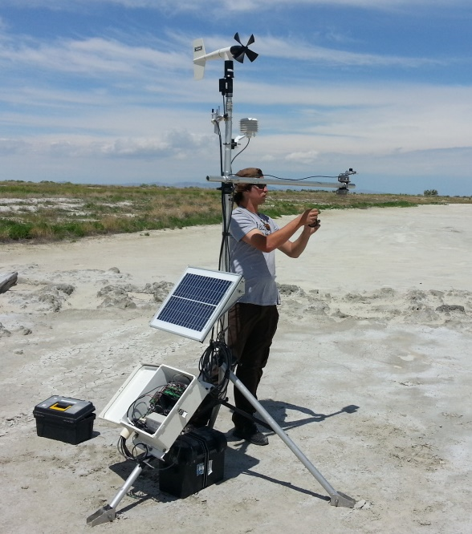
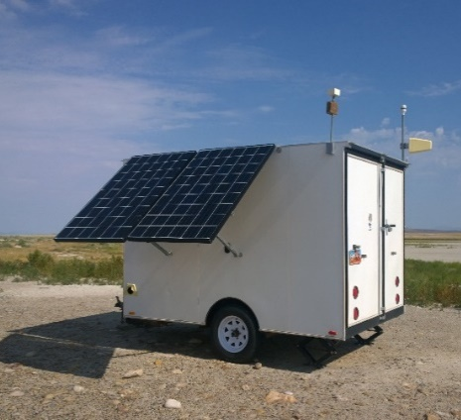
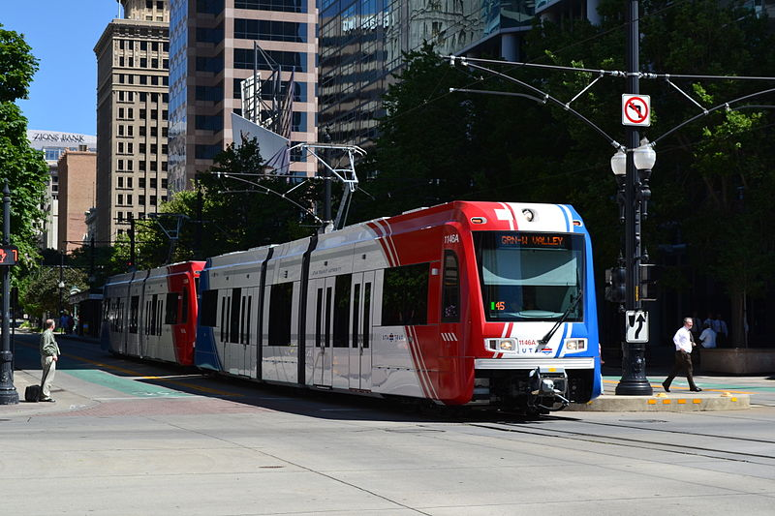
Observational Assets: JJA 2015
26 permanent and seasonally deployed ozone monitors
Ozone sensors on:
vehicles
.
KSL helicopter
& field campaign met sensors
.
meso2.chpc.utah.edu/gslso3s/
Notes:
During last year’s summer filed study, we deployed all sorts of instrumentation to measure weather conditions and ozone concentrations.
Two dozen ozone monitors deployed by Utah’s DAQ,
Surface Observations through MesoWest
TDWR (specifically looking at radial velocities)
And two unique mobile ozone observation platforms
4) The KSL News Helicopter—We get ozone observations wherever it flies, usually several times in a week. Alex Jacques has a poster about that Friday.
5) Some of you may have ridden TRAX. We have instruments including an ozone monitor on the roof of one of the trains. Logan Mitchell will talk about those observations tomorrow.
I show some of these observations, just know that this was part of a much bigger field study.
These observations and more are available online

Slide 5
16-30 June 2015
Ridging aloft
Highest ozone concentrations of summer
Local processes dominate
Analysis and simulation of impact of lake breeze:
B. Blaylock, M.S. thesis
Blaylock et al. (2016, submitted)
Two-week composites illustrating aggregate effects of thermally-driven flows
A. Long, M.S. thesis
Notes:
During last year’s summer filed study, we deployed all sorts of instrumentation to measure weather conditions and ozone concentrations.
Two dozen ozone monitors deployed by Utah’s DAQ,
Surface Observations through MesoWest
TDWR (specifically looking at radial velocities)
And two unique mobile ozone observation platforms
4) The KSL News Helicopter—We get ozone observations wherever it flies, usually several times in a week. Alex Jacques has a poster about that Friday.
5) Some of you may have ridden TRAX. We have instruments including an ozone monitor on the roof of one of the trains. Logan Mitchell will talk about those observations tomorrow.
I show some of these observations, just know that this was part of a much bigger field study.
These observations and more are available online

Slide 6
18 June lake breeze
Great Salt Lake
TDWR
KSLC
Wasatch Mtns.
Salt Lake Valley
Oquirrh Mtns.
Google Earth
Notes:
High ozone is often observed along the Wasatch mountain range in the summer, and it’s thought the Great Salt Lake plays a role in summer air quality.
Here’s a map of our study area…Notice the complex geography surrounding the Salt Lake Valley.
We deal with complex wind patterns influenced by the mountains and the Great Salt Lake. These winds in turn influence air pollution in the valley.

Slide 7
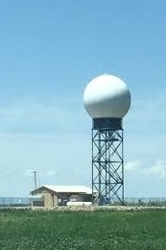
18 June lake breeze: TDWR radial velocity
TDWR
TDWR
TDWR
12:00 MDT
15:00 MDT
18:00 MDT
Full barb: 2 m s⁻¹
Notes:
These are a few snapshots from that video.
The left panel, 1800 UTC, you can see strong southerly winds holding the lake breeze, which contributed to the later propagation of the lake breeze. These southerly winds also contribute to strong frontogenesis evident in the later times.
In the center panel, 2100 UTC, the lake breeze begins to move south into the valley
And afterwards, accelerates and with a single pulse fills the valley after with a clearly defined lake breeze front shown at 0000 UTC.

Slide 8
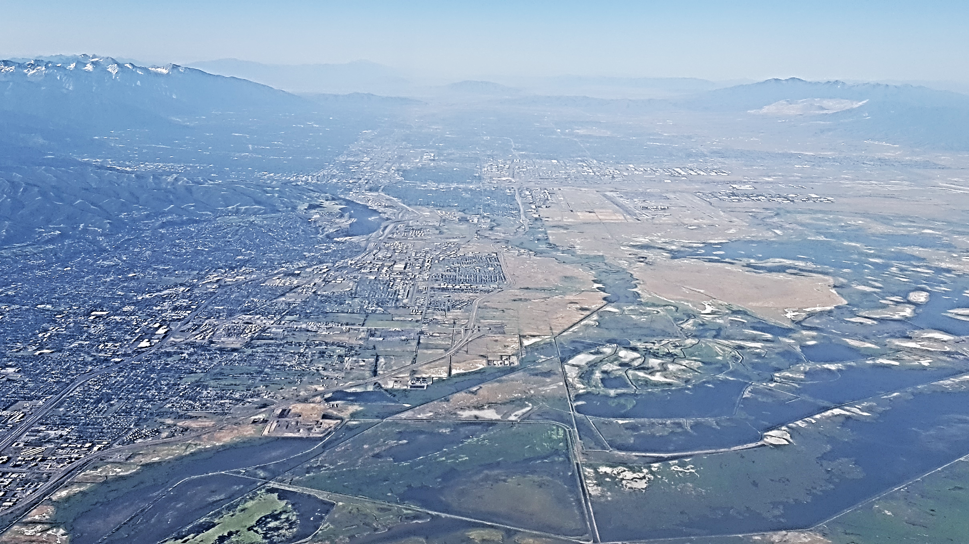
QHW
Salt Lake Valley
NAA
MTMET
Urban
S
Wetland
O3S02

Slide 9
Lake breeze transports high ozone into Salt Lake Valley: afternoon 18 June 2015
O3S02
MTMET
QHW
NAA
6:00 12:00 18:00 0:00
MDT
UTC
Notes:
Now let me take you back to last June 18th, just over a year ago.
These are the ozone observations on that day at those four sites.
First, notice the orange line. This is the site nearest the lake. Ozone concentrations here were highest just afternoon.
Concentrations at the sites in the valley didn’t see those high values until later in the day
Ozone was relatively consistent between noon an 2200 UTC followed by a sharp 20 ppb increase.
This is interesting. What would cause ozone in the Salt Lake Valley to suddenly spike to unhealthy levels?
We’ll take a look at the winds on this day to do what happened…

Slide 10
18 June 2015
KSL Chopper
TDWR Front
O3S02
Observation Details
Mobile obs. between
16:40-17:40 MDT
TRAX plotted every 3-min
KSL copter plotted every 30-sec
MesoWest obs ending at 17:40 MDT
Frontal position at
17:12 MDT
Time copter crosses front
QSA
MTMET
NAA
QHW
FWP
S2OZN
QH3
Full barb: 2 m s⁻¹
Notes:
This is a map shows all the observations in the afternoon.
The squares are the stationary ozone observation sites we have already looked at,
wind barbs show winds,
Diamonds show observations from the TRAX train some of you have between here and the airport.
The circles are the KSL helicopter, which luckily flew a course bisecting the valley and crossed the lake breeze front.
We also see in the helicopter data that ozone concentrations were higher within the lake breeze air.

Slide 11
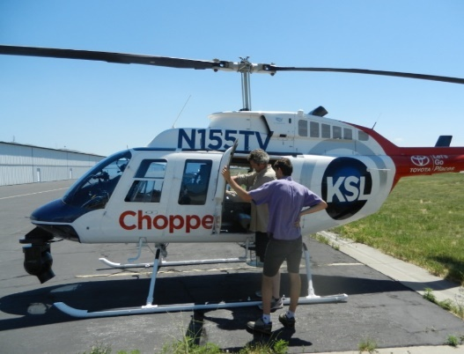
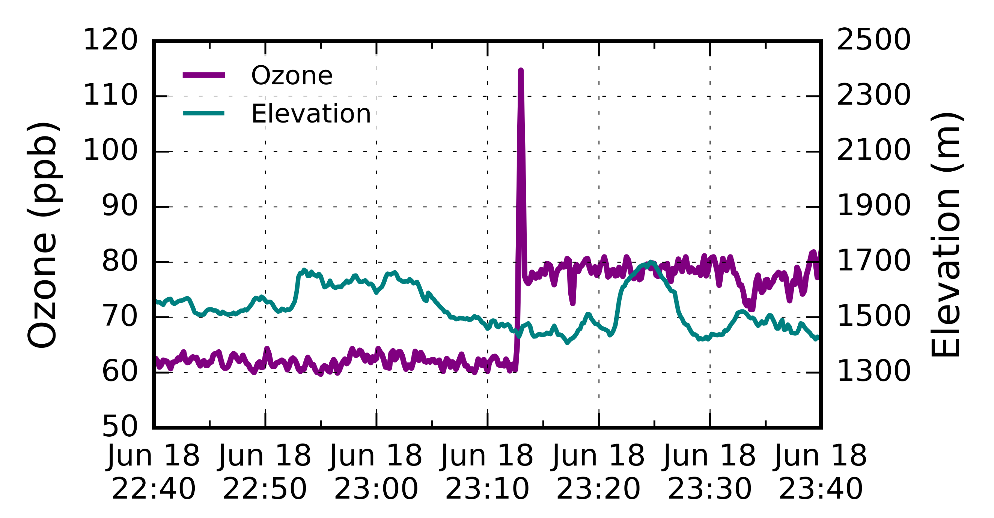
Helicopter travelling north through lake breeze front
Lake breeze head
Surface
16:40 17:00 17:20 17:40
MDT
Notes:
Now, if you follow me, I’m going to turn the helicopter data sideways…
…and look at a time series of ozone during the flight.
Ozone is in purples, helicopter elevation is in teal.
At the south end of the valley, ozone hovers around 60 ppb. Which is consistent with the surface observation before the lake breeze passage.
As the helicopter flew north, it crossed the lake breeze front and ozone spiked to over 100 ppb.
We believe this is the lake breeze head where pollutants have been packed together by convergence.
Then as the helicopter continued north ozone stabilized at 80 ppb.
These helicopter observations and the surface ozone monitors showed that ozone within the lake breeze were 20 ppb higher than observed before the lake breeze passed.

Slide 12
Hourly 1 km 2-D variational analyses vector wind and ozone concentrations
Tyndall and Horel (2013, WAF)
10-m vector wind
Background from 1 h High Resolution Rapid Refresh (HRRR) forecasts
Adjust background by all available surface wind observations
Ozone concentration
Background from statistical fits to subsets of fixed-site sensor data (rural, lakeshore, urban)
Adjust background by all available ozone observations (fixed and mobile sensors)

Slide 13
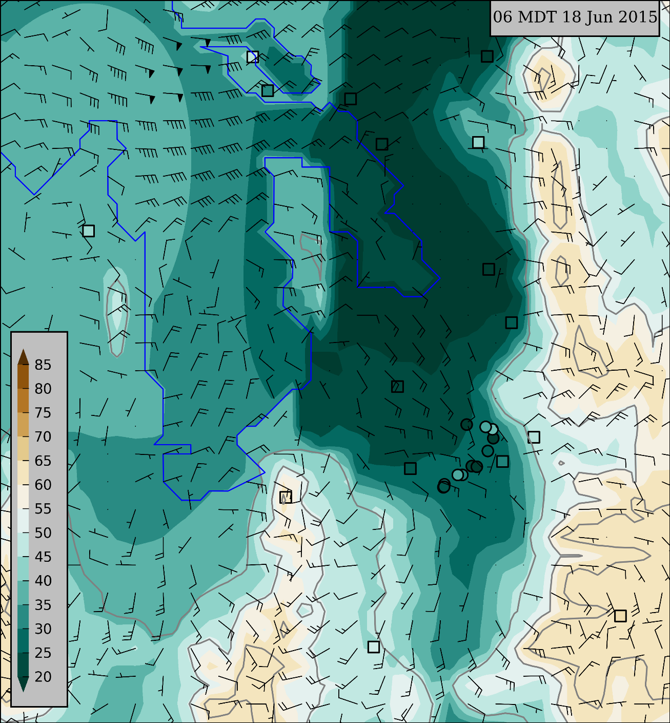
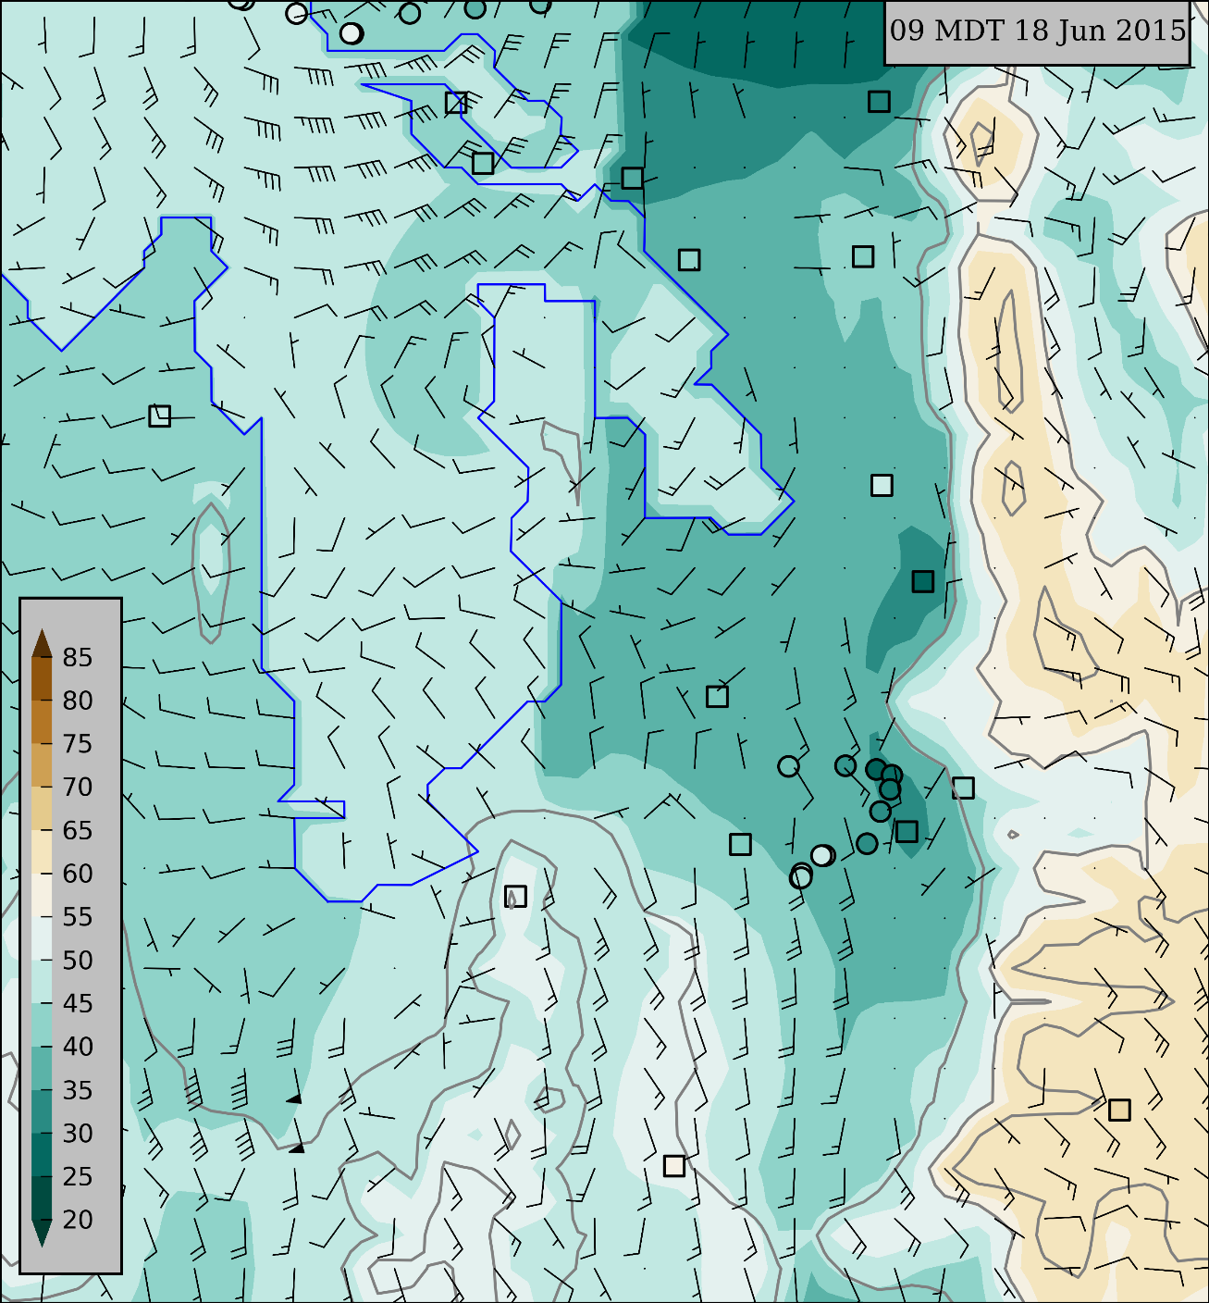
18 June lake breeze case: 6 & 9 MDT
High
ozone
ppb
Low
ozone
Full barb 2 m s⁻¹

Slide 14
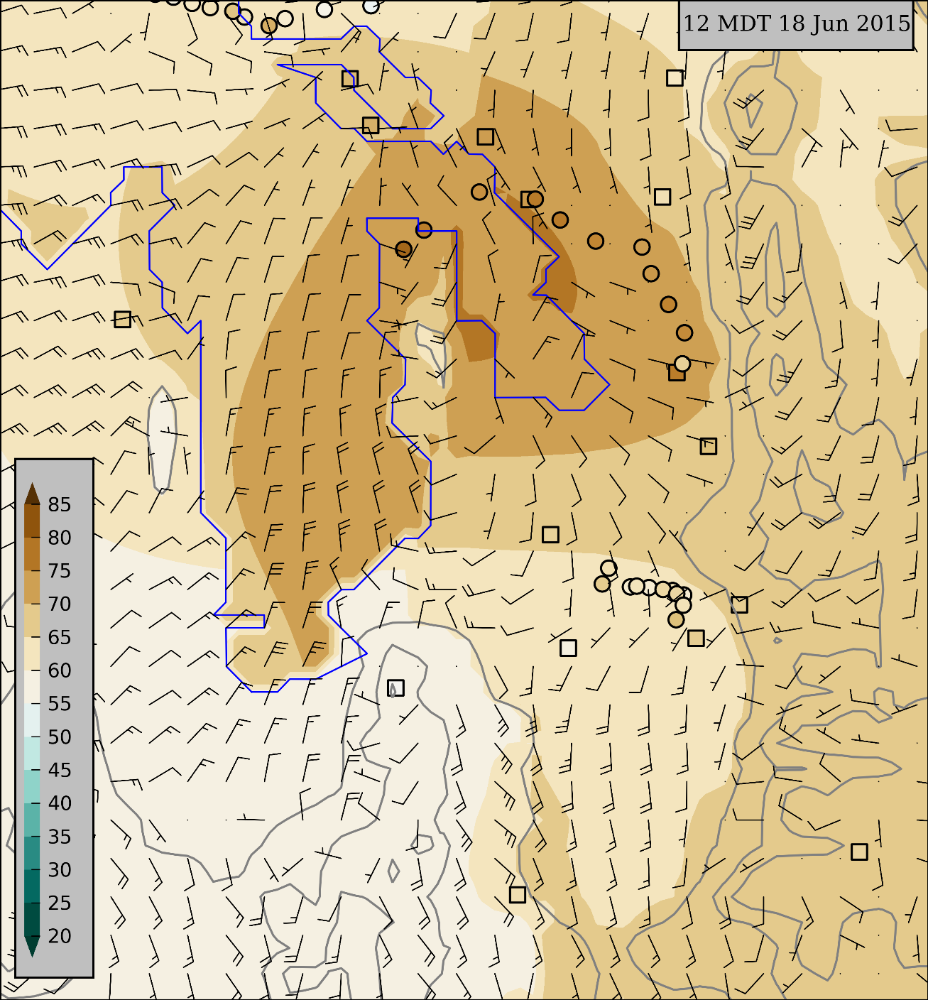
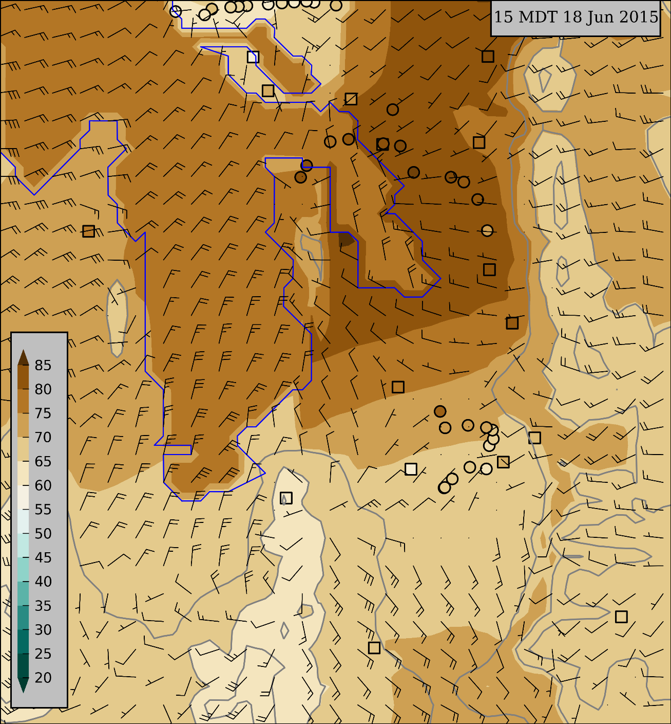
18 June lake breeze case: 12 & 15 MDT
High
ozone
ppb
Low
ozone
Full barb 2 m s⁻¹

Slide 15
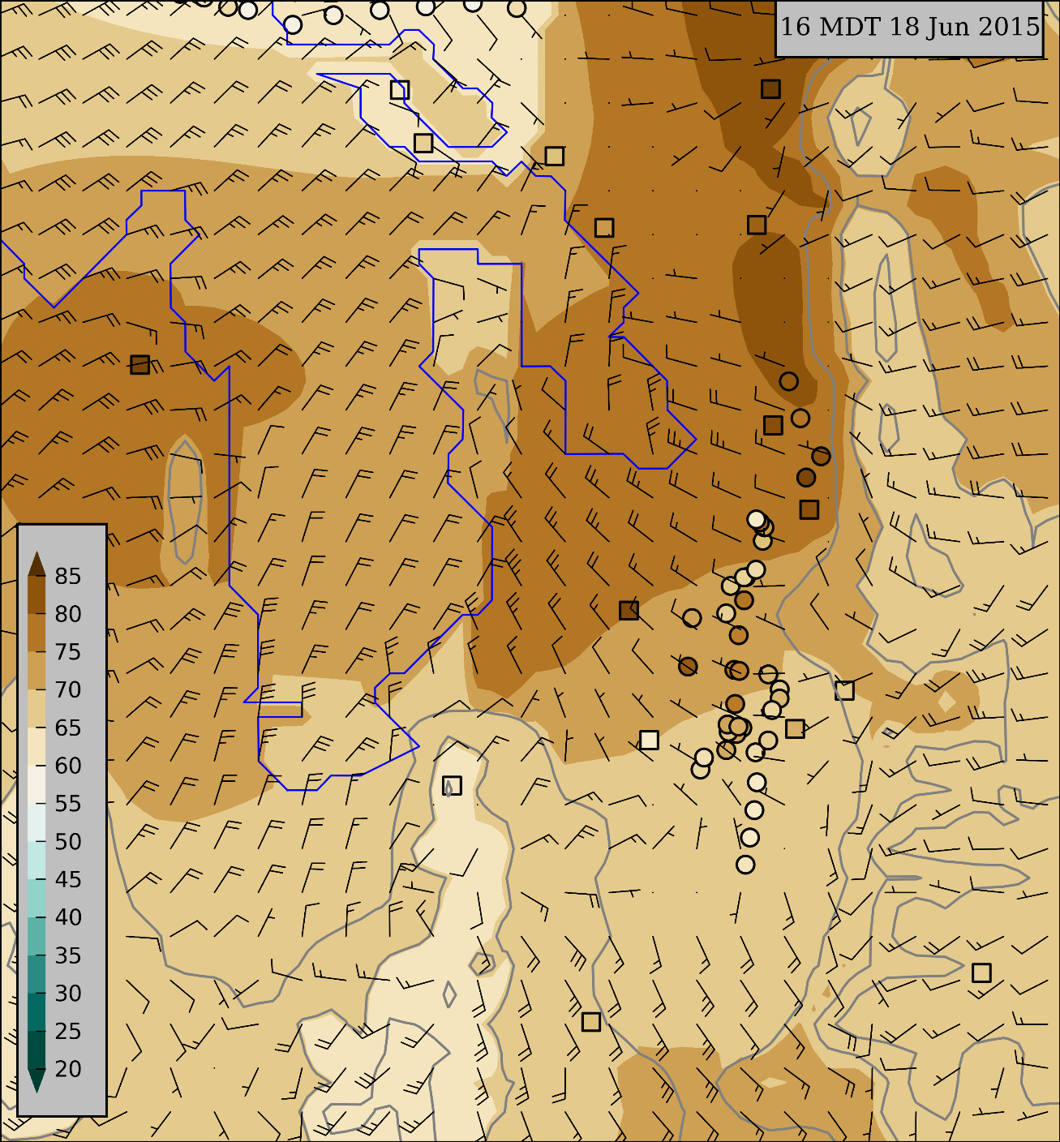
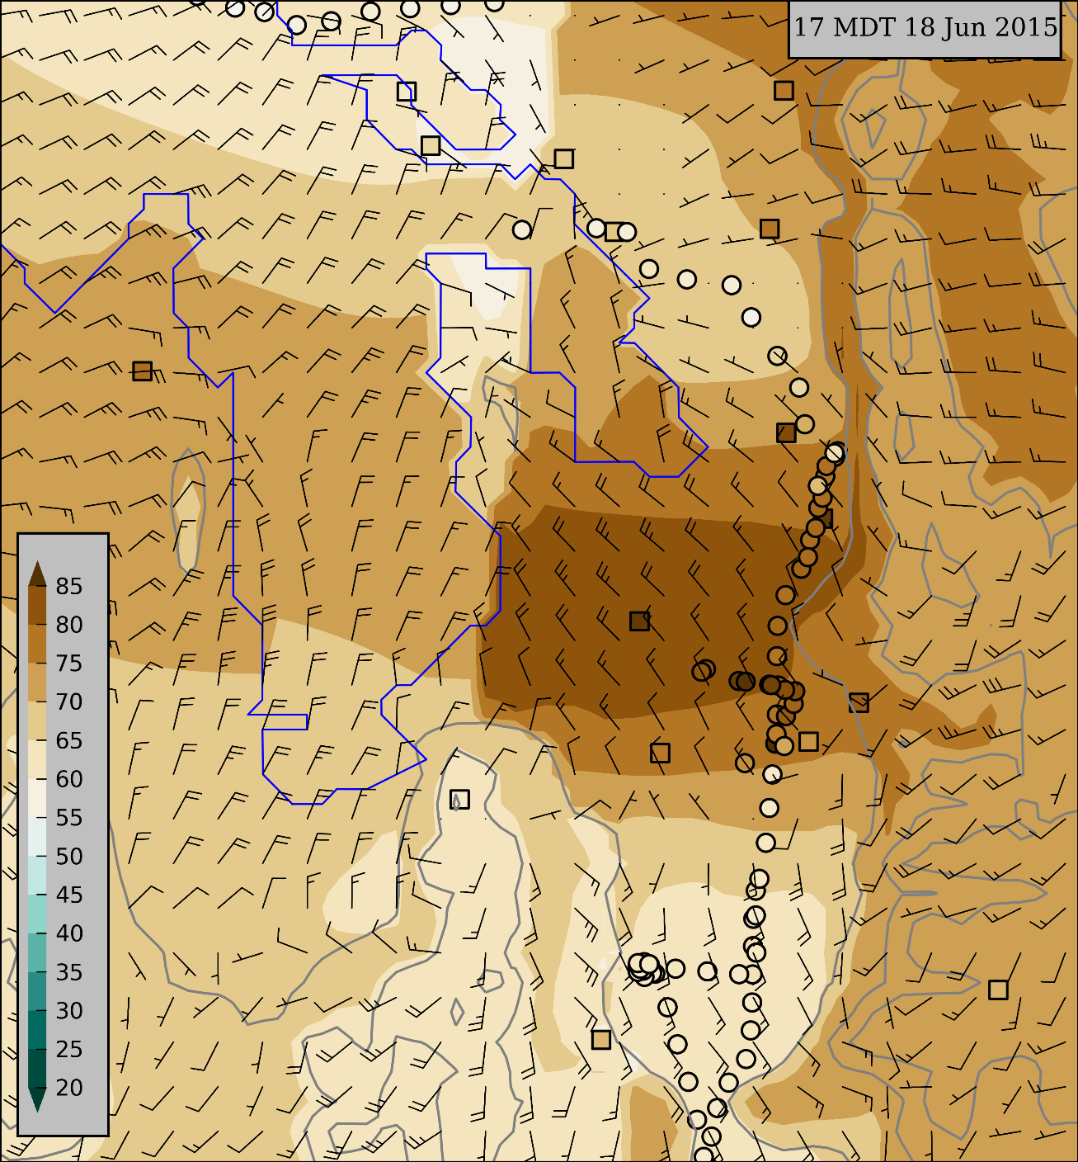
18 June lake breeze case: 16 & 17 MDT
High
ozone
ppb
Low
ozone
Full barb 2 m s⁻¹

Slide 16
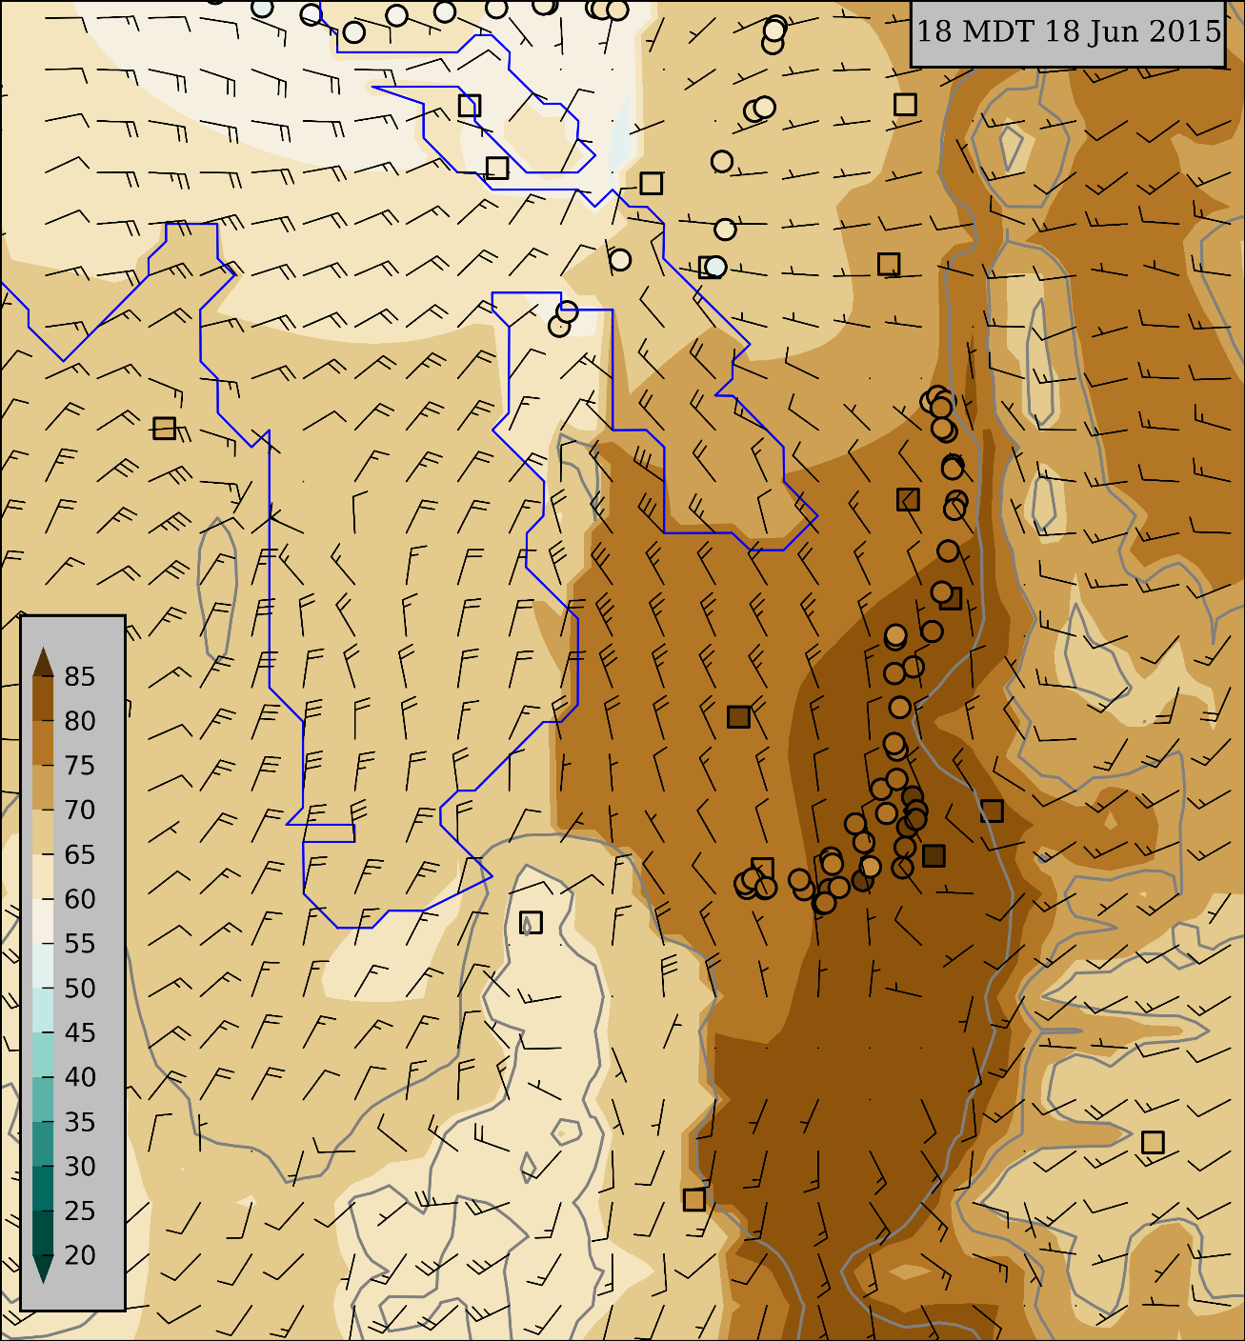
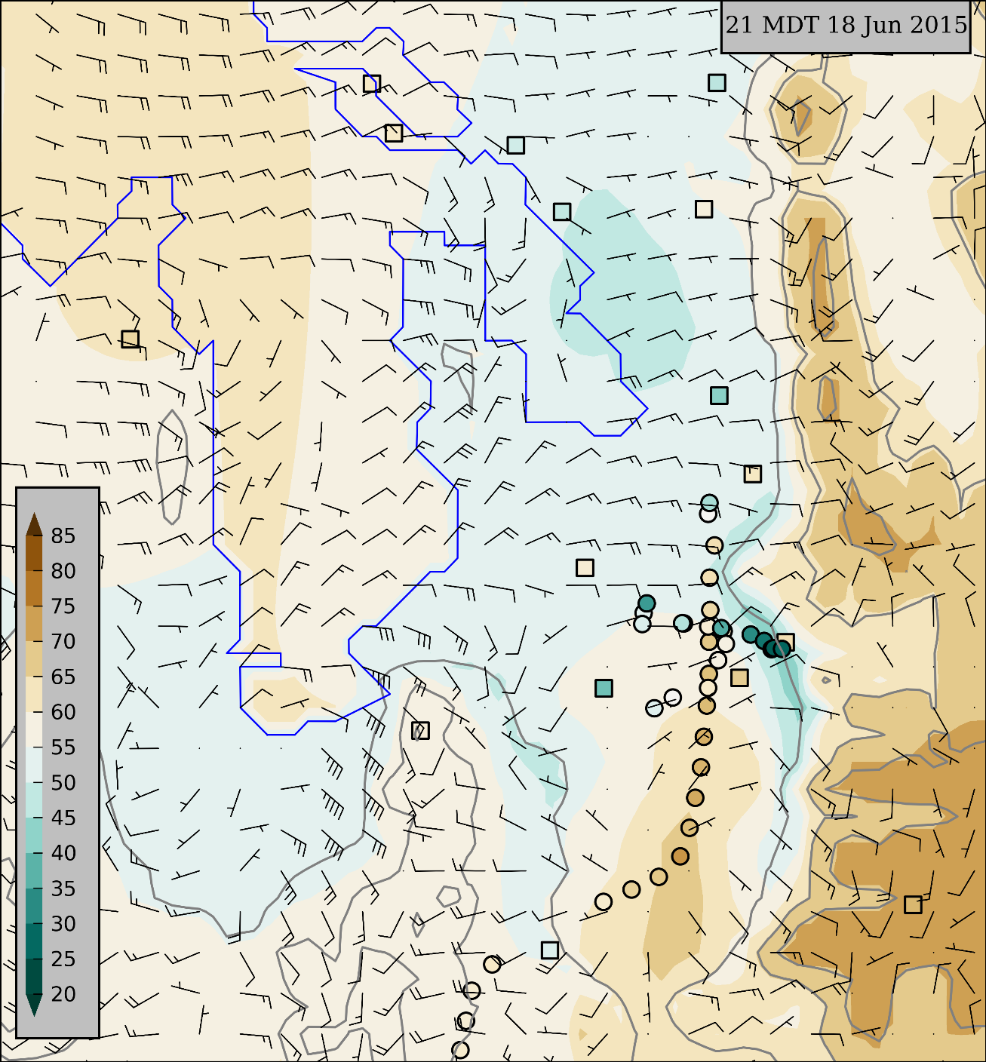
18 June lake breeze case: 18 & 21 MDT
High
ozone
ppb
Low
ozone
Full barb 2 m s⁻¹

Slide 17
Composites: 16-30 June 2015
Two-week composites illustrating aggregate effects of thermally- driven flows
Averages within 3-h blocks of hourly analyses at 1 km resolution of 10-m vector wind and ozone concentration
Notes:
During last year’s summer filed study, we deployed all sorts of instrumentation to measure weather conditions and ozone concentrations.
Two dozen ozone monitors deployed by Utah’s DAQ,
Surface Observations through MesoWest
TDWR (specifically looking at radial velocities)
And two unique mobile ozone observation platforms
4) The KSL News Helicopter—We get ozone observations wherever it flies, usually several times in a week. Alex Jacques has a poster about that Friday.
5) Some of you may have ridden TRAX. We have instruments including an ozone monitor on the roof of one of the trains. Logan Mitchell will talk about those observations tomorrow.
I show some of these observations, just know that this was part of a much bigger field study.
These observations and more are available online

Slide 18
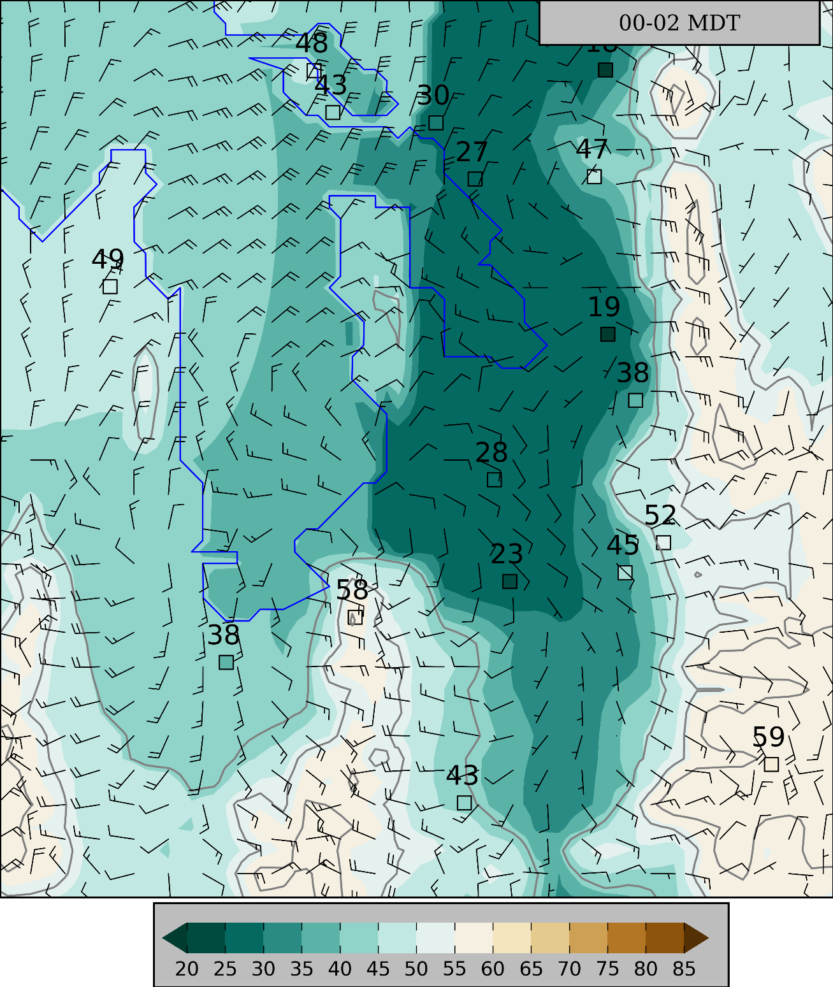
Midnight – 2 AM MDT
Low ozone concentrations in urban corridor
Moderate ozone levels over Oquirrh and Wasatch Mountains
Nocturnal drainage flows
Easterly winds across central Lake
Full barb 2 m s⁻¹

Slide 19
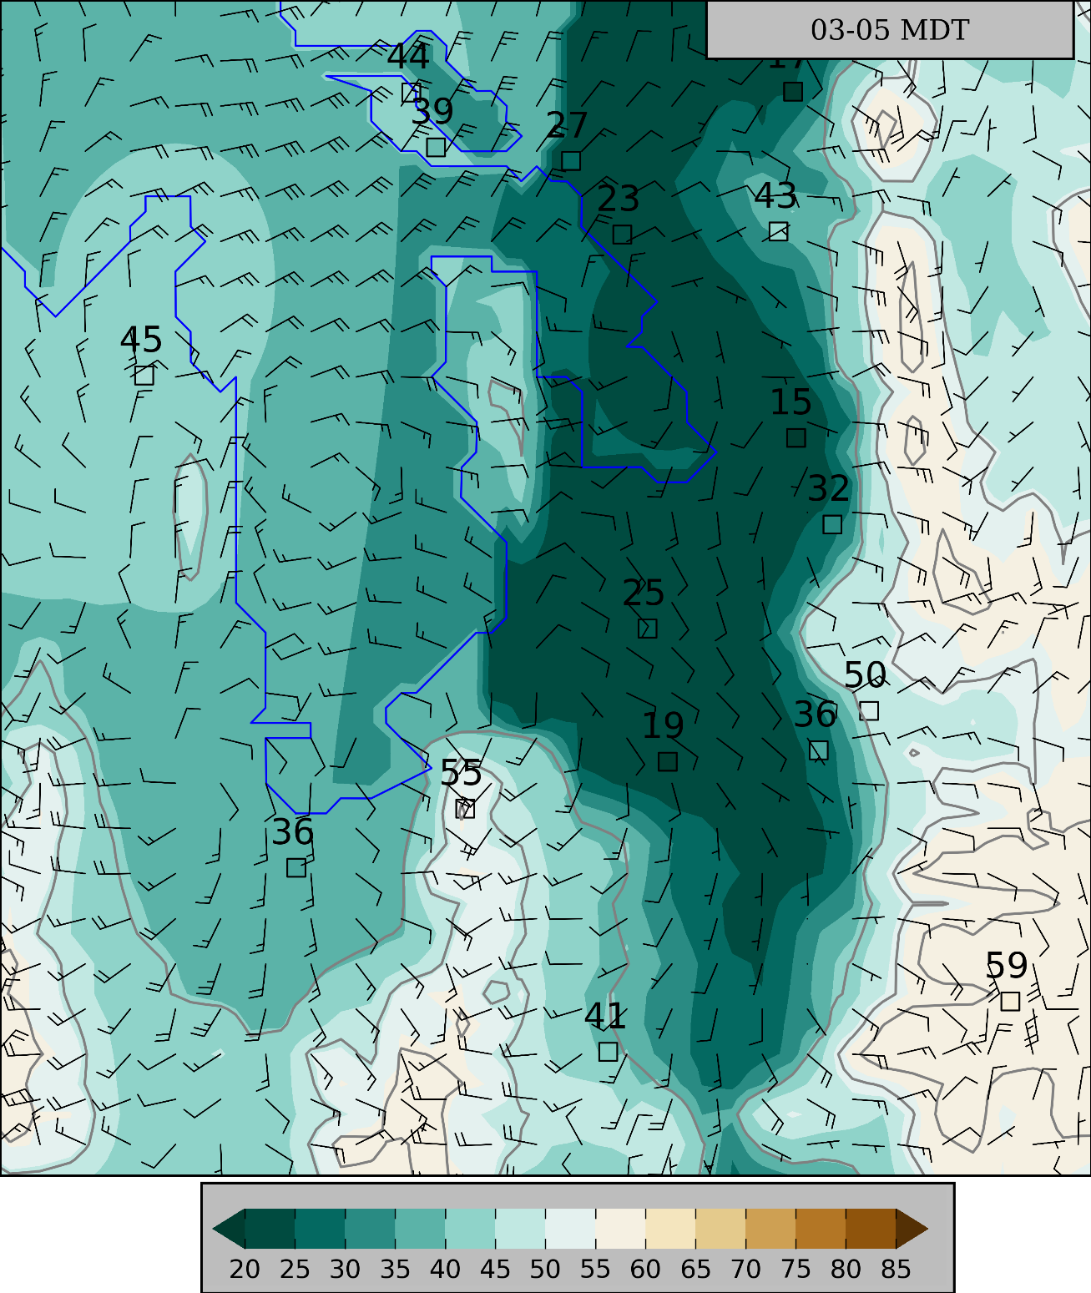
3 – 5 AM MDT
Lowest ozone levels resulting from nocturnal titration in urban corridor & wetlands southeast of the Lake
Easterly winds across central Lake continue
Full barb 2 m s⁻¹

Slide 20
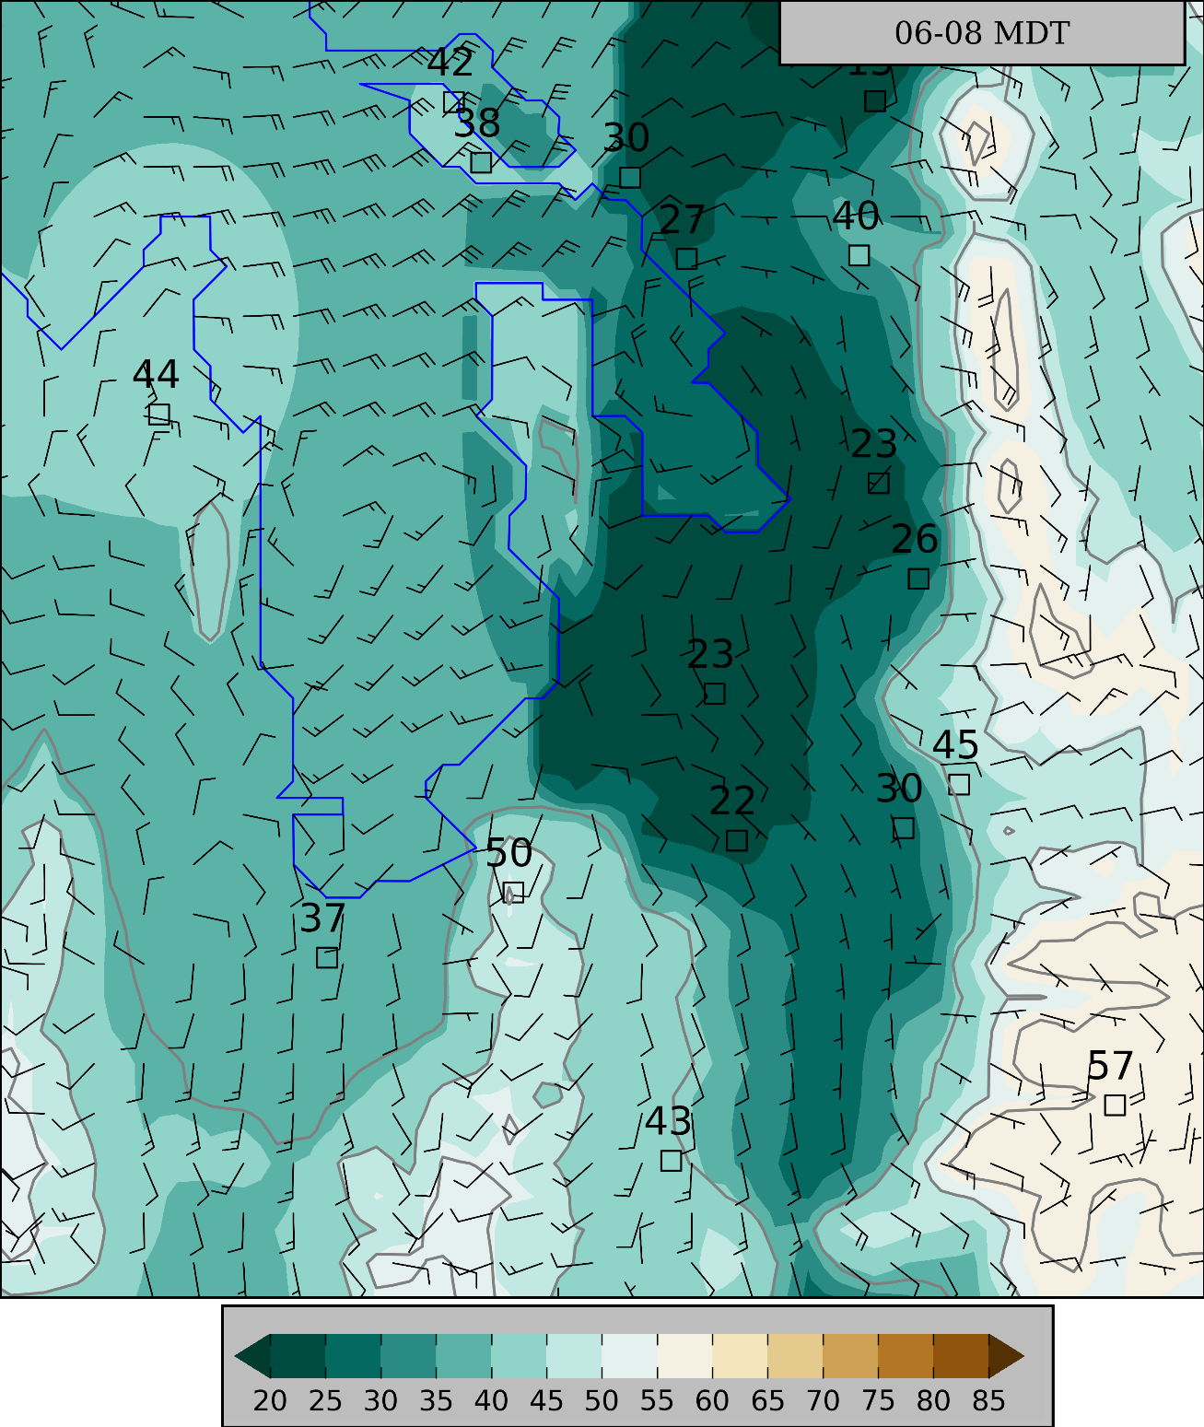
6 – 8 AM MDT
Full barb 2 m s⁻¹

Slide 21
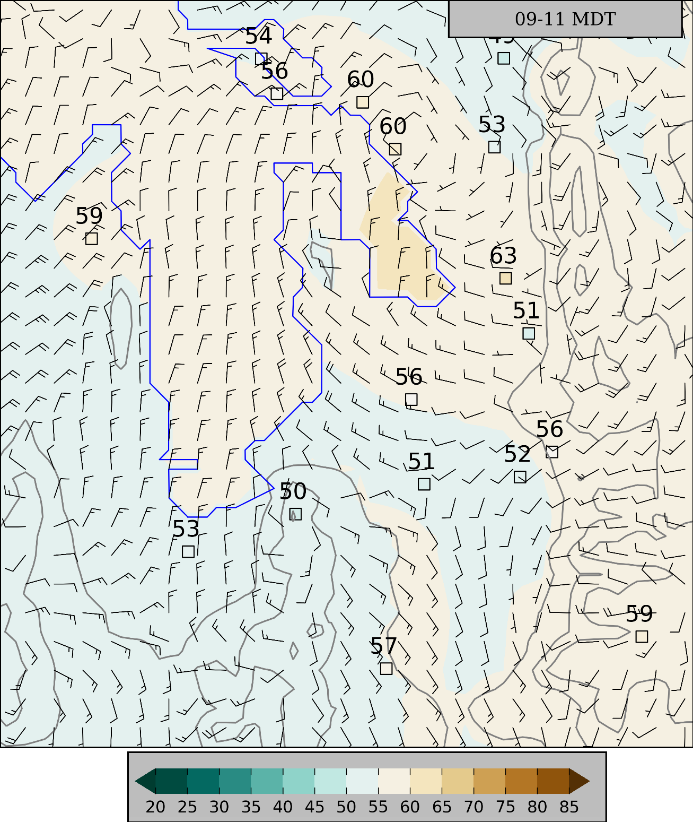
9 – 11 AM MDT
Increasing ozone levels east/southeast of the Lake with highest concentrations in wetlands
Lake breezes developing to east and south of Lake
Full barb 2 m s⁻¹

Slide 22
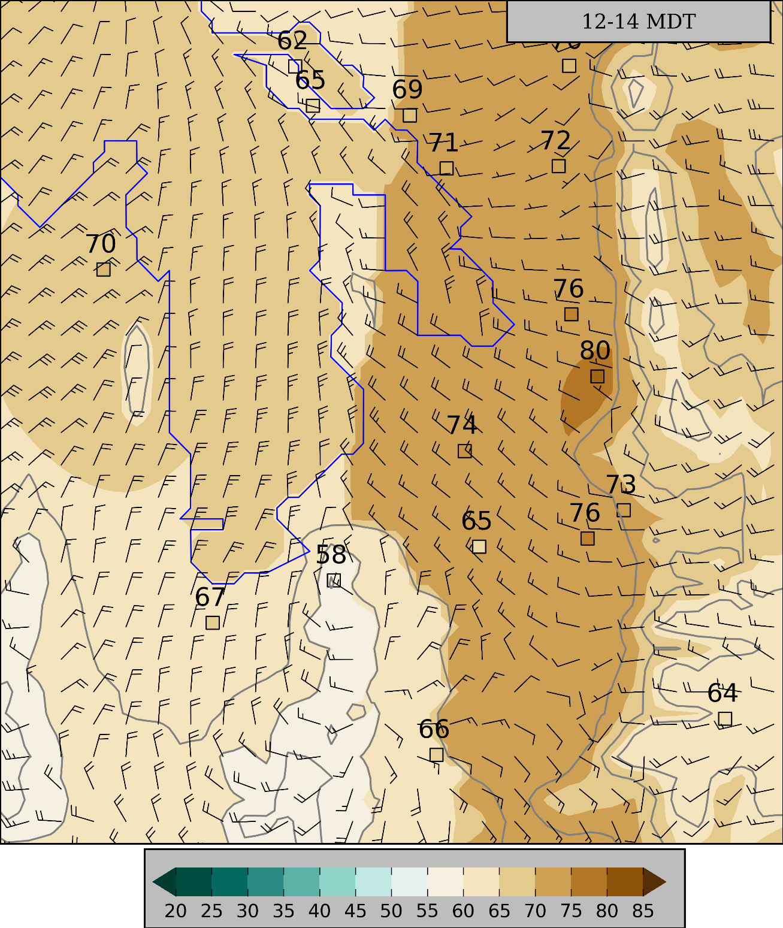
Noon – 2 PM MDT
Highest ozone levels east/southeast of the Lake
Lake breezes penetrating southward
Full barb 2 m s⁻¹

Slide 23
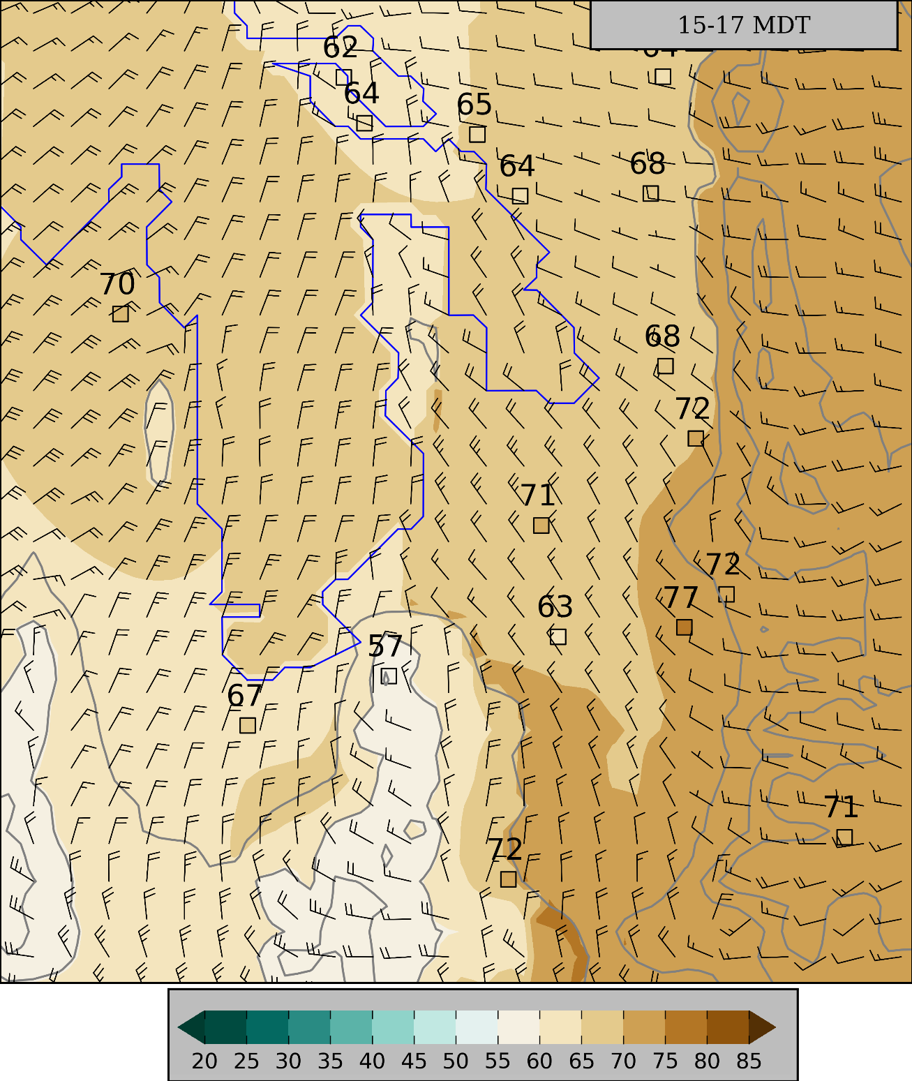
3 – 5 PM MDT
Higher ozone levels in southern Salt Lake Valley
Higher ozone levels in Wasatch than Oquirrhs
Full barb 2 m s⁻¹

Slide 24
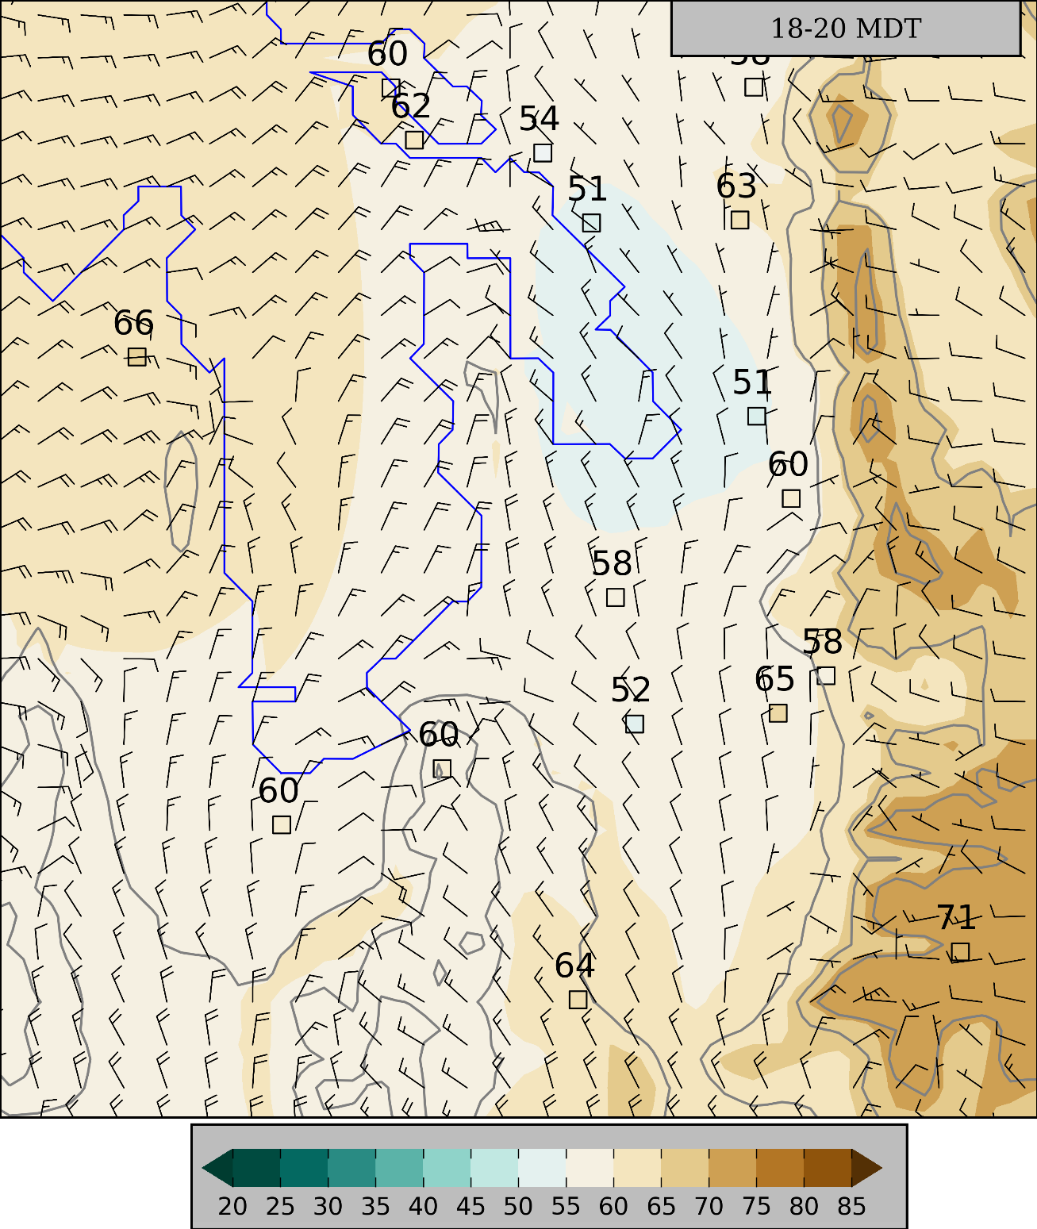
6 – 8 PM MDT
Highest ozone concentrations in Wasatch
Full barb 2 m s⁻¹

Slide 25
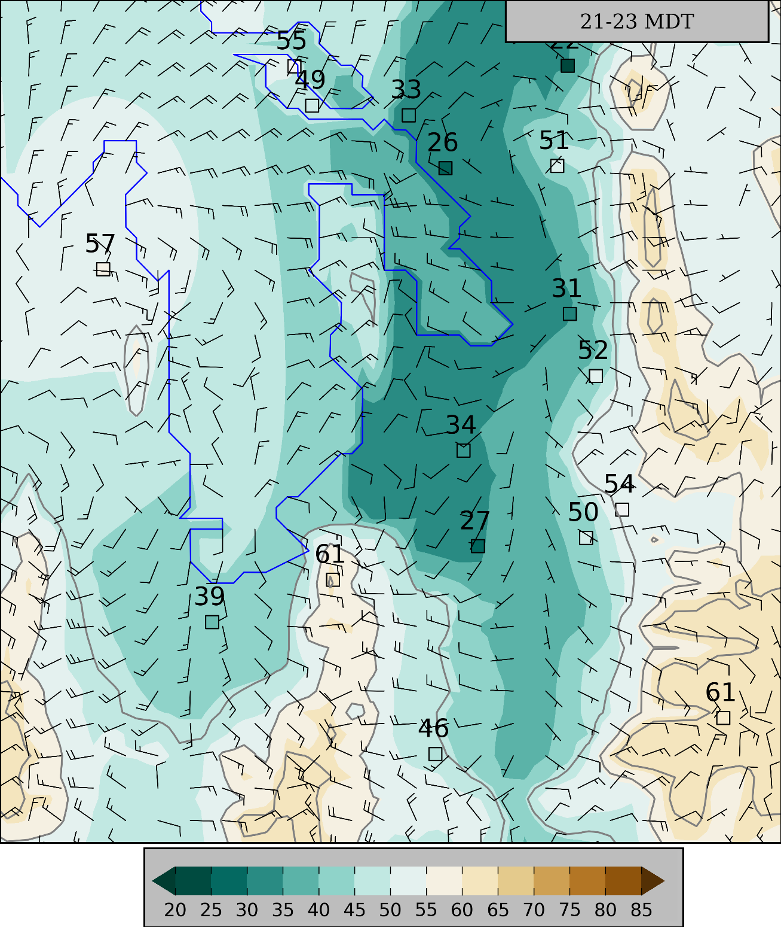
9 – 11 PM MDT
Higher ozone concentrations in mountains and “benches”
Nocturnal flows developing
Full barb 2 m s⁻¹

Slide 26
Summary
Utilized existing infrastructure, temporary deployments, and sensors on diverse mobile platforms to monitor ozone concentrations
Case studies in June (lake breeze) and August (distant wildfires) highlight the diverse processes affecting ozone levels along the Wasatch Front
Ozone pollution roses and 15-day composites illustrate the aggregate effects of local thermally-driven circulations on ozone concentrations
Summer Ozone Concentrations in the Vicinity of the Great Salt Lake. Atmospheric Science Letters. Accepted. 2016. J. Horel, E. Crosman, A. Jacques, B. Blaylock, S. Arens, A. Long, J. Sohl, R. Martin
Impact of Lake Breezes on Summer Ozone Concentrations in the Salt Lake Valley. J. Appl. Meteor. Clim. Submitted. B. Blaylock, J. Horel, E. Crosman
Online info: meso2.chpc.utah.edu/gslso3s/
Further Info
Notes:
To conclude, we hope you take these points home with you…
Ozone is bad, and hopefully you realize that residents on the WF are exposed to unhealthy levels through the summer.
.
.
.
.

Slide 27
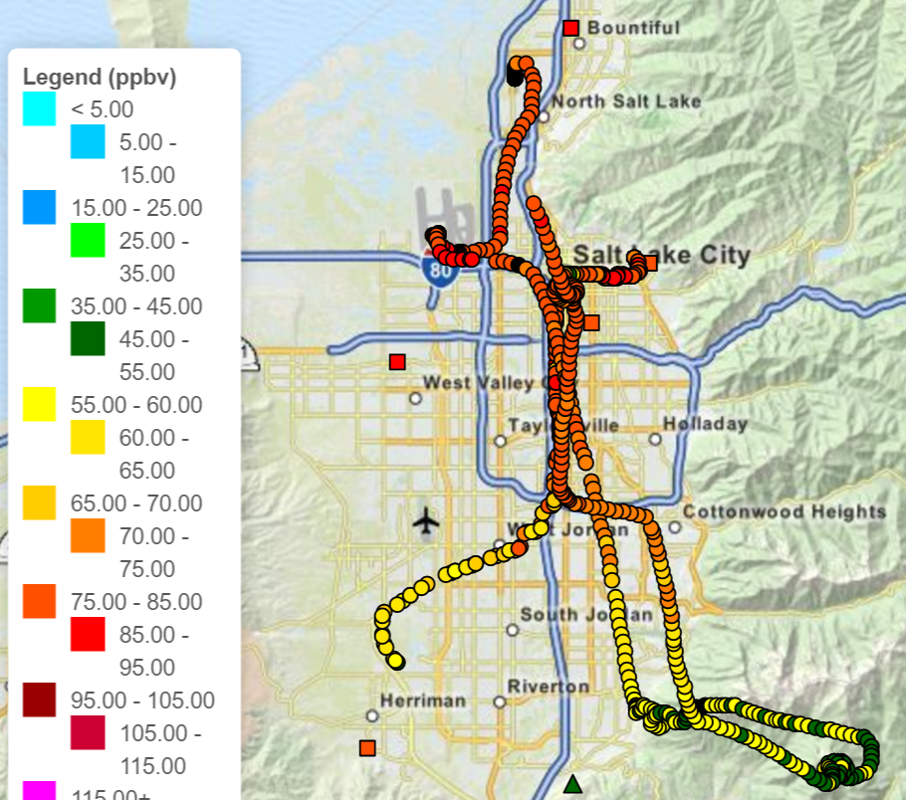
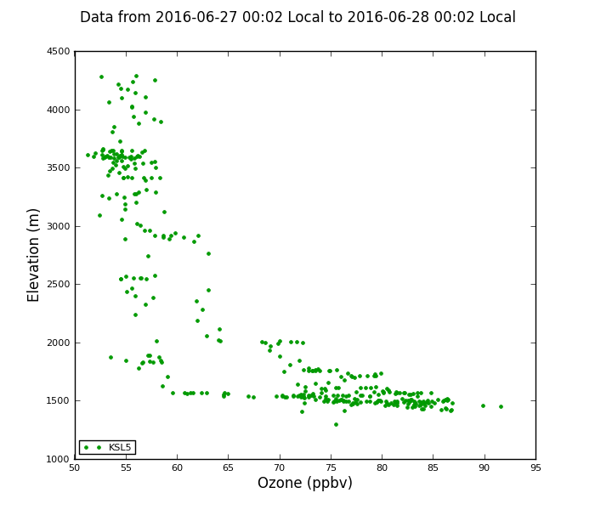
Ongoing Work
Mon, 27 June 2016
Ozone and PM2.5 sensors onboard 2 TRAX cars and KSL copter
Observations available in real-time
Clear need for field campaigns/modeling to improve understanding of air quality in urban valleys and basins during summer as well as winter
Future Work
Notes:
To conclude, we hope you take these points home with you…
Ozone is bad, and hopefully you realize that residents on the WF are exposed to unhealthy levels through the summer.
.
.
.
.

Slide 28
Daily 8-h Maximum Ozone in Salt Lake Valley (Hawthorne) during summer
Wildfire Smoke
Synoptic Ridge

Slide 29
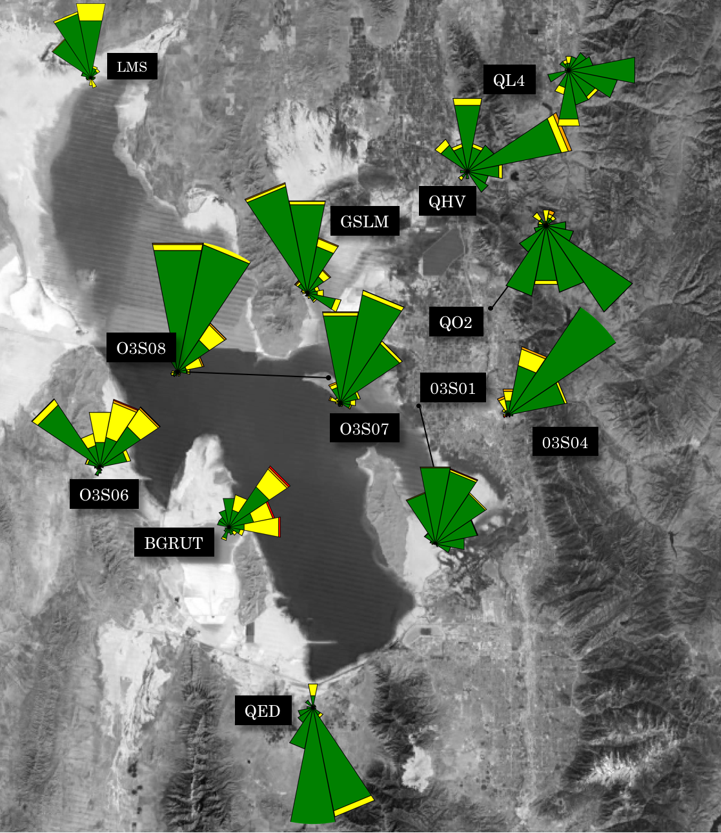
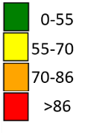
16-30 June: ozone pollution roses
Night: 8 PM- 8 AM MDT
ppb
Day: 8 AM- 8 PM MDT
Percentage of time ozone concentrations in ranges as function of wind direction
Notes:
During last year’s summer filed study, we deployed all sorts of instrumentation to measure weather conditions and ozone concentrations.
Two dozen ozone monitors deployed by Utah’s DAQ,
Surface Observations through MesoWest
TDWR (specifically looking at radial velocities)
And two unique mobile ozone observation platforms
4) The KSL News Helicopter—We get ozone observations wherever it flies, usually several times in a week. Alex Jacques has a poster about that Friday.
5) Some of you may have ridden TRAX. We have instruments including an ozone monitor on the roof of one of the trains. Logan Mitchell will talk about those observations tomorrow.
I show some of these observations, just know that this was part of a much bigger field study.
These observations and more are available online

Slide 30
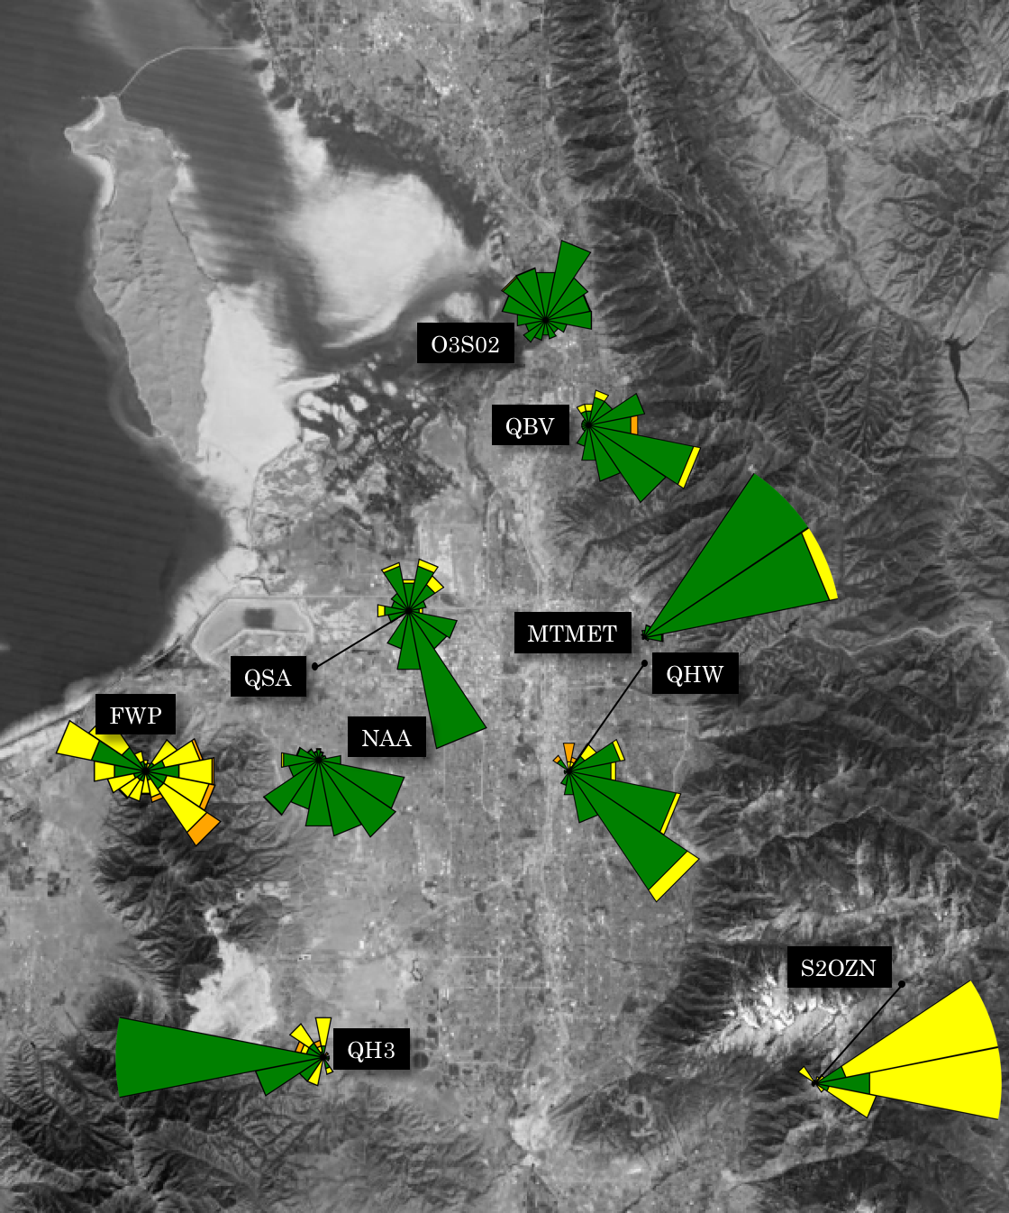
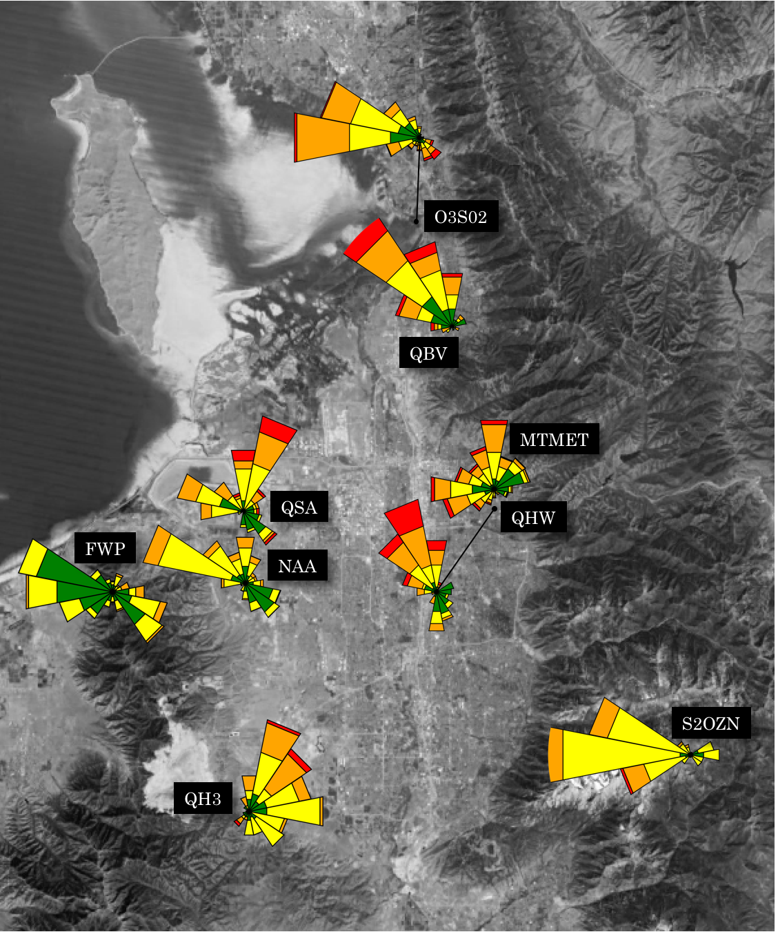
16-30 June: ozone pollution roses
ppb
Night: 8 PM- 8 AM MDT
Day: 8 AM- 8 PM MDT
Percentage of time ozone concentrations in ranges as function of wind direction
Notes:
During last year’s summer filed study, we deployed all sorts of instrumentation to measure weather conditions and ozone concentrations.
Two dozen ozone monitors deployed by Utah’s DAQ,
Surface Observations through MesoWest
TDWR (specifically looking at radial velocities)
And two unique mobile ozone observation platforms
4) The KSL News Helicopter—We get ozone observations wherever it flies, usually several times in a week. Alex Jacques has a poster about that Friday.
5) Some of you may have ridden TRAX. We have instruments including an ozone monitor on the roof of one of the trains. Logan Mitchell will talk about those observations tomorrow.
I show some of these observations, just know that this was part of a much bigger field study.
These observations and more are available online

