Slide 1
IOP 2 Summary
July 15-16, 2015
Wed-Thu
Website
WordPress Blog

Slide 2
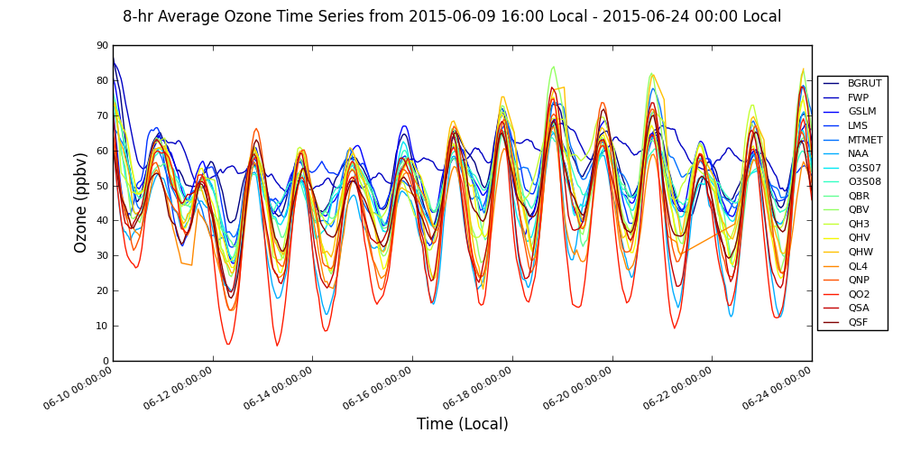
June 8-hr Ozone
Full Daily Description
IOP 1
10
11
12
13
14
15
16
17
18
19
20
21
22
23
24
DAQ SL County Forecast
Rain
Ridge/Trough
***High Lake Ozone/High Urban Ozone/High Marsh Ozone
Notes:
14 days of 8-hr ozone concentrations from the in-situ stations

Slide 3
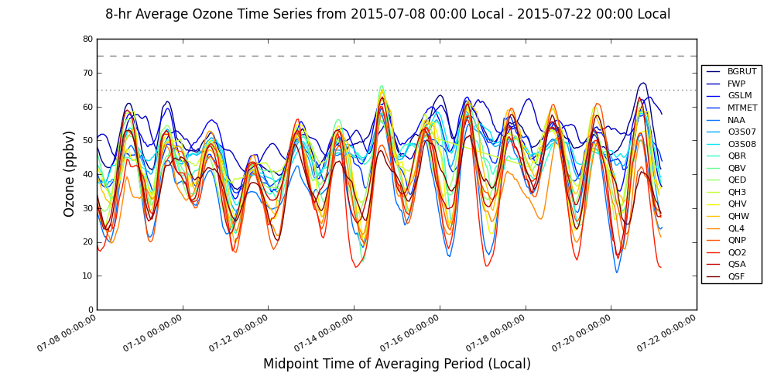
July 8-hr Ozone
Full Daily Description
IOP 2
*Midpoint averages
08
09
10
11
12
13
14
15
16
17
18
19
20
21
22
DAQ SL County Forecast
 |  |  |  | ?
Rain
Ridge/Trough
***High Lake Ozone/High Urban Ozone/High Marsh Ozone
Notes:
14 days of 8-hr ozone concentrations from the in-situ stations

Slide 4
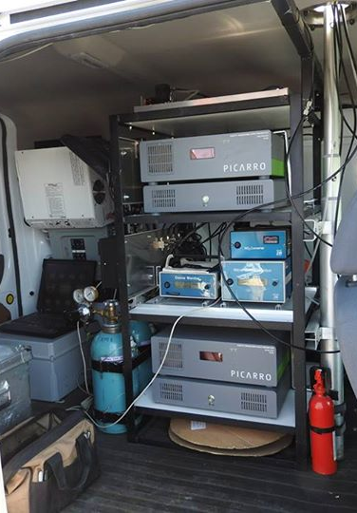
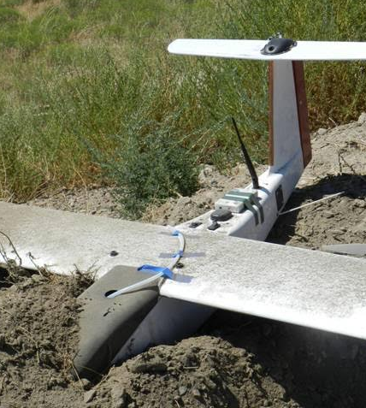
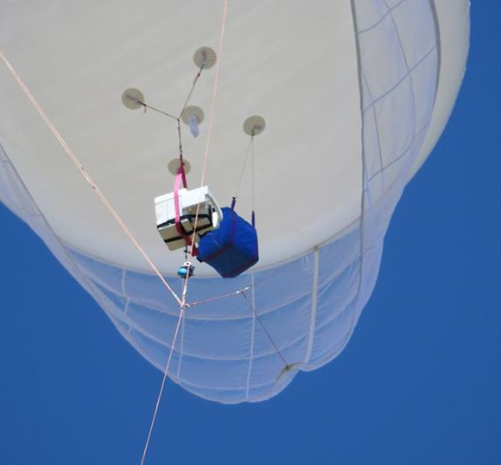
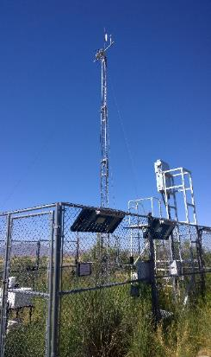
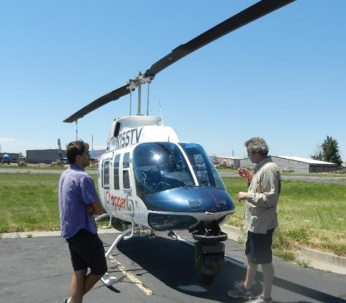
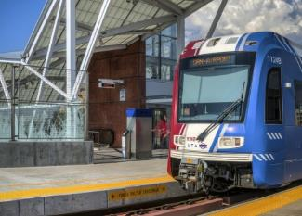
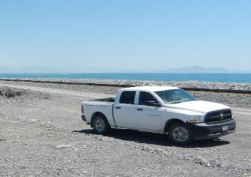
Operations IOP 2
Nerdmobile
Aerostat
UAV
Trucks
TRAX
KSL Chopper 5
17+ in situ
Notes:
Aside from the 17+ in-situ stations, IOP 1 had a large observation fleet of mobile units and a balloon.

Slide 5
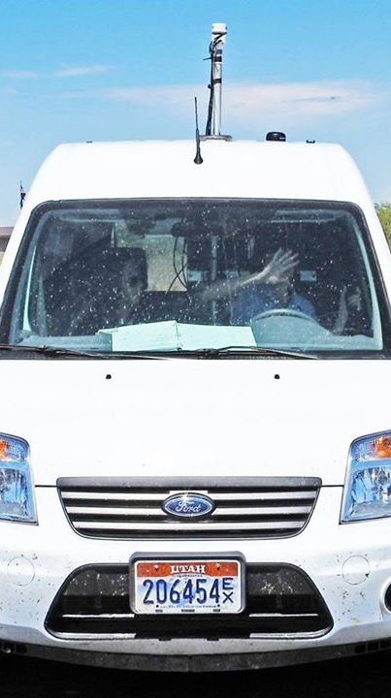
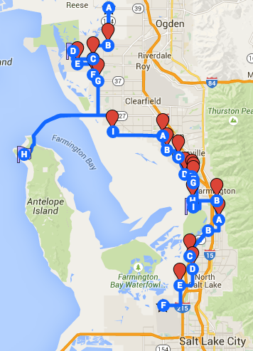
Nerdmobile
Transects between North Ogden, Antelope Island, and SLC Airport
Tuesday, July 14
Wednesday, July 15
Thursday, July 16
Data being processed

Slide 6
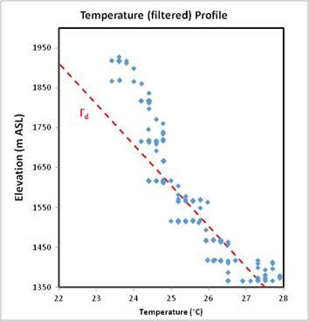
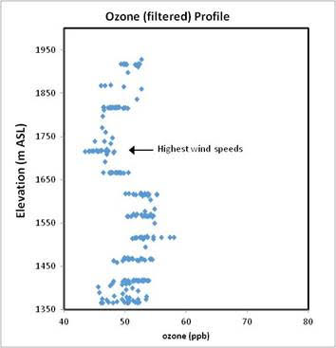
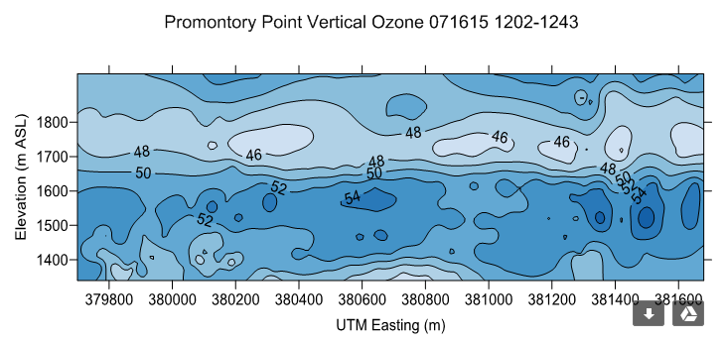
Utah State UAV

Slide 7
Aerostat and AtmoSniffer
Thursday, July 16
Antelope Is. causeway gate
More Pictures

Slide 8
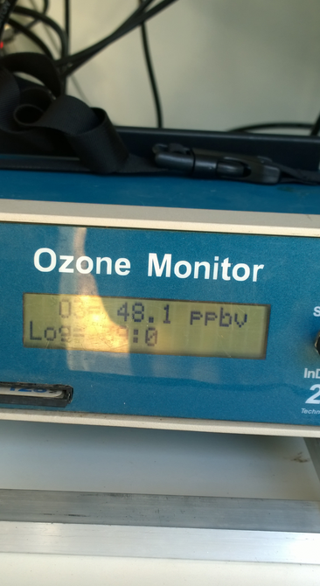
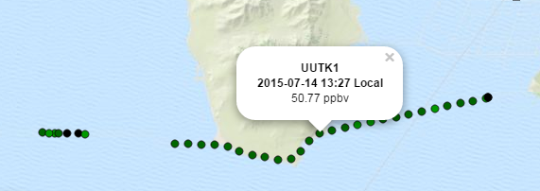
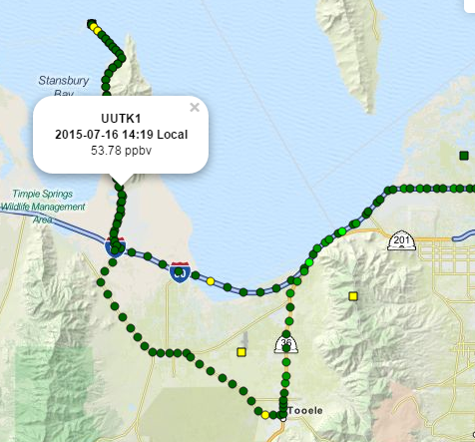
UU Truck 1
Tuesday – Causeway (GPS and power issues--only did one run)
Thursday
Tooele to Badger Is.
~12:30 PM – 3:30 PM

Slide 9
UU Truck 3
Wednesday
Promontory Point Causeway
Start 1:30 PM
End 4:30 PM
Thursday UUTK3
Promontory Point Causeway
Start 1:00 PM
End 5:00 PM

Slide 10
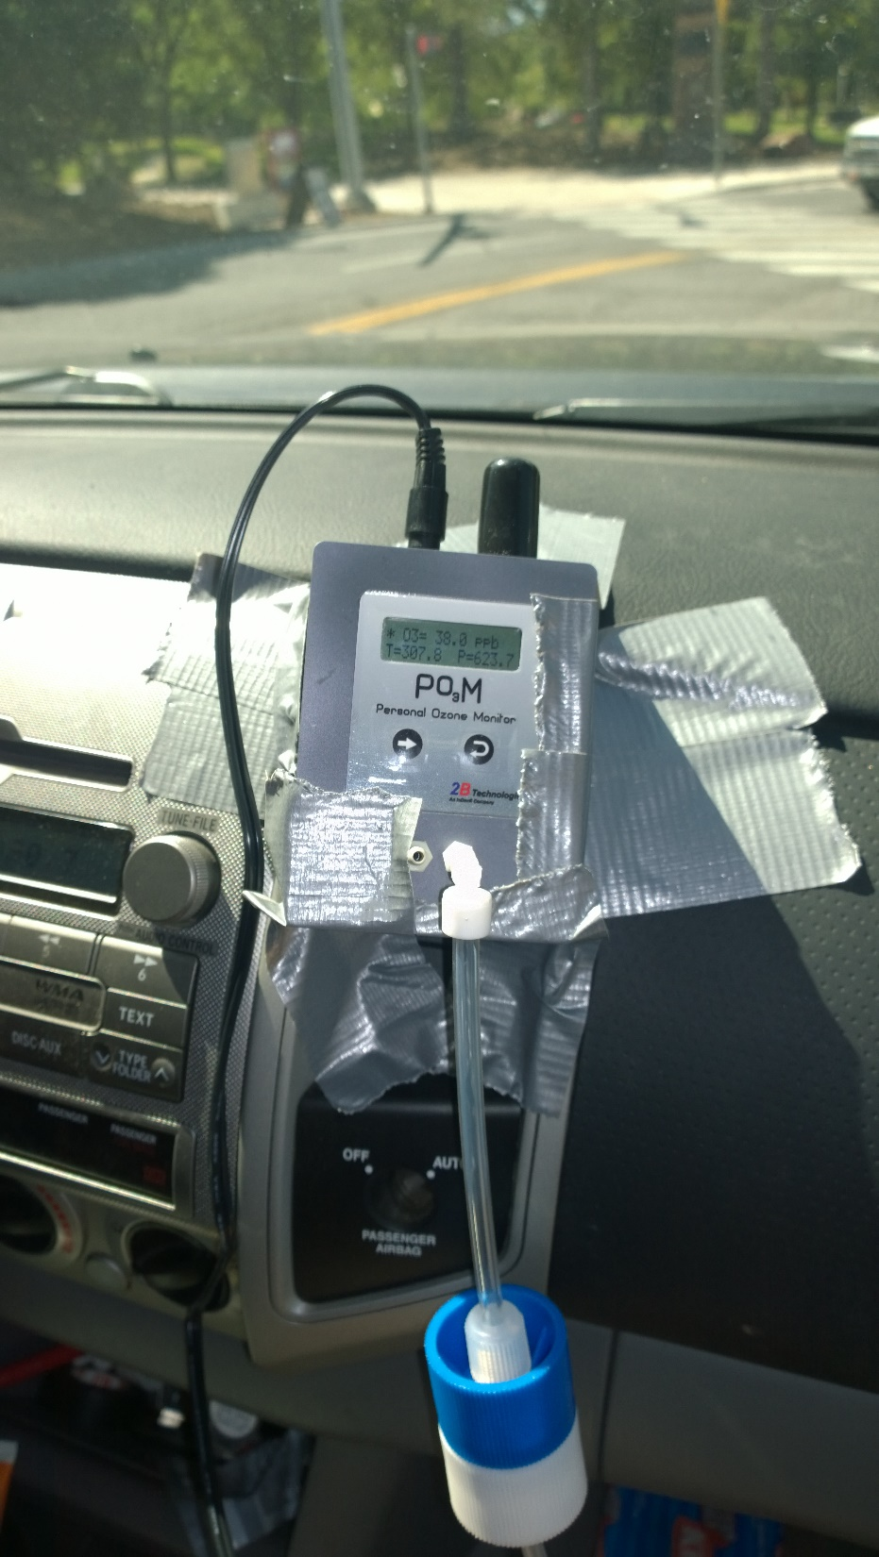
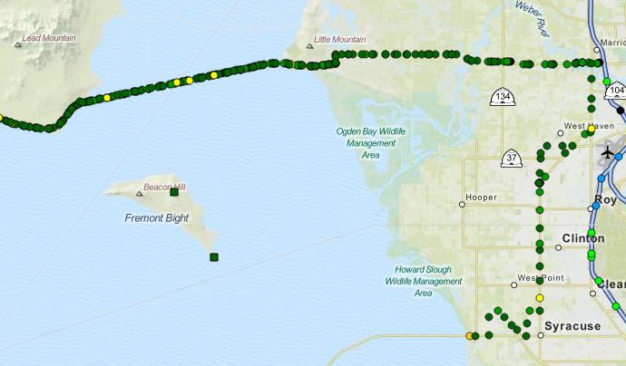
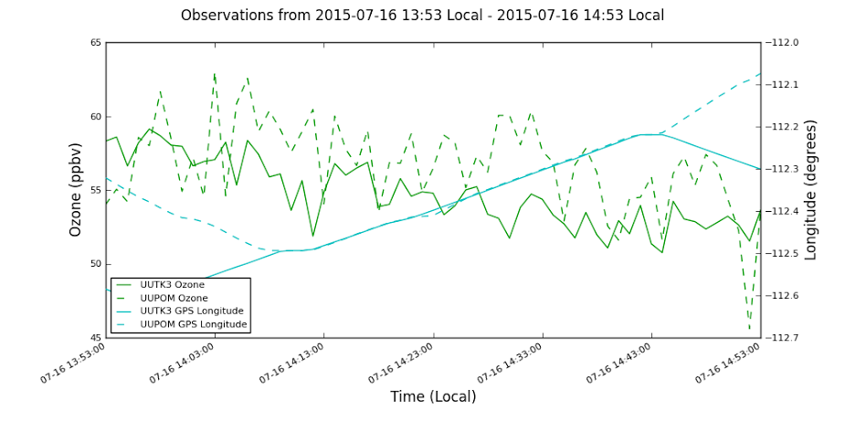
UU Truck 3/POM
Thursday
Comparison of POM and 2B Ozone Monitors on the Causeway

Slide 11
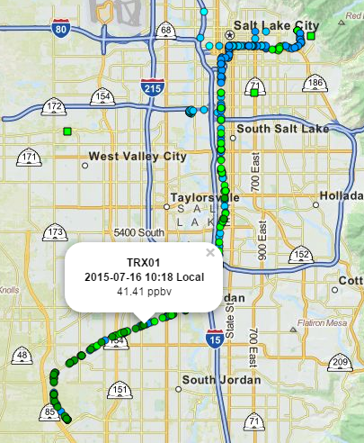
TRAX
Tuesday, Wednesday, Thursday
Red Line

Slide 12
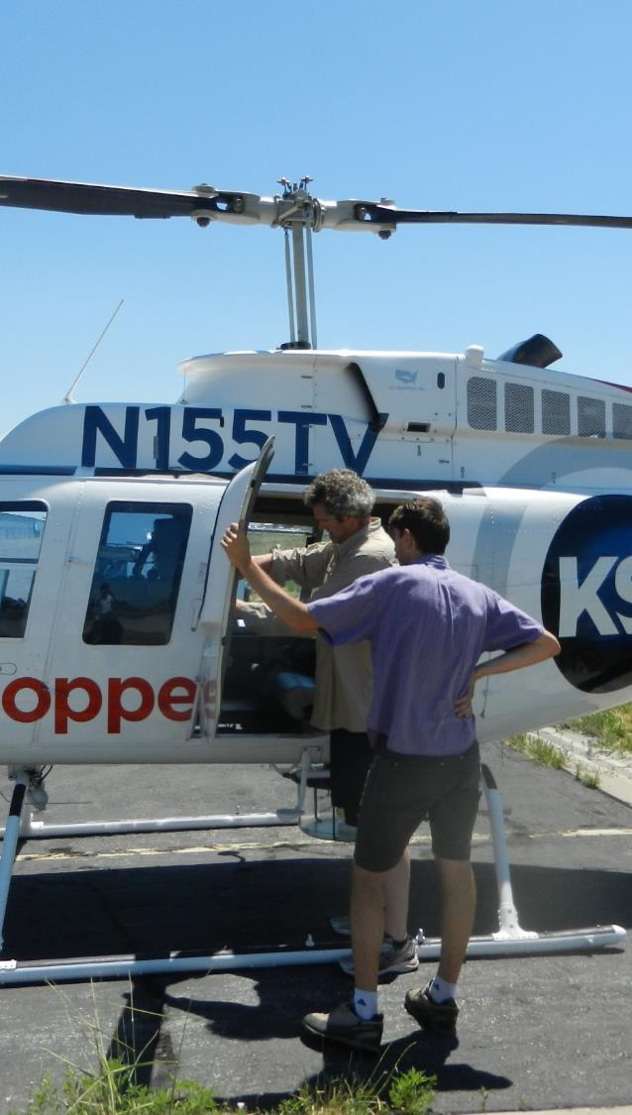
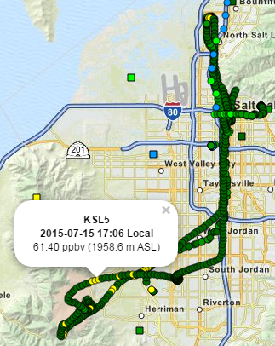
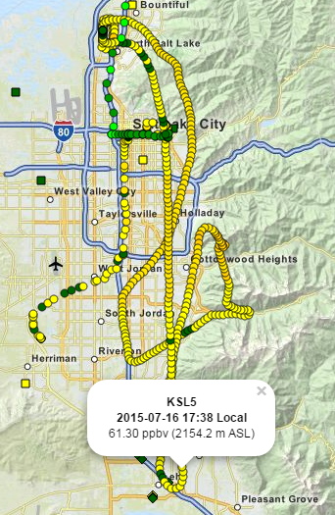
KSL Chopper 5
Tuesday
Evening
Wednesday
Evening
Thursday Evening

Slide 13
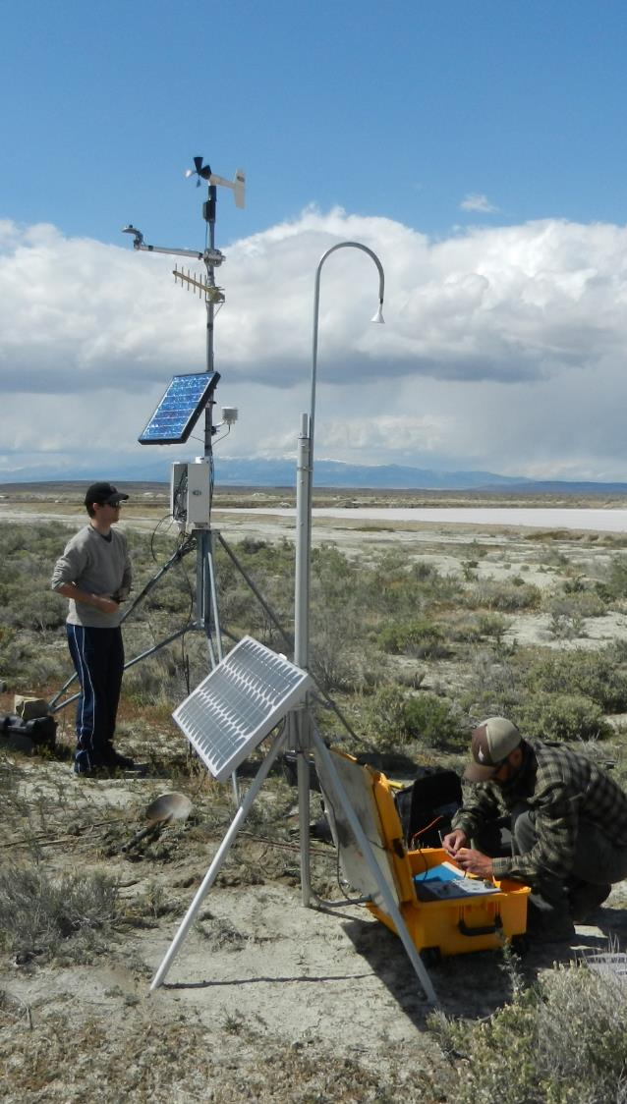
Other Observations
17+ in situ observations
Sodars
Badger Island
Antelope Causeway
Ceilometers
Lidar
MesoWest
Conway Trucks

Slide 14
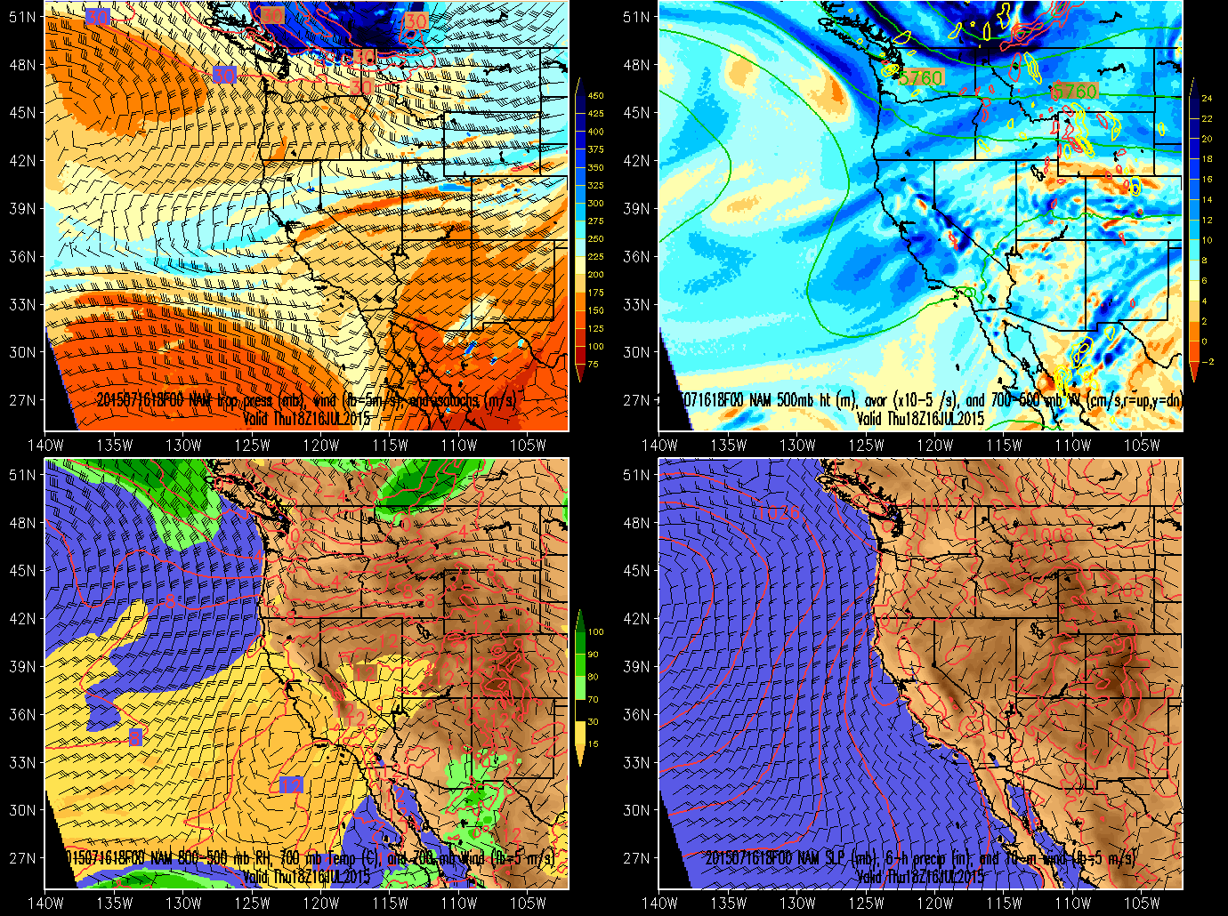
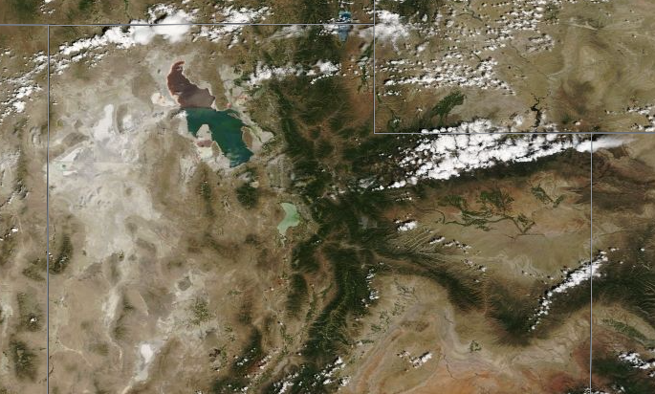
Weather Summary
NAM Analysis: 2015071618 z
MODIS TERRA
July 16, 2015, 12:35 PM (18:35 UTC)
Notes:
Smoke from California fires came to Utah around Saturday

Slide 15
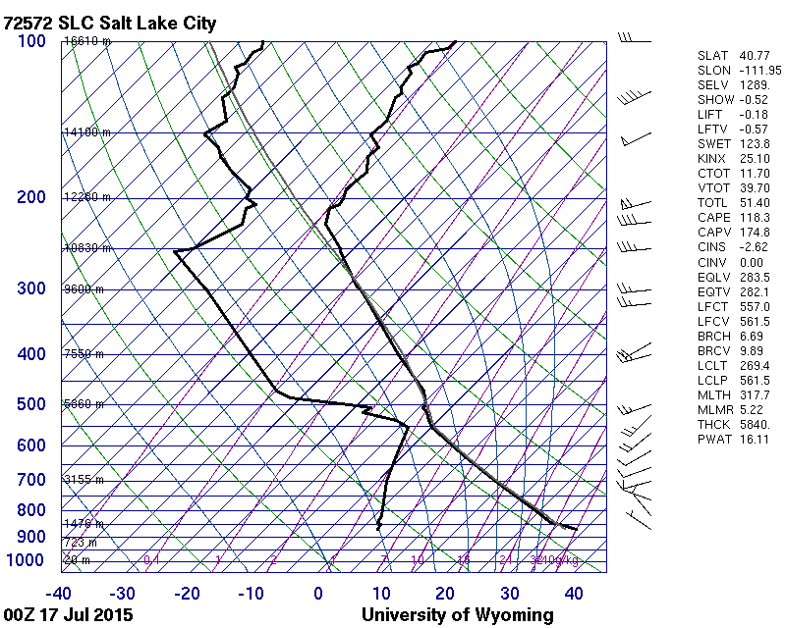
Weather Summary
July 16, 6:00 PM (00 UTC) Sounding
Well mixed, deep boundary layer up to 550 mb
HRRR Soundings

Slide 16
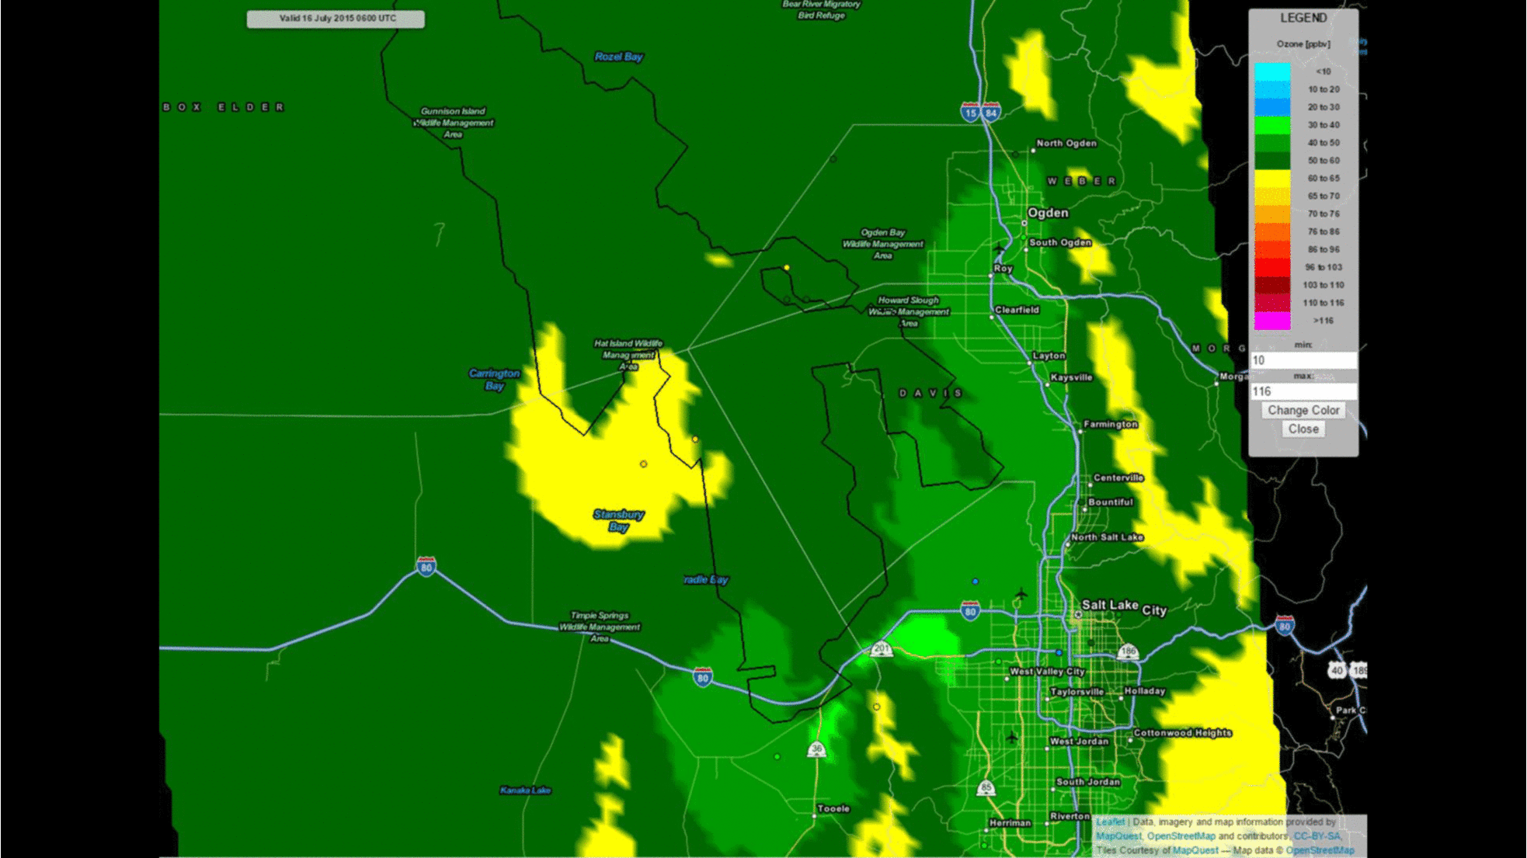
UU2DVAR July 16-17
Play Animation

Slide 17
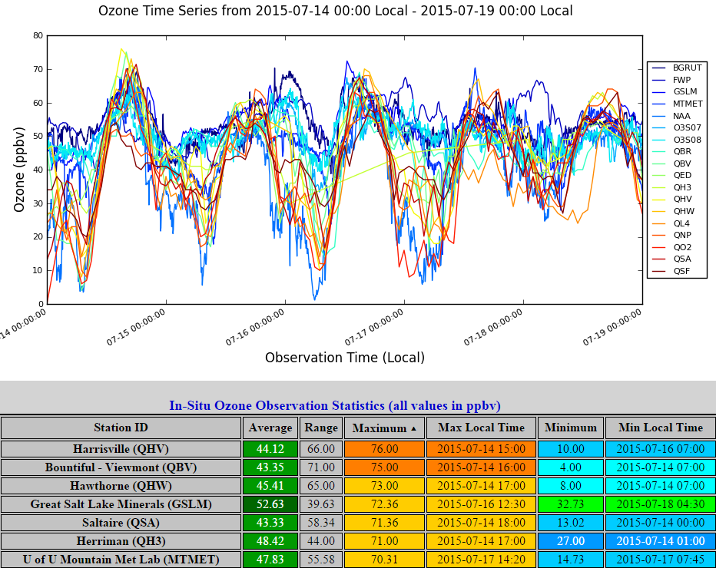
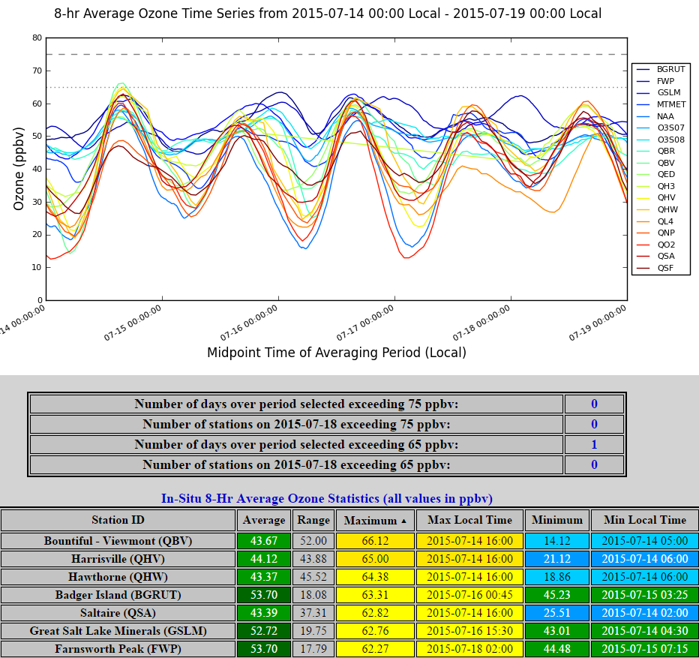
In-situ Ozone Summary

Slide 18
Other topics
Please provide 1-2 paragraph descriptions of Nerdmobile, USU UAV, WSU sonde systems, etc. for reports and future pubs
Obtaining data from other fixed sites

Slide 19
IOP 3
Brian, Ansley, Alex will monitor conditions August 3-7
Call likely August 7 10 AM
Unless optimal conditions on Mon August 10, IOP will be in the Aug. 11-14 window
Limited operations if conditions unfavorable and no intent to push back operations to later in August
Operations similar to IOP-2: if conditions are really favorable, then might do UU sonde launches

