Slide 1

Environmental Instrumentation
ATMOS 5050/6050/ME EN 6960
Hands-on instrumentation courses are increasingly rare in U.S. environmental programs
Environmental fields depend on data and scientists need to know strengths and limitations of how that information is obtained
Some employers are looking for prospective employees to have working knowledge of instrumentation

Slide 2
Lecture/Discussion/Quiz Combo
Class time is precious- focus on hands-on, involved, cooperative learning
Certain concepts are critical to be able to prepare for, participate in, and complete labs
These lectures provide core material, the text is a resource as well
Lectures discussed briefly and an online quiz review must be completed typically by the end of that day

Slide 3
Lecture 1 Outline
Intro
Time response
Preparing for Lab 1

Slide 4
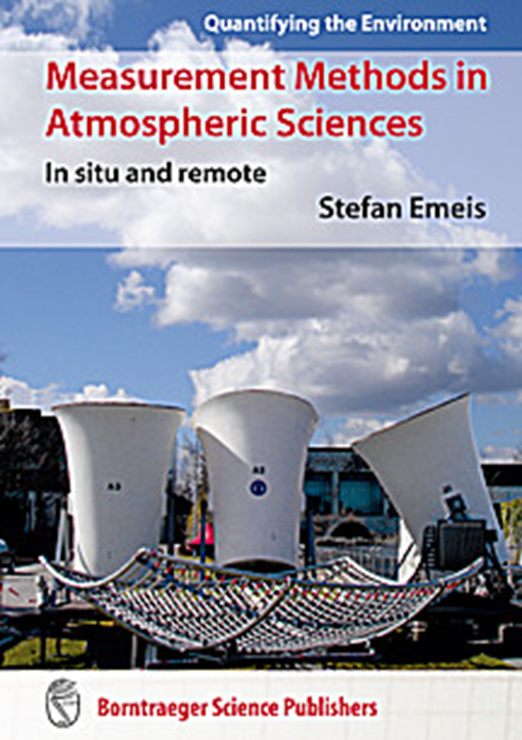
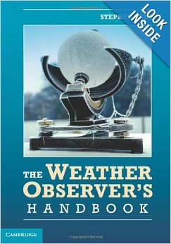
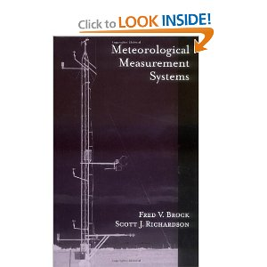
Course Text and Other Resources
Technical: Brock and Richardson Good Mix: Emeis Down-to-earth: Burt

Slide 5
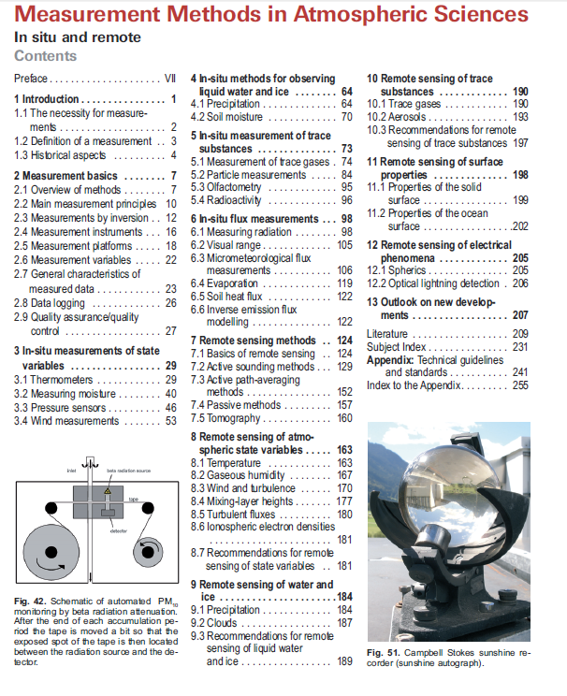
Week 1 Reading: Chapter 1

Slide 6
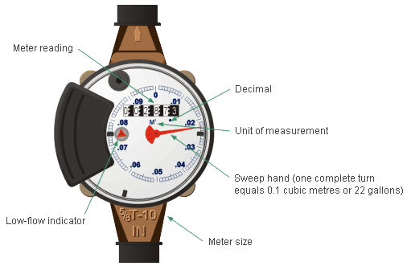
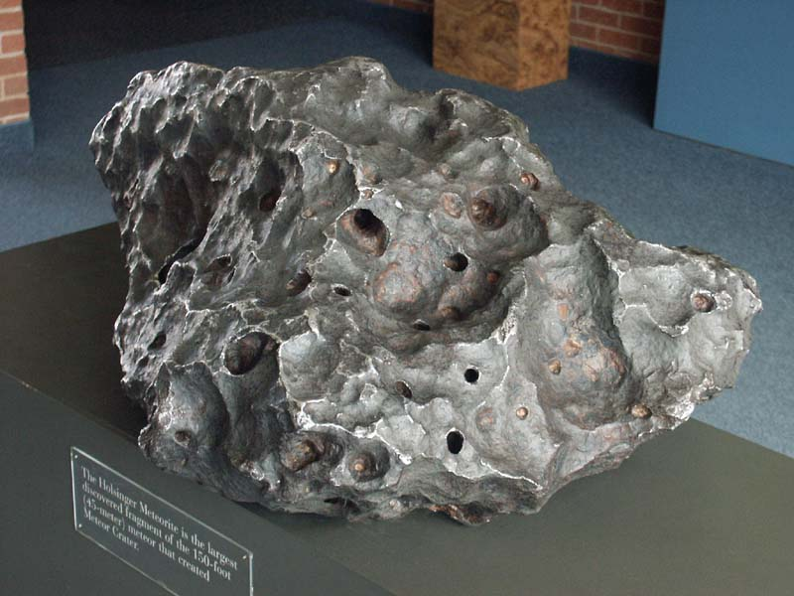
Metrology vs. Meteorology
Metrology is the science of measurement
Meteorology is the science of the atmosphere

Slide 7

Measurement
A number obtained from a device that measures a state variable (e.g., temperature) relative to a predefined scale (e.g., K) or reference for that variable

Slide 8
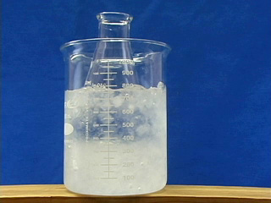
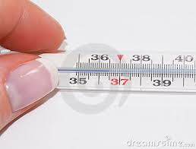
Sources of Error
Static- measured when environmental conditions remain constant
  Can be random or systematic
Dynamic- as environmental conditions change, a sensor may exhibit a lag in responding to those changes
Drift- arise due to physical changes in the sensor over time
Exposure- imperfect coupling between the sensor and the environment
  Instrument may measure its peculiar state rather than that of the surrounding environment

Slide 9
Sensor performance characteristics or specifications
Most specifications are defined statically, i.e., when the environment in which the sensor is exposed is not changed, e.g. controlled laboratory
Time response examined in Lab 1 is a dynamic performance characteristic
You get what you pay for
  Manufacturers develop instruments for specific markets and customers
  Performance characteristics will vary widely
  Generally calibrated relative to known standard reference sensors

Slide 10
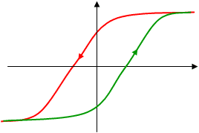
Another Dynamic Characteristic: Hysteresis
Dependence of a system not only on its current environment but also on its past environment
delayed response of measurement
Or lag in response may differ depending on whether environmental conditions are increasing or decreasing
output
input

Slide 11
Time Response: Dynamic sensor characteristic
Time elapsed between change in environment and change in output of sensor
Short response time- instrument responds rapidly to environmental change
Long response time may be appropriate if environmental conditions change slowly (e.g. ocean temperature)
Time response provides an estimate of how fast the sensor changes to an instantaneous change in the environment

Slide 12
Calculating time response of temperature sensor
Consider situation where thermometer is initially at T_{i}- an artificially high temperature
Then it cools, eventually reaching T_{f}- the environmental temperature
How long does it take to cool off?

Slide 13

Specific heat: The ratio of the energy released by a
$$\text{system} \text{to} \text{the} \text{corresponding} \text{temperature} \text{fall} \text{per} \text{unit} \text{mass}$$
$$c_{p}−specific heat of air$$
$$\text{C}\text{ – }\text{specific} \text{heat} \text{of} \text{thermometer}$$
Energy gain by air = Energy loss by thermometer
The change in energy for mass M of air in time dt is:
$−Mc_{p}$(T-T_{f}) dt = C dT
$\frac{dT}{dt}$= - $\frac{C}{Mc_{p}}$ (T-T_{f})
$\frac{dT}{dt}$= - $\frac{1}{\text{t}}$ (T-T_{f}) where τ is the time response
At the initial time t = 0, T = T_{i}
At time t = t, T = T
At the final time t = ∞, T = T_{f}

Slide 14
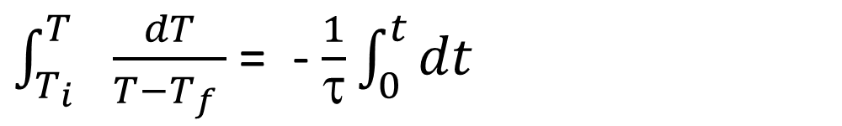
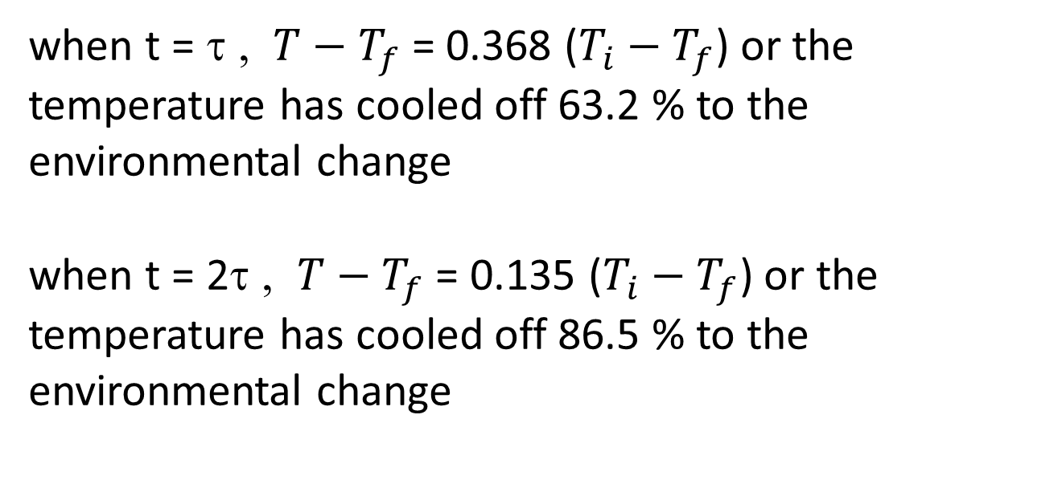

Separating variables and integrating:
ln$\frac{T−T_{f}}{T_{i}−T_{f}}$ = - $\frac{t}{\text{t}}$ or $\frac{T−T_{f}}{T_{i}−T_{f}}$ = exp(- $\frac{t}{\text{t}}$ )
$\int_{T_{i}}^{T_{}}{\frac{dT}{T−T_{f} } }$= - $\frac{1}{\text{t}}\int_{0}^{t}{dt}$
when t = τ , $T−T_{f}$ = 0.368 ($T_{i}−T_{f}$) or the temperature has cooled off 63.2 % to the environmental change
when t = 2τ , $T−T_{f}$ = 0.135 ($T_{i}−T_{f}$) or the temperature has cooled off 86.5 % to the environmental change

Slide 15
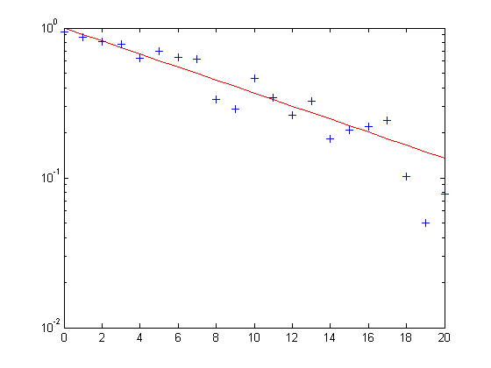
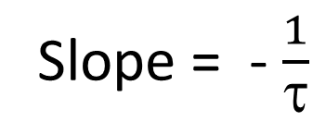

Plot on semilog graph
Slope = - $\frac{1}{\text{t}}$
$\frac{T−T_{f}}{T_{i}−T_{f}}$
Time (t sec)

Slide 16
Lab 1: Time Response and Introduction to CR1000 DataLogger
  We will use the CR1000 dataloggers as tools to help interrogate sensors. The CR1000 and the associated LoggerNet software have a rich number of features, most of which are well beyond what we have time to use in this course.
  Read through the brochure about the CR1000 available from: http://www.campbellsci.com/documents/product-brochures/b_cr1000.pdf
  Review the information on thermocouples in the text. The description there is pretty limited. Graduate students, for some additional context, look at the wiki page on thermocouples.

Slide 17
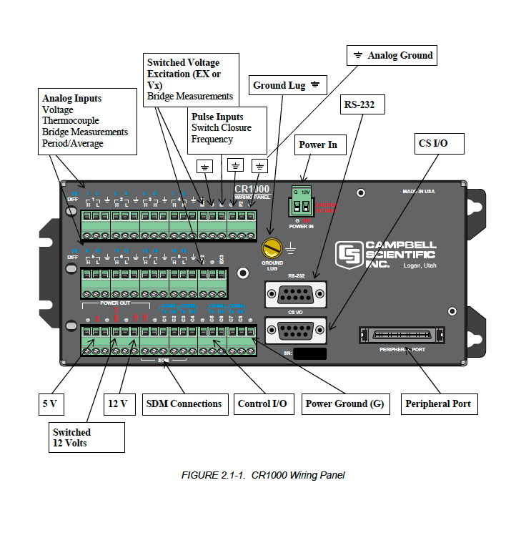
Preparing for First Lab

Slide 18
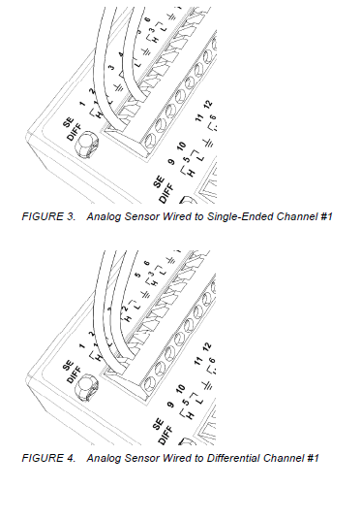
Analog sensors
Analog sensors output continuous voltages that vary with environmental conditions
Analog sensors connect to analog terminals
Single-ended: sensor outputs are measured with respect to ground
Differential: high sensor outputs are measured with respect to the low output
Thermocouple is a differential analog sensor

Slide 19
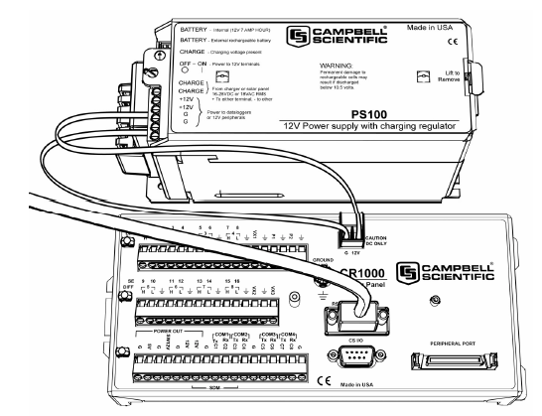
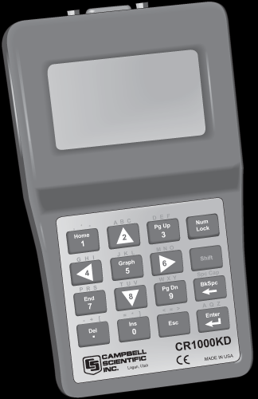
Plugging in power and Serial line
Make sure +12v and ground from battery connected to correct terminals on little green connector
USB to RS232 connects to RS232 9 pin
CR1000KD connects to CS I/O 9 pin

Slide 20
Thermoelectric sensors
copper
Reference junction
Thermocouple
  Physical basis-
    2 different metals joined together to make a circuit
    Electrons flow from one metal to another until a voltage difference V typical for those metals and environmental temperature is reached
  Temperature difference between junctions provides a relative measure of the voltage difference
  One junction must have a known reference temperature
  Range of copper-constantan Type T: -75 to 200C
  Voltage difference is small: ~40μV/C for Type T
Thermopile- thermocouples in series to amplify voltage difference
constantan

Slide 21
Thermocouple measurement with CR1000
micro-volt resolution and low-noise voltage measurement is well suited for measuring thermocouples
A thermocouple consists of two wires, each of a different metal or alloy, joined at one end to form the measurement junction
At the opposite end, each lead connects to terminals of a voltage measurement device, the CR1000, to form the reference junction
If the two junctions (measurement and reference) are at different temperatures, a voltage proportional to the difference is induced in the wires
Knowledge of the reference junction temperature provides the determination of a reference junction compensation voltage, corresponding to the temperature difference between the reference junction and 0°C
This compensation voltage, combined with the measured thermocouple voltage, can be used to compute the absolute temperature of the thermocouple junction

Slide 22
Thermocouple measurement with CR1000
A thermistor is integrated into the CR1000 wiring panel for measurement of the reference junction temperature by means of the PanelTemp() instruction.
TCDiff() thermocouple instructions determine thermocouple temperatures using the following sequence.
  First, the temperature (°C) of the reference junction is determined.
  A reference junction compensation voltage is computed based on the temperature difference between the reference junction and 0 °C
  the reference temperature is measured with the PanelTemp() instruction
  The actual thermocouple voltage is measured and combined with the reference junction compensation voltage.
  It is then used to determine the thermocouple junction temperature based on a polynomial approximation of NIST thermocouple calibrations.

Slide 23
Summary
Time response is an important sensor characteristic
Thermocouples simple and powerful sensors for measuring temperature in variety of environments

