Slide 1

Outline
Uncertainty
Measurement systems
Sensor characteristics

Slide 2

True value
Value of a quantity sought through measurement
In most instances it is unknown
We do know the boiling/melting temperature of pure water

Slide 3
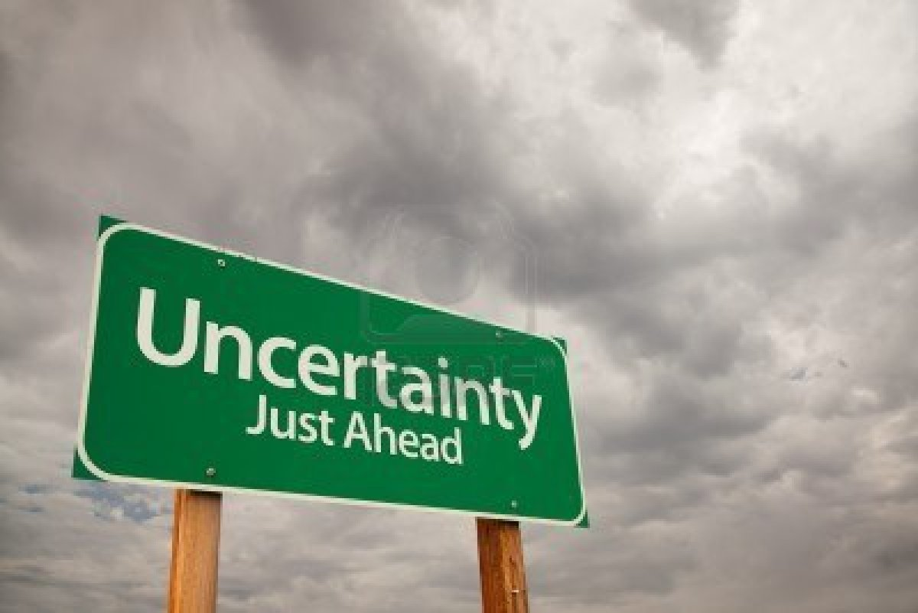
Measurement Uncertainty
Quantitative estimate on either side of a measured value within which the “true” value is expected to lie

Slide 4
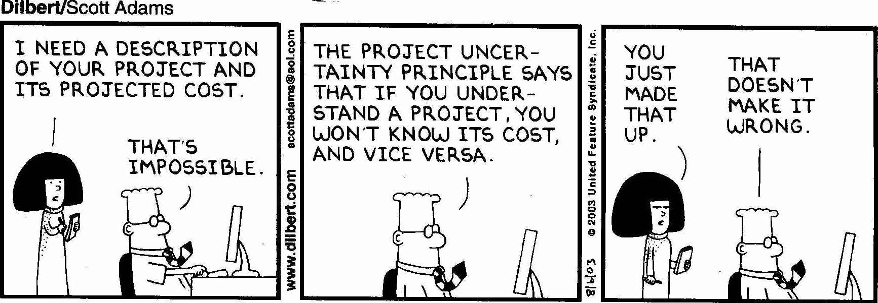
Uncertainty
Uncertainty arises because:
  we can never measure the environment with complete accuracy and precision
  the environment is a chaotic system, which is a maddening combination of randomness and order arising from the characteristics of a complex nonlinear system
  our understanding of environmental systems is imperfect

Slide 5
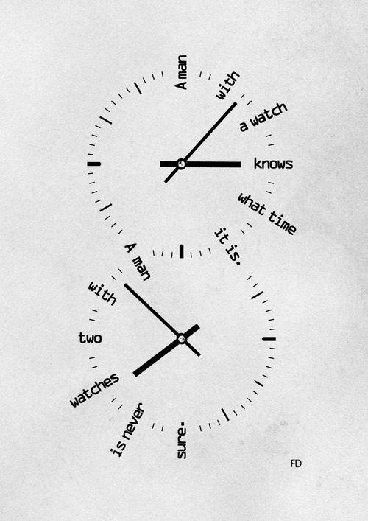
Uncertainty
Always assume that ALL observations are uncertain:
  Was a human observer involved?
  Did the same observer take the observations each time?
  What automated equipment was used?
  What metadata (data describing the data) are available to explain how the observations were taken?
“Segal's law”: A man with a watch knows what time it is. A man with two watches is never sure.

Slide 6
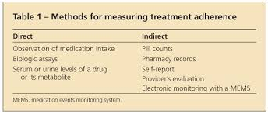
Direct vs. Indirect measurements
Direct- direct comparison of an object in terms of its length, time, and mass
Indirect- impact of variable of interest on sensor
Nearly all environmental sensors are indirect

Slide 7
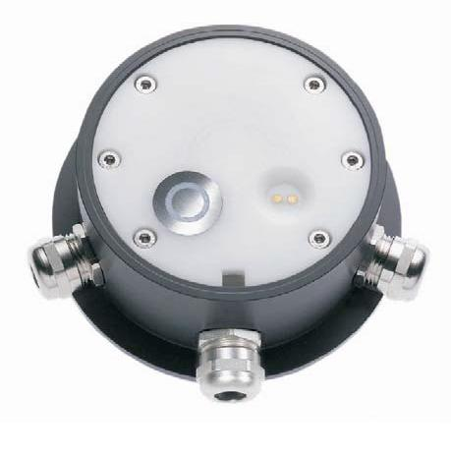
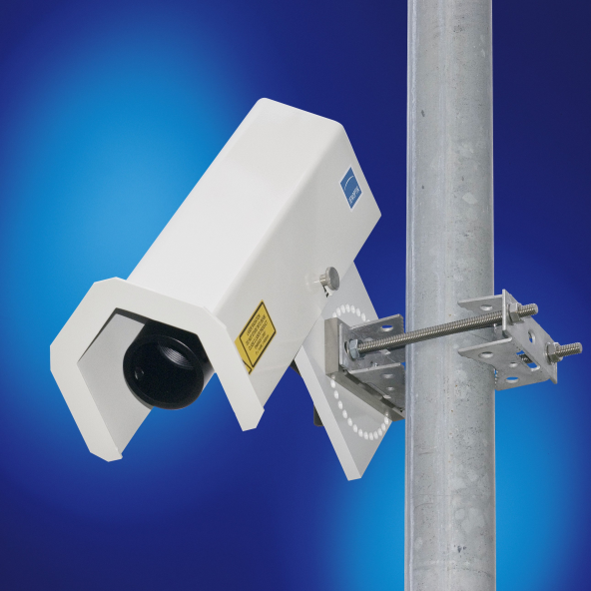
In situ vs. remote
In situ- direct contact between sensor and measured variable
  Sensor may influence measurement
Remote- no contact between sensor and measured variable
Example of road temperature sensors:
  in situ: puck destroyed every time pavement redone
  Remote: Noninvasive road temperature

Slide 8
Data Acquisition
Input signal
Instrument
Sensor
Amplifier
Display
output signal

Slide 9
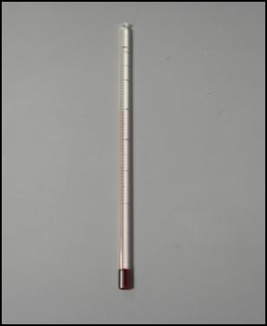
Data Acquisition:
Mercury in glass thermometer
Input signal
Transducer is a device that converts a signal in one form of energy to another form of energy: electrical, mechanical, electromagnetic, chemical, acoustic and thermal energy.
A sensor is used to detect a parameter in one form and report it in another form of energy (often an electrical signal).
Amplifier
Display
Sensor
output signal

Slide 10
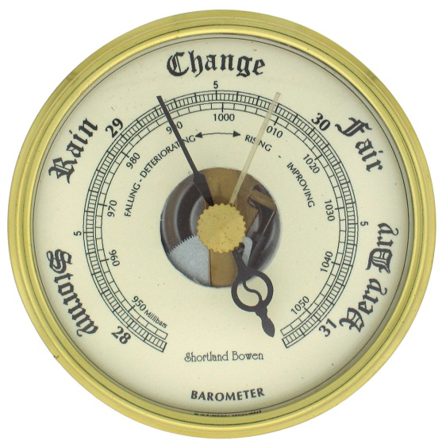
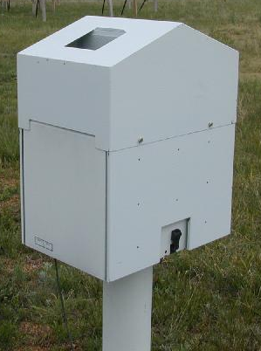
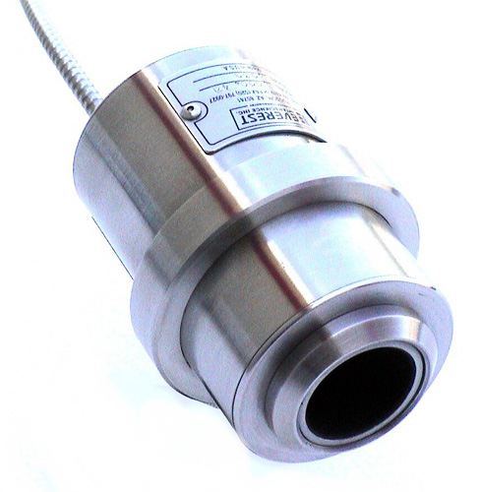
Active vs. passive instruments
many of the common sensors are no longer passive in the strict sense indicated in text (e.g., wind speed sensor no longer connected to just a dial)
Passive- energy of output signal obtained from input signal
Active- have own power supply
My view:
  Passive- radiometer- responds to environment
  Active-radar/lidar- requires energy source to create input

Slide 11
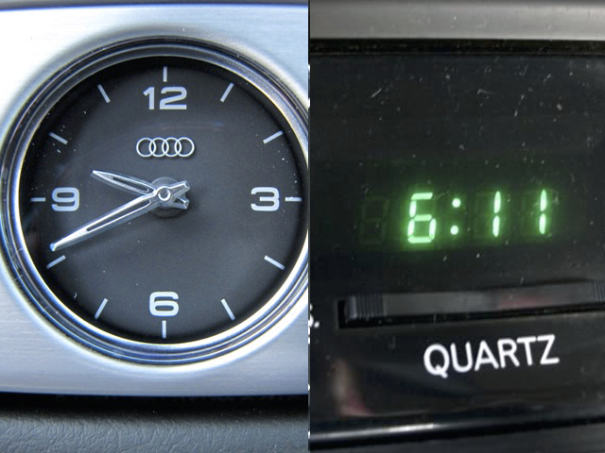
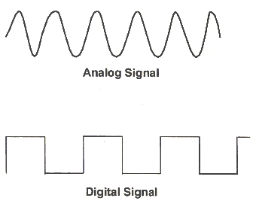
Analog vs digital
Analog- continuous measured response to changes in the environment- requires a transducer to convert from input change to continuous output
Digital- discrete output signal as a function of input signal
Many mechanical type of analog sensors where dial or scale is transducer
Many electronic type of analog sensors where environmental change is measured by voltage changes
Analog: information is translated into electric pulses of varying amplitude
Digital: translation of information into binary format (zero or one) where each bit is representative of two distinct amplitudes.

Slide 12
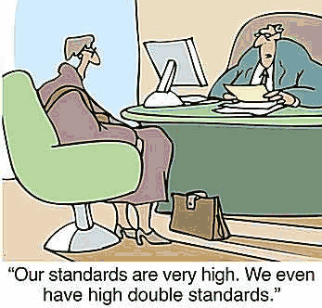
Standards
Calibration standards- NIST
Performance- framework for testing instrument typically in laboratory
Exposure- WMO. Difficult to follow in all cases
Procedural- sampling and averaging periods
  NWS/FAA uses 30 sec wind vs RAWS 10 min average
See Appendix of text but mostly beyond scope of this class

Slide 13
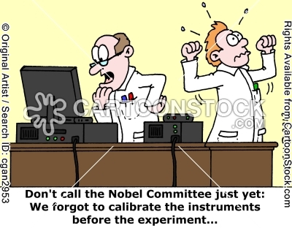
Calibration
Calibration is a comparison between measurements – one of known magnitude made with one device (standard) and another measurement made in as similar a way as possible with a second device (test)
Intended to reduce as much as possible the systematic (bias) errors

Slide 14
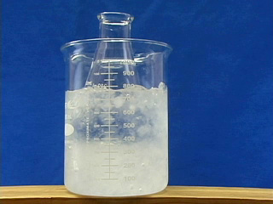
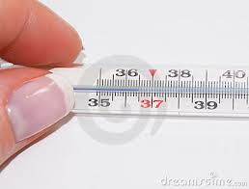
Sources of Error
Static- measured when environmental conditions remain constant
  Can be random or systematic
Dynamic- as environmental conditions change, a sensor may exhibit a lag in responding to those changes
Drift- arise due to physical changes in the sensor over time
Exposure- imperfect coupling between the sensor and the environment
  Instrument may measure its peculiar state rather than that of the surrounding environment

Slide 15
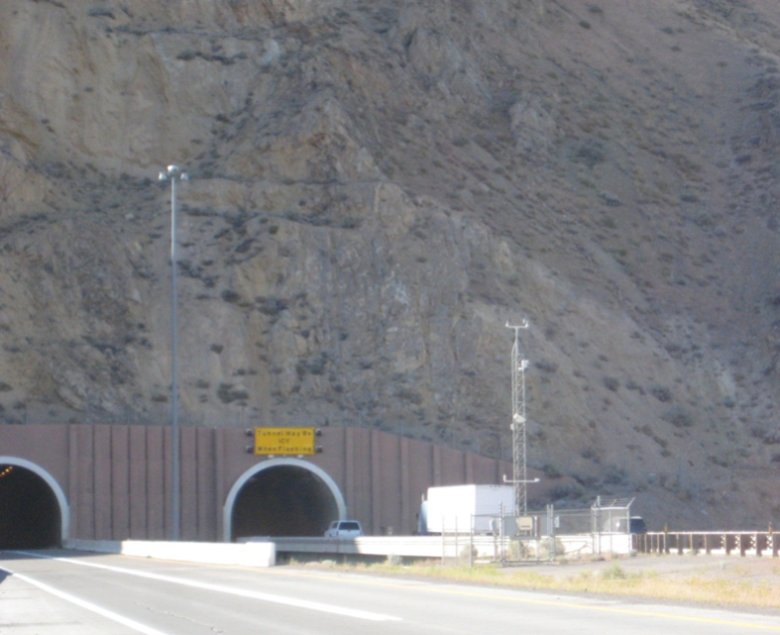
Siting Errors
Metadata errors
Instrument errors (exposure, maintenance, sampling)
Local siting errors (e.g., artificial heat source, overhanging vegetation, observation at variable height above ground due to snowpack)
“Errors of representativeness” – correct observations that are capturing phenomena that are not representative of surroundings on broader scale (e.g., observations in vegetation-free valleys and basins surrounded by forested mountains)

Slide 16
Sensor performance characteristics or specifications
Most specifications are defined statically, i.e., when the environment in which the sensor is exposed is not changed, e.g. controlled laboratory
You get what you pay for
  Manufacturers develop instruments for specific markets and customers
  Performance characteristics will vary widely
  Generally calibrated relative to known standard reference sensors

Slide 17
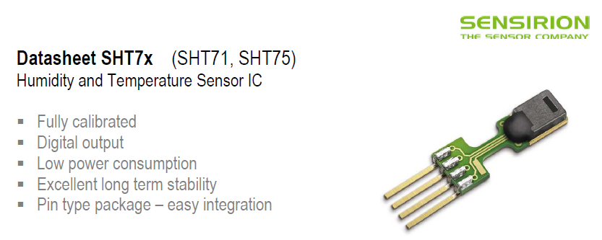
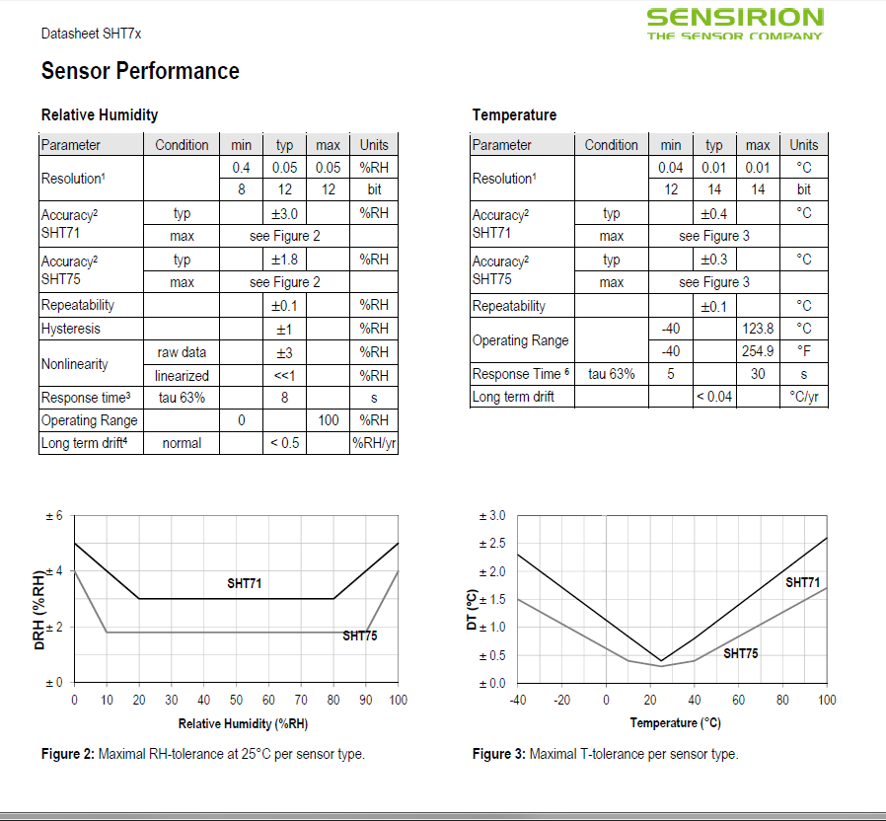

Slide 18
Accuracy vs. Precision
Precision
  How well repeated measurements of some quantity agree with one another
  A precise instrument can be inaccurate
Accuracy
  How close a measurement is to the “true” value
  Difference in response between a standard and sensor in varying environmental conditions
  Not same as precision as given in text unless there is no bias (systematic error) in the measurement
  High accuracy may be very expensive

Slide 19
Consider the following shots at a “bulls eye”, where the goal is to hit the X, the true value. While it is certainly best to have observations that are both accurate and precise, it may be too costly to do so.
X
X
X
X
High accuracy Low accuracy High accuracy Low accuracy
High precision High precision Low precision Low precision
Small uncertainty Large uncertainty Large uncertainty Large uncertainty

Slide 20
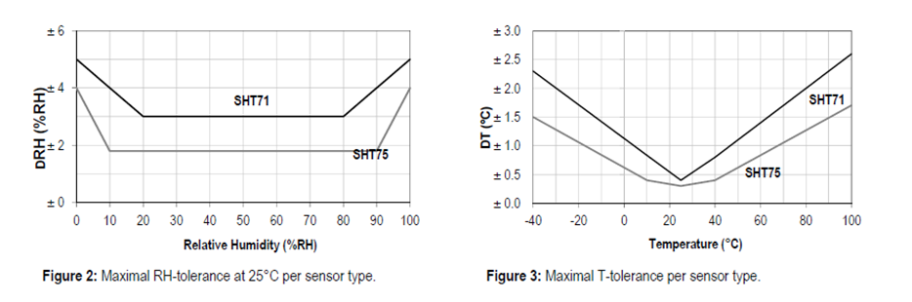
Span (or range)
difference between the 2 extreme measurable signal readouts
  Large range is nice, but may lead to problems near the extremes such as being less accurate
  Want the range to span forseeable range of interest

Slide 21
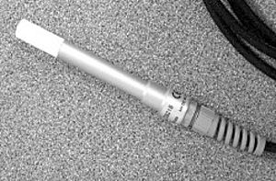
Limitation
Or limiting condition of operation
Capability of a sensor to give accurate readings within specific range
At extreme ranges, readings may be less accurate
Example: Temperature Measurement from CS 215
Measurement Range: -40° to +70°C
Accuracy: ±0.3°C at 25°C;
±0.4°C over +5° to +40°C;
±0.9°C over -40° to +70°C

Slide 22
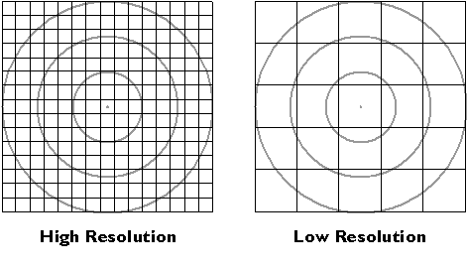
Resolution
Smallest change in ambient environment that causes a detectable change in instrument
Fine resolution implies instrument is able to detect small changes

Slide 23
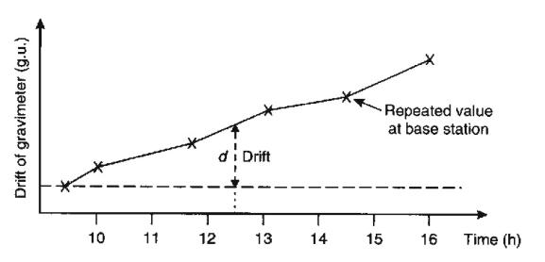
Stability
Inverse is drift
Ability of instrument to maintain its calibration

Slide 24
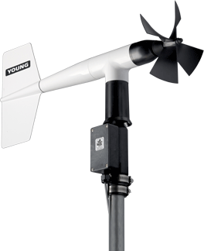
Threshold
Or detection limit
Smallest measurable input
e.g., wind sensors often don’t record really light winds
Range: 0-100 m/s (224 mph), 0- 360°
Accuracy:Wind Speed: ±0.3 m/s (0.6 mph) or 1% of reading, Wind Direction: ±3 °
Operating Temperature: -50 to 50°C
Threshold: Propeller: 1.0 m/s (2.2 mph) Vane: 1.1 m/s (2.4 mph)

Slide 25
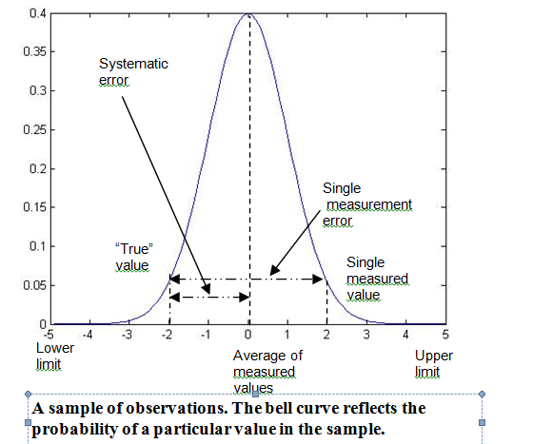
Summary of Error Characteristics from one and many measurements

Slide 26
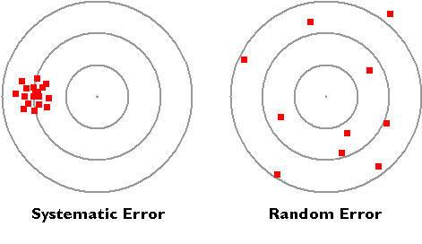
Systematic vs.
Random Errors
The tendency in environmental fields is to overstate the amount of random error and underestimate systematic errors (or biases)
Random- that which is not precisely predictable or determinable
  arise physically due to sudden changes in the environment, due to turbulence or other processes.
  Random errors can also occur due to faulty equipment or observer carelessness.
Systematic- errors arise from a consistent response of a measuring device to environmental conditions or faulty characteristics of instrumentation that occurs frequently.
  Systematic errors can vary as a function of weather regime
  nonaspirated thermistors will tend to be affected by radiational cooling and heating of the enclosure when the winds are light, for example
  Reflection of solar radiation from snow surface that contributes to heating of sensor base
Looking at the bulls eye plots, high accuracy and low precision observations are an example of random errors while low accuracy and high precision observations are an example of systematic errors.

Slide 27
Sensitivity
Change in system output for a given change of the input signal
Measure of accuracy of output signal

Slide 28
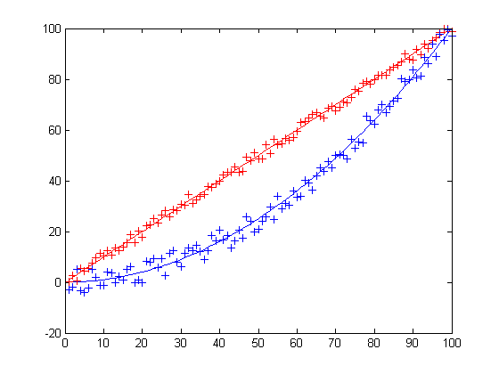
Transfer Plot
Sensor output vs. environmental conditions over the range of the sensor
Output
linear
nonlinear
Input
Sensitivity is the slope of the line
Sensitivity is constant for linear sensor

Slide 29
Signal to Noise Ratio
Signal-to-noise ratio compares the level of a desired signal to the level of background noise.
Ratio of signal power to the noise power, often expressed in decibels. A ratio higher than 1:1 (greater than 0 dB) indicates more signal than noise

Slide 30
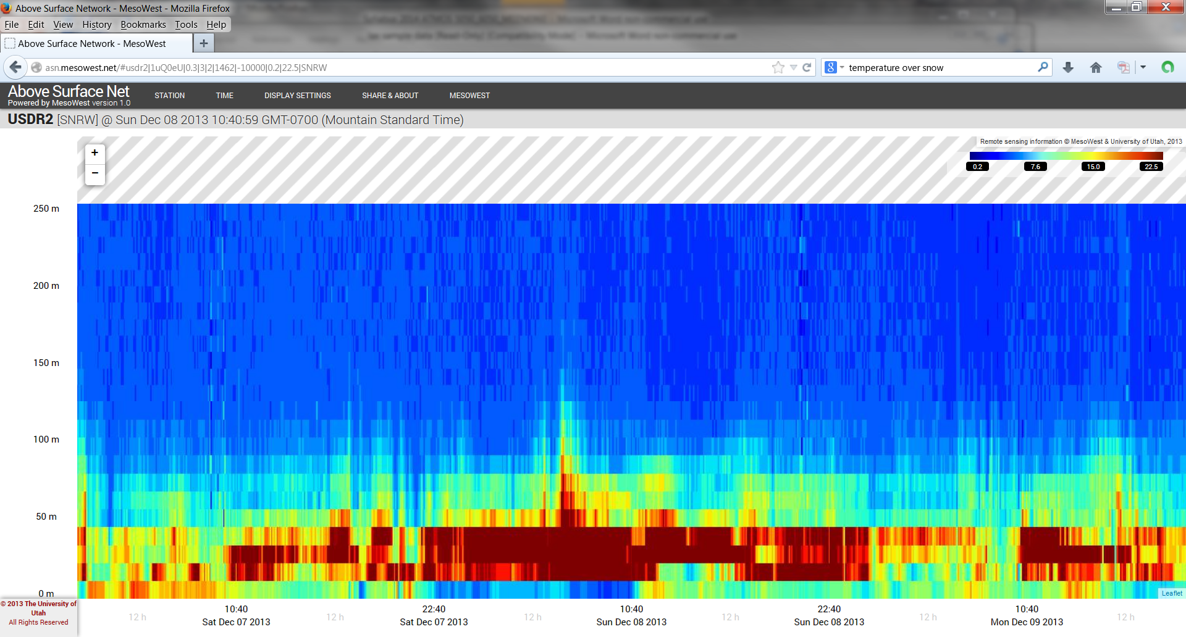
Sodar Example
Scaled such that 10 signal-to-noise ratio separates useful signal
“good” ratio: reds- 20:1
“poor” ratio: blues- 5:1

Slide 31
Summary
every observation is subject to many sources of uncertainty
define sensor characteristics needed and info on those characteristics before buying
Users of environmental data tend to assume errors are just “random” when there are many reasons for systematic or biased data
Environmental fields are blessed (and cursed) with the opportunity to take many measurements that allow analysis of sensor characteristics in varying conditions

Slide 32
Additional Resources for geeks
WMO: http://www.wmo.int/pages/prog/gcos/documents/gruanmanuals/CIMO/CIMO_Guide-7th_Edition-2008.pdf
NWS: http://www.ofcm.gov/fmh-1/pdf/FMH1.pdf

