Slide 1
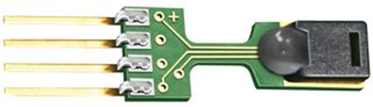
Outline
Meteorological sensors for
  Temperature
  Humidity
  Pressure
  Wind

Slide 2
Temperature
Measuring the vibrational energy of molecules in solids or the average speed at which molecules in a gas (or liquid) move

Slide 3
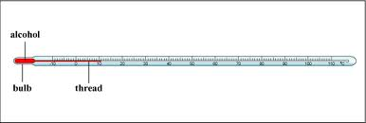
Mechanical Thermometers
Expansion type
  Physical basis- expansion/contraction of liquid as function of temperature
  Range of mercury in glass -39C to 357C
  Range of alcohol in glass -117C to 79C
  Range determined by freeing/boiling points

Slide 4
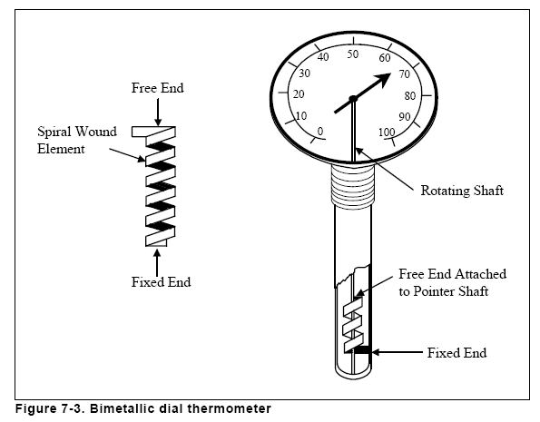
Mechanical Thermometers
Deformation type
  Physical basis- thermal elongation and contraction of metals
  Bimetallic (iron/brass, for example)
    Brass expands twice as much as iron
    Turkey thermometers, snow temperature
  Bourdon tube- hollow metal tube filled with alcohol
    As alcohol expands/contracts pushes metal

Slide 5
Thermoelectric sensors
copper
Reference junction
Thermocouple
  Physical basis-
    2 different metals joined together to make a circuit
    Electrons flow from one metal to another until a voltage difference V typical for those metals and environmental temperature is reached
  Temperature difference between junctions provides a relative measure of the voltage difference
  One junction must have a known reference temperature
  Range of copper-constantan Type T: -75 to 200C
  Voltage difference is small: ~40μV/C for Type T
Thermopile- thermocouples in series to amplify voltage difference
constantan

Slide 6
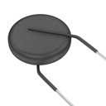
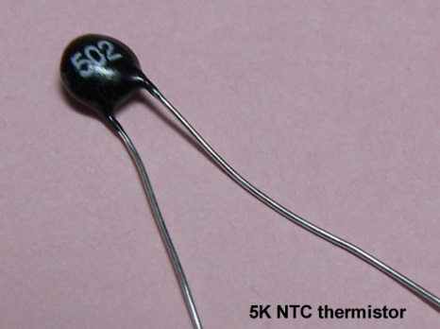
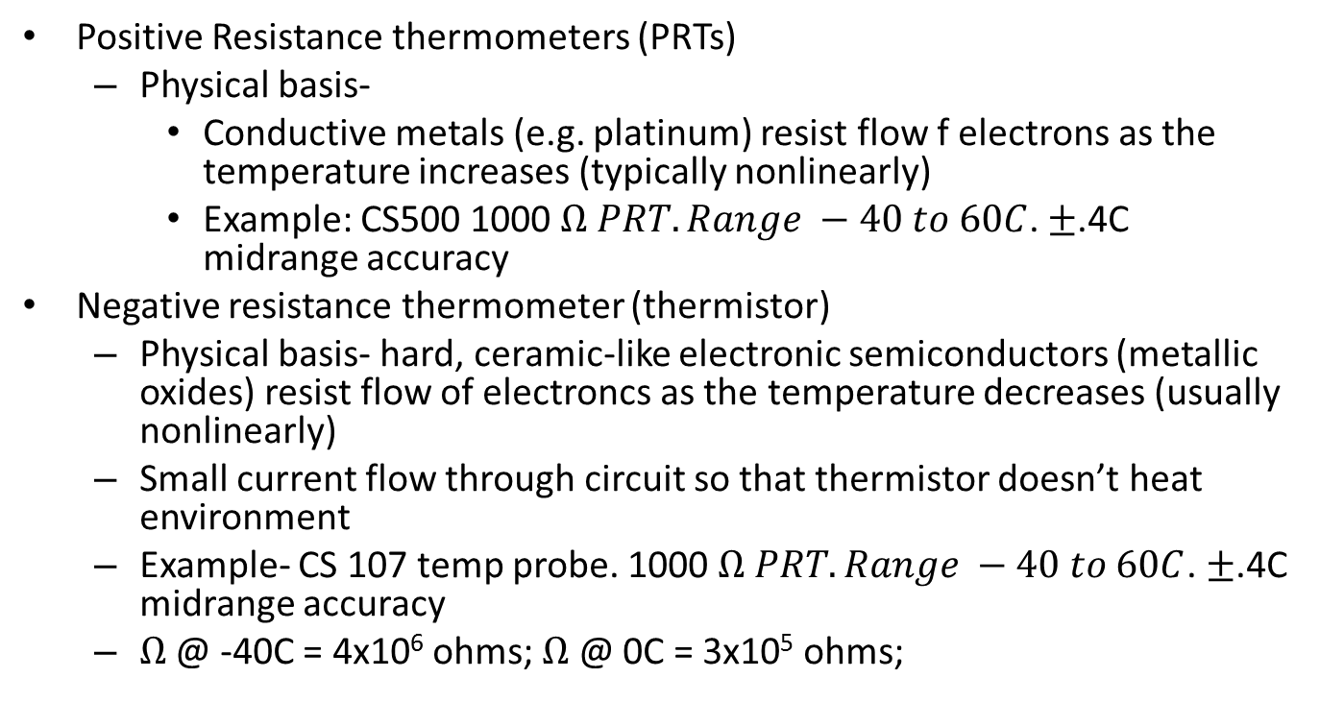
Thermoelectric sensors
Positive Resistance thermometers (PRTs)
  Physical basis-
    Conductive metals (e.g. platinum) resist flow f electrons as the temperature increases (typically nonlinearly)
    Example: CS500 1000 $Ω PRT. Range −40 to 60C$. ±.4C midrange accuracy
Negative resistance thermometer (thermistor)
  Physical basis- hard, ceramic-like electronic semiconductors (metallic oxides) resist flow of electroncs as the temperature decreases (usually nonlinearly)
  Small current flow through circuit so that thermistor doesn’t heat environment
  Example- CS 107 temp probe. 1000 $Ω PRT. Range −40 to 60C$. ±.4C midrange accuracy
  $Ω$ @ -40C = 4x10⁶ ohms; $Ω$ @ 0C = 3x10⁵ ohms;

Slide 7
Thermoelectric sensors
thermocouple
Voltage
difference
(mV)
PRT
thermistor
Temperature ->

Slide 8
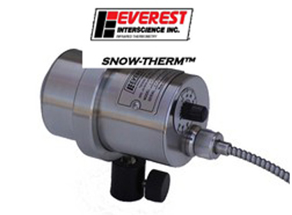
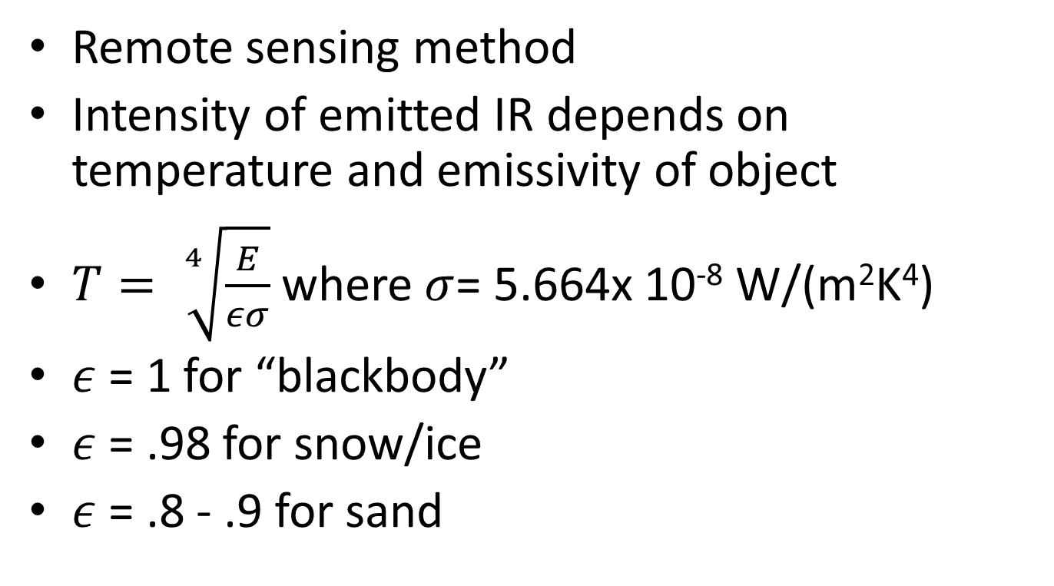
Infrared Sensor- Pyrometer
Remote sensing method
Intensity of emitted IR depends on temperature and emissivity of object
$T= \sqrt[4]{\frac{E}{εσ}}$ where $σ$= 5.664x 10⁻⁸ W/(m²K⁴)
$ε$ = 1 for “blackbody”
$ε$ = .98 for snow/ice
$ε$ = .8 - .9 for sand

Slide 9
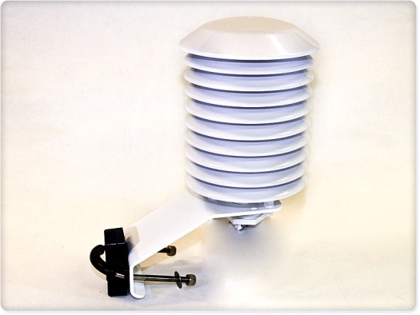
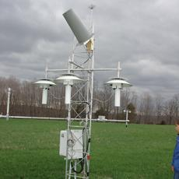
Issues Related to Measuring Temperature
Sensor needs to be in radiative, convective, and conductive equilibrium with environment
Radiation and convection must be minimized (use shield, aspirate)
Convection must be maximized (through aspiration, but that requires power source to run fan)

Slide 10
Temperature errors
Transients- mismatch of environmental conditions and response time of sensor
Conduction- want sensor not to be in contact with anything other than the substance being measured
Wind speed. Small error except when sensor on airplane where friction and compression increase the temperature (more random molecular motion, internal energy). Errors can be as large as 10C for 100 m/s
Radiation- most significant error typically
  Radiation errors largest when max solar radiation, light winds, and a highly reflective ground (snow)
  Measured temperature will be too warm during clear days and too cold during cold nights

Slide 11
Humidity Sensors
Measuring the amount of water vapor in the atmosphere
Humidity measured in variety of ways
  Weight, volume, partial pressure, or fraction of saturation
Remove water vapor from moist air in Lab- dessicant, freezing, filtering
  Chemical reaction approach- remove water vapor by chemical process and weigh in lab

Slide 12
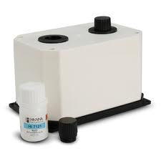
Calibrating RH sensors in lab
Salt/Temperature (C) | 5.0 | 10.0 | 15.0 | 20.0 | 25.0
Lithium chloride | 11.3 | 11.3 | 11.3 | 11.3 | 11.3
Magnesium chloride | 33.6 | 33.5 | 33.3 | 33.1 | 32.8
Potassium carbonate | 43.1 | 43.1 | 43.1 | 43.2 | 43.2
Sodium bromide | 63.5 | 62.2 | 60.7 | 59.1 | 57.6
Sodium chloride | 75.7 | 75.7 | 75.6 | 75.7 | 75.3
Potassium chloride | 87.7 | 86.8 | 85.9 | 85.1 | 84.3
Potassium sulphate | 98.5 | 98.2 | 97.9 | 97.6 | 97.3
Put sensor in air tight chamber above water/salt saturated solution

Slide 13
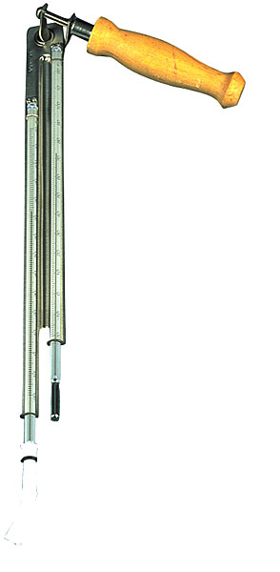
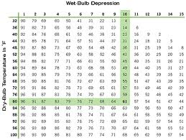
Psychromtery
Add water vapor to measure cooling effect of evaporating water from “wet” bulb vs. dry bulb

Slide 14
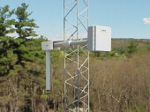
Chilled Mirror/Dew Cells
Attain vapor-liquid or vapor-solid equilibrium
Chilled Mirror: measure the dew/frost point temperature by exposing a cooled mirror to moist air. Can be very accurate
Dew Cell: small heating element surrounded by a solution of lithium chloride. Conduction across this heating element increases as solution absorbs moisture from the air. This absorption causes the current to increase, raising the temperature, which in turn evaporates moisture from the solution. At a certain point, the amount of moisture absorbed equals the amount evaporated.
http://www.yesinc.com/products/met-hyg.html

Slide 15
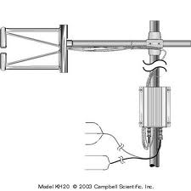
Physical properties of moist air
Refractivity, sound speed, conductivity
absorption of UV light (krypton hygrometer)
  Path length only a few mm
  Accuracy 5-10%

Slide 16
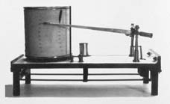
Hygrometers
Use sorption properties of water- hygroscopic substances change length, volume, weight, etc.
Mechanical- horse/human hair

Slide 17
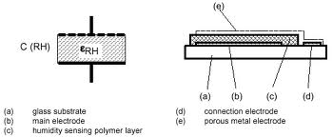
Capacitive (electric hygrometers)
Hygroscopic thin (1um) polymer film between 2 thin metal layers
Upper layer is permeable to water vapor
As water increases in air, capacitance increases

Slide 18
Pressure
Ambient (static) pressure- weight of air above point: Force/unit area
Generally, measure pressure directly but can also measure indirectly from boiling point of liquid exposed to atmosphere (hypsometer)
1 mb per 8 m change in vertical, so knowing correct elevation critical

Slide 19
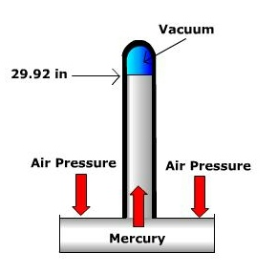
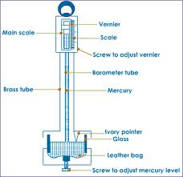
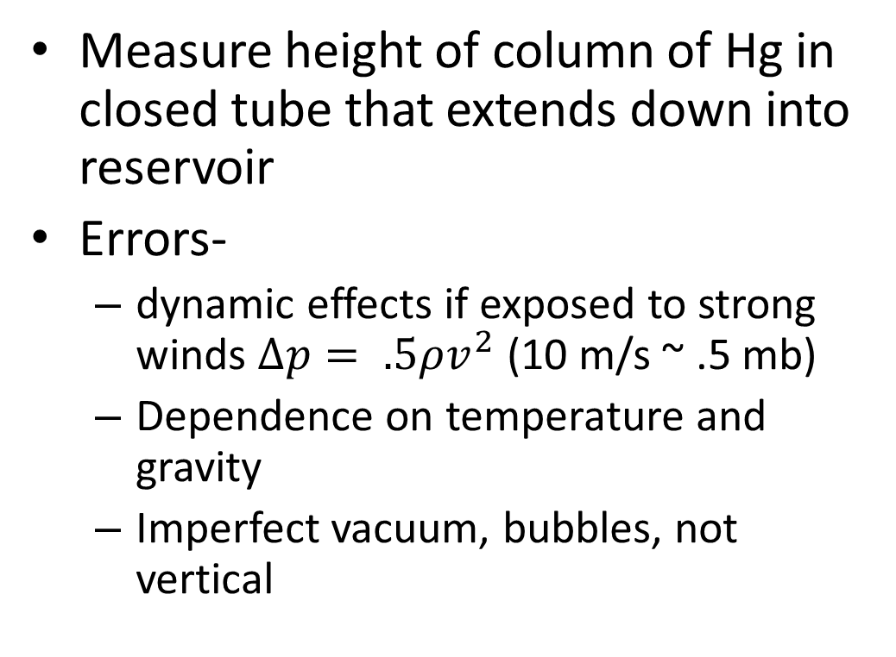
Mercury barometer
Measure height of column of Hg in closed tube that extends down into reservoir
Errors-
  dynamic effects if exposed to strong winds $∆p= .5ρv^{2}$ (10 m/s ~ .5 mb)
  Dependence on temperature and gravity
  Imperfect vacuum, bubbles, not vertical

Slide 20
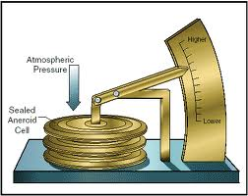
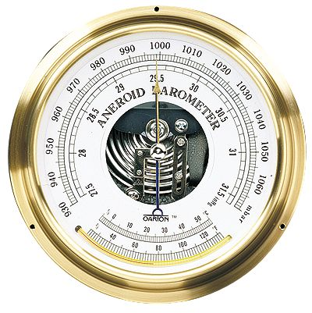
Aneroid (without fluid) barometer
Evacuated chamber with flexible diaphragm that moves in response to applied pressure

Slide 21
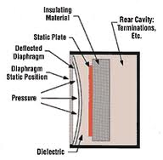
Capacitive pressure transducers
Ceramic capsule that deforms in proportion to applied pressure
As capsule deforms, capacitance of electric circuit changes
As distance between diaphragm and static plate shrings, capacitance increases

Slide 22
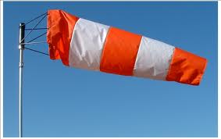
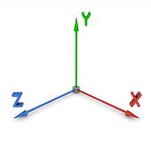
Wind Sensors
Measuring 1-3 dimensions of air motion
Can measure wind speed and direction separately, deduce combined horizontal motion, or measure all 3 components together
Critical to post-process data correctly to determine mean horizontal speed and direction
w
u
v

Slide 23
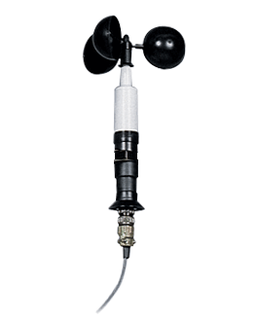
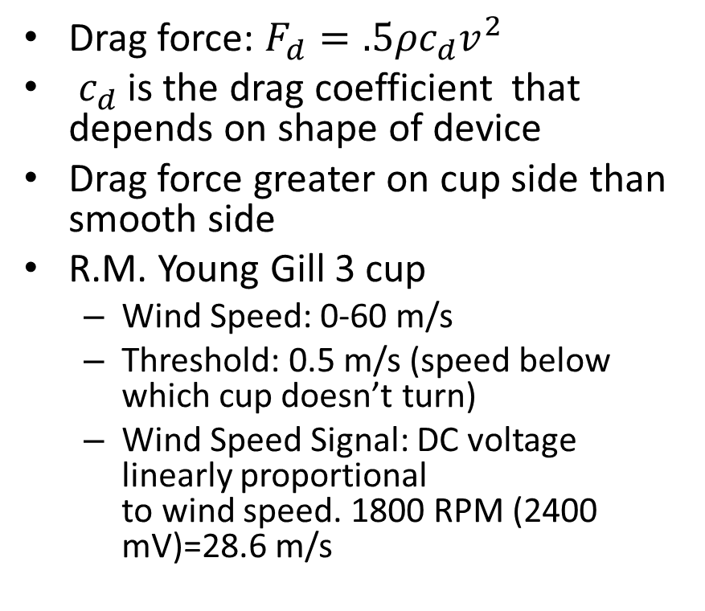
Cup anemometer
Drag force: $F_{d}=.5{ρc}_{d}v^{2}$
$c_{d}$ is the drag coefficient that depends on shape of device
Drag force greater on cup side than smooth side
R.M. Young Gill 3 cup
  Wind Speed: 0-60 m/s
  Threshold: 0.5 m/s (speed below which cup doesn’t turn)
  Wind Speed Signal: DC voltage linearly proportional
  to wind speed. 1800 RPM (2400 mV)=28.6 m/s

Slide 24
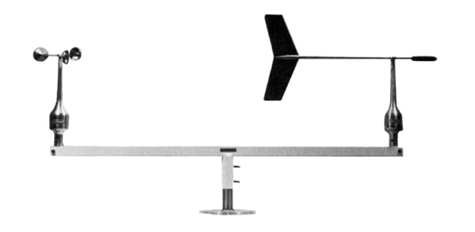
Wind direction
Potentiometer: Variations in wind direction produce a corresponding varying voltage

Slide 25
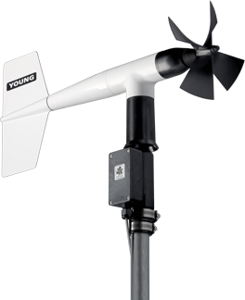
Aerovanes (wind speed and direction)
R.M. Young wind monitor
Range: 0-100 m/s, 0- 360°
Accuracy:Wind Speed: ±0.3 m/s, Wind Direction: ±3 °
Threshold: Propeller: 1.0 m/s (2.2 mph) Vane: 1.1 m/s (2.4 mph)
Signal Output: Wind speed: magnetically induced AC voltage, 3 pulses per revolution. 1800 rpm (90 Hz) = 8.8 m/s (19.7 mph) Wind direction: DC voltage from conductive plastic potentiometer − resistance 10K Ω, linearity 0.25%, life

Slide 26
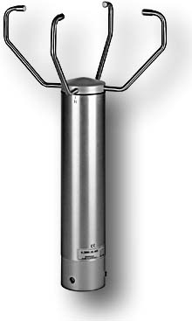
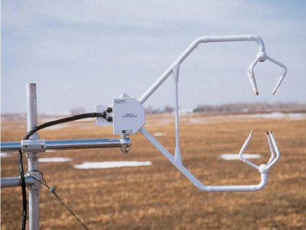
2-D and 3-D Sonic Anemometers
measure wind speed based on the time of flight of sonic pulses between pairs of transducers
Measurements from pairs of transducers can be combined to yield a measurement of velocity in 2-, or 3-dimensional flow
Suitable for measuring turbulent motions (e.g., 1Hz, cycle/sec)
Also measure virtual temperature as need to correct for temperature dependence of speed of sound
No moving parts but tips can get rimed
Wind measurements affected by precipitation

Slide 27
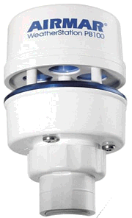
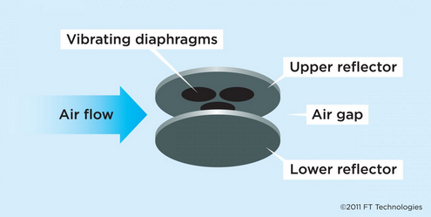
Acoustic Resonance Anemometers
resonating acoustic (ultrasonic) waves within a small cavity
Array of ultrasonic transducers inside cavity, which separate standing-wave patterns at ultrasonic frequencies
Are less accurate than other sonic sensors but:
  cost considerably less
  More compact, less likely to break
  Suitable for measuring winds when mounted on moving vehicles

Slide 28
Distance constant
Hysteresis of some wind sensors can be substantial (cups speed up faster than they slow down)
Convention for wind sensors is to use distance constant rather than time response (τ)
d (distance constant) = τ v
So, “distance” anemometer takes to drop to 37% of original speed for τ = 1 sec and v = 10 m/s is 10 m

Slide 29
Summary
Automated observations require sensors that can convert environmental state into electronic signals
Constantly evolving technologies for nearly all types of sensors
Some sensors are becoming very inexpensive but accuracy of those sensors can be an issue

