Slide 1
Outline
Siting equipment
Metadata
Communicating with remote sites

Slide 2
Siting and Exposure
… is always a compromise
  Why, When, What do you want to measure?
  Is this part of a larger network with specific goals?
  Property access and leasing?
  Power and communication?
  Safety and Vandalism?
  Temporary or permanent deployment?
  Impacts of installation?
The basics: flat and away from obstructions
Sounds simple but…
  Building codes
  Urban areas
  Nearby water bodies
  Canyons
  Cost of communications in remote area
  Carrying cement long distances

Slide 3
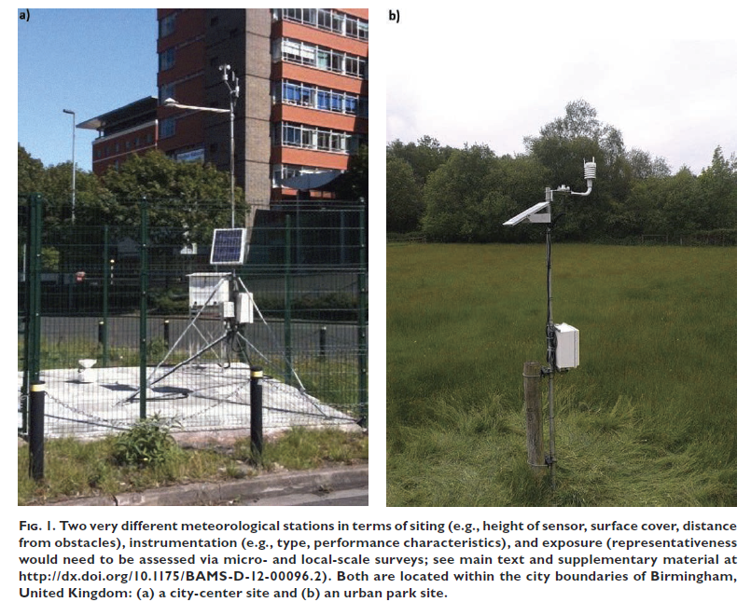

Slide 4
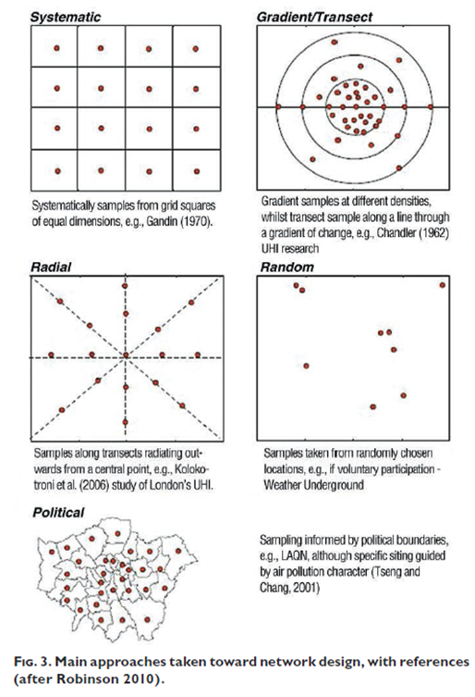
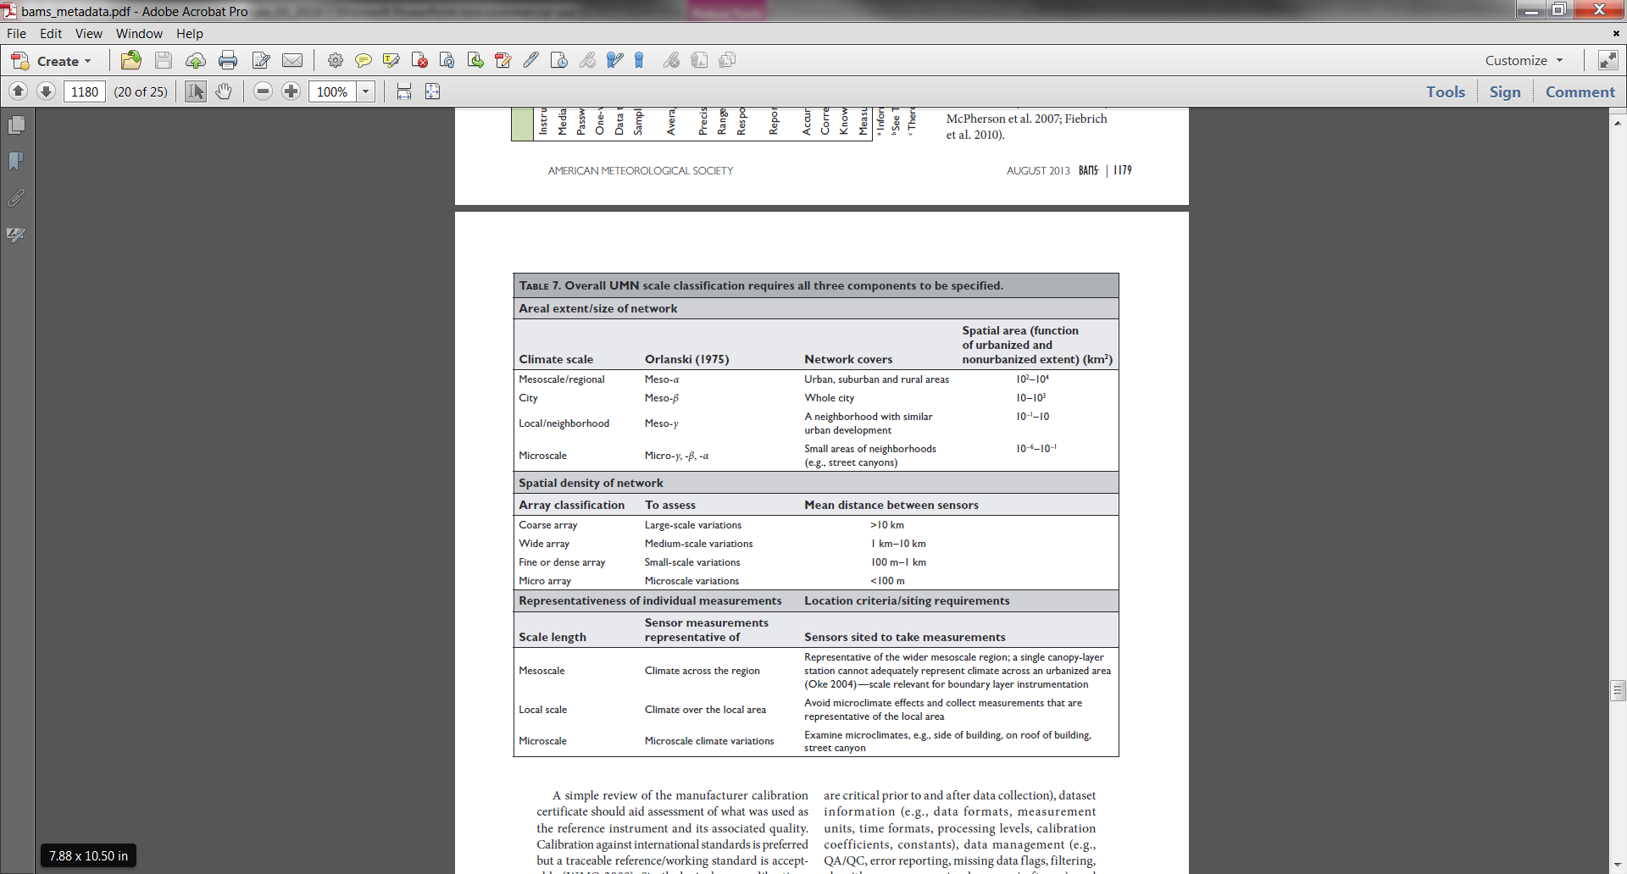
Network Designs

Slide 5
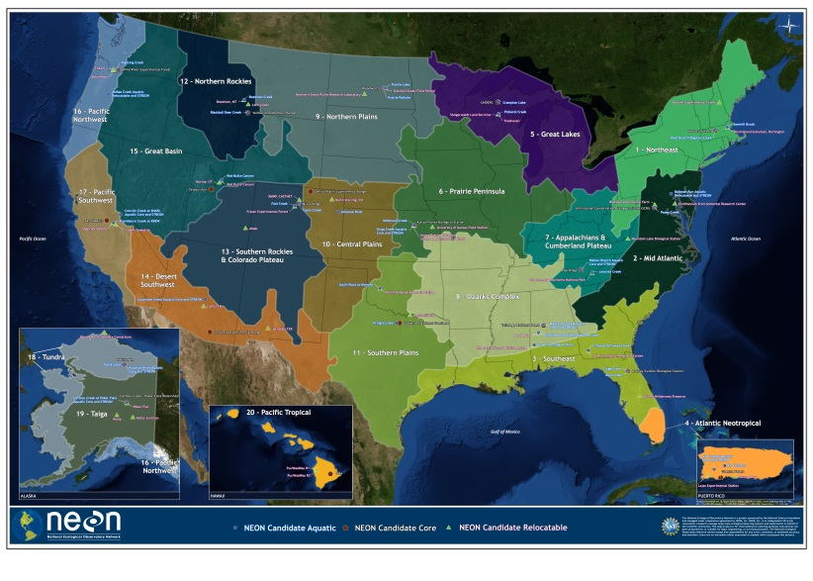
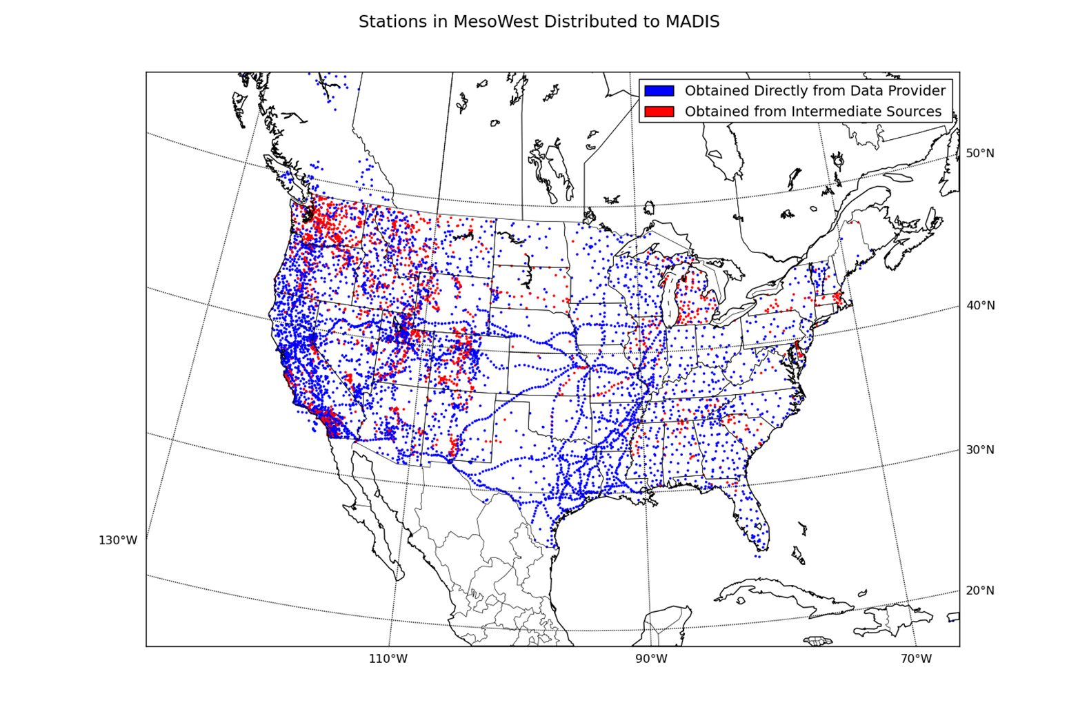
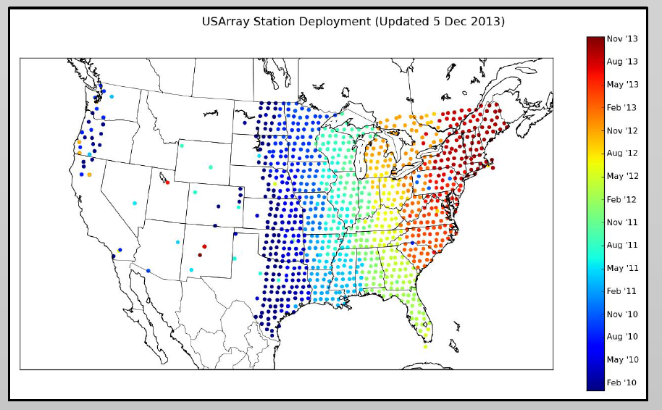
Network Designs
Planned vs organic

Slide 6
The Ultimate Source
WMO Guidelines: http://www.wmo.int/pages/prog/gcos/documents/gruanmanuals/CIMO/CIMO_Guide-7th_Edition-2008.pdf
Easier to swallow: http://www.wxqa.com/resources.html

Slide 7
Sensor Heights
Temperature: typically 1.5-2 m above ground
Radiation: as high as possible and not obstructed from west-south-east aspect
Pressure: inside mounted enclosure
Precipitation as low to ground as possible
Wind: (ugh)
  10 m is aviation standard
  6.3 m (20 ft) is fire weather standard
  Climate Reference Network uses wind speed sensor at 1.5 m
  Lots of 3 m short towers
  Lots of sensors mounted immediately above roofs

Slide 8
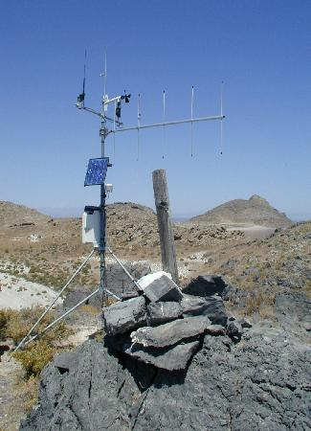
Recognizing Observational Uncertainty Due to Siting
Observations vs. the truth:
  how well do we know the current state of the atmosphere?
All that is labeled data Is NOT gold!
  Lockhart (2003)

Slide 9
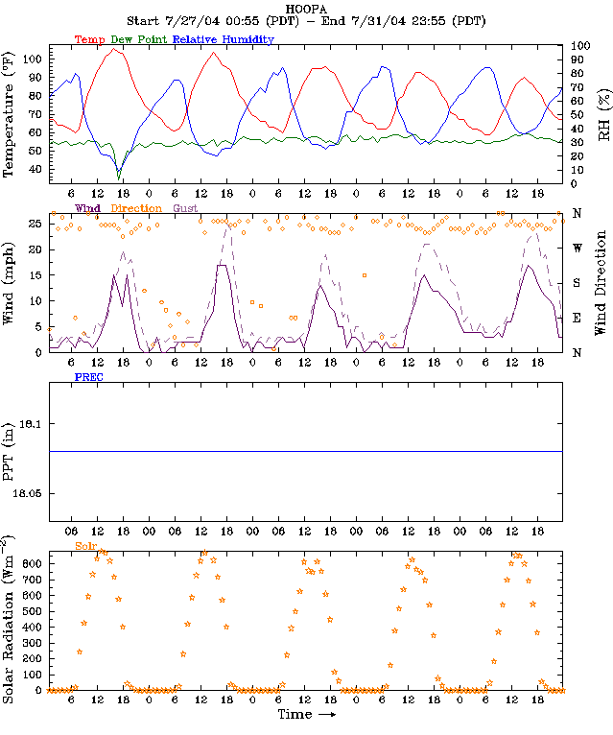
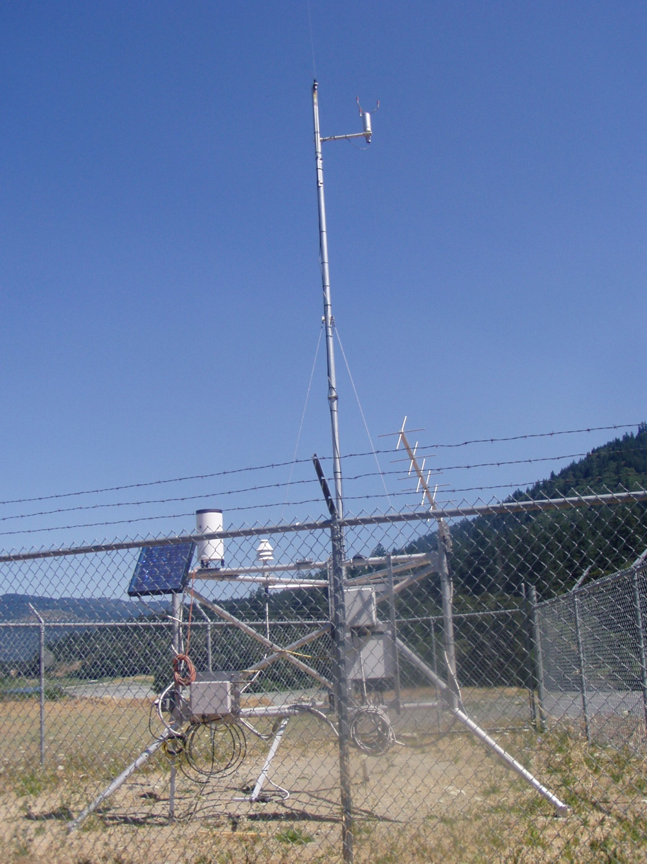
HOOPA RAWS

Slide 10
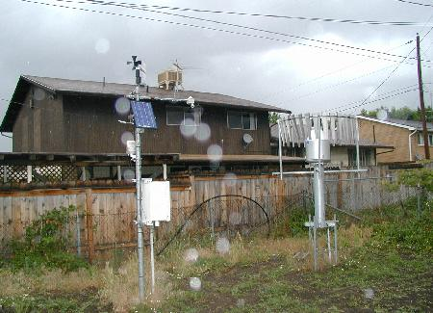
Getting a Handle on Siting Issues & Observational Errors
Metadata errors
Instrument errors (exposure, maintenance, sampling)
Local siting errors (e.g., artificial heat source, overhanging vegetation, observation at variable height above ground due to snowpack)
“Errors of representativeness” – correct observations that are capturing phenomena that are not representative of surroundings on broader scale (e.g., observations in vegetation-free valleys and basins surrounded by forested mountains)

Slide 11
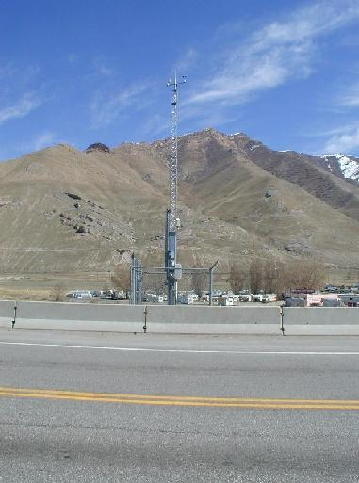
Are All Observations Equally Good?
Why was the sensor installed?
  Observing needs and sampling strategies vary (air quality, fire weather, road weather)
Station siting results from pragmatic tradeoffs: power, communication, obstacles, access
Use common sense and experience
  Wind sensor in the base of a mountain pass will likely blow from only two directions
  Errors depend upon conditions (e.g., temperature spikes common with calm winds)
  Pay attention to metadata
Monitor quality control information
  Basic consistency checks
  Comparison to other stations

Slide 12
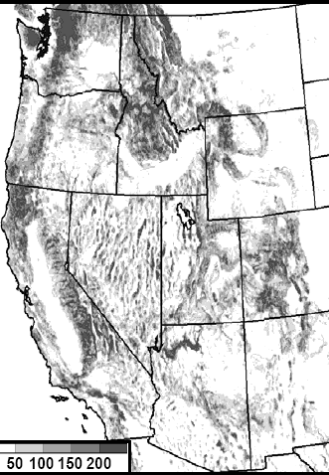
Representativeness Errors
Observations may be accurate for that specific location…
But the phenomena they are measuring is not at scales of interest- this is interpreted as an error of the observation
Common problem over complex terrain
Also common when strong inversions
Can happen anywhere
Sub-5km terrain variability (m)
(Myrick and Horel, WAF 2006)

Slide 13
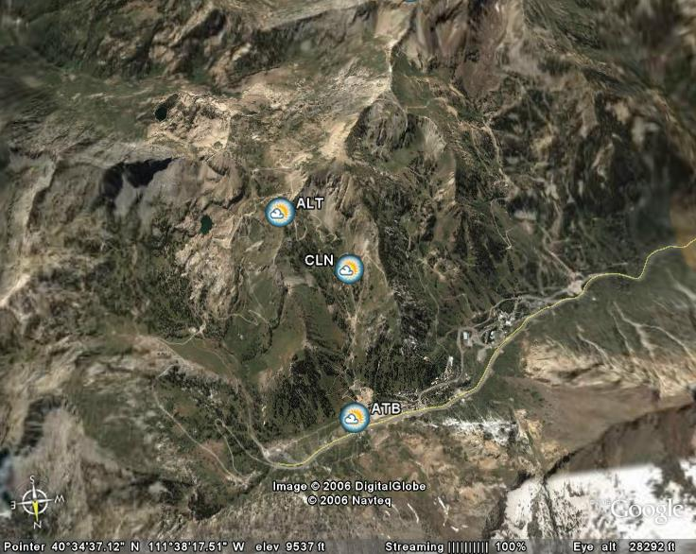
Representative errors to be expected in mountains
Alta Ski Area
~5 km
~2.5 km
~2.5 km
~5 km

Slide 14
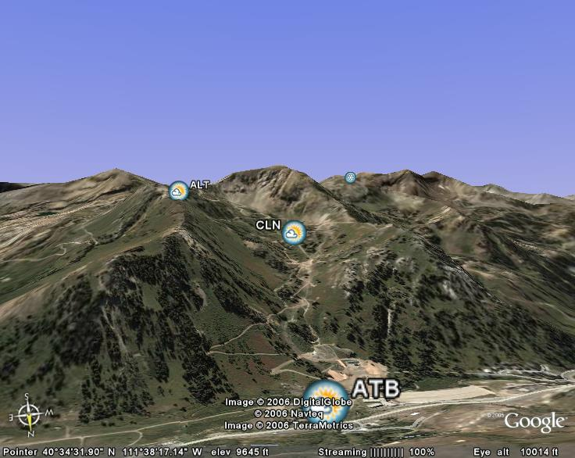
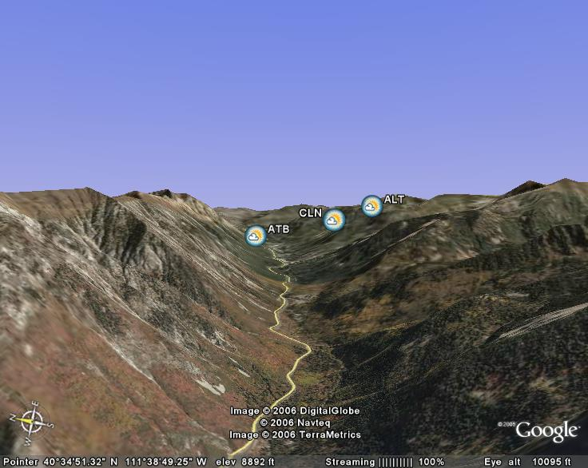
Alta Ski Area
3183m
2944m
2610m
Looking up the mountain
Looking up Little Cottonwood Canyon

Slide 15
Alta Ski Area
2100 UTC 17 July 2007
18ºC
22ºC
25ºC

Slide 16
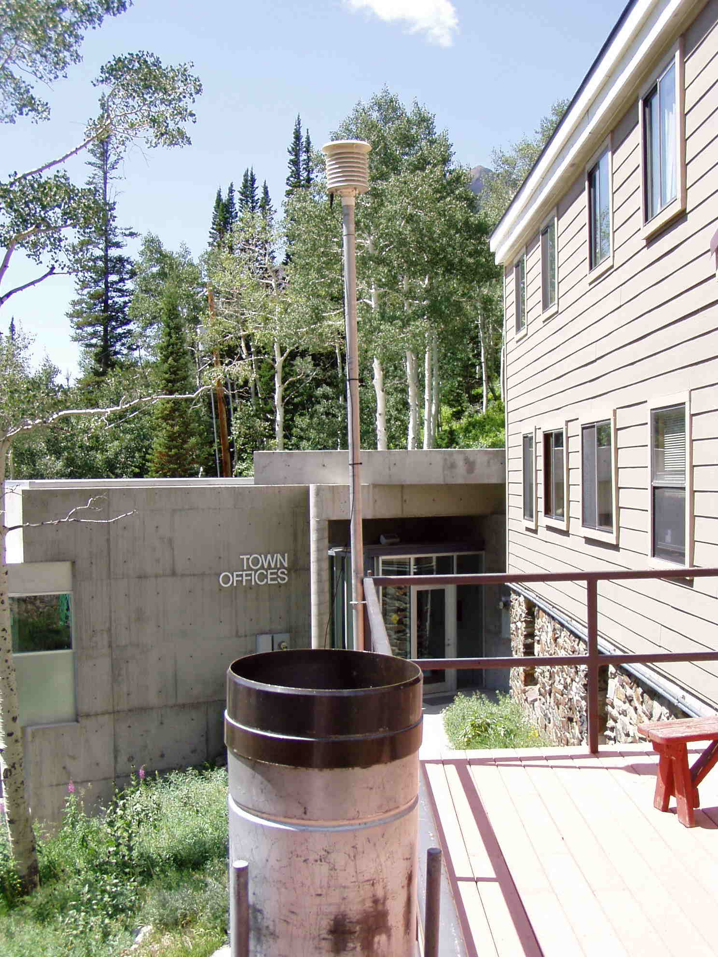
Alta Coop

Slide 17
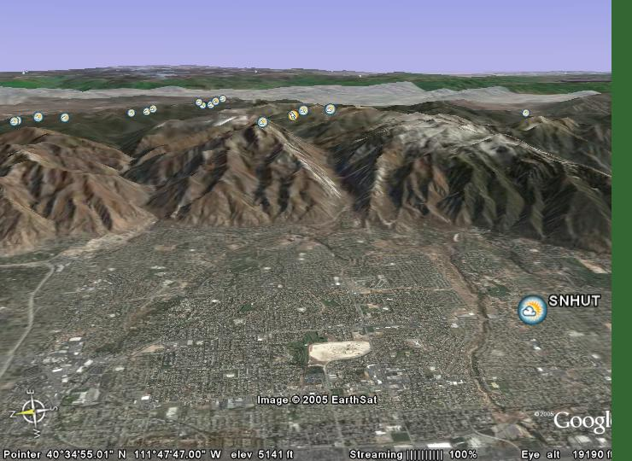
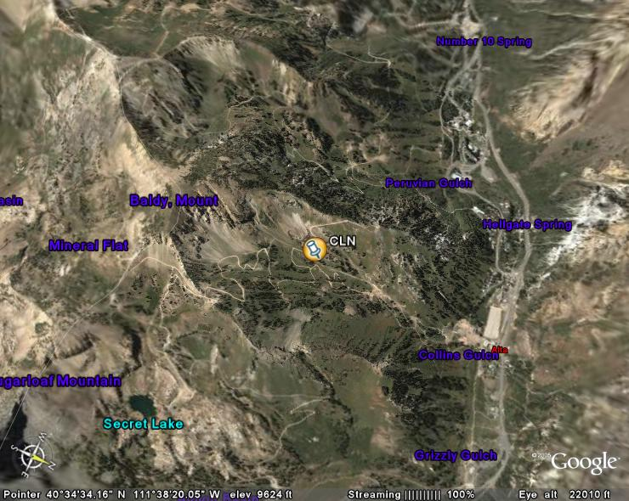
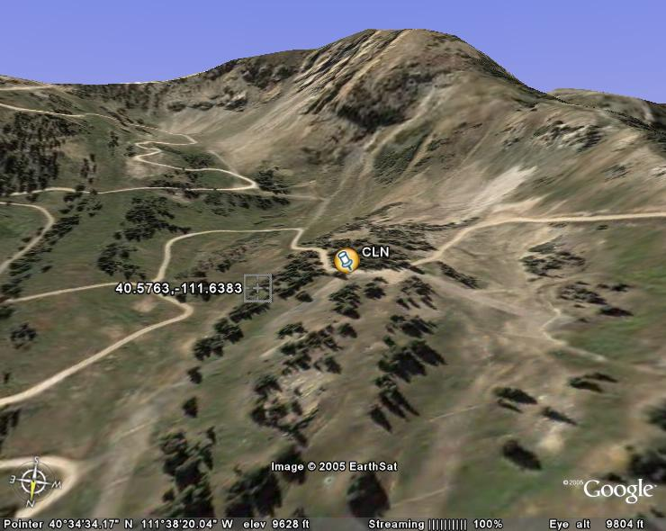
Alta Collins
40.576097, -111.638989

Slide 18
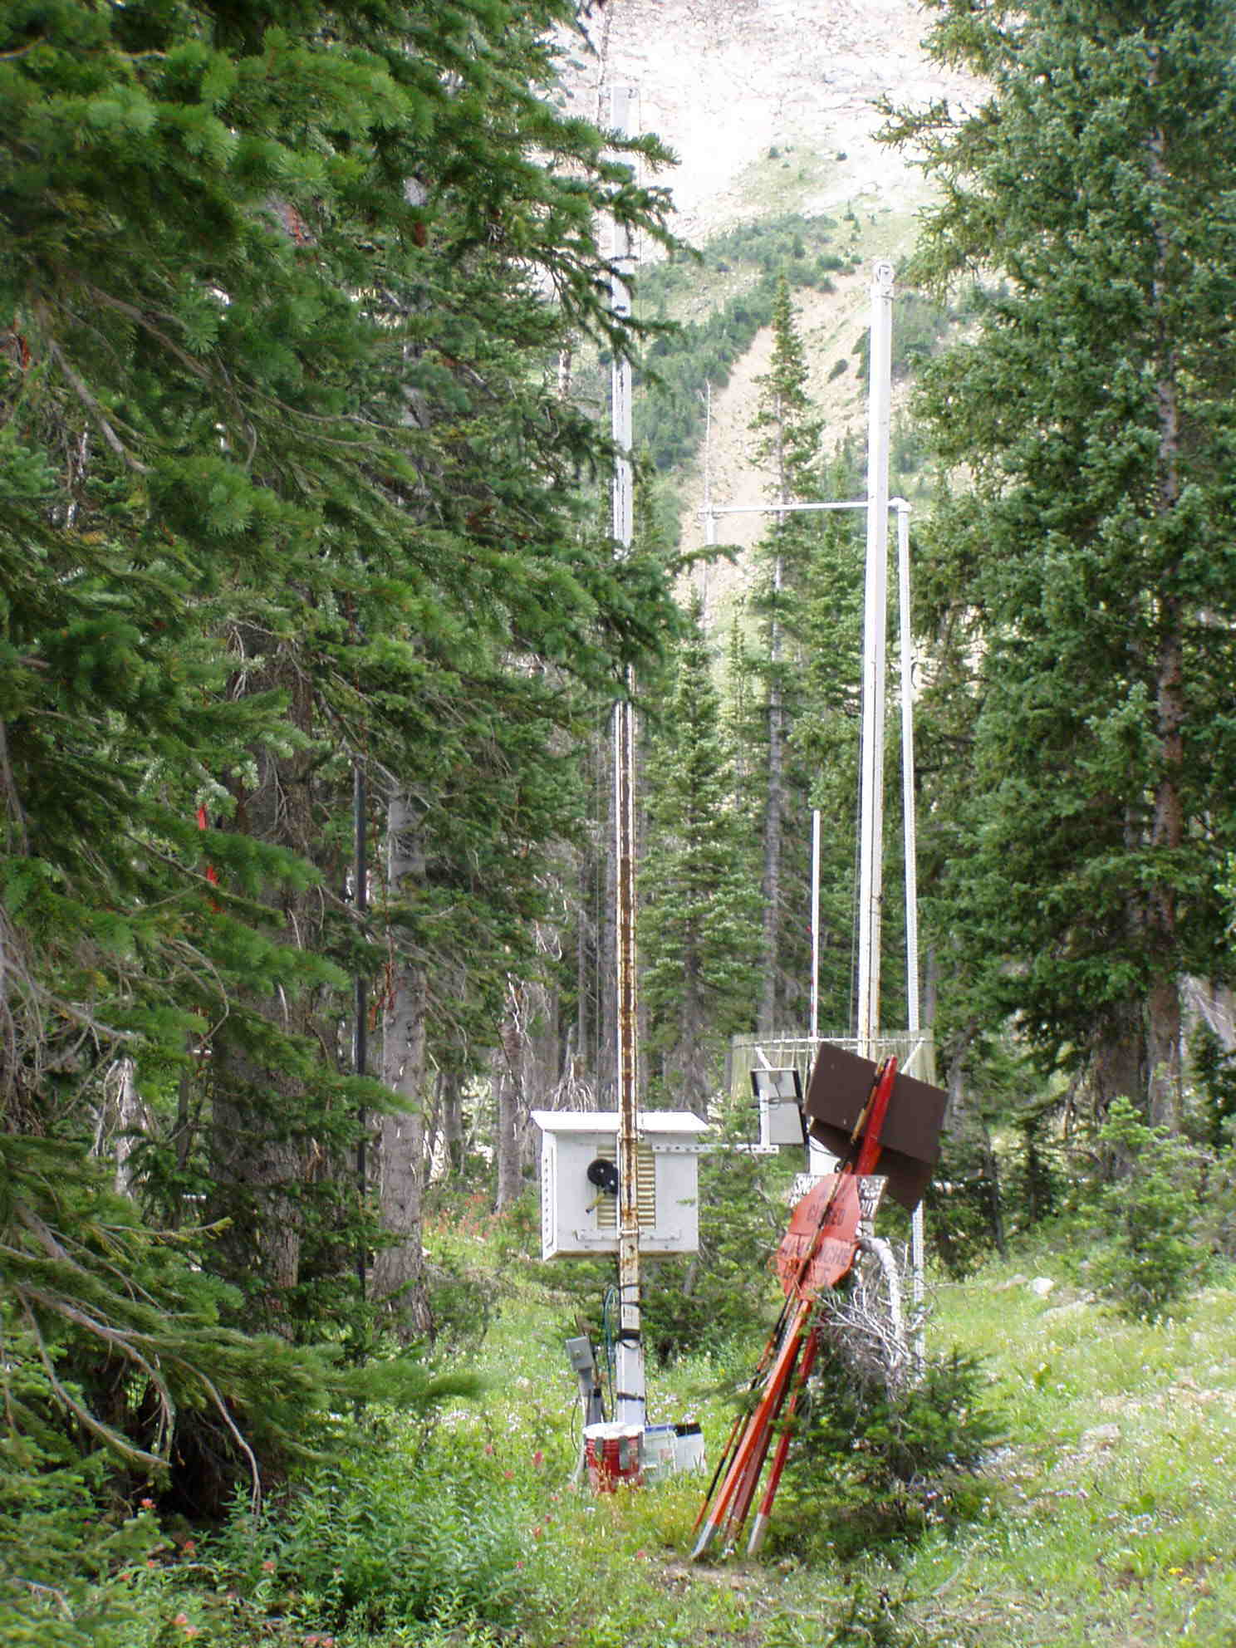
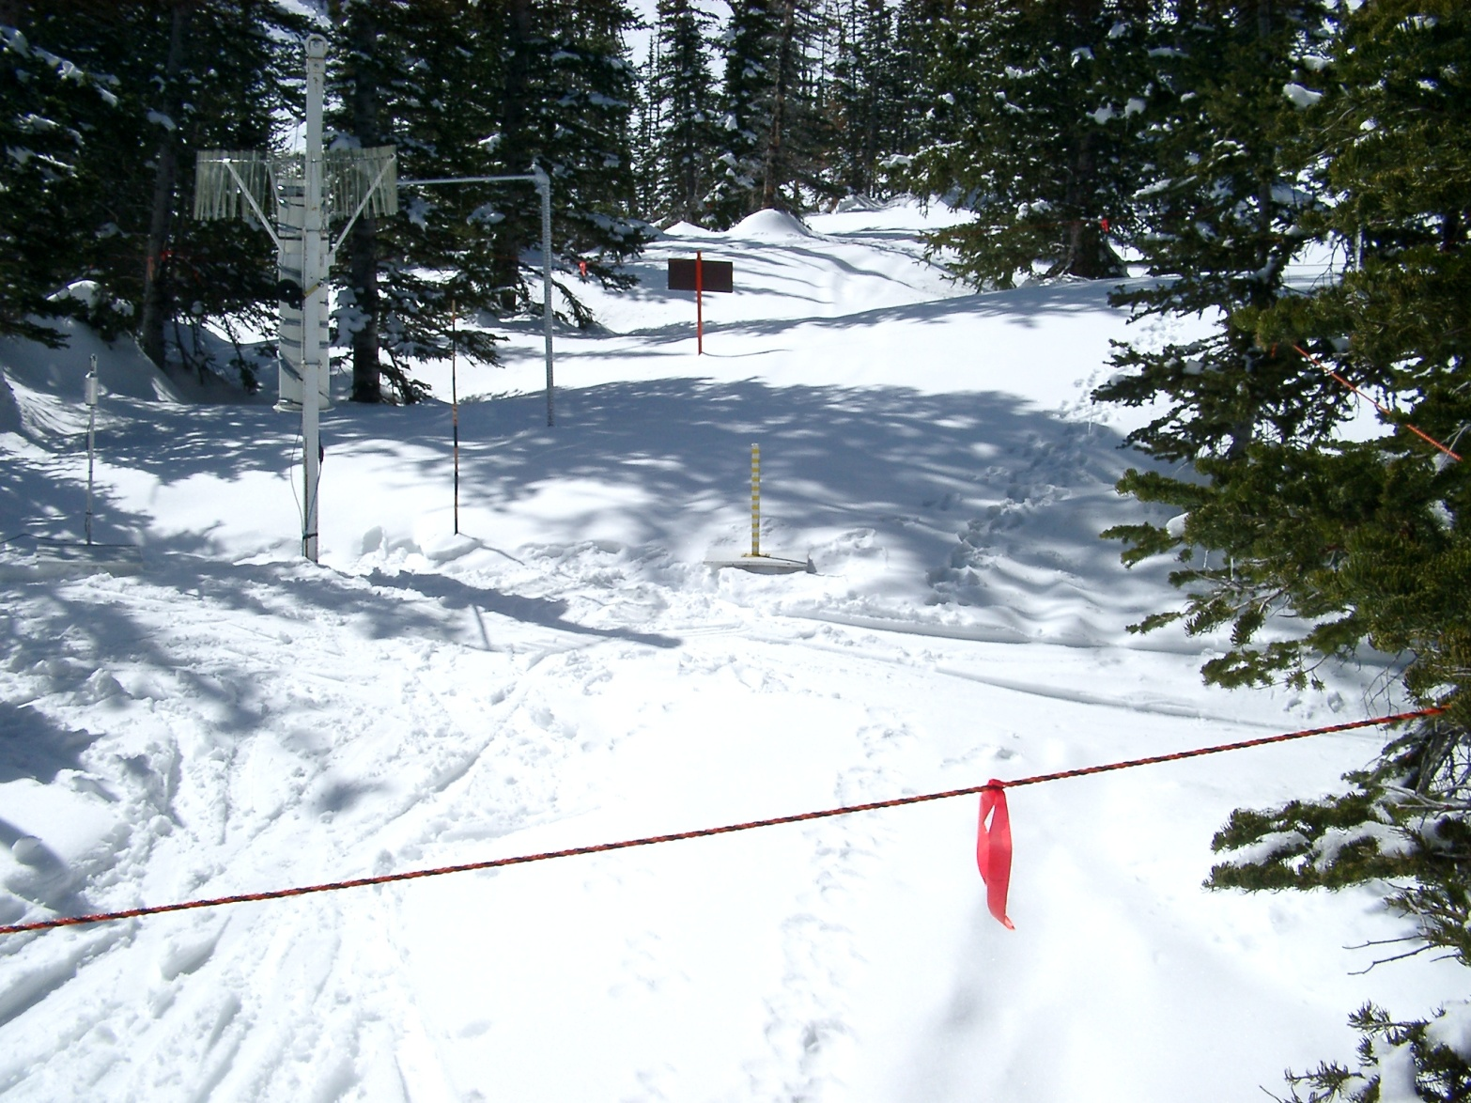
Alta Collins
August 21, 2005
April 12, 2005
D. Whiteman
J. Horel

Slide 19
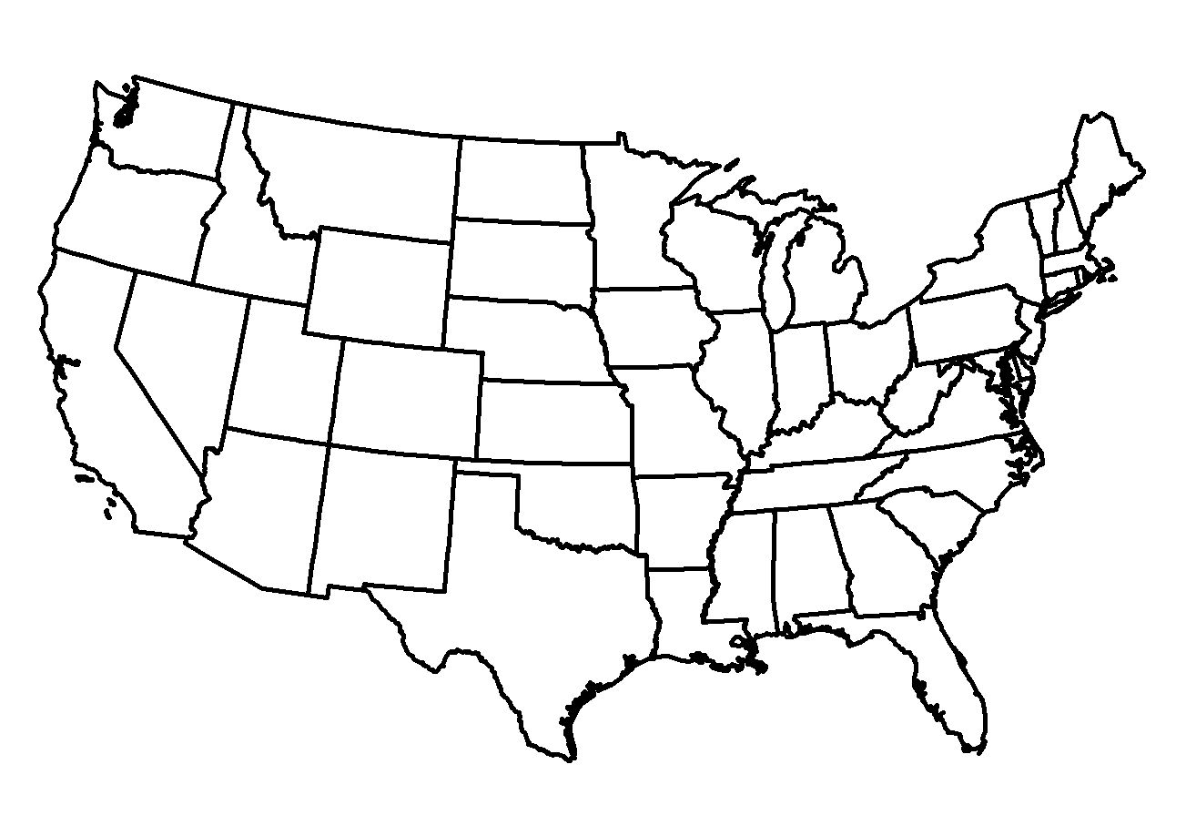
USCRN CONUS Deployments
Installed Pair (14)
Installed Single (100)
+ 4 in Alaska and 2 in Hawaii
As of August 15, 2008

Slide 20
USCRN sensors
http://www.ncdc.noaa.gov/crn/instrdoc#SENSORS

Slide 21
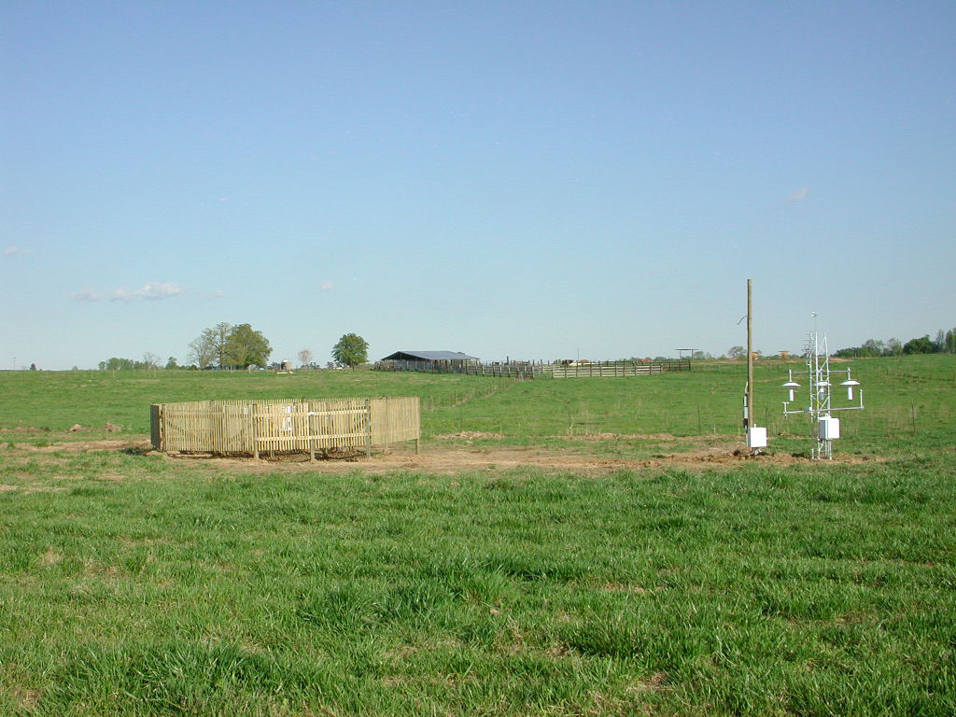
AL Gadsden 19 N, Sand Mountain Research Extension (Northwest Pasture)
34.3 N 86.0 W 1160’
April 14, 2005

Slide 22
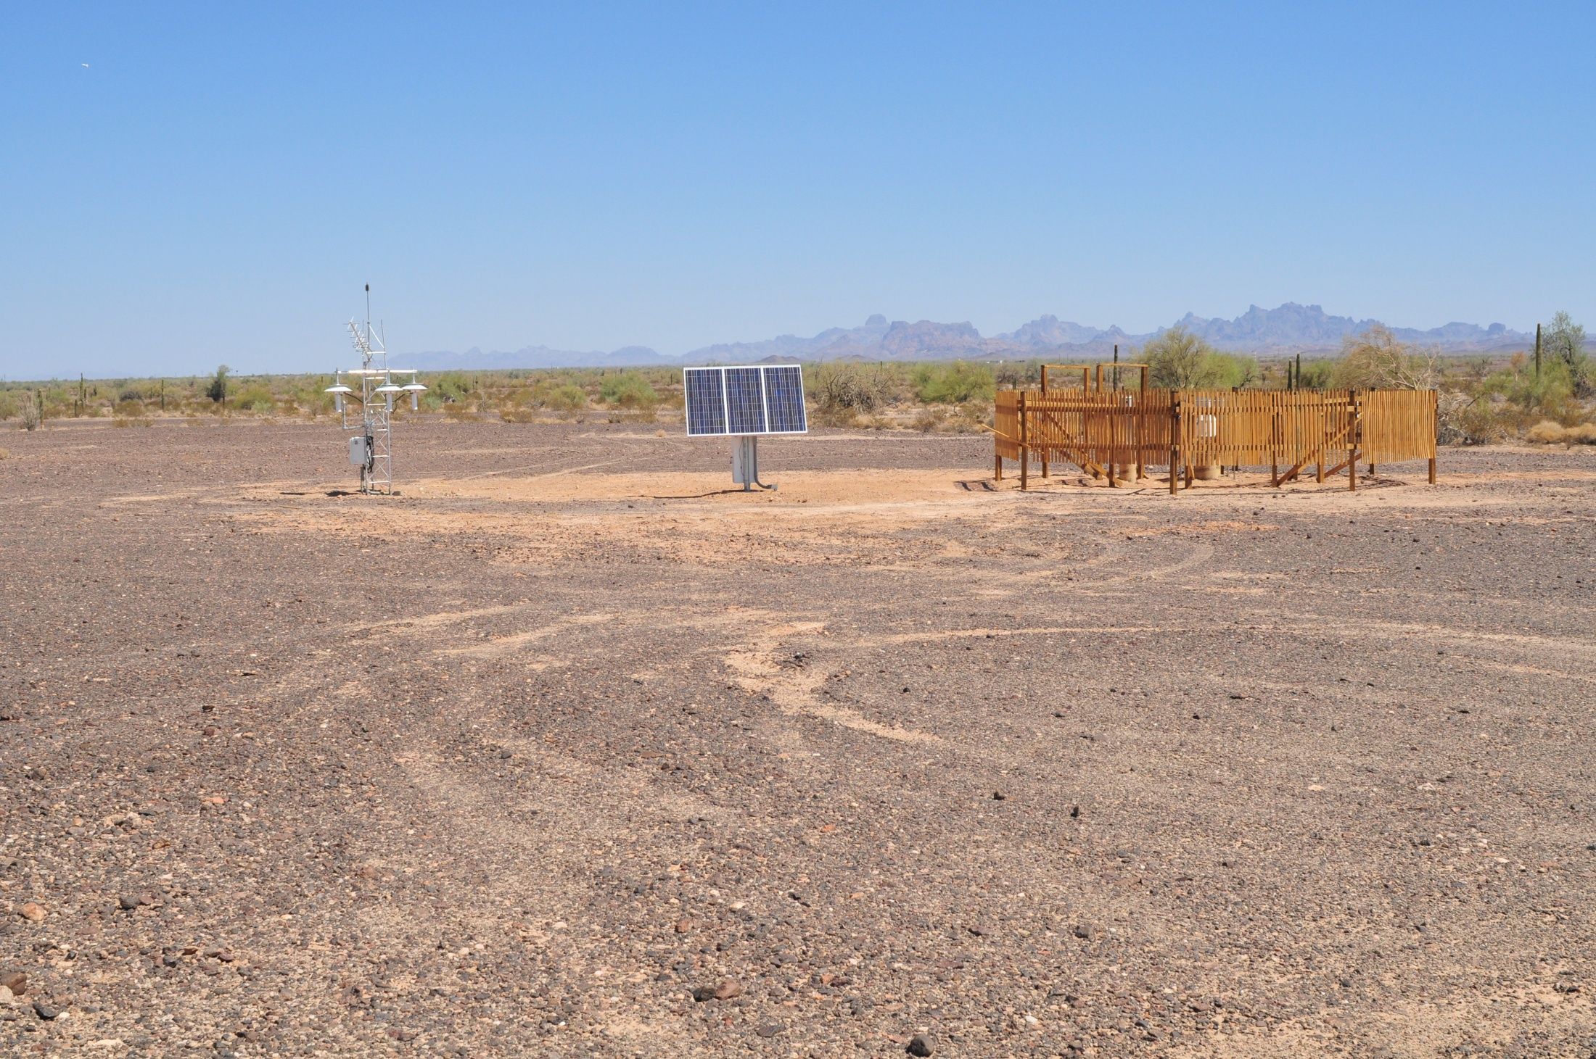
AZ Yuma 27 ENE, U.S. Army Yuma Proving Ground (Redbluff Pavement Site)
32.8 N 114.2 W 600’
March 19, 2008

Slide 23
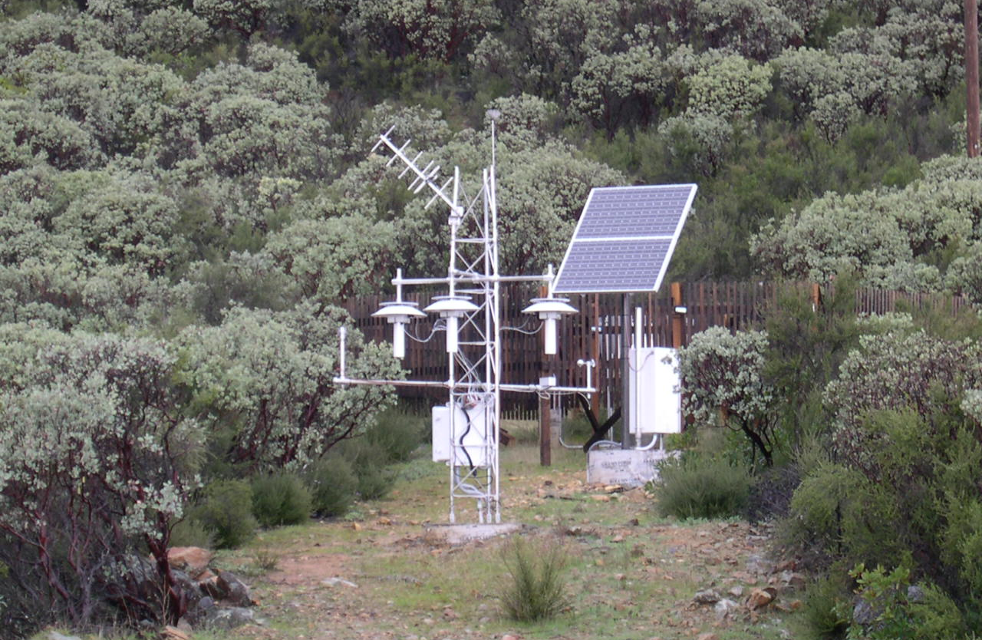
CA Redding 12 WNW, Whiskeytown National Recreation Area (RAWS Site)
40.7 N 122.6 W 1412’
March 25, 2003

Slide 24
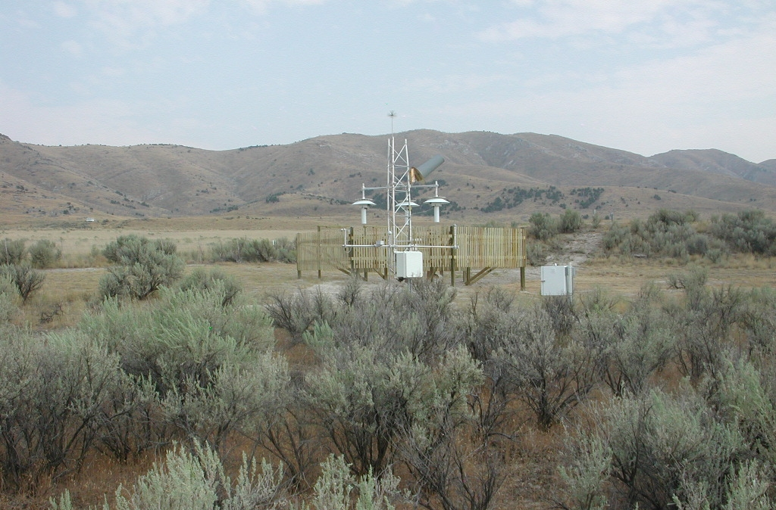
UT Brigham City 28 WNW, Golden Spike National Historic Site
41.6 N 112.5 W 4938’
October 26, 2007

Slide 25
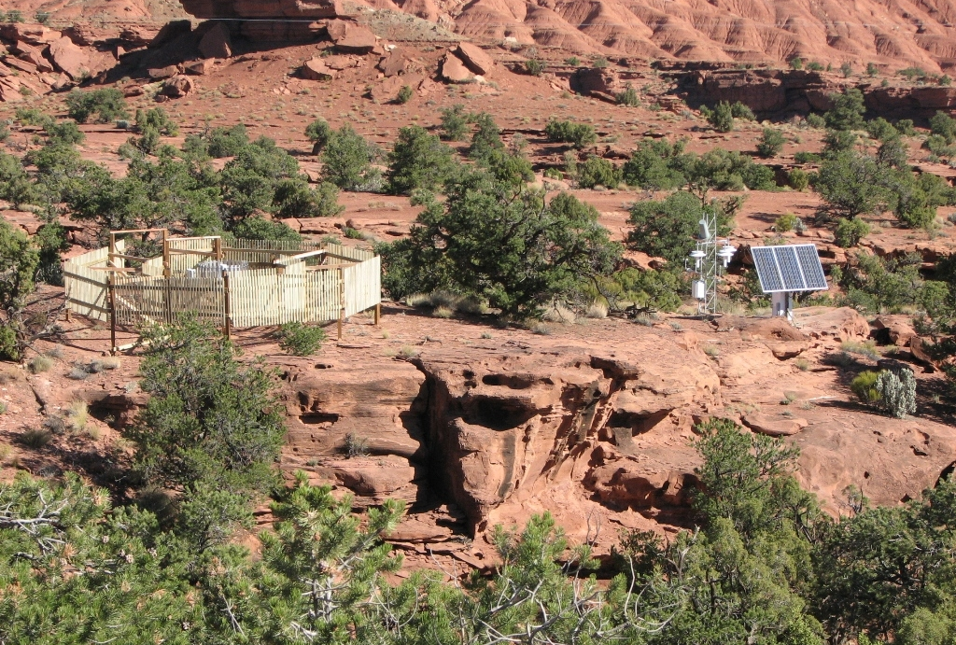
UT Torrey 7 E, Capitol Reef National Park (Goosenecks Road Site)
38.3 N 111.3 W 6211’
October 2, 2007

Slide 26
Metadata
We need to know:
  What, Where, How, When, and Why observations are taken
Metadata is the information about the data
  Understanding “why” is the key- people don’t collect data without a reason
US Climate Reference Network and Oklahoma Mesonet are examples of excellent efforts to keep accurate metadata

Slide 27
Reasons People Provide No or Inaccurate Metadata
Difficult to keep track of
Out of date standards in reporting
Security concerns
Example:
  Brighton UT NRCS: http://www.wcc.nrcs.usda.gov/nwcc/site?sitenum=366&state=ut
  40 deg; 36 min N; 111 deg; 35 min W

Slide 28
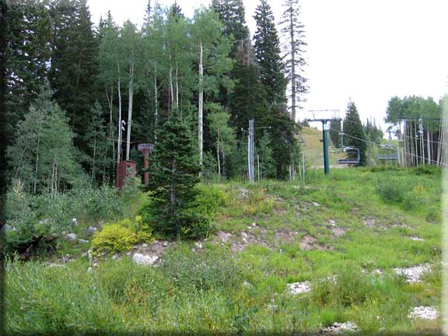
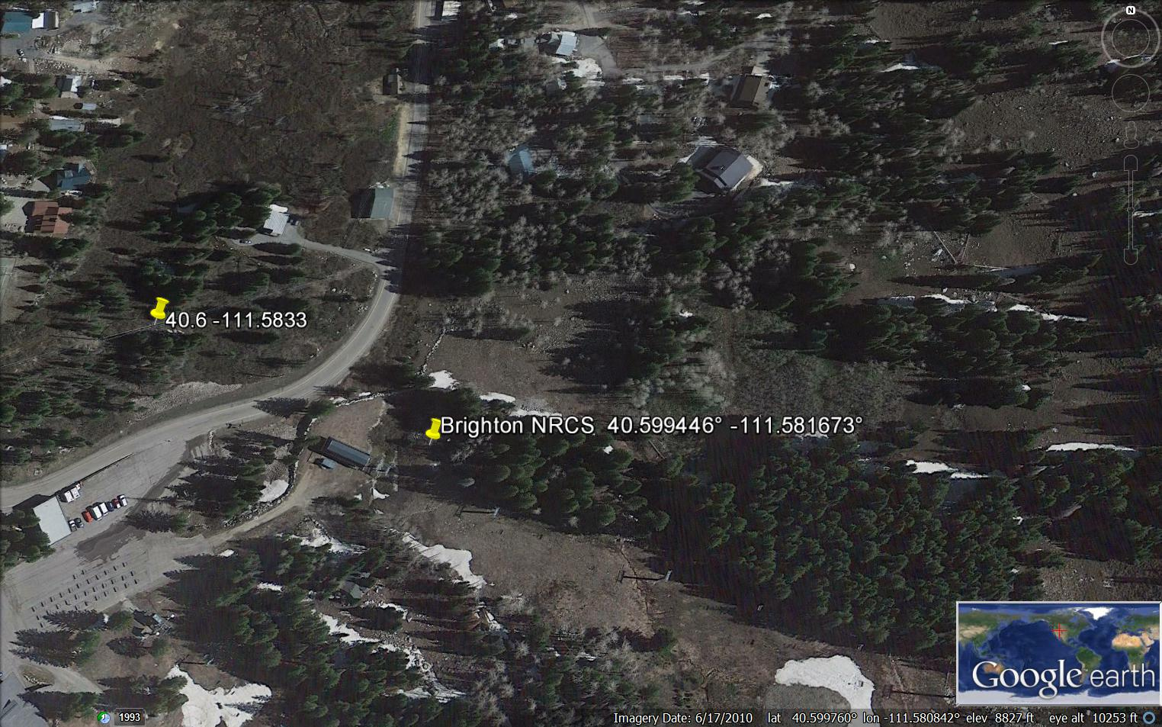
Brighton NRCS

Slide 29
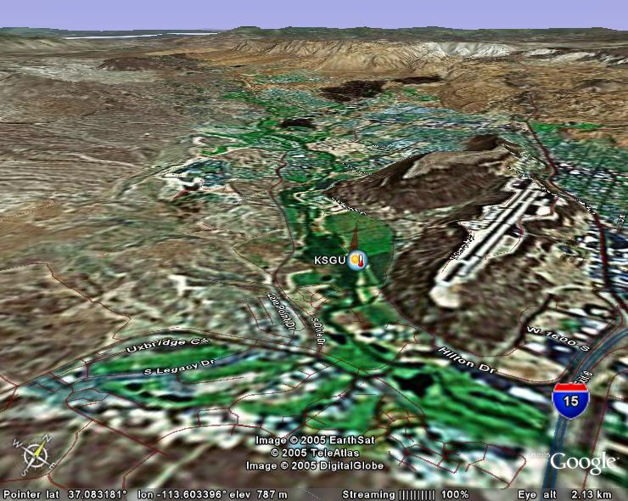
(OLD) Inaccurate Metadata

Slide 30
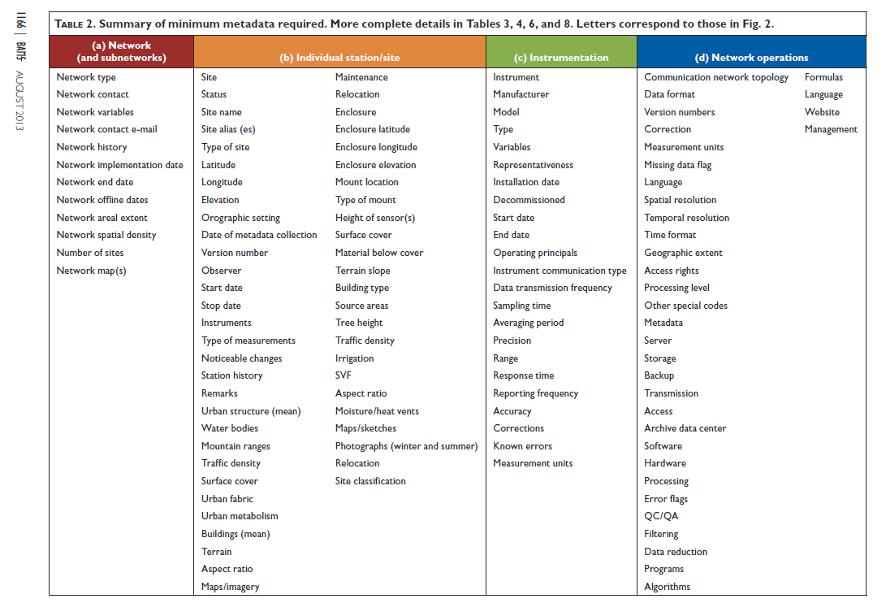
Metadata in Urban Environments

Slide 31
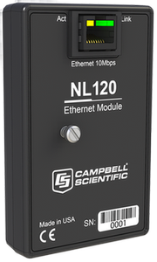
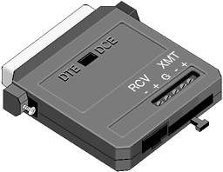
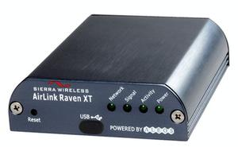
Communicating with Remote Sites
Sneakernet
  An outdoor person’s preference?
ethernet using TCP/IP
  Need fixed IP address
  But beware of fire wall issues
Short haul modems
  Range 5-6 mi
  Requires ethernet at one end
Phone/Cell phone
  flexible option
  Ongoing costs
  Nearest cell phone tower

Slide 32
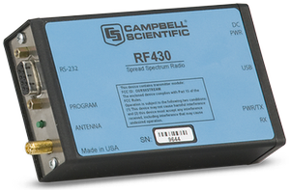
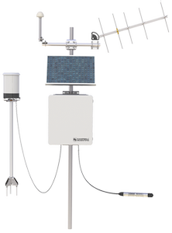
Communicating with Remote Sites
Spread spectrum radio
  Great for local networks
  Requires at least 2 radios
  No recurring costs
GOES or ARGOS polar satellite radio
  Only game in town for really remote sites
  Expensive
  limited bandwidth, unidirectional
  Requires coordination with NOAA
Meteor burst scattering
  Used by NRCS
  Only allows communication once every few hours

Slide 33
Summary
Siting: be realistic, perfect sites are hard to find
Metadata: keep track and pass the info along
Communication: Best equipment is not doing any good if you can’t get to the site

