Slide 1
Outline
Basic electronic circuitry
Batteries and power supplies

Slide 2
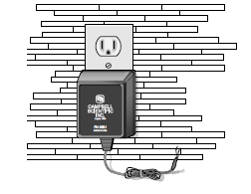
Use of direct current
Most instrumentation uses small current, small voltage to not affect the environment in which the measurement is taken
CR1000 logger typically operating ~1 amp (always less than 3 amp)
Alternating current (60 cycles/sec; 110-120 Volt)
If power source available, then often use transformer to step 110 Volt AC down to 12 volt DC (or 12 Vdc)
Campbell 9591: 18 Vac 1.2 Amp Wall Plug Charger
In remote locations, deep cycle battery connected to 10 Watt solar panels typically sufficient for basic instrumentation, but not enough for fans or heaters that require extra power

Slide 3
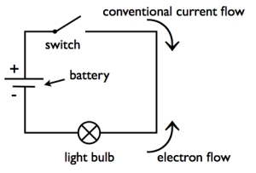
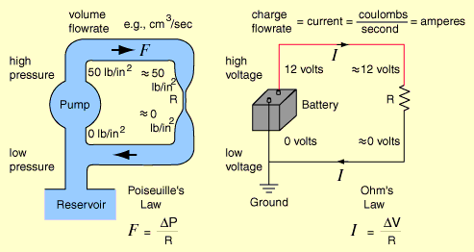
Basic Circuit
Consider a circuit in which a 12 volt battery is driving a flow of electrons
Think of the voltage difference between the two terminals of the battery as “pushing” the flow of electrons from the negative terminal to the positive terminal
Remember- convention is the current “flows” from the positive terminal to the negative terminal

Slide 4
Basic Circuit
The negative terminal (low voltage) can be considered to be at 0 voltage relative to the earth “ground”
Voltage difference akin to the atmospheric pressure difference “pushing” air molecules or pump pushing water

Slide 5
Ohm’s Law
V- Voltage drop (difference) across a resistor with resistance (R) and current (I) is
V = I * R
Units: Volts = amps * ohms
V is also related to the power loss P or dissipation of heat by the resistor
P = I * V = I² * R
Power is the rate at which energy is used
Power Units: Watts = Joules / sec
Example: 12 ohm resistor connected to a 12 volt battery (I = 1 amp), then P = 12 Watts
Stating the obvious
  connecting the two leads from a battery directly in a DC circuit will cause a short-circuit potentially leading to the battery smoking and eventually catching on fire if no fuse or circuit breaker in the loop because there is very small resistance and then way too much current
  Charging a battery incorrectly by crossing the leads is similar

Slide 6
Avoiding an oops
  connecting the two leads from a battery directly in a DC circuit will cause a short-circuit potentially leading to the battery smoking and eventually catching on fire if no fuse or circuit breaker in the loop because there is very small resistance and then way too much current
  Charging a battery incorrectly by crossing the leads is similar

Slide 7
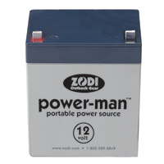
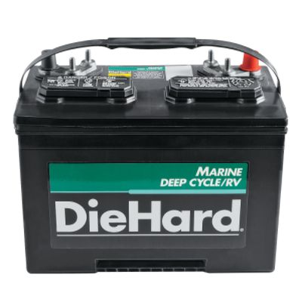
Deep cycle battery
Gel cells are safer (no spilling of acid) but more expensive than deep cycle and lower amount of stored energy
200 amp hour means that 1 amp can be supplied for 200 hours and remain above 10 volts, below which electron flow typically too weak for instrumentation

Slide 8
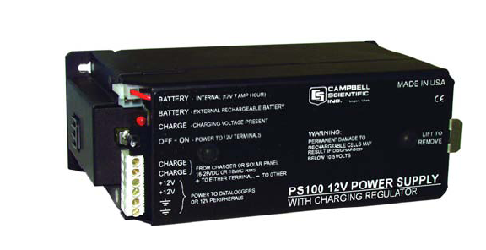
Recharging a Battery With a Solar Panel
10 Watt solar panel- that is max power
Typically designed for 16.8 max voltage
Then I = .59 amp
What happens if add a second or bigger panel? 20 watts
Then I = 1.1 amp
But, PS100 power supply/
regulator has 1.2 amp limit
Result- fry regulator
Solution- buy new
regulator that allows higher current flow

Slide 9
Kirchoff’s Law
Voltage- the sum of all voltage drops around a circuit is zero
Current- the sum of all current flowing into/out of a junction is zero (what comes in must go out)

Slide 10
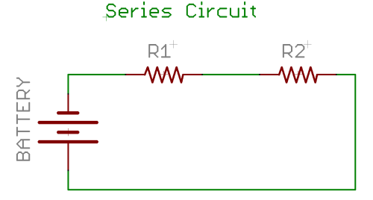
Series Circuit
In a series circuit, where a battery with voltage drop V, then according to Kirchoff’s law:
V – V₁ – V₂ = 0 or V = V₁ + V₂
V₁ = I R₁ and V₂ = I R₂ then V = I (R₁ + R₂ ) = I R_{e}
R_{e} = effective resistance of the combined effect of the 2 resistors in series

Slide 11
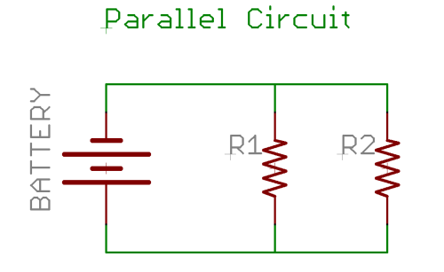
Parallel Circuit
In a parallel circuit, current splits at A and recombines at B
With a battery with voltage drop V, then according to Kirchoff’s law:
At A: I – I₁ – I₂ = 0 At B: I₁ + I₂ – I = 0
Then I = I₁ + I₂ and V /R_{e} = V /R₁ + V /R₂
then R_{e} = (R₁ R₂)/ (R₁ + R₂ )
R_{e} = effective resistance of the combined effect of the 2 resistors in parallel
A
B

Slide 12
Examples
Series: V = 12 volt; R₁ = 5 ohms; R₂ = 7 ohms
What is the effective resistance?
  R_{e} = (R₁ + R₂ ) = 12 ohms
What is the current? I = V/ R_{e} = 1 amp
Parallel: V = 12 volt; R₁ = 5 ohms; R₂ = 7 ohms
What is the effective resistance?
  R_{e} = (R₁ R₂)/ (R₁ + R₂ ) = 35/12 ~ 3 ohms
What is the total current? I = V/ R_{e} ~ 4 amps
I₁ = V /R₁ = 12/5 = 2.4 amps; I₂ = V /R₂ = 12/7 = 1.6 amps

Slide 13
Key Relationships
In series:
  Effective resistance of multiple resistors is always higher than individual ones
  Voltage is divided between the resistors
  Current is the same through all resistors
In parallel:
  Effective resistance of multiple resistors is always lower than individual ones
  Voltage is the same through the resistors
  Current is divided between the resistors

Slide 14
Voltage Divider
When resistors are in series, then they “divide” the voltage input into:
V₁ = I R₁ and V₂ = I R₂
Since (R₁ + R₂ ) = R_{e} and V = I R_{e} then
V₁ = V * R₁/ R_{e} and V₂ = V * R₂/ R_{e} and V₁ /V= R₁/ R_{e} and V₂ /V = R₂/ R_{e}
Example: V = 12 volts; R₁ = 240 ohms; R₂ = 120 ohms; then R_{e} = 360 ohms.
  So V₁ = 8 volts; So V₂ = 4 volts
The input voltage is divided depending on the relative size of the 2 resistors

Slide 15
Potentiometer (POT)
Assume R₂ is variable- free to be big or small by turning a knob like a car radio tuner or could be big or small by changes in environmental conditions
We attach electrodes of a voltmeter on either side of the variable resistor
As before, R_{e} = R₁ + R₂ . Then the voltmeter sees: V₂ = V * R₂/ R_{e}
Now, if R₁ >> R₂ , V₂ / V = R₂/ R₁
What is known? V and R₁ are fixed. We measure V₂ and then we can compute R₂ which is a variable response to environmental conditions
Voltmeter

Slide 16
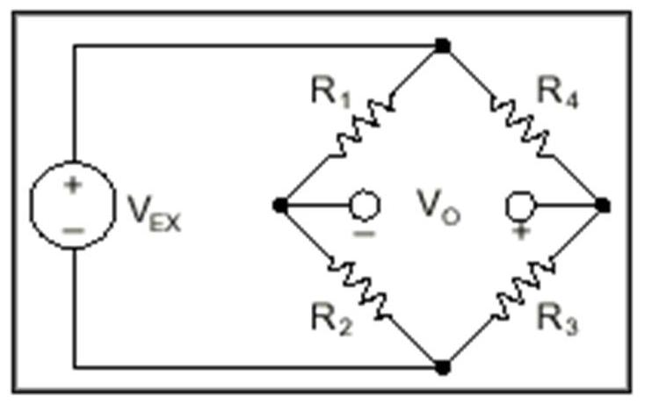
Wheatstone Bridge
Resistors are often used to measure temperature
Consider for a circuit with a 12 volt battery that there are two serial pairs of resistors: Series 1 has resistors R₁ and R₂ while series 2 has R₃ and R₄. Series 1 and Series 2 are in parallel.
We connect a voltmeter V_{o} from the middle of Series 1 and 2.
Assume that R₁ = 1 ohm R₂ = 2 ohm, then V₁ = 4 volts and V₂ = 8 volts
Assume further that R₃= 200 ohm R₄ = 100 ohm, then V₃ = 8 volts and V₄ = 4 volts
The voltmeter would measure 0 and the bridge is said to be balanced since R₂/ R₁ = R₃/ R₄

Slide 17
Wheatstone Bridge
Now let R₃ be a variable resistor and that we don’t know the size of R₂ (it is the environment that we want to know)
R₁ and R₄ are fixed and known
We adjust R₃ until R₂/ R₁ = R₃/ R₄ then R₂ = R₃ R₁ / R₄

Slide 18

Campbell 10T CRT thermocouple reference
Older Campbell loggers (pre CR1000) did not have an internal temperature sensor that could be used as a reference for thermocouples
You can purchase a 10T CRT to serve as a reference, which is basically a voltage divider with 2 resistors and a thermistor
Thermistors measure tiny voltages so we need to put some large resistors in the circuit to be able to detect those tiny voltages
The applied voltage to the circuit is commonly 2500 millivolts or 2.5 volts
Voltmeter
s

Slide 19
Campbell 10T CRT thermocouple reference
The voltage is then measured on either side of R₂ = 1000 ohm while R₁ = 249000 ohm
The instrument manufacturer designs the thermistor such that R_{s} = 351017 ohms when the temperature is 0C,R_{s} = 126740 ohms when 20C and R_{s} = 79422 ohms at 30C
V₂ = V * R₂/ R_{e} = 2.5 * 1000 / (1000 + R_{s} + 249000)
Then V₂= 4.2 millivolts at 0C; 6.7 millivolts at 20C and 7.8 millivolts at 30C
When the logger/voltmeter detects 4.2 millivolts, then the temperature is 0C
Voltmeter
s

Slide 20
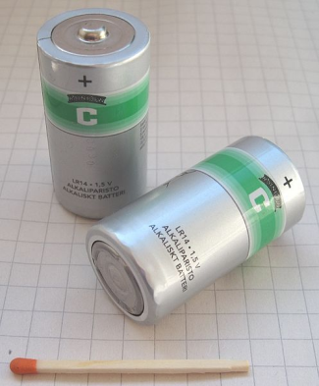
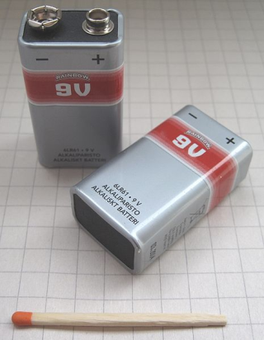
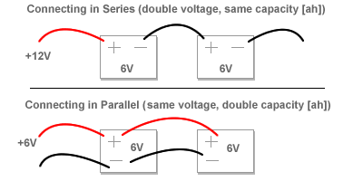
More on batteries
Most AAA to D cell batteries provide 1.5 volts per fresh battery and range from 1.2 amp-hour to 12 amp-hour respectively
Obviously, the little 9 volt batteries provide 9 volts but only ~ .5 amp-hour
Campbell PS 100 is a 12 amp-hour
Inside CR1000 is a 3 volt lithium battery to retain program and clock

Slide 21
More on batteries
Batteries in series
  increase voltage and keeping the same capacity
  Like batteries in flashlight- plus connected to minus
  Not usual approach for instrumentation as don’t need more voltage
Batteries in parallel
  Same voltage but increasing the amp-hours available
  Connect + and – of logger to one battery
  Think of solar panel as second battery so connected in parallel
What not to do
  Mix batteries of different amp-hour rating- batteries discharge at different rates and shorten life
  Have one charged and one uncharged- charged battery run down attempting to charge second

Slide 22

Ground
The function of a ground wire in an electric circuit is in many ways analogous to the reservoir attached to the analogous water circuit
Once the pipe is filled with water, the pump can circulate the water without further use of the reservoir, and if it were removed it would have no apparent effect on the water flow in the circuit
The reservoir provides a pressure reference, but is not part of the functional circuit
Likewise, the battery can circulate electric current without the ground wire
The ground provides a reference voltage for the circuit, but if it were broken, there would be no obvious change in the functioning of the circuit
The ground wire protects against electric shock and in many cases provides shielding from outside electrical interference

Slide 23
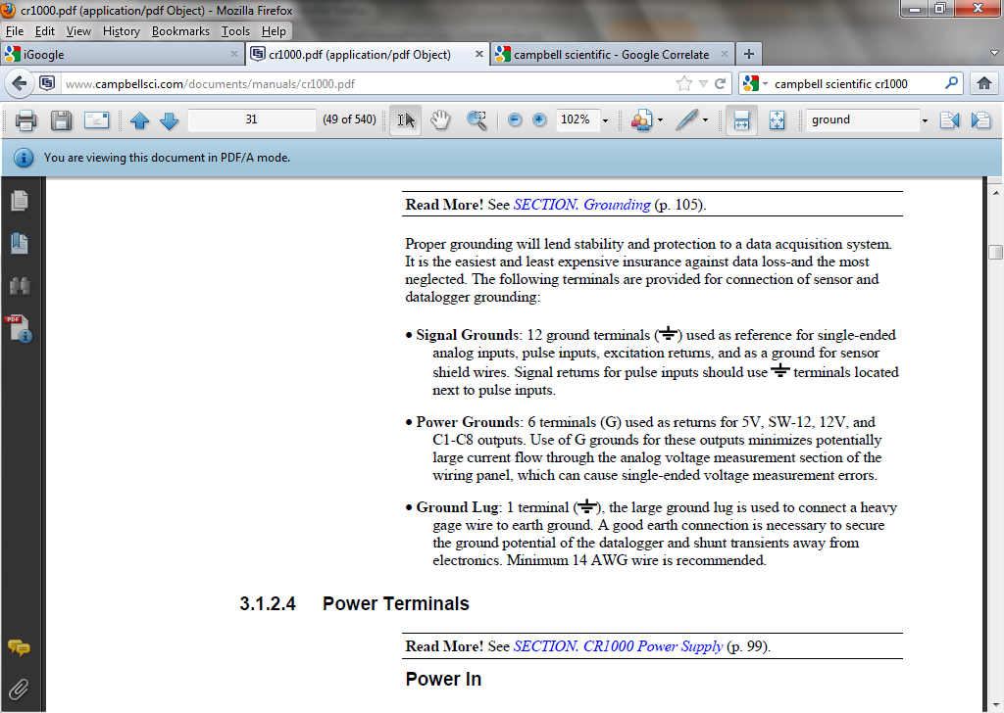
Grounding and CR-1000
Proper grounding will lend stability and protection to a data acquisition system
It is the easiest and least expensive insurance against data loss- and the most neglected
On CR-1000
Signal Grounds: ground terminals used as reference for single-ended analog inputs, pulse inputs, excitation returns, and as a ground for sensor shield wires
Power Grounds: terminals (G) used as returns for 5V, SW-12, 12V, and C1-C8 outputs. Use of G grounds for these outputs minimizes potentially large current flow through the analog voltage measurement section of the wiring panel, which can cause single-ended voltage measurement errors
Practically, signal and power grounds are interchangeable, but the above uses should be followed as a general rule
Ground Lug: used to connect a heavy gauge wire to earth ground. A good earth connection is necessary to shunt transients away from electronics. Minimum 14 AWG wire is recommended.

Slide 24
Summary
Electronic instrumentation use variety of series and parallel circuits
Sensors typically require small currents and impose or measure small voltages
Be careful setting up power sources for sensor systems

