Slide 1
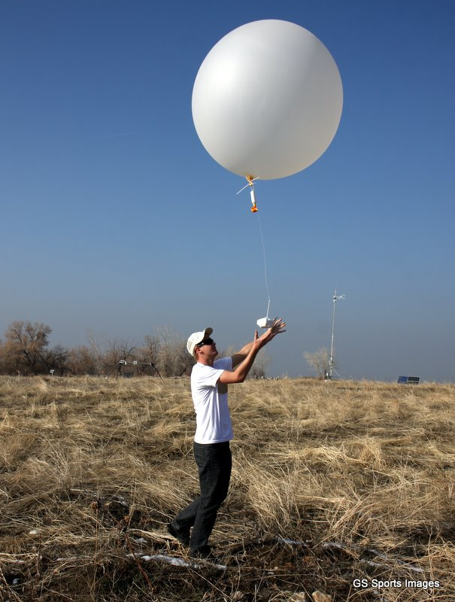
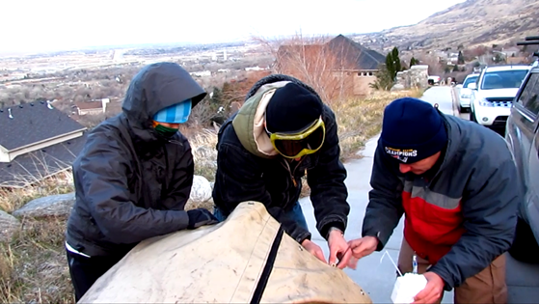

Measurements from Free-flight balloons
Balloons and payloads
Sensors and calculating wind speed and direction
Other types of balloon-borne systems
Graw and Windsond systems
Read pdf of chapter 12 from Brock and Richardson

Slide 2
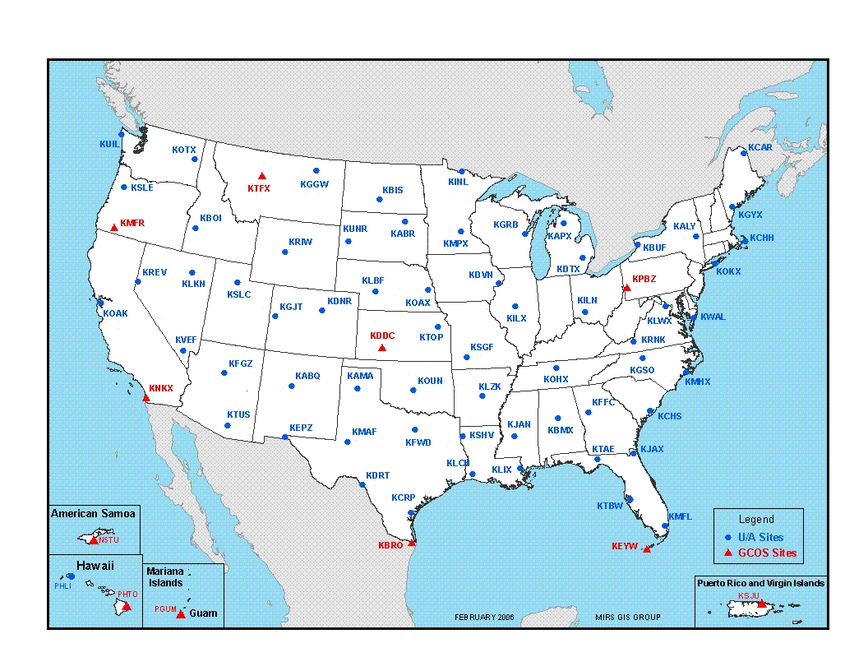
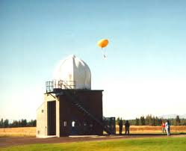
NWS Rawinsonde Network
http://www.ua.nws.noaa.gov/factsheet.htm
<300 milliwatt radio transmitter sends sensor info to a ground tracking antenna in 1676-1682 MHz band
75,000 radiosondes launched by NWS each year, less than 20% recovered
800 upper-air observations points in world. Most in Northern hemisphere. 93 in US

Slide 3
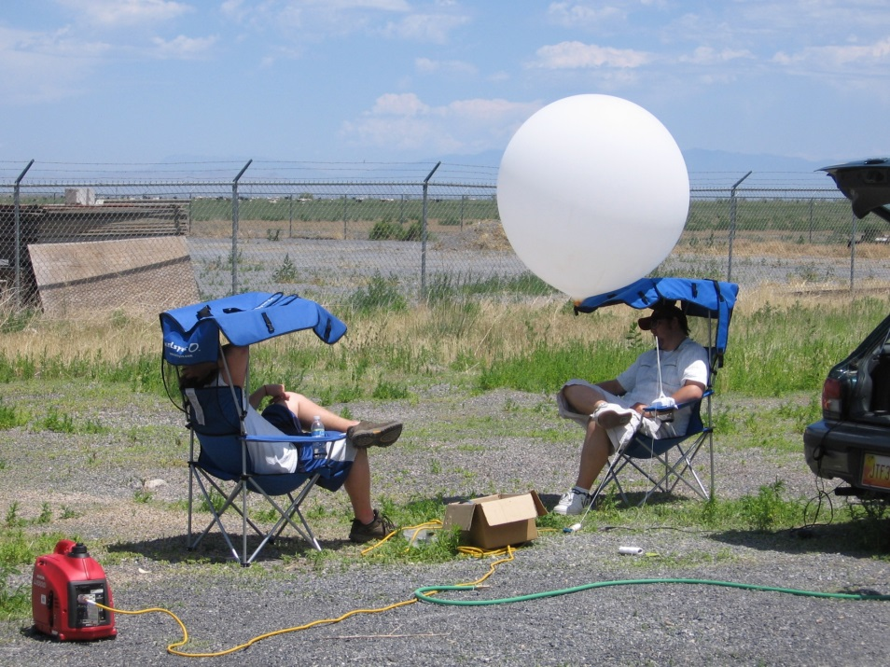
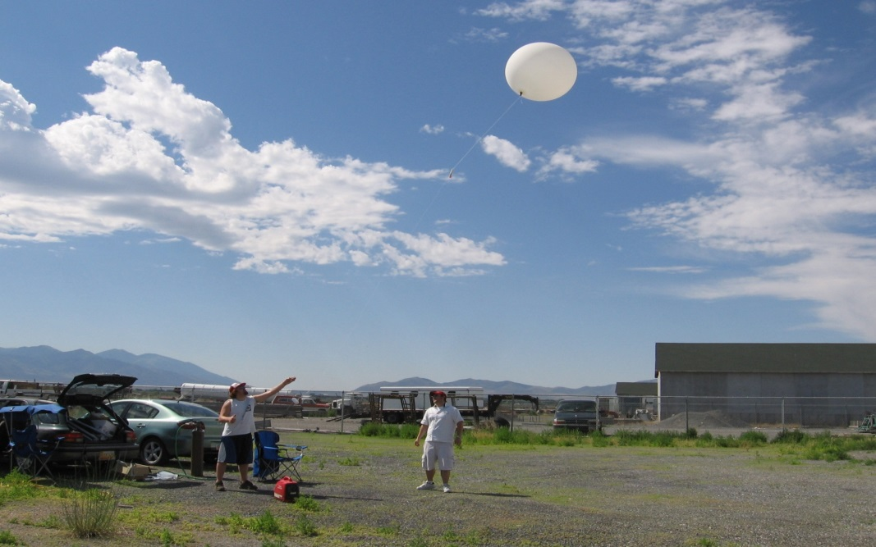
GRAW GPS radiosonde balloon launch near Tooele UT. Summer 2009

Slide 4
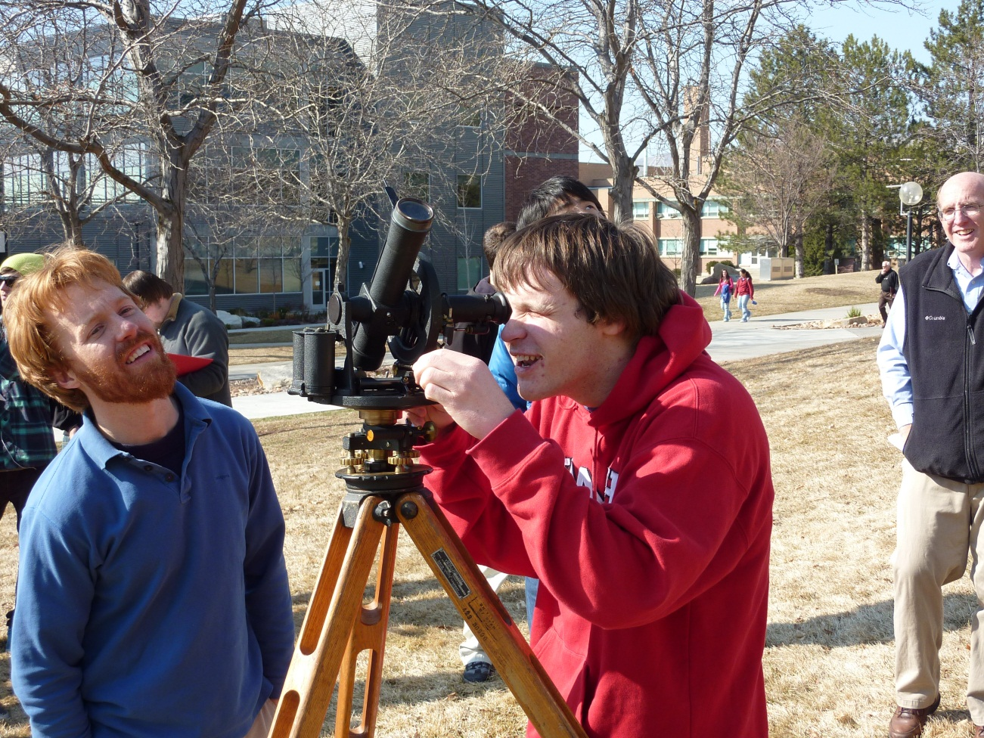
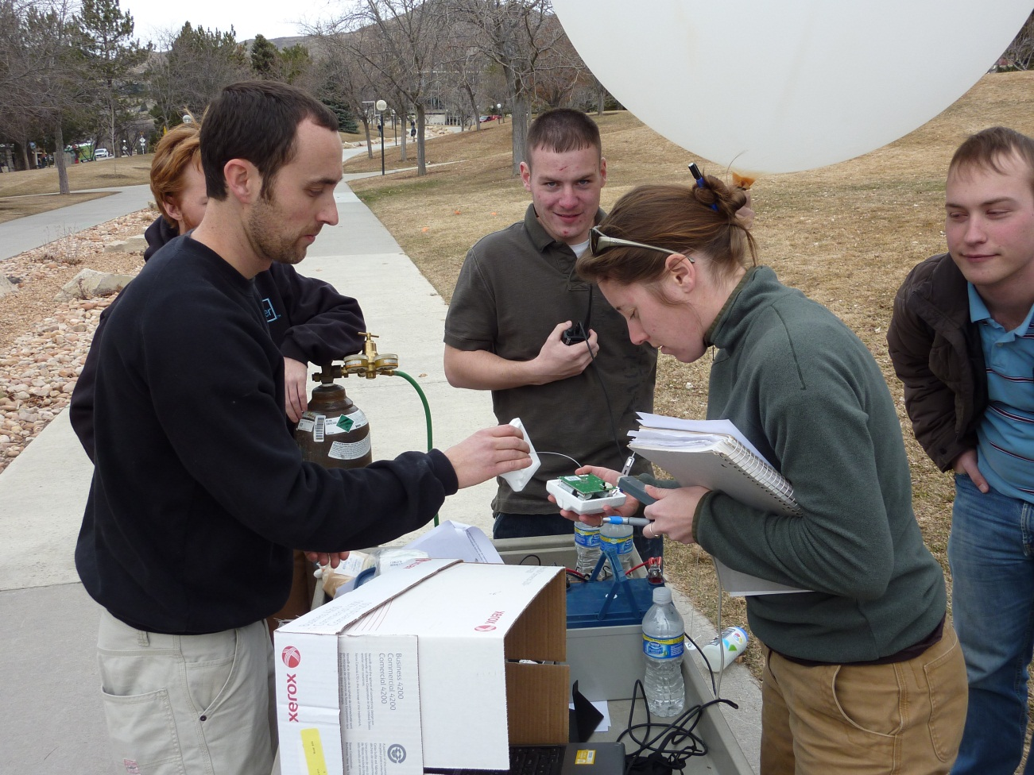
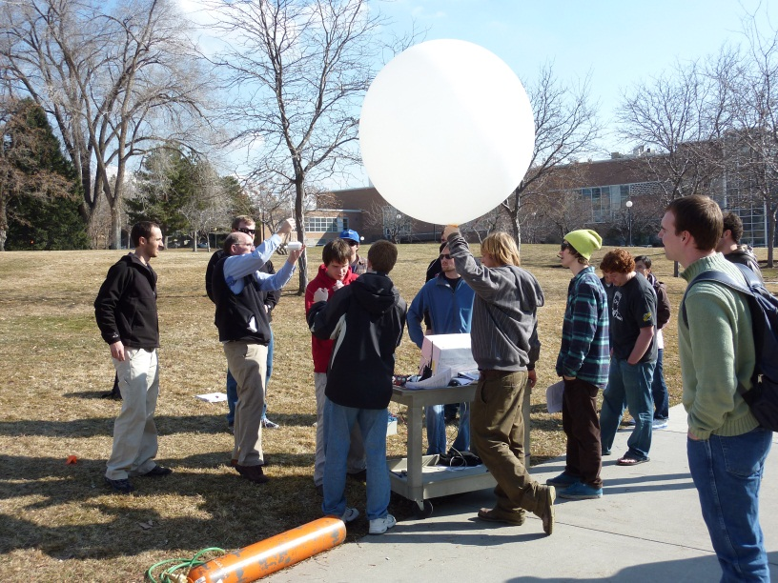
Earlier instrumentation class launches

Slide 5
Upper Air Measurements
Advantages of free-flying balloon-borne instruments
Increasingly inexpensive
Remote sensing methods tend to provide indirect estimates of variables of interest
Disadvantages of free-flying balloon-borne instruments
Very poor spatial and temporal resolution
Typically sensor package only used once
Other options:
Tethered balloons
Sensors mounted on drones, helicopters, etc.

Slide 6
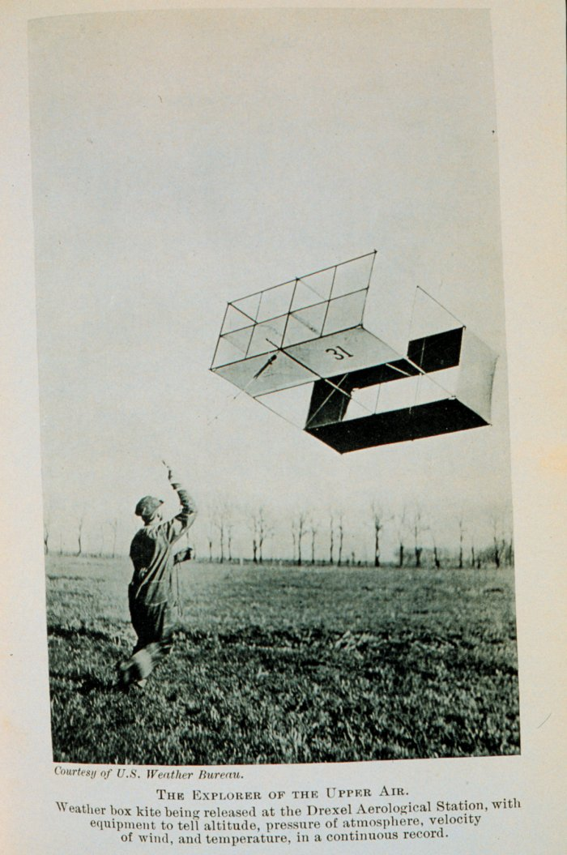
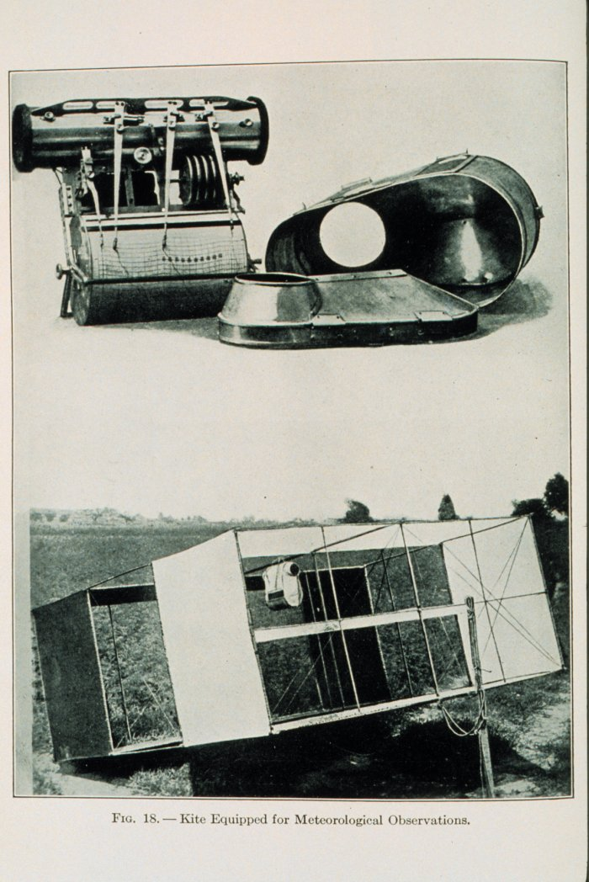
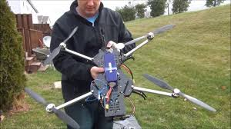
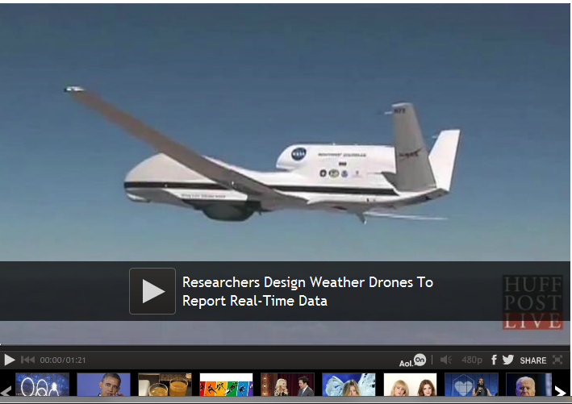
Early “weather kite” 1900 with meteograph

Slide 7
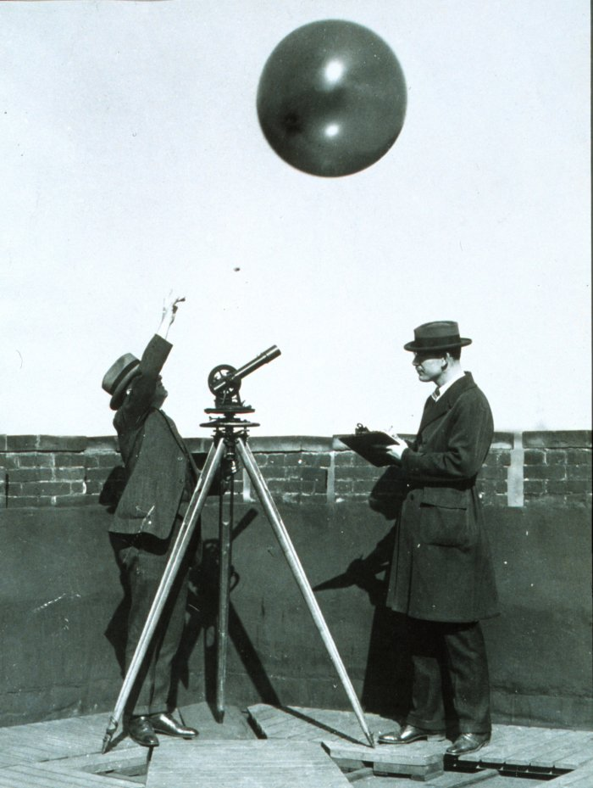
Theodolite Wind Calculation
Pilot balloon is tracked visually with theodolite
Balloon ascent rate must be known (from known balloon weight and gas specifications)
Position determined and wind velocity inferred from successive balloon positions

Slide 8
Radiosondes
Radiosonde (Sonde is French for probe) is a unit for use in weather balloons and measures various atmospheric parameters and transmits them to a fixed receiver.
Radiosondes operate in specific frequency ranges near 403 or 1680 MHz)
A rawinsonde is a radiosonde that also measures wind speed and direction.
Radiosondes measure or calculate the following variables: Pressure, Altitude, Latitude/Longitude, Temperature, RH, Wind speed and direction
Rise ~3-5 m/s
Rise to ~35 km (115,000 feet)
Travel up to hundreds of km from release point

Slide 9
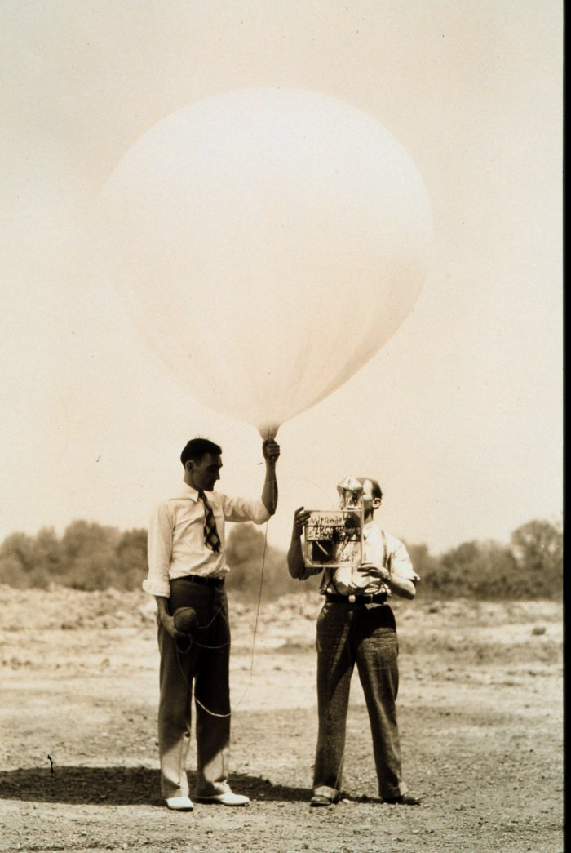
Early model radiosonde being attached to a balloon. Circa 1936.

Slide 10
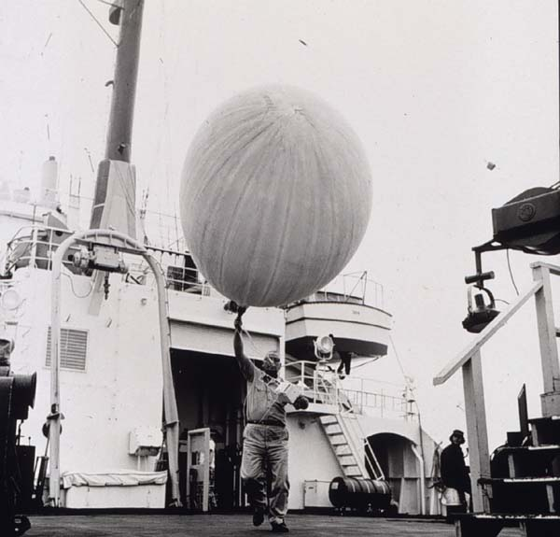
Balloons
Most are extensible (stretch)
Volume increases until they reach bursting altitude
Inextensible balloon
Constant level balloon
Balloon color: light preferred on clear day, dark on cloudy day

Slide 11
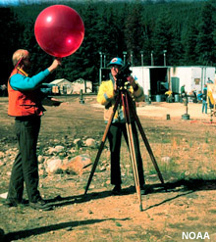
Balloons and Payloads
Party balloons: 1-2 g payload
Pilot balloons, typically no payload, 10-100 g weight
Sounding balloons, Payload of up to 300 gm, 50-1800 g weight
Inflated with either hydrogen or helium
Helium = inert. Hydrogen = very explosive
2 meter balloon expands to about 8 meters before bursting

Slide 12
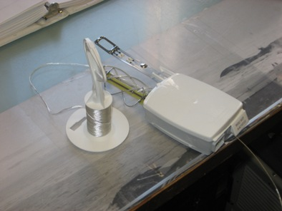
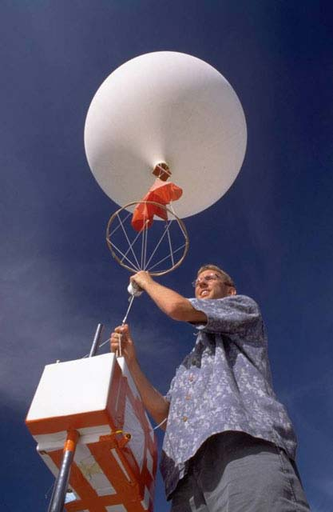
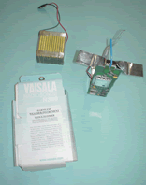
Payload (Instrumentation)
VIASALA RAWINSONDE

Slide 13
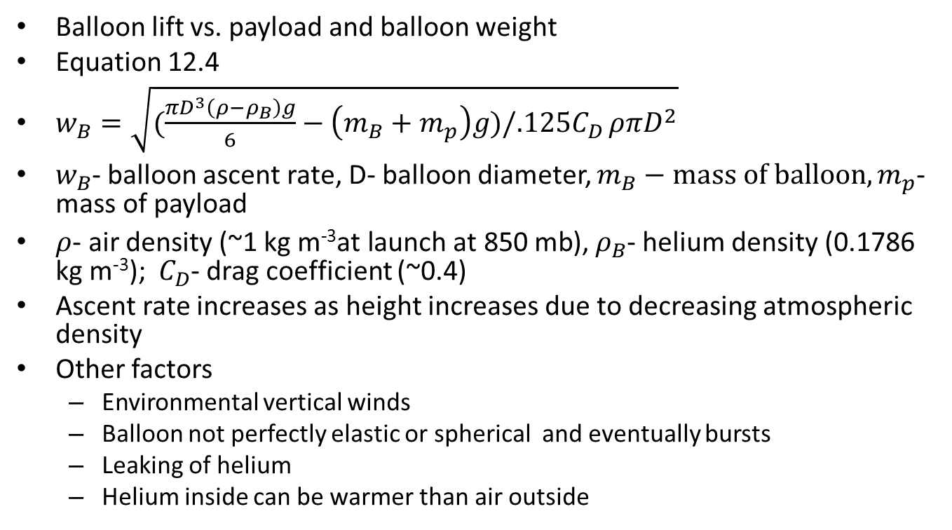
Balloon ascent rate

Slide 14
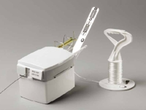
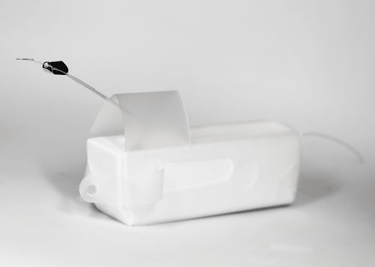
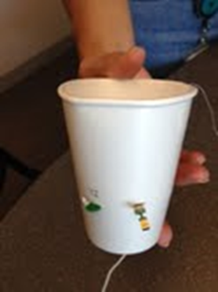
Sonde Sensor Packages
Vaisala Graw Windsond

Slide 15
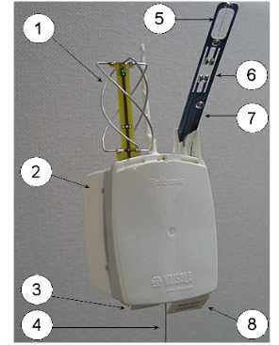
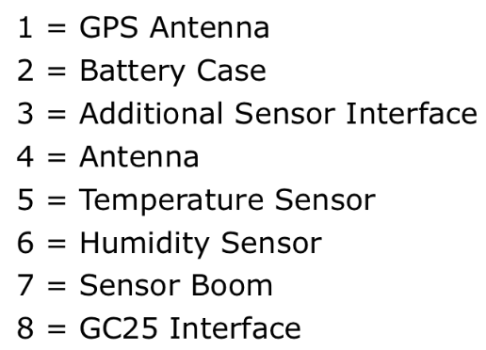
Vaisala RS92 sonde

Slide 16
Sensors
Vaisala-
Dual RH sensors to compensate for moisture
Unshielded temp sensors subject to radiational errors
Capacitive pressure sensor
Graw
Single RH sensor, unshielded temp
Model DFM-06: Pressure usually determined from GPS, surface pressure and hydrostatic relationship unless pressure sensor added
Windsond
Single RH and temp sensor, capacitive pressure sensor
Considerable usually proprietary postprocessing applied to compensate for errors

Slide 17
Measuring horizontal winds
From position determined from GPS
Large volume of balloon to small mass implies balloon follows predominantly horizontal winds
Time constant of balloon is short (~1 sec) so quickly adjusts to environmental conditions
String unwinder used to damp oscillations of payload, which are most severe in turbulent situations

Slide 18
Calculation of wind speed and direction from GPS radiosonde
“Differential GPS”
If 4 or more satellites are seen by ground station, location is known to within 100 m
Sonde also has built-in GPS receiver
Sonde transmits received GPS signal to ground station
Ground station computes position of sonde relative to ground (differential GPS)
The GPS receiving device determines the distance from GPS satellite to receiver from the frequency deviation of radio waves from the satellite due to the Doppler shift
On the ground, reception of radio waves from the radiosonde allows observation of wind direction and wind speed in the upper air.

Slide 19
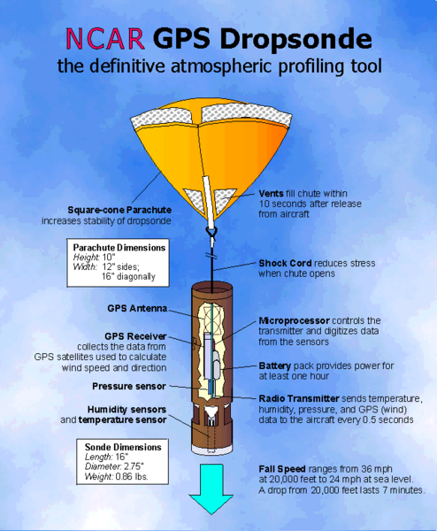
Dropsonde
Dropsonde created by the NCAR, designed to be dropped from an aircraft to measure tropical storm conditions and now many other applications
The dropsonde contains a GPS receiver, along with pressure, temperature and humidity sensors.
The device's descent is usually slowed by a parachute, allowing for more readings to be taken before it reaches the water beneath.

Slide 20
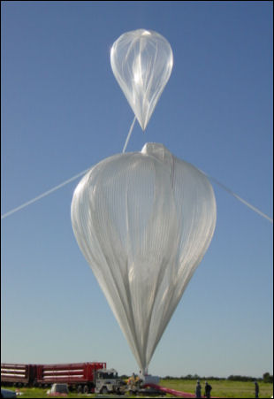
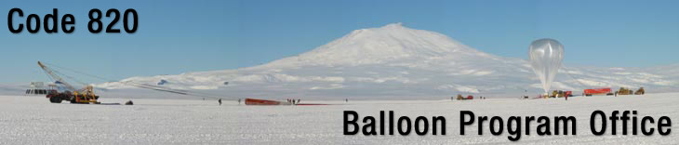
NASA High-Altitude Balloon Program
--High altitude scientific balloon platforms for scientific and technological investigations.
--Fundamental scientific discoveries that contribute to our understanding of the Earth, the solar system, and the universe.
Example over Antarctica: Balloon flights carry the balloons and their instruments at the edge of space and are used to investigate the nature of ultra-high-energy cosmic rays and search for anti-matter, as air currents that circle Antaratica.

Slide 21
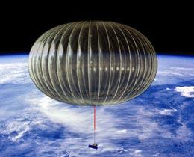
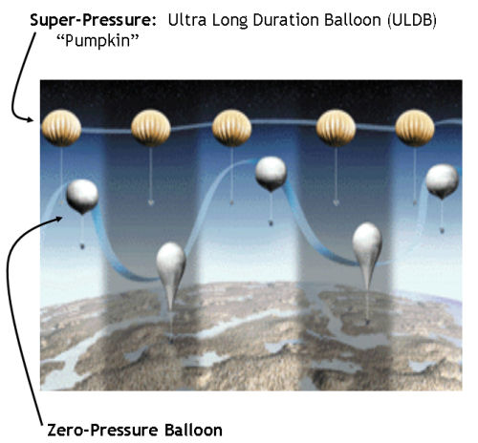
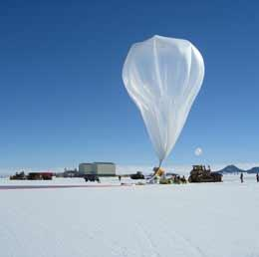
NASA Super Pressure Pumpkin Balloon
Super Pressure Balloon Requirements
1-ton instrument to 100 kft
100-day flight goal
Little or no day/night altitude variation
http://www.nature.com/news/2009/090208/full/news.2009.85.html

Slide 22

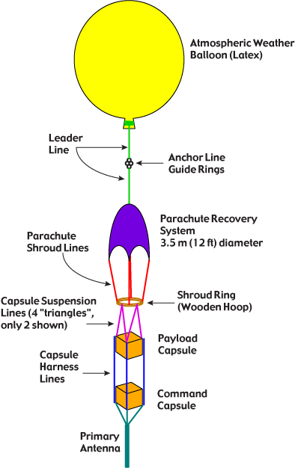
Weber State HARBOR
http://planet.weber.edu/harbor/

Slide 23
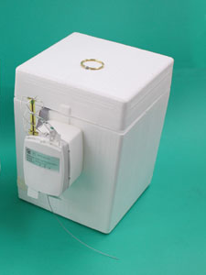
Ozonesondes
Teflon air pump and electrochemical ozone sensor combined with a radiosonde
Air enters sensor cell containing potassium iodide solution
The reaction of ozone and iodide generates an electrical signal proportional to the amount of ozone

Slide 24
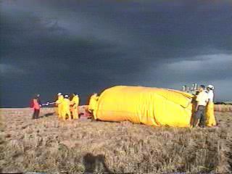
Weather Balloon Launches for Severe Thunderstorm and Electrification Study (TELEX)
There are two types of weather balloons used: latex (beige colored) and plastic (clear). The plastic is used to minimize the effects of hail hitting the balloon, i.e, the plastic does not burst instantly when punctured. The latex balloon is used if hail is not expected.
The basic instrument train consists of a parachute; a radiosonde for measuring temperature, relative humidity, pressure, and GPS-derived winds and location; and an electric field meter for measuring the vector electric field in the storm along the flight path.

Slide 25

Graw Radiosonde System Components
Radiosonde
Groundstation (PC laptop connected receiver)
GRAW software
Accessories (unwinders, balloons, helium)

Slide 26
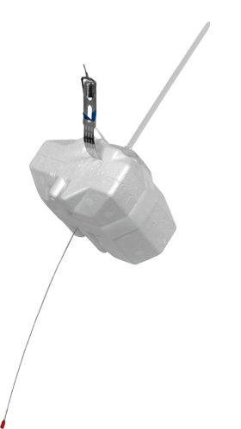
The DFM-06 is standard radiosonde for most applications. Due to its excellent characteristics and the reasonable costs, it is perfectly suited for synoptic observations or military applications. Very Low Weight (90g) Sensors All sensors are Ready To Fly - completely factory calibrated, no additional ground calibration is necessary. High-Power Lithium Battery GPS for Wind Finding Fast and Easy Initialization Frequency Agile Microprocessor Controlled
DFM-06 Radiosonde

Slide 27
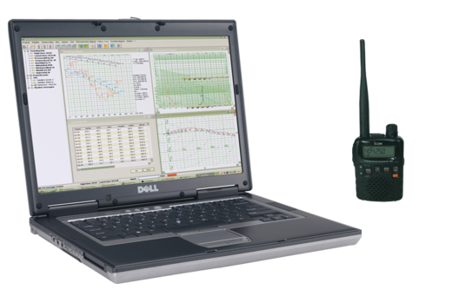
Groundstation Equipment GS-H High Mobility Station
Main components
Lightweight Handheld 400 MHz receiver with integrated antenna
Standard notebook with soundcard port
Meteorological software GRAWMET

Slide 28
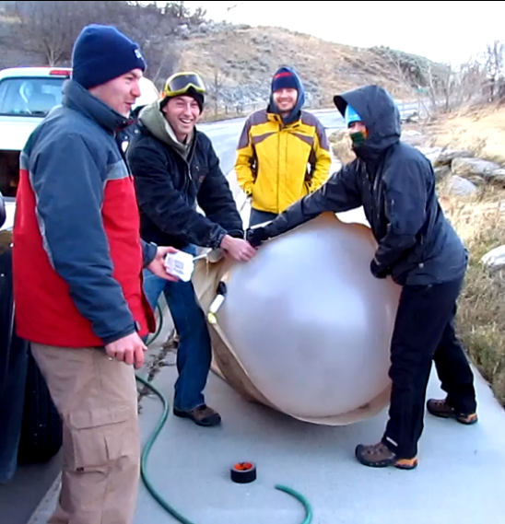

Slide 29
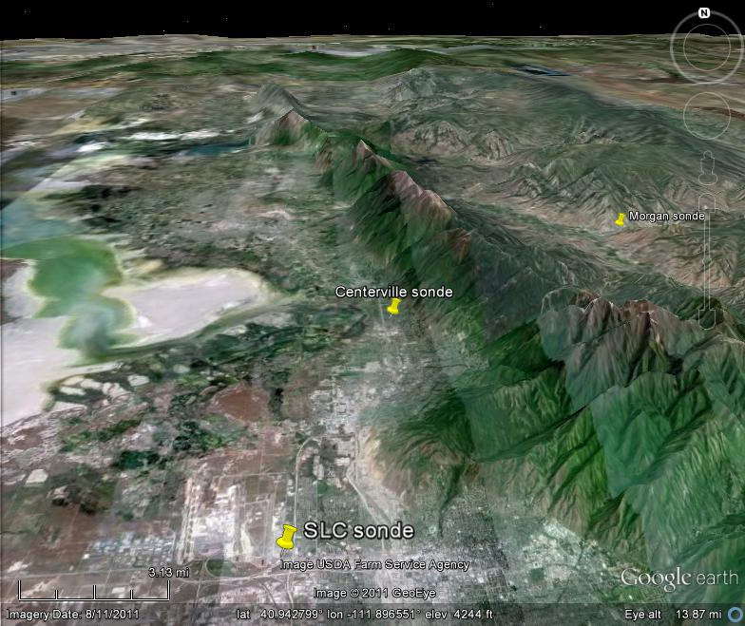

Slide 30
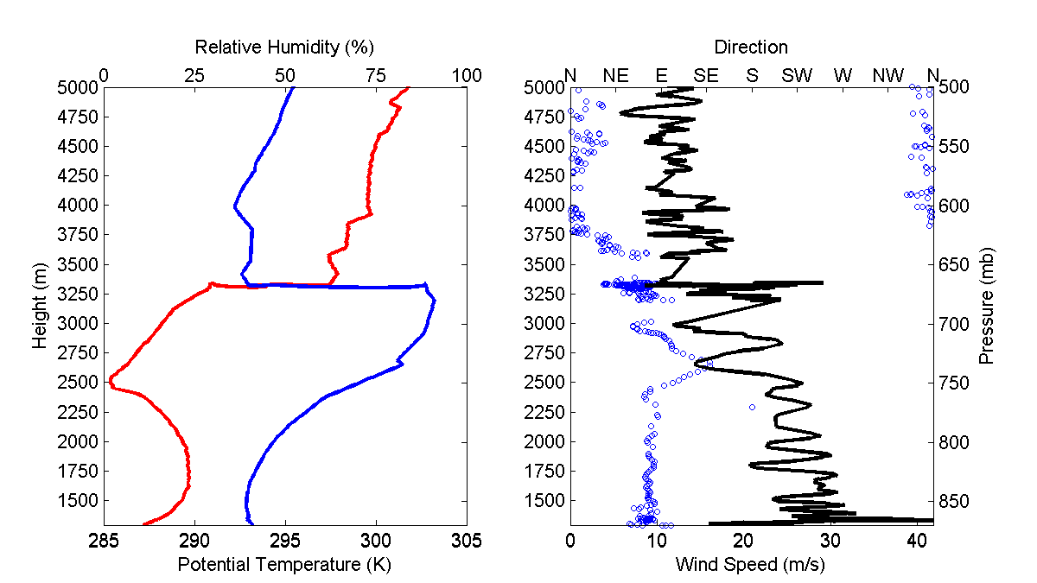
Wasatch Front Sonde
Northerly
Peak Wind
Cloud
layer
24 m/s
Easterly
Peak Wind

Slide 31

Stab at what was happening
1.3 km
5.8 km

Slide 32

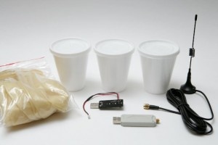
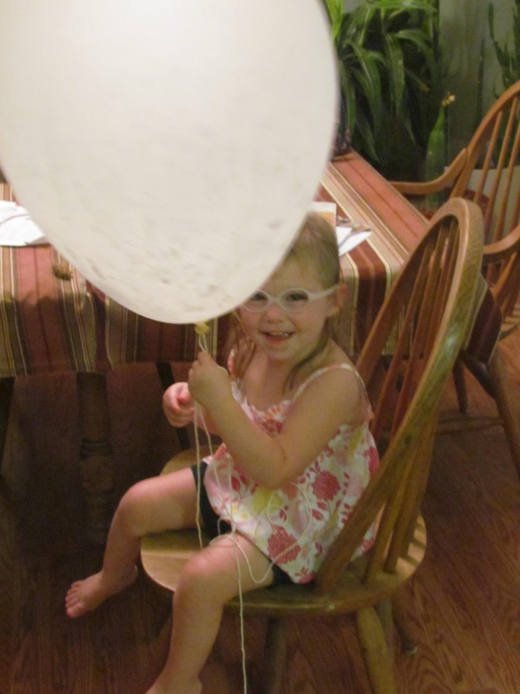
Windsond
http://kiwiembedded.com/windsond/
12 grams (0.42 oz), requires ~30 liters of helium for lift

Slide 33
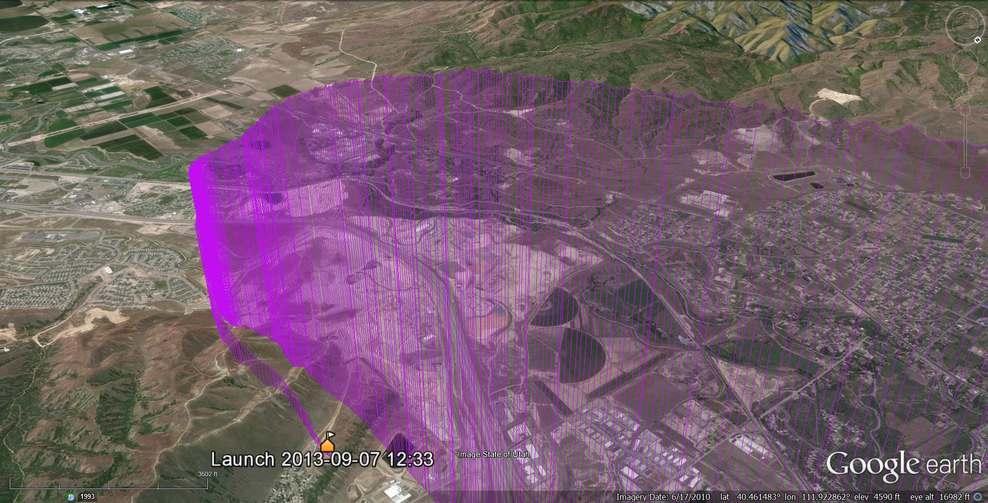
Launch from North Flight Park. Sonde headed south over Traverse then curved back into Salt Lake Valley.

Slide 34
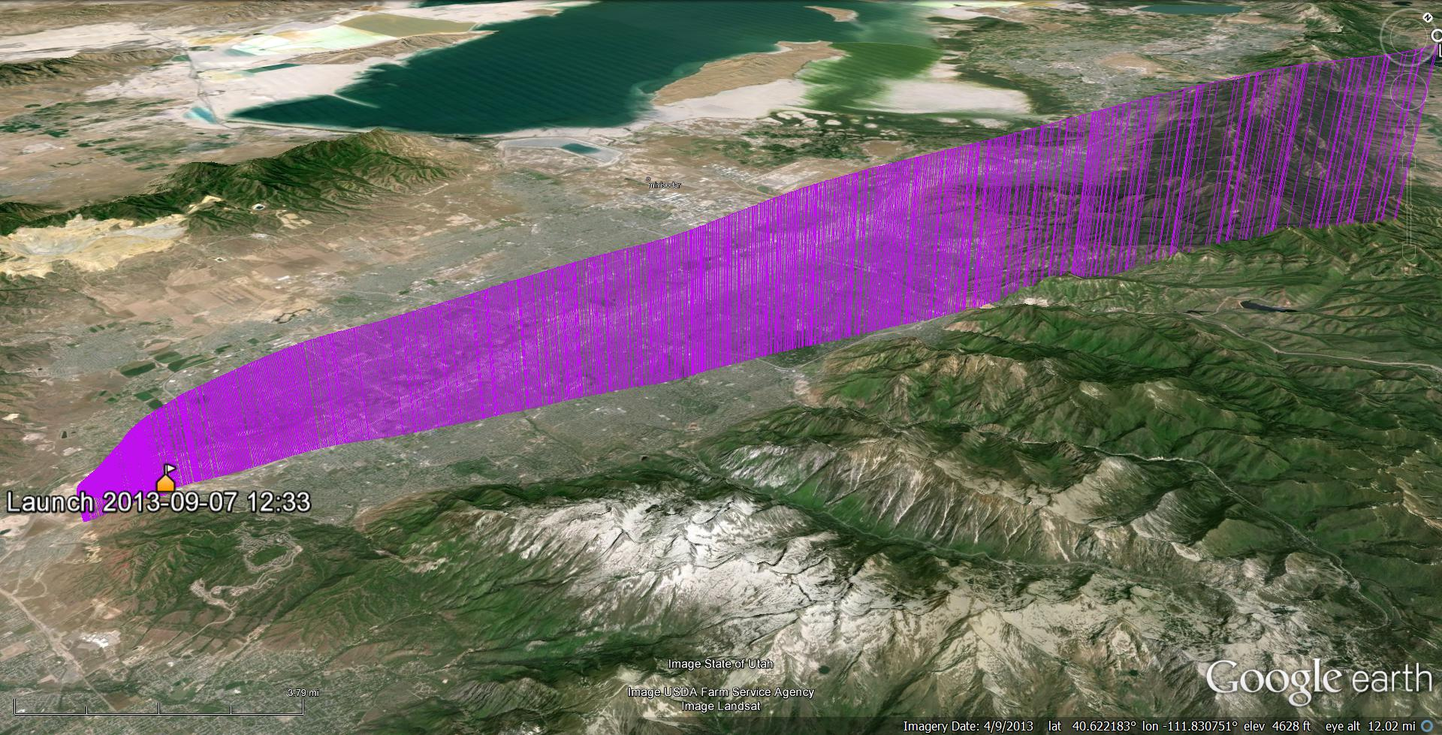
Flight past Red Butte Canyon Reaching 280 mb; 9700 m MSL; ~50 km away. Incorrectly tying thread to sonde (knotted instead of single connection) kept sonde from releasing and battery eventually dropped to minimum voltage ending flight

Slide 35
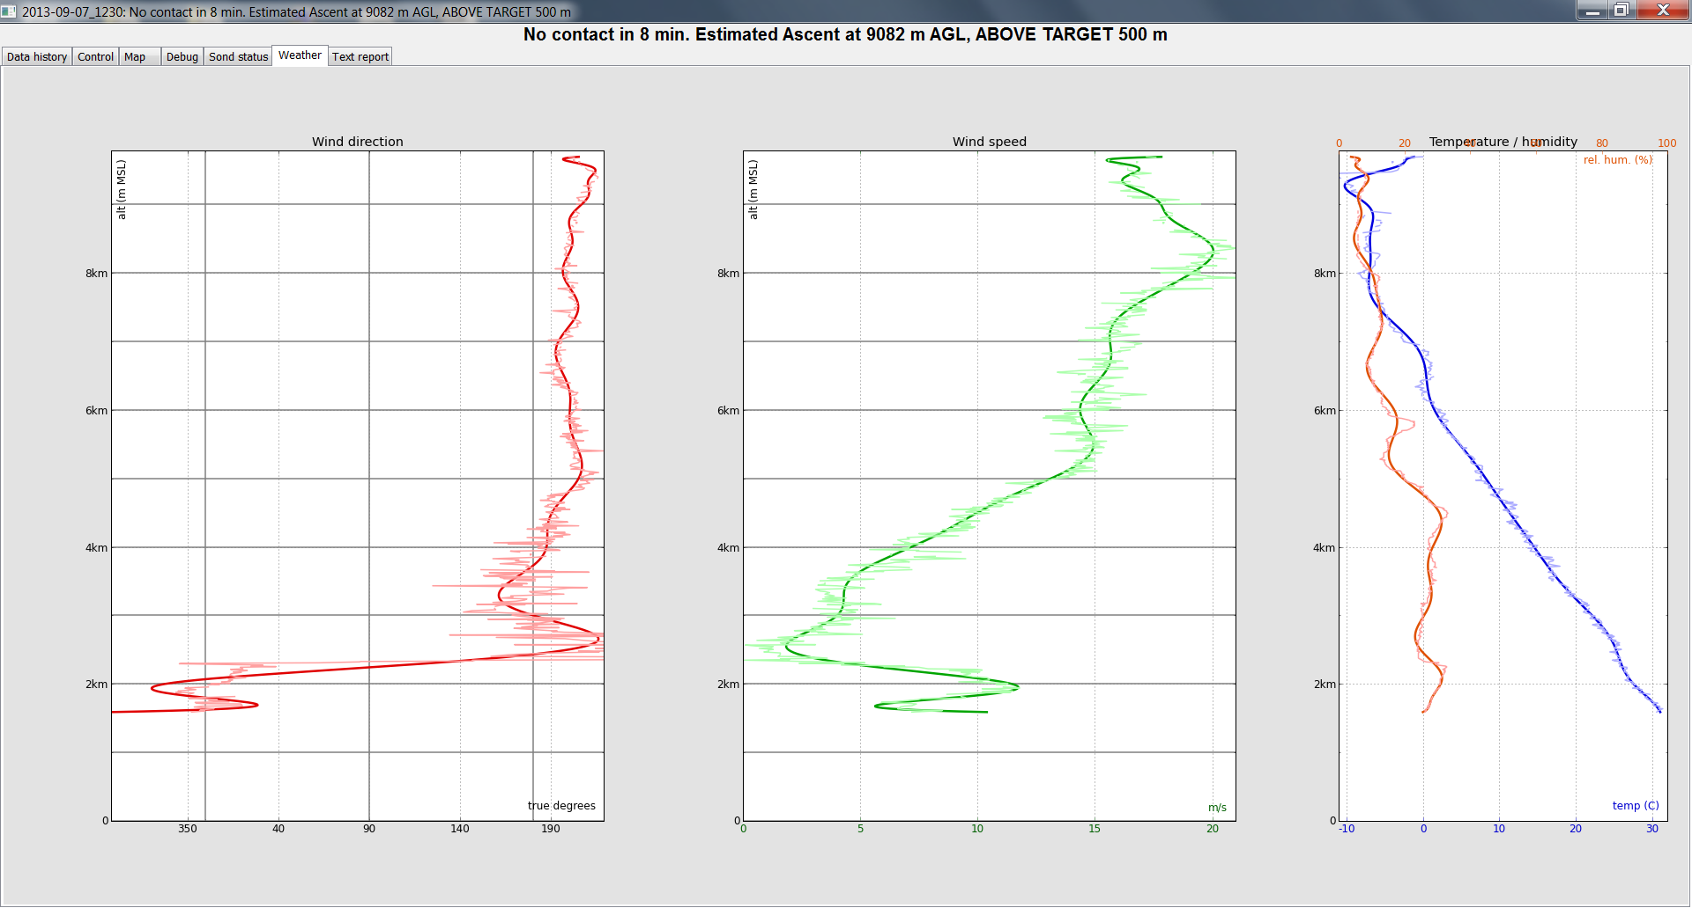
Real-Time Displays

Slide 36
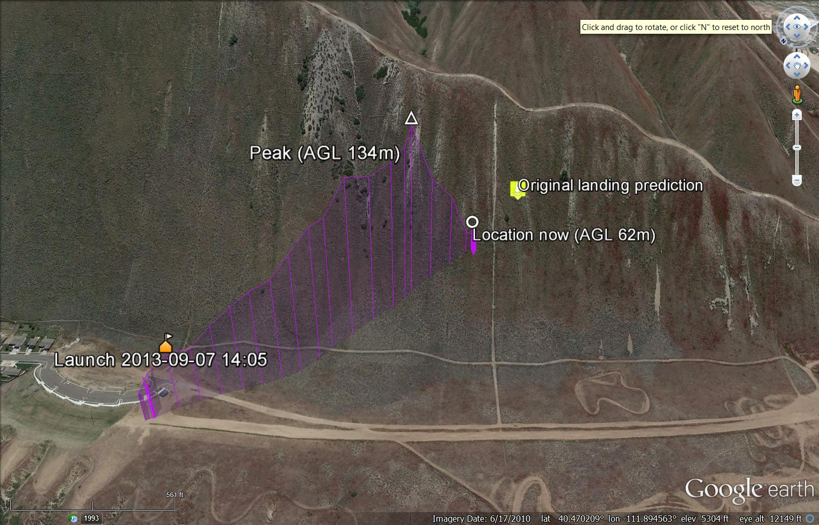
Second Short Flight. Successful sonde recovery

Slide 37
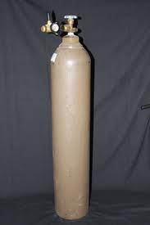
Safety
Helium tanks must be secured and handled carefully
Considerable attention must be placed on launching balloons safely avoiding electrical lines, highways, etc.
Notify FAA in advance when launching balloons and follow FAA regulations

Slide 38
Summary
Free-flight sonde systems are invaluable source of information on temperature, moisture, and wind structure in the vertical
Consumable costs are a burden for operational as well as research applications
Drone plane/copters may provide alternatives
Errors can be substantive and manufacturers tend to make it difficult to evaluate some of the errors through proprietary software

