Slide 1
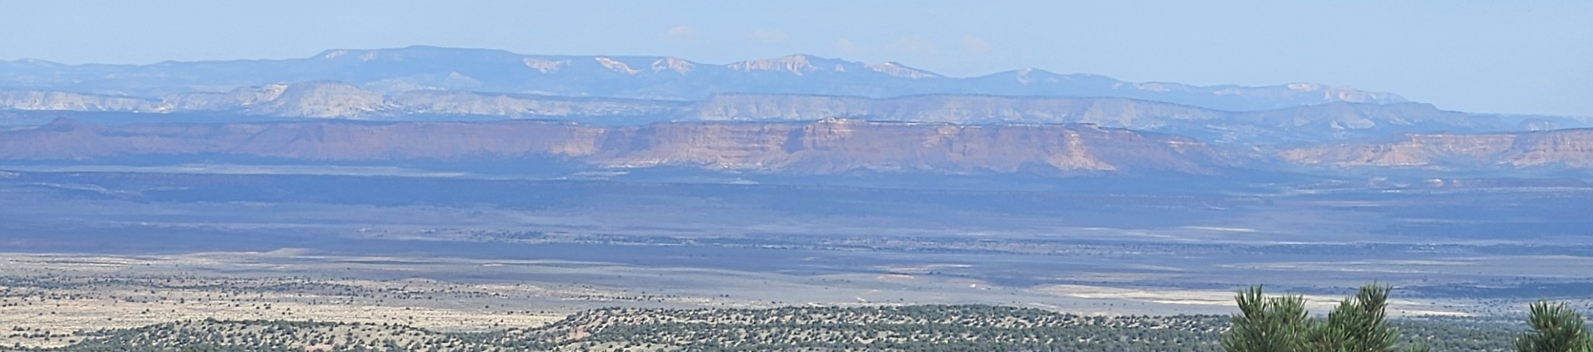
Flash Floods in the National Parks and Monuments of Southwestern Utah with a detour to discuss drought and wildfires
John Horel
University of Utah
john.horel@utah.edu
Contributors: Sherlyn Hilton, James Powell, Alex Jacques
Acknowledge: National Weather Service Salt Lake City Weather Forecast Office staff:
D. Church, J. Cunningham, G. Merrill, M. Seaman, & D. Van Cleave
Grand Staircase Escalante National Monument
Bryce

Slide 2
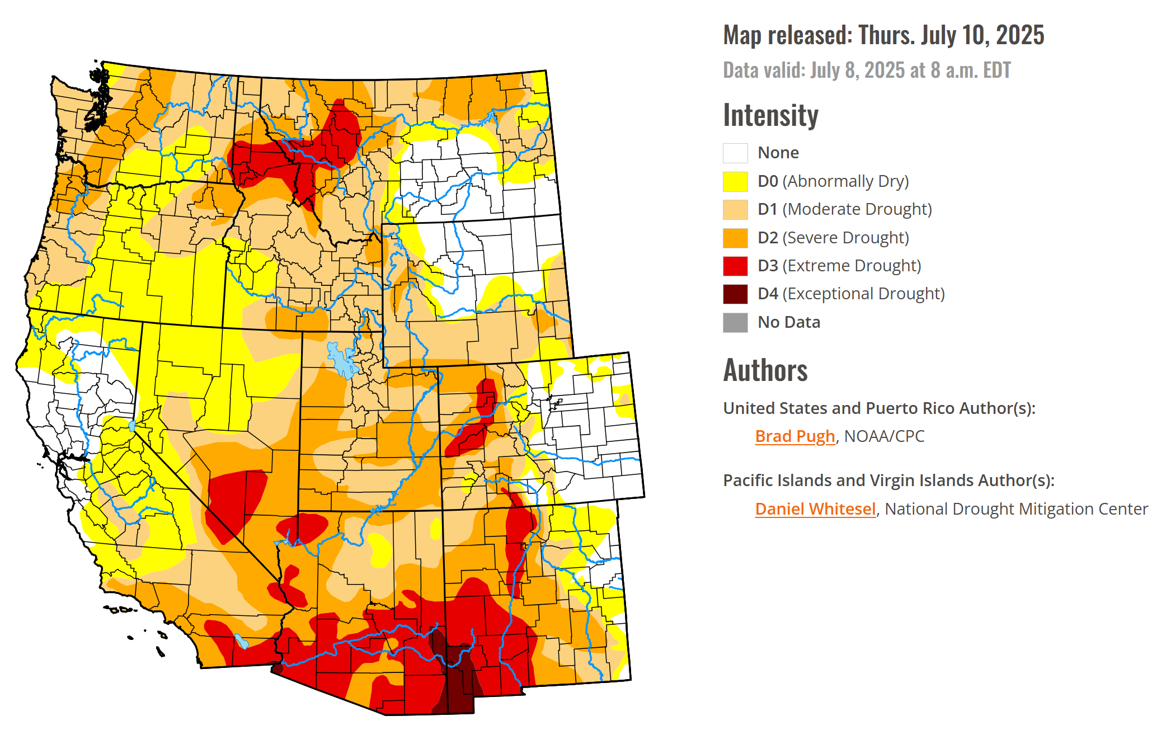
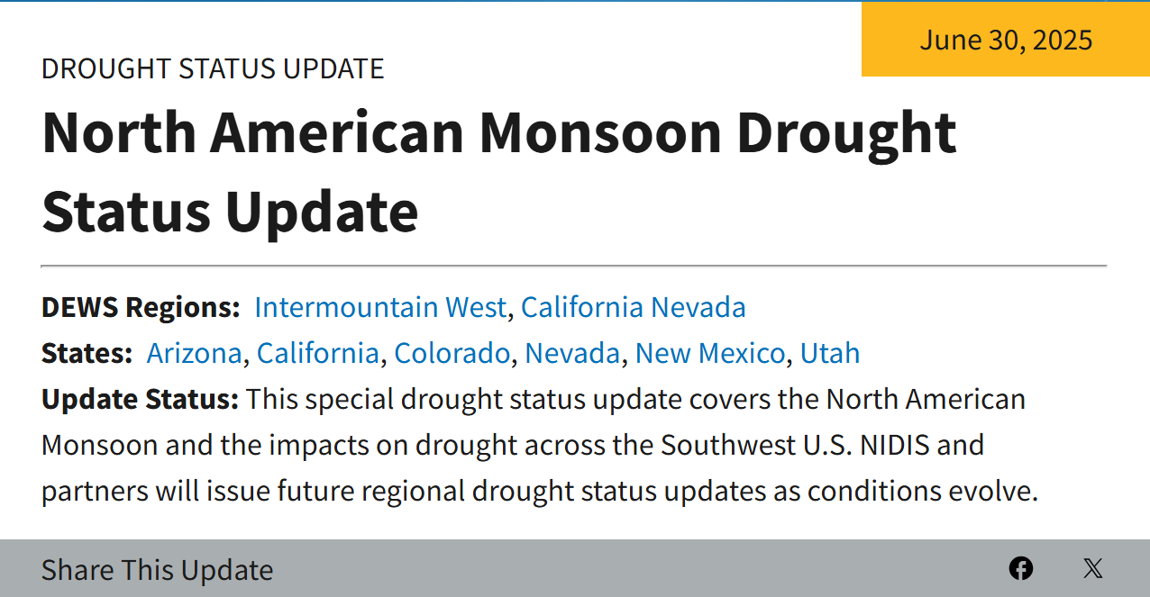
U.S. Drought Monitor

Slide 3
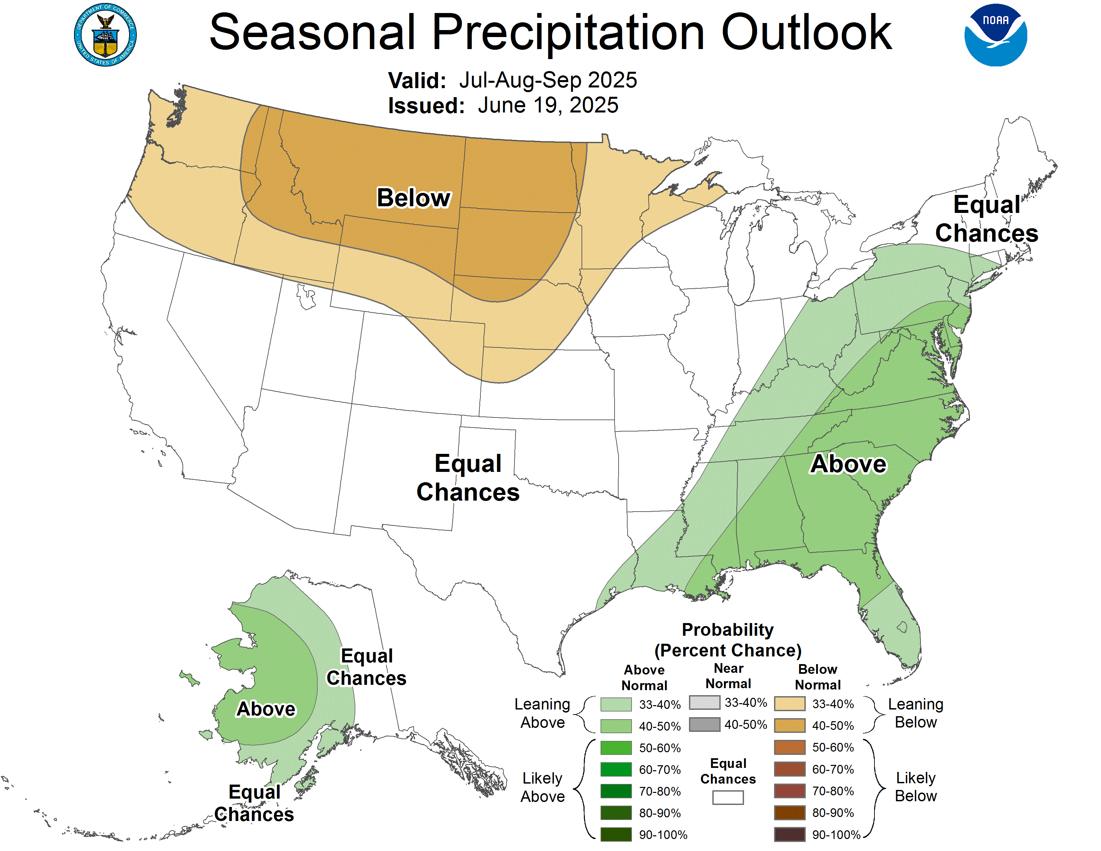
Climate Prediction Center - Seasonal Outlook

Slide 4
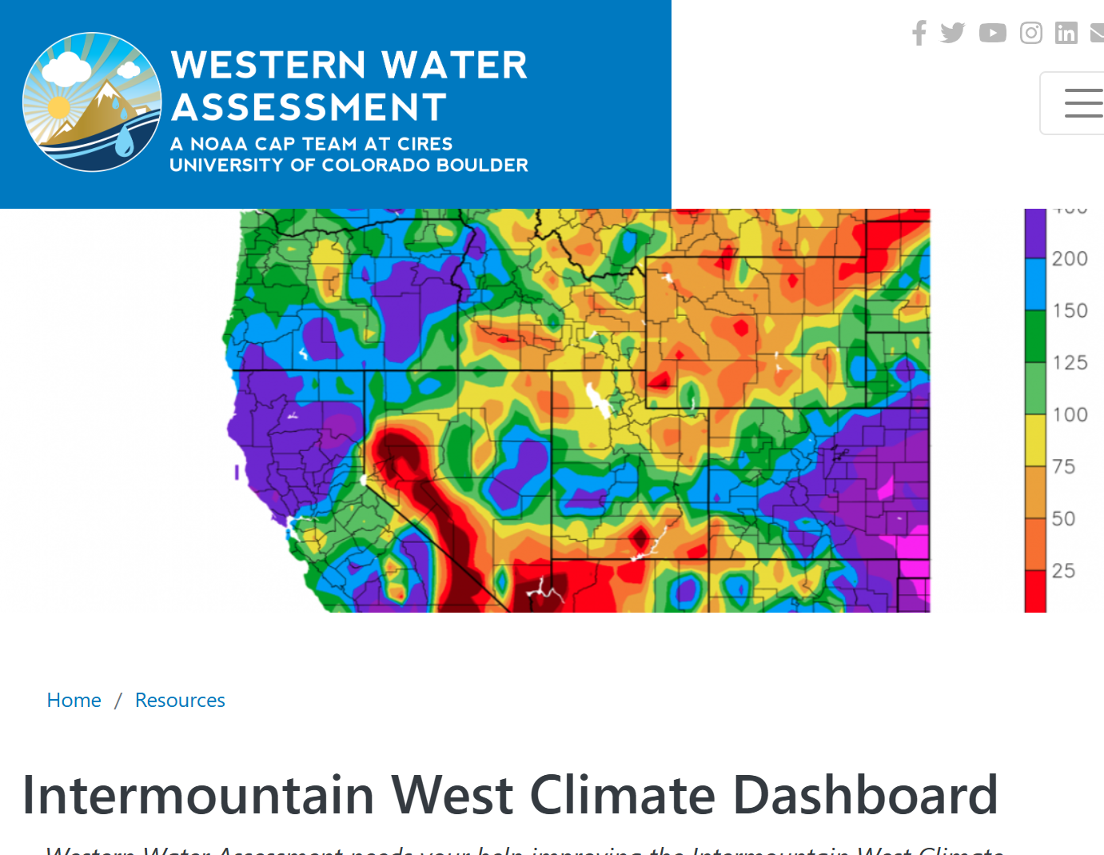
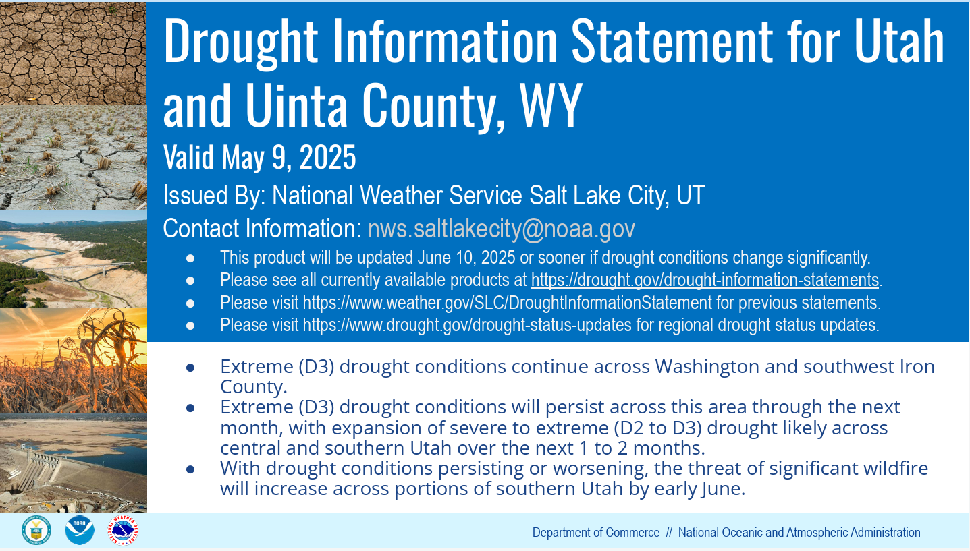
Drought Information Western Water Assessment

Slide 5
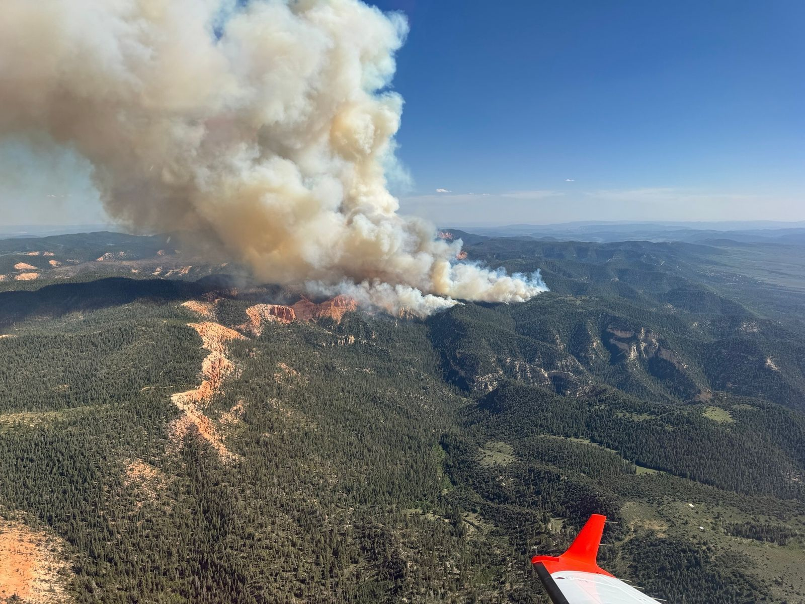
France Canyon wildfire: June 11- west of Bryce National Park
U.S. Forest Service

Slide 6
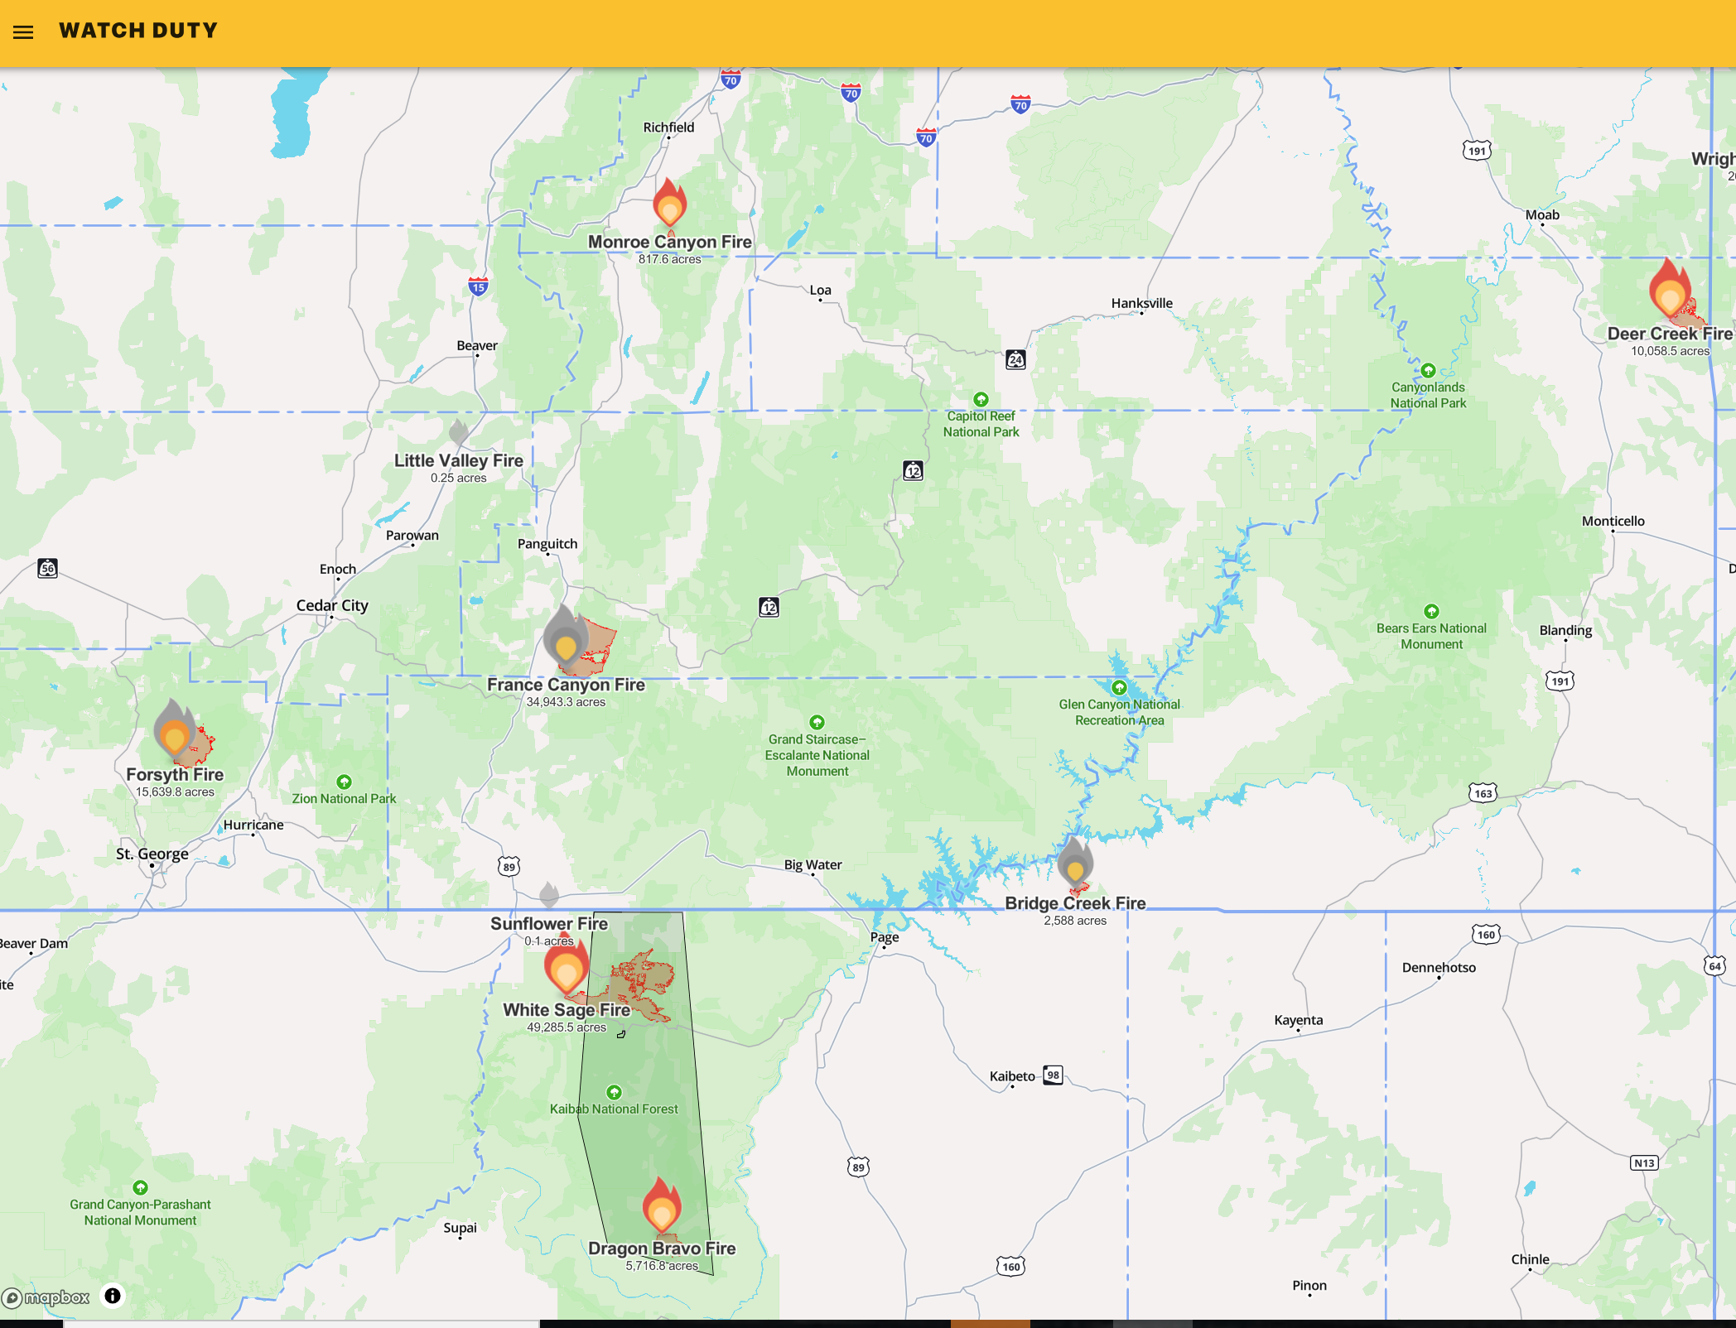
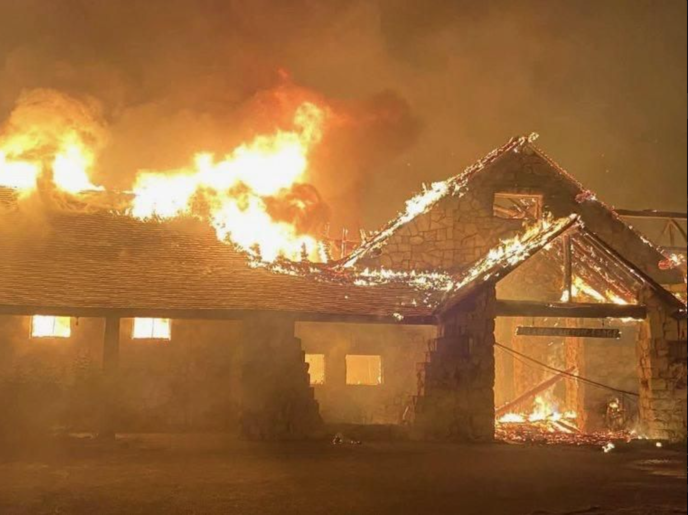
Watch Duty: an excellent app to monitor hazardous conditions https://watchduty.org
https://app.watchduty.org/
Grand Canyon North Rim Lodge

Slide 7
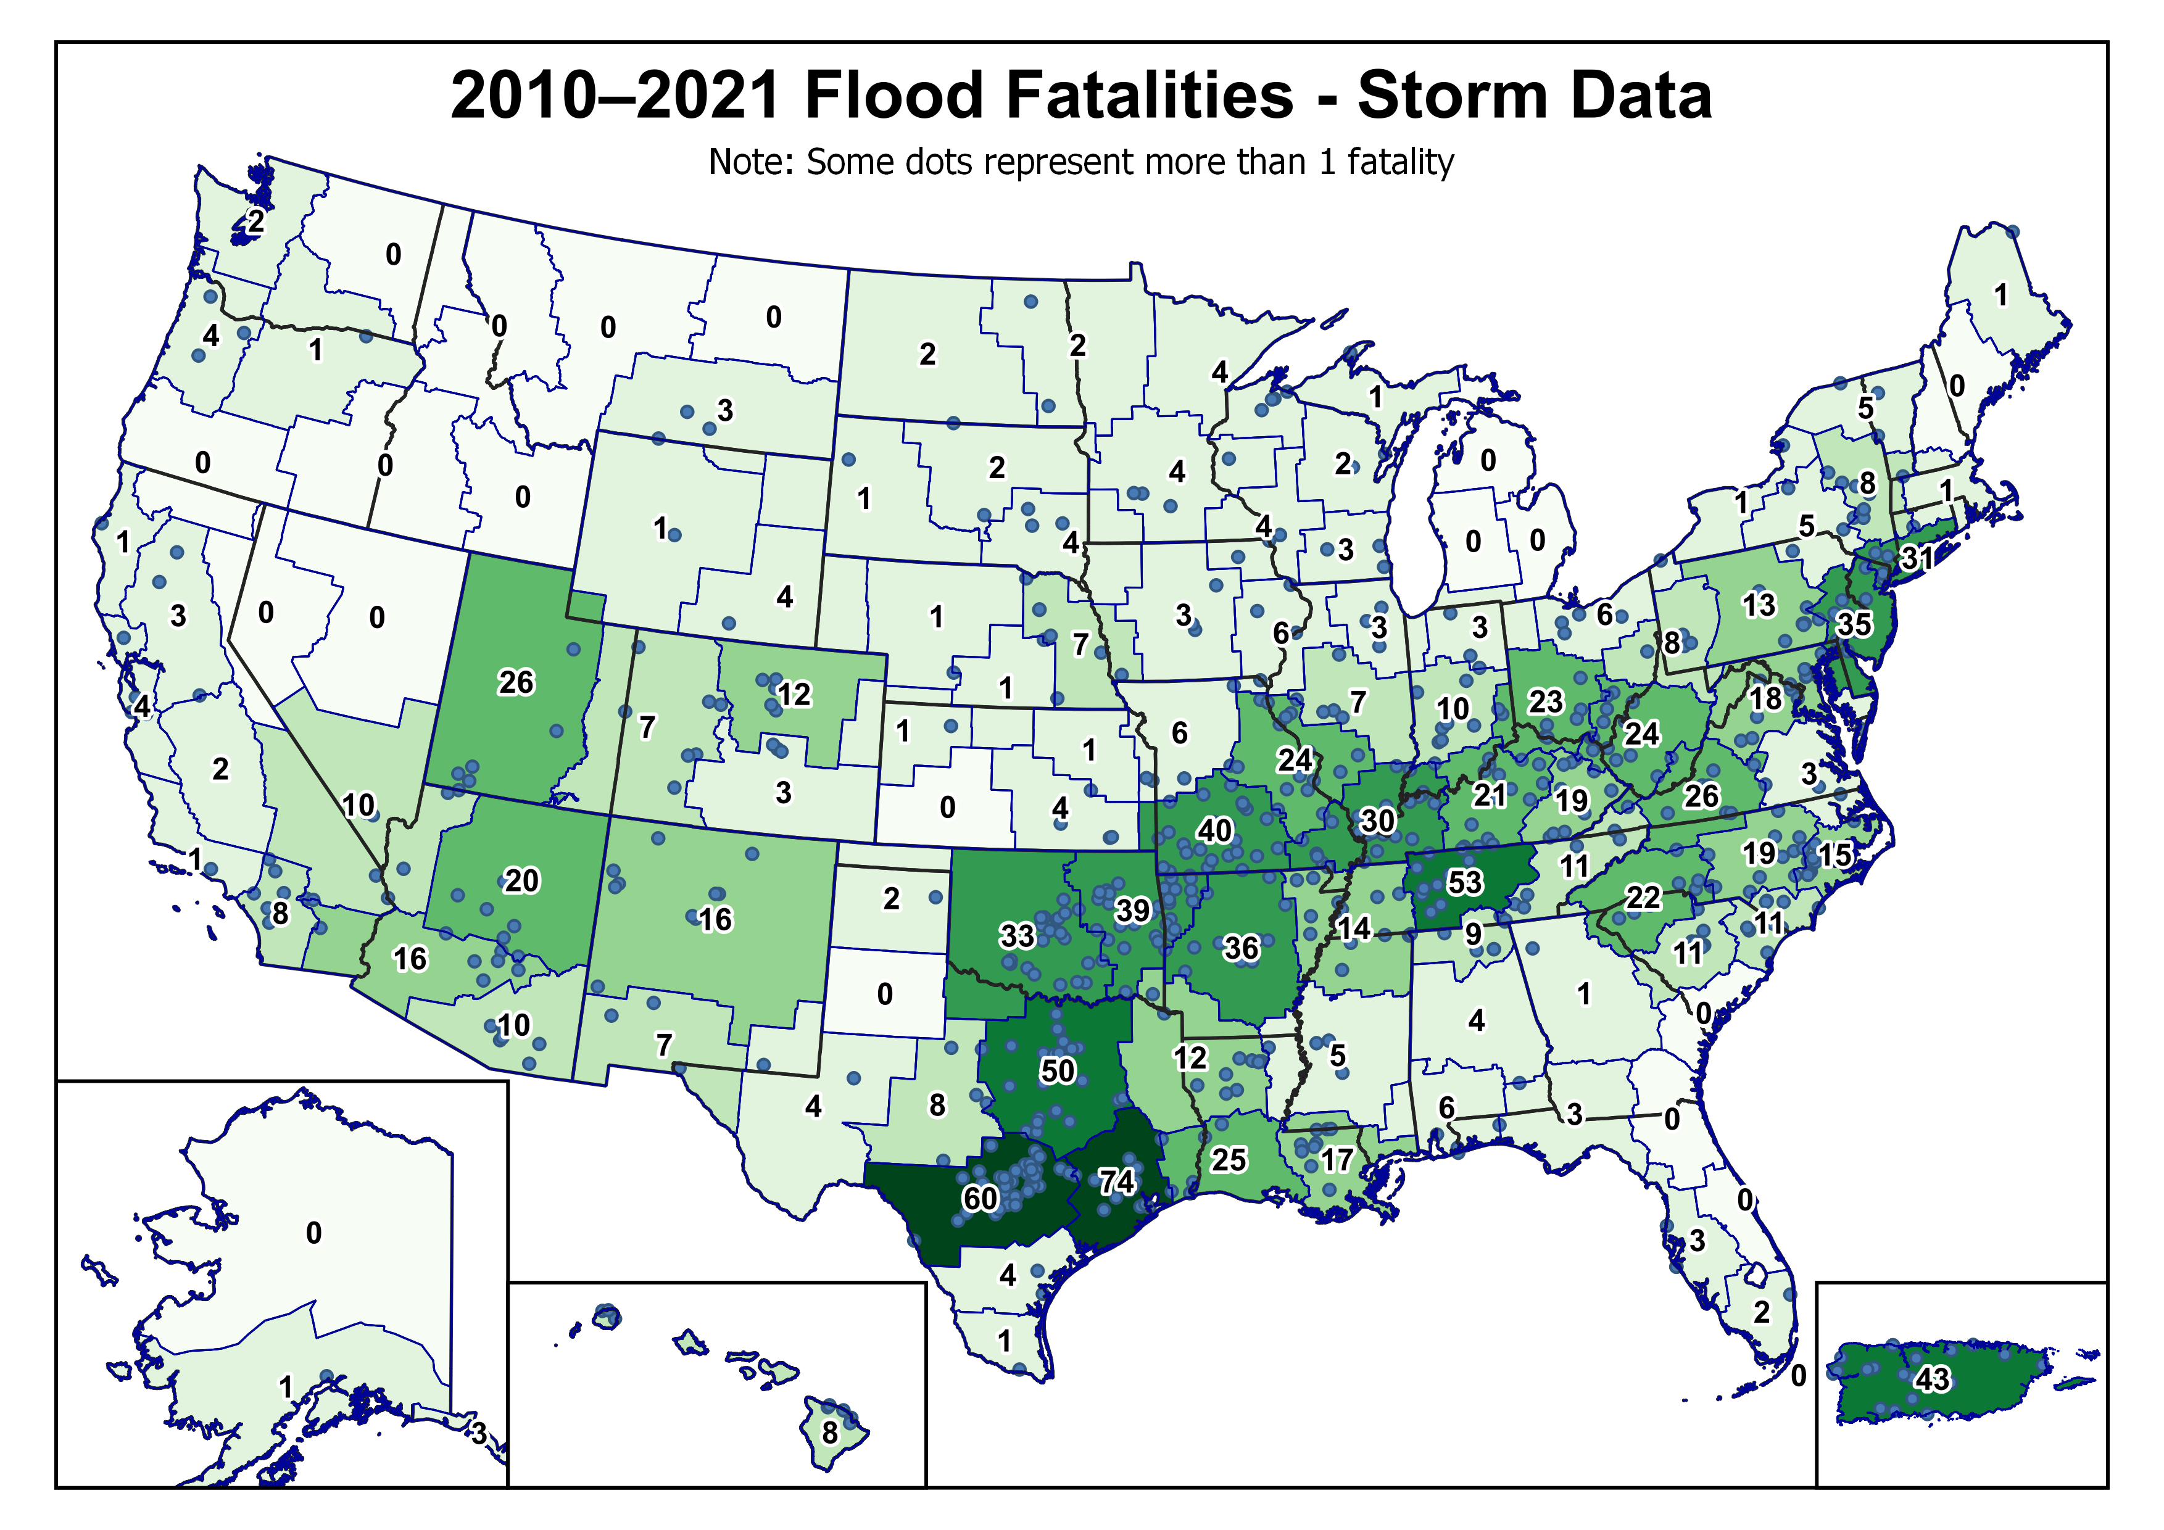
Utah: 34 flood fatalities from 2010-2024
(2010-2021 26)
+8

Slide 8
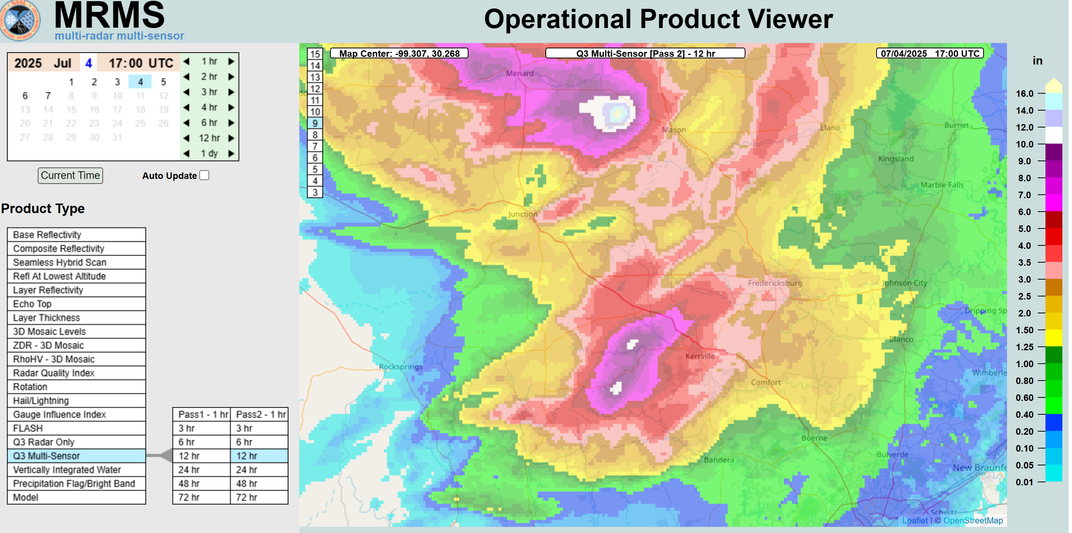
July 4, 2025 Kerr County, TX Flood Event

Slide 9
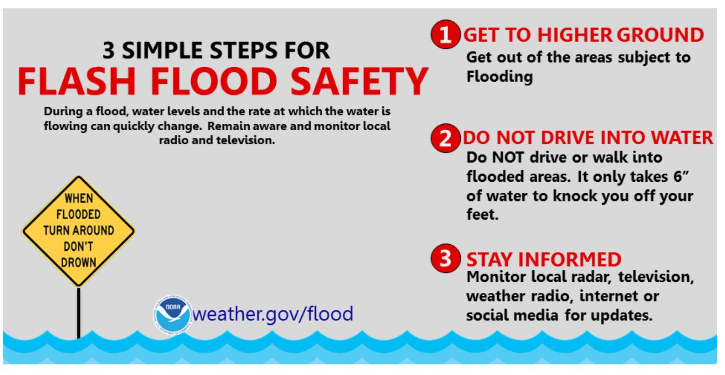

Slide 10
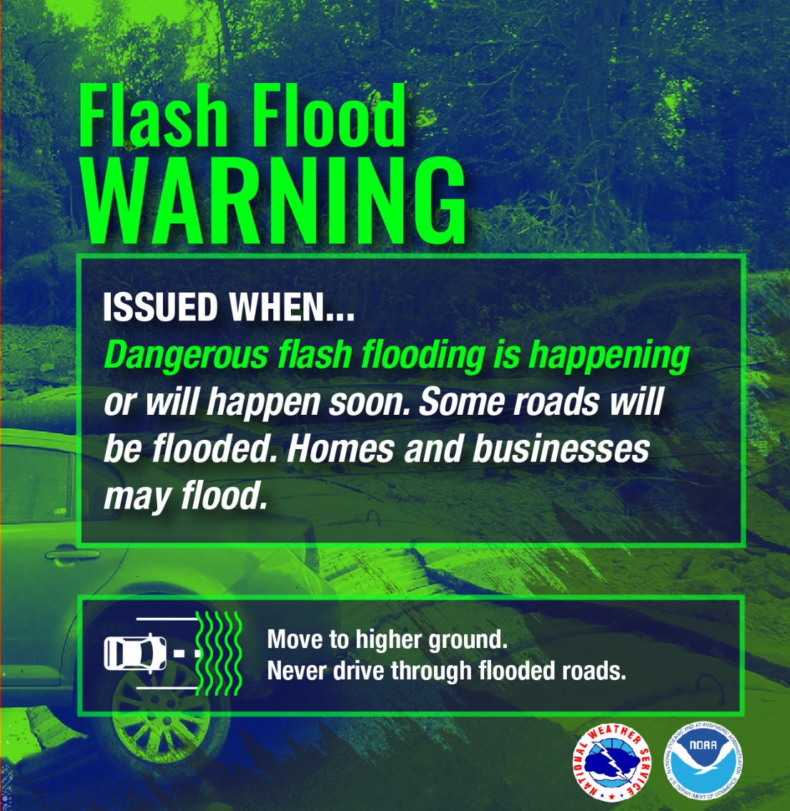
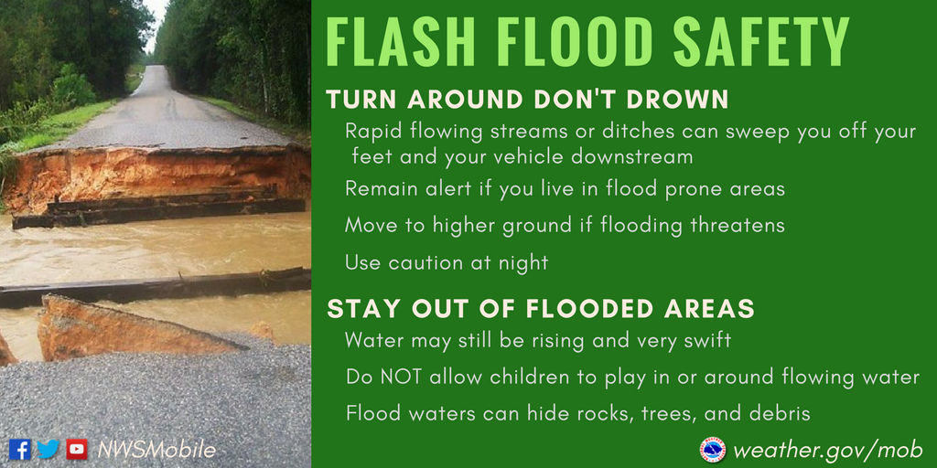
What can you do?
Follow flash flood safety guidance

Slide 11
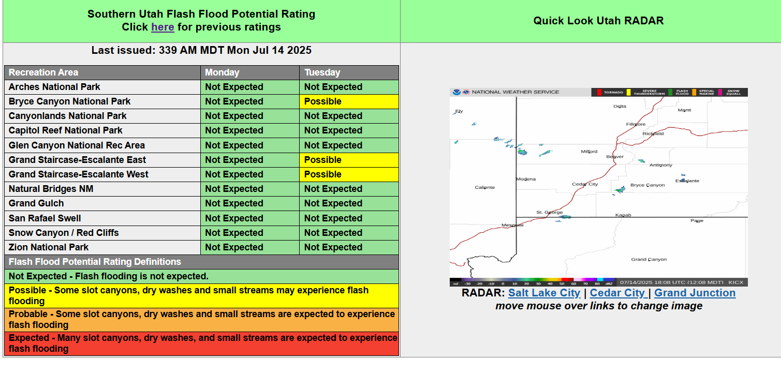
Salt Lake City National Weather Service
Flash Flood Information

Slide 12
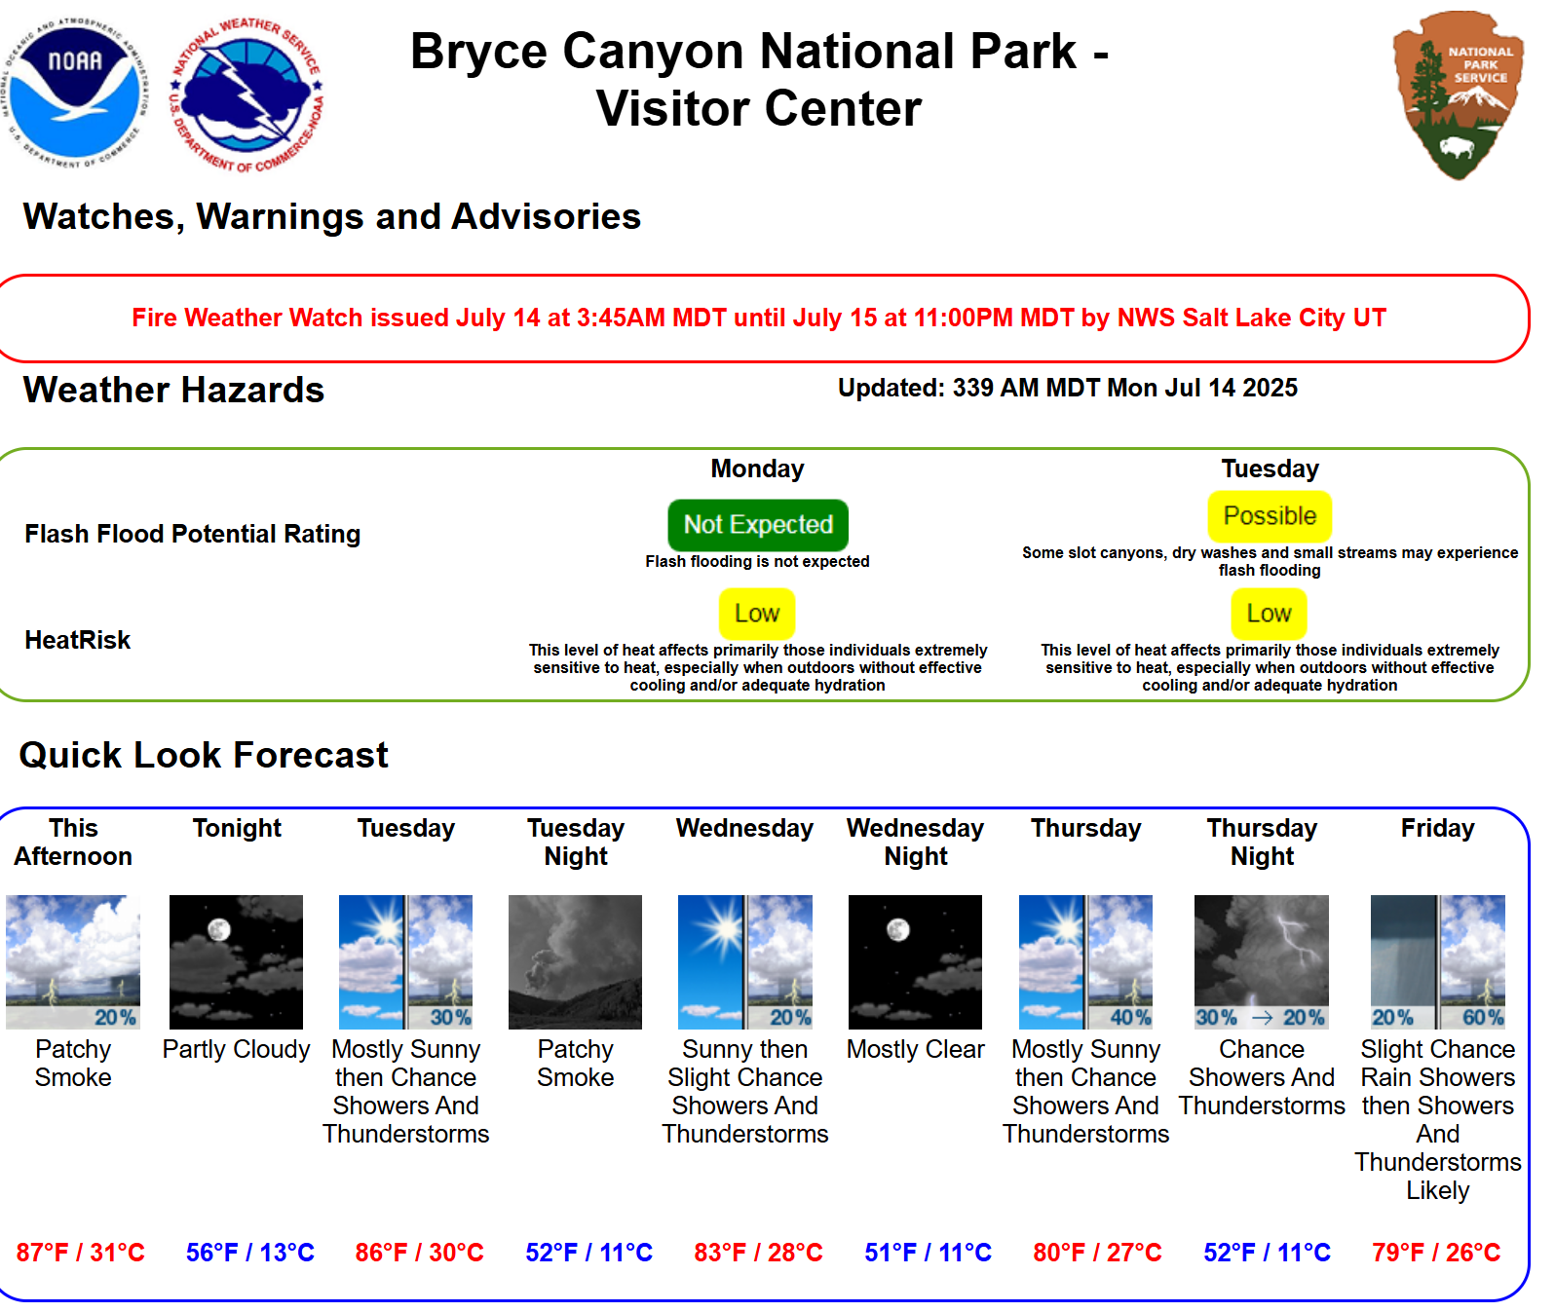
https://www.weather.gov/source/slc/flashflood/index.html?BryceCanyon

Slide 13
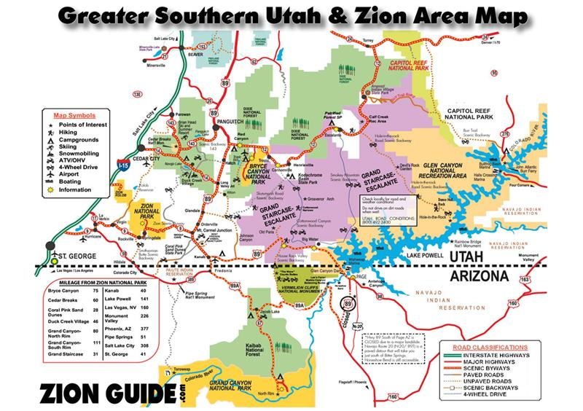

Slide 14
Videos of Utah/Arizona flash floods
Hilldale, UT 2015: https://www.foxweather.com/watch/play-5e7dcfaa9000042
Rankin Studios: https://rankinstudio.com/flashfloods
Wildhorse Canyon: https://youtu.be/wj7WnkgjhM0
Escalante: https://www.youtube.com/watch?v=-bgpoLfaL2s
Capitol Reef: https://www.youtube.com/watch?v=FJOpZF_4b-w
Zion Narrows: https://www.youtube.com/watch?v=E5sn1ZMltak
Tropic: https://www.facebook.com/watch/?v=339802807700656
Red Canyon: https://www.youtube.com/watch?v=ERiRwRwGH3w
Bryce Canyon fatality: https://www.youtube.com/watch?v=2H84ttm7O8k
Havasupai, AZ : https://youtu.be/U9Gt9EAQRsk
Kerr County, TX July 4, 2025: https://www.foxweather.com/watch/fmc-lxzd62cifarph2bx

Slide 15
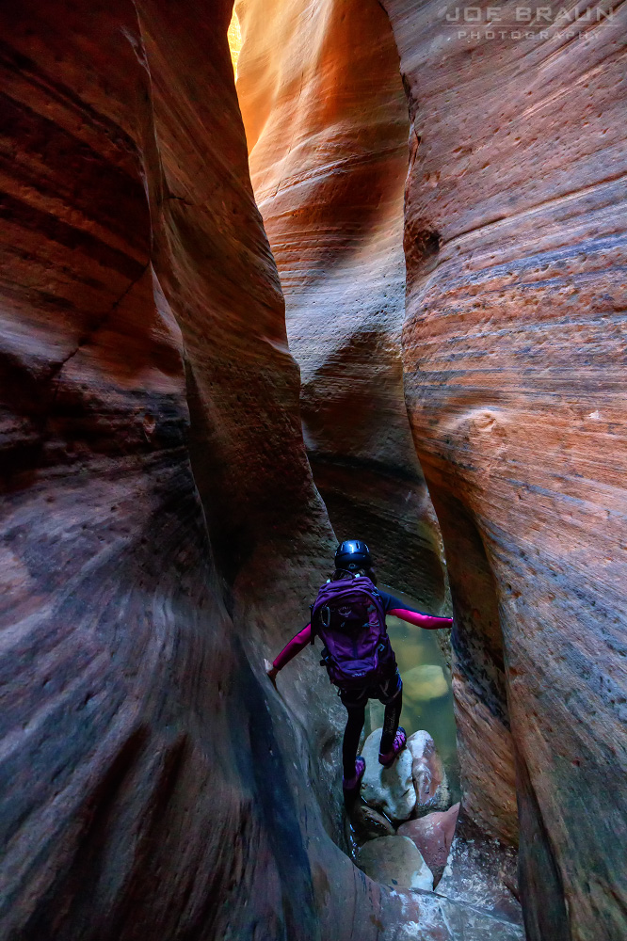
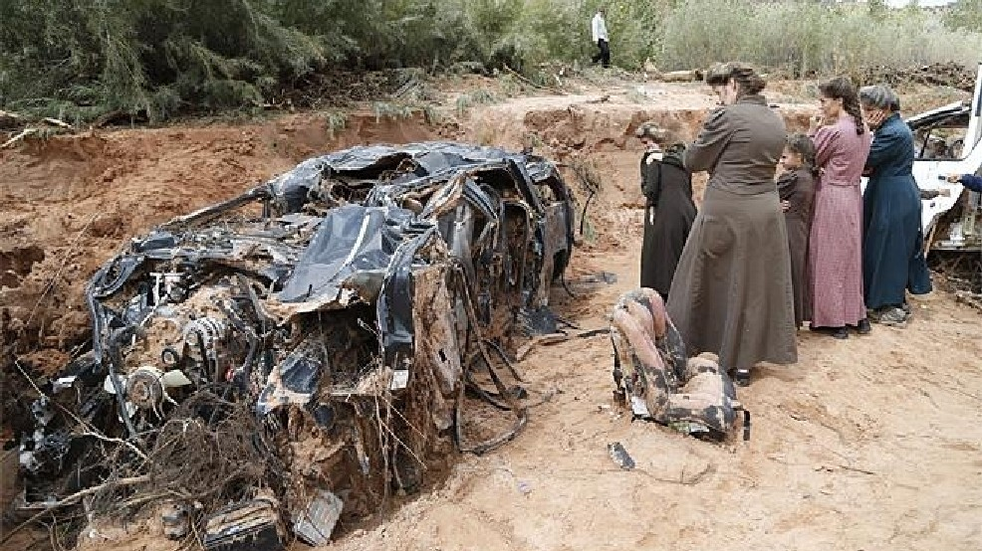
14 Sept 2015
Keyhole, ZNP:
7 fatalities
Hilldale, UT: 13 fatalities
https://www.foxweather.com/watch/play-5e7dcfaa9000042
Joe Braun

Slide 16
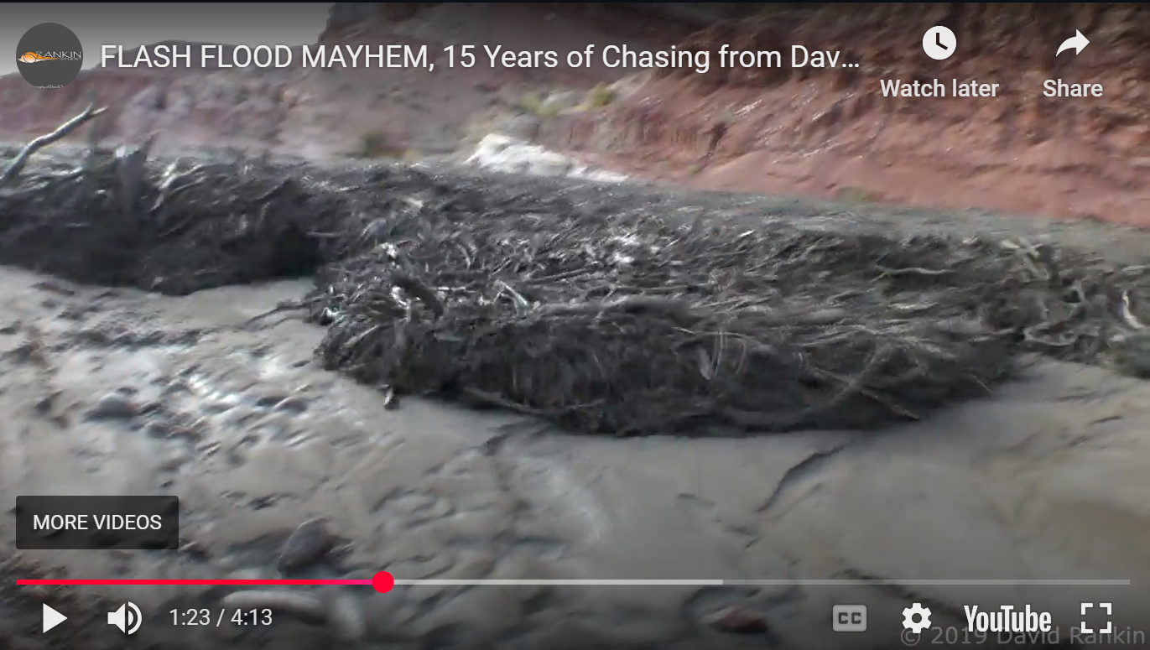
Rankin Studios Flash Floods

Slide 17
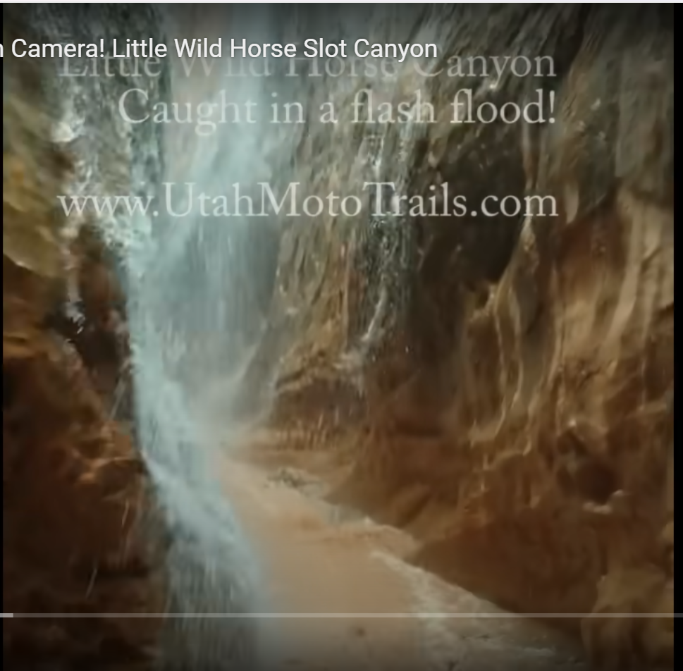
https://youtu.be/wj7WnkgjhM0

Slide 18
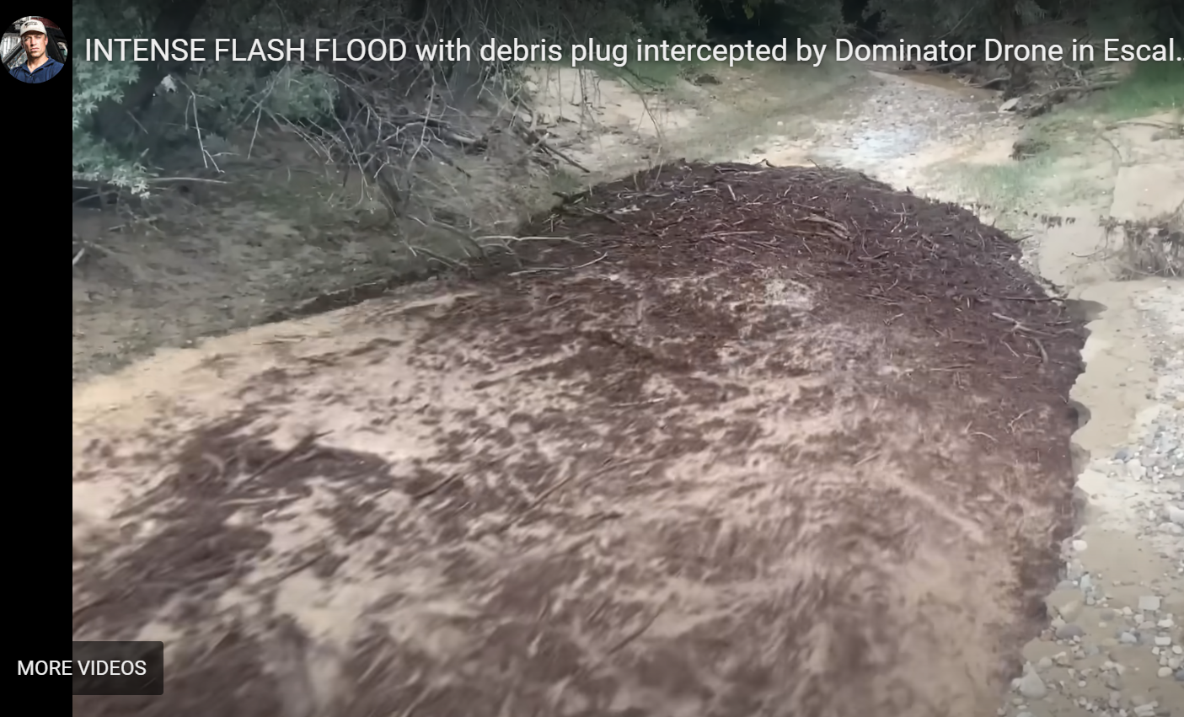
https://youtu.be/-bgpoLfaL2s

Slide 19
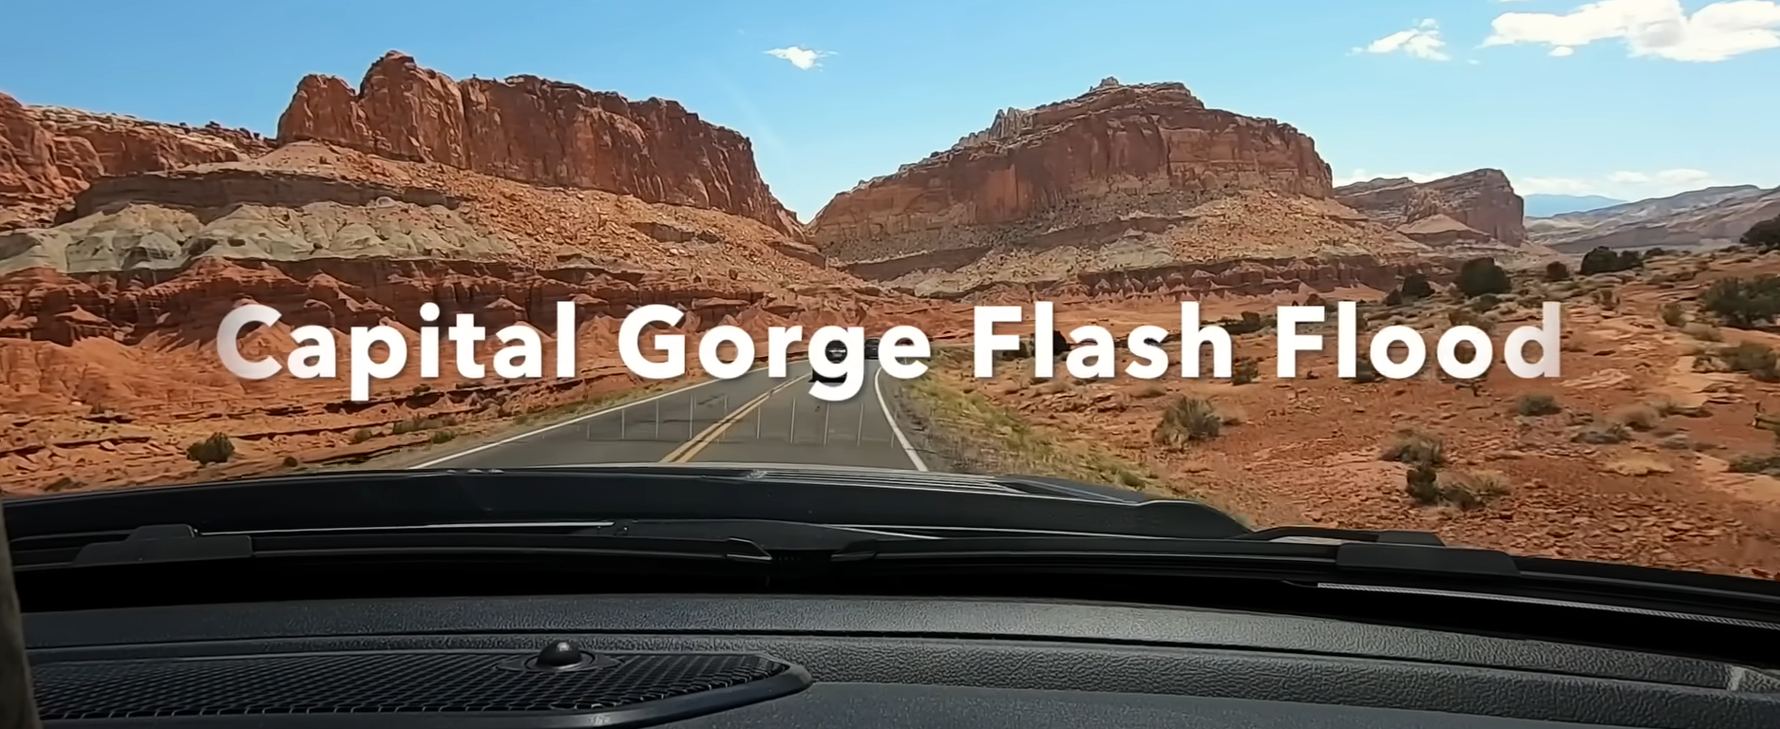
https://www.youtube.com/watch?v=FJOpZF_4b-w

Slide 20
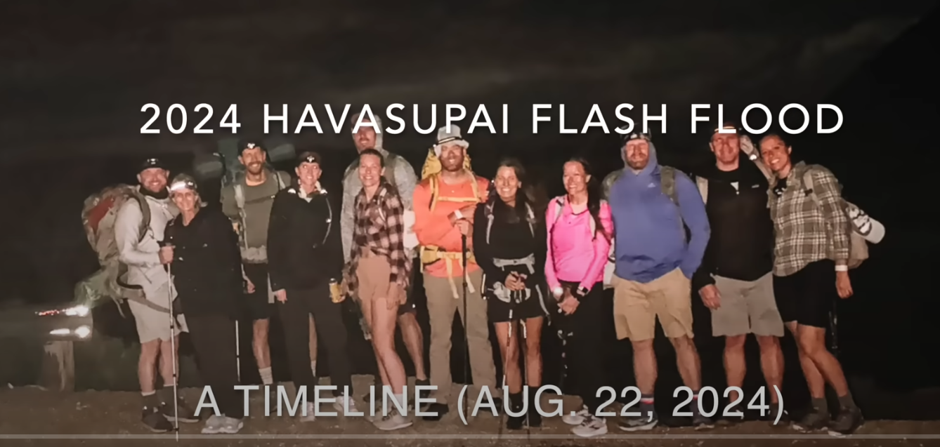
https://youtu.be/U9Gt9EAQRsk

Slide 21
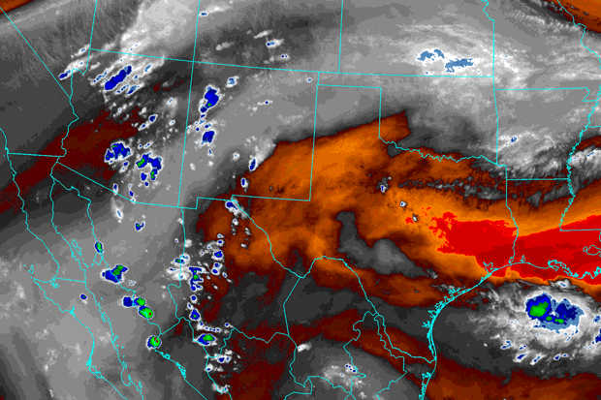
North American Monsoon
Responsible for frequent intense rainfall over southwestern U.S. mountain ranges
Northern monsoon extension into southern Utah leads to potential for flash floods from June to September
Southern Utah:
  ~300,000 permanent residents
  > 10 million visits annually to national parks, monuments, and recreation areas

Slide 22
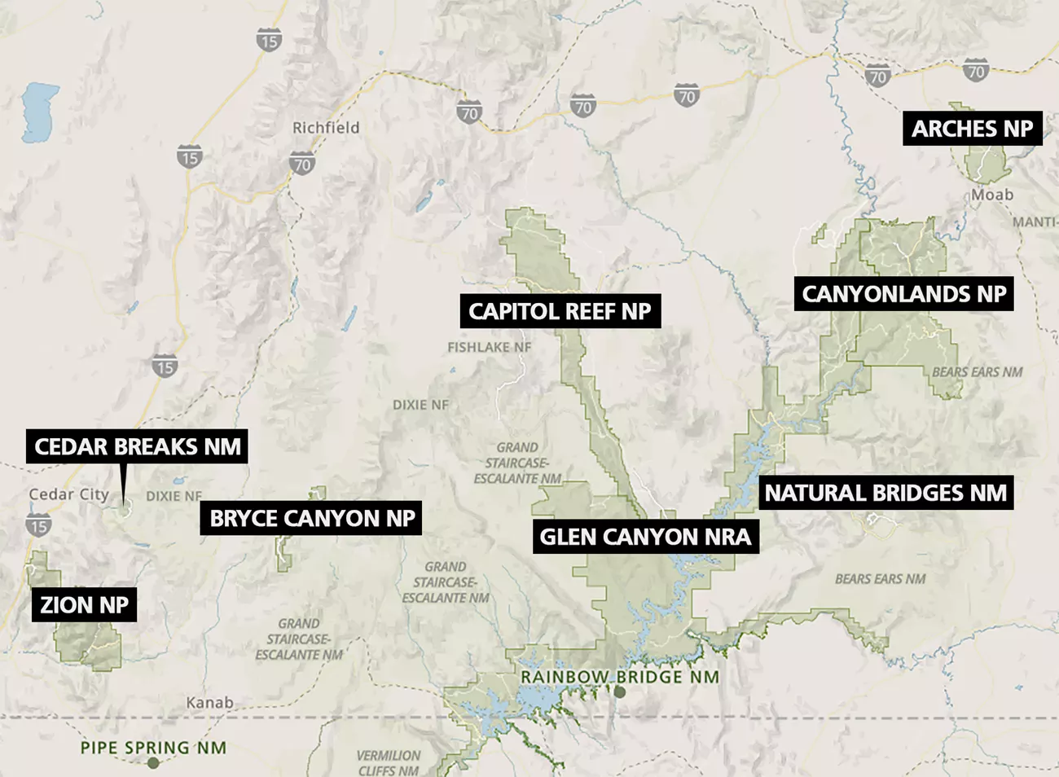
Federally Protected Areas
GRAND STAIRCASE-
ESCALANTE NM
BEARS EARS NM

Slide 23
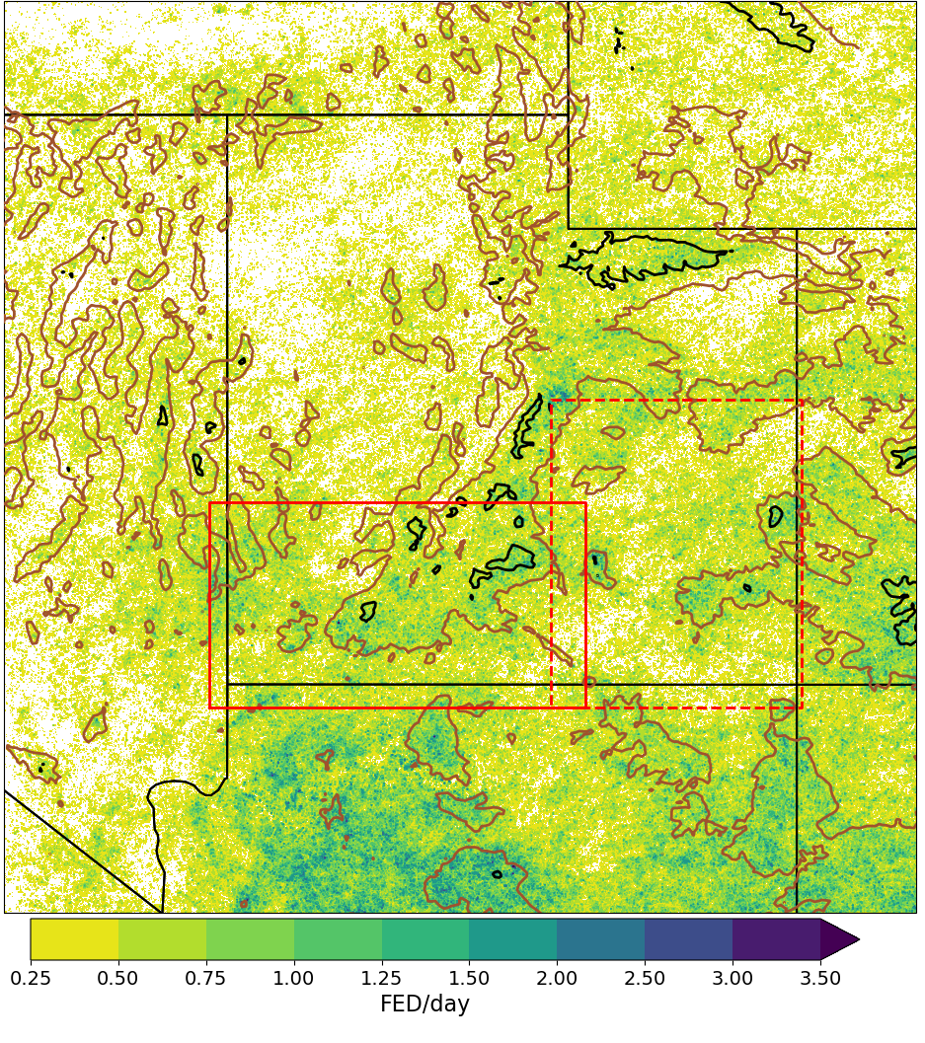
North American Monsoon
Daily Lightning 2021-2024
SLC
Observations of rainfall are limited across the region
Use lightning as a proxy for rainfall
Heavy rainfall is not always accompanied by lightning
(National Lightning Detection Network (NLDN) reformatted to Multi-Radar Multi-Sensor (MRMS) grid)
Cloud-Ground Lightning Density (Flashes km⁻² day⁻¹)

Slide 24
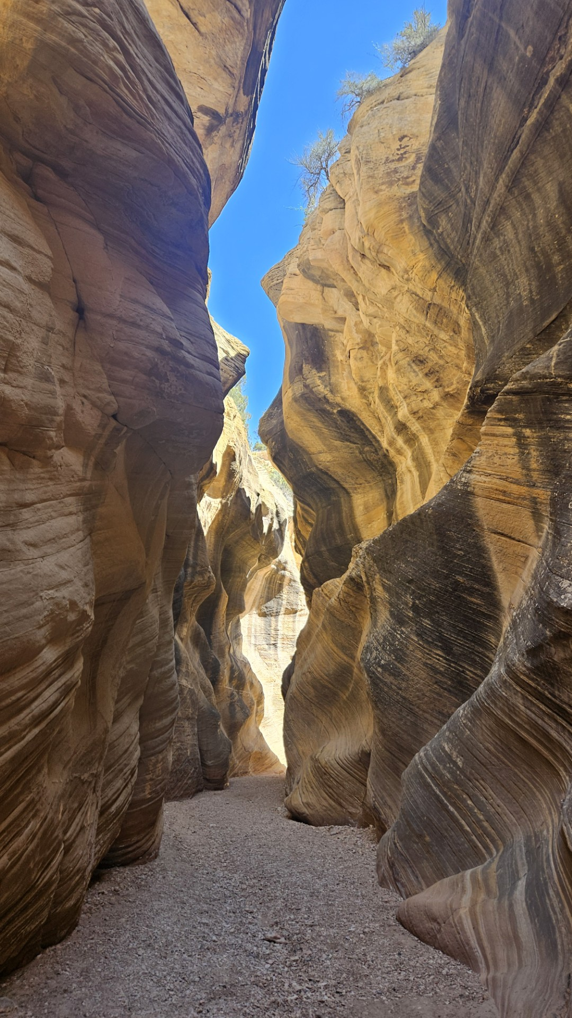
What leads to increased flash flood risk in southern Utah?
Sufficient rain (0.5-1.0 inch per hour) during the afternoon/evening as storm cells progress across a watershed
Rain falls on bare/dry soils and rocks within watershed upstream of narrow channels or canyons
Flash flood: water collects within upstream watershed and often appears initially as a rapid onset of deep water moving rapidly downstream
Risk is increased when visitors not aware of hazardous rainstorm hours ago far upstream of their location
Impedes backcountry travel across main channel far downstream
Harris Wash, GSENM

Slide 25
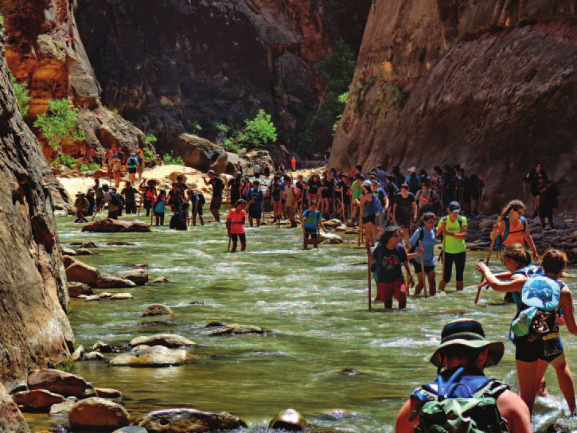
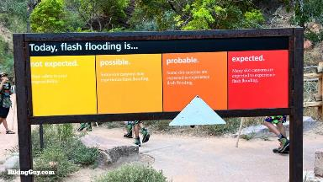
The Narrows Hike
Zion National Park
Access to the Narrows closed when NWS Salt Lake City (SLC) Weather Forecast Office issues Flash Flood Warning
NWS SLC Flash Flood Potential Ranking helps inform visitors of risk
Yu-Fai Leung
The Narrows Hike Zion National Park

Slide 26
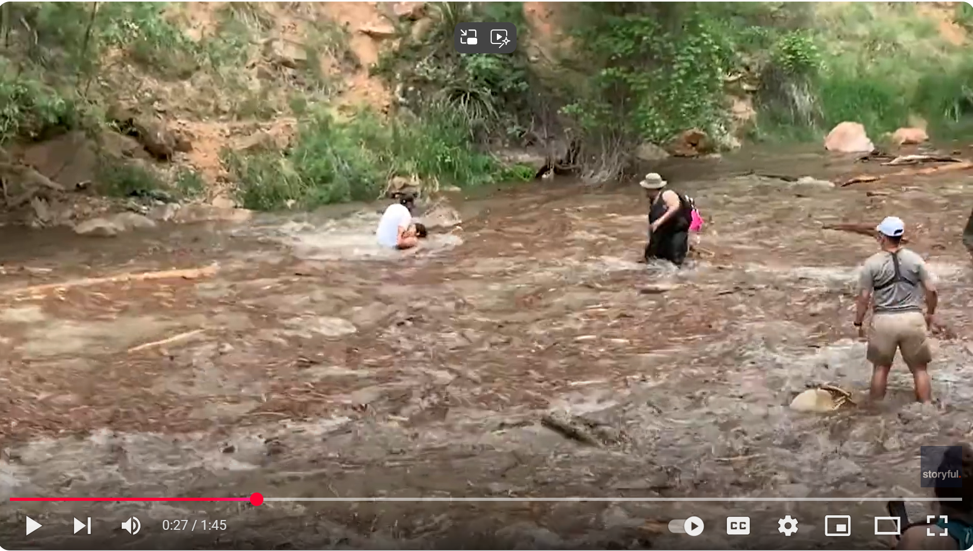
Flash flood at entrance to Narrows: July 31 2021

Slide 27
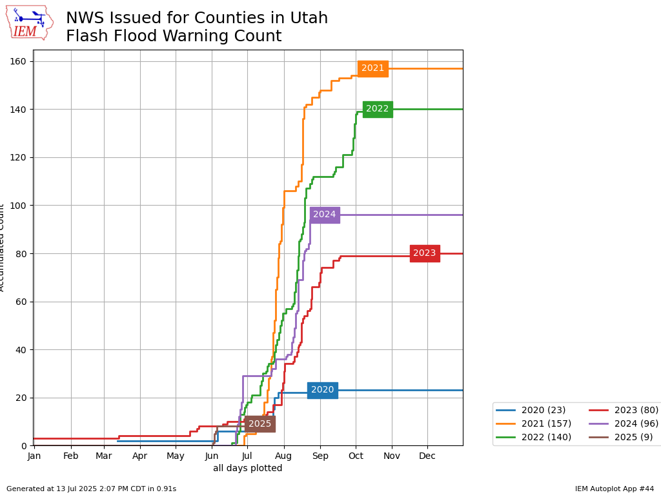
Automated Data Plotter
Accumulated Counts

Slide 28
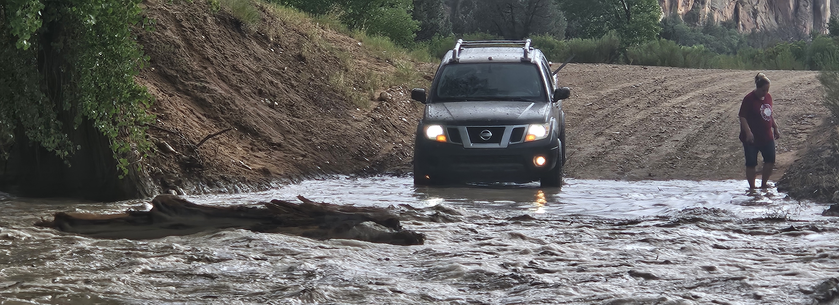
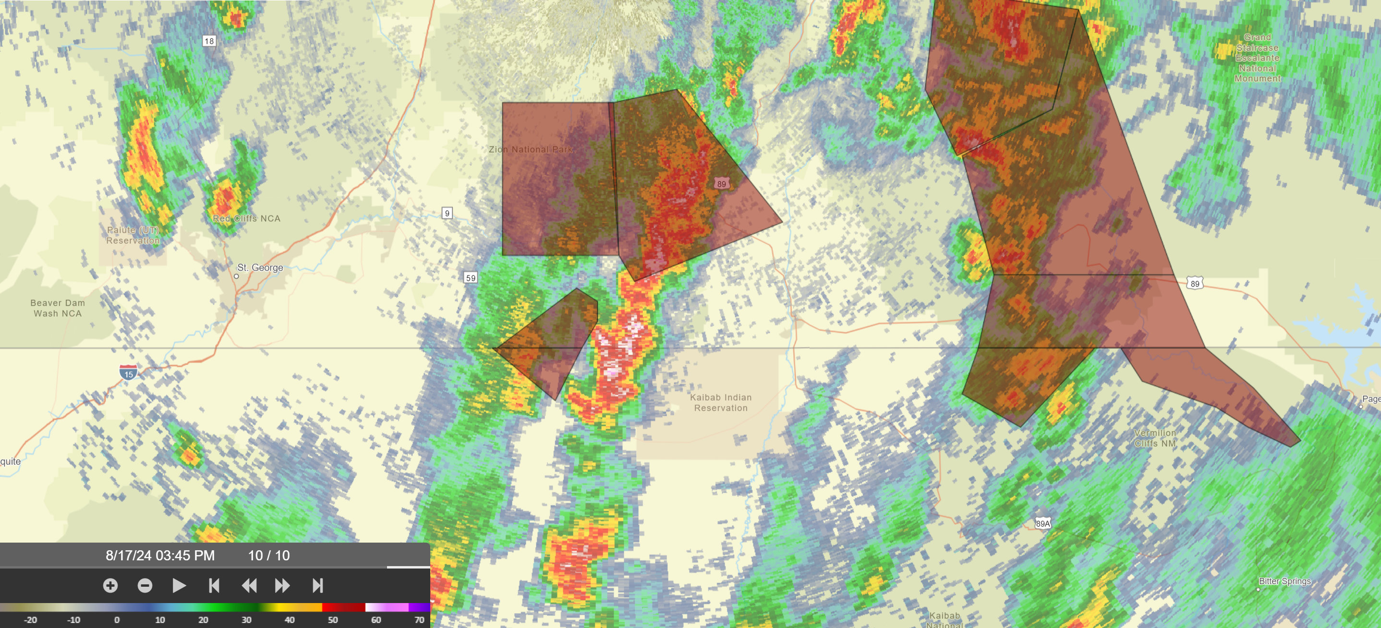
J. Horel
SLC WFO Flash Flood Warnings
17 Aug, 2024
Zion
NP
Virgin
River
Paria River
Colorado City

Slide 29
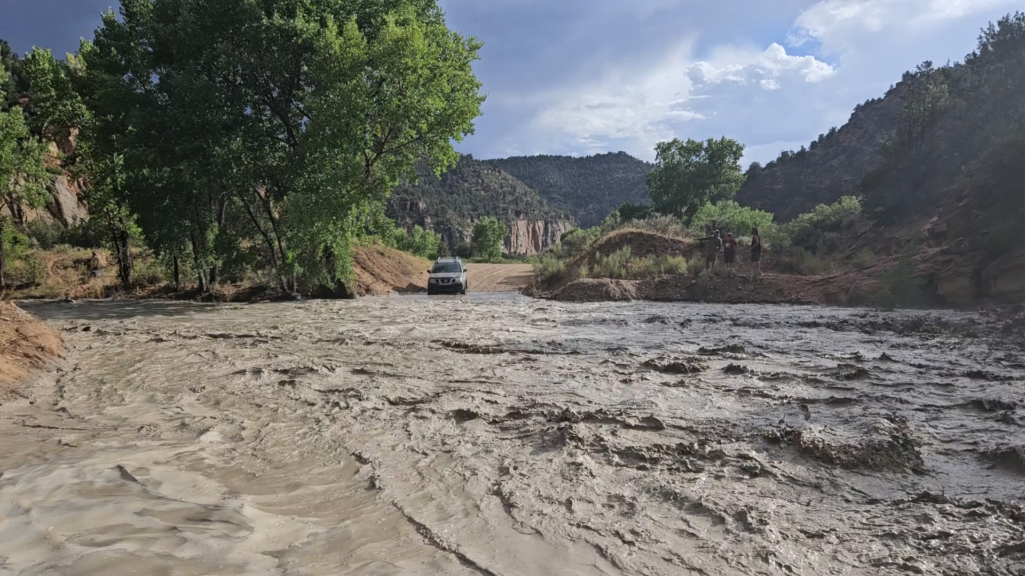
East Fork of the Virgin River near Mt. Carmel Junction

Slide 30
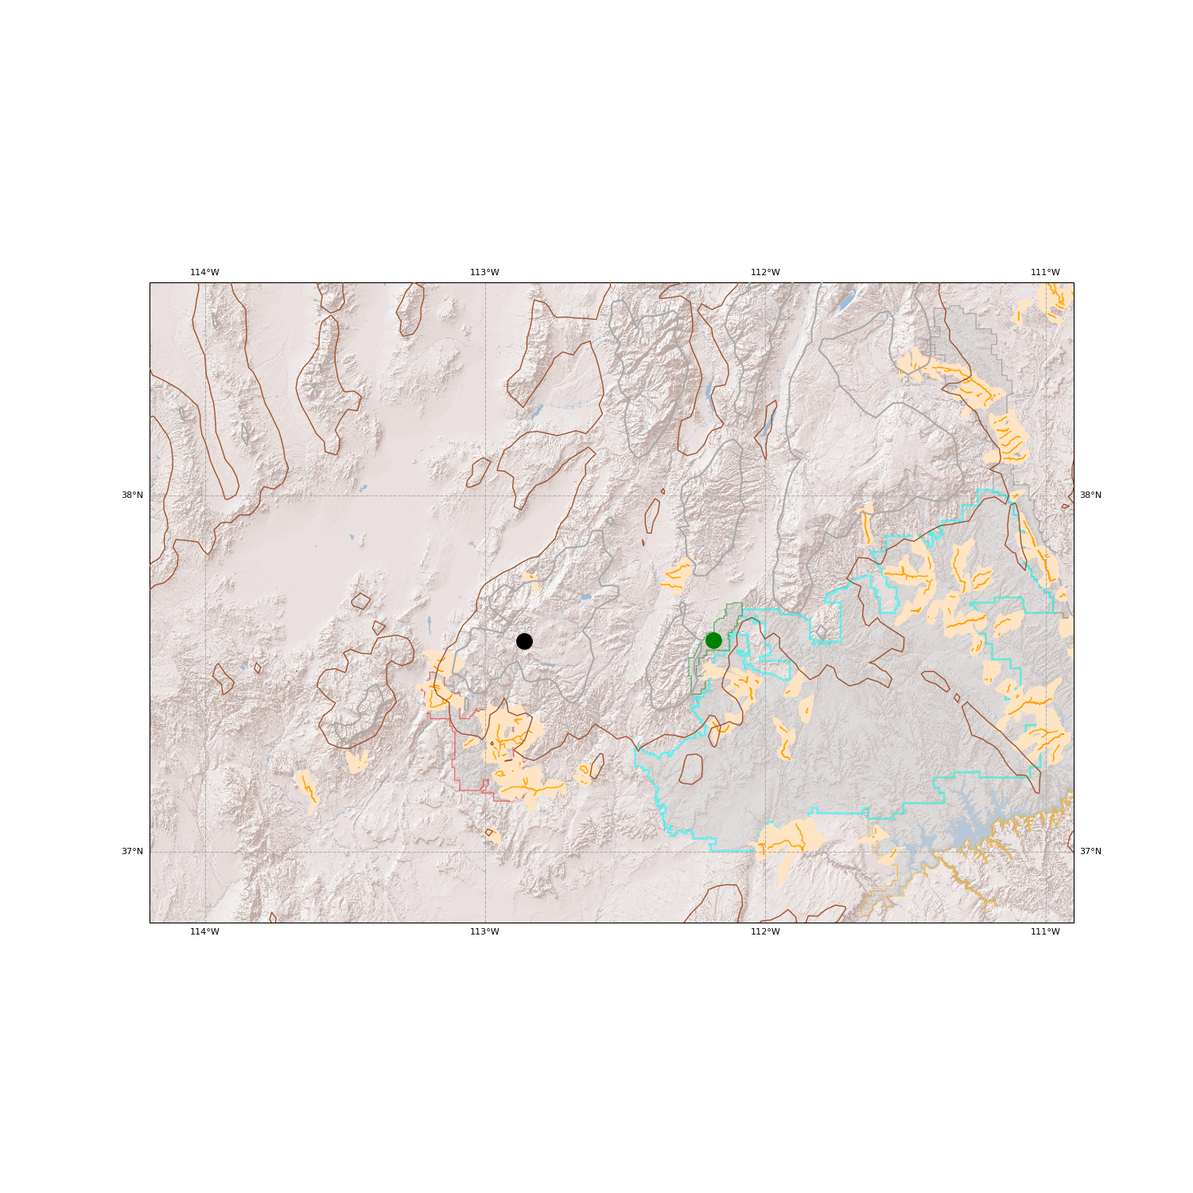
Where are some of the high risk areas for flash floods?
Watersheds (shaded)
slot canyons (lines)
Identified by M. Seaman, NWS from:
  flash flood reports
  local, federal and state agency feedback
  hiking guidebooks
Capitol Reef
Escalante
Zion
Paria

Slide 31
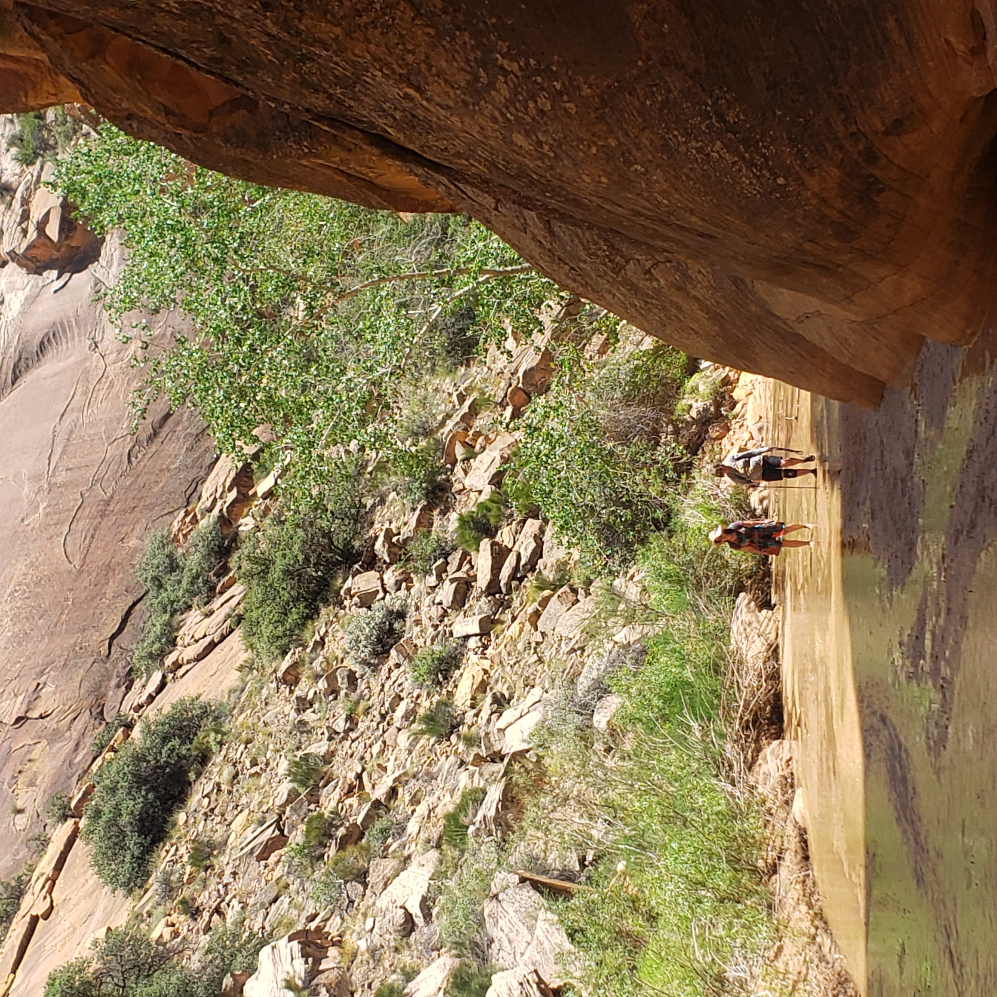
Identifying areas of increased flash flood risk
Consider stream segments defined by the United States Geological Survey that are at least 500 m (~1/3 mile) long
Ignore where streambed is very steep > 20º slope
Stream bank slopes ≥ 30º within 20 m (~60 ft) on each side along 20% or more of the stream segment (length of a football field)
Hackberry Canyon
GSENM

Slide 32
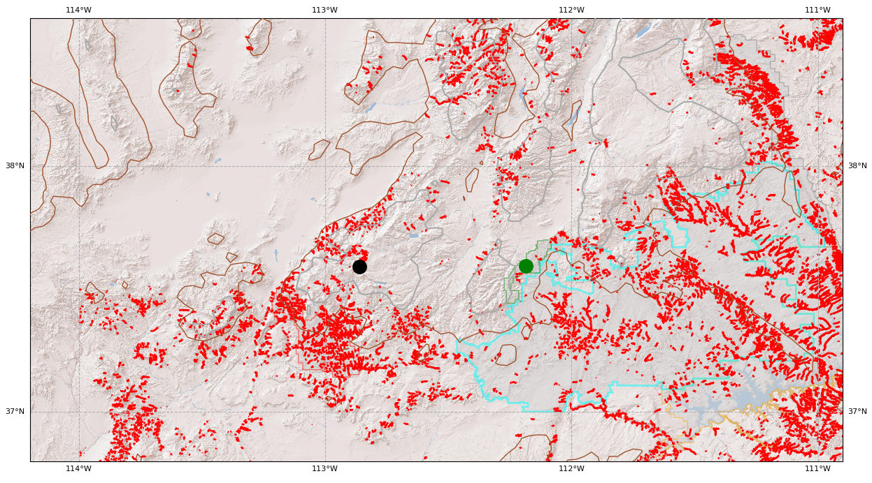
Increased risk areas: ~10% of all stream segments
Stream segments farther downstream hazardous for travel
Capitol Reef
Escalante
Hole in the Rock
Zion
Paria

Slide 33
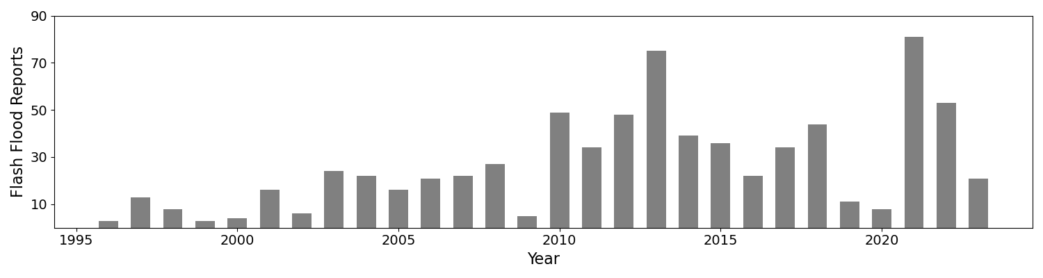
Flash flood reports in southwestern Utah
Flash flood reports in the seven-county region of southwestern Utah
Flash floods are under reported!

Slide 34
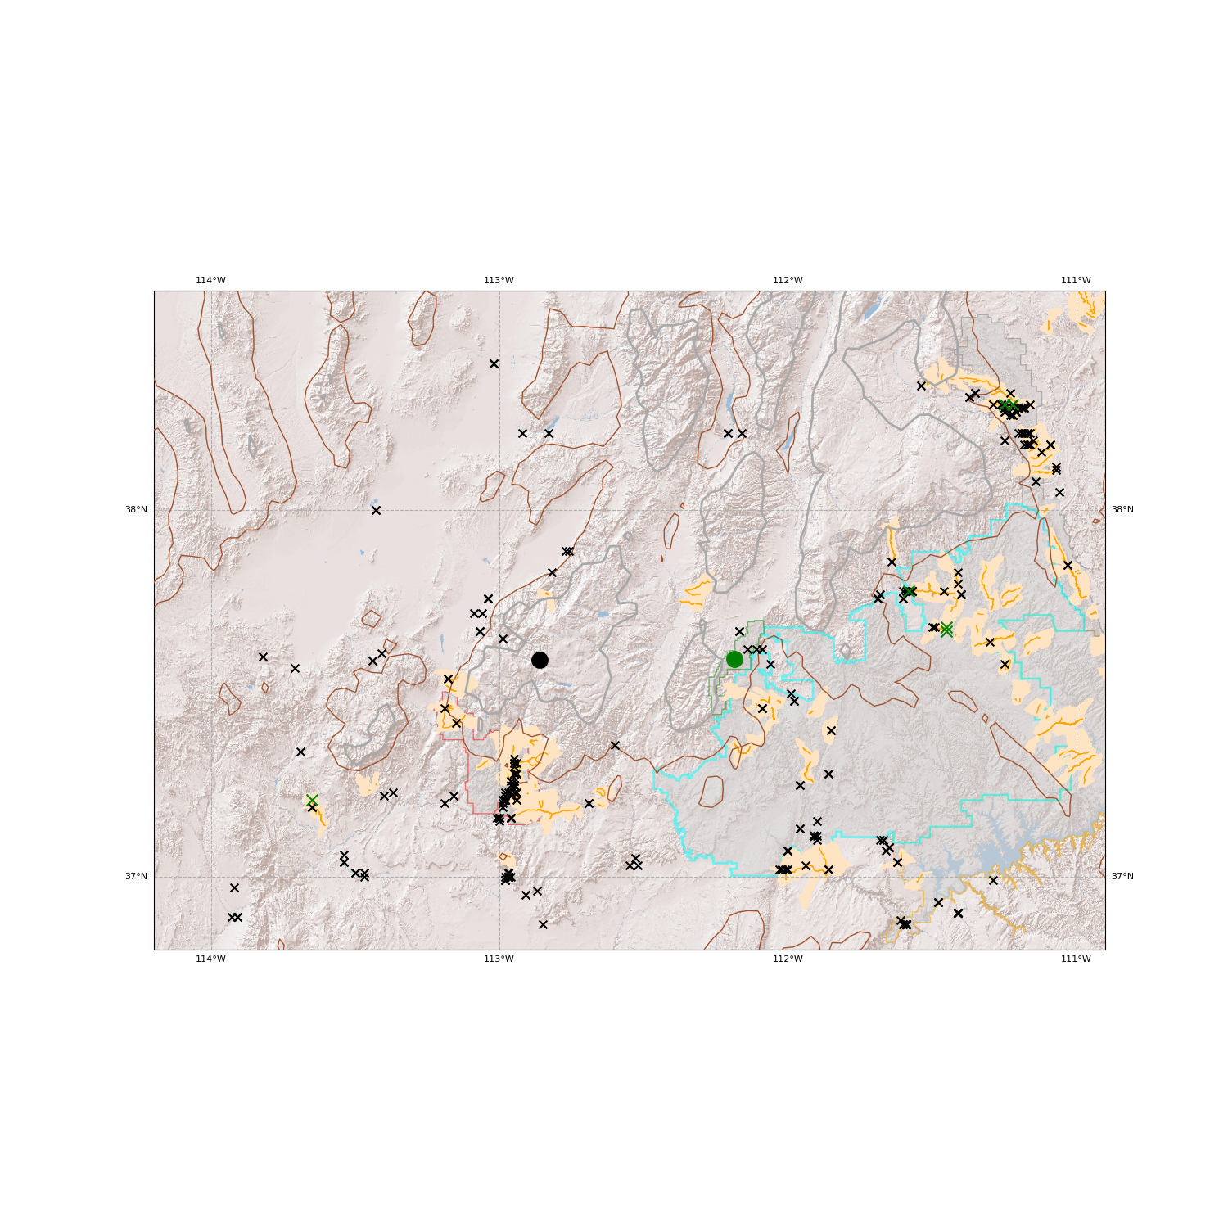
Flash flood reports during June-September 2021-2025
Requires automated gauge observations or information received by National Weather Service from other agencies or public

Slide 35
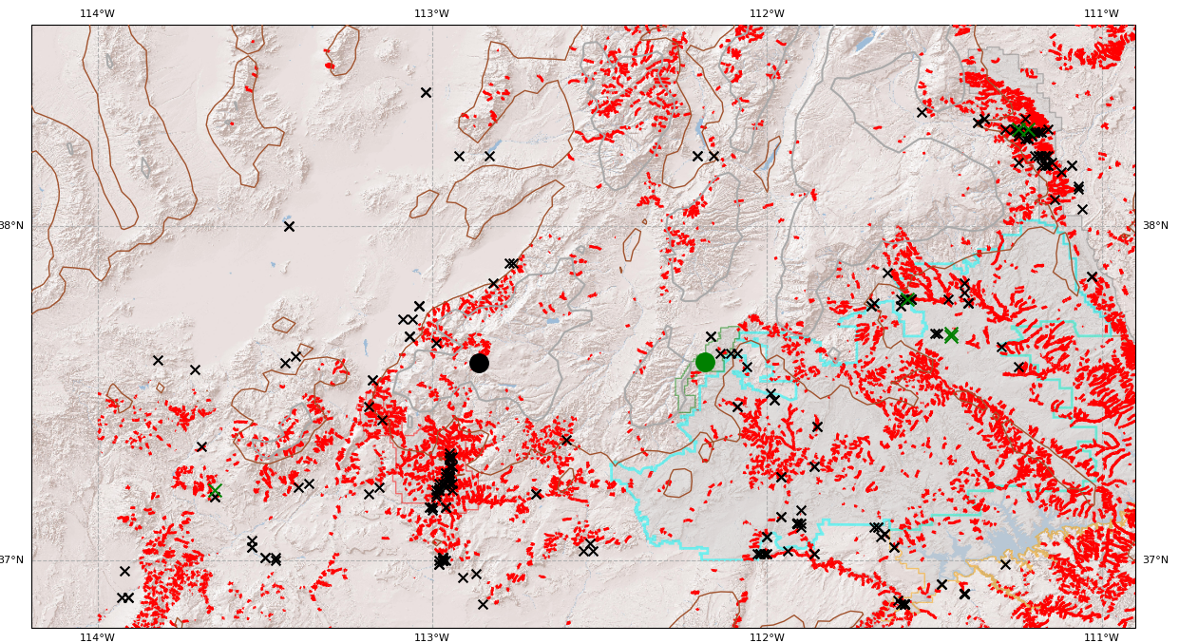
Flash flood reports during June-September 2021-2025

Slide 36
Selected flash flood research in southern Utah
2005-present
  SLC WFO developed and implemented Flash Flood Potential forecasts for national parks
  Seaman, M., D. Church, and J. Cunningham, 2024: Leveraging probabilistic high resolution model guidance to improve flash flood forecasting across southern Utah
  https://ams.confex.com/ams/104ANNUAL/meetingapp.cgi/Paper/430507.
  Seaman, M., D. Church, and J. Cunningham, 2025: Utilizing Machine Learning and Probabilistic High Resolution Model Guidance to Improve Flash Flood Forecasts Across Southern Utah. Monday. https://ams.confex.com/ams/105ANNUAL/meetingapp.cgi/Paper/448231
24 year lightning climatology and case studies including 2015 event
  Smith et al., 2019: The Paroxysmal precipitation of the desert: Flash floods in the southwestern United States. Water Resources Research 10.1029/2019WR025480
2021-2023 monsoon seasons
  Horel, John and James Powell, 2024: Analysis and prediction of summer rainfall over southwestern Utah. Wea. Forecasting. https://doi.org/10.1175/WAF-D-24-0018.1

Slide 37
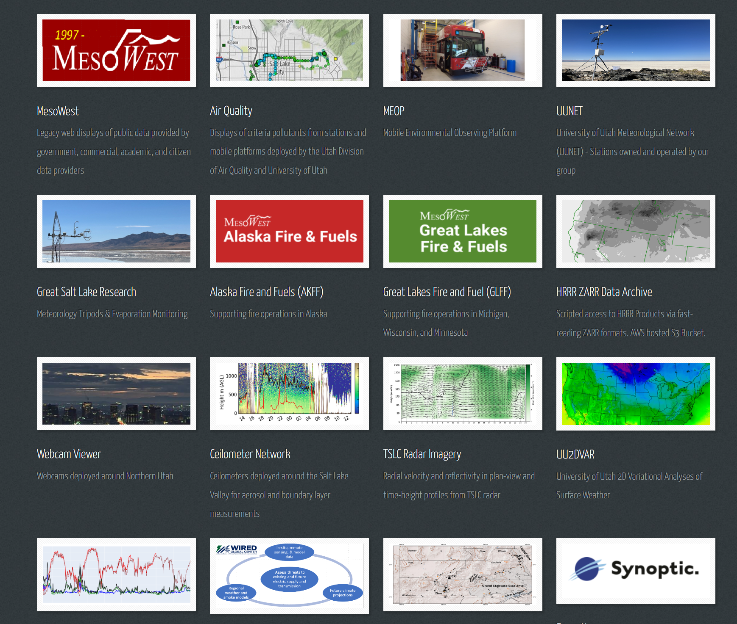
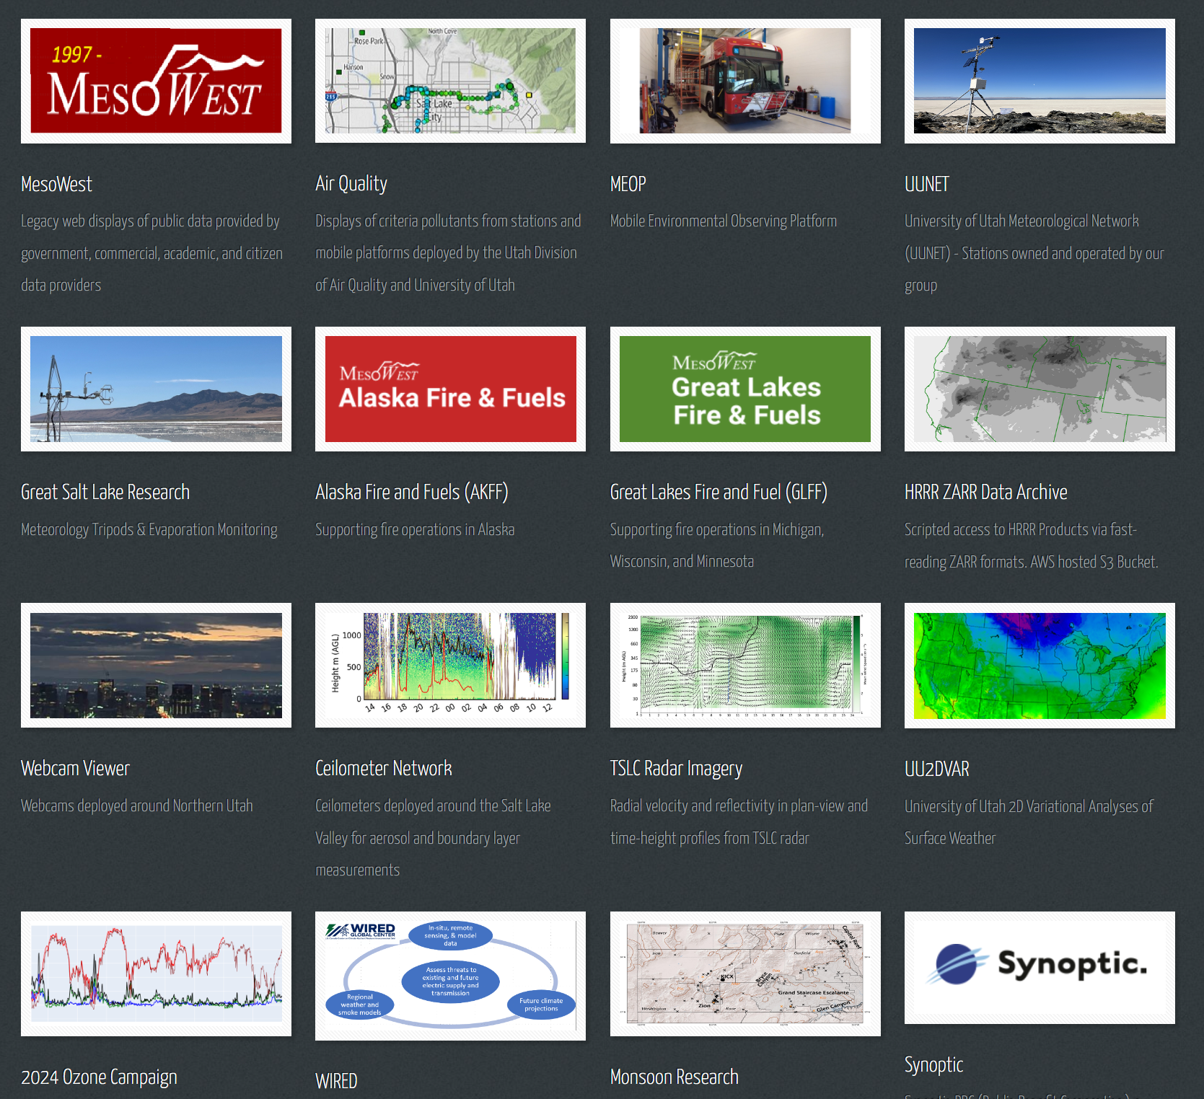
https://horel.chpc.utah.edu
Software R&D
Observing Networks
Data Mining & Modeling
Sensor Systems

Slide 38
Flood Safety

Slide 39
What can you do?
Pass along flash flood safety messaging

Slide 40
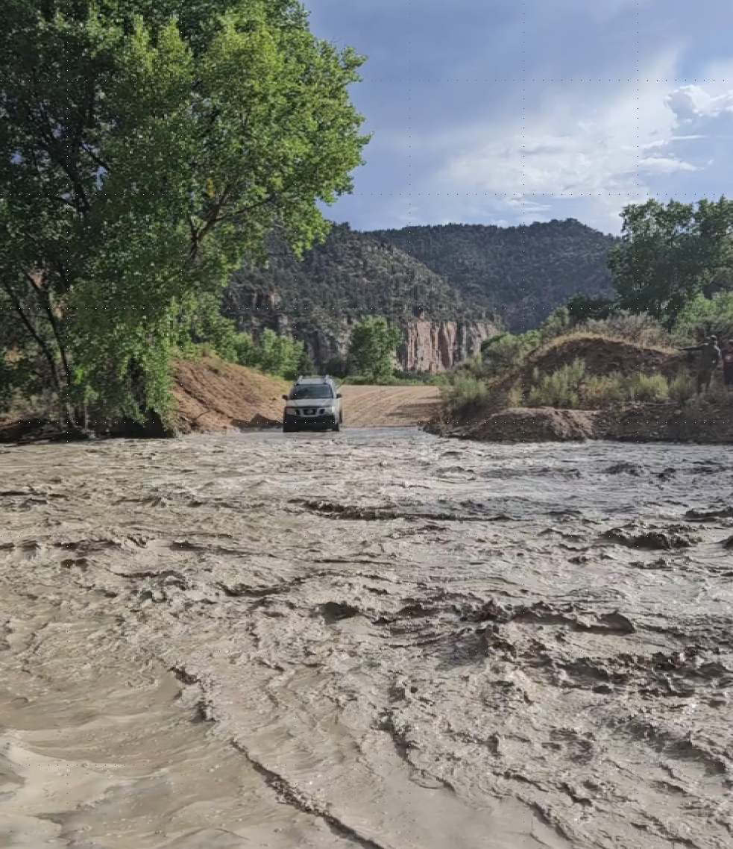
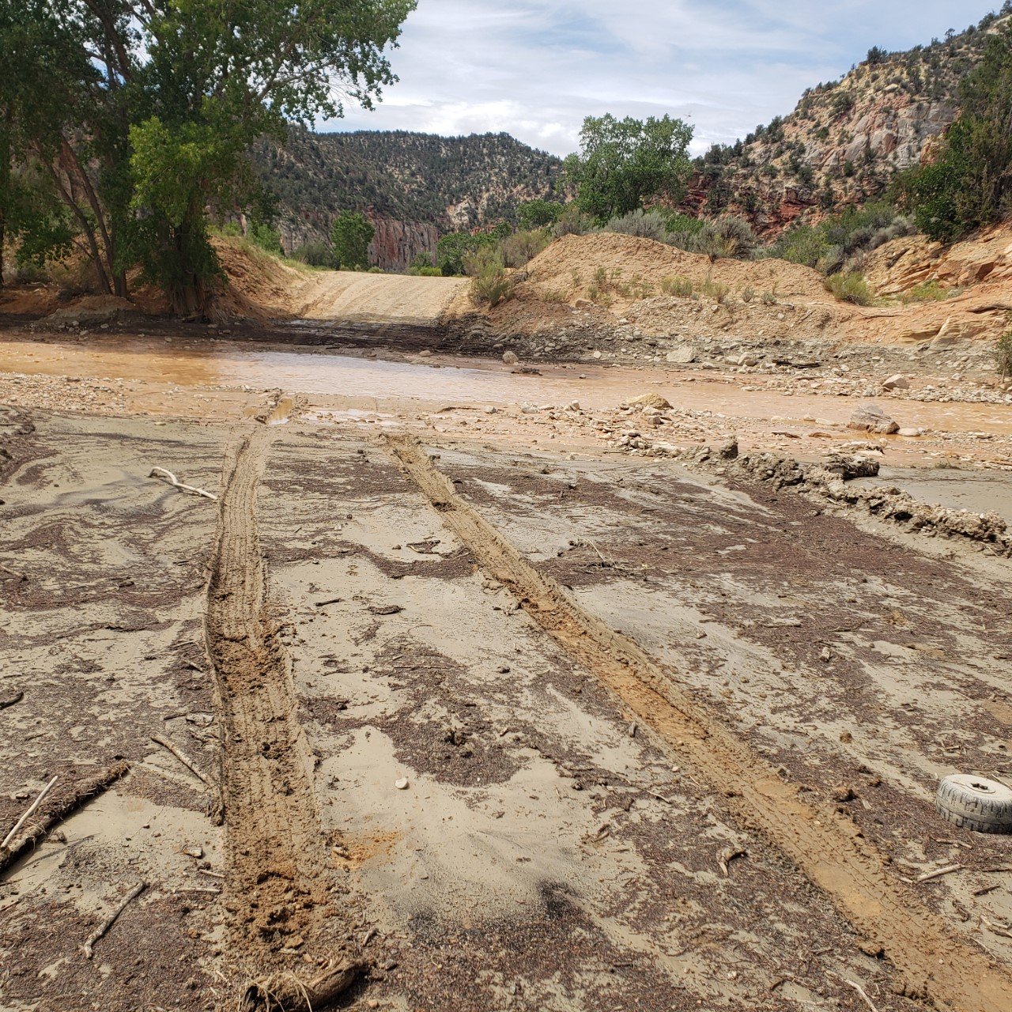
Questions? john.horel@utah.edu

