Slide 1
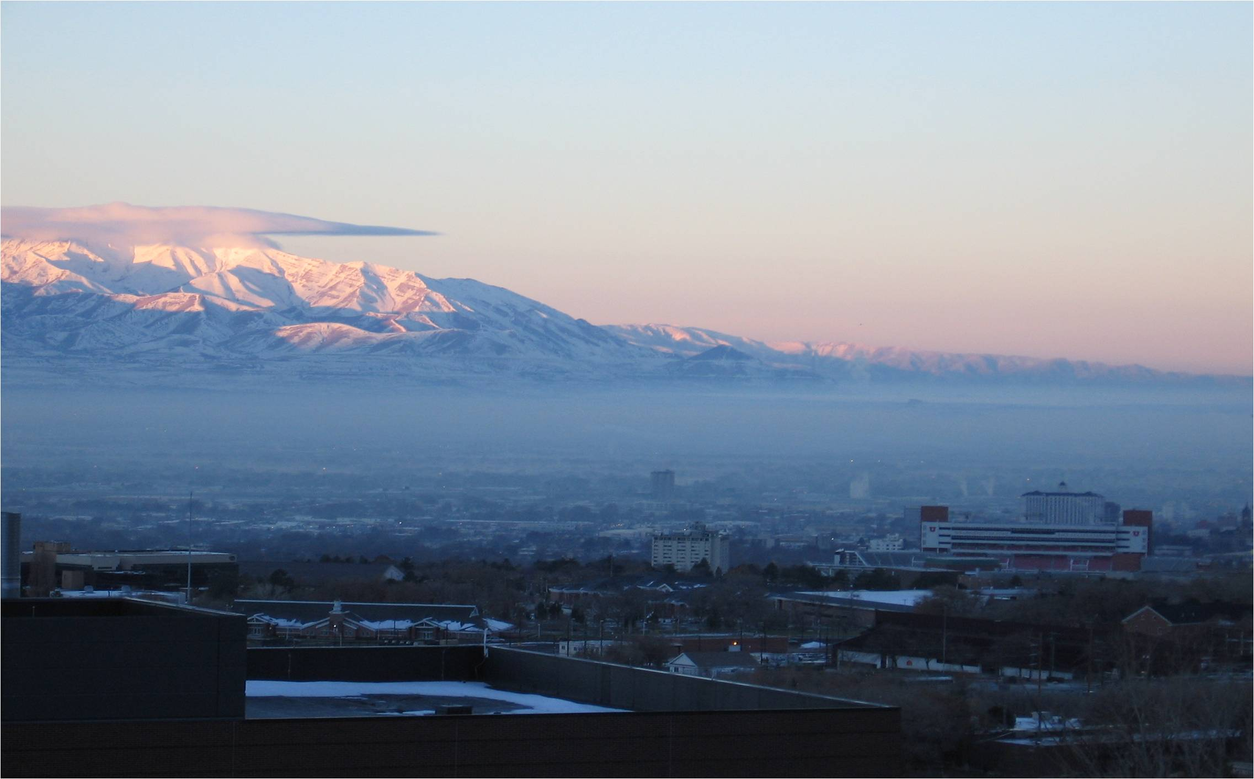
Understanding the Weather Leading to Poor Winter Air Quality
Erik Crosman¹, John Horel¹, Chris Foster¹, Lance Avey²
¹University of Utah
Department of Atmospheric Sciences
²Utah Division of Air Quality

Slide 2
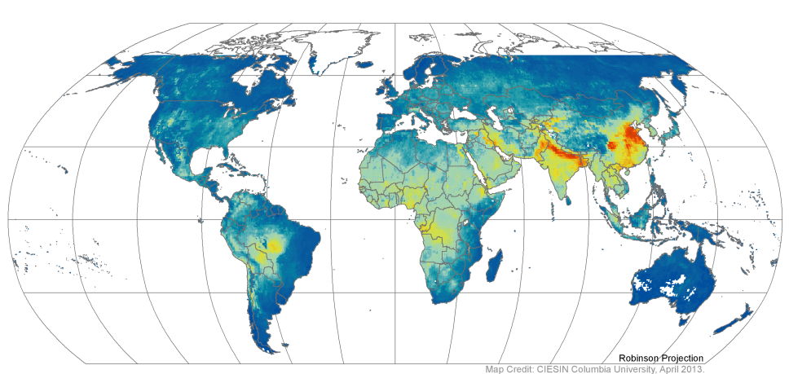
A Global Problem Exacerbated by Topography
Salt Lake
Basin
Moscova River Basin
Beijing
Los Angeles
Basin
dust
Shanghai
Sichuan Basin
Valley of Mexico
fires
Johannesburg,
South Africa
Annual Average PM2.5 Grids from MODIS and MISR Aerosol Optical Depth (AOD),
2001–2010. Palisades, NY: NASA Socioeconomic Data and Applications Center (SEDAC).
http://sedac.ciesin .columbia.edu/data/set/sdei-g lobal-annual-avg -pm2-5-2001-2010

Slide 3
MODIS Satellite Image of Pollution Episode February 24, 2005 Source: Asian Air Pollution edited by David L. Alles
Sichuan Basin, China

Slide 4
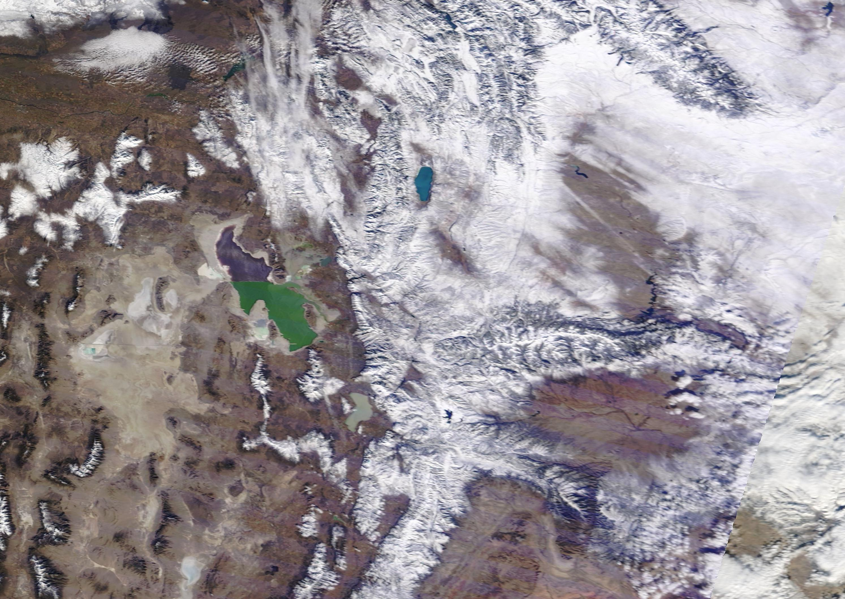
Utah Basins
Cache Valley
Salt Lake Valley—Medium-sized partly open valley with large urban population
Uintah Basin—Large very deep basin with small population
Each basin has characteristic snow cover climatology and depth of ‘inversion’ resulting from confining topography
Cache
Valley
Great Salt Lake
Basin
Salt Lake
Valley
Utah
Valley
Uintah Basin

Slide 5
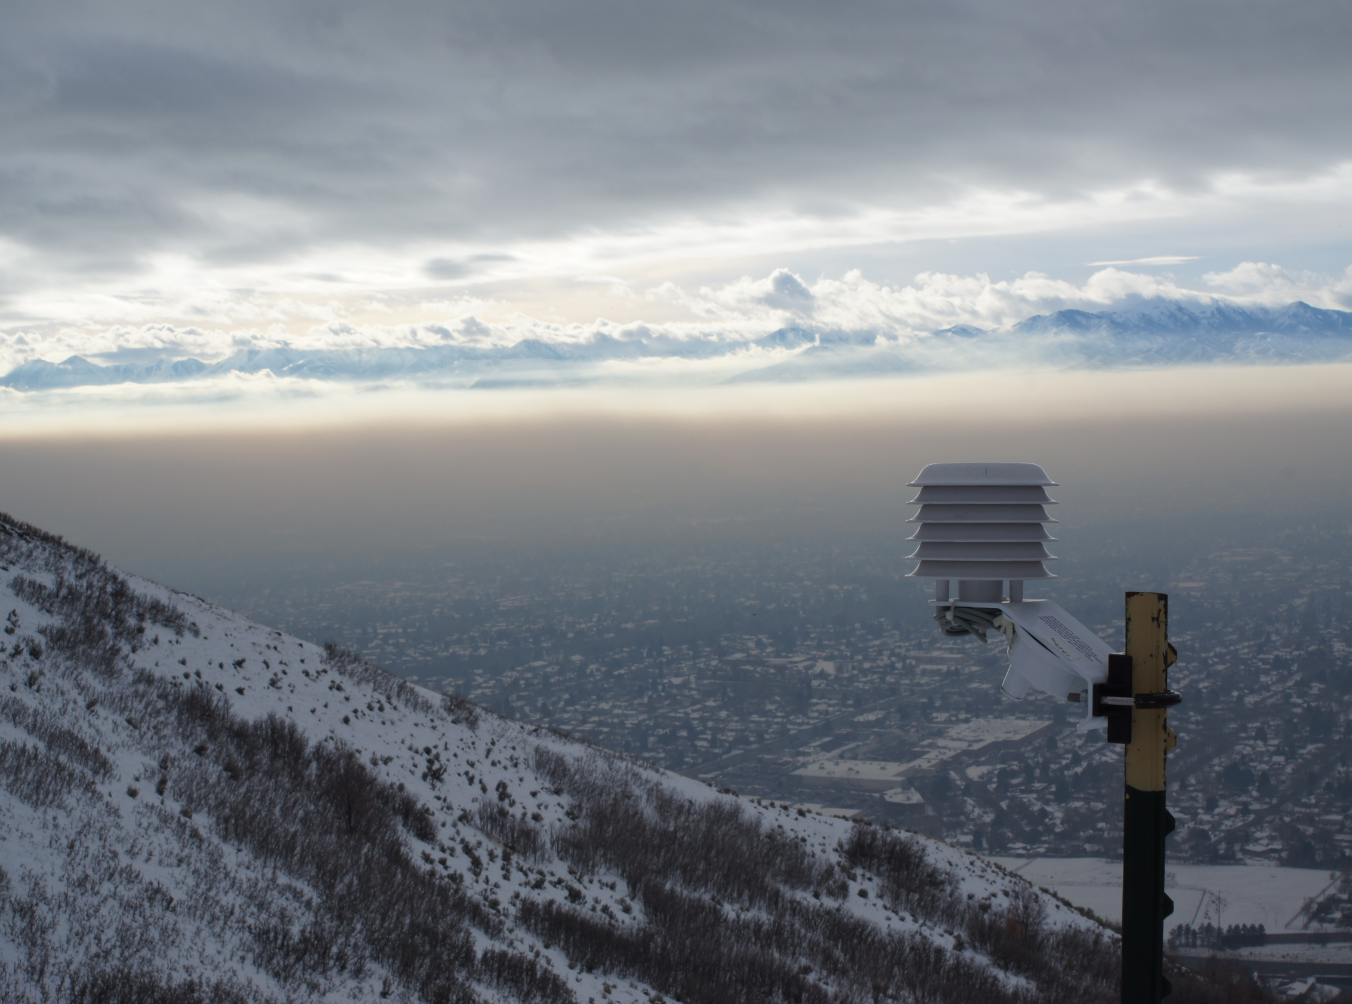
Basic Weather Features Associated with Poor Winter Air Quality: Well-Understood
H
High pressure
Warm, clean air
Cold, dirty air
Light winds

Slide 6
Critical Weather Details Associated with Poor Winter Air Quality: Difficult to Predict
Mixing
Transport
Clouds
Depth of
polluted layer
Transport
Snow Cover and Land Use

Slide 7
Wintertime ‘Inversions’: Models Needed to Understand Complex Feedbacks
DEPTH?
SNOW?
DURATION
CLOUDS?

Slide 8
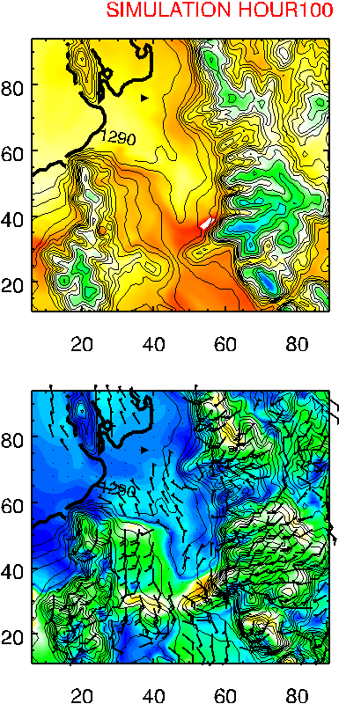
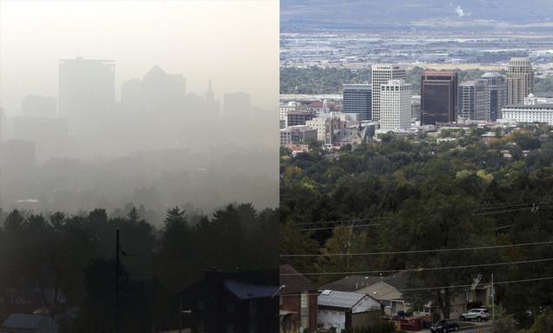
Which Model is Right?
Temperature (ᵒC)
Temperature (ᵒC)
10
Great
Salt
Lake
Great
Salt
Lake
Salt
Lake
Valley
5
Salt
Lake
Valley
0
-5
Toxic soup continues…
Time to exercise!
Wind Speed (m s⁻¹)
Wind Speed (m s⁻¹)
12
9
6
3
sltrib.com
0

Slide 9
Improving Weather Models of Wintertime Inversions
The Environmental Protection Agency (EPA), Western Regional Air Partnership (WRAP) and Utah Division of Air Quality (UDAQ) have identified the need for improved meteorological models of wintertime stagnation episodes
Collaborative effort (July 2014-January 2016) between UofU and UDAQ to improve modeling funded by the Utah Legislature
Builds on collaborative work with Utah State University

Slide 10
Weather Research and Forecasting Model (WRF)
Grid spacing = 12 km
Full-physics meteorological
model
Model time step in inner domain
~5 seconds
Run in parallel on 100-200
processors
Parameterizations
for clouds, radiation, surface
fluxes, turbulent mixing,
precipitation, etc
Grid spacing = 4 km
Grid spacing
= 1.3 km

Slide 11
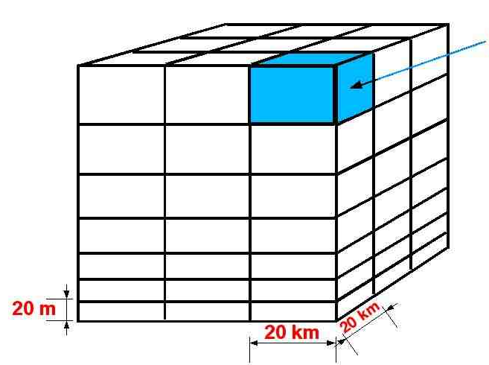
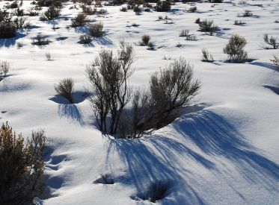
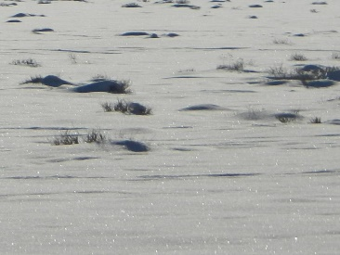
Improvements Being Tested For Wintertime Modeling in Utah Basins
1) Improved cloud and mixing algorithms
2) Increased model grid spacing
3) Improved model initialization
4) Improved treatment of snow cover and vegetation
See posters x.x and x.x for more detailed information
Liquid
Ice

Slide 12
Critical Components: Snow and Clouds
High sensitivity to snow cover and snow age and reflectivity
Current research focused on identifying appropriate sources of land use and vegetation information
Cloud thickness and type varies depending on parameterization chosen
Current research focused on improving model treatment of clouds

Slide 13
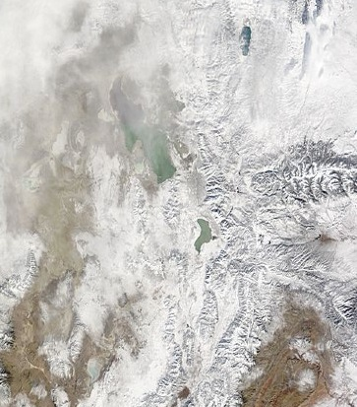
Christmas 2014 Snowfall
20 December 2014
27 December 2014
Cache
Valley
Great
Salt
Lake
Basin
Salt Lake
Valley
Utah
Valley
Uintah Basin

Slide 14
WRF CAP Sensitivity to Initialization Time Identical simulations started 1 day apart
Timing is Everything!
Initialization 24 hours later
is significantly warmer
Initialization 1
Obs
1 Jan
1 Jan
31 Dec
31 December 2010
1 January 2011
2 January 2011

Slide 15
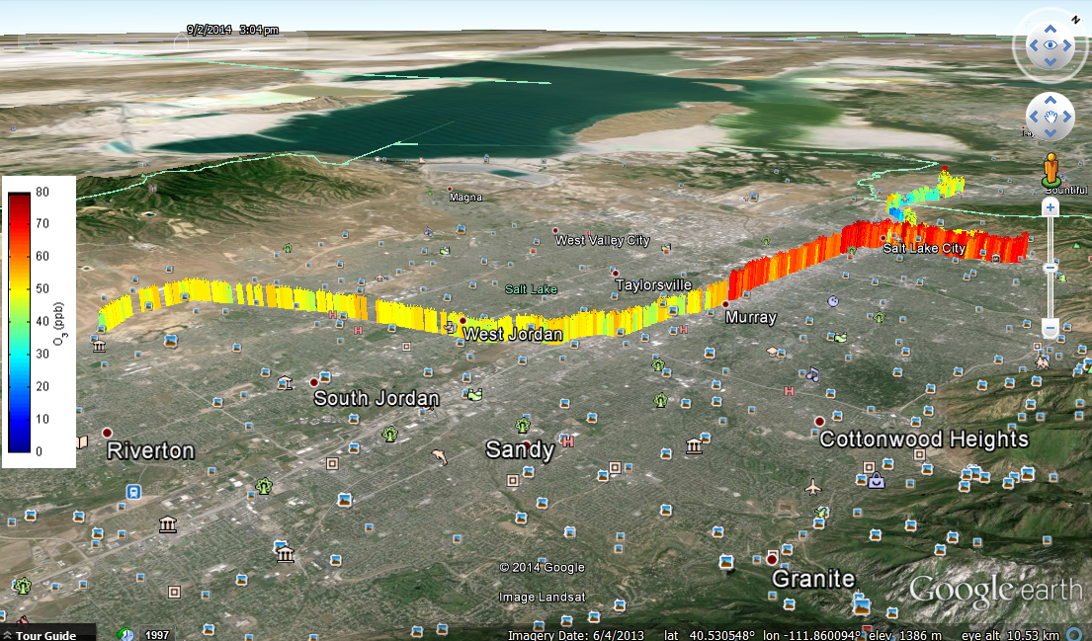
Synthesizing Observations and Modeling in Utah Basins…
Monitoring air pollution from TRAX (see Mitchell et al. poster x.x).
U of U ceilometer and mini-sodar network
additional experimental air quality and met instrumentation installed during last few months
2 September 2013 TRAX Red Line
http://meso1.chpc.utah.edu/mesotrax/

Slide 16
Summary and Future Work
Ongoing work to improve wintertime modeling for Wasatch Front and Cache Valley
Work focusing on:
model grid resolution
cloud parameterization schemes
specifying snow surface appropriately

Slide 17
Background Information
Neemann, E.M., E.T. Crosman, and L. Avey, Simulations of a cold-air pool with elevated wintertime ozone in the Uintah Basin, Utah. Atmos. Chem. Phys., 14, 1-17, 2014.
Lareau, N. P. and Horel, J. D.: Dynamically induced displacements of a persistent cold-air pool, Bound.-Lay. Meteor., doi: 10.1007/s10546-014-9968-5, available at: http://link.springer.com/article/10.1007%2Fs10546-014-9968-5, 2014.
Lareau, N. P., Crosman, E. T., Whiteman, C. D., Horel, J. D., Hoch, S. W., Brown, W. O. J., and Horst, T. W.: The persistent cold-air pool study, B. Am. Meteorol. Soc., 94, 51–63, doi:10.1175/BAMS-D-11-00255.1, 2013.

