Slide 1
Measurement Capabilities of the Mountain Meteorology Group of the Atmospheric Sciences Department relevant to Air Quality Studies
Dave Whiteman, John Horel, Jim Steenburgh, Sebastian Hoch
Capabilities are focused on - but not limited to - the key meteorological variables controlling vertical and horizontal mixing of pollutants.
Temperature
surface values and vertical structure; controls atmospheric stability
-> cold air pools, inversions
Wind speed and direction; surface and vertical profile
-> mixing, dispersion, wind shear
Winds
Others Pressure, Precipitation, Surface Energy Balance, Aerosol Backscatter, Ozone

Slide 2
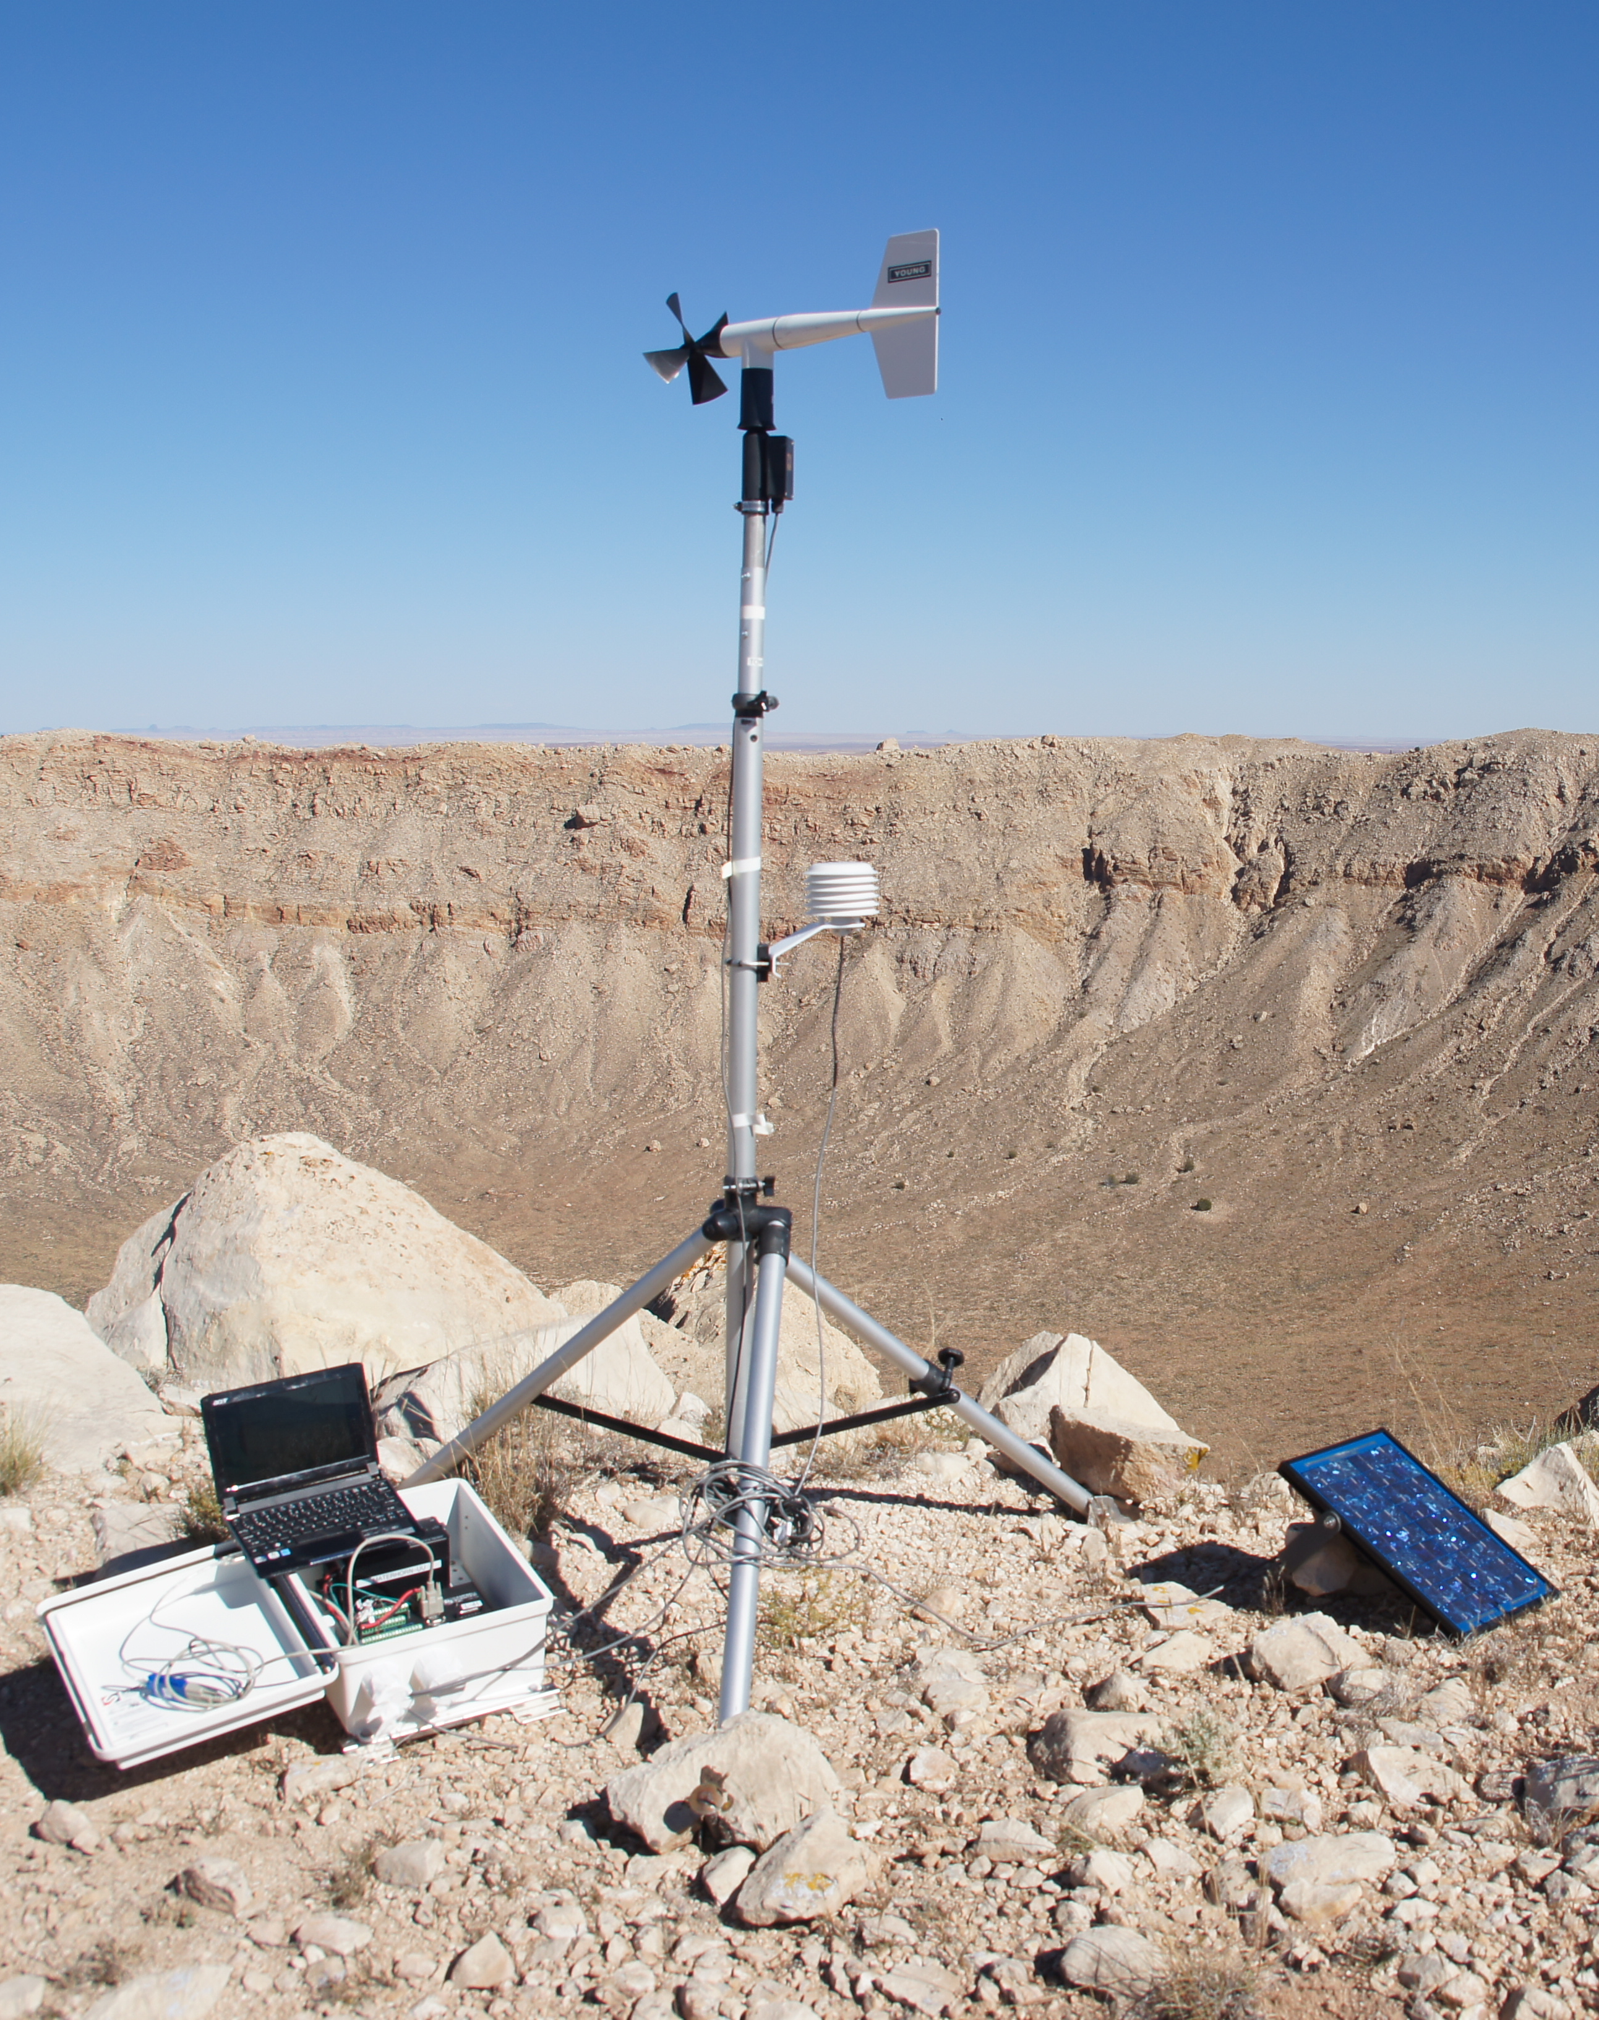
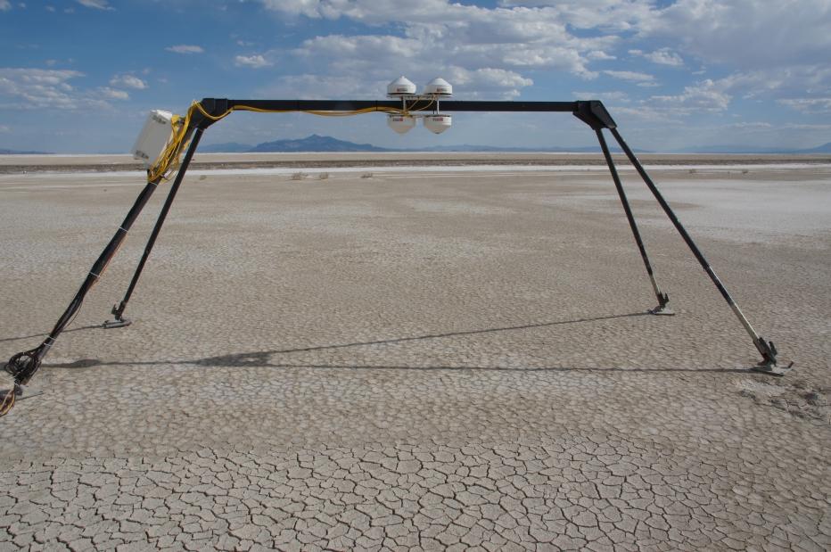
Surface observations
Automatic Weather Stations (AWS) (5)
T, RH, Winds, pressure, solar radiation
Energy Balance Stations (2)
Sensible Heat Flux, Latent Heat Flux, Net Radiation, Ground Heat Flux
Automatic Temperature Dataloggers (HOBOs)
Near-surface Temp/RH

Slide 3
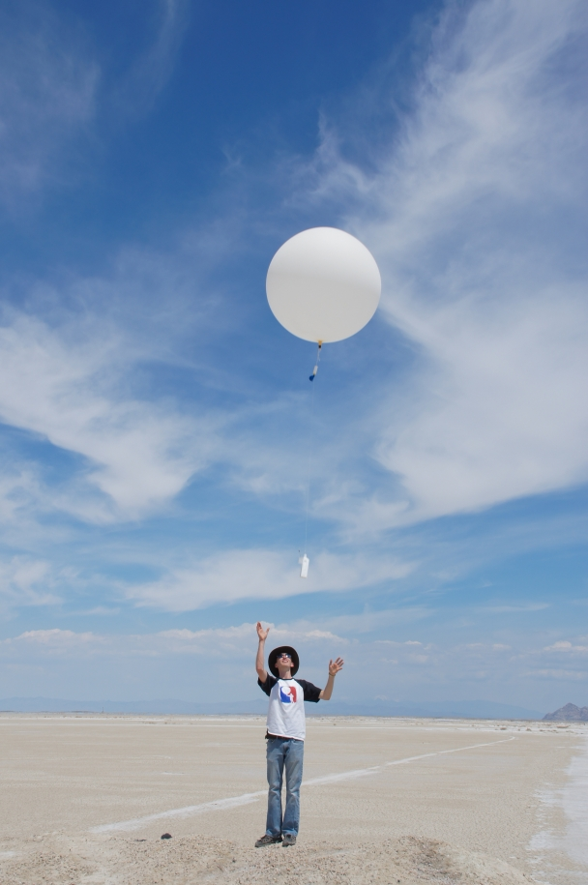
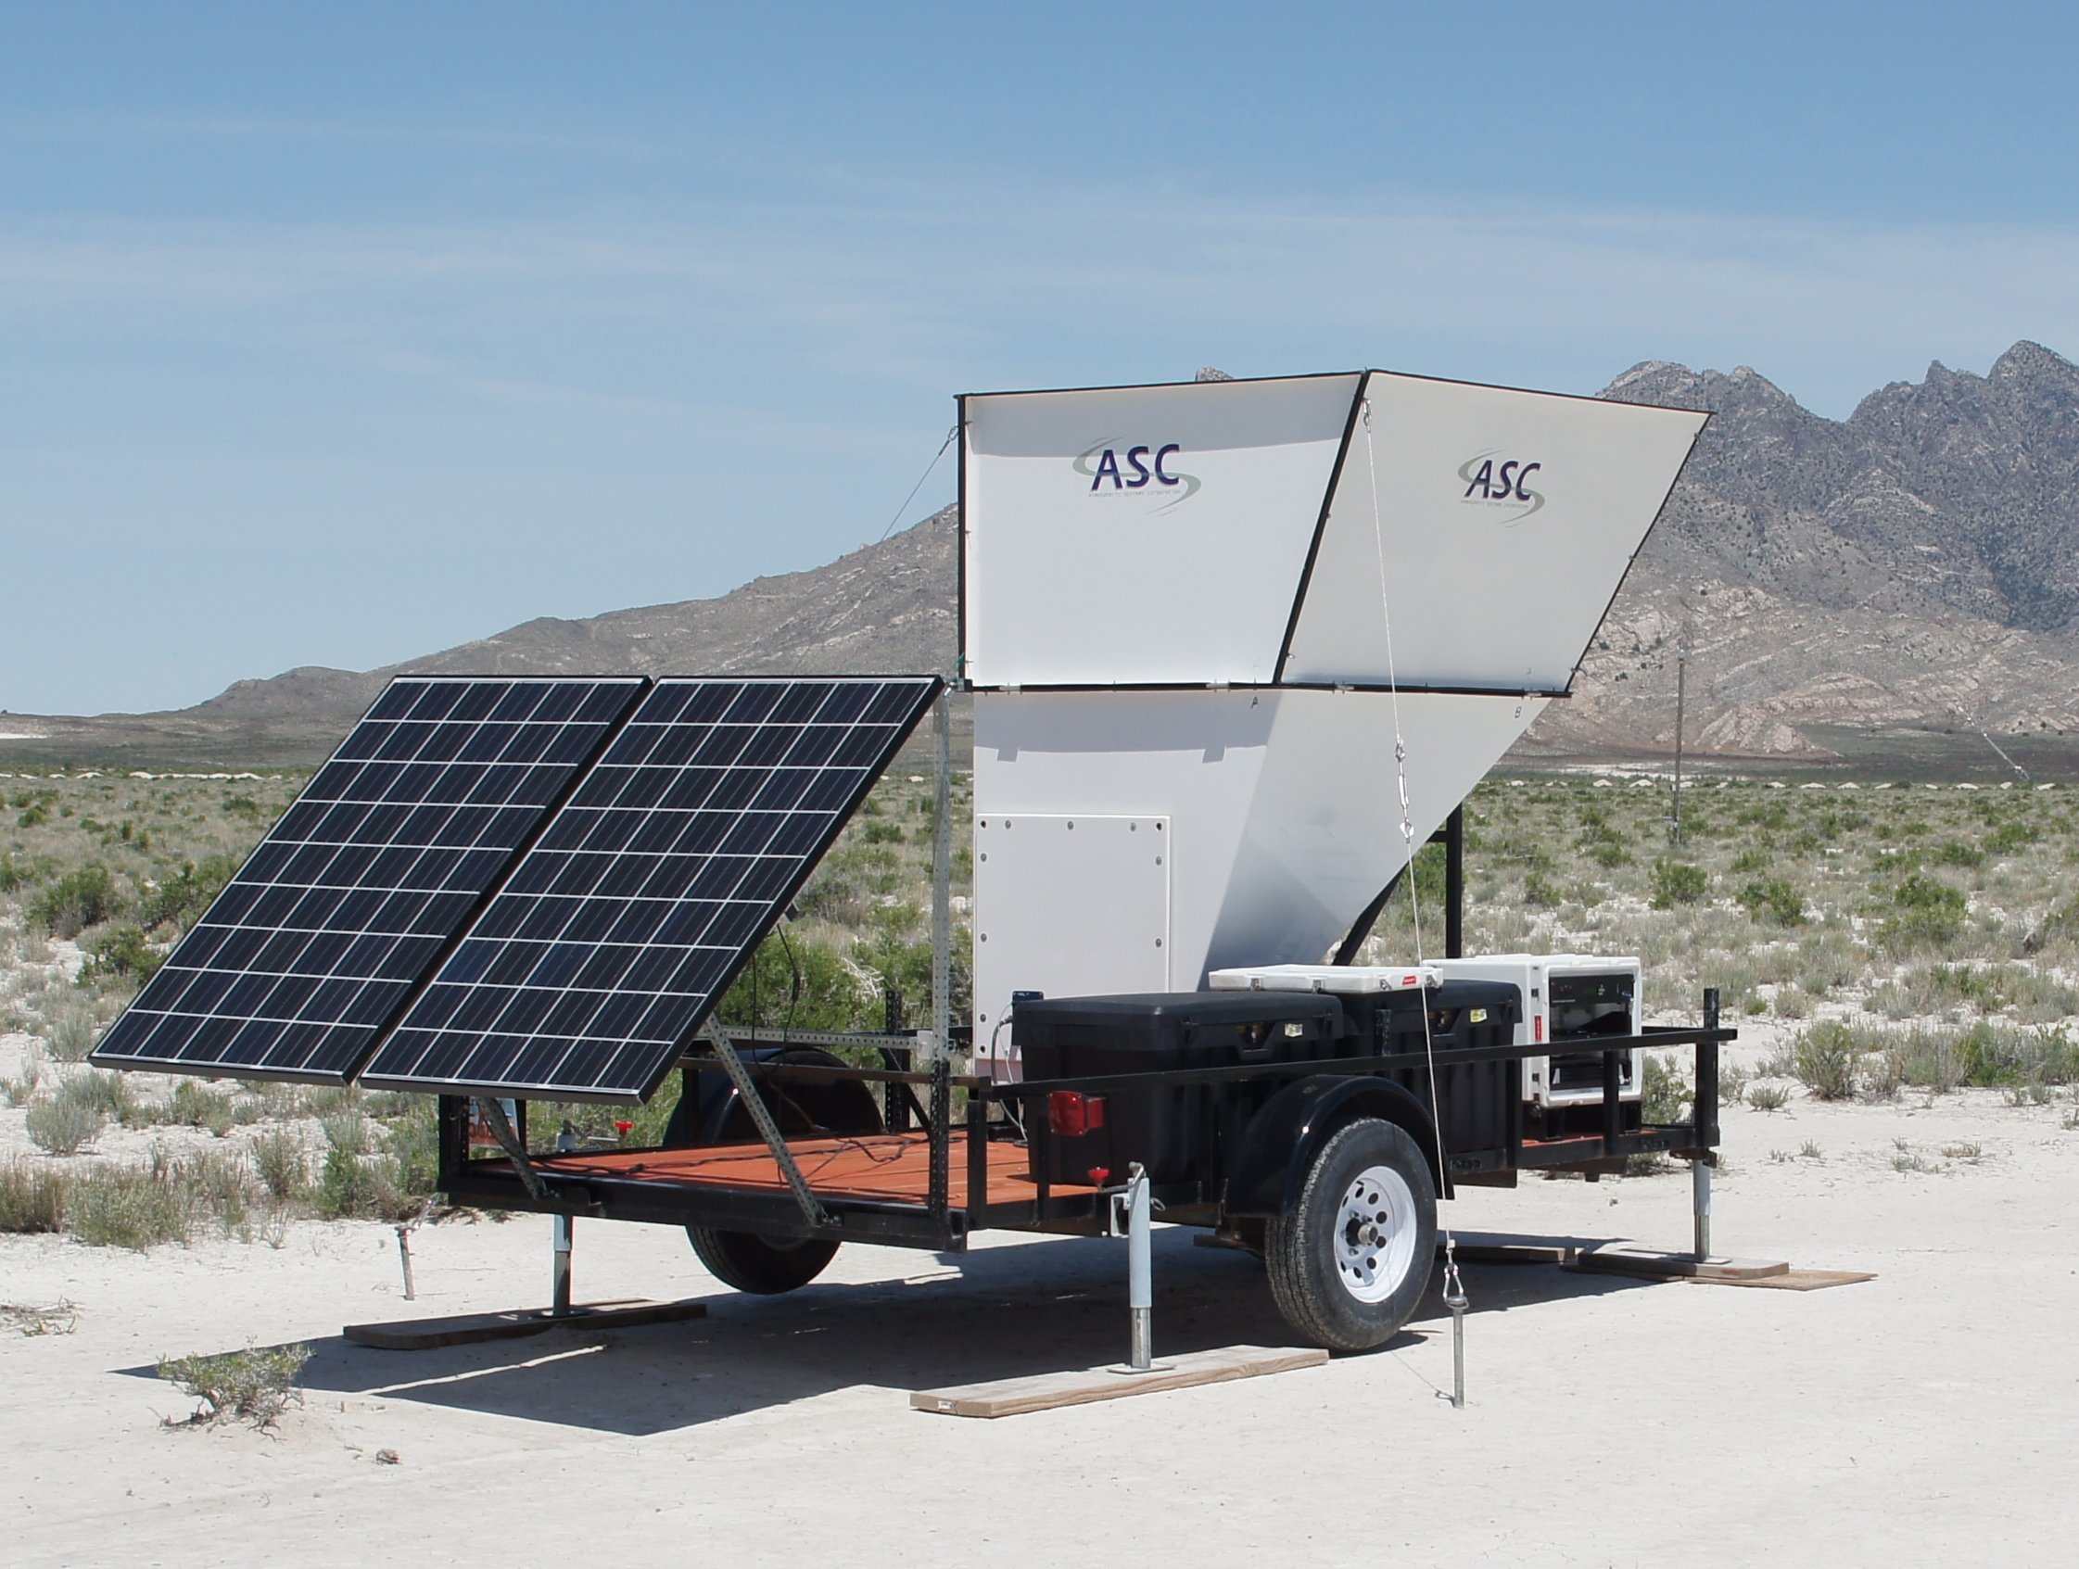
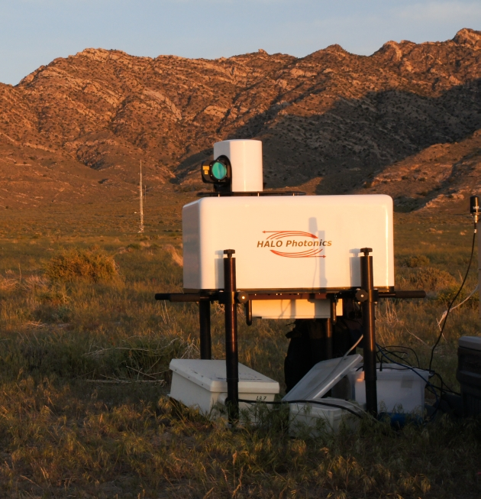
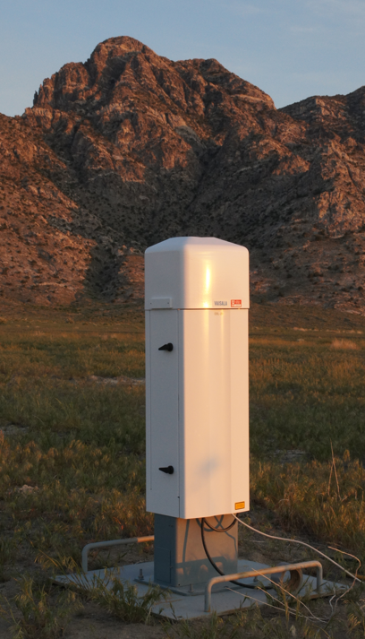
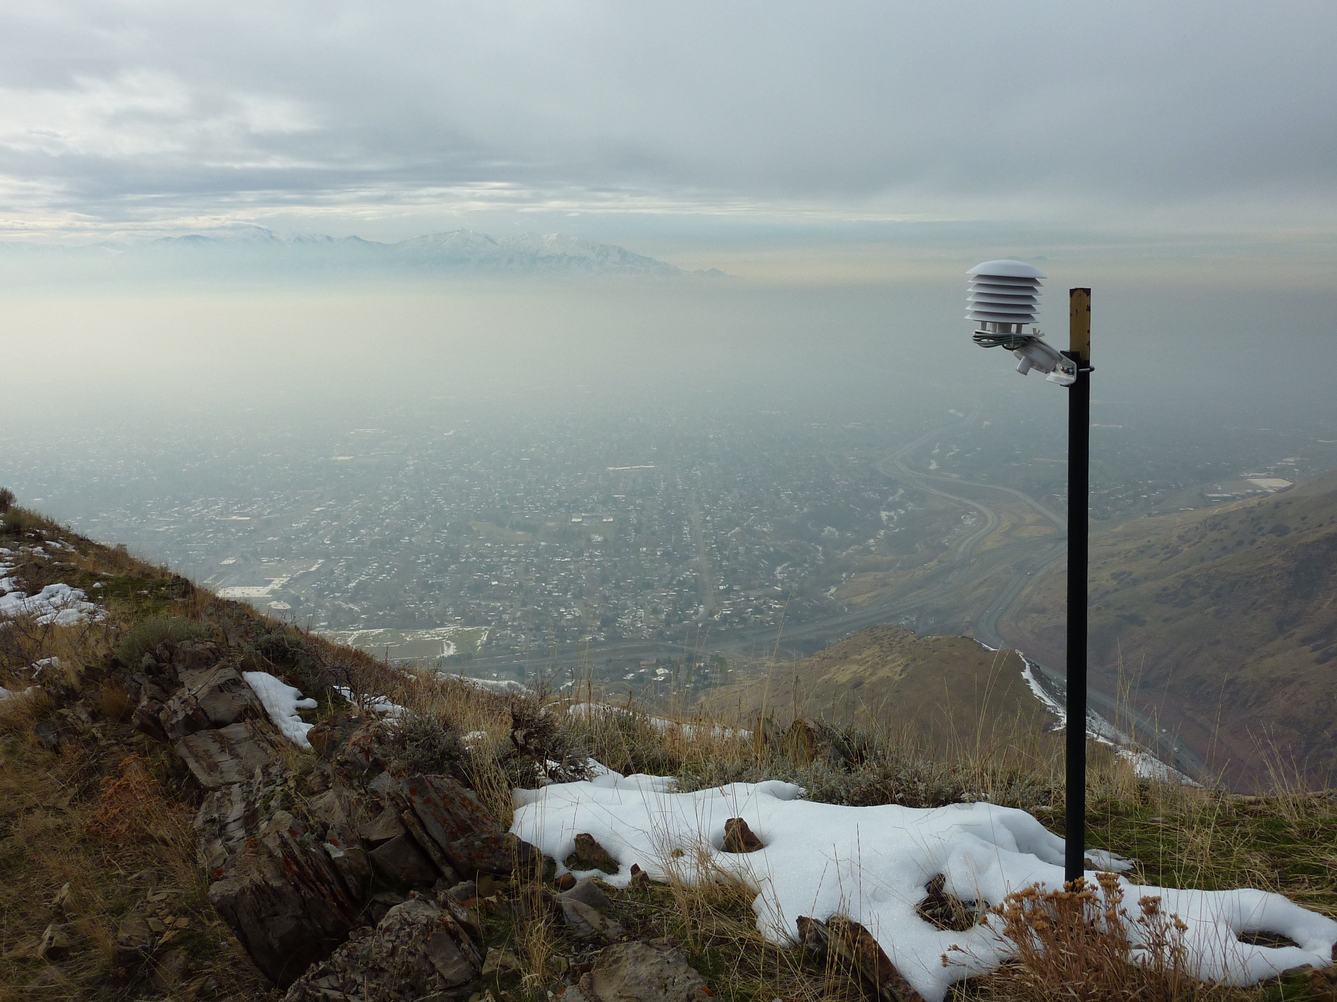
Vertical and pseudo-vertical profiles
Radiosondes (T, RH, Winds)
Entire troposphere (Surface to ~16 km)
Single profile, $ 250, (2 systems)
Boundary layer
Reusable sondes, ~$100 (2 systems)
SoDAR (3) & LiDAR (1) (Winds)
Lowest 200 m – 1 km
Continuous
Automatic Temperature Dataloggers (HOBOs)
Near-surface observations on valley sidewalls
Continuous, cheap, dependable, (~85 sensors)
Ceilometers
Aerosol Backscatter (4 sensors)

Slide 4
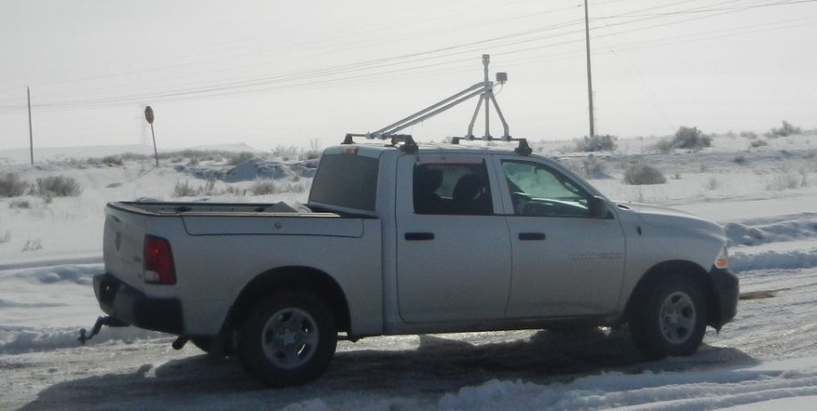
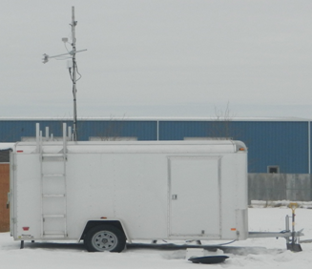
Mobile observations
Mobile Weather Stations (2)
Mounted on vehicle (ski rack)
T, RH, Winds, pressure, Ozone
Mobile Trailer
T, RH, Winds, turbulence, pressure
Base for radiosonde operations

Slide 5
Monitoring Capabilities
Access to real-time observations
Near real-time web-based access to data from 150 networks providing data from ~30,000 locations; data types: meteorological, air quality, hydrologic, forest fuel, road conditions, oceanographic
Monitoring
Know when your equipment is not working
Data repository
Historic data can be retrieved from the MesoWest database
http://mesowest.utah.edu

Slide 6
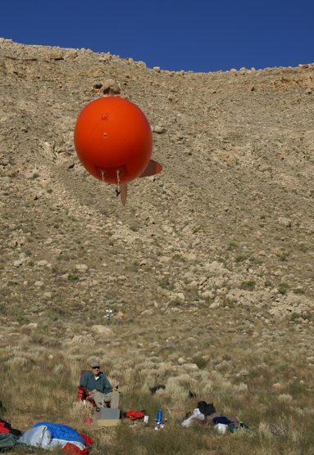
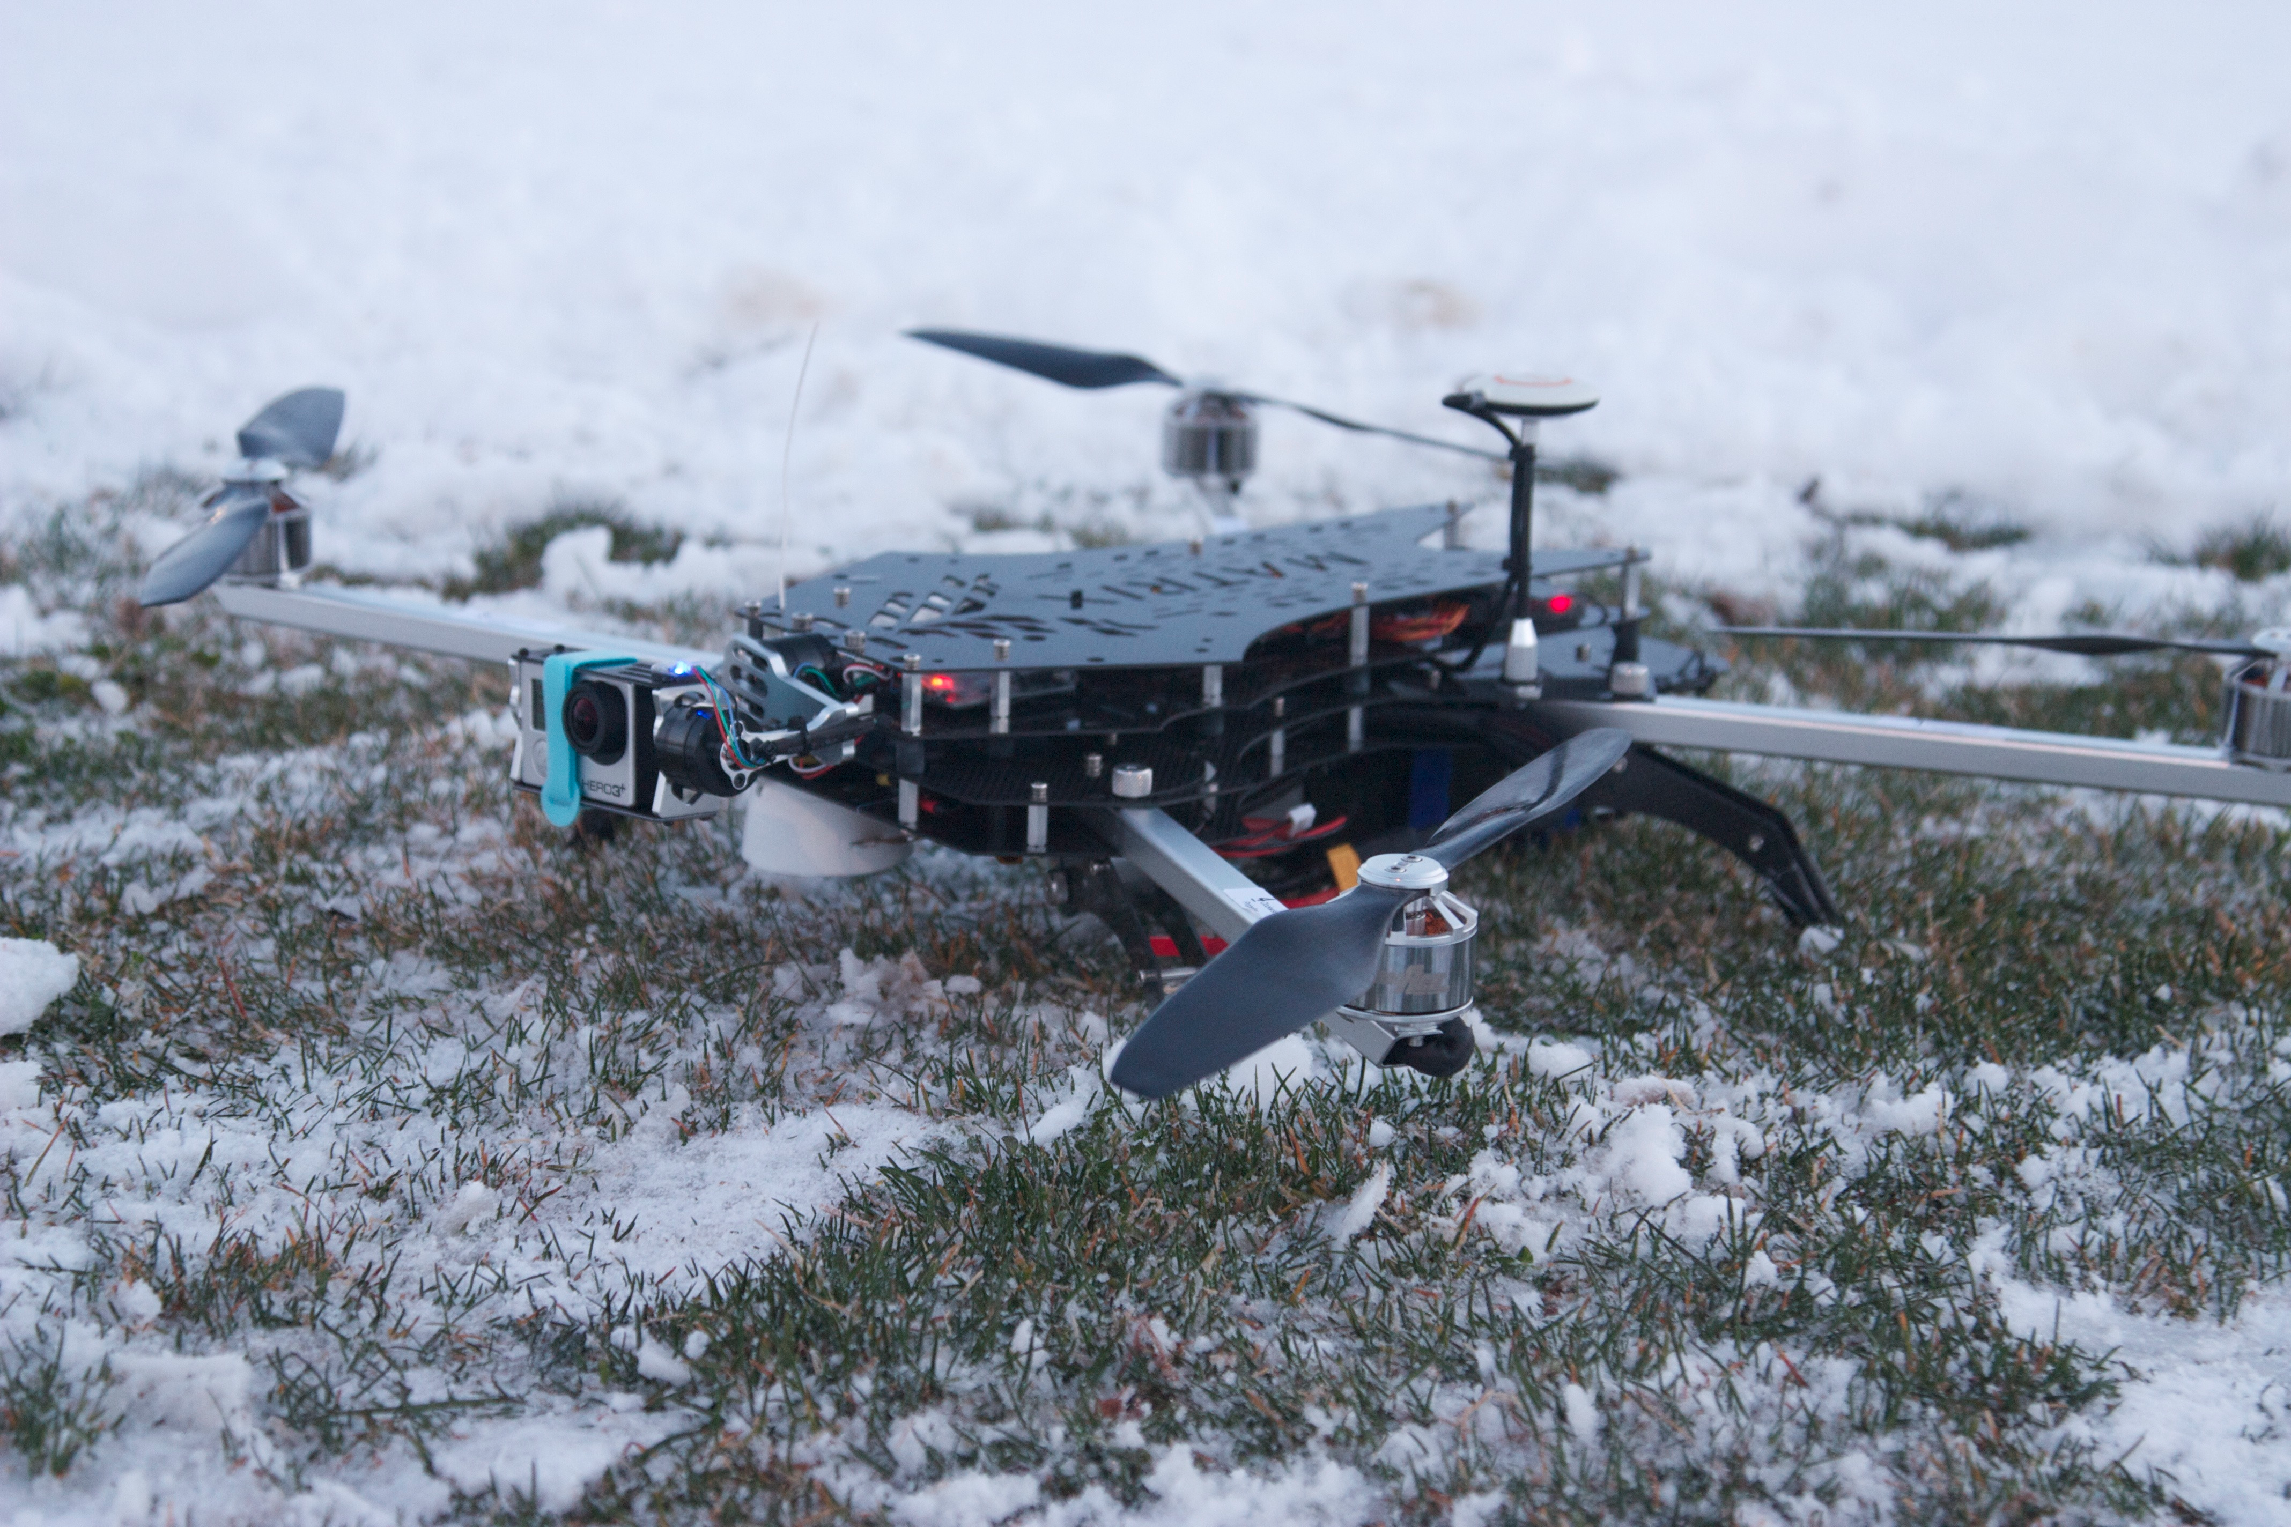
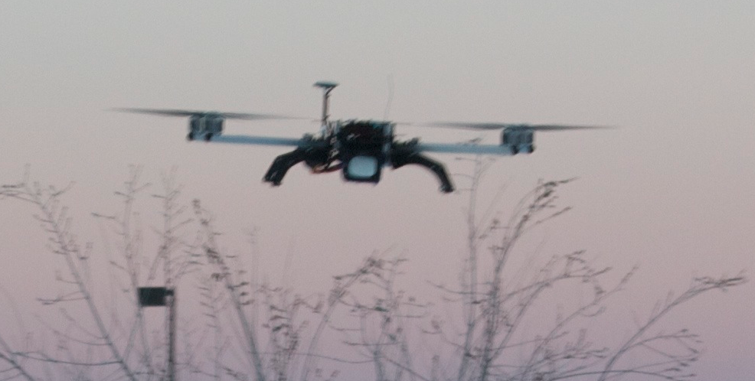
Miscellaneous
Tethered Balloon Systems (3)
Balloons and winches for 500 g payload
Precipitation RaDAR (2)
Continuous tropospheric profile of storm structure.
Automatic Snow Depth Sensors (8)
Quadcopter (1):
Carry payload of ~350 g for temperature, pressure, ozone concentration
©Adam Abernathy
©Adam Abernathy

