Slide 1
Rapidly Evolving Observing Technologies Applicable to Air Quality Studies

Slide 2
Existing Capabilities-> New Opportunities
Twice daily rawinsondes
ASOS cloud height
Campbell datalogger
Instrumented towers
DAQ pollutant monitoring
EPA hourly reporting standards
Research quality sensors
Field campaign characterization of boundary layer
GRAW, Windsonde, copter
Ceilometer backscatter
Rasberry pi/Arduino
Mobile: Nerdmobile, truck, TRAX, KSL chopper,
County network(s); USU, U/Utah sensors
<1-5 minute observations
Ozone, VOC chips
Real-time monitoring of boundary layer (w sodar, radiometer)

Slide 3
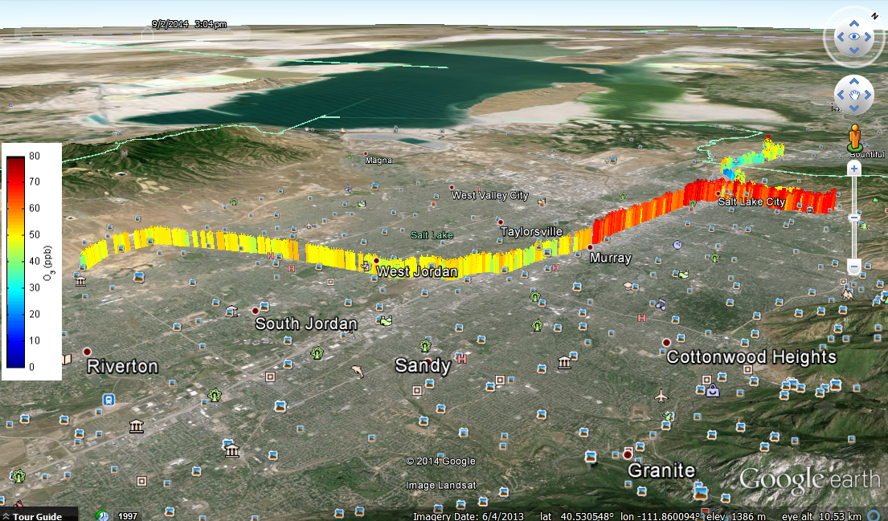
TRAX observations 2 September 2013:
Gradient in Ozone in Salt Lake Valley Associated with Lake Breeze
Google earth imagery provided by Logan Mitchell, LAIR Research Group U of U

Slide 4
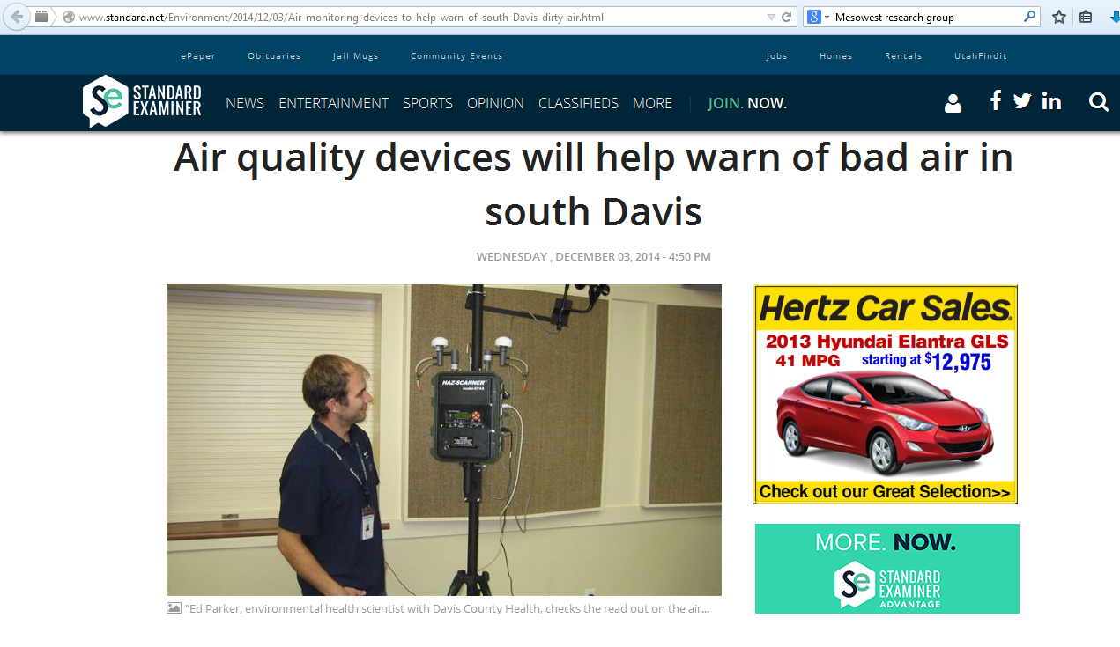

Slide 5
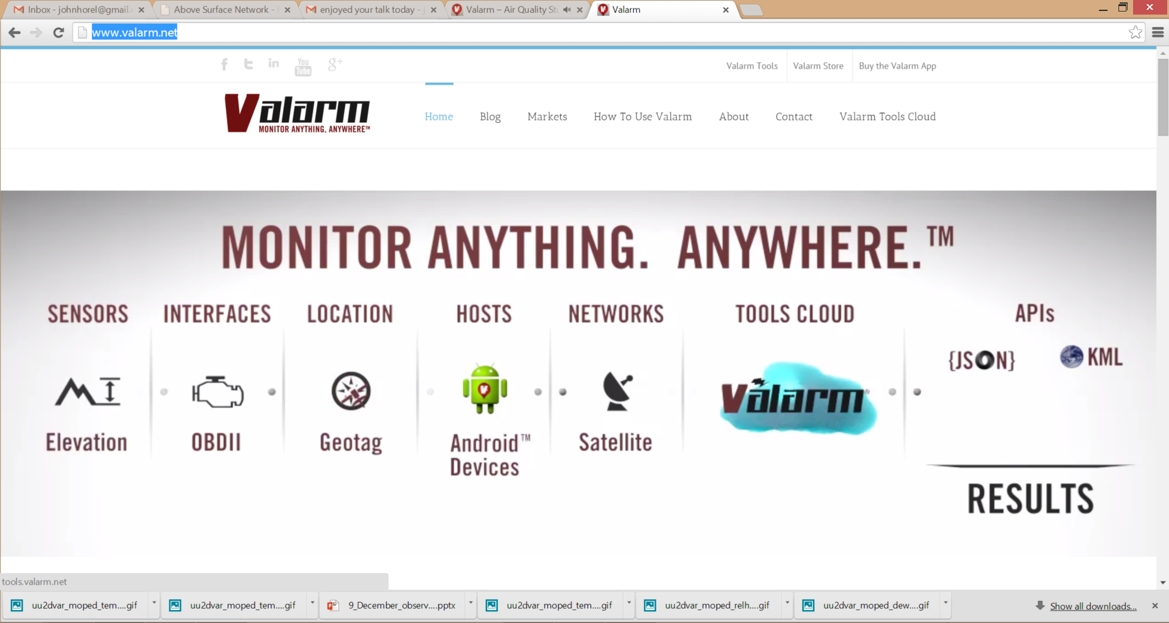
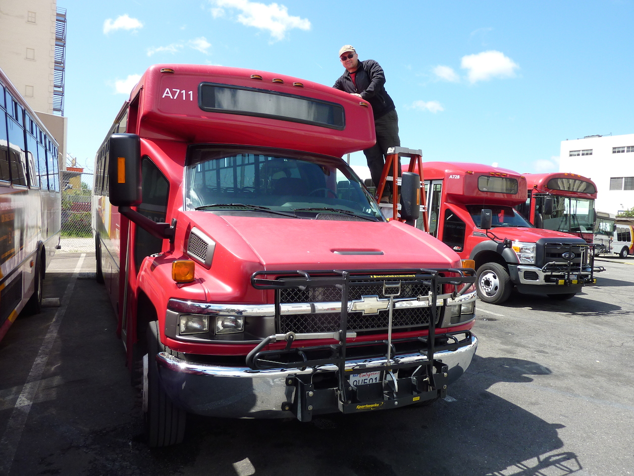
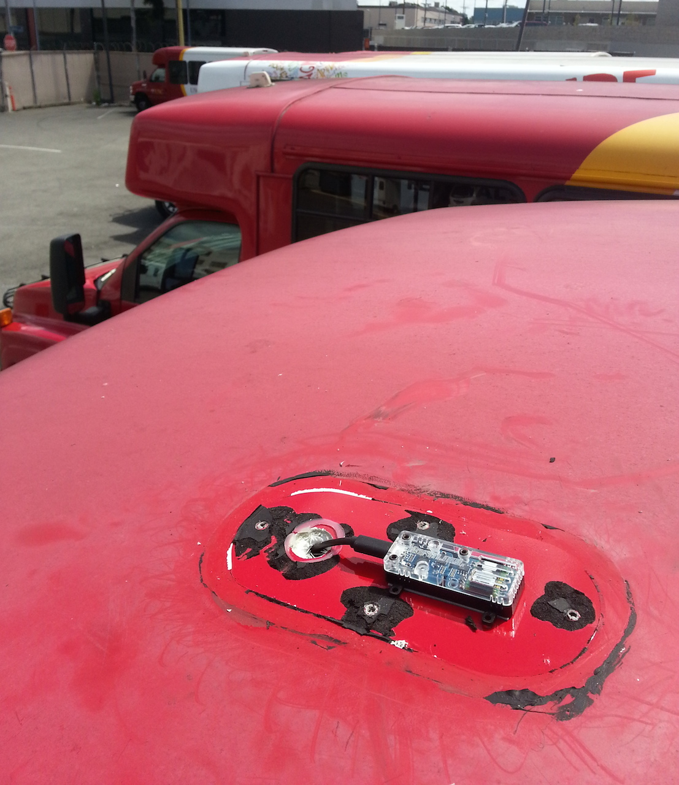
http://www.valarm.net/
Connect sensors to Android phone
Use ESRI GIS software in cloud to monitor sensors continuously

Slide 6
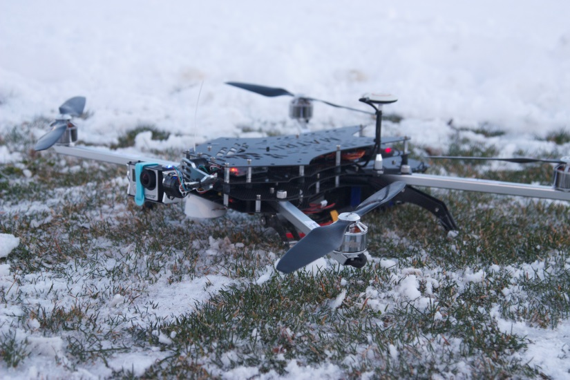
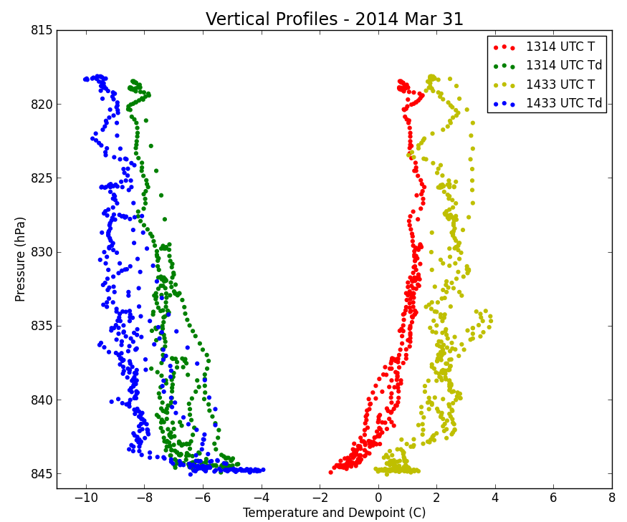
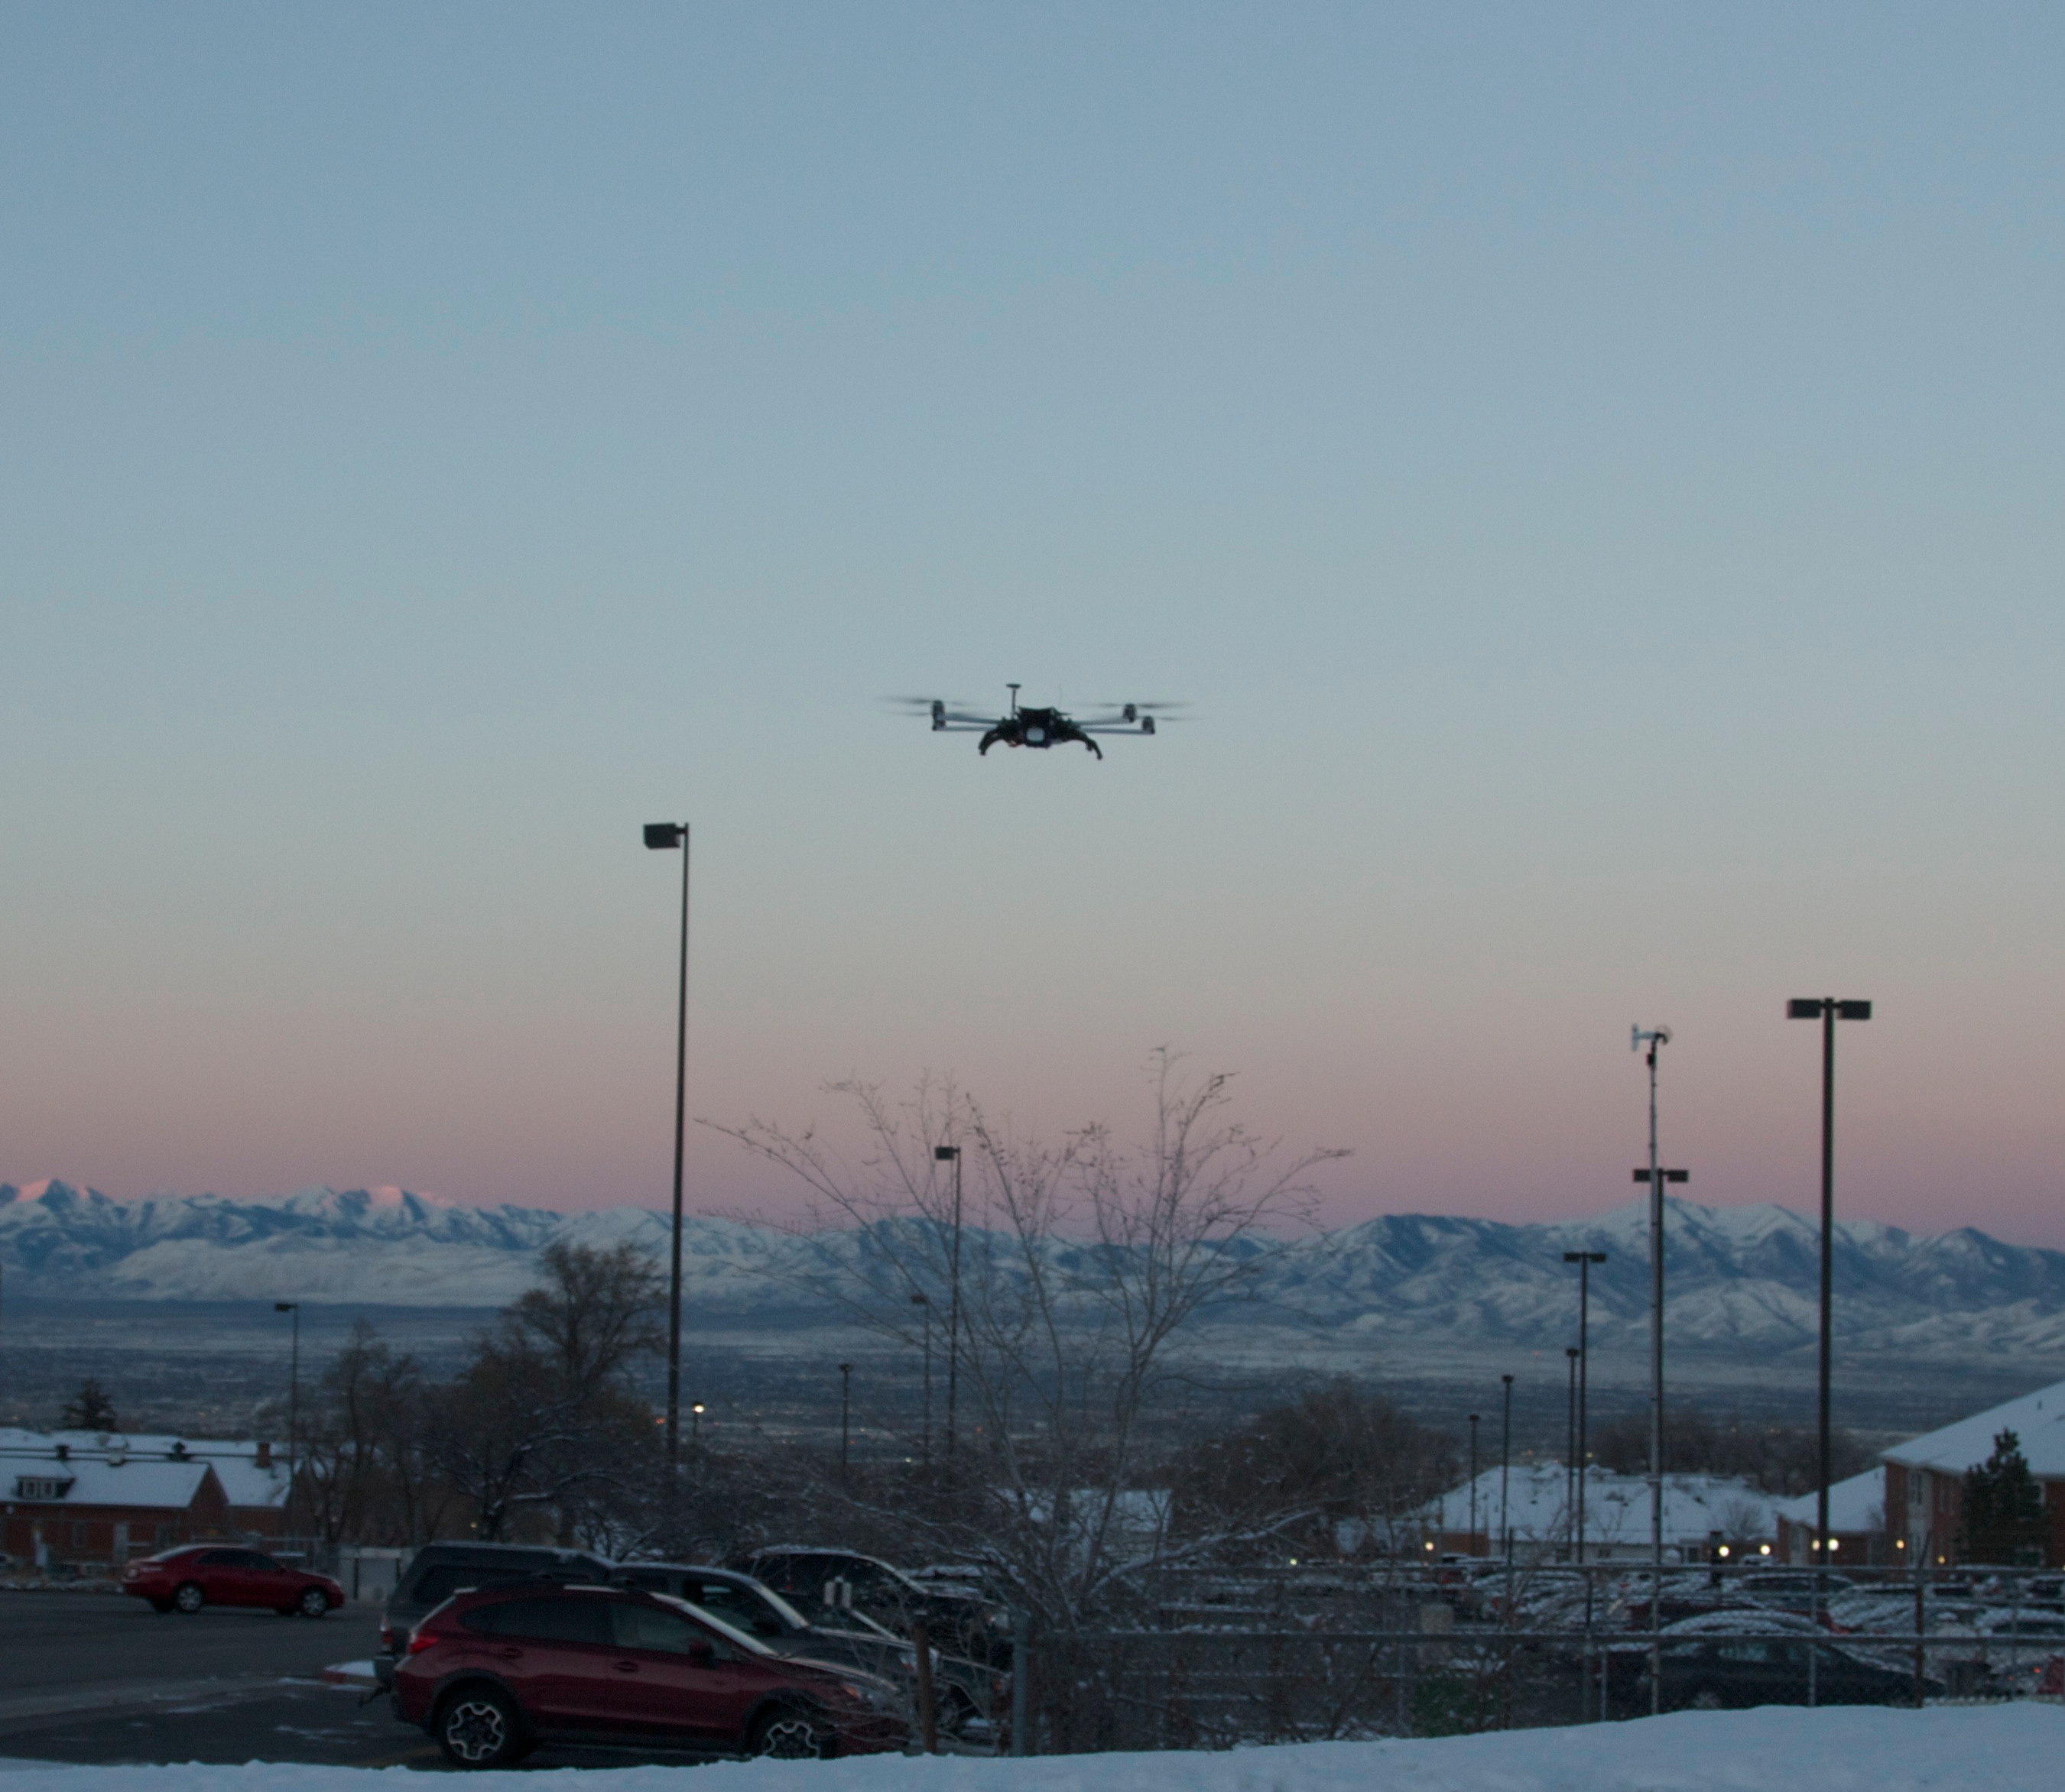
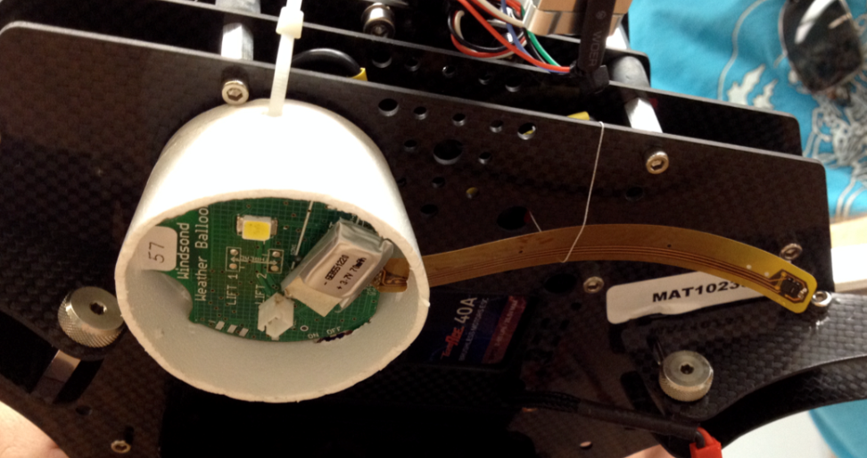
Quadcopter: temp, moisture, pressure with more to follow

Slide 7
Laser Ceilometer Applications (Young and Whiteman 2015 JCAM)
Started during PCAPS
4 purchased since
Two deployed for field campaigns (Whiteman/Hoch)
Two reporting in real time (MTMET; Uintah Basin)
Measuring aerosol backscatter, which is sensitive to deliquescence (absorption of water by aerosols)

Slide 8
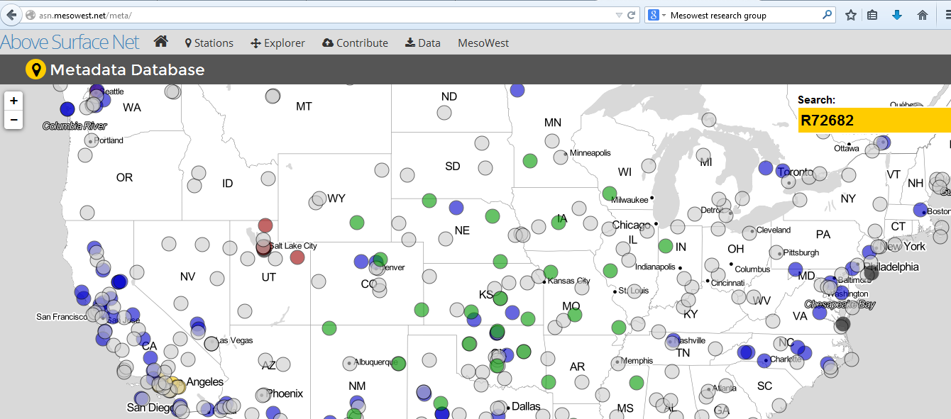
http://asn.mesowest.net/

Slide 9
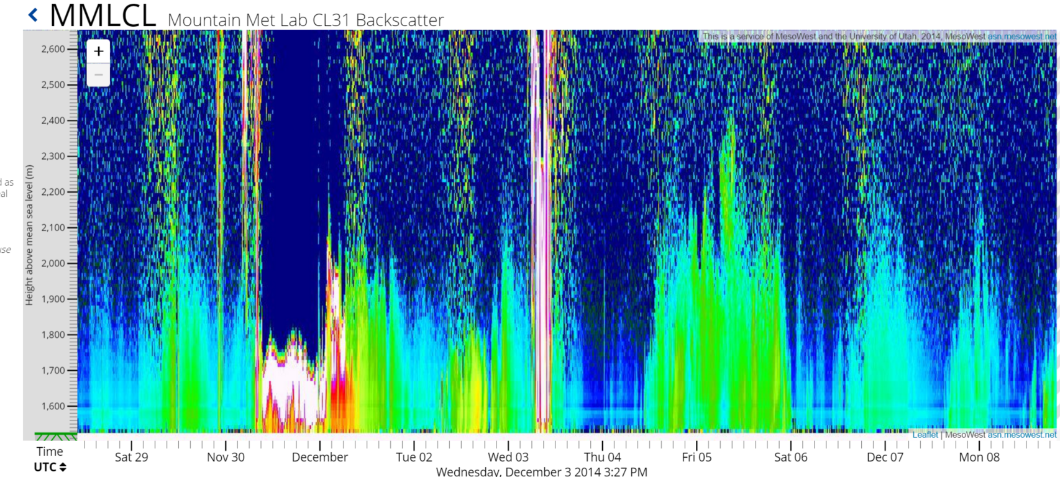
MTMET Ceilometer

Slide 10
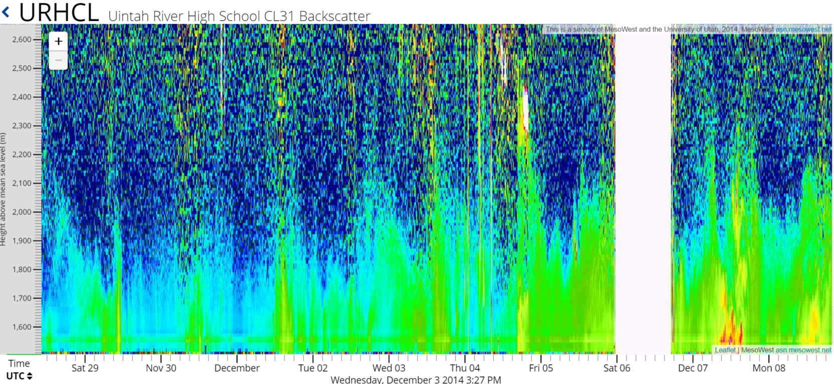
Uintah Basin ceilometer

Slide 11
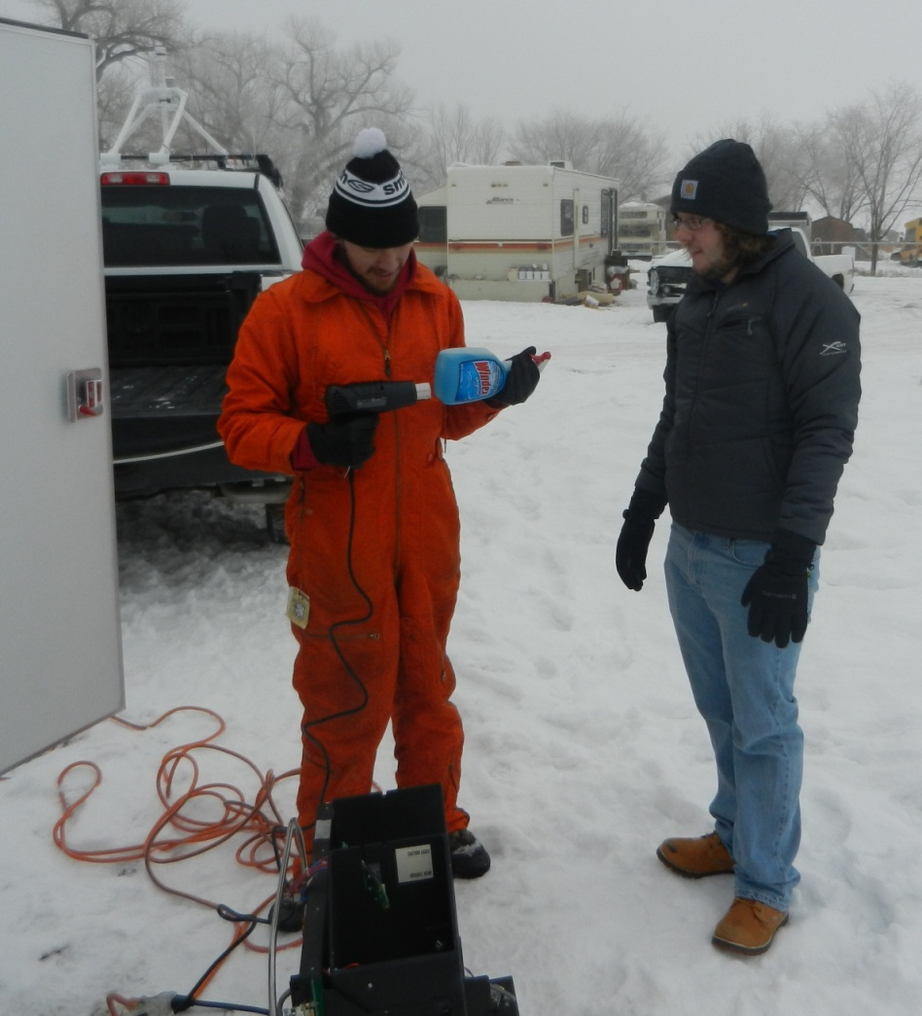
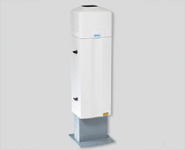
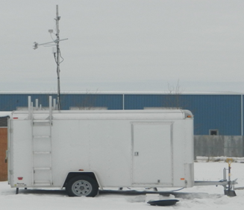
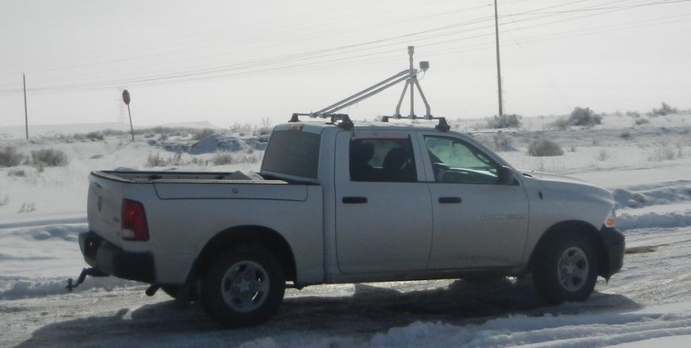
UU Atmospheric Sciences Truck and Trailer Platforms
Winter 2013 goal:
Characterize Uintah basin meteorology (specifically boundary layer evolution -height, winds, thermal structure) using less than 1% of UBOS project budget
2014 goal:
Contribute to NOAA project on CO2 and Methane by sampling met conditions
Laser ceilometer
(continuous vertical profile)
Met tower and rawinsonde research trailer
Mobile ozone and meteorology

Slide 12
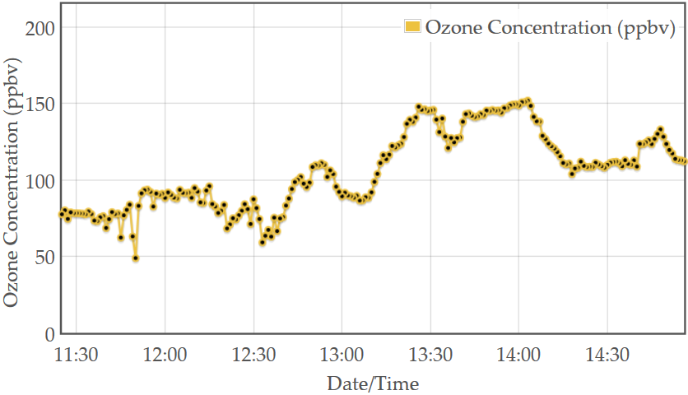
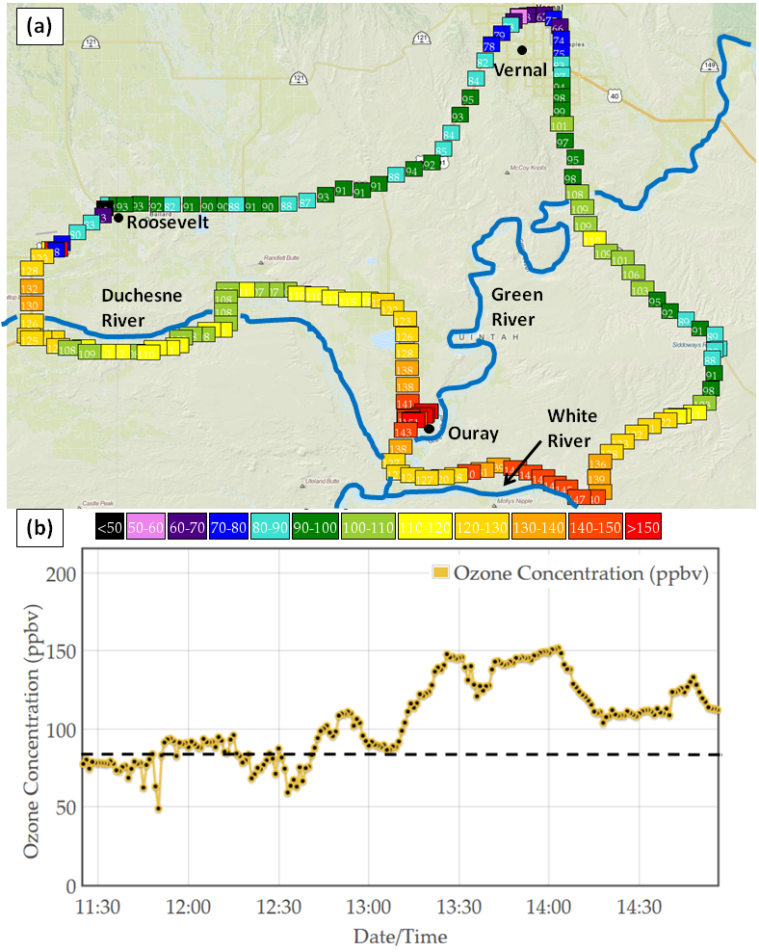
Mobile Ozone Transect - 6 Feb 2013
High concentrations measured through the basin
Greatest values in lower elevations and river valleys
NAAQS
Ouray

Slide 13
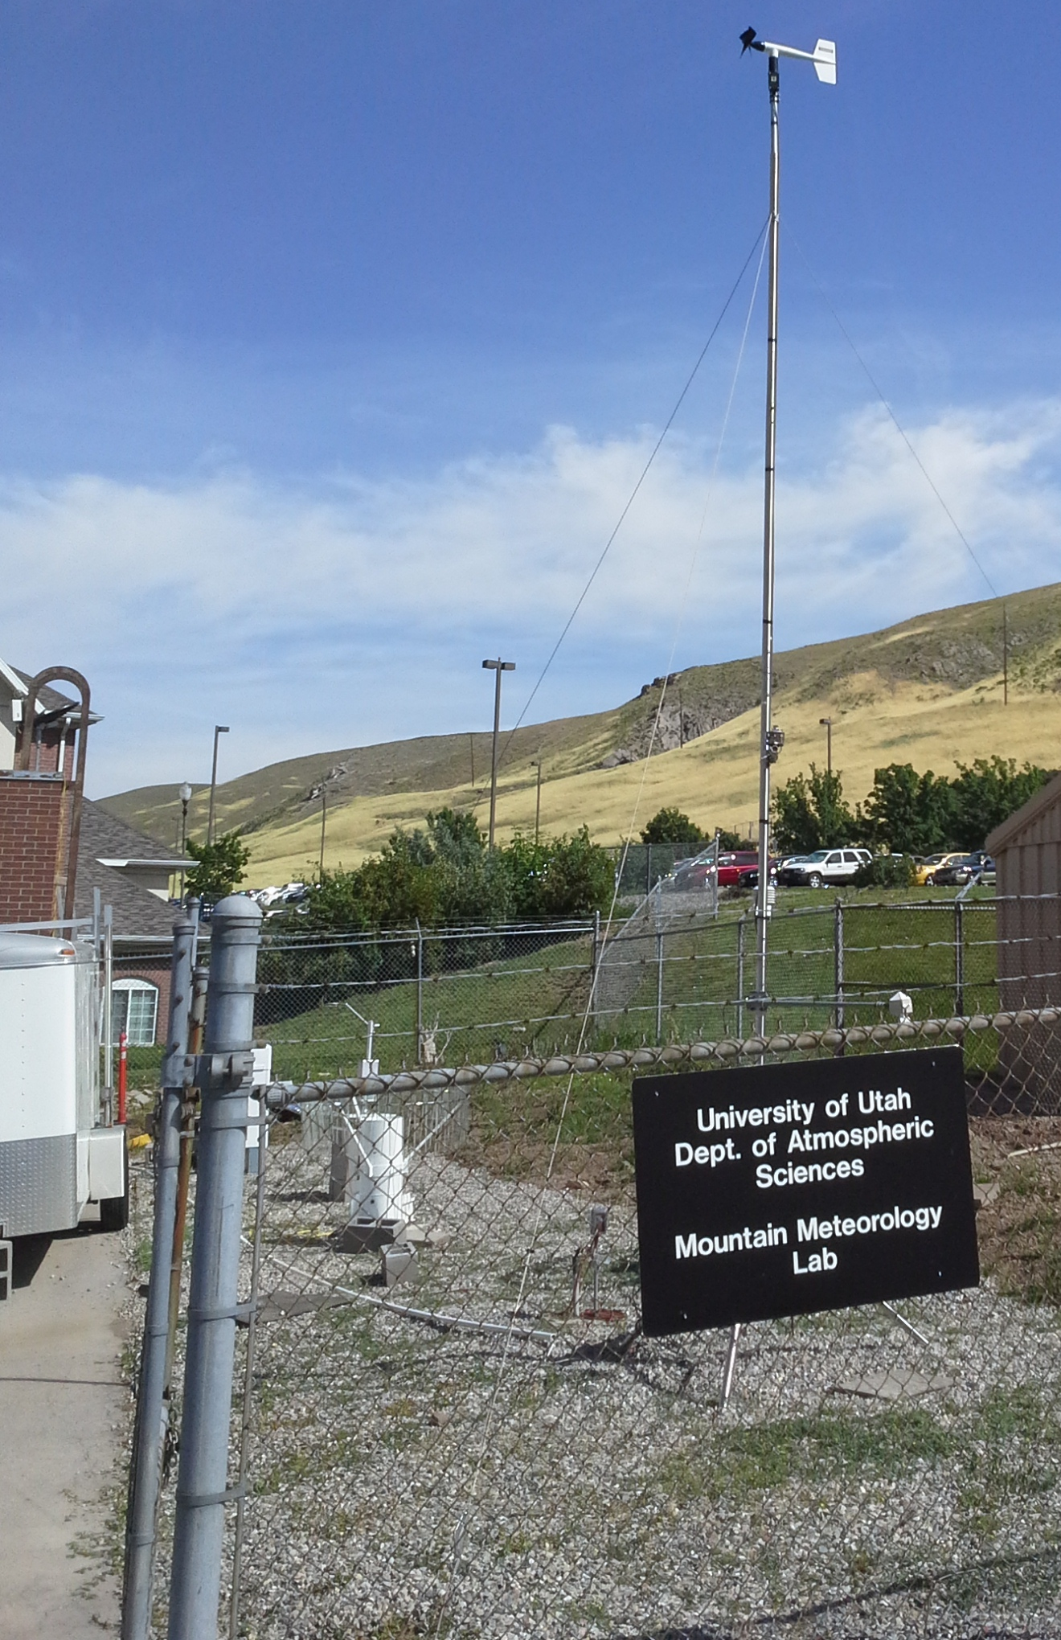
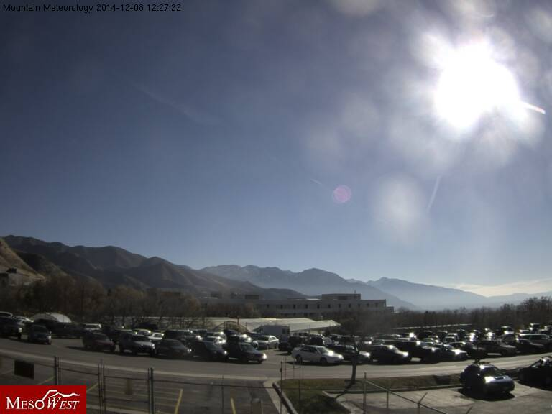
WBB
roof is complicated to use: security concerns, networking hassles
MTMET
Space and networking controlled by Mtn Met group
20 foot tower + building to stage equipment and mount instrumentation on roof
Good on-campus site for field deployments elsewhere
Current equipment:
Met sensors, ceilometer, E-Sampler 2.5 micron particulate
Camera with view to south
Summer season: ozone
Prior testing: hot plate precipitation; vertically pointing radar
http://155.97.226.135/view/viewer_index.shtml?id=2229

Slide 14
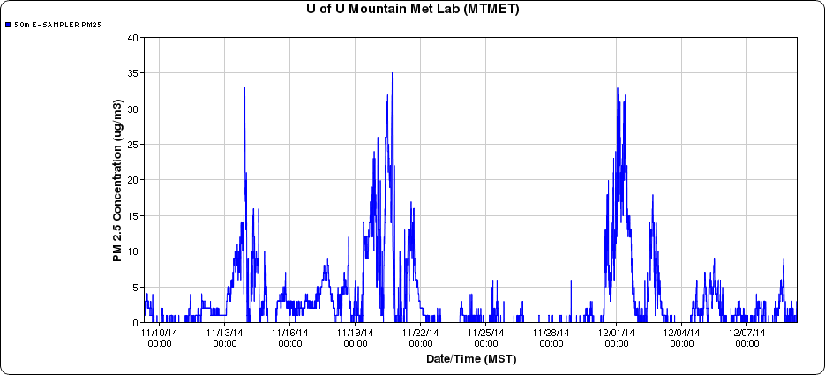
MTMET E-Sampler 2.5 micron Concentration
http://mesowest.utah.edu/cgi-bin/droman/meso_base_dyn.cgi?stn=MTMET&unit=0&time=LOCAL&year1=2014&month1=12&day1=8&hour1=12&hours=&graph=1&past=0
Met-One E-Sampler: 650 nm laser with intake air heated to lower RH to 30%
5 min averages at MTMET

Slide 15
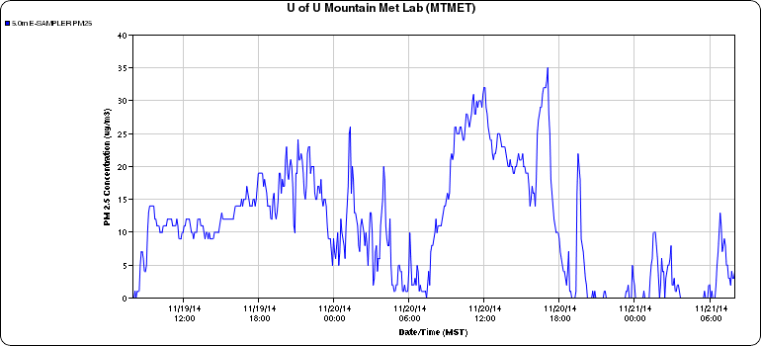
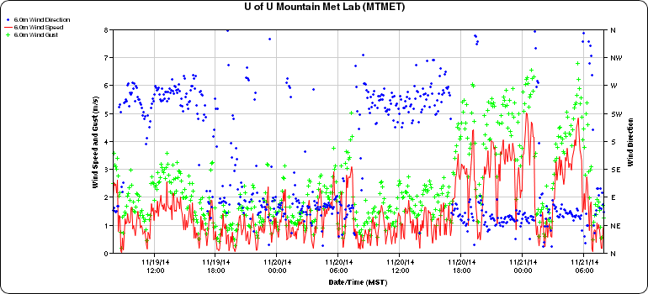
Improving Understanding of Pollutant Transport
High Low
Westerly Easterly

Slide 16
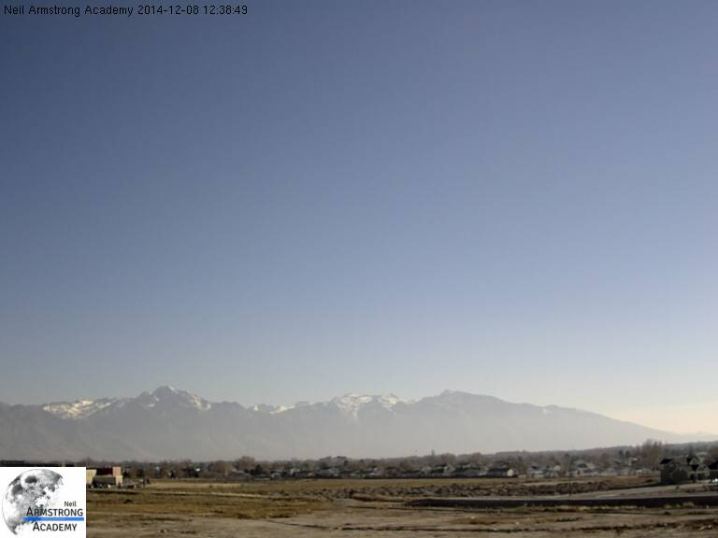
NAA: Neil Armstrong Academy (~5800 W; 2800S)
Sensors mounted on roof of STEM school and in/out greenhouse
Current equipment:
Met sensors, E-Sampler 2.5 micron particulate
Camera with view to southwest
Summer season: ozone
http://205.124.147.71/view/viewer_index.shtml?id=794

Slide 17
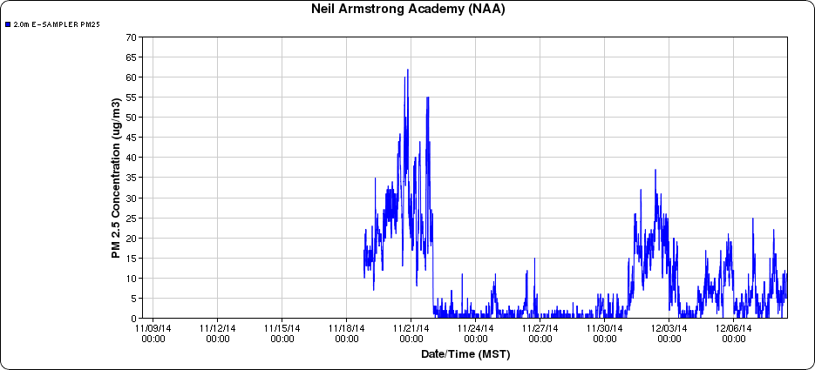
NAA: Neil Armstrong Academy
http://mesowest.utah.edu/cgi-bin/droman/meso_base_dyn.cgi?stn=NAA&unit=0&time=LOCAL&year1=2014&month1=12&day1=8&hour1=12&hours=&graph=1&past=0
Met-One E-Sampler: 650 nm laser with intake air heated to lower RH to 50%**
5 min averages

Slide 18
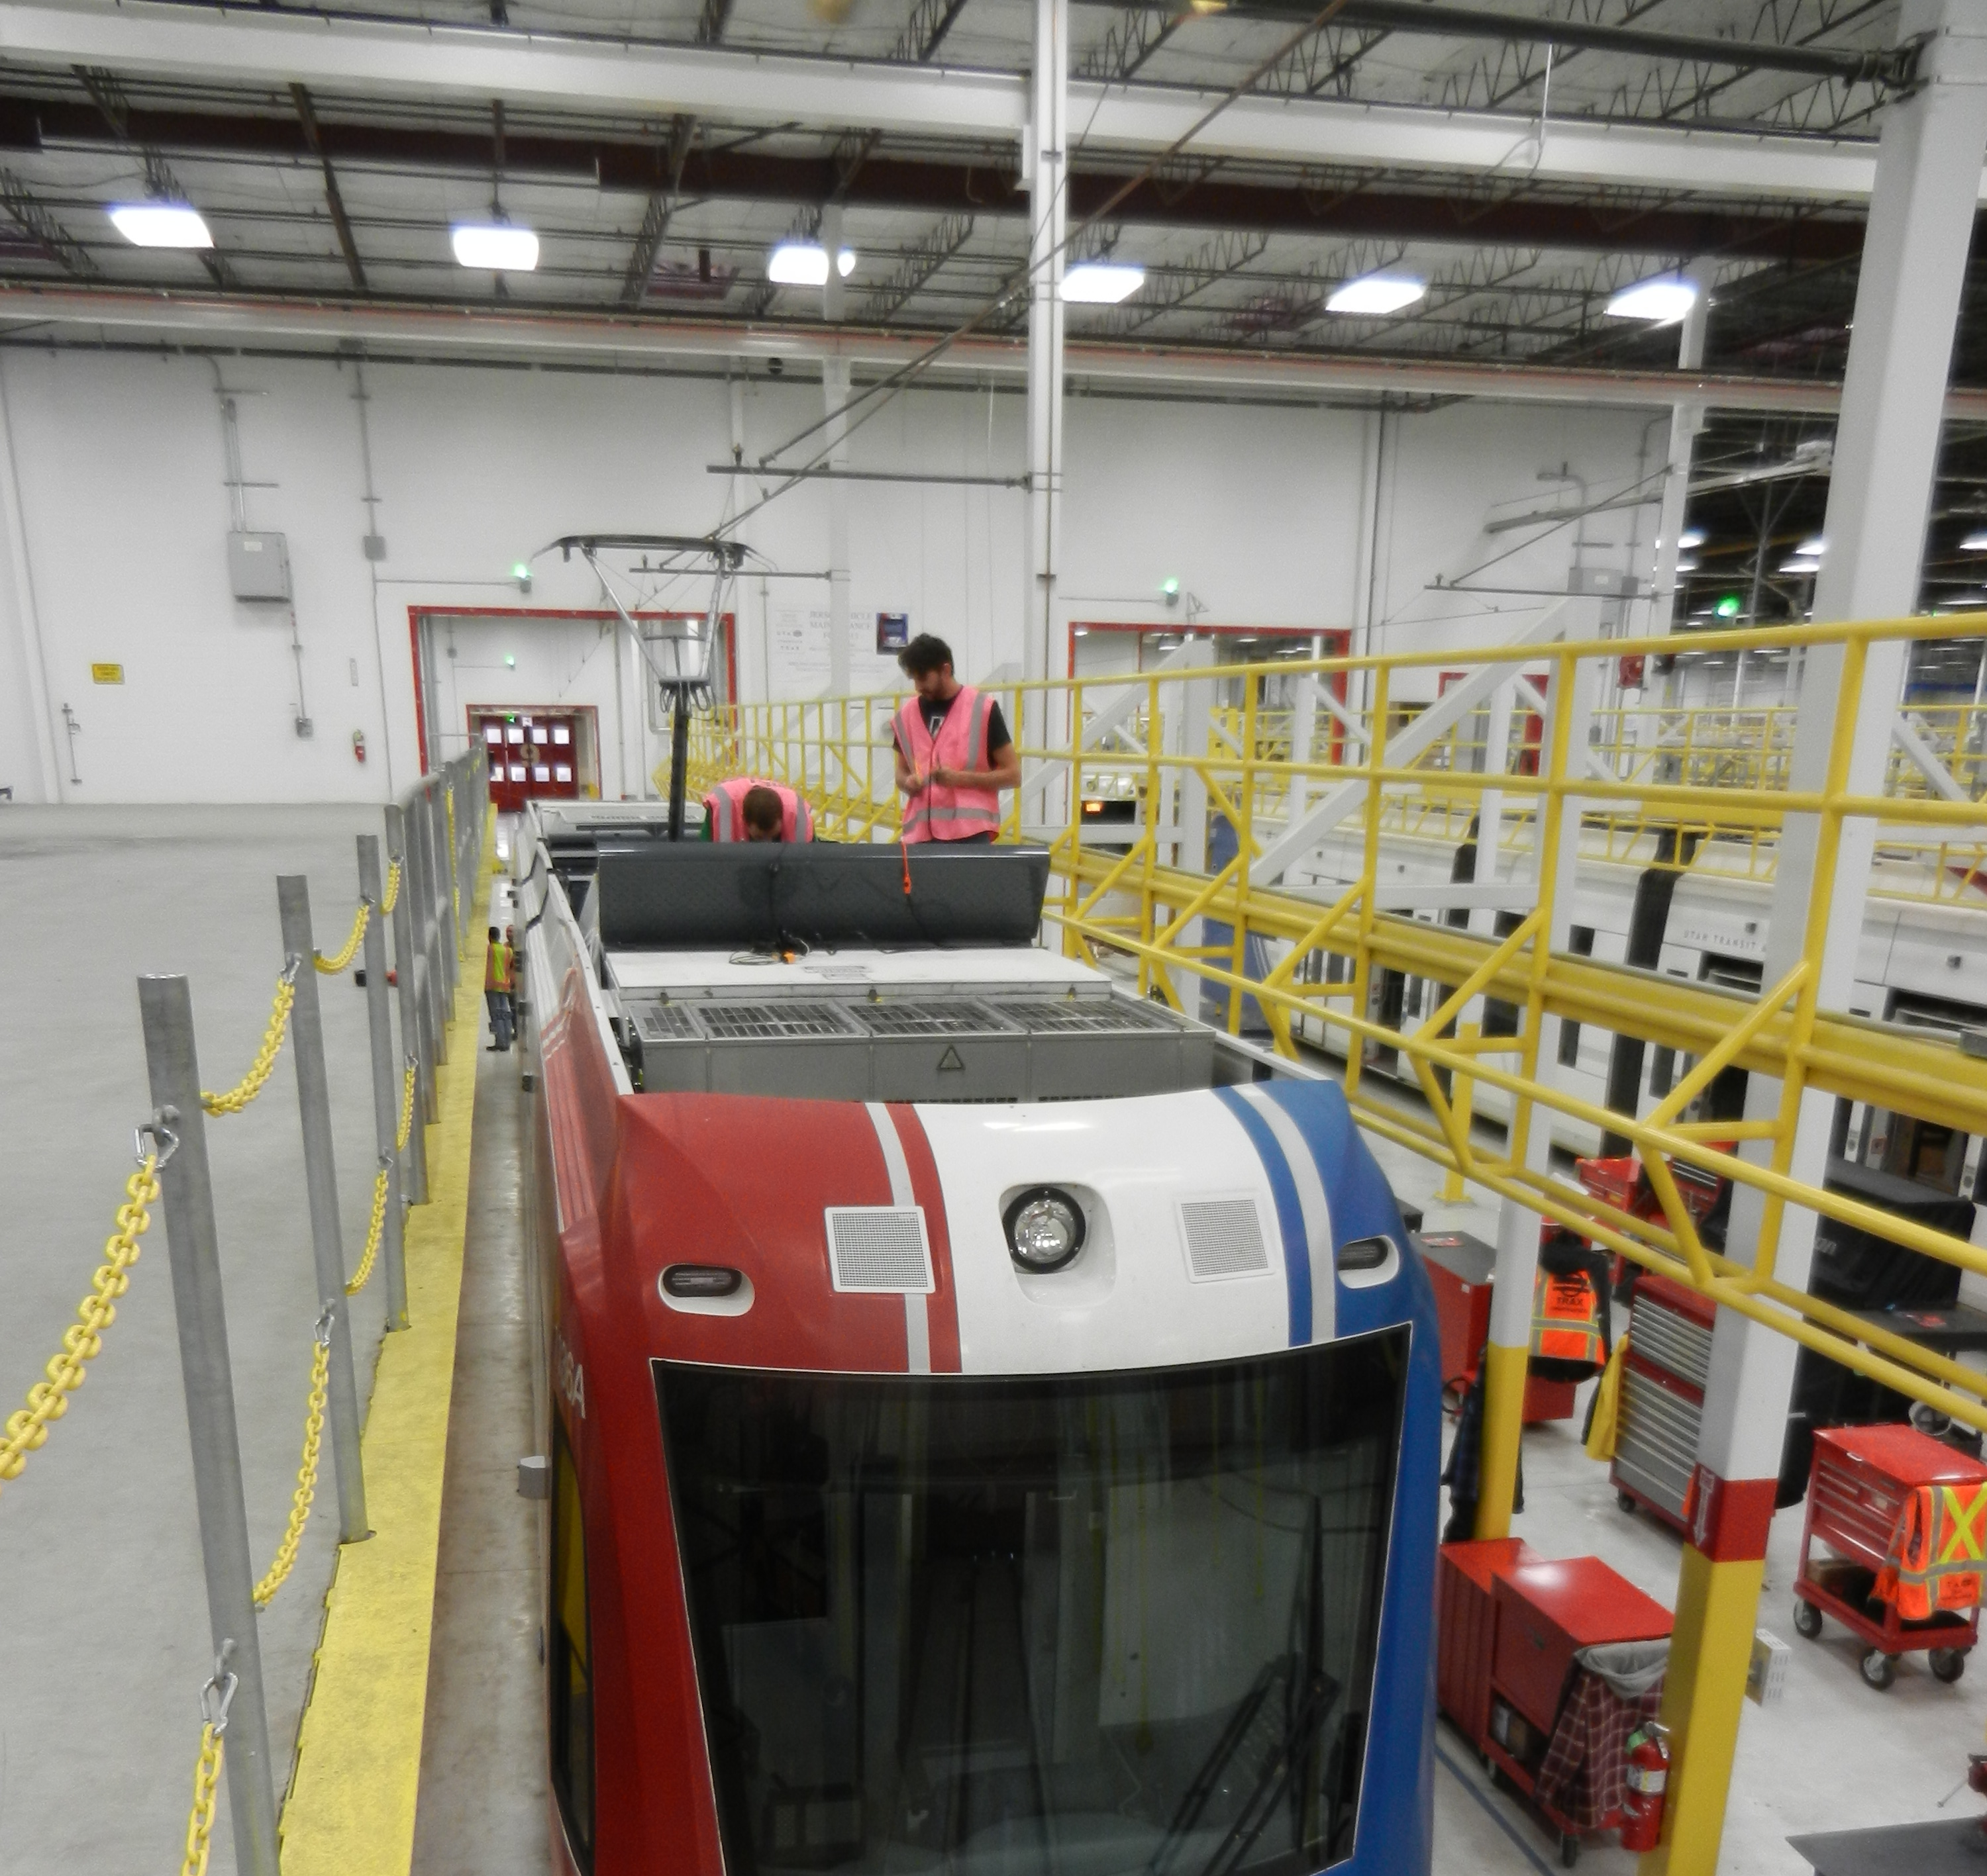
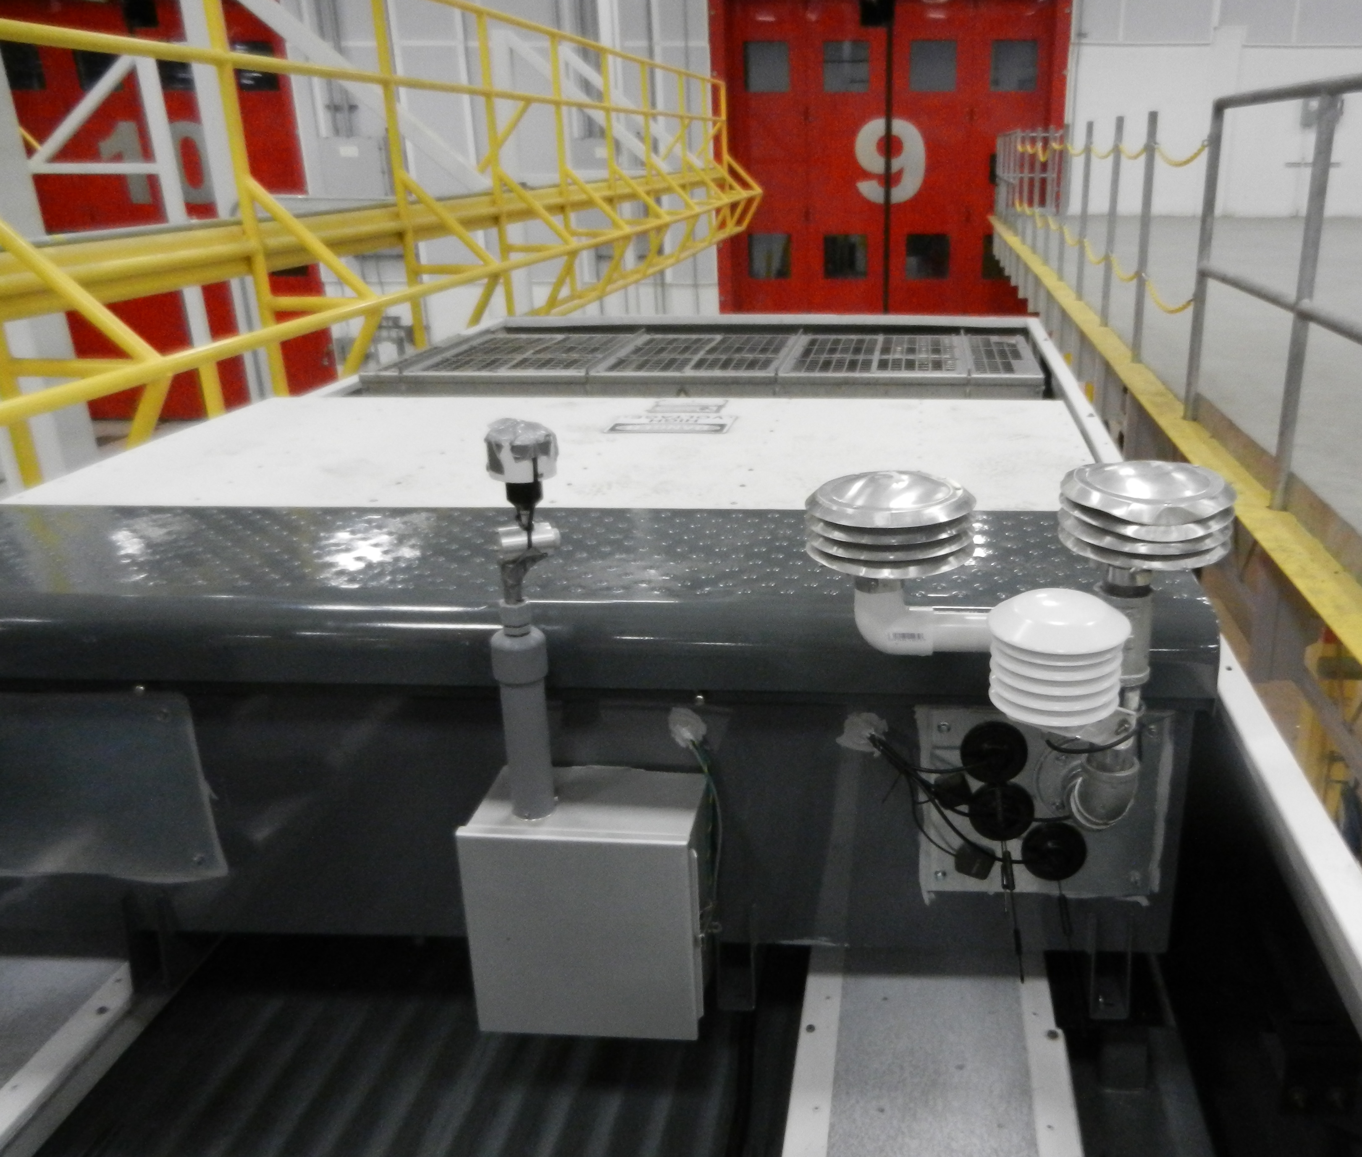
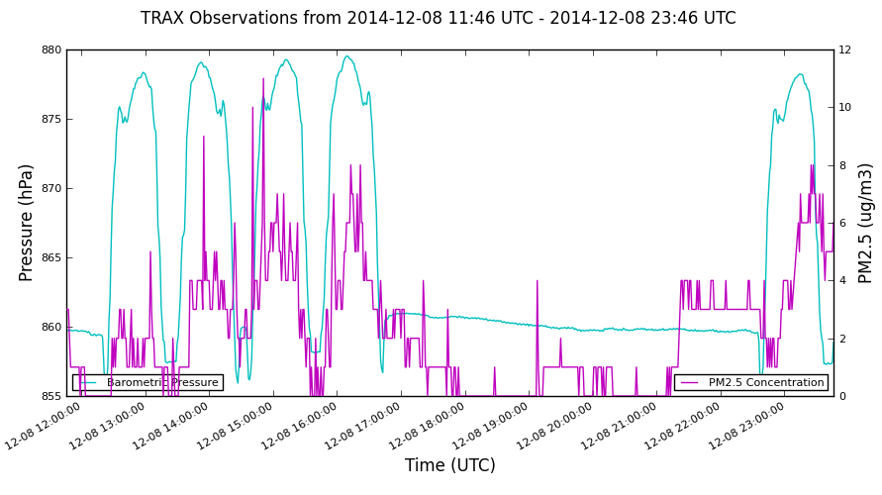
UTA TRAX
Met sensors (temp, RH, pres)
Particulate sampler (GRIMM, E-Sampler)
LGR (CO2, CH4)
Campbell, Rasberry Pi loggers
3 cell phones for real time comms
Real-time display(s):
http://meso1.chpc.utah.edu/mesotrax/
More to follow
Valley
Bench

Slide 19
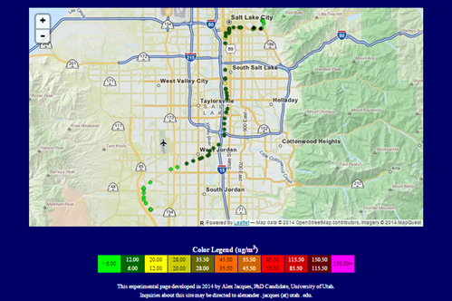
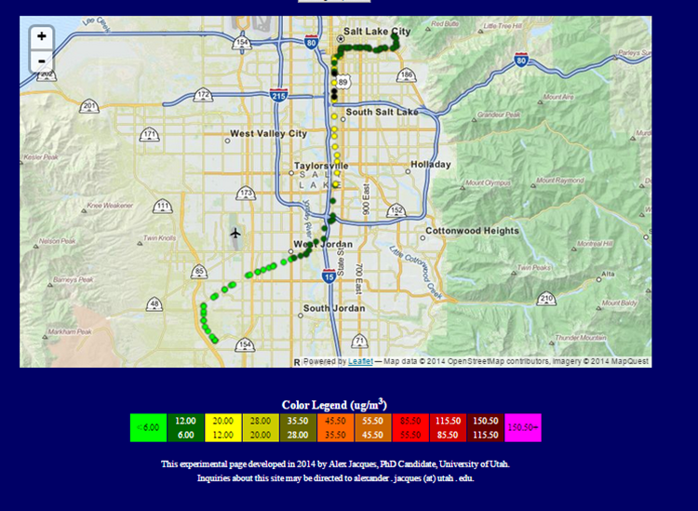
PM2.5 Today: 5:30-7:30 AM (left) 10:noon (right)

Slide 20
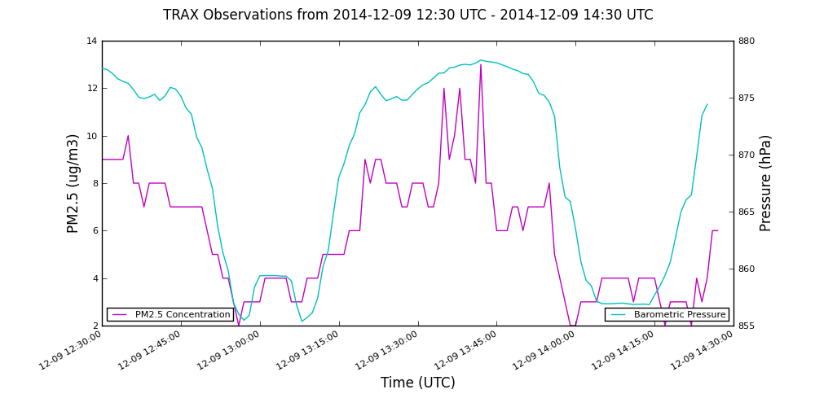
PM2.5 This morning
cyan: pressure
violet: PM2.5
Urban DayBreak Urban Hospital

Slide 21
The TRAX “Crew”
Horel: MesoWest
Erik Crosman
Will Howard
Alex Jacques
Nate Larsen
Luke Leclair-Marzolf
John Lin: LAIR
Ryan Bares (Jim E)
Ben Fasoli
Logan Mitchell

Slide 22
Existing Capabilities-> New Opportunities
Twice daily rawinsondes
ASOS cloud height
Campbell datalogger
Instrumented towers
DAQ pollutant monitoring
EPA hourly reporting standards
Research quality sensors
Field campaign characterization of boundary layer
GRAW, Windsonde, copter
Ceilometer backscatter
Rasberry pi/Arduino
Mobile: Nerdmobile, truck, TRAX,
County network(s); USU, U/Utah sensors
<1-5 minute observations
Ozone, VOC chips
Real-time monitoring of boundary layer (w sodar, radiometer)

