Slide 1
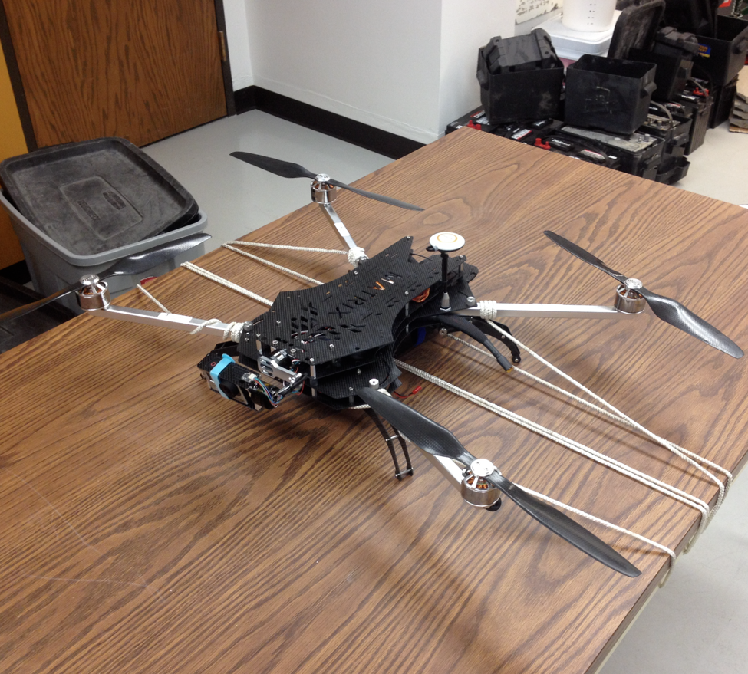
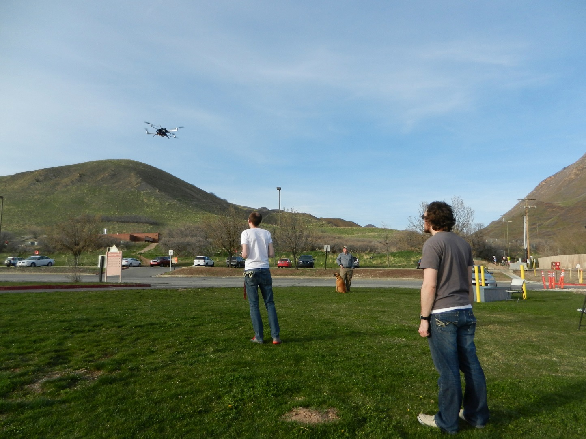
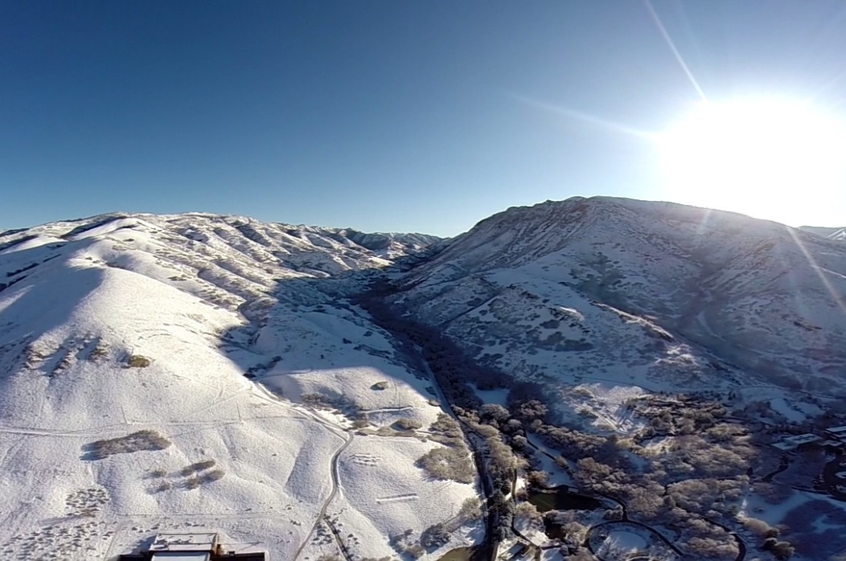
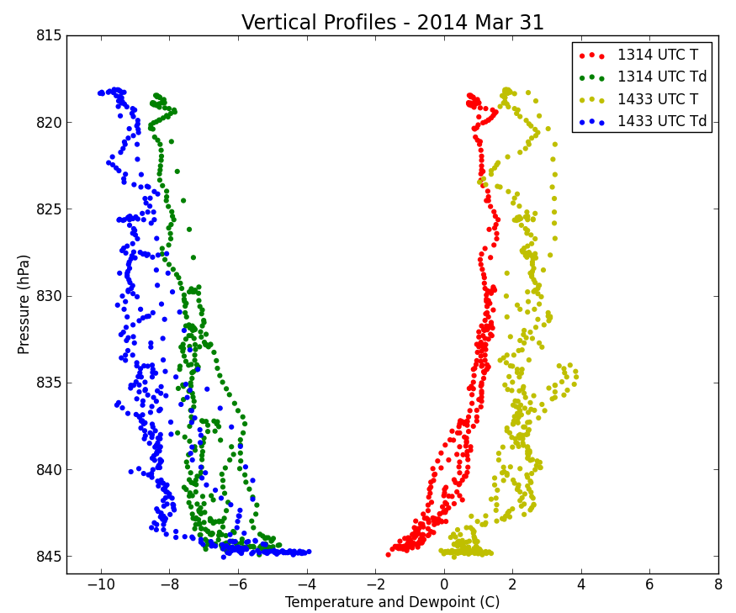
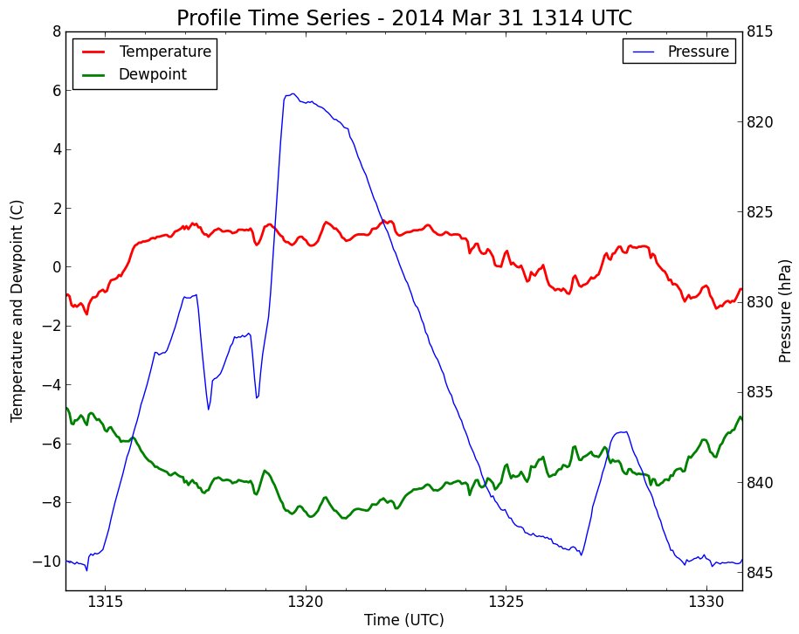
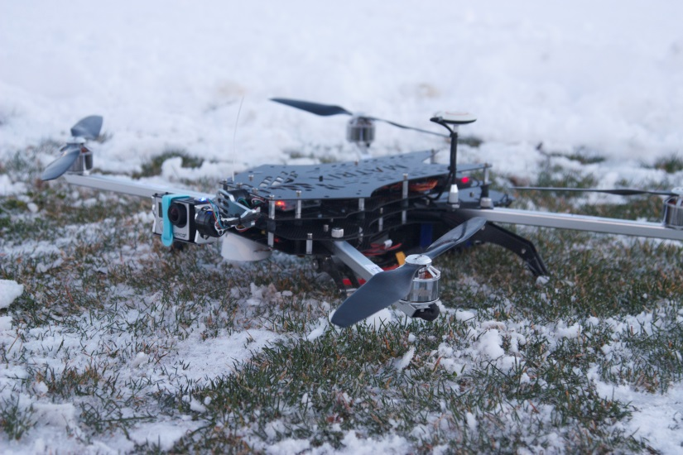
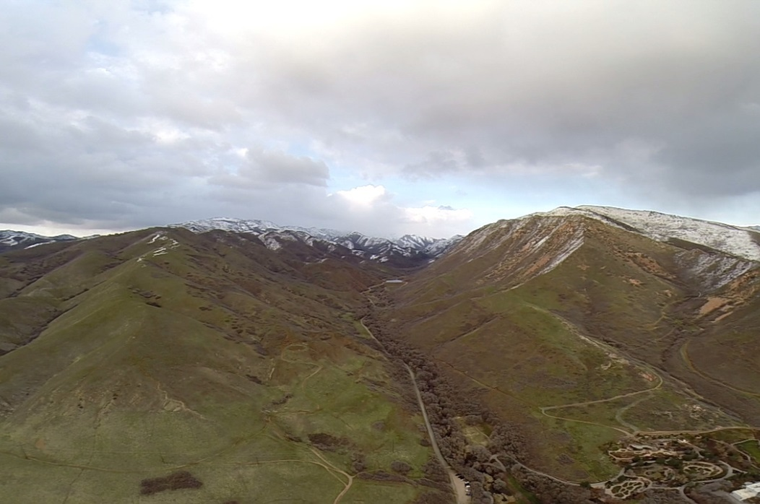
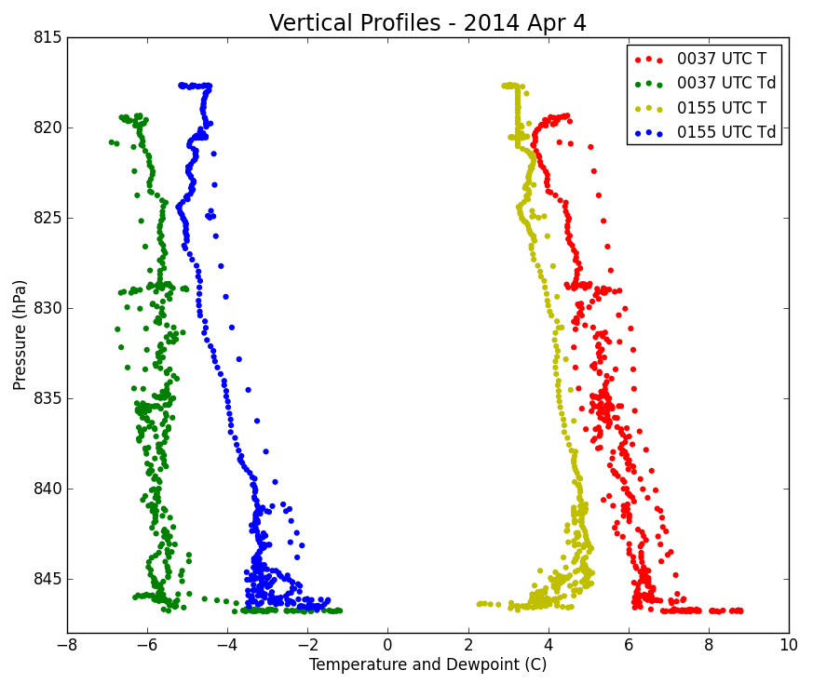
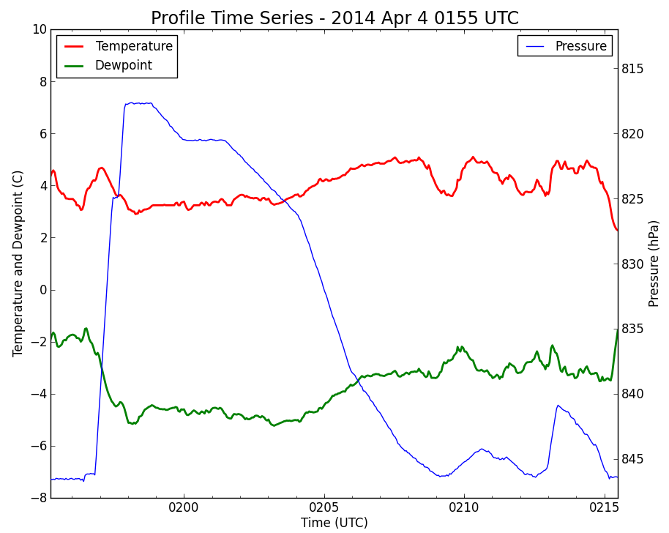
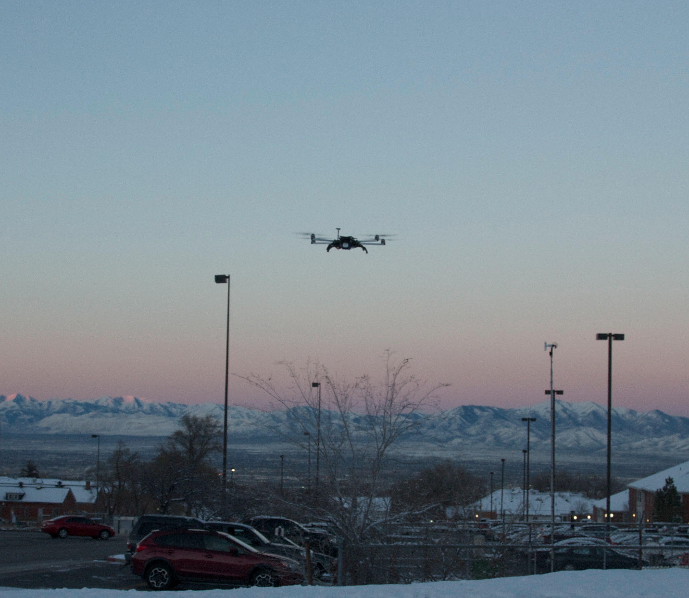
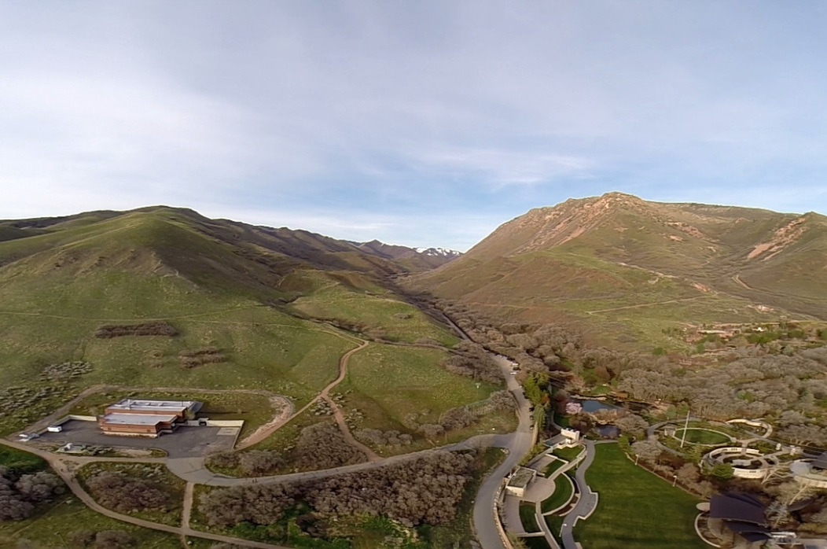
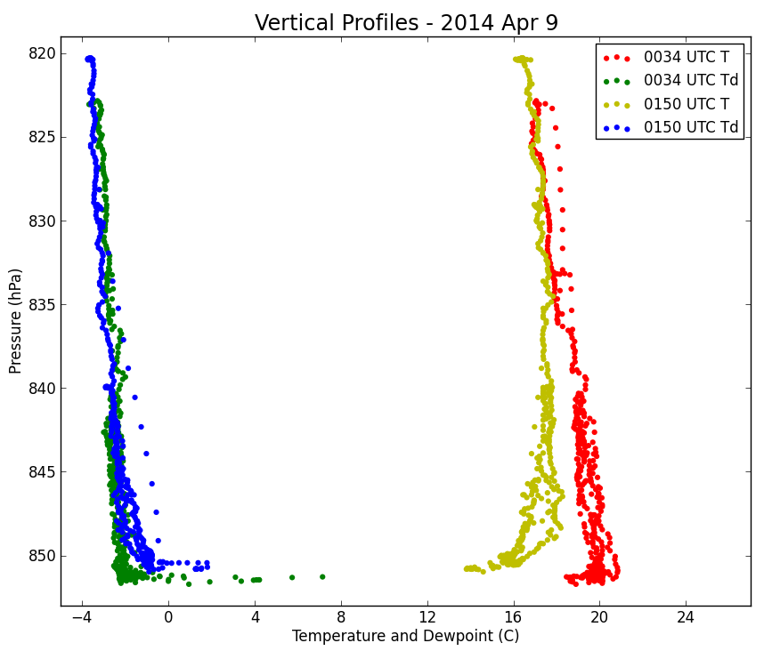
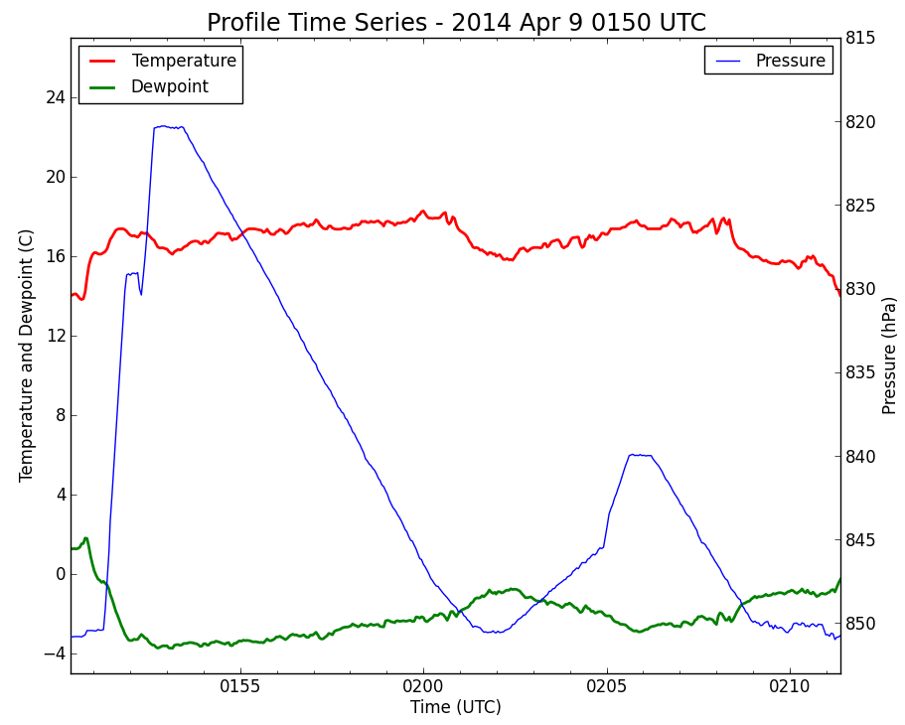
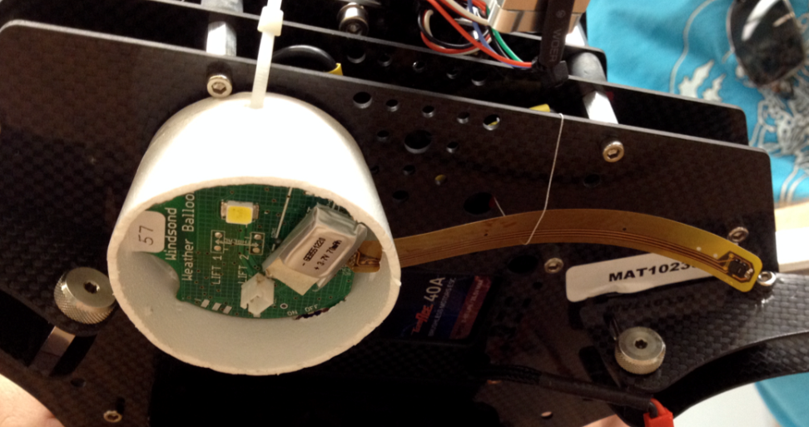
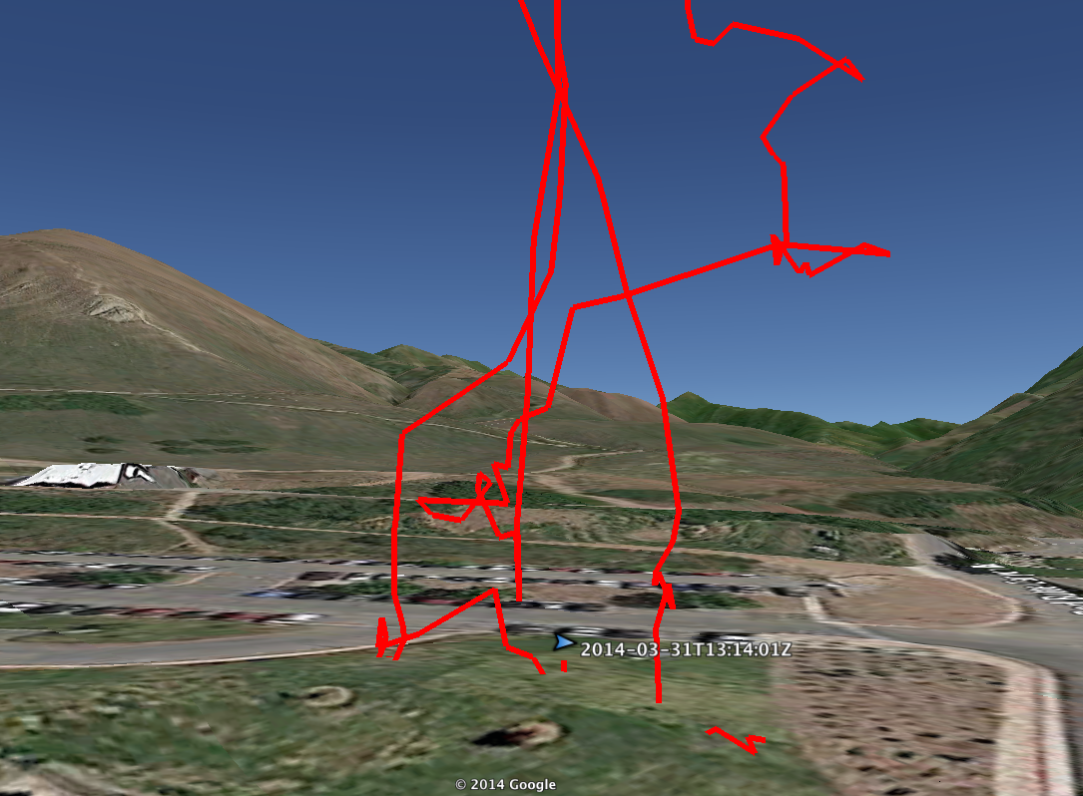
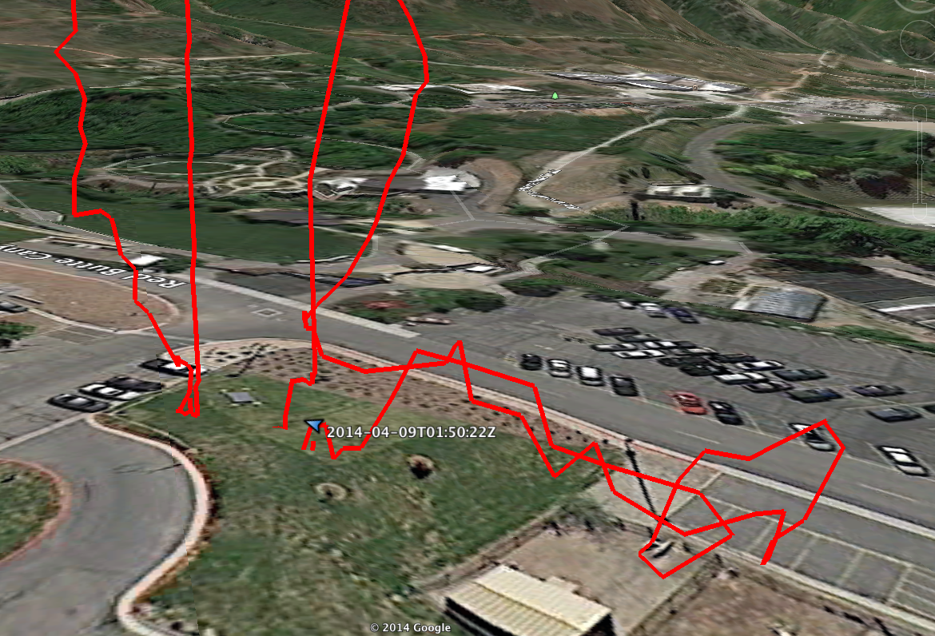
Using a Quadcopter as a Near-Surface Observing Platform
Christopher S. Foster (chris.foster@utah.edu), Alex Jacques, Matt Lammers, and John D. Horel
Department of Atmospheric Sciences, University of Utah
##
Motivation
Test Flights: Data, Results, and Imagery
Summary and UAV Issues
Objective: Evaluate cost-effective options for sampling the boundary layer in basins and valleys for air quality applications
Near-surface vertical profiles of temperature, moisture, and trace gas concentrations in the boundary layer often contain complex structures that vary in space and time and are poorly resolved by balloon or tether sondes
A sonde mounted on a quadcopter provides the capability to control the monitoring of near-surface conditions continuously for 20-30 min flights
Date/Time | Location | Conditions/Goals
23 Mar 2014 Noon MDT | William Browning Building (WBB) | Clear skies and slightly breezy. Initial test of vertical profile procedure and equipment.
31 Mar 2014 715 AM MDT | Mountain Meteorology Lab (MML) | Clear skies with fresh snow cover. Attempted to capture morning PBL transition before and after sunrise.
3 Apr 2014 630 PM MDT | Mountain Meteorology Lab (MML) | Mostly cloudy with convective showers dissipating. Attempted to capture evening PBL transition/canyon drainage.
8 Apr 2014 630 PM MDT | Mountain Meteorology Lab (MML) | Very warm with some high cirrus cloud. Attempted to capture evening PBL transition/canyon drainage.
Captures surface layer fluctuations well (ascent/descent provides repeated readings at same levels)
Windsond sensors and software are easy to use with generally reliable communications
Controlled sampling allows for collection of both vertical and horizontal profiles of temperatures, moisture, pressure, trace gas concentrations, etc.
Quadcopter Specifications
GoProTM Imagery and Data from Flights
Build: | Carbon Fiber
Navigation: | DJI Naza-M V2 GPS
Imaging: | GoPro Camera Mount
Payload Weight: | 1-1.5 kg (~2-3 pounds)
Flight Time: | ~20 min, depending on wind/stress
Max Winds: | 10-15 m/s
Power Source: | 6-Cell LiPo battery
31 Mar 2014
UAV Issues:
Requires obtaining Concept of Operations Approval from the FAA, which is difficult to obtain at the present time
FAA rules are changing within the next 6 months
Goal is to fly next summer and sample meteorological and air quality conditions
Instrument Limitations
Sensor response slow when rising/falling quickly
Apparent hysteresis problems
No valid wind measurements
Quadcopter Limitations
Short flight time
VFR conditions only
No precipitation
Low wind speeds
3 Apr 2014
Potential Time Response and/or Hysteresis Issues
Current Instrumentation
Kiwi Embedded Windsond
Sensirion SHT25 Temperature/RH Sensor
On-board pressure sensor
Real-time GPS and met data available via radio
The quadcopter and sonde only require two people to operate
8 Apr 2014
Future Work
Both summer and winter periods are of interest, but each presents its own variety of issues
Potentially use other instrumentation packages:
Ozonesonde
Arduino or Rasberry PI sensor systems
Deployment Procedure
Acknowledgements
Charge all batteries before flights
Mount batteries and Windsond to the copter
Test the copter for balance to ensure optimum flight time and stability
Turn on sonde and Windsond software; sonde automatically connects and will acquire GPS
Turn on GoPro and check settings to capture video during flight
Turn on copter transmitter and copter and wait to acquire GPS and transmitter signals
Fly!
Total prep time (outside of charging): ~10 min
We’d like to thank Stephan de Wekker, University of Virginia, for his insight on the FAA Concept of Operations Approval process
We’d also like to thank Kiwi-Embedded and Anders Petersson for his development of the Windsond instrument system and software
To download a copy of this poster, please feel free to scan the following code provided here:
QR CODE

