Slide 1
2013 Uintah Basin Winter Ozone Study
http://www.deq.utah.gov/locations/
uintahbasin/studies/UBOS-2013.htm
John Horel and Erik Crosman
Mountain Meteorology Group
Department of Atmospheric Sciences
University of Utah
john.horel@utah.edu
erik.crosman@utah.edu

Slide 2
2013 Uintah Basin Winter Ozone Study
Researchers From:
Utah State University
National Oceanic and Atmospheric Administration
Utah Department of Environmental Quality
University of Utah
University of Colorado, Boulder
University of Wyoming
University of California Los Angeles
University of Washington
See report for researchers’ contact info
http://www.deq.utah.gov/locations/
uintahbasin/studies/UBOS-2013.htm

Slide 3
2013 Uintah Basin Winter Ozone Study
Funding:
Uintah Impact Mitigation Special Service District
Western Energy Alliance
Questar Energy Products
Bureau of Land Management
National Oceanic and Atmospheric Administration
Environmental Protection Agency
Utah Department of Environmental Quality
Utah Science Technology and Research Initiative
Utah School and Institutional Trust Lands Administration

Slide 4
2013 Uintah Basin Winter Ozone Study
Background
Current EPA standard: 75 ppb
First measured elevated ozone: 2009
First extensive study: 2011
Ongoing field campaigns: 2012-2014
http://www.deq.utah.gov/locations/
uintahbasin/studies/UBOS-2013.htm

Slide 5
2013 Uintah Basin Winter Ozone Study
Takeaway Points
Oil and gas production is large and growing
Production releases particulates and array of gases
When snow on ground and stable atmosphere, ozone generated photo-chemically and trapped near ground
Key unknowns:
Emissions
Role of ozone precursor gases, such as nitrous acid and formaldehyde
http://www.deq.utah.gov/locations/
uintahbasin/studies/UBOS-2013.htm

Slide 6
Simulation of a Cold-Air Pool and Winter Ozone Episode in Utah’s Uintah Basin
E. Neemann, E. Crosman, J. Horel, L. Avey
Atmospheric Chemistry and Physics To be submitted
2014
1 Feb
2 Feb
3 Feb
4 Feb
5 Feb
6 Feb

Slide 7
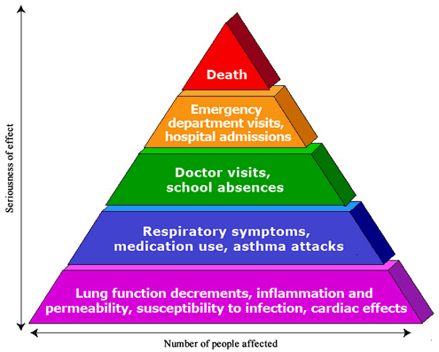
Background - Ozone & Health
Surface ozone is a significant health hazard to humans
Respiratory irritation and inflammation
Aggravated asthma
Long-term lung damage
Increased hospital admissions
and ER visits
Increased mortality
U.S. EPA: http://www.epa.gov/apti/ozonehealth/population.html

Slide 8
Winter Ozone Production
(Precursors)O + hν O
O + O2 O3
NO_{x}
O₃
Z
VOCs
Snow Cover
θ
Oil and gas operations release ozone precursors: volatile organic compounds (VOCs) and nitrous oxides (NOx)
Pollutants trapped near surface when stable conditions aloft
Snow cover sustains cold air near surface
High albedo snow reflects sunlight back to atmosphere enhancing photochemical reactions with ozone precursors
Leads to elevated ozone levels trapped near the surface

Slide 9
Increase in Oil and Gas Drilling in Utah

Slide 10
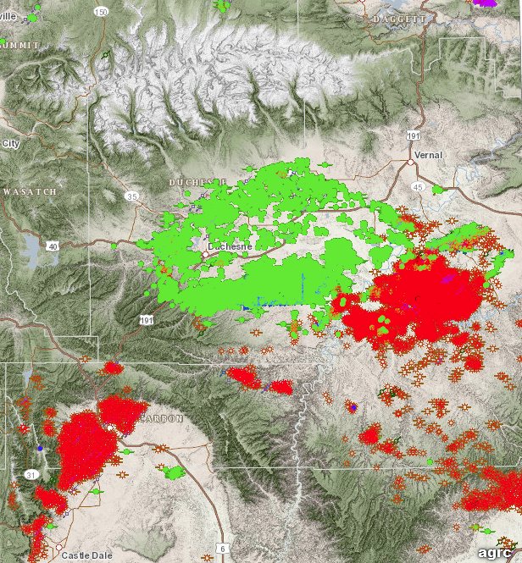
Uintah Basin
9,400 oil & gas producing wells in March 2014
Over 3,600 permits for additional wells since Jan 2012
Courtesy of Utah Division of Oil, Gas, and Mining

Slide 11
Emissions (Barickman 2014)
Emission inventories for the Basin remain incomplete
Difficult to obtain emissions data due to diverse surface and mineral rights
VOC emissions depend on well and equipment types
Inventory data specific to winter ozone season needed as emissions from evaporation ponds and methanol uses have large seasonal variations

Slide 12
Volatile Organic Compound (VOCs) by Hydroxyl (OH) reactivity measured during UBOS 2013
Roberts et al. (2014)

Slide 13
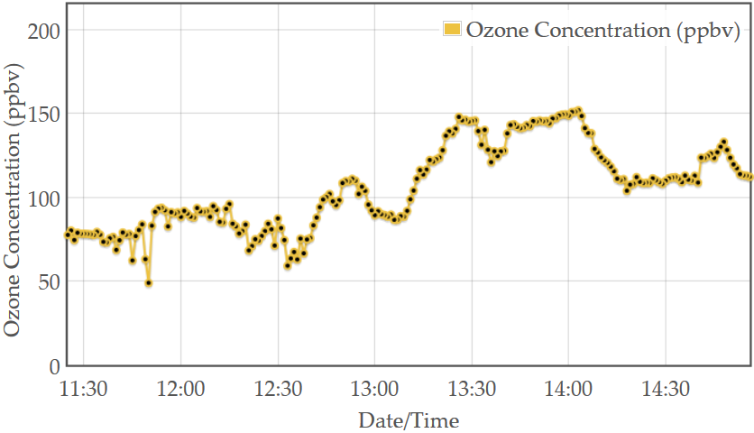
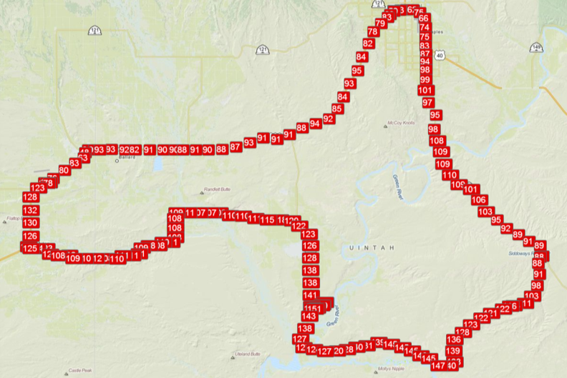
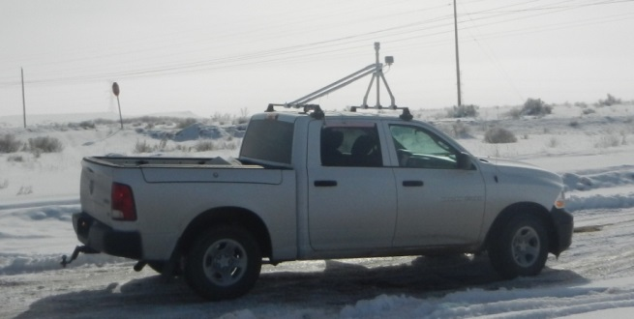
Mobile Ozone Transect - 6 Feb 2013
High concentrations measured throughout the basin
Greatest values in lower elevations and river valleys
NAAQS
Vernal
Roosevelt
Duchesne
River
Green
River
Ouray
White
River

Slide 14
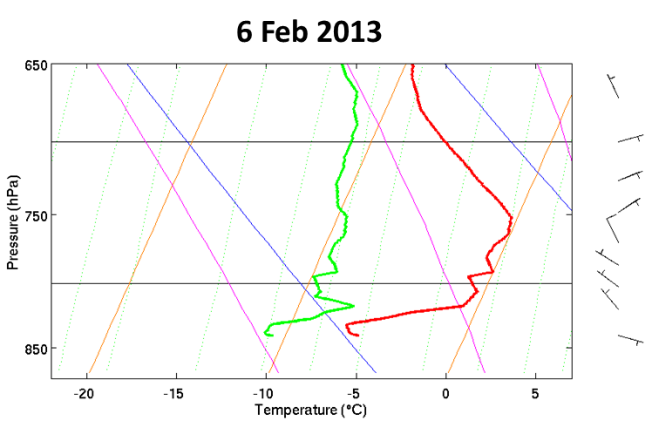
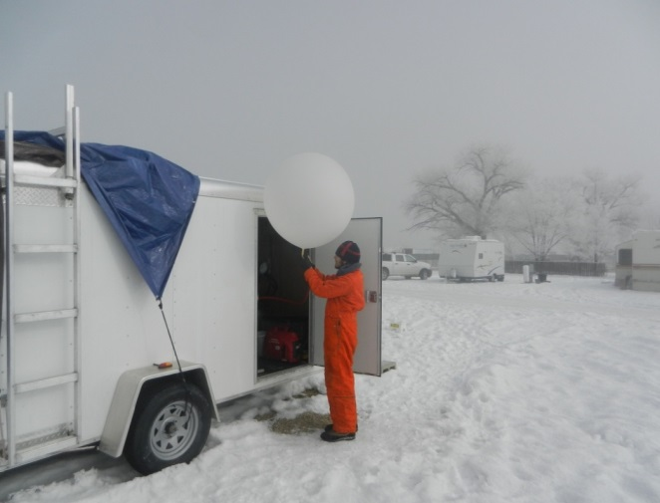
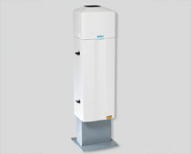
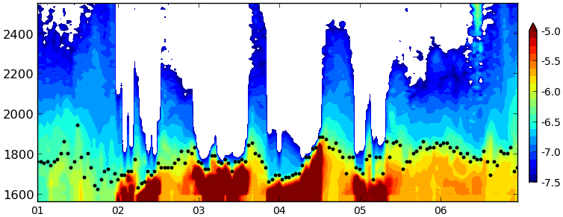
Atmospheric Stability Aloft Traps Pollutants
Dewpoint
Temp
WARM
COLD
1-6 Feb 2013: Backscatter and Estimated Aerosol Depth
FOG/LOW CLOUDS
CLEAN AIR
Elevation (m)
POLLUTED LAYER
Time ->
Photos: Erik Crosman

Slide 15
Karion et al. (2014)
Temp
OZONE
Figure 4-13. Profiles of constituents measured on the aircraft on January 31 in the vicinity of the natural gas field and gas processing plants.

Slide 16
Current EPA ozone standard violated if:
3-yr average of the annual calendar year 4th highest daily max 8-hr average exceeds 75 ppb
Ozone levels in Uintah Basin over past 5 winters:
2010 2011 2012 2013 2014

Slide 17
Current EPA ozone standard violated if:
3-yr average of the annual calendar year 4th highest daily max 8-hr average exceeds 75 ppb
Ozone levels in Uintah Basin over past 5 winters:
2010 2011 2012 2013 2014
Above
Above
Below
Above
Below

Slide 18
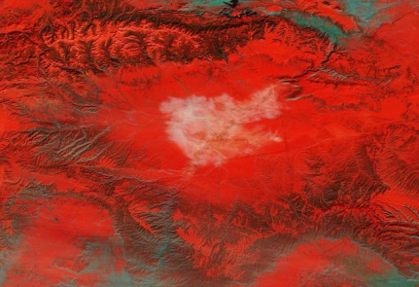
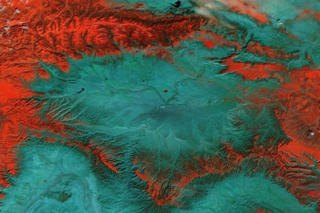
Current EPA ozone standard violated if:
3-yr average of the annual calendar year 4th highest daily max 8-hr average exceeds 75 ppb
Ozone levels in Uintah Basin over past 5 winters:
2010 2011 2012 2013 2014
Which is largely controlled by extent of snow cover in basin:
2 Feb 2013
SNOW: red
NO SNOW: cyan
CLOUDS: white
Above
Above
Below
Above
Below
Wide
Wide
Little
Wide
Little
21 Feb 2014

Slide 19
Schnell et al. (2014)

Slide 20
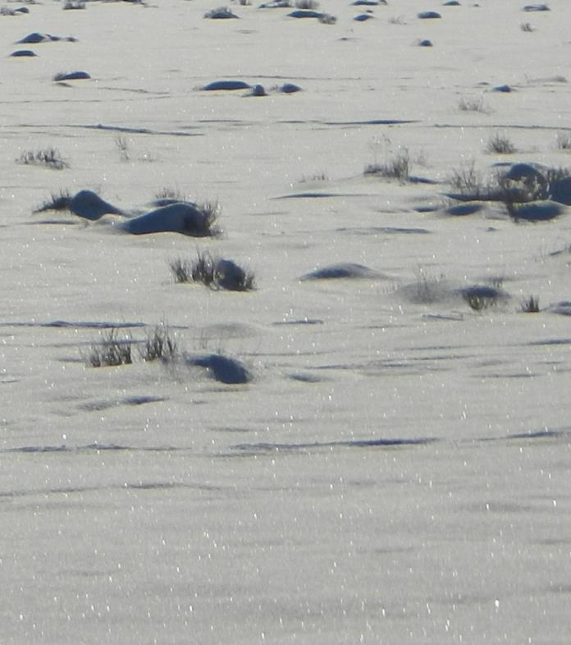
Snow in the Uintah Basin
It doesn’t snow often and, when it does, it usually doesn’t snow much
Stable, stagnant conditions inhibit ablation (ice -> vapor)
Fog/low clouds reflect water cycling: ice-> vapor -> cloud -> snow via deposition/riming
Albedo can remain high due to metamorphism of snow pack over time
Complex chemistry happening with ozone precursors in the snow pack
Photo: Erik Crosman

Slide 21
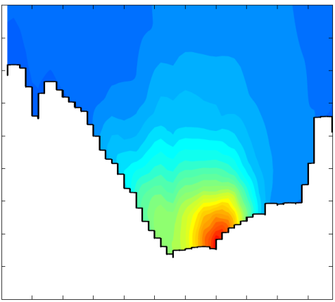
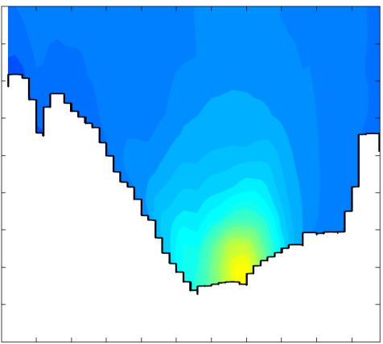
What If? Simulation of Mean Afternoon Ozone
1100 - 1700 LST 1-6 February 2013
SNOW
NO SNOW
3.0
3.0
2.8
2.8
2.6
2.6
2.4
2.4
2.2
Wasatch
2.2
Wasatch
Height (km)
Height (km)
2.0
2.0
1.8
1.8
1.6
1.6
1.4
Green River
1.4
Green River
1.2
1.2
ppb
30
40
50
60
70
80
90
100
Ozone concentrations notably higher in numerical simulation with SNOW cover
From Neemann, Crosman, Horel, Avey (2014)

Slide 22
2013 Uintah Basin Winter Ozone Study
Takeaway Points
Oil and gas production is large and growing
Production releases particulates and array of gases
When snow on ground and stable atmosphere, ozone generated photo-chemically and trapped near ground
Key unknowns:
Emissions
Role of ozone precursor gases, such as nitrous acid and formaldehyde
http://www.deq.utah.gov/locations/
uintahbasin/studies/UBOS-2013.htm

Slide 23
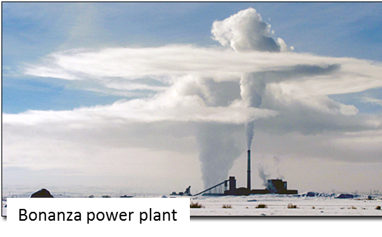
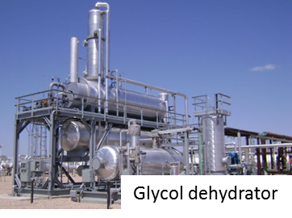
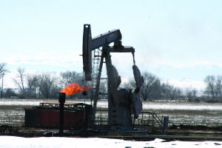
2013 Uintah Basin Winter Ozone Study
Developing Control Strategies
Episodic or seasonal controls may be appropriate for winter ozone concerns
Emission reductions at Bonanza power plant are unlikely to have any effect on winter ozone episodes
Reductions in all VOC emissions will be beneficial
reductions in formaldehyde and aromatic VOC will be more beneficial on a per ton basis; however, less reactive VOCs dominate emissions and ozone production
Personal opinion: business as usual is not an option…
Uintah Basin Standard

Slide 24
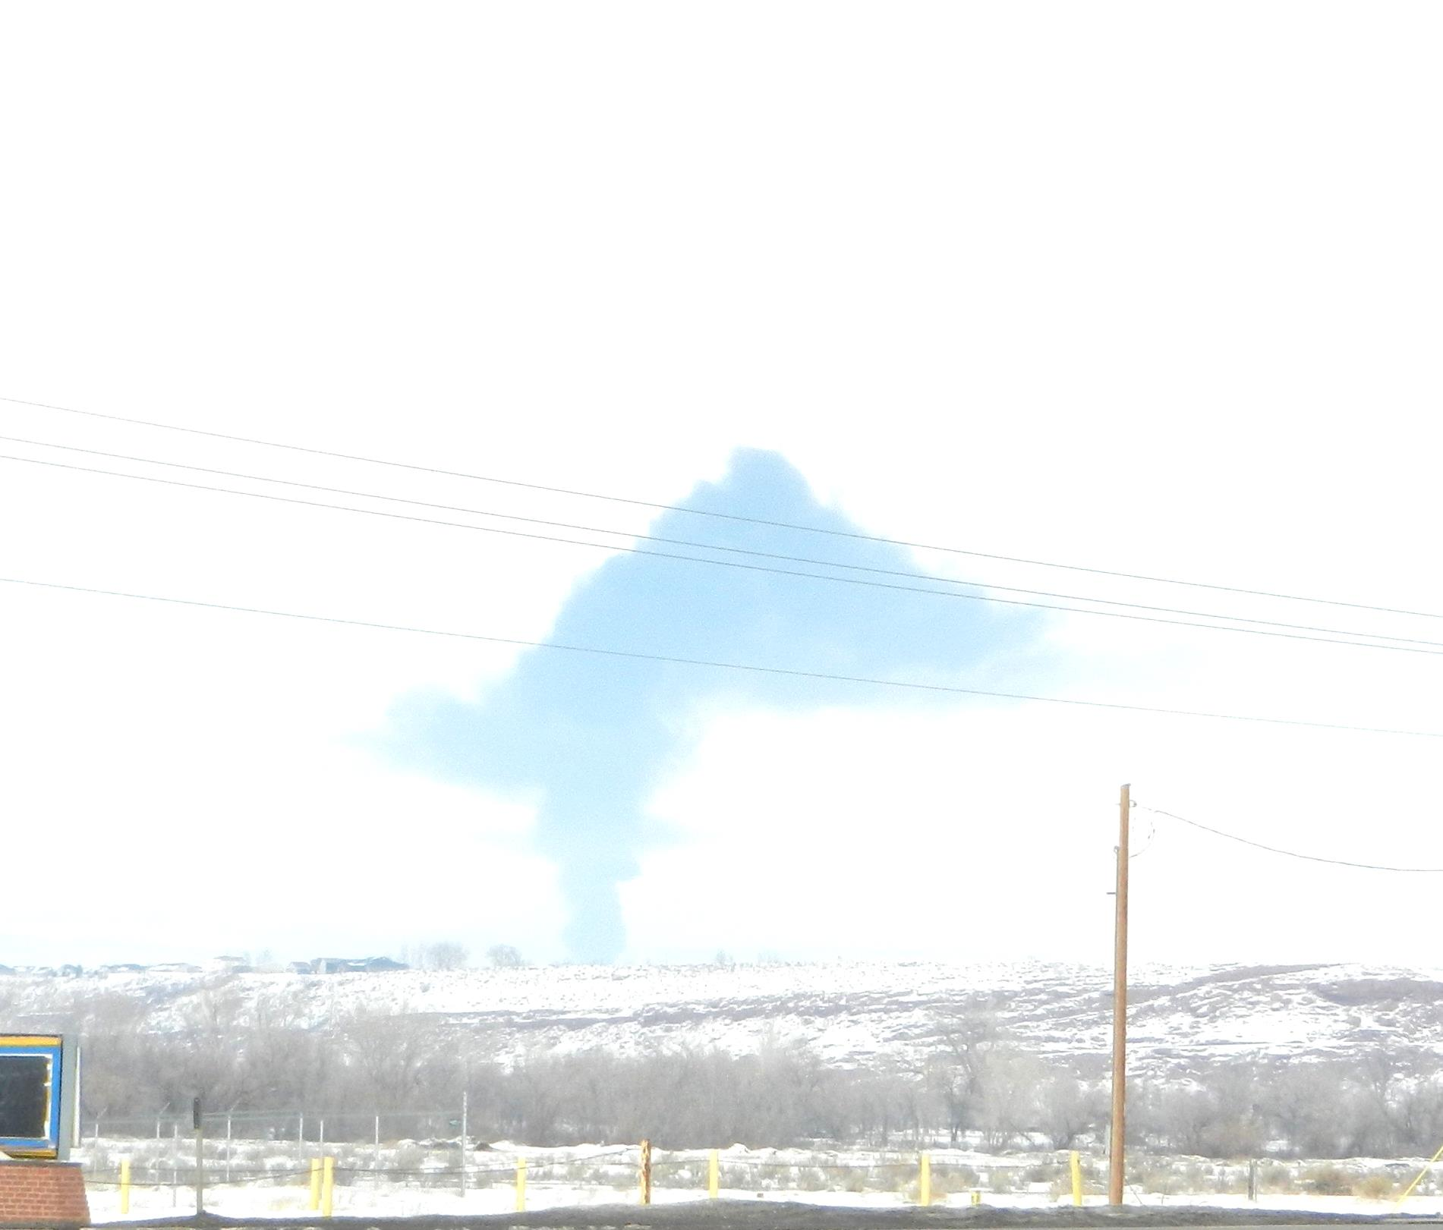
Collaborations Involving UU
State of Utah Energy Initiatives and Imperatives Program:
Computer Modeling of Winter Ozone Formation in the Uintah Basin
M. Mansfield (USU), J. Horel ( UU), S. Lyman (USU), J. Hansen (BYU) (1-year project)
NOAA:
The Uintah Basin Greenhouse Gas Study: Understanding emissions of CO2 and CH4 from oil and gas fields
J. Lin, J. Horel, J. Ehleringer (3-year project)

