Slide 1
Web Services for Fire Weather Applications
John Horel, Chris Galli, Joe Young, Judy Pechmann
Department of Atmospheric Sciences
University of Utah atmos-mesowest@lists.utah.edu
https://mesowest.org/20/
http://mesowest.utah.edu
https://synopticlabs.org

Slide 3
MesoWest Objective: access, archive, and disseminate publicly-accessible environmental data as soon as possible
Key Drivers
NWS
Fire Weather
Field Projects
Research & Public Service
Air Quality
Road Weather
MesoWest software development funded over the years by:
NWS
Other federal land agencies
State road, air quality, and land agencies
Commercial firms

Slide 4
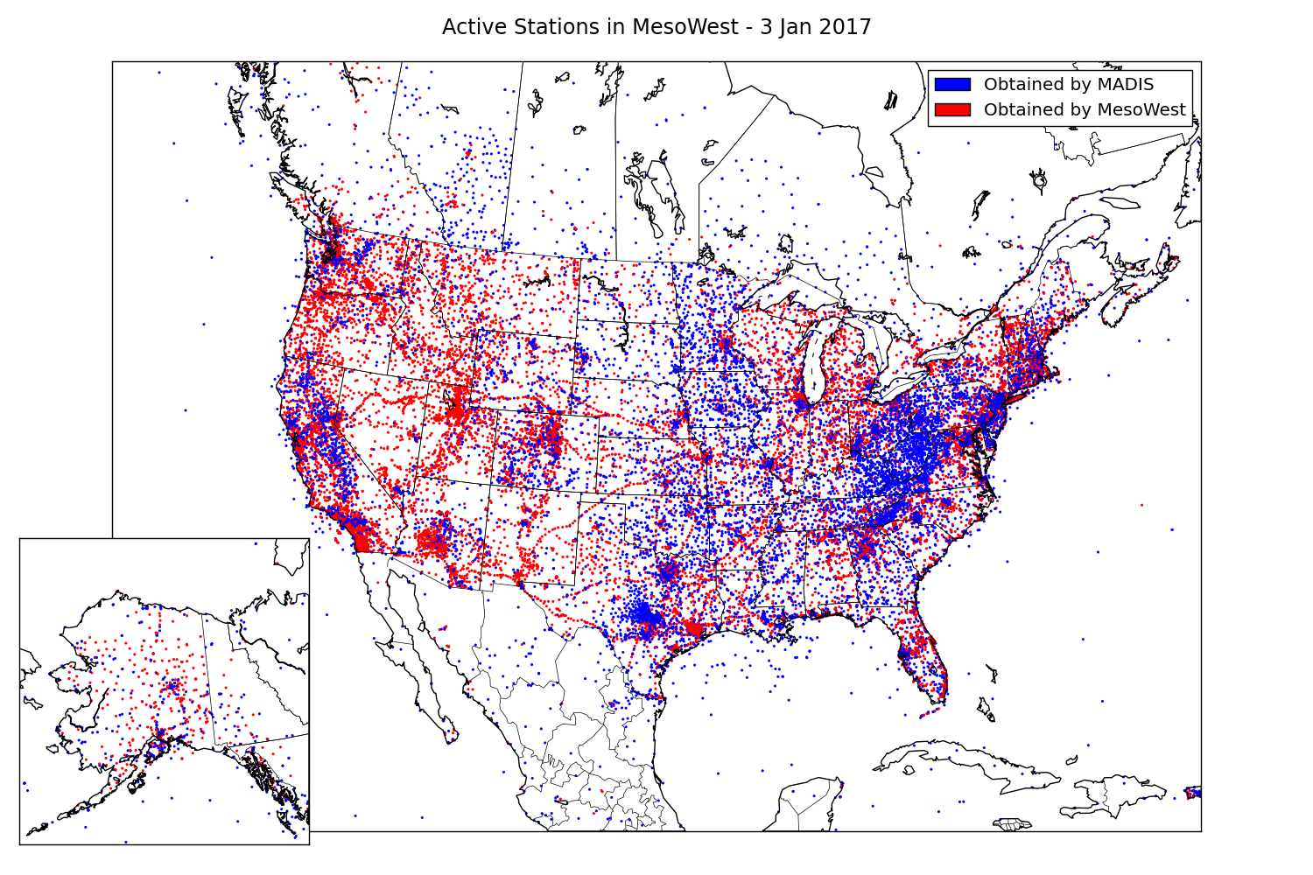
MesoWest Growth Over the Years

Slide 5
Recent Focus
Acquire
Process
Archive
QC
Disseminate
Improve uptime and reliability
shift acquisition and processing of data from NWS Western Region to Amazon Web Services (AWS) cloud computing
Improve archiving as number of networks, stations, and variables continues to increase
Vastly improved performance to store and access databases on AWS cloud servers
Develop enhanced QC and integrate QC with data
Provide application programming interface (api) for other software developers to deliver environmental information efficiently
Be responsive to data provider and data user needs

Slide 6
Data Flow and Services
Data Ingest & Processing
API Services
AKFF
Updated GLFF
Environmental
Data
MesoWest
MySQL Master Databases
UU Web Services
NWS MySQL Databases
NWS Internal & Web Services

Slide 7
Fire Weather Related Software Development at the University of Utah
Project | Funding Agency | Development Cycle | Major innovation | Web link
MesoWest | NWS National Mesonet Program + others | Since mid 1990’s | Integration of diverse data sources | mesowest.utah.edu
ROMAN | Land agencies | 2003-2010 | Tailored to operational fire community | raws.wrh.noaa.gov /roman
Great Lakes Fire and Fuels | Great Lakes Compact | 2008-2012, 2017* | Inclusion of current and forecast grids | glffc.utah.edu
Spot forecast verification | JFSP | 2011-2015 | Exploration of forecast performance | meso1.chpc.utah. edu/jfsp
SynopticLabs api | NWS + others | Since 2012 | Improved access to data | synopticlabs.org
Alaska Fire and Fuels | Alaska BLM | 2014-2017* | Enhanced integration of weather and fuel information relative to Great Lakes | akff.mesowest.org
ROMAN refresh | ?? | ?? | Further integration nationwide including fuel moisture

Slide 8
ROMAN lives on… code base on AWS server

Slide 9
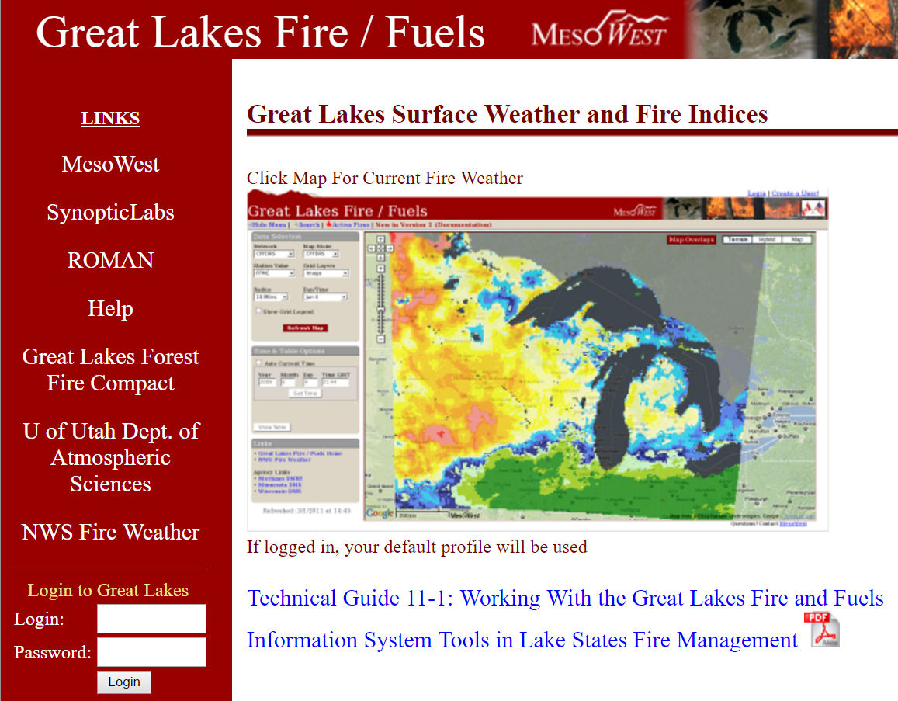
Operational Great Lakes Fire and Fuels: http://glffc.utah.edu
http://www.publish.csiro.au/wf/WF12186

Slide 10
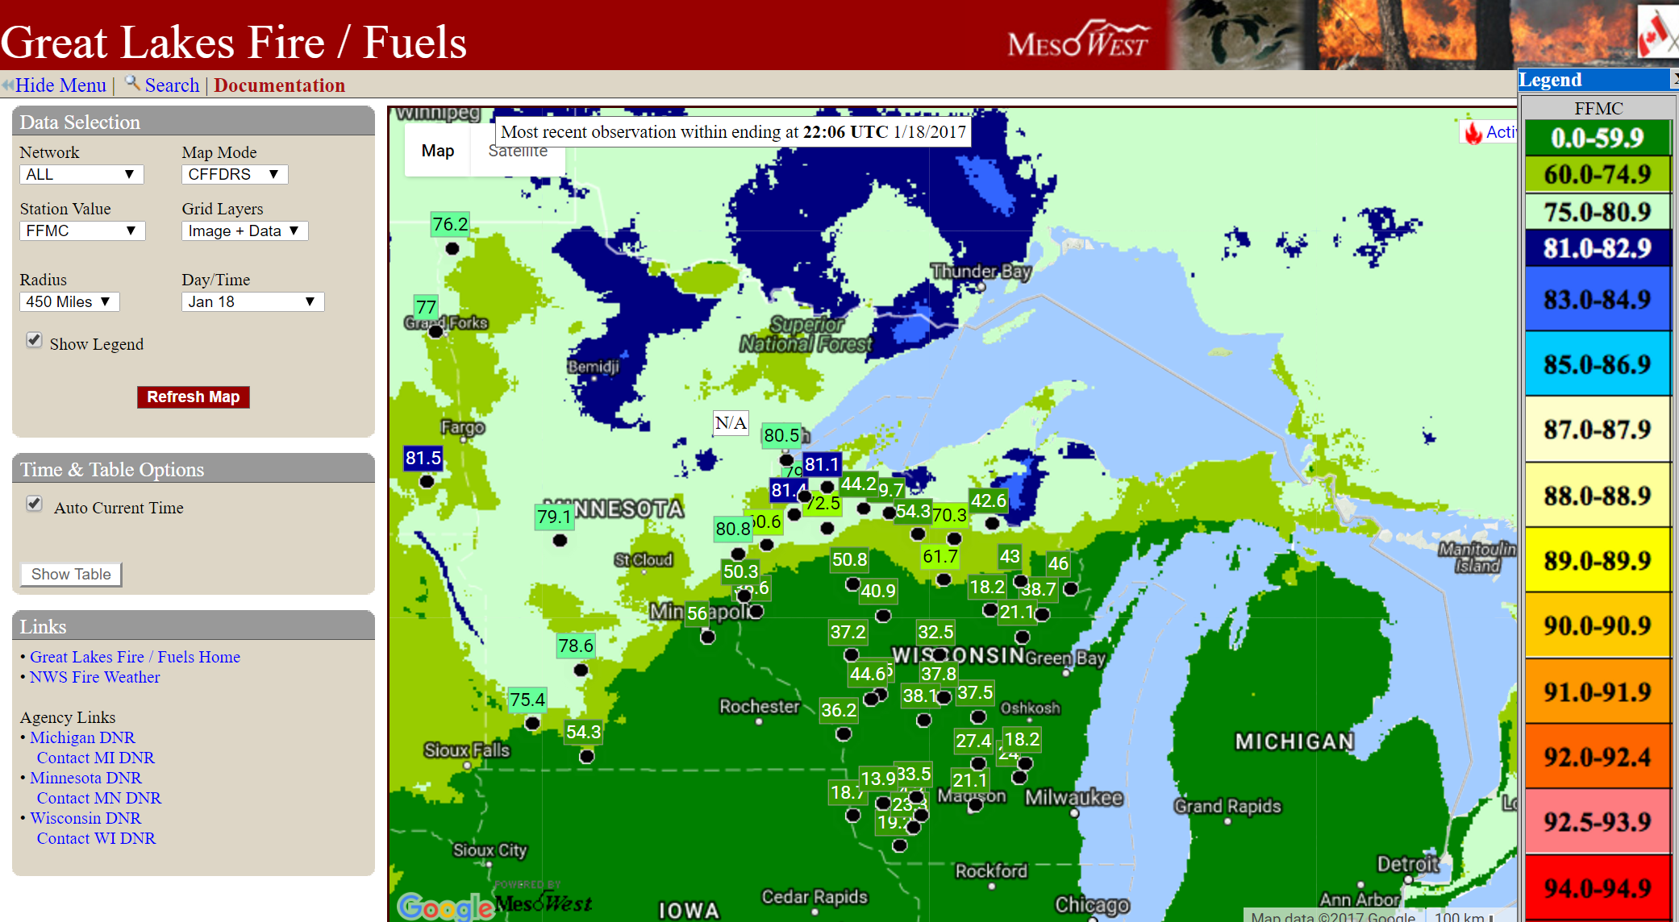

Slide 12
Operational Alaska Fire & Fuels http://akff.mesowest.org/
Go back and look at conditions during past summer
In midst of adding new features this winter, so some features may not be working at this time

Slide 14
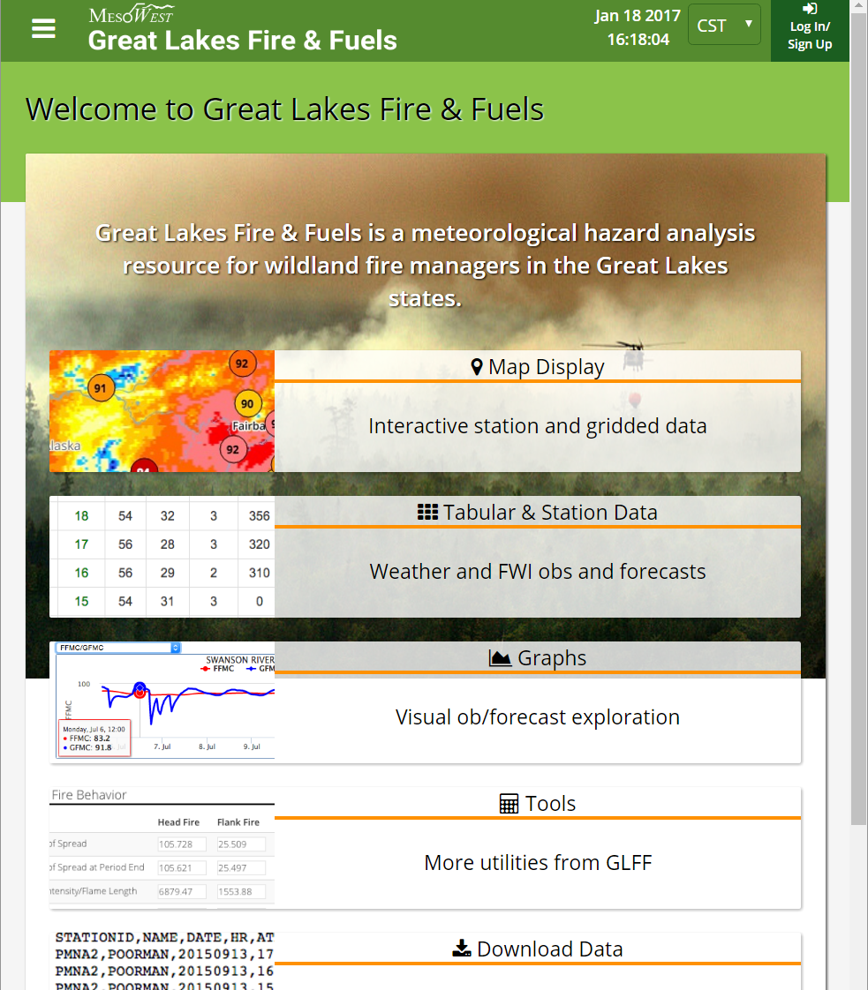
Technical Refresh: Great Lakes Fire & Fuels
Build on capabilities of Alaska Fire & Fuels and in turn AKFF will take advantage of GLFF development
More complete and seamless integration of station and gridded weather information using AWS cloud servers
Support NFDRS and CFFDRS products
Fire Behavior Calculator with tabular and graphical output

Slide 15
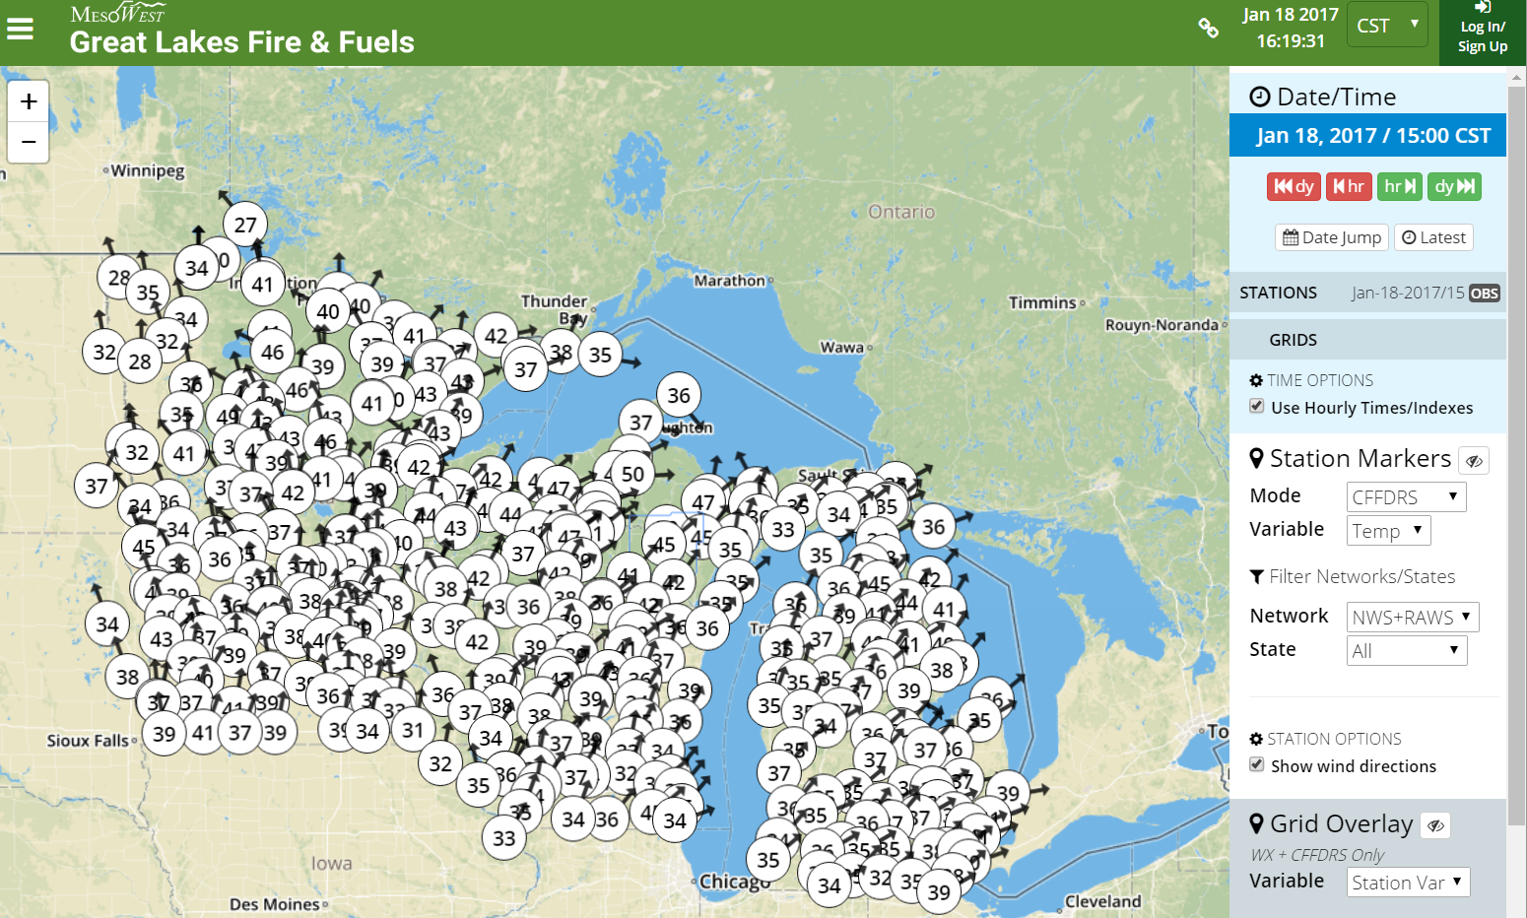

Slide 16
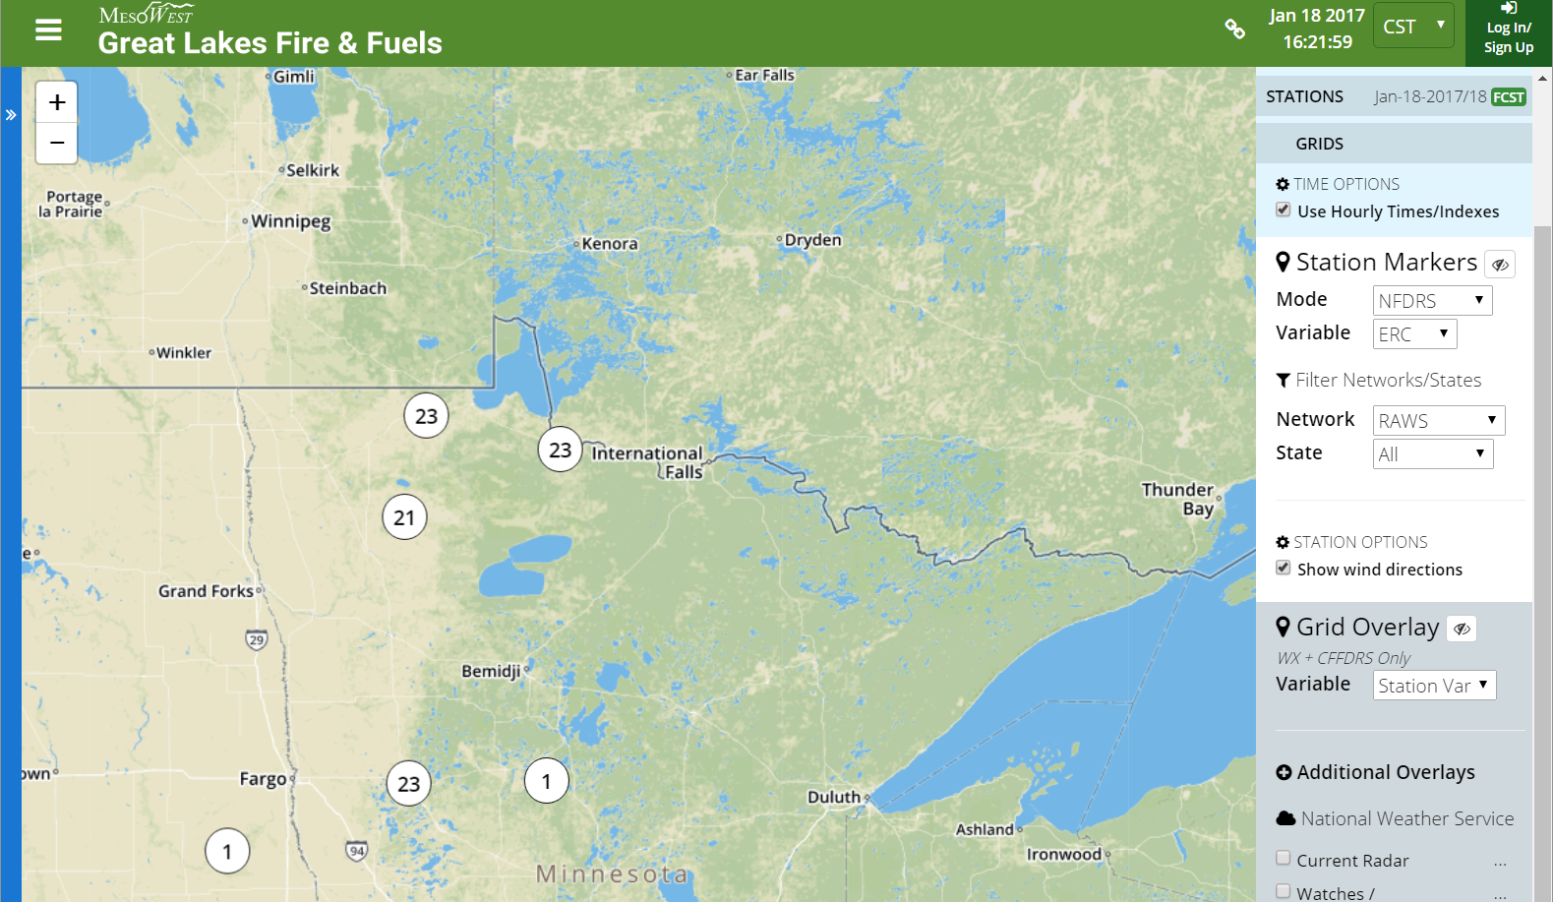

Slide 17
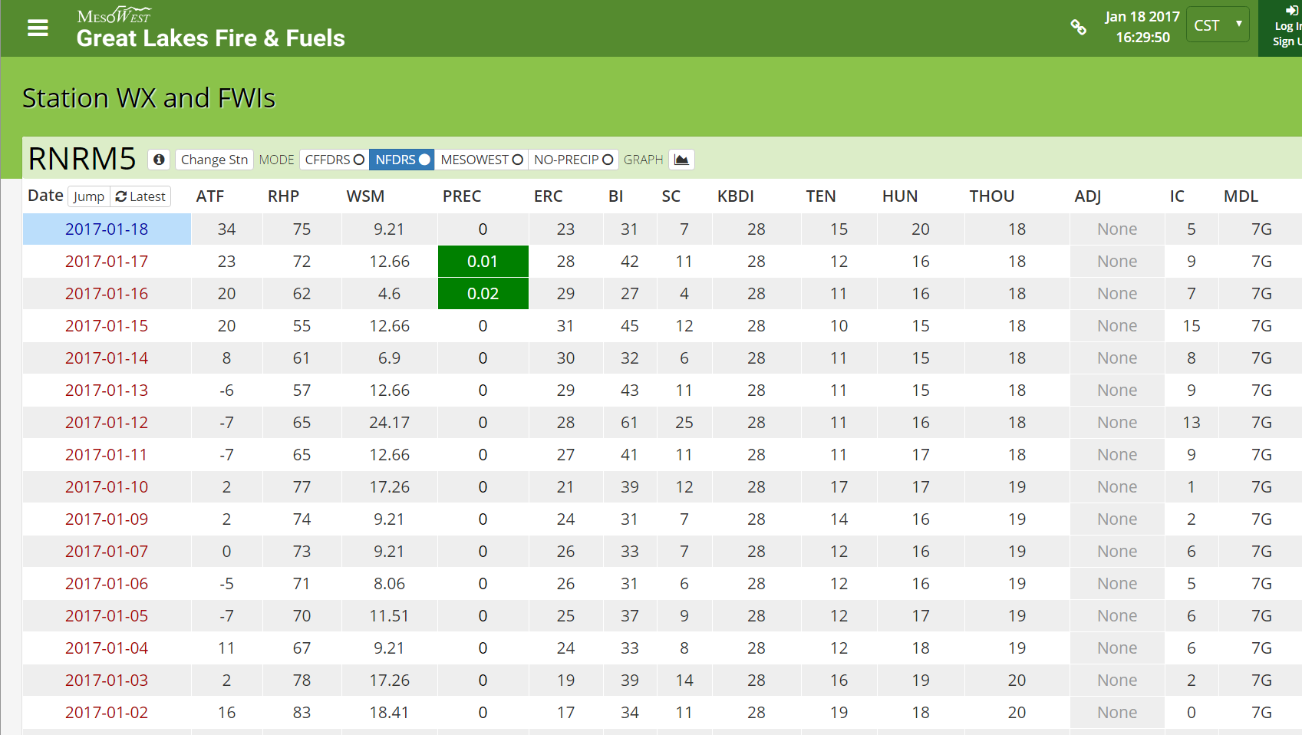

Slide 18
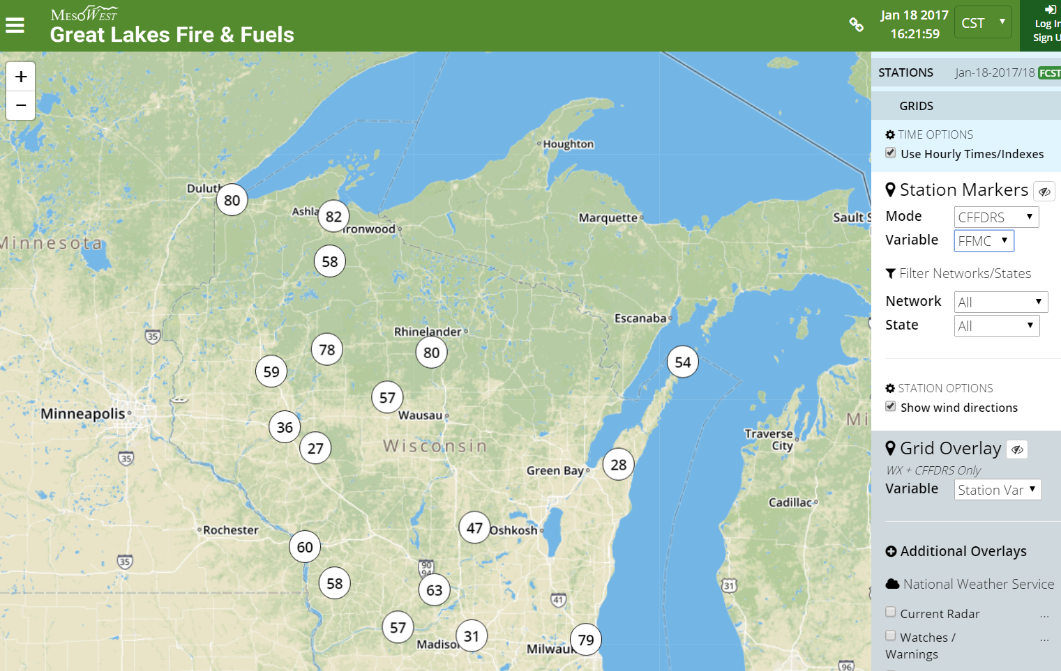

Slide 19
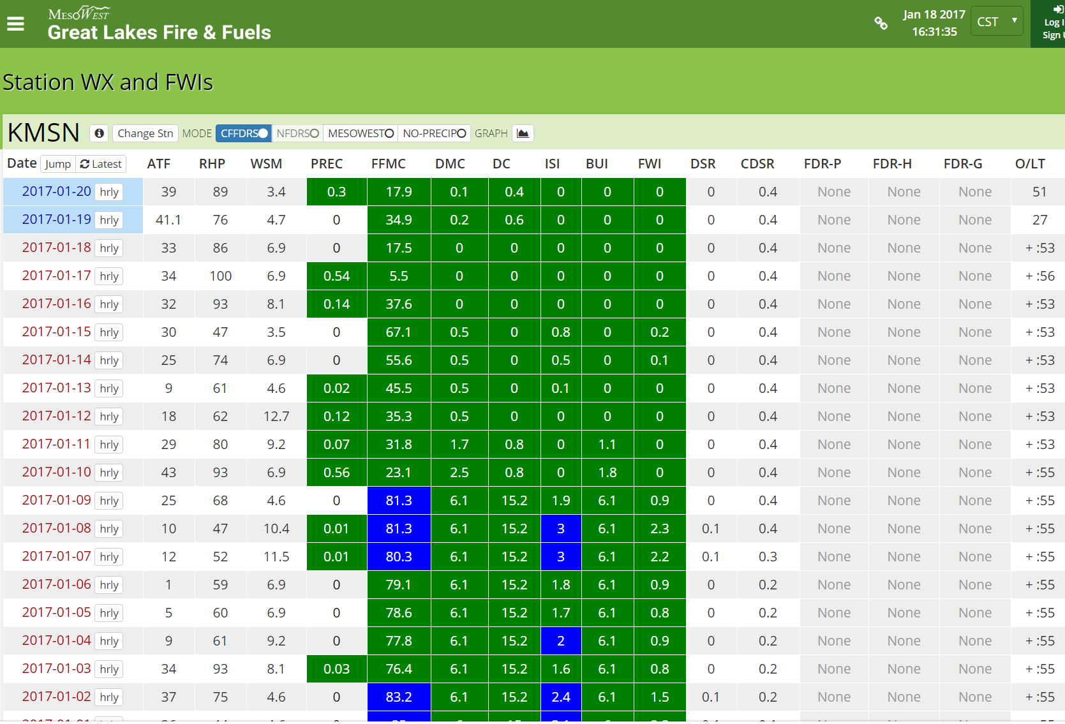

Slide 20
Map grids… chris will update

Slide 21
Additional points
Opportunity to expand regional character of GLFF to CONUS but that does require additional resources
Seamless transition from prior, current, and forecast conditions at observation locations as well as from analysis (RTMA) and NWS forecast (NDFD) grids
NFDRS station and experimental gridded products can be utilized
Using CFFDRS requires local expertise to define regional startup values

Slide 22
Questions and comments?

