Slide 1
Images of what, who, when, why, how, or where
(Entity you are describing)
MISSION:
Your current objectives or description of activities
MOVING FORWARD:
How your objectives might change in the future. Or, best practices you use or challenges you may face in the future
Images don’t need to be completely self describing
Use this slide to encourage others
to seek you out for more explanation of the content
Slides will be available for download during the meeting
Logo, web link, or both
Name and Affiliation
Email

Slide 2
The following slides are 3 separate examples

Slide 3
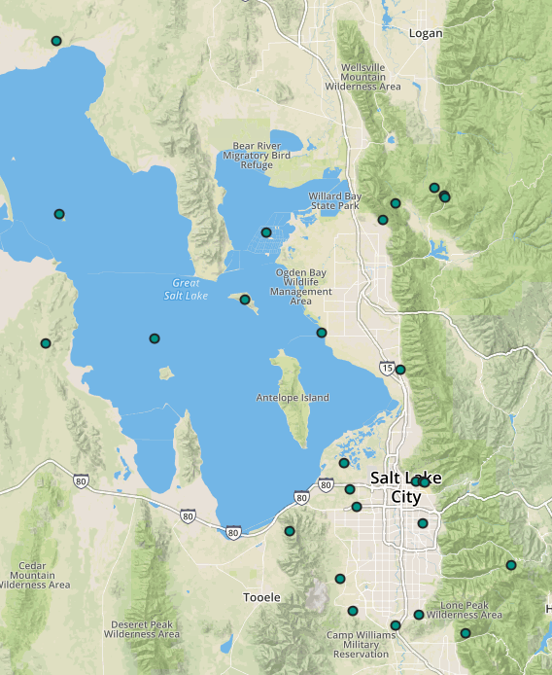
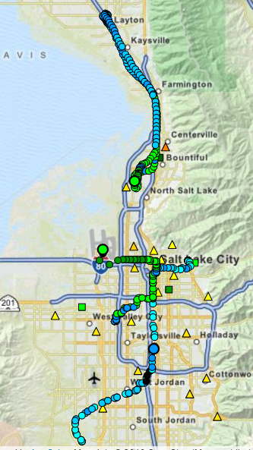
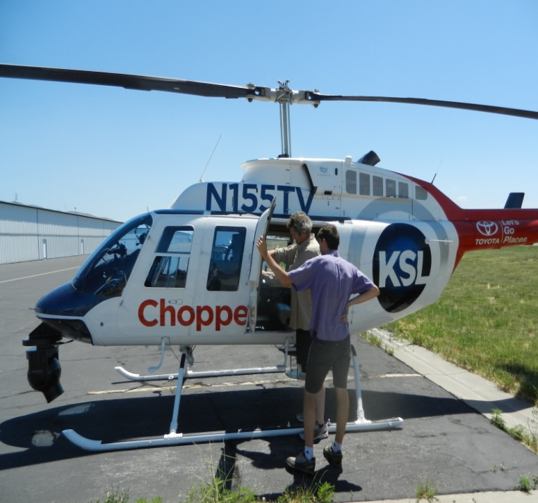
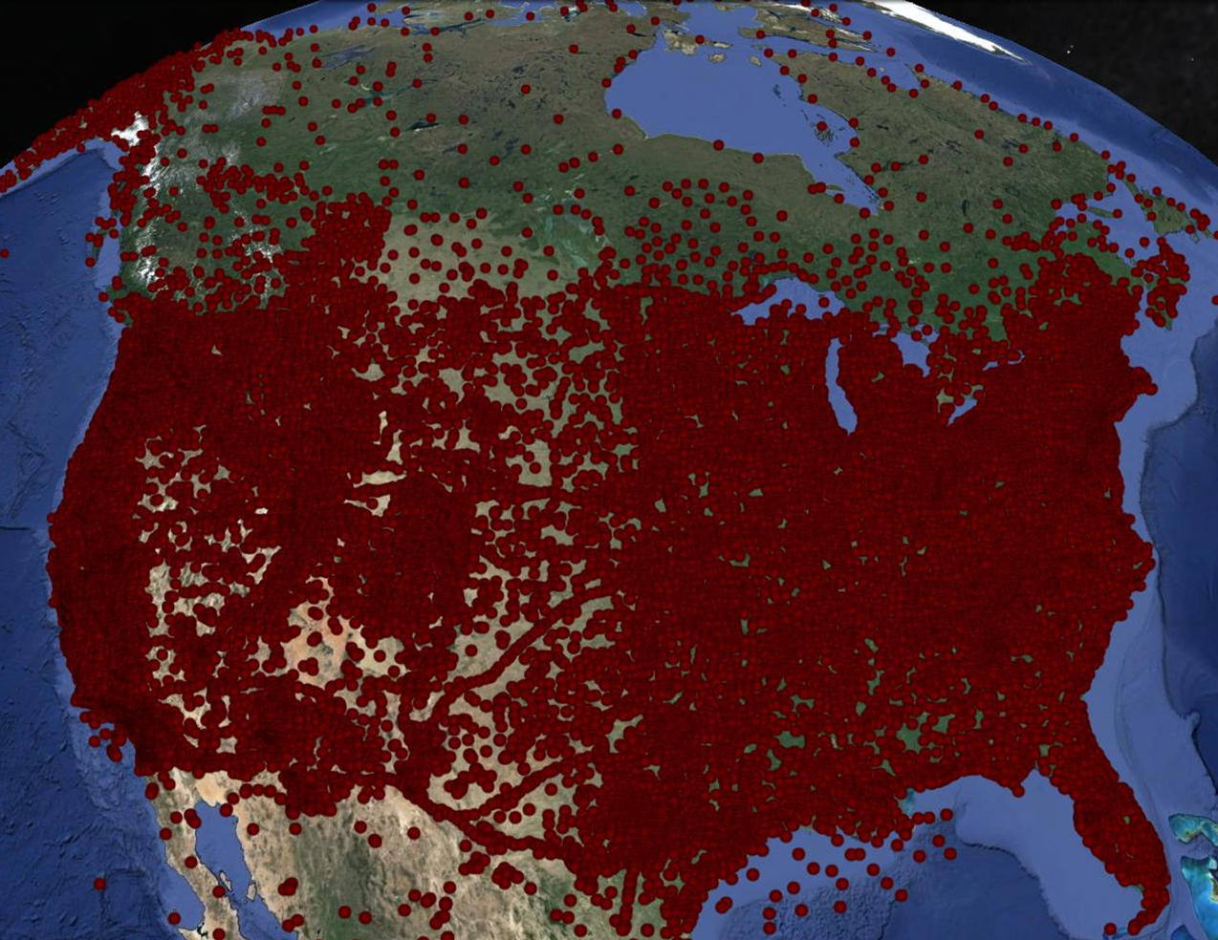
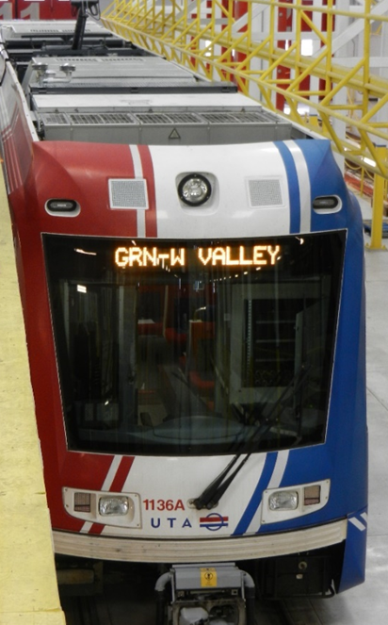
Local Network
MesoWest
MISSION:
Operate local observing network in Utah. Collect and disseminate data from over 200 other networks in collaboration with MADIS.
FUTURE:
Enhance observing systems
using novel mix of platforms
and sensors—
UAVs, vehicles, copter, trains, remote sensors, IOT devices
Air Quality
MesoWest
mesowest.org
John Horel University of Utah
john.horel@utah.edu

Slide 4
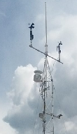
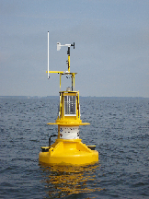
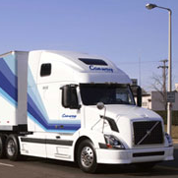
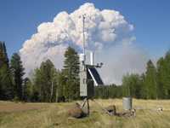
SynopticLabs Data Services
Data Observation Platforms & Aggregation
OBJECTIVE:
Provide surface-based data services for all public National Mesonet observations and more. data available through on-demand APIs and push/alert services
MOVING FORWARD:
More data delivery formats and protocols are needed to satisfy growing demands. Integrate into existing and emerging data mining and big data environments
Time-series Data Store
Data Services: API, monitoring, alerts ...
synoticlabs.org
Chris Galli SynopticLabs
chris.galli@utah.edu

Slide 5
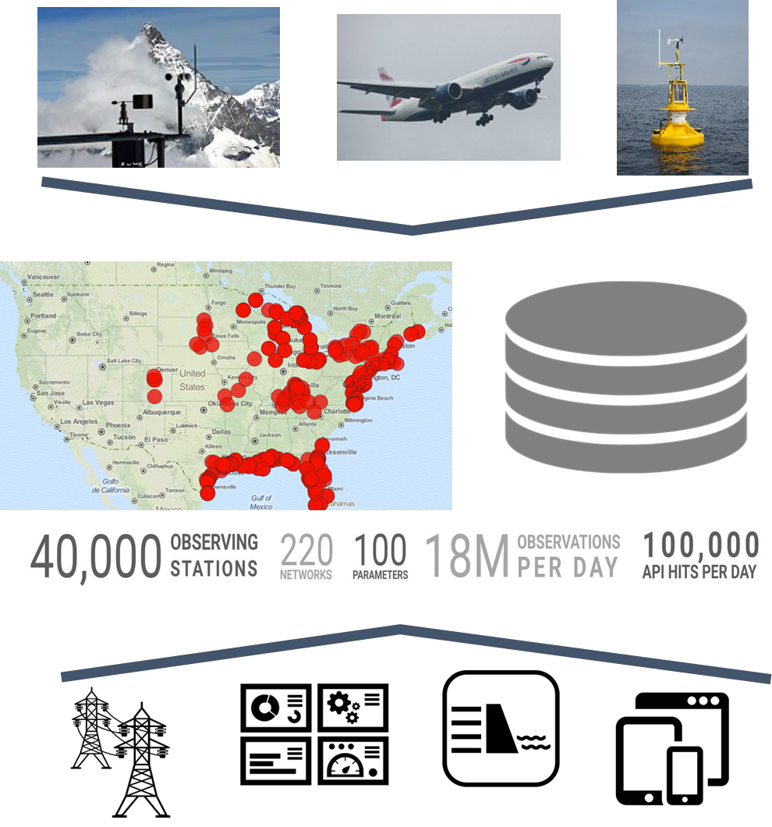
Synoptic Data
A one-stop data hub for environmental data from across the globe
Our future involves:
expanded coverage globally
increased boundary layer observations
real time analytics and alerts from existing and new data sources
synopticdata.com
Steve Woll, Joe Young
steve.woll@synopticdata.com, joe.young@synopticdata.com

