Slide 1
Meeting Objectives
Updates regarding MesoWest
What we are doing
Where we are headed
Provide update on National Mesonet Expansion project

Slide 2
MesoWest Mission
Promote and support access, storage, and use of weather observations across the nation

Slide 3
ATMOS MesoWest Team
Staff
Xia Dong: Network analysis
Chris Galli: Programming support
Alex Jacques: Programming support
John Horel: Program management
Nola Lucke: Program management
Judy Pechmann: Relational database
Yan Zheng: Relational database
Students
Alex Hansen
James Judd
Matt Lammers

Slide 4
UU-related Collaborators for the National Mesonet Expansion Project
Mike Splitt, Florida Institute of Technology
Further evaluation of metadata related to wind observations
Mark Albright, University of Washington
Coordination for metadata in Pacific Northwest
Suresh Venkat and Jeff Phillips, CS
Improved data mining query methodologies for identifying high impact weather and quality control
Developing collaboration with SCI Institute staff

Slide 5
Core Capabilities of MesoWest Software
Collect provisional data as they become available from hundreds of sources
Archive the data in relational databases
Provide access to the data via the web and through variety of data pushes and pulls
Surface observations received asynchronously
from many sources in different formats
Web Displays
MySql Databases
1997-present
Ingest Software
QC Processing
Metadata
Synchronous output in defined formats (csv, xml) via web/LDM to MADIS and other users

Slide 6
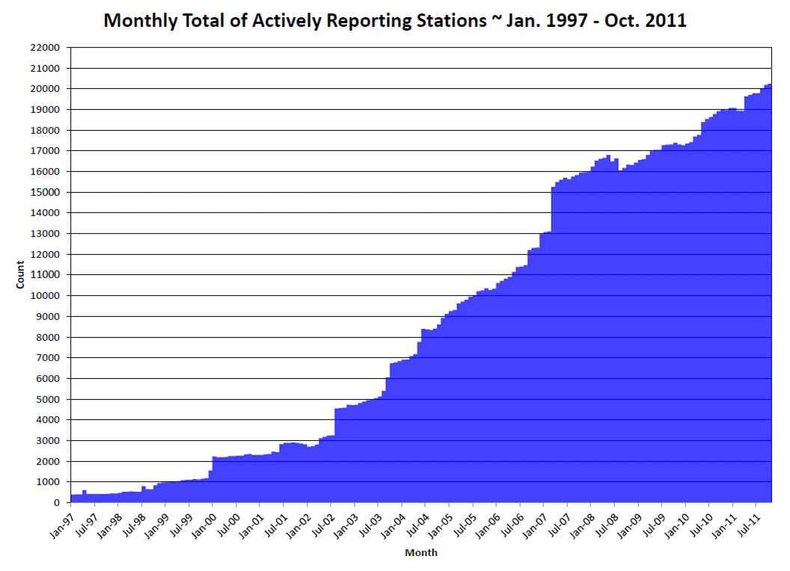

Slide 7
# of observations

Slide 8
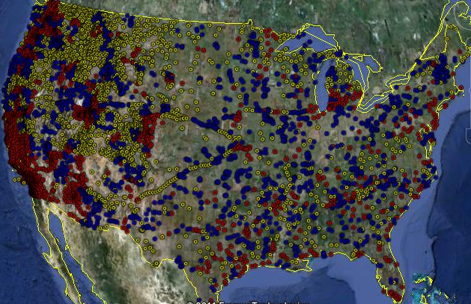
MesoWest Contributions to MADIS
Red: metropolitan county
Blue: micropolitan county
Yellow: rural country
MesoWest currently provides 5,338 observational stations to MADIS from 80 different networks.

Slide 9
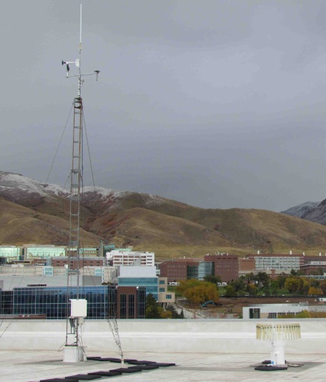
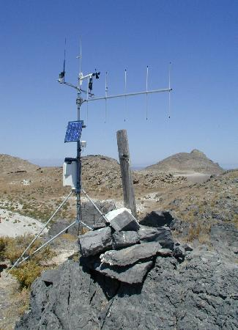
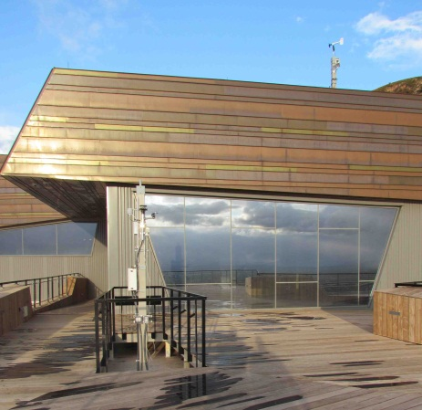
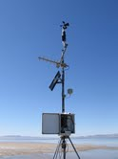
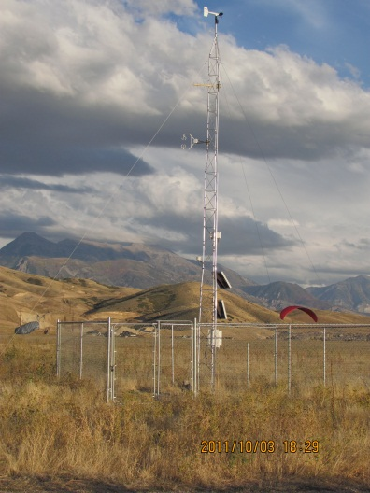
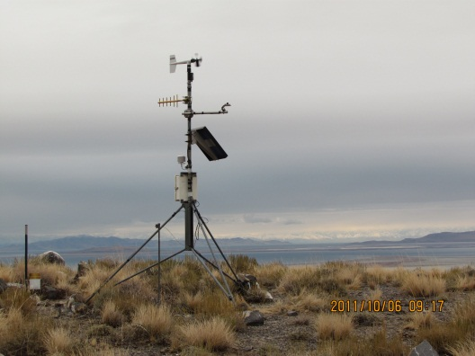
Our Real-Time“Network”

Slide 10
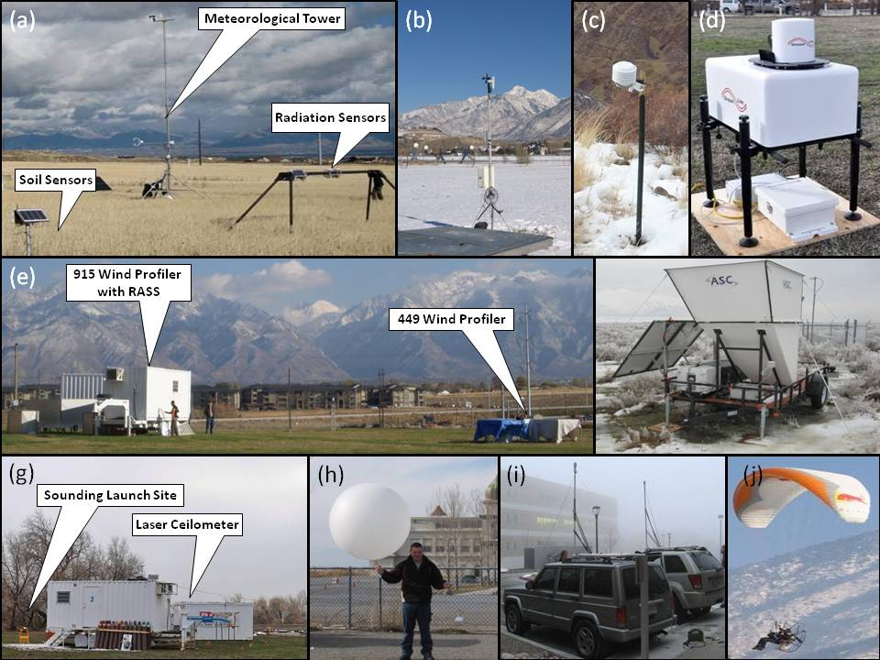
Boundary-layer research weather equipment Mountain Meteorology Group
Research deployments
Six 3-meter weather stations deployed to support field projects
(ASC) mini-SoDAR
Halo Photonics Streamline LiDAR
Two GRAW portable rawinsondes
ASOS ceilometers
Field project data sets
PCAPS fig

Slide 11
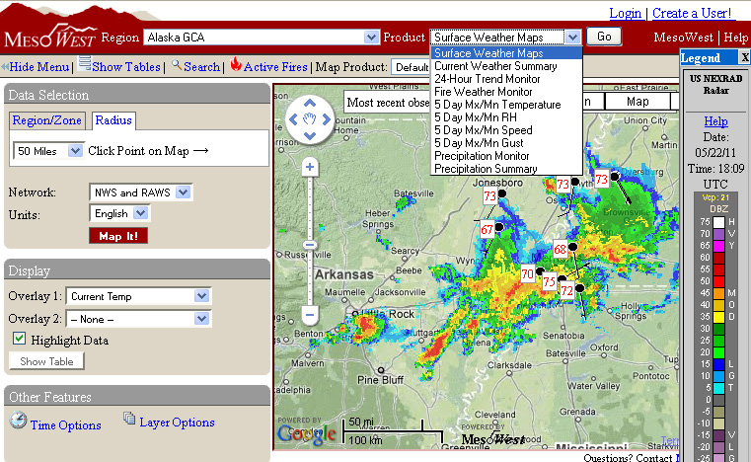
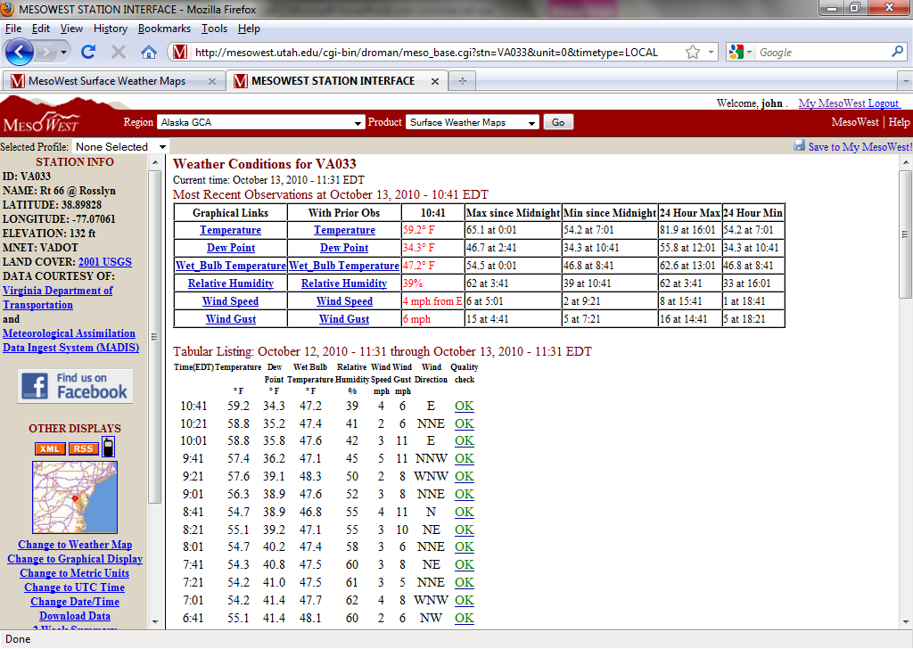
MesoWest Product Examples

Slide 12
MesoWest Users
Google analytics
(Sep 1 2009-Oct 28, 2011)
10 million page views
463,000 visitors
207,000 visited 200+ times
9000 people built profiles

Slide 13
We’ll be asking our customers for feedback via survey monkey over next month
Why do you use MesoWest?
How often do you use MesoWest?
How well does MesoWest meet your needs for access to current and historical weather conditions?
Have you created a profile on MesoWest? If so, has it been helpful?
Have you downloaded data? If so, approximately what is the largest amount you have downloaded at one time?
What do you like about MesoWest?
What features would you like to see in future versions of MesoWest? Please choose as many options as you like and feel free to elaborate on these or others

Slide 14
MesoWest Contributions to National Mesonet Program
Build and expand on existing relationships with our 80+ data providers, ESRL MADIS, and NWS at WFOs and regional levels
Continue to foster access to and stewardship of data and metadata from networks throughout country
Contribute to enhanced services and capabilities of National Mesonet Program and MADIS based on expertise related to relational databases, web-based user interfaces, data mining tools, and network design

Slide 15
Under the Hood Software Developments
Software version control
Bugzilla tracking of software issues
Parallel data bases
Tables for each year-month for grouped wx elements
Fast queries for maps
Tables for each station for all wx elements
Fast queries for specific station and QC
Integration of NDFD and RTMA grids with observations

Slide 16
Current MesoWest Infrastructure
University of Utah
Western Region HQ
Issues
Data ingest on pubftp a single point of failure
ROMAN shifting to Kansas City FS virtual server environment
Websrvr
Data Ingest
Websrvr
PUBFTP Data Ingest
DBs
DBs
CGI Web
LDM CRONs
ROMAN
DBs
Apps: MesoWest, GLFFC, etc.
RAWS/HADS data ingest and 81 non MADIS networks

Slide 17
Coming Very Soon
University of Utah
Western Region HQ
Real time syncing into Cloud: DB and App replication
Websrvr
Data Ingest
Websrvr
PUBFTP Data Ingest
DBs
DBs
CGI Web
LDM CRONs
ROMAN
DBs
MesoWest.net Cloud Operations
Apps: MesoWest, GLFFC, etc.
RAWS/HADS data ingest and 81 non MADIS networks
A fully redundant environment for data ingest and other services
FS NITC via OpsNet
Websrvr
Data Ingest
Websrvr
DBs
ROMAN with RAWS data ingest
DBs
CGI Web
LDM CRONs
ROMAN

Slide 18
Software in Development
Data and image engine API
Contributions to expansion project Observation and Metadata Handling Systems
Efficient CONUS-scale analysis tool for display and QC
Estimating impact of station(s) locally
Estimating impact of mesonets/mesonet types on CONUS-scale analyses
Fast queries for display and QC

Slide 20
Conus analysis
Hourly T, TD, Wind CONUS Analyses on 8 processors in ~20 minutes

Slide 21
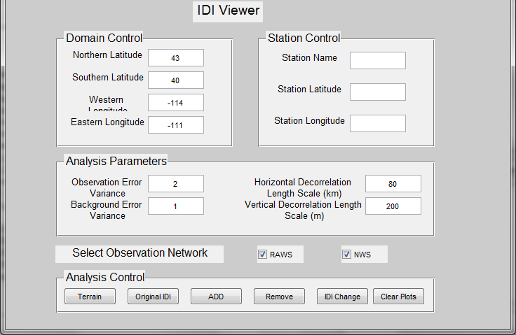
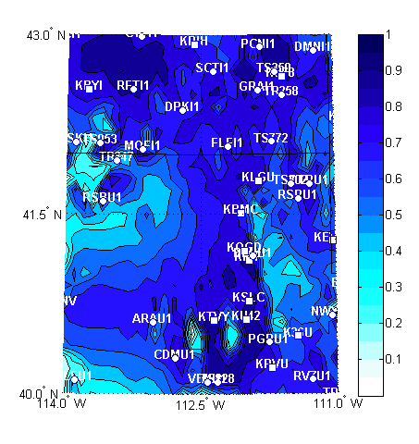
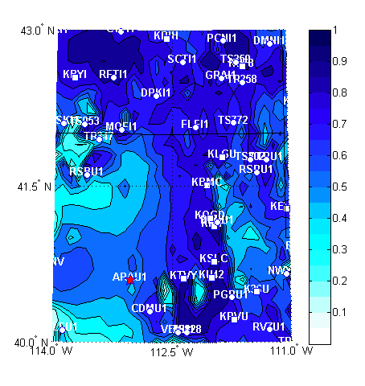
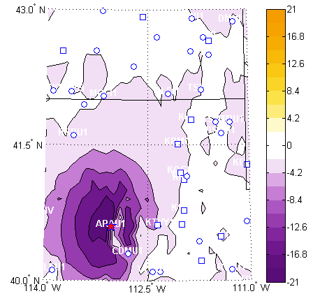
Impact of adding or removing a NWS/ RAWS station

Slide 22
Median Impact of Wind Speed Observations from Selected Network Categories. 100 Analyses
NWS
FED+
High Impact
RAWS
PUBLIC
Low Impact

Slide 23
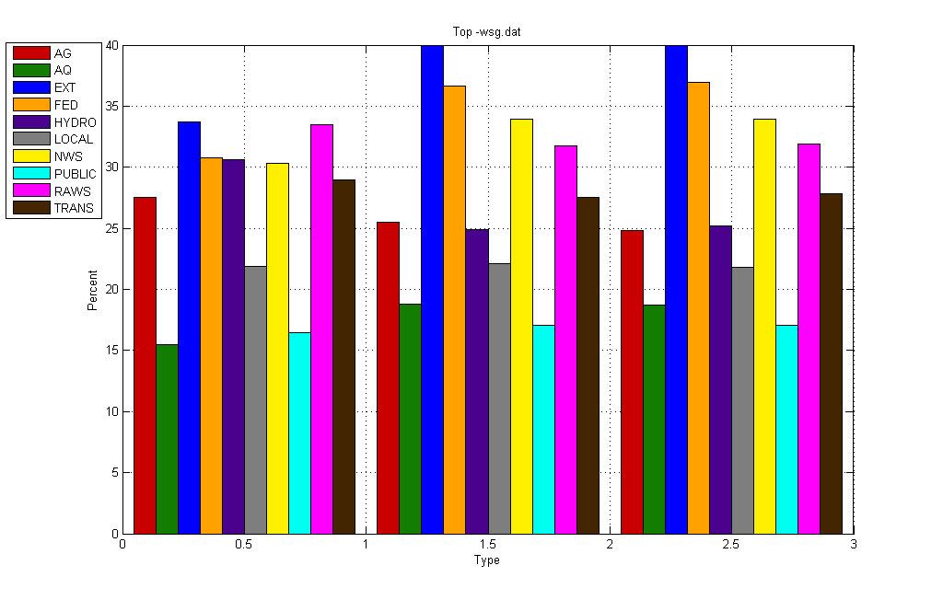
Fraction of Reports in Network Category with Impact In Upper Quartile (Impact >= 75%). 100 Analyses
*
*
*
*
+
*
*
*
*
*
*
*
*
*
*
*
*
*
*
*
*
*
*
*
Equal
Stn
Impact
*
*
*
*
*
Fraction (%)
*
*
Temperature DewPoint Wind Speed
A priori error variance assumptions:
*${{{ : σ}_{o}}^{2}}/{{σ_{b}}^{2}}=1$
$${{{∗: σ}_{o}}^{2}}/{{σ_{b}}^{2}}=1.5$$
$${{{∗: σ}_{o}}^{2}}/{{σ_{b}}^{2}}=2$$

Slide 24
Identifying High Impact WX/QC Tools: (CS partners)
Consider each weather station year as a curve:
26K stations and 145K station-years
station year averages 17K temperature readings
about 50GB of data
Question: given interval (November 1 - November 15)
Which k (say k=50) stations had highest average temp?
Approach: Aggregate Top-k Queries
Exact: answers in about 2 seconds
Approximate: answers in < 0.01 seconds, very high accuracy
uses 100 MB
Next question: given query curve, what are k closest curves?
Would help with estimation of what to expect for nowcasting as well as QC

Slide 25
Frequency-based Curve Fitting (CS partners)
Goal: Build a model for one curve with small number of parameters.
avoid over-fitting
small space for storing model, and fast
Take one station (10 years of data):
translate to Fourier domain
take top k (=10) amplitude frequencies = model parameters
For window (last 24 hours) find best fit for k frequencies:
fast, robust model
Next step: Build model over several years, and nearby days.
Seek deviations from distribution model.

Slide 26
Where Are We Going?
Continue MesoWest R&D and transfer to operations
Core activity in department for education, research, and public service
Existing O&M contracts from several customers to support access to weather observations
Improve reliability and functionality for the long-term
To the cloud…
Moving critical operational components of MesoWest to virtual servers
Understand our users
Improve capabilities
Obtaining metadata info from data providers
Metadata handling
QC/QA
Data API engine
User-defined dashboard
Monitoring conditions above 3-10 m
Transferring technology to MADIS
Evaluating contributions of specific stations or networks to the national mesonet
Continued participation in MesoUS Consortium

