Slide 1
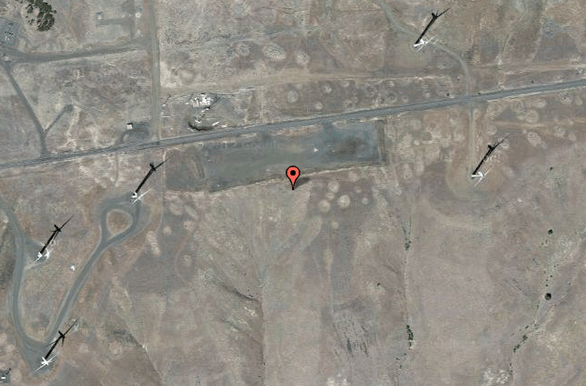
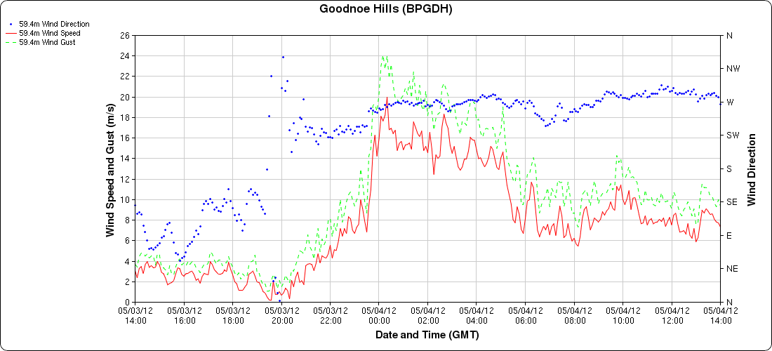
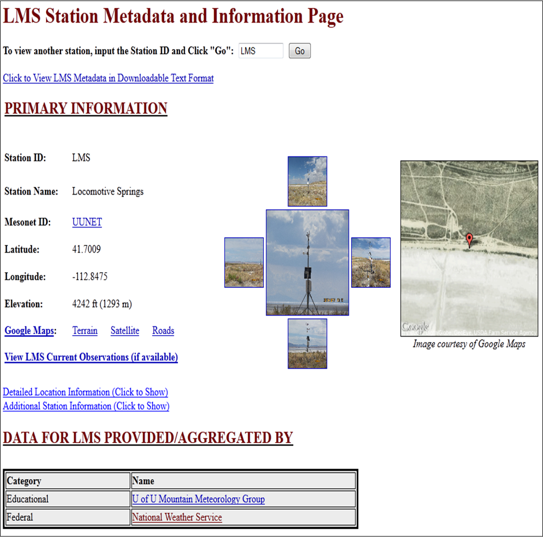
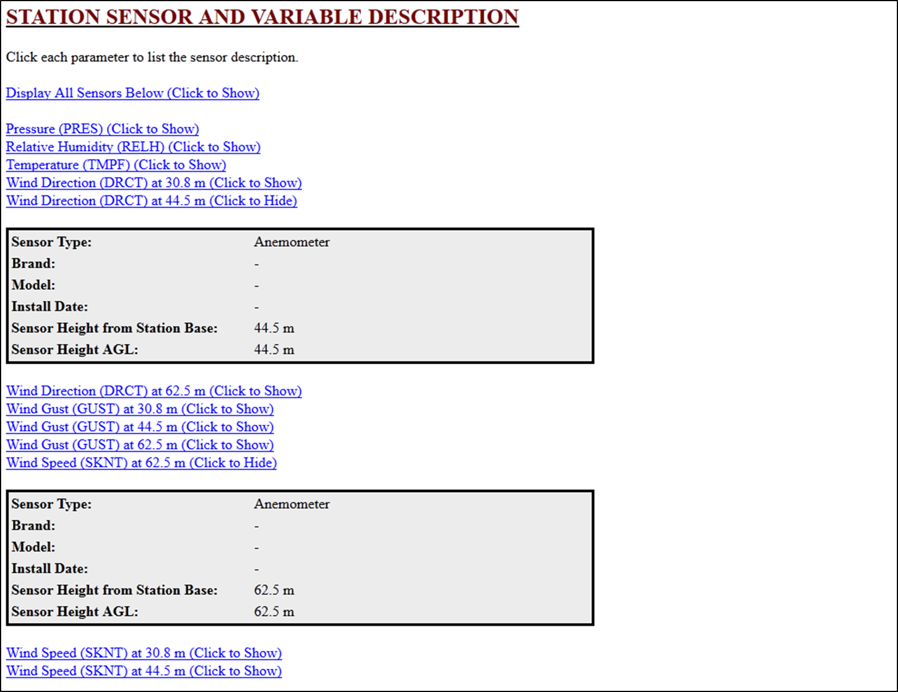
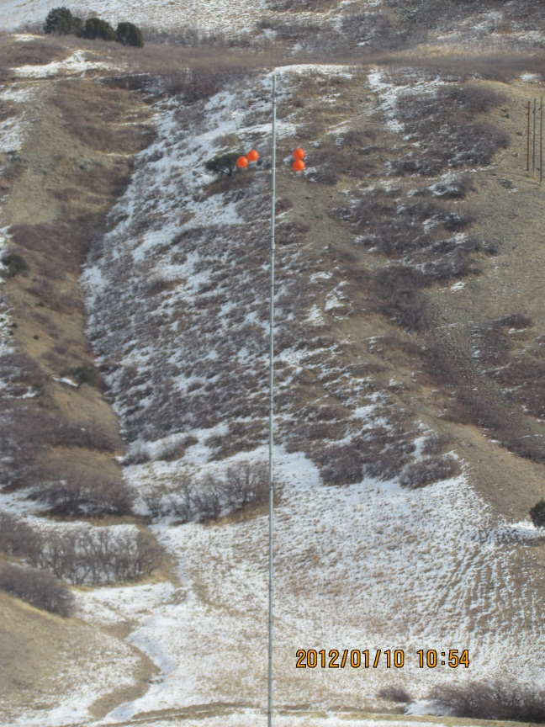
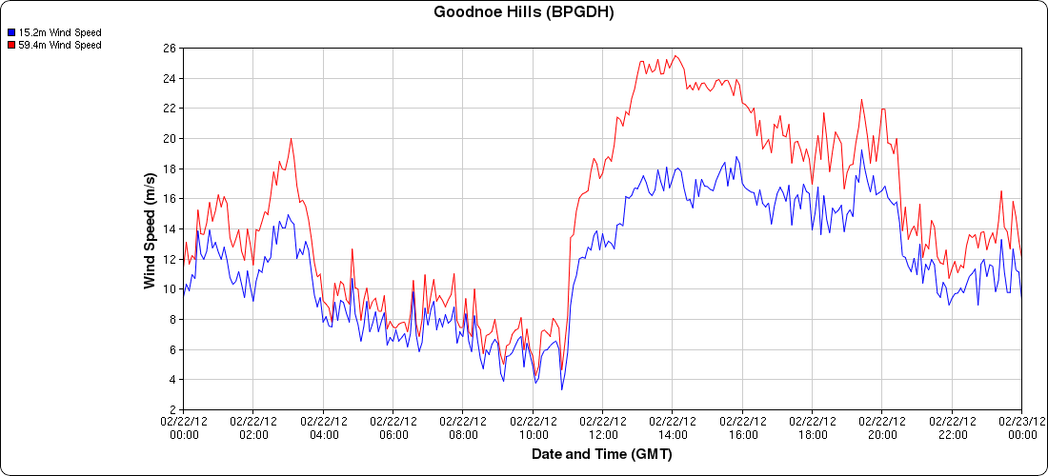
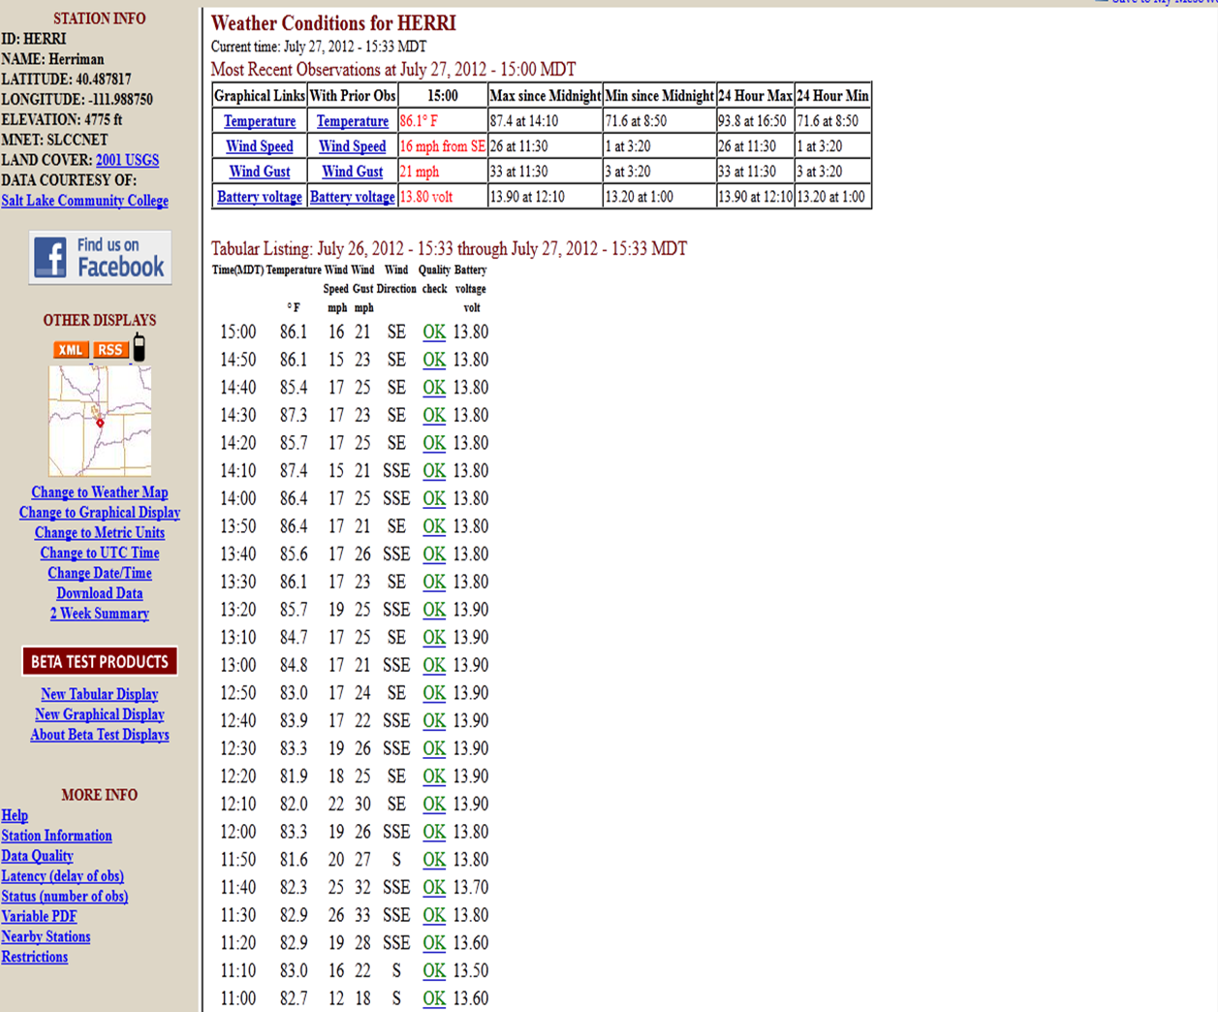
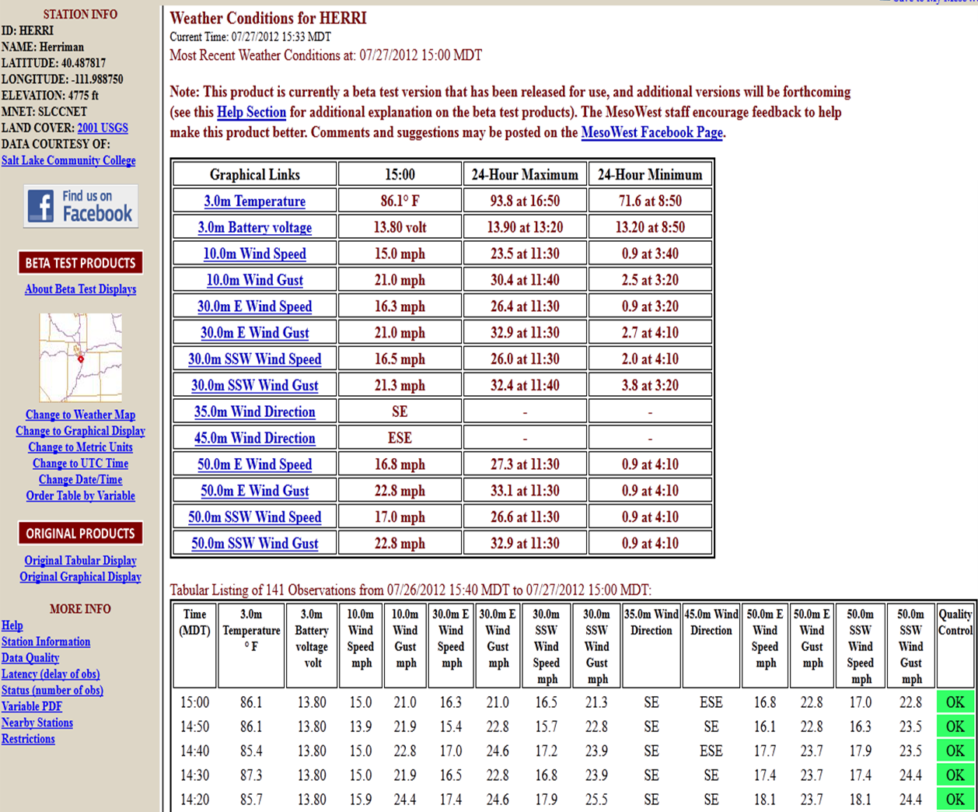
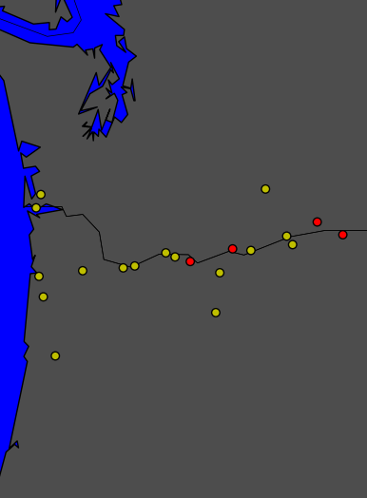
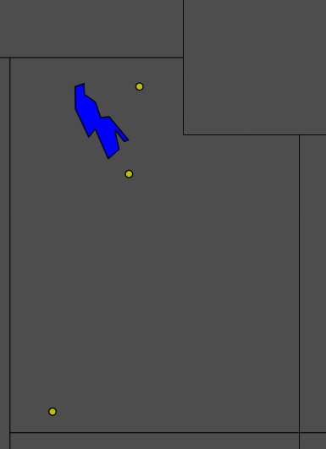
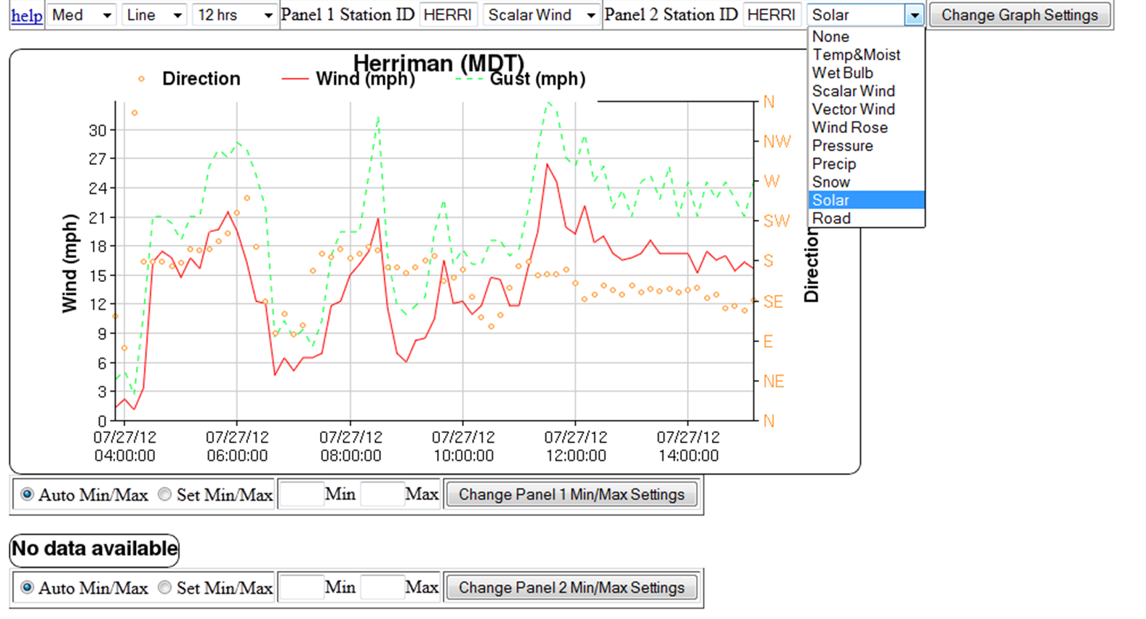
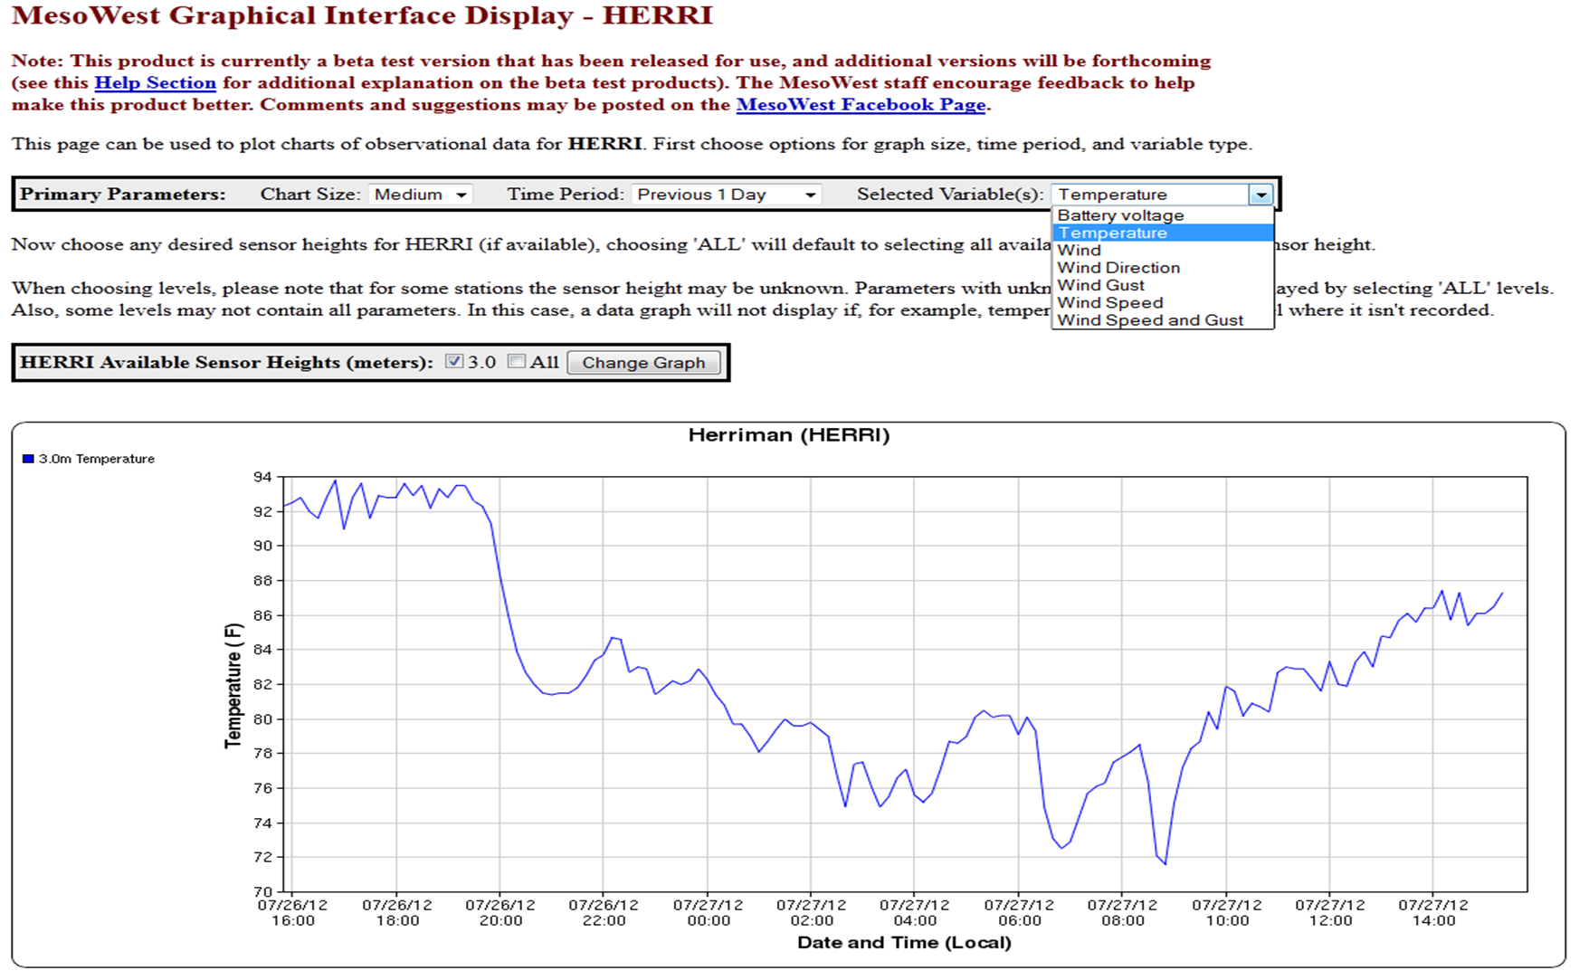
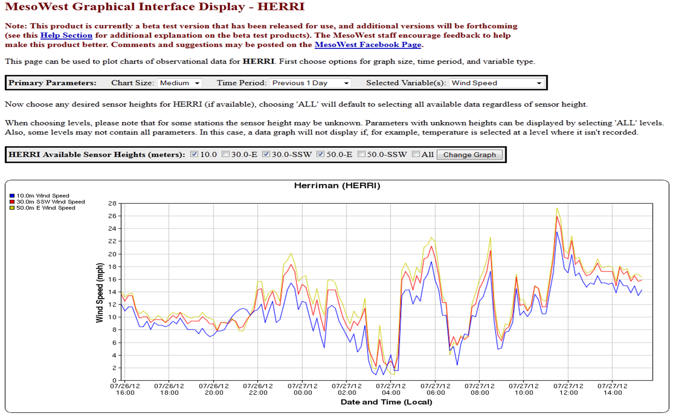
Examining Publicly-Accessible Tall-Tower Wind Observations In Real-Time
Alexander A. Jacques and John D. Horel
University of Utah
PROJECT MOTIVES
Storing and Visualizing Tall-Tower Observations
WIND RAMP EVENT EXAMPLES
University of Utah’s MesoWest group is interested to improve access to real-time tall-tower observations available in the public domain for a wide variety of applications
Utah Office of Energy Development’s Anemometer Loan Program is now managed by Salt Lake Community College
In partnership with MesoWest, real-time cell phone access to wind observations from sensors on up to fifteen 20 m to 60 m towers
Requests to host and archive data/metadata from several MesoWest data providers with public tall-tower data have been implemented
I. Internal Data Storage in MesoWest
New philosophy needed to store tall-tower data and metadata in MesoWest
Original philosophy: one station with unique variables (e.g. temperature, wind gust, etc.)
Philosophy began to break down when MesoWest started ingesting RWIS data (multiple road sensors)
Result: create a database structure such that each variable is unique itself
Developed new data and metadata relational databases, which MesoWest refers to as “dynamic”
One can describe an observational variable through may different permutations of metadata
Data processing for tall-tower stations was developed after so that data could flow in real-time
Station Selected: BPANET Station Goodnoe Hills (BPGDH)
Station located within wind farm area
5-minute wind observations from two sensors at 15.2 and 59.4 m AGL
MesoWest archive: late January 2012 to present day with minimal gaps
Data primarily of good quality
Ramp events below identified using Deppe et al. (2012) criteria
Courtesy: Google Maps API
II. Data Display Products
New display products on the MesoWest web interface were developed to access dynamic databases
1) Station Metadata Page
Station Tabular Display (active product on left, new beta-test product on right) for Herriman, UT station
3) Station Graphical Display (active product on top-right, new beta-test products below)
59.4 m AGL wind: 14 UTC 3 May 2012 – 14 UTC 4 May 2012
Ramp-up event ~22-01 UTC; ramp-down event ~5-7 UTC
15.2 m and 59.4 m Wind Speed: 0-24 UTC 22 Feb 2012
Strong ramp-up event ~10-14 UTC
Wind speeds near turbine shutdown region ~13-15 UTC
Large differences in 15.2 and 59.4 m winds ~11-16 UTC
BACKGROUND
MesoWest: ongoing collaborative project between the University of Utah, NWS, and other participating organizations
Goal: provide access to current and archived surface weather observations across the United States
Data for 34,000 unique stations (21,800+ in real-time)
Important data aggregation and dissemination source for…
Meteorological Automated Data Ingest System (MADIS)
National Center for Environmental Prediction (NCEP)
National Weather Service Forecast Offices
Sleeker format
More images
Menu display options
Extended sensor metadata (if it is available for the station)
Text file option
Network | BPANET | SLCCNET
Stations | 20 | 3 (more expected)
States | OR/WA | UT
Data | Jan 2012 – pres. | June 2012 – pres.
Displays observations from multiple sensors
Extended metadata
Observation count for 24-hour period
Can order table by variable type or by sensor height
Retained options to change units, time period, and time-zone
Bonneville Power Administration
(BPANET)
Salt Lake Community College
(SLCCNET)
Blacksmith’s Fork Canyon
SUMMARY/FUTURE WORK
Herriman
Database and initial product developments successful
Ingesting tall-tower data from 3 networks in real-time
Develop data download and dissemination products
Provide tall-tower data to MADIS and others
Refine available products
Facebook feedback (http://www.facebook.com/mesowest)
Continue project with SLCC and add additional UT tall-towers
Parameters pertinent to each station (not a default list)
Dynamically changing list of sensor heights
Ability to plot one or multiple levels of data on a single chart
Larger graph sizes
Better legend location
Expected in future version releases:
Plot and compare two graphs at once
Set range min/max values
Single-level Towers
Multi-level Towers
Anderson Junction
ACKNOWLEDGEMENTS
Tall-towers: important source of data for nowcasting conditions in the lower boundary layer for public safety
Impacts numerous operations, including wind energy
Critical wind energy issue: nowcasting wind ramp events (Freedman et al. 2008; Kamath 2009; Greaves et al. 2009; Marquis et al. 2011)
Defined as events that result in a 50+% change in turbine power capacity over a period of less than 4 hours
“ramp-up”/“ramp-down” refer to increases/decreases.
Deppe et al. (2012) quantified ramps in terms of wind speed
Approximated using a typical wind turbine power curve
Ramp event defined as a ±3 ms-1 change in wind speed
Wind speed within 6-12 ms-1 (critical power ramp area)
Also when winds cause turbine shutdown (> ~25 ms-1).
Funding for this project and MesoWest provided by NWS Support, CSTAR, and the National Mesonet and Alignment (NMPX/NMPA) projects. MesoWest staff Chris Galli and Judy Pechmann were also an integral part in coming up with new database design. We would also like to thank Brandon Malmann (SLCC) for his participation in the Anemometer Loan Program, and for setting up real-time communications with the UT tall towers.
A PDF copy of this poster can be found by scanning the following QR code given here:
QR
CODE

