Slide 1
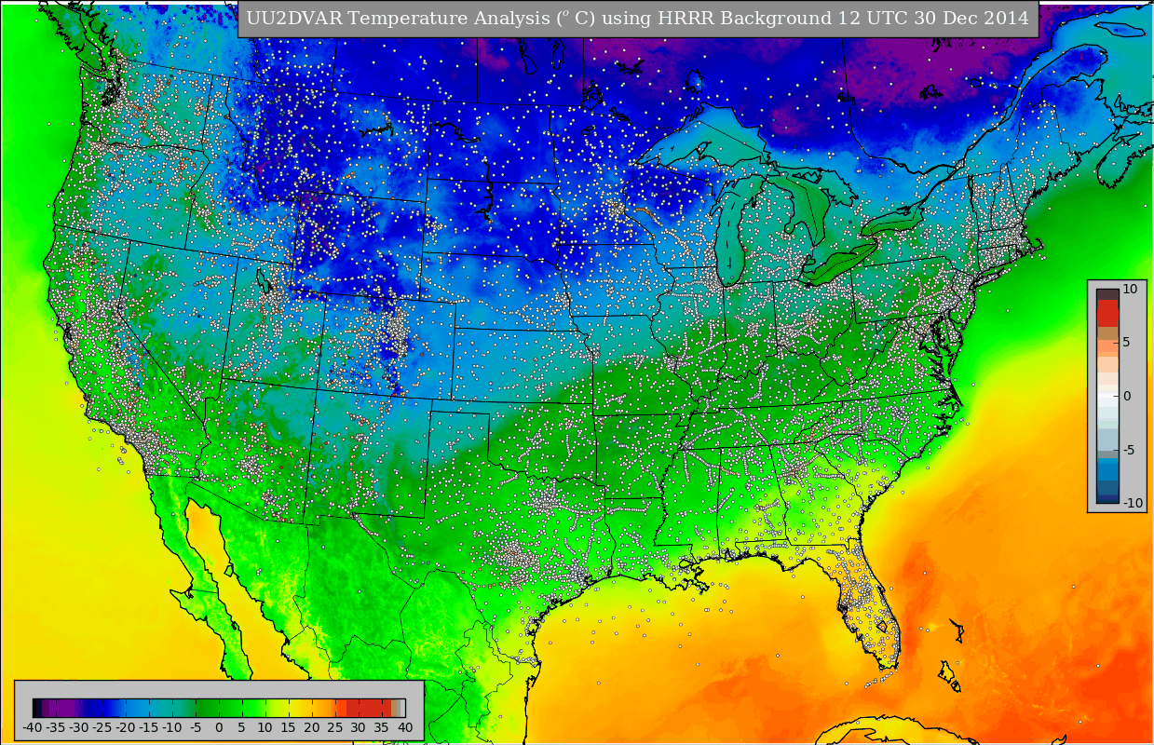
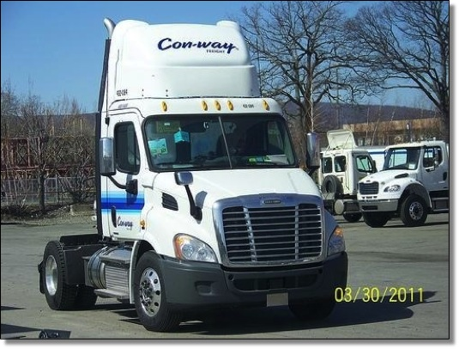
Evaluation of MoPED Observations in Surface Analyses
John Horel, Xia Dong, Alexander Jacques
john.horel@utah.edu
University of Utah
Paul Heppner
Global Science and Technology, Inc.
http://meso1.chpc.utah.edu/uu2dvar/

Slide 2
Overview
Mobile Platform Environmental Data (MoPED) system developed by Global Science & Technology Inc. provides access to environmental observations collected on board more than 200 commercial vehicles
Vehicles travelling primarily during weekday daylight hours along major transportation routes in the eastern third of the United States as well as a few highway routes in the West
Observations of temperature, pressure, and relative humidity at subminute intervals are bundled at the University of Utah into 5 minute median values
Utilizing the 12 values available for each hour from each vehicle, up to ~2500 observations are incorporated into surface analyses of temperature, relative humidity, and dew point temperature using the University of Utah Two-Dimensional Variational Analysis (UU2DVAR) system

Slide 3
MoPED Observations: 12 November, 2014

Slide 4
Objectives
Test feasibility of using the MoPED observations for analysis systems such as the NCEP Real-Time Mesoscale Analysis (RTMA) & Un-Restricted Mesoscale Analysis (URMA)
Contrast biases and improvements to a background field from MoPED observations relative to those from publicly-accessible fixed-site observations available via MADIS/MesoWest

Slide 5
Publicly-Accessible Surface Observing Sites Available via MADIS/MesoWest (http://mesowest.utah.edu)
These observations (plus observations from proprietary networks) are used by the NCEP URMA analyses

Slide 6
Bias of NWS temperature observations
Bias of MoPED temperature observations
Number of observations
Bias: observations minus downscaled (2.5 km) Rapid Refresh background
November 2014

Slide 7
Bias of NWS relative humidity observations
Bias of MoPED relative humidity observations
Number of observations
Bias: observations minus downscaled Rapid Refresh background
November 2014

Slide 8
UU2DVAR Analyses
University of Utah Two-Dimensional Variational Analysis (UU2DVAR) system similar to RTMA/URMA (see Tyndall and Horel 2013, WAF)
The UU2DVAR analyses at 2.5 km horizontal resolution use ~12,000 observations within the continental United States from fixed sites every hour
UU2DVAR analyses also incorporate ~2500 observations every hour from MoPED weighting observations near the top of the hour more heavily
An objective measure of improvement is used to evaluate the impact of the MoPED observations for temperature and moisture
Statistics on improvement from MoPED observations relative to other networks (ASOS, RAWS, CWOP, RWIS etc.) have been collected since March 2014

Slide 10
Assessing improvement provided by observations on UU2DVAR
Want general approach applicable to all networks including MoPED
Improvement (decreased error $δe^{y}$at observation location y) when computing analysis a from background b (Todling 2013, MWR):
$$δe^{y}= δe_{b}^{y}− δe_{a}^{y}=\left[y_{o}−H\left(x_{b}\right)\right]P_{o}^{−1 }{[y}_{o}−H\left(x_{b}\right)]−[y_{o}−H\left(x_{a}\right)]P_{o}^{−1 }{[y}_{o}−H\left(x_{a}\right)]$$
Easily calculated and interpreted
Improvement should be positive
better agreement between analysis and observations than background and observations
Able to diagnose contributions from each station, each network, each network type
Can be examined separately for locations that are experiencing high impact weather: high wind speeds, temperatures near 0, etc.
Rank the observations from those that have the smallest to largest improvement to the UU2DVAR for each hour of every day for temp, RH, dew point

Slide 11
19 UTC 12 November, 2014 MoPED Observations

Slide 12
19 UTC 12 November, 2014 Temperature Analysis
Automated Quality Control:
20928 stations accepted
513 observations rejected

Slide 13
Accumulate 20928 Temperature Observations into 1º x 1º bins for 19 UTC 12 November 2014

Slide 14
2062 MoPED Temperature Observations Available for 19 UTC 12 November 2014

Slide 15
Where are the Largest Temperature Improvements (Top 10%) for 19 UTC 12 November 2014?

Slide 16
Where are the Largest Temperature Improvement Fractions (Top 10%/Total Number) for 19 UTC 12 November 2014?

Slide 17
Where are the Largest Temperature Improvement Fractions (Top 10%/Total Number) for MoPED Observations on 19 UTC 12 November 2014?

Slide 18
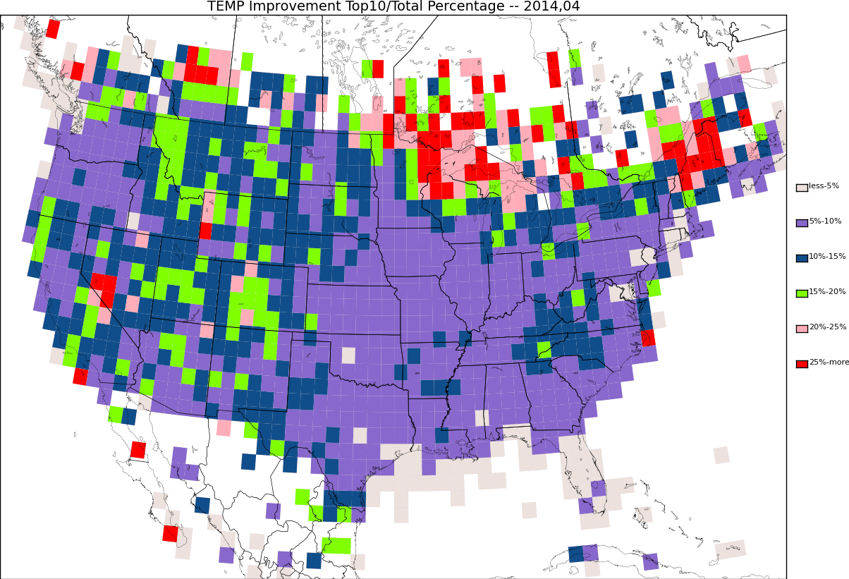
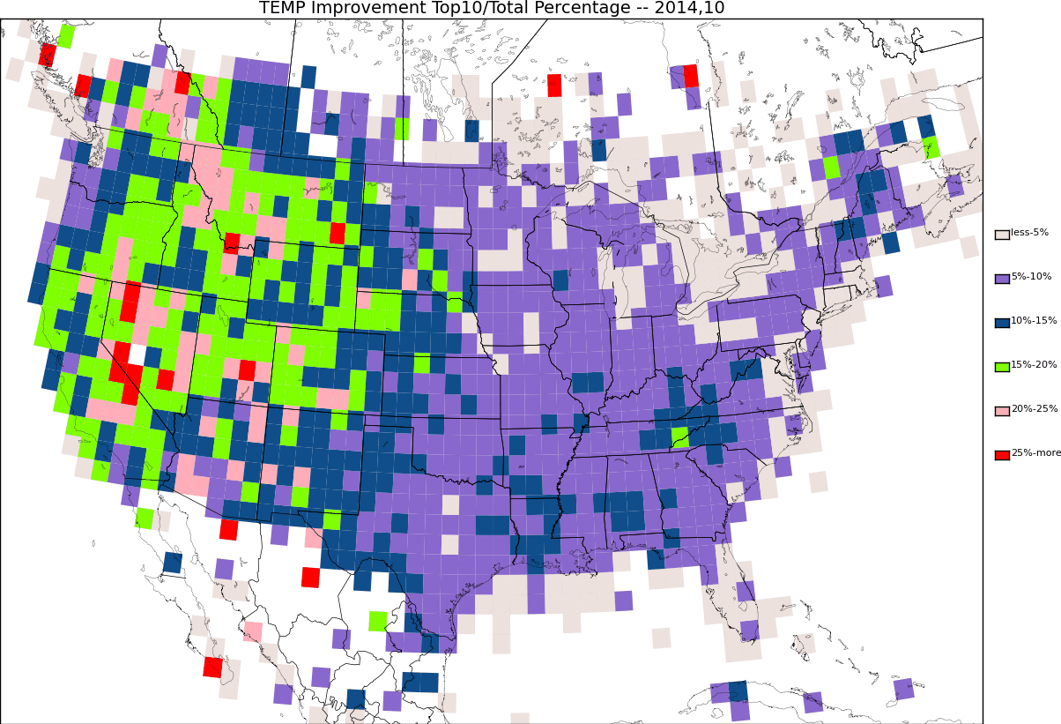
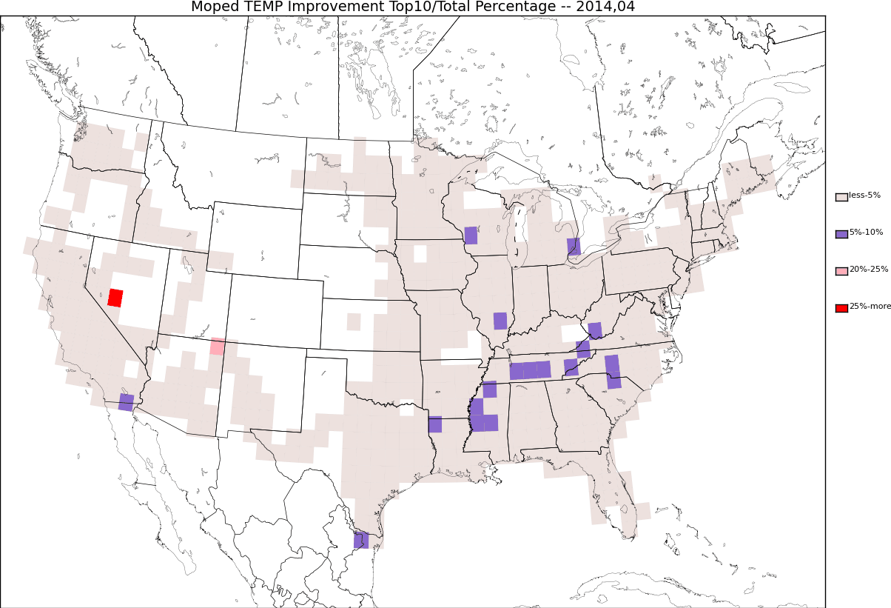
Temperature Improvement Fraction (Top 10%/Total Number) for All Observations
APR 2014
OCT 2014
Temperature Improvement Fraction (Top 10%/Total Number) for MODIS Observations
APR2014
OCT 2014

Slide 19
Summary
MoPED observations are a valuable additional data resource for surface analyses of temperature and moisture although fewer observations at night and on weekends
MoPED observations help to fill in gaps between cities along major travel corridors in the southeast
Individual trucks in the West fill in major data voids
MoPED temperature observations tend to have a warm bias
Improvement metric highlights the value of surface observations for adjusting gridded fields
Value of observations depends strongly on weather conditions, terrain, and season
Statistics for downscaled Rapid Refresh available for 2013 and 2014 and High Resolution Rapid Refresh since November 2014

Slide 20
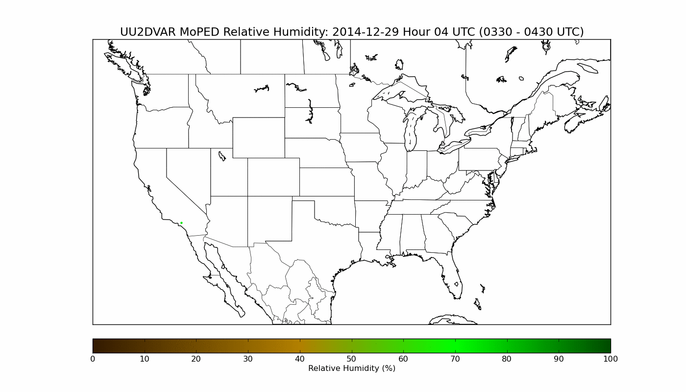
Questions?
For further information: john.horel@utah.edu http://meso1.chpc.utah.edu/uu2dvar/
Loop below will be replaced with one for next Monday

Slide 21
Remaining are extras

Slide 22
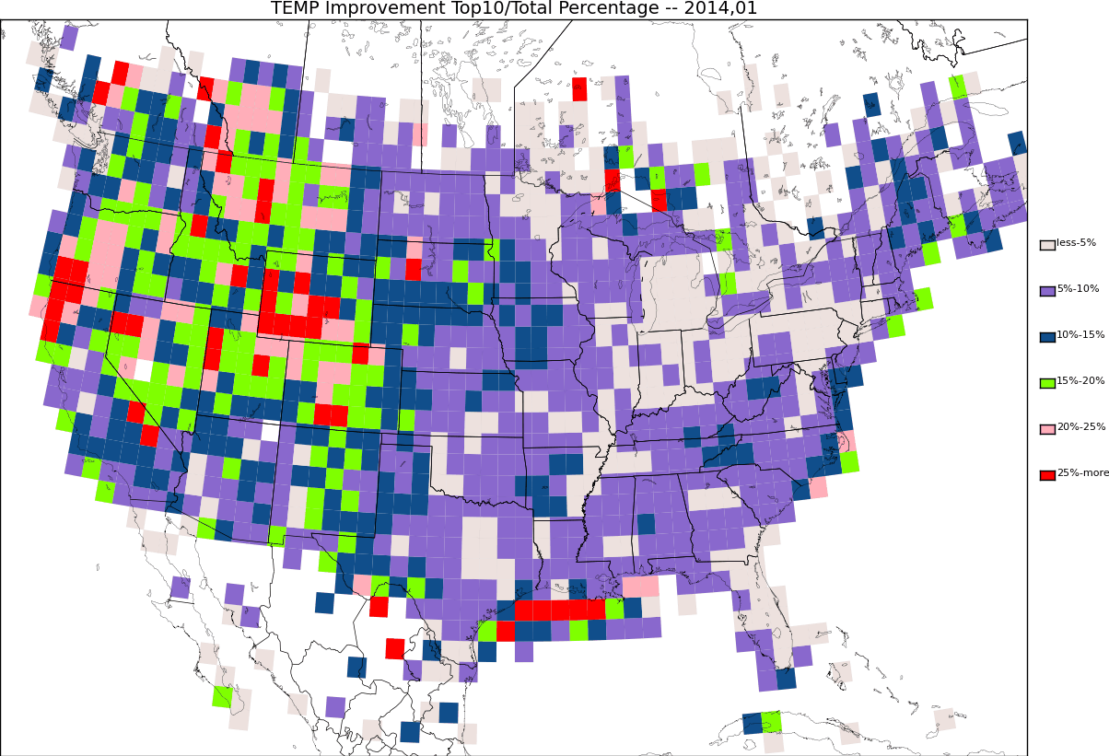

Slide 23
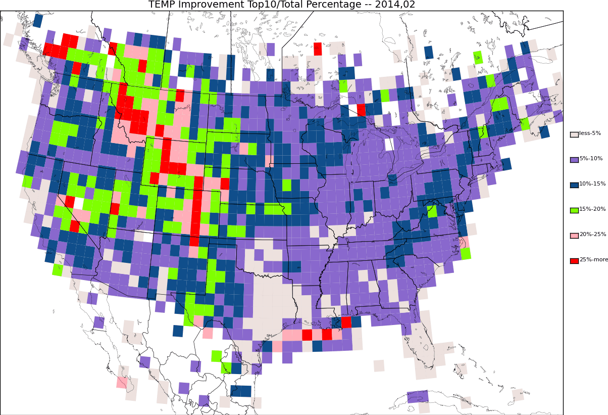

Slide 24
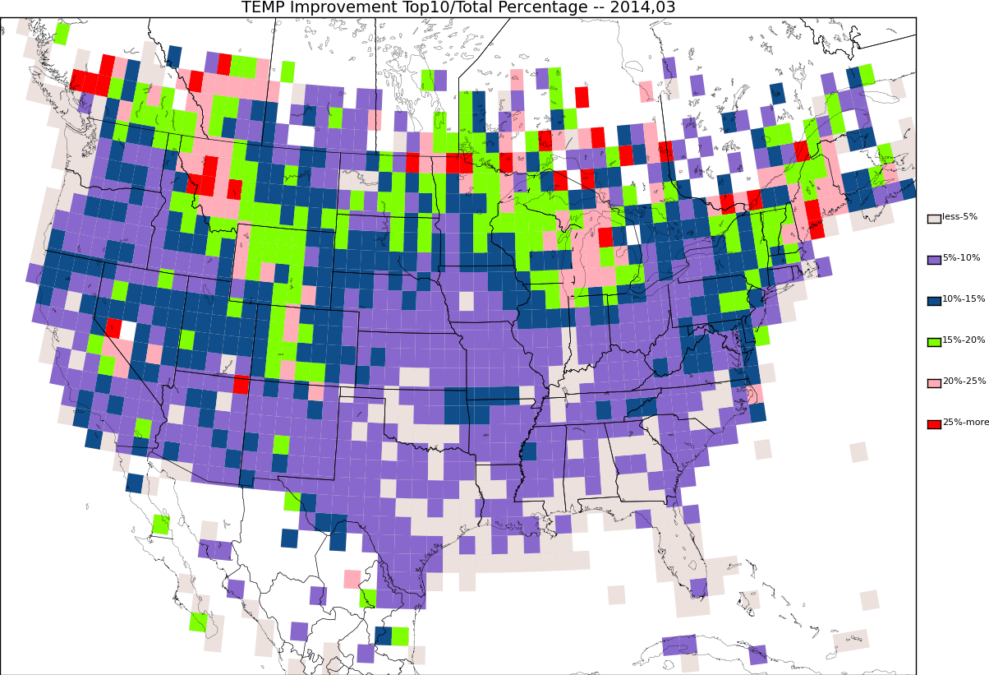

Slide 26
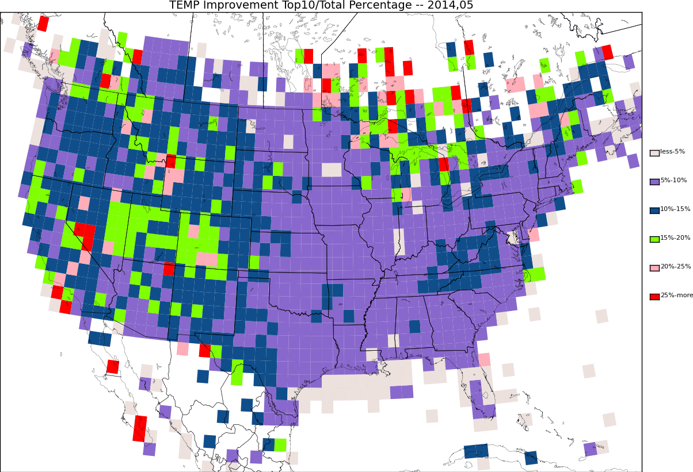

Slide 28
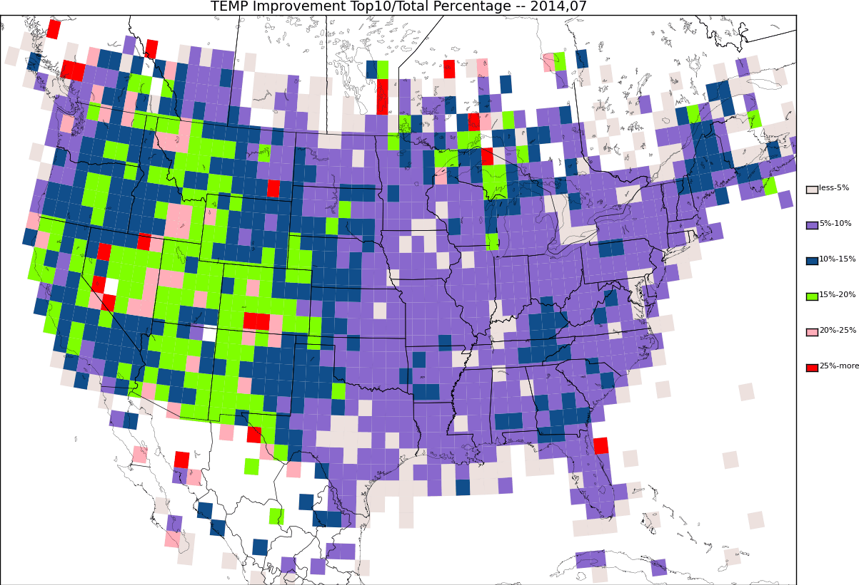

Slide 29
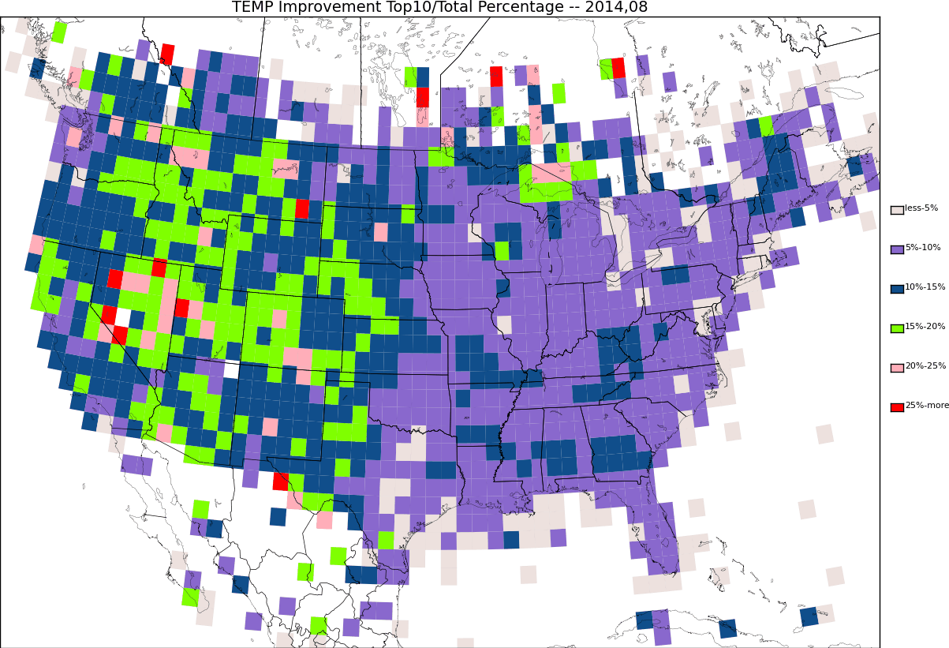

Slide 30
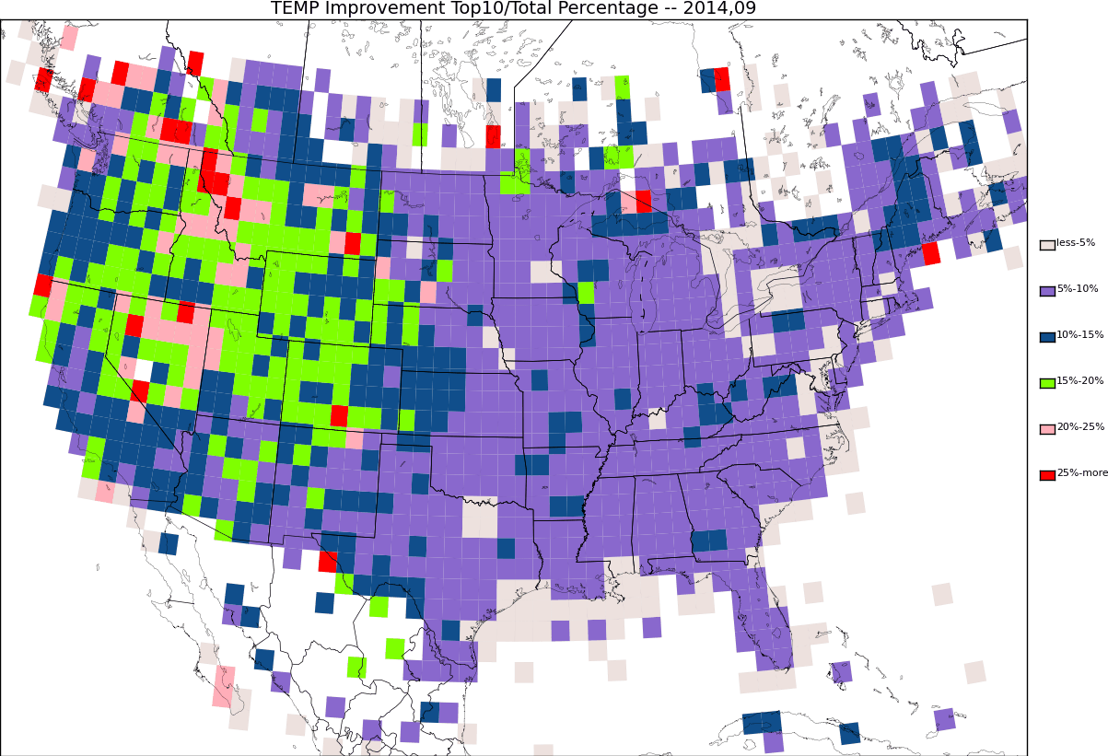

Slide 33
Add dec when available

