Slide 1
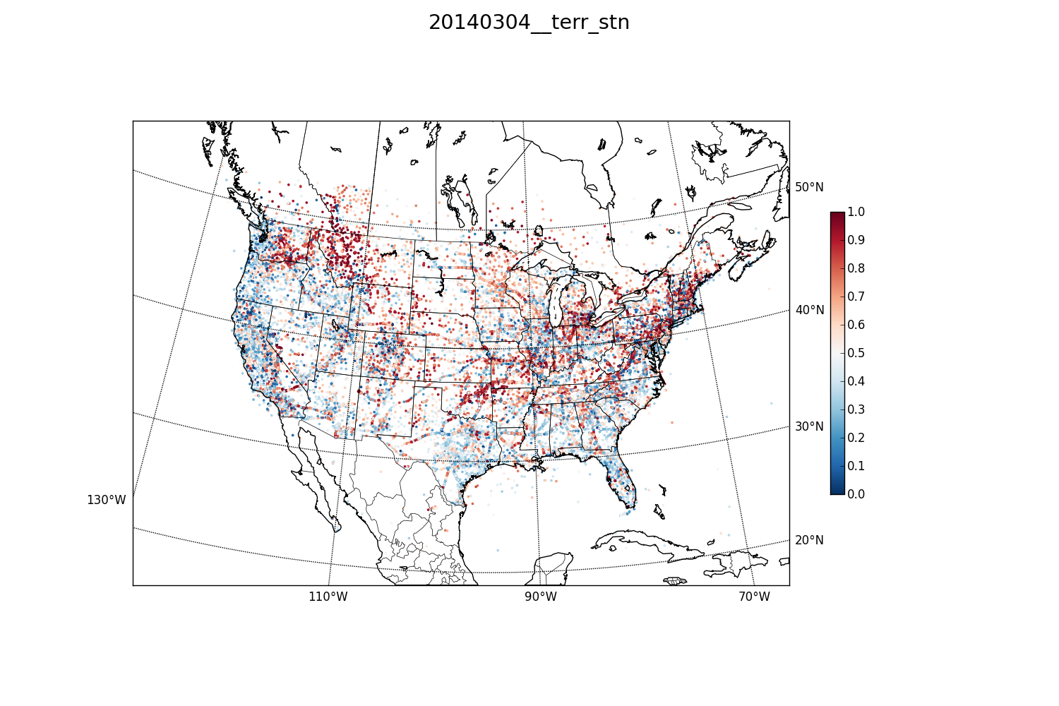
All stations reporting temp: red indicates ob had big effect on analysis;
blue small effect

Slide 2
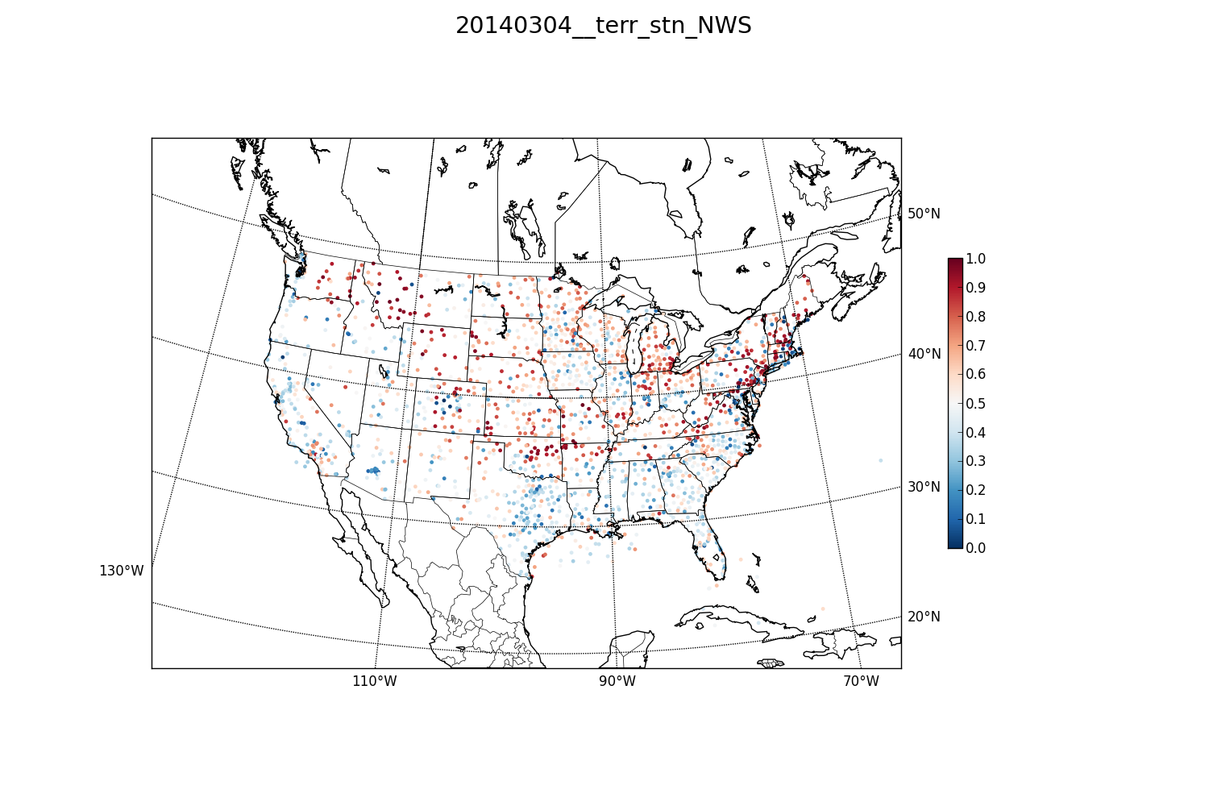
All NWS stations reporting temp: red indicates ob had big effect on analysis; blue small effect

Slide 3
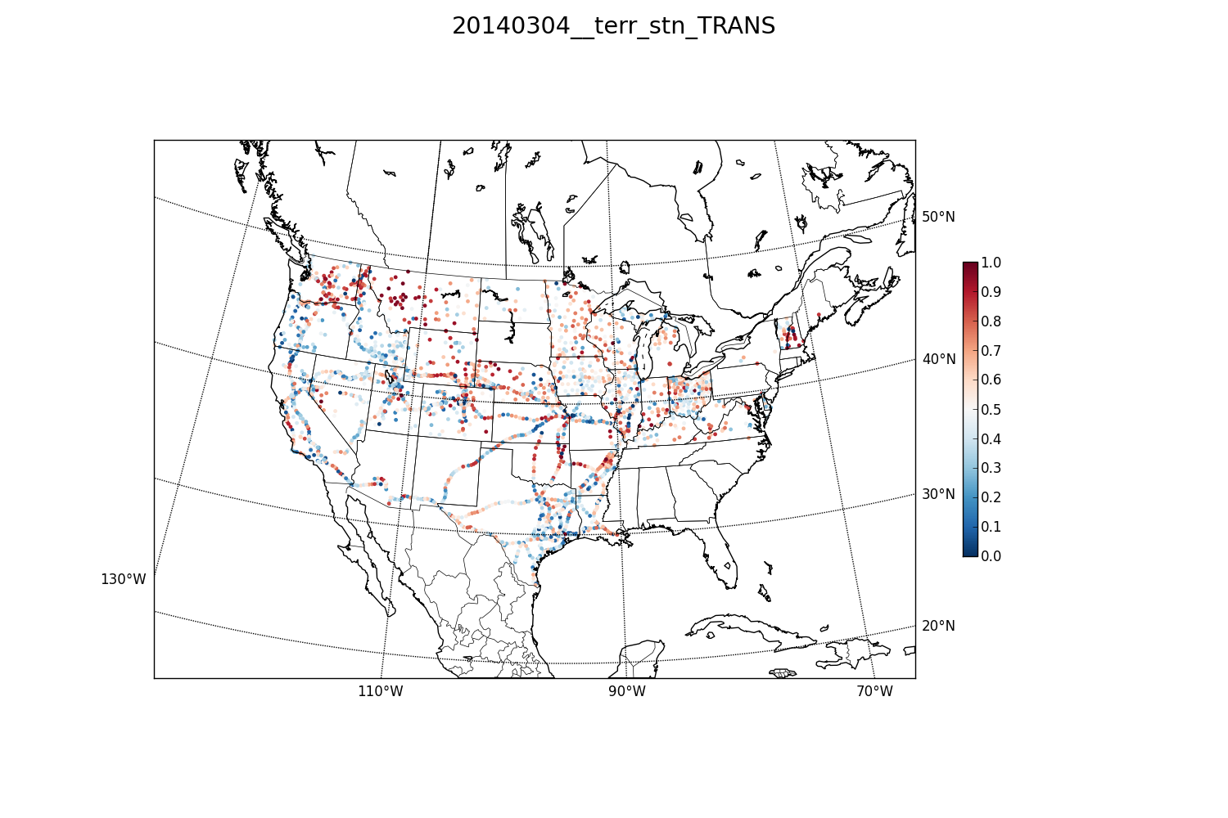
All RWIS and railroad stations reporting temp: red indicates ob had big effect on analysis; blue small effect
All NWS stations reporting temp: red indicates ob had big effect on analysis; blue small effect

Slide 4
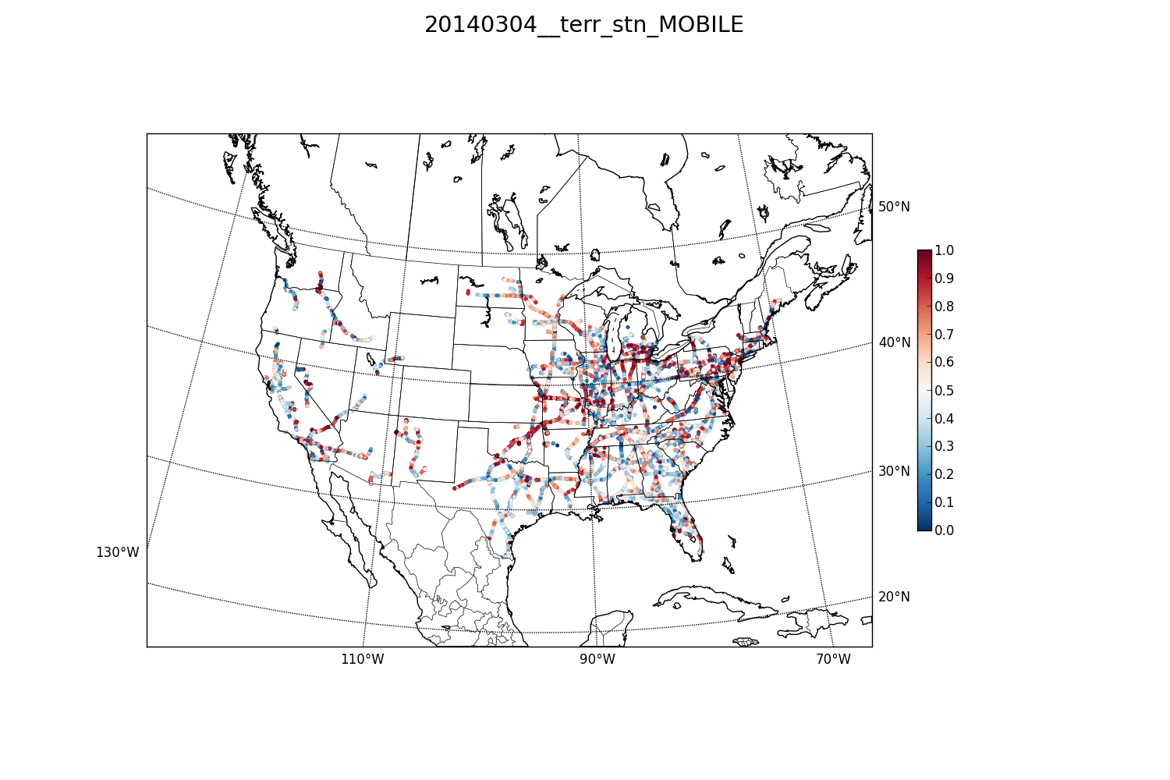
All moped reporting temp: red indicates ob had big effect on analysis; blue small effect

Slide 5
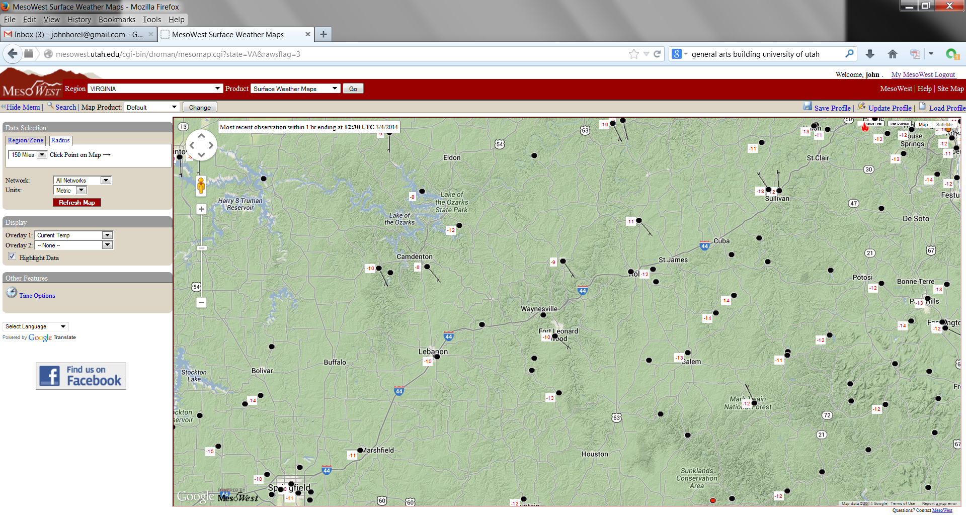

Slide 6
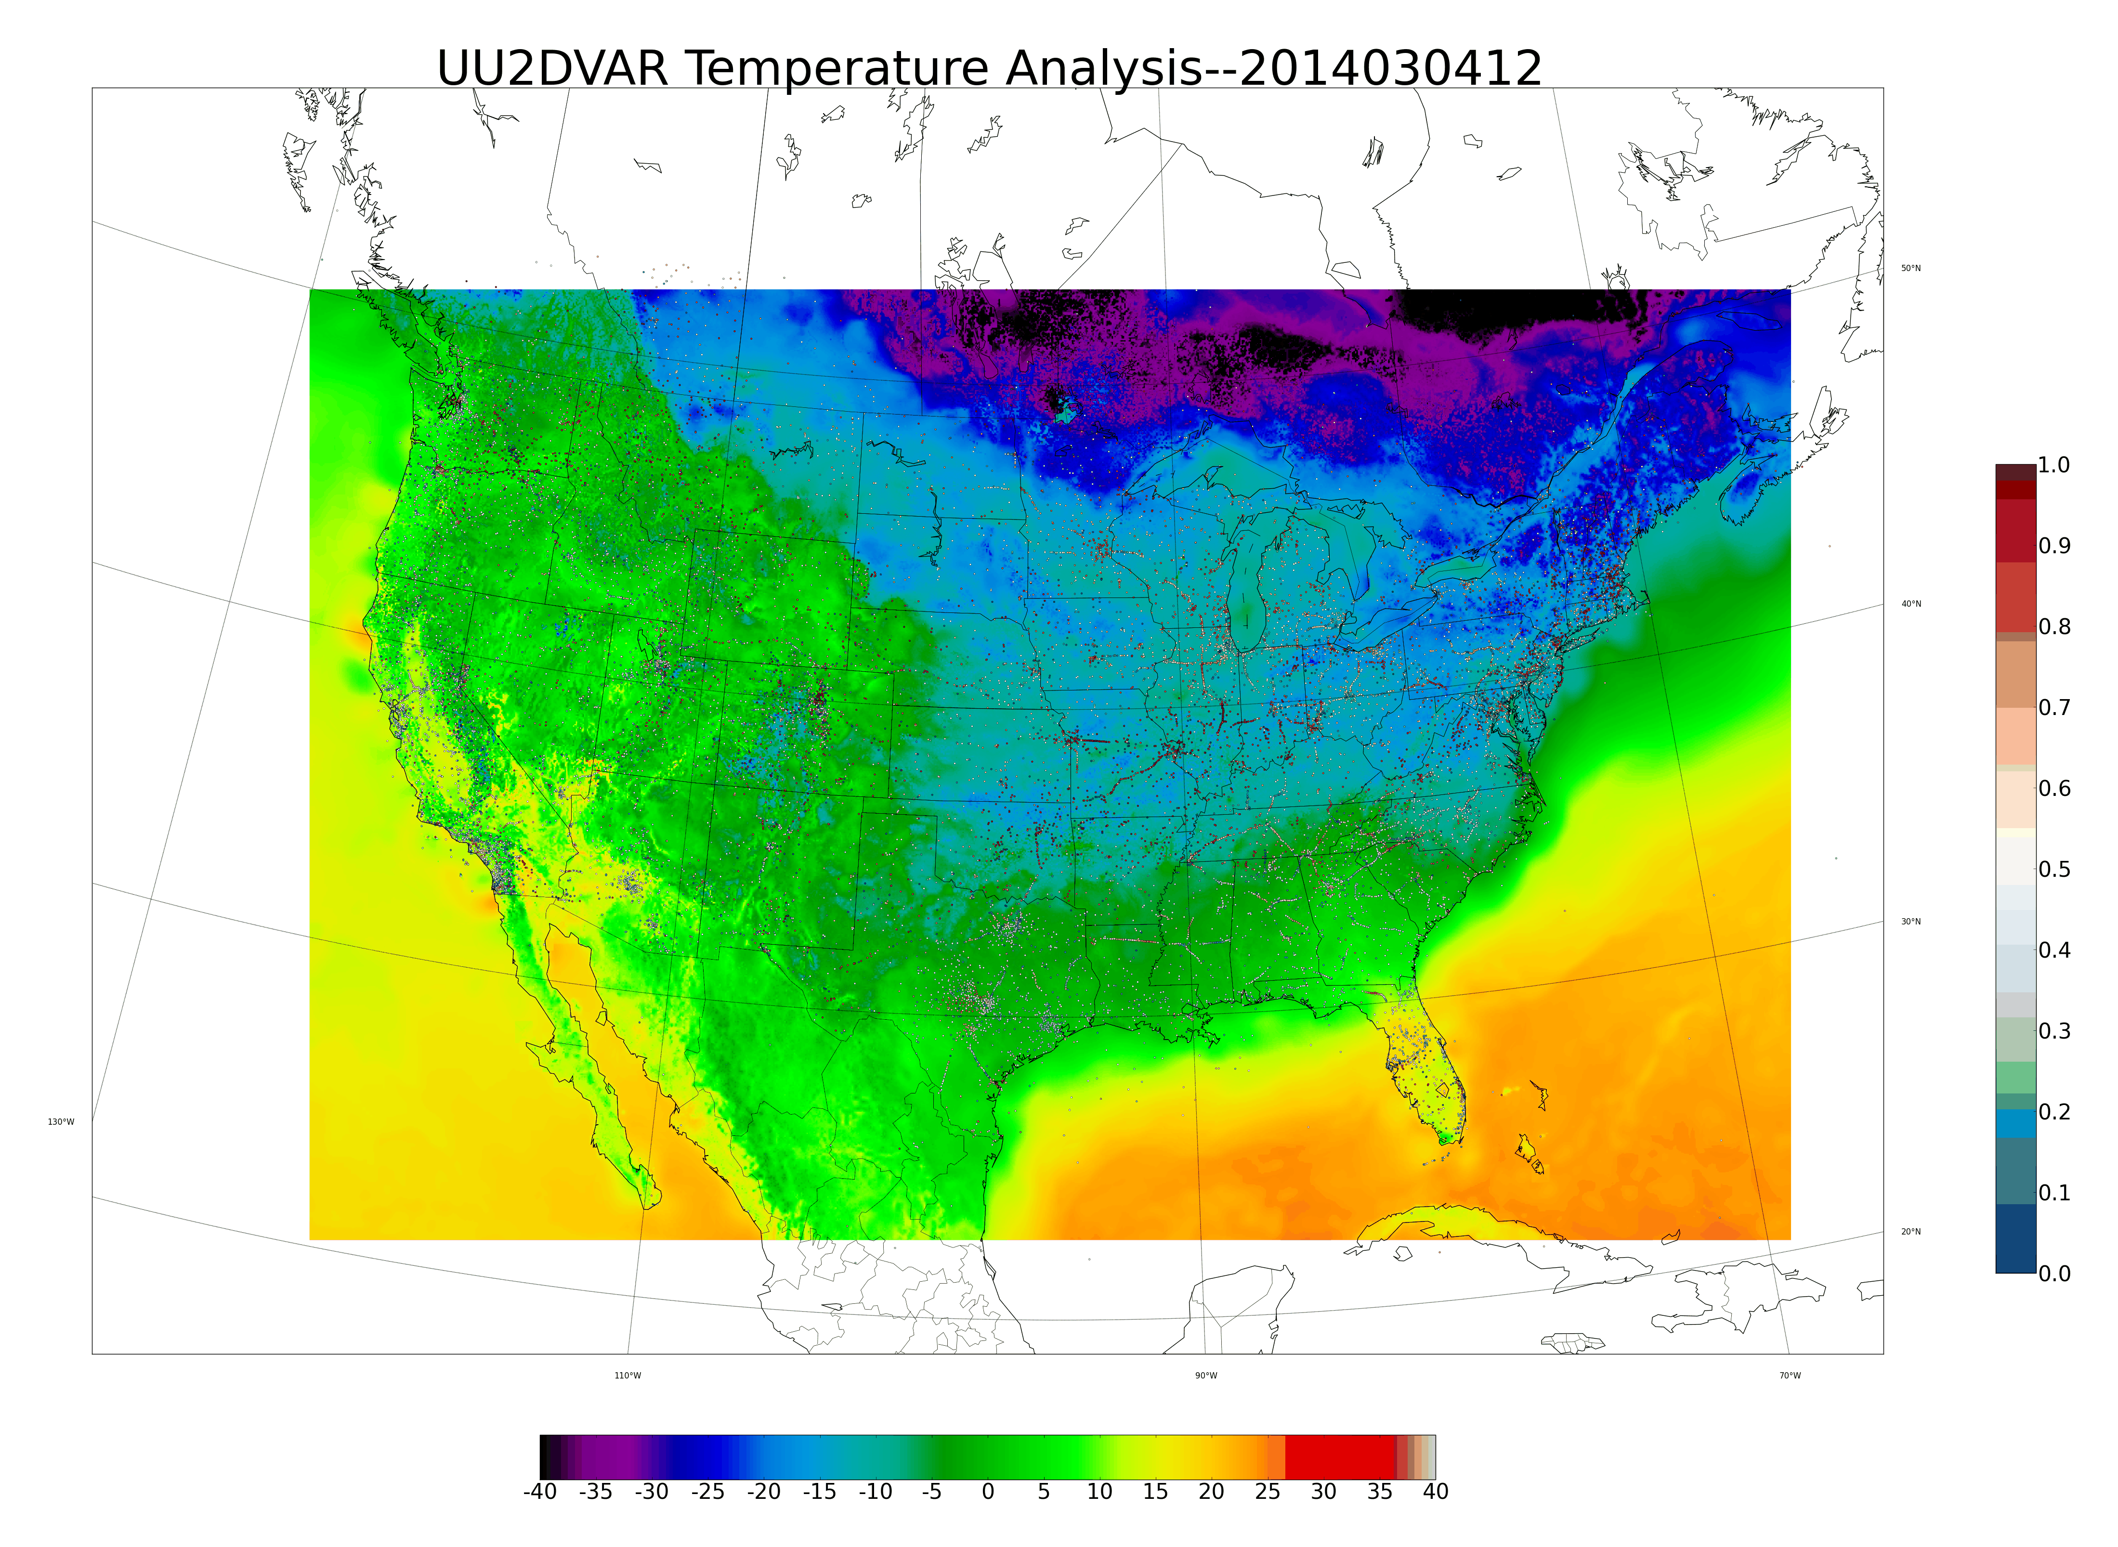
http://gl2.chpc.utah.edu/uu2dvar/uu2dvar_improve/20140304/2014030412/2014030412_temp_analysis_detailed.png

Slide 7
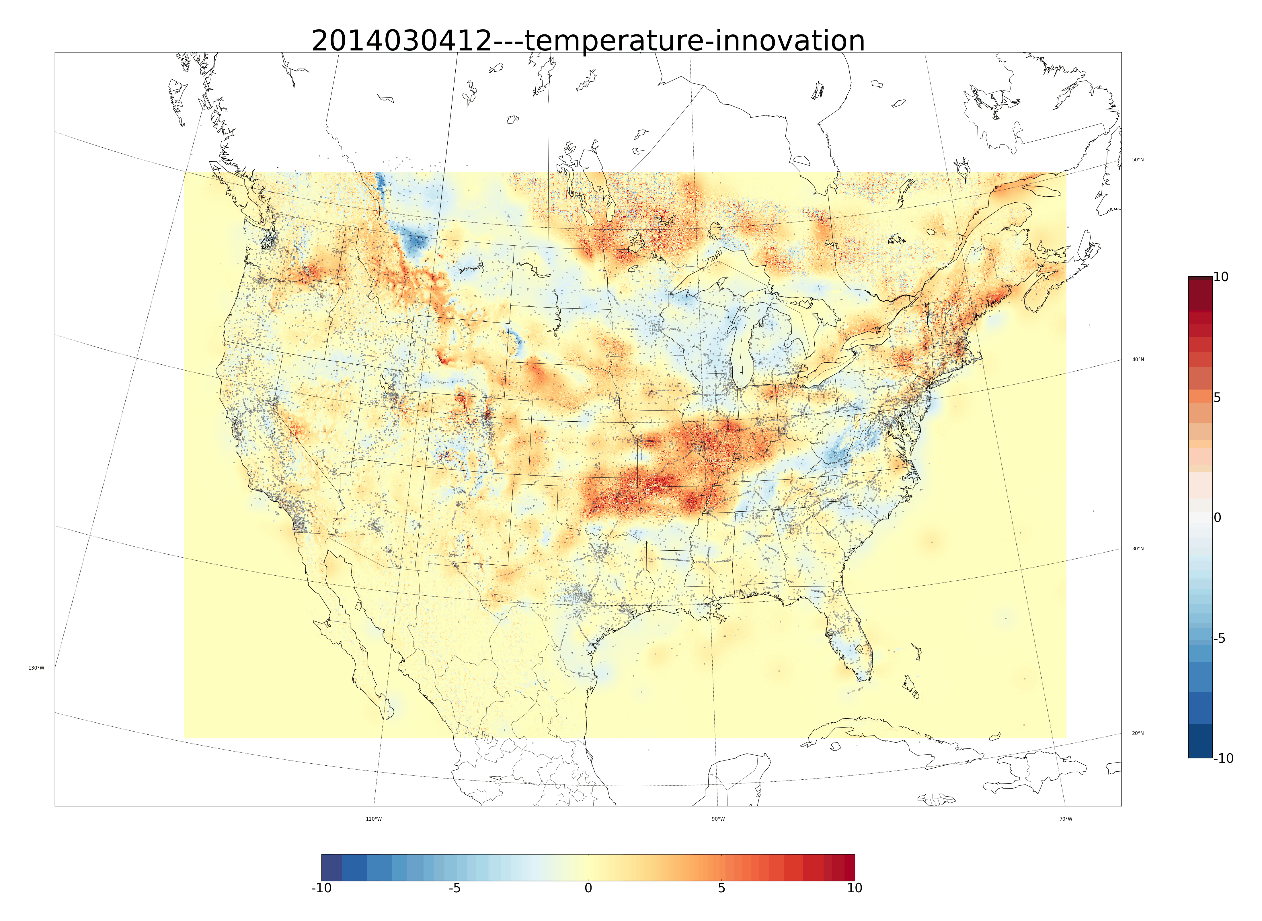
http://gl2.chpc.utah.edu/uu2dvar/uu2dvar_bias/20140304/2014030412/2014030412_temperature_innovation_detailed.png

