Slide 1
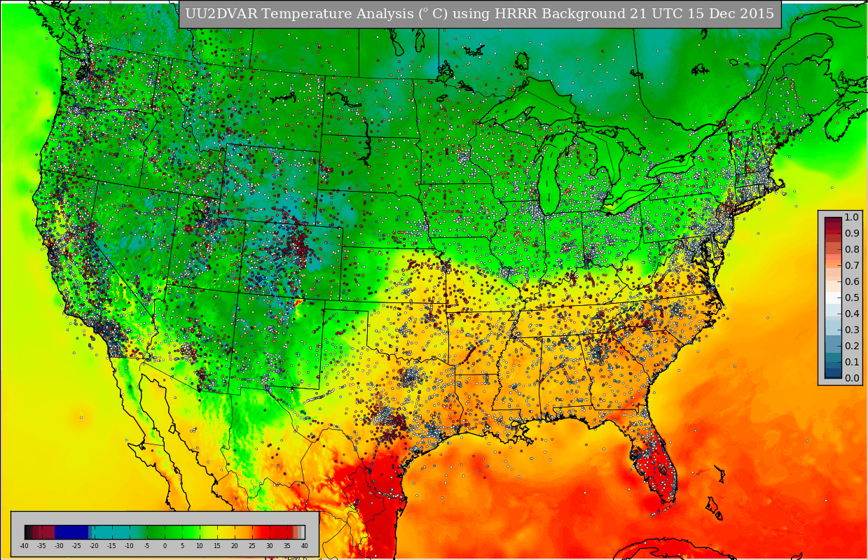
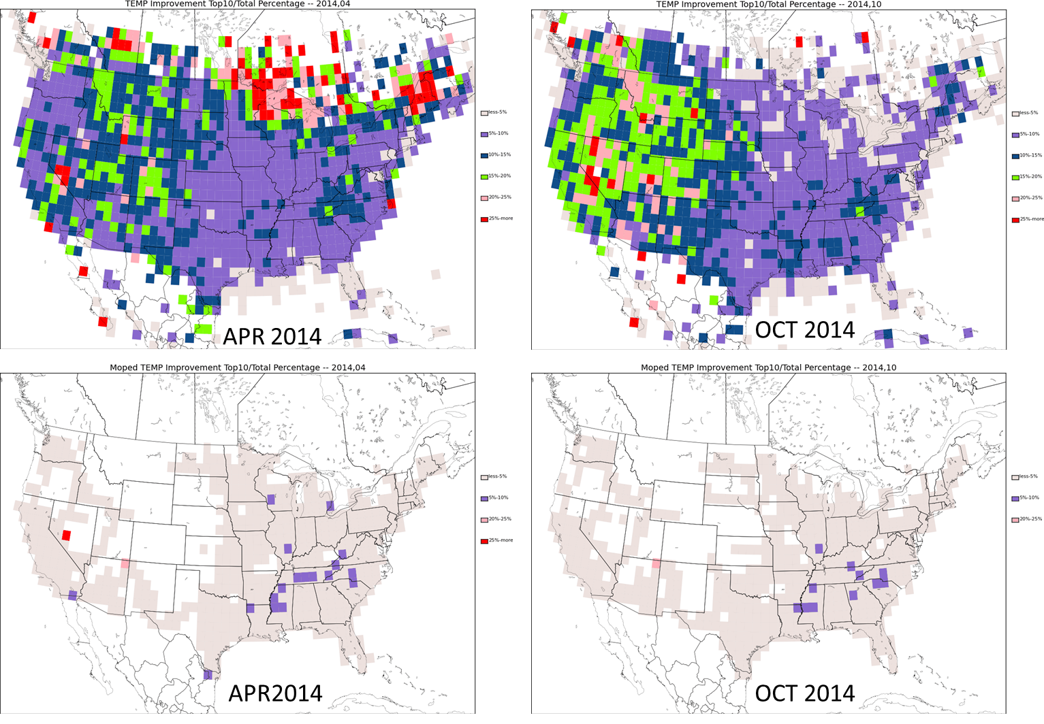
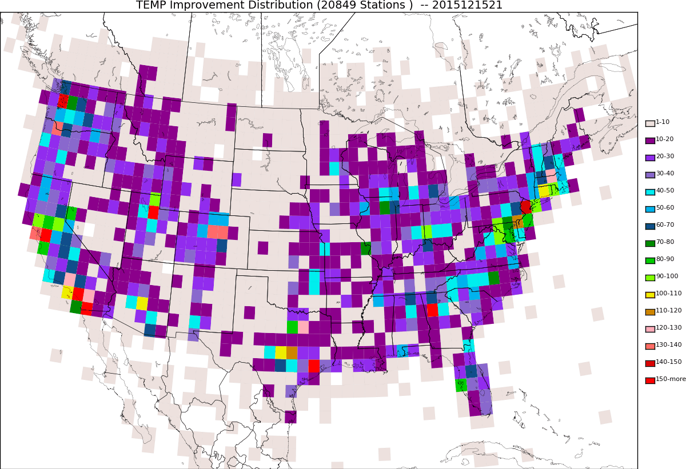
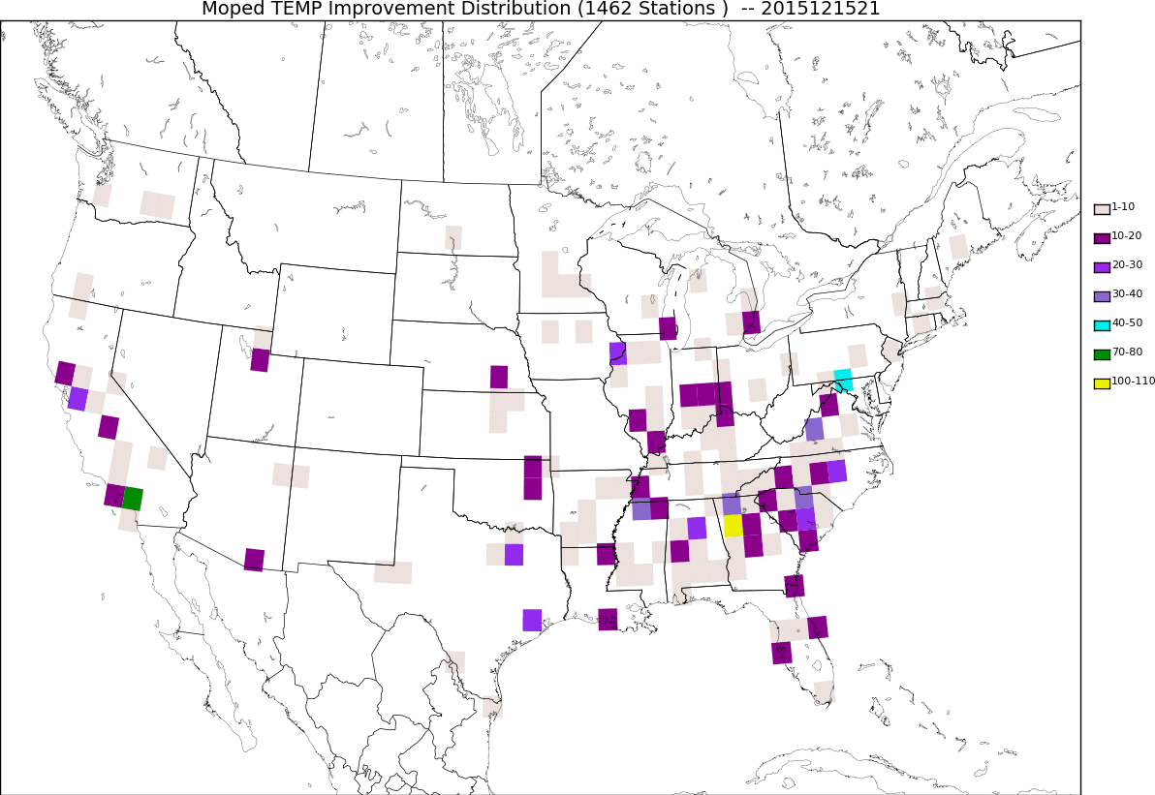
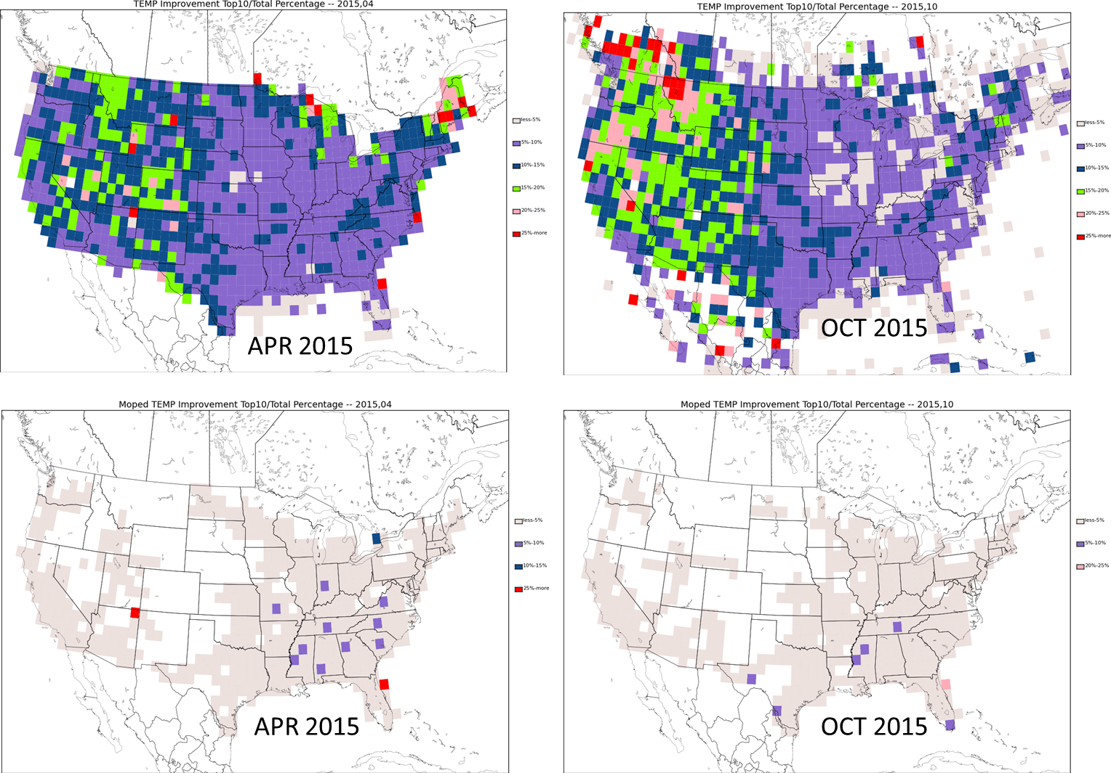
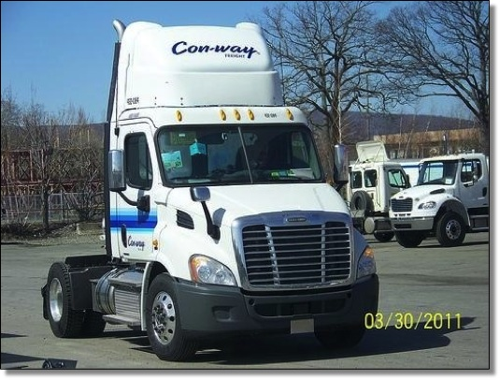
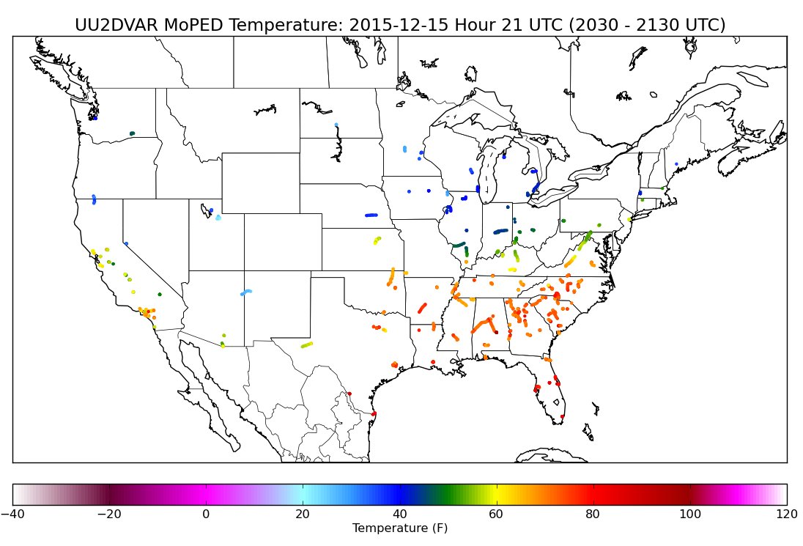
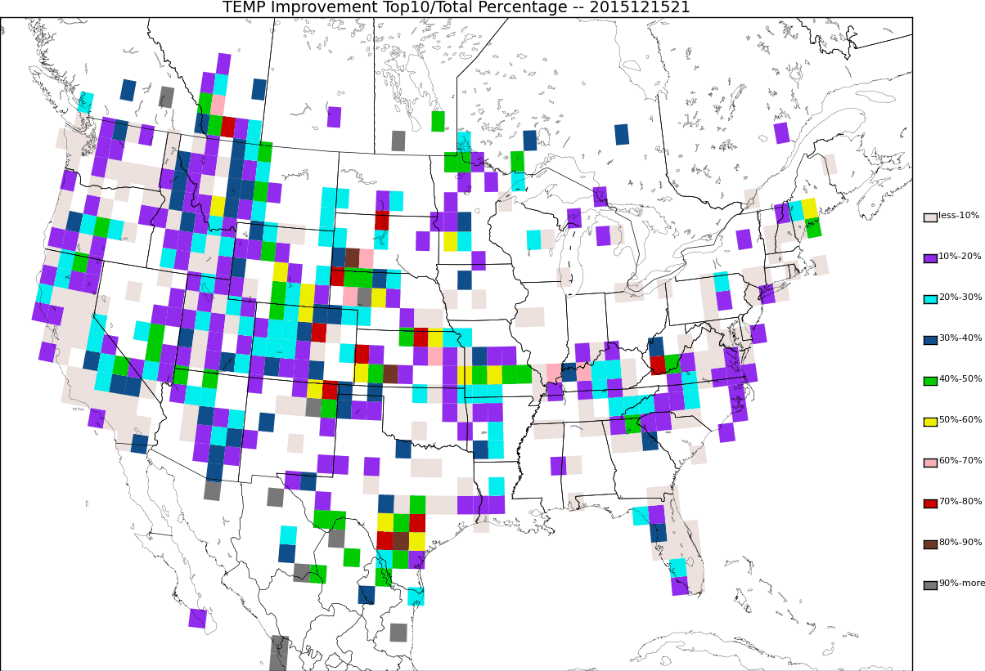
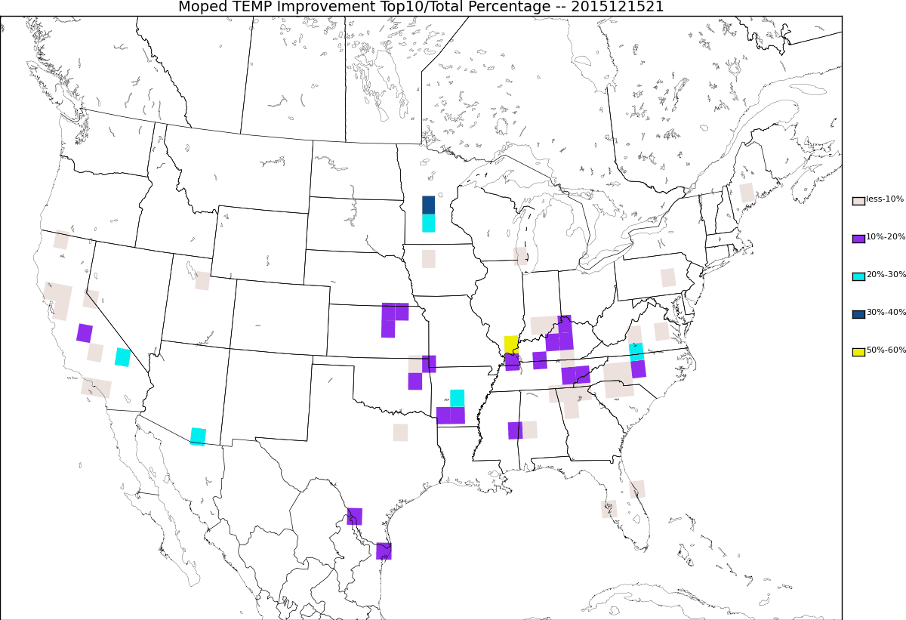
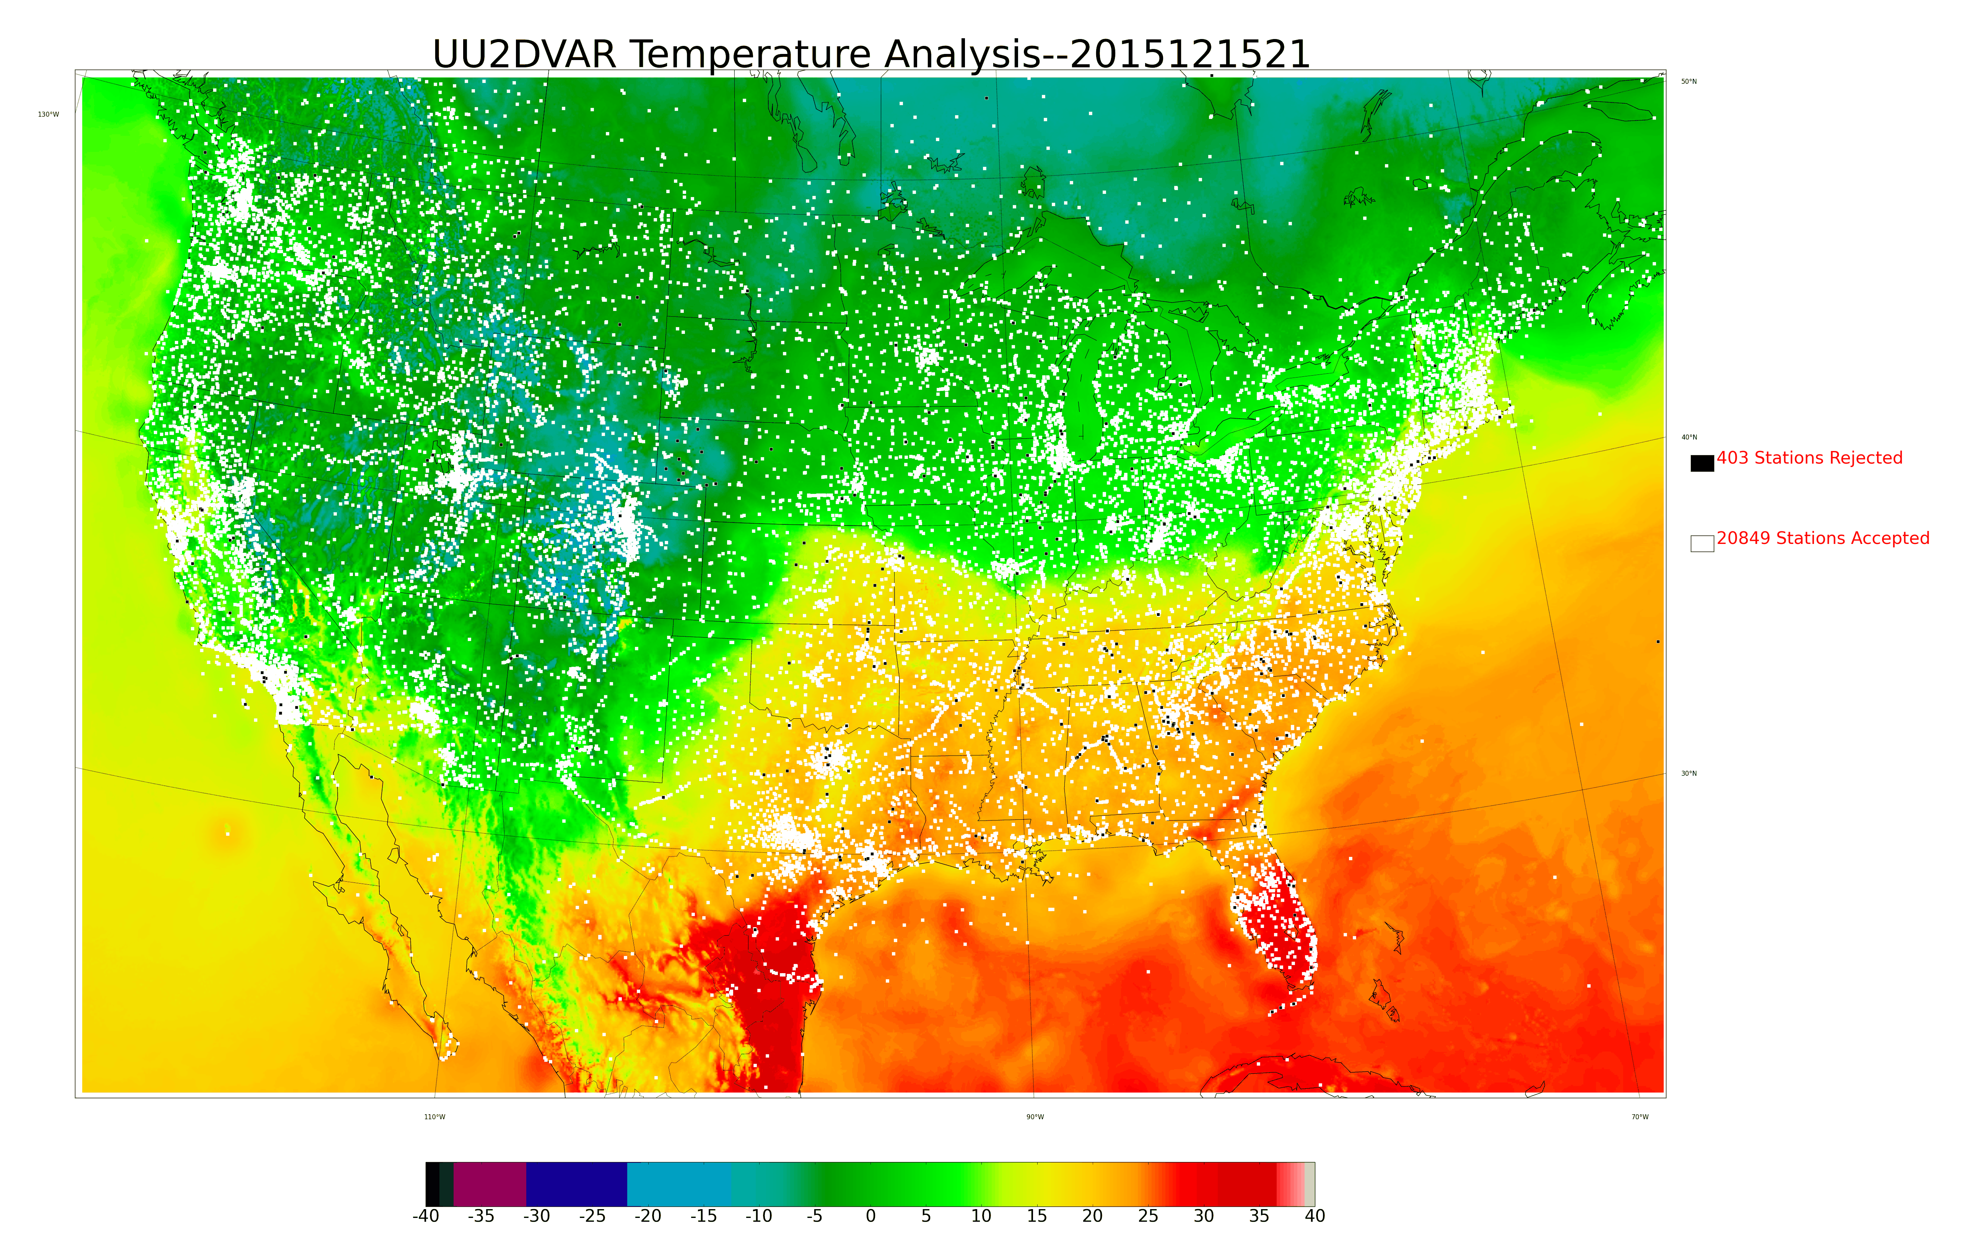
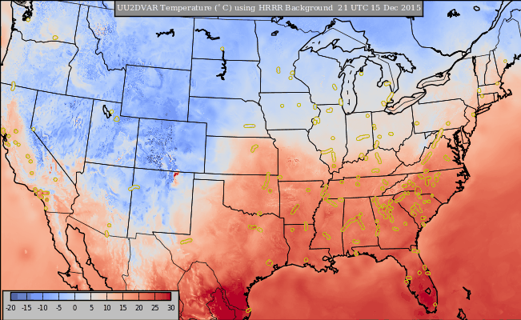
Sensitivity of Surface Analyses to Mobile Observations
John D. Horel, Xia Dong, Alexander Jacques
Department of Atmospheric Sciences, University of Utah
659
Overview and Motivation
21 UTC 15 Dec 2015 Improvement
Cumulative Statistics
Weather Telematics and Global Science & Technology Inc. collaborate to provide environmental observations collected on board commercial vehicles to the National and Oceanic Atmospheric Administration
The Mobile Platform Environmental Data (MoPED) system acquires the data from over 600 vehicles that are travelling primarily during weekday daylight hours along major transportation routes in the eastern third of the United States as well as a more limited amount of highway routes in the West.
Objectives
Test feasibility of using the MoPED observations for analysis systems such as the NCEP Real-Time Mesoscale Analysis (RTMA) & Un-Restricted Mesoscale Analysis (URMA)
Contrast improvements to a background field from MoPED observations relative to those from publicly-accessible fixed-site observations available via MADIS/MesoWest
Temperature Improvement
Fraction
(Top 10%//Total Number) for All Observations
Temperature Improvement
Fraction
(Top 10%//Total Number) for All Observations
MoPED & UU2DVAR
Analysis Temperature (ºC)
Relative Improvement: Observations in red have larger impact on analysis
MoPED temperature, pressure, and relative humidity observations at sub-minute intervals are accessed and bundled at the University of Utah into 5 minute median values
Utilizing the 12 values available for each hour, over 2500 observations are available typically to use in surface analyses of temperature, relative humidity, and dew point temperature as part of the University of Utah
For images of MoPED data:
http://home.chpc.utah.edu/~u0790486/wxinfo/uu2dvar_moped.html
UU2DVAR analyses of temperature, moisture, and wind at 2.5 km horizontal resolution incorporate 10-20,000 observations within the continental United States from fixed sites
Small fraction of observations from fixed and mobile sensors are rejected objectively
See http://meso1.chpc.utah.edu/uu2dvar/ for extensive UU2DVAR image archive
Temperature Improvement Fraction
(Top 10%/ Total Number) for MoPED Observations
Temperature Improvement Fraction
(Top 10%/ Total Number) for MoPED Observations
Temperature Improvement
Fraction
(Top 10%//Total Number) for All Observations
Temperature Improvement
Fraction
(Top 10%//Total Number) for All Observations
Where do fixed site and MoPED observations contribute the most improvement?
Top left: Accumulate 20849 Temperature Observations into 1º x 1º bins
Top right: Accumulate 1462 MoPED Observations into 1º x 1º bins
Bottom left: Bins with the largest fraction of top 10% improvement
Bottom right: MoPED bins with the largest fraction of top 10% improvement
Temperature Improvement Fraction
(Top 10%/ Total Number) for MoPED Observations
Temperature Improvement Fraction
(Top 10%/ Total Number) for MoPED Observations
Summary
Improvement due to NWS/FAA & MoPED
Mobile observations, such as MoPED, are a valuable additional data resource for surface analyses of temperature and moisture available 6 days per week
MoPED observations help to fill in gaps between cities along major travel corridors in the East
Individual trucks in the West fill in some data voids
MoPED temperature observations tend to have a small warm bias (not shown here)
Improvement metric highlights the value of surface observations for adjusting gridded fields
Value of observations depends strongly on weather conditions, terrain, and season
Statistics for downscaled Rapid Refresh available for 2013 and 2014 and High Resolution Rapid Refresh since November 2014
Acknowledgments
Weather Telematics (T. Klein) and Global Science and Technology (Paul Heppner, B. Werner) for providing access to the MoPED data. This research was conducted under the auspices of the NWS-sponsored National Mesonet Program
Relatively constant number of reports from NWS/FAA sites during 1-16 Dec 2015
Assessing Improvement
Relatively constant improvement arising from all NWS/FAA reports
General approach applicable to all networks including MoPED
Improvement (decreased error $δe^{y}$at observation location y) when computing analysis a from background b (Todling 2013, MWR):
$$δe^{y}= δe_{b}^{y}− δe_{a}^{y}=\left[y_{o}−H\left(x_{b}\right)\right]P_{o}^{−1 }{[y}_{o}−H\left(x_{b}\right)]−[y_{o}−H\left(x_{a}\right)]P_{o}^{−1 }{[y}_{o}−H\left(x_{a}\right)]$$
Able to diagnose contributions from each station, each network, each network type
Can be examined separately for locations that are experiencing high impact weather: high wind speeds, temperatures near 0, etc.
Rank the observations from those that have the smallest to largest “relative” improvement to the UU2DVAR for each hour of every day for temp, relative humidity, dew point, wind speed
Fluctuating number of reports from MoPED during 1-16 Dec 2015 with no reports on Sunday
Higher variability in
improvement
Arising from all MoPED reports
High (0.71)
Improvement:
21 UTC
15 Dec

