Slide 1
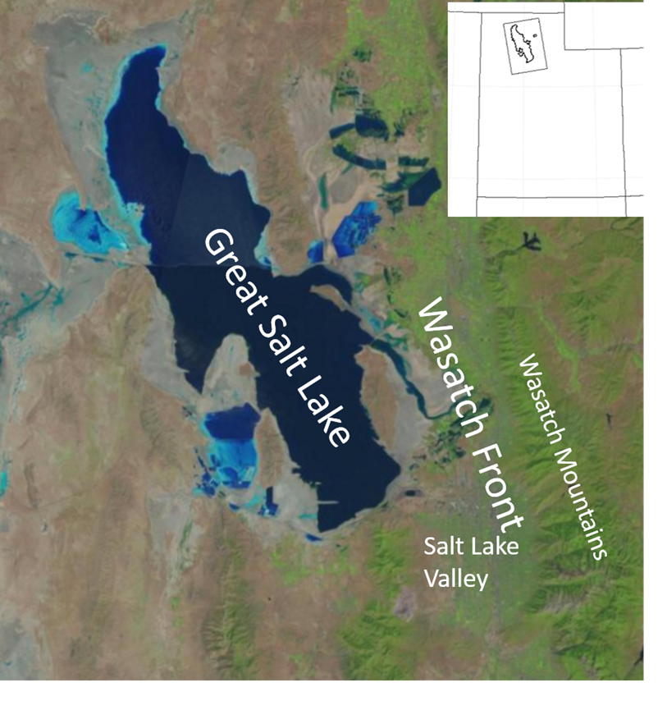
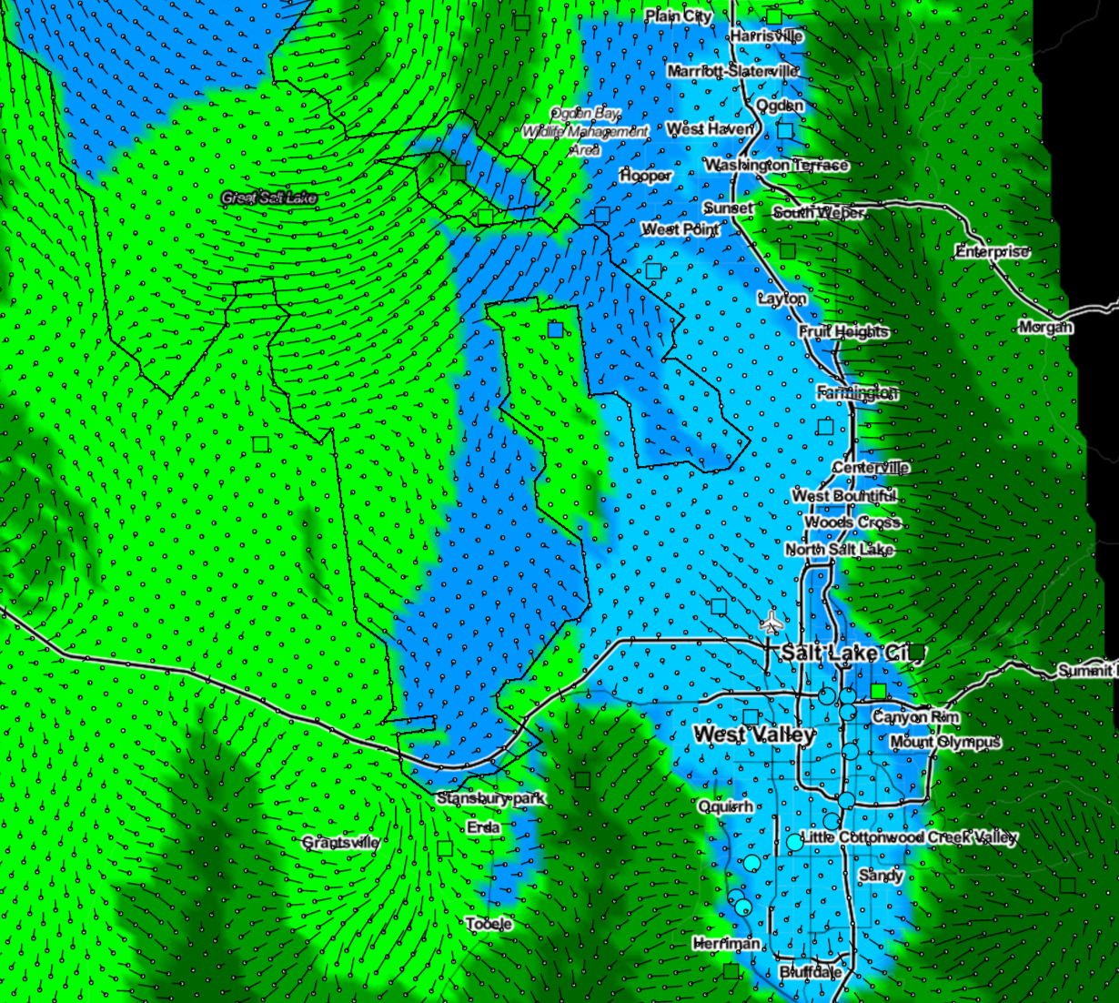
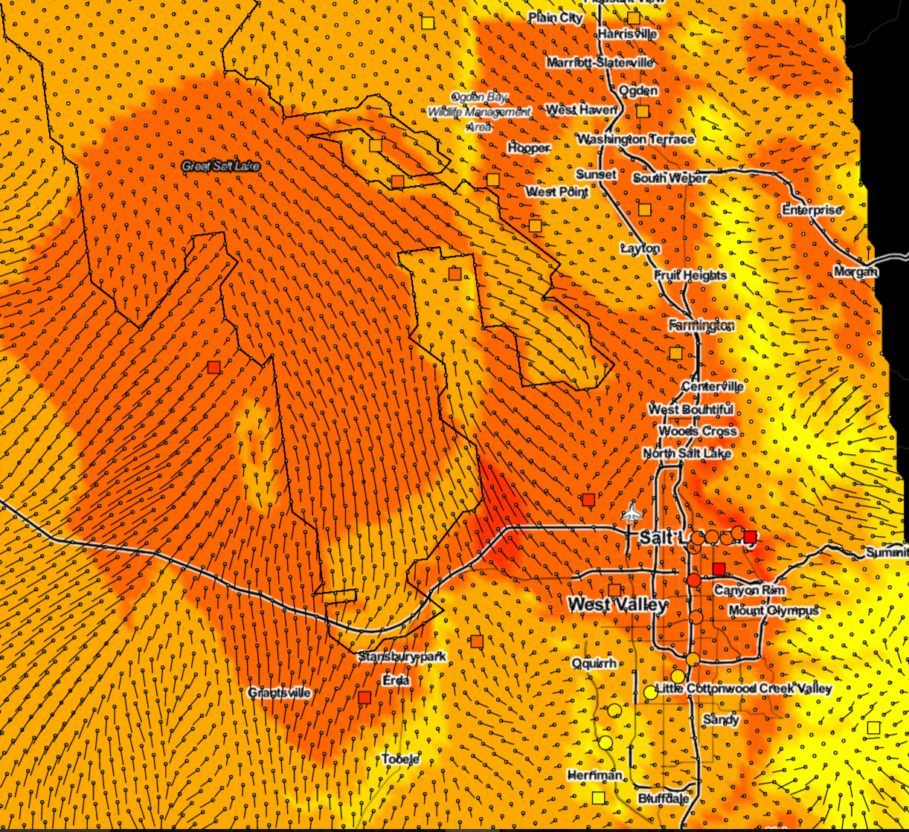
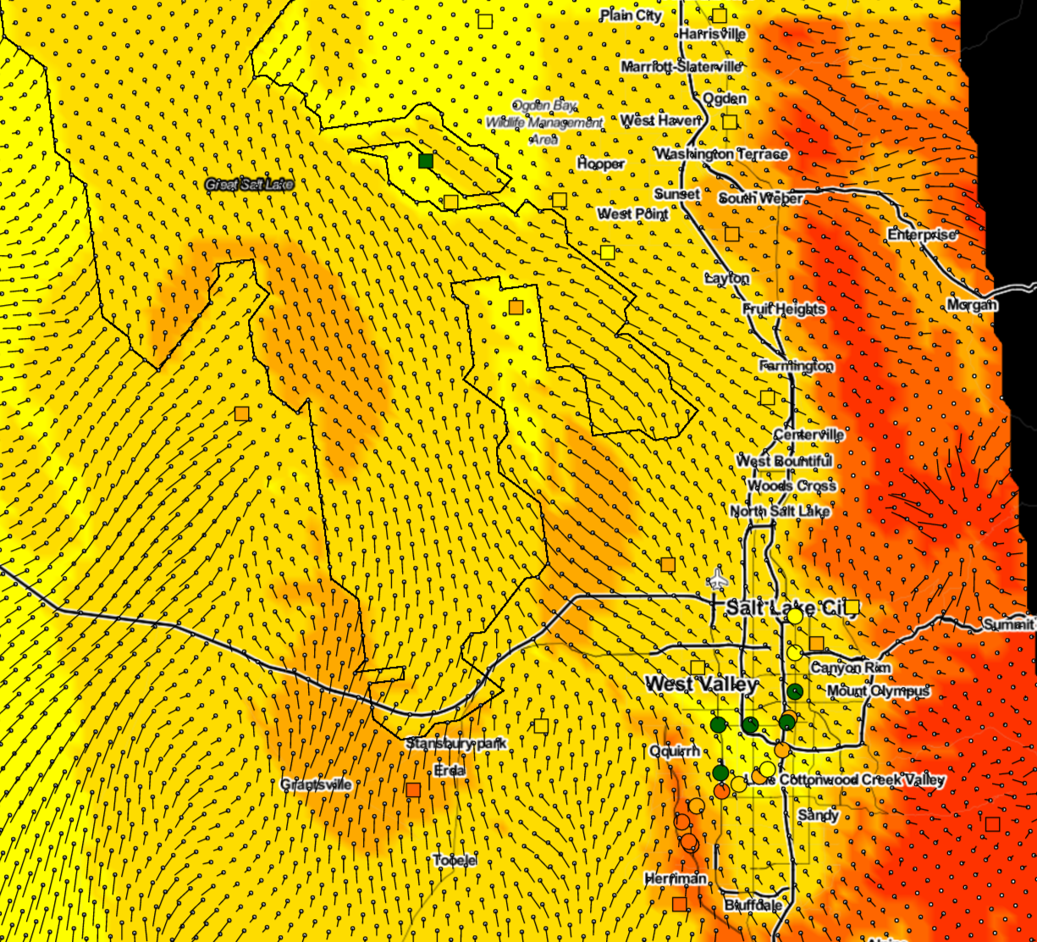
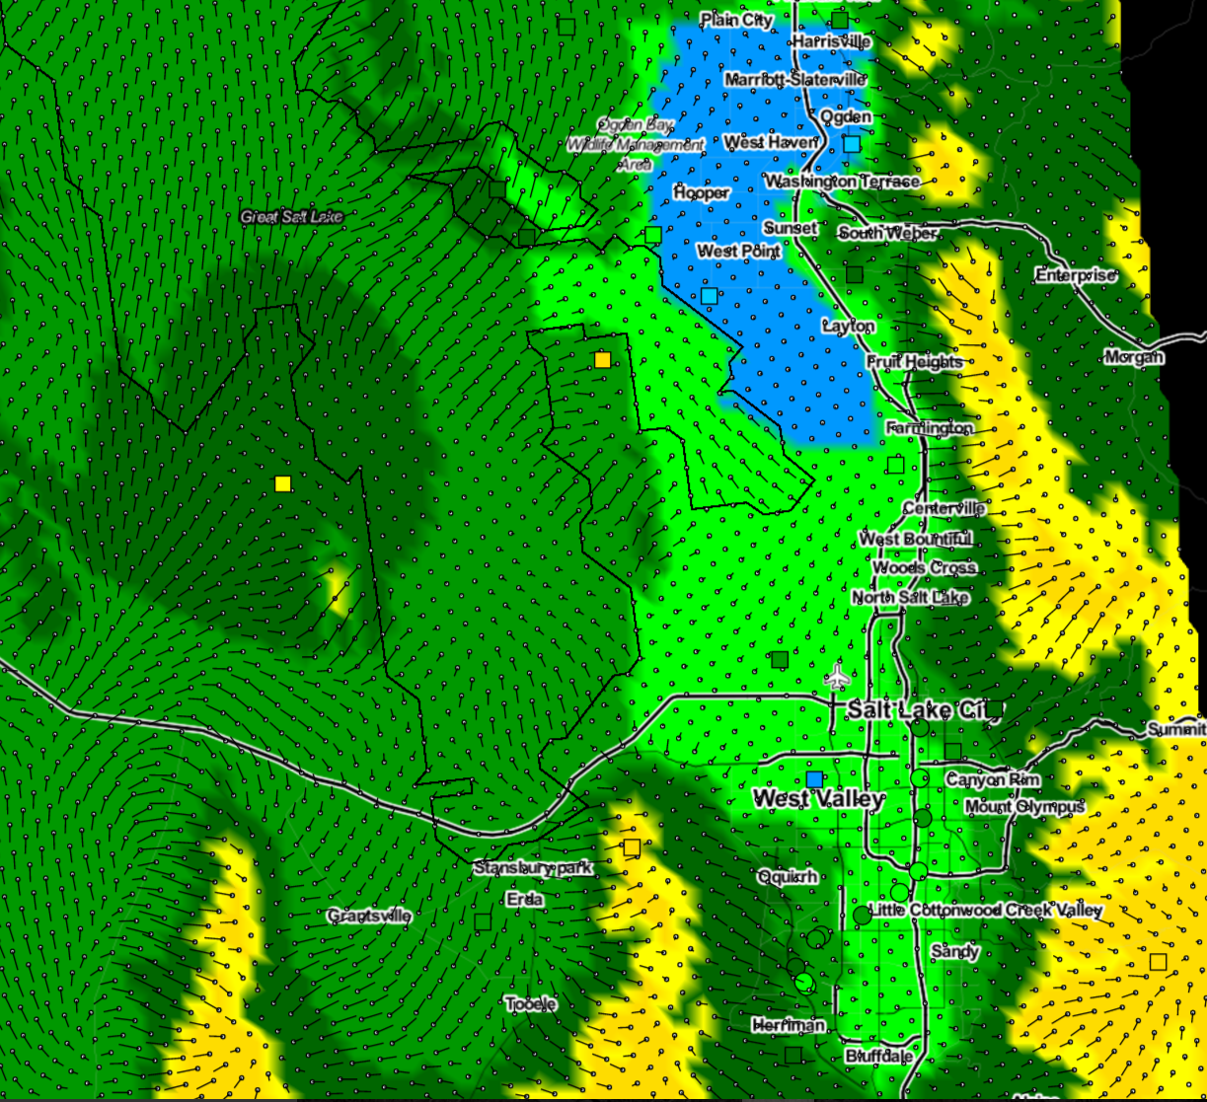
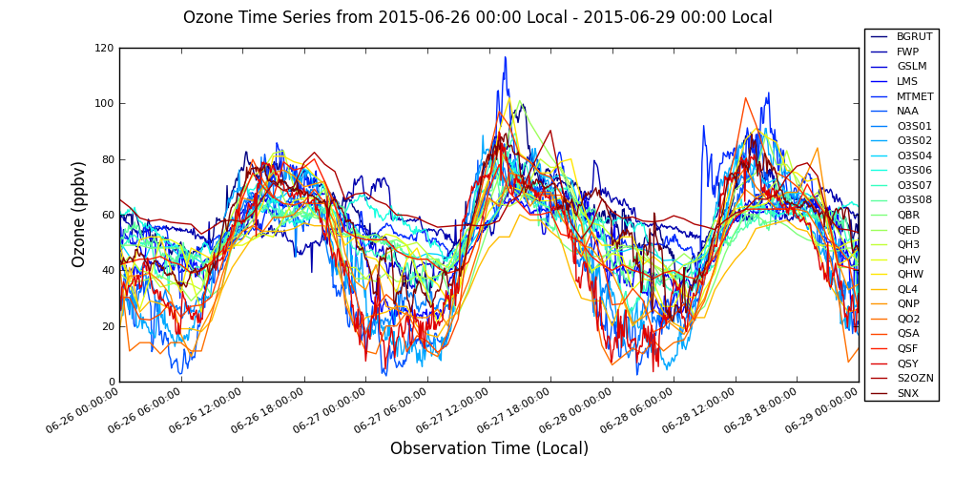
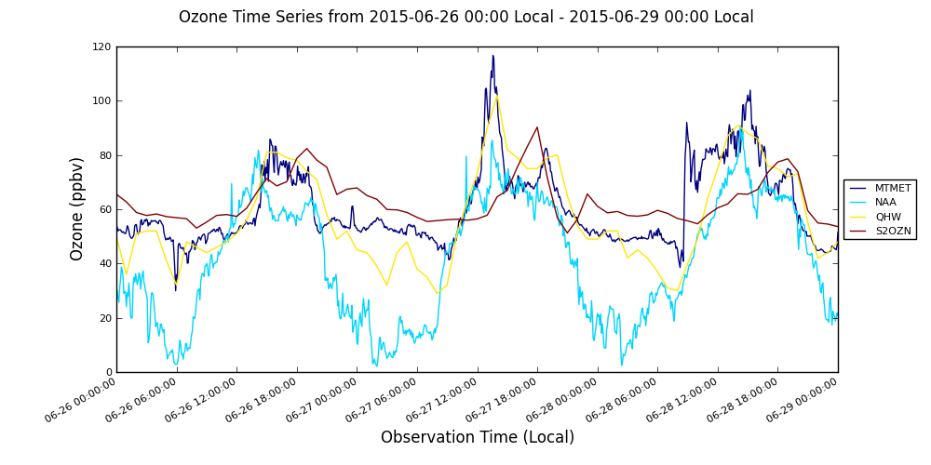
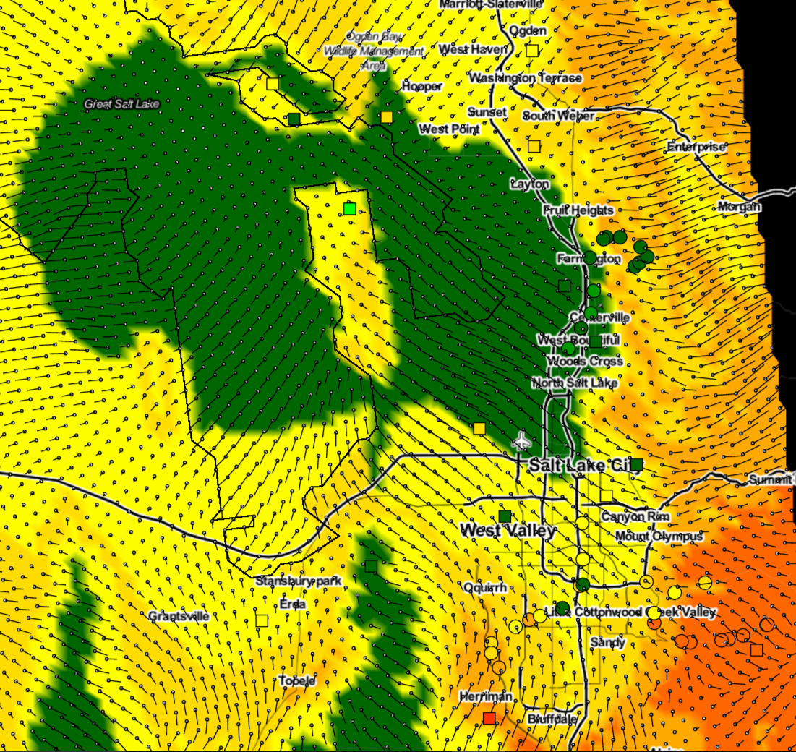
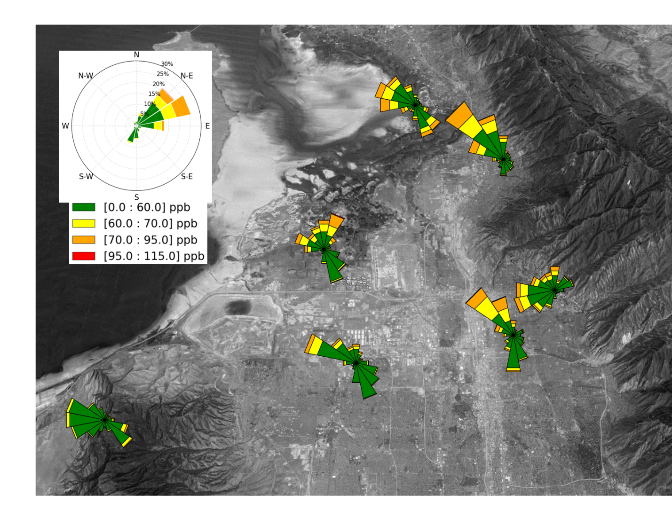
Spatial and Temporal Distribution of Summer Ozone Near the Great Salt Lake
K. A. Long, J. D. Horel and X. Dong
Department of Atmospheric Sciences, University of Utah
ansley.long@utah.edu, john.horel@Utah.edu
274
Overview and Motivation
Sensor Locations
Ozone & Wind: 27 June 2015
Impacts of the Great Salt Lake on ozone concentrations in nearby urban areas of northern Utah have not been studied, e.g., direct (effects of enhanced halogen concentrations) or indirect (land/lake breezes)
Northern Utah residents exposed to ozone levels exceeding current National Ambient Air Quality Standard (8 h average > 70 ppb) on as many as 18 days during June-August 2015
Salt Lake Summer Ozone Study (GSLSO₃S) leveraged existing and temporary observing infrastructure during summer 2015
27 ozone sensors in rural and urban locations continuously monitored ozone concentrations
Sensors deployed during scheduled and opportunistic observing periods mounted on vehicles, a light rail car, traffic helicopter, unmanned aerial vehicle, and tethered sonde
Over one hundred meteorological towers supplemented with surface-based remote sensors (2 sodars, 2 ceilometers, lidar)
Objective
Aggregate available observations to assess temporal and spatial variations in ozone concentrations near the Great Salt Lake during summer 2015 in relation to meteorological conditions
6 AM MDT
2 PM MDT
Met Sites
DAQ ozone Temp ozone
monitors monitors
Light rail Mobile
routes transects
Hourly Analyses
Ozone Salt Lake Valley
6 PM MDT
11 PM MDT
Gridded analyses of near-surface ozone concentration, wind, temperature, and moisture at hourly intervals at 1 km horizontal resolution derived using the University of Utah two-dimensional variation analysis system (UU2DVAR; Tyndall and Horel 2013, WAF)
Background meteorological grids from 1-h High Resolution Rapid Refresh (HRRR) downscaled at NCEP to 2.5 km for Real-Time Mesoscale Analysis (RTMA) then interpolated here to 1 km
Since no model forecast available for ozone, background ozone grids defined each hour from subsets of station observations as a function of grid point location and elevation
Grid point classes: lake; urban- Utah, Salt Lake, Davis, Weber counties within 40.3-41.3ºN east of 112.05ºW ≤ 1500 m; rural-all other grid points below 1500 m; mountain- all grid points > 1500 m
At Lake grid points. Median of 7 fixed-site sensor observations adjacent to Lake and mobile observations along causeways
At rural (urban) grid points. Linear regression between site elevation and ozone derived from 8 (12) rural (urban) sites
At mountain grid points. Between 1500-2400 m- linear with elevation between 1500 m regression estimate and Farnsworth Peak (Snowbird) observation for rural (urban). Above 2400 m: set to Farnsworth (Snowbird) for rural (urban)
Background grids adjusted by available observations using variational analysis approach, which is dependent on assumptions listed below for observational and background error covariances
UU2DVAR analyses of temperature, moisture, and wind at 2.5 km horizontal resolution incorporate 10-20,000 observations within the continental United States from fixed sites
Small fraction of observations from fixed and mobile sensors are rejected objectively
Synoptic Ridge
Wildfire Smoke
26-29 June
All fixed sites
MTMET
NAA
QHW
S2OZN
Salt Lake Valley transect
5 PM 19 Aug: Snowbird & Vehicle Comparison
Summary
Observations obtained continuously at over two-dozen fixed sites as well as intermittently from mobile sensors onboard vehicles and a light rail car highlight the complexity of the spatial and temporal variations in ozone near the Great Salt Lake
Hourly analyses of ozone concentration at 1 km resolution help to illustrate the complex spatial and temporal variations observed over the summer albeit affected by the assumptions required to define the background gridded fields
While the typical diurnal cycle of lower ozone during the night and early morning relative to late afternoon was most common at all urban locations, less nocturnal titration and greater dependence on local and regional wind circulations were evident at rural sites on the western shore of the Great Salt Lake as well as at high elevation to the west and east of the Salt Lake Valley
Thermally-driven circulations (whether up/down slope, mountain/valley, or land/lake breezes) strongly affected ozone levels throughout the region
Acknowledgments: We greatly appreciate the assistance of University of Utah colleagues E. Crosman, A. Jacques and B. Blaylock and all of the other GSLSO₃S participants. This research were supported by a grant from the Utah Division of Air Quality.
Analysis Parameters
Ozone Wind Roses
Type | Background | Observation to background error variance ratio | Horizontal/verticalbackground error decorrelation length scales
Meteorological fields: wind, temperature, moisture | HRRR interpo-lated to 1 km grid | 1-2.5 depending on observational network type | 25 km/250 m
Ozone concentration | Statistical fits to subsets of observations | 0.8 for fixed site and 1.5-2 for mobile observations | 25 km./100 m
Badger Island
8AM-8PM
More Information
Great Salt Lake Summer Ozone Study: http://meso2.chpc.utah.edu/gslso3s/
Hourly analyses: http://meso1.chpc.utah.edu/uu2dvar/webGL/so3s.html
Today. Poster 45. Jacques et al. Mobile Air Quality Measurements on Light Rail and Helicopter
3:45 PM. Tue. Rm 350. Jacques et al. Real-time Ozone Measurements During the 2015 GSL Ozopne Study
11:00AM Wed. Rm 243. Horel et al. The 2015 Great Salt Lake Summer Ozone Study
11:15 AM Wed, Rm 243. Blaylock et al. WRF Simulation of a Summer Ozone Event Initialized from HRRR Analyses

