Slide 1
Great Salt Lake Summer Ozone Study (GSLSO₃S)
Project Web Page: http://meso2.chpc.utah.edu/gslso3s/

Slide 2
IOP 1 Summary
June 17-18, 2015
Wed-Thu
Website
WordPress Blog

Slide 3
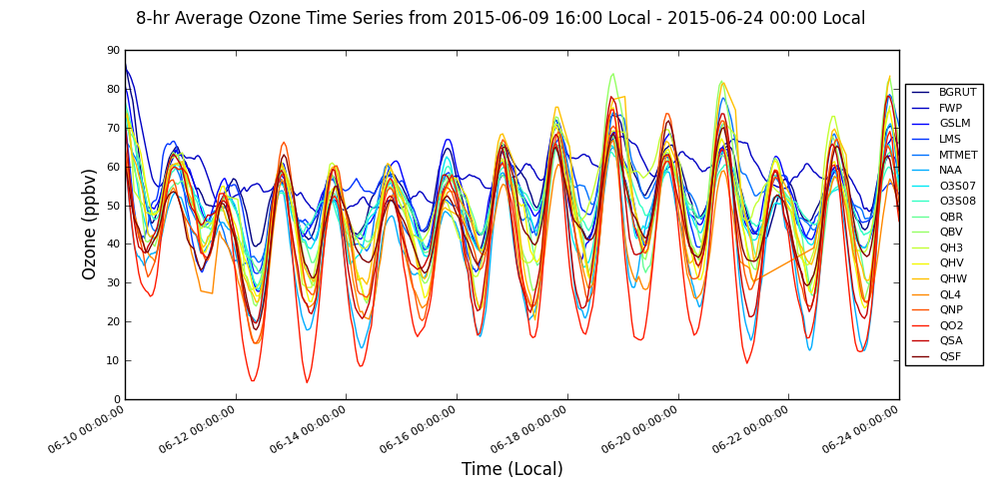
June 8-hr Ozone
Full Daily Description
IOP 1
10
11
12
13
14
15
16
17
18
19
20
21
22
23
24
DAQ SL County Forecast
Rain
Ridge/Trough
***High Lake Ozone/High Urban Ozone/High Marsh Ozone
Notes:
14 days of 8-hr ozone concentrations from the in-situ stations

Slide 4
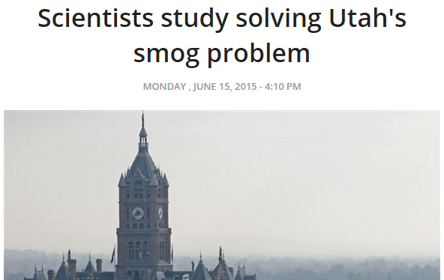
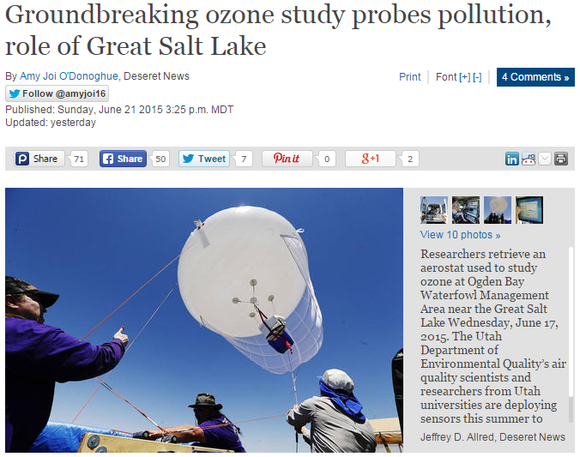
News
More Stories…
Notes:
Already have had some attention from the press. Even Randy Martinez was interviewed!

Slide 5
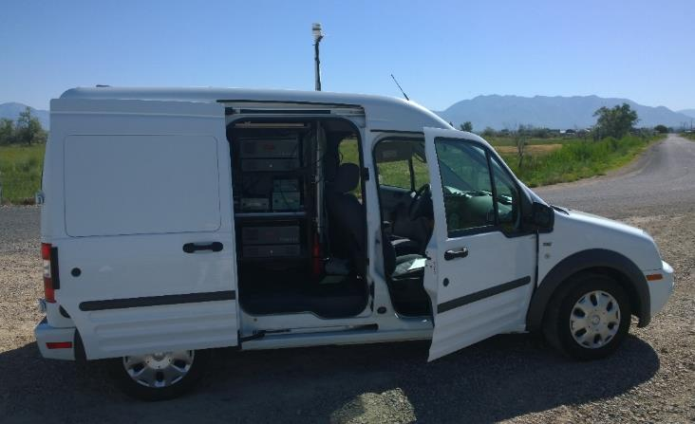
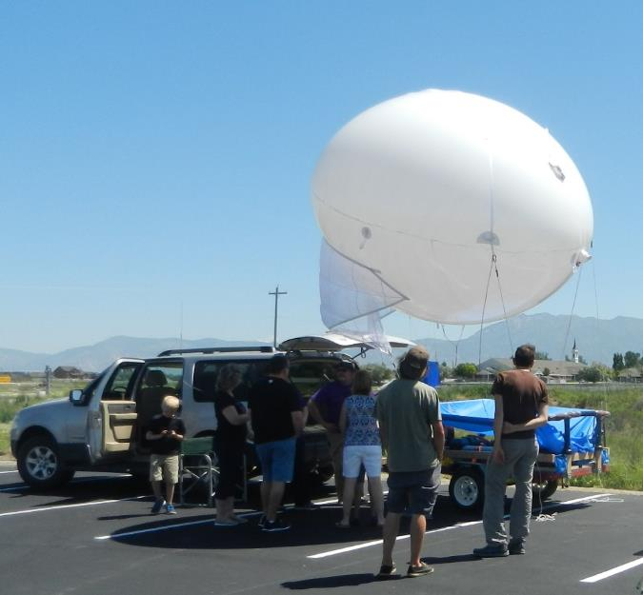
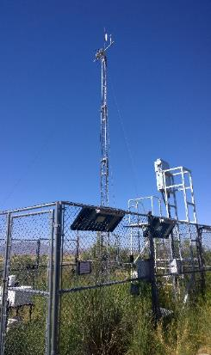
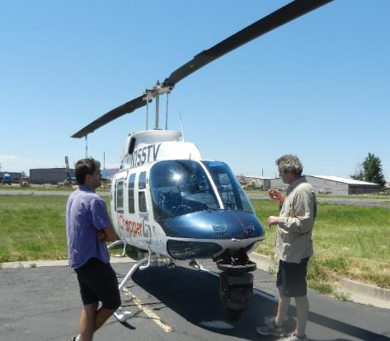
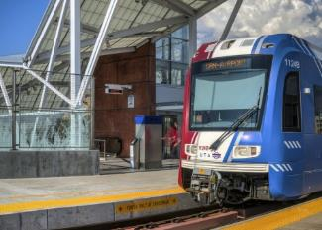
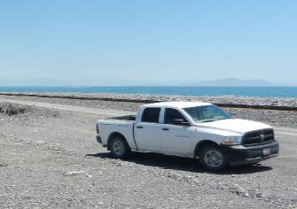
Operations
Nerdmobile
Ogden Bay
Truck
TRAX
KSL Chopper 5
17+ in situ
Notes:
Aside from the 17+ in-situ stations, IOP 1 had a large observation fleet of mobile units and a balloon.

Slide 6
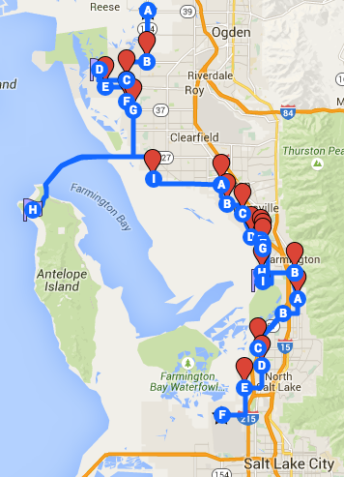
Nerdmobile
Transects between North Ogden, Antelope Island, and SLC Airport
Wednesday – 3 transects
Start 9:30 AM
End 7:00 PM
Thursday – 4 transects
Start 10:35 AM
End 8:20 PM
Messy data being processed

Slide 7
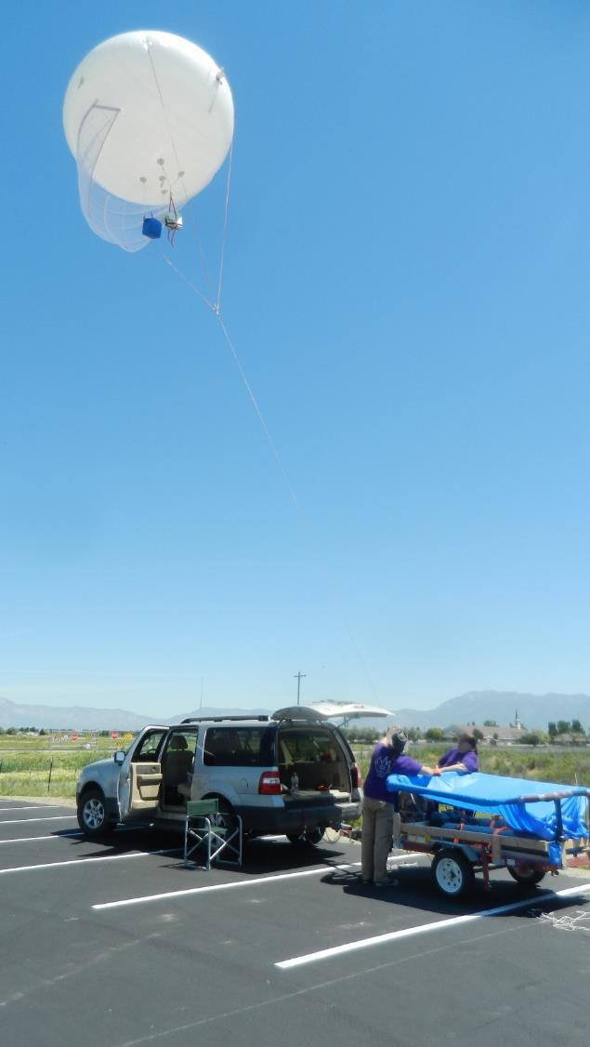
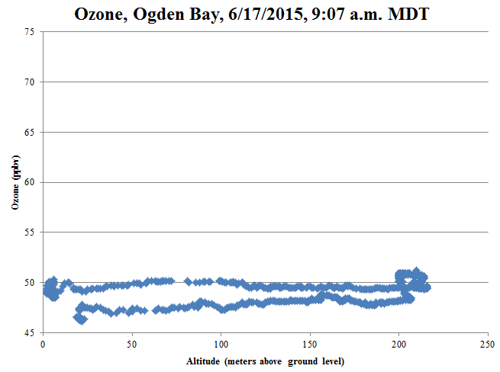
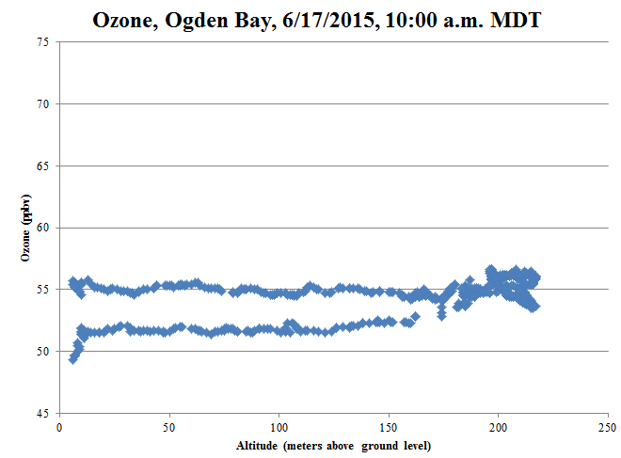
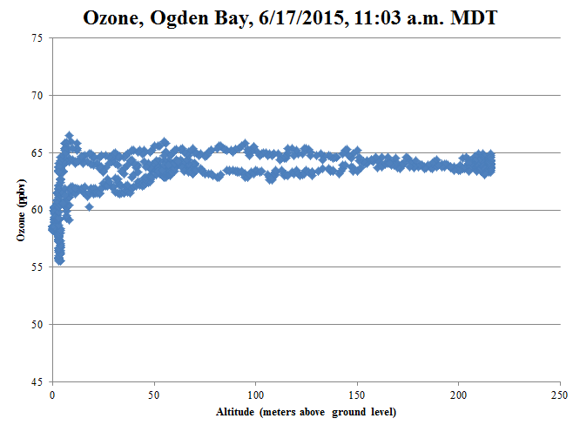
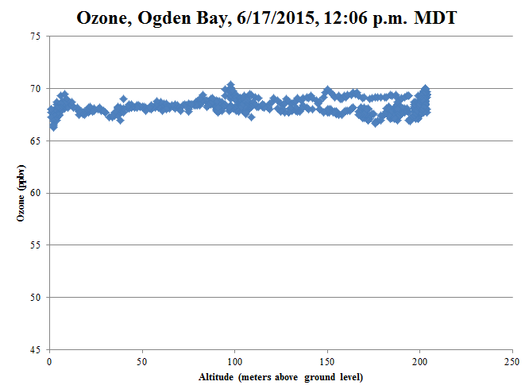
Ogden Bay
Data Available on FTP server

Slide 8
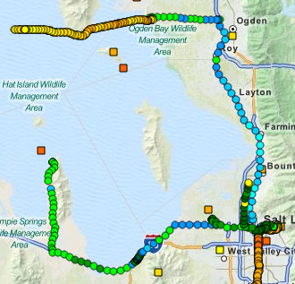
UU Truck 1 and 2
Wednesday
Promontory Point
Start 7:45 AM
End 6:00 PM
I-80 to Badger Island
Start 9:00 AM
End 1:30 PM
Thursday
Promontory Point
Start 7:00 AM
End 8:00 PM

Slide 9
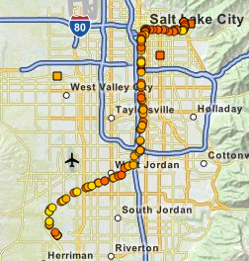
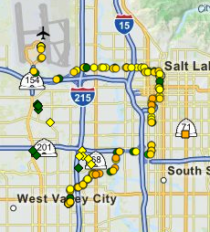
TRAX
Wednesday
Red Line
Thursday
Green Line

Slide 10
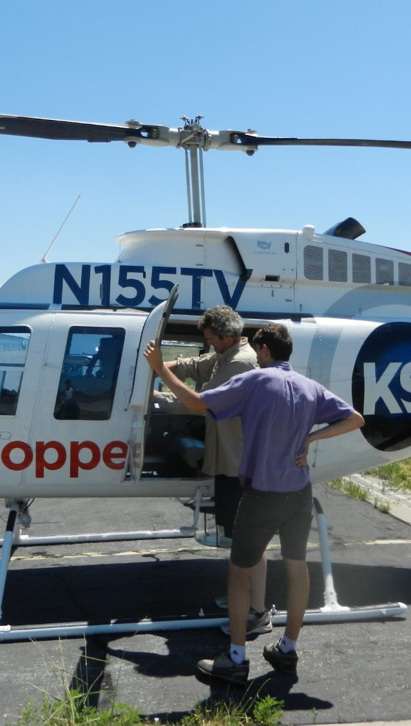
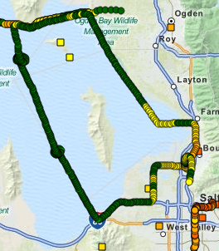
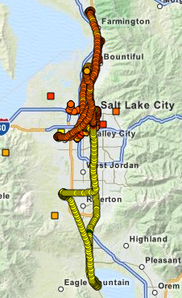
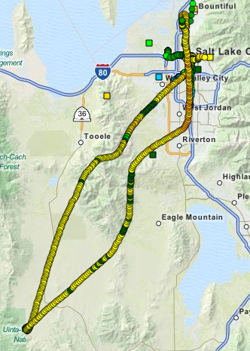
KSL Chopper 5
Wednesday Afternoon
Thursday Afternoon
Thursday Evening

Slide 11
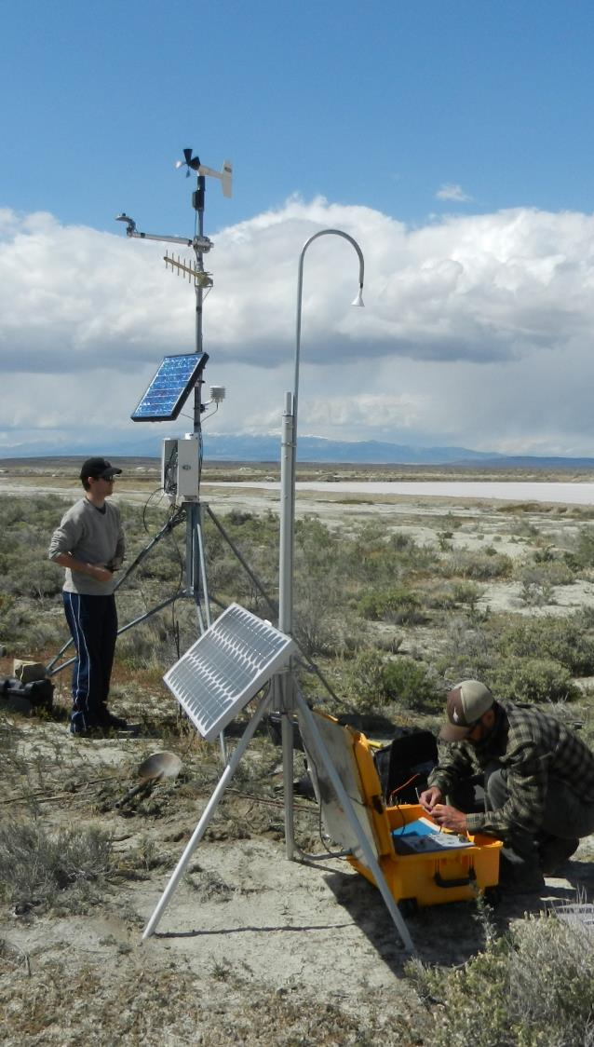
Other Observations
17+ in situ observations
Sodars
Badger Island
Landfill
Ceilometers
Lidar
MesoWest
Conway Trucks

Slide 12
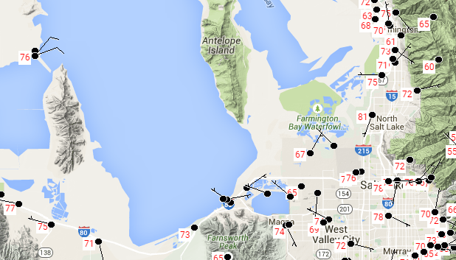
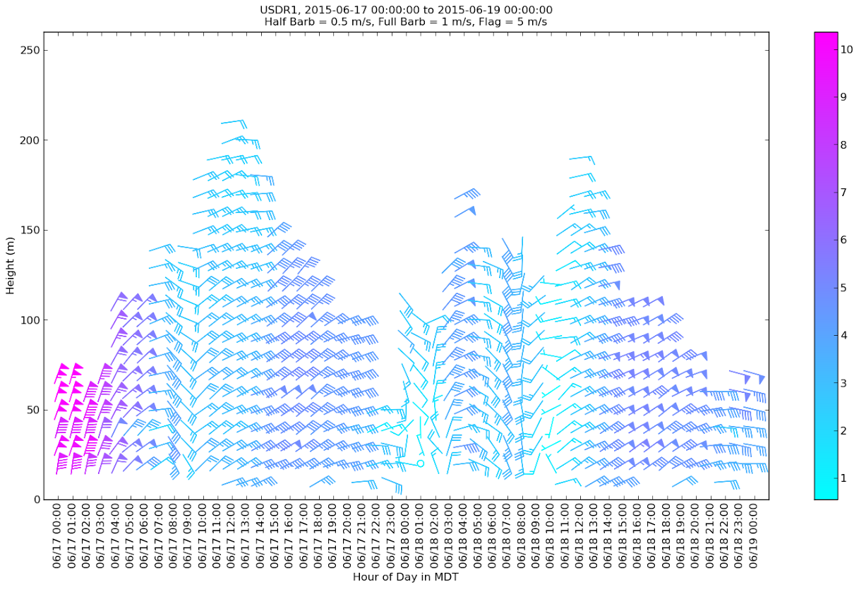
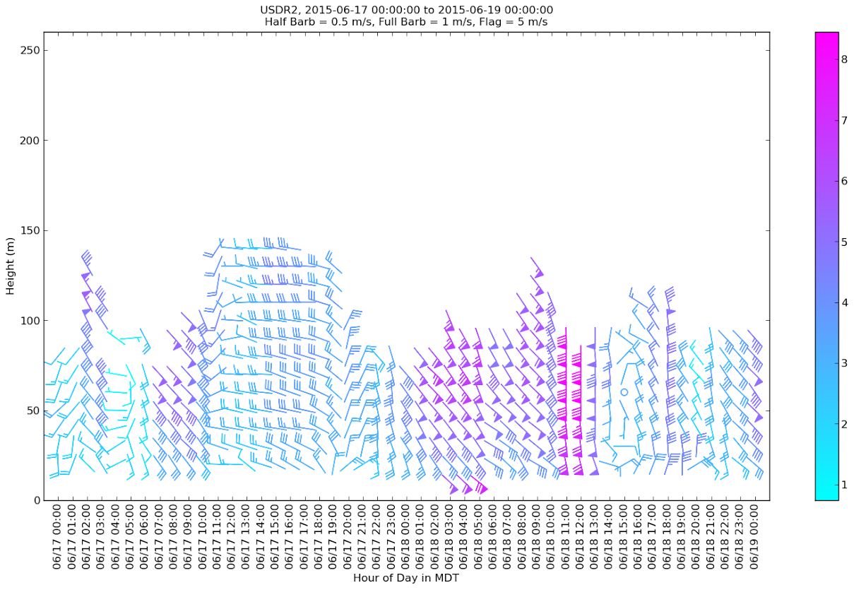
Sodars
Badger Is.
SLC Landfill
Lake Front
Notes:
Sodar 3 will be available next IOP

Slide 13
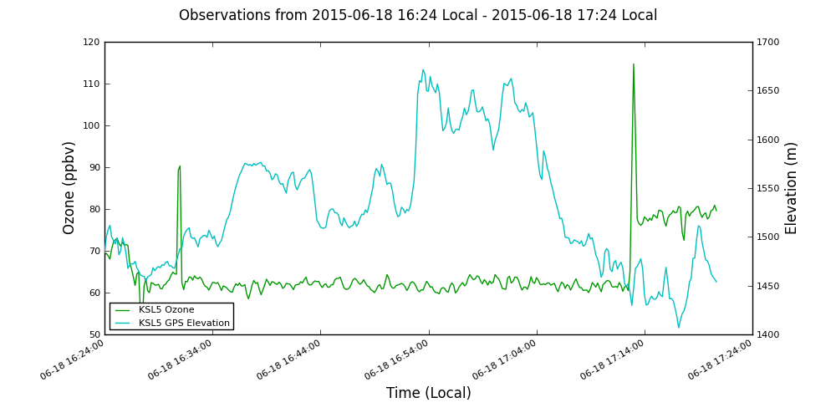
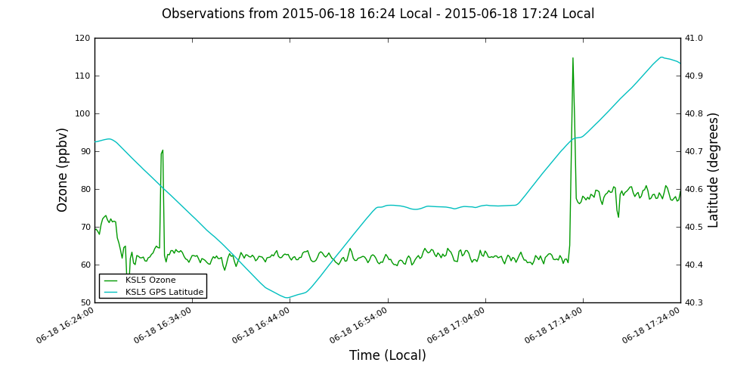
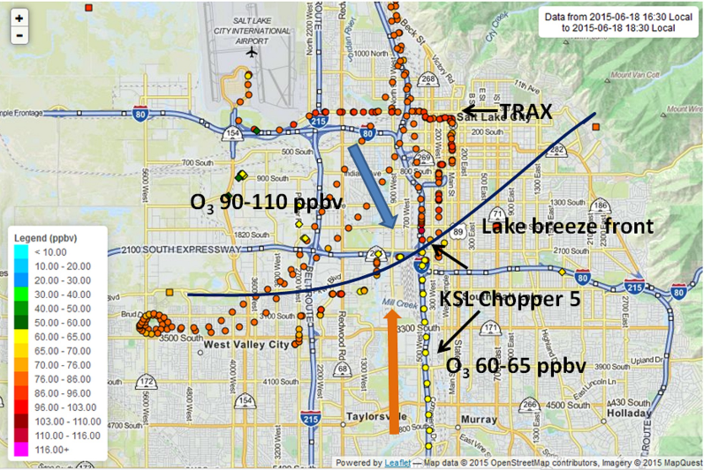
High Ozone Observed When Crossing Lake Breeze Front
Lake breeze carried higher ozone concentrations into the Salt Lake Valley with peak concentrations at leading edge of the front
KSL Chopper flew threw through lake breeze front on June 18 at 4:15 and 5:13 PM

Slide 14
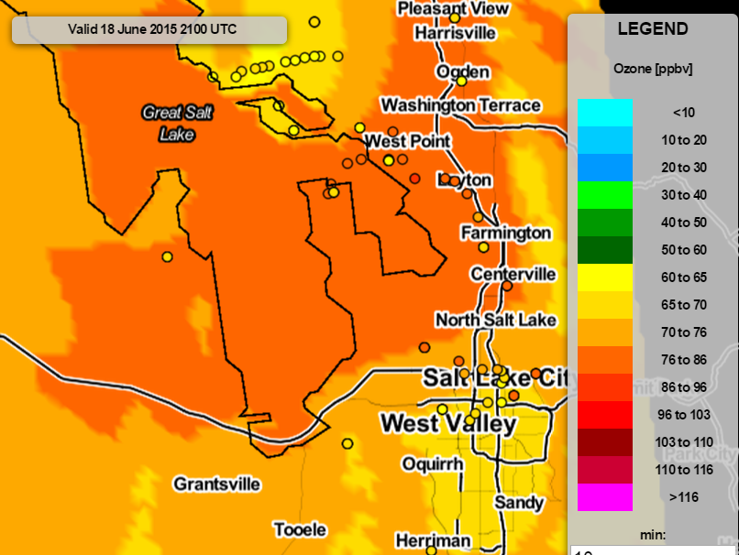
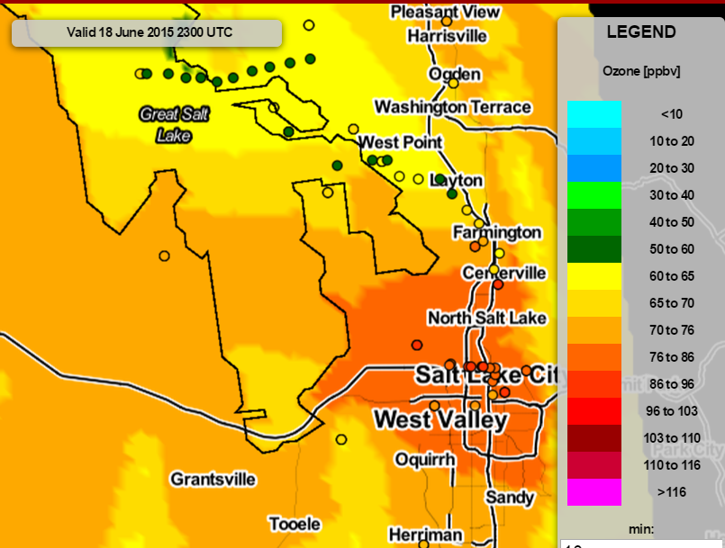
Putting All the Observations Together: Afternoon push of high ozone over Lake into Salt Lake Valley behind Lake breeze front
June 18, 3 PM
June 18, 5 PM

Slide 15
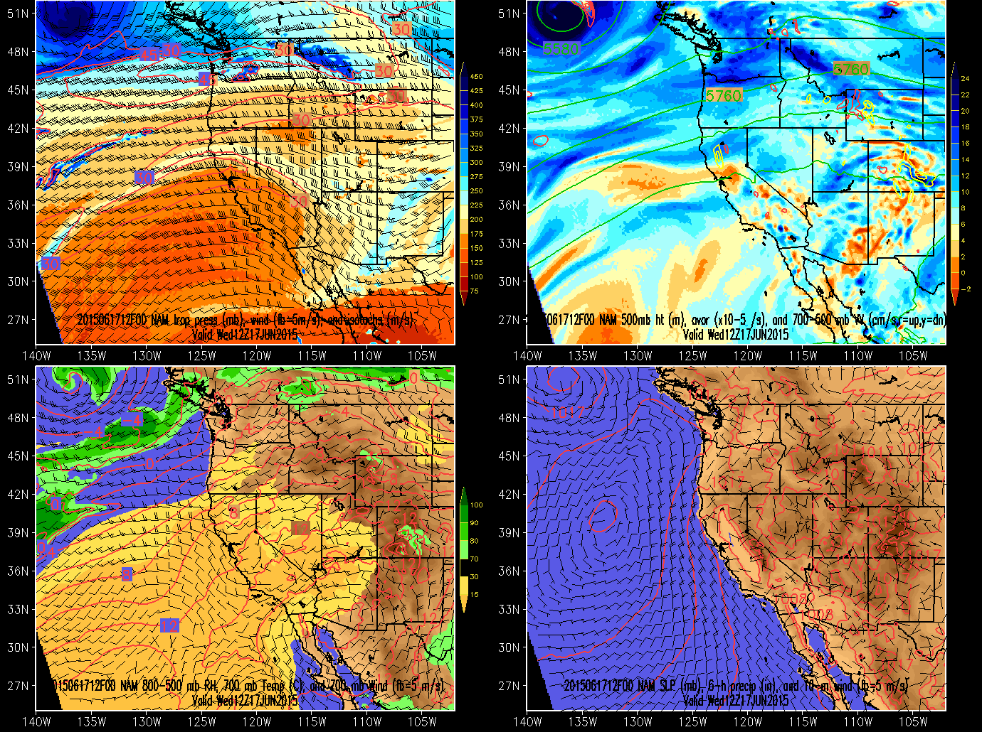
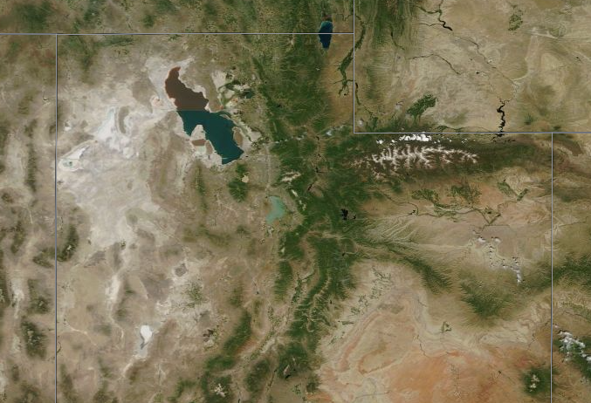
Weather Summary
NAM Analysis: 2015061900 z run
Drying conditions
Mostly Clear Skies
No Precip.
No Smoke
MODIS
June 18, 2015, 12:009 PM (18:09 UTC)
Notes:
Smoke from California fires came to Utah around Saturday

Slide 16
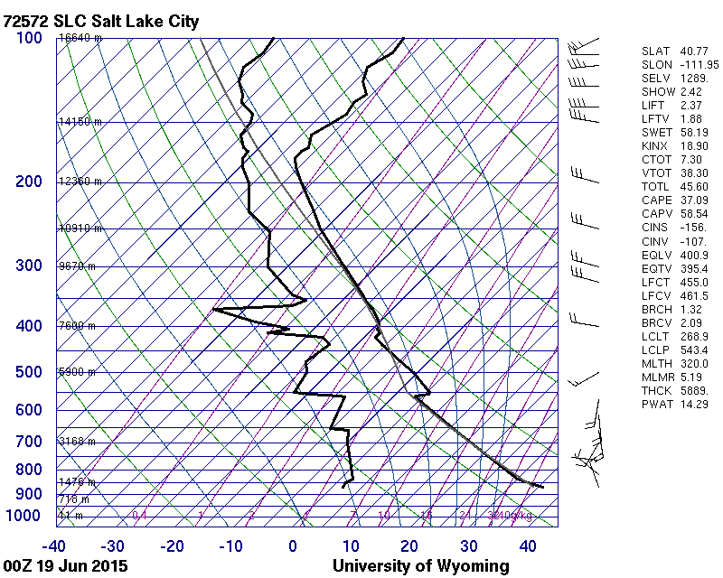
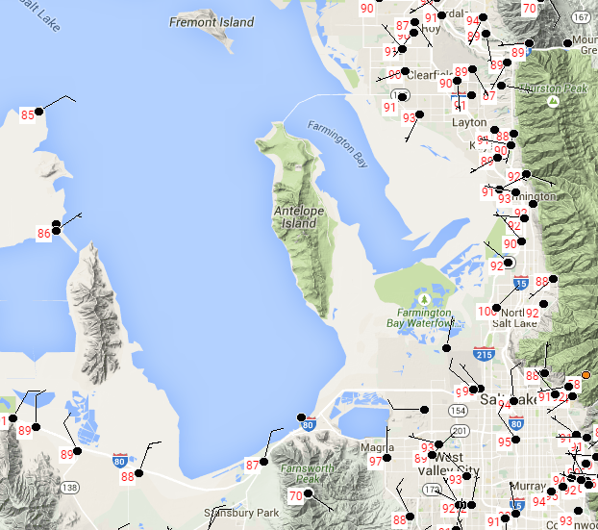
Weather Summary
June 18, 6:00 PM (00 UTC) Sounding
Well mixed boundary Layer
Valley max temps >90 °F
Near lake max temps >85 °F
Note: 00 z sounding on June 18 is unavailable
HRRR Soundings
Thursday Max Temperatures

Slide 17
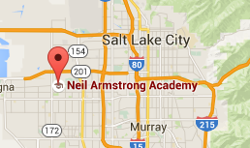
Neil Armstrong Camera
Time Lapse:
June 17, 6:20 PM –June 18, 6:00 PM
Click for video ->

Slide 18
Lake Breeze
KSL Chopper flew threw through lake breeze front on June 18 at 4:15 and 5:13 PM (23:23 UTC).
Click for video ->

Slide 19
High Ozone Observed When Crossing Lake Breeze Front

Slide 20
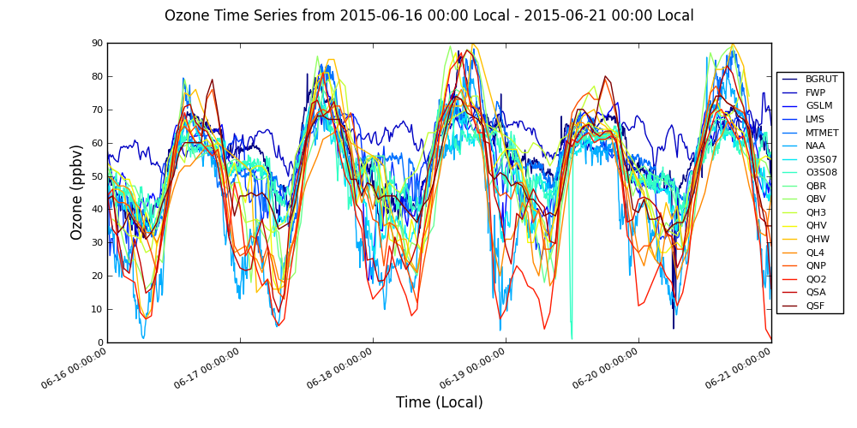
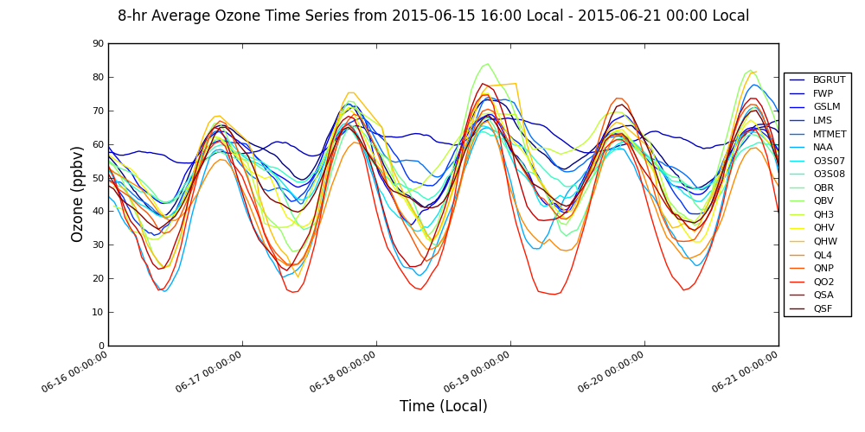
In-situ Ozone Summary
DAQ Forecast
Wednesday | Moderate (voluntary action) for Salt Lake, Davis, Carbon, Utah, and Weber counties.
Thursday | Moderate in Box Elder, Carbon, Davis Duchesne, Salt Lake, Tooele, Uintah, Utah, and Weber counties.

Slide 21
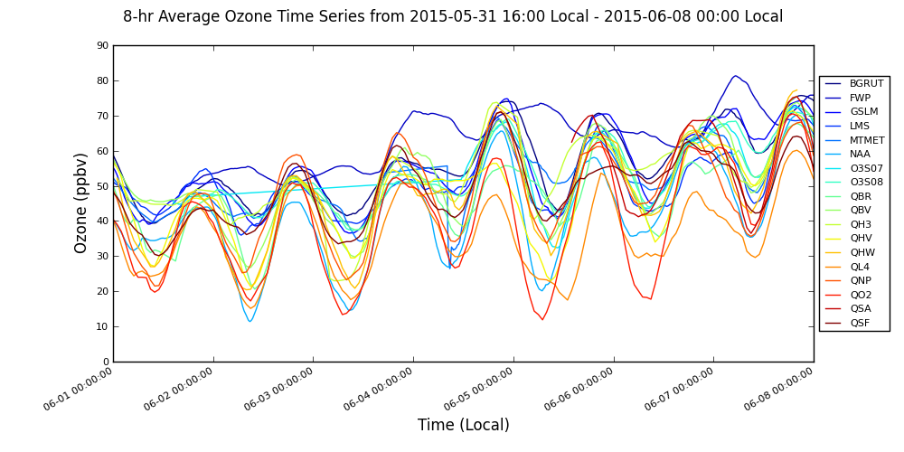
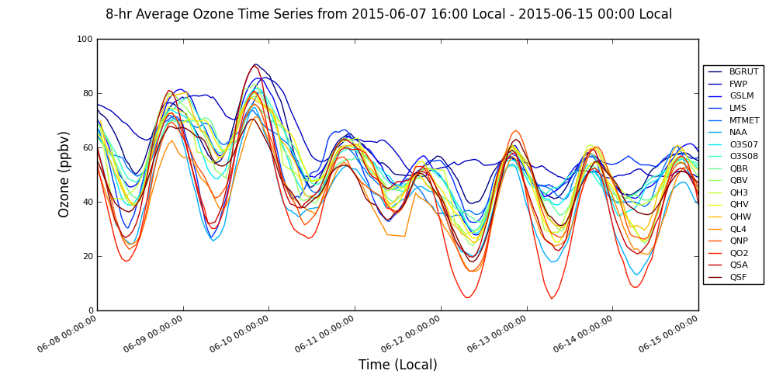
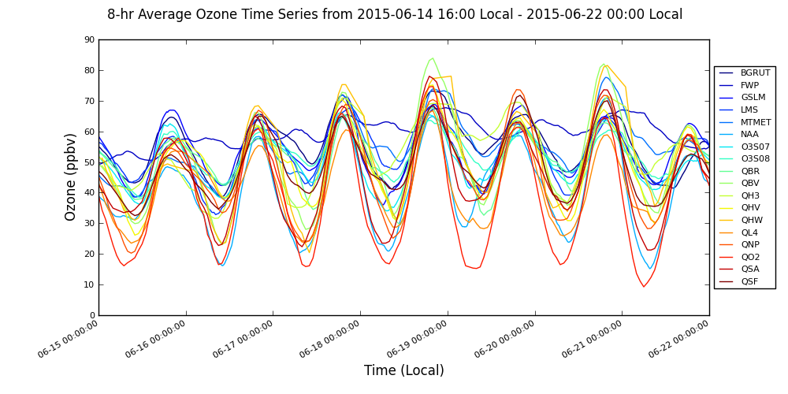
June 8-hr Ozone
Full Description
IOP 1
1
2
3
4
5
6
7
8
9
10
11
12
13
14
15
16
17
18
19
20
21
22
23
24
DAQ SL County Forecast
Rain
Ridge/Trough
High Lake Ozone/High Urban Ozone/High Marsh Ozone

