Slide 1
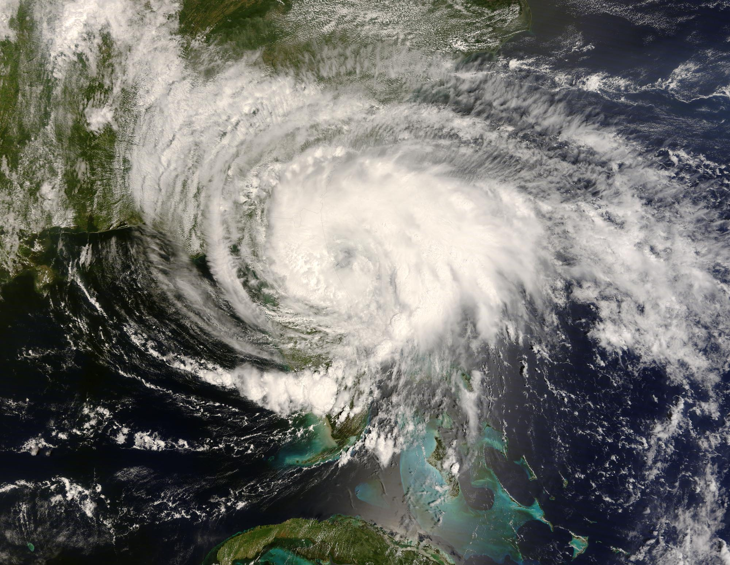
ATMOS 1010:
Severe and Unusual Weather
FASB 295 MW 11:50-1:10
Instructors: Erik Crosman, Research Assistant Professor
Taylor McCorkle, Graduate Research Assistant

Slide 2
Assignments
Chapter 5, 6 Quiz Canvas due 14 Sept
Module 1 Practice test/study guide
Module 1 review/test prep today
Module 1 test (in class) 17 Sept

Slide 3
Chapter 5-6 Quiz
Heat transfer
What causes seasons/weather?
Parcel theory/stability
Don’t forget!

Slide 4
Module 1 Test
Focus on making sure you understand PPT slides on canvas through 10 Sept.
Use study guide on canvas in concert with PPT presentations
Make sure you understand all of the quiz and practice test problems
Test will have several questions from quizzes and practice test repeated verbatim
Several questions from test will be variations on quiz and practice test problems

Slide 5
Test 1
Entire class period, Monday September 17th
No notes or textbook allowed. No calculator needed.
Scantron true, false, or multiple choice (see practice test.
50 questions (2 points each).
Look at study guide for few quantitative numbers, etc you need to memorize.

Slide 6
Module 1 Review and Test Prep
All material thus far in class
Only time you will be directly tested on these concepts (other modules are NOT comprehensive)

Slide 7
Module 1 Review and Test Prep
Atmospheric composition
Atmospheric pressure, temperature, water vapor, winds
Rawinsonde/Radiosonde/Weather Balloon
Radar
Weather satellite
Planetary orbit
Atmospheric stability

Slide 8
Module 1 Review and Test Prep
Atmospheric composition
Atmospheric pressure, temperature, water vapor, winds
Rawinsonde/Radiosonde/Weather Balloon
Radar
Weather satellite
Planetary orbit
Atmospheric stability

Slide 9
Atmospheric Composition
Nitrogen (78%) – Important building block for life. Soil forms nitrates out of nitrogen in the air.
Lightning also reacts with nitrogen and adds nitrates to soil.
Oxygen (21%) – Role in survival of many forms of life elevates its significance.
Water vapor (0-4%) – Most important greenhouse gas, keeps earth warm enough to support life. Superb solvent, carries nutrients to cells and waste away
Carbon Dioxide, Methane – Important greenhouse gases. CO2 vital for plant processes – photosynthesis

Slide 10
Module 1 Review and Test Prep
Atmospheric composition
Atmospheric pressure, temperature, water vapor, RH, dew point winds
Rawinsonde/Radiosonde/Weather Balloon
Radar
Weather satellite
Planetary orbit
Atmospheric stability

Slide 11
What’s Pressure?
Atmospheric pressure - force (weight) of column of air above a 1 m² surface
Pressure ALWAYS decreases with height
1 m²
Pressure in the atmosphere can be thought of as the weight of the gases that are above

Slide 12
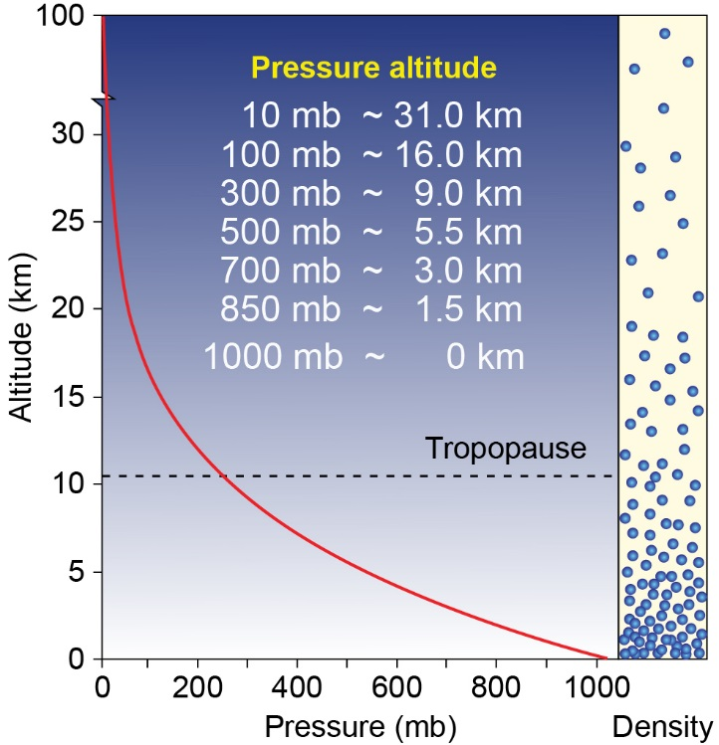
Decrease of pressure with height
Sea level

Slide 13
Practice Exercise
Top of Atmosphere
The pressure at Salt Lake City averages about 0.85 atm (850 mb).
0 atm
What fraction of the atmosphere is ABOVE Salt Lake City?
Answer = 85%
0.85 atm ≈ 850 mb
1 atm
Ground

Slide 14
Practice Exercise
Top of Atmosphere
The pressure at Salt Lake City averages about 0.85 atm (850 mb).
0 atm
What fraction of the atmosphere is below Salt Lake City?
Answer = 15%
0.85 atm ≈ 850 mb
1 atm
Ground

Slide 15
Temperature
Measure of the average speed at which molecules in a gas (or liquid) move
Cold air: air molecules moving slower
Hot air: air molecules are moving faster
Typically decreases in the atmosphere as you go up (except during an inversion when is increases with height).

Slide 16
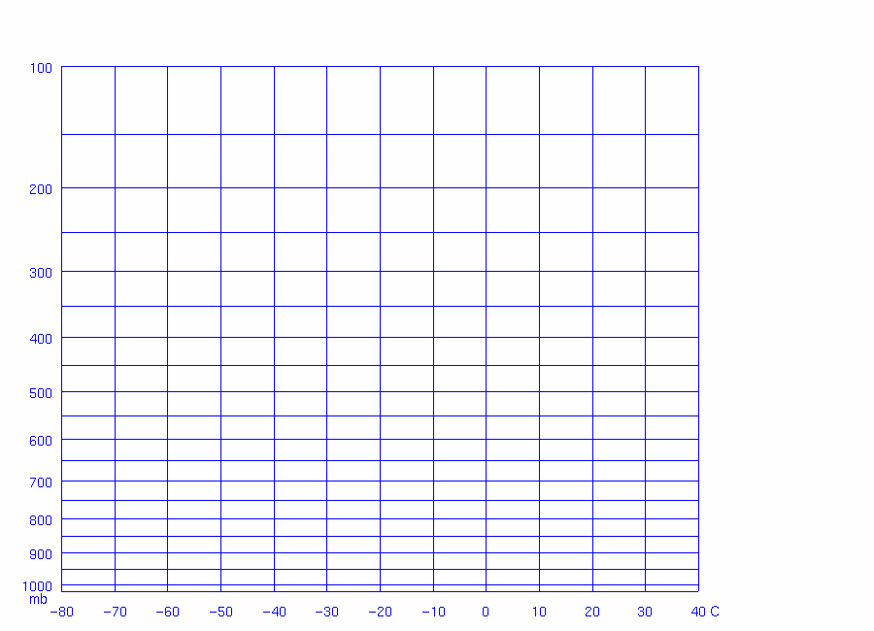
Example “Typical” Temperature Profile
Temperature decreases with height in the troposphere
Increases with height in the stratosphere
Tropopause (boundary between troposphere
And stratosphere)
Jet aircraft flight level
Pressure (mb)
Mountaintop level
Ground level (SLC)
Sea Level
Temperature (°C)

Slide 17
Example Temperature Profile With “Inversions”
Temperature decreases with height in the troposphere
Increases with height in the stratosphere
Inversion
Jet aircraft flight level
Inversion
Pressure (mb)
Mountaintop level
Inversion
Ground level (SLC)
Sea Level
Temperature (°C)

Slide 18
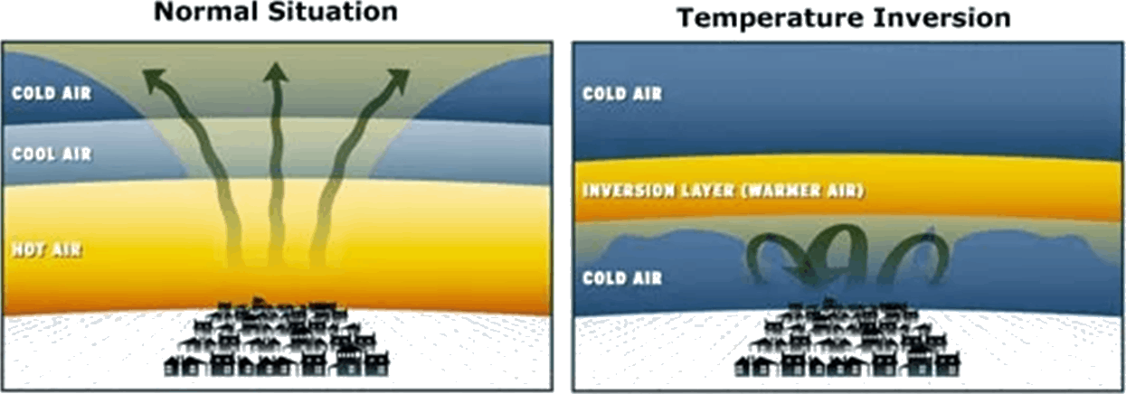
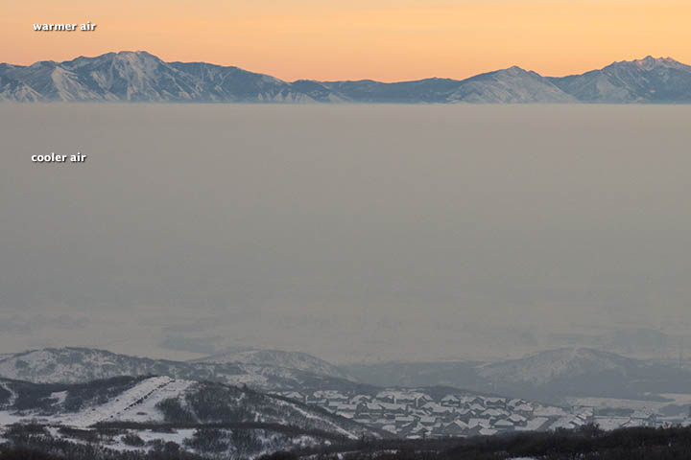
‘Temperature Inversion’

Slide 19
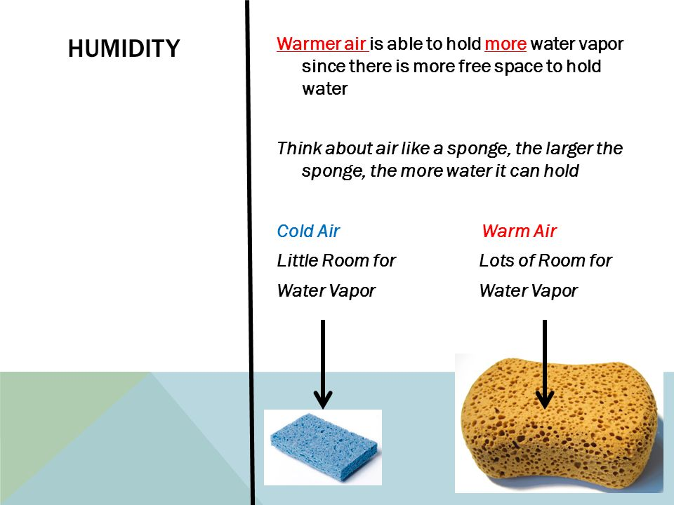
Air Temperature & Moisture
The amount of water vapor that air can hold is dependent on temperature
Hot air can hold more vapor than cold air

Slide 20
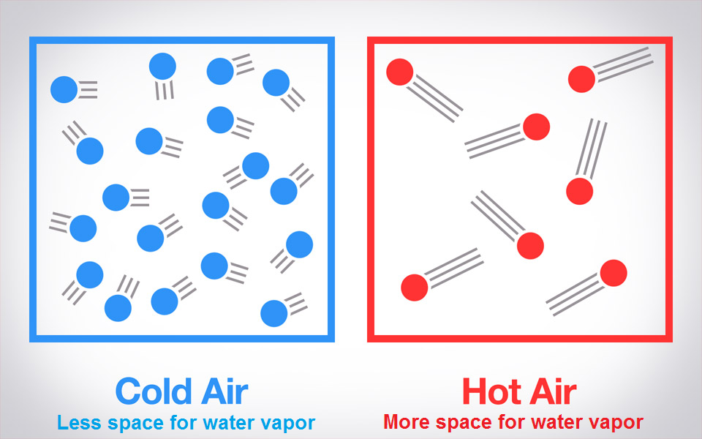

Slide 21
Dewpoint Temperature
The temperature to which an air parcel must be cooled (at constant pressure) for it to become saturated (RH=100%)
Saturated means if there is any more cooling of the air the water vapor will condense into liquid water

Slide 22
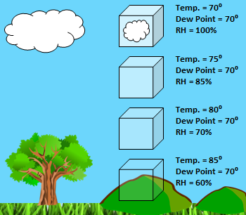

Slide 23
Dewpoint Temperature
High dewpoint temperatures indicate high moisture contents
Low dewpoint temperatures indicate low moisture contents
Dew point temperature is a good measure of how much moisture the air can hold

Slide 24
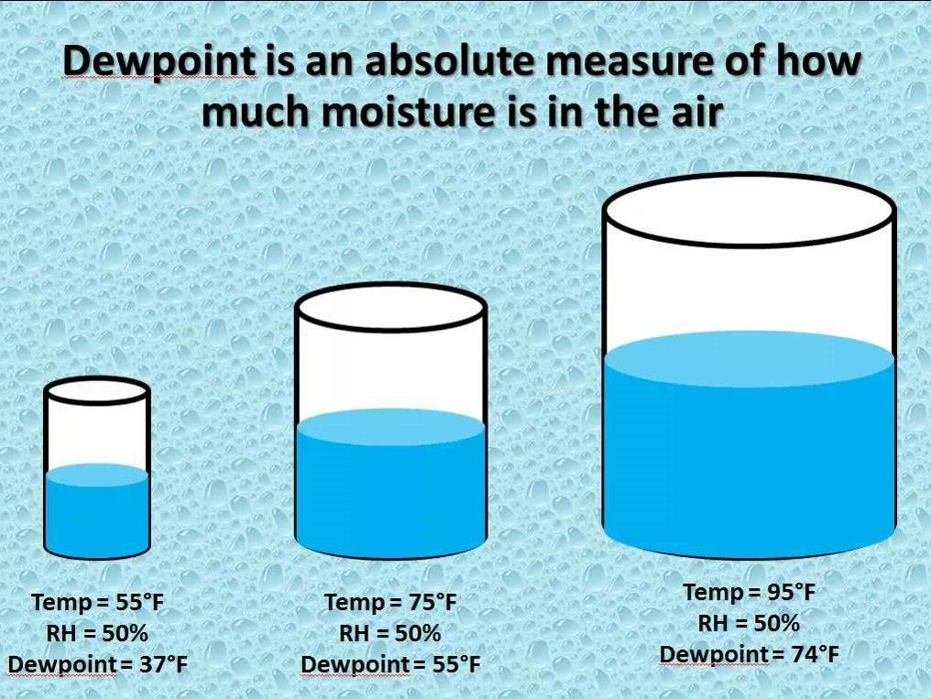
Lots of water vapor
Little
Water
vapor

Slide 25
Relative Humidity
RH definition: Amount of water vapor in the atmosphere relative to atmosphere’s capacity for moisture at a given temperature
Indicates how close you are to saturation
High RH indicates that the air is close to saturation
Low RH indicates that the air is far from saturation

Slide 26
Definitions: Wind
Bulk movement of air
Horizontal winds speeds generally stronger but vertical ones can result in severe weather
Has both speed and direction
Understand that southerly wind comes from the south
Northerly wind comes from the north

Slide 27
Identifying Cloud Layers on Stuve Plots
Clouds exist where air temperature = dew point temperature (saturated RH = 100%)
Inversion
Jet aircraft flight level
Inversion
Pressure (mb)
Cloud
Mountaintop level
Inversion
Cloud = Fog
Ground level (SLC)
Sea Level
Temperature (°C)

Slide 28
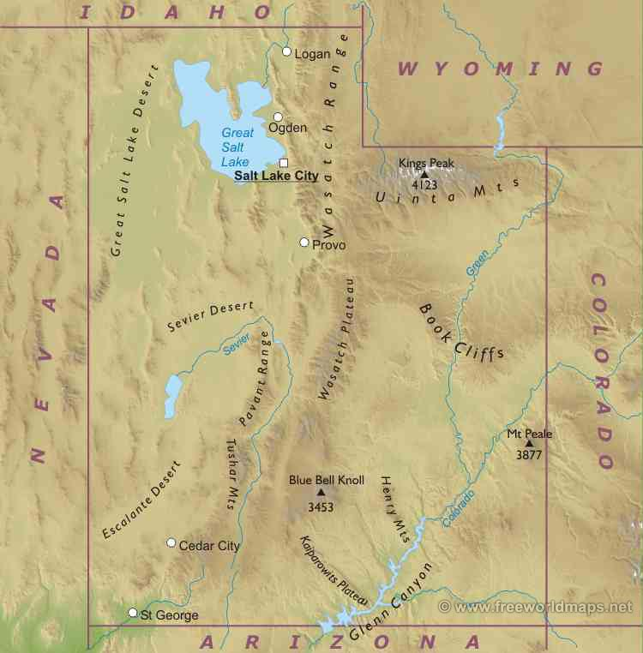
Northerly wind
Westerly wind
Easterly wind
Southerly wind

Slide 29
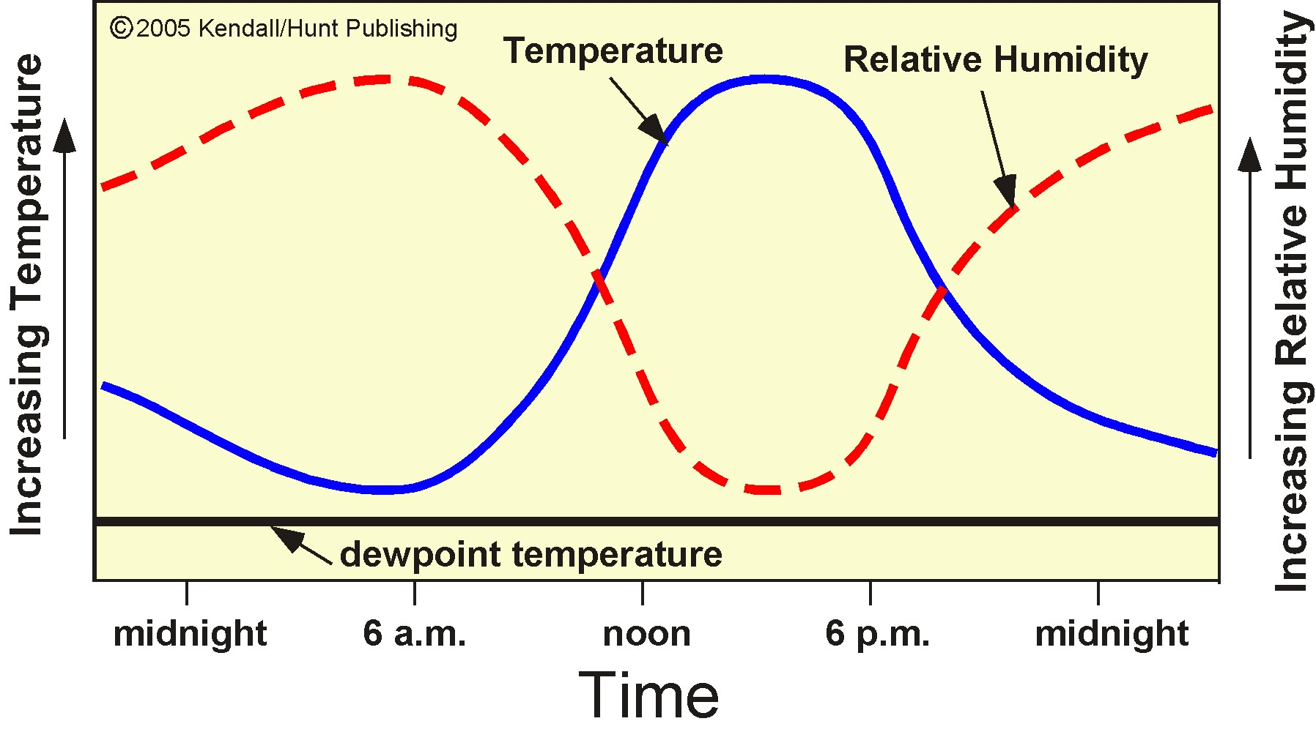
Common Daily (Diurnal) Changes
Small difference between air and dewpoint temperature
Large
difference between air and dewpoint temperature
amount of water vapor constant

Slide 30
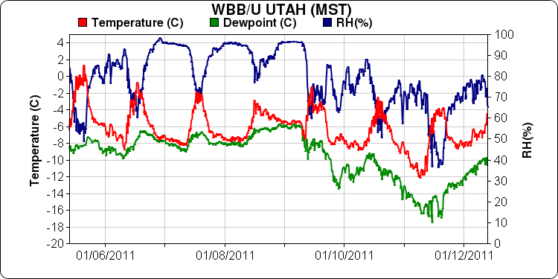
Variation in T, TH,TD with Time: 1 Week

Slide 31
Universal Coordinated Time (UTC)
Is defined as the time in the Greenwich England (time zone Z)
All meteorological measurements are reported in UTC time to avoid confusion
UTC is sometimes called Zulu (Z) time or Greenwich Mean Time (GMT)

Slide 32
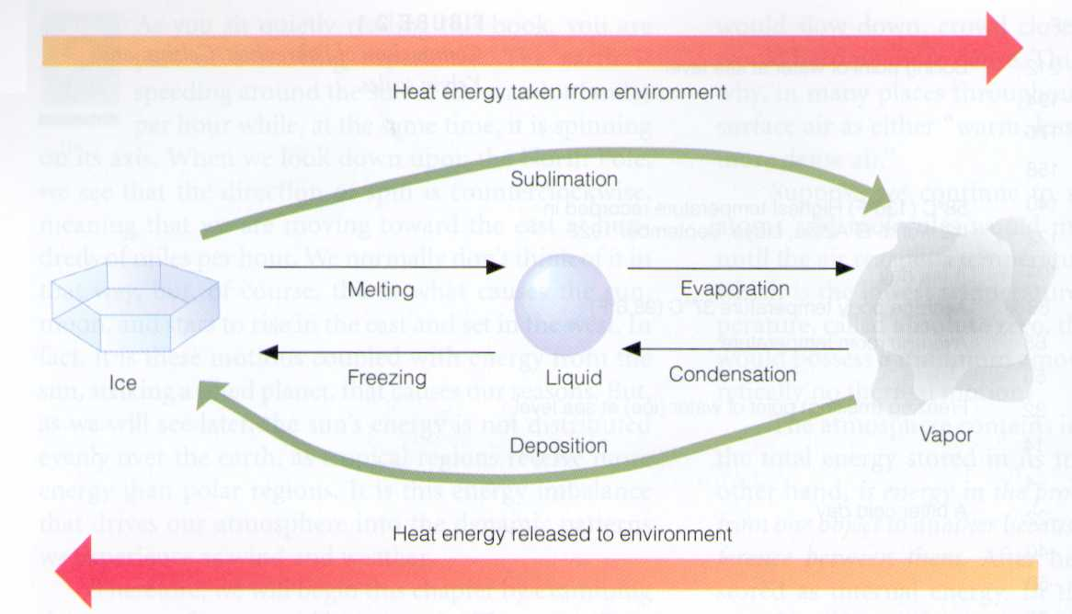
Know 4 Key Phase Changes

Slide 33
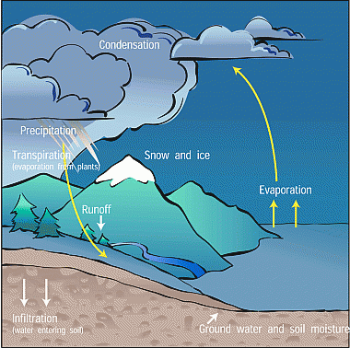
Global Water Cycle
Water vapor unusual substance as it can exist in all three phases in atmosphere
Main source of water vapor to atmosphere is through evaporation
(sun heats surface and evaporates the water there from oceans, etc)
Atmosphere then releases most of that water vapor back to surface through condensation which results in precipitation

Slide 34
Module 1 Review and Test Prep
Atmospheric composition
Atmospheric pressure, temperature, water vapor, winds
Rawinsonde/Radiosonde/Weather Balloon
Radar
Weather satellite
Planetary orbit
Atmospheric stability

Slide 35
Upper-Air Observing System
Rawinsondes are a critical data source for the National Weather Service
Provide vertical measurements of temperature, dewpoint temperature, pressure, windspeed, and wind direction
Components of Rawinsonde system include:
Balloon
Sensor package (met measurements)
Navigation/telemetry (GPS and receiver)
Analysis software

Slide 36
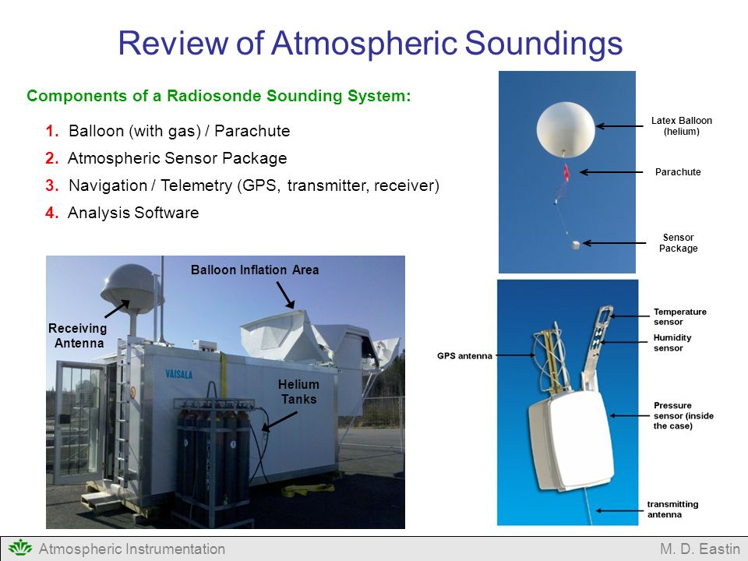

Slide 37
Module 1 Review and Test Prep
Atmospheric composition
Atmospheric pressure, temperature, water vapor, winds
Rawinsonde/Radiosonde/Weather Balloon
Radar
Weather satellite
Planetary orbit
Atmospheric stability

Slide 38
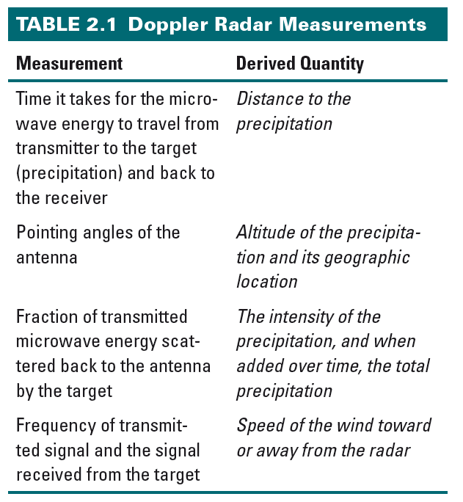

Slide 39
Module 1 Review and Test Prep
Atmospheric composition
Atmospheric pressure, temperature, water vapor, winds
Rawinsonde/Radiosonde/Weather Balloon
Radar
Weather satellite
Planetary orbit/seasons
Atmospheric stability

Slide 40
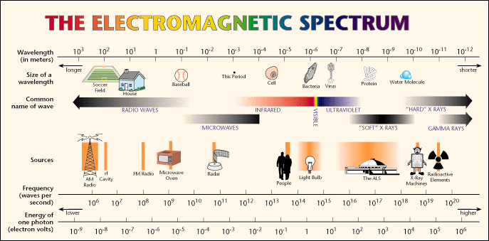
Types of Radiation

Slide 41
What Controls the Type of Radiation Emitted by an Object?
All objects emit electromagnetic radiation
Hotter objects emit shorter wavelengths of radiation
Cooler objects emit longer wavelengths of radiation
https://www.youtube.com/watch?v=nNzDXXUiqRs

Slide 42
Critical Aspects of Satellite Observations (Chapter 2)
satellite orbit
  Geostationary (GOES)
    ~36000 km above surface
    Remains fixed above particular point on equator
    Rotates with earth
  Polar (POES) (“low earth orbits”)
    ~850 km above surface
    Earth rotates beneath satellite (satellite is sun synchronous)
    Travels north and south over poles

Slide 43
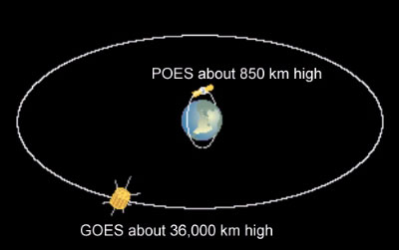
Polar vs. geostationary orbit

Slide 44
Satellite Observations (Chapter 2)
3 key portions of electromagnetic spectrum that sensor measures for weather satellite:
  Visible light (wavelength ~ .4 - .7 microns)
  Infrared (wavelength 10-11 microns)
  Water vapor (wavelength ~ 6-7 microns)
Satellite sensor sees radiation returned upwards from earth’s surface or top of clouds

Slide 45
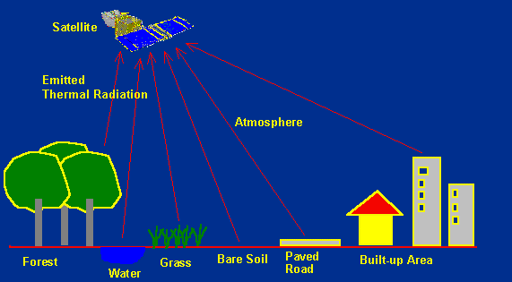
Satellite Receives Thermal Longwave Radiation from Earth

Slide 46
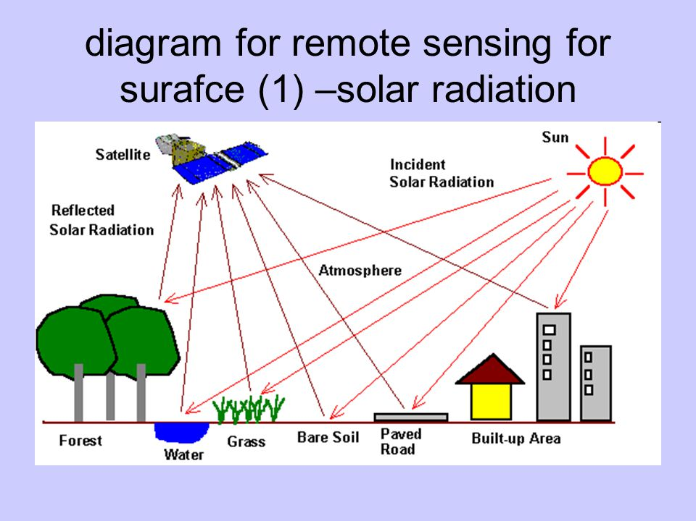
Satellite Receives Solar Shortwave Radiation from Sun Reflected off of Earth

Slide 47
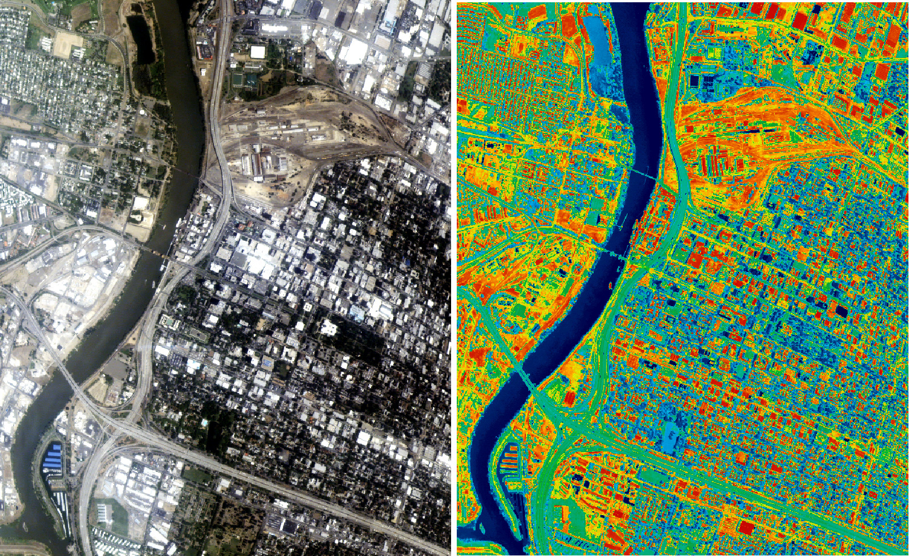
Visible ‘reflected solar’ image
IR thermal ‘heat’ image

Slide 48
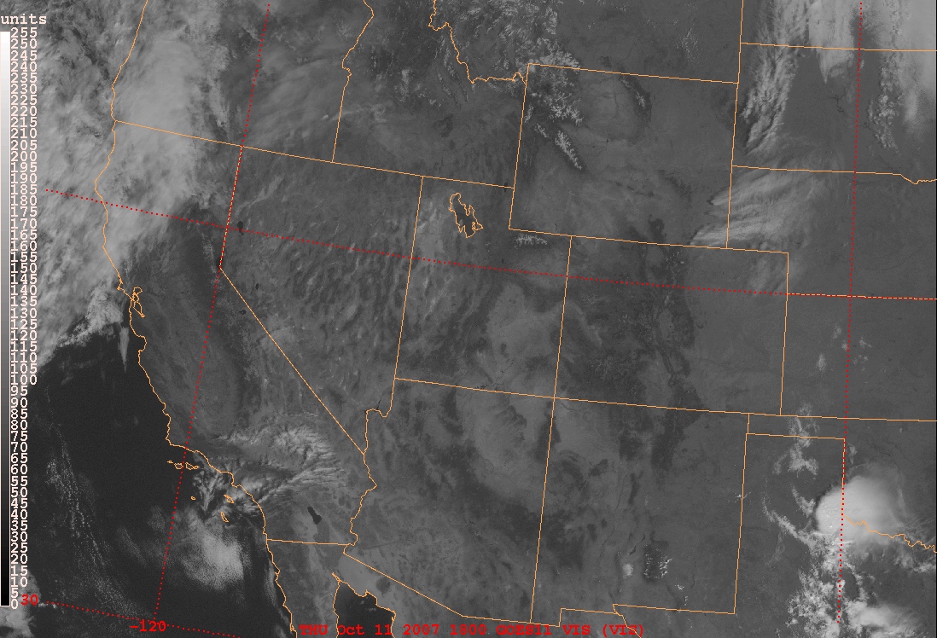
Broadband visible: GOES
Lots of reflected solar
Little reflected solar

Slide 49
Visible Satellite Observations
Broadband (all visible wavelengths .4-.7 micron)
Measures amount of light reflected upward from earth’s surface and from clouds
More reflective surfaces and thick clouds reflect more visible light
  Common convention is to display as white
Only useful during the day
Water surfaces, vegetation, and thin clouds reflect less visible light
  Common convention is to display as dark

Slide 50
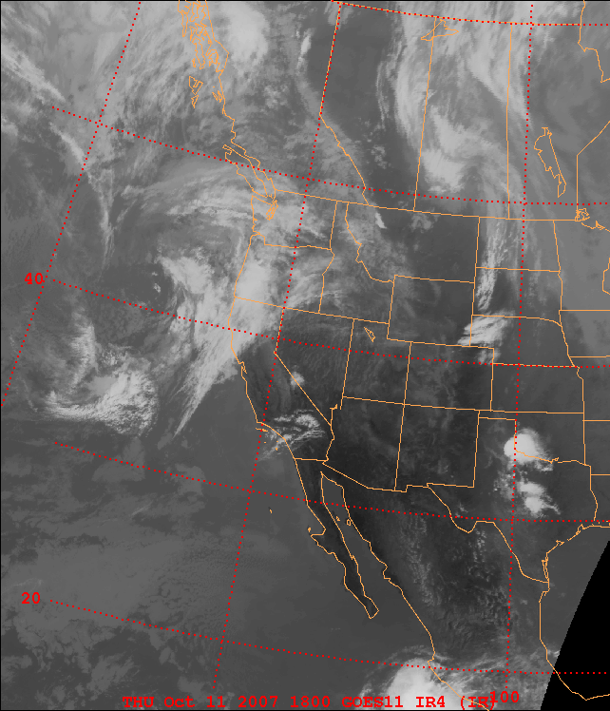
GOES Infrared
IR
image
Cold clouds
Warm ground

Slide 51
Infrared Satellite Observations
Sensor measures energy in 10-11 micron range
Measures amount of energy emitted upward from all earth objects (surface and clouds)
Directly related to temperature: warm objects emit lots of infrared; cold objects emit little
Available 24 hours
Common convention is to display:
  cold objects as white
  warm objects as dark

Slide 52

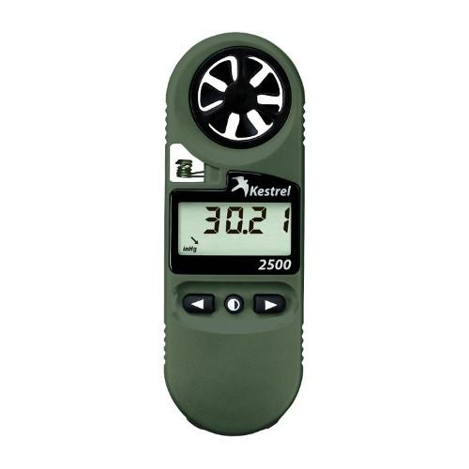
Using Infrared Sensor to Measure Temperature
Using Kestrel Hand-Held Weather Station
directly measures
Temperature via voltage changes in thermocouple
thermocouple
Mini satellite receiving
radiation
Object emitting radiation

Slide 53
Module 1 Review and Test Prep
Atmospheric composition
Atmospheric pressure, temperature, water vapor, winds
Rawinsonde/Radiosonde/Weather Balloon
Radar
Weather satellite
Planetary orbit/seasons
Atmospheric stability

Slide 54
3 Forms of Energy Transfer Mechanisms (Chapter 5 1st Section Only)
Radiation: Transfer of energy by electromagnetic waves
Conduction: Transfer of energy through direct physical contact
Convection: Transfer of energy by organized (macroscopic) fluid motions

Slide 55
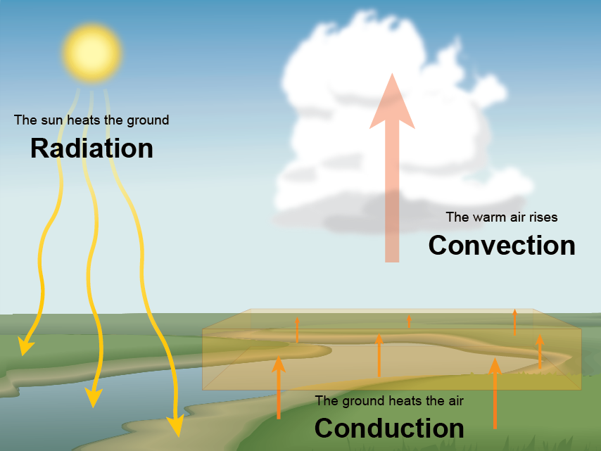

Slide 56
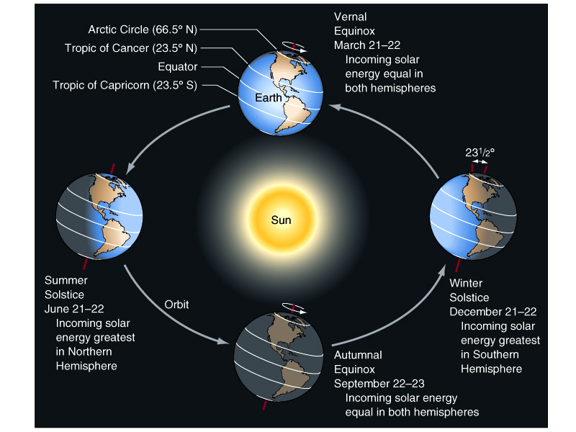
Notice how the north pole is always pointing toward the same part of the solar system (i.e., Polaris the north star)

Slide 57
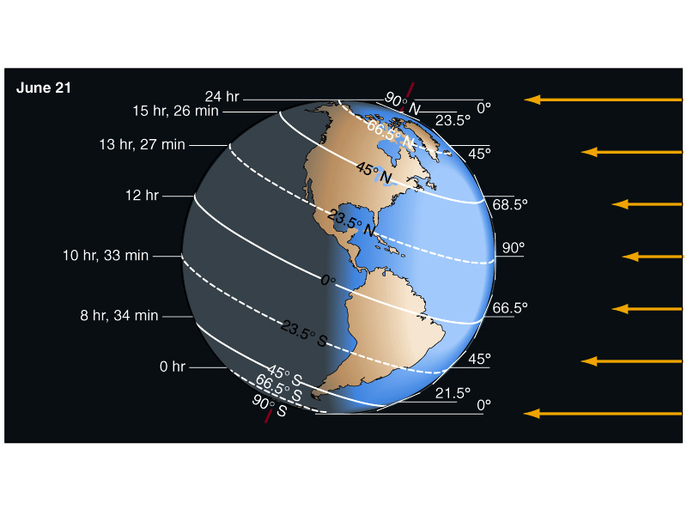
Northern Hemisphere Summer Solstice
Southern Hemisphere Winter Solstice

Slide 58
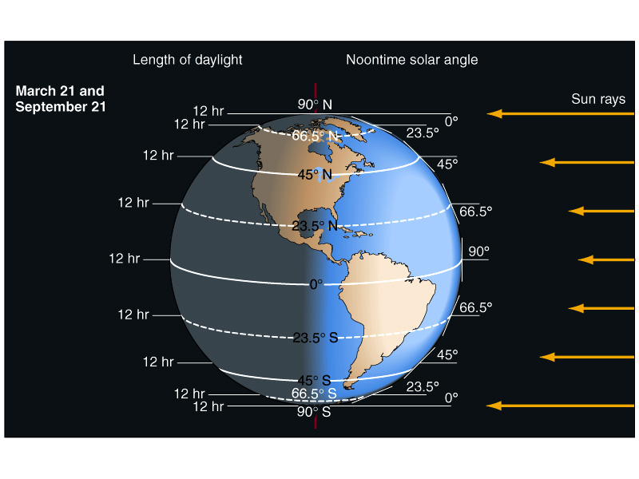
Equinox

Slide 59
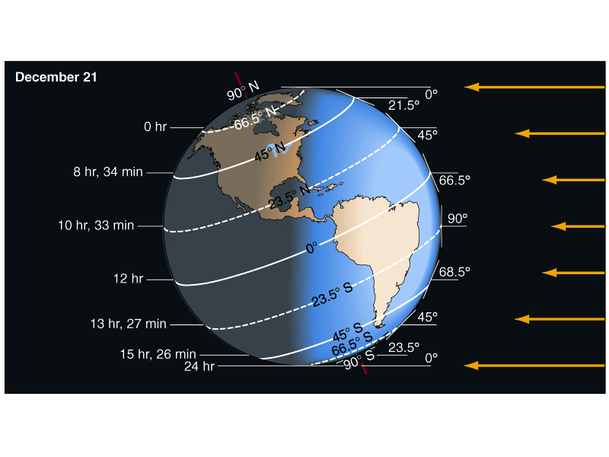
Northern Hemisphere Winter Solstice
Southern Hemisphere Summer Solstice

Slide 60
Module 1 Review and Test Prep
Atmospheric composition
Atmospheric pressure, temperature, water vapor, winds
Rawinsonde/Radiosonde/Weather Balloon
Radar
Weather satellite
Planetary orbit/seasons
Atmospheric stability

Slide 61
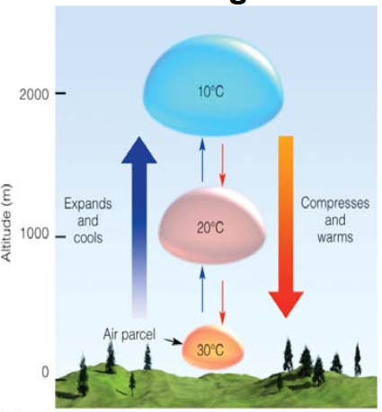

Slide 62
Dry Adiabatic Lapse Rate (DALR)
Dry: A dry air parcel is defined as unsaturated air (i.e., RH < 100%)
Adiabatic: No exchange of mass or energy with the environment (imagine a sealed balloon)
If these conditions are met, then the temperature of an air parcel will ALWAYS decrease at a rate of 10°C km⁻¹ (i.e., the DALR) if it is lifted upward.

Slide 63
How Does the Temperature of a Dry Air Parcel Change When it is Lifted?
2
1
0
Dry Adiabatic Lapse Rate (DALR)
= -10 °C km⁻¹
Altitude (km)
0 10 20
Temperature (°C)

Slide 64
How Does the Temperature of a Dry Air Parcel Change When it Forced Downward?
2
1
0
Dry Adiabatic Lapse Rate (DALR)
= +10 °C km⁻¹
Altitude (km)
0 10 20
Temperature (°C)

Slide 65
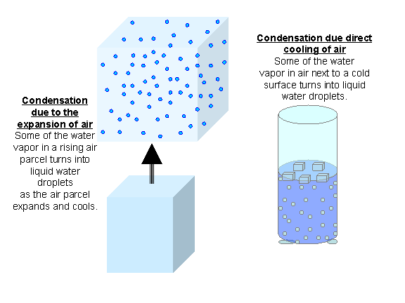
Moist Adiabatic Lapse Rate (MALR)
Moist: A moist air parcel is defined as saturated air (i.e., RH = 100%)
Condensation process “warms” parcel --offsetting rising and cooling process
Heat release from
phase change

Slide 66
Moist Adiabatic Lapse Rate (MALR)
Includes effects of latent heat release associated with phase changes as vapor condenses to water or ice (latent heat warms parcel).
Saturated parcel does not cool off as fast as it rises because condensation process heats the air, partially offsetting the simultaneous rising and cooling.
Moist Adiabatic Lapse Rate varies 6-8 °C km⁻¹

Slide 67
How Does the Temperature of an Moist Air Parcel Change When it is Lifted?
2
1
0
MALR
What is the relative humidity in this layer?
RH = 100%
Altitude (km)
What is the relative humidity in this layer?
DALR
RH < 100%
0 10 20
Temperature (°C)

Slide 68
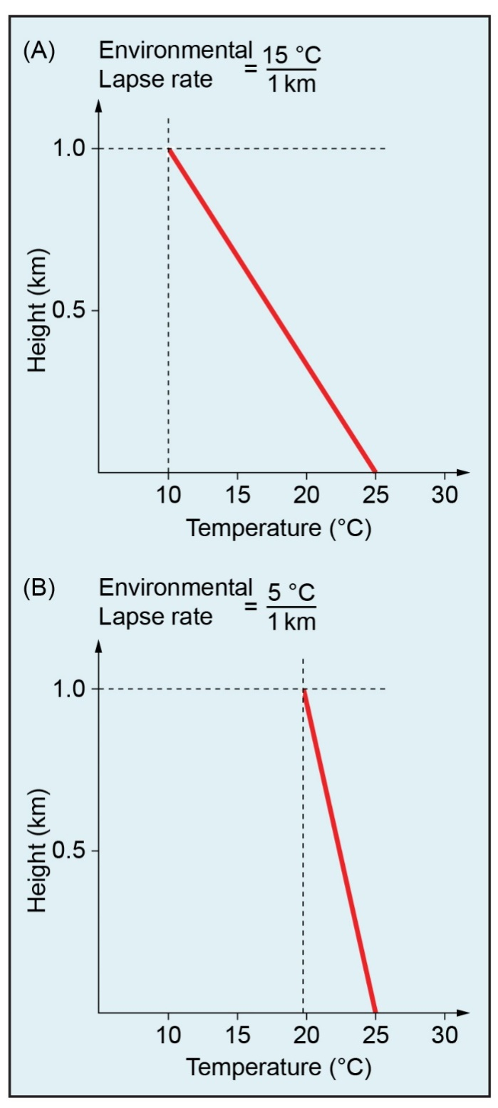
Example Environmental Lapse Rates
Temperature decreases (lapses) with increasing altitude
(be able to read lapse rate on these for test)

Slide 69
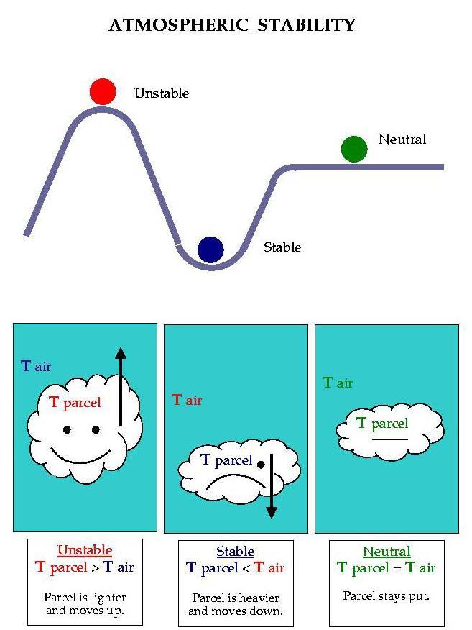
Putting it all together…
Parcel + environmental temperature

Slide 70
Atmospheric Stability
We think of stability in terms of how a parcel of air behaves in its environment
If a parcel temperature is warmer than its environment it is unstable (and will rise)
If a parcel temperature is cooler than its environment it is stable (and will sink)
If a parcel is the same temperature as its environment it is neutral (and will not rise or sink)

Slide 71
Determining Atmospheric Stability (Example #1: Isothermal Atmosphere)
= Rawinsonde (environment)
= Air Parcel
Is the air parcel colder or warmer than the environment after it has been lifted?
2
1
0
Colder
Is the air parcel more or less dense than the environment?
Altitude (km)
More Dense
Will the air parcel rise, sink, or remain stationary?
Sink
Is the atmosphere stable, unstable, or neutral?
Stable
0 10 20
Temperature (°C)

Slide 72
Determining Atmospheric Stability (Case #2: ELR > DALR)
= Rawinsonde (environment)
= Air Parcel
Is the air parcel colder or warmer than the environment after it has been lifted?
2
1
0
Colder
Is the air parcel more or less dense than the environment?
Altitude (km)
More Dense
Will the air parcel rise, sink, or remain stationary?
Sink
Is the atmosphere stable, unstable, or neutral?
Stable
0 10 20
Temperature (°C)

Slide 73
Determining Atmospheric Stability (Case #3: ELR = DALR)
= Rawinsonde (environment)
= Air Parcel
Is the air parcel colder or warmer than the environment after it has been lifted?
2
1
0
Same
Is the air parcel more or less dense than the environment?
Altitude (km)
Same
Will the air parcel rise, sink, or remain stationary?
Remain Stationary
0 10 20
Is the atmosphere stable, unstable, or neutral?
Neutral
Temperature (°C)

Slide 74
Determining Atmospheric Stability (Case #4: ELR < DALR)
= Rawinsonde
= Air Parcel
Is the air parcel colder or warmer than the environment after it has been lifted?
2
1
0
Warmer
Is the air parcel more or less dense than the environment?
Altitude (km)
Less Dense
Will the air parcel rise, sink, or remain stationary?
Rise
Is the atmosphere stable, unstable, or neutral?
Unstable
0 10 20
Temperature (°C)

Slide 75
Determining Atmospheric Stability (Case #5: Temperature Inversion)
= Rawinsonde
= Air Parcel
Is the air parcel colder or warmer than the environment after it has been lifted?
2
1
0
Colder
Is the air parcel more or less dense than the environment?
Altitude (km)
More Dense
Will the air parcel rise, sink, or remain stationary?
Sink
Is the atmosphere stable, unstable, or neutral?
Stable
0 10 20
Temperature (°C)

Slide 76
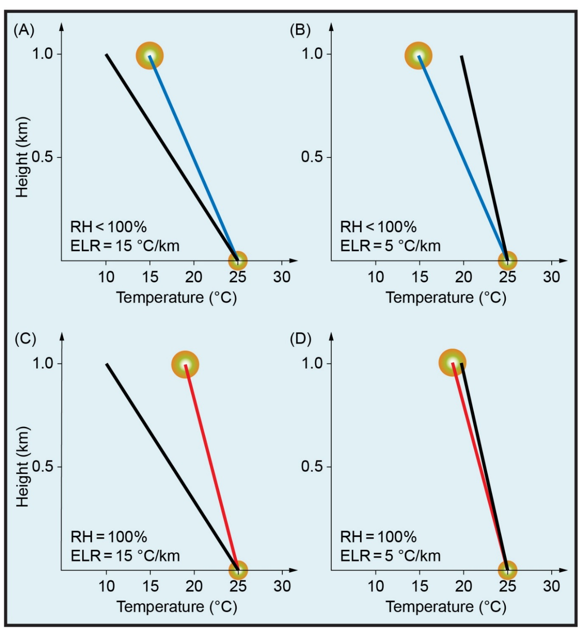
Parcel vs Environment
UNSTABLE
STABLE
DRY
Black line = Environmental temperature
Red line = Saturated rising parcel temperature (MALR)
Blue line = Dry rising parcel temperature (DALR)
UNSTABLE
STABLE
SATURATED

