Slide 1
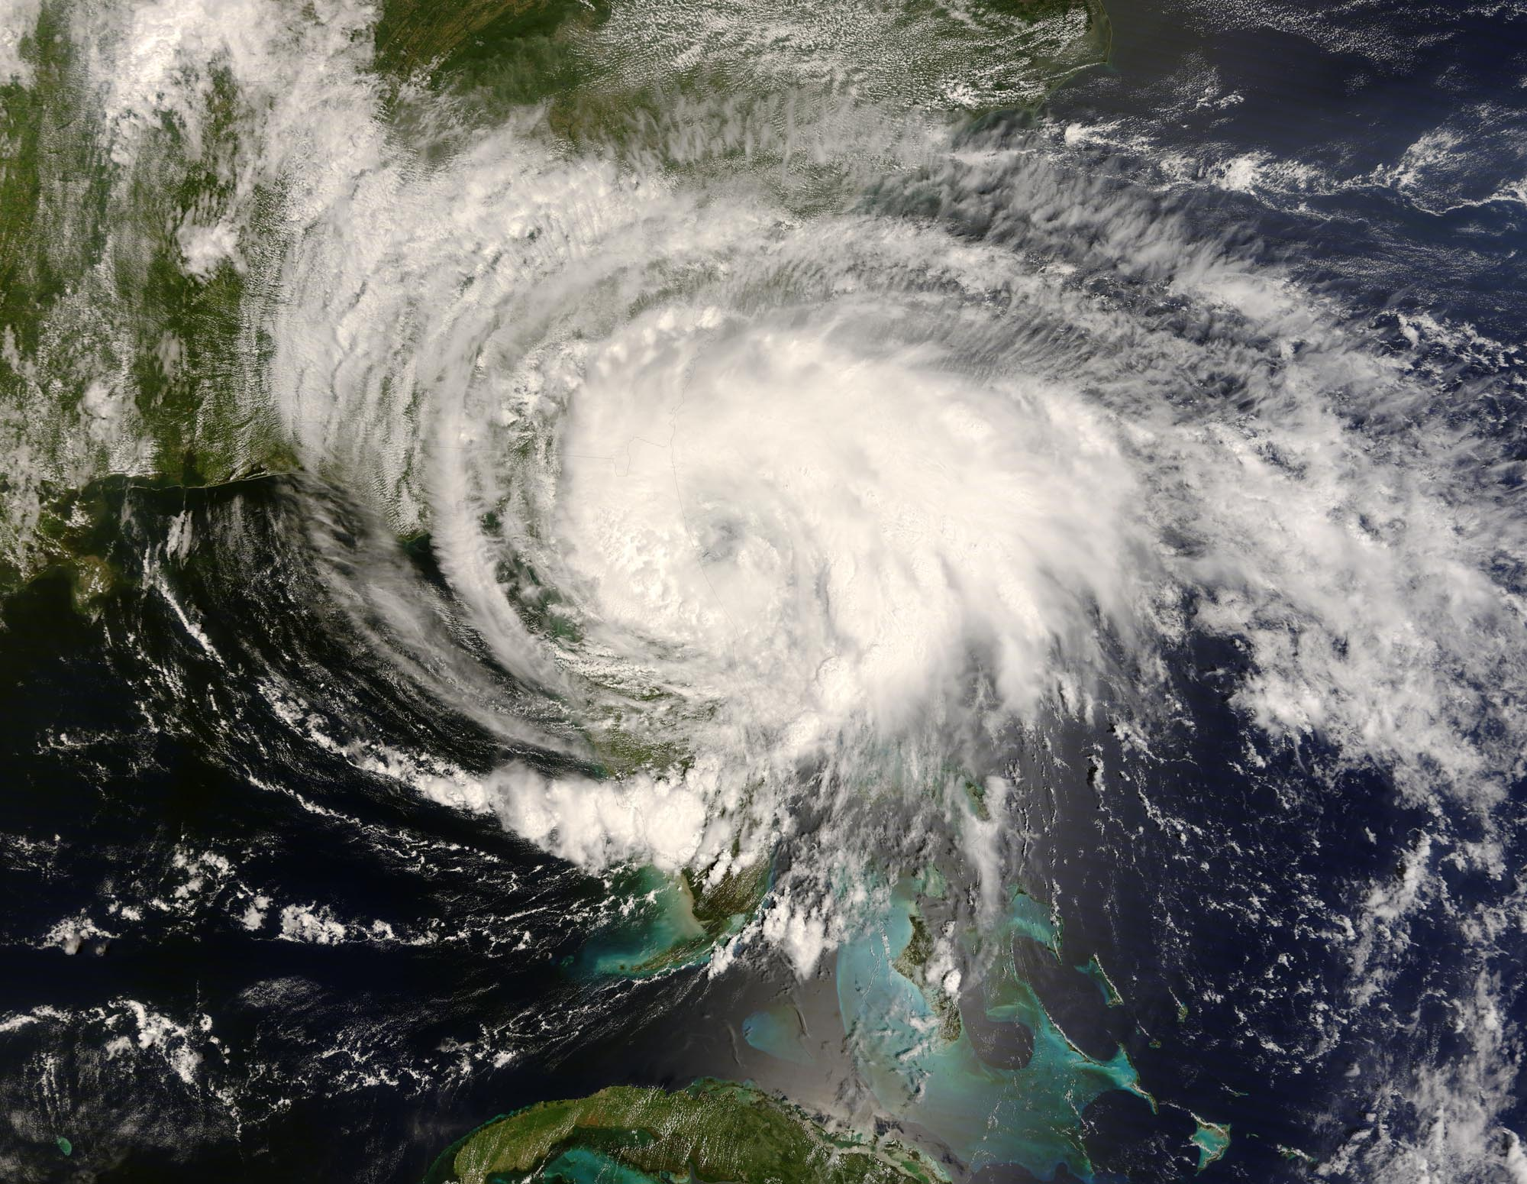
ATMOS 1010:
Severe and Unusual Weather
FASB 295 MW 11:50-1:10
Instructors: Erik Crosman, Research Assistant Professor
Taylor McCorkle, Graduate Research Assistant

Slide 2
Course Outline
Four blocks each lasting 3-4 weeks:
(1) The basics
    Properties of atmosphere, observing weather and global change
(2) Summer thunderstorms and other severe weather
    Leading cause of weather-related deaths in Intermountain Region
(3) Weather forecasting and mid-latitude cyclones
    Major impact on economy of Intermountain Region
(4) Clouds, snow, avalanches, and air quality
    Wasatch mountain ski weather!
Photo: D. Judd

Slide 3
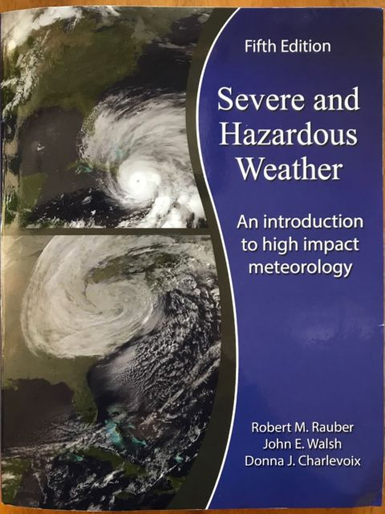
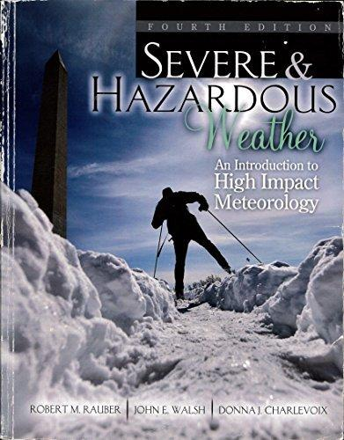
Course Textbook: Severe and Hazardous Weather (3rd, 4th, or 5th edition)
Library reserve copy available. Refer to
http://campusguides.lib.utah.edu/course_reserves_guide

Slide 4
During Each of the Four Blocks…
1-3 canvas-based quizzes or in-class required assignments
In-class exam review session
Practice exam
1 exam (final exam for module 4 is not comprehensive)

Slide 5
Grading: see syllabus
Lowest of 4 exam grades will be dropped
There are no makeup exams after the scheduled exam periods
With petition by the student at least two days in advance and instructor approval, a student may be able to schedule taking an exam early.
3 exams worth 60% of total grade
Assignments (in-class 15%; online quizzes 25%) worth 40% of total grade
THERE IS NO EXTRA CREDIT
Final grades are based on the following scale:
> 90 % guarantees an A or A-
> 80 % guarantees a B+, B, or B-
> 70 % guarantees a C+, C, or C-
> 60 % guarantees a D+, D, or D-
< 60% may result in an E
Cutoff points for the specific grades are identified to define reasonable distribution of grades

Slide 6
Daily Weather Discussion
Supposed to be fun and showcase current weather issues/events
First 10-20 minutes of class
Material in daily discussions will not be directly tested on, but goal will be that core class concepts will be solidified

Slide 7
More Properties of the Atmosphere (Chapter 1 + 2)
Pressure variation with height
Temperature variation with height
Water vapor/moisture and clouds
Wind
Measuring atmospheric properties in space and time

Slide 8
Module 1 Topics/Text Reference
Properties of the atmosphere (Chapter 1)
Meteorological measurements (Chapter 2; Surface station beginning Chapter 3)
Radiation and the seasons (start of Chapter 5)
Atmospheric stability (Chapter 6)
Forces and force balances (Chapter 7)

Slide 9
What’s Pressure?
Atmospheric pressure - force (weight) of column of air above a 1 m² surface
Depends the most on the number of air molecules above you
Pressure ALWAYS decreases with height
(Temperature usually decreases with height)
1 m²

Slide 10
What is Pressure?
The force applied divided by the area over which the force is distributed (i.e., Force/Area)
Pressure in the atmosphere can be thought of as the weight of the gases that are above

Slide 11
Question from last class
Why don't I feel the miles of air above me that are crushing me down?
http://wtamu.edu/~cbaird/sq/2015/09/14/why-dont-i-feel-the-miles-of-air-above-me-that-are-crushing-me-down/
https://www.youtube.com/watch?v=xJHJsA7bYGc&index=6&list=RDQeAp3CuGjk8

Slide 12

Answer: Air is a fluid that acts in all directions at once, canceling out forces

Slide 13
Question from last class
“Air does not crush you down. As a fluid, air flows around you and tries to crush you in.”
Stand outside in a field and look straight up. You are looking at a one-hundred kilometer (62 mile) column of air that is being pulled down toward you by gravity.

Slide 14
This canceling of forces on your hand only happens if atmospheric air is able to reach both the palm and the back of your hand. If you remove the air that is pushing up on the back of your hand, there will no longer be a canceling of forces and you will experience 10 bowling balls worth of weight on your hand overall. You can partially experience this using a vacuum cleaner.
Vacuum is lowering pressure inside so that immense weight of atmosphere can push air into the tube.

Slide 15
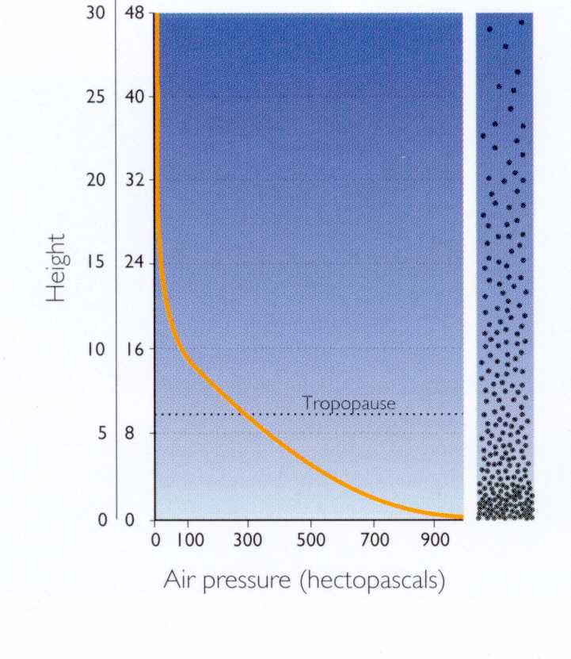
Pressure vs. Height

Slide 16
Practice Exercise
Top of Atmosphere
What is the approximate pressure at sea level?
0 atm ≈ 0 mb
What is the approximate pressure at the top of the atmosphere?
1 atm ≈ 1000 mb
Ground

Slide 17
Practice Exercise
Top of Atmosphere
The pressure at Salt Lake City averages about 0.85 atm (850 mb).
0 atm
What fraction of the atmosphere is ABOVE Salt Lake City?
Answer = 85%
0.85 atm ≈ 850 mb
1 atm
Ground

Slide 18
Practice Exercise
Top of Atmosphere
The pressure at Salt Lake City averages about 0.85 atm (850 mb).
0 atm
What fraction of the atmosphere is below Salt Lake City?
Answer = 15%
0.85 atm ≈ 850 mb
1 atm
Ground

Slide 19
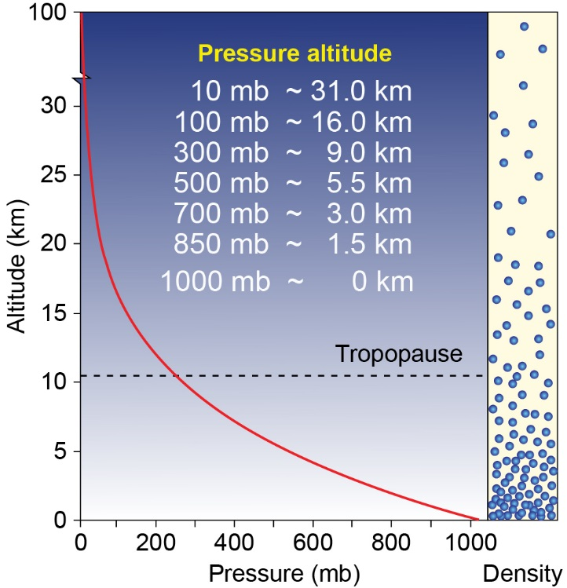
Decrease of pressure with height
Sea level

Slide 20
Decrease of pressure with height
1.5 km: Salt Lake

Slide 21
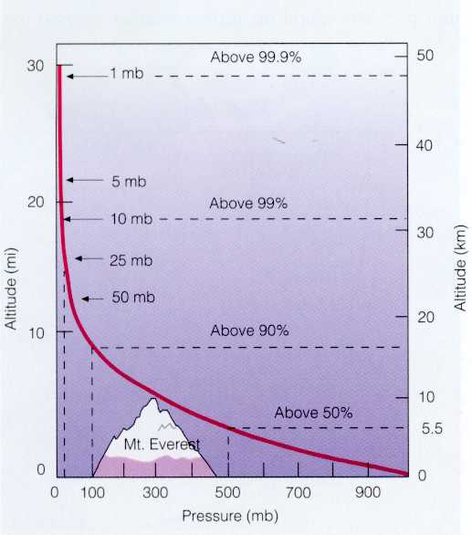
Why Does Pressure Decrease Exponentially with Height?
Answer: Air is a compressible gas. The air at the bottom of the atmosphere is compressed into a smaller volume due to the higher pressure.

Slide 22
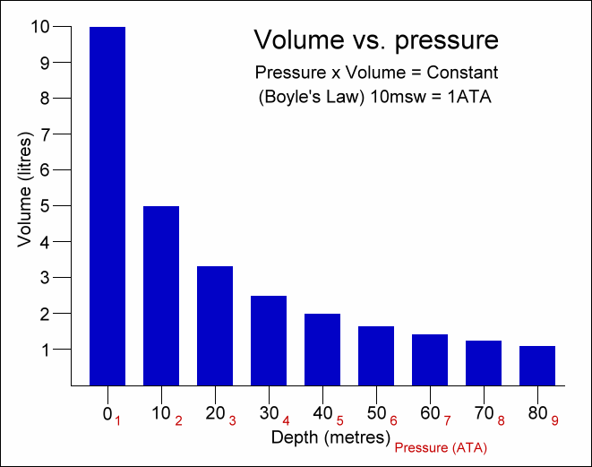
Large Increases in Pressure Underwater

Slide 23
What’s Temperature?
Measure of the vibrational energy of molecules in solids or the average speed at which molecules in a gas (or liquid) move
Cold air: air molecules are moving slower
Hot air: air molecules are moving faster
Jiggling atoms video demonstration
https://www.youtube.com/watch?v=StLulh_KKd0

Slide 24
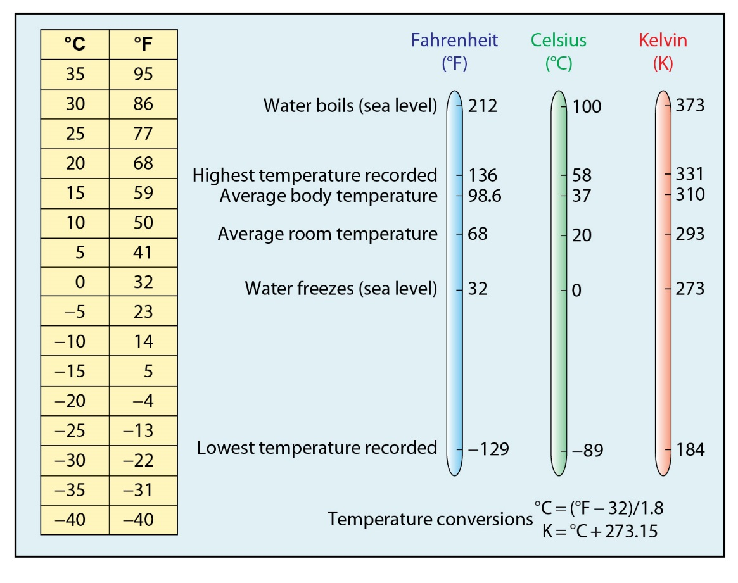
Temperature

Slide 25
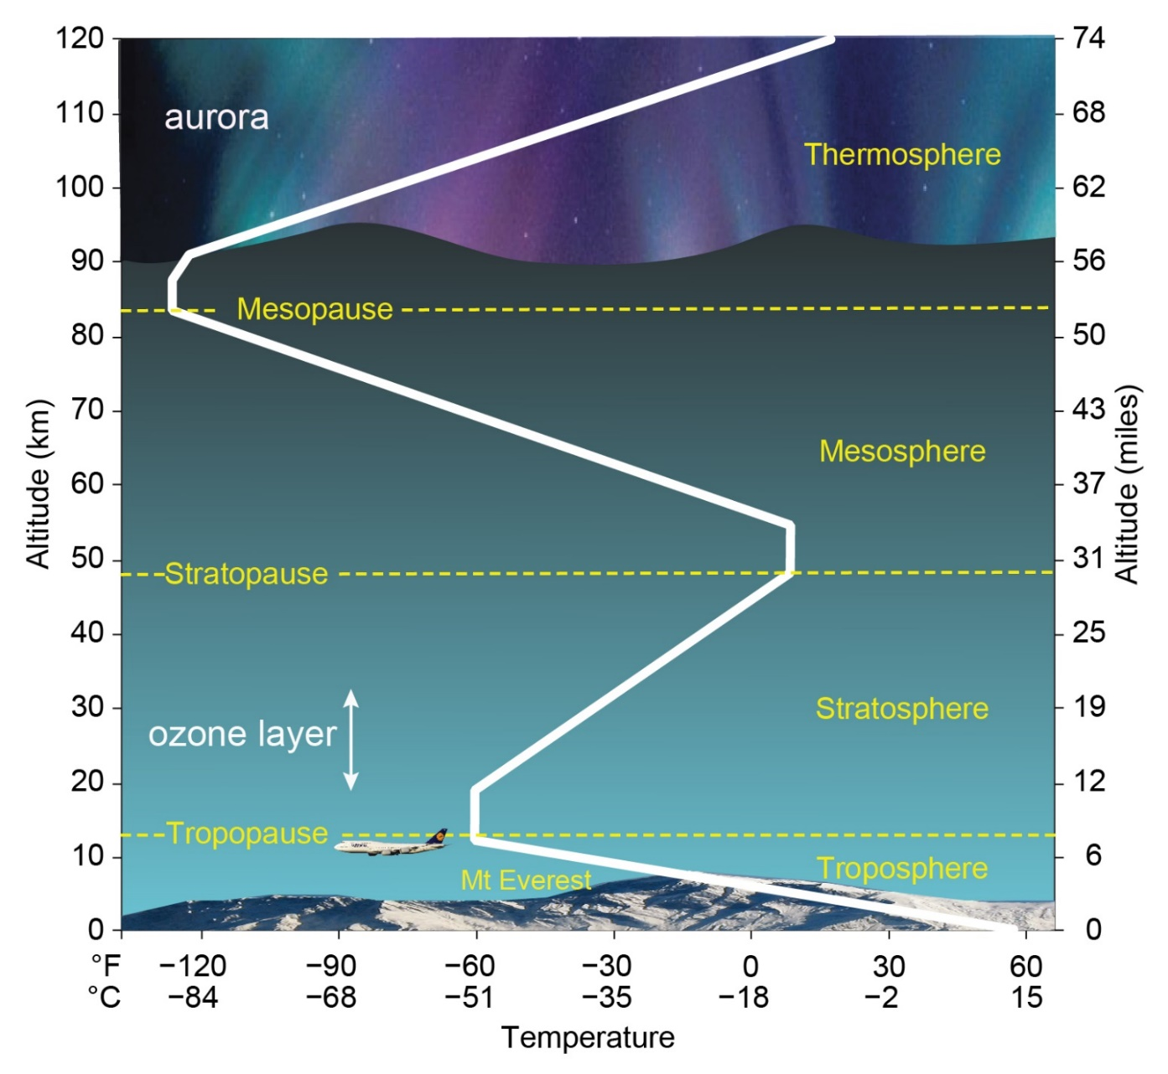
Variation in Temperature with Height

Slide 26
Variation in Temperature with Height
Layer of air in the lower atmosphere where temperature decreases with height is caused troposphere. This is where most
Of our “weather” occurs.
Layer of air above called stratosphere where temperature increases with height due to solar radiation being absorbed by ozone

Slide 27
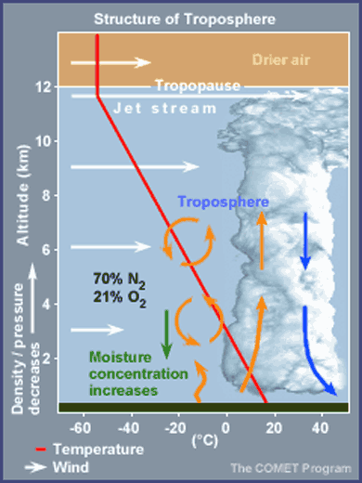

Slide 28
Variation in Temperature with Height
Most of the “weather” that we will be studying in this class happens within the troposphere (0 – 10 km)
Typically the temperature
decreases with height in this lower layer (troposphere)

Slide 29
Variation in Temperature with Height
Tropopause-
Boundary between the troposphere and stratosphere

Slide 30
Water in the Atmosphere
Only substance than can exist as a solid, liquid, and gas
Water vapor is odorless, colorless, and invisible
The water vapor concentration can be described by the dewpoint temperature or the relative humidity
Water vapor is a critical ingredient for most weather of interest

Slide 31
Water Can Exist in the Atmosphere in three different phases:
1. Gas
2.Liquid
3. Solid
Air contains water vapor and clouds contain liquid water and ice (solid)
Phase changes: water to vapor (evaporation) vapor to water (condensation) ice to water (melting) water to ice (freezing) ice to vapor (sublimation) vapor to ice (deposition)

Slide 32
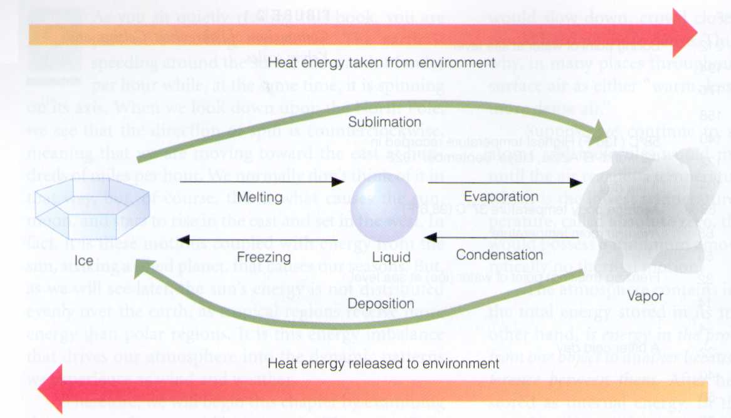
Changes of Phase

Slide 33
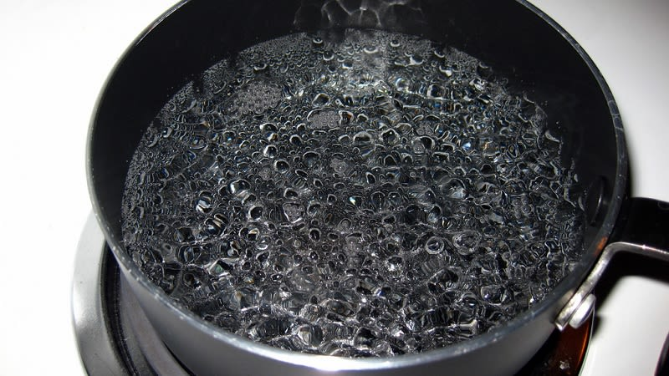
Understanding “Latent Heat”
Take a pot of water and boil on stove; takes ~ 10 minutes
Take a boiling pot of water and let it all evaporate? Takes longer
Energy is needed from the environment
(e.g., hot burner) to boil or evaporate water
If you took hot water and cooled in freezer until water turned to ice, energy is released from the hot water
into the surrounding air
Water has higher energy state;
ice has lower energy state

Slide 34

NASA Video: Earth's Water Cycle https://pmm.nasa.gov/education/videos/earths-water-cycle

Slide 35
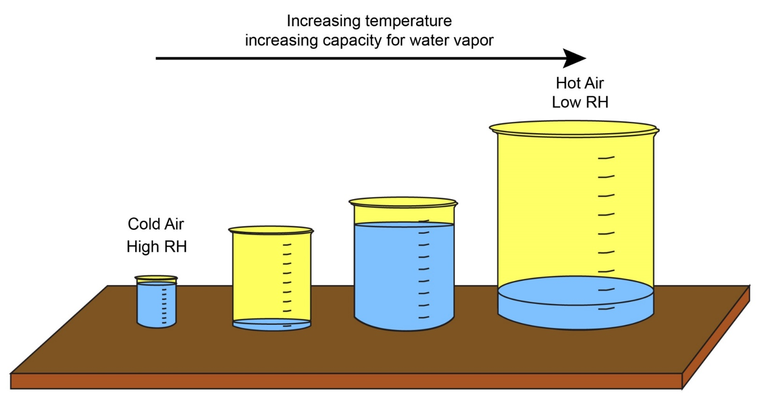
Saturation Vapor Pressure
The maximum amount of water vapor that can exist in an air parcel
Controlled by temperature

Slide 36
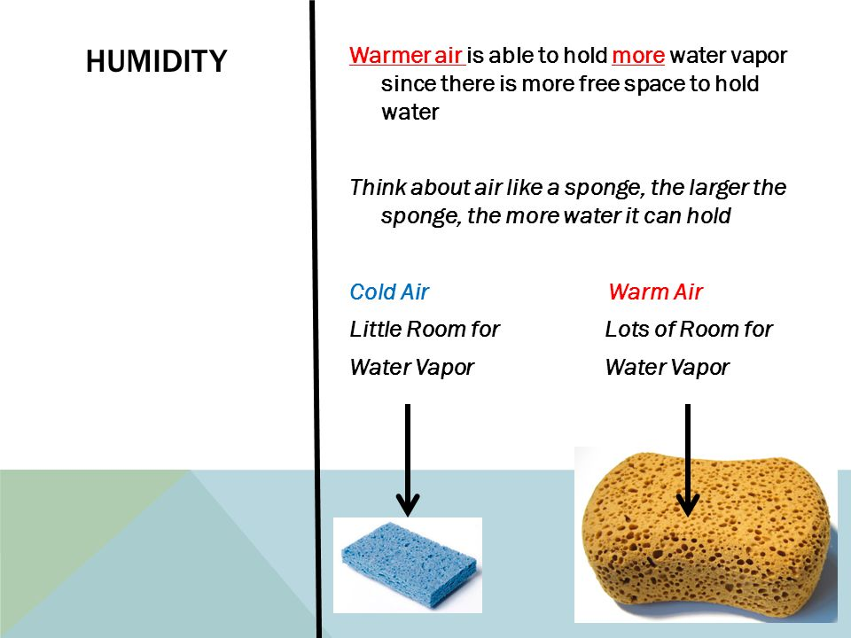
Saturation Vapor Pressure
The maximum amount of water vapor that can exist in an air parcel
Controlled by temperature

Slide 37
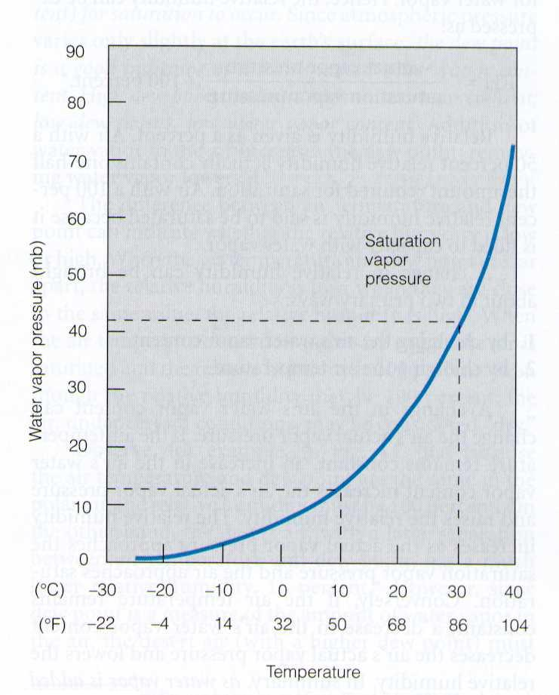
Saturation Vapor Pressure of H₂O

Slide 38
Dewpoint Temperature
The temperature to which an air parcel must be cooled (at constant pressure) for it to become saturated (RH=100%)
High dewpoint temperatures indicate high moisture contents
Low dewpoint temperatures indicate low moisture contents

Slide 39
Relative Humidity
RH definition: Amount of water vapor in the atmosphere relative to atmosphere’s capacity for moisture at a given temperature
Indicates how close you are to saturation
High RH indicates that the air is close to saturation
Low RH indicates that the air is far from saturation

Slide 40
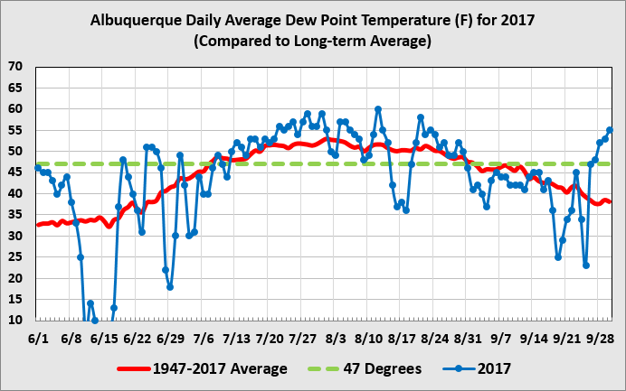
RH is not a good measure of how much moisture is in the air. A very low RH airmass in a hot locale can have a higher moisture content than a high RH airmass in a cold locale
Dew point temperature is a good measure of how much moisture the air can hold
“monsoon indicator”
higher dewpoint
temperature → greater
moisture to fuel thunderstorms

Slide 41
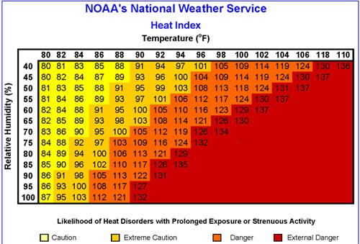
Deadly Combination of Heat and High Relative Humidity
High dew points are uncomfortable because the air's humidity slows the evaporation of perspiration from your body, which is nature's way of cooling you off. The National Weather Service calculates the heat index, which doesn't measure the actual air temperature, but rather what the humidity makes the air “feel like

Slide 42
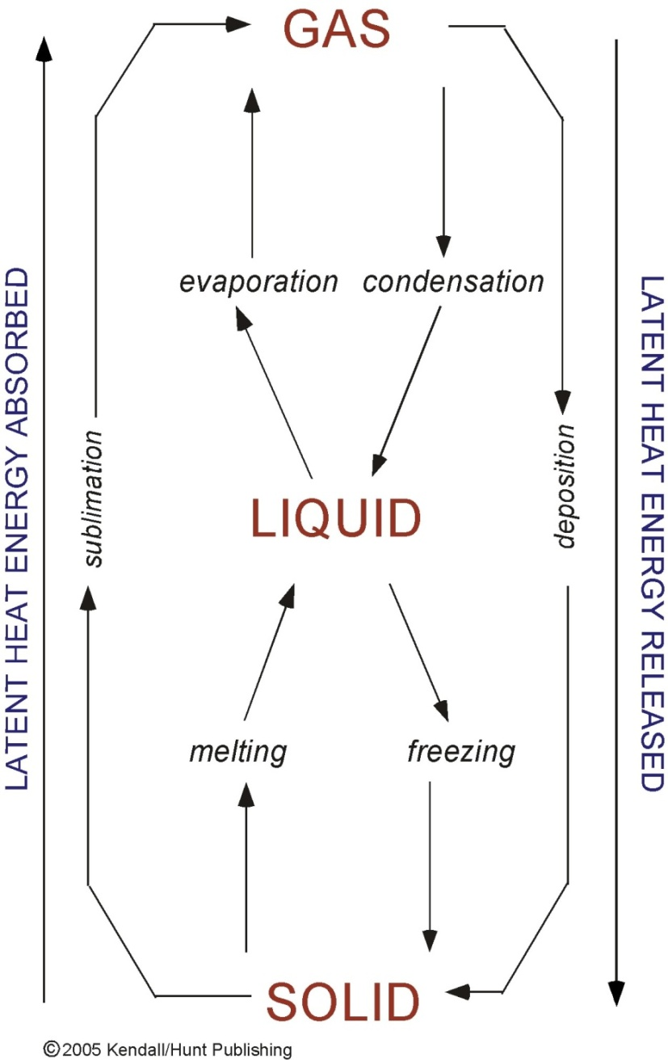
Water Can Exist in Atmosphere as Gas, Liquid, Solid
Invisible
Visible

Slide 43
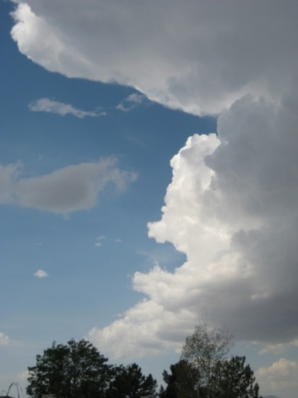
What is a Cloud?
An aggregate of minute suspended particles of water or ice, or both, that are in sufficient concentrations to be visible
Characteristics:
clouds are tenuous and transitory
most small clouds in the lower atmosphere exist for only a few minutes
life cycle of larger clouds typically order 30 minutes
https://www.youtube.com/watch?v=232LFz-aiz4

Slide 44
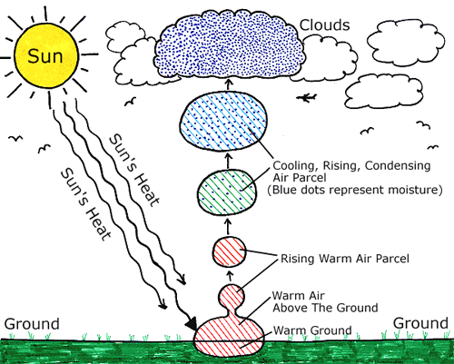
Cloud Formation (discussed more later)

Slide 45
Measuring the Amount of Clouds
How much of the sky dome is covered?
  Clear < 10% of the sky
  Scattered: 10-50% of the sky
  Cloudy: 50-90% of the sky
  Overcast: > 90% of the sky

