Slide 1
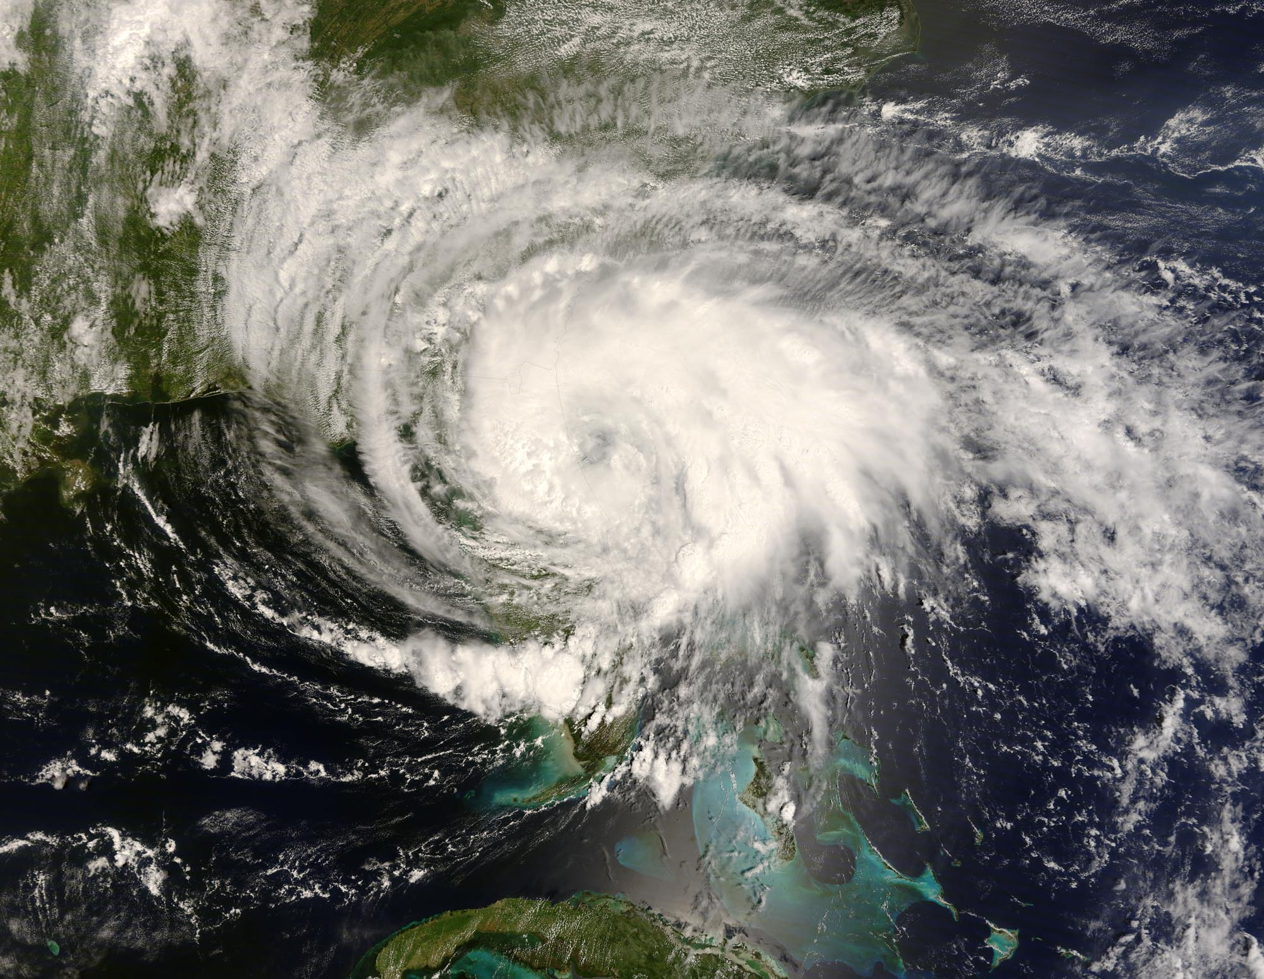
ATMOS 1010: Severe and Unusual Weather FASB 295 MW 11:50-1:10
Instructors: Erik Crosman, Research Assistant Professor
Taylor McCorkle, Graduate Research Assistant

Slide 2
Assignments
Chapter 1 + 2 Quiz Canvas due This Friday 7 Sept
In-class exercise 2 (today)
Chapter 5, 6 Quiz Canvas due 14 Sept
Module 1 Practice test/study guide
Module 1 review/test prep 12 Sept
Module 1 test (in class) 17 Sept

Slide 3
Module 1 Test
Focus on making sure you understand PPT slides on canvas through 10 Sept.
Use study guide on canvas in concert with PPT presentations
Make sure you understand all of the quiz and practice test problems
Test will have several questions from quizzes and practice test repeated verbatim
Several questions from test will be variations on quiz and practice test problems

Slide 4
Module 1 Test Review
Class period, Wednesday 12 September
Bring any questions you have! (there are no stupid questions).
We will work through some practice test questions, etc.
Email me if you have any questions and want to meet one-on-one to discuss.
I will be available after class each day as well.

Slide 5
Test 1
Entire class period, Monday September 17th
No notes or textbook allowed.
Scantron true, false, or multiple choice (see practice test.
50 questions (2 points each).
Look at study guide for few quantitative numbers, etc you need to memorize.

Slide 6
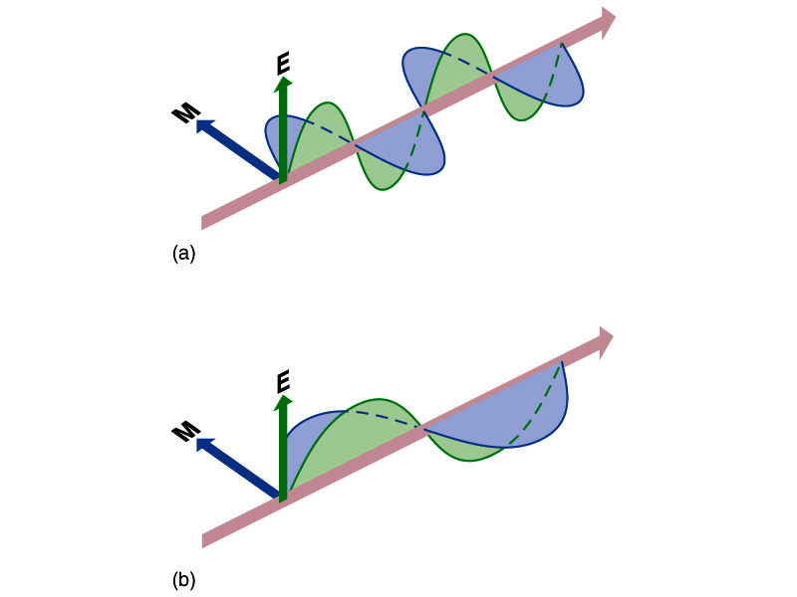
What is Radiation? (Start of Chapter 5)
Transfer of energy by electromagnetic waves
Doesn’t require a medium for transport
Travels at the speed of light 186,000 miles per second!
Only takes 8.5 minutes to travel from the sun to the Earth

Slide 7
Types of Radiation

Slide 8
What Controls the Type of Radiation Emitted by an Object?
All objects emit electromagnetic radiation
Hotter objects emit shorter wavelengths of radiation
Cooler objects emit longer wavelengths of radiation
https://www.youtube.com/watch?v=nNzDXXUiqRs

Slide 9
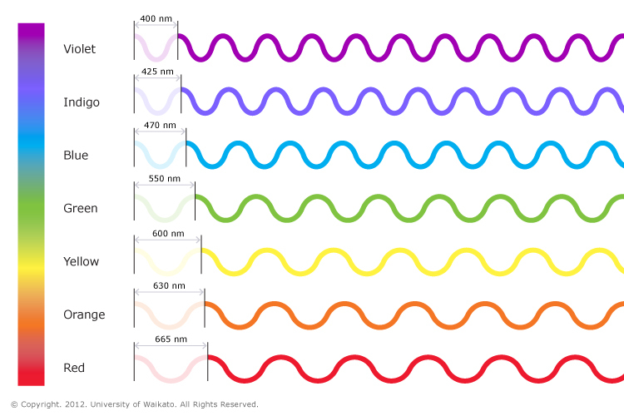
Shortwave solar radiation from sun Temperature = 9,941 F
Longwave radiation from Earth
Temperature 58 F

Slide 10
Satellite Receives Thermal Longwave Radiation from Earth

Slide 11
Satellite Receives Solar Shortwave Radiation from Sun Reflected off of Earth

Slide 12
Visible ‘reflected solar’ image
IR thermal ‘heat’ image

Slide 13
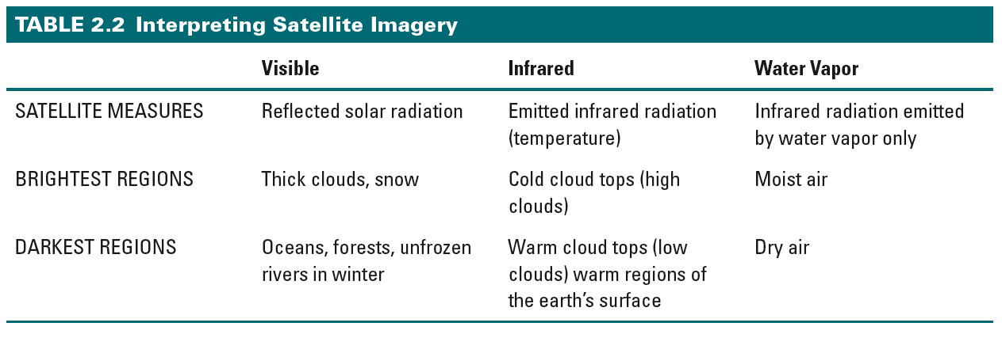
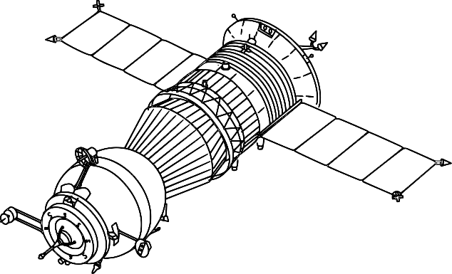
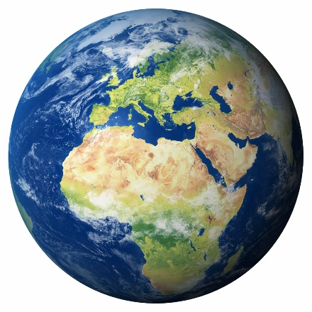
Reflected
Solar radiation
Solar radiation
Longwave radiation
from Earth

Slide 14
Satellite Observations (Chapter 2)
Portion of electromagnetic spectrum that sensor measures
Visible light (wavelength ~ .4 - .7 microns)
Infrared (wavelength 10-11 microns)
Water vapor (wavelength ~ 6-7 microns)
Satellite sensor sees radiation returned upwards from earth’s surface or top of clouds
If atmosphere or clouds absorb radiation before it reaches top of atmosphere, then sensor can not detect it

Slide 15
Visible Satellite Observations
Broadband (all visible wavelengths .4-.7 micron)
Measures amount of light reflected upward from earth’s surface and from clouds
More reflective surfaces and thick clouds reflect more visible light
Common convention is to display as white
Only useful during the day
Water surfaces, vegetation, and thin clouds reflect less visible light
Common convention is to display as dark

Slide 16
Shortwave solar radiation from sun Temperature = 9,941 F
Longwave radiation from Earth
Temperature 58 F

Slide 17
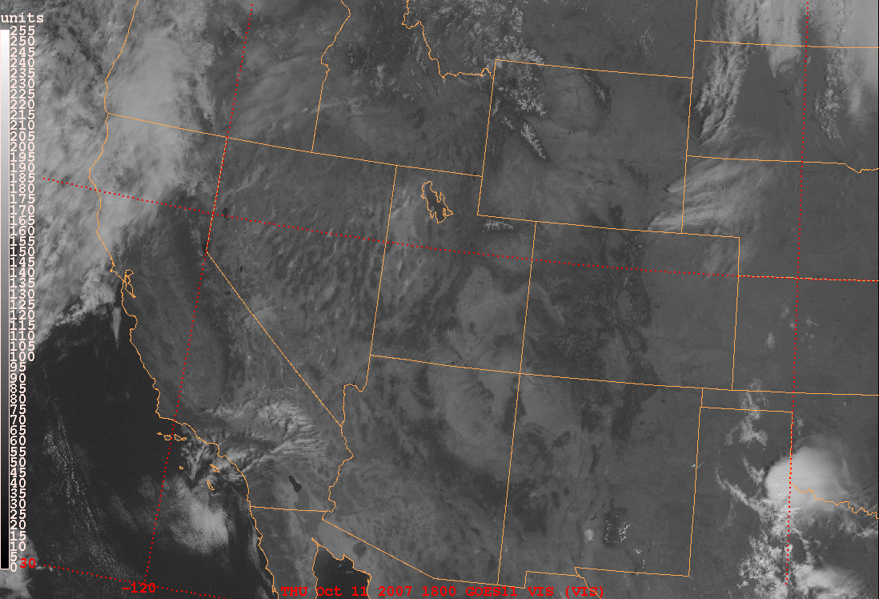
Broadband visible: GOES
Lots of reflected solar
Little reflected solar

Slide 18
Animation of Today’s Visible Imagery
http://weather.rap.ucar.edu/satellite/
Which areas are reflecting MORE solar radiation to the satellite?
--white areas on the image
Which areas are reflecting LESS solar radiation to the satellite?
--dark areas on the image

Slide 19
Infrared Satellite Observations
Sensor measures energy in 10-11 micron range
Measures amount of energy emitted upward from all earth objects (surface and clouds)
Directly related to temperature: warm objects emit lots of infrared; cold objects emit little
Available 24 hours
Common convention is to display:
cold objects as white
warm objects as dark

Slide 20
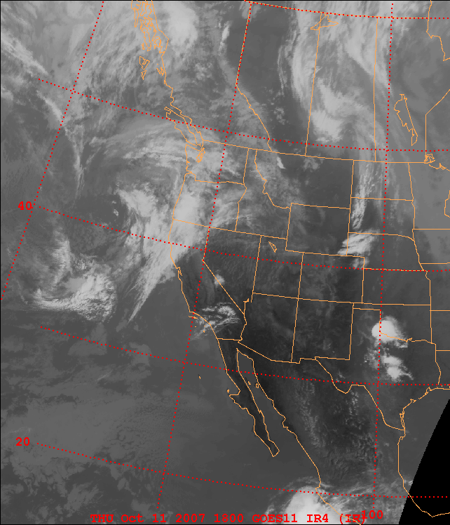
GOES Infrared
Cold clouds
Warm ground

Slide 21
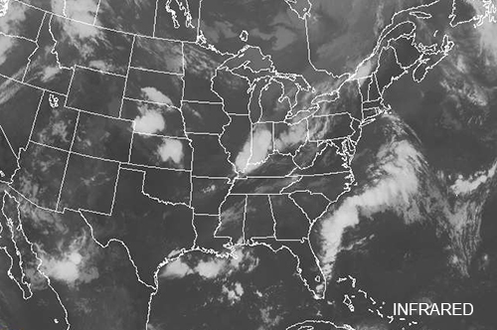
IR vs. Visible White (dark) = cold (warm) in IR White (dark) = more reflective (less reflective) in visible

Slide 22
Animation of Today’s IR Imagery
https://www.aviationweather.gov/satellite
Which areas are reflecting MORE infrared radiation (hotter surfaces) to the satellite?
--dark areas on the image
Which areas are reflecting LESS infrared radiation (cold surfaces) to the satellite?
--white areas on the image

Slide 23
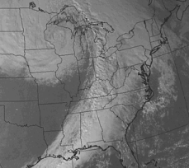
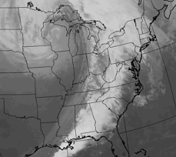
Comparing IR and Visible Imagery
http://ww2010.atmos.uiuc.edu/(Gh)/guides/rs/sat/img/irvis.rxml

Slide 24
Water Vapor Satellite Observations
Sensor measures energy in 6-7 micron range
Measures amount of energy emitted upward primarily from invisible water vapor and visible cloud
Available 24 hours
Common convention is to display as white those areas where there is a lot of water vapor or cloud
Common convention is to display as dark those areas where there is a little water vapor or cloud
Most sensitive to water vapor from 3-10 km above earth’s surface

Slide 25
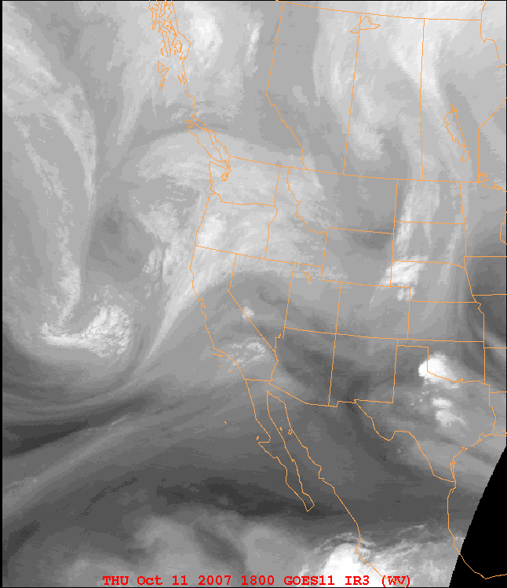
GOES Water Vapor
Lots of water vapor
Less water vapor

Slide 26
Energy Transfer Mechanisms (Chapter 5 1st Section Only)
Radiation: Transfer of energy by electromagnetic waves
Conduction: Transfer of energy through direct physical contact
Convection: Transfer of energy by organized (macroscopic) fluid motions
https://www.youtube.com/watch?v=WMYb5684Kp0

Slide 27
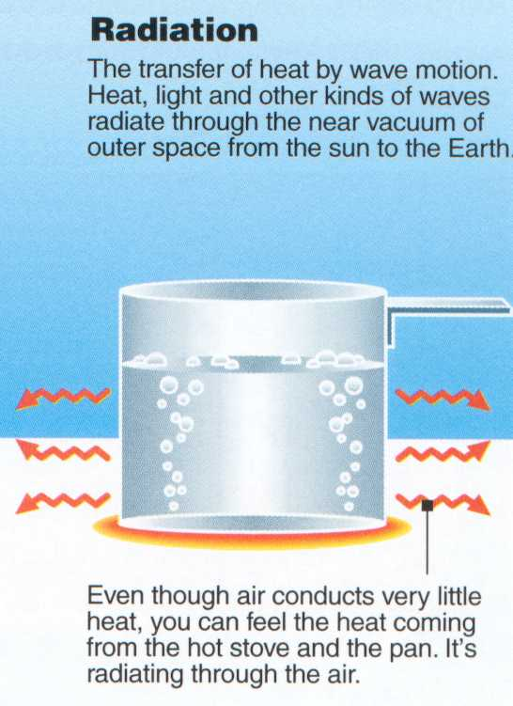
The same principle applies if you are sitting next to a campfire. You feel warm due to the absorption of infrared radiation emitted by the fire.

Slide 28
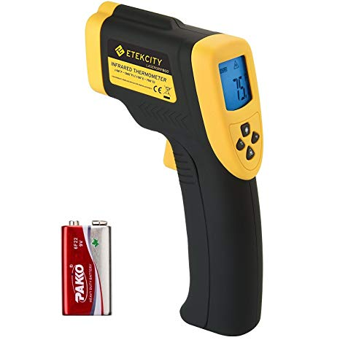
Measuring IR Radiation to Determine Temperature
Instrument senses IR radiation being
emitted → estimates object’s temperature

Slide 29
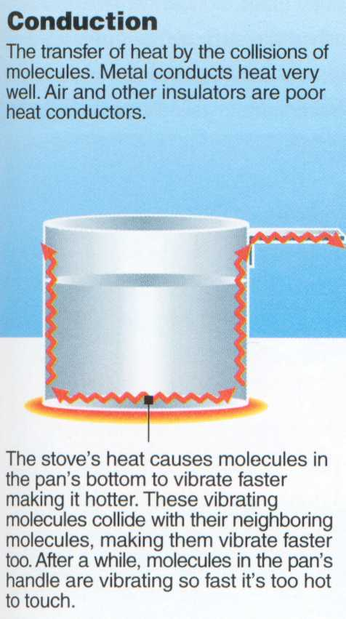
Good Conductors
Metal
Water
Snow
Poor Conductors
Air
Wood
Glass
Foam insulation

Slide 30
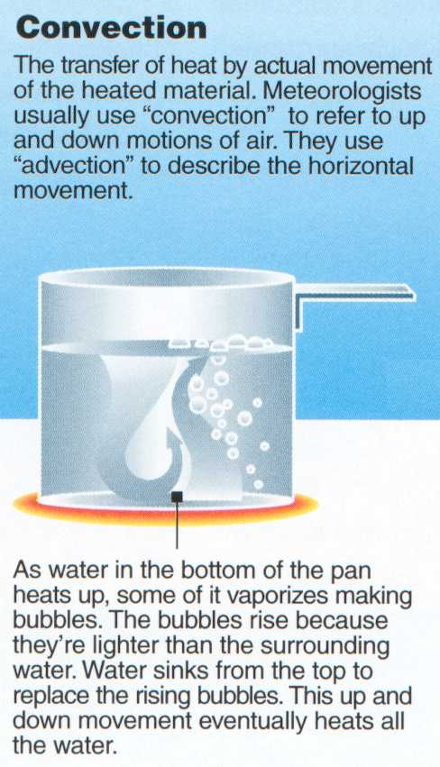
Sun
Cloud
Hot Air
Atmospheric Convection does not always have to form a cloud

Slide 31
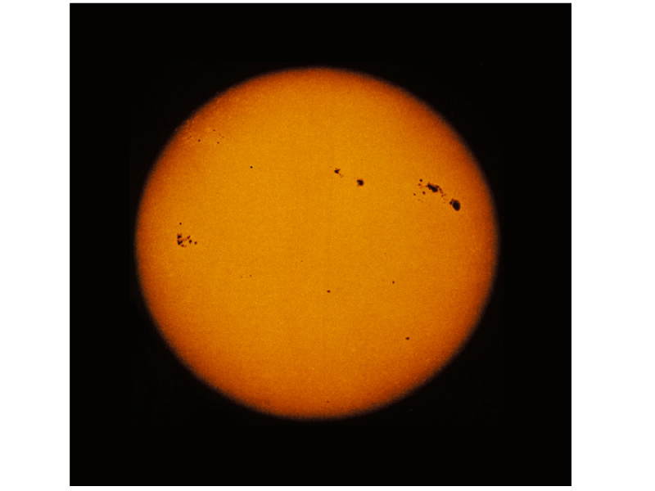
What is the Source of Most of Earth’s Energy?
The sun produces energy through nuclear fusion (i.e., fusing hydrogen into helium at immense temperatures and pressures)
Surface temperature is ~ 5800 K
Sun is the ultimate driver of Earth’s weather
Approximately 50% of earth is illuminated by sun at any given time
The Sun

Slide 33
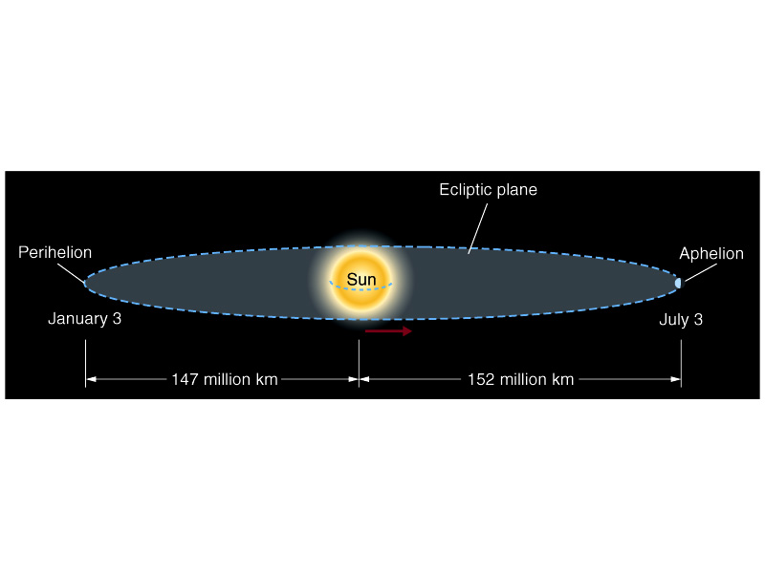
Earth’s Orbit is Not Circular
Aphelion distance is ~3.4% greater than the Perihelion distance
Earth is closest to the sun in January and farthest from the sun in July

Slide 34
What Causes the Seasons?
Changes in the length of the day/night
Changes in the sun angle
Both of these are caused by the 23.5° declination angle of the Earth
NP
NP
0° declination
23.5° declination
SP
SP

Slide 35
Different Seasons Video https://www.youtube.com/watch?v=WgHmqv_-UbQ

Slide 36
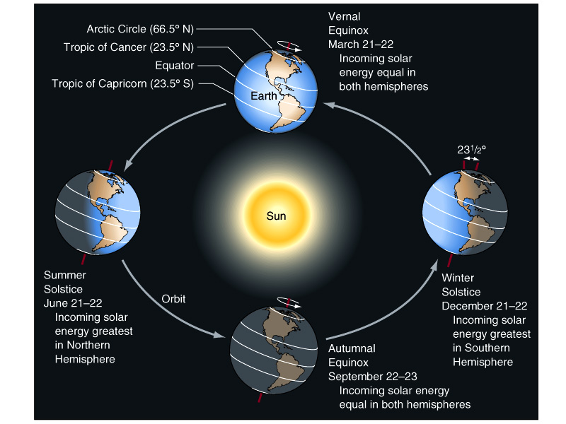
Notice how the north pole is always pointing toward the same part of the solar system (i.e., Polaris the north star)

Slide 37
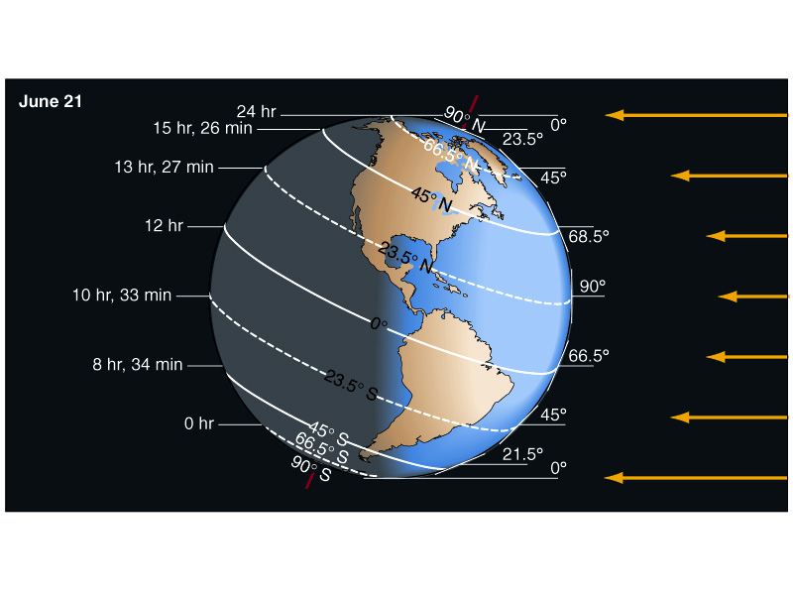
Northern Hemisphere Summer Solstice
Southern Hemisphere Winter Solstice

Slide 38
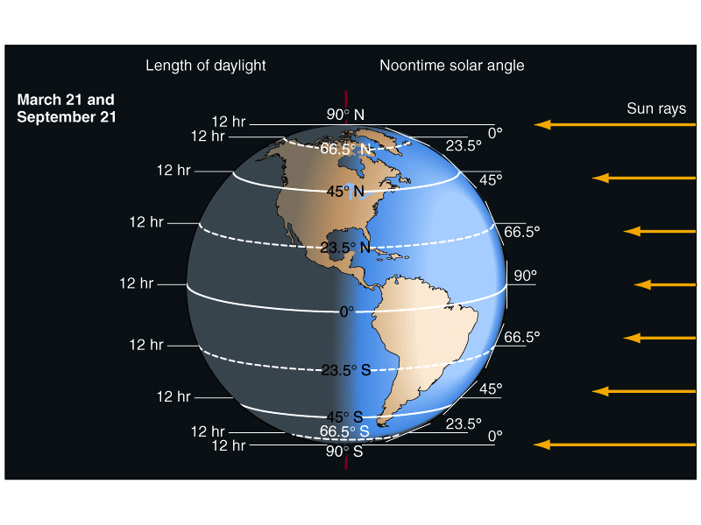
Equinox

Slide 39
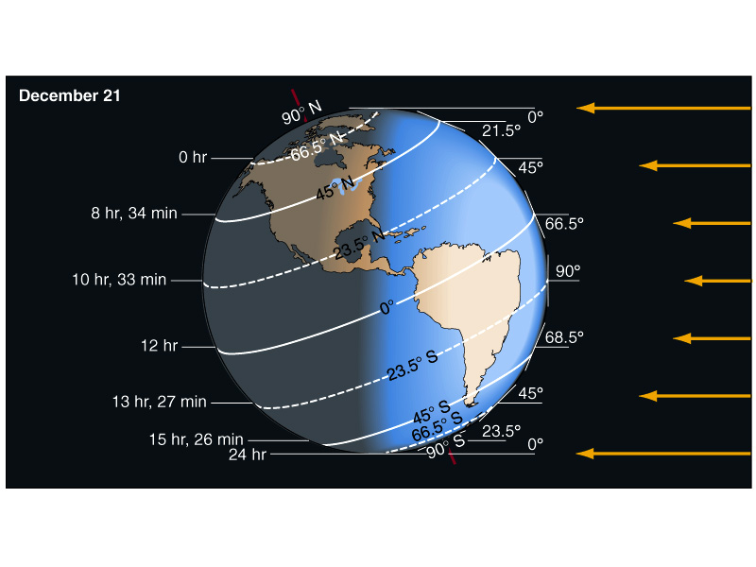
Northern Hemisphere Winter Solstice
Southern Hemisphere Summer Solstice

Slide 40
Impact of Latitude on Sun Angle

Slide 41
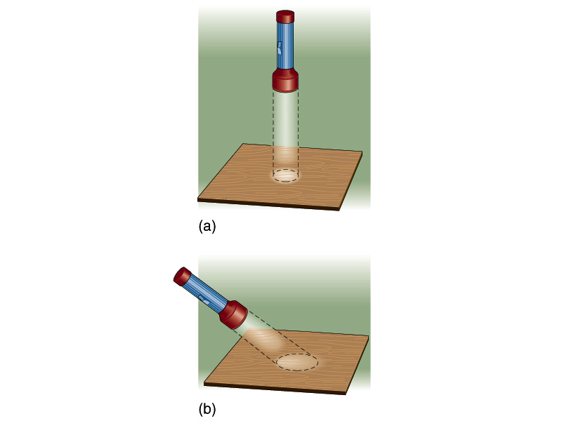
Effects of Solar Angle
Direct overhead Sun
As the angle of the flashlight changes what happens?
Light is spread out over a larger area
Brightness decreases
Sun that is not directly overhead

Slide 42
The uneven distribution of solar heating from the sun (more at the equator than poles) is the primary driver of the geographical variation of earth’s climate and weather.

Slide 43
Using Infrared Sensor to Measure Temperature
Objective: Use infrared sensor to measure temperature of different surfaces (snow, tree, concrete, hand, etc.)
Outcome: turn in the assignment at the end of class

Slide 44
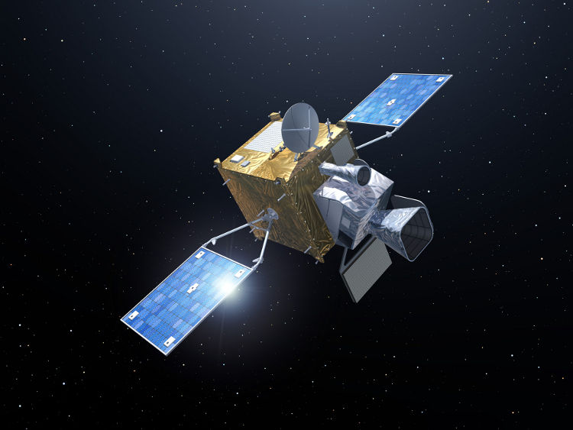
Using Infrared Sensor to Measure Temperature

