Slide 1




Orographic Convection in the Tropics: Wind Speed Control and Convective Initiation
Alison D. Nugent
University of Utah Seminar
April 16, 2015
Collaborators:
Ronald B. Smith,
Justin R. Minder,
and Campbell D. Watson
Yale University
NSF Grant # 0930356

Slide 2
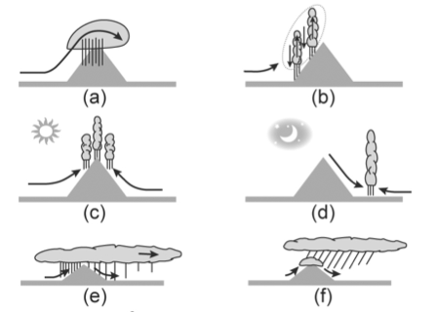
Basic Orographic Mechanisms
Orography provides the necessary lifting for clouds and precipitation to form ➔ precipitation can be strongly controlled by orography
Stable upslope flow
Unstable upslope flow
Thermal heating
Katabatic flow
Orographic enhancement
Seeder feeder
Houze et al. 2012
Notes:
Orographic Effects on Precipitation Clouds

Slide 3
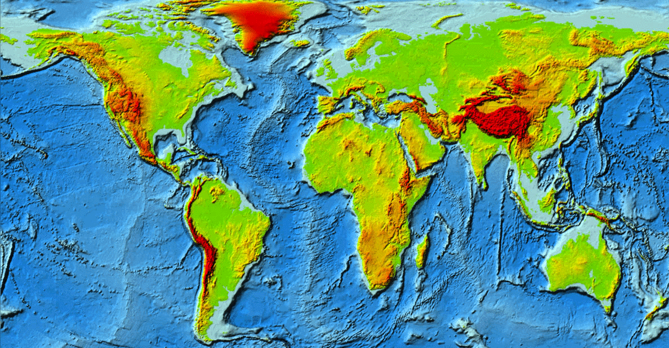
Mid-Latitude Focus, Complex Topo
COPS, 2007
IPEX, 2000
PyrEx, 1990
MAP, 1999
ALPEX, 1982
IMPROVE, 2001
TAMEX1987
TIMREX, 2008
HaRP, 1990
PACJETS, 2003
CALJETS, 2003
DOMEX, 2011
SALPEX, 1996
CuPIDO, 2006
http://annebobroffhajal.com/2009/07/the-most-exposed-terrain-on-earth/
Notes:
Taiwan – heavy precip events that lead to flash floods
Hawaii – large island
Dominica – typical island convection

Slide 4
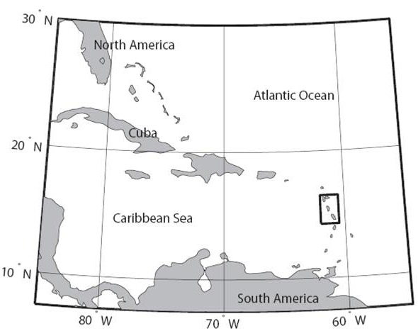
Commonwealth of Dominica
An “ideal natural laboratory”
Easterly trade wind flow is typical
No islands upstream or downstream
Terrain consists of two 1.4 km high near-symmetric mountain peaks
U
Smith et al. 2012

Slide 5
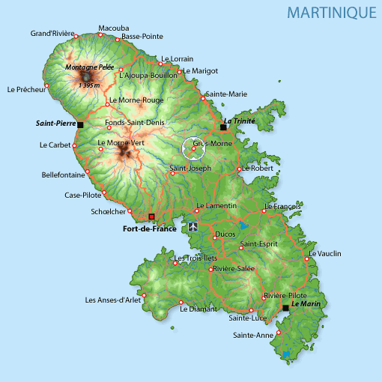
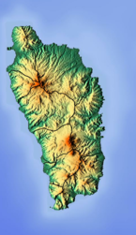
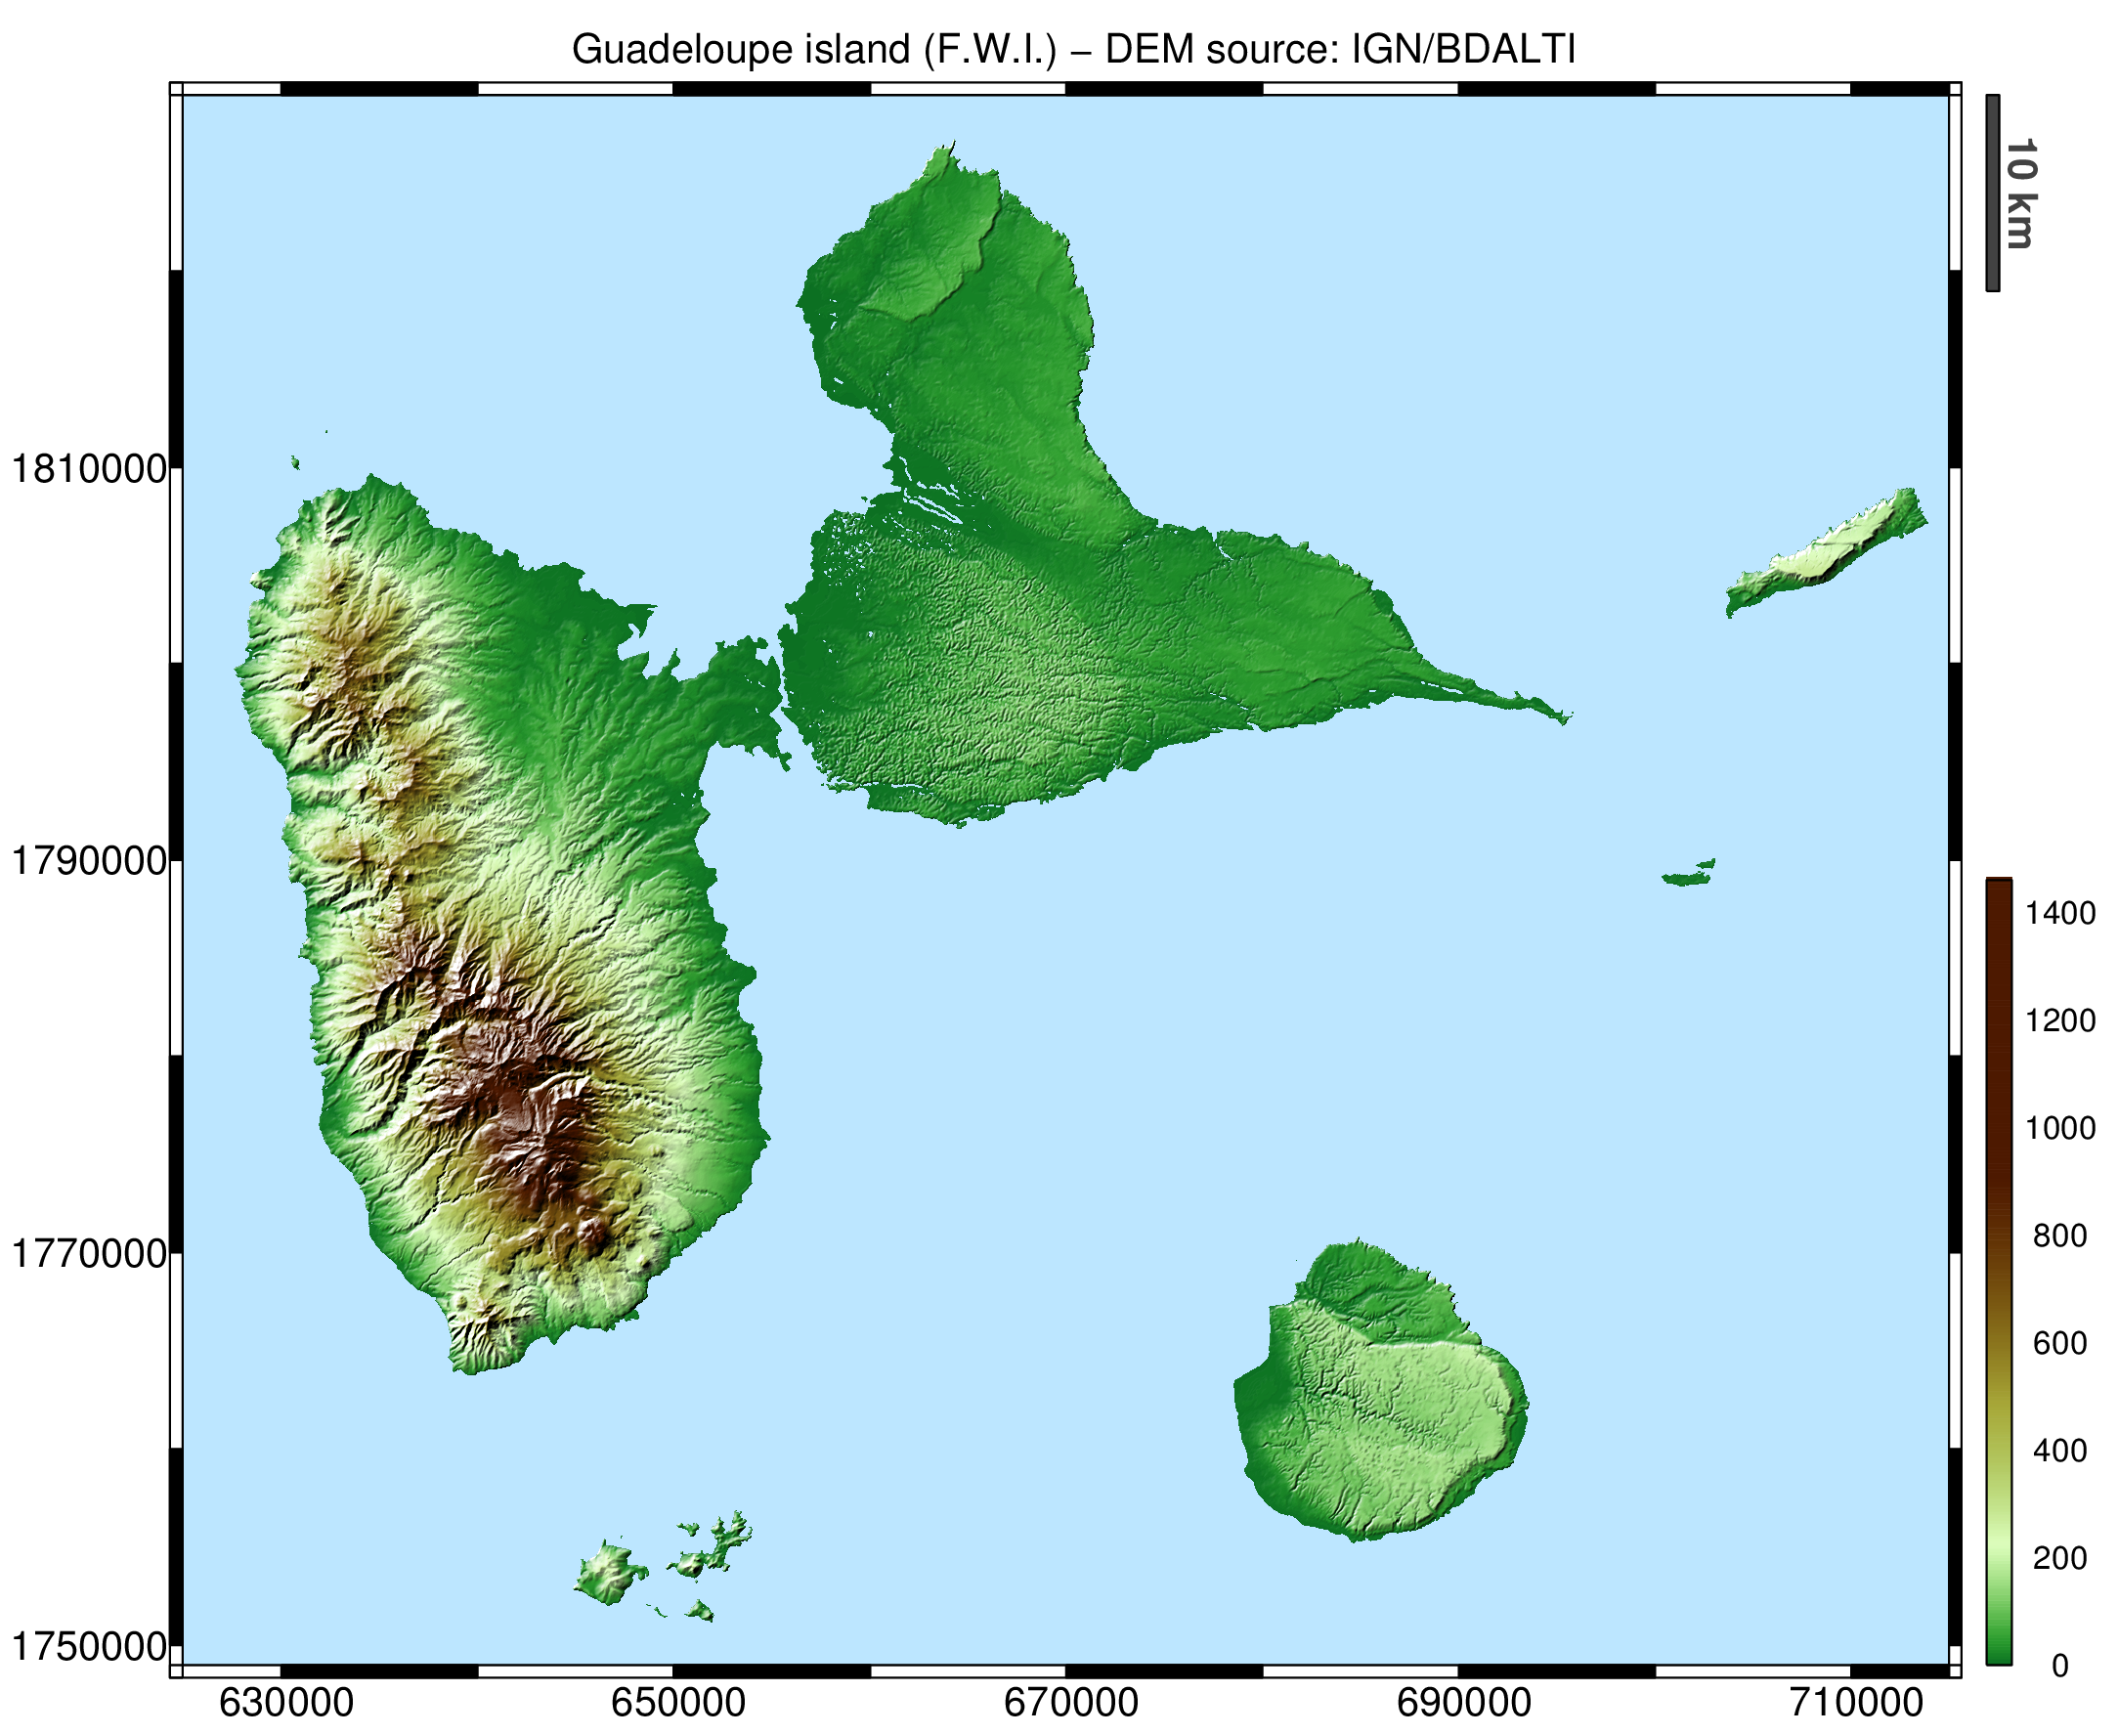
Commonwealth of Dominica
Martinique
An “ideal natural laboratory”
Easterly trade wind flow is typical
No islands upstream or downstream
Terrain consists of two 1.4 km high near-symmetric mountain peaks
Dominica
Guadeloupe
Wiki Images

Slide 6
Outline
Introduction and overview of DOMEX
Part 1: Effects of Wind Speed
  Thermally vs mechanically driven convection
  Observations and the WRF numerical model
Part 2: Initiation of Convection
  Upstream humidity “seed” observations and a theoretical model

Slide 7
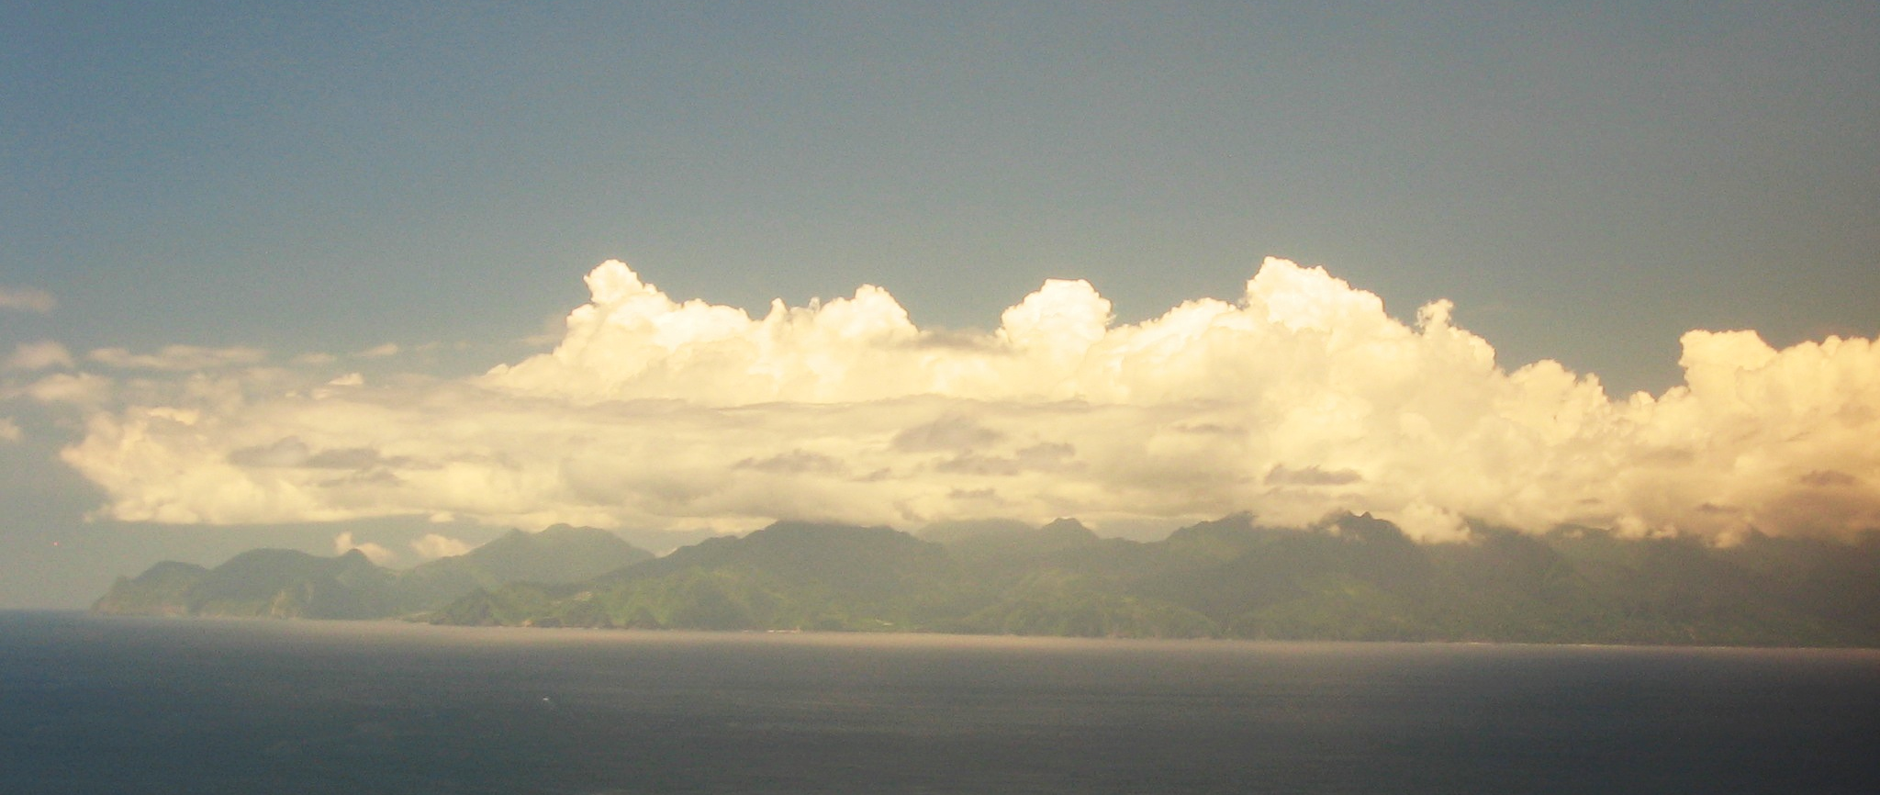

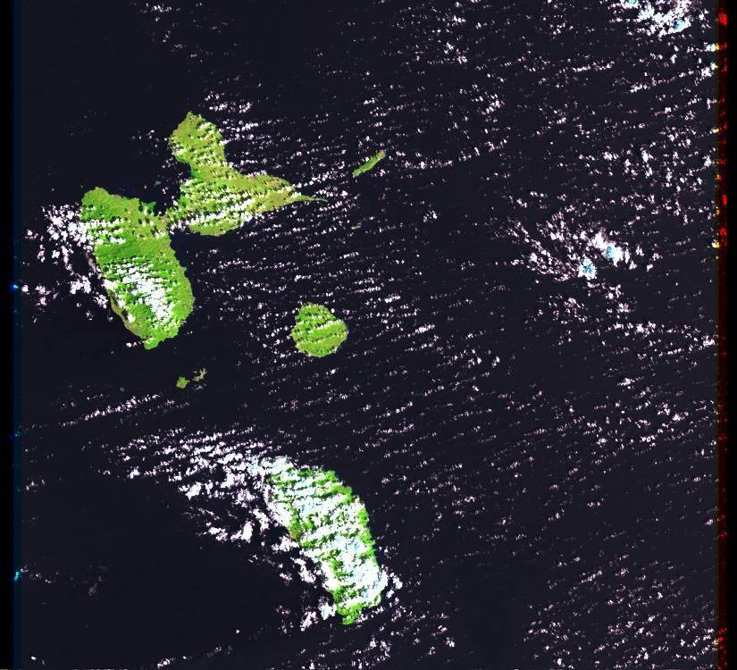
The Commonwealth of Dominica
Photo from Upstream
U
Photo from Aircraft
Landsat Image

Slide 8

Trade Wind Convection
Courtesy of C. Watson and thanks to Larry Bonneau

Slide 9
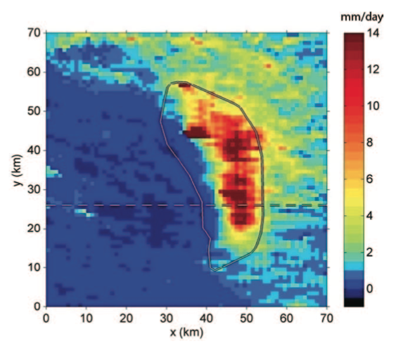
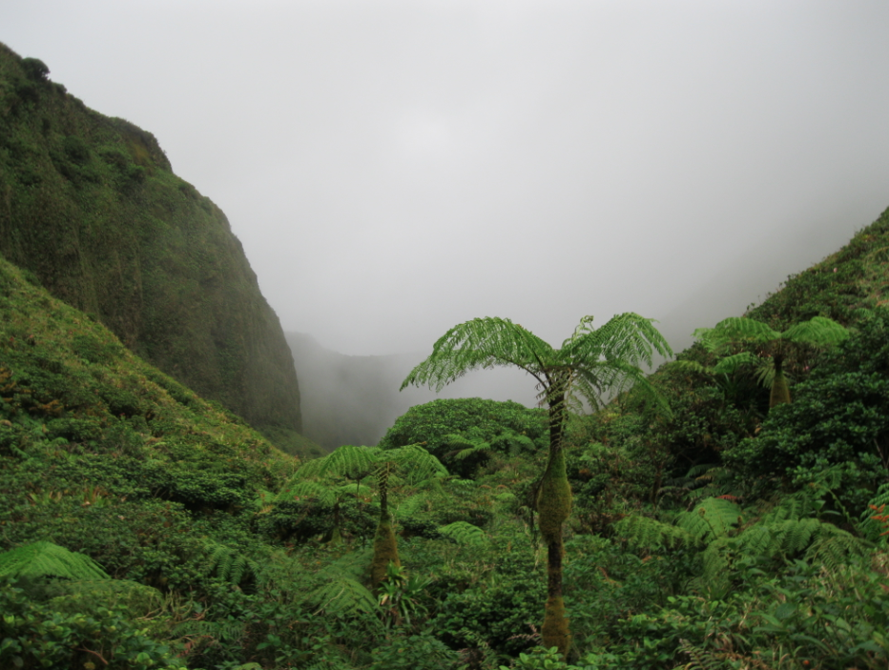
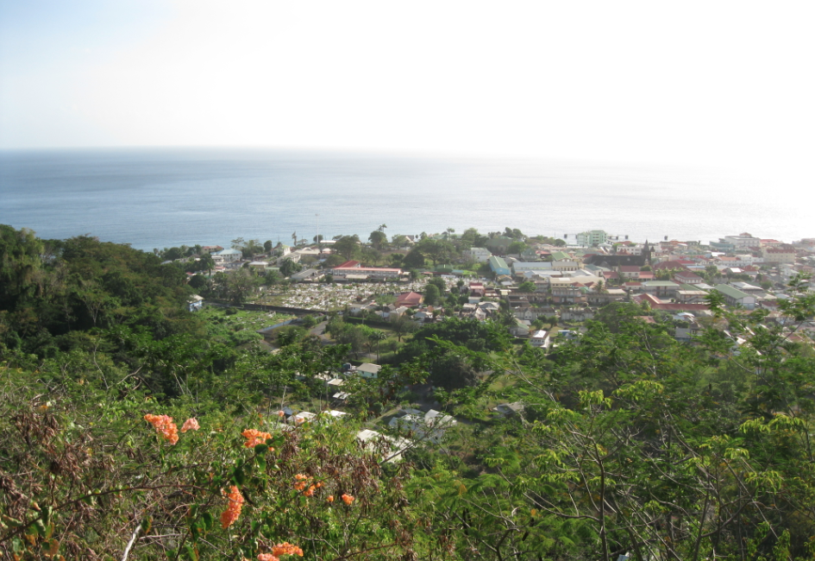
Precipitation Distribution
Rainforest
Grassland
Smith et al. (2009), photos by J. Minder (2011),
Courtesy of C. Watson

Slide 10
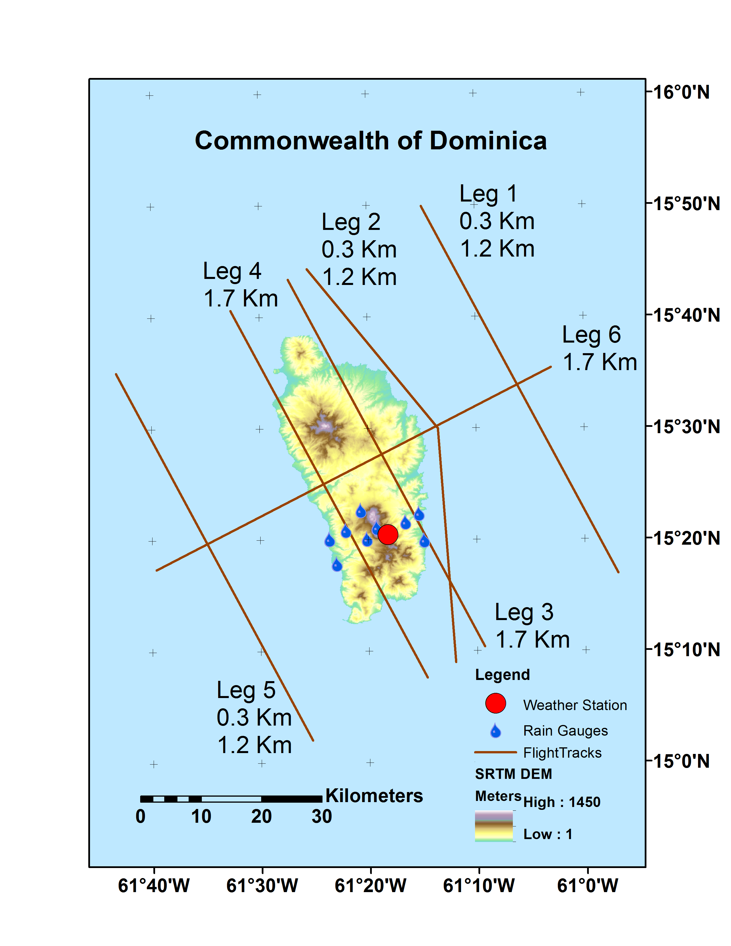
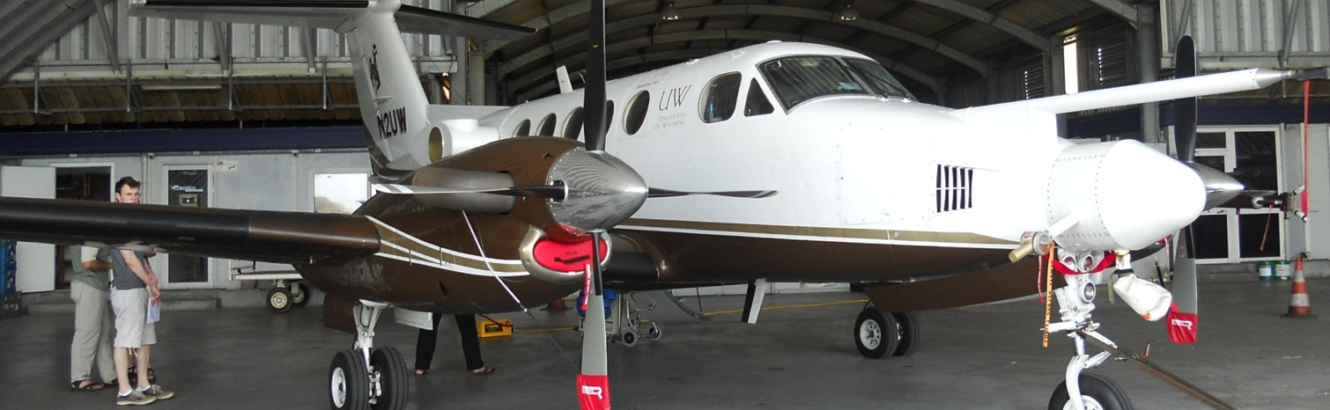
DOMEX - April 2011
In-situ measurements from the Wyoming King Air
21 research flights with fixed flight tracks
Dynamical and microphysical quantities measured
U

Slide 11
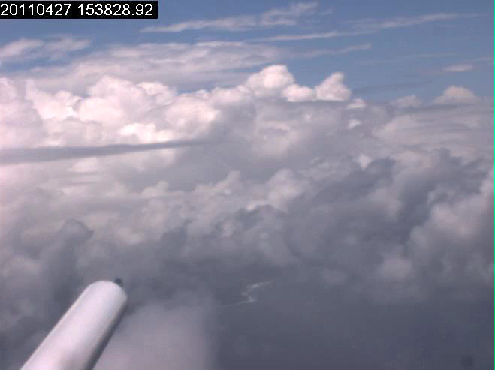
Courtesy of C. Watson

Slide 12
Variable Conditions During DOMEX
The 21 research flights sampled a range of wind speeds and rain conditions

Slide 13
Variable Conditions: Low Wind
Diurnal Cycle
Low Precip
High Wind
Low Wind

Slide 14
Variable Conditions: High Wind
~ Constant T
Heavy Precip
High Wind

Slide 15
Q1: How do the dynamics of tropical orographic convection depend on wind speed?
15
Low Wind: Thermal
2. High Wind: Mechanical
Sun heats surface
Surface warms air above it
Air becomes buoyant and rises
Rising air forms clouds and sometimes precipitation
Background flow encounters elevated terrain
Air is forced up over the terrain
Rising air forms clouds and precipitation

Slide 16
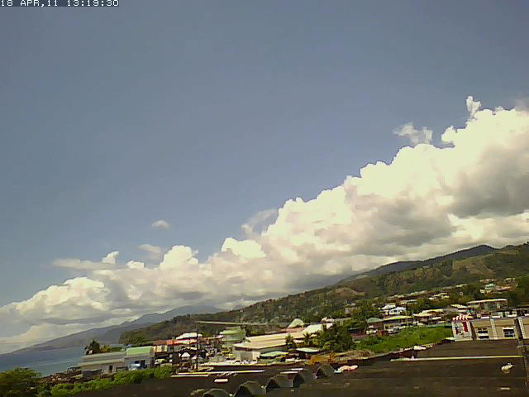
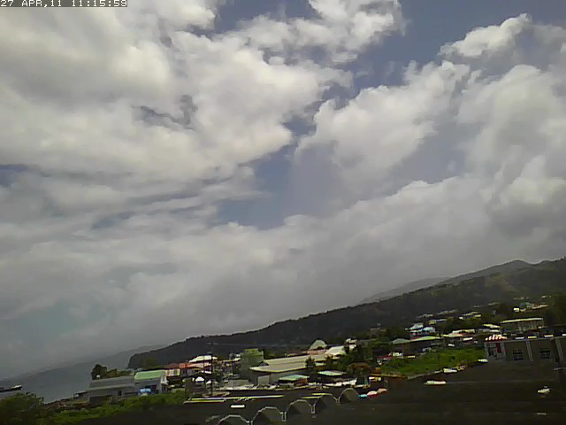
High vs Low Wind Convection
Low Wind: Thermal
2. High Wind: Mechanical
Courtesy of C. Watson

Slide 17
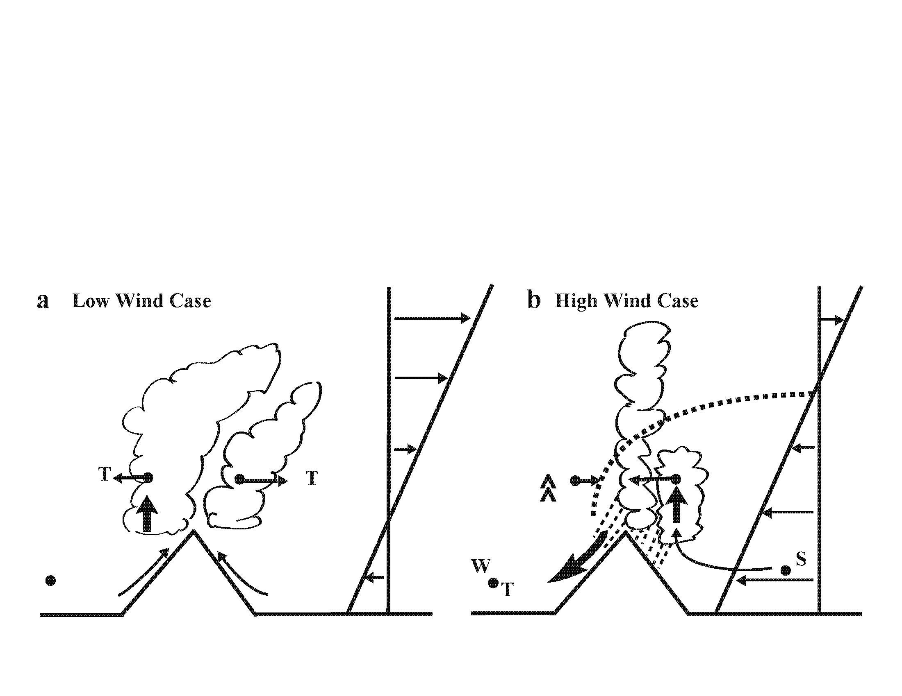
Quantitative Signs of a Transition
Signs of the transition between Thermally and Mechanically driven convection
  1. Airflow divergence above mountain (div)
  2. Shift in location of cloud fraction (CF)
  3. Mountain Top Temperature
1
Smith, 2012
2
  Can a model capture the differences between the two mechanisms?

Slide 18

WRF v3.2.1
T_{d}
T
3d domain with ridge shaped “Dominica like” mountain
  h=1km, a=10km, b=40 km
Conditionally unstable sounding
200 m grid spacing
Periodic B.C.s
Sheared wind profiles:
  high (10 ms⁻¹) and low (2 ms⁻¹)
200 Wm⁻² SH flux over terrain
Thompson microphysics scheme
Additional simplified 2D simulations at every wind speed 0-15 ms⁻¹

Slide 19
3D Model Mean
Low Wind/ Thermal
High Wind/ Mechanical
Colors: Wind speed, Contours: Isotherms, Dark Outline: Average Qc

Slide 20
1. Divergence Aloft
Low Wind/Thermal
High Wind/Mechanical
Positive Divergence
Negative Divergence

Slide 21


1. Divergence Aloft : Obs & 3D
U
Leg 3
Leg 4

Slide 22
1. Divergence Aloft : 2D & 3D
U
Leg 3
Leg 4

Slide 23
2. Cloud Fraction
Low Wind/Thermal
High Wind/Mechanical
Over Mtn Clouds
Windward Side Clouds
Convection location shifts upwind with increasing wind speed

Slide 24

2. Cloud Fraction : Obs & 3D
Upstream Side
Downstream Side

Slide 25
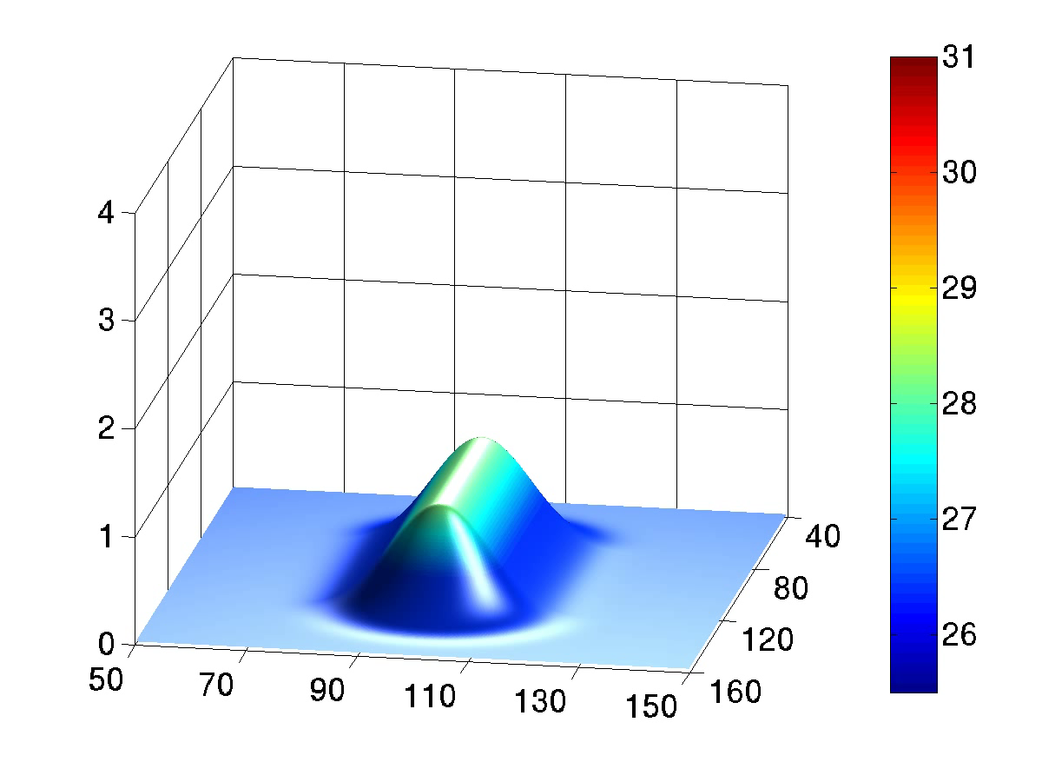
3. Mountain Top Temperature
Low Wind/Thermal: 2 ms⁻¹
High Wind/Mechanical: 10 ms⁻¹
Wind L to R, Surface T (°C), Qc Contours 0.2 g kg⁻¹
10 min increments for 3 hrs while the model reaches steady state

Slide 26

3. Mountain Top Temperature
Extension of Smith 2011 BL theory
Heat accumulates at low wind speeds

Slide 27
3. Mountain Top Temperature
U
– especially during clear sky conditions!

Slide 28
3. Mountain Top Temperature
U

Slide 29
Q1: How do the dynamics of tropical orographic convection depend on wind speed?
29
The boundary between low and high wind, and thus the transition from thermally to mechanically driven convection is found to be 3-6 m/s
With increasing wind…
divergence (associated with cloud top outflow) changes to convergence (associated with plunging flow)
convection shifts upstream from the leeward to the windward side of the mountain (associated with a change in the initiation mechanism)
mountain top temperature decreases (due to increased heat ventilation and shading)

Slide 30
Q2: How is convection initiated upon orographic uplift?
30
Two conceptual layer lifting methods:
  1. Non-uniform lifting by complex terrain
  2. Uniform lifting of a nonhomogeneous atmosphere
Both have been used to generate convection in numerical models
This study will analyze the second model with observational data and basic thermodynamics

Slide 31
Q2: How is convection initiated upon orographic uplift?
31
Non-homogeneous temperature (T) and humidity (Q) data from upstream Leg 1L used to investigate uniform lifting
300 m high
70 km long

Slide 32
T’ & Q’ Along Leg 1L

Slide 33

Virtual Temperature

Slide 34
Virtual Temperature
Correlation
= -0.81

Slide 35
Virtual Temperature
Average
Correlation
= -0.78

Slide 36

“Seeds” of plume convection

Slide 37
Lifting Method
If a non-homogeneous layer of atmosphere at flight level is lifted uniformly by the terrain, how much differential buoyancy is generated?
Lift each parcel observed by the aircraft through the LCL (400-600 m) neglecting entrainment
Compute T_{v}’ and its standard deviation
Estimate vertical accelerations (w_{t})
Interpret magnitude and scale of w_{t}

Slide 38
Lifting Parcels Through the LCL
Due to the atmosphere’s non-homogeneities, differential buoyancy is generated when a layer is lifted
Initially
Dry
Parcel
Δ T
Initially
Moist
Parcel
Moist Adiabat
LCL for Dry Parcel
Height
LCL for Moist Parcel
Dry Adiabat
Two parcels,
one moist,
one dry
Woodcock, 1960
Temperature
Notes:
(Say: Upon lifting, the moist parcels hit their LCL first and quickly develop buoyancy through latent heat release)

Slide 39

Perturbation
Activation
3
+
-
+
-
+
-
+
-
+
-
+
-
Anti-correlated patches upstream
Layer uniformly lifted by terrain
Differential buoyancy is generated
2
Layer
Uniformly Lifted
1
+
-
+
-
+
-
+
-
+
-
+
-
-
Warm & Dry
3
+
Cool & Moist
2
H
1
300 m
Easterlies
~7 m/s

Slide 40
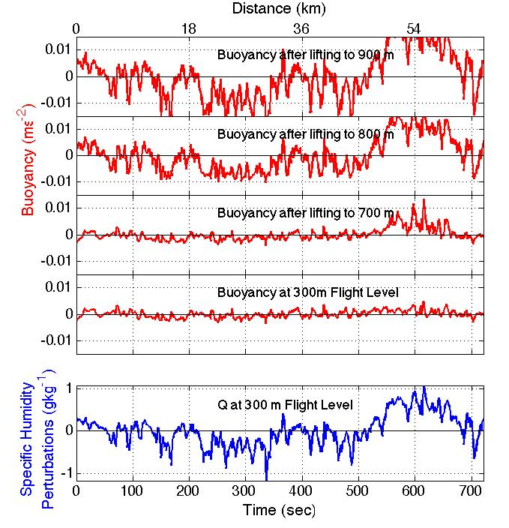
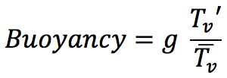
Buoyancy
Production
Buoyancy is generated in the initially moist parcels
Upon lifting to saturation, parcels become buoyant with respect to each other

Slide 41



Predicted Acceleration
2-D Euler and Continuity give vertical accelerations (w_{t}) by the PDE:
General Case: Predict accelerations in Fourier space
Special Case: w_{xx} >> w_{zz}
1
Added Mass Effect
0
w_{t}
0
k
10
high P
w_{t}
Layer
Depth
H = 1 km
+
+
low P
Notes:
Say: Short wavelength density anomalies (kH<<1) accelerate quickly consistent with reduced gravity
Longer wavelength density anomalies accelerate more slowly due to the lateral circulations that must develop to allow parcels to rise
High-pass filter removes non-physical acceleration

Slide 42
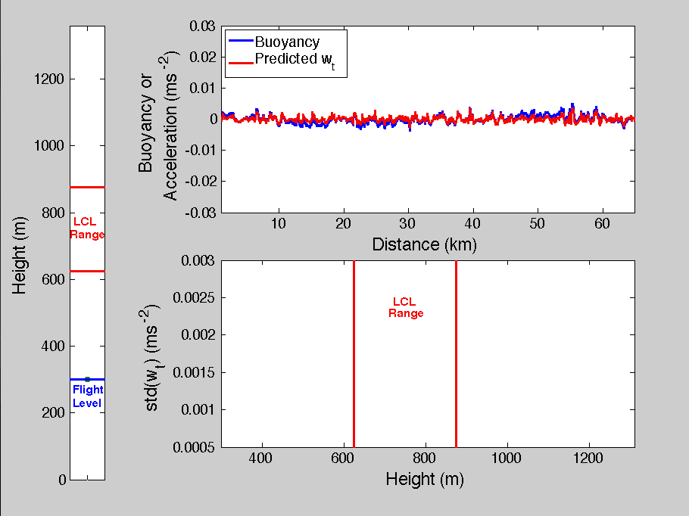

~ 2 km
TQ Anti-correlation
Strength
Initial Moisture
Variations
Notes:
We view the std of acceleration as a statistical measure of the tendency of the layer to break up into upward and downward motions that may lead to convection

Slide 43
Why Std(w_{t})?
3
+
-
+
-
+
-
+
-
+
-
+
-
σ(w_{t}) is a statistical measure of the tendency of the lifted layer to break up and generate vertical velocities which could lead to convection
2
Layer
Uniformly Lifted
1
+
-
+
-
+
-
+
-
+
-
+
-
-
Warm & Dry
3
+
Cool & Moist
2
H
1
300 m
Easterlies
~7 m/s

Slide 44
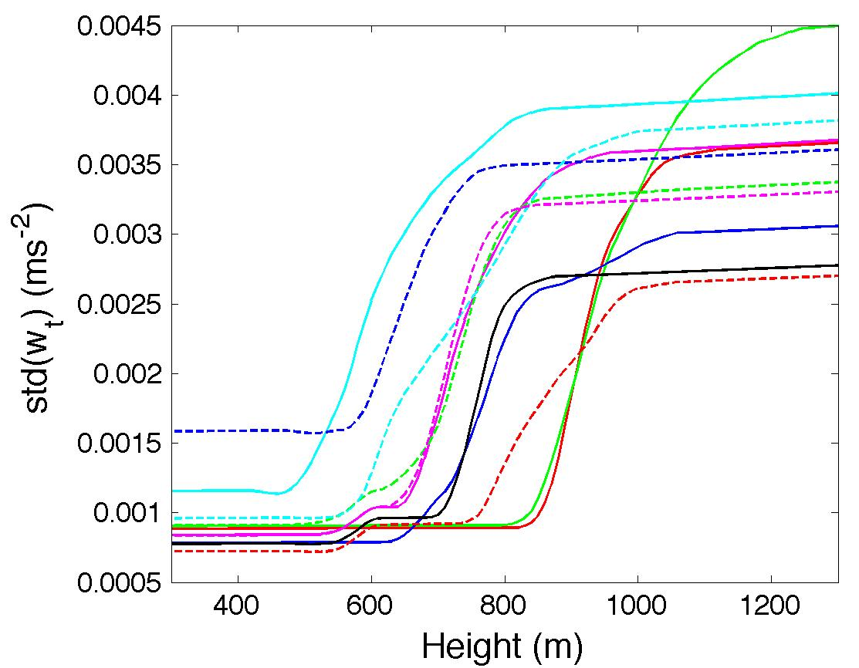
σ(w_{t}) Created Upon Uplift
Each line represents a different research flight flown on a different day

Slide 45





Transition to Convection
Is σ(w_{t}) large enough to trigger convection in the advective time scale?
If parcel velocities are large enough, convection is initiated as parcels leave their layer
Requirement for convective initiation is given by:

Slide 46
Required Acceleration
The required parcel acceleration (0.0021) is exceeded for every research flight

Slide 47
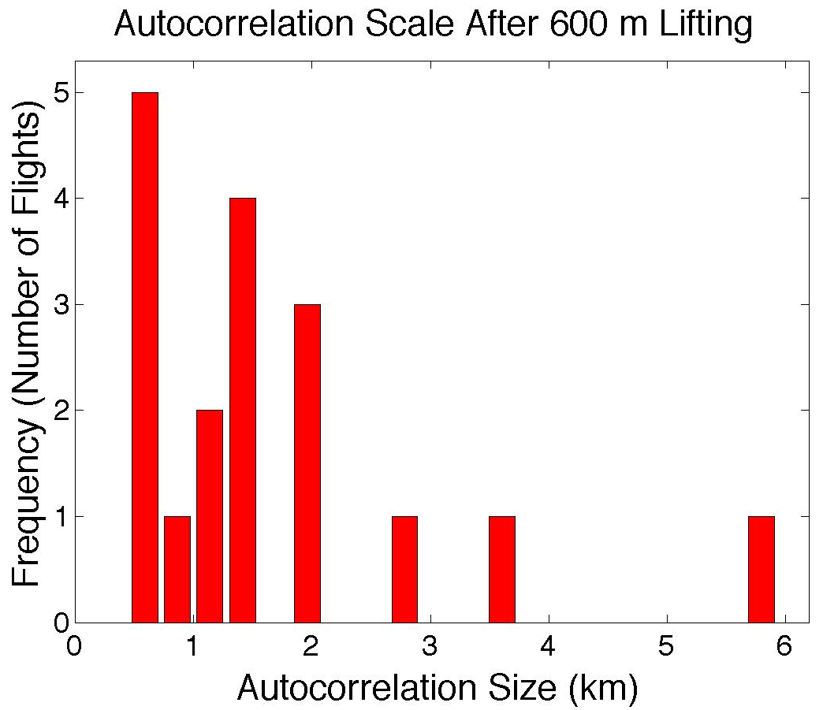
Dominant Scale of Predicted Accelerations
Scale from the first zero crossing of the auto-correlation
Predicted scale of 1.6 km is in general agreement to scale of clouds over Dominica

Slide 48
Q2: How is convection initiated upon orographic uplift?
48
Moist “seeds” upstream with neutral buoyancy found
Buoyancy generated through lifting past the LCL
Provides a theoretical model for how convection may be initiated
Predicted accelerations have magnitude and scale consistent with observations
Has implications for modeling convection

Slide 49
References
Minder, J. R., R. B. Smith, and A. D. Nugent, 2013: The Dynamics of Ascent-Forced Orographic Convection in the Tropics: Results from Dominica. J. Atmos. Sci., 70, 4067–4088.
Nugent, A. D., R. B. Smith, and J. R. Minder, 2014: Wind speed control of tropical orographic convection. J. Atmos. Sci., 71, 2695–2712.
Nugent, A. D and R. B. Smith, 2014: Initiating Moist Convection in an Inhomogeneous Layer by Uniform Ascent. J. Atmos. Sci., 71, 4597–4610.
Smith, R. B. and Coauthors, 2012: Orographic precipitation in the tropics: The Dominica Experiment. Bull. Amer. Meteor. Soc., 93, 1567–1579.
Smith, R. B., P. Schafer, and D. J. Kirshbaum, E. Regina,2009: Orographic Precipitation in the Tropics: Experiments in Dominica. J. Atmos. Sci., 66 , 1698-1716
Watson, C. D., A. D. Nugent, and R. B. Smith, 2015: Processes controlling precipitation in shallow, orographic, trade-wind convection. J. Atmos. Sci., In Press, JAS-D-14-0333.
Woodcock, A. H., 1960: The Origin of Trade-Wind Orographic Shower Rains. Tellus, 12, 315-326.

Slide 50

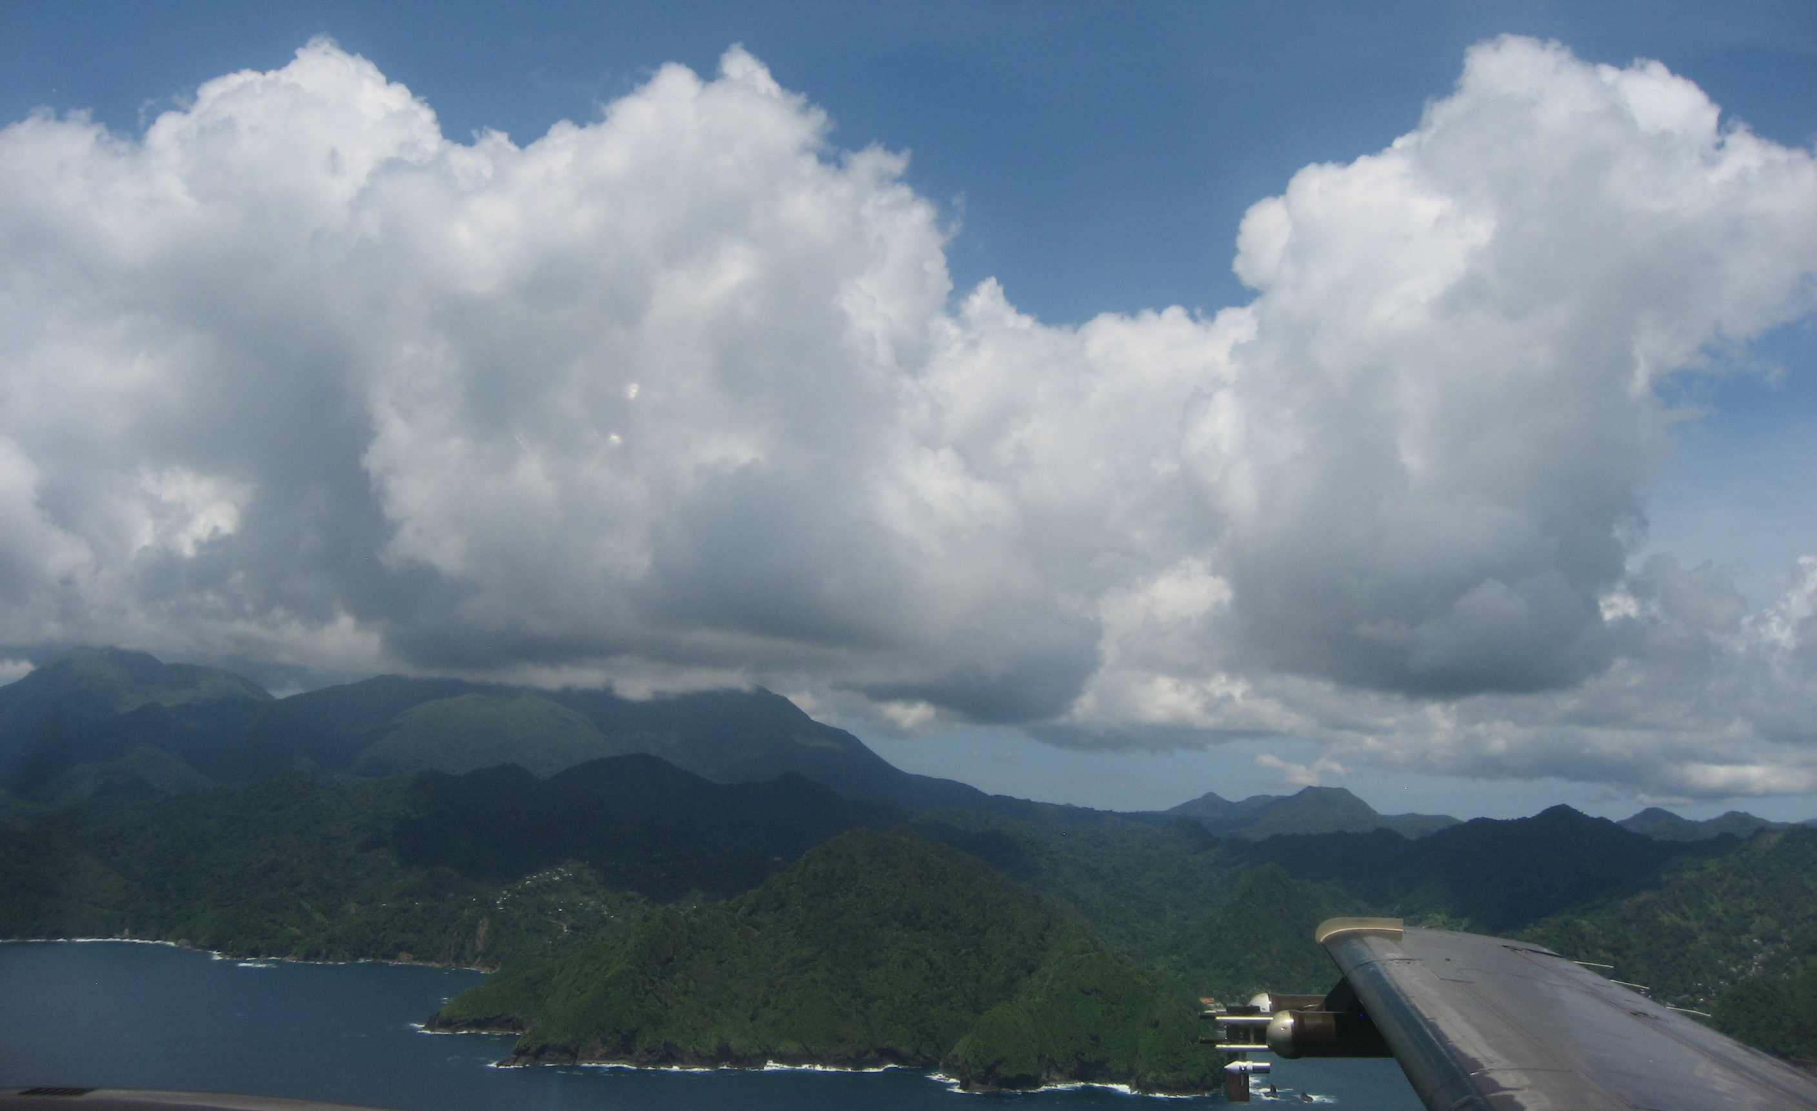

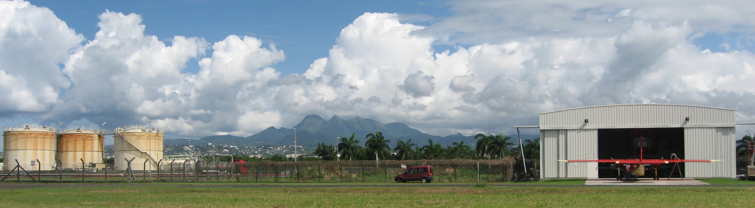
Thank You!

