Slide 1
Ph.D. Proposal Defense
Neil Lareau
28 November 2012

Slide 2
Committee Members
Chair: John Horel – U of U Atmos.
C. David Whiteman – U of U Atmos.
Ronald Smith – Yale – Geology/Geophysics
Courtenay Strong – U of U Atmos.
Eric Pardyjak – U of U Mech. Eng.

Slide 3
Personal Background: Interests and Goals
Research interests: Dynamics of the atmosphere across a range of scales
Mid-latitude dynamics (MS thesis)
Storm tracks
CAP dynamics (PhD thesis)
CAP break-up
Mountain Meteorology
Career Goals:
Teaching
Research
POST-DOC/FACULTY POSITION

Slide 4
Personal Background: Timeline
BFA: Oil Painting Carnegie Mellon University
Weather Observer: Mount Washington Observatory
Applied to Grad Schools ( no go )
MWR Storm Track Paper
TA Instrumentation Class
Cyclone Workshop
High Pass Qualifying Exam (May)
NCAR ASP summer colloquia (June)
PCAPS Project Design
PCAPS operations (Dec 2010-Feb 2011)
Undergrad MET Classes at U of U
MesoWest
Apply to Grad School
Synoptic Met. II instructor
Long Ago
2007
2008
2009
2010
2011
2012
2013
Begin Grad School Aug 2008
Storm Track Research
Defend Master’s Thesis (August )
Present Work at Mountain Met Conference
DOMEX field work (Martinique)
Boundary Layer
Mountain Met
PCAPS BAMS PAPER

Slide 5
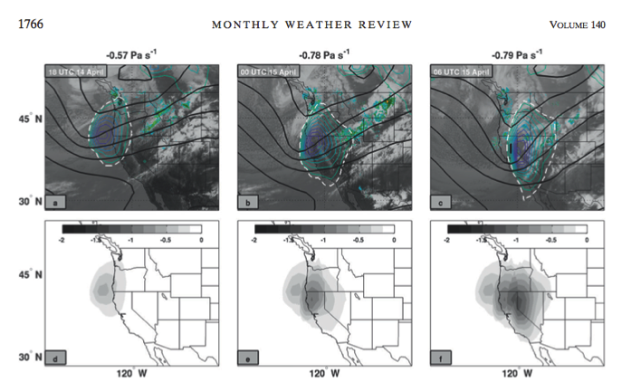
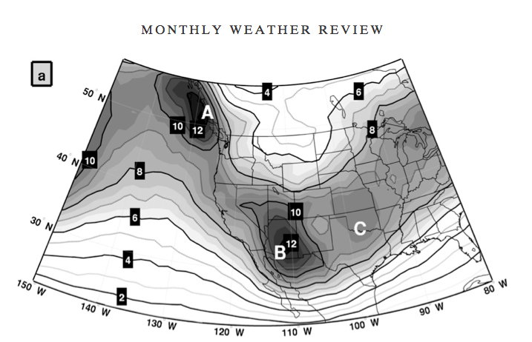
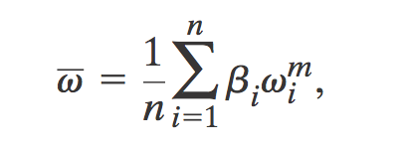
MASTERS RESEARCH AND “SPIN OFFS”
Lareau and Horel 2012

Slide 6
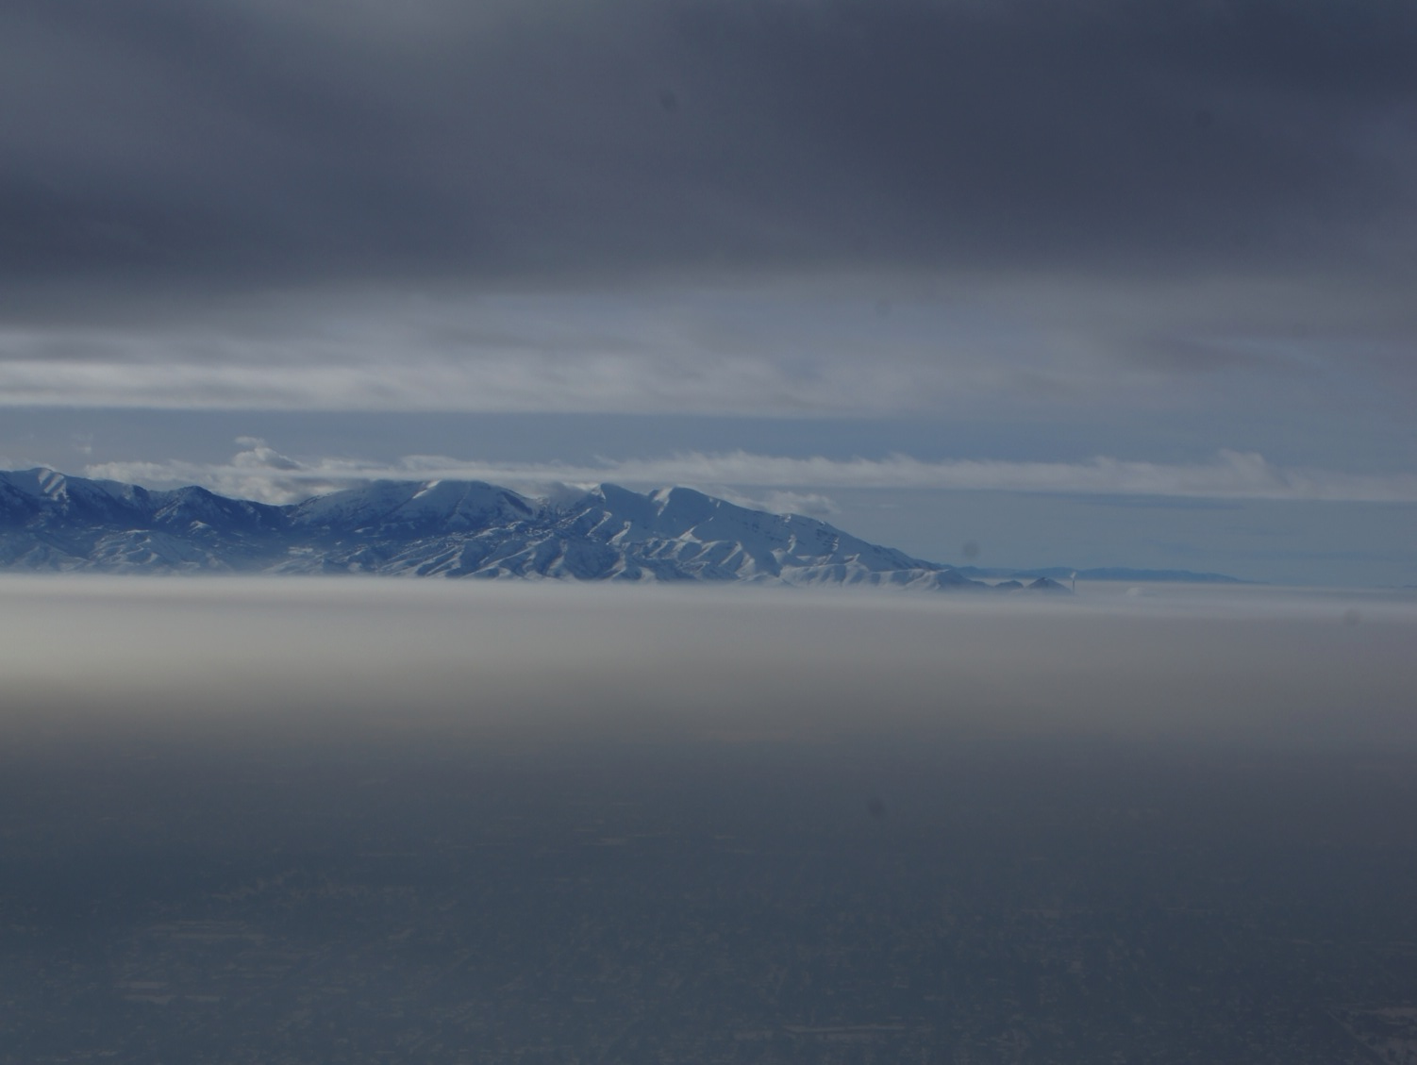
Dynamical Mechanisms of Persistent Cold-Air Pool Removal
Thesis Proposal
Notes:
What we are really here to discuss is the Dynamical Mechamisms of persistent CAP removal

Slide 7
Definitions:
CAP: topographic depression filled with cold-air.
Forms by cooling of the air near the surface, warming aloft, or often both
Stable stratification prevents vertical mixing
Topography prevents lateral displacement, leads to stagnation.
Diurnal CAP: CAP forming at night and decaying during the daytime growth of CBL (and basin scale circulations).
Persistent CAP: CAP surviving through multiple diurnal cycles
Often accompanied by air pollution and fog
Lareau et al. 2013
Notes:
First lets start out with some definitions to make sure we are all on the same page.
This talk and this research focuses on PCAPS

Slide 8
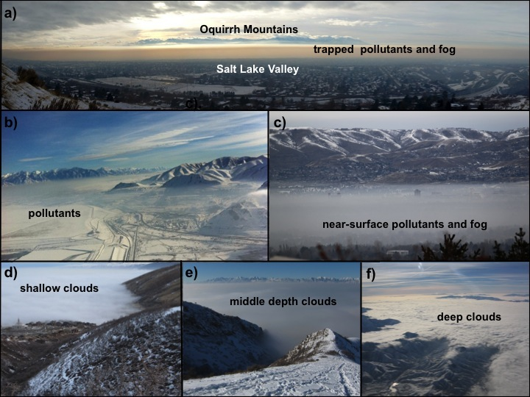
Notes:
Here are some examples of PCAPS observed in the Salt Lake Valley during the winter of 2010/2012
Note that they are often deep, though occasionally very shallow, and of broad expanse

Slide 9
Problem Statement
The degree of interaction between persistent CAPs with passing weather systems is poorly resolved.
The timing or extent of CAP break-up is particularly difficult to predict.
What processes will matter… turbulence, CAA, CBL growth, all of the above?
Why this matters:
Air quality forecasts
Sensible weather

Slide 10
Problem Example
WRF SIMULATION
CAP too shallow
Premature dynamically driven mix-out
Observations
Dense fog and unhealthy air quality persist!
Notes:
Here is an example of just this problem. Even using WRF at relatively high resolution compared to operational models, there are systematic errors in CAP depth and an erroneous mix out event that did not occur. The too shallow cap allows strong winds aloft to break to the surface, removing the CAP and ventilating the valley. In reality the CAP persists through that period, prolonging dangerous air quality and in this case dense fog/stratocumulus.

Slide 11
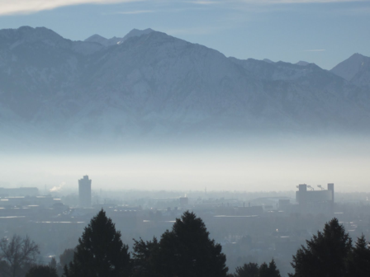
Research Goals
Contribute to our scientific understanding of the dynamical mechanisms affecting the removal of CAPs from valleys and basins.
Mechanisms:
Mountain Wave/CAP interaction
Turbulent CAP erosion
CAP displacement
Density current dynamics
Tools:
Observations from a field campaign
Large Eddy Simulations
Notes:
To address these problems we propose research as follows:

Slide 12
Literature synthesis
Notes:
Now for some background on this issue

Slide 13
Persistent CAP Lifecycle
Typically occur during the quiescent interlude between storms.
Initiated during warming aloft by advection and/or subsidence
Strengthened by surface cooling (or emplacement of cold air).
Multi-layered and deeper than diurnal CAPs
Survive through weak disturbances aloft (partial mix-outs)
Fog/clouds may form and feedback on CAP strength and duration
May last up to two weeks
Break up due to many processes, typically associated with approaching trough:
Most often CAA destabilizes the CAP, ventilates valley.
Sometimes CBL growth acts along with some other destabilizing mechanism
Displacement and erosion processes (dynamic)
Notes:
To begin, lets have a look at the life cycle of persisent CAPs, particularly those in the intermountain west.

Slide 14
Lareau et al. 2013

Slide 15
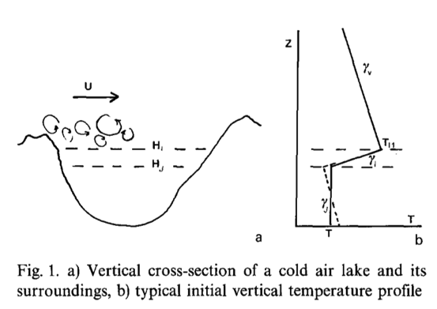
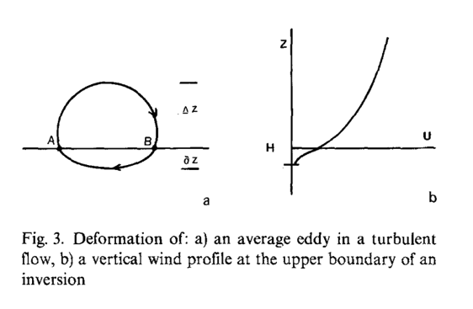
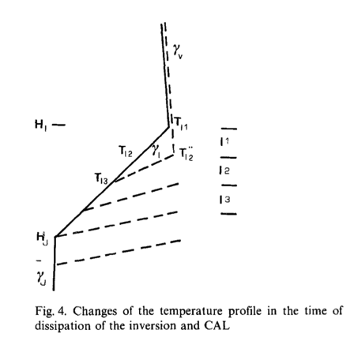
TOP DOWN TURBULENT EROSION
Key Concepts:
-Turbulence aloft encroaches on top of CAP
-CAP air is mixed into the adiabatic layer aloft
-Local inversion strength is enhanced
-Turbulence is damped by increased buoyant consumption
-Continuously accelerating winds are required to maintain erosion
Problem: What is the depth of the layer that is removed?
Petkovšek 1992
Notes:
Focusing in on the dynamic processes, the topic that has received the most attention, though not necessarily enough attention is TURBULENT CAP EROSION
Petkovsek was the first to propose an analytic approach at this problem.

Slide 16
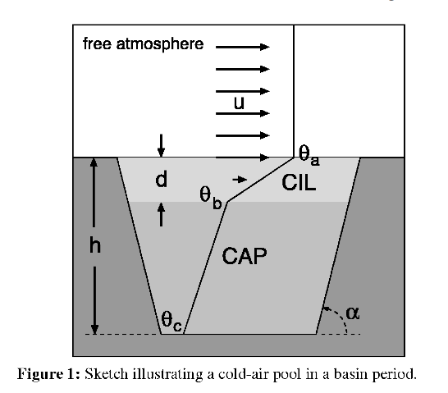
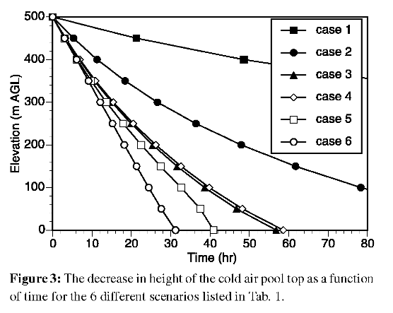
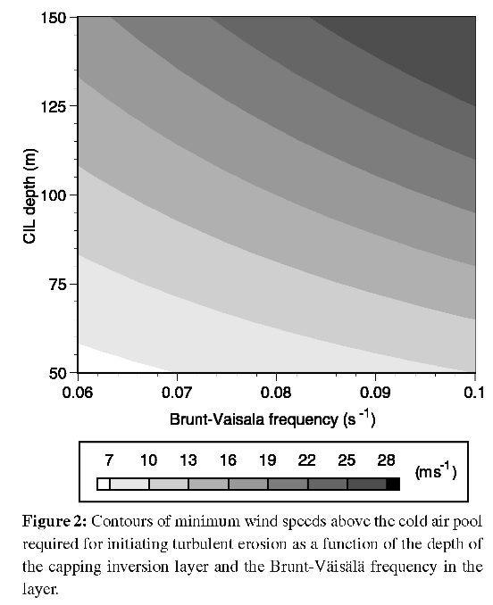
TIME SCALE FOR TURBULENT EROSION
Conclusion: For typical CAP scales, turbulent erosion is unlikely to be the sole source of breakup
Zhong et al. 2003
Notes:
Zhong et al revist this issue using a very similar approach to derive time scales for CAP break up over a range of representative conditions.
Importantly they note the decay of the erosion rate, consistent with Petkovsek, but ultimately conclude that the time scales associated with turbulent break up are too long for it to be the key mechanism.

Slide 17
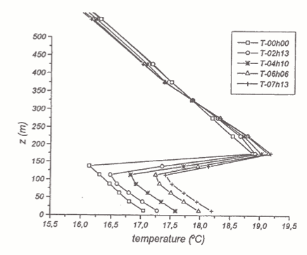
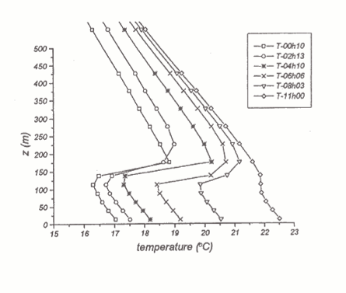
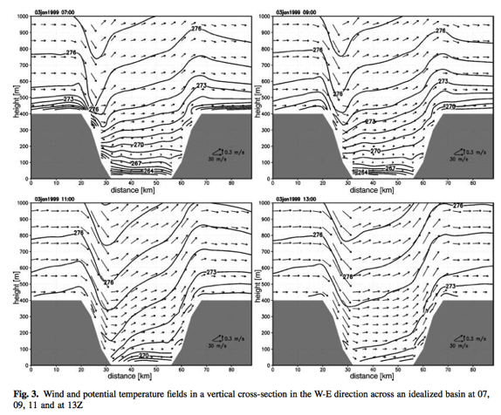
Numerical Simulations of Turbulent Erosion
Vrhovec and Hrabar 1996
Rakovec et al. 2002
Conclusion: Accelerating winds can act to dissipate a CAP, weak steady winds do not

Slide 18
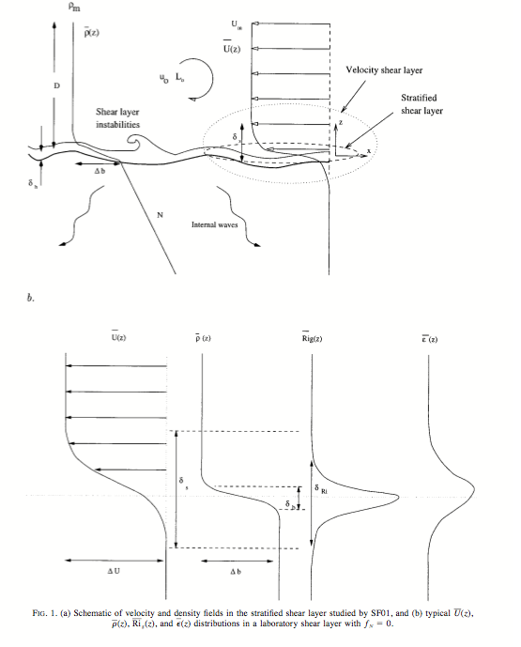
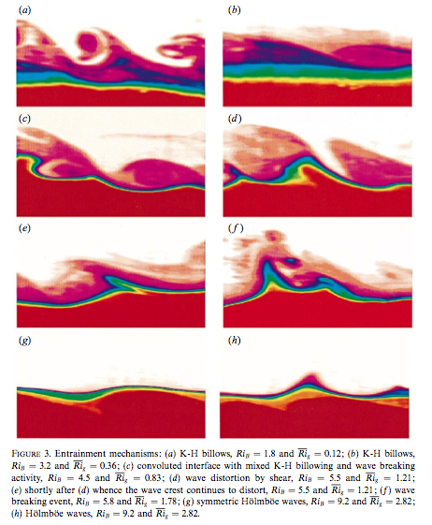
Laboratory Investigations
Strang and Fernando (2001a,b)

Slide 19
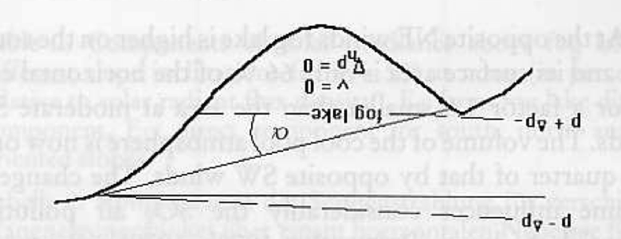
CAP Tilting
Conclusion: CAP will develop a tilt to compensate for a regional pressure gradient.
Petkovšek and Vrhovec 1994
Notes:
Note this effect is similar to the component of a storm surge attributable to reduced pressure

Slide 20
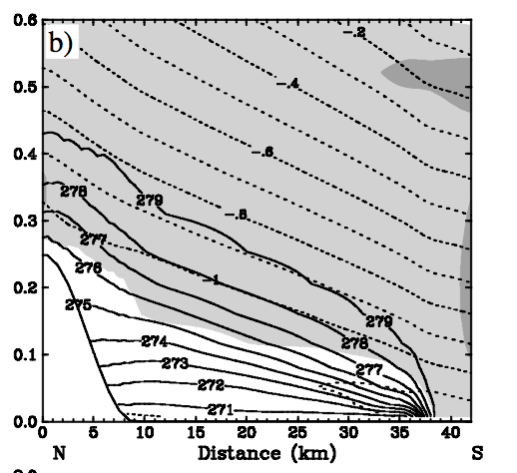
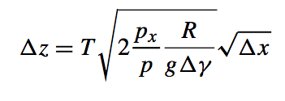
CAP Tilting
Key Points:
CAPs break-up by “spilling over” due to tilting.
Shape is “square root”
Develops a frontal interface
Momentum transfer to front/CAP enhance the tilt.
Fastest break up is during partially blocked ageostrophic flow upstream of a barrier
Zängl 2003
Notes:
Zangl refines the margules formula approach using gradients, rather than temperature itself. Integrates the hydrostatic equations within and without the CAP and derives and expression for CAP depth versus distance from the leading edge.

Slide 21
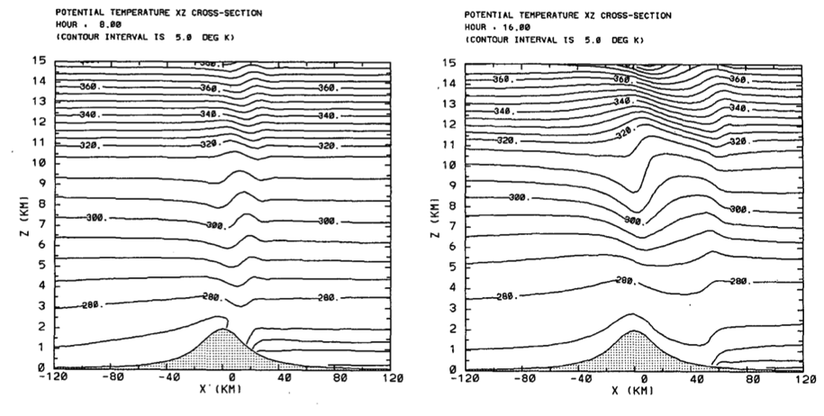
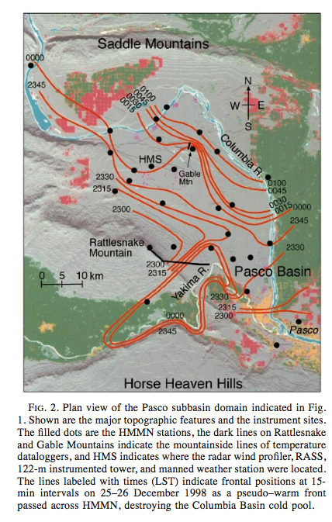
CAP Displacement: Mtn Waves/Warm Fronts
Lee et al. 1989
Also known to occur in the Alpine Föhn (e.g. Flamant et al. (2006)
Whiteman et al. 2001
Notes:
Lee et al 1989 run numerical simulations to investigate the flushing of a lee side inversion by mount waves.

Slide 22
Literature Summary
Turbulent erosion, CAP tilting, and mountain waves are the primary dynamical mechanisms for CAP erosion
More work is required to:
Test theory against observations
Expand on theory using high resolution simulations

Slide 23
Data and observations

Slide 24
The Persistent Cold-Air Pool Study
Research Objectives
Identify and observe the meteorological processes affecting the life-cycle persistent CAPs
PCAPS are CAPs that last for more than one diurnal cycle (often many more)
Determine the consequences of these processes on air pollution transport and diffusion in urban basins
Assess how models can be improved to provide more accurate simulations of long-lived CAPs
Lareau et al. 2013 (BAMS)

Slide 25
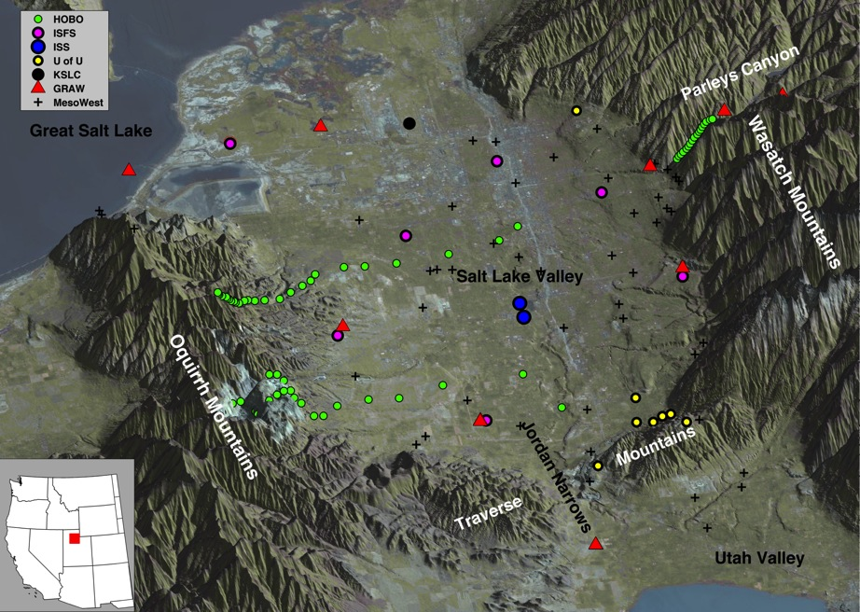
PCAPS: Salt Lake Valley
1 December 2010-7 February 2011
Lareau et al. 2013 (BAMS)
Notes:
We had a chance to test some of these theories during PCAPS

Slide 26
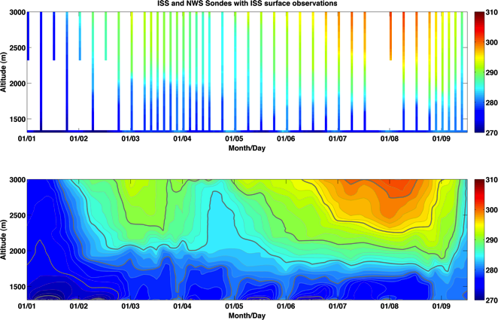
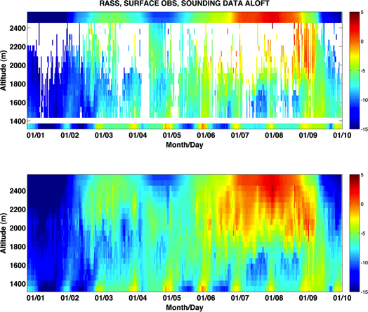
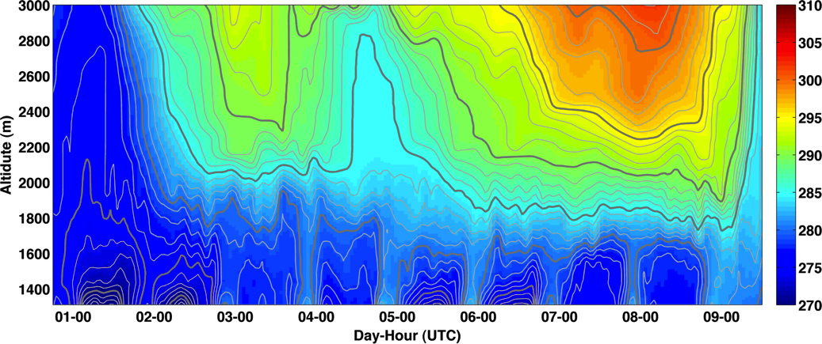
Post Processed Data
Soundings
RASS
BLENDED DATA SET

Slide 27
PCAPS IOP-1 Partial Mix-out Case study
Progress to date:

Slide 28
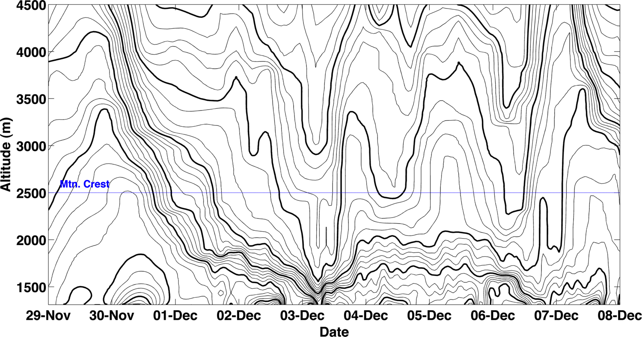
IOP-1: Nov 30th – Dec 7th, 2010
Potential Temperature Time Height
Period of Interest for this talk
(Increasing Time)

Slide 29
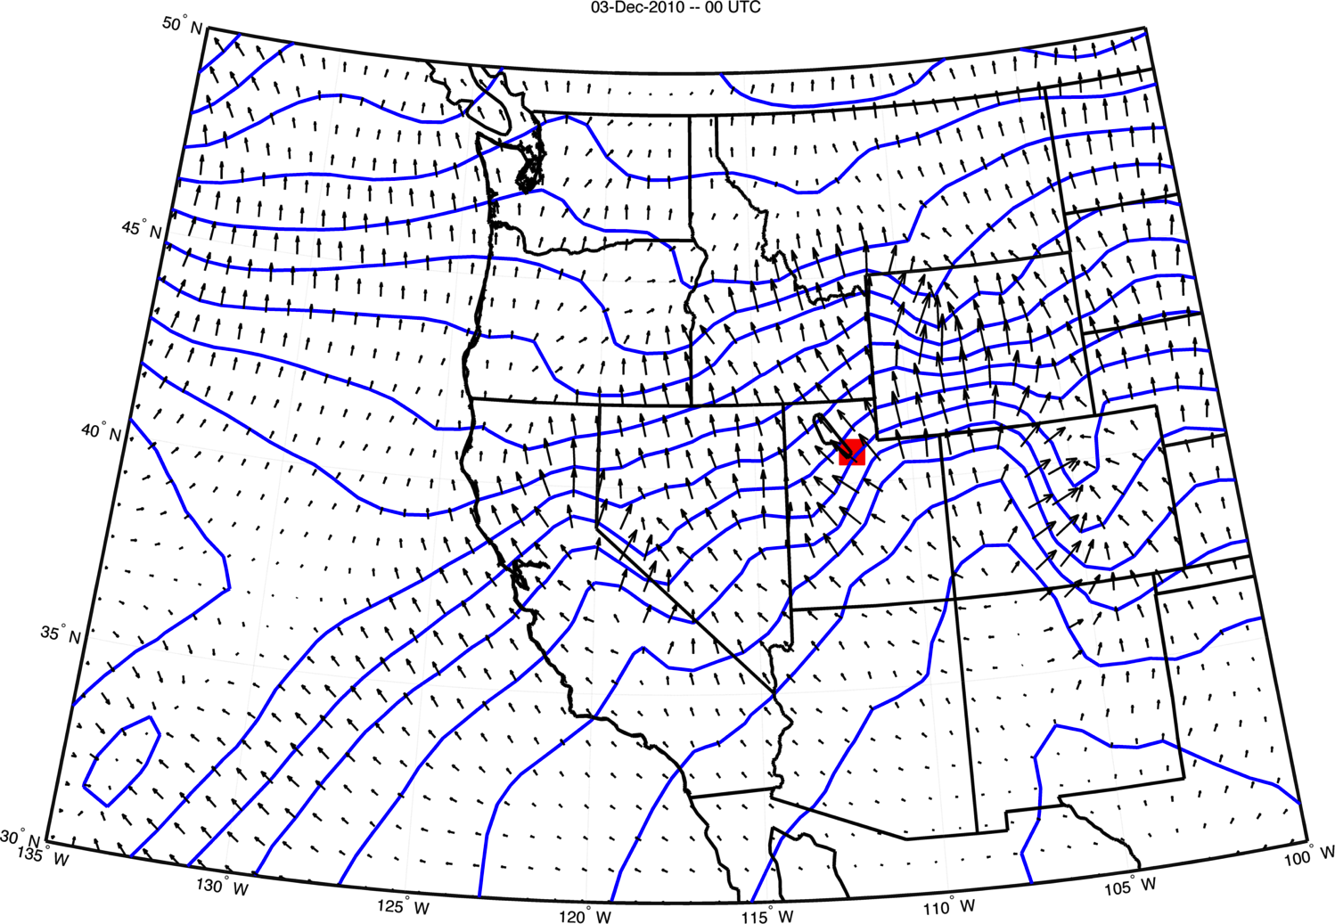
SYNOPTIC OVERVIEW: 03-DEC 00 UTC (1700 LST)

Slide 30
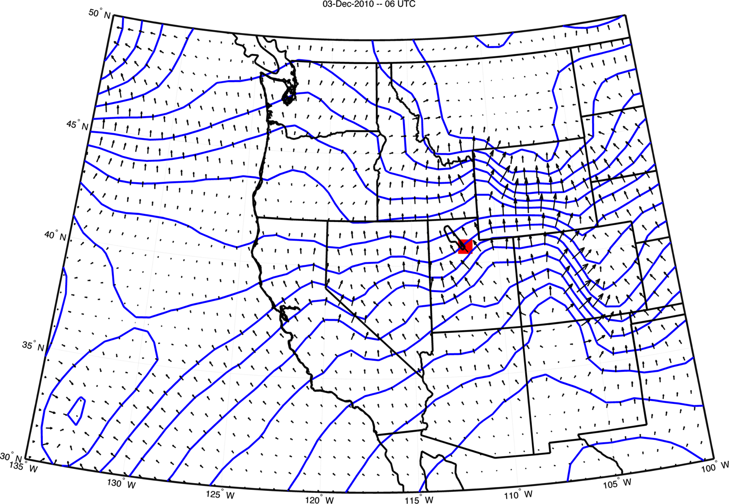
SYNOPTIC OVERVIEW: 03-DEC 06 UTC (2300 LST)

Slide 31
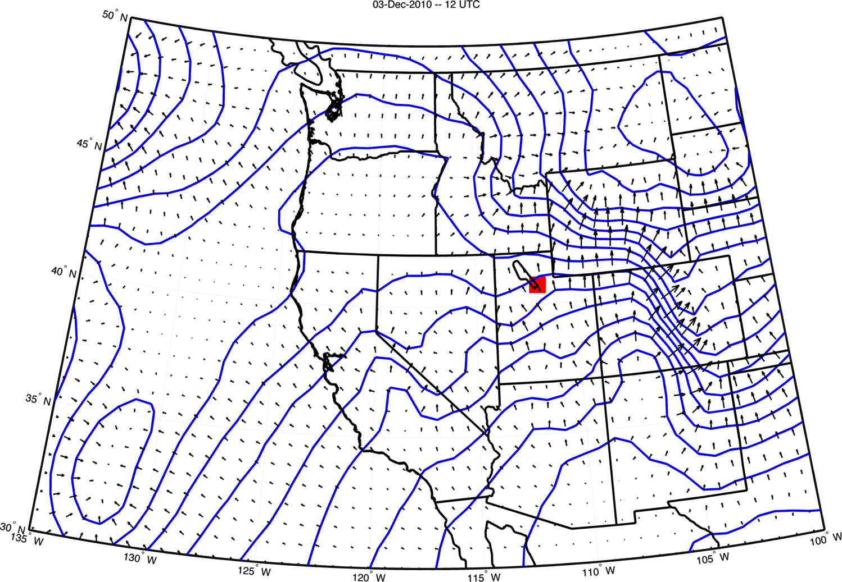
SYNOPTIC OVERVIEW: 03-DEC 12 UTC (0500 LST)

Slide 32
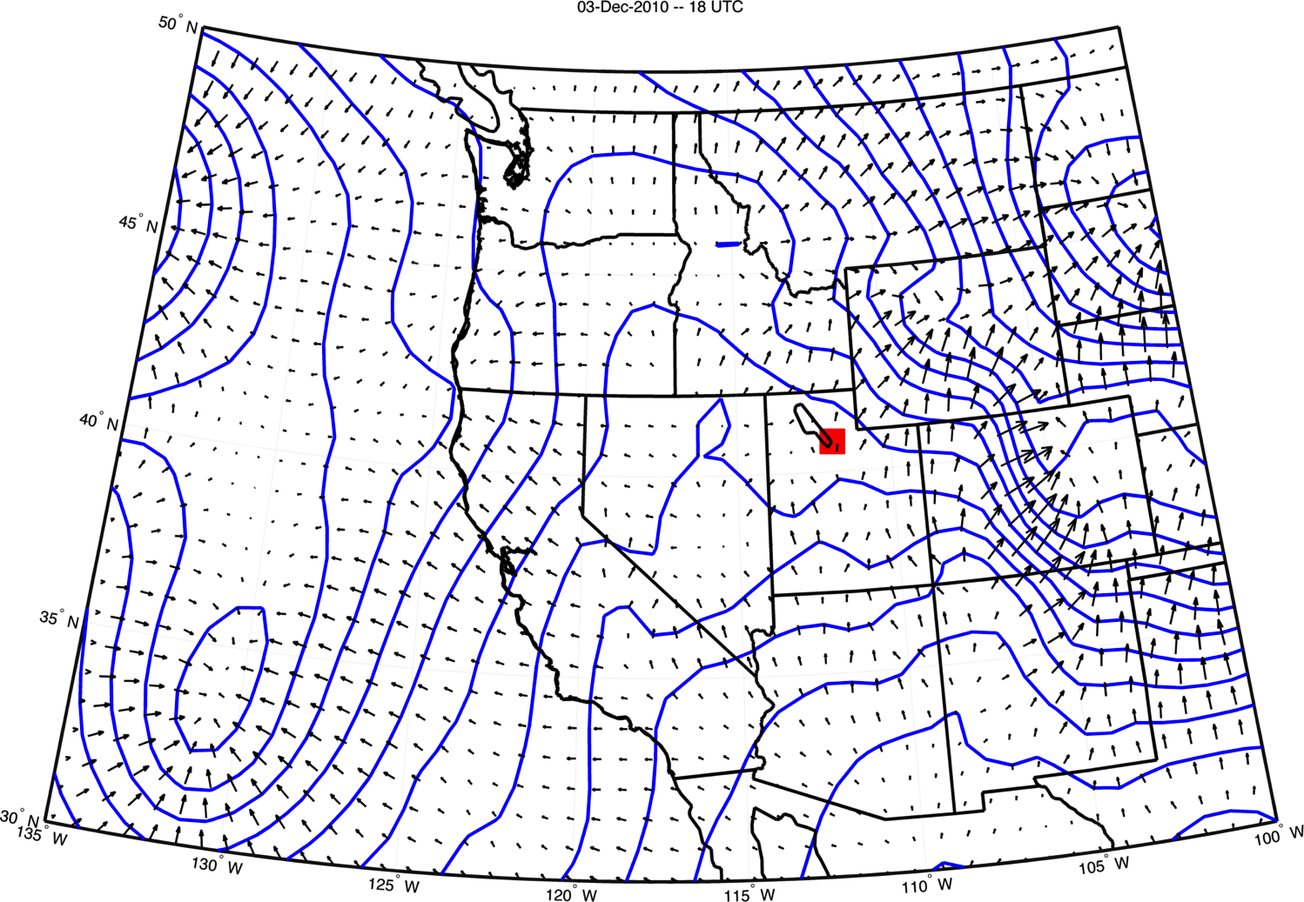
SYNOPTIC OVERVIEW: 03-DEC 18 UTC (1100 LST)

Slide 33
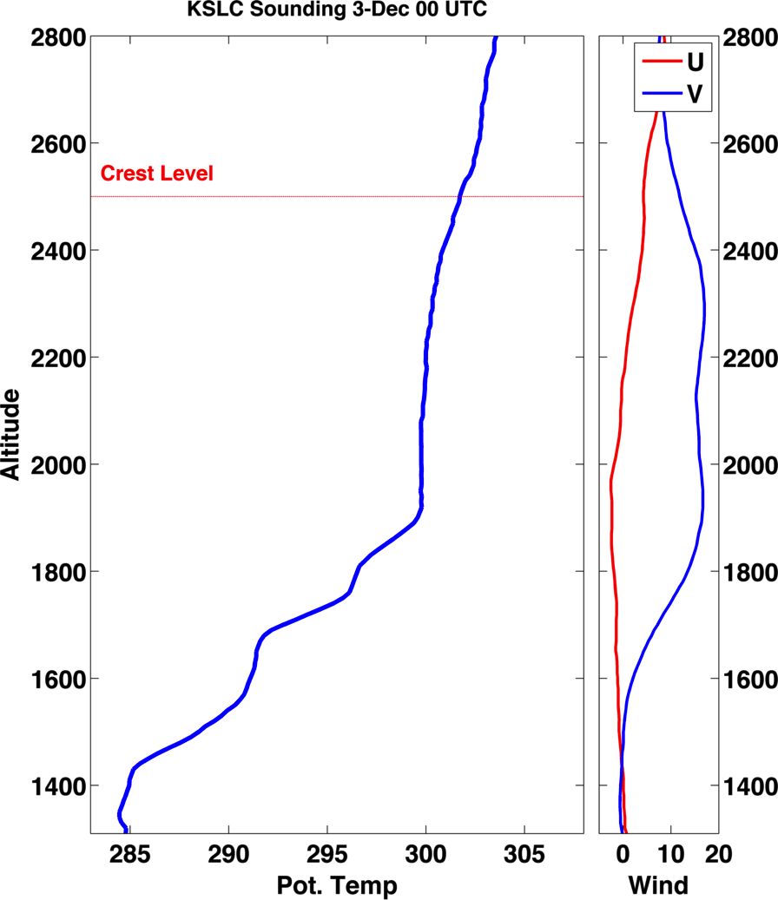

Slide 34
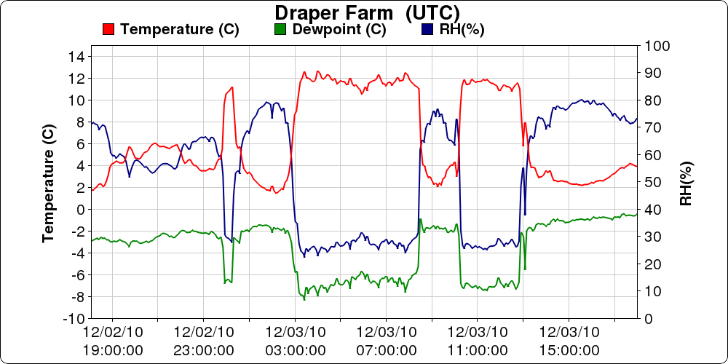
TIME UTC

Slide 35
Spatial evolution
Barnes objective analysis using surface observations and sounding data as a background

Slide 36
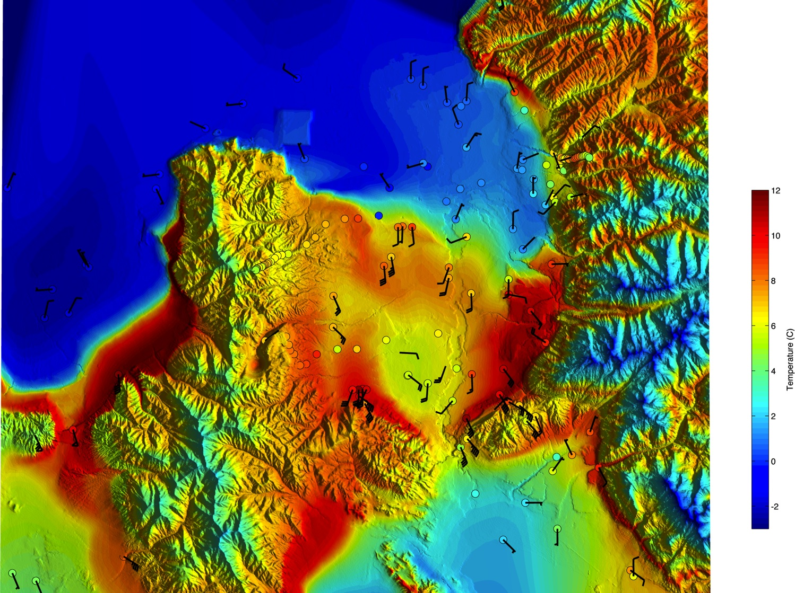
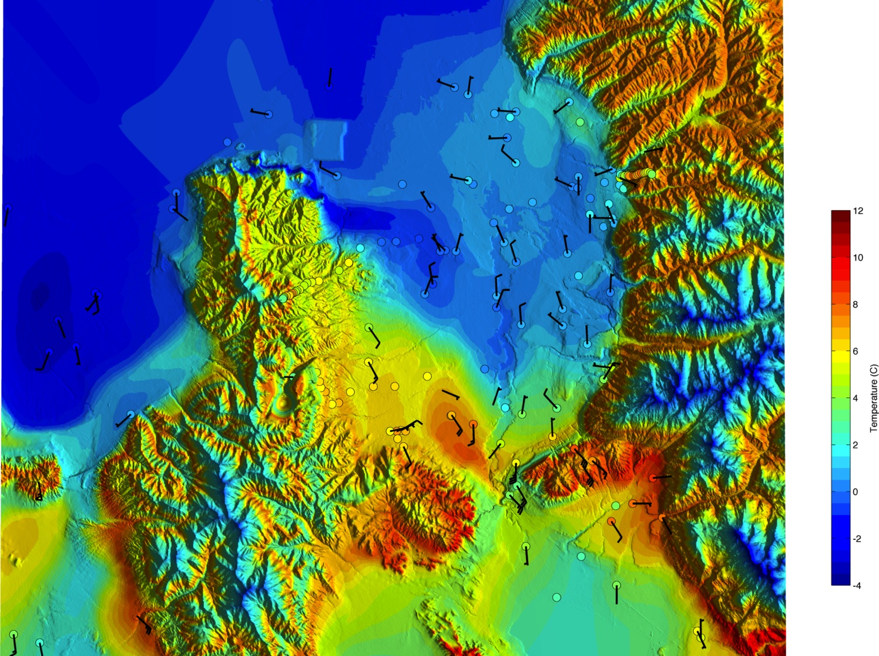
3-Dec 01 UTC (18 MST)

Slide 37
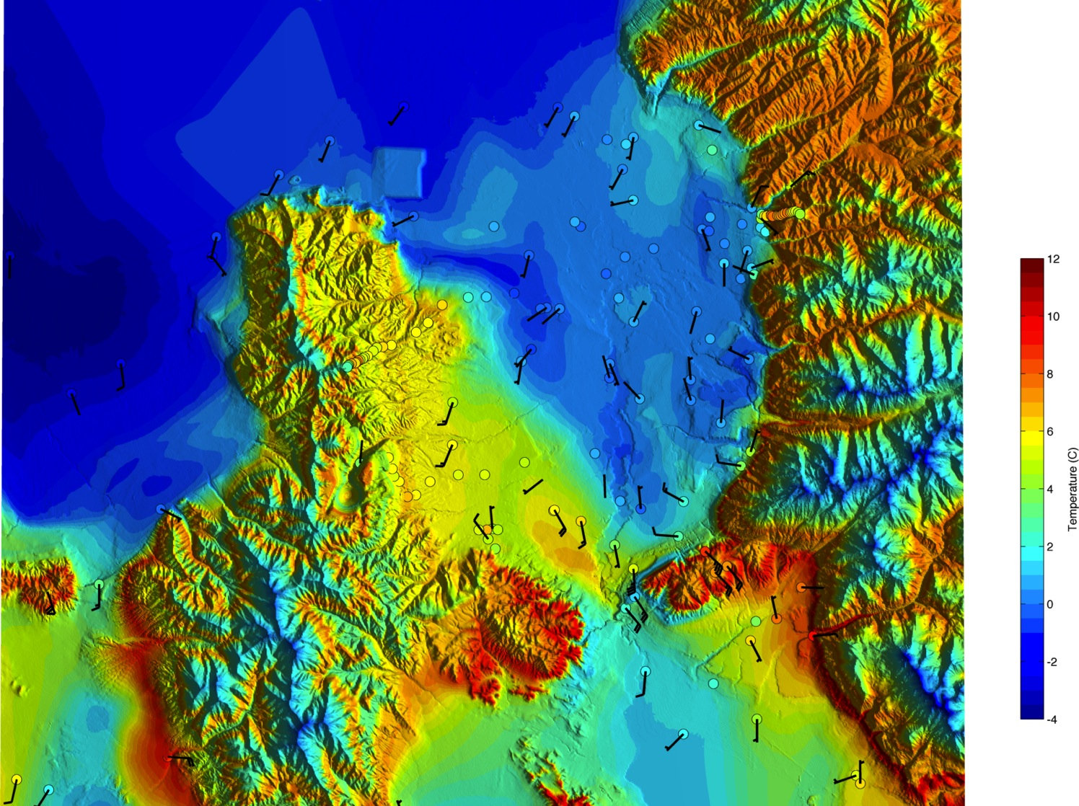
3-Dec 02 UTC (19 MST)

Slide 38
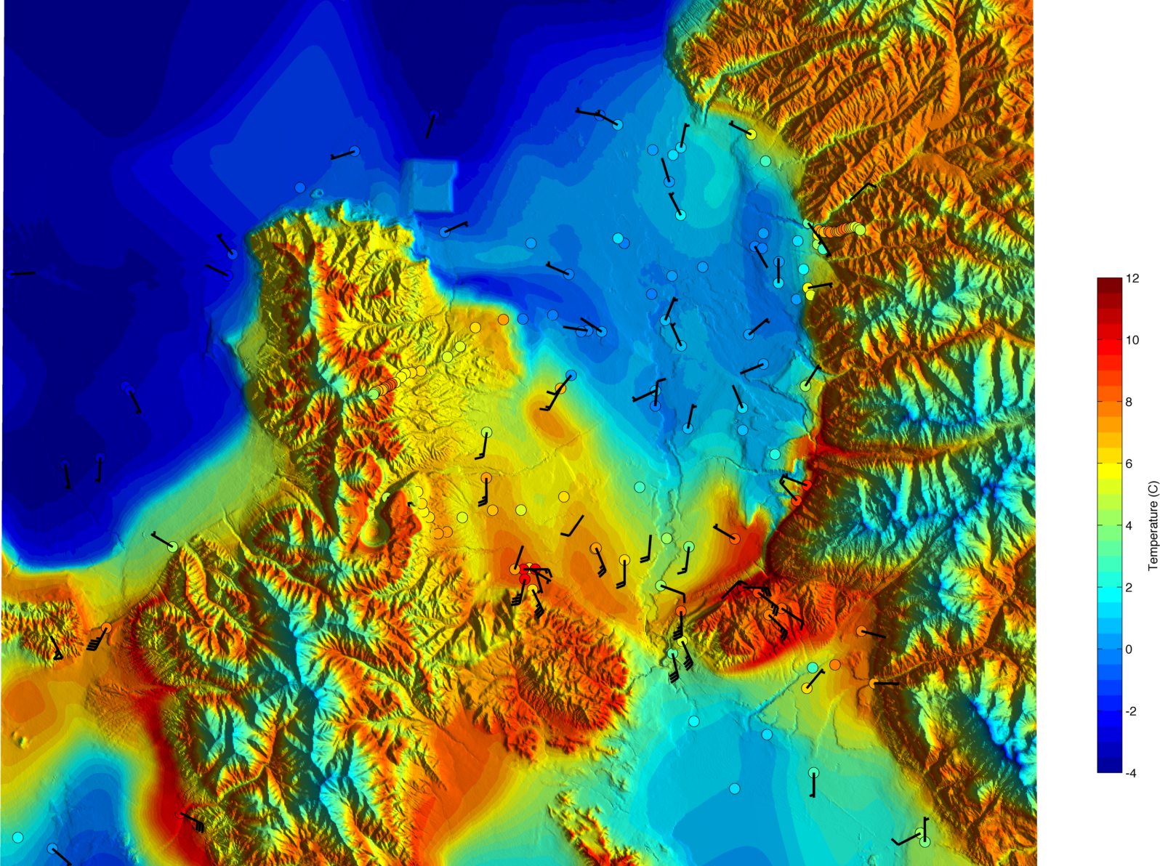
3-Dec 03 UTC (20 MST)

Slide 39
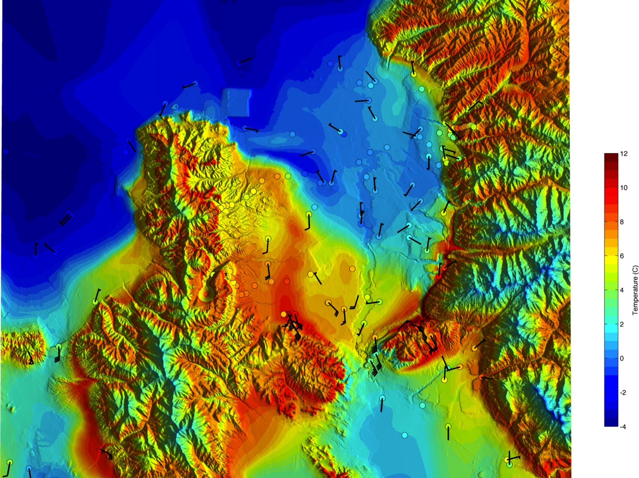
3-Dec 04 UTC (21 MST)

Slide 40
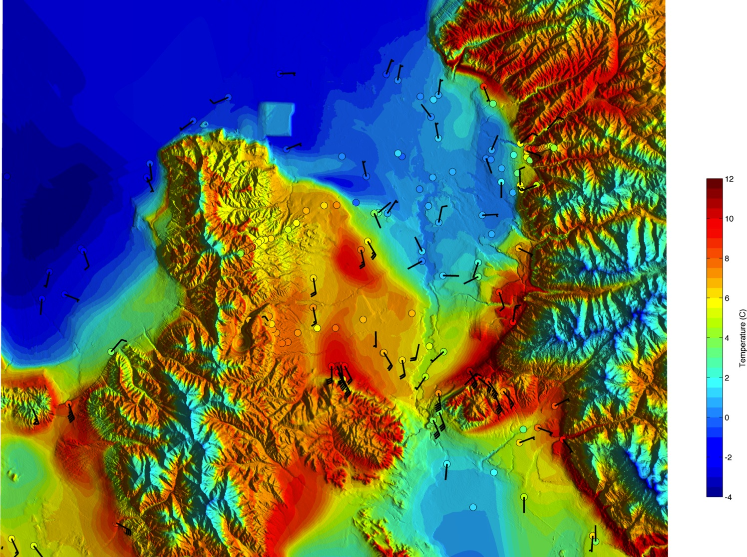
3-Dec 05 UTC (22 MST)

Slide 41
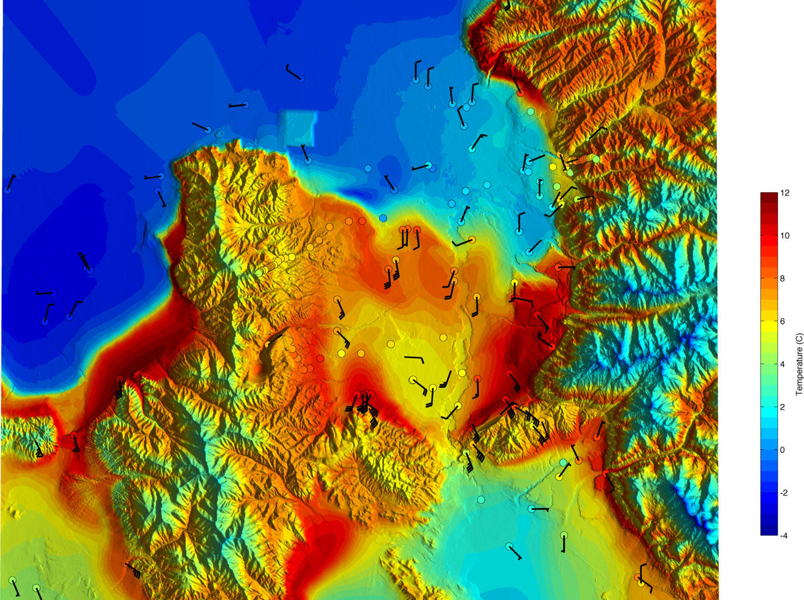
3-Dec 06 UTC (23 MST)

Slide 42
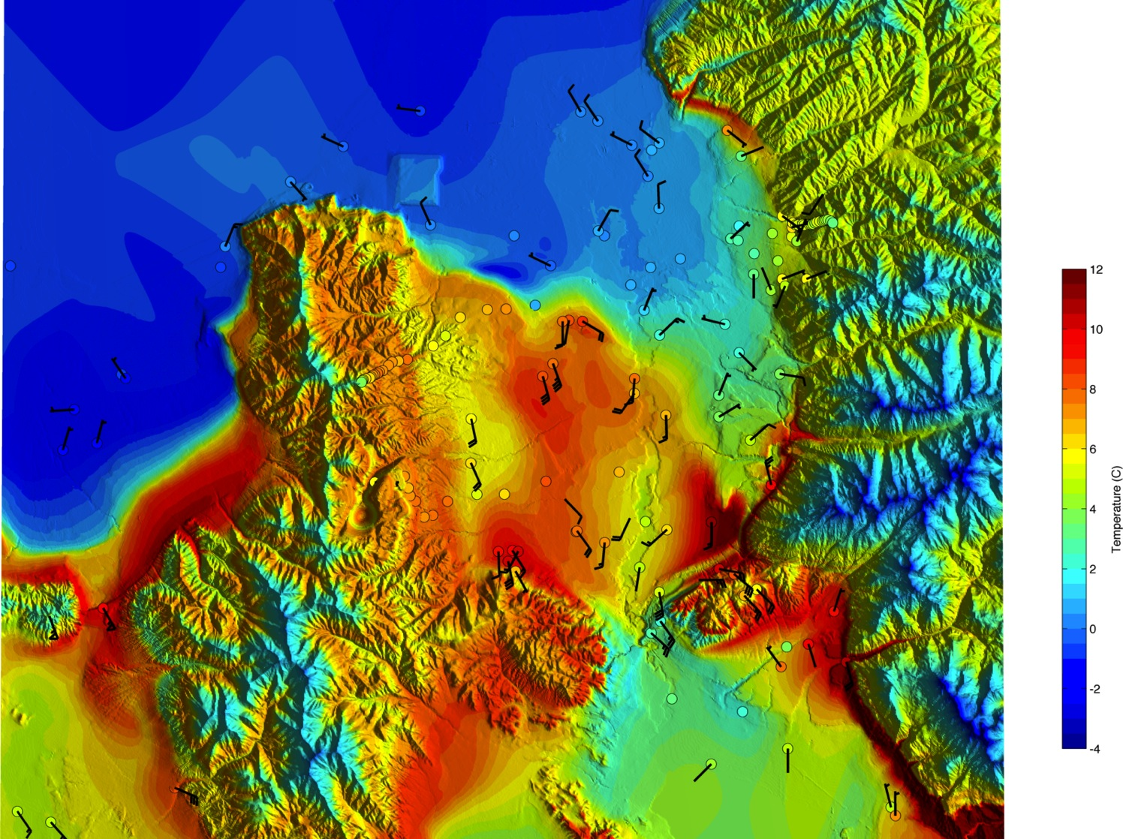
3-Dec 07 UTC (00 MST)

Slide 43
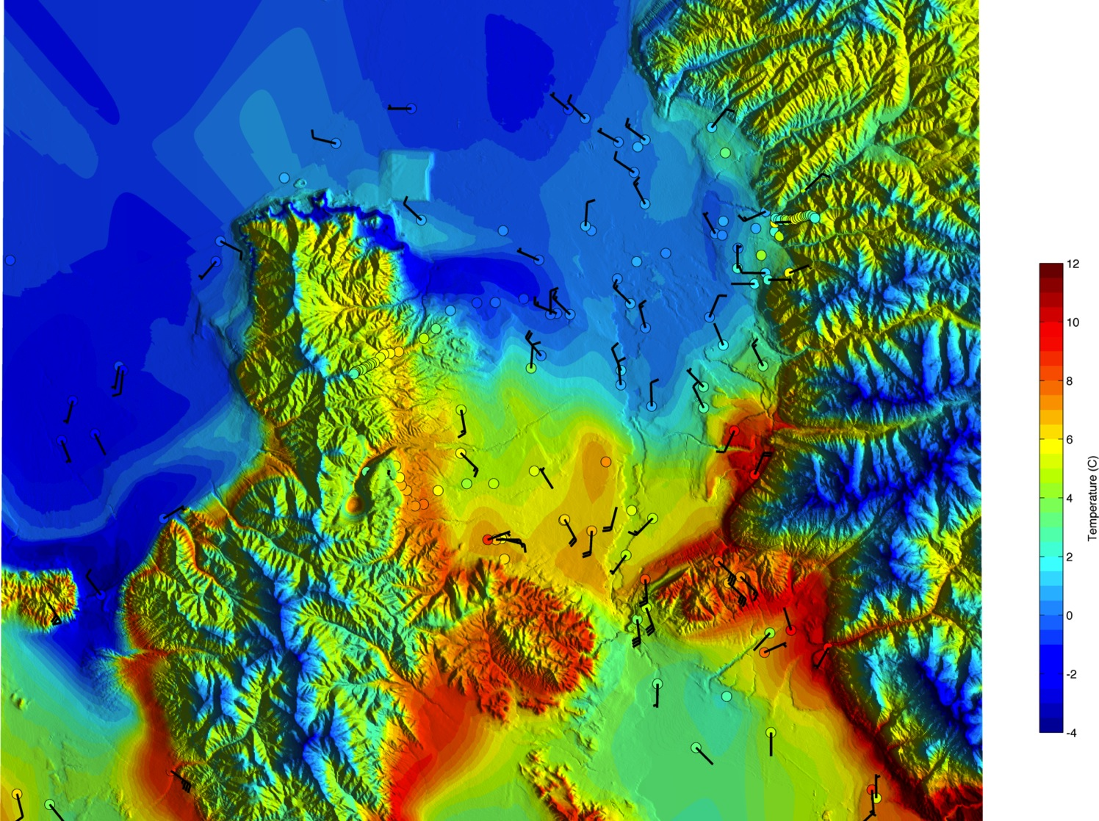
3-Dec 08 UTC (01 MST)

Slide 44
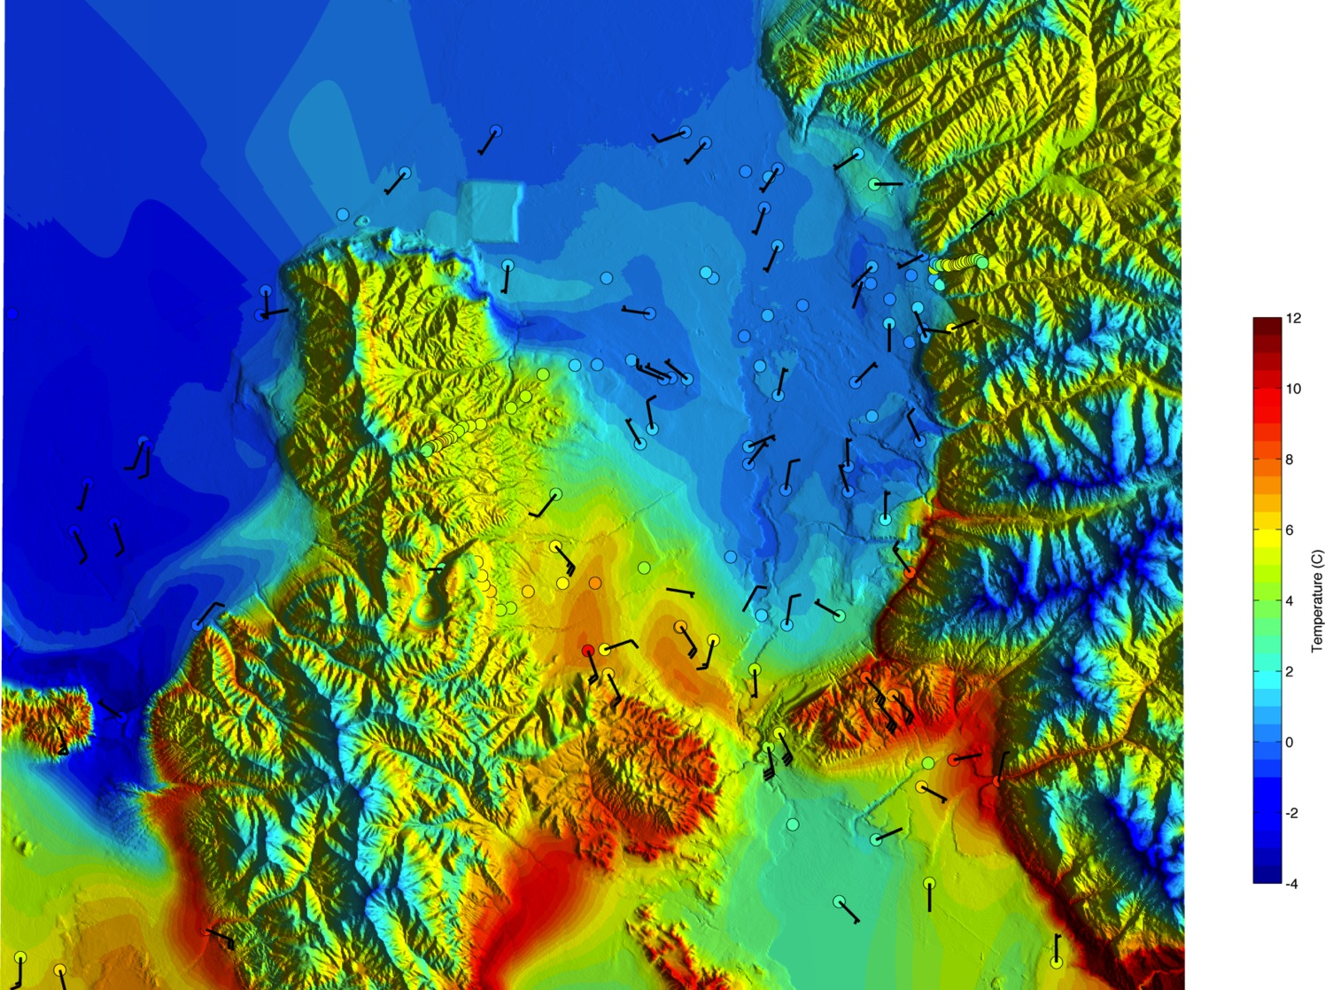
3-Dec 09 UTC (02 MST)

Slide 45
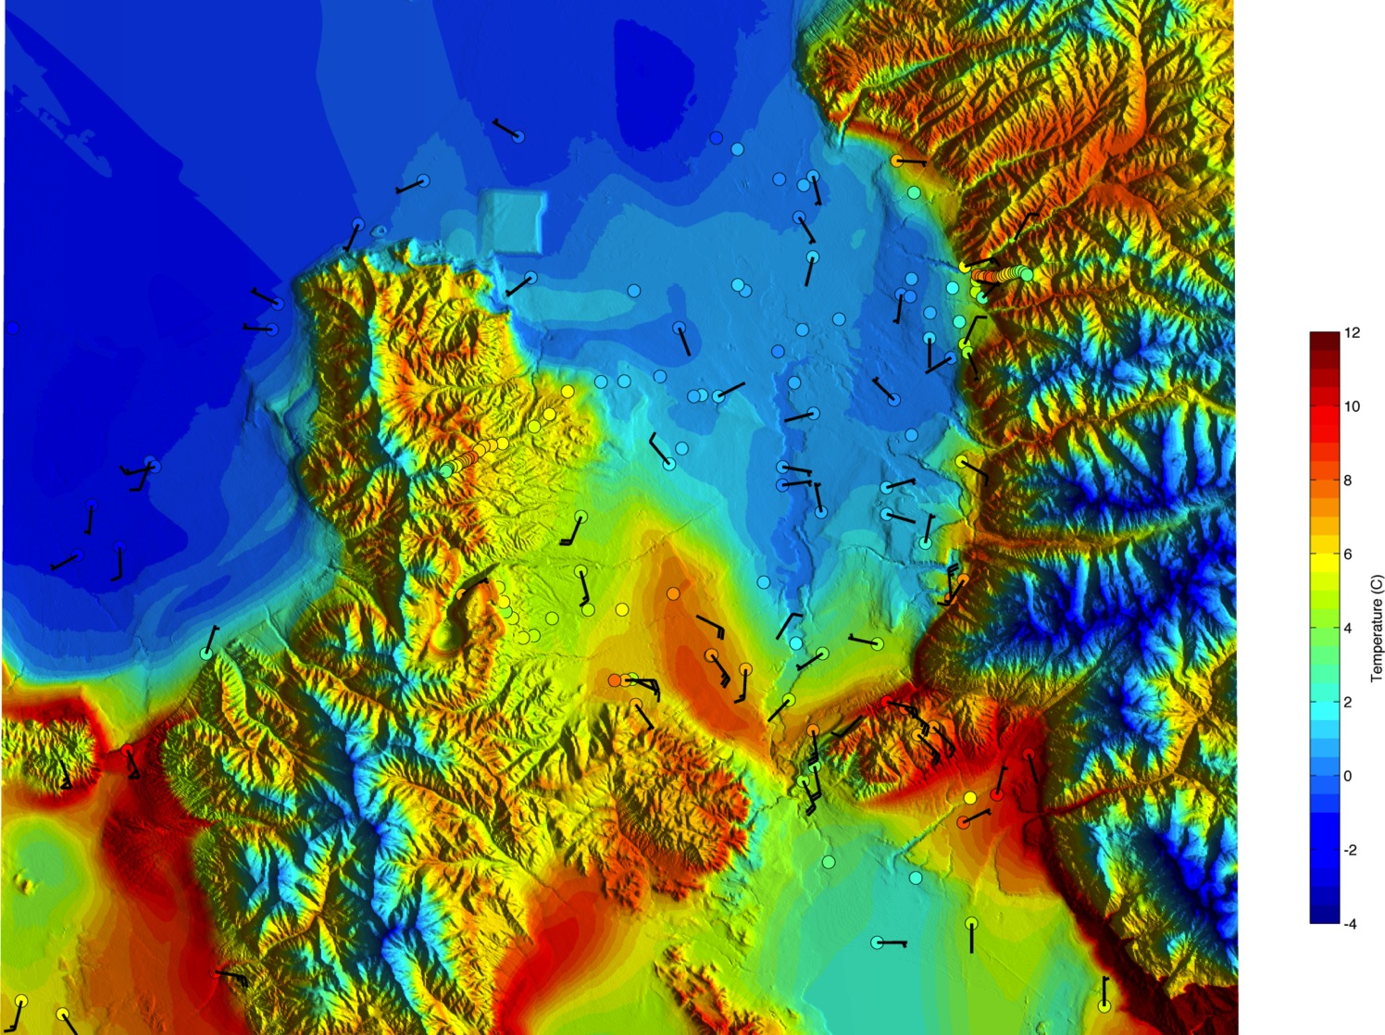
3-Dec 10 UTC (03 MST)

Slide 46
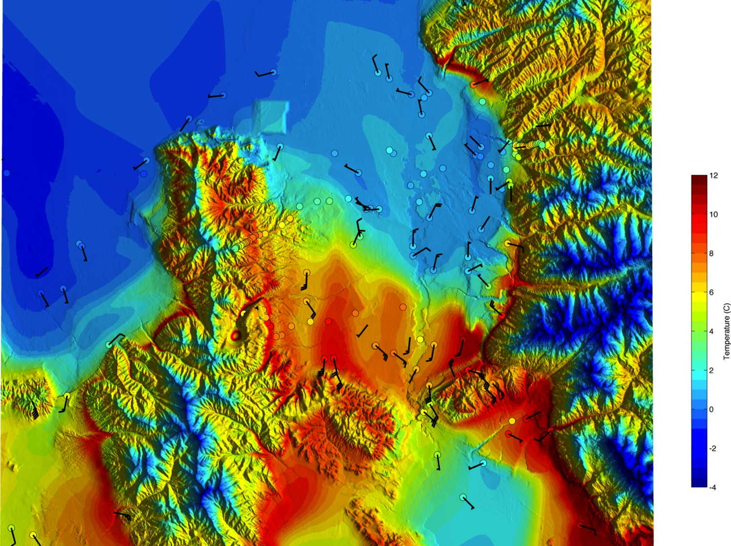
3-Dec 12 UTC (05 MST)

Slide 47
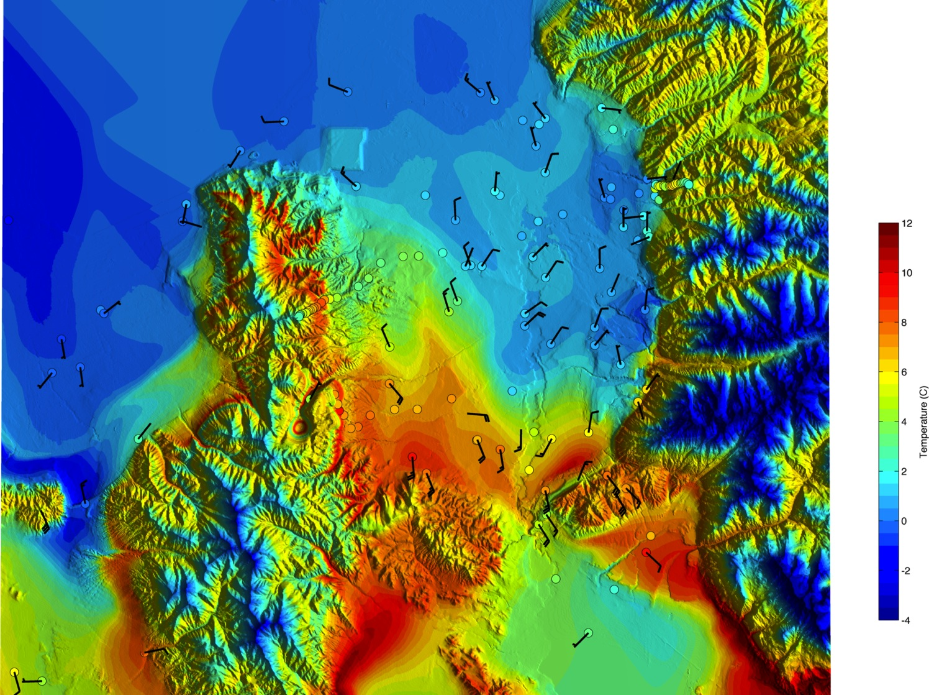
3-Dec 13 UTC (06 MST)

Slide 48
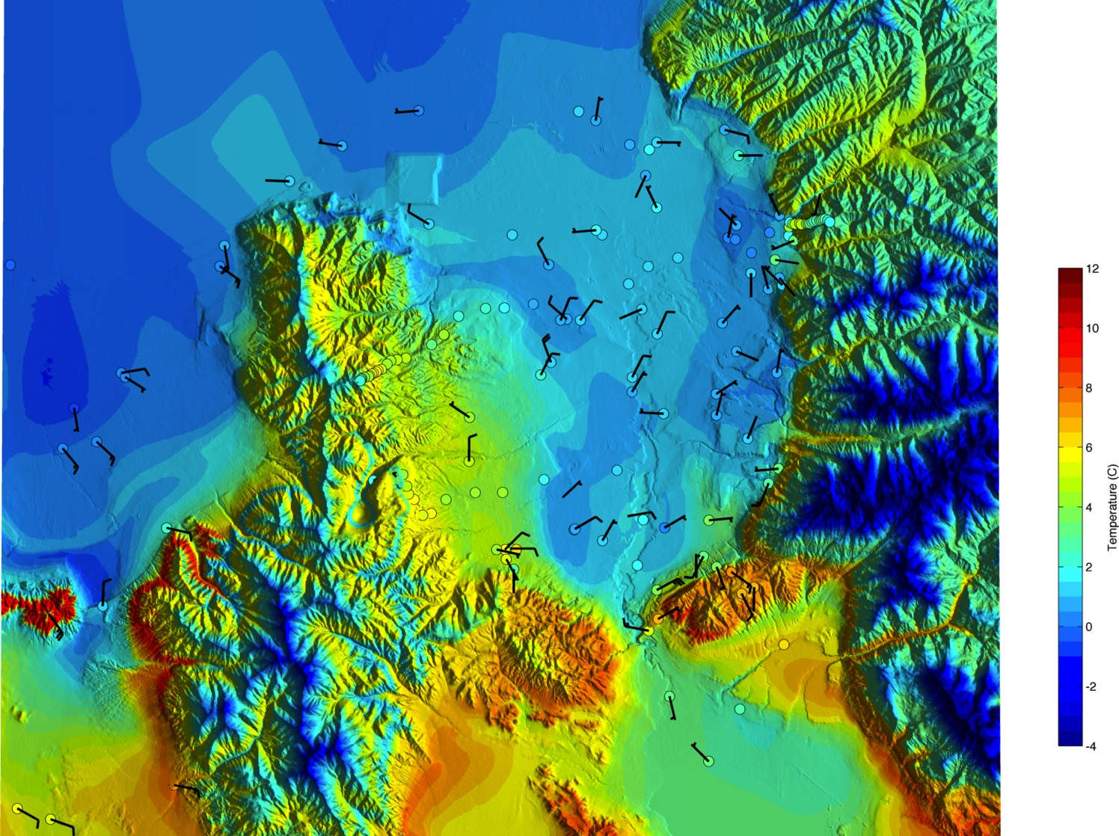
3-Dec 14 UTC (07 MST)

Slide 49
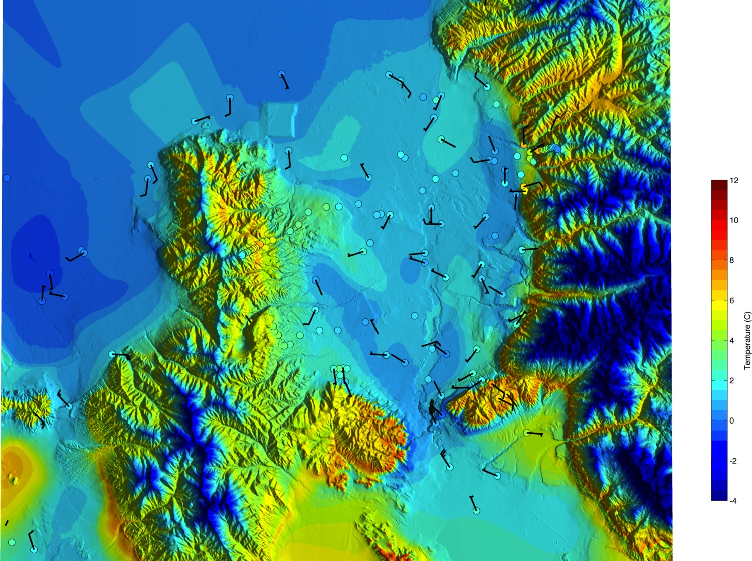
3-Dec 15 UTC (08 MST)

Slide 50
Vertical evolution
Observations as “front” passes over a point in the center of the valley

Slide 51
Potential Temp. and RASS Virtual Temp.
Notes:
Lowering of CAP top, warming aloft.
Warm temperature penetrate to surface, providing an partial mix out.
Note that during mix out the elevated CAP remains in place

Slide 52
Wind Speed (RWP) and Pot. Temp.
Altitude (m)
Day – Hour (UTC)
Notes:
Winds accelerate in time above the CAP and lower into the valley. Strongest winds are around 07 UTC.
Dramatic reduction in winds after 12 UTC, which corresponds to the slosh back of the CAP
Strong shear across the CAP throughout.

Slide 53
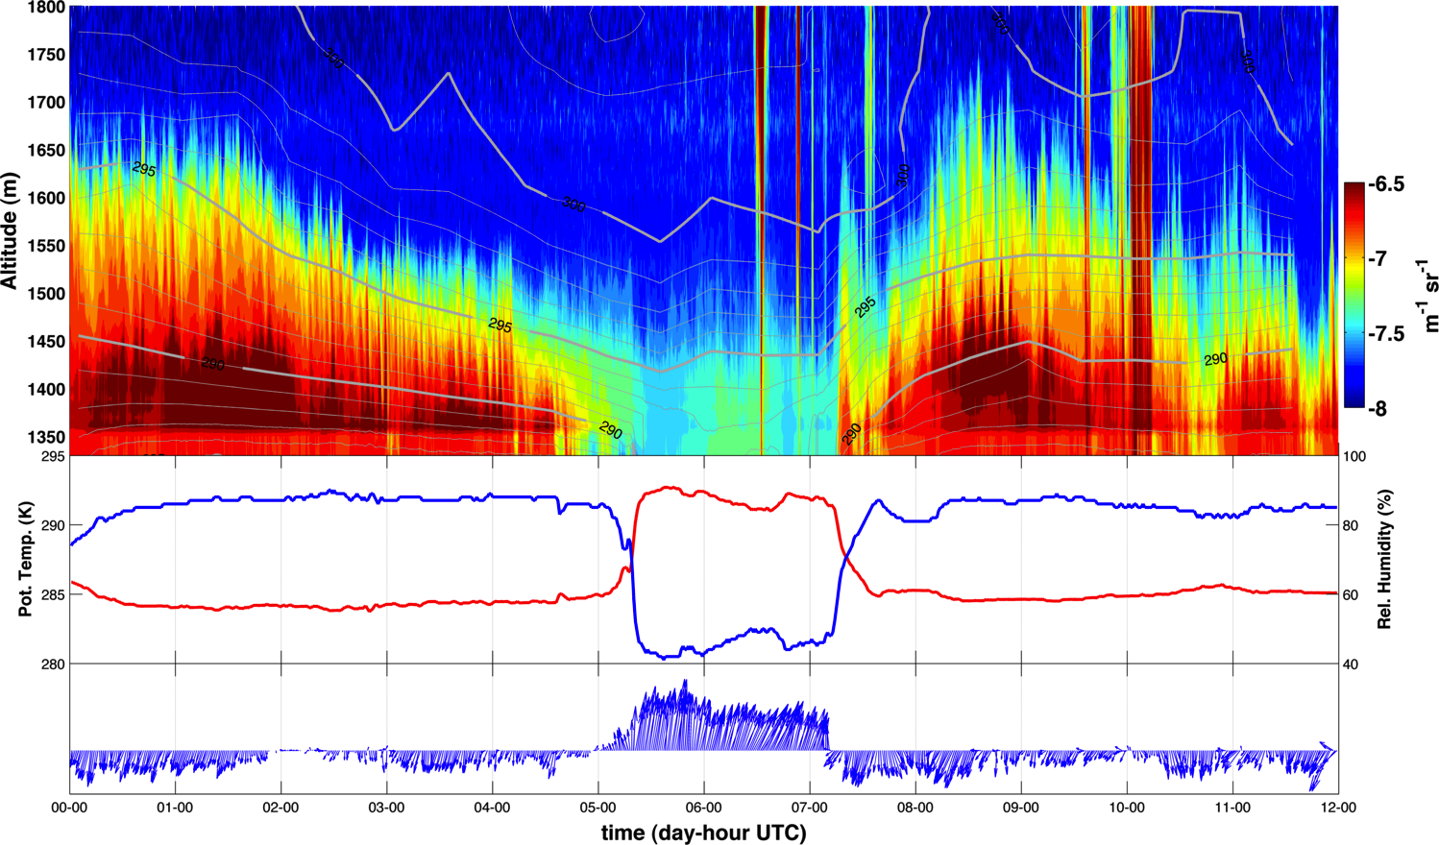
Laser Ceilometer: Aerosol Backscatter
Radiosonde Launch
Notes:
Aerosol concentration is high within CAP, follows the isentropic evolution.

Slide 54
Frontal Structure
Density current dynamics

Slide 55
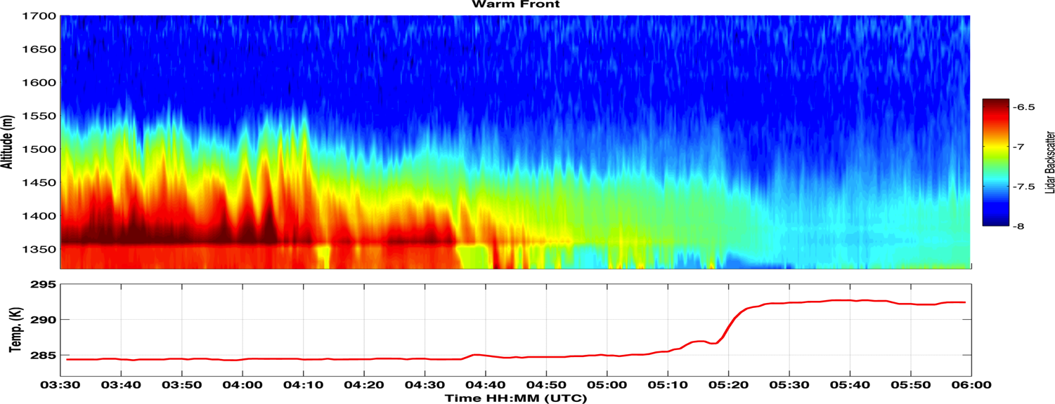
Advancing ~1.75 m/s
Pandoe and Edge (2004)
Notes:
Warm front slowly lowers towards surface. Resembles a saline wedge.
Front is moving very slowly, ~ 1.75 m/s
Moderately supressed turbulence as the front approaches
Reduced aerosol concentration after FROPA
Sounding launched at 05:14 UTC from this sight

Slide 56
NCAR ISS SOUNDING (0514 UTC)
Pot. Temp.
Buoyancy Freq.
Shear
Ri_{g}
Notes:
Two layered inversion.
Strong wind shear leads to RI< Ric within the lowest part of the CAP.
Allowing mixing to occur in this layer, the surface temp should jump to 293, and mix to 1450 m

Slide 57
Assume conservative mixing where Ri<.25
1450 m
293 K

Slide 58
Mixing of Aerosol
1450 m
293 K
Notes:
This predicition holds true. Note aerosol become well mixed over this depth.

Slide 59
Super Critical
Super Critical
Advancing ~5.8 m/s
7-9 m/s
4-7 m/s
Single Trapped Wave
Single Trapped Wave
White and Helfrich 2012 (JFM)
Notes:
Cold FROPA.
Density current moving into a two layered ambient environment
Distinct head, with waves in its wake.
Moving fast (5.8 m/s)
Strong convergent flow.
Temperature drop is less quick despite the faster motion… likely a result of friction and mixing.
Lifting of the upstream two layered system.
Matches well with highly idealized simulations of similar systems…
Preliminary analysis sugguests that it is not actually supercritical (u> speed of the bore)
So perhaps the single trapped wave at the leading edge is a possible “partially blocked” scenario

Slide 60
Turbulent Mixing: Kelvin-Helmholtz Instability
Notes:
Speaking of turbulent mixing….

Slide 61
Turbulent Erosion: Kelvin-Helmholtz Instability
100 m
~ 3 min => ~1800 m (assuming v= 10 m/s)
Turbulent mixing occurs within the CAP!!! Not necessarily just along the top edge. Note: We do not know what is going on at the top edge due to the lack of aerosol.
Notes:
Top panel shows a sequence of KH waves that move past ISS. The waves are growing in amplitude in the sequenece and break down to smaller waves after 04:05.
The largest amplitudes are about 100 m, and the wave frequence is about once every 3 mins, giving a very rough spatial scale of >1500m
The waves extrude high aerosol air into the cleaner air aloft
Later, using a sounding, we can see that the waves occur WITHIN the two layered CAP structure where Ri<Ric, not necessarily acting as top down erosion, but instead internal erosion. This complicates the highly idealized scenarios of Petkovsek and Zhong.

Slide 62
Mountain Waves and Cap displacement

Slide 63
Mountain Wave
Notes:
There is evidence of a mountain wave contributing to the CAP partial mix-out.
The top panels show the rapid development of an adiabatic profile along the traverse ridge, suggesting isentropes are following the terrain in a hydraulic type flow.
During the same period winds at the base of the range accelerate. Equaling and surpassing the winds at ridge crest.
It is during these hydraulic flow periods that the warm front mobilizes through the valley.
When the hydraulic flow subsides the CAP sloshes back to the south as a cold front with the density current nose described above.

Slide 64
Tilting CAP

Slide 65
SLOPING CAP SURFACE
3-Dec 11 UTC (04 MST)
Airport
NCAR-ISS
Traverse Mtn
Notes:
At 11 UTC the tilt of the CAP is pronounced.
Slope is about 400 m over 25 Km.

Slide 66
Event Summary
Short wave trough, enhanced pressure gradient, and strong winds aloft disturb the IOP-1 CAP
A warm (cold) front forms moving north (south) through the valley
The warm (cold) front advances slowly (quickly) acting as a density current.
KH Waves appear WITHIN the multi-layered CAP.
A mountain wave exerts control on the timing of frontal movement
The CAP shows a sloping surface throughout the valley.

Slide 67
Some Additional Thoughts
Persistent CAPs are many layered.
CAPs within CAPs
Turbulence and wave instability may act at the interface between these “internal” layers.
Horizontal density differences generate density currents
Can be caused by turbulence or differential heating (e.g. lake breezes)
The density current then helps to generate/restore a multilayered structure.

Slide 68
RESEARCH TRAJECTORY

Slide 69
Large Eddy Simulations (LES)
Simulate and quantify the mountain wave, density current, tilting, and KHI impacts on CAP breakup
Explicitly resolve the inertial scale eddies most directly responsible for mixing in the CAP
Avoid parameterized mixing
Notes:
Observations alone are insufficient to advance our knowledge of PCAPS destruction by dynamical processes. Modeling is required

Slide 70
Proof of Concept WRF-LES Runs
Upstream profile: Adiabatic with sheared boundary layer
CAP profile: Hyperbolic tangent for wind and temperature
Mtns: 400 m tall
Domain: 15 KM, dx=100, dz=50 m

Slide 71
Proof of Concept Runs

Slide 72
TO DO:
-Define the parameter space (targeting scales of SLV and PCAPS)
-Accelerating winds
-Refinements to experiment design/resolution/etc.
-TKE and Heat Budget terms for the valley atmosphere during mix-out
-Compare results with PCAPS observations / Turbulence Statistics

Slide 73
Real Data Simulations
Model set up
Event:
NAM initialization
12.15 km/4.05 km/1.35 km
Tests with both YSU and MYJ boundary layers
IOP 9:
Most data rich event
Fog/clouds
Strong winds
Forecast challenge
Goal: Assess model fidelity as function of resolution to capture CAP dynamics

Slide 74
WRF IOP-9 Simulation

Slide 75
Research Timeline
December 2012-January 2013:
Refine LES experiments, execute model runs
Feb-April:
Process model results, re-runs, synthesize results with observations
May-July:
Distill results into a conceptual model for CAP breakup.
Prepare thesis
August:
Thesis defense
Prepare journal articles
Sept.
Transition to post-doc or other employment opportunities

Slide 77
QUESTSIONS?
Acknowledgements: Joe Young for ceilometer data, Erik Crosman for modeling collaborations, the entire PCAPS team

