Slide 1
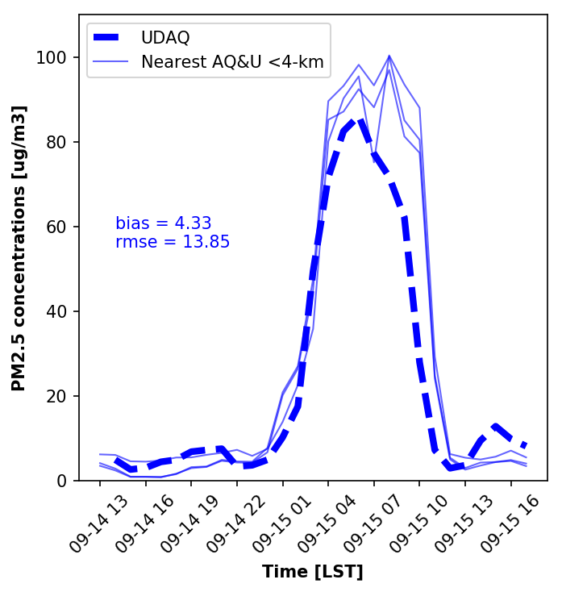
Plot of Air Quality Data for September 14-15th 2018 for Salt Lake City

Slide 2
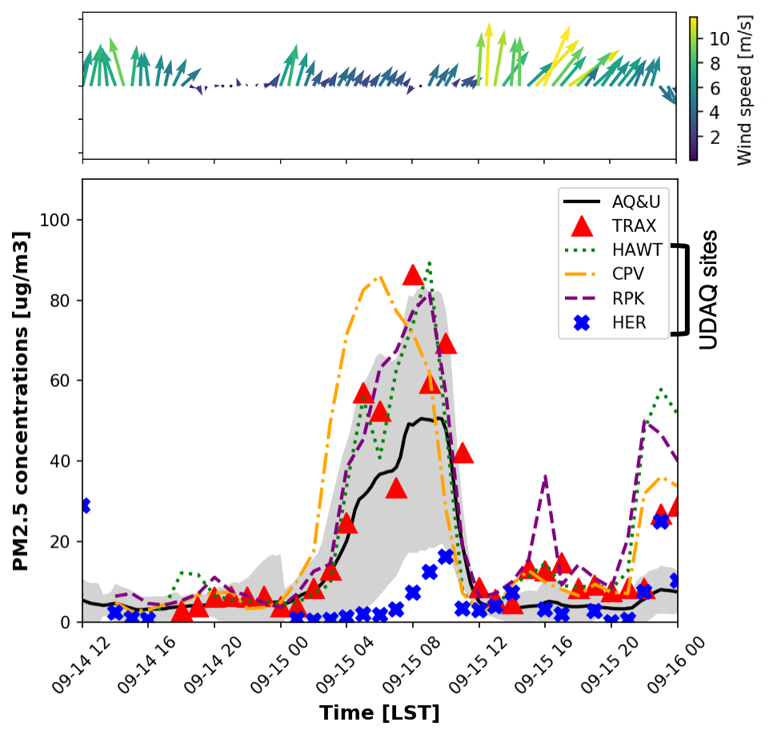
Fancier time series plot with wind vectors and air quality data for multiple stations….

Slide 3
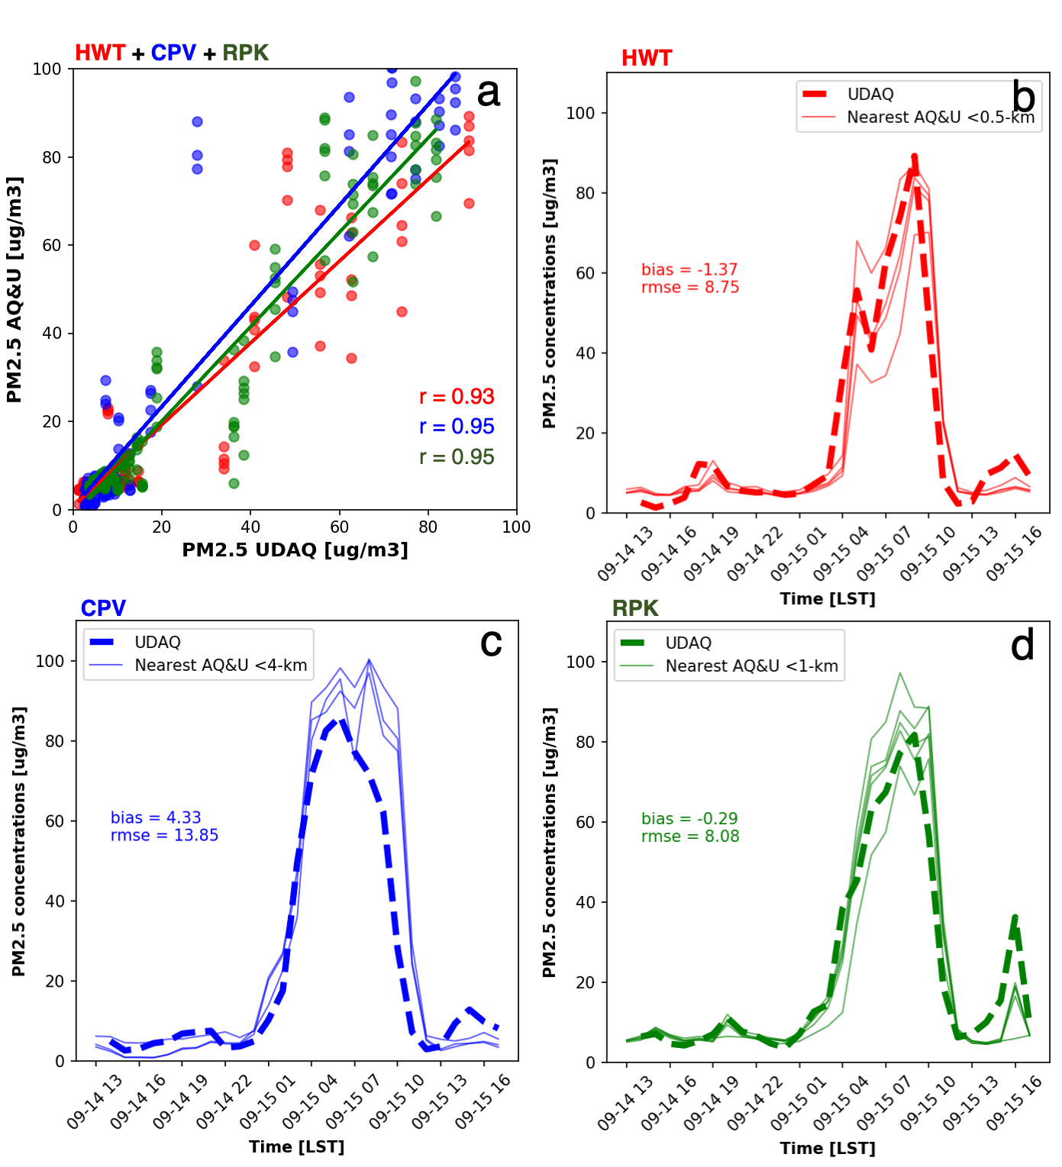
Panel plots and a scatter plot (air quality data)

Slide 4
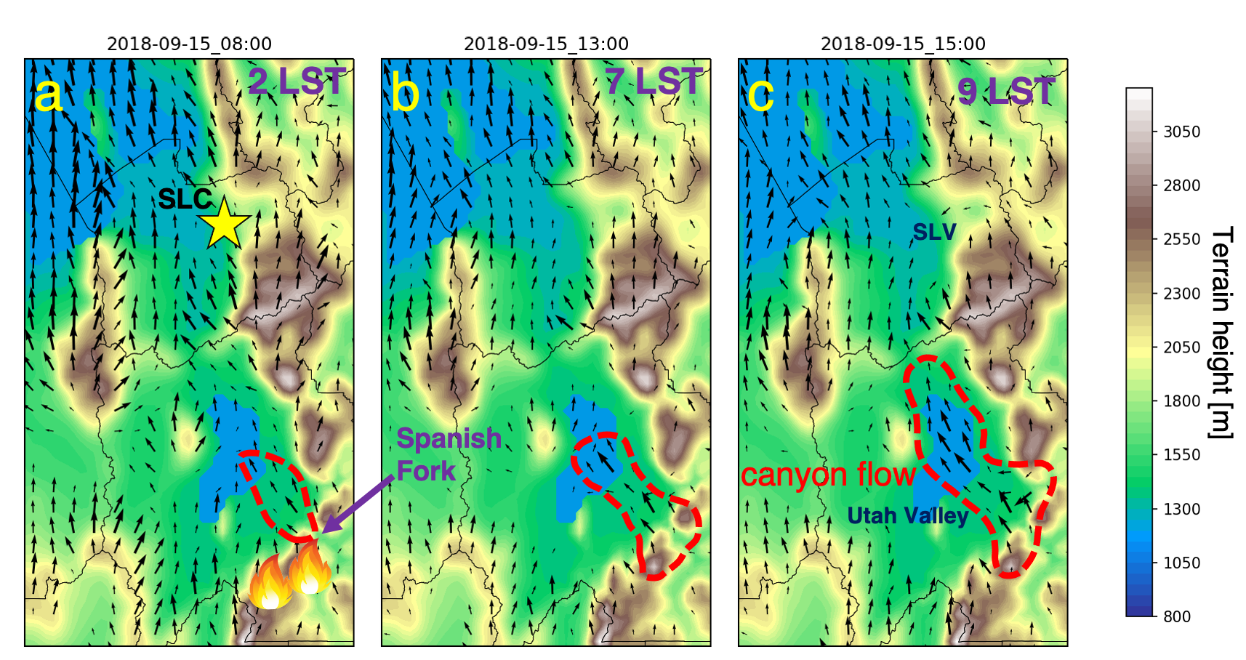
Can plot up gridded sets from weather model output!

Slide 5
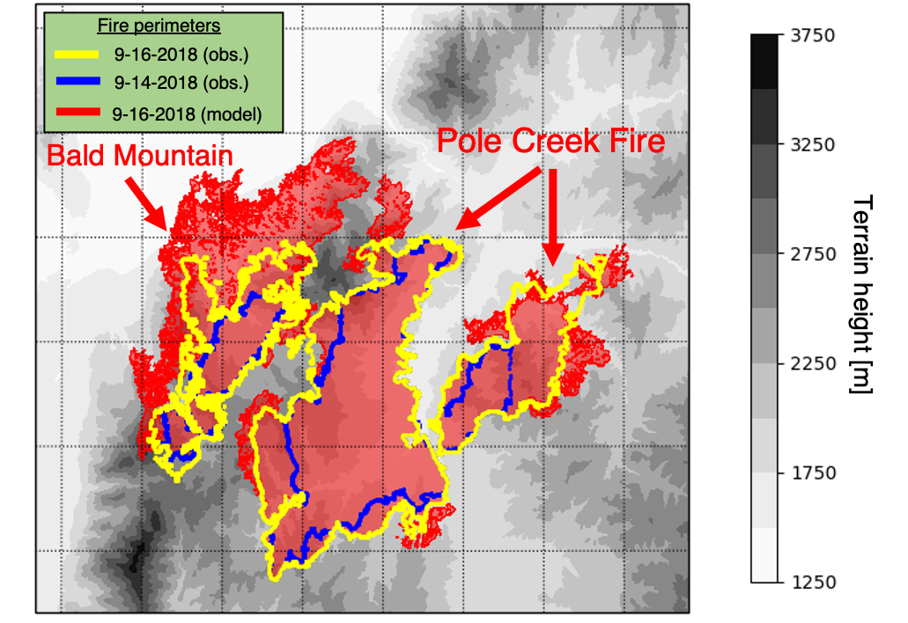
Has been used to plot up fire perimeters from kmz files

Slide 6
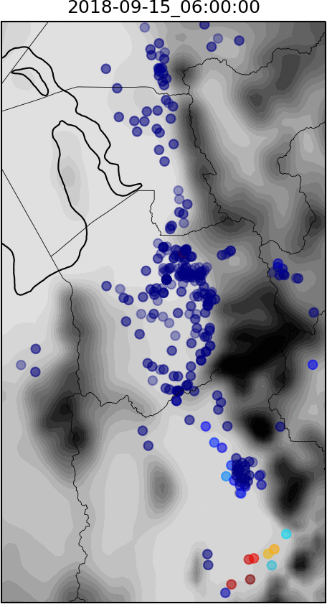
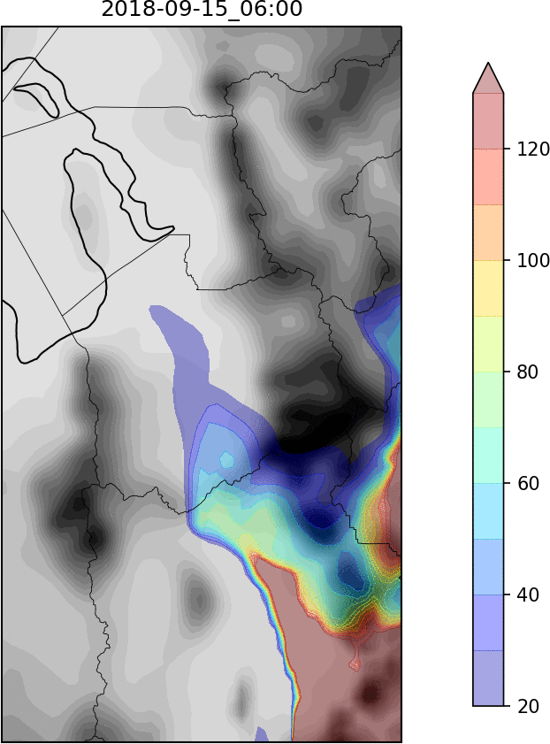
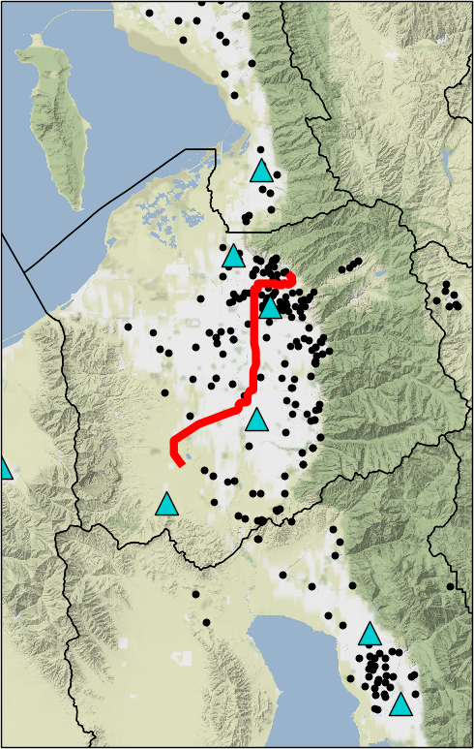
If you are feeling adventurous, you can take multiple images and combine them together to create a loop via ImageMagick (this is a case where linux commands are *very* useful!)

Slide 7
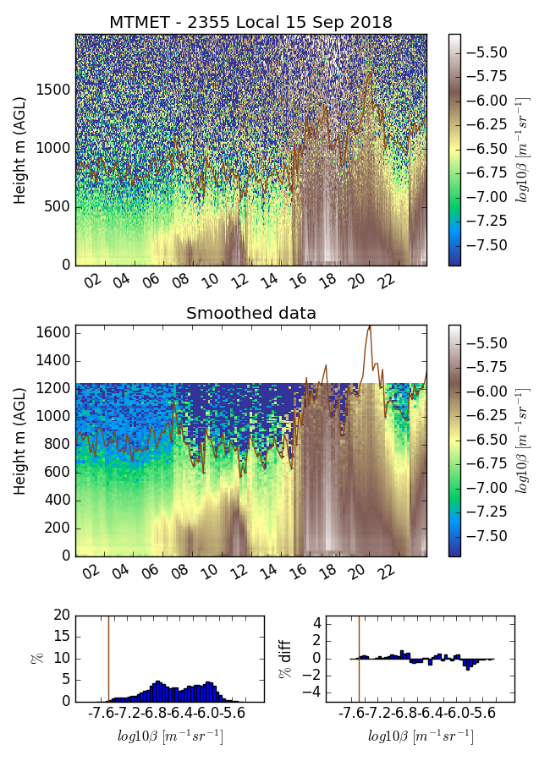
Plot up other gridded data sets such a ceilometer data. Courtesy of Alex Jacques

Slide 8
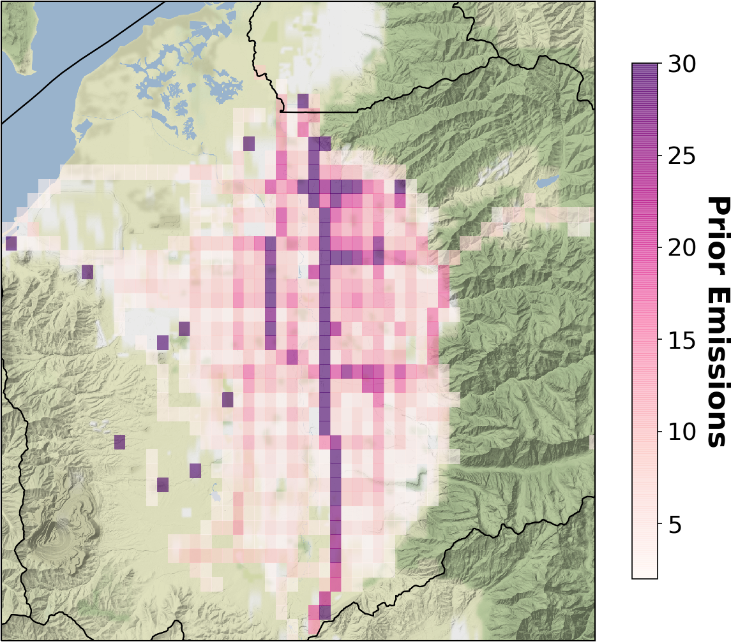
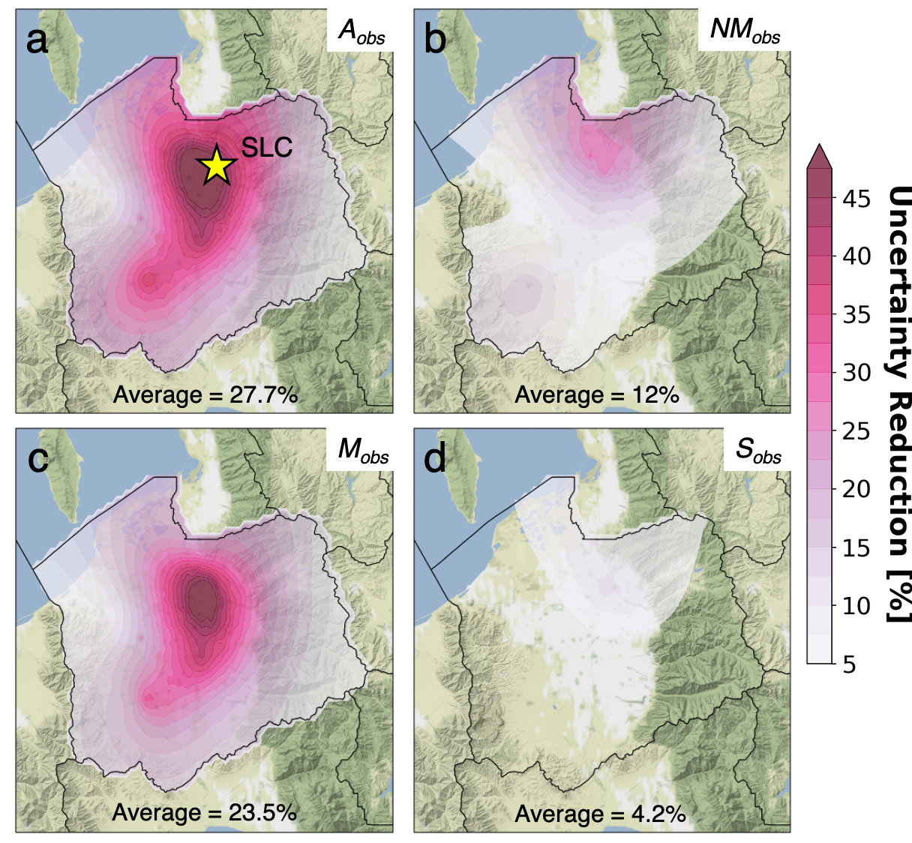
Some more plots….
CO₂ emission data for Salt Lake City

