Slide 1
Spatial Assessment of Mesoscale Pressure Perturbations using the US Transportable Array
Alexander A. Jacques, John D. Horel, and Erik T. Crosman
Department of Atmospheric Sciences, University of Utah
American Meteorological Society
16th Conference on Mesoscale Processes
Boston, MA
August 4, 2015

Slide 2
Earthscope US Transportable Array (USArray TA)
“Rolling” deployment of ~400 surface stations across CONUS and Alaska for earth mapping and seismic-related research
2010: Barometric pressure sensors added (1 and 40 Hz sampling)

Slide 3
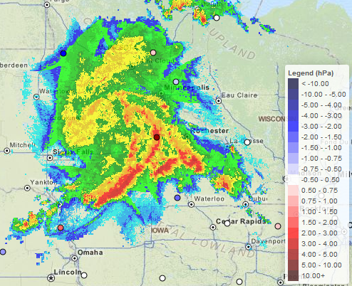
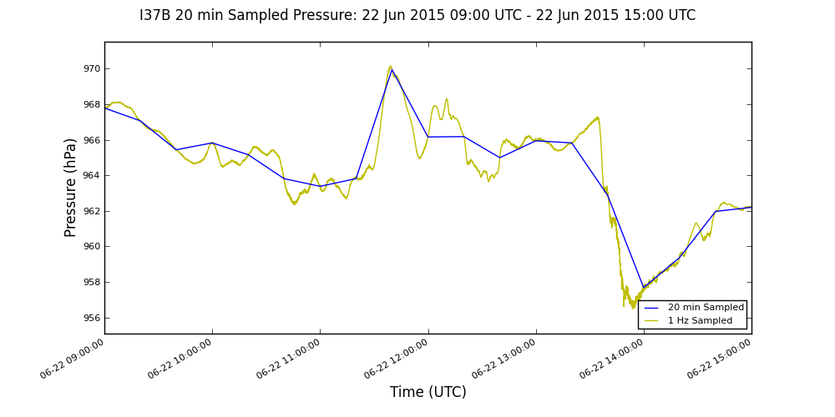
Project Motivation and Objectives
USArray TA provides unique dataset to study mesoscale surface pressure fluctuations from convection, gravity waves, etc.
21-22 June 2015 Overnight Midwest Derecho
Mesoscale Pressure Perturbations: 1140 UTC 22 June 2015
I37B 1 Hz and 20 min-sampled Pressure Time Series
http://meso1.chpc.utah.edu/usarray/cgi-bin/usarray_pres_perturbation_archive.cgi?yr=2015&mo=06&dy=22

Slide 4
Project Motivation and Objectives
USArray TA provides unique dataset to study mesoscale surface pressure fluctuations from convection, gravity waves, etc.
21-22 June 2015 Overnight Midwest Derecho
Mesoscale Pressure Perturbations: 1140 UTC 22 June 2015
I37B 1 Hz and 20 min-sampled Pressure Time Series
http://meso1.chpc.utah.edu/usarray/cgi-bin/usarray_pres_perturbation_archive.cgi?yr=2015&mo=06&dy=22

Slide 5
Project Motivation and Objectives
Additional unique characteristics:
Cartesian-based deployment (~70 km spacing)
Uniformity (same setup/equipment for each station)
Reliability for 1 Jan 2010 – 30 Jun 2015 (1047 stations):
Median station availability percentage: 99.8%
Median station availability post-QC: 99.7%
Goal: assess and describe pressure signatures/perturbations at multiple scales of atmospheric phenomena
Individual stations: time series analysis
Spatial assessment: observations combined with gridded datasets via numerical models

Slide 6
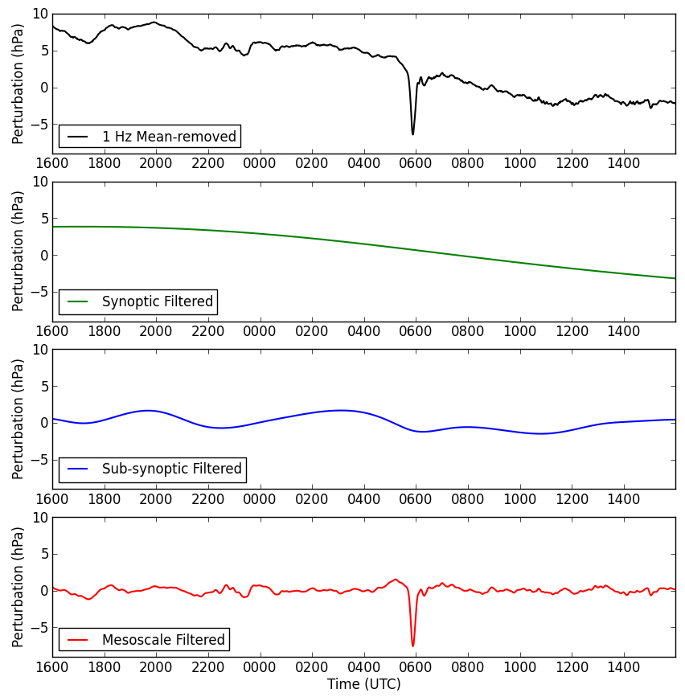
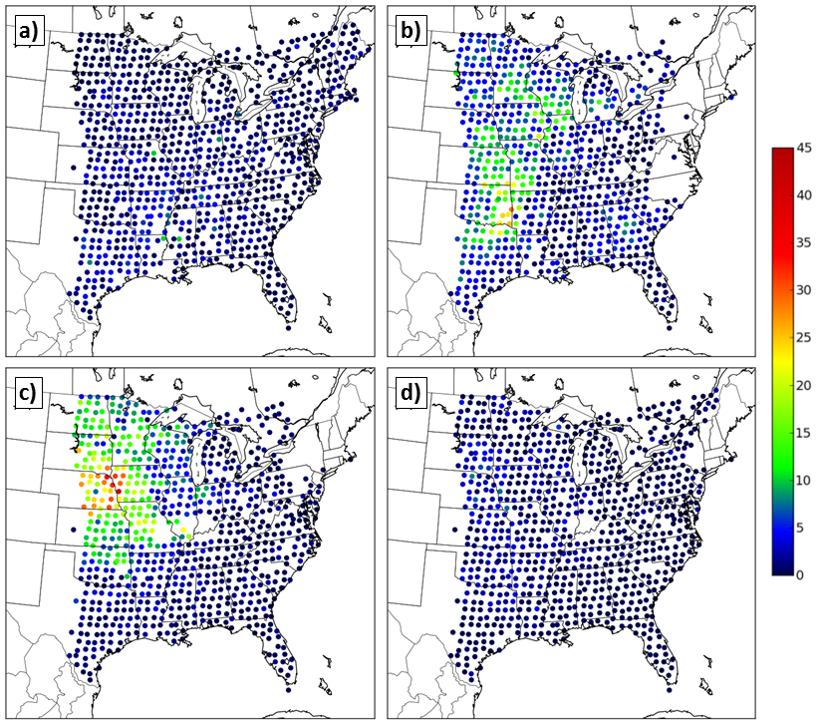
Time Series Analyses
Jacques, A. A., J. D. Horel, E. T. Crosman, and F. L. Vernon, 2015: Central and Eastern United States Surface Pressure Variations Derived from the USArray Network. Monthly Weather Review, 143, 1472-1493, doi:10.1175/MWR-D-14-00274.1
24 h Station Time Series
Seasonal Large (≥ 3 hPa) Mesoscale Pressure Signatures
Winter
Spring
Gravity Wave
Gravity Wave
Summer
Autumn

Slide 7
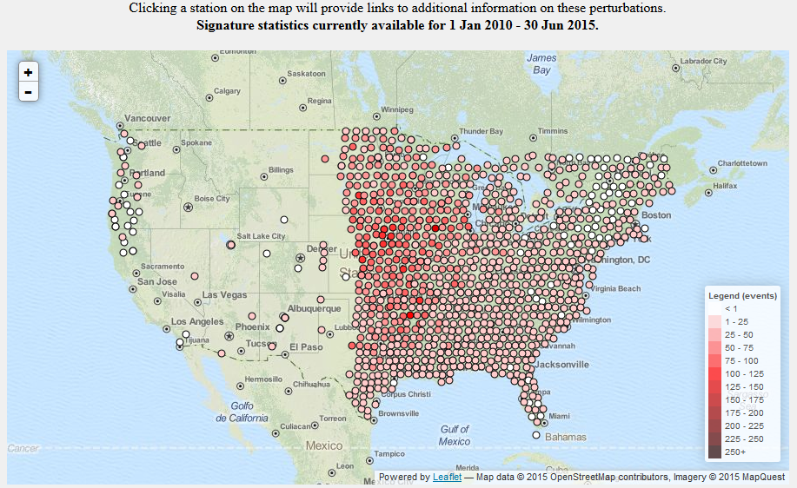
Time Series Analyses
Case studies perused further via developed web products (http://meso1.chpc.utah.edu/usarray)

Slide 8
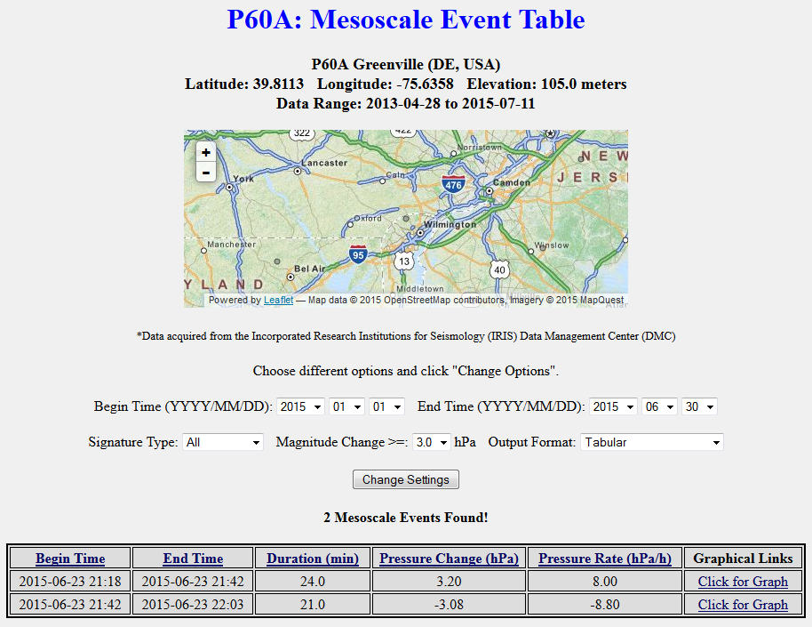
Time Series Analyses
Case studies perused further via developed web products (http://meso1.chpc.utah.edu/usarray)

Slide 9
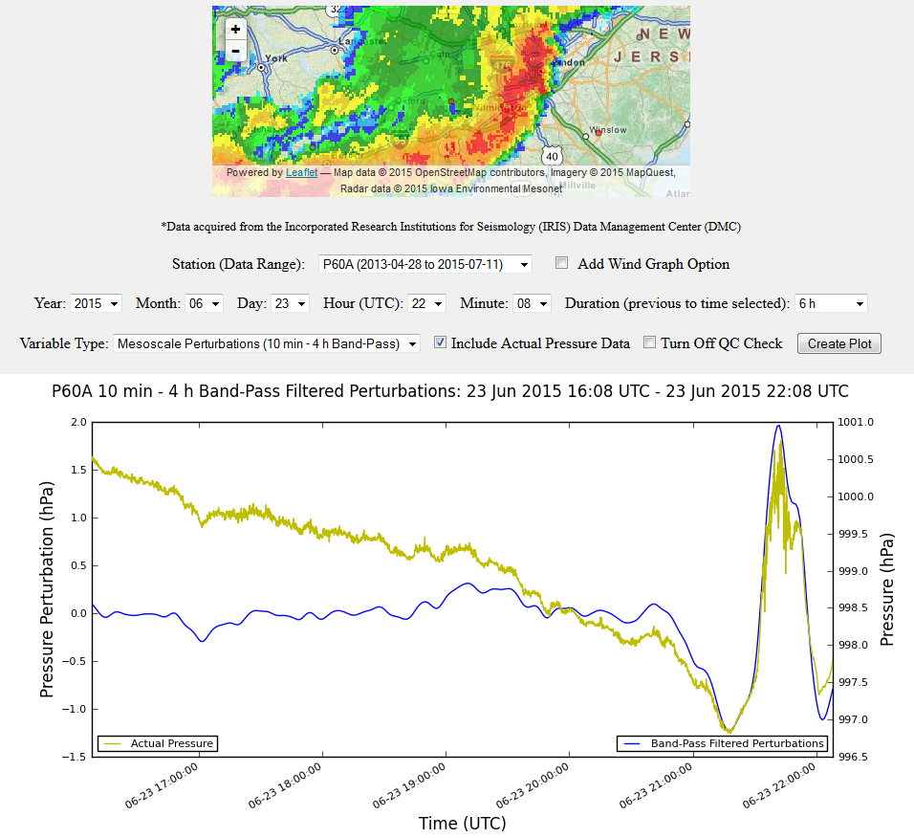
Time Series Analyses
Case studies perused further via developed web products (http://meso1.chpc.utah.edu/usarray)

Slide 10
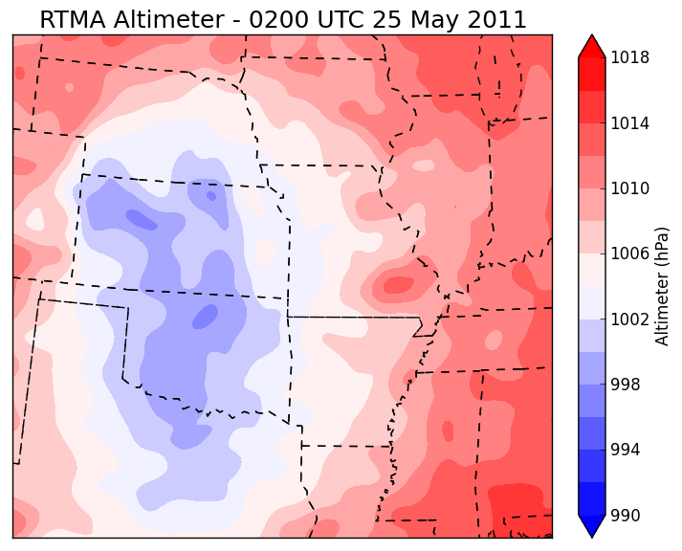
Mesoscale Pressure Perturbation Spatial Analyses
Potential to utilize USArray TA with gridded datasets
USArray TA: higher temporal, lower spatial resolution
Grids: lower temporal, higher spatial resolution
RTMA Analysis and USArray TA Altimeter: 0200 UTC 25 May 2011

Slide 11
UU2DVAR Introduction
University of Utah Two-Dimensional Variational Analysis (Tyndall and Horel 2013)
Background grids courtesy NCEP RTMA
USArray TA data functions as “independent observation dataset”
Observation and background error covariances assumed
Analysis produced using variational approach to “map” observation innovations (differences between observations and background)
More on UU2DVAR: http://meso1.chpc.utah.edu/uu2dvar/

Slide 12
Five Minute Pressure Analyses
Hourly surface pressure background interpolated every 5 minutes to take advantage of TA temporal frequency
Background and observations converted to 1 hr pressure tendency to eliminate background/observation elevation discrepancies
UU2DVAR analysis grids generated every 5 minutes
Analysis grids converted back to sea level using background terrain

Slide 13
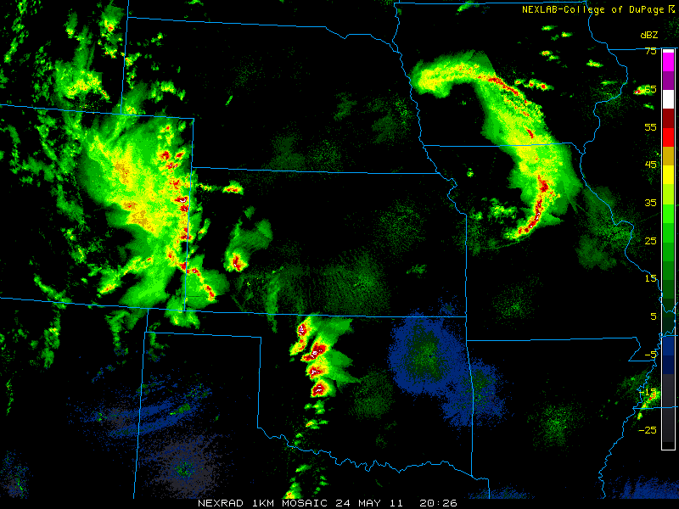
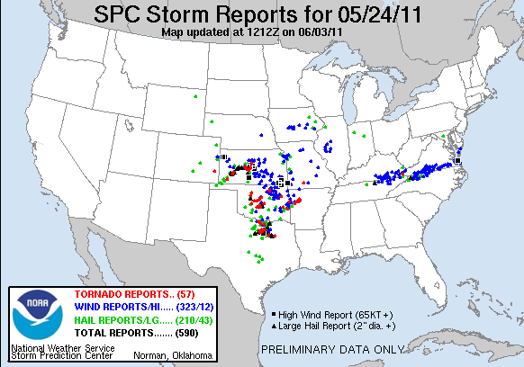
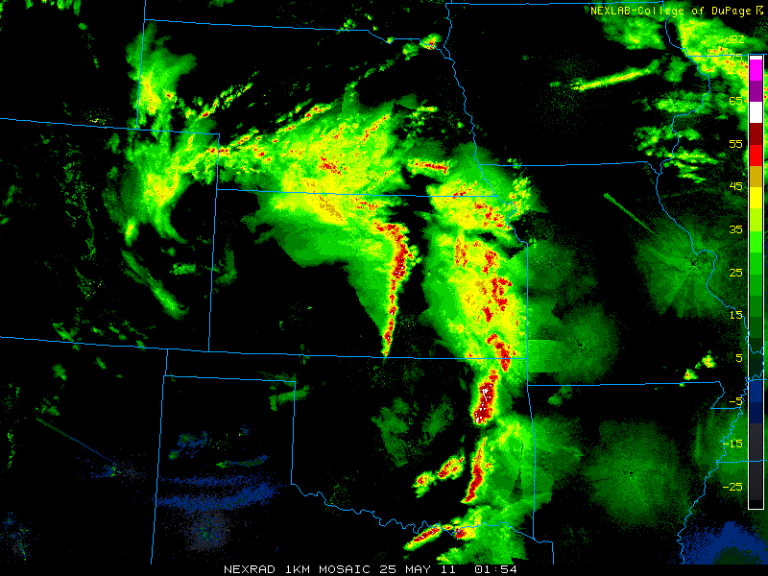
Case – Severe Weather Outbreak 24 May 2011
57 tornado reports including EF5 which resulted in 9 fatalities
Several convective modes (linear systems, supercells, etc.)
2026 UTC 24 May 2011
0154 UTC 25 May 2011

Slide 14
Case – Severe Weather Outbreak 24 May 2011
Analysis grids temporally band-pass filtered (10 min – 8 h) to isolate mesoscale pressure perturbations

Slide 15
Case – Severe Weather Outbreak 24 May 2011

Slide 16
Perturbation Identification Methodology
Centroid-based technique being developed to identify individual large (≥1 hPa) mesoscale pressure perturbations

Slide 17
Case – Severe Weather Outbreak 24 May 2011

Slide 18
Future Work
Refine/expand perturbation identification methods
Determine additional perturbation characteristics (e.g. propagation speed)
Expand spatial analysis dataset beyond shown case examples
Archives of 1 Hz observations remain accessible at http://meso1.chpc.utah.edu/usarray/
Real-time and archive 5-min averaged TA observations remain available through MesoWest (http://mesowest.utah.edu)

Slide 19
Acknowledgements and References
This research is funded by National Science Foundation Grant Number 1252315. We would like to thank Dr. Frank Vernon of Scripps Institution of Oceanography, the USArray Array Network Facility (ANF), and the Incorporated Research Institutions for Seismology (IRIS) for providing access to live data streams for the USArray project. We would also like to acknowledge the Center for High Performance Computing (CHPC) at the University of Utah.
Jacques, A. A., J. D. Horel, E. T. Crosman, and F. L. Vernon, 2015: Central and Eastern United States Surface Pressure Variations Derived from the USArray Network. Monthly Weather Review, 143, 1472-1493, doi:10.1175/MWR-D-14-00274.1
Tyndall, D., and J. Horel, 2013: Impacts of mesonet observations on meteorological surface analyses. Wea. Forecasting, 28, 254-269, doi:10.1175/WAF-D-12-00027.1

