Slide 1
USArray TA Surface Pressure Observations within the Atmospheric Science Community
Alexander A. Jacques, John D. Horel, and Erik T. Crosman
Department of Atmospheric Sciences, University of Utah
Plenary Session II: From Groundwater to the Ionosphere
Earthscope National Meeting 2015
Stowe, VT
June 15, 2015

Slide 2
Introduction
Early 2012: MesoWest research group at Univ. of Utah contacted by IRIS about surface pressure data available from USArray TA
March 2012: automated procedures put in place to acquire real-time data from IRIS and store in MesoWest
Ingest code still running for TA, CEUSN, and Alaska stations
Collaboration with Dr. Frank Vernon (co-PI) led to NSF proposal to further research 1 Hz sampled surface pressure observations with respect to atmospheric phenomena
Jacques, A. A., J. D. Horel, E. T. Crosman, and F. L. Vernon, 2015: Central and Eastern United States Surface Pressure Variations Derived from the USArray Network. Monthly Weather Review, 143, 1472-1493, doi:10.1175/MWR-D-14-00274.1

Slide 3
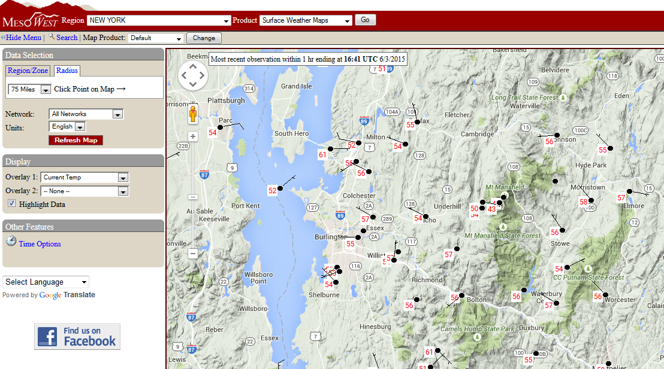
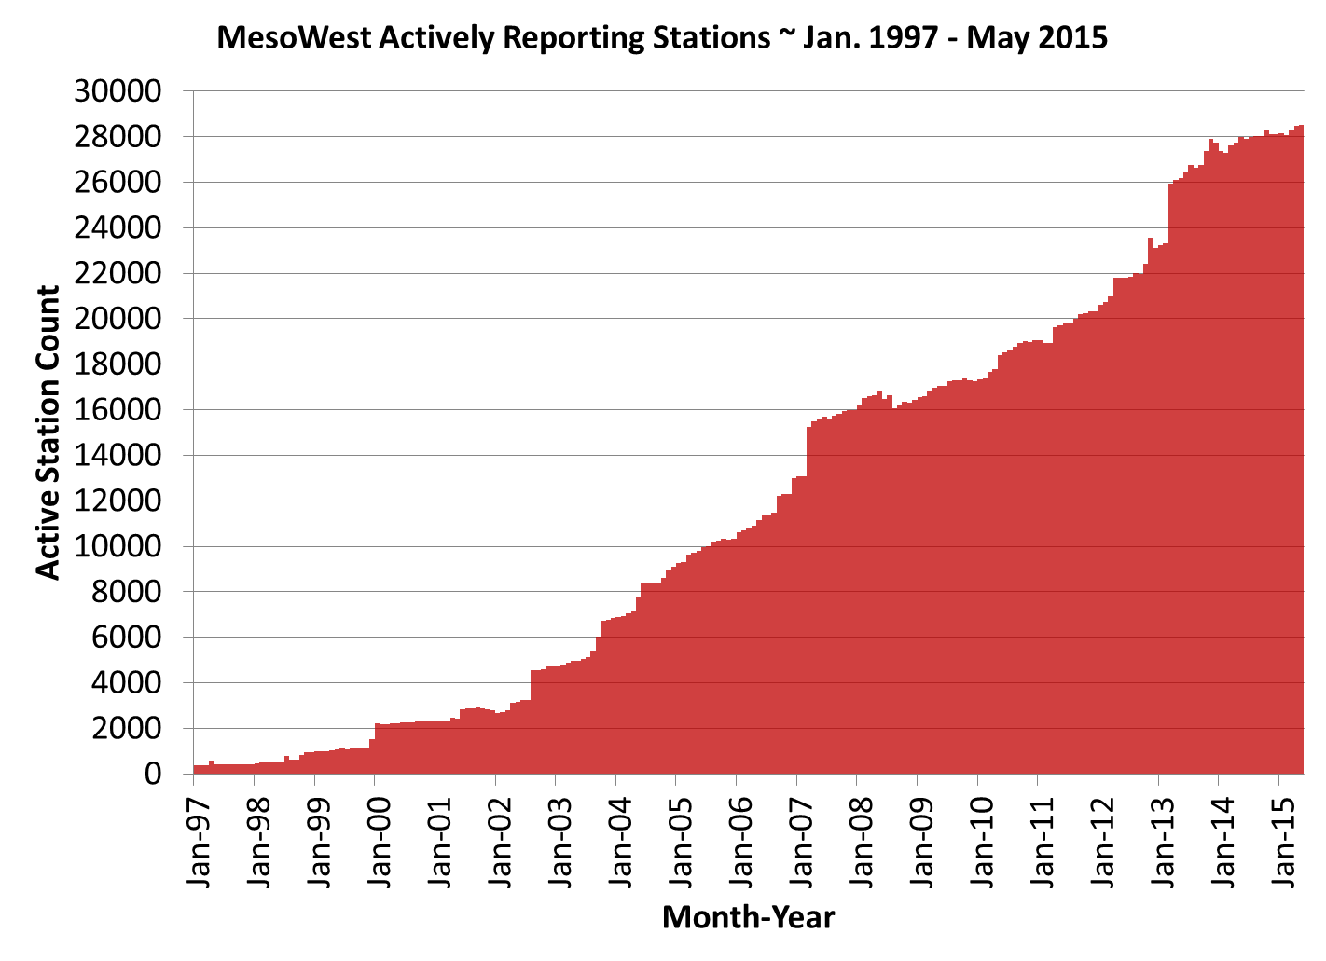
What is MesoWest? (http://mesowest.utah.edu)
Ongoing project with National Weather Service to collect and disseminate surface observations from various “mesonets”
Aviation, fire weather, road weather, public, research, etc.
28,521 active stations reporting as of 1 June 2015
Stowe, VT

Slide 4
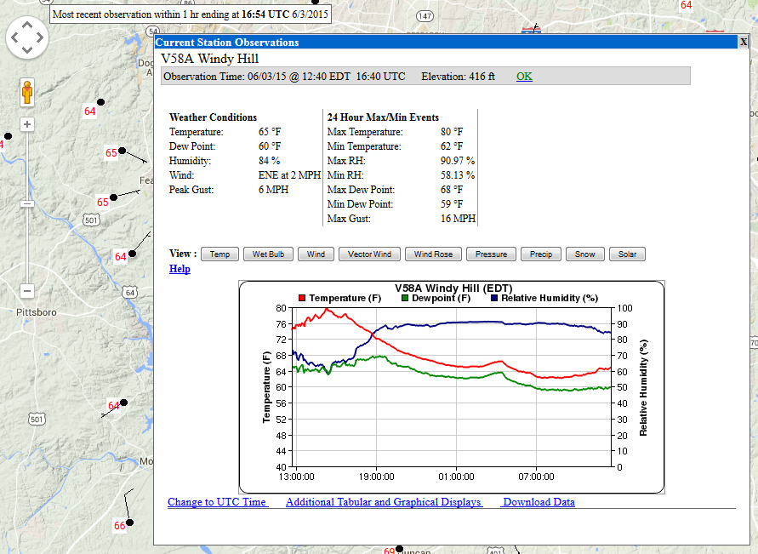
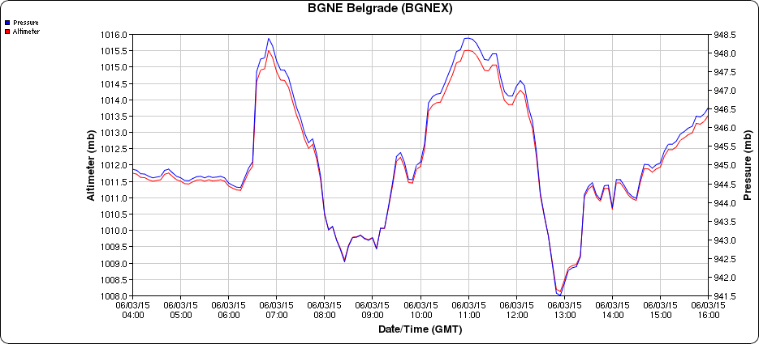
USArray TA and MesoWest (http://mesowest.utah.edu)
1 Hz surface pressure observations collected from IRIS
5 minute averages produced to satisfy real-time data needs
Other atmospheric data also collected for TA-Inframet sites

Slide 5
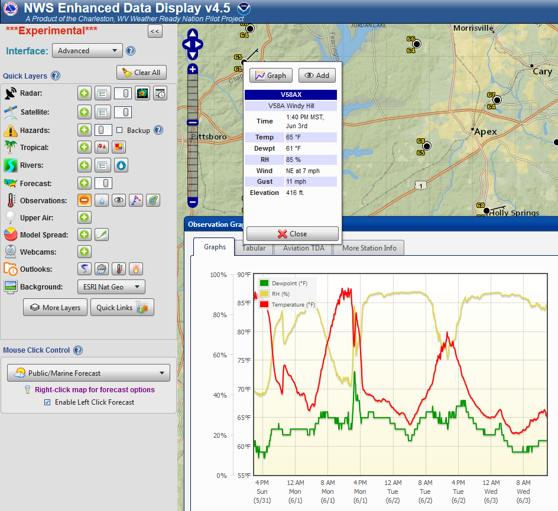
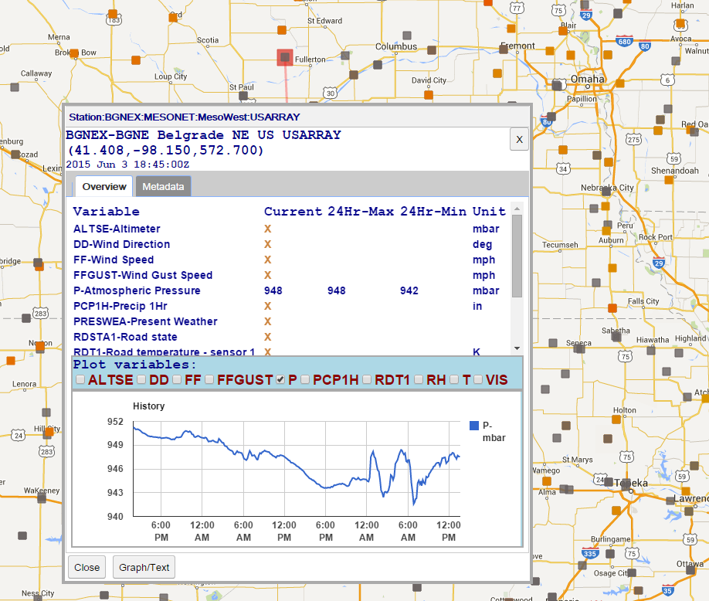
USArray TA and MesoWest (http://mesowest.utah.edu)
MesoWest data disseminated to NWS Western Region and NOAA Meteorological Automated Data Ingest System (MADIS), which sends to National Centers for Environmental Prediction (NCEP)
http://preview.weather.gov/edd
https://madis-data.ncep.noaa.gov/MadisSurface/

Slide 6
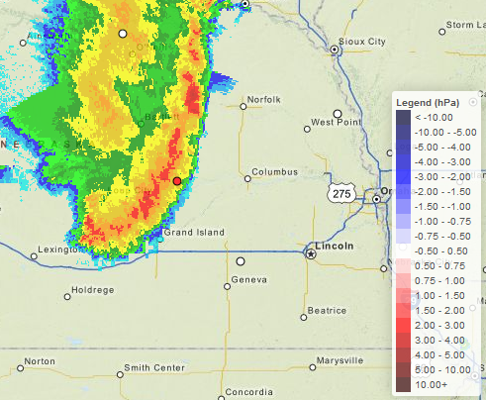
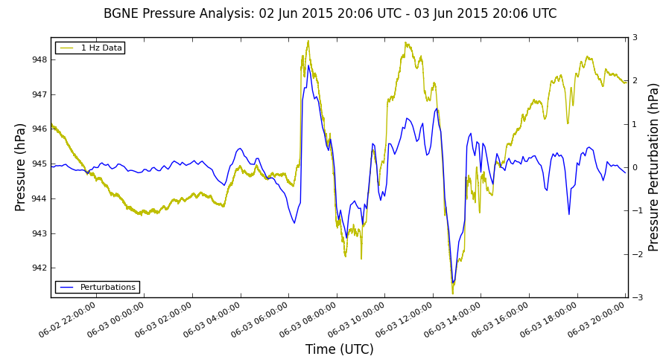
USArray TA Observations for Research Activities
Additional processing collects 1 Hz surface pressure data on a daily basis and archives in compressed HDF5 format for quick access
Web tools also developed (http://meso1.chpc.utah.edu/usarray)
Pressure Perturbation Maps
1 Hz and Filtered Perturbation Time Series
TA-BGNE

Slide 7
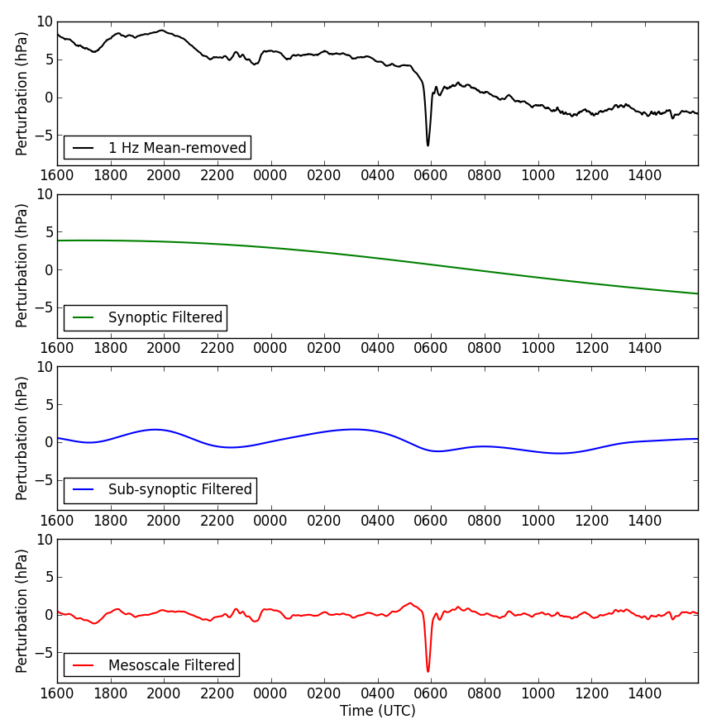
Pressure Time Series Analyses
Band-pass filters applied to extract perturbations of interest at several different scales of phenomena (Jacques et al. 2015)
1 Hz
Actual Observations
Synoptic
(30 h – 5 days)
High/low pressure
systems, blizzards
Sub-synoptic
(4 – 30 h)
Diurnal fluctuations,
fronts, some convection
Mesoscale
(10 min – 4 h)
Thunderstorm complexes,
gravity waves

Slide 8
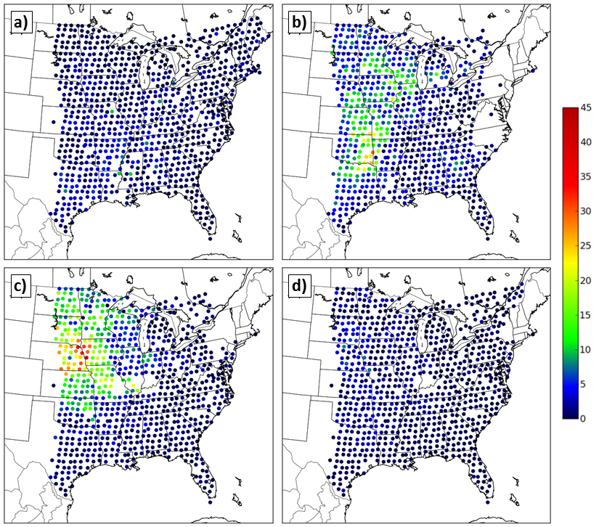
Pressure Time Series Analyses
Perturbation “climatologies” provide additional geographical and seasonal information on occurrences of high-impact phenomena
Mesoscale Perturbations (per season) > 3 hPa in Magnitude
Winter
Spring
Summer
Autumn

Slide 9
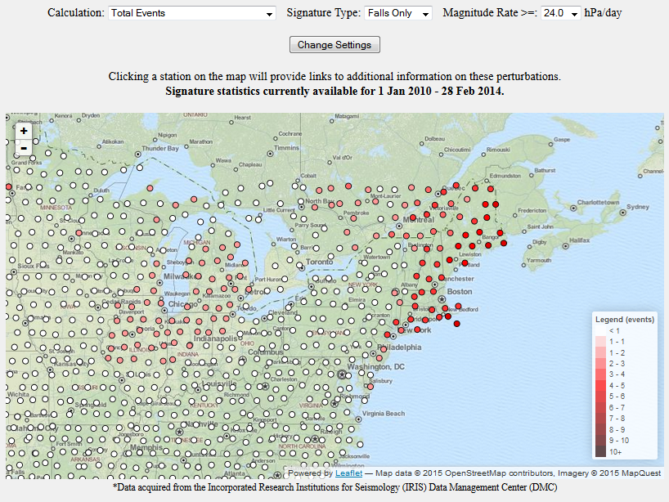
Pressure Time Series Analyses
Web tools provide ability to examine individual events
Synoptic Filtered Pressure Falls > 24 hPa/day from 1 Jan 2010 – 28 Feb 2014

Slide 10
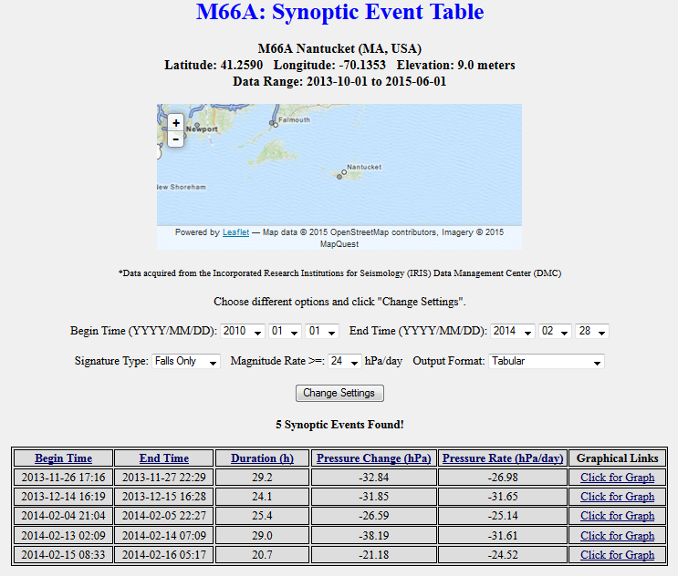
Pressure Time Series Analyses
Web tools provide ability to examine individual events
Synoptic Filtered Pressure Falls > 24 hPa/day from 1 Jan 2010 – 28 Feb 2014

Slide 11
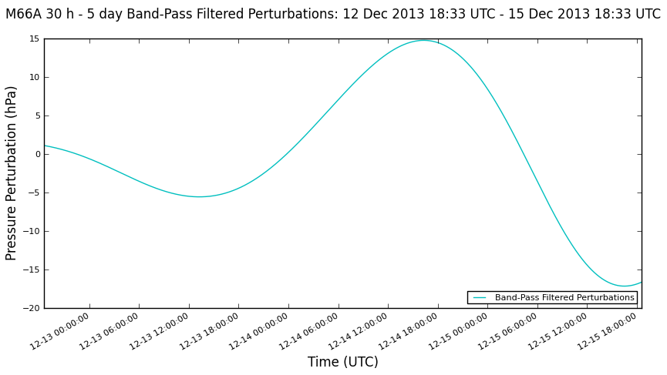
Pressure Time Series Analyses
Web tools provide ability to examine individual events
Synoptic Filtered Pressure Falls > 24 hPa/day from 1 Jan 2010 – 28 Feb 2014

Slide 12
Spatial Perturbation Analyses
Inclusion of USArray TA observations (high temporal resolution) with gridded model data (high spatial resolution) may improve evaluation of perturbations
University of Utah Two-Dimensional Variational Analysis (UU2DVAR)
Start with gridded data that represents “background”
Collect observations independent of background
Assume background and observation error covariances
Use 2D variational approach to map observations onto background to produce an analysis grid
Further information on UU2DVAR described by Tyndall and Horel (2013)

Slide 13
Spatial Perturbation Analyses
Prior to analysis, hourly background grids interpolated every 5 min to better utilize temporal resolution of USArray TA
Grids and observations converted to 1 hour pressure tendency (avoids any elevation conflicts between model terrain and station elevation)
UU2DVAR analysis performed on 1 hour tendency data and final analysis grid converted to altimeter setting (sea-level pressure)
Analysis grid time series are band-pass filtered (10 min – 8 h) to better identify perturbations produced by primarily mesoscale processes

Slide 14
Spatial Perturbation Analyses

Slide 15
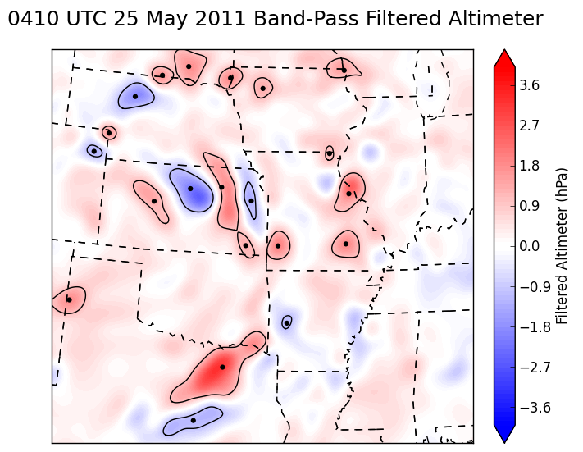
Spatial Perturbation Identification
Work underway to develop and test several algorithms to identify large perturbation features within the filtered analysis grids

Slide 16
Spatial Perturbation Identification

Slide 17
Acknowledgements and References
This research is funded by National Science Foundation Grant Number 1252315. We would like to thank Dr. Frank Vernon of Scripps Institution of Oceanography, the USArray Array Network Facility (ANF), and the Incorporated Research Institutions for Seismology (IRIS) for providing access to live data streams for the USArray project. We would also like to acknowledge the Center for High Performance Computing (CHPC) at the University of Utah.
Jacques, A. A., J. D. Horel, E. T. Crosman, and F. L. Vernon, 2015: Central and Eastern United States Surface Pressure Variations Derived from the USArray Network. Monthly Weather Review, 143, 1472-1493, doi:10.1175/MWR-D-14-00274.1
Tyndall, D., and J. Horel, 2013: Impacts of mesonet observations on meteorological surface analyses. Wea. Forecasting, 28, 254-269, doi:10.1175/WAF-D-12-00027.1.

