Slide 1
CPEX-AW Dry Run Analysis
Zipser Group
James Russell and Mani Rajagopal

Slide 2
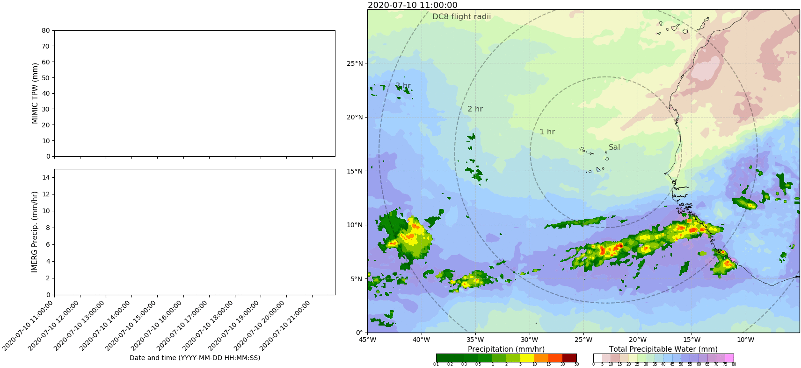
CPEX-AW Flight July 10th 2020
http://home.chpc.utah.edu/~u0816744/CPEXAW/IMGTPW_CPEXAW_20200708.html

Slide 3
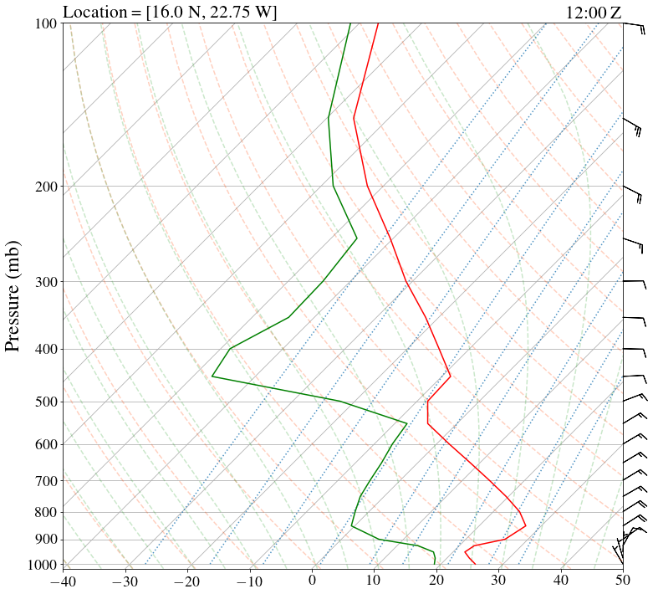
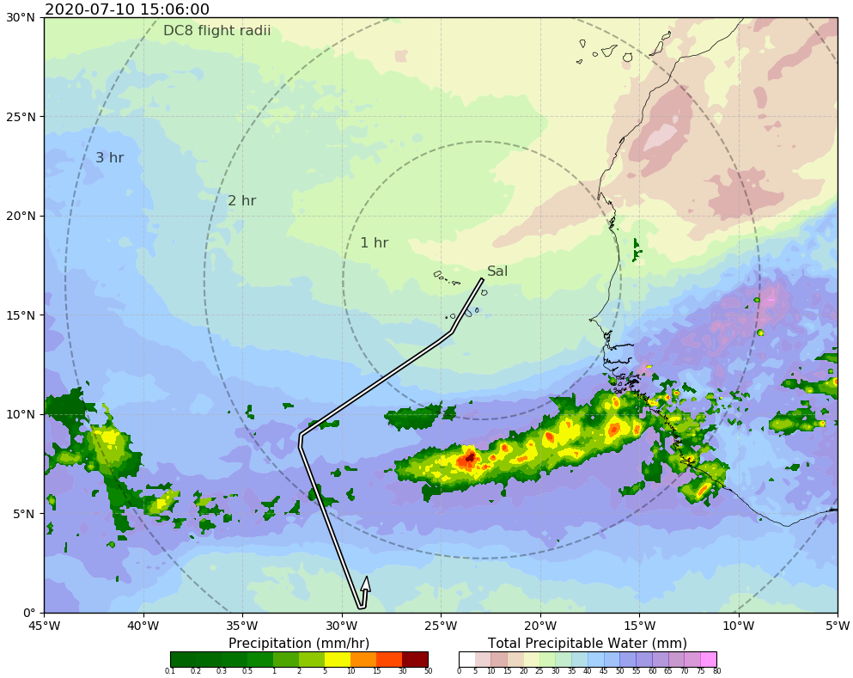
CPEX-AW Flight July 10th 2020
Red-Circle denotes the sounding location. The vertical profile constructed from GFS analysis to simulate dropsonde observation. SAL creates a strong inversion close to surface and a second inversion near 500 hpa; SAL outbreak over Cape Verde on this day.

Slide 4
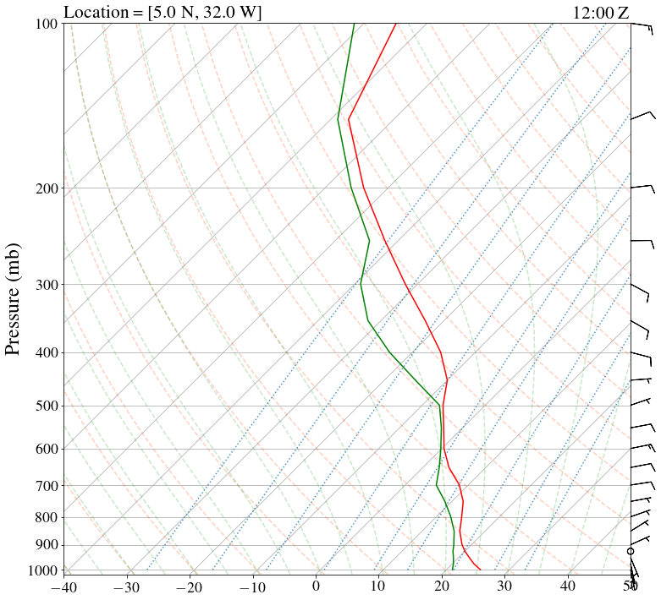
CPEX-AW Flight July 10th 2020
High TPW band with a very moist profile; Mid-level clouds around 500 hpa

Slide 5
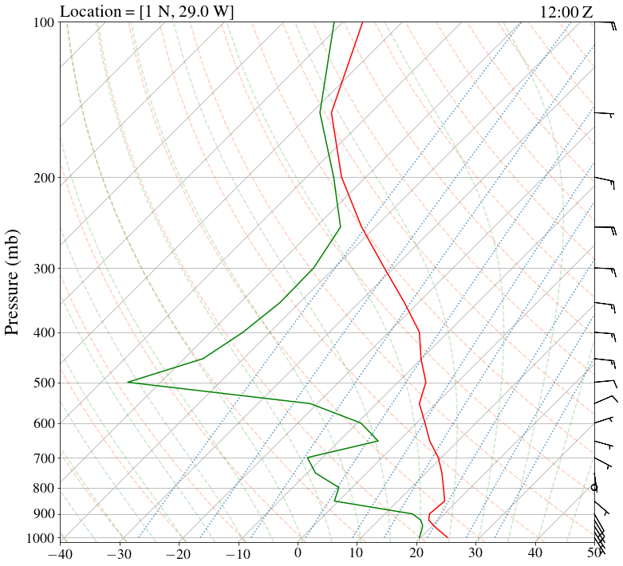
CPEX-AW Flight July 10th 2020
Dry lower and mid-Troposphere – Moisture similar to sounding over Cape Verde; However only a weak temperature inversion.

Slide 6
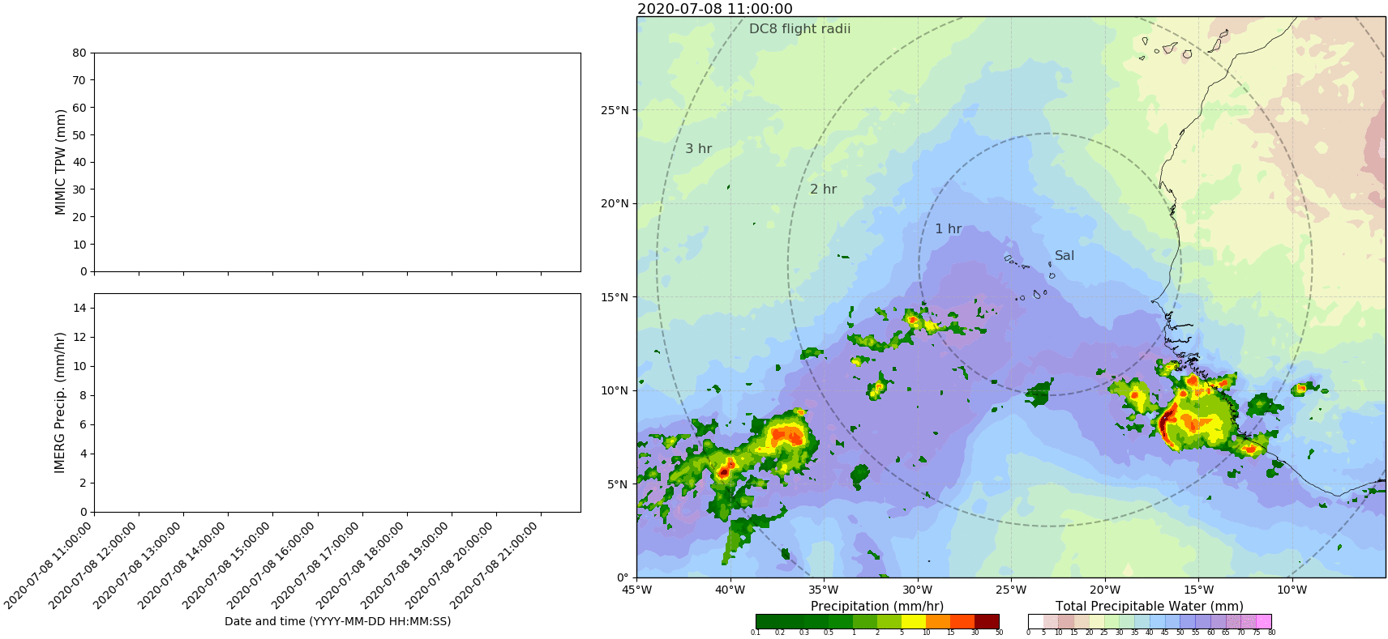
CPEX-AW Flight July 8th 2020
http://home.chpc.utah.edu/~u0816744/CPEXAW/IMGTPW_CPEXAW_20200708.html
MIMIC TPW and IMERG Precip

Slide 7
Sal Soundings: Full Campaign Time-Series
Funding for 4 time-launches per day (need grad students to assist launches)
Provide synoptic-scale temporal variability for length of campaign
Characterize Easterly Waves and Jet

Slide 8
Sal Soundings: Full Campaign Time-Series
Funding for 4 time-launches per day (need grad students to assist launches)
Provide synoptic-scale temporal variability for length of campaign
Characterize Easterly Waves and Jet

Slide 9
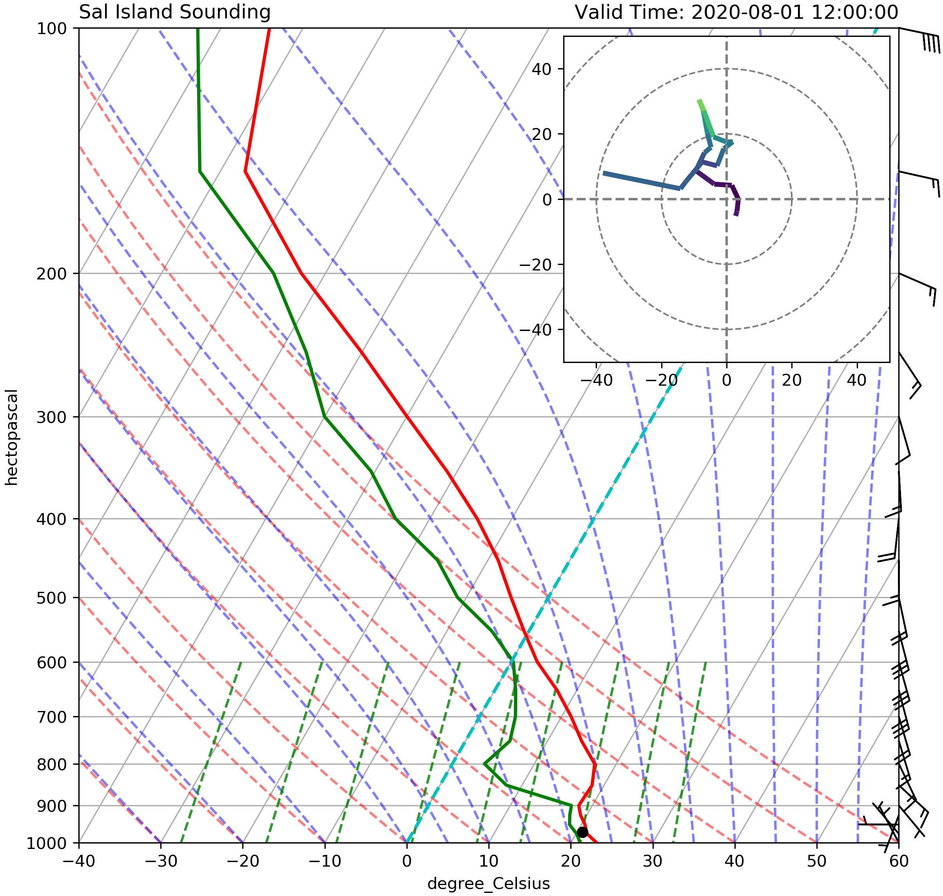
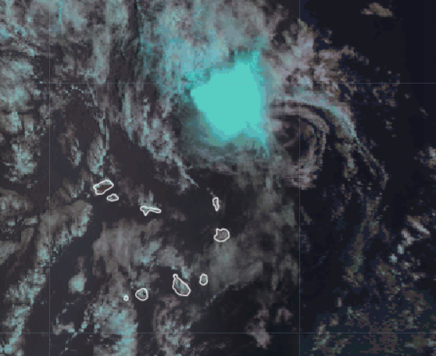
Sal Soundings: Tropical Depression 10
If we get a rare event of interest in Sal, we also intend to investigate these
12Z sounding and images from GDAS when TD moved north of Sal
Shear from Easterly Jet (but mostly cold SSTs) likely played a role in weakening TD

