Slide 1
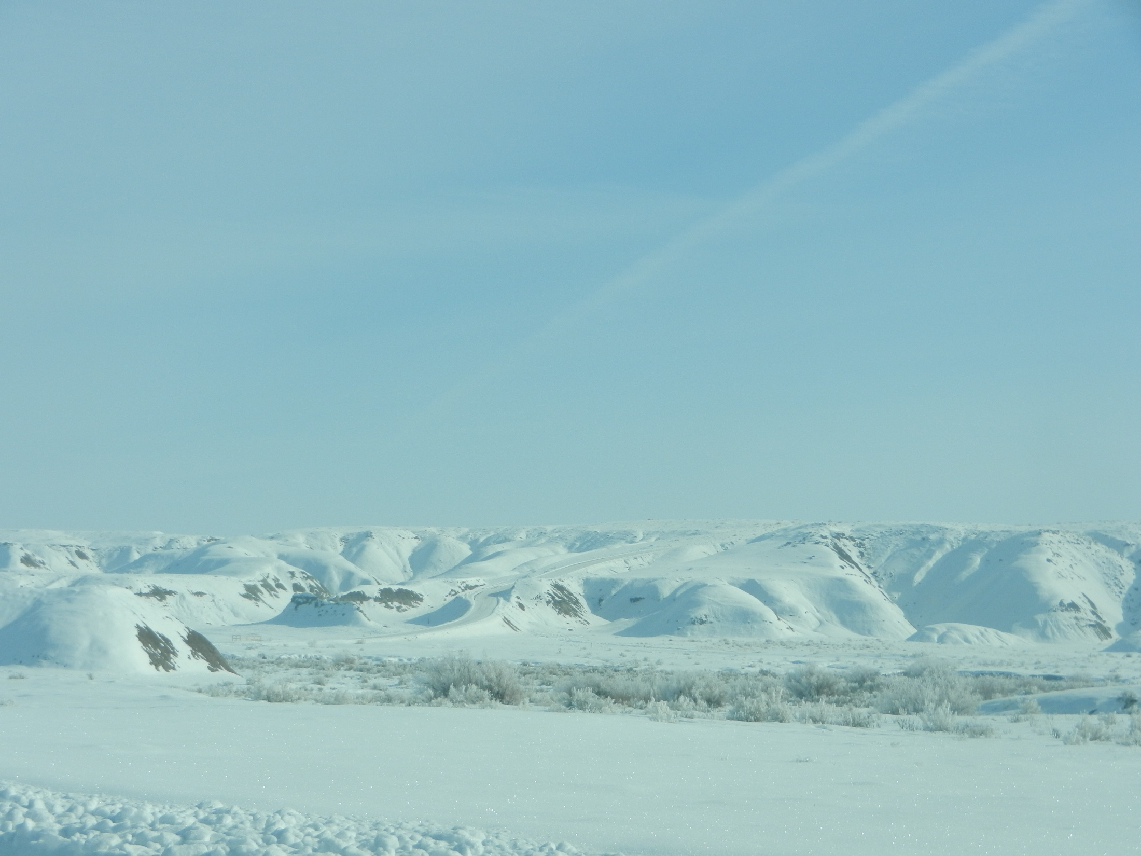
Uintah Basin WRF Testing
Erik Neemann
20 Sep 2013

Slide 2
Overview
Description of WRF Setup & Microphysics edits
Explanation of WRF edits
Reasoning for Microphysics edits
General Results
Examples of simulation differences
Errors, Time Series plots, & Vertical profiles
Conclusions

Slide 3
Summary of Recent WRF Testing & Modifications
Idealized snow cover in Uintah Basin and mountains
Initialized colder skin temperature in the Uintah Basin
Updated land use data to NLCD 2006
Modified VEGPARM.TBL
Snow albedo changes
Edited relative humidity in NAM input files
Microphysics modifications (Thompson)
  Changes to homogeneous freezing temperature
  Changes to ice nucleation temperature
  Turning off cloud ice sedimentation
  Turning off cloud ice autoconversion to snow

Slide 4
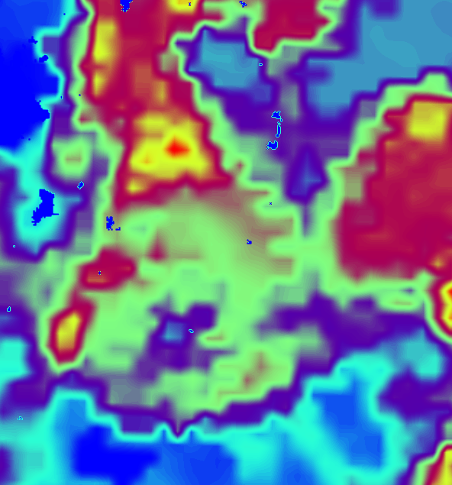
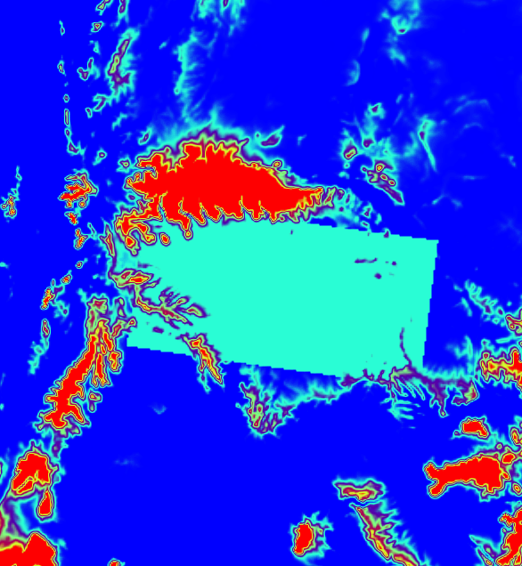
Idealized snow cover in Uintah Basin and mountains
00Z 1 Feb 2013
NAM Analysis Snow Cover
00Z 1 Feb 2013
Domain 3 Modified Snow Cover
22 to 28 cm
(overestimation inside Uintah Basin)
17 cm
Elevation-dependent snow cover above 2380 m (17 cm to 1 m above 2900 m)
Uniform snow in basin (17 cm depth, 21.25 kg/m³ SWE, 8:1 ratio)

Slide 5
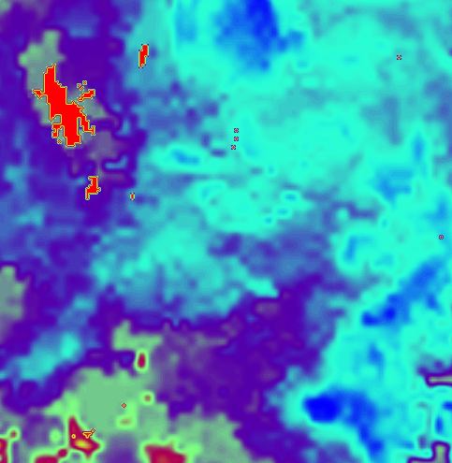
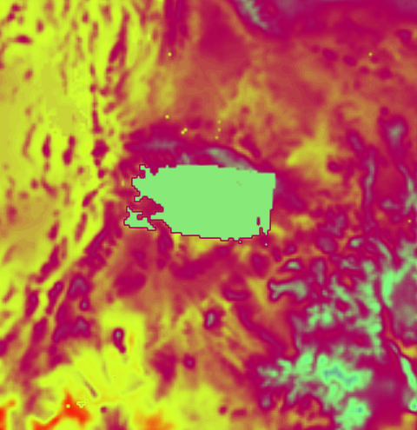
Initialized colder skin temperature in Uintah Basin
00Z 1 Feb 2013
NAM Analysis Skin Temperature
00Z 1 Feb 2013
Modified Skin Temperaure
262 K
267 to 268 K
Initialized skin temperature to 262 K in the basin (below 2380 m)

Slide 6
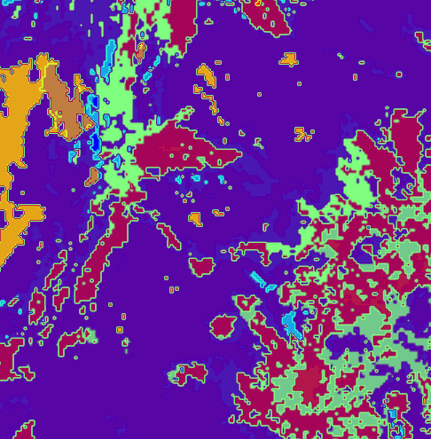
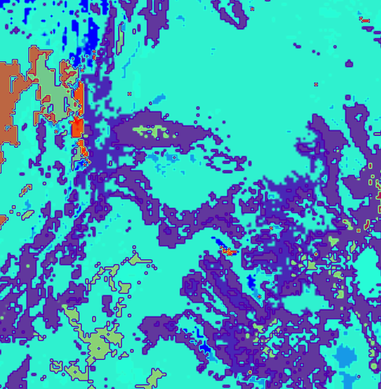
Updated Land Use data
Old USGS Land Use data
New NLCD 2006 data
More urban categories
262 K
267 to 268 K
Changes in Uintah Basin
Updated land use data to NLCD 2006 (1 arc-second)
Uintah Basin primary “shrubland” and “cropland/grassland mosaic”
  “Barren or sparsely vegetated”, “grassland”, and “irrigated cropland & pasture” significantly decreased

Slide 7
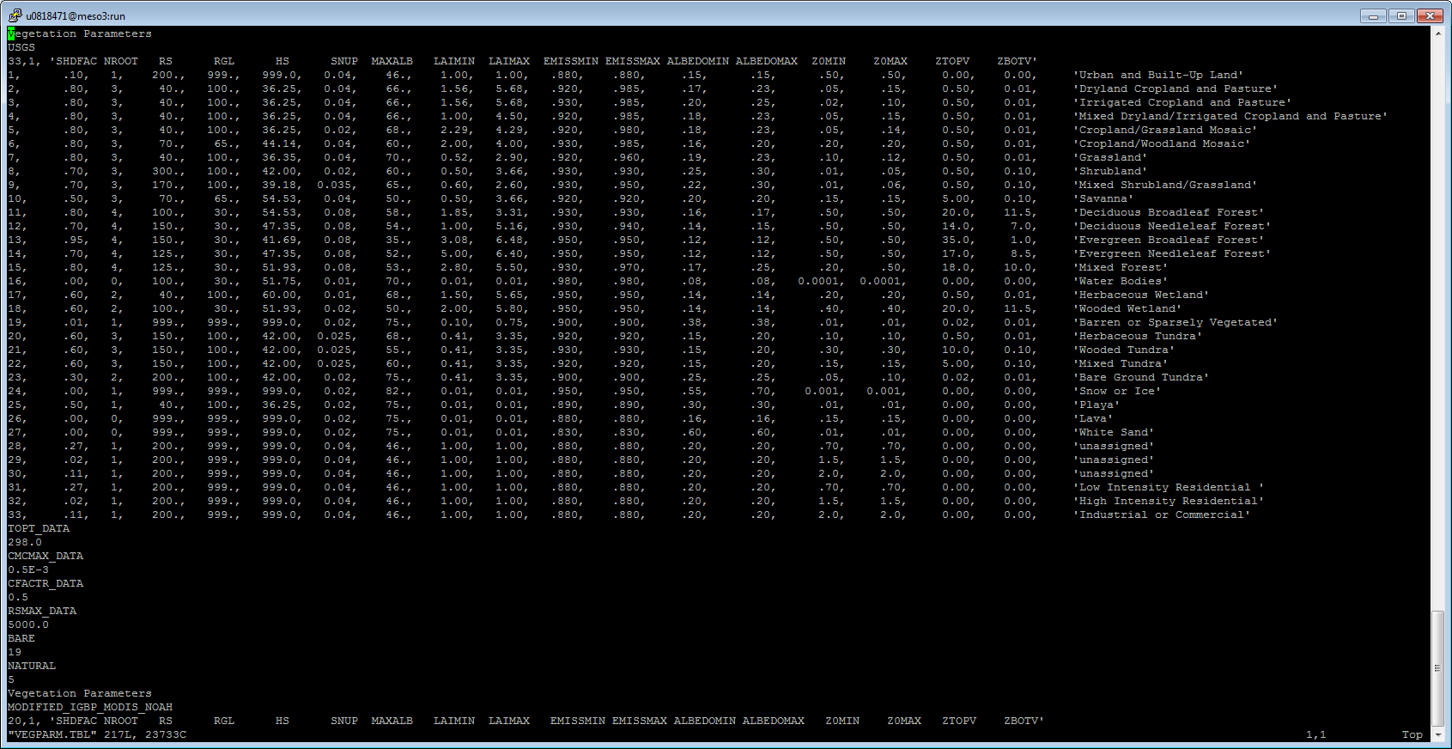
Modified VEGPARM.TBL
Changed from .04 to .02
Changed from .03 to .02
Modified VEGPARM.TBL “SNUP” to 0.02 for vegetation categories 5 & 8 (cropland/grassland mosaic & shrubland)
  Allows 2 cm of SWE (20 kg/m³) to “cover up” vegetation with snow
  Enables albedo to attain “max snow albedo”, instead of combination of snow albedo and vegetation albedo

Slide 8
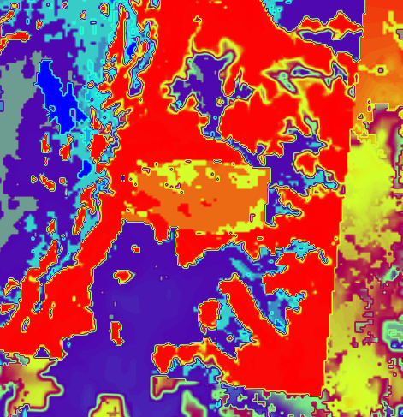
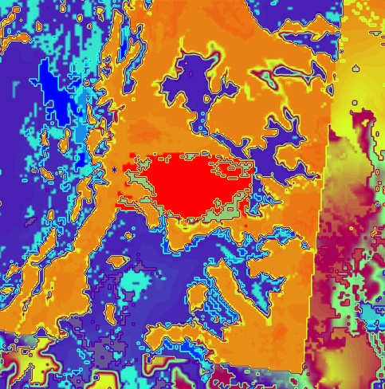
Snow Albedo changes
Original snow albedo edits
(0.71 everywhere)
New snow albedo edits
(0.82 in Basin, 0.71 outer box)
*Note: color scale are different
0.76
0.76
0.72
0.82
Combination of VEGPARM.TBL and snow albedo edits achieved desire albedos
Set snow albedo to 0.82 within the basin (below 2380 m)
Set snow albedo to 0.71 outside the basin within domain 2

Slide 9
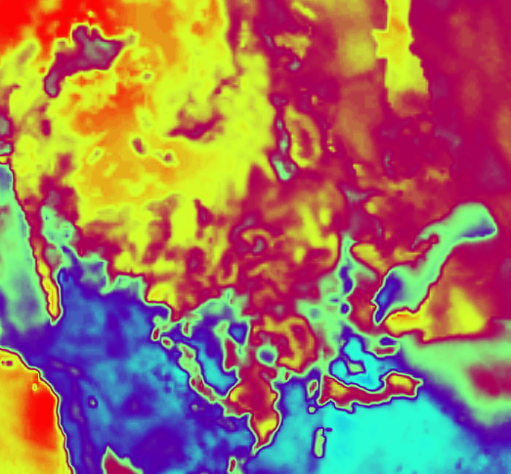
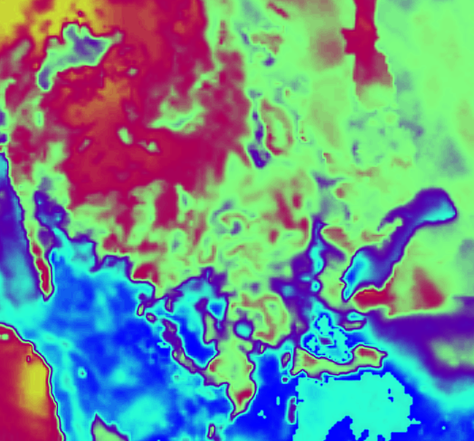
Edited RH in NAM input files
00Z 1 Feb 2013
Original NAM RH
00Z 1 Feb 2013
Edited NAM RH reduced 20 %
Crudely subtracted 5, 20, or 40% from RH in NAM input files
Reduced RH by fraction if already very low to prevent negative values

Slide 10
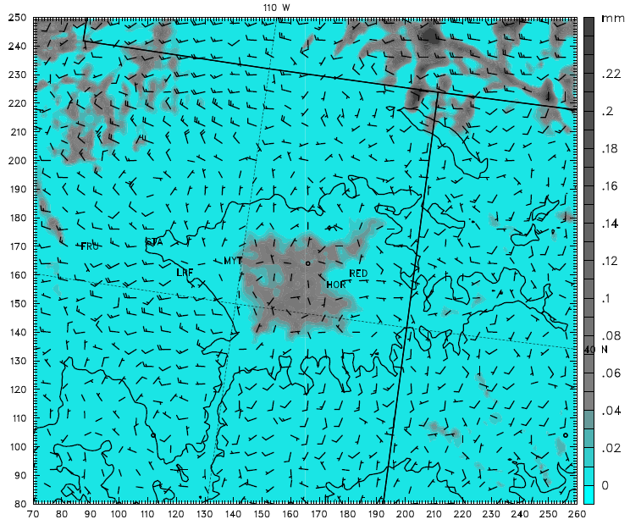
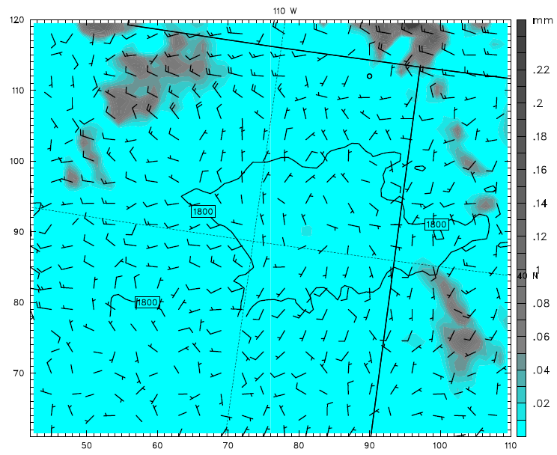
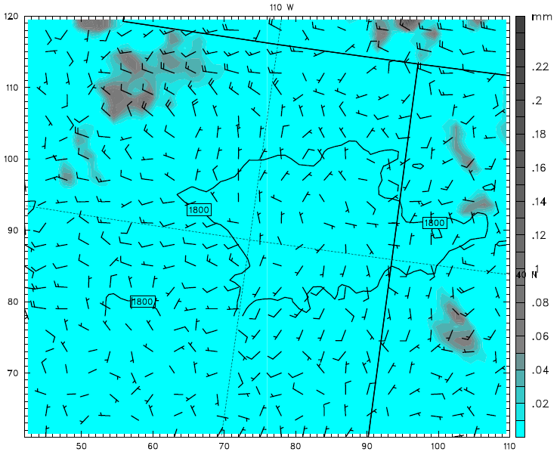
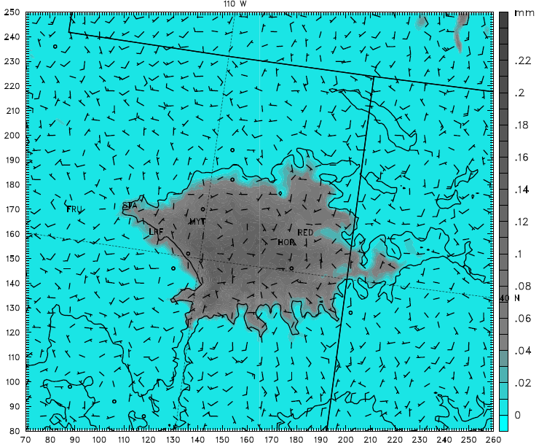
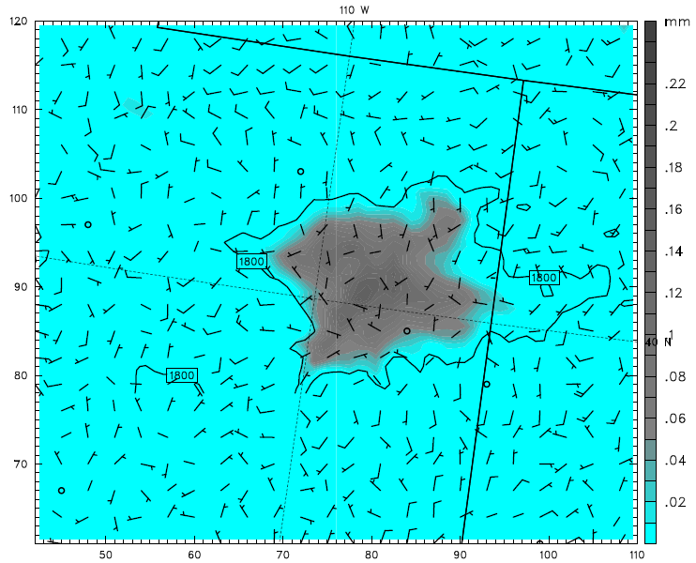
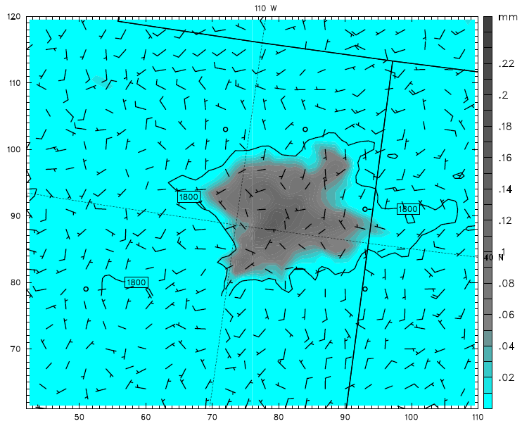
Edited RH in NAM input files - Integrated clouds hydrometeors
Thompson 1.33km
Thompson 4km RH-5%
Thompson 4km RH-20%
15Z 1 Feb 2013
15Z 5 Feb 2013
Reduced RH decreased clouds earlier in simulation (1-2 days)
All simulations converged on very similar cloudy solution after first couple days

Slide 11
Reasoning for Microphysics Modifications
Several modification were made to Thompson microphysics schemes:
  Changes to homogeneous freezing temperature (HGFR) from 235 to 271 K
    Desired effect of changing liquid clouds to ice clouds
  Changes to ice nucleation temperature from -12 to range of -3 to -15 C
    Desired same effect as changing homogeneous freezing temperature, but more physically realistic
  Turning off cloud ice sedimentation
    Effort to prevent cloud ice from “falling out” of cloud
  Turning off cloud ice autoconversion to snow
    Effort to maintain cloud ice by preventing it’s conversion into snow category and precipitating out of cloud
Modifications were conducted in various combinations to determine impact on model simulations
In final tests, modifications were then only allowed in lowest 15 model levels (~500 m), while everything above was unchanged
  Effort to create more realistic simulation by only changing low levels

Slide 12
General Results of Microphysics Modifications
Combination of edits seemed to converge on 3 solutions:
  1 - “clear sky” solution with very little cloud ice and negligible LW radiation
    Simulations where ice clouds were created and:
      Ice autoconversion to snow was ON
      Autoconversion OFF, but sedimentation of cloud ice ON
  2 - “thick ice cloud” solution with moderate LW radiation
    Simulations where ice clouds were created and:
      Both autoconversion and sedimentation were OFF
  3 - “thick liquid cloud” solution with strong LW radiation when:
    No microphysics edits
    Simulations where ice clouds were created via ice nucleation:
      Either sedimentation or autoconversion was ON

Slide 13
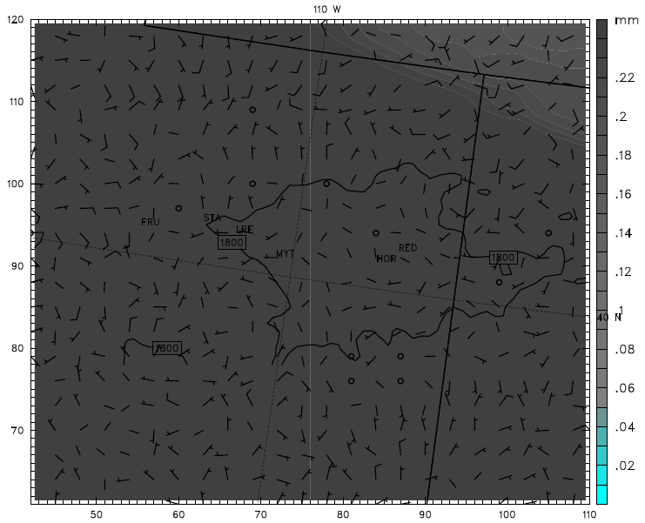
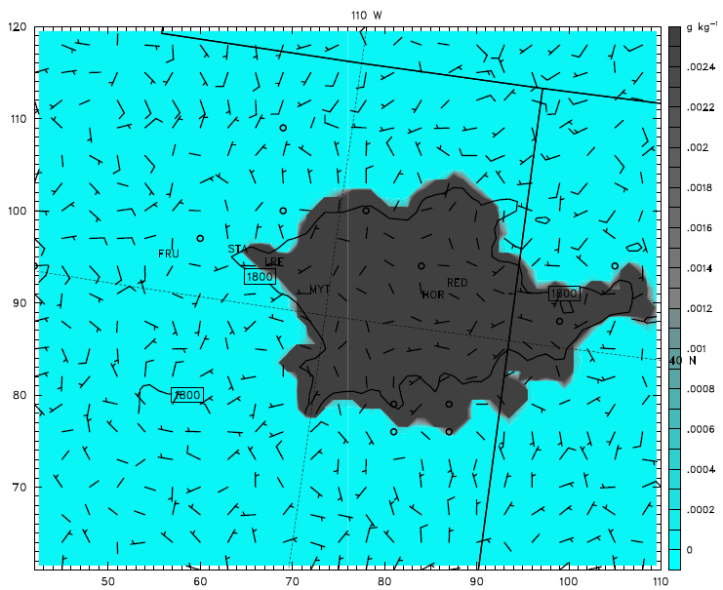
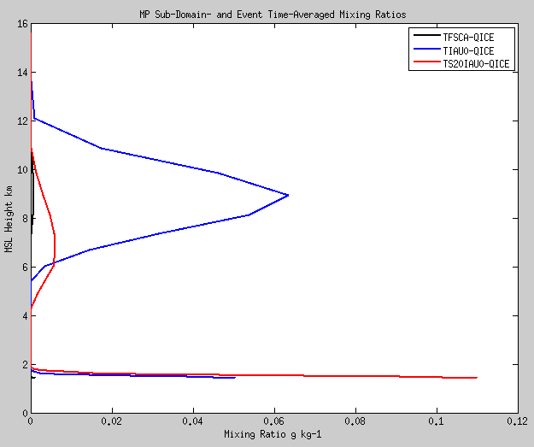
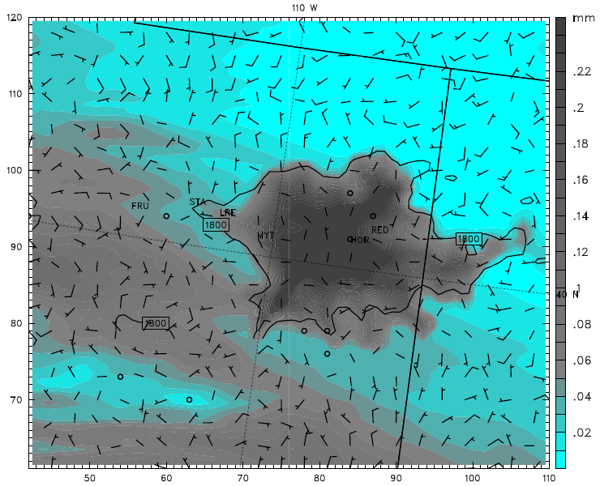
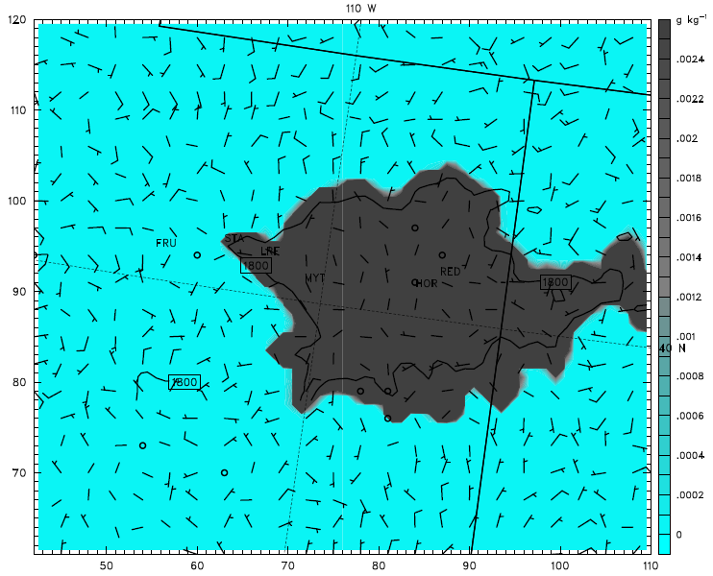
Microphysics Modifications - Cloud Ice sedimentation
Integrated Clouds
Cloud Ice bottom 10 levels
09Z 3 Feb 2013
TIAU0
TIAU0
TS20IAU0
TS20IAU0

Slide 14
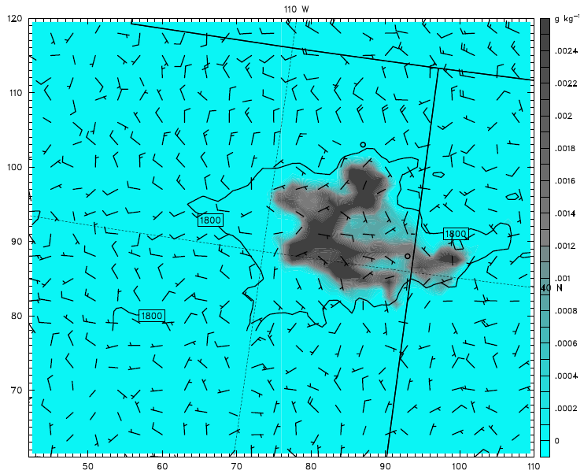
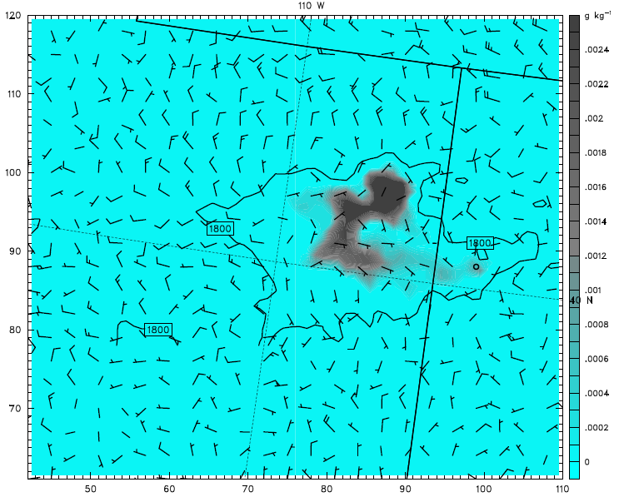
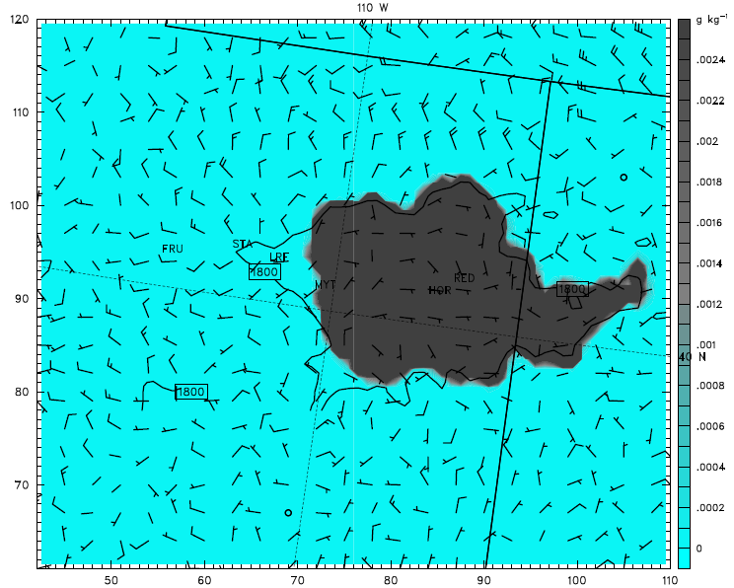

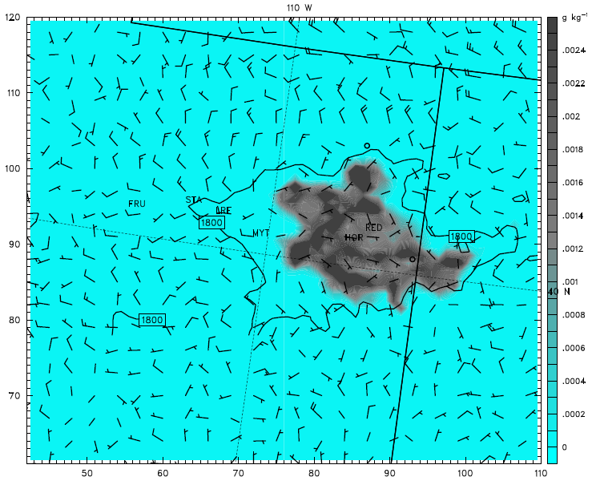
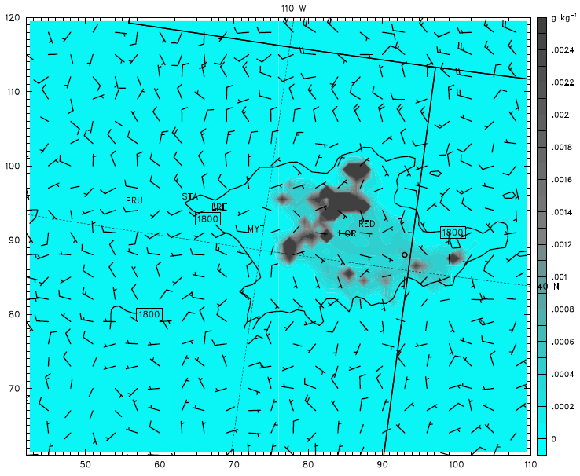
Microphysics Modifications - Sedimentation and Autoconversion
Cloud ice bottom 10 levels - 06Z 4 Feb 2013
TFSCA
WSM3A
TIAU0
TIAU20
TIAU5
TSIAU0

Slide 15
Microphysics Modifications - Sedimentation and Autoconversion
Cloud ice bottom 10 levels - 4 Feb 2013 06Z
Sedimentation OFF,
Autoconversion ON
Sedimentation OFF,
Autoconversion OFF
WSM3 Microphysics
Sedimentation OFF,
20% Autoconversion
Sedimentation OFF,
5% Autoconversion
Sedimentation ON,
Autoconversion OFF

Slide 16
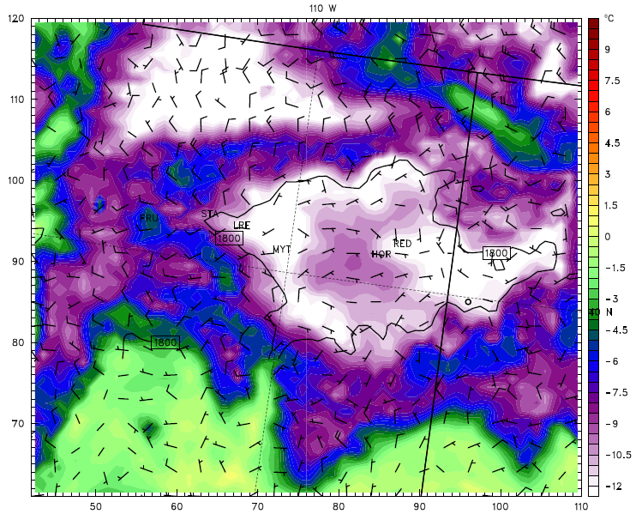
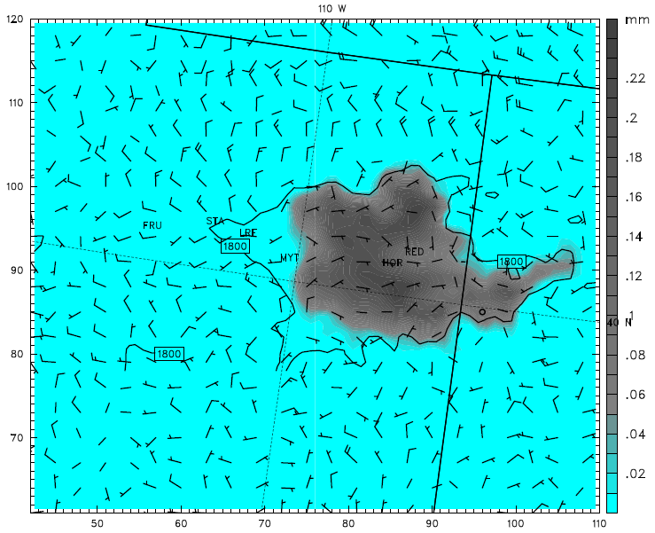
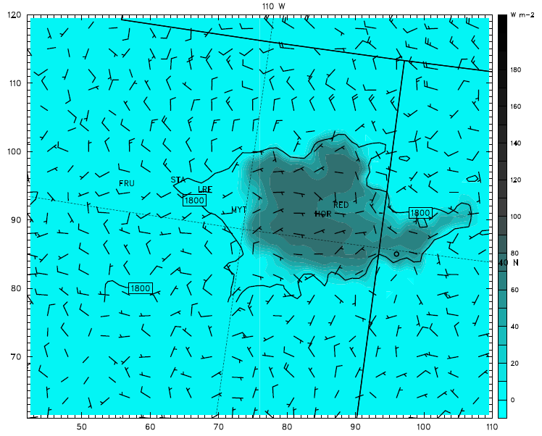
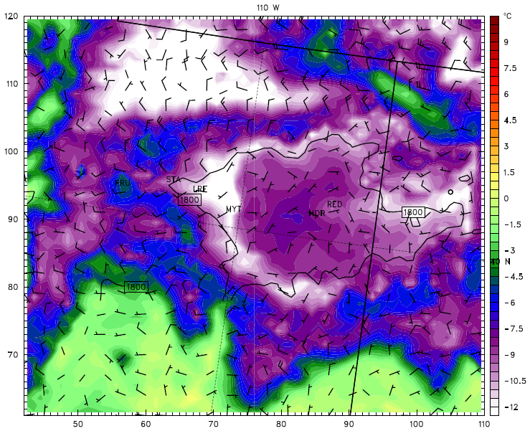
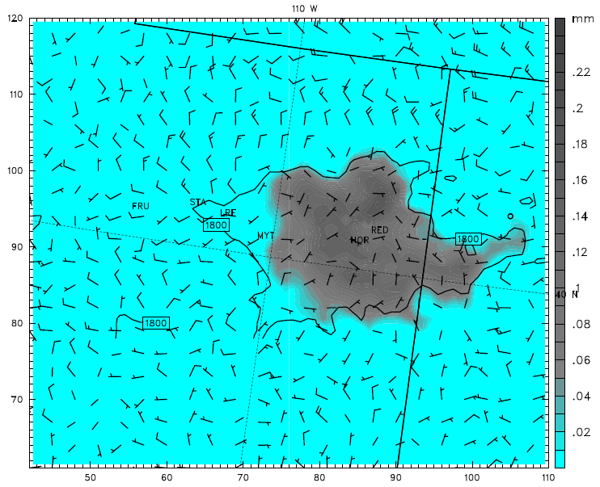
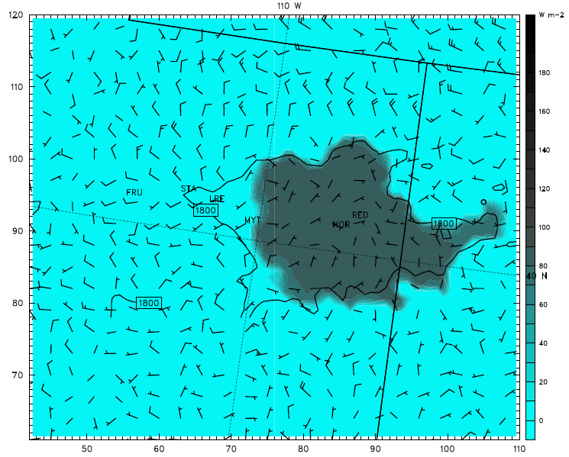
Effect of Sedimentation on 2m Temps, Clouds, LW Radiation
06Z 4 Feb 2013
2m Temps
Integrated Clouds
LW Radiation at sfc
TIN3IAU0 - Ice sedimentation OFF
TSIN3IAU0 - Ice sedimentation ON
2m Temps
Integrated Clouds
LW Radiation at sfc

Slide 17
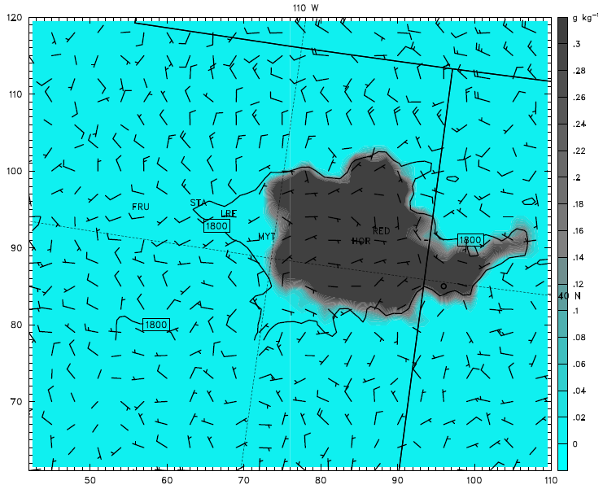
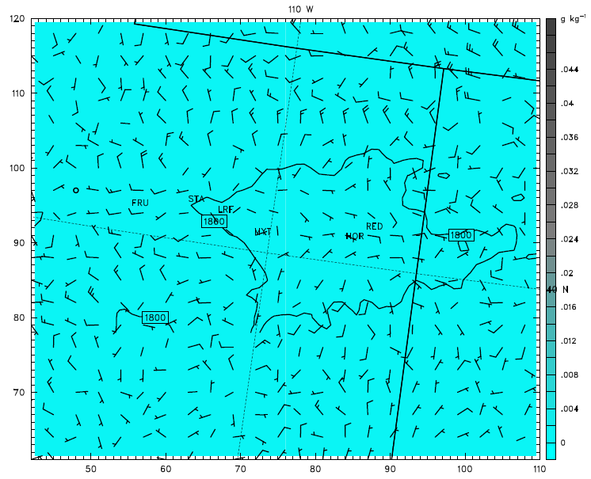
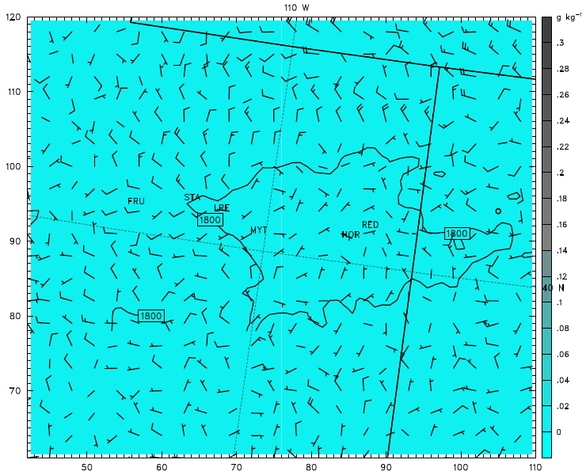
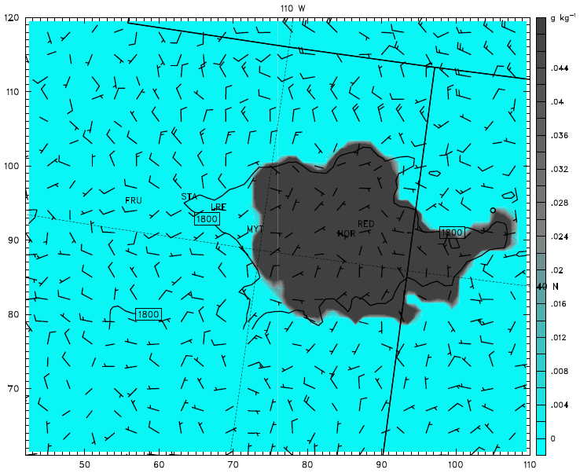
Sedimentation - Average cloud ice & cloud water bottom 10 levels
06Z 4 Feb 2013
Cloud Ice
Cloud Water
TIN3IAU0
- Ice sedimentation OFF
Cloud Ice
Cloud Water
TSIN3IAU0
- Ice sedimentation ON

Slide 18
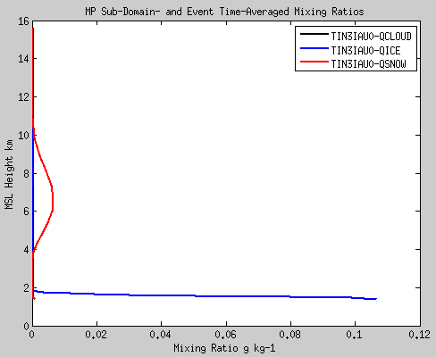
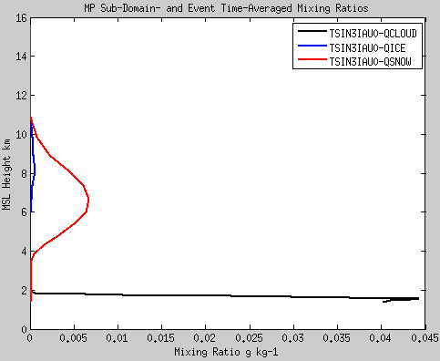
Uintah Basin CAP Simulation 1-6 Feb 2013
Distribution of cloud ice with and without sedimentation
TIN3IAU0
TSIN3IAU0
QSNOW 6.6x10⁻³
QICE 5.6x10⁻⁴
QICE 0.11 g/kg
QCLOUD 0.045 g/kg
Allowing cloud ice sedimentation in low levels resulted in a liquid-phase dominated cloud
Both cases had essentially identical results above 2-3 km

Slide 19
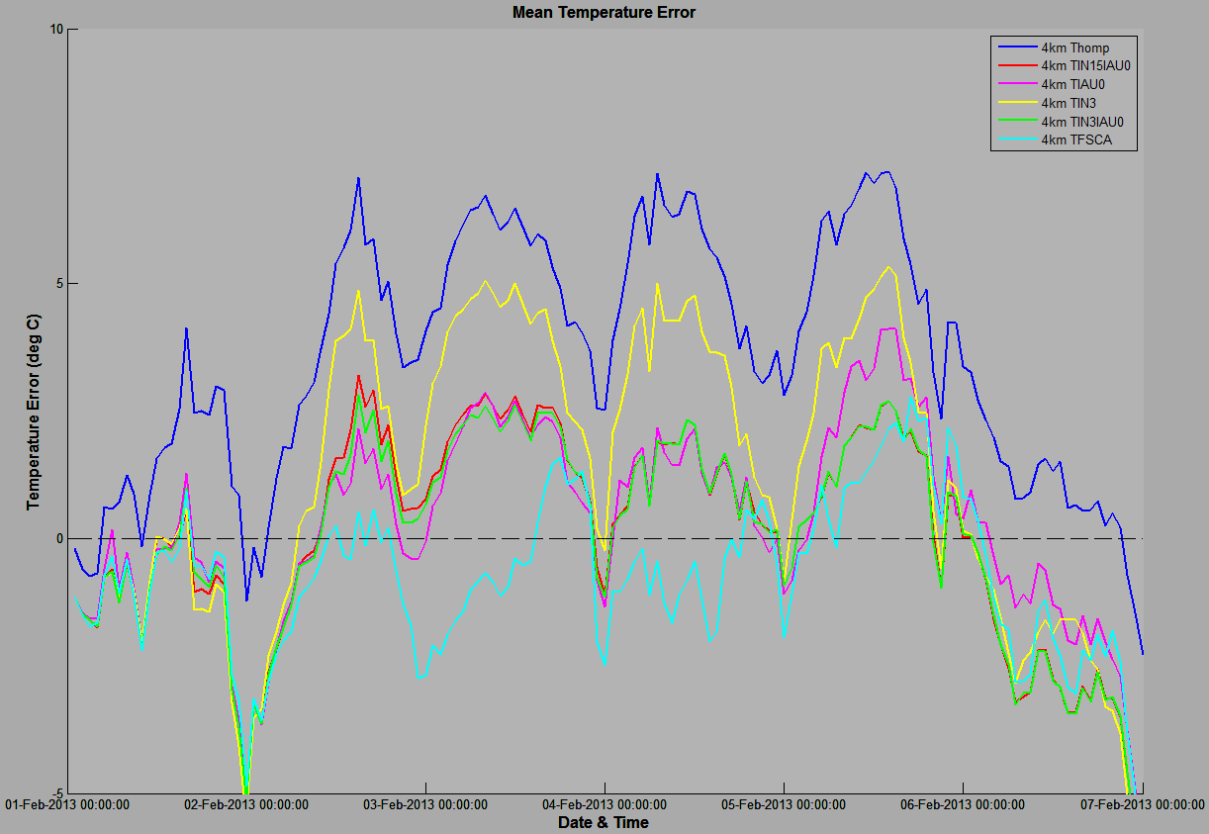
Uintah Basin CAP Simulation 1-6 Feb 2013
Mean Errors:
Original Thomp 4km = 3.5576 C
WSM3 0.82 alb 4km = 1.9254 C
Thomp RH-40%, 0.82 alb = 2.9908 C
Thomp 300 CCN 0.82 alb = 1.3055 C
Thomp ice, fall speed zero = 3.0842 C
Thomp ice, FS=0, 300 CCN, alb = -0.75 C
“thick liquid cloud”
“thick ice cloud”
“clear sky”

Slide 20
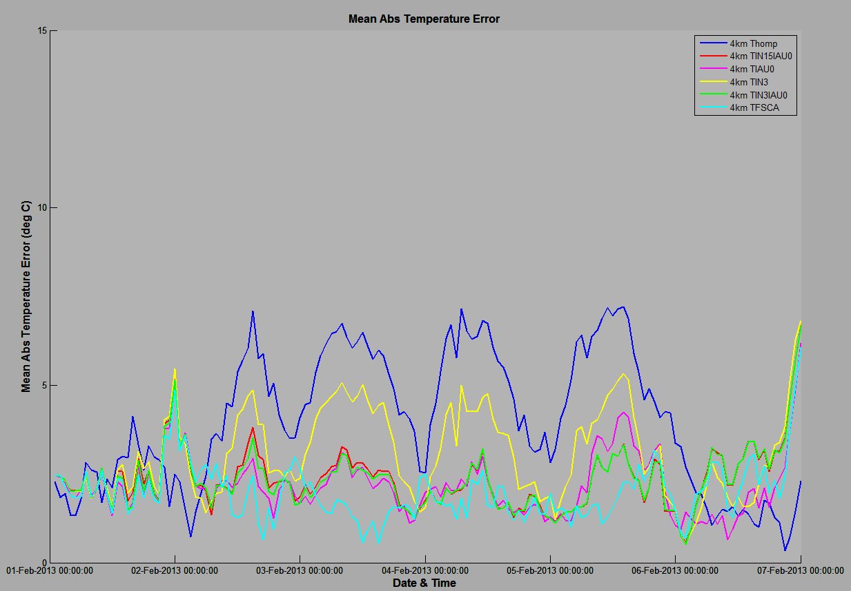
Uintah Basin CAP Simulation 1-6 Feb 2013
Mean Abs Errors:
Original Thomp 4km = 3.9772 C
WSM3 0.82 alb 4km = 2.5456 C
Thomp RH-40%, 0.82 alb = 2.6232 C
Thomp 300 CCN 0.82 alb = 3.1315 C
Thomp ice, fall speed zero = 3.4003 C
Thomp ice, FS=0, 300 CCN, alb = 3.9772 C

Slide 21
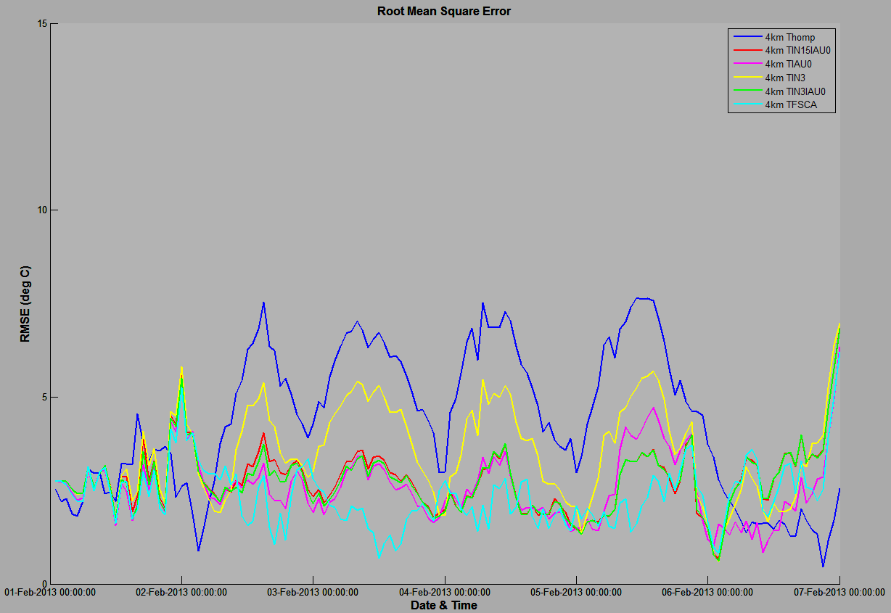
Uintah Basin CAP Simulation 1-6 Feb 2013
RMSE:
Original Thomp 4km = 4.7447 C
WSM3 0.82 alb 4km = 3.1065 C
Thomp RH-40%, 0.82 alb = 3.2344 C
Thomp 300 CCN 0.82 alb = 3.8061 C
Thomp ice, fall speed zero = 3.9650 C
Thomp ice, FS=0, 300 CCN, alb = 2.5162 C

Slide 22
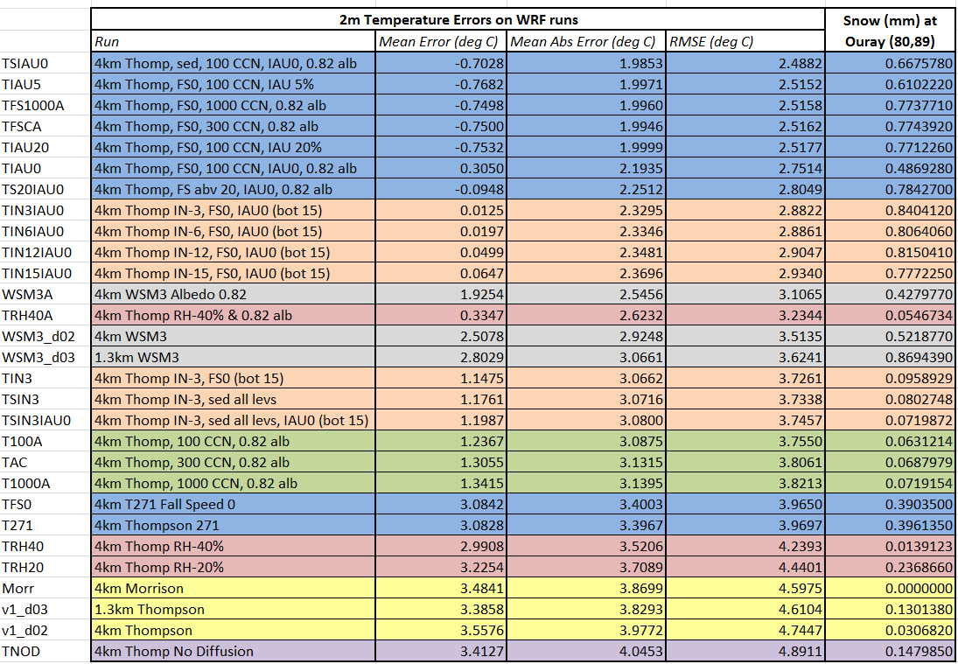
2m Temperature Errors for all runs and accumulated snow at Ouray
Thompson runs with HGFR temp = 271.15
No tweaks to microphysics (Thompson & Morrison)
WSM3 runs
Thompson runs with different cloud droplet concentrations
Thompson runs with reduced RH in boundary conditions
Thompson runs with ice nucleation changes in bottom 15 model levels

Slide 23
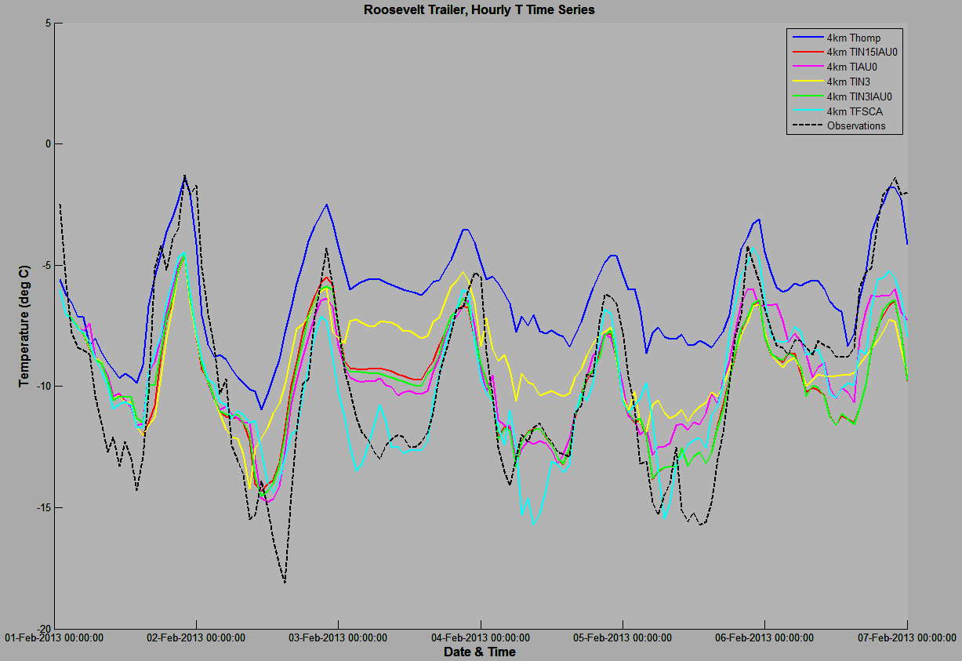
Uintah Basin CAP Simulation 1-6 Feb 2013

Slide 24
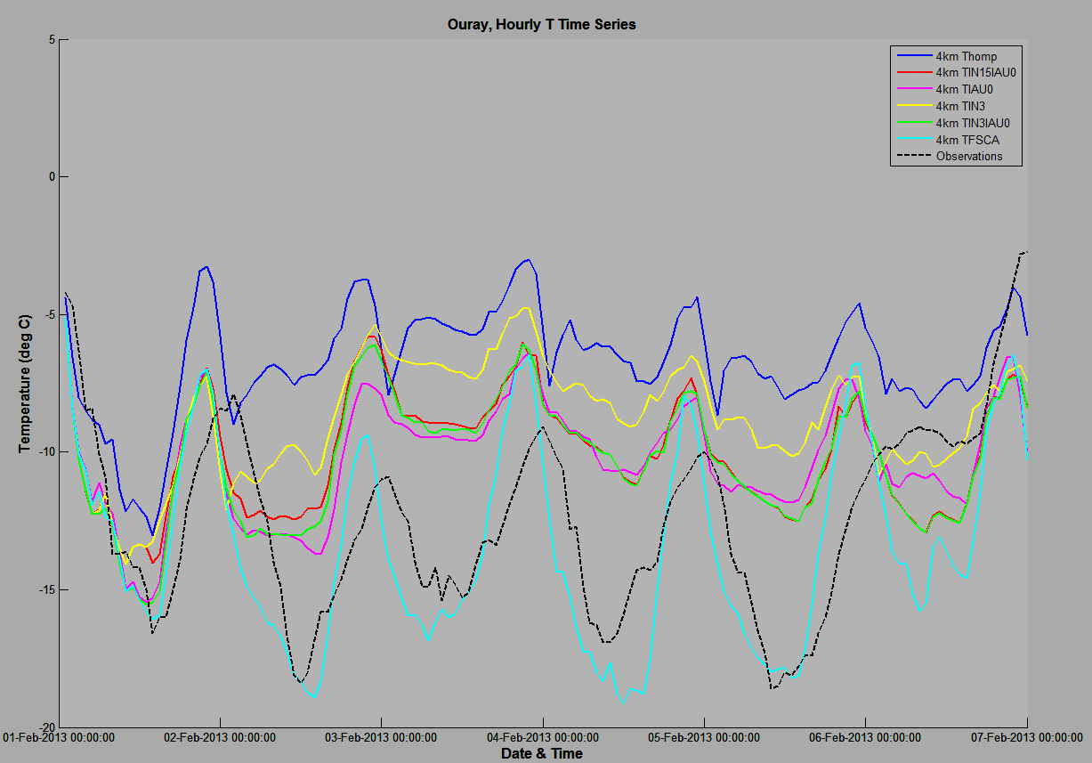
Uintah Basin CAP Simulation 1-6 Feb 2013

Slide 25
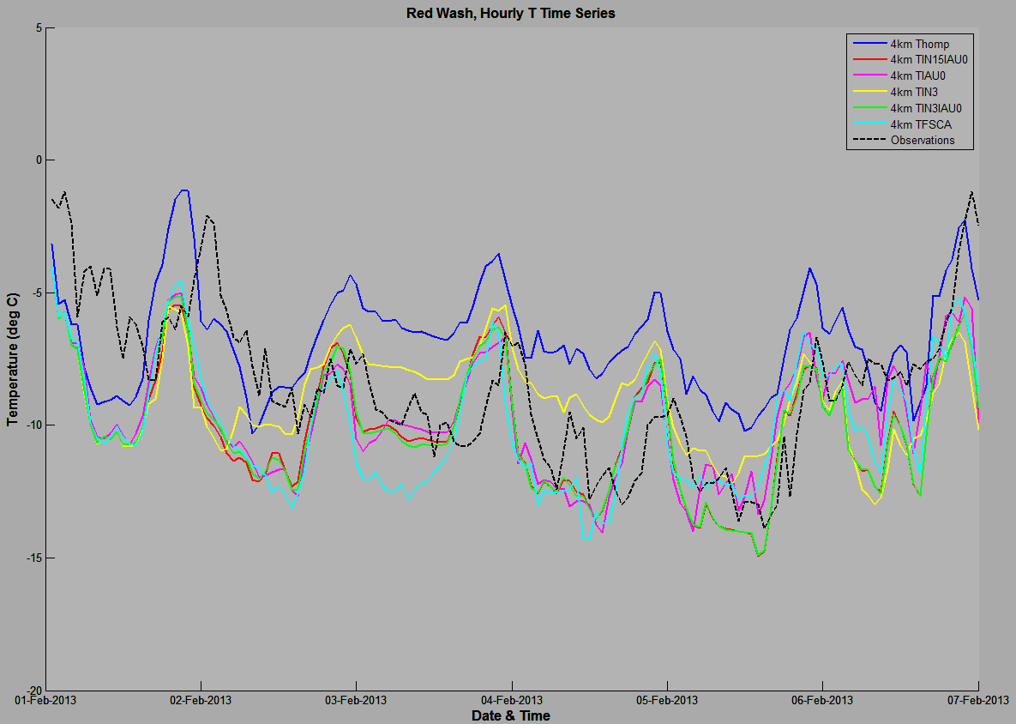
Uintah Basin CAP Simulation 1-6 Feb 2013

Slide 26
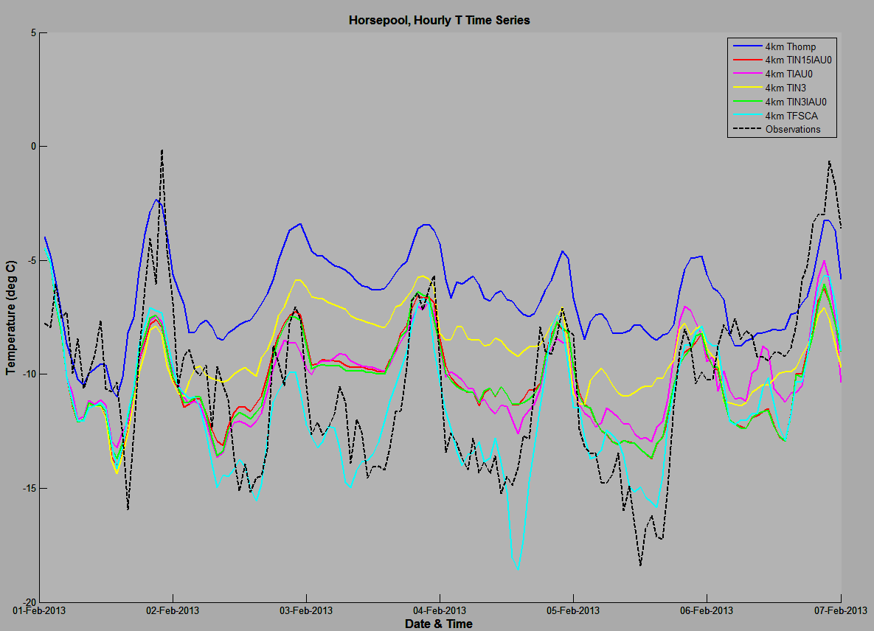
Uintah Basin CAP Simulation 1-6 Feb 2013

Slide 27
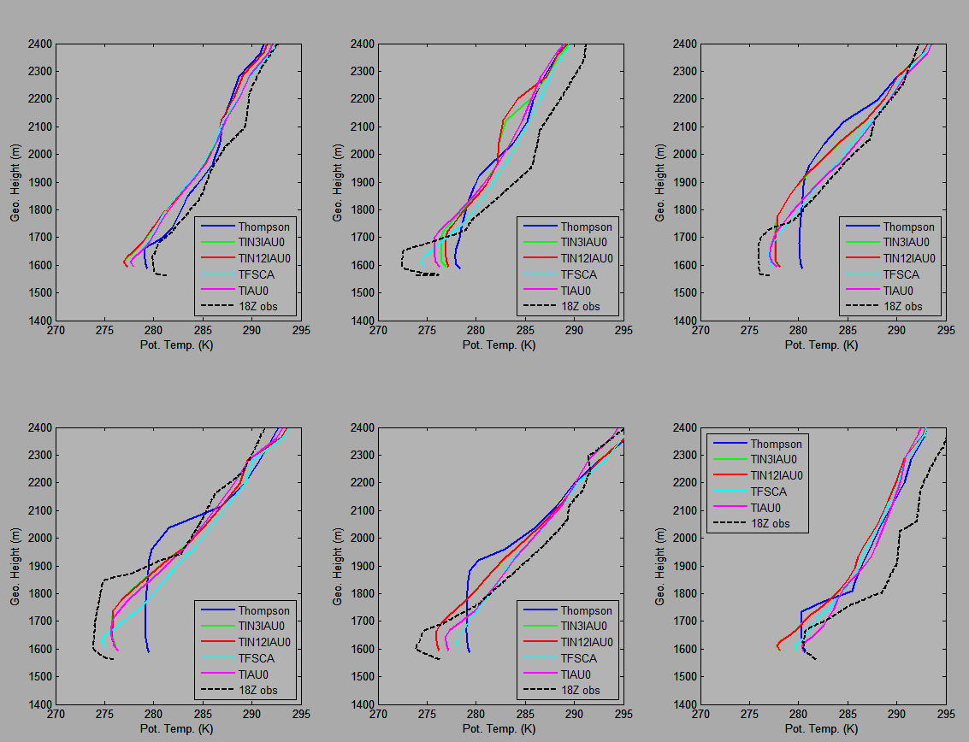
18Z Roosevelt
1 Feb 2013
2 Feb 2013
3 Feb 2013
4 Feb 2013
5 Feb 2013
6 Feb 2013

Slide 28
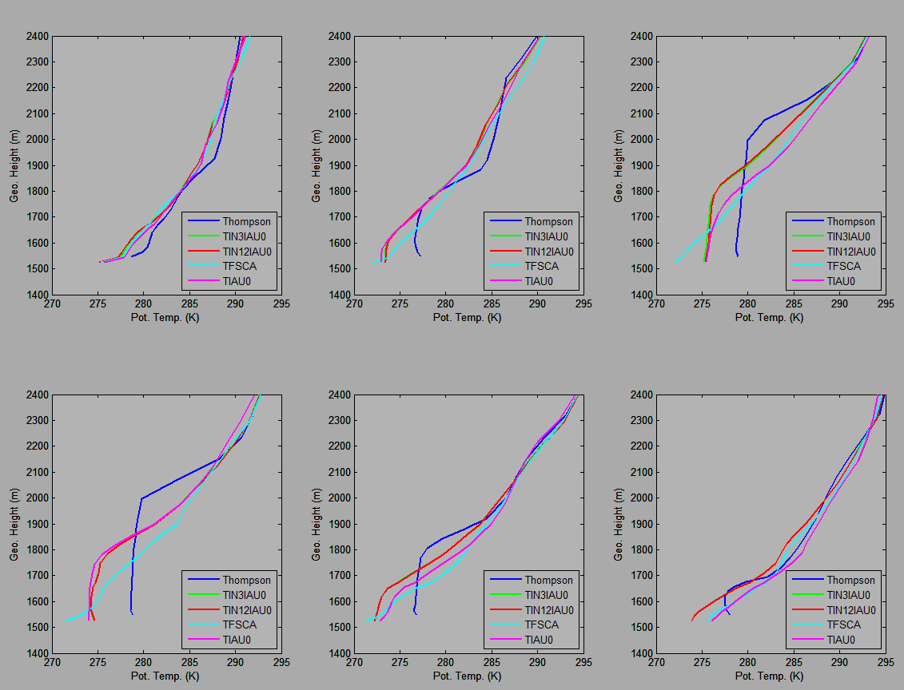
12Z Horsepool
1 Feb 2013
2 Feb 2013
3 Feb 2013
4 Feb 2013
5 Feb 2013
6 Feb 2013

Slide 29

12Z Ouray
1 Feb 2013
2 Feb 2013
3 Feb 2013
4 Feb 2013
5 Feb 2013
6 Feb 2013

Slide 30

12Z Red Wash
1 Feb 2013
2 Feb 2013
3 Feb 2013
4 Feb 2013
5 Feb 2013
6 Feb 2013

Slide 31
Conclusions
Preferred WRF run and edits (TIN12IAU0)
  Include idealized snow cover, albedo, skin temperature, updated land use, and edited VEGPARM.TBL
  Do not edit RH in NAM initialization/boundary condition files
  Only make microphysics edits in lowest 15 model levels
  Leave ice nucleation at default temperature of -12 C
  Turn off autoconversion and sedimentation in bottom 15 model levels
Preferred setup results in:
  Ice-phase clouds in place of original liquid-phase cloud
  Colder surface temperatures with smaller errors/bias
  More physically representative radiative properties of ice-phase cloud
  Shallower PBL that more closely matches observed soundings

