Slide 1



NO_{x}
O₃
Z
VOCs
Snow Cover
θ
Fig. 1.1: Simplified schematic of typical situation leading to high wintertime ozone concentrations. Red line represent potential temperature profile with stable layer trapping pollutants and ozone precursors in the low levels. Snow cover reflects solar radiation and increases photolysis rates leading to enhanced ozone concentrations near the surface.

Slide 2
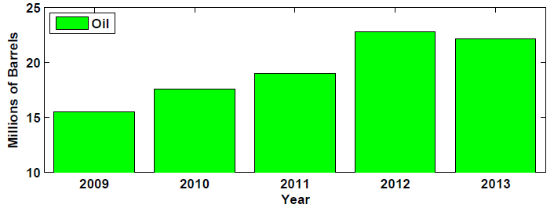
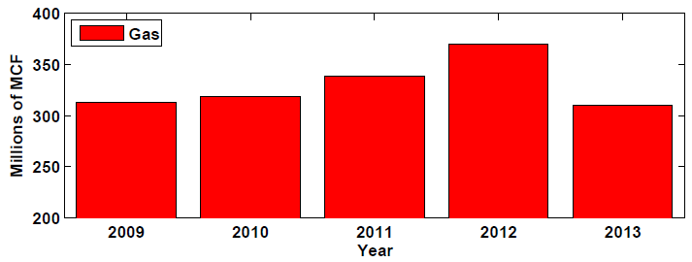
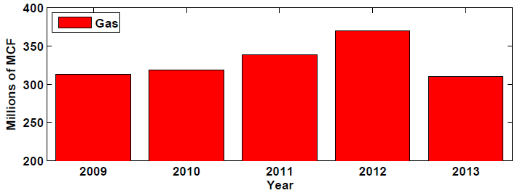
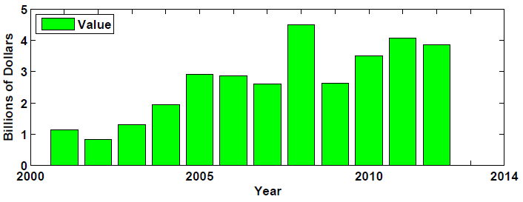
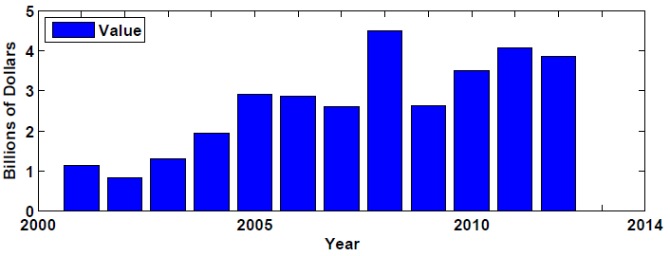
(a)
(b)
(c)
Fig. 1.2: Annual fossil fuel production in Uintah Basin since 2009 for (a) oil and (b) gas. (c) Total value of fossil fuel production in Utah since 2001. 1 barrel = 42 US gallons, 1 MCF = 1,000 cubic feet. Data provided by Utah Division of Oil, Gas, and Mining.

Slide 3
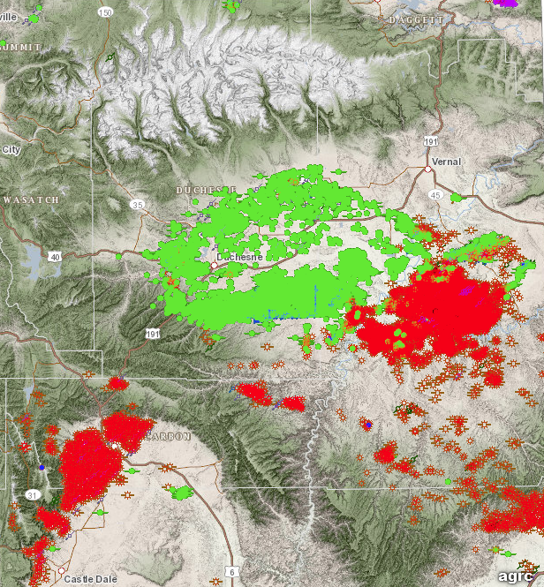
Fig. 1.3: Location of oil wells (green) and gas wells (red) operating inside the Uintah Basin in March 2014. Data provided by Utah Division of Oil, Gas, and Mining.

Slide 4
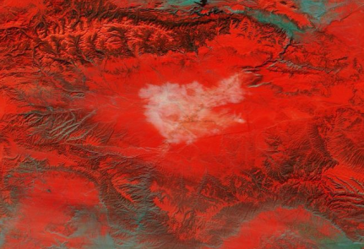
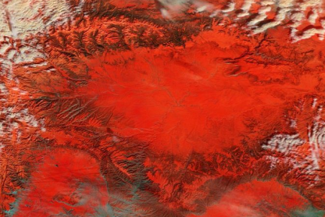
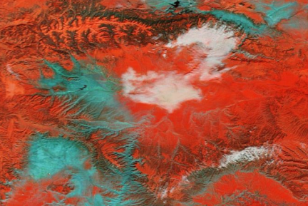
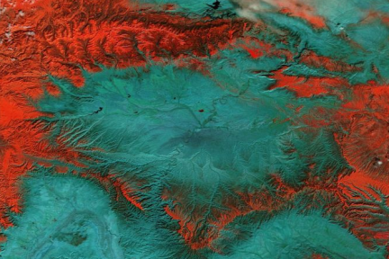
(a)
(b)
(c)
Fig. 1.4: Satellite images showing examples of spatial snow cover variations in the Uintah Basin from the NASA SPoRT program’s snow-cloud product. Snow cover appears red, bare ground is cyan, and cloud cover is white. (a) Full snow cover on 2 Feb 2013, (b) snow melted in western portion of basin on 2 Feb 2014, and (c) no snow cover on basin floor on 21 Feb 2014.

Slide 5
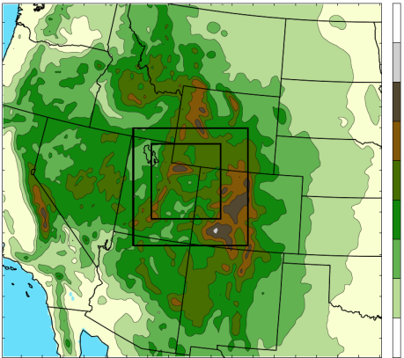
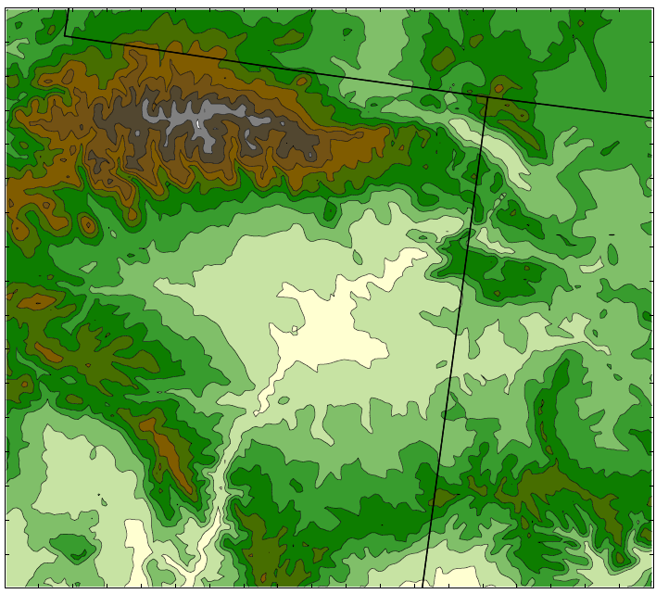
4500
(a)
4000
3500
3000
2500
1.33 km
2000
4 km
1500
1000
500
12 km
0
4000
(b)
WY
3750
Uinta Mountains
UT
3500
CO
3250
VER
3000
ROO
2750
Wasatch Range
RED
MYT
HOR
2500
OUR
2250
Tavaputs
2000
Plateau
1750
Desolation Canyon
1500
1250
Fig. 1.5: WRF 12-, 4-, and 1.33-km domains (a) with terrain contoured every 500 m. (b) Subdomain used for plotting with terrain contoured every 250 m and major geographic features labeled. Black dots indicate locations of MesoWest stations used for verification: Horsepool (HOR), Myton (MYT), Ouray (OUR), Red Wash (RED), Roosevelt (ROO), and Vernal (VER). Red line indicates position of vertical cross sections shown later in this paper.

Slide 6
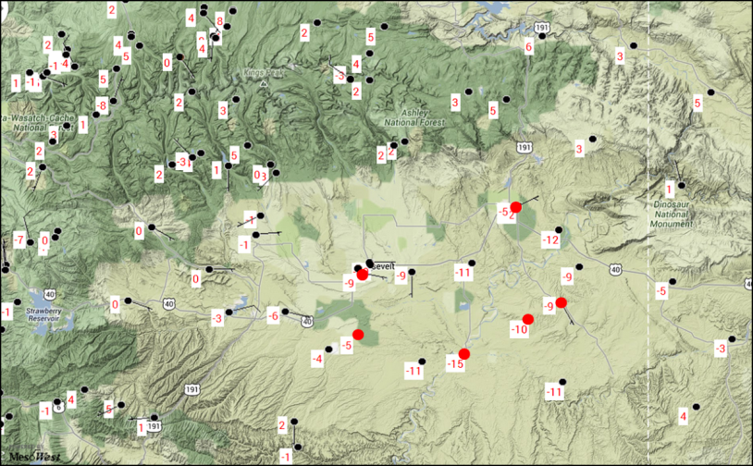
Fig. 2.1: Surface observations inside the Uintah Basin at 1800 UTC on 2 February 2013. Dots represent station location and plotted values are air temperature (C). Red dots indicate locations used for model validation.

Slide 7
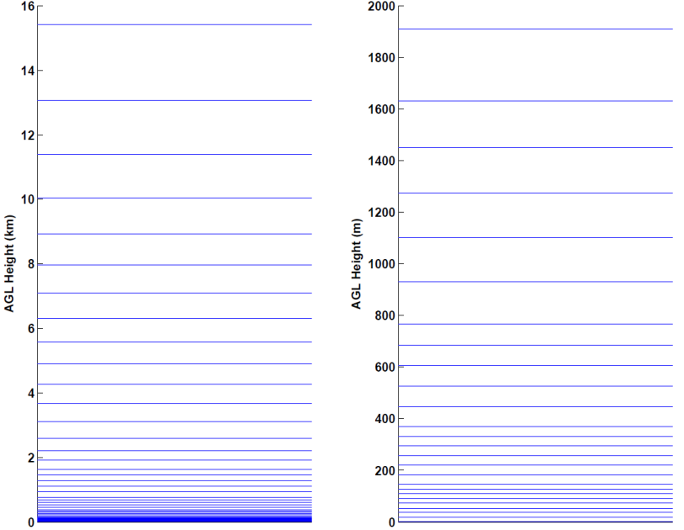
(a)
(b)
Fig. 2.2: WRF vertical model level setup. The bottom of model levels are plotted for (a) entire model domain (in km) and (b) lowest 2 km of domain (in m).

Slide 8
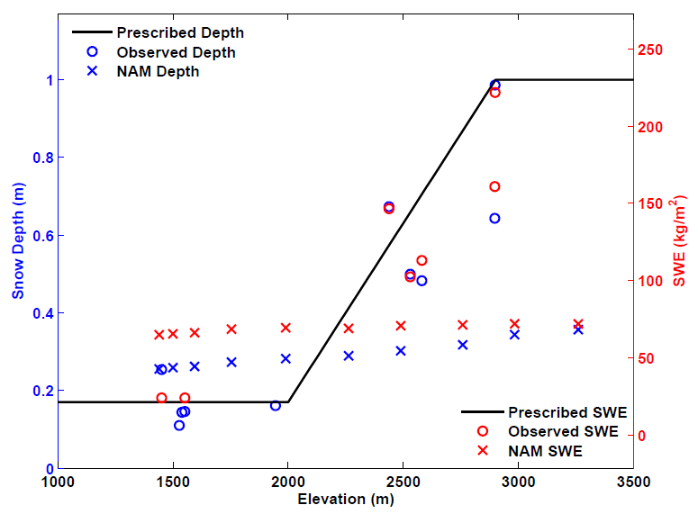
Fig. 2.3: Snow depth (blue) and snow water equivalent (red) as a function of elevation. Plotted values are from 0000 UTC on 1 Feb 2013 for Prescribed snow applied to WRF simulations (black line), observations (O) from the Uintah Basin and surrounding mountains, and NAM analysis (X). NAM analysis data was extracted along a southeast to northwest transect from the center of the basin to the center of the Uinta Mountains.

Slide 9
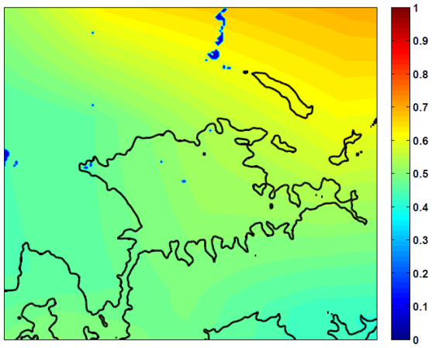
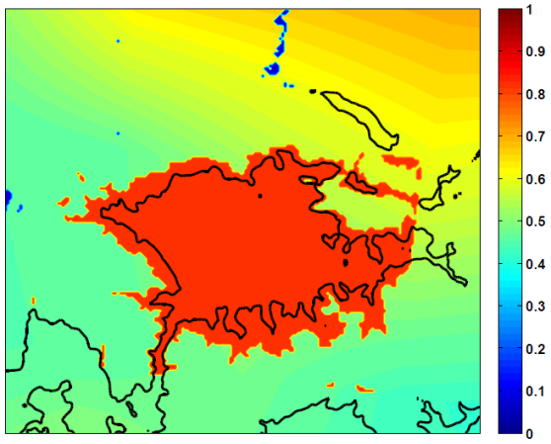
(a)
(b)
Fig. 2.4: WRF snow albedo field at 0100 UTC 01 Feb 2013 for (a) before and (b) after modifications to WRF snow albedo and VEGPARM.TBL. High albedos were attained in the Uintah Basin from the combination of edits to the WRF initial snow field, vegetation parameter table, and snow albedo. After these modifications, the Noah LSM produced albedo values within the basin in line with those measured by the Horsepool radiation suite.

Slide 10
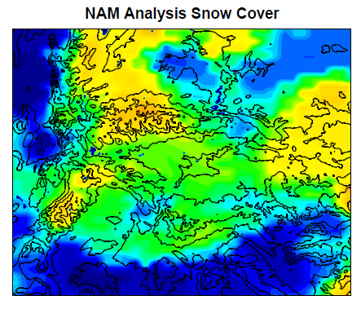
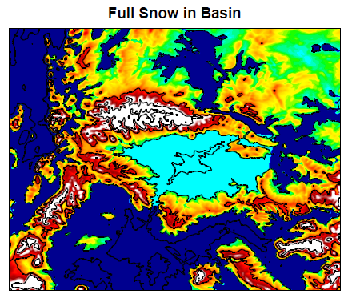
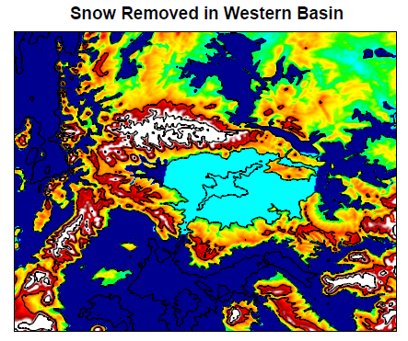
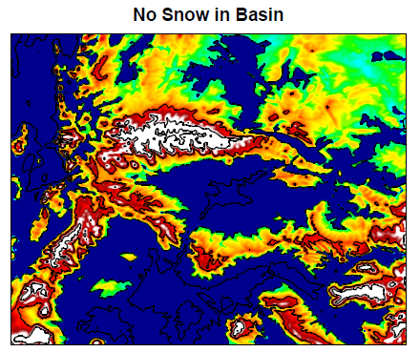
(a)
(b)
(c)
(d)
0
0.1
0.2
0.3
0.4
0.5
0.6
0.7
0.8
0.9
1
Fig. 2.5: Snow depth field from (a) NAM analysis at 0000 UTC 01 Feb 2013 and initialized snow depth field for (b) “Full Snow” case in BASE/FULL simulations, (c) “No Western Snow” case in NW simulation, and (d) “No Snow” case in NONE simulation.

Slide 11
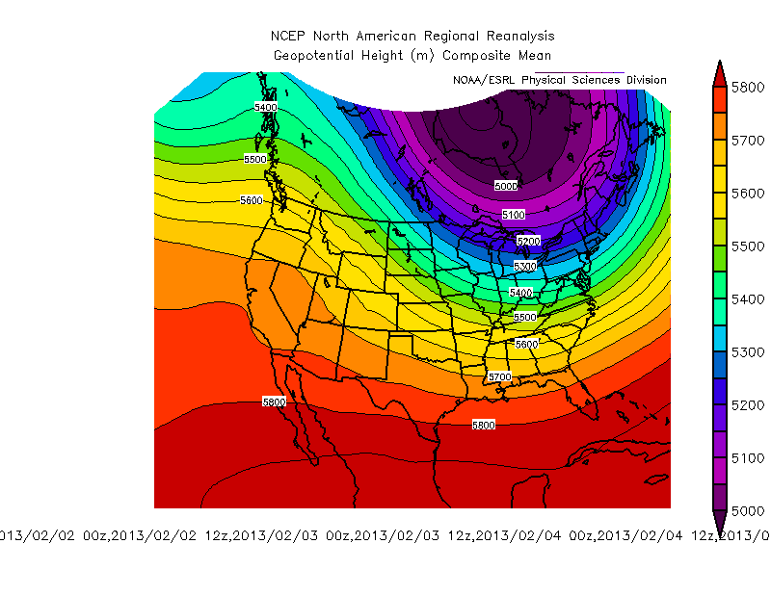
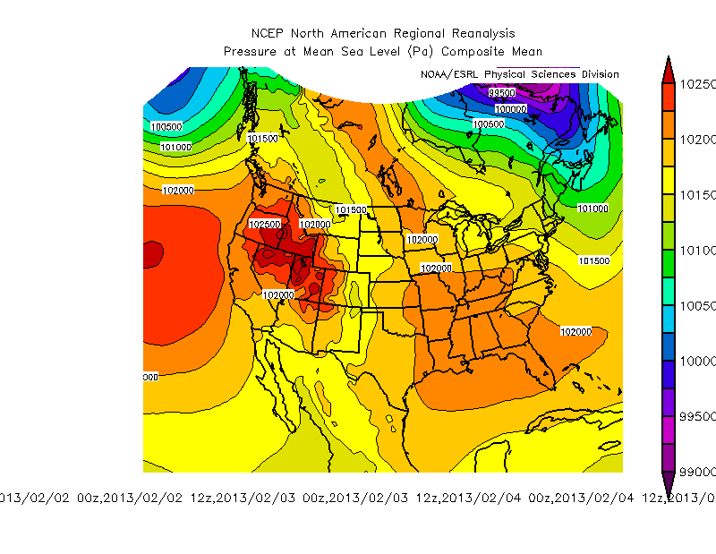
(a)
5800
5700
5600
5500
5400
5300
5200
5100
5000
(b)
1025
1020
1015
1010
1005
1000
995
990
Fig. 3.0: NCEP North American Regional Reanalysis composite plots from 0000 UTC 1 February to 0000 UTC 7 February 2013 for (a) 500 hPa geopotential height (in m) and (b) mean sea level pressure (in hPa).

Slide 12
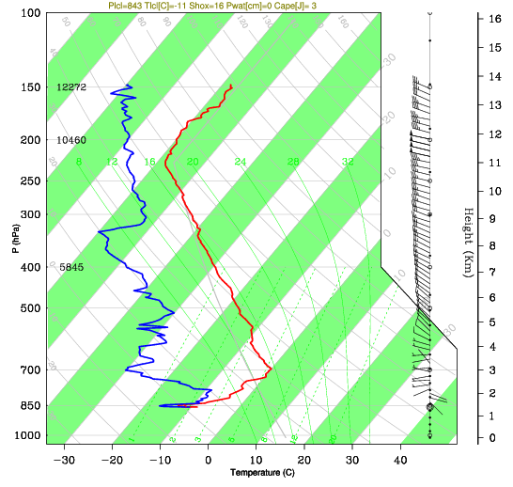
Pressure (hPa)
Fig. 3.1: Rawinsonde released from Roosevelt at 1800 UTC on 2 February 2013. Temperature is in red and dewpoint is in blue. Wind barbs on right side denote wind speed and direction (full barb = 10 m s⁻¹).

Slide 13
(a)
(b)
(c)
Fig. 3.1: Rawinsondes released from Roosevelt at (a) 1800 UTC 2 February 2013, (b) 1800 UTC 4 February 2013, and (c) 1800 UTC 6 February 2013. Temperature is in red and dewpoint is in blue. Wind barbs on right side denote wind speed and direction (full barb = 5 m s⁻¹).

Slide 14
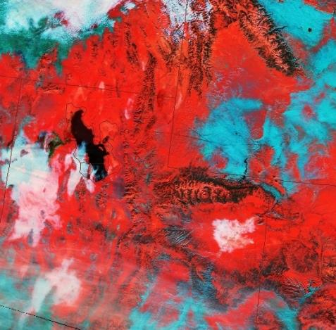
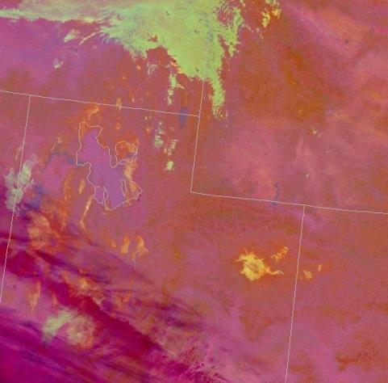
(a)
(b)
Fig. 3.2: VIIRS satellite imagery from NASA SPoRT program. (a) Nighttime Microphysics RGB product at 0931 UTC 2 Feb 2013 and (b) Snow-Cloud RGB product at 1815 UTC 2 Feb 2013.

Slide 15
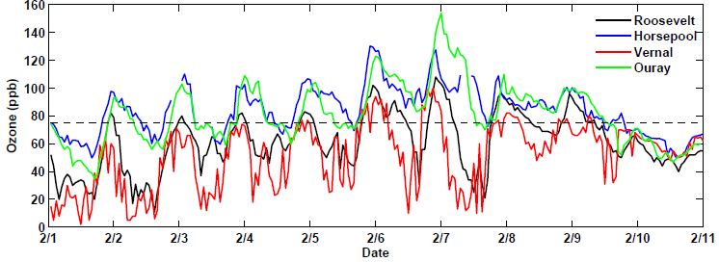
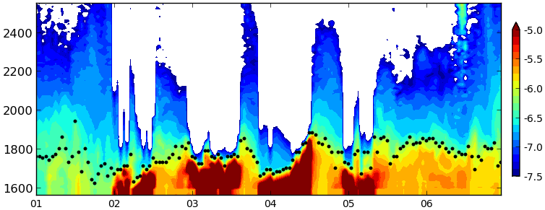
(a)
4 km
(b)
Fig. 3.3: (a) Ozone concentrations from 1-10 February 2013 for Roosevelt (black), Horsepool (blue), Vernal (red), and Ouray (green). The NAAQS of 75 ppb (8-hour mean) is noted by the thin black dashed line. (b) Ceilometer backscatter (shaded) and estimated aerosol depth (black dots) at Roosevelt from 1 - 7 Feb 2013. Red colors indicate the presence of fog or clouds and unshaded regions indicate beam attenuation.

Slide 16
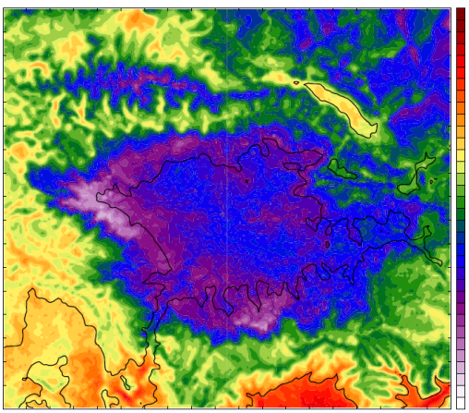
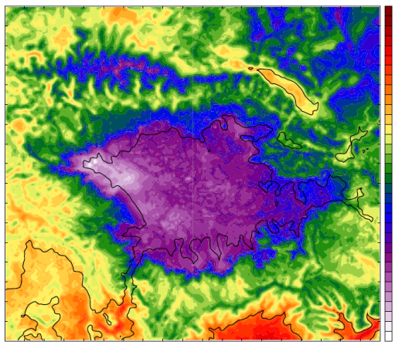
(a)
4
2
0
-2
-4
-6
-8
-10
-12
(b)
4
2
0
-2
-4
-6
-8
-10
-12
Fig. 3.4: 2-m Temperatures shaded every 0.5 °C at 1800 UTC 2 Feb 2013 for (a) BASE and (b) FULL simulations. Black contour indicates terrain elevation of 1800 m as a reference for Uintah Basin location.

Slide 17
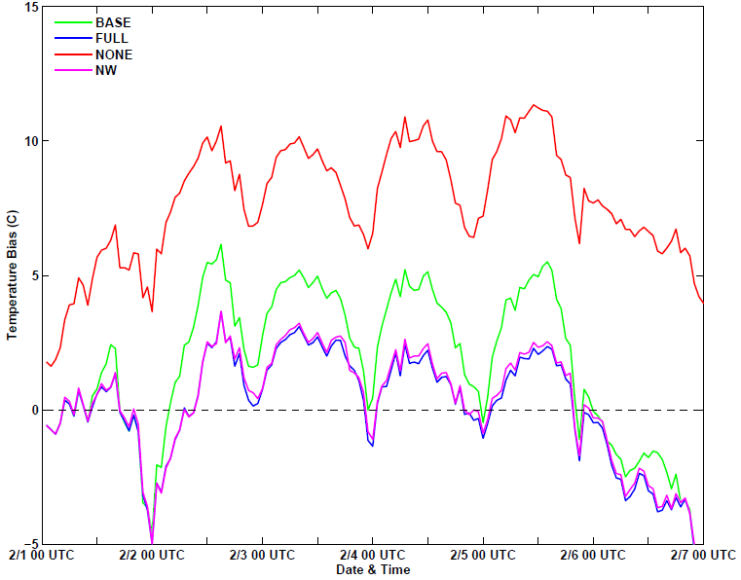
Fig. 3.5: Time series of mean 2-m Temperature Bias for BASE (red), FULL (blue), NONE (red), and NW (magenta) simulations. Biases are averaged for the six surface stations in Fig. 1b.

Slide 18
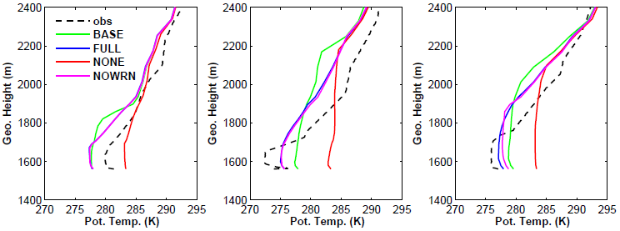
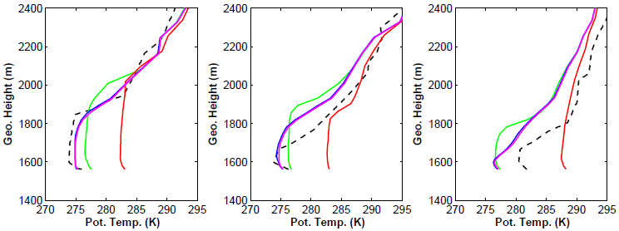
(a)
(b)
(c)
(d)
(e)
(f)
Fig. 3.6: Potential temperature profiles at Roosevelt at 1800 UTC on (a) 1 Feb 2013, (b) 2 Feb 2013, (c) 3 Feb 2013, (d) 4 Feb 2013, (e) 5 Feb 2013, and (f) 6 Feb 2013. Profiles are shown for the observed sounding (dashed black), BASE (green), FULL (blue), NONE (red), and NW (magenta). On several plots, FULL (blue) is covered by NW (magenta) because the profiles are so similar.

Slide 19
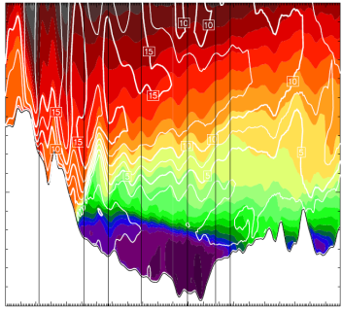
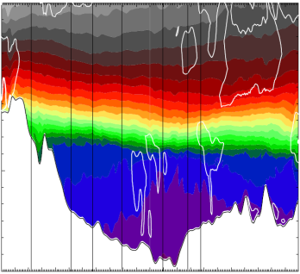
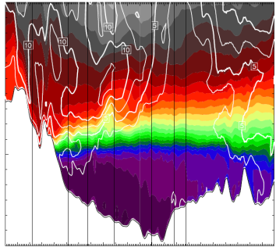
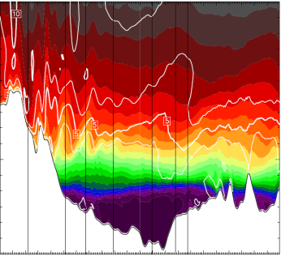
3.0
(a)
3.0
(b)
2.5
2.5
2.0
2.0
1.5
1.5
W
E
W
E
3.0
(c)
3.0
(d)
2.5
2.5
2.0
2.0
1.5
1.5
W
E
W
E
Fig. 3.7: Vertical cross sections of potential temperature (shaded every 1 K) and wind speed (contoured every 2.5 m s⁻¹, bold and labeled every 5 m s⁻¹), taken along red line in Fig. 1b. Results shown from BASE simulation for (a) 1800 UTC 1 Feb 2013, (b) 0600 UTC 3 Feb 2013, (c) 1800 UTC 4 Feb 2013 and (d) 1500 UTC 6 Feb 2013.

Slide 20

(a) BASE
(b) FULL
(c) NONE
1
2
3
4
5
6
7
Day of February
Fig. 3.8: Time-height plot of potential temperature (shaded and contoured every 1 K) at Horsepool from 1 - 6 Feb 2013.

Slide 21
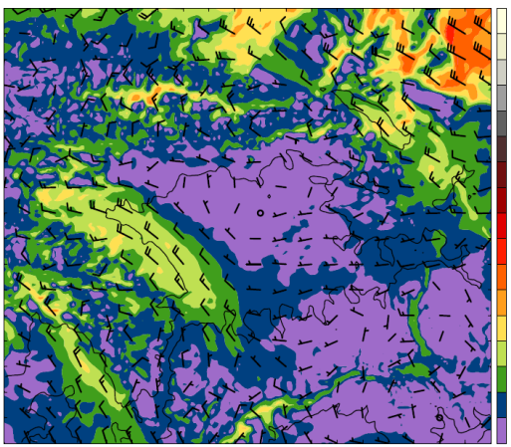
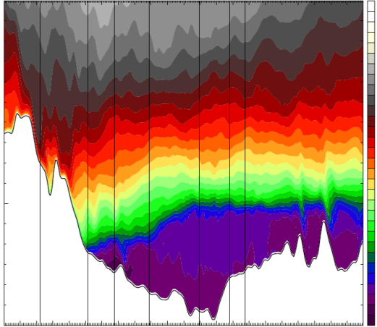
(a)
40
35
30
25
20
15
10
5
3.0
FRU
STA
LRF
MYT
OUR
HOR
ROO
(b)
304
302
300
298
2.5
296
294
Height (km)
292
290
2.0
288
286
284
282
280
1.5
278
276
W
50
100
150
200
E
Distance (km)
Fig. 3.9: BASE simulation results at 0600 UTC 4 Feb 2013 for (a) 2.3km MSL wind speed (shaded every 2.5 m s⁻¹) and barbs. (b) Vertical cross section of potential temperature (shaded every 1 K) along red line in Fig. 1b.

Slide 22
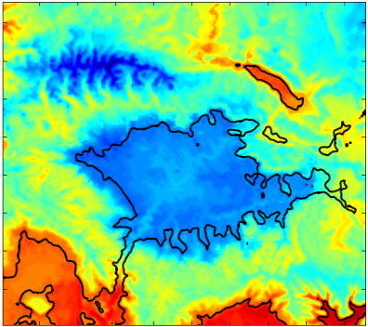
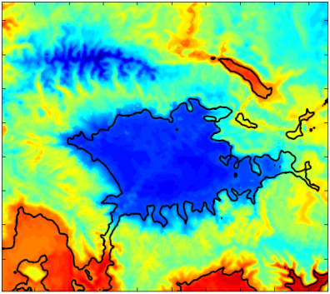
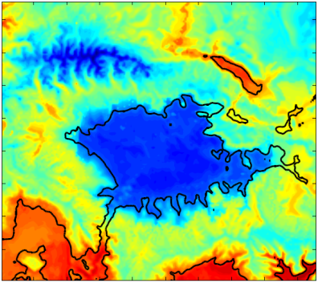
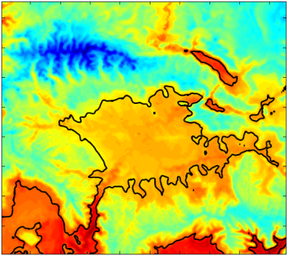
(a)
(b)
(c)
(d)
-12
-10
-8
-6
-4
-2
0
2
Fig. 3.10: Mean 2-m temperature (C) over entire 6-day simulation for (a) BASE, (b) FULL, (c) NW, (d) NONE.

Slide 23
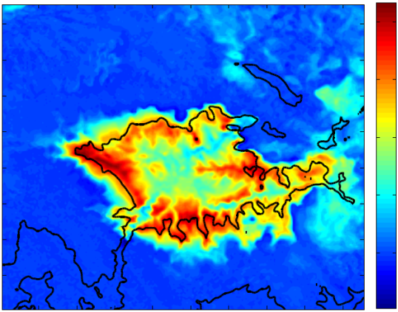
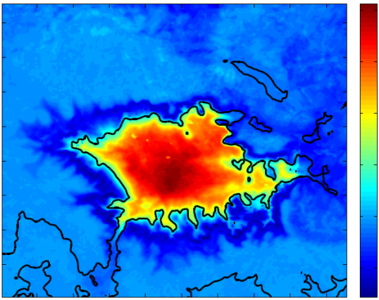
(a) Difference In longwave Radiation from Clouds (W m⁻²)
20
15
10
5
0
(b) 2-m Temperature Difference (C)
2
1.5
1
0.5
0
-0.5
Fig. 3.11: (a) Average difference in downwelling longwave radiation (BASE - FULL) from 1 Feb 0000 UTC to 7 Feb 0000 UTC. Liquid clouds in BASE generally produced 10-20 Wm⁻² more longwave radiation than ice clouds in FULL. (b) Average difference in 2-m temperatures (BASE - FULL) for the same period.

Slide 24
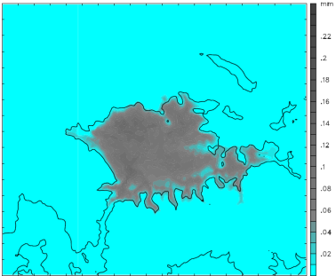
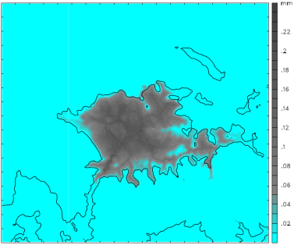
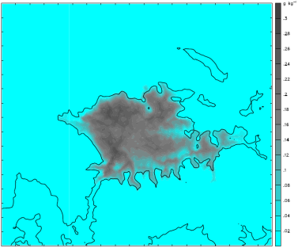
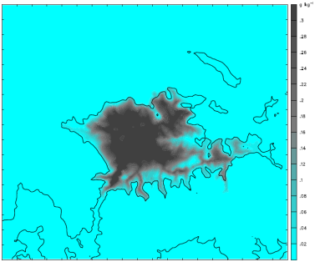
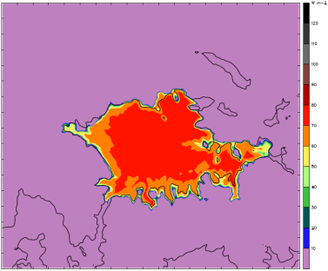

(a) Integrated Clouds (mm)
(b) Integrated Clouds (mm)
(c) Cloud Water (g kg⁻¹)
(d) Cloud Ice (g kg⁻¹)
(e) LW Radiation from Clouds (W m⁻²)
(f) LW Radiation from Clouds (W m⁻²)
Fig.3.12: Comparison of cloud characteristics between BASE (a,c,e) and FULL (b,d,f) model runs at 0600 UTC 5 Feb 2013. (a,b) Integrated cloud amount (c) mean cloud water in bottom 15 model levels, (d) mean cloud ice in bottom 15 model levels, (e,f) net downwelling longwave radiation from clouds.

Slide 25




(a)
(b)
(c)
(d)
Fig. 3.13: Potential temperature profiles at Ouray on 3 Feb at (a) 0900 UTC, (b) 1200 UTC, (c) 1500 UTC, and (d) 1800 UTC for FULL (blue) and NONE (red). Tethersonde observations below 1700 m MSL at 1500 and 1800 UTC are shown for comparison.

Slide 26

Fig. 3.14: Mean zonal wind difference (m s⁻¹) between NW and FULL simulations (NW-FULL). Results averaged over entire 6-day simulation. Thick black contour represents terrain elevation o f 1800 m, thin black contour represents region where snow is removed in the NW simulation.

Slide 27


(a)
(b)
Fig. 3.15: Time- and space-averaged zonal wind along cross-section in Fig. X over the entire simulation period for (a) FULL and (b) NONE. Westerly flow is filled red, easterly flow is filled blue. Westerly contours are every 2 m s⁻¹, easterly contours are at -0.5, -1, and -2 m s⁻¹. Values are averaged over a 26-km region perpendicular to the cross section with 10 grid points on each side of the centerline.

Slide 28


(a)
(b)
Fig. 3.16: Same as Fig. 3.15, but only daytime hours (0800 to 1700 local time) are included in the time-average.

Slide 29


(a)
(b)
Fig. 3.17: Same as Fig. 3.16, except for nighttime hours (1800 to 0700 local time).

Slide 30




(a)
N
NW
NE
W
E
(b)
SW
SW
S
N
E
S
W
N
Fig. 3.18: Mean 10-m wind direction during (a) daytime periods (0800 to 1700 local time) and (b) nighttime periods (1800 to 0700 local time) for the FULL simulation.

Slide 31
Potential Figures for AQ section

Slide 32


(a)
(b)
Fig. 4.1 Ozone concentrations from mobile transect on 6 Feb 2013 from 1130 to 1500 Mountain Standard Time. (a) Spatial concentration

Slide 33


(a) FULL
(b) NONE
Fig. 4.2: Time-averaged ozone concentration (ppb) on lowest CMAQ model level (~17.5 m) for (a) FULL (b) NONE WRF simulations. Only mid- to late-day hours (1100 to 1700 local time) are included. Thin black line outlines region of greater than 75 ppb ozone concentration. Thick black line contours terrain elevation of 1800 m as a reference for Uintah Basin location.

Slide 34

Fig. 4.3: 4km model domain used in CMAQ simulations with terrain shaded and contoured every 500 m. The thick red line marks location of ozone cross sections in Fig. 4.4 and the thin red lines indicate spatial extent of area-average in direction perpendicular to cross section. The blue box represents the area used for mean shortwave radiation calculations in Fig. 4.7, and the green dot indicates location of Seven Sisters ozone monitoring station discussed in text.

Slide 35


(a) FULL
(b) NONE
Fig. 4.4: Time- and space-averaged ozone concentration along cross section in Fig. 1b for (a) FULL (b) NONE WRF simulations. Only mid- to late-day hours (1100 to 1700 local time) are included in time-average. Output from the 4-km domain was run through CMAQ to produce concentrations at 4-km resolution. Values are averaged over a 24-km region perpendicular to the cross section with 3 grid points on each side of the centerline.

Slide 36



(a) Roosevelt
(b) Horsepool
(c) Seven Sisters
Fig. 4.5: Time Series of ozone concentrations for (a) Roosevelt, (b) Horsepool, and (c) Seven Sisters. Observations are in black, CMAQ output from FULL (NONE) is blue (red), and the NAAQS is noted by the thin black dashed line.

Slide 37
(a) FULL
1
2
3
4
5
6
7
(b) NONE
1
2
3
4
5
6
7
Day of February
Fig. 4.6: Time-height plot of potential temperature (shaded and thin black contours) and ozone concentrations (colored contours) for (a) FULL and (b) NONE simulations. Ozone concentrations are contoured every 10 ppb, starting at 75 ppb and alternate between solid and dashed every 10 ppb.

Slide 38


(a) Downward Shortwave
(b) Upward Shortwave
(b) Total Shortwave (Up + Down)
Fig. 4.7: Time series of shortwave radiation data for FULL (blue), and NONE (red) simulations. (a) Downward radiation at the surface, (b) upward (reflected) radiation at the surface, and (c) Total radiation (Up + Down). Values are averaged over a 26 by 39 km box in the center of the basin (shown in Fig 4.3).

Slide 39
Tables

Slide 40
Table 2.1. Summary of WRF setup and parameterizations
Parameter | Chosen Setup | Reference
Initial/Boundary Conditions | NAM Analysis
Vertical Levels | 41
Domains | 3 one-way nests
Resolution | 12 km, 4 km, 1.33 km
Time Step | 45 s, 15 s, 5 s
Microphysics | Thompson | Thompson et al. 2008
Shortwave Radiation | RRTMG | Iacono et al. 2008
Longwave Radiation | RRTMG | Iacono et al. 2008
Boundary Layer | Mellor-Yamada-Janjic (MYJ) | Janjic 1994
Surface Layer | Eta Similarity
Land Surface | Noah | Chen and Dudhia 2001
Cumulus | Kain-Fritsch (12 km domain only) | Kain 2004
Diffusion | 2nd order on coordinate surfaces

Slide 41
Table 2.2. Overview of WRF sensitivity studies
 | Snow Cover in basin | Cloud Ice Sedimentation | Cloud Ice Auto-conversion to Snow | Simulation Name
Microphysics Sensitivity Simulations | Full Snow | ON | ON | BASE
 | Full Snow | OFF | OFF | FULL
Snow Cover Sensitivity Simulations | No Snow below 2100 m in Western 1/4 of basin | OFF | OFF | NW
 | No Snow below 2000 m | OFF | OFF | NONE

Slide 42
Table 3.1. 2-m temperature errors from WRF simulations. Mean errors calculated from the six surface stations in Fib 1b.
Simulation | Bias (C) | Mean Abs Error (C) | RMSE (C)
BASE | 1.65 | 3.25 | 3.97
FULL | 0.11 | 2.44 | 2.98
Table 3.2. WRF simulation sensitivity to microphysics. Difference in longwave radiation and 2-m temperature between BASE and FULL simulations. Mean values shown for area below selected terrain contours within the basin.
BASE-FULL Difference | < 1800 m | < 1700 m | < 1600 m | < 1500 m
Longwave (W m⁻²) | 11.77 | 10.63 | 8.97 | 7.21
2-m Temperature (C) | 1.24 | 1.46 | 1.65 | 1.78
Table 3.3. 2-m temperature difference from FULL simulation
Simulation | Difference (C) | Mean Abs Diff (C) | RMSD (C)
NW | 0.14 | 0.21 | 0.28
NONE | 7.60 | 7.60 | 7.85

Slide 43
Table 4.1. Ozone statistics from CMAQ model forced by FULL and NONE simulations.
 | FULL | NONE
Highest mean O₃ - Afternoon (ppb) | 97.2 | 81.2
Highest mean O₃ - Non afternoon (ppb) | 61.9 | 51.0
Maximum Hourly O₃ (ppb) | 134.4 | 118.0
Area of mean afternoon O₃ > 75 ppb (km²) | 896 | 144

Slide 44
Other Figs for Defense

