Slide 1
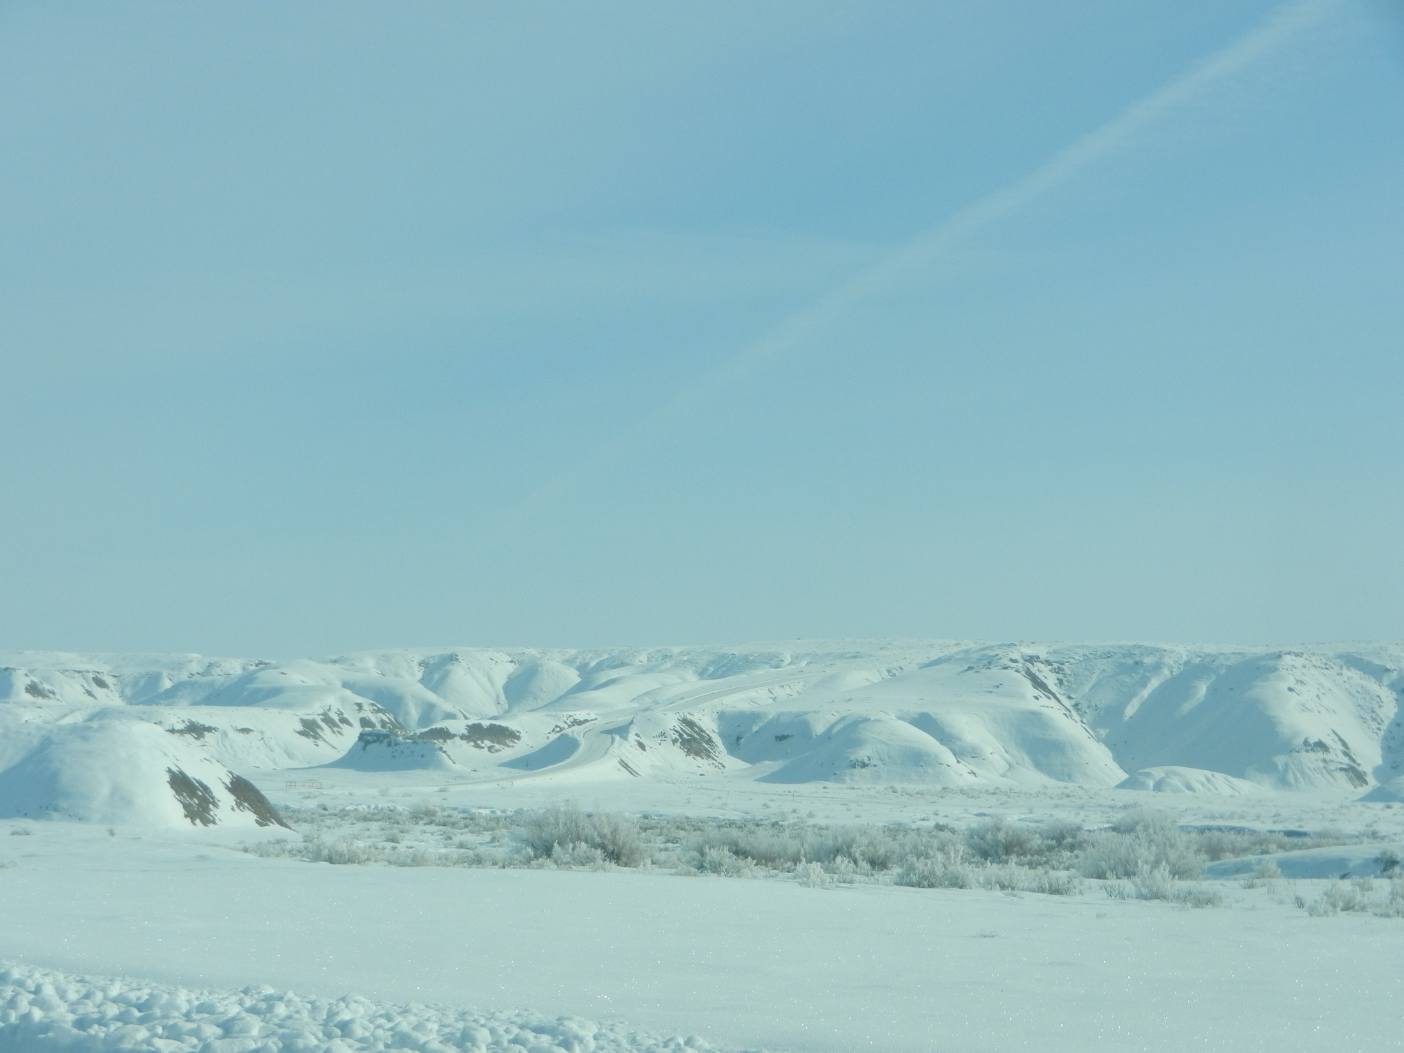
Uintah Basin WRF Testing
Erik Neemann
21 Nov 2013

Slide 2
Overview
WRF Setup & Modifications
Microphysics Edits & Outcomes
General Results
Flow Patterns in the Basin
Tracer Runs

Slide 3
UofU & DEQ WRF Setup
See Alcott and Steenburgh 2013 for further details on most aspects of this numerical configuration:
http://journals.ametsoc.org/doi/abs/10.1175/MWR-D-12-00328.1
Namelist used for real.exe is located at: http://home.chpc.utah.edu/~u0818471/namelist.wps
Namelist used for wrf.exe is located at: http://home.chpc.utah.edu/~u0818471/namelist.input
Overview summary of WRF Namelist options
map_proj= 1: Lambert Conformal
NAM analyses provide initial cold start and land-surface conditions, and lateral boundary.
Idealized snowcover as function of height input to replace poor NOHRSC snow
3 Domains (see next slide)
Number of vertical levels = 41
Time step = 45 seconds (15, 5 s for inner 2 grids)
Microphysics: Thompson scheme
Radiation: RRTM longwave, RRTMG shortwave
Surface layer: Monin-Obukov
NOAH land-surface option
MYJ PBL Scheme
Kain-Fritsch cumulus scheme in outer coarse 12 km grid
Slope effects for radiation, topo shading turned on
2nd order diffusion on coordinate surfaces
Horizontal Smagorinsky first-order closure for eddy coefficient

Slide 4
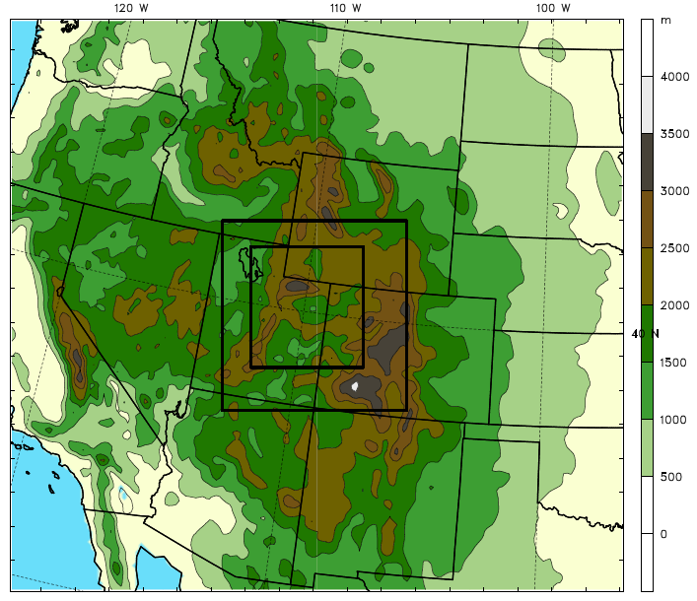
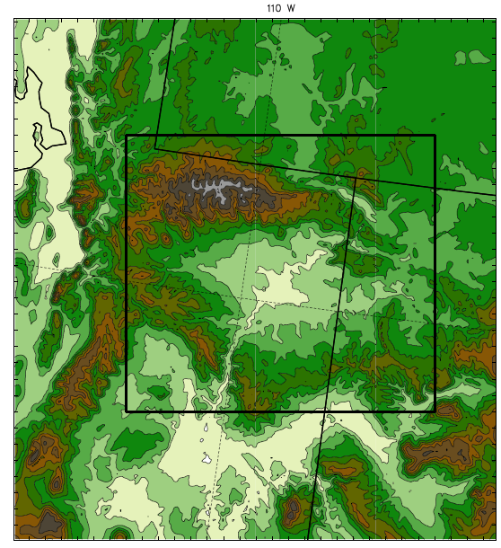
WRF Domains
Outer Domain
Inner Domain & Subdomain
1.33 km
4 km
Subdomain
12 km

Slide 5
Summary of Recent WRF Testing & Modifications
Idealized snow cover in Uintah Basin and mountains
Initialized colder skin temperature in the Uintah Basin
Updated land use data to NLCD 2006
Modified VEGPARM.TBL
Snow albedo changes
Microphysics modifications (Thompson)
Changes to homogeneous freezing temperature
Changes to ice nucleation temperature
Turning off cloud ice sedimentation
Turning off cloud ice autoconversion to snow

Slide 6
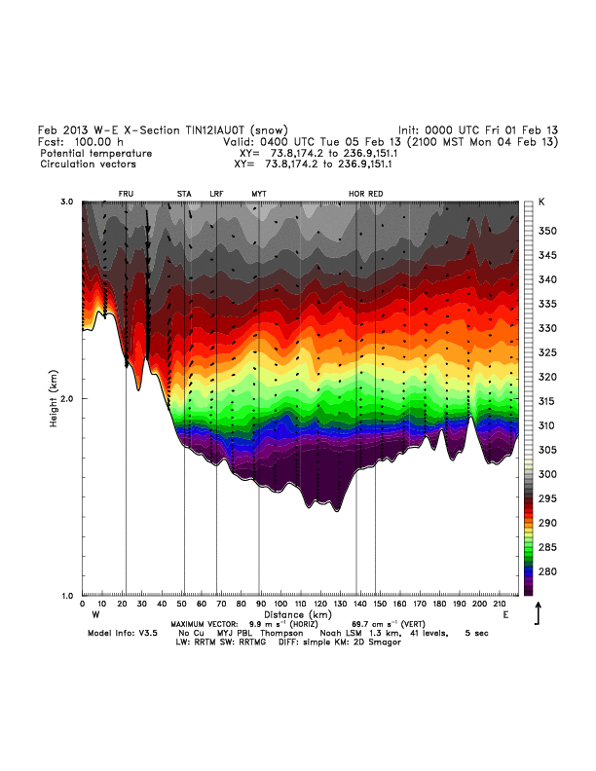
Cold Pool Evolution hours 70-100

Slide 7
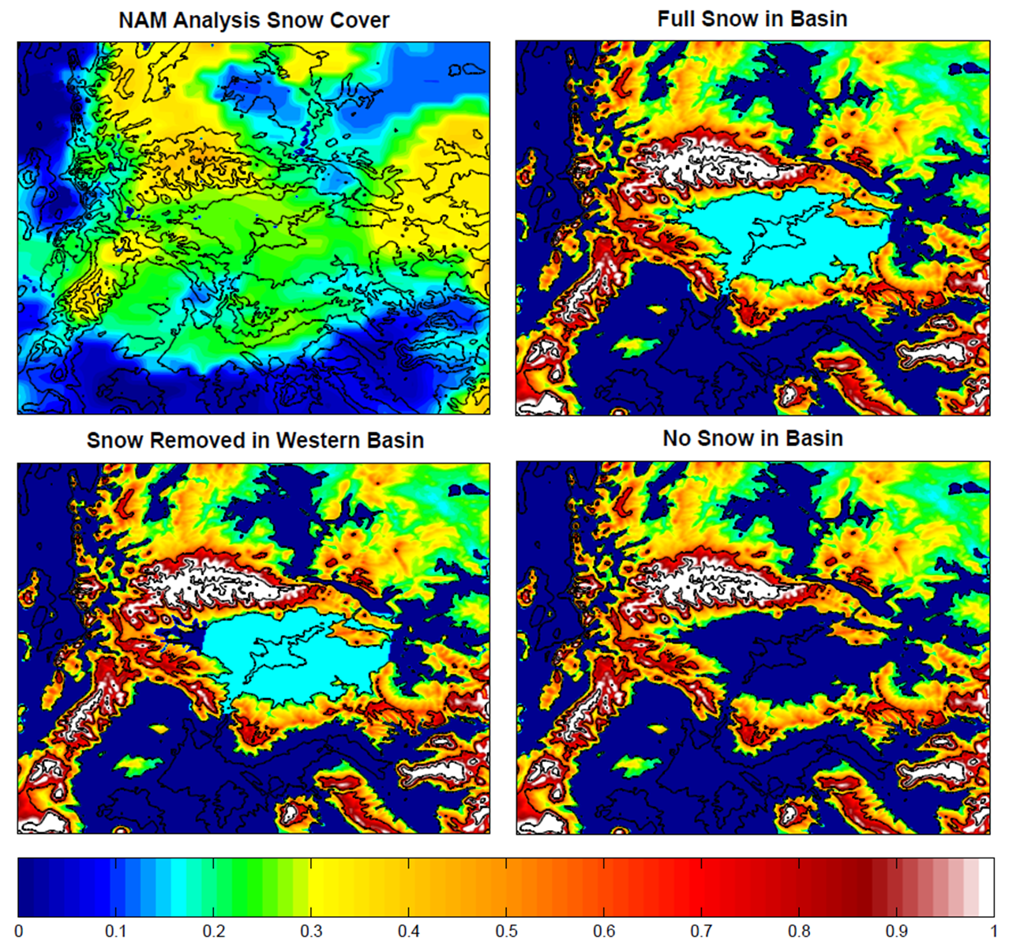
Idealized snow cover in Uintah Basin and mountains
00Z 1 Feb 2013
NAM overestimation inside Uintah Basin (22 to 28 cm)
Elevation-dependent snow cover above 2000 m (17 cm to 1 m above 2900 m)
Uniform snow in basin (17 cm depth, 21.25 kg/m³ SWE, 8:1 ratio)

Slide 8
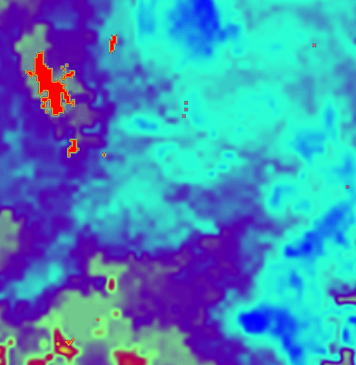
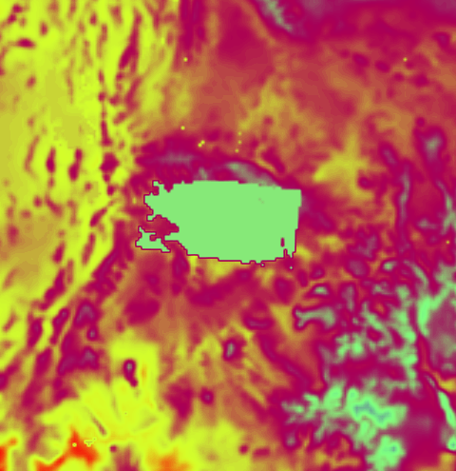
Initialized colder skin temperature in Uintah Basin
00Z 1 Feb 2013
NAM Analysis Skin Temperature
00Z 1 Feb 2013
Modified Skin Temperaure
262 K
267 to 268 K
Initialized skin temperature to 262 K in the basin (below 2000 m)

Slide 9
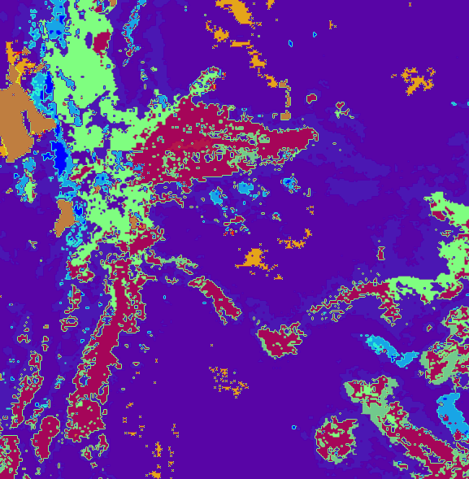
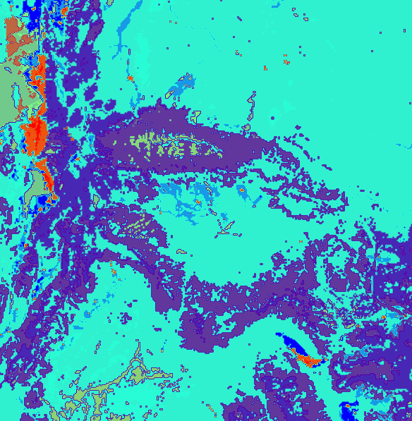
Updated Land Use data
Old USGS Land Use data
New NLCD 2006 data
More urban categories
Changes in Uintah Basin
Updated land use data to NLCD 2006 (1 arc-second)
Uintah Basin primary “shrubland” and “cropland/grassland mosaic”
“Barren or sparsely vegetated”, “grassland”, and “irrigated cropland & pasture” significantly decreased

Slide 10
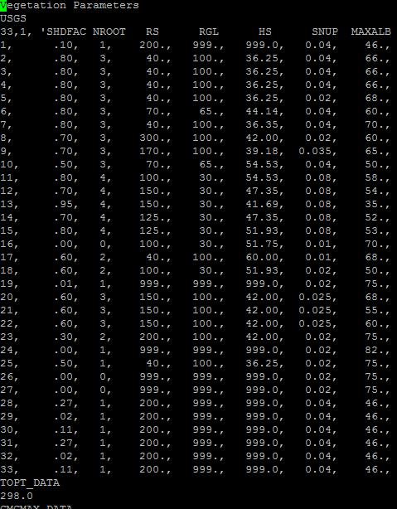
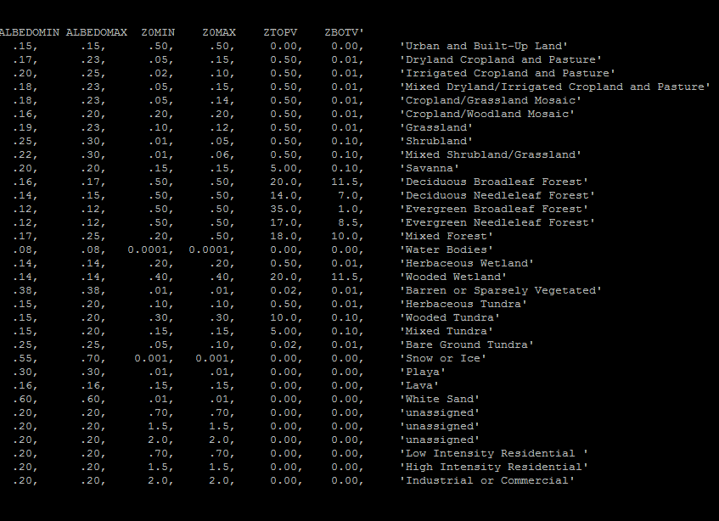
Modified VEGPARM.TBL
Changed from .04 to .02
Changed from .03 to .02
Modified VEGPARM.TBL “SNUP” to 0.02 for vegetation categories 5 & 8 (cropland/grassland mosaic & shrubland)
Allows 2 cm of SWE (20 kg/m³) to “cover up” vegetation with snow
Enables albedo to attain “max snow albedo”, instead of combination of snow albedo and vegetation albedo

Slide 11
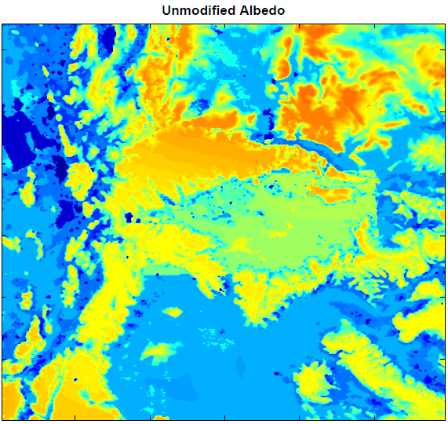
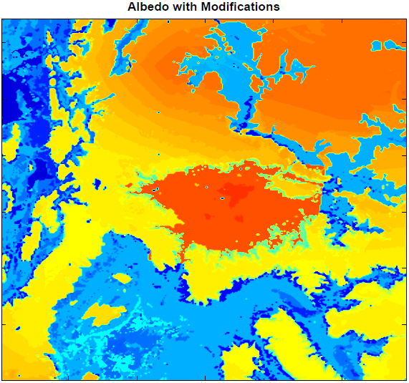
Snow Albedo changes
0.52 - 0.57 Average
0.8 - 0.82 Average
Combination of VEGPARM.TBL and snow albedo edits achieve desired albedos
Set snow albedo to 0.82 within the basin (below 2000 m)
Left snow albedo as default value outside the basin
Change in land use dataset accounts for differences outside the basin

Slide 12
Thompson Microphysics Scheme Modifications
Model vertical and horizontal structure reasonably well simulated
2-m temperatures too high because of excessive liquid-phase fog/stratus in what is observed to be an ice fog environment
Modifications to Thompson microphysics scheme were tested
3 types of solutions:
Liquid cloud (default): strong cloud downward LW radiation
Clear sky: very little cloud ice and negligible cloud LW radiation
Ice cloud: moderate downward cloud LW radiation
In lowest 15 model levels (~500 m):
Turn off cloud ice sedimentation: prevent cloud ice from falling out of cloud
Turn off cloud ice autoconversion to snow: prevent ice conversion into snow, which precipitates out of cloud

Slide 13
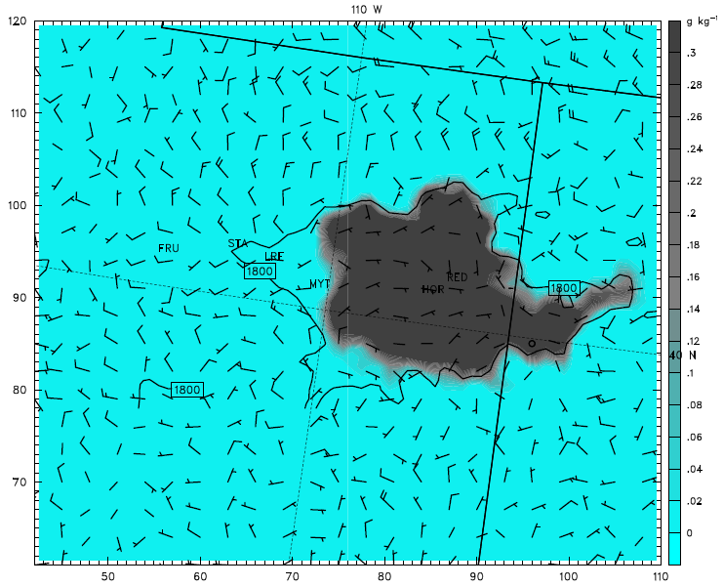
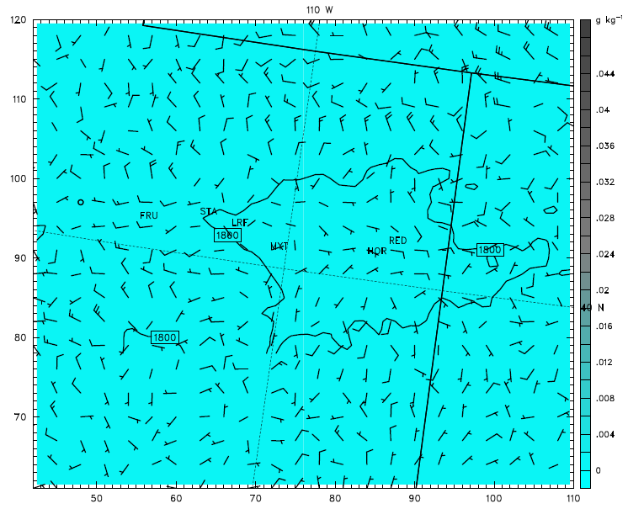
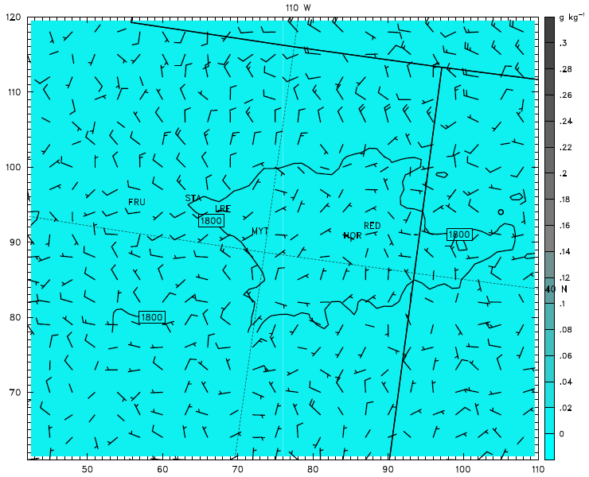
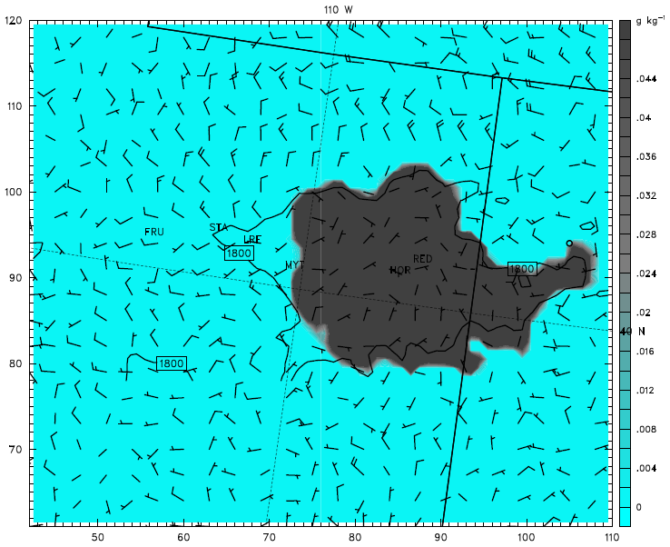
Sedimentation - Average cloud ice & cloud water bottom 10 levels
4 Feb 2013 06Z
Cloud Ice
Cloud Water
*Both runs have Autoconversion OFF
Ice sedimentation OFF
= Ice Cloud
Cloud Ice
Cloud Water
Ice Sedimentation ON
= Liquid Cloud

Slide 14
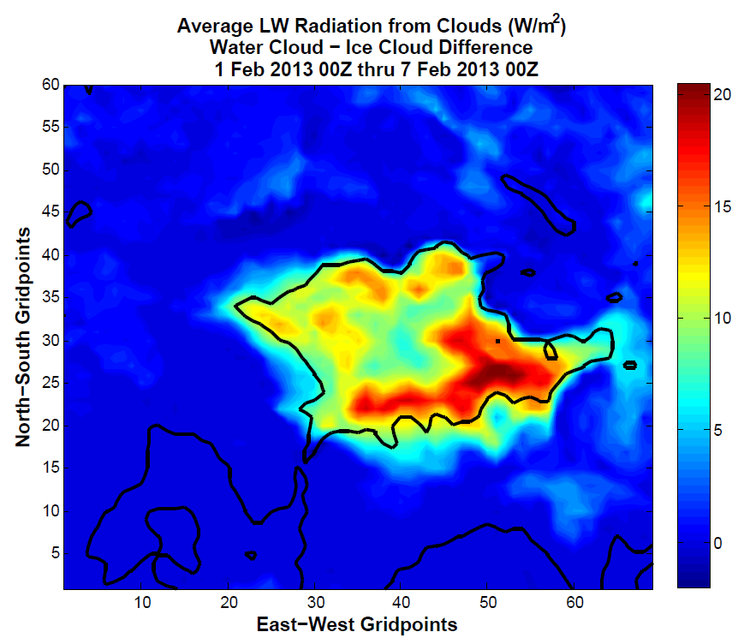
Impact of Liquid Clouds vs. Ice Clouds
Over the entire model run, liquid clouds produced an average of 7-20 W/m² more longwave energy than ice clouds in the Unitah Basin

Slide 15
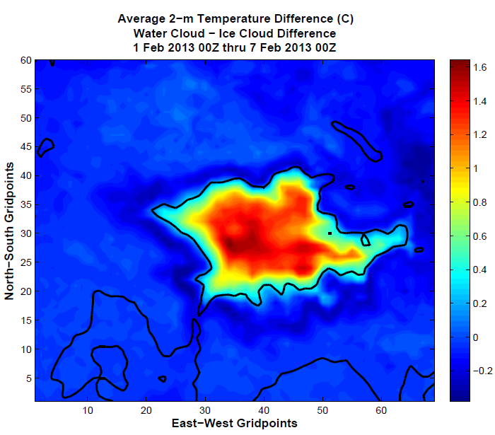
Impact of Liquid Clouds vs. Ice Clouds
Over the entire model run, liquid cloud case averaged 0.4 - 1.6 deg C warmer than the ice cloud case in the Uintah Basin

Slide 16
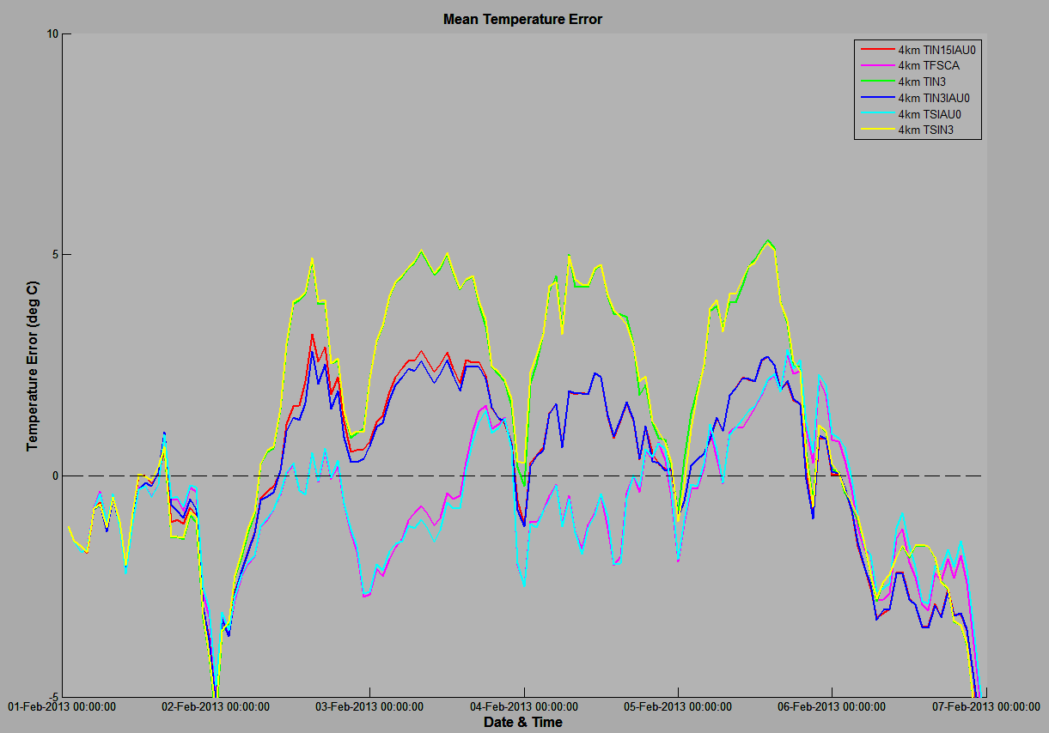
Primary Outcomes from Microphysics Testing
Model runs with “thick liquid clouds”
Model runs with “thick ice clouds”
Additional 2-3 deg C warm bias overnight
Model runs with “clear sky”

Slide 17
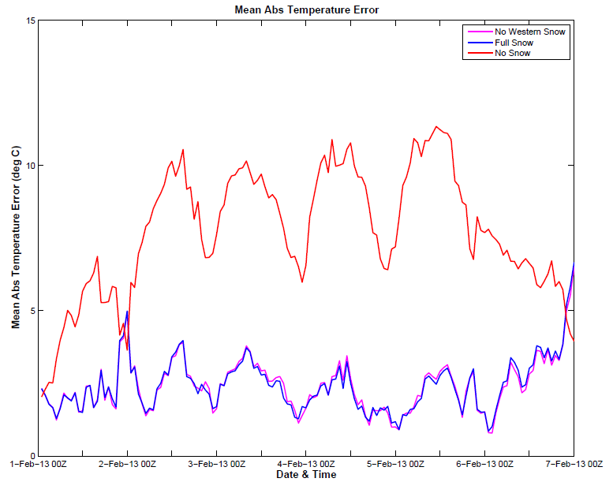
2m Temperature Errors for Primary Experiments
Model Run | Bias (deg C) | Mean Abs Error (deg C) | RMSE (deg C)
Original Thompson | 3.3858 | 3.8293 | 4.6104
Modified - Full Snow | 0.1134 | 2.4394 | 2.9837
Modified - No Western Snow | 0.2538 | 2.4417 | 2.9899
Modified - No Snow | 7.7146 | 7.7425 | 8.2922

Slide 18
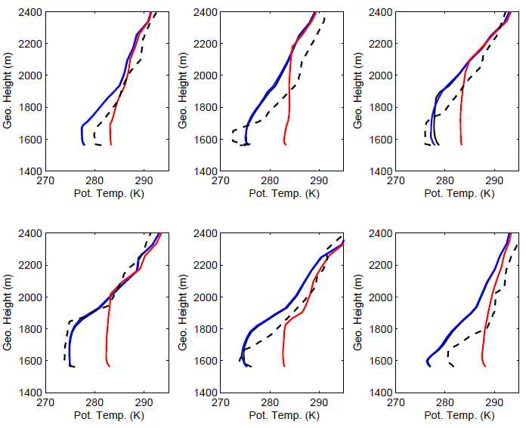
Vertical Structure
Roosevelt soundings at 18Z
Boundary layer depth and temperature generally well-captured
Stability within the inversion not quite strong enough
1 Feb
2 Feb
3 Feb
4 Feb
5 Feb
6 Feb

Slide 19
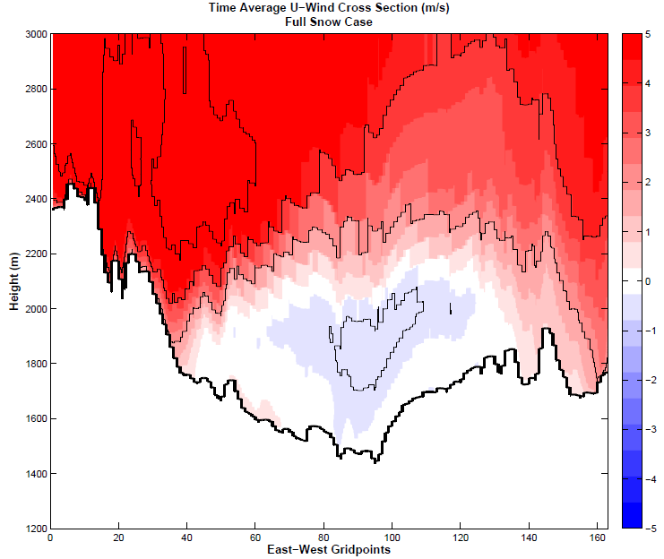
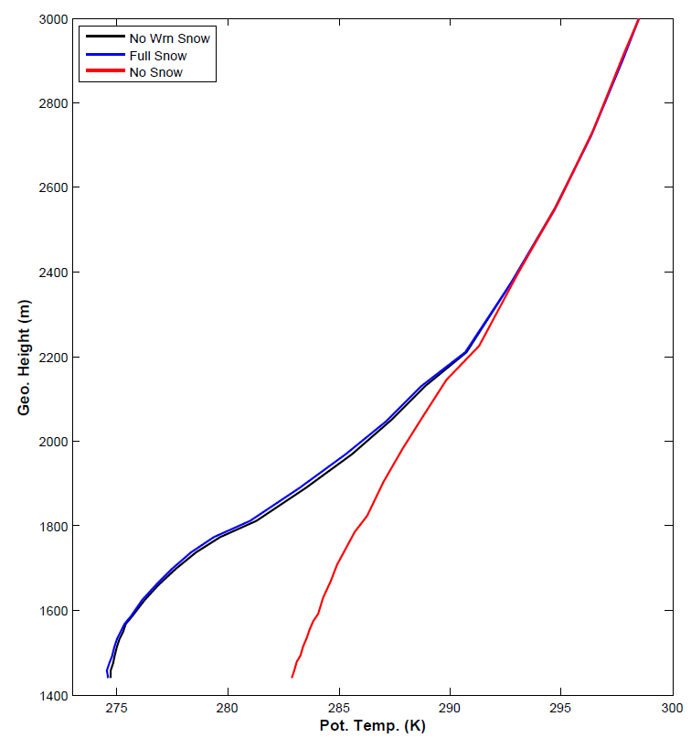
Uintah Basin Flow Patterns
Average Potential Temperature profile at Ouray
Average Zonal Wind - All Hours
Greatest Stability
Inversion/greatest stability typically between 1700 - 2100 m MSL
Weak easterly flow exists within and below inversion layer
Core greater than 0.5 m/s
Likely important role in pollutant transport within the basin

Slide 20
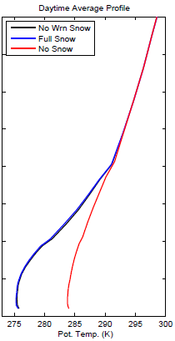
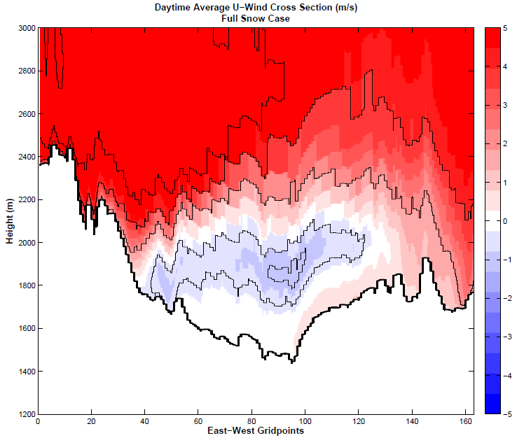
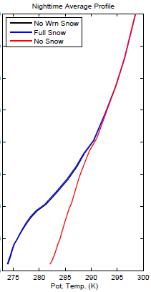
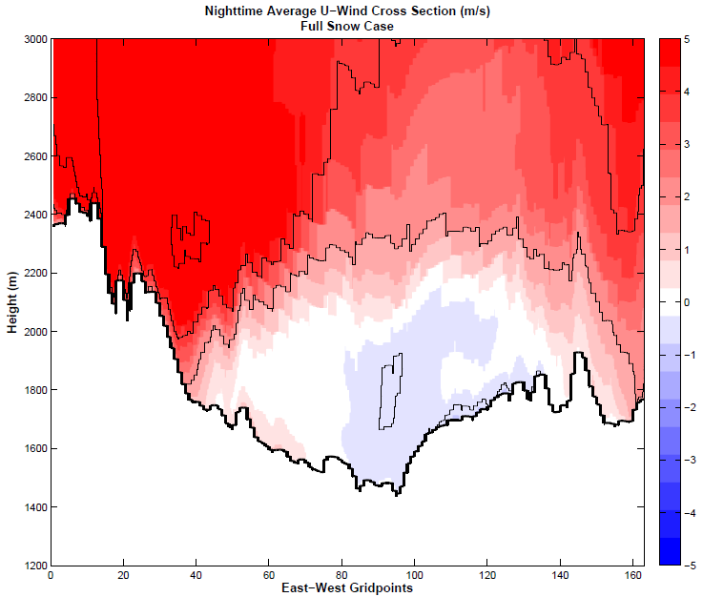
Uintah Basin Flow Patterns
Daytime Hours
0800L - 1600L
Nighttime Hours
1700L - 0700L
Inversion
Stable down to Surface
Weak “mixed” layer
Easterly flow stronger during the day, weaker during the night
Indicates thermal gradients likely the main driver
Core winds greater than 1 m/s during the day
Diurnal upslope/downslope flows also apparent in day/night plots

Slide 21
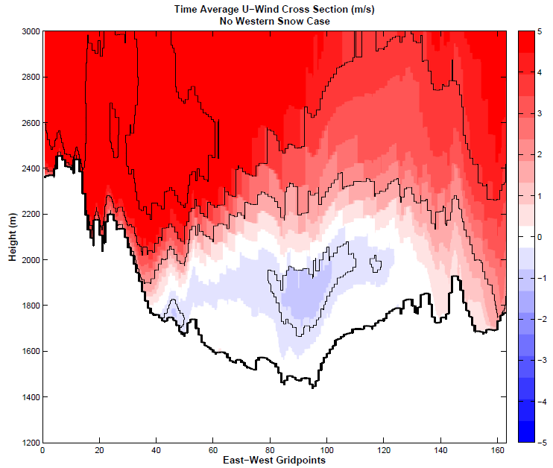
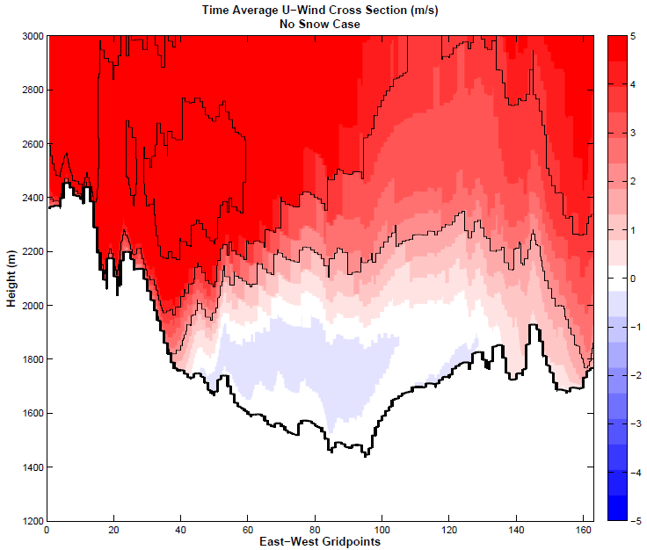
Uintah Basin Flow Patterns
Full Snow
No Western Snow
No Snow
Snow removed
Snow removed
Stronger easterly flow exists when snow is removed from the western portion of the basin
Particularly true near snowline at the surface
Easterly flow still present within the basin when snow cover is removed below 2000 m

Slide 22
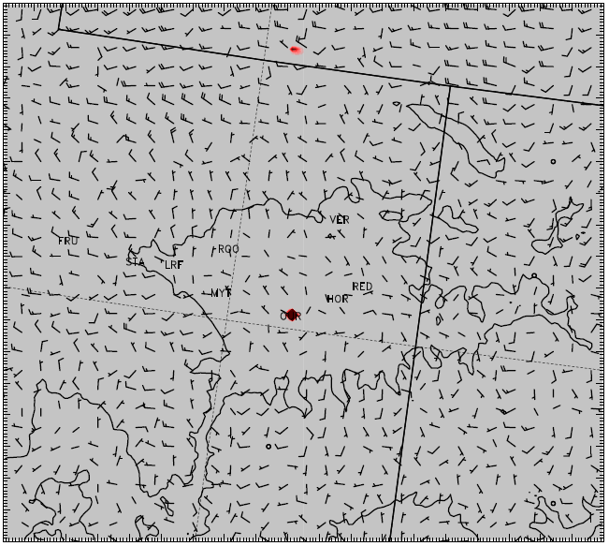
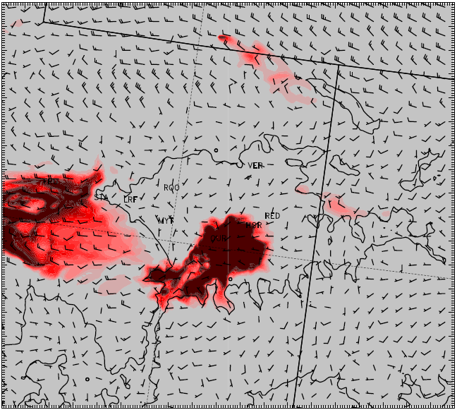
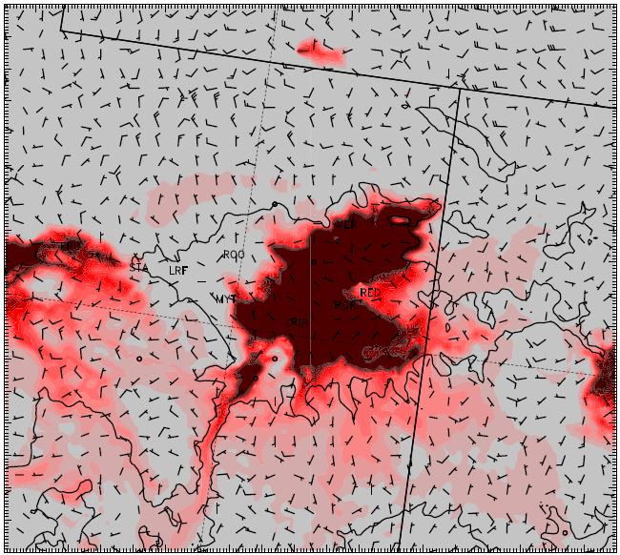
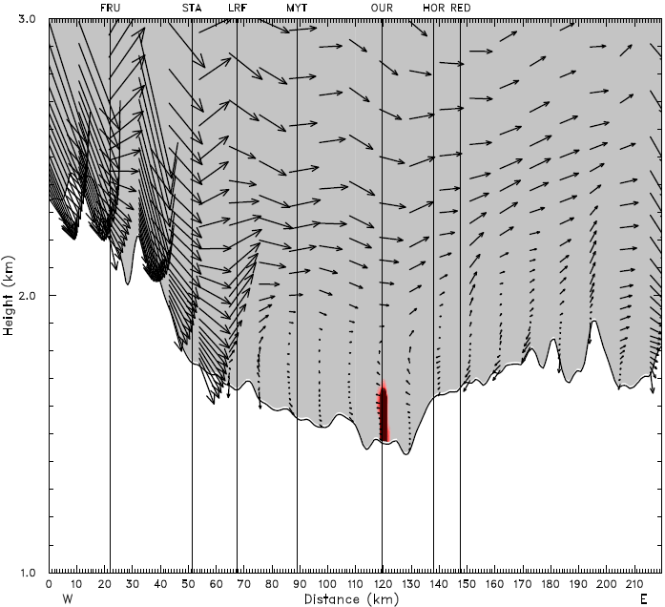
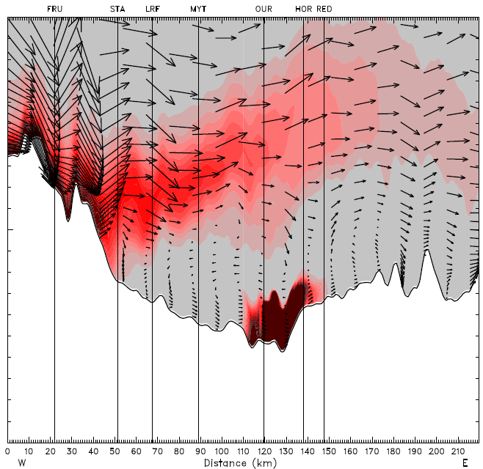
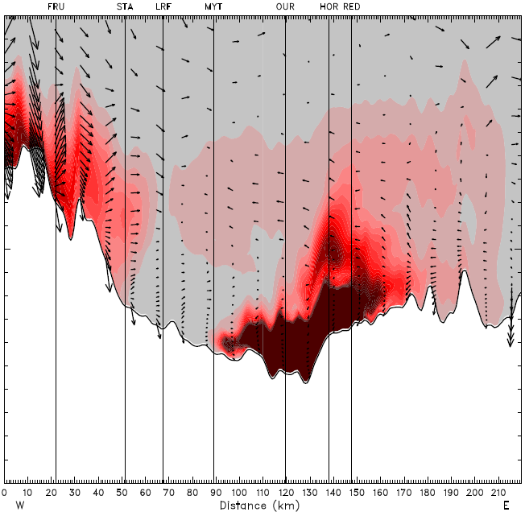
WRF 24-Hour Tracer Run - Full Snow
- Tracer released from Ouray at every time step in lowest 200 m
1 Feb 1200 UTC
1 Feb 2200 UTC
2 Feb 1200 UTC
* Average of bottom 10 model levels

Slide 23
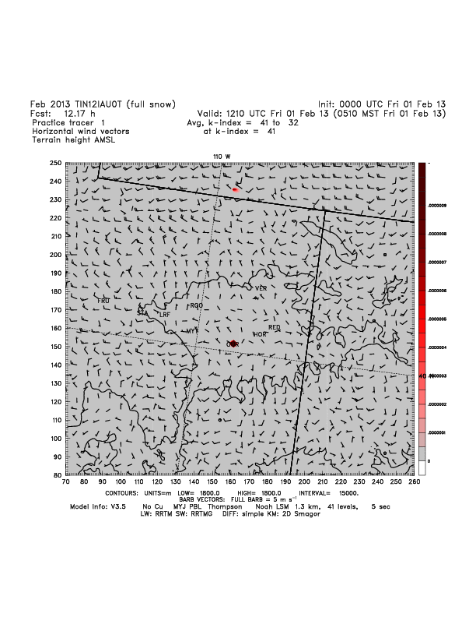
WRF 24-Hour Tracer Run - Full Snow
Animation for bottom 10 model levels

Slide 24
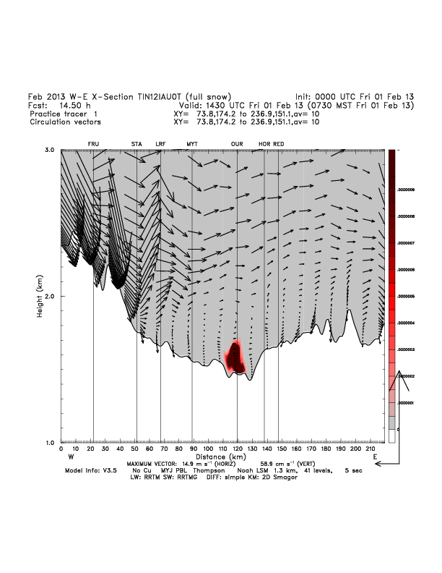
WRF 24-Hour Tracer Run - Full Snow
Cross Section Animation

Slide 25
Microphysics Conclusions
Preferred WRF run and edits (TIN12IAU0)
Include idealized snow cover, albedo, skin temperature, updated land use, and edited VEGPARM.TBL
Do not edit RH in NAM initialization/boundary condition files
Only make microphysics edits in lowest 15 model levels
Leave ice nucleation at default temperature of -12 C
Turn off autoconversion and sedimentation in bottom 15 model levels
Preferred setup results in:
Ice-phase clouds in place of original liquid-phase cloud
Colder surface temperatures with smaller errors/bias
More physically representative radiative properties of ice-phase cloud
Shallower PBL that more closely matches observed soundings

Slide 26
Reasoning for Microphysics Modifications
Several modification were made to Thompson microphysics schemes:
Changes to homogeneous freezing temperature (HGFR) from 235 to 271 K
Desired effect of changing liquid clouds to ice clouds
Changes to ice nucleation temperature from -12 to range of -3 to -15 C
Desired same effect as changing homogeneous freezing temperature, but more physically realistic
Turning off cloud ice sedimentation
Effort to prevent cloud ice from “falling out” of cloud
Turning off cloud ice autoconversion to snow
Effort to maintain cloud ice by preventing it’s conversion into snow category and precipitating out of cloud
Modifications were conducted in various combinations to determine impact on model simulations
In final tests, modifications were then only allowed in lowest 15 model levels (~500 m), while everything above was unchanged
Effort to create more realistic simulation by only changing low levels

