Slide 1
Reasoning for Microphysics Modifications
Several modification were made to Thompson microphysics schemes:
Changes to homogeneous freezing temperature (HGFR) from 235 to 271 K
Desired effect of changing liquid clouds to ice clouds
Changes to ice nucleation temperature from -12 to range of -3 to -15 C
Desired same effect as changing homogeneous freezing temperature, but more physically realistic
Turning off cloud ice sedimentation
Effort to prevent cloud ice from “falling out” of cloud
Turning off cloud ice autoconversion to snow
Effort to maintain cloud ice by preventing it’s conversion into snow category and precipitating out of cloud
Modifications were conducted in various combinations to determine impact on model simulations
In final tests, modifications were then only allowed in lowest 15 model levels (~500 m), while everything above was unchanged
Effort to create more realistic simulation by only changing low levels

Slide 2
General Results of Microphysics Modifications
Combination of edits seemed to converge on 3 solutions:
1 - “clear sky” solution with very little cloud ice and negligible LW radiation
Simulations where ice clouds were created and:
Ice autoconversion to snow was ON
Autoconversion OFF, but sedimentation of cloud ice ON
2 - “thick ice cloud” solution with moderate LW radiation
Simulations where ice clouds were created and:
Both autoconversion and sedimentation were OFF
3 - “thick liquid cloud” solution with strong LW radiation when:
No microphysics edits
Simulations where ice clouds were created via ice nucleation:
Either sedimentation or autoconversion was ON

Slide 3
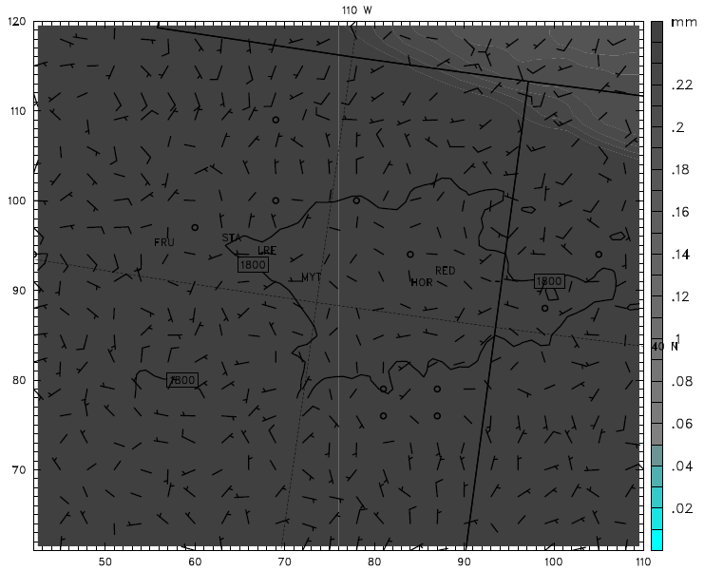
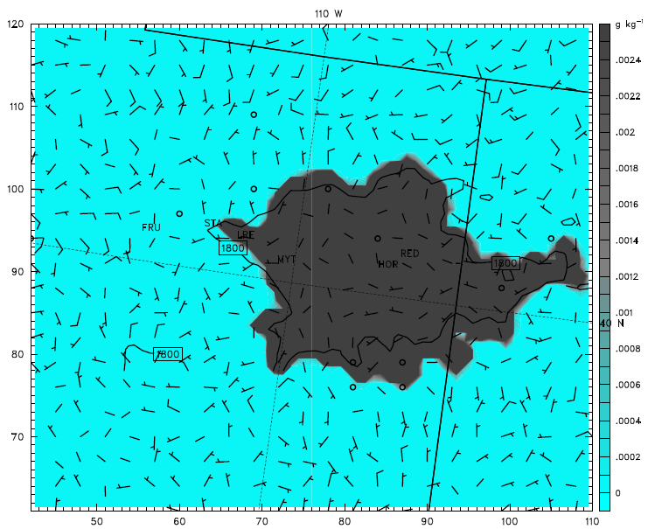
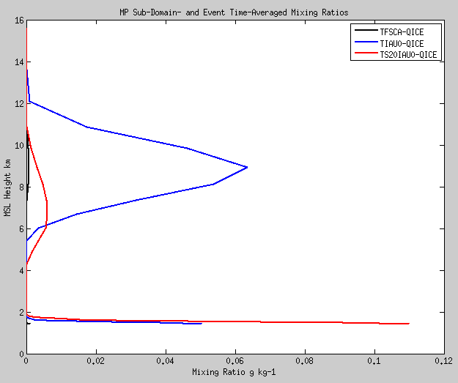
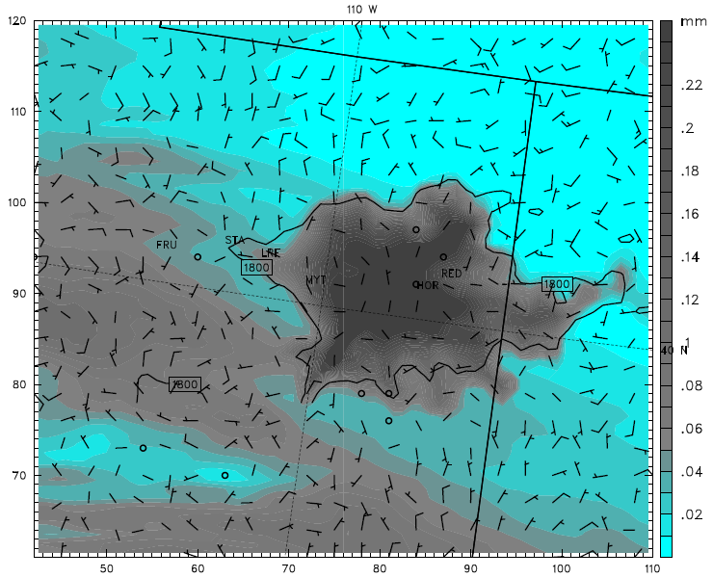
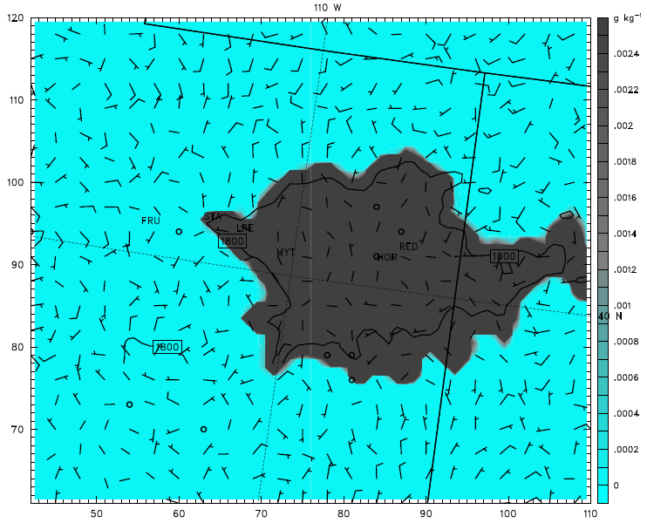
Microphysics Modifications - Cloud Ice sedimentation
Integrated Clouds
3 Feb 2013 09Z
Cloud Ice bottom 10 levels
No Sedimentation
Cloud Ice Profile
No Sedimentation
Sedimentation above 1 km
Sedimentation above 1 km

Slide 4
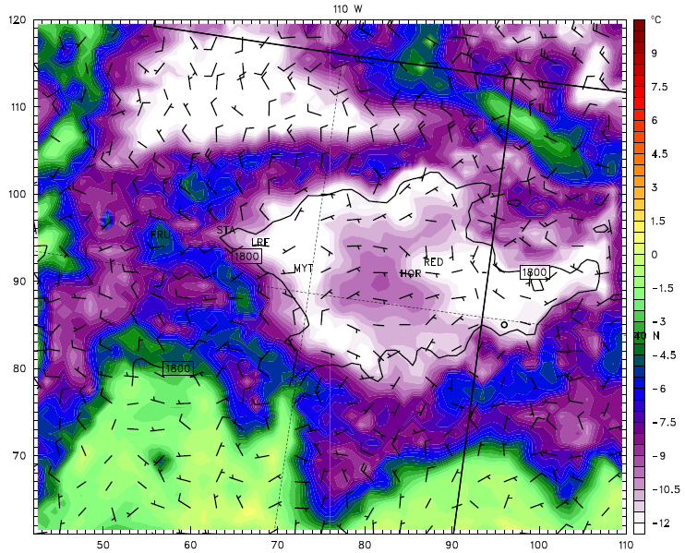
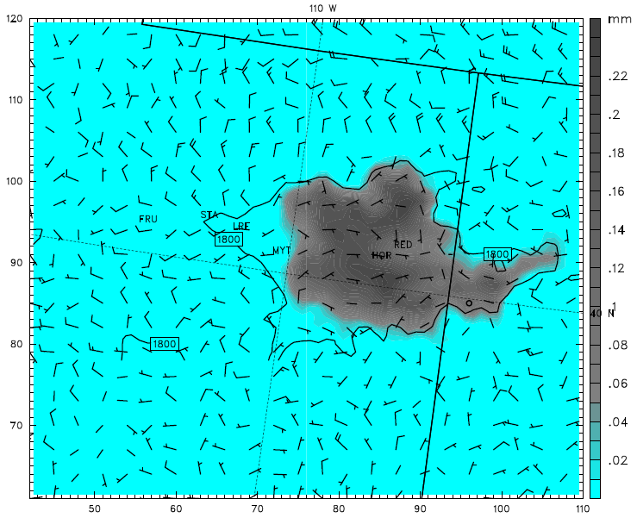
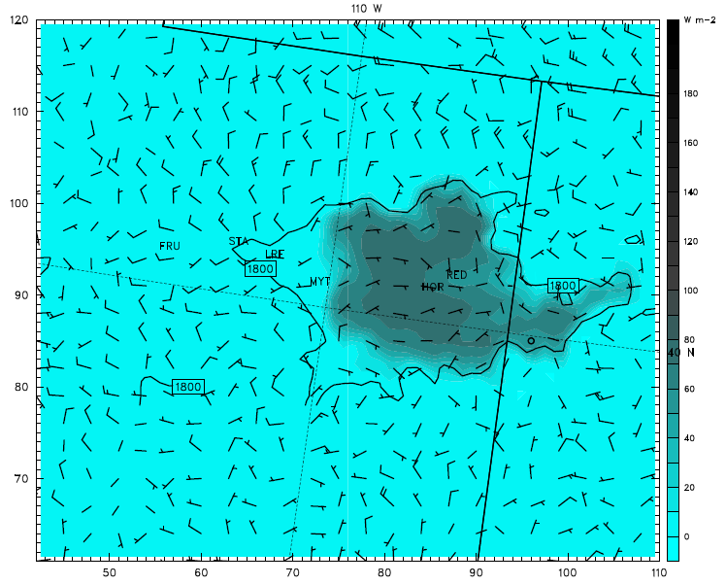
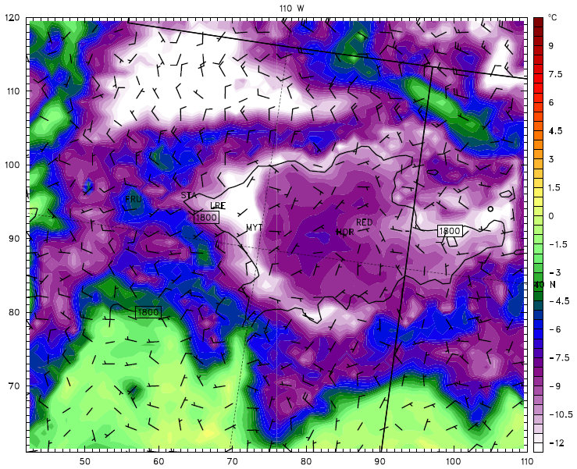
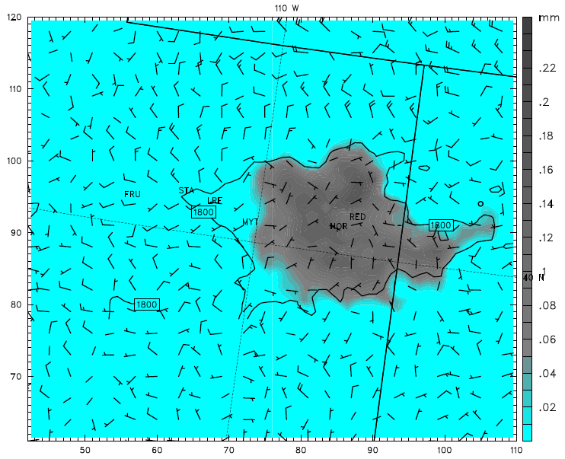
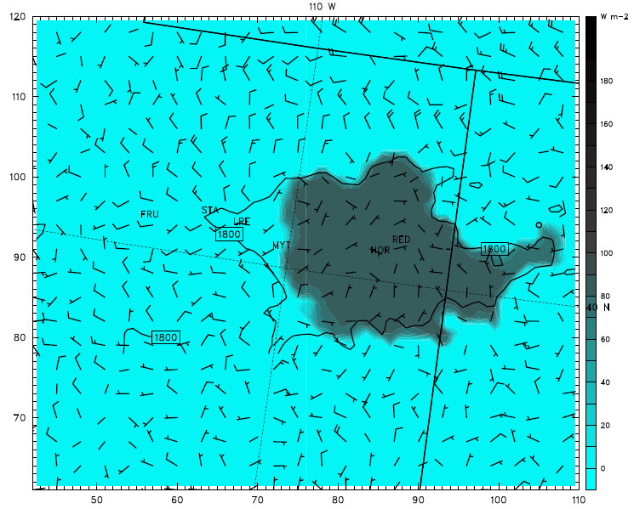
Effect of Sedimentation on 2m Temps, Clouds, LW Radiation
4 Feb 2013 06Z
2m Temps
Integrated Clouds
LW Radiation at sfc
Ice sedimentation OFF
Ice sedimentation ON
2m Temps
Integrated Clouds
LW Radiation at sfc

Slide 5
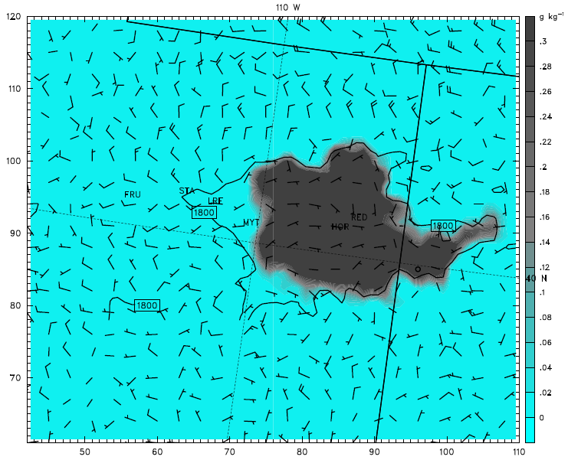
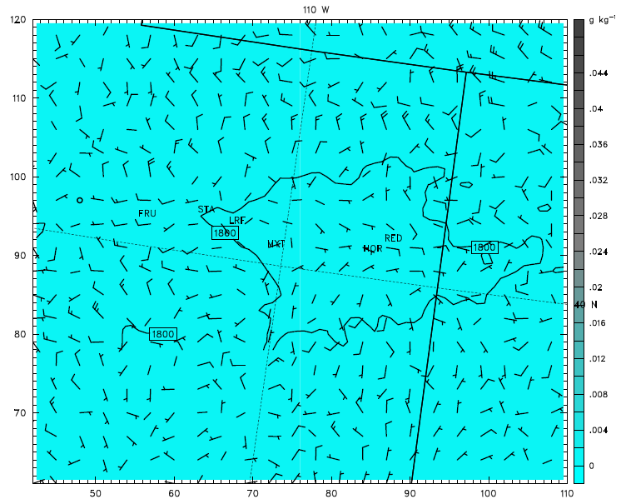
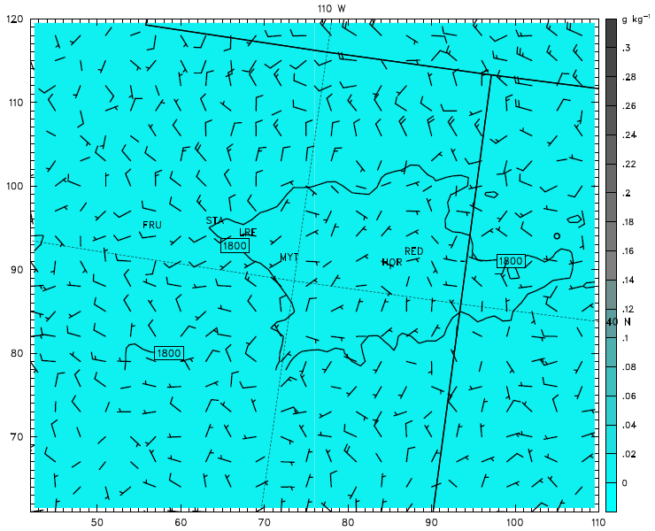
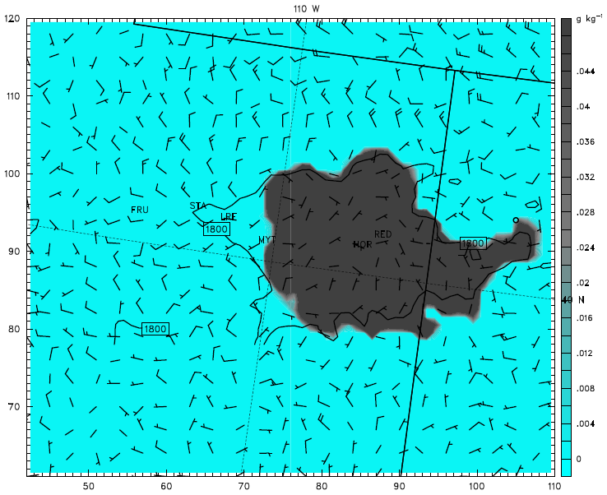
Sedimentation - Average cloud ice & cloud water bottom 10 levels
4 Feb 2013 06Z
Cloud Ice
Cloud Water
*Both runs have Autoconversion OFF
Ice sedimentation OFF
= Ice Cloud
Cloud Ice
Cloud Water
Ice Sedimentation ON
= Liquid Cloud

Slide 6
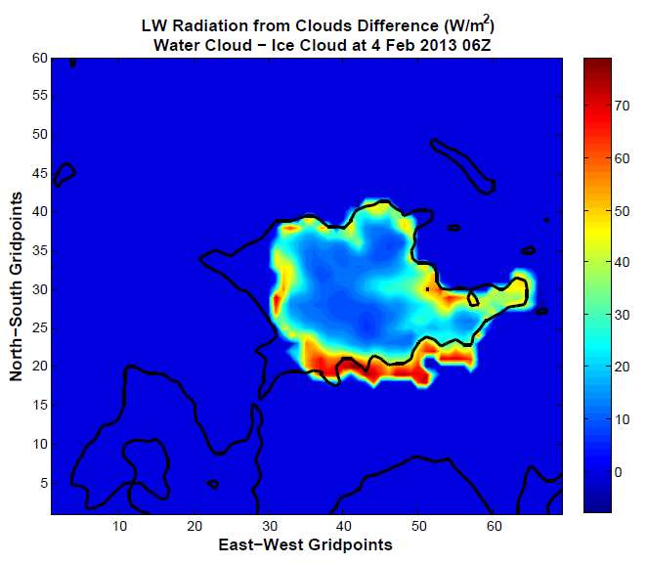
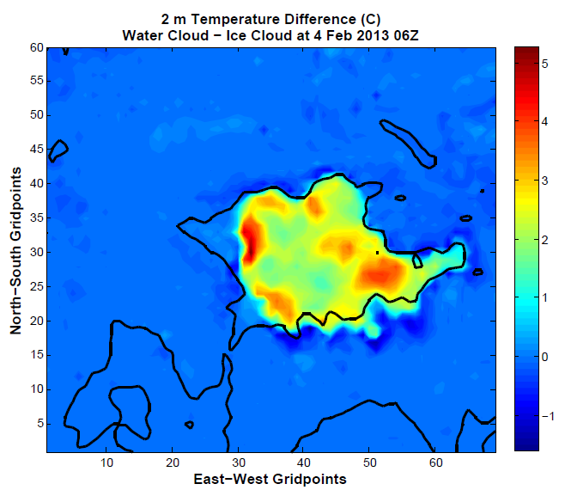
Impact of Liquid Clouds vs. Ice Clouds
4 Feb 2013 06Z
Liquid clouds in the Uintah Basin resulted in an additional 10-70 W/m² of Longwave radiation the surface on 4 Feb 2013 at 06Z
Additional energy kept surface temperatures warmer by 2-5 degrees C inside the Uintah Basin on 4 Feb 2013 at 06Z

Slide 7
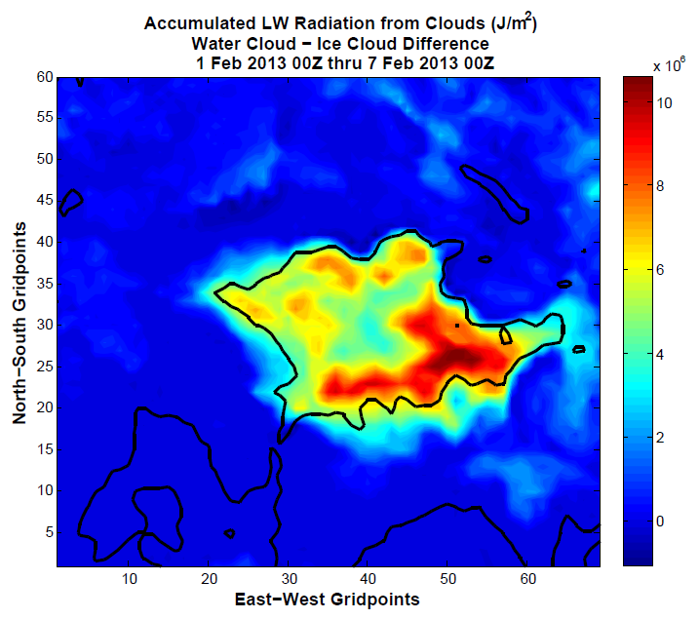
Impact of Liquid Clouds vs. Ice Clouds
Over the entire model run, liquid clouds produced 4-10 million J/m² more longwave energy than ice clouds

Slide 8
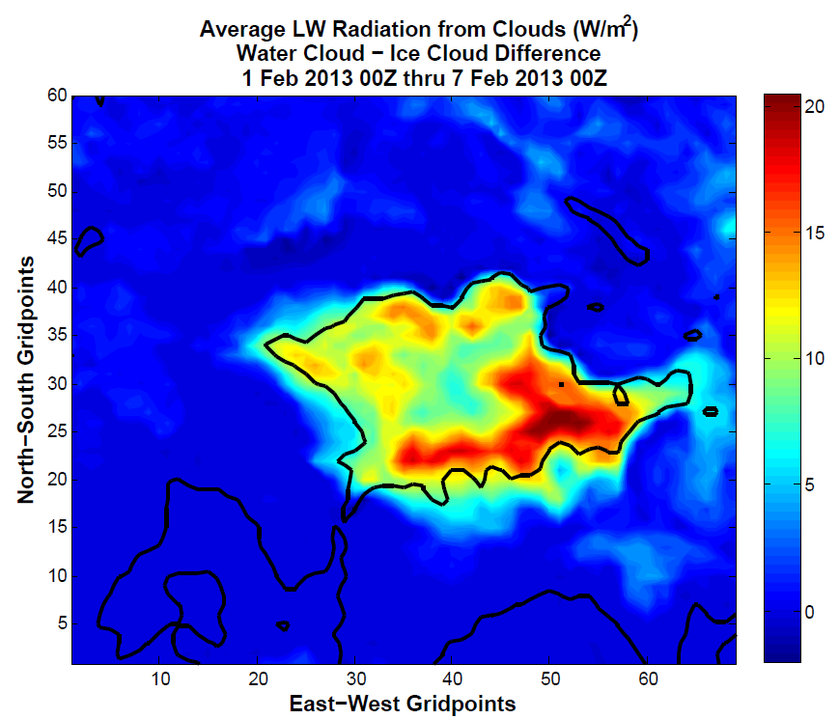
Impact of Liquid Clouds vs. Ice Clouds
Over the entire model run, liquid clouds produced an average of 7-20 W/m² more longwave energy than ice clouds in the Unitah Basin

Slide 9
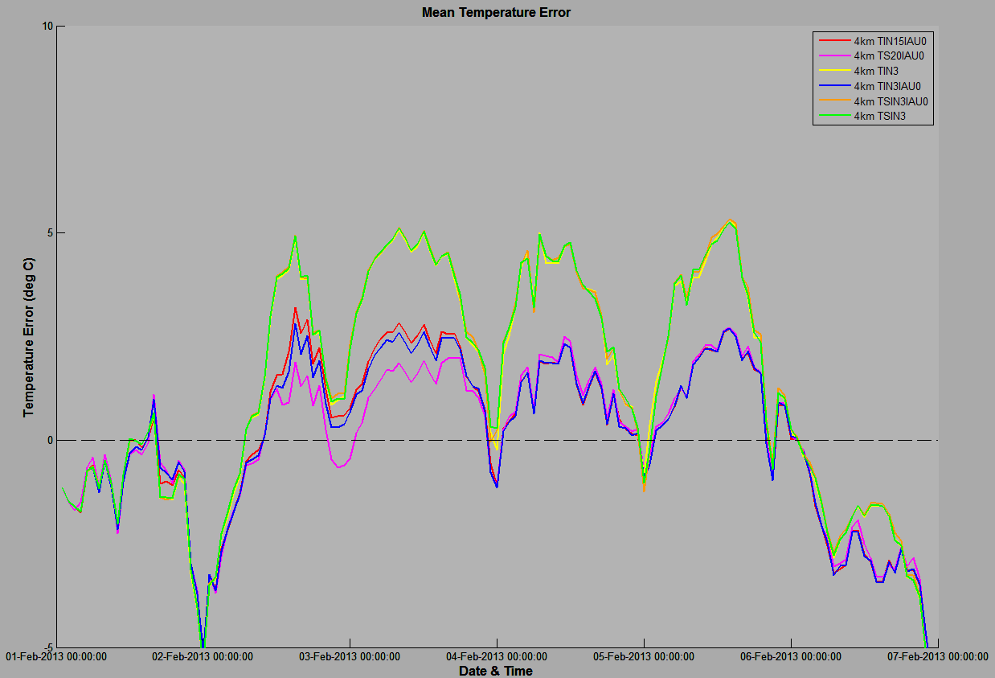
Uintah Basin CAP Simulation 1-6 Feb 2013
Model runs with “thick liquid clouds”
Additional 2-3 deg C warm bias overnight
Model runs with “thick ice clouds”

Slide 10
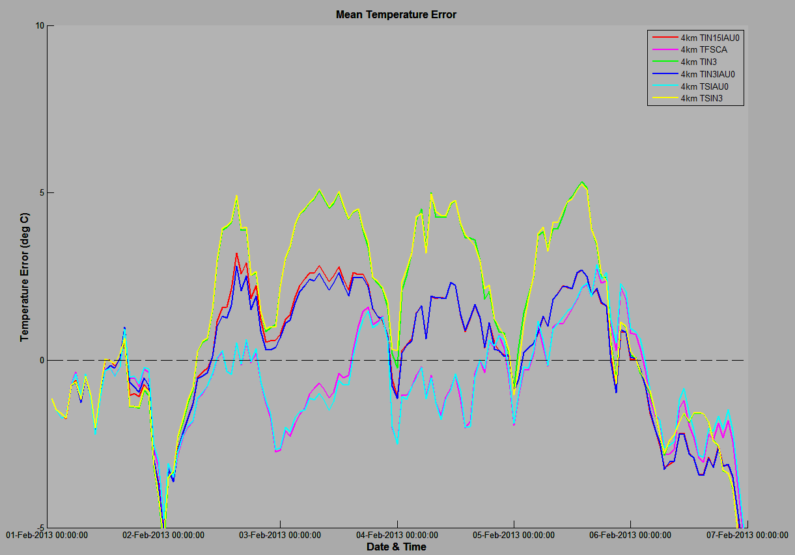
Uintah Basin CAP Simulation 1-6 Feb 2013
Model runs with “thick liquid clouds”
Model runs with “thick ice clouds”
Additional 2-3 deg C warm bias overnight
Model runs with “clear sky”

Slide 11
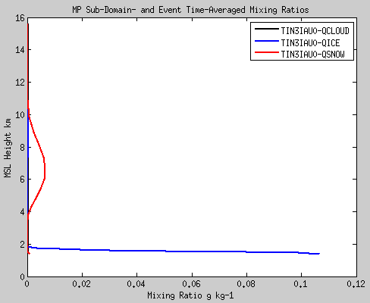
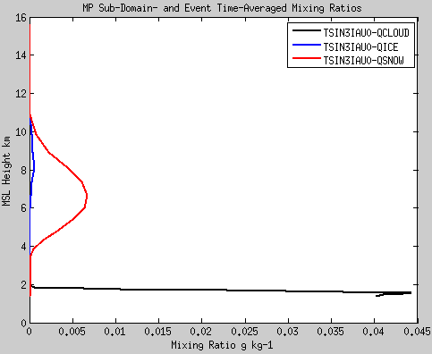
Uintah Basin CAP Simulation 1-6 Feb 2013
Distribution of cloud ice with and without sedimentation
Sedimentation OFF
Sedimentation ON
QSNOW 6.6x10⁻³
QICE 5.6x10⁻⁴
QICE 0.11 g/kg
QCLOUD 0.045 g/kg
Allowing cloud ice sedimentation in low levels resulted in a liquid-phase dominated cloud
Both cases had essentially identical results above 2-3 km

