Slide 1
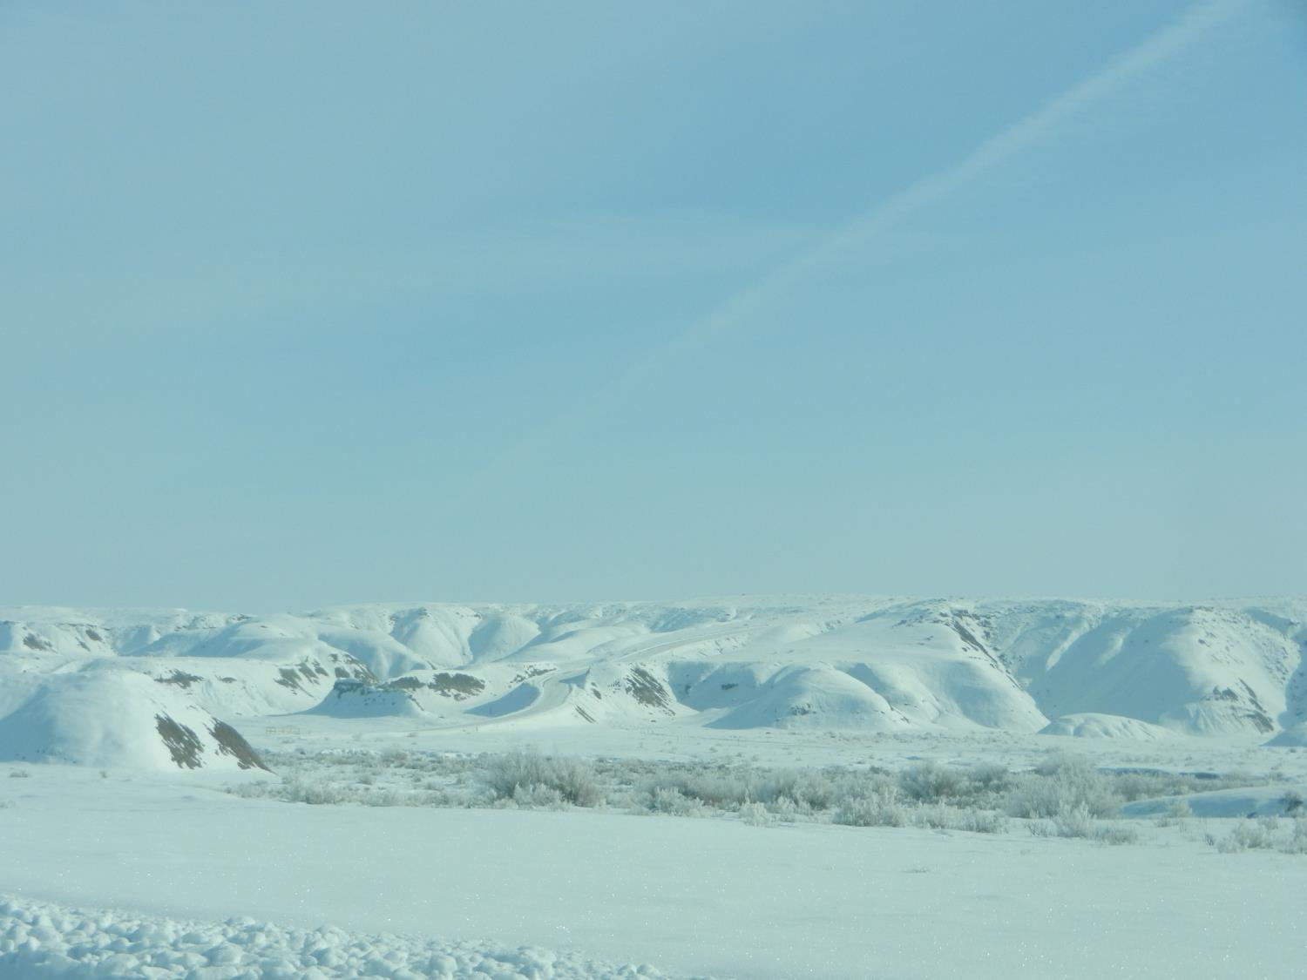
Numerical Simulations of Persistent Cold-Air Pools in the Uintah Basin, Utah
Erik M. Neemann, University of Utah
Erik T. Crosman, University of Utah
John D. Horel, University of Utah
94th AMS Annual Meeting - 4 Feb 2014
1

Slide 2
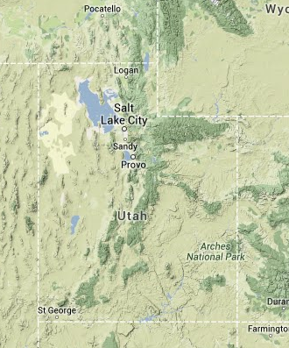
Overview
Uintah Basin Characteristics
Model Setup & Modifications
Boundary Layer Characteristics
Flow Patterns in the Basin
Impact of Spatial Snow Cover Variations
Uintah Basin

Slide 3
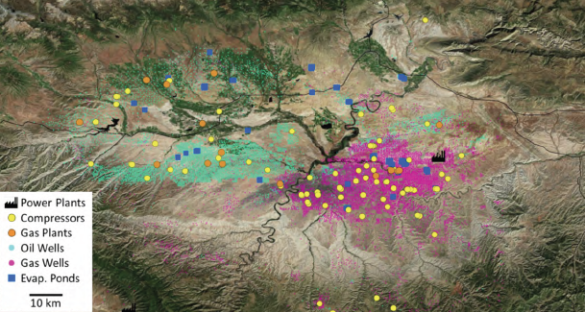
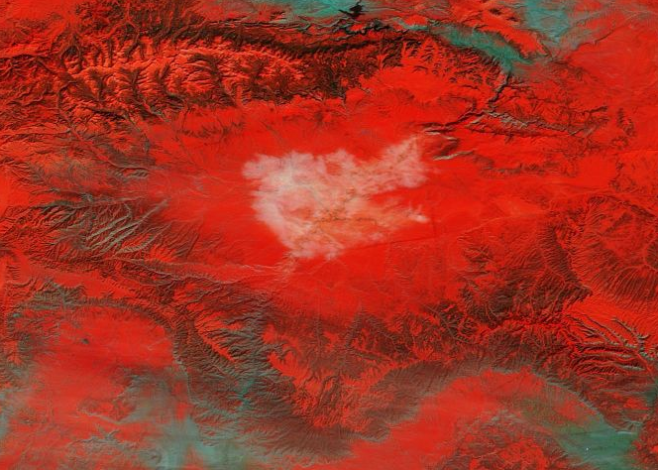
Uintah Basin
Large, deep bowl-like basin with mountains rising over 1000 m on all sides
Extensive oil & gas operations result in large pollutant emissions
NO_{x}
Z
VOCs
Snow Cover
θ
Pollution builds below inversion
MODIS 3-6-7 RGB Snow/Cloud Product
FINAL REPORT. 2012 UINTAH BASIN WINTER OZONE & AIR QUALITY STUDY
Presence of snow cover aids formation of strong cold-air pools (CAPs) below upper-level ridging
Stagnant conditions trap pollutants near surface, building concentrations
High-albedo snow enhances photolysis, leading to high ozone concentrations
Fog/Stratus
Snow Cover
Bare Ground
2 Feb 2013
Notes:
The Uintah Basin suffers from a wintertime ozone problem. Wintertime ozone issues in rural areas have come into the scientific crosshairs over the past 5-10 years, first in WY UGRB. They are really the result of 3 factors: Industry, Geography, and Meteorology. As you can see from the top image here, the UB has extensive industrial fossil fuel extraction in the form of oil & gas operations, which result in large pollutant emission into the lower atmosphere. The geography of the UB, as a large, deep, bowl restricts horizontal mixing and airmass exchange from outside the basin. And finally, meteorology contributes to stagnant conditions that further restrict mixing in the form of persistent CAPs. These CAPs inhibit vertical mixing due to the presence on strong stability and low level inversions. Turbulent mixing is further inhibited within the CAP by light winds. These factors combine to allow for building pollutant concentrations. The snow cover also results in large photolysis rates due solar radiation passing through the near atmospheric layer twice. This leads to ozone production thru photolysis and a significant health problem for the local population.

Slide 4
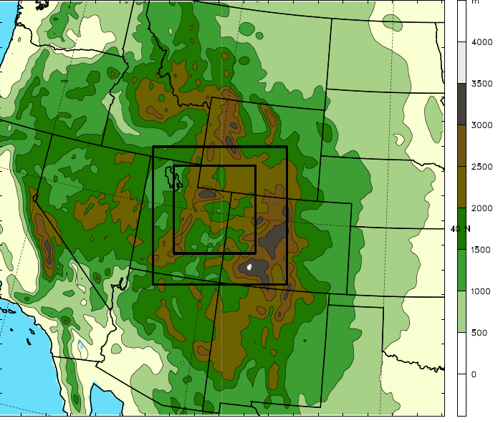
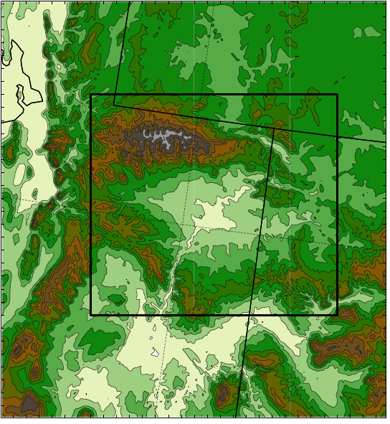
Model Setup & Domains
Outer Domain
WRF-ARW v3.5
- NAM analyses for initial & lateral BC
- 41 vertical levels
- Time step = 45, 15, 5 seconds
- 1 Feb 0000 UTC to 7 Feb 0000 UTC 2013
Inner Domain
WY
1.33 km
4 km
Subdomain
SLV
Uinta Mountains
12 km
Wasatch Range
Parameterizations:
- Microphysics: Thompson
- Radiation: RRTMG LW/SW
- Land Surface: NOAH
- Planetary Boundary Layer: MYJ
- Surface layer: Eta Similarity
- Cumulus: Kain-Fritsch (12 km domain)
- Landcover/Land use: NLCD 2006 (30 m)
Tavaputs
Plateau
Desolation Canyon
UT
CO

Slide 5
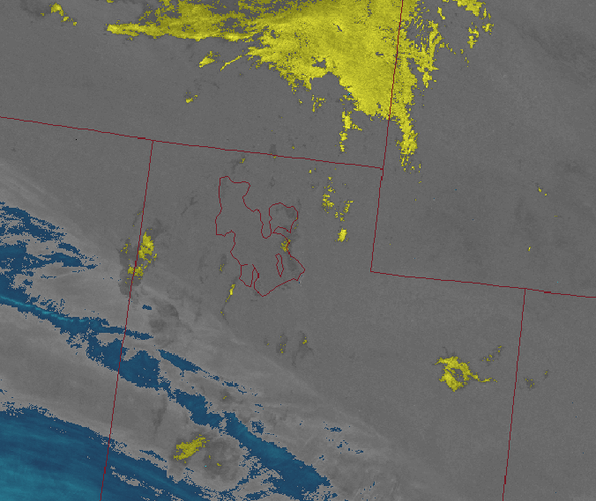
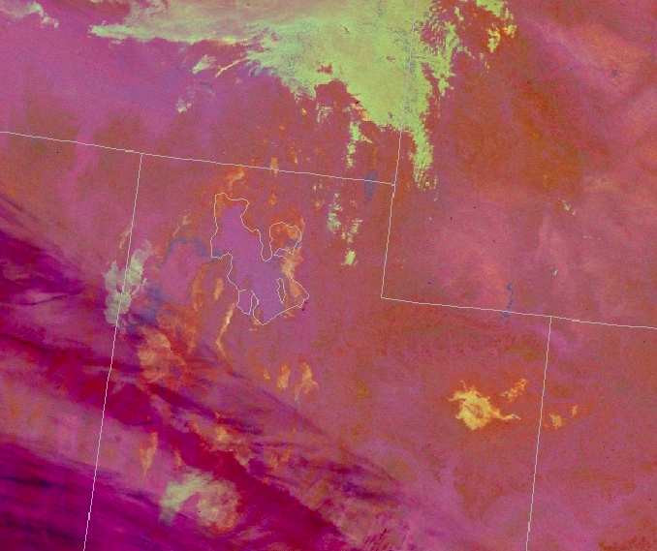
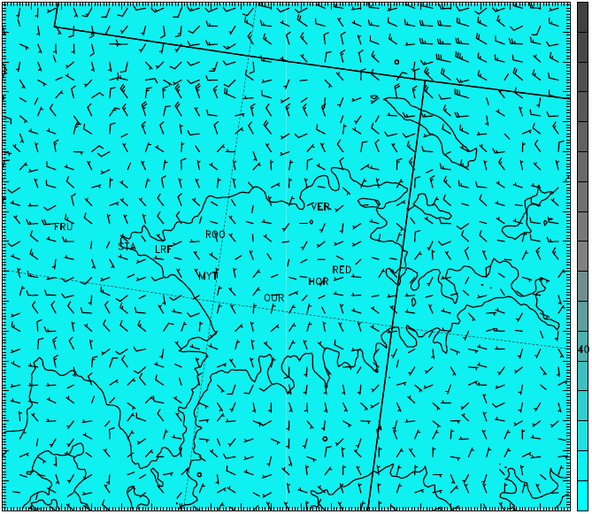
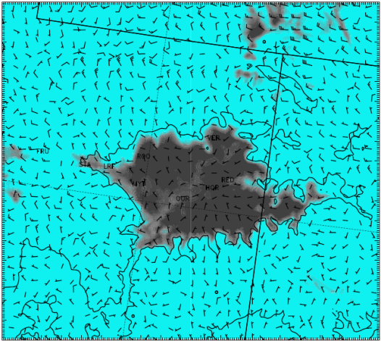
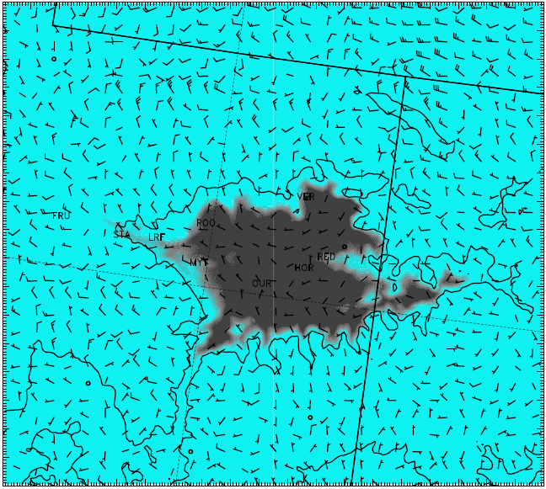
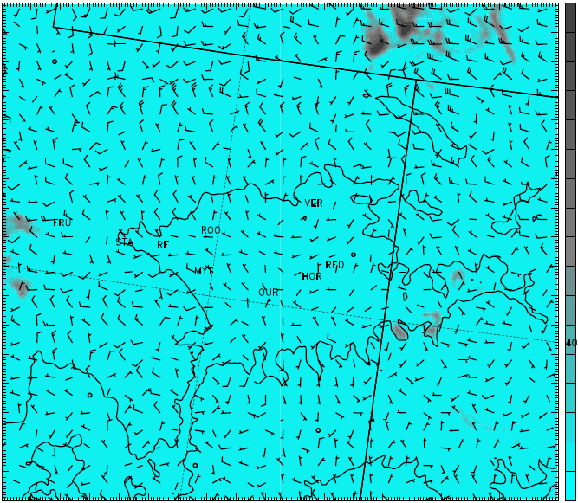
Summary of WRF Modifications
Idealized snow cover in Uintah Basin and mountains
Snow albedo changes
Edited VEGPARM.TBL
Microphysics modifications (Thompson) in lowest ~500m:
Turned off cloud ice sedimentation
Turned off cloud ice autoconversion to snow
→ Results in ice-phase dominated low clouds/fog vs. liquid-phase dominated
Allows model to achieve high albedos measured in basin
Sensitivity to Microphysics
Low stratus, fog
Before
After
Fog containing ice particles
Cloud Ice
Cloud Water
Cloud Ice
Cloud Water
VIIRS 11-3.9 Spectral Difference - 0931 UTC 2 Feb 2013
VIIRS Nighttime Microphysics - 0931 UTC 2 Feb 2013

Slide 6
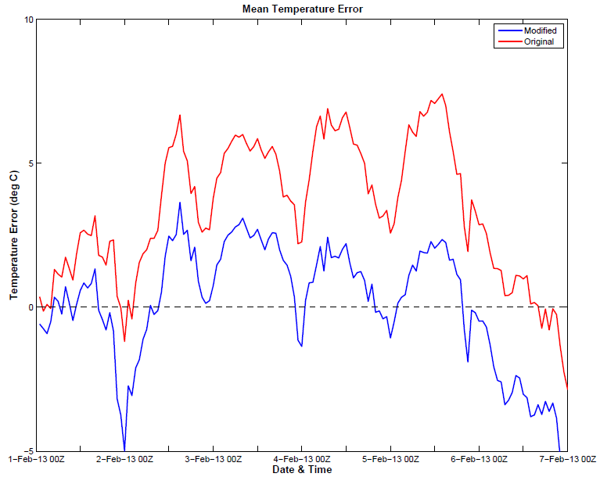
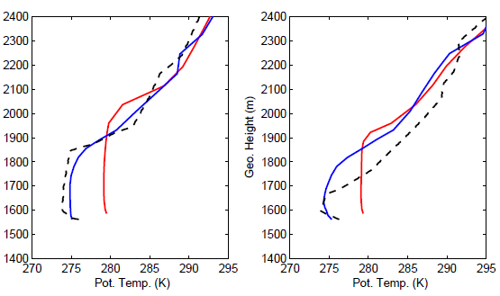
WRF Sensitivity to Modifications
2-m Temperature Bias
Roosevelt Potential Temperature profiles
Original
Modified
Original
Modified
Observed
4 Feb 2013
5 Feb 2013
Model Run | Bias (deg C) | Mean Abs Error (deg C) | RMSE (deg C)
Original Thompson | 3.3858 | 3.8293 | 4.6104
Modified - Full Snow | 0.1134 | 2.4394 | 2.9837

Slide 7
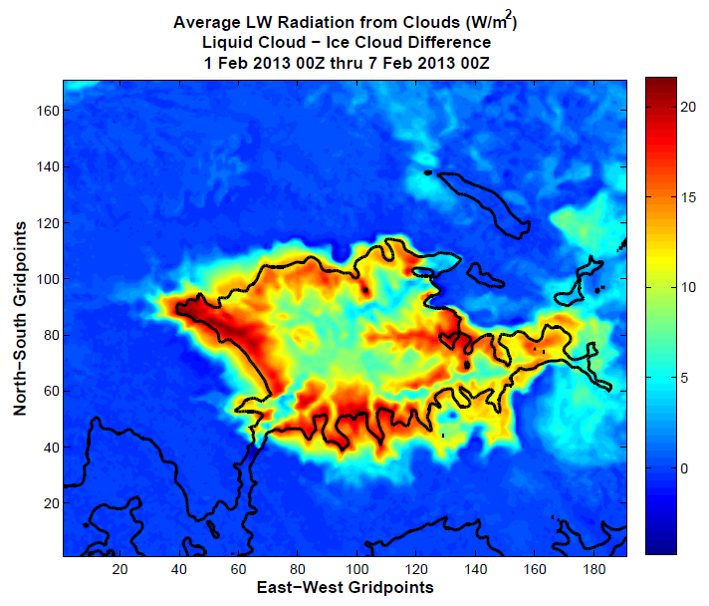
Impact of Liquid Clouds vs. Ice Clouds
Over the entire model run, liquid clouds produced an average of 7-20 W/m² more longwave energy than ice clouds in the Uintah Basin

Slide 8
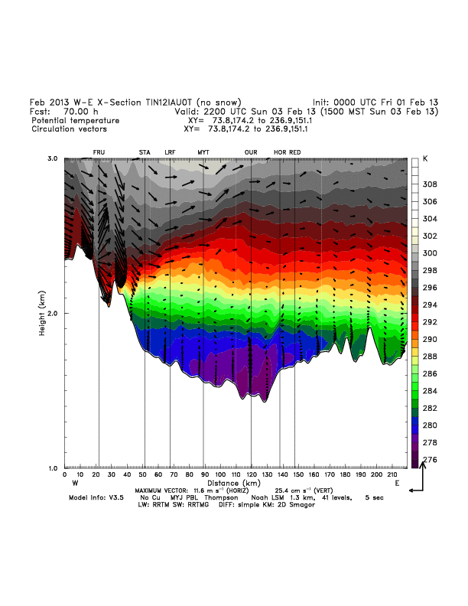
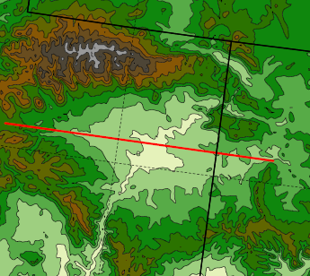
Simulated Cold Pool Evolution 3 Feb 22 UTC to 5 Feb 14 UTC

Slide 9
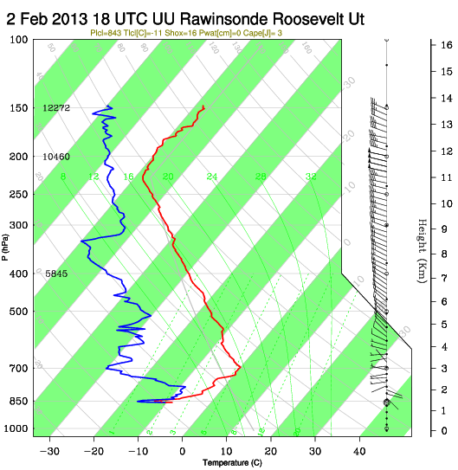
Uintah Basin Flow Patterns

Slide 10
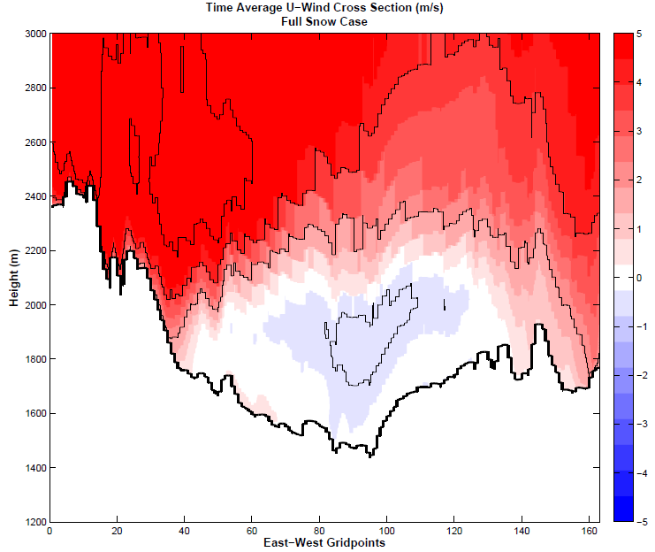
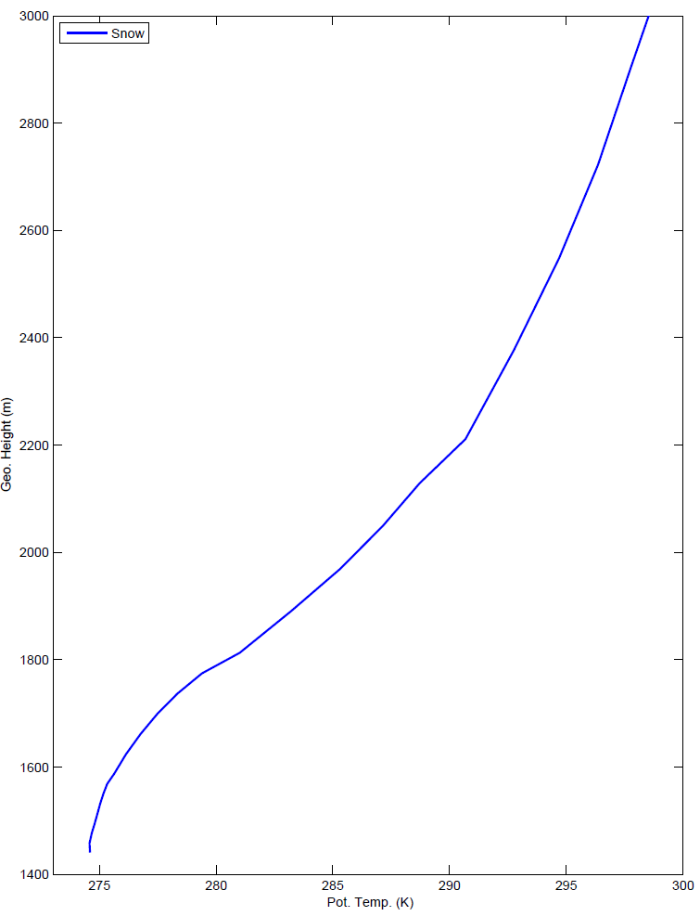
Uintah Basin Flow Patterns
Average Potential Temperature profile at Ouray
Average Zonal Wind - All Hours
Greatest Stability
Ouray
Inversion/greatest stability typically between 1700 - 2100 m MSL
Weak easterly flow exists within and below inversion layer
Core greater than 0.5 m/s
Likely important role in pollutant transport within the basin

Slide 11
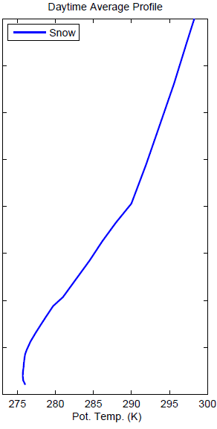
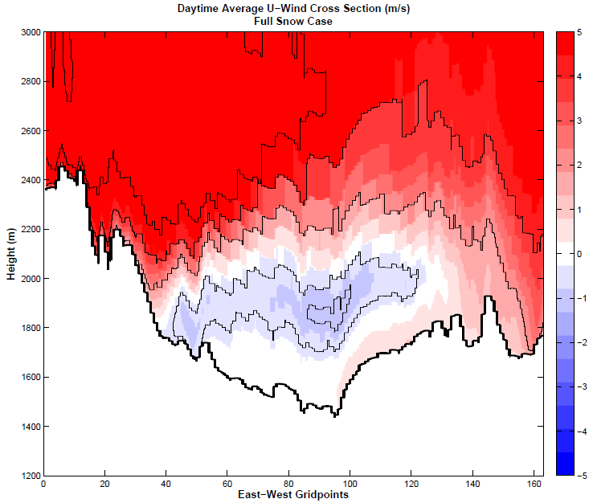
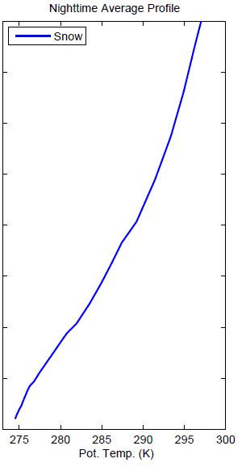
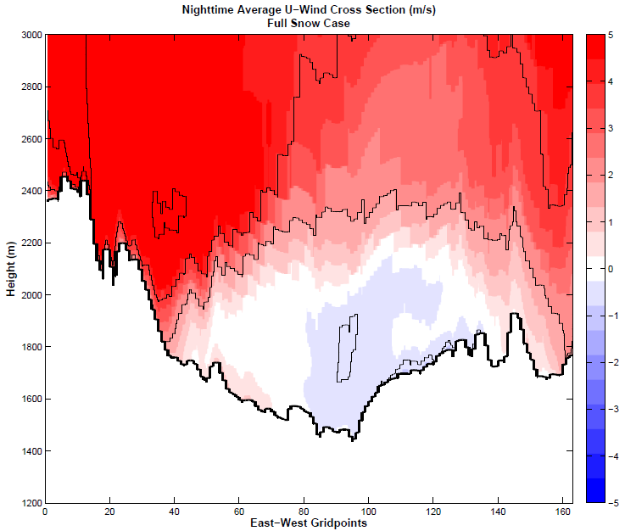
Uintah Basin Flow Patterns
Daytime Hours
0800L - 1600L
Nighttime Hours
1700L - 0700L
Inversion
Stable down to Surface
upslope
downslope
Weak “mixed” layer
Easterly flow stronger during the day, weaker during the night
Indicates thermal gradients likely the main driver
Core winds greater than 1 m/s during the day
Diurnal upslope/downslope flows also apparent in day/night plots

Slide 12
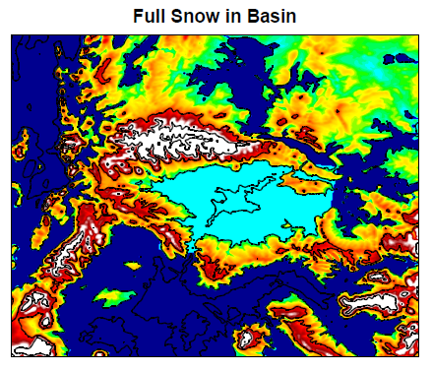
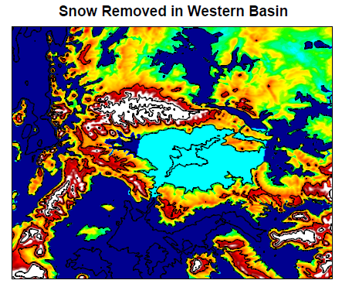
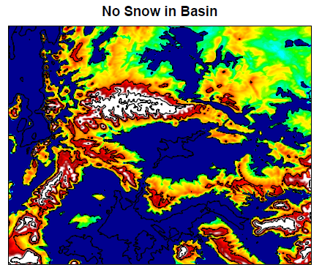
Idealized Snow Cover in Uintah Basin and mountains
Uniform snow on basin floor
17 cm depth, 21.25 kg/m³ SWE, 8:1 ratio
Elevation-dependent snow cover above 2000 m
17 cm to 1 m above 2900 m
Constructed to reflect observations inside basin and SNOTEL data in mountains
00Z 1 Feb 2013:
Simulation start time

Slide 13
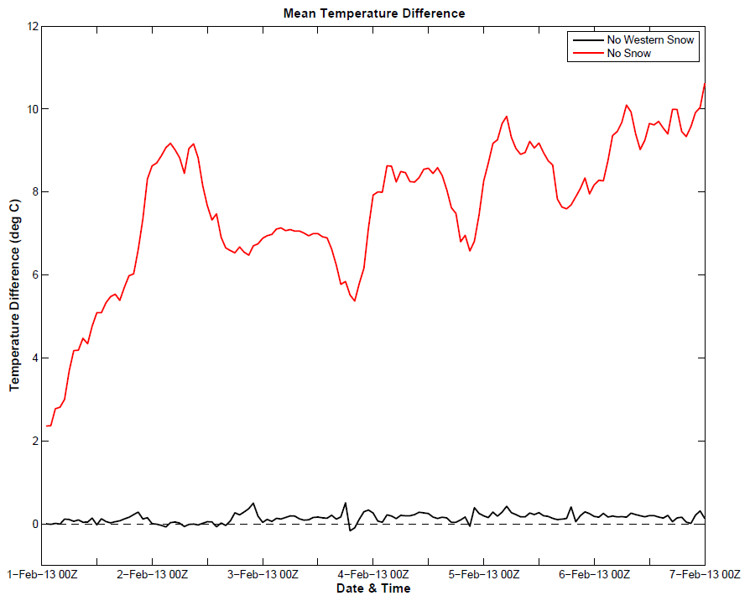
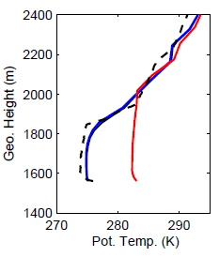
Sensitivity to Snow Cover Experiments
2-m Temperature:
Difference from Full Snow case
Potential Temperature Profile
UPDATE
No Snow
No Western Snow
No Snow
No Western Snow
Full Snow
Observed
4 Feb 2013
Model Run | Difference (deg C) | Mean Abs Diff (deg C) | RMSD(deg C)
No Western Snow | 0.1404 | 0.2097 | 0.2835
No Snow | 7.6012 | 7.6012 | 7.8506

Slide 14
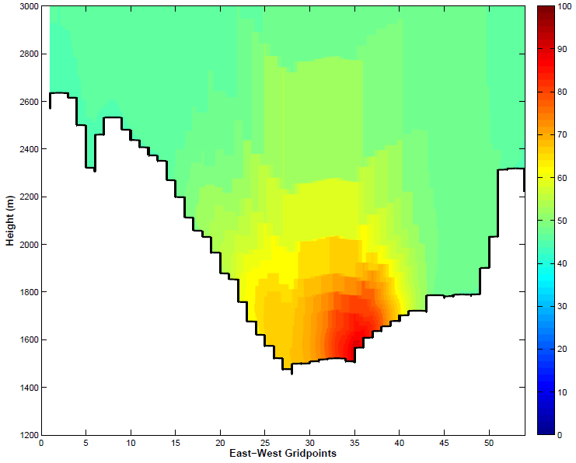
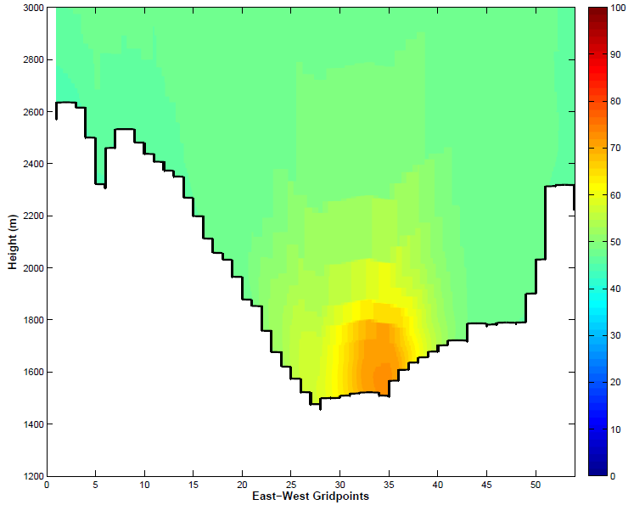
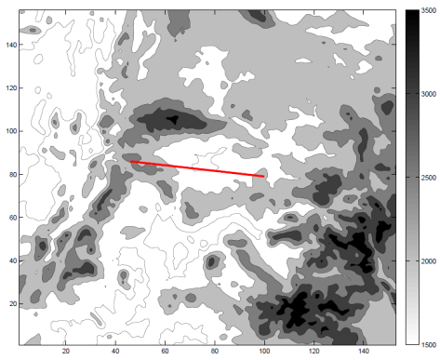
Mean Afternoon Ozone Concentration
1 - 6 Feb 2013
1800 - 0000 UTC
Snow
CMAQ output provided by Lance Avey at UTDAQ
No Snow
4km WRF output run through Utah DAQ’s air quality model (CMAQ)
Modified WRF produced ozone concentrations up to 129 pbbv
Average decrease of ~ 25 ppbv when snow removed from basin floor
Highest concentrations confined to lowest 200-300 m in stable PBL/inversion, as observed during UBOS 2013
No Snow run contains much lower ozone and deeper PBL

Slide 15
Questions?

Slide 17
WRF v3.5 Setup
See Alcott and Steenburgh 2013 for further details on most aspects of this numerical configuration:
http://journals.ametsoc.org/doi/abs/10.1175/MWR-D-12-00328.1
Overview summary of WRF Namelist options:
map_proj= 1: Lambert Conformal
NAM analyses provide initial cold start, land-surface conditions, & lateral boundary conditions
Idealized snow cover as function of height input to replace poor NOHRSC snow
3 Domains with 12, 4, 1.33 km horizontal resolution (see next slide)
Number of vertical levels = 41
Time step = 45 seconds (15, 5 s for inner 2 grids)
Microphysics: Thompson scheme
Radiation: RRTMG longwave, RRTMG shortwave
Surface layer: Monin-Obukov
Land Surface: NOAH
Planetary Boundary Layer: MYJ
Kain-Fritsch cumulus scheme in outer coarse 12 km grid
Slope effects for radiation, topographic shading turned on
2nd order diffusion on coordinate surfaces
Horizontal Smagorinsky first-order closure for eddy coefficient
Landcover/Land use: National Land Cover Database (NLCD) 2006 1 arc-second (30 m)
Terrain Data: U.S. Geological Survey 3 arc-second (90 m)

Slide 18
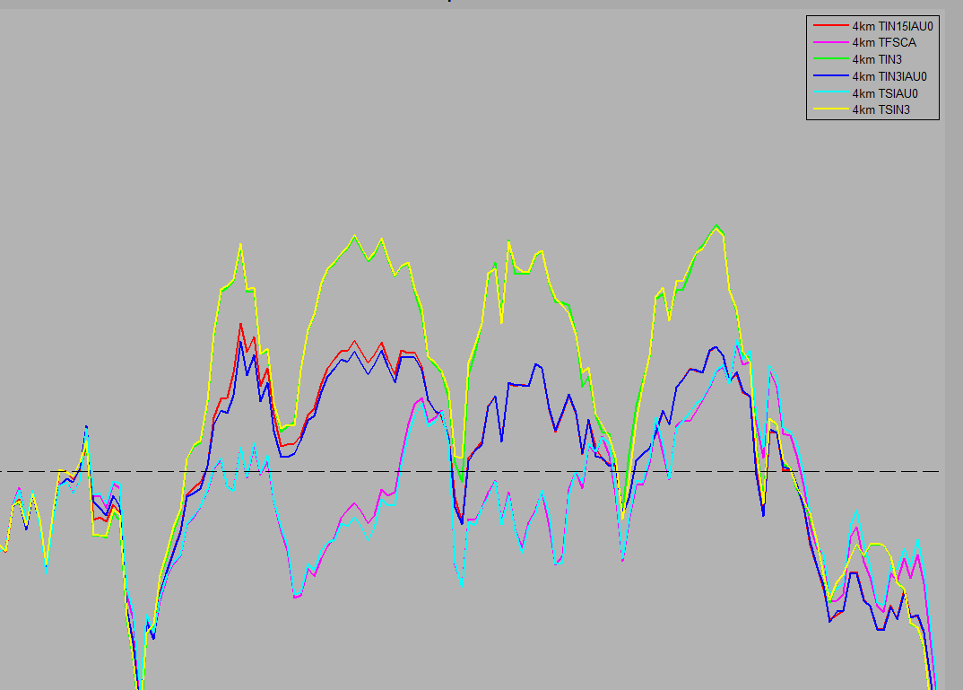
Primary Outcomes from Microphysics Testing
Model runs with “thick liquid clouds”
Model runs with “thick ice clouds”
Additional 2-3 deg C warm bias overnight
Model runs with “clear sky”

Slide 19
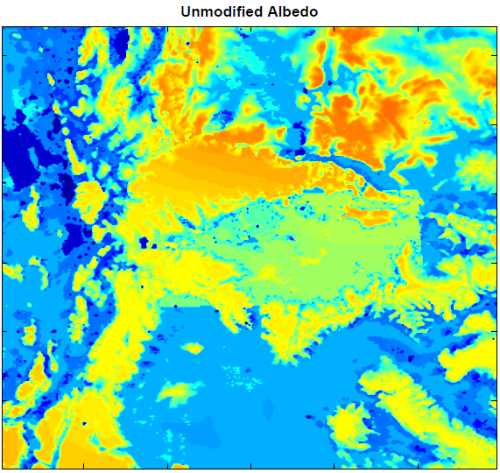
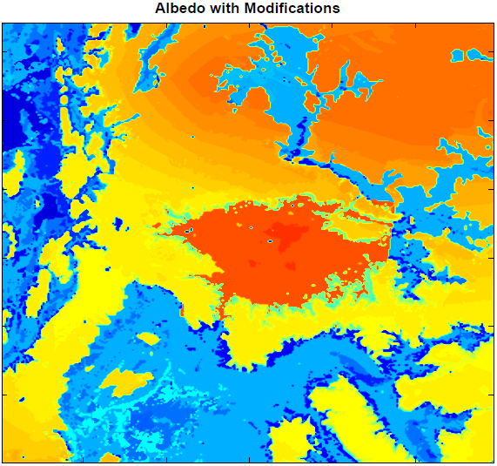
Snow Albedo changes
0.52 - 0.57 Average
0.8 - 0.82 Average
Combination of VEGPARM.TBL and snow albedo edits achieve desired albedos
Set snow albedo to 0.82 within the basin (below 2000 m)
Left snow albedo as default value outside the basin
Change in land use dataset accounts for differences outside the basin
19

Slide 20
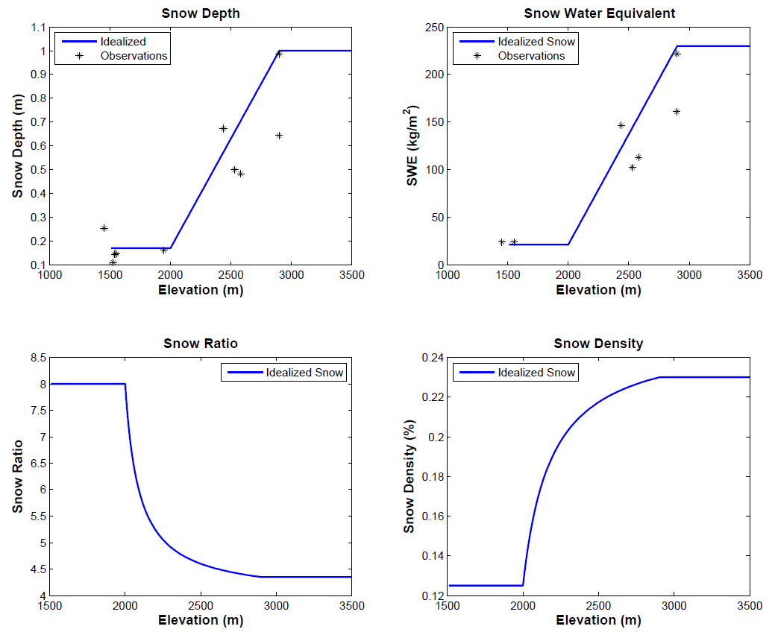
Idealized Snow Cover
20

Slide 21
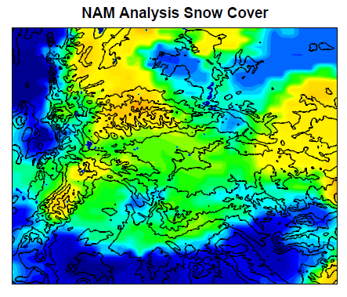
Idealized Snow Cover in Uintah Basin and mountains
00Z 1 Feb 2013
NAM overestimation inside Uintah Basin (22 to 28 cm)
Elevation-dependent snow cover above 2000 m (17 cm to 1 m above 2900 m)
Uniform snow in basin (17 cm depth, 21.25 kg/m³ SWE, 8:1 ratio)

Slide 22
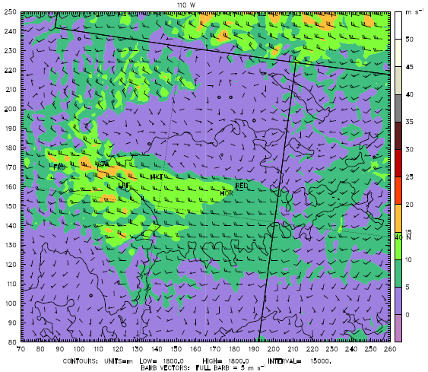
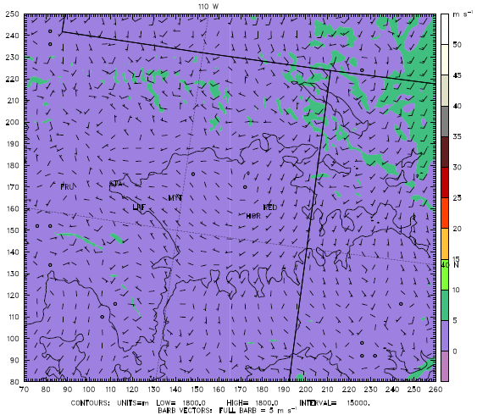
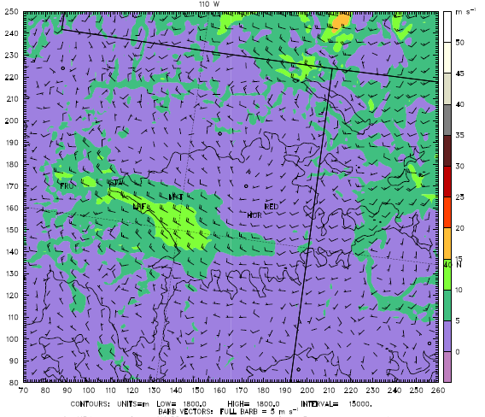
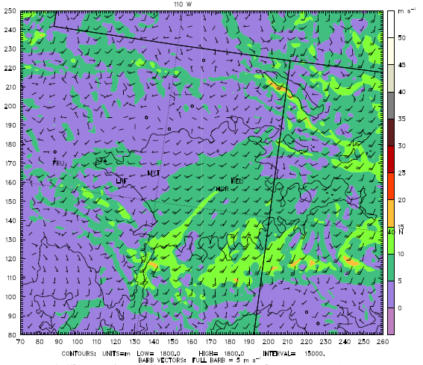
Westerly Wind Intrusion
775 hPa winds
(2.3km MSL)
Large variation in 775 hPa winds during the 1-7 Feb period
Driven by synoptic scale conditions and flow patterns
18Z 1 Feb
12Z 3 Feb
06Z 5 Feb
06Z 6 Feb

