Slide 1
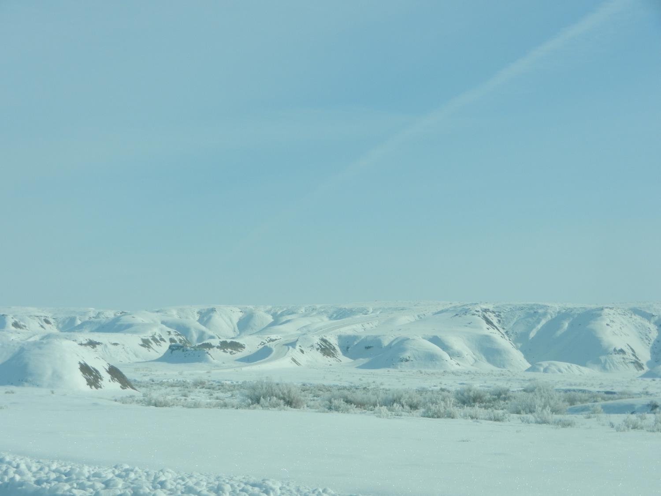
Analysis and Simulation of a Cold-Air Pool and High Wintertime Ozone Episode in Utah’s Uintah Basin
Erik M. Neemann
M.S. Candidate
31 March 2014
1

Slide 2
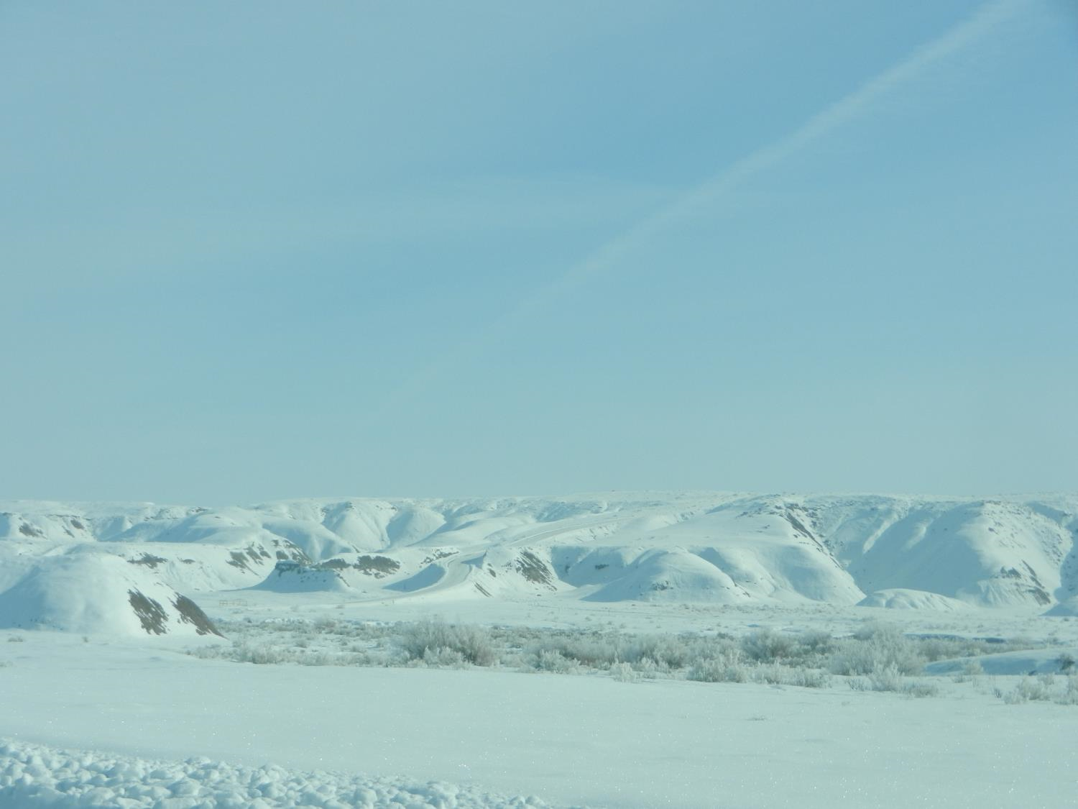
Overview
Background & Motivation
Research Questions
Model Setup & Modifications
Evolution of 1-6 Feb 2013 Cold-Air Pool
Base Run & Sensitivity Studies
Flow Features in the Basin
Ozone & Air Quality
Conclusions & Future Work

Slide 3
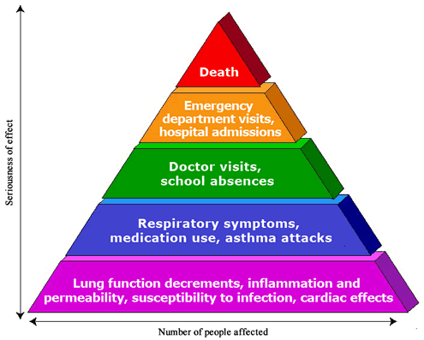
Background - Ozone & Health
Surface ozone is a significant health hazard to humans
  Respiratory irritation and inflammation
  Aggravated asthma
  Long-term lung damage
  Increased hospital admissions and ER visits
  Increased mortality
Younger adults more sensitive than older adults
Background levels typically 20-45 ppb (U.S. EPA 2006)
EPA National Ambient Air Quality Standard (NAAQS) is 75 ppb for an 8-hour average
U.S. EPA: http://www.epa.gov/apti/ozonehealth/population.html

Slide 4
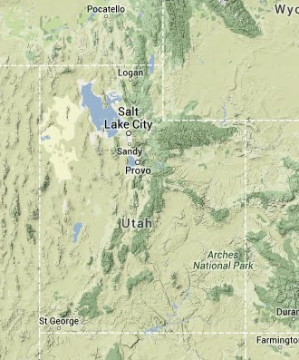
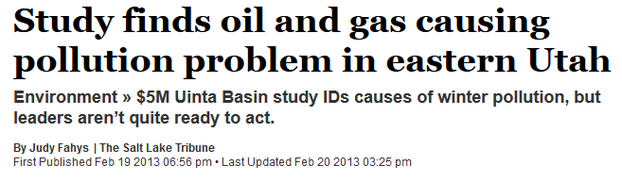
Background - Ozone in Rural Basins
2005 - High wintertime ozone concentrations first analyzed in Upper Green River Basin, WY (Schnell et al. 2009)
  2008 - Several instances where ozone exceeded 100 ppb
2009 - High ozone levels first detected in Uintah Basin
2012 - WY counties designated as non-attainment areas
Upper Green River and Uintah Basins share many characteristics:
  Extensive oil & gas operations
  Frequent winter snow cover
  Similar climate and vegetation
Upper Green River Basin
Uintah Basin

Slide 5
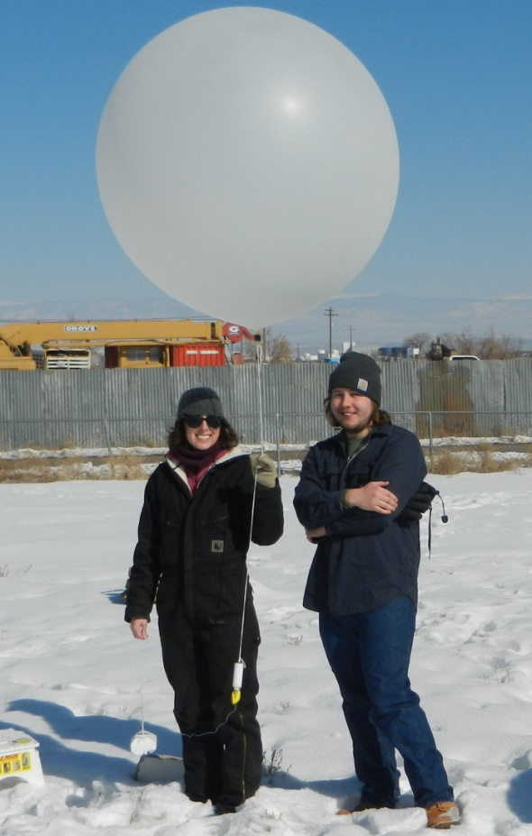
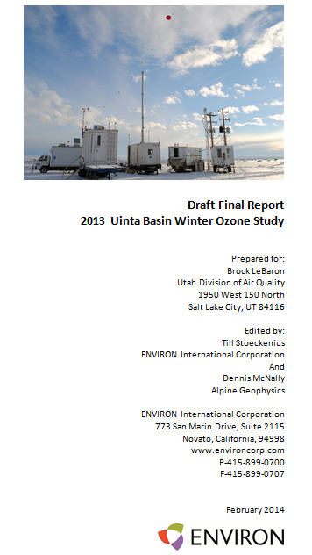
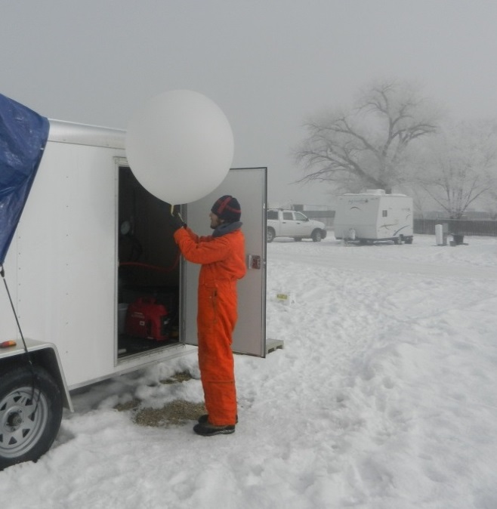
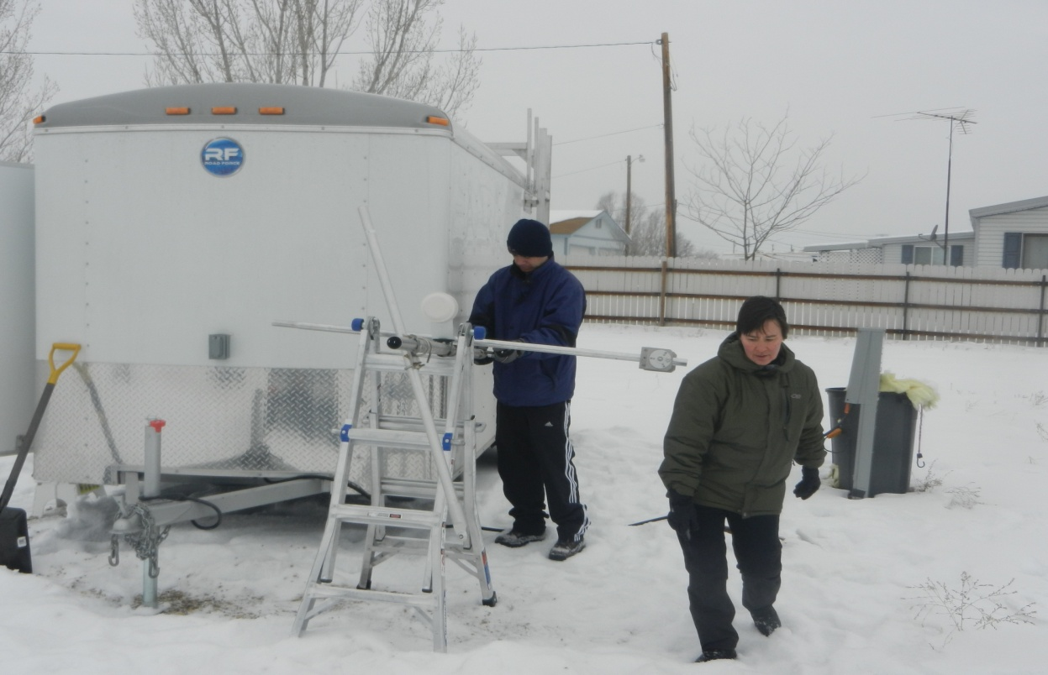
2013 Uintah Basin Winter Ozone Study
Collaborators:
  Utah Division of Air Quality
  NOAA/GMD
  NOAA/CSD
  NOAA/PMEL
  NOAA/ESRL
  Environment Canada
  Utah State University
  University of Utah
  University of Colorado CIRES
  University of Wyoming
  Karlsruhe Institute of Technology
  Environ
  Alpine Geophysics
  Science & Technology Corporation
Photos: Erik Crosman

Slide 6
Background - Cold-Air Pools (CAPs)
Stagnant, stable layer of air confined in a topographical depression with warmer air typically aloft (Lareau et al. 2013)
  Diurnal or persistent
  Solar heating insufficient to destroy low level volume of cold air
Onset coincident with mid-level warming, removed by mid-level cooling (Reeves and Stensrud 2009)
Many studies link persistent CAPs to poor air quality
  Malek et al. 2006, Silcox et al. 2012, Whiteman et al. 2014
  Whiteman et al. 2001, Lareau et al. 2013, Lareau and Horel 2014
Roosevelt, UT 4 Feb 2013
Inversion
Cold Pool

Slide 7
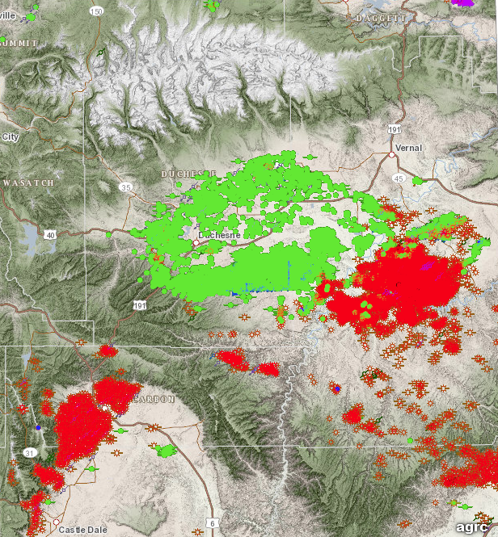
Uintah Basin
Large (~15,000 km²) and bowl-like basin ringed by mountains
Over 500 m of relief from basin center to ridgelines
9,400 oil & gas producing wells in March 2014
Over 3,600 permits for additional wells since Jan 2012
Oil
Gas
Courtesy of Utah Division of Oil, Gas, and Mining

Slide 8
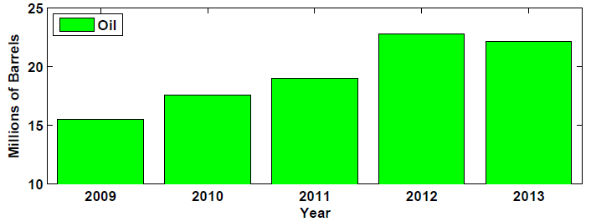
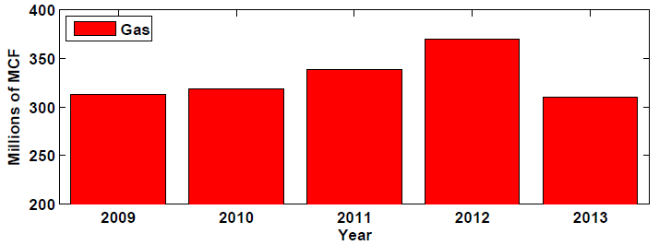
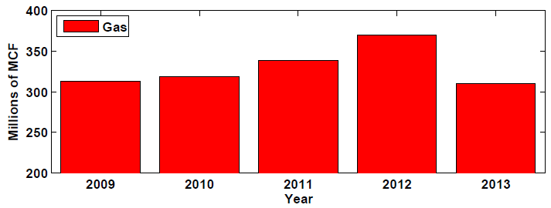
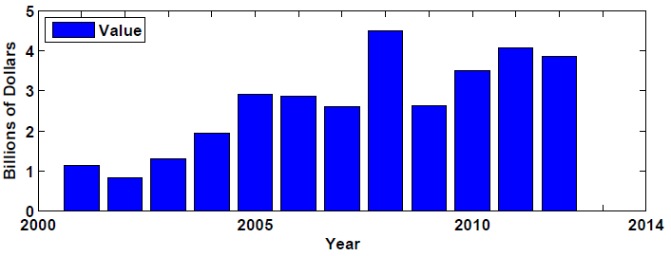
Fossil Fuel Production
Notable increase in drilling since 2009
60% of local economy tied to oil & gas industry (Salt Lake Tribune 2013)
Increasing trend expected to continue
Notes:
Annual fossil fuel production in Uintah Basin since 2009 for (a) oil and (b) gas. (c) Total value of fossil fuel production in Utah since 2001. 1 barrel = 159 L, 1 MCF = 28.3 m³.

Slide 9



Winter Ozone Production
NO_{x}
O₃
Z
VOCs
Snow Cover
θ
Snow cover aids formation of strong CAPs under upper ridging
Pollutants trapped near surface in stagnant conditions
High-albedo snow increases actinic flux and enhances photolysis rates to ~50% greater than summer (Schnell et al. 2009)
  → Rapid ozone production
Notes:
State what actinic flux is: Energy available to photochemical reactions, without consideration of direction. Includes direct, reflected, and scattered radiation. (quanta cm⁻² s⁻¹ on order of 10¹⁴)
The Uintah Basin suffers from a wintertime ozone problem. Wintertime ozone issues in rural areas have come into the scientific crosshairs over the past 5-10 years, first in WY UGRB. They are really the result of 3 factors: Industry, Geography, and Meteorology. As you can see from the top image here, the UB has extensive industrial fossil fuel extraction in the form of oil & gas operations, which result in large pollutant emission into the lower atmosphere. The geography of the UB, as a large, deep, bowl restricts horizontal mixing and airmass exchange from outside the basin. And finally, meteorology contributes to stagnant conditions that further restrict mixing in the form of persistent CAPs. These CAPs inhibit vertical mixing due to the presence on strong stability and low level inversions. Turbulent mixing is further inhibited within the CAP by light winds. These factors combine to allow for building pollutant concentrations. The snow cover also results in large photolysis rates due solar radiation passing through the near atmospheric layer twice. This leads to ozone production thru photolysis and a significant health problem for the local population.

Slide 10
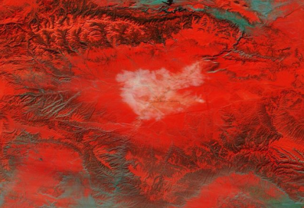
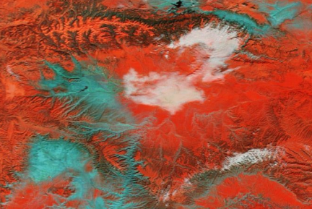
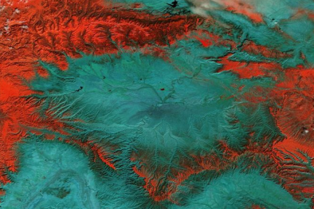
Snow Cover Variations…
Large year-to-year variations in snow cover
Depends on if snow from early-winter storms can be sustained into February
2 Feb 2013
Courtesy NASA SPoRT program
2 Feb 2014
21 Feb 2014

Slide 11
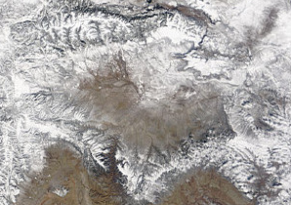
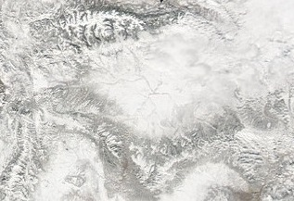
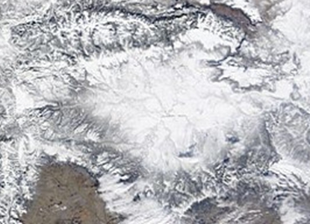
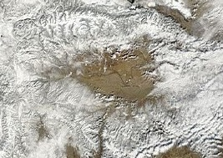
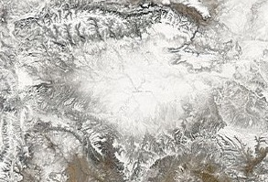
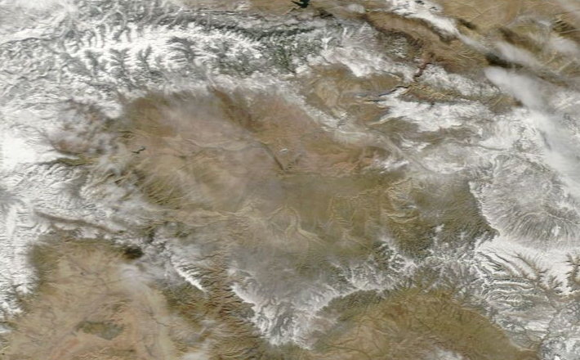
…Set to Ozone Expectations
2009
NAAQS exceedance days at Ouray:
2010
1
24
39
40
1
3
2011
2012
2013
2014
2013 Uintah Basin Winter Ozone Study

Slide 12
Research Questions
What is the sensitivity of simulated CAP structure and evolution to cloud microphysics?
How do snow cover variations affect CAP simulations and structure?
What are the important wind flow regimes in the Uintah Basin CAP? Can they be diagnosed by mesoscale modeling and how might they affect air quality in the basin?
What is the influence of snow cover on simulated air quality in the Uintah Basin?
Notes:
The Uintah Basin suffers from a wintertime ozone problem. Wintertime ozone issues in rural areas have come into the scientific crosshairs over the past 5-10 years, first in WY UGRB. They are really the result of 3 factors: Industry, Geography, and Meteorology. As you can see from the top image here, the UB has extensive industrial fossil fuel extraction in the form of oil & gas operations, which result in large pollutant emission into the lower atmosphere. The geography of the UB, as a large, deep, bowl restricts horizontal mixing and airmass exchange from outside the basin. And finally, meteorology contributes to stagnant conditions that further restrict mixing in the form of persistent CAPs. These CAPs inhibit vertical mixing due to the presence on strong stability and low level inversions. Turbulent mixing is further inhibited within the CAP by light winds. These factors combine to allow for building pollutant concentrations. The snow cover also results in large photolysis rates due solar radiation passing through the near atmospheric layer twice. This leads to ozone production thru photolysis and a significant health problem for the local population.

Slide 13
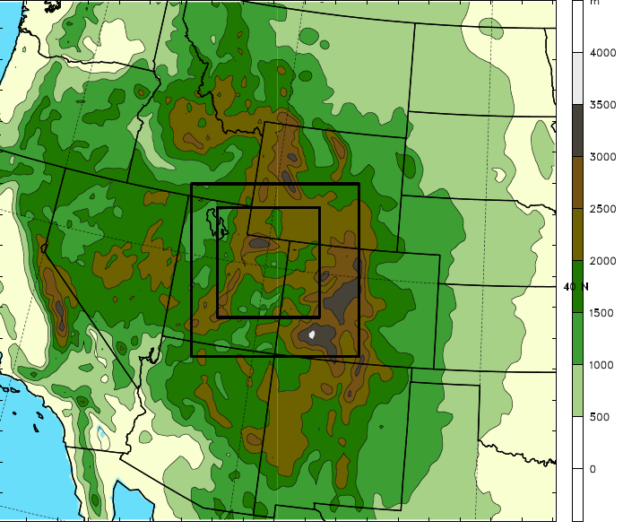
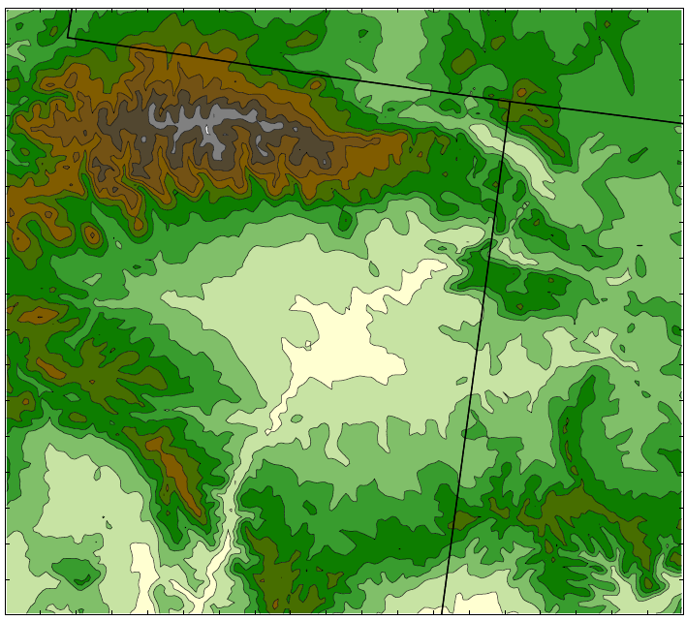
Model Setup & Domains
Outer Domain
WRF-ARW v3.5
- NAM analyses for initial & lateral BC
- 41 vertical levels
- Time step = 45, 15, 5 seconds
- 1 Feb 0000 UTC to 7 Feb 0000 UTC 2013
m
4000
Subdomain
WY
3750
1.33 km
Uinta Mountains
UT
3500
4 km
CO
3250
Vernal
3000
Roosevelt
12 km
Wasatch Range
2750
Red Wash
Parameterizations:
- Microphysics: Thompson
- Radiation: RRTMG LW/SW
- Land Surface: Noah
- Planetary Boundary Layer: MYJ
- Surface layer: Eta Similarity
- Cumulus: Kain-Fritsch (12 km domain)
- Landcover/Land use: NLCD 2006 (30 m)
Myton
2500
Horsepool
Ouray
2250
Tavaputs
2000
1750
Plateau
1500
Desolation Canyon
1250

Slide 14
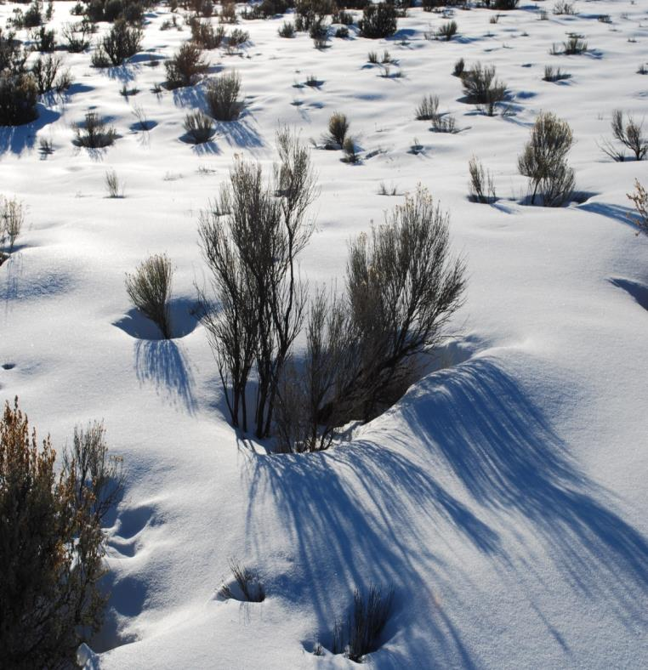
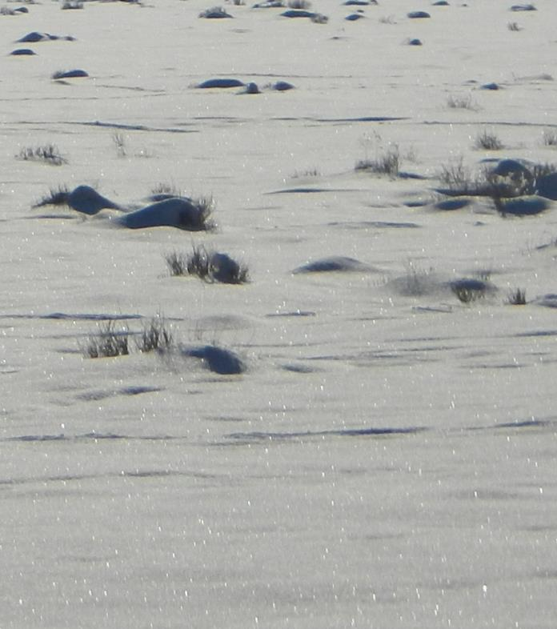
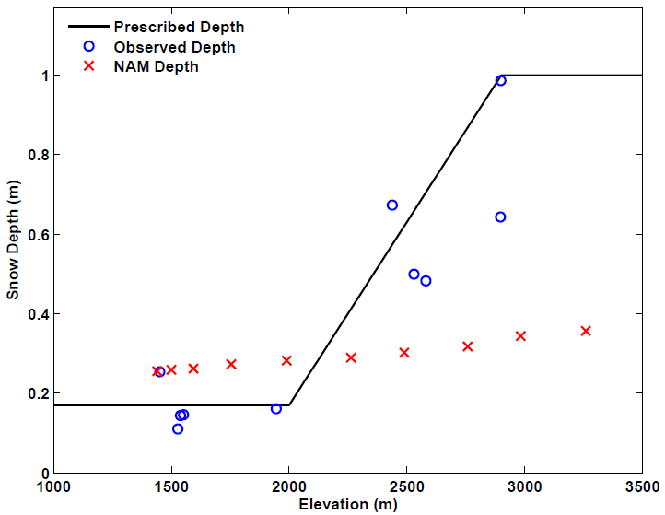
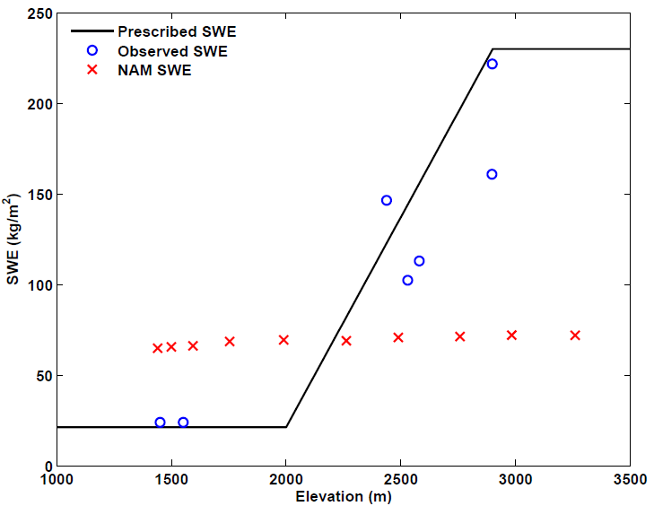
WRF Modifications
Idealized snow cover in Uintah Basin and mountains
Snow albedo changes
Edited VEGPARM.TBL
  Allows model to achieve high albedos measured in basin
Snow Depth
Snow Water Equivalent
Photos: Erik Crosman

Slide 15
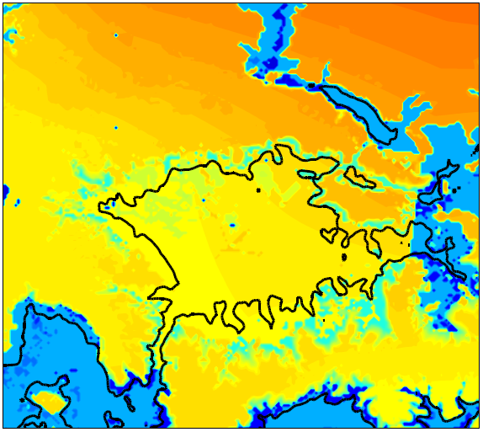

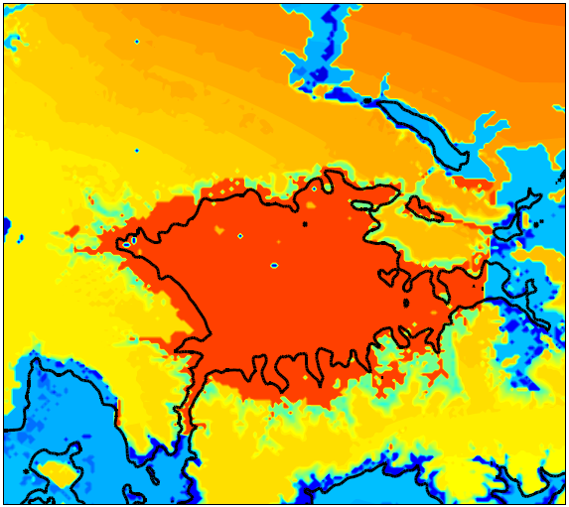
Albedo Changes
Original
Modified
0.62 - 0.65
0.81 - 0.82
0.82 is average albedo measured at Horsepool during 2013 Uintah Basin Winter Ozone Study

Slide 16
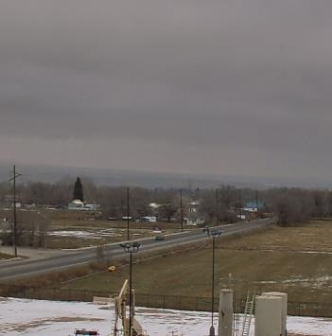
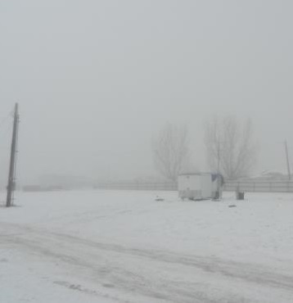
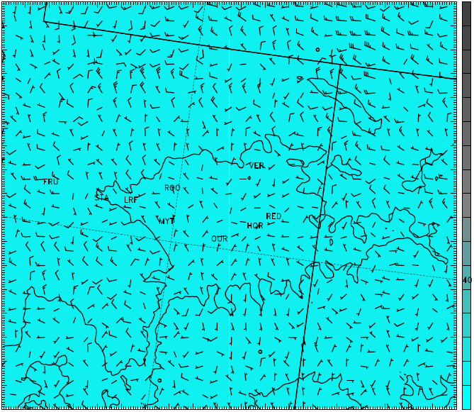
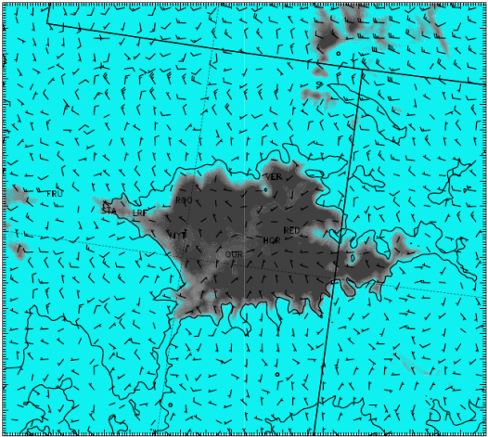
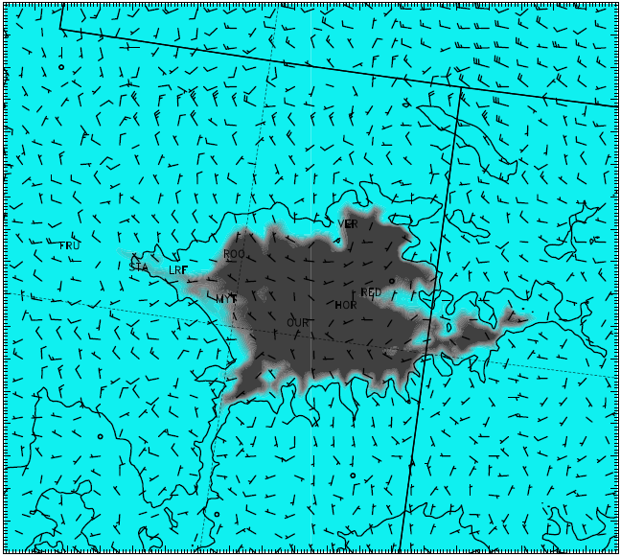
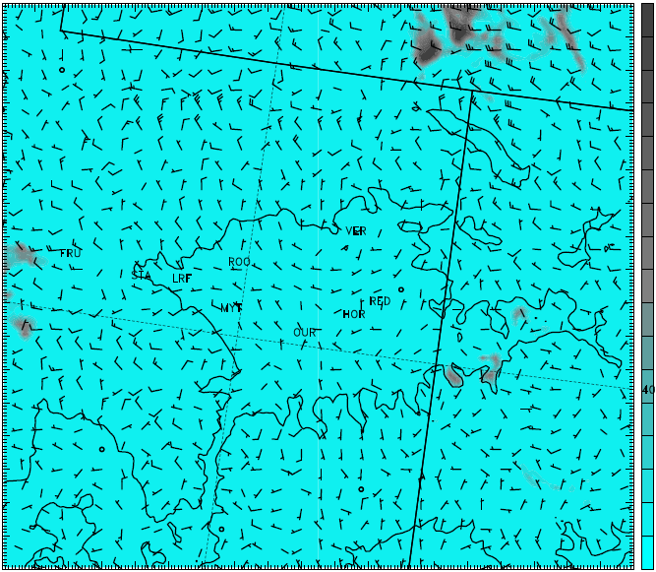
WRF Modifications
Microphysics modifications (Thompson) in lowest 15 model layers (~500m):
  Turned off cloud ice sedimentation
  Turned off cloud ice autoconversion to snow
  → Results in ice-phase dominated low clouds/fog vs. liquid-phase dominated
  Simulated Clouds
  Reality
Before
After
Cloud Ice
Cloud Water
Cloud Ice
Cloud Water
http://wwc.instacam.com/instacamimg/UBATC/UBATC_l.jpg
Photo: Erik Crosman

Slide 17
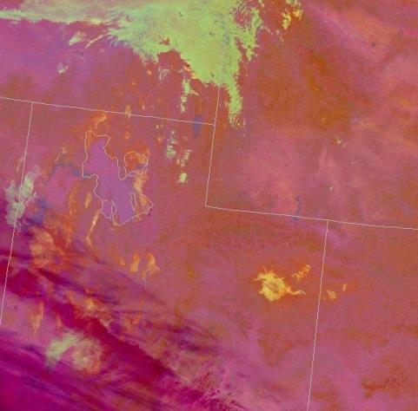
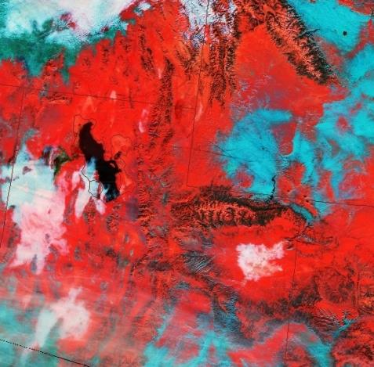
Satellite Imagery
VIIRS Nighttime Microphysics RGB
MODIS Snow-Cloud
Low stratus, fog
Fog containing ice particles
0931 UTC 2 Feb
1815 UTC 2 Feb
Satellite imagery courtesy NASA SPoRT program

Slide 18
WRF Sensitivity Tests
 | Snow Cover in basin | Cloud Ice Sedimentation | Cloud Ice Auto-conversion to Snow | Simulation Name
Microphysics Sensitivity Simulations | Full Snow | ON | ON | BASE
 | Full Snow | OFF | OFF | FULL
Snow Cover Sensitivity Simulations | No Snow below 2100 m in Western 1/4 of basin | OFF | OFF | NW
 | No Snow below 2000 m | OFF | OFF | NONE

Slide 19
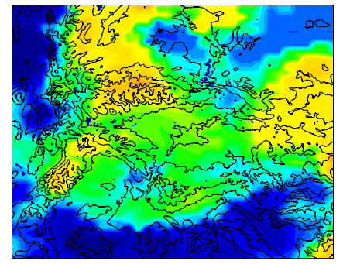
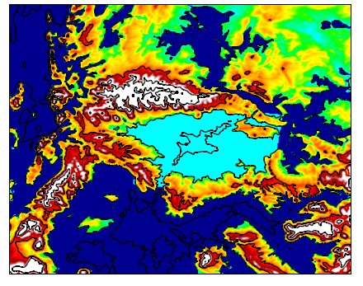
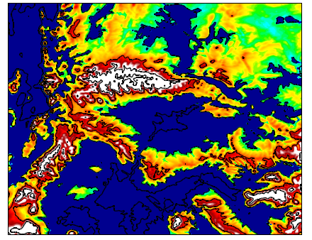
NAM and Prescribed Snow Cover
m
1
Snow cover difference in primary model simulations
Depth/SWE prescribed by elevation
Based on observations available in Uintah Basin and surrounding mountains
0.9
0.8
0.7
0.6
NAM
0.5
0.4
0.3
0.2
0.1
FULL/BASE
NONE
0

Slide 20
1-6 Feb 2013 CAP Evolution
1800 UTC Roosevelt Soundings
2 Feb 2013
4 Feb 2013
6 Feb 2013
High RH in low levels on 2 & 4 Feb
Mixed layer deepens 2-4 Feb, then becomes more shallow by 6 Feb
Inversion near 700 hPa descends to 750 hPa from 4-6 Feb
Light easterly flow in stable layer on 2 & 4 Feb with stronger, westerly flow above

Slide 21
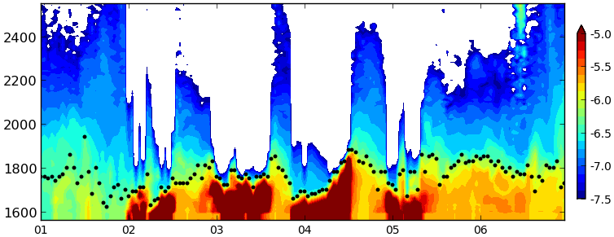
1-6 Feb 2013 CAP Evolution
Ceilometer Backscatter and Estimated Aerosol Depth (Roosevelt, UT)
Cloud-free in low levels 1 & 6 Feb
Pattern of low shallow clouds/fog overnight before thinning by mid-day from 2-5 Feb
Greatest low clouds and fog on 3-4 Feb

Slide 22
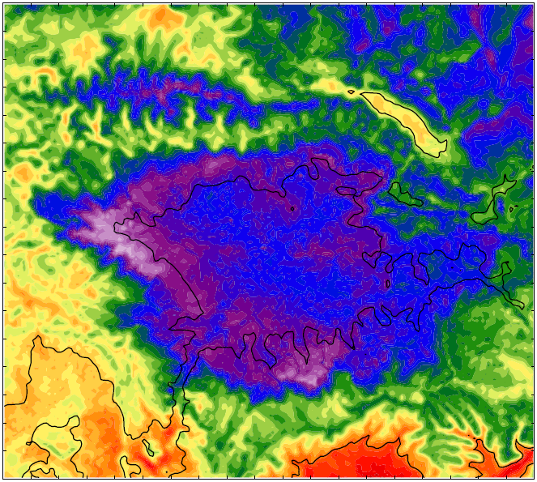
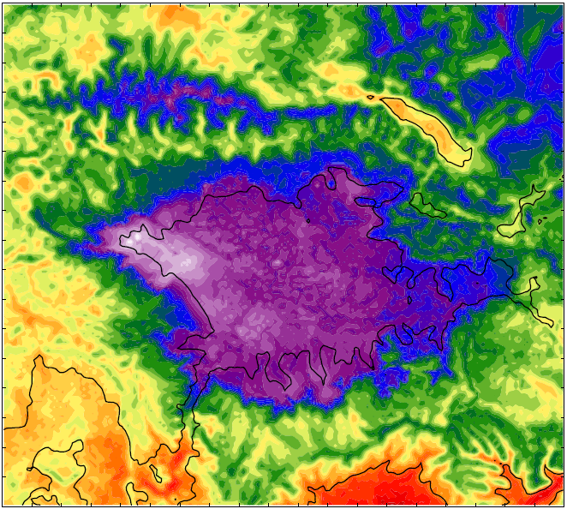
Microphysics Sensitivity
2-m Temperatures 1800 UTC 2 Feb 2013
BASE
°C
FULL
4
2
0
-2
-6 °C
-4
-9 °C
-6
-8
-10
-12
Unrealistic warm region often present in center of BASE simulation
  Greatest during overnight and morning hours
Notable improvement in FULL simulation with lower temperatures

Slide 23
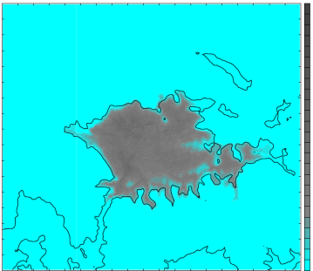
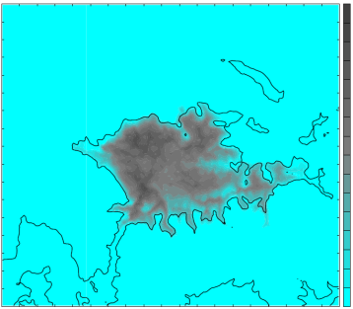
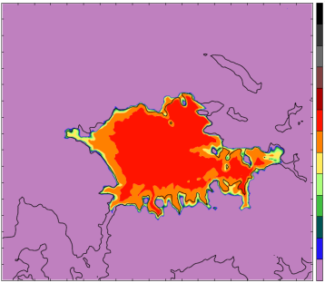
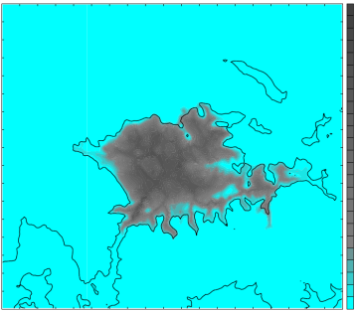
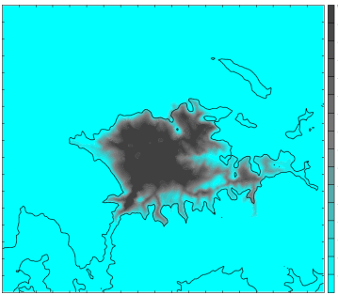

Microphysics Sensitivity
0600 UTC 5 Feb 2013
BASE
Integrated Clouds (mm)
Cloud Water (g kg⁻¹)
0.30
Longwave from Clouds (W m⁻²)
120
0.2
100
0.20
80
0.1
60
0.1
40
20
0
0
0
Integrated Clouds (mm)
Cloud Ice (g kg⁻¹)
0.30
Longwave from Clouds (W m⁻²)
120
0.2
100
0.20
80
60
0.1
0.1
40
20
0
0
0
FULL

Slide 24


Microphysics Sensitivity
Mean BASE - FULL Difference
2-m Temperature
Longwave Radiation from Clouds
°C
W m⁻²
2
20
1.5
15
1
10
0.5
5
0
0
-0.5
-5
Mean temperature in basin ~1.5 °C higher in BASE simulation
Related to additional longwave radiation from clouds of 7-20 W m⁻²
Greater coverage of stratus in BASE vs. ice fog in FULL leads to large differences where stratus is present but ice fog isn’t

Slide 25



Mean 2-m Temperatures
BASE
FULL
NONE
-7.7 °C
-9.7 °C
-2.1 °C
°C
-12
-10
-8
-6
-4
-2
0
2
Warm bias in BASE due to cloud phase sensitivity greatly reduced in FULL
Removal of snow in NONE leads to mean temperatures 7.6 °C greater than FULL
All simulations nearly identical outside the Uintah Basin

Slide 26


Vertical Profile Comparisons (Roosevelt)
4 Feb 2013
5 Feb 2013
Mixed layer in BASE generally deeper than observed
Improved results in FULL simulation for temperature and PBL depth
NONE simulation much warmer (~7 °C) with deeper mixed layer
Minimal differences above ~500 m AGL

Slide 27
Potential Temperature Time-Heights (Horsepool)
K
BASE
FULL
NONE
1 Feb
2 Feb
3 Feb
4 Feb
5 Feb
6 Feb

Slide 28


Simulated Cold Pool Evolution
00 UTC 1 Feb to 00 UTC 7 Feb

Slide 29



Simulated Uintah Basin Flow Features
Mean Zonal Wind - All Hours
m s⁻¹
3000
5
Simulated
Mean Potential Temperature Profile at Ouray
2800
4
3
2600
2
2400
1
2200
0
Height (m)
2000
-1
Greatest Stability
-2
1800
-3
1600
-4
275
280
285
290
295
300
1400
-5
Ouray
Inversion/greatest stability typically between 1800 - 2000 m MSL
Weak easterly flow exists within and below inversion layer
  Core greater than 0.5 m s⁻¹
  Likely important role in pollutant transport within the basin

Slide 30


Simulated Uintah Basin Flow Features
Daytime (0800 - 1700 MST)
Nighttime (1800 - 0700 MST)
3.0
3.0
2.8
2.8
2.6
2.6
2.4
2.4
2.2
2.2
Height (km)
Height (km)
2.0
2.0
1.8
1.8
1.6
1.6
diurnal
flows
1.4
1.4
m s⁻¹
-5
-4
-3
-2
-1
0
1
2
3
4
5
Easterly flow stronger during the day, weaker at night
  Indicates thermal gradients likely the main driver
  Core winds greater than 1 m s⁻¹ during the day
Diurnal flows apparent in day/night plots

Slide 31


Snow Cover Differences
FULL - mean all hours
NONE - mean all hours
3.0
3.0
2.8
2.8
2.6
2.6
2.4
2.4
2.2
2.2
Height (km)
Height (km)
2.0
2.0
1.8
1.8
1.6
1.6
1.4
1.4
m s⁻¹
-5
-4
-3
-2
-1
0
1
2
3
4
5
Core easterly winds weaker and shallower in NONE simulation
Weaker stability in NONE likely allows synoptic-scale westerlies to extend down closer to the surface
Snow removal only affects near-surface atmosphere below capping inversion

Slide 32

1-6 Feb 2013 CAP Evolution
Observed Ozone Concentrations
Gradual buildup of ozone concentrations during multi-day episode
All Locations exceed NAAQS standard on several days
Ozone depletion seen overnight at Vernal
Horsepool and Ouray above NAAQS nearly all hours after 3 Feb
Strong system cleared basin on 9 Feb

Slide 33


Mobile Ozone Transect - 6 Feb 2013
High concentrations measured through the basin
Greatest values in lower elevations and river valleys
NAAQS
Vernal
Roosevelt
Duchesne
River
Green
River
Ouray
White
River

Slide 34


Air Quality Simulations
  Utah Division of Air Quality’s Community Multi-Scale Air Quality Model (CMAQ)
  Provided courtesy of Lance Avey
  Combines meteorological data, emissions inventory, and chemistry-transport model to simulate pollutant concentrations
  Atmospheric variables forced by 4-km domain WRF output
    FULL and NONE simulations
km
3.5
19 vertical levels
- 13 below 1km
3.0
Roosevelt
2.5
Horsepool
Seven Sisters
2.0
1.5

Slide 35



CMAQ Mean Afternoon Ozone
1100 - 1700 L
FULL
NONE
ppb
Concentrations in FULL simulation 15-30% greater than NONE
Areal extent of region exceeding NAAQS 6 times larger in FULL
FULL simulation adequately represents observations in southeast quadrant, underpredicts concentrations elsewhere

Slide 36


CMAQ Mean Afternoon Ozone
1100 - 1700 L
FULL
NONE
3.0
3.0
2.8
2.8
2.6
2.6
2.4
2.4
2.2
2.2
Height (km)
Height (km)
2.0
2.0
1.8
1.8
1.6
1.6
1.4
1.4
1.2
1.2
ppb
30
40
50
60
70
80
90
100
Ozone concentrations notably higher in FULL simulation
Drop-off to background level (~60 ppb) occurs near 2000 m in FULL
  Observed drop-off to ~60 ppb around 1900 m at Horsepool (Karion et al. 2014)

Slide 37


CMAQ Ozone Variations
Simulated zone concentrations remain under NAAQS at Roosevelt
Ozone concentrations at Seven Sisters are simulated quite well
Performance disparity among locations illustrates CMAQ’s struggle to represent broad extent of observed high ozone concentrations

Slide 38
CMAQ Ozone Variations (Horsepool)
FULL
1 Feb
2 Feb
3 Feb
4 Feb
5 Feb
6 Feb
NONE
1 Feb
2 Feb
3 Feb
4 Feb
5 Feb
6 Feb

Slide 39
Conclusions
What is the sensitivity of simulated CAP structure and evolution to cloud microphysics?
  Simulated ice fog leads to reduced 2-m temperature bias and shallower, more realistic mixed layer within CAP vs. liquid stratus
  Improvement attributed to changes in longwave radiation and greater cooling due to cloud phase change
How do snow cover variations affect CAP simulations and structure?
  Removing snow from basin results in much greater 2-m temperatures and a much deeper boundary layer
  Differences contained in lowest ~1 km AGL due to strong stability above CAP

Slide 40
Conclusions
What are the important wind flow regimes in the Uintah Basin CAP? Can they be diagnosed by mesoscale modeling and how might they affect air quality in the basin?
  1.3 km simulations resolve flow features fairly well
  Synoptic intrusions of clean air, elevated easterly flow in stable layer, and diurnal thermally driven flows are all important
  Redistribution of pollutants by these flows likely impacts air quality within the basin
What is the influence of snow cover on simulated air quality in the Uintah Basin?
  Snow cover and high surface albedo critical to high wintertime ozone:
    Strengthens CAP and increases stability
    Increases photolysis rates, leads to rapid ozone production

Slide 41
Future Work
Expand number of CAP cases investigated
More sophisticated application of microphysics modifications, and examine sensitivity with other microphysics schemes
Utilize different PBL parameterizations and improve performance of schemes in stable boundary layers
Improve representation of snow variables in analysis and initialization fields
  Incorporate use of snow physics model

Slide 42
Acknowledgements
My Committee: John Horel, John Lin, Jim Steenburgh
Erik Crosman
The U of U WRF User’s Group
Graduate classmates
2013 Uintah Basin Winter Ozone Study participants
  Utah Division of Air Quality - Lance Avey
  Alex Jacques, Matt Lammers, John & Maggie Lawson, Nola Lucke
  Utah State University
NASA SPoRT program
Air Force Institute of Technology
The views expressed in this presentation are those of the author and do not reflect the official policy or position of the United States Air Force, Department of Defense, or the U.S. Government.

Slide 43
Questions?

Slide 45

2-m Temperature Bias

Slide 46

Primary Outcomes from Microphysics Testing
Model runs with “thick liquid clouds”
Model runs with “thick ice clouds”
Additional 2-3 deg C warm bias overnight
Model runs with “clear sky”

Slide 47
WRF v3.5 Setup
See Alcott and Steenburgh 2013 for further details on most aspects of this numerical configuration:
http://journals.ametsoc.org/doi/abs/10.1175/MWR-D-12-00328.1
Overview summary of WRF Namelist options:
  map_proj= 1: Lambert Conformal
  NAM analyses provide initial cold start, land-surface conditions, & lateral boundary conditions
  Idealized snow cover as function of height input to replace poor NOHRSC snow
  3 Domains with 12, 4, 1.33 km horizontal resolution (see next slide)
  Number of vertical levels = 41
  Time step = 45 seconds (15, 5 s for inner 2 grids)
  Microphysics: Thompson scheme
  Radiation: RRTMG longwave, RRTMG shortwave
  Surface layer: Monin-Obukov
  Land Surface: NOAH
  Planetary Boundary Layer: MYJ
  Kain-Fritsch cumulus scheme in outer coarse 12 km grid
  Slope effects for radiation, topographic shading turned on
  2nd order diffusion on coordinate surfaces
  Horizontal Smagorinsky first-order closure for eddy coefficient
  Landcover/Land use: National Land Cover Database (NLCD) 2006 1 arc-second (30 m)
  Terrain Data: U.S. Geological Survey 3 arc-second (90 m)

Slide 48


2 February 2013 1836 UTC Landsat 7 ETM+ (60 m resolution)
Differential Heating in Uintah Basin
Warm
Cold
Visible: Cyan- snow; light grey- cloud
Skin temperature (ºC)

Slide 49

Elevated Easterly Flow on 26 Jan 2013
Semi-permanent easterly ‘jet’ embedded within inversion layer during weak NW synoptic flow
Oil well fire plume, looking north
Westerly flow above strong stable layer
Easterly ‘jet’ within strong stable layer
Calm near-surface cold pool

Slide 50




Variations in Westerly Synoptic Flow
Large variation in 2.3 km MSL winds during the 1-7 Feb period
18Z 1 Feb
12Z 3 Feb
07Z 5 Feb
07Z 6 Feb

Slide 51

Impact of Downslope on Snow Cover
Typical snow-free
downslope zone
Predominant westerly
flow

Slide 52

1800 UTC 2 Feb 2013 Observations

Slide 53


WRF vs. CMAQ Vertical Levels
WRF
CMAQ

Slide 54


WRF Snow Albedo Variable
Original
Modified
0.49 - 0.56
0.82

Slide 55


NARR Composites 1-7 Feb 2013
500 hPa
SLP
5800
1025
5700
1020
5600
1015
5500
1010
5400
5300
1005
5200
1000
5100
995
5000
990

Slide 56


Roosevelt 1800 UTC Profiles
(a)
(b)
(c)
(d)
(e)
(f)

Slide 57
Mean 1-6 Feb 2-m Temperature

Slide 58
Ouray Profiles 3 Feb 0900 - 1800 UTC

Slide 59

Mean Zonal Wind Difference (NW-FULL)

Slide 60
Potential Temperature Cross Sections

Slide 61
West Basin Mix-Out

Slide 62
Mean Wind Direction Day/Night

Slide 63

CMAQ Domain

Slide 64
Ozone Timeseries

Slide 65
SW Radiation from FULL/NONE

Slide 66


Model Setup & Domains
Outer Domain
WRF-ARW v3.5
- NAM analyses for initial & lateral BC
- 41 vertical levels
- Time step = 45, 15, 5 seconds
- 1 Feb 0000 UTC to 7 Feb 0000 UTC 2013
Inner Domain
WY
1.33 km
4 km
Subdomain
SLV
Uinta Mountains
12 km
Wasatch Range
Parameterizations:
- Microphysics: Thompson
- Radiation: RRTMG LW/SW
- Land Surface: Noah
- Planetary Boundary Layer: MYJ
- Surface layer: Eta Similarity
- Cumulus: Kain-Fritsch (12 km domain)
- Landcover/Land use: NLCD 2006 (30 m)
Tavaputs
Plateau
Desolation Canyon
UT
CO

