Slide 1
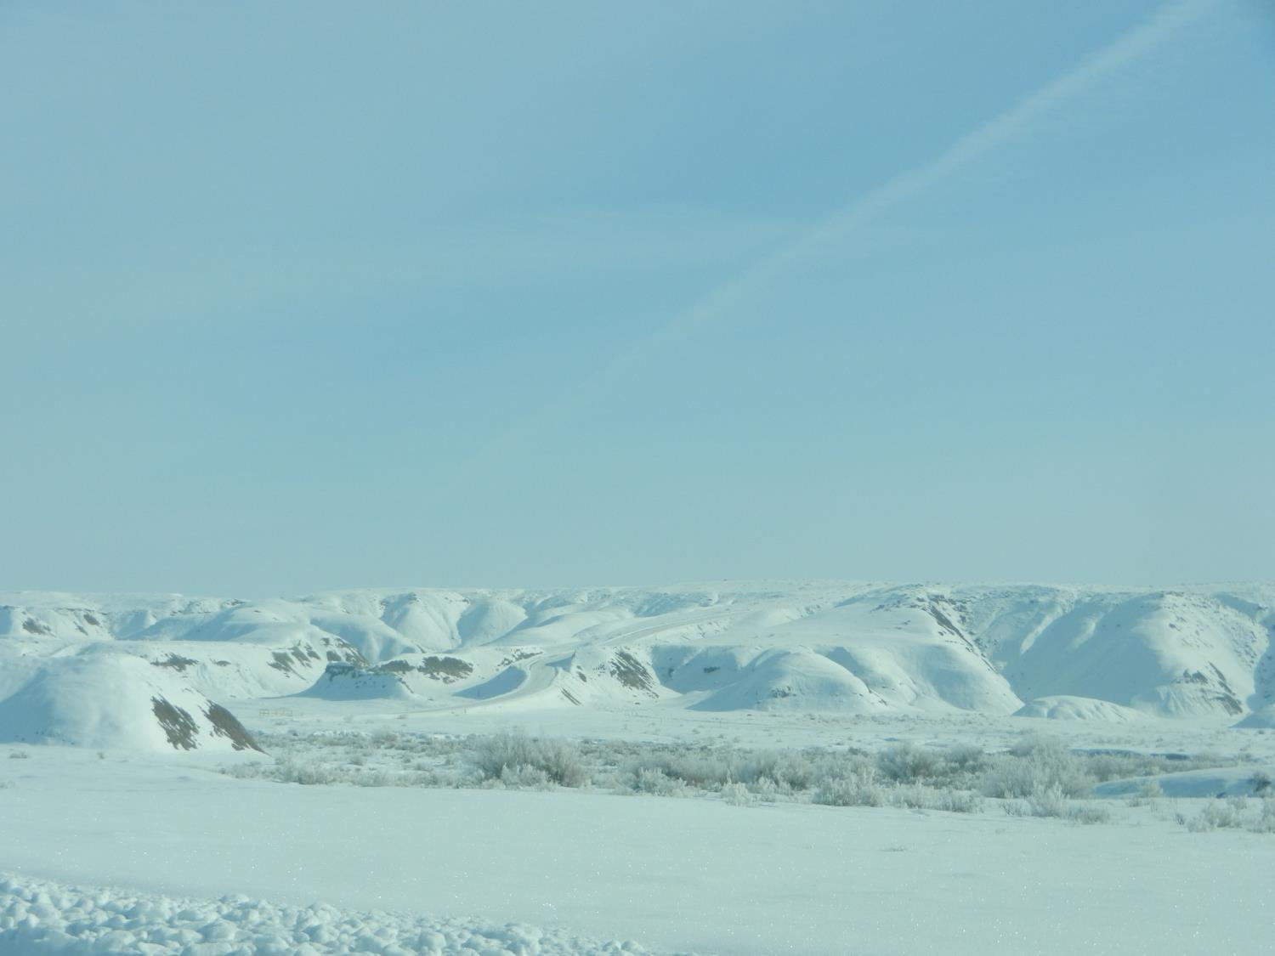
Numerical Modeling of Wintertime Persistent Cold Air Pools
Erik Neemann U of U
Lance Avey Utah DAQ
Erik Crosman U of U
John Horel U of U
5 Dec 2013

Slide 2
Topics
Why is it so hard to model stable boundary layers?
Overview of WRF modeling at the University of Utah and Utah DEQ
Highlight importance of vertical profiles in validating wintertime stable layers
Discuss modifications made to WRF model to improve simulations in Uintah Basin
Example results

Slide 3
Why is it so hard to model the stable boundary layer?!?*
Stable boundary layer (SBL) complexity originates from “multiplicity of processes” (e.g., turbulent mixing, gravity waves, katabatic flows, fog, radiative cooling)
Processes and their interactions “insufficiently understood” which hampers model parameterization development
SBL turbulence is suppressed by stable stratification. Within very SBL, a well-established scaling framework between local gradients of wind and potential temperature and vertical fluxes is missing
“Qualitatively, this regime is dominated by intermittent and unpredictable weak turbulence, waves, drainage flows, and other submesoscale motions”
Typical model errors for SBL are:
“Overestimation of surface vegetation temperature on calm nights”
“Overestimation of SBL depth”
“Low level jets too deep with too weak of winds”
“Underestimated near surface temperature and wind speed gradients and diurnal cycle”
*G.J Steenvald. Stable Boundary Layer Issues http://www.met.wau.nl/medewerkers/steeneveld/SteeneveldProceedingsECMWFGABLSworkshop.pdf

Slide 4
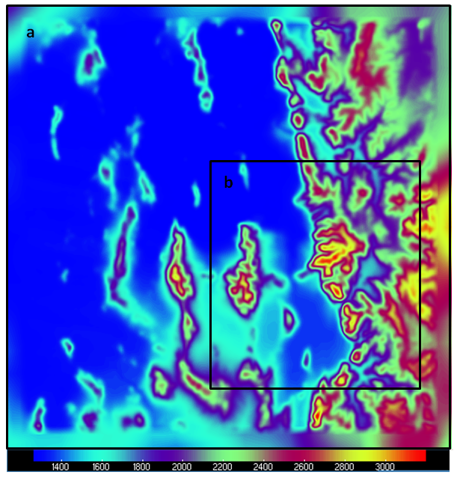
University of Utah WRF Large-Eddy Simulations
Idealized
ΔX = 50 m
Real (Salt Lake Valley
ΔZ = 10 m
ΔX = 750 m
Evaluates mixing terms in
physical space (x,y,z)
Subgrid scale model 1.5 order TKE closure (3D)
No PBL
Salt Lake
Valley
ΔX = 250 m
ΔZ = 50 m
Explicitly resolve some of turbulence using a Large Eddy Simulation (LES) which provides a more realistic representation of the complex processes occurring in stable boundary-layer (Teixiera et al. 2008).

Slide 5
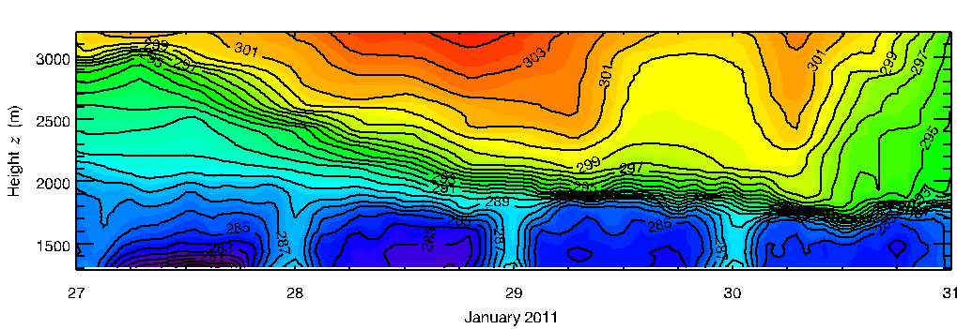
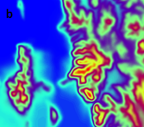
PCAPS: The Importance of Validating Model Performance with Vertical Profiles
COARSE ΔX 1335 m
PBL parameterizations
Remove most of cold pool
on January 30
CAP too shallow
LES ΔX 250 m
LES looks more
Like reality
OBSERVATIONS

Slide 6
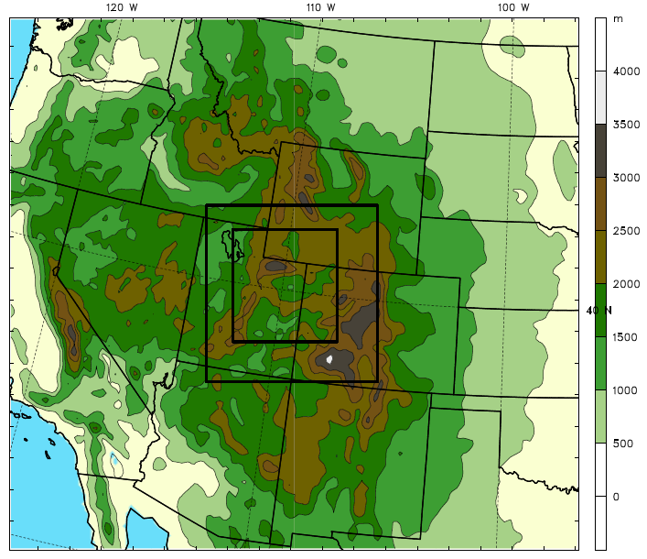
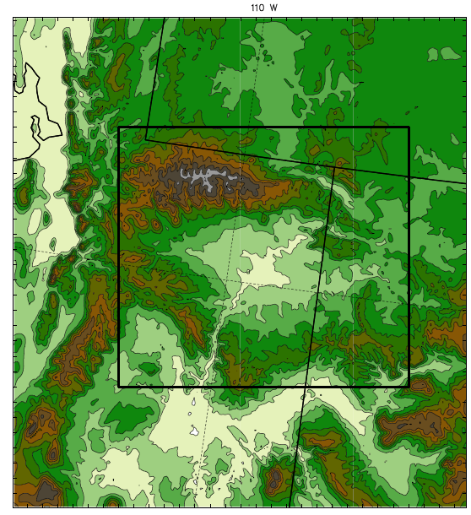
University of Utah Uintah Basin WRF Mesoscale Simulation Domains
Outer Domain
Inner Domain & Subdomain
1.33 km
4 km
Subdomain
12 km

Slide 7
Improving WRF Mesoscale Wintertime CAP Simulations
No magic fix. PBL schemes fundamentally limited in simulating stable boundary layers until better parameterizations are developed and implemented.
However, some things can be done to get a better simulation:
Determine which combination of parameterization schemes (e.g., pbl, land surface) produce more realistic cold pools without affecting other meteorological situations (orographic precipitation, convection, etc….)
Improve model initialization
Improve physical representation land use/snow cover/boundary layer clouds

Slide 8
Improving WRF Mesoscale Wintertime CAP Simulations
STEP 1: Determine which combination of parameterization schemes (e.g., pbl, land surface) produce most realistic cold pools
The University of Utah and Michigan State University have found that YSU and MYJ produce better CAPs than the other WRF PBL options
Too few vertical layers significantly limits accurate modeling of stable layer structure. Several layers with ~10 m vertical spacing near surface suggested, with more than 35 total model levels recommended
We did not rigorously test differences between NAM, GFS, RUC, etc initialization, but through personal communication with a number of scientists it appears to be case-dependent (but often NAM is better than GFS because of more vertical levels to resolve cold pools). We recommend NAM or something with equivalent or more vertical levels
We did not find significant improvements implementing with the new Jimenez stable layer scheme (with YSU) in WRF for our few case studies but would recommend further testing
Jimenez et al. Jiménez, Pedro A., Jimy Dudhia, J. Fidel González-Rouco, Jorge Navarro, Juan P. Montávez, Elena García-Bustamante, 2012: A Revised Scheme for the WRF Surface Layer Formulation. Mon. Wea. Rev., 140, 898–918.

Slide 9
UU/UDEQ WRF Configuration
41 Vertical levels
NAM IC/BC
KF Cumulus (not 4-km);
Thompson Microphysics (modified)
RRTM LW/RRTMG SW radiation schemes
Noah Land Surface Model
MYJ Planetary Boundary Layer scheme
NLCD 2006 30 m resolution land use (better urban representation)
Slope effects /shading ON
Idealized snow cover to replace potentially poor NOHRSC snow analyses

Slide 10
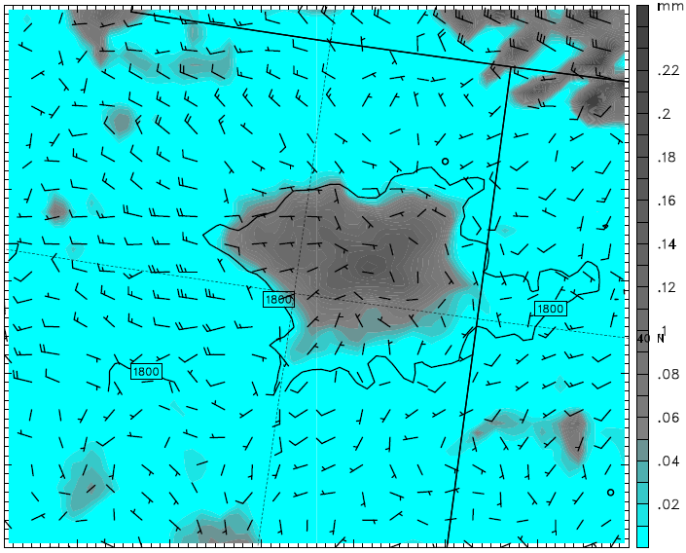
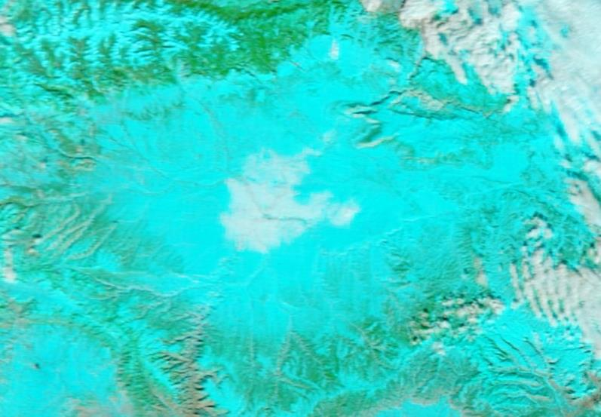
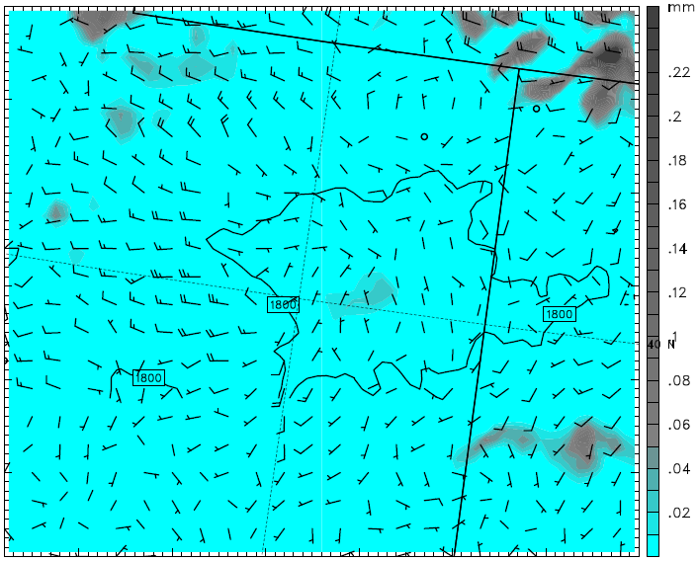
YSU run
1 Feb 2013 18Z
MYJ used because did not
over-predict basin cloud cover as much as YSU
MODIS 1 Feb 2013 1910Z
MYJ run
1 Feb 2013 18Z

Slide 11
Improving WRF Mesoscale Wintertime CAP Simulations
STEP 2: Improve snow cover and ground temperature model initialization
Model initialization snow cover fields sometime good, sometimes poor.
Initialized new snow cover fields based on in situ observations
Corrected model skin and ground temperature (Soil Climate Analysis Network) based on in situ observations

Slide 12
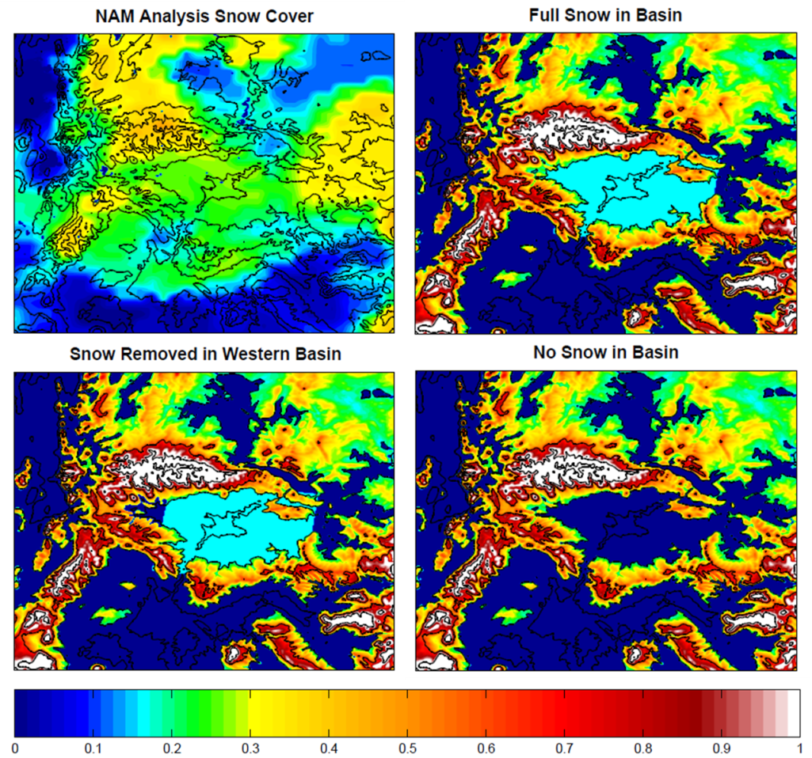
Idealized snow cover in Uintah Basin and mountains
00Z 1 Feb 2013
NAM overestimation inside Uintah Basin (22 to 28 cm)
Elevation-dependent snow cover above 2000 m (17 cm to 1 m above 2900 m)
Uniform snow in basin (17 cm depth, 21.25 kg/m³ SWE, 8:1 ratio)

Slide 13
Improving WRF Mesoscale Wintertime CAP Simulations
STEP 3: Improve model physical representation land use/snow cover/boundary layer clouds
Updated land use with high resolution (60 m) 2006 data set
Modified vegetation to be more easily covered by snow
Number of microphysical edits to obtain more realistic boundary layer clouds

Slide 14
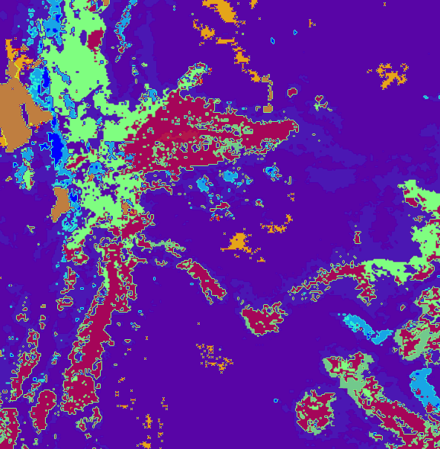
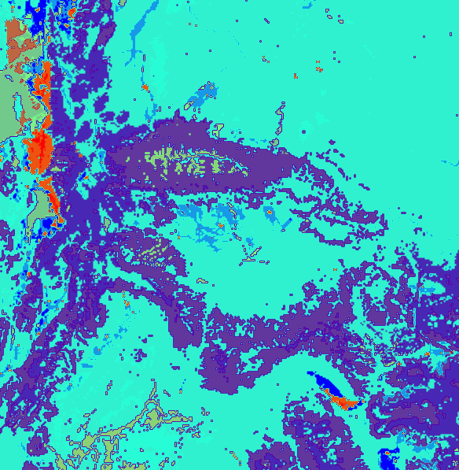
Updated Land Use data
Old USGS Land Use data
New NLCD 2006 data
More urban categories
Changes in Uintah Basin
Updated land use data to NLCD 2006 (1 arc-second, ~30 m)
Uintah Basin primary “shrubland” and “cropland/grassland mosaic”
“Barren or sparsely vegetated”, “grassland”, and “irrigated cropland & pasture” significantly decreased

Slide 15
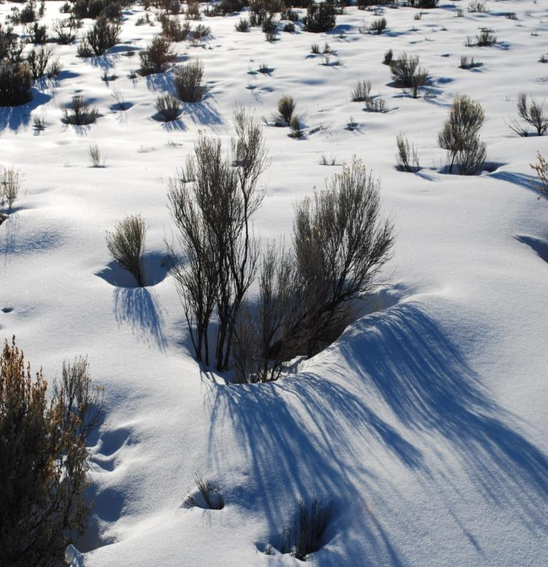
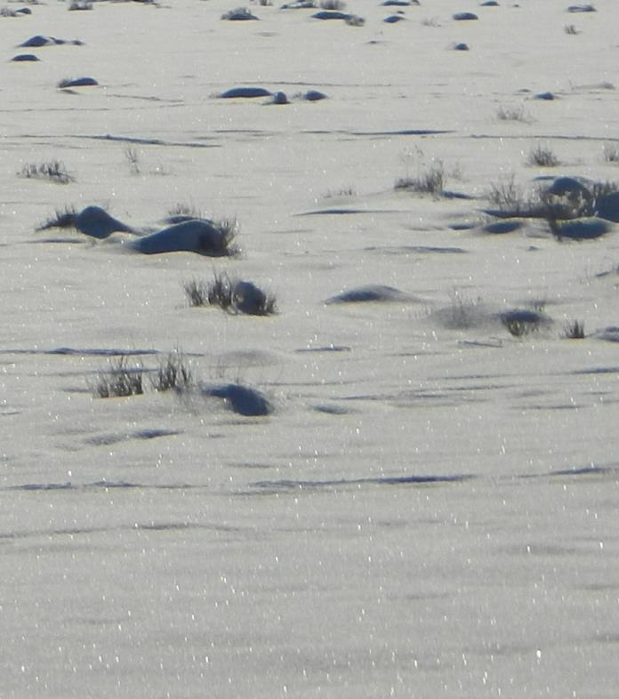
Fixing the effective vegetation depth
INCORRECT
CORRECT
What model was simulating BEFORE edits
(photo NOT from Uintah Basin)
What model simulating AFTER edits
(photo taken in Uintah Basin Feb 2013)

Slide 16
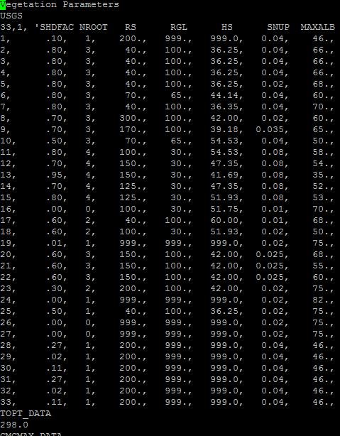
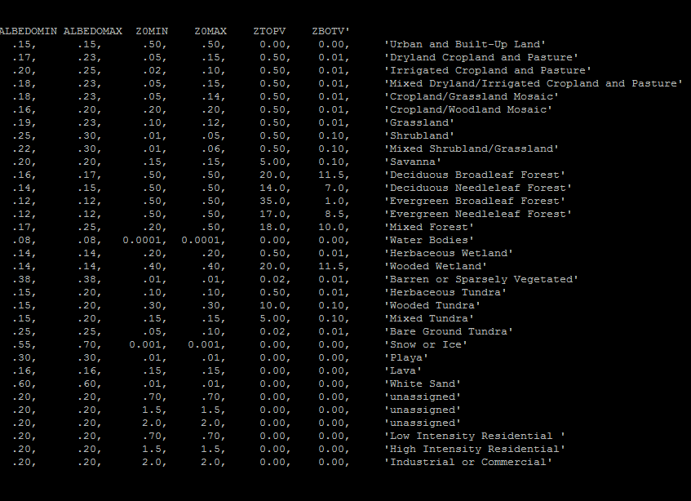
Modified VEGPARM.TBL
Changed from .04 to .02
Changed from .03 to .02
Modified VEGPARM.TBL “SNUP” to 0.02 for vegetation categories 5 & 8 (cropland/grassland mosaic & shrubland)
Allows 2 cm of SWE (20 kg/m³) to “cover up” vegetation with snow
Enables albedo to attain “max snow albedo”, instead of combination of snow albedo and vegetation albedo

Slide 17
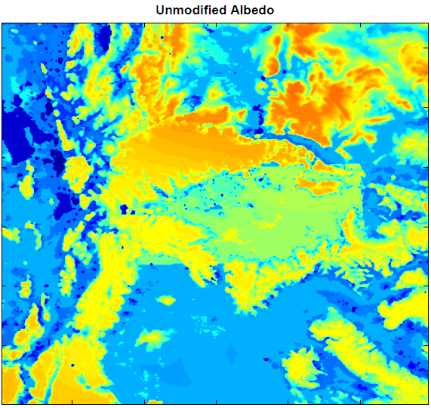
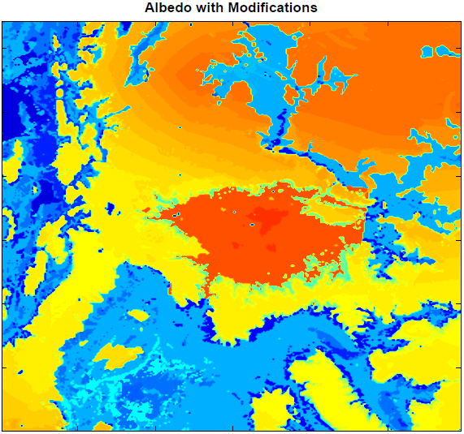
Snow Albedo changes
0.52 - 0.57 Average
0.8 - 0.82 Average
Combination of VEGPARM.TBL and snow albedo edits achieve desired albedos
Set snow albedo to 0.82 within the basin (below 2000 m)
Left snow albedo as default value outside the basin
Change in land use dataset accounts for differences outside the basin

Slide 18
Microphysics Modifications (Thompson)
Changes to homogeneous freezing temperature
Changes to ice nucleation temperature
Turning off cloud ice sedimentation
Turning off cloud ice autoconversion to snow

Slide 19
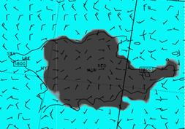
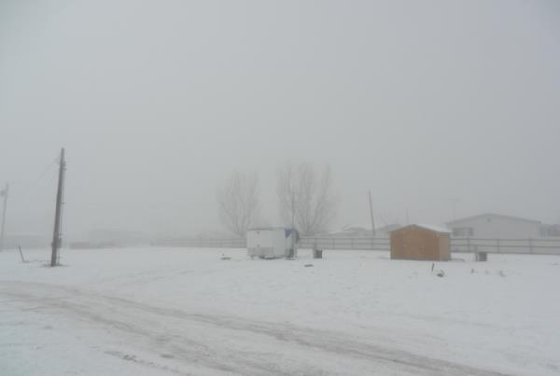
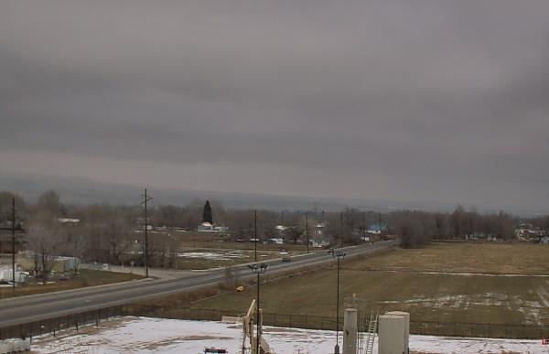
Observed
WRF Model before microphysics edits
Shallow near surface low clouds and ice fog
Deep, extensive liquid low clouds
?
Dense surface freezing fog

Slide 20
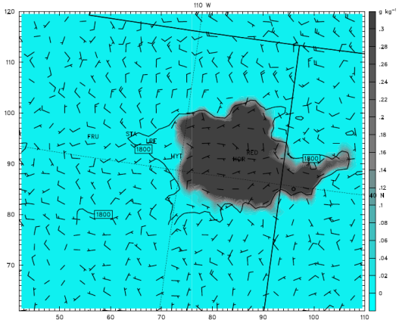
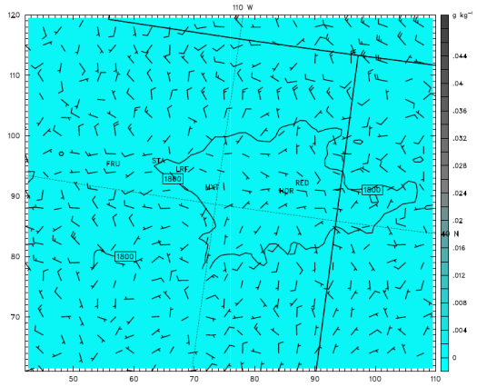
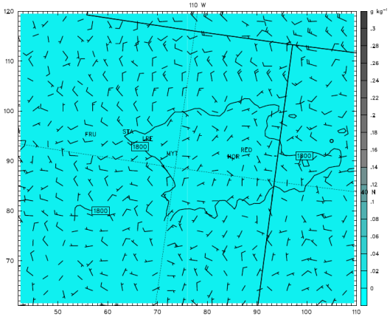
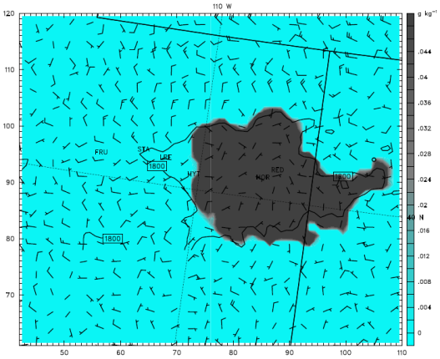
Sedimentation - Average cloud ice & cloud water bottom 10 levels
4 Feb 2013 06Z
Cloud Ice
Cloud Water
*Both runs have Autoconversion OFF
Ice sedimentation OFF
= Ice Cloud
Cloud Ice
Cloud Water
Ice Sedimentation ON
= Liquid Cloud

Slide 21
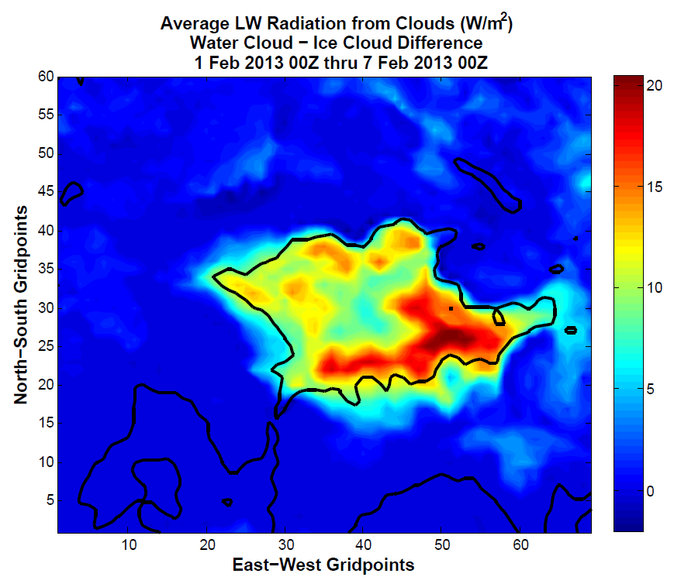
Impact of Liquid Clouds vs. Ice Clouds
Over the entire model run, liquid clouds produced an average of 7-20 W/m² more longwave energy than ice clouds in the Unitah Basin

Slide 22
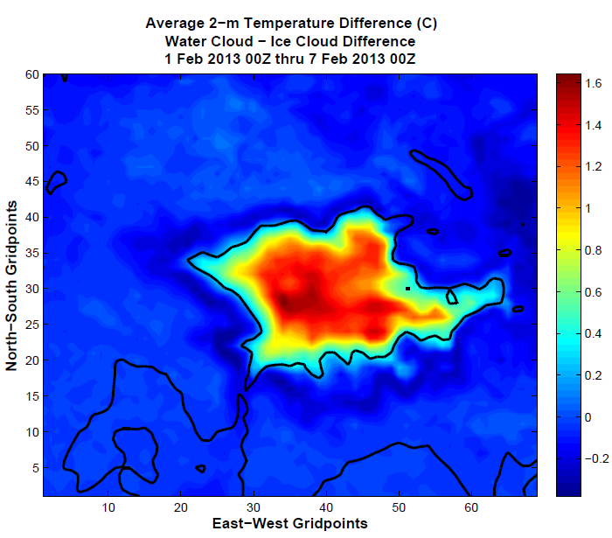
Impact of Liquid Clouds vs. Ice Clouds
Over the entire model run, liquid cloud case averaged 0.4 - 1.6 deg C warmer than the ice cloud case in the Uintah Basin

Slide 23
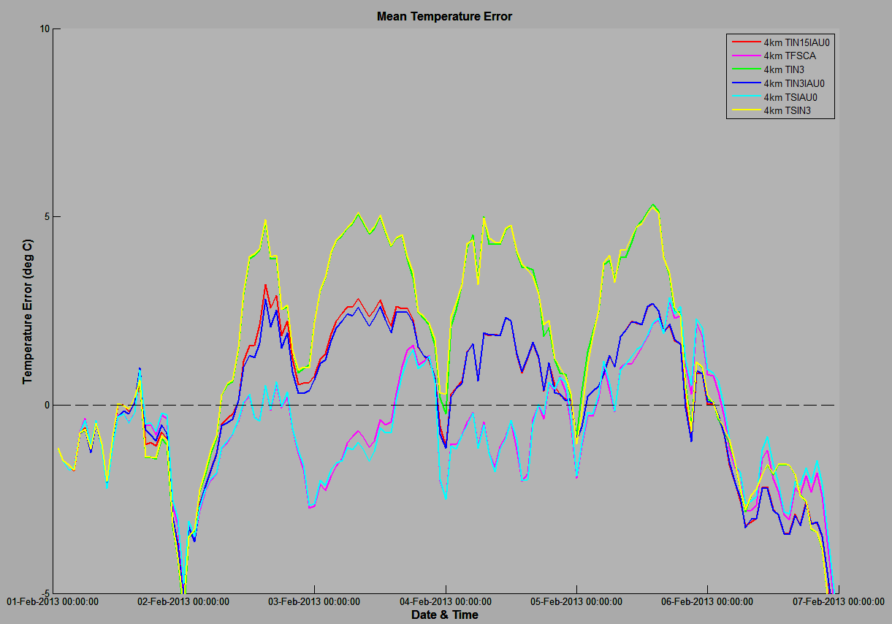
Primary Outcomes from Microphysics Testing
Model runs with “thick liquid clouds”
Model runs with “thick ice clouds”
Additional 2-3 deg C warm bias overnight
Model runs with “clear sky”

Slide 24
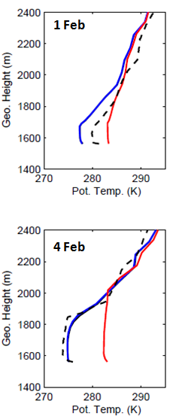
Modeled Vertical Structure
Boundary layer depth and temperature generally well-captured
Stability within the inversion not quite strong enough at some times

Slide 25
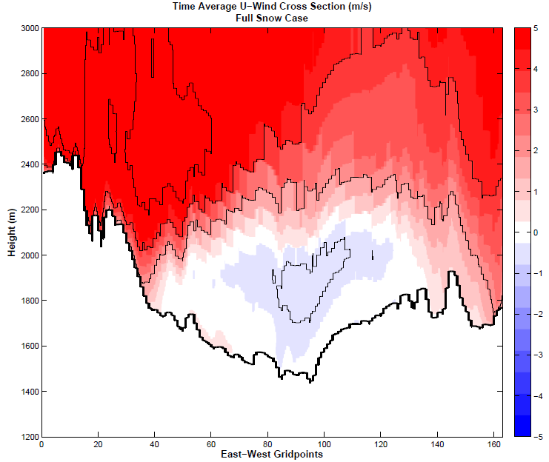
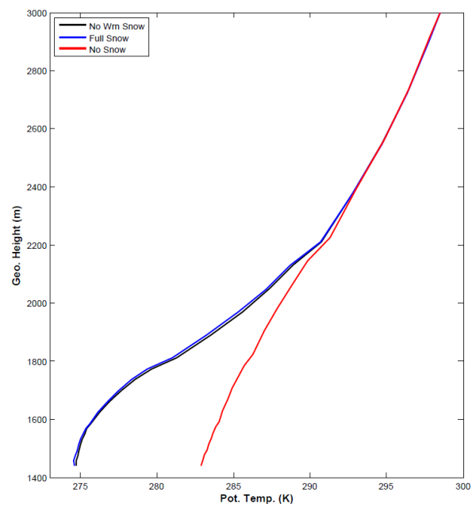
Uintah Basin Flow Patterns
Average Potential Temperature profile at Ouray
Average Zonal Wind - All Hours
Greatest Stability
Inversion/greatest stability typically between 1800 - 2200 m MSL
Weak easterly flow exists within and below inversion layer
Core greater than 0.5 m/s
Likely important role in pollutant transport within the basin

Slide 26
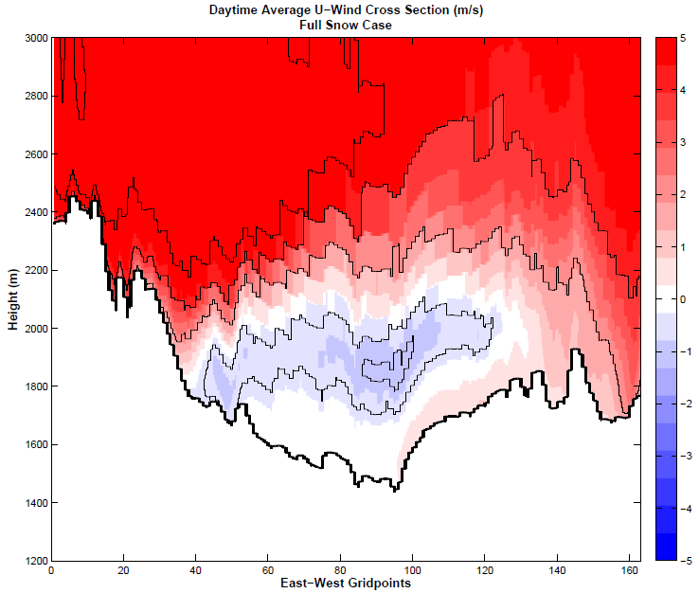
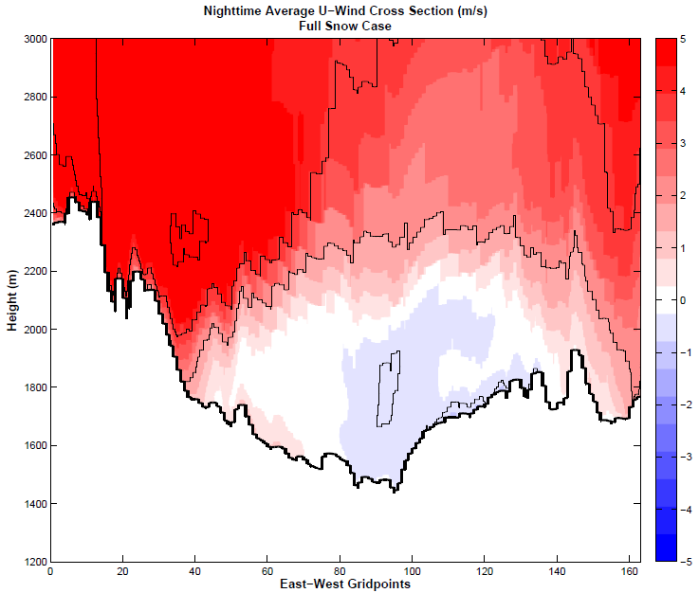
Uintah Basin Flow Patterns
Daytime Hours
0800L - 1600L
Nighttime Hours
1700L - 0700L
Easterly flow stronger during the day, weaker during the night
Indicates thermal gradients likely the main driver
Core winds greater than 1 m/s during the day
Diurnal upslope/downslope flows also apparent in day/night plots

Slide 27
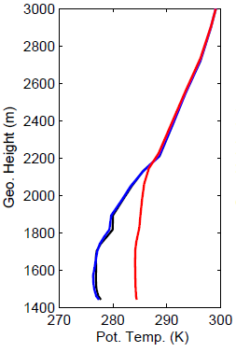
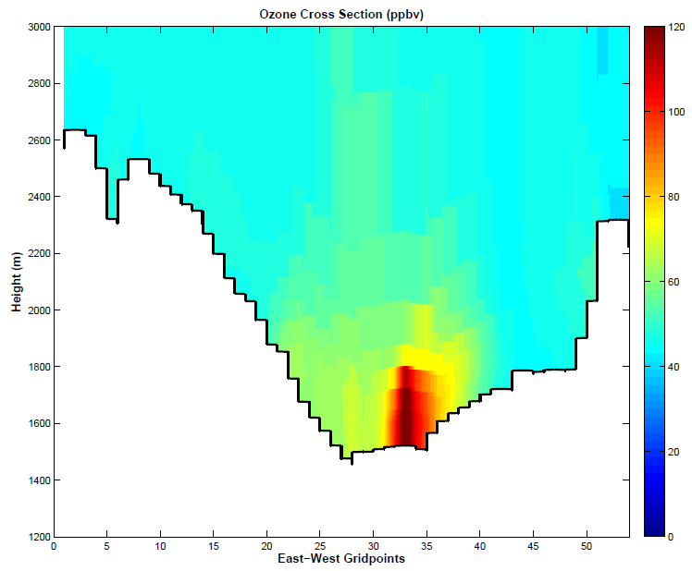
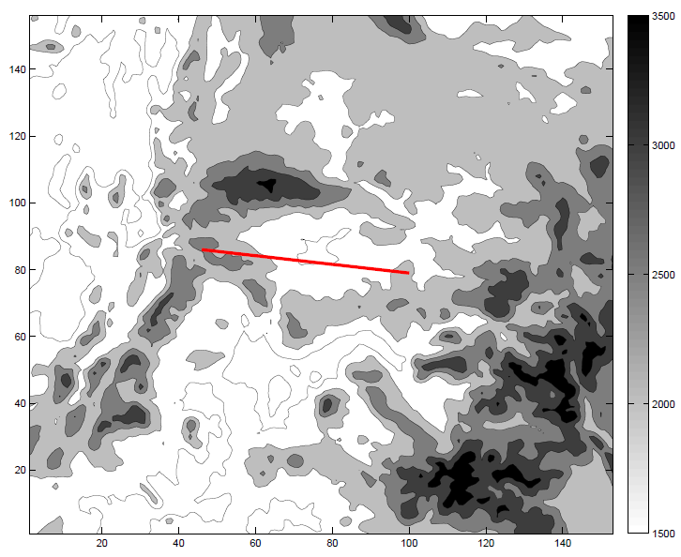
Uintah Basin Ozone
Greatest Stability
2200 UTC 2 Feb 2013
4km WRF output run through DAQ’s air quality model (CMAQ)
Model produced ozone concentrations up to 129 pbbv
Increase of 20-30 ppbv over base WRF runs
Highest concentrations confined to lowest 200-300 m in stable PBL/inversion, as observed during UBOS 2013

Slide 28
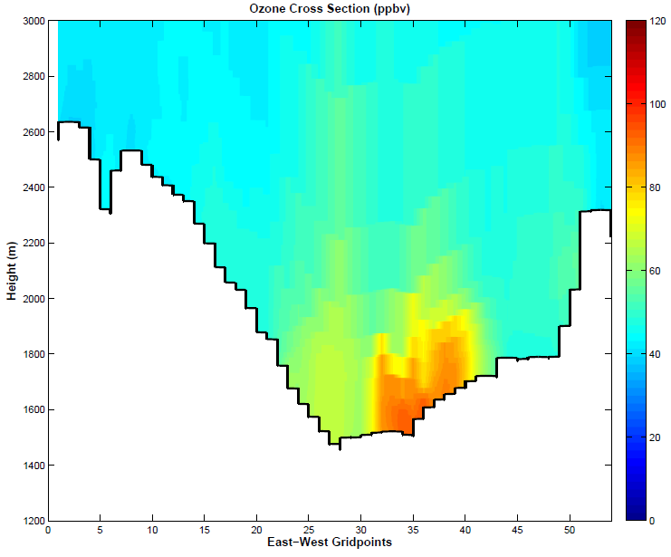
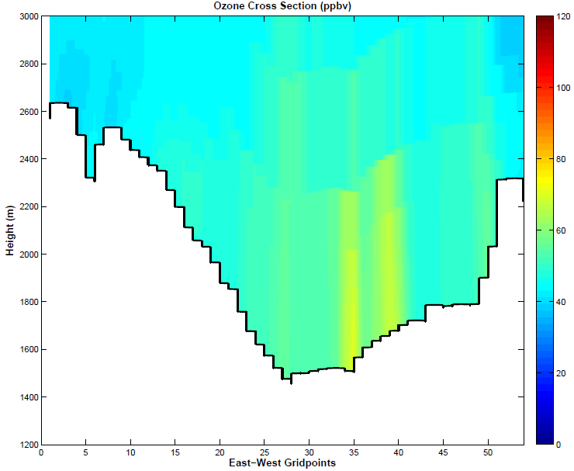
Uintah Basin Ozone - 2200 UTC 2 Feb 2013
Snow - Modified
Snow - Base
No Snow
4km WRF output run through DAQ’s air quality model (CMAQ)
Modified WRF produced ozone concentrations up to 129 pbbv
Increase of 20-30 ppbv over base WRF runs
Highest concentrations confined to lowest 200-300 m in stable PBL/inversion, as observed during UBOS 2013
No Snow run contains much lower ozone and deeper PBL

Slide 29
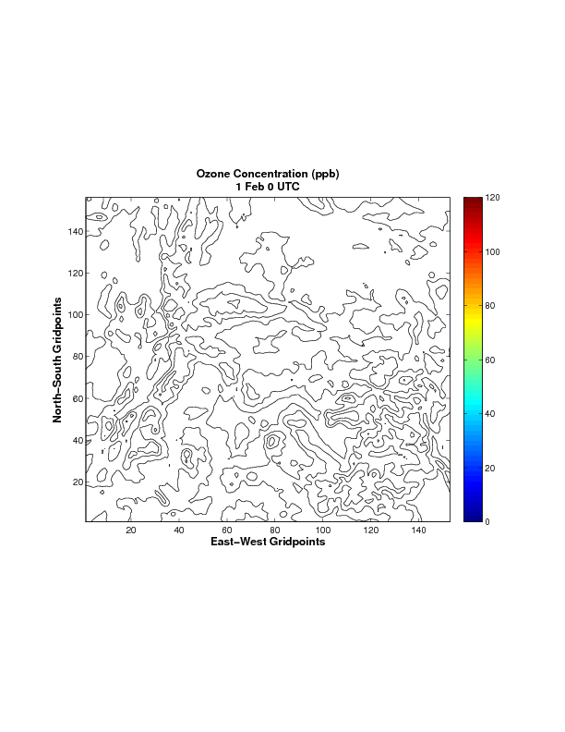
Surface Ozone Concentration
1 - 5 Feb 2013

Slide 30
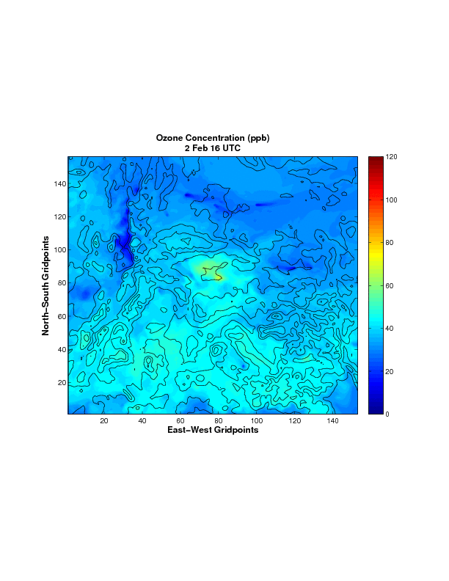
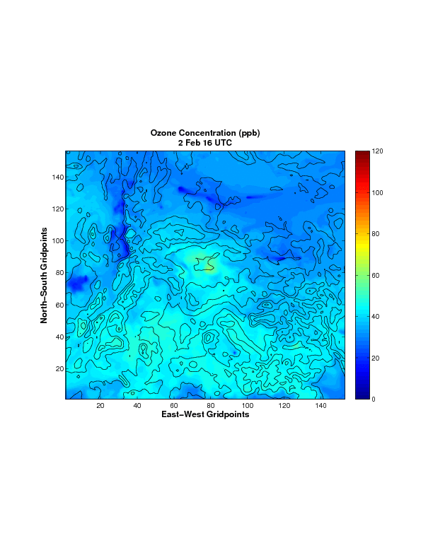
Surface Ozone Concentration
2 - 5 Feb 2013
Snow - Modified
Snow - Base
No Snow

Slide 31
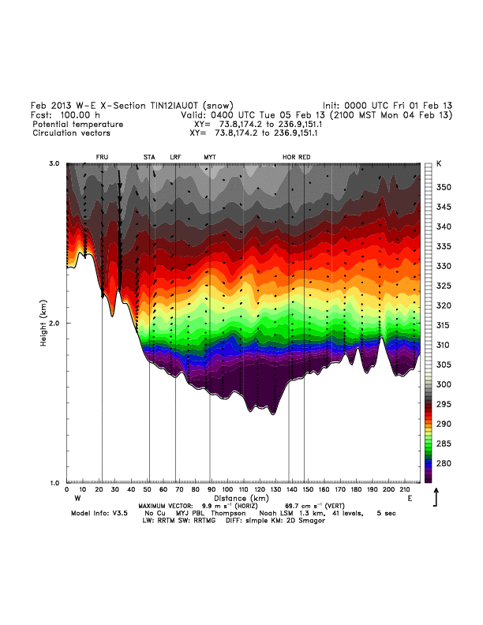
Cold Pool Evolution hours 70-100

Slide 32
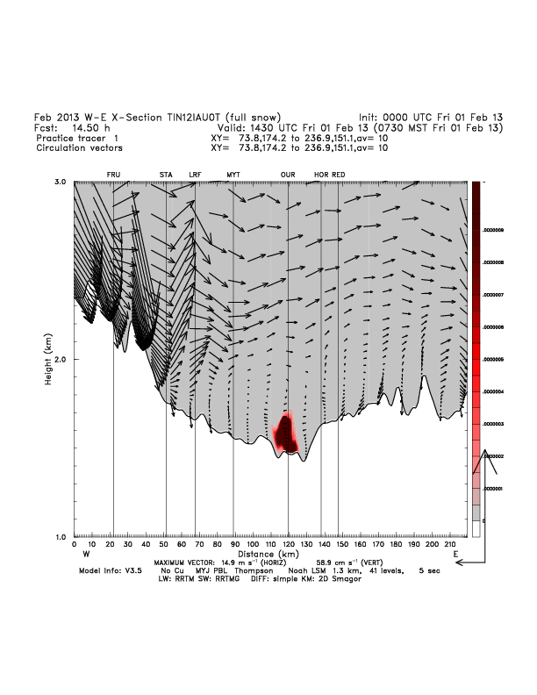
WRF 24-Hour Tracer Run - Full Snow
Cross Section Animation

Slide 33
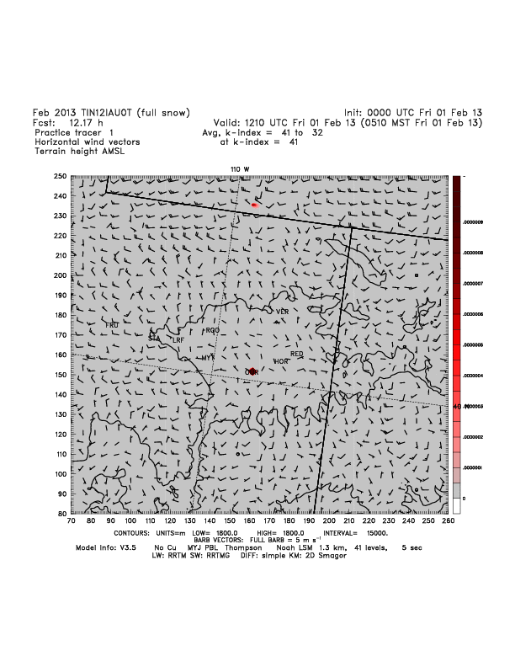
WRF 24-Hour Tracer Run - Full Snow
Animation for bottom 10 model levels

Slide 34
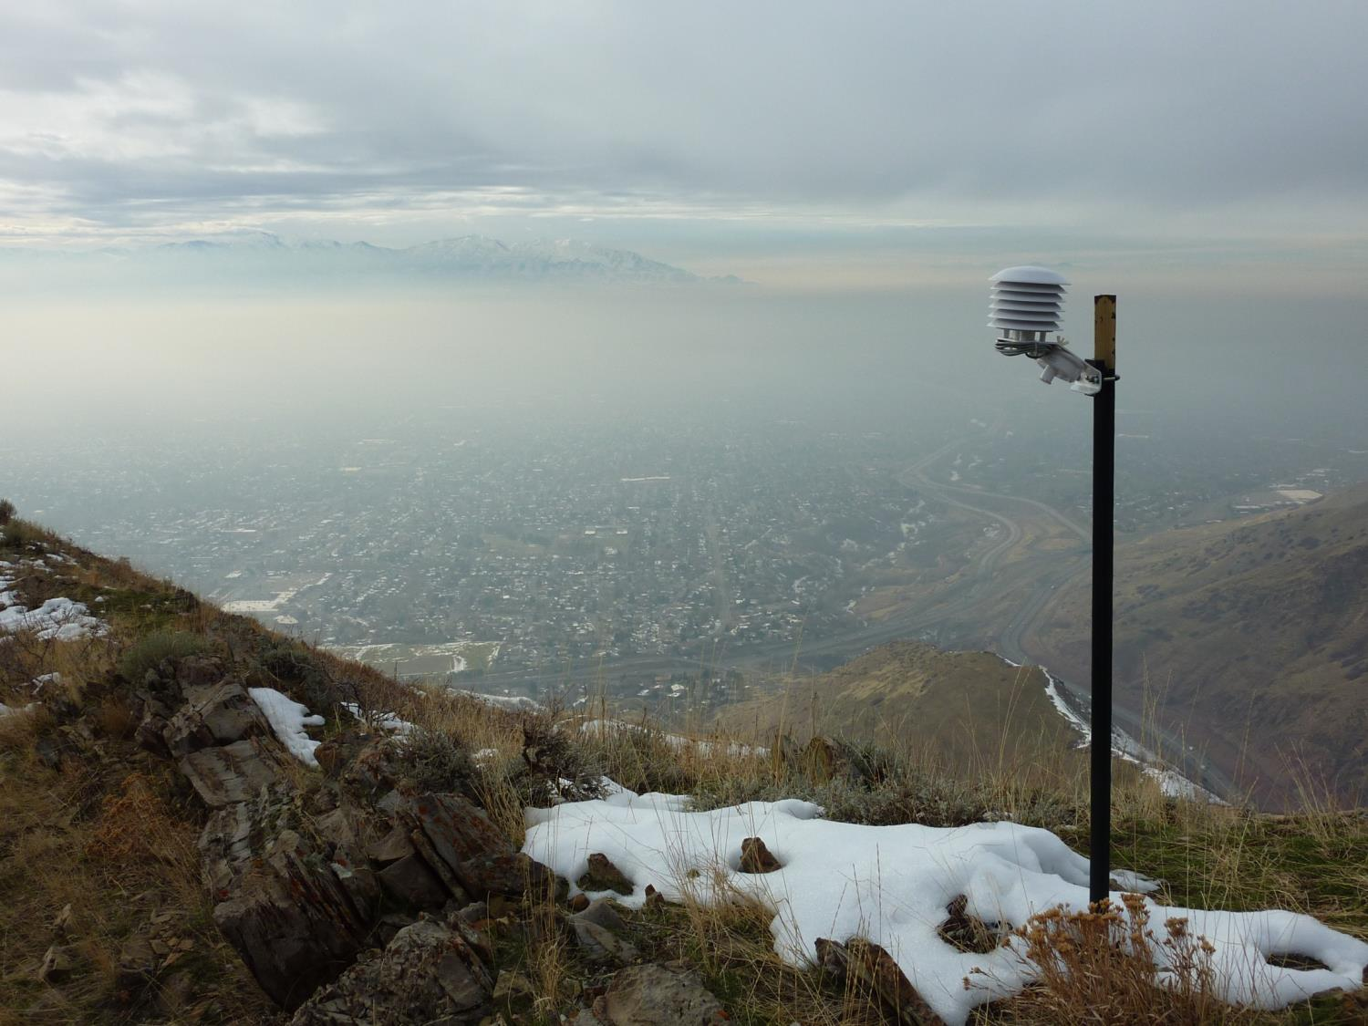
The End

