Slide 1
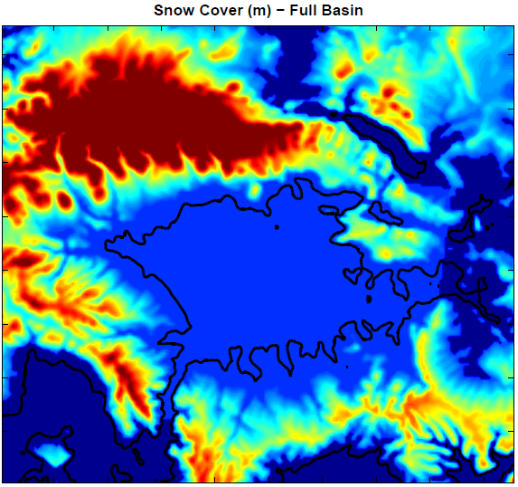
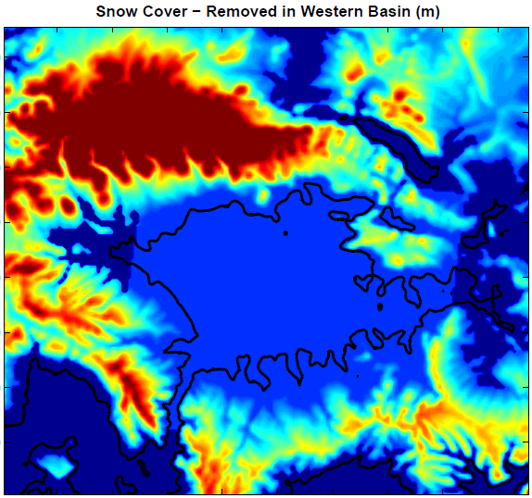
Idealized snow cover in Uintah Basin and mountains
00Z 1 Feb 2013
Elevation-dependent snow cover above 2000 m (17 cm to 1 m above 2900 m)
Uniform snow in basin (17 cm depth, 21.25 kg/m³ SWE, 8:1 ratio)
Removed west of -110.4 W longitude below 2100 m

Slide 2
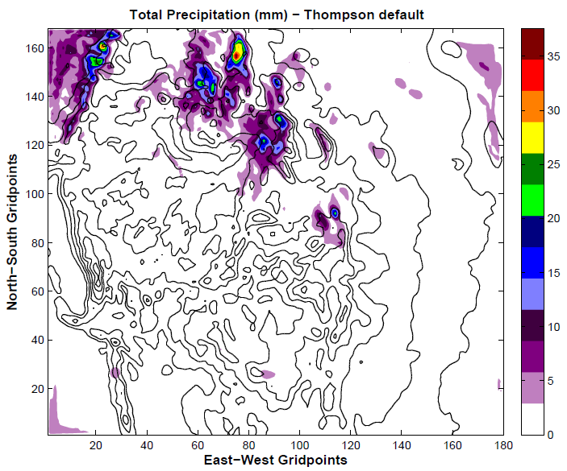
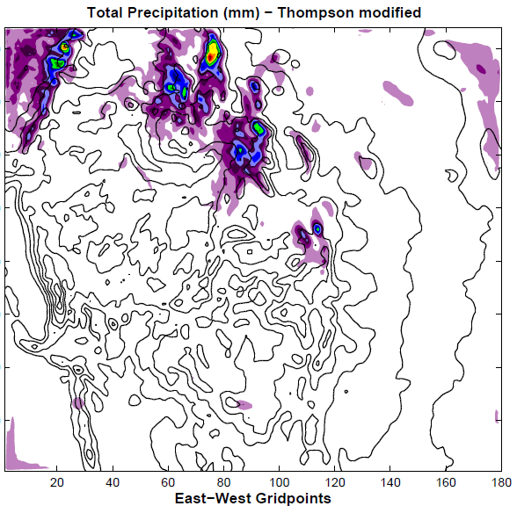
Impact of Microphysics Modifications on
Accumulated Precipitation in Domain 1
Basic precipitation pattern and maximas are very similar
Small differences in mountainous terrain

Slide 3
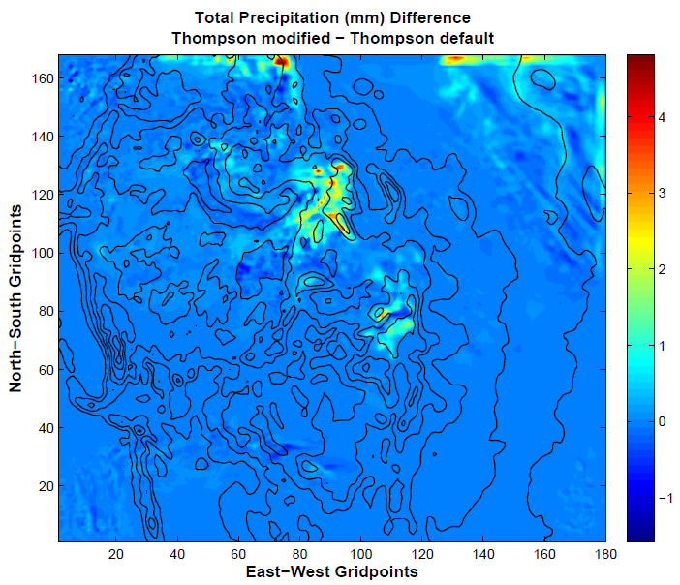
Impact of Microphysics Modifications on
Accumulated Precipitation in Domain 1
Minor increases of 2-4 mm in ID/WY and CO mountains
Very small increase (~.1 or .2 mm) in center of Uintah Basin - almost imperceptible

Slide 4
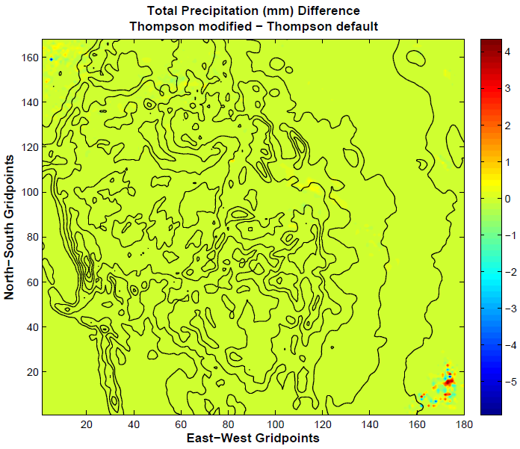
Impact of Microphysics Modifications on
Accumulated Convective Precipitation in Domain 1
No significiant impacts for early Feb 2013 case

Slide 5
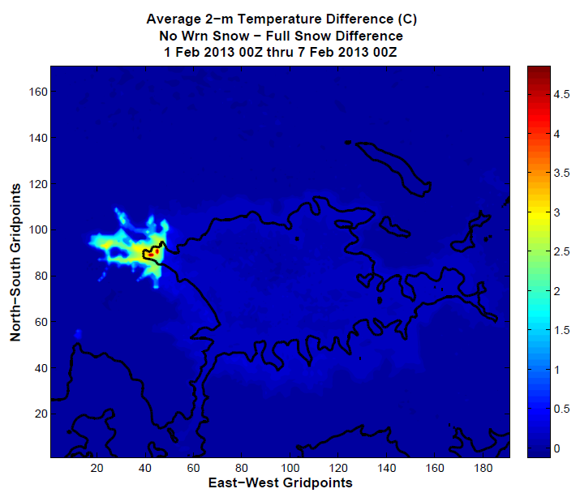
2-m Temperature Difference with Western Snow Removed

Slide 6
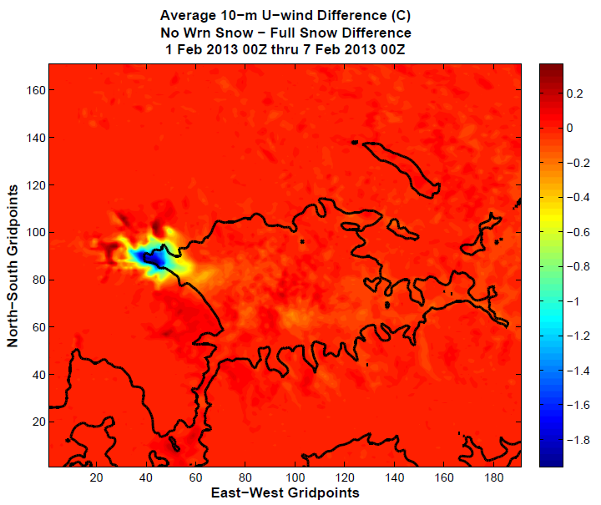
10-m U-Component Wind Difference with Western Snow Removed

Slide 7
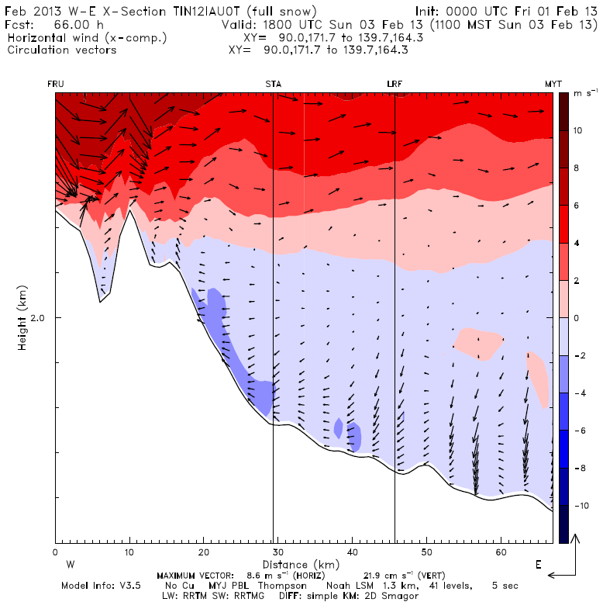
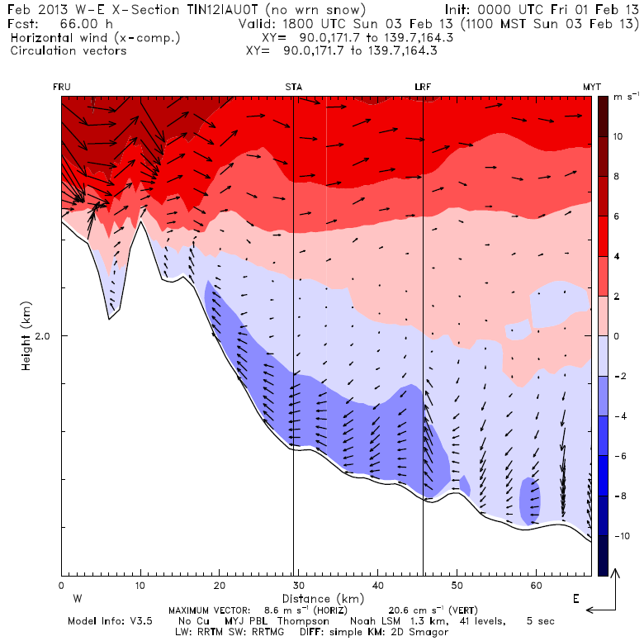
U-wind Cross Sections
Full Snow
No Western Snow
Stronger Easterly flow typically seen near surface along snow/no snow boundary in “No Western Snow” run

Slide 8
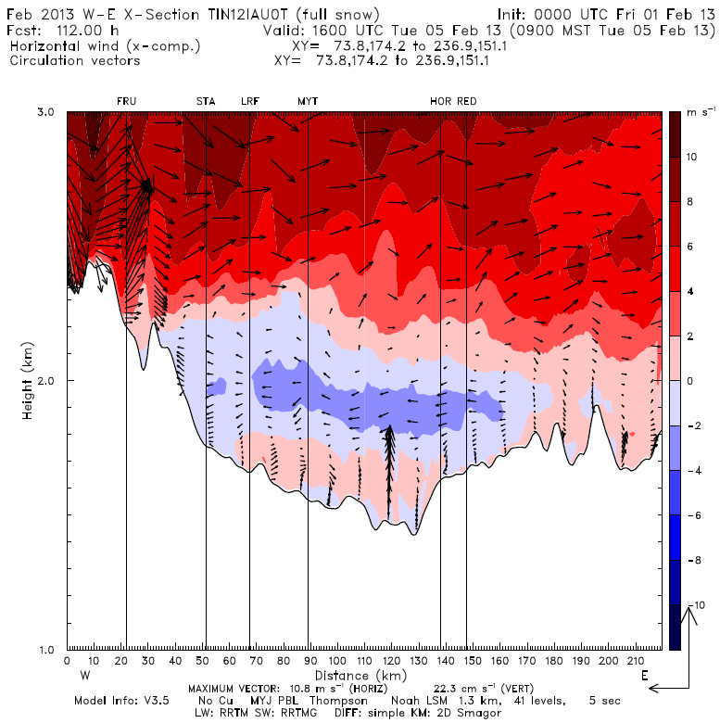
U-wind Cross Sections
Full Snow
No Western Snow
Overall flow patterns largely the same in both cases

Slide 9
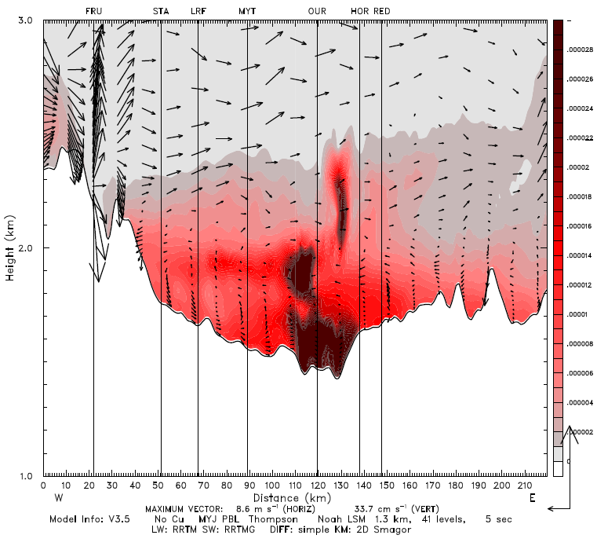
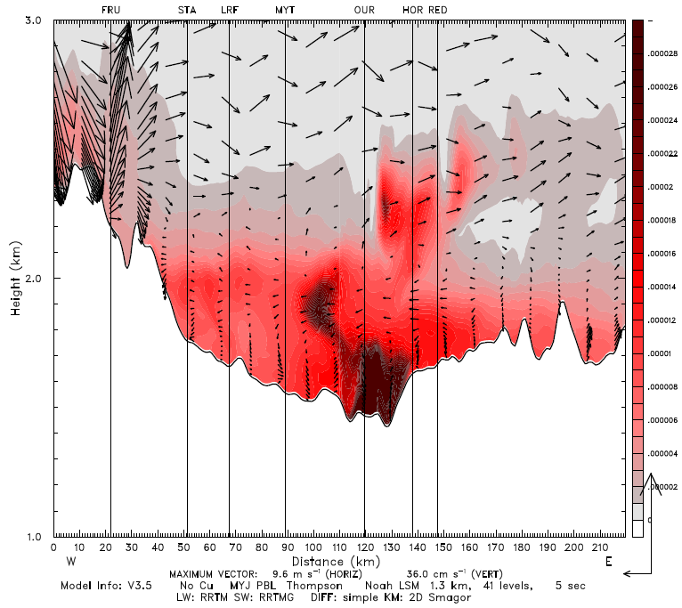
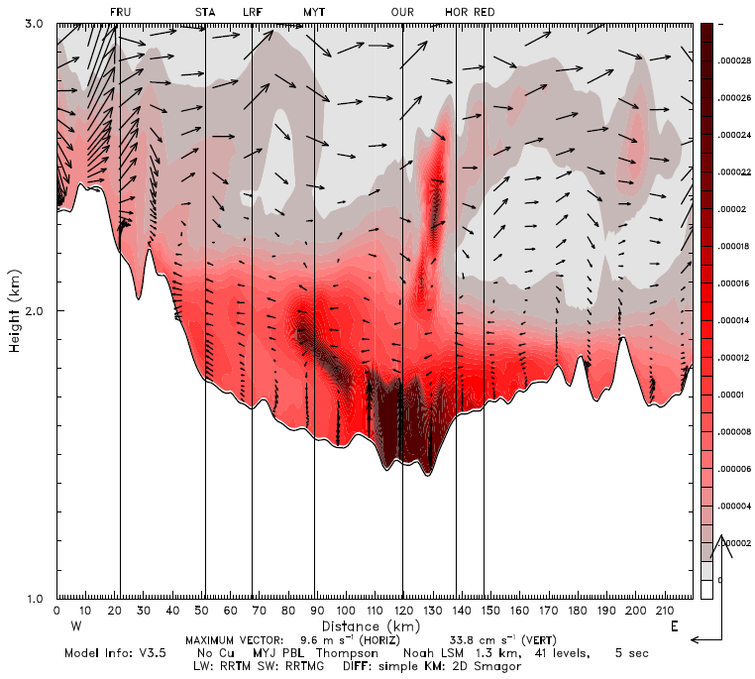
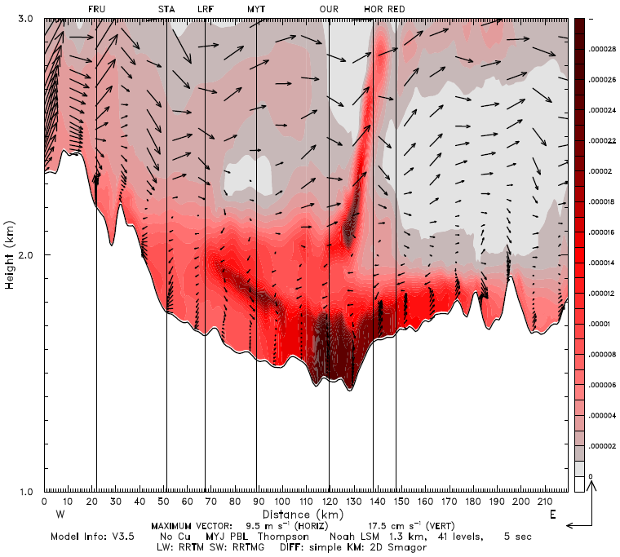
Tracer Cross Sections
11Z 5 Feb
13Z 5 Feb
Tracer plume moving west in easterly flow from 11-17 Z on 5 Feb 2013
15Z 5 Feb
17Z 5 Feb

Slide 10
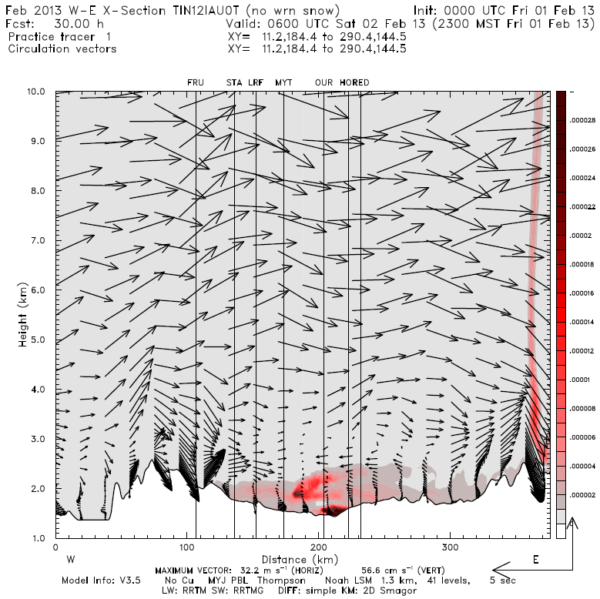
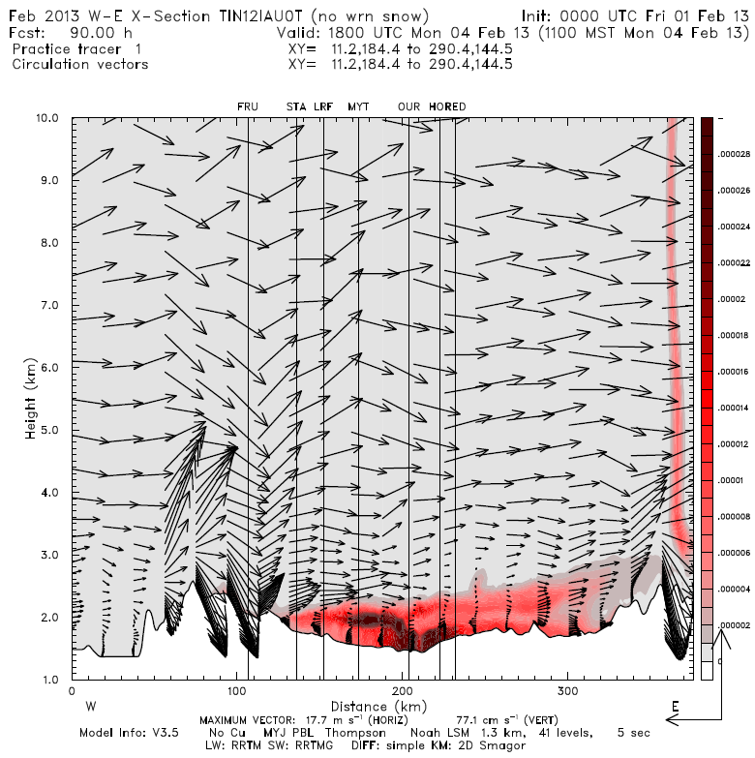
Tracer Cross Sections
06Z 2 Feb
18Z 4 Feb
Tracer concentrations build in low levels throughout the simulation
Pushed around by flows within basin and depth is modulated by stability

Slide 11
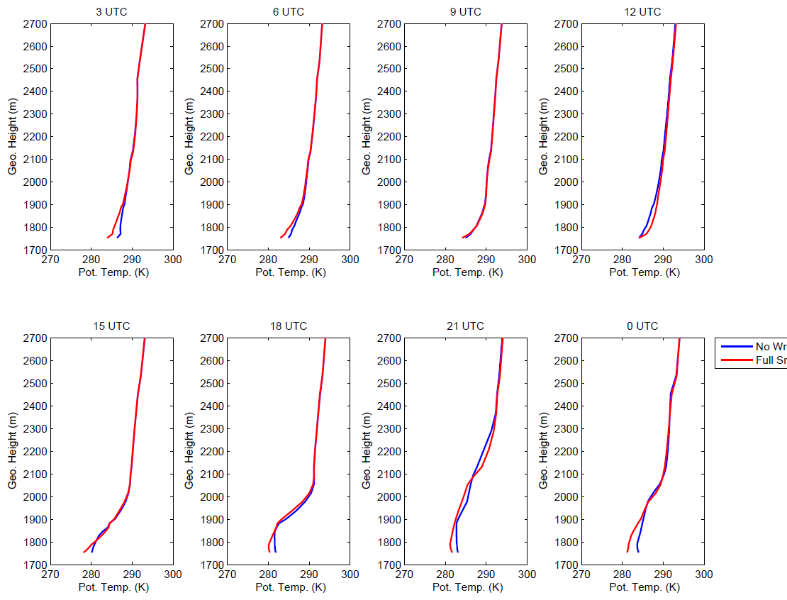
Starvation 1 Feb 2013

Slide 12
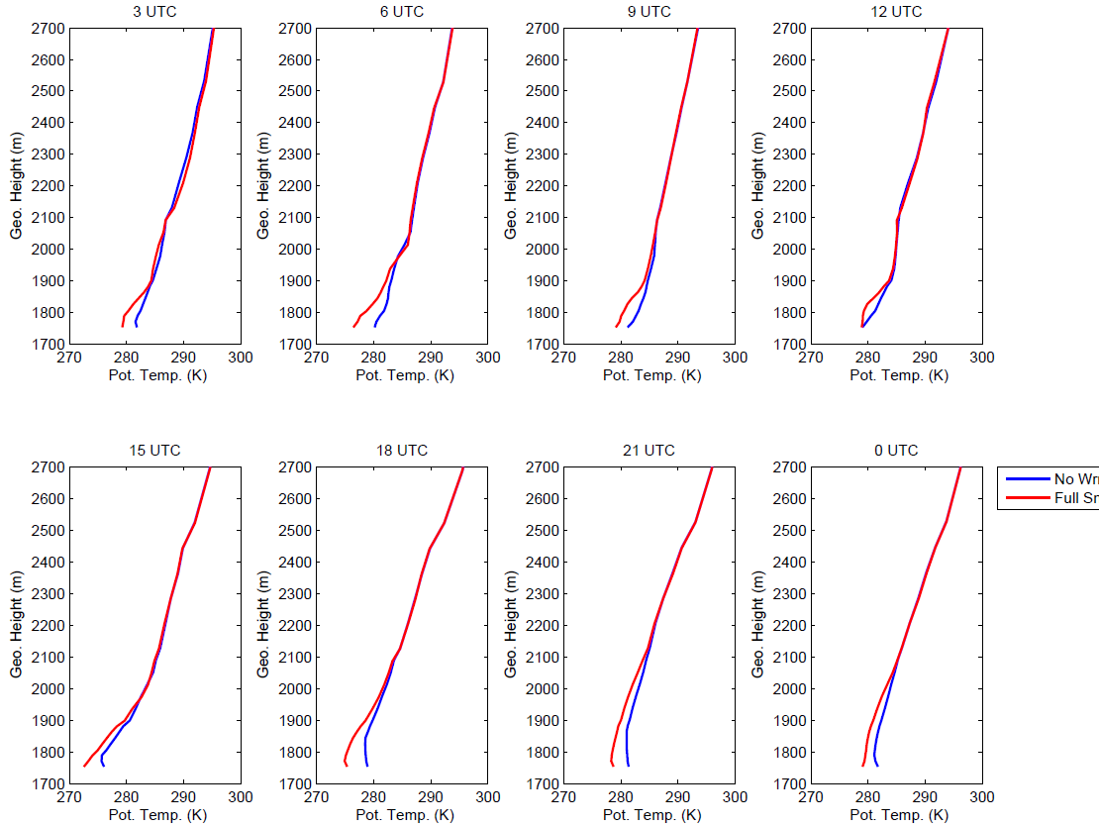
Starvation 2 Feb 2013

Slide 13
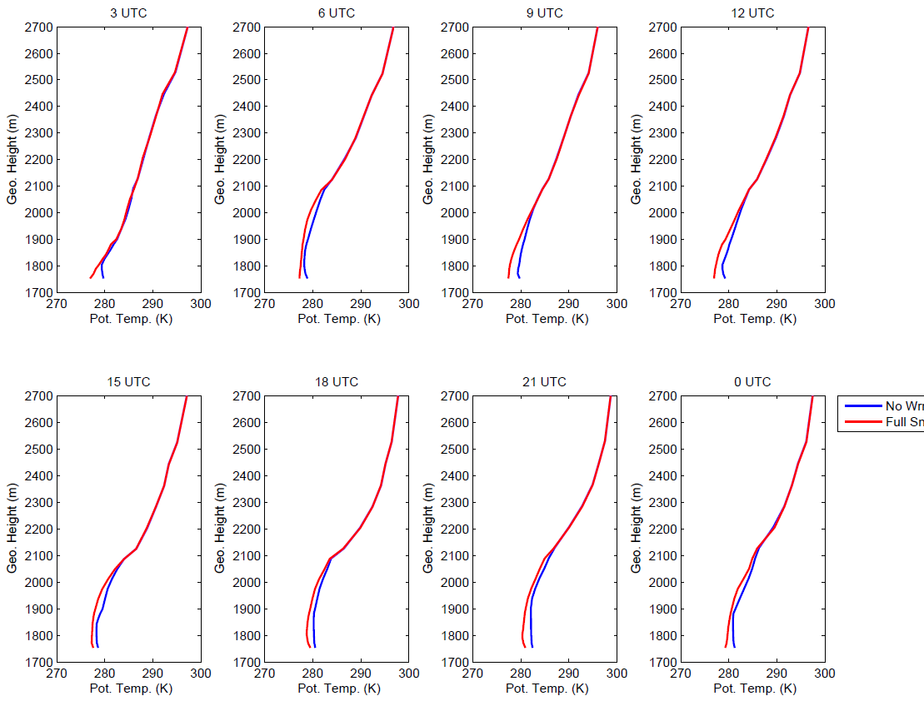
Starvation 3 Feb 2013

Slide 14
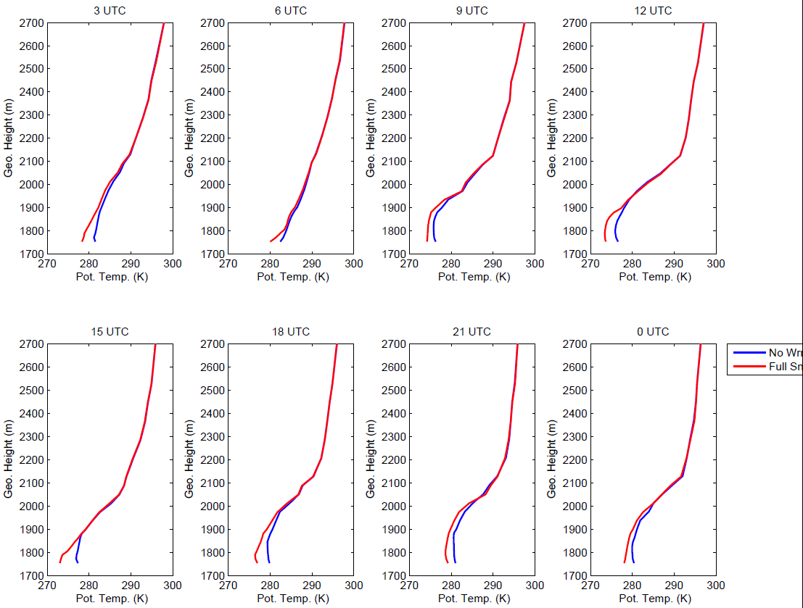
Starvation 4 Feb 2013

Slide 15
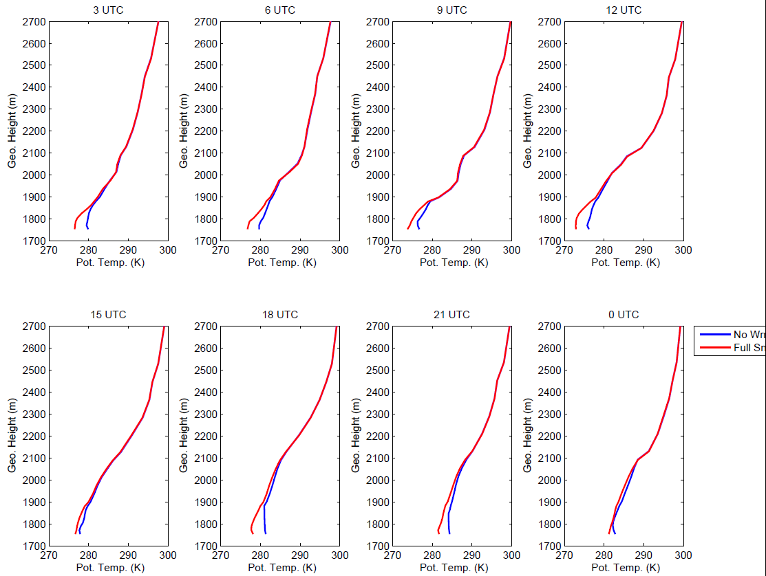
Starvation 5 Feb 2013

Slide 16
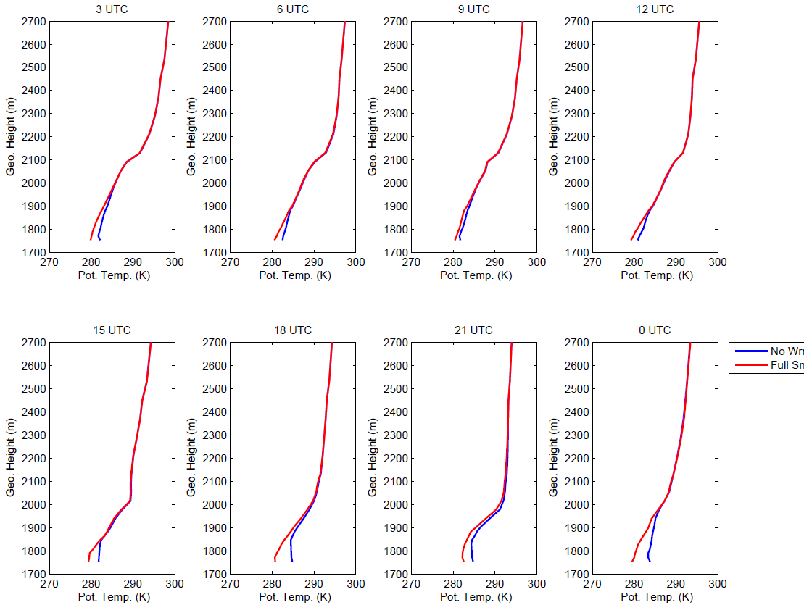
Starvation 6 Feb 2013

