Slide 1
UU Unitah Basin WRF Model Configuration (same as DEQ)
See Alcott and Steenburgh 2013 for further details on most aspects of this numerical configuration:
http://journals.ametsoc.org/doi/abs/10.1175/MWR-D-12-00328.1
Namelist used for real.exe is located at: http://home.chpc.utah.edu/~u0818471/namelist.wps
Namelist used for wrf.exe is located at: http://home.chpc.utah.edu/~u0818471/namelist.input
Overview summary of WRF Namelist options
map_proj= 1: Lambert Conformal
NAM analyses provide initial cold start and land-surface conditions, and lateral boundary.
Idealized snowcover as function of height input to replace poor NOHRSC snow
3 Domains (see next slide)
Number of vertical levels = 41
Time step = 45 seconds (15, 5 s for inner 2 grids)
Microphysics: Thompson scheme
Radiation: RRTM longwave, RRTMG shortwave
Surface layer: Monin-Obukov
NOAH land-surface option
MYJ PBL Scheme
Kain-Fritsch cumulus scheme in outer coarse 12 km grid
Slope effects for radiation, topo shading turned on
2nd order diffusion on coordinate surfaces
Horizontal Smagorinsky first-order closure for eddy coefficient

Slide 2
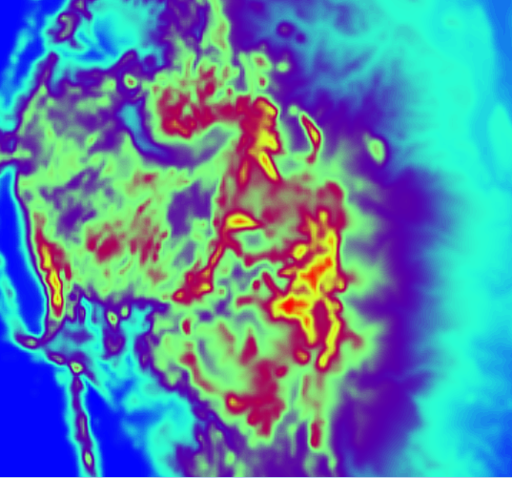
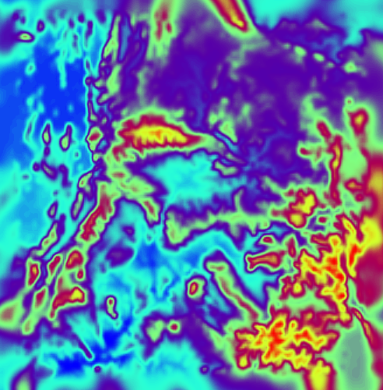
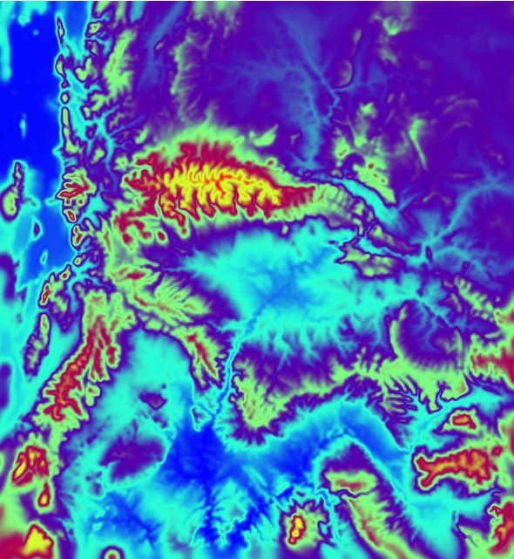
WRF Domains
3 one-way nested domains
1 - Outer (12 km)
2 - Middle (4 km)
3 - Inner (1.333 km)

Slide 3
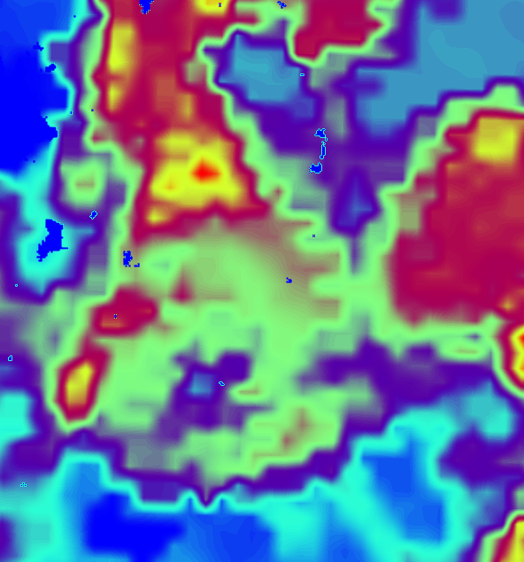
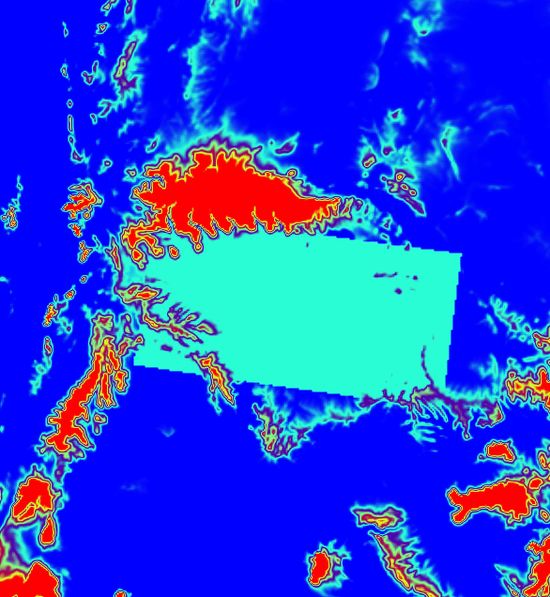
Idealized Snow Cover and Gradient
00Z 1 Feb 2013
NAM Analysis Snow Cover
00Z 1 Feb 2013
Domain 3 Modified Snow Cover
22 to 28 cm
(overestimation inside Uintah Basin)
17 cm
12 cm

Slide 4
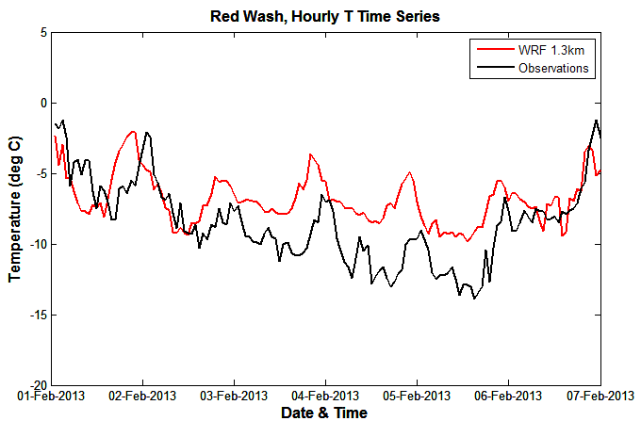
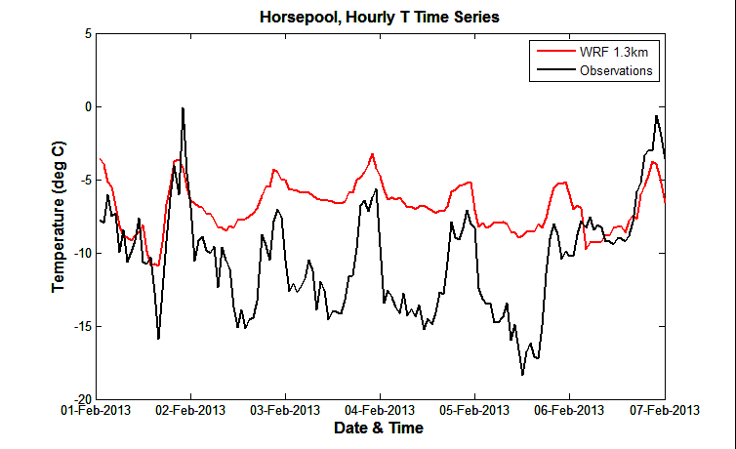
WRF Performance – 2m Temperatures
Elevation 1630 m
Average warm bias for 2 m temperatures of 3.4 C within Uintah Basin
Larger errors for interior, low level location
Better performance at higher elevations in the basin
Larger errors overnight due to overproduction of cloud cover
Average error = 1.7 C
Elevation 1570 m
Average error = 3.6 C

Slide 5
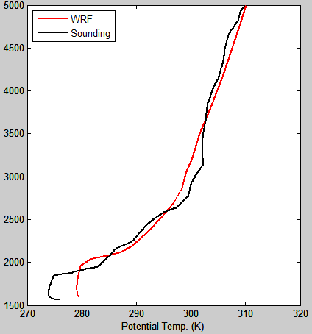
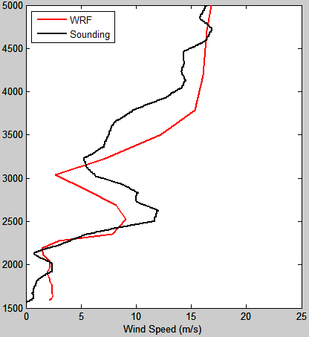
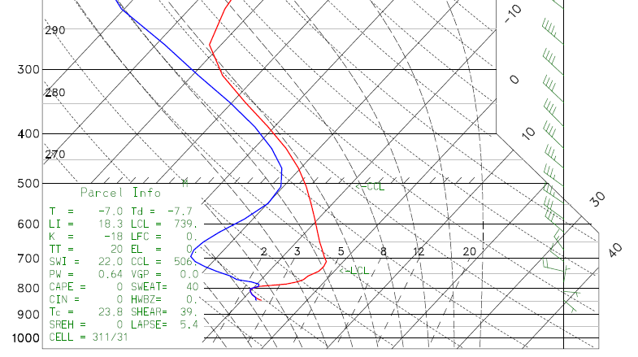
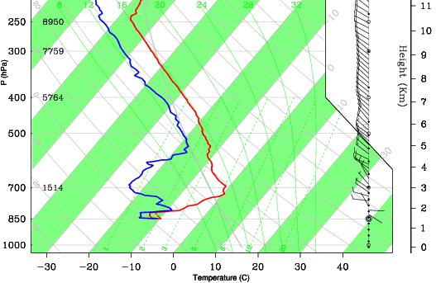
WRF Performance - Vertical Structure
Temperature and depth of PBL is over-predicted
Temperature, Moisture, and winds, well-represented outside of the PBL and above 750 mb
WRF
Observed
Height (m)
18Z 4 Feb 2013
Potential Temperature (K)
Wind Speed (m/s)
WRF Sounding
Observed Sounding

Slide 6
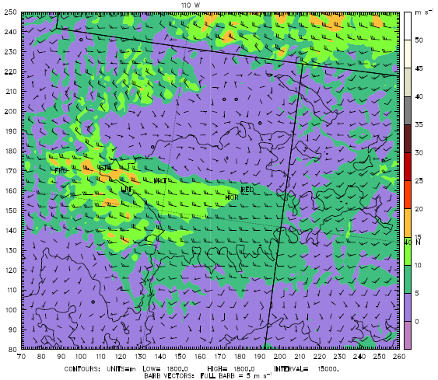
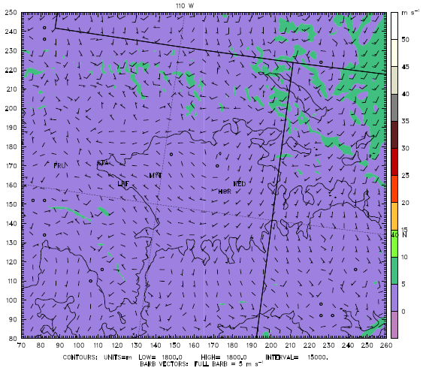
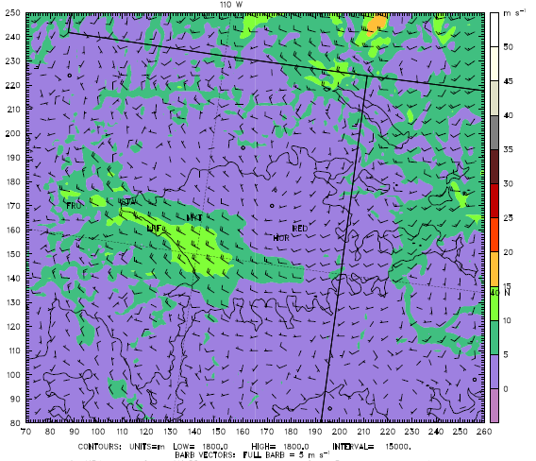
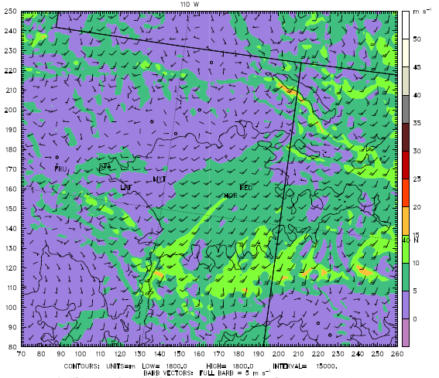
Westerly Wind Intrusion
775 hPa winds
(2.3km MSL)
Large variation in 775 hPa winds during the 1-7 Feb period
Driven by synoptic scale conditions and flow patterns
18Z 1 Feb
12Z 3 Feb
06Z 5 Feb
06Z 6 Feb

Slide 7
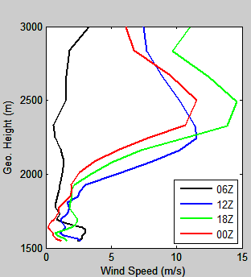
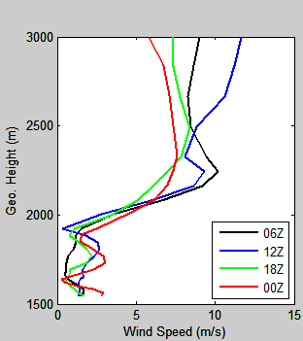
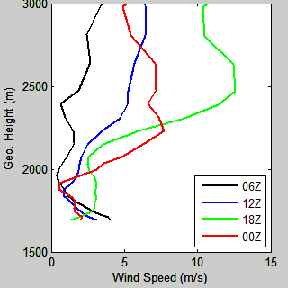
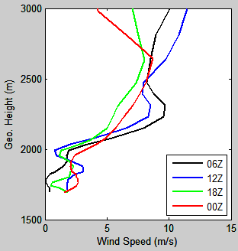
Westerly Wind Intrusion
1 Feb 2013
1 Feb 2013
6 Feb 2013
Horsepool vs. Red Wash wind profile comparison
12Z on 1 Feb:
2 m/s at Horsepool
3 m/s at Red Wash
Similar wind profiles on 6 Feb, particularly the weak jet around 2.3 km at 06Z & 12Z
Horsepool
Red Wash

Slide 8
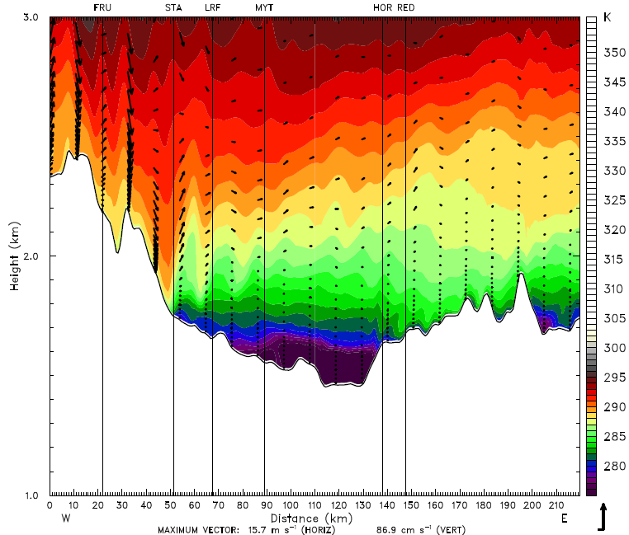
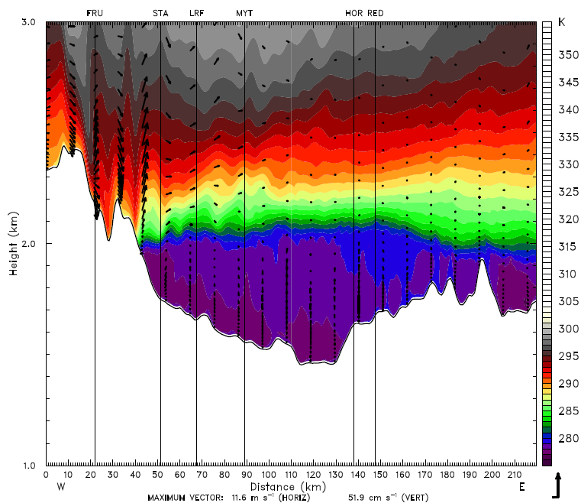
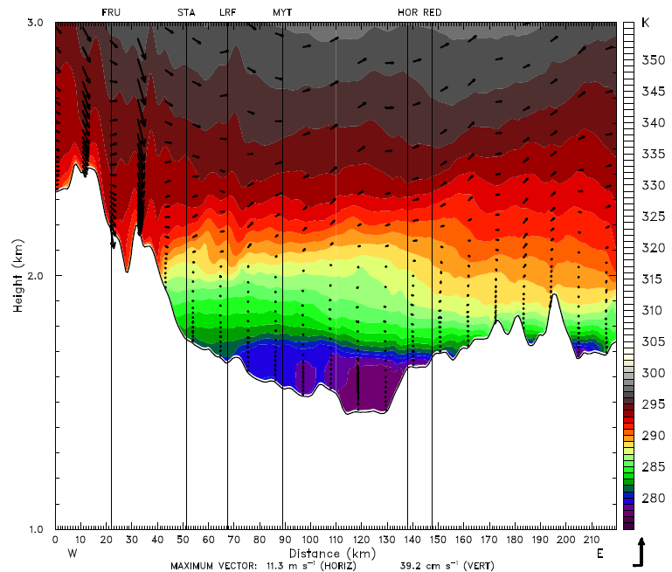
Evolution of Boundary-Layer Height
2.0 km
1.6 km
15Z 1 Feb
15Z 4 Feb
From 1-7 February, boundary layer depth undergoes several changes in depth
Starts shallow 1-2 Feb
Steadily grows into 4 Feb
Fluctuates 4-5 Feb
Lowers 5-6 Feb
1.7 km
12Z 6 Feb

Slide 9
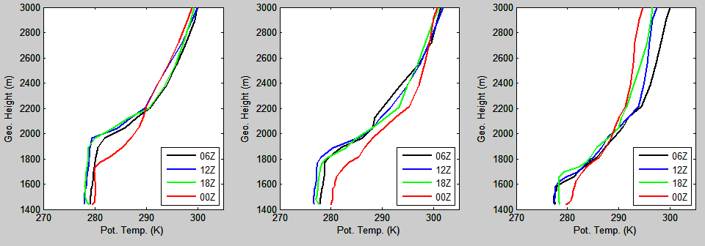
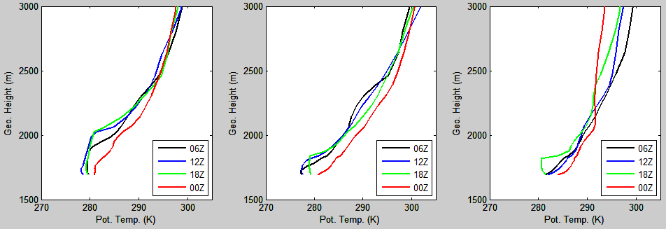
Evolution of Boundary-Layer Depth
Ouray
550m
350m
175m
4 Feb
5 Feb
6 Feb
Red Wash
300m
150m
0m

Slide 10
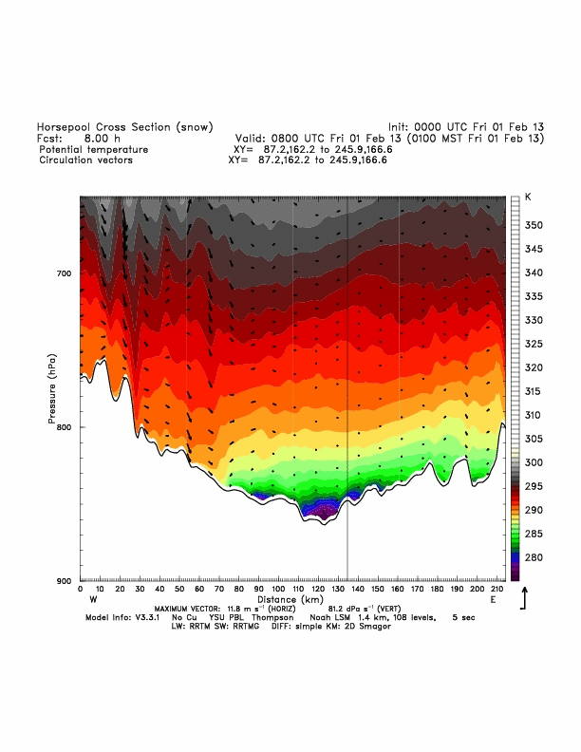
Future Work
Detailed case study analysis of temporal evolution and spatial variability in PCAP boundary-layer thermodynamic structure and winds
Effect of snow spatial variability on modeled thermally-driven flows
Snow-No Snow differences in synoptic/boundary-layer interactions
Snow
No Snow

