Slide 1
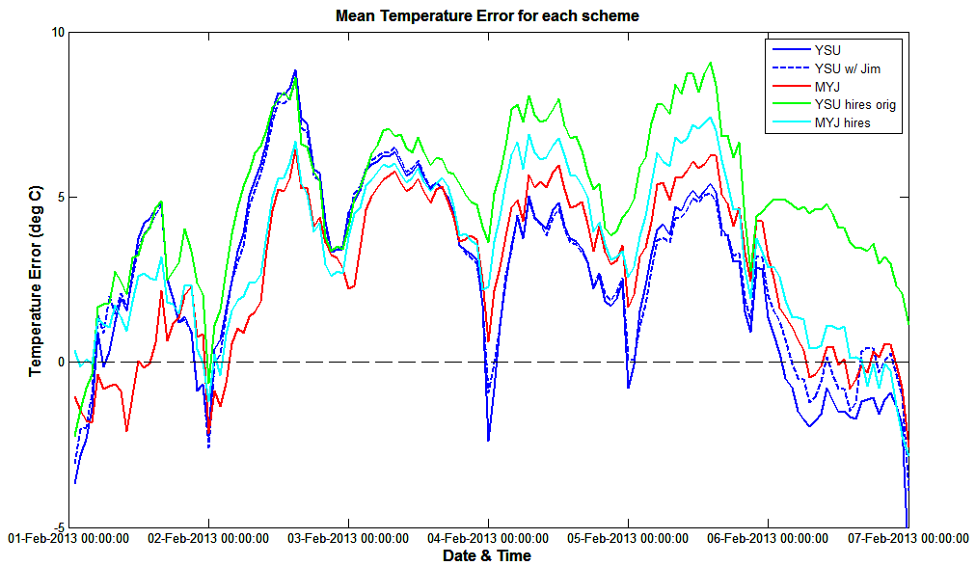
*Averaged over 6 locations
Mean Errors:
YSU = 2.6408 C
YSU w/ Jim = 2.8141 C
MYJ = 2.7112 C
YSU hi-res = 5.0295 C
MYJ hi-res = 3.3858 C

Slide 2
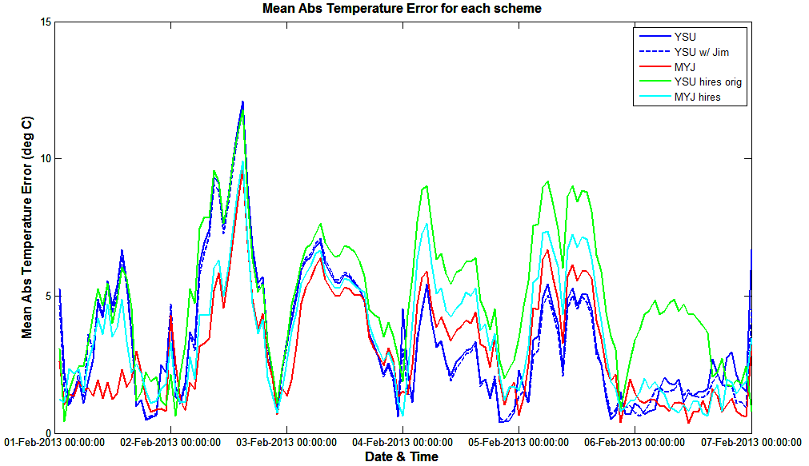
*Averaged over 6 locations
Mean Absolute Errors:
YSU = 3.4631 C
YSU w/ Jim = 3.3373 C
MYJ = 3.0023 C
YSU hi-res = 4.9352 C
MYJ hi-res = 3.5584 C

Slide 3
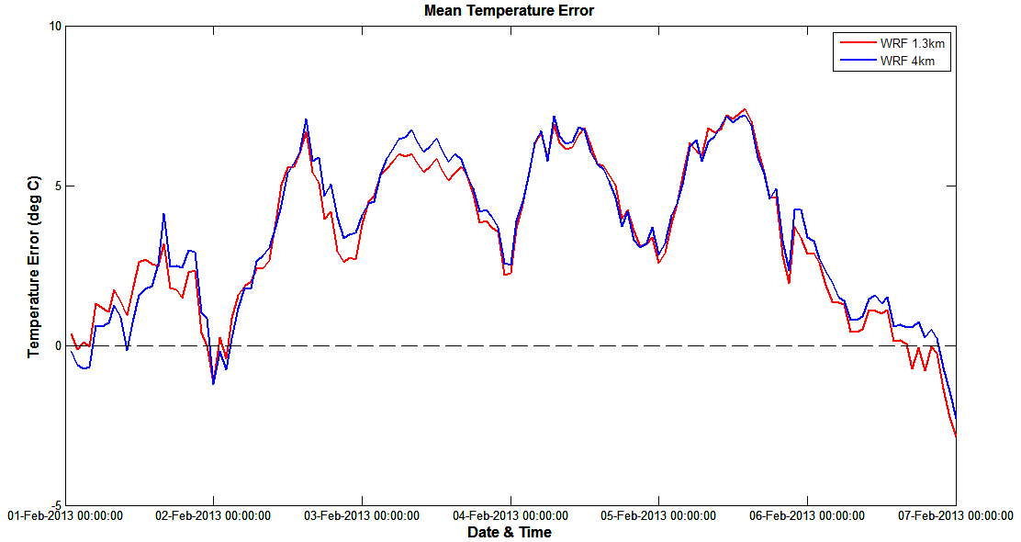
Mean Absolute Errors:
1.33 km = 3.3858 C
4 km = 3.5576 C

Slide 4
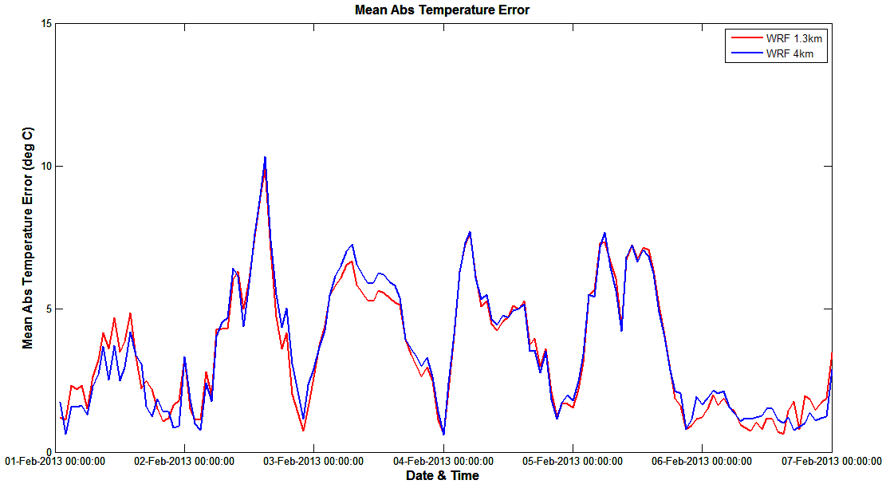
Mean Absolute Errors:
1.33 km = 3.5584 C
4 km = 3.5963 C

Slide 5
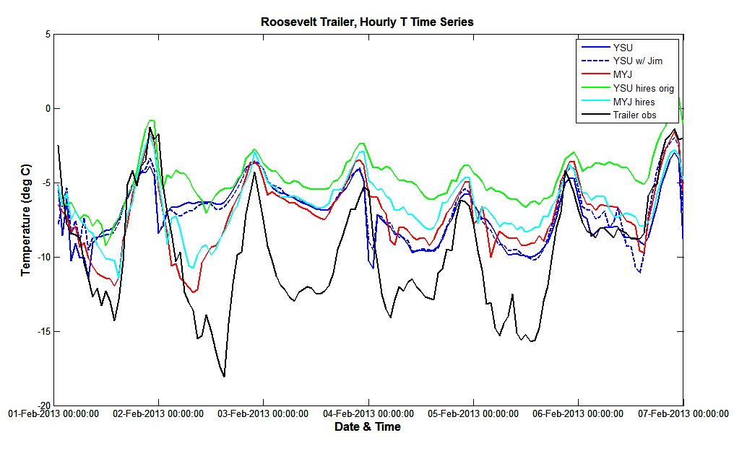

Slide 6
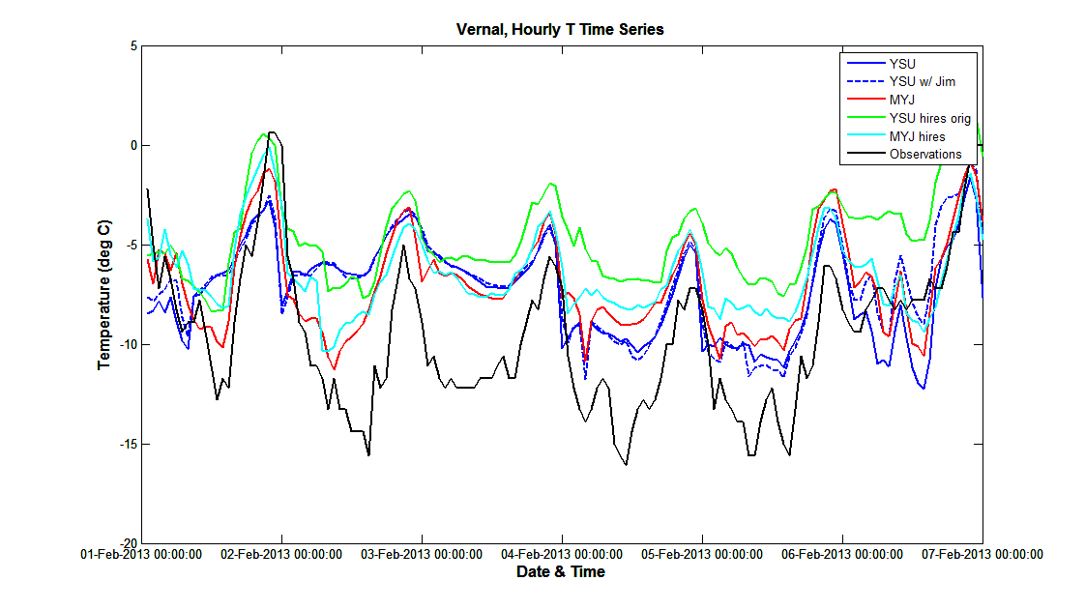

Slide 7
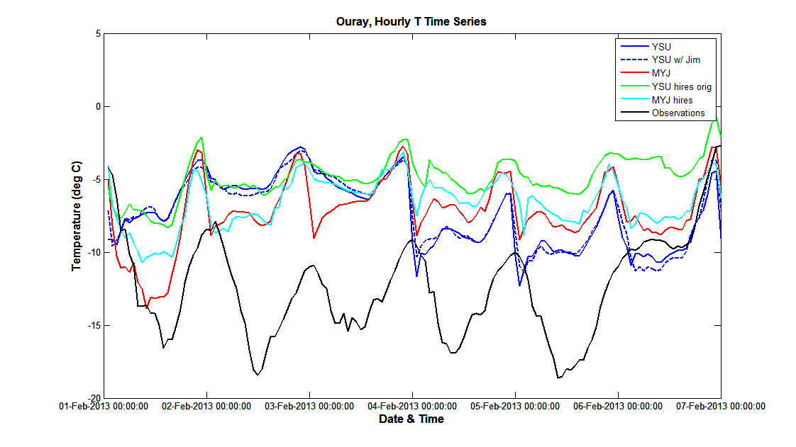

Slide 8
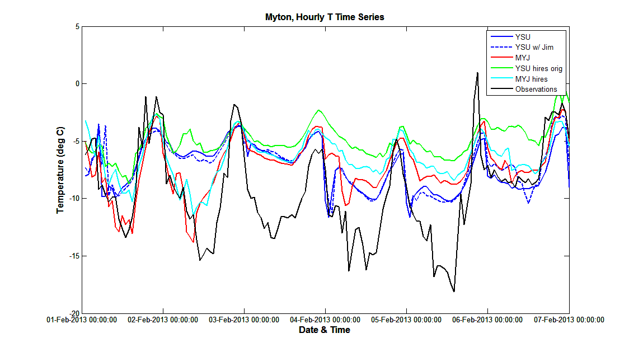

Slide 9
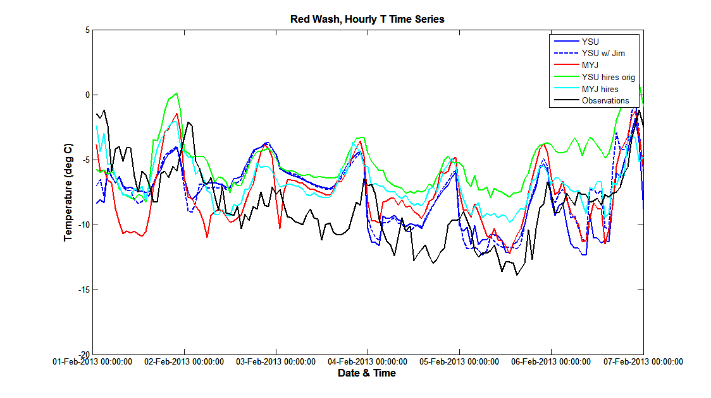

Slide 10
